Slide 1






Asian and stratospheric influences on western U.S. ozone air quality
Arlene M. Fiore
Acknowledgments. Meiyun Lin (Princeton), Vaishali Naik (GFDL), Larry Horowitz (GFDL), Jacob Oberman (U WI), Harald Rieder (CU/LDEO), Libby Barnes (NOAA, CU/LDEO), Pat Dolwick (EPA OAQPS), Joe Pinto (EPA NCEA)
AQAST4
Sacramento, CA
November 29, 2012

Slide 2

Some challenges for WUS O₃ air quality management
stratosphere
Warming climate
+in polluted regions
[Jacob & Winner, 2009 review]
+ natural sources
[recent reviews: Isaksen et al., 2009; Fiore et al., 2012]
? Transport pathways
Natural events e.g., stratospheric [Langford et al [2009]; fires [Jaffe & Wigder, 2012]
lightning
CH₄
Rising Asian emissions
[e.g., Jacob et al., 1999;
Richter et al., 2005;
Cooper et al., 2010]
intercontinental
transport
“Background Ozone”
X
Wildfire, biogenic
Asia
Pacific
Western USA
Need process-level understanding on daily to multi-decadal time scales
Today’s talk: 1) Model estimates of background (TTP)
2) Developing space-based indicators for Asian + Strat. sources
3) Changing variability (emissions, climate warming)

Slide 3
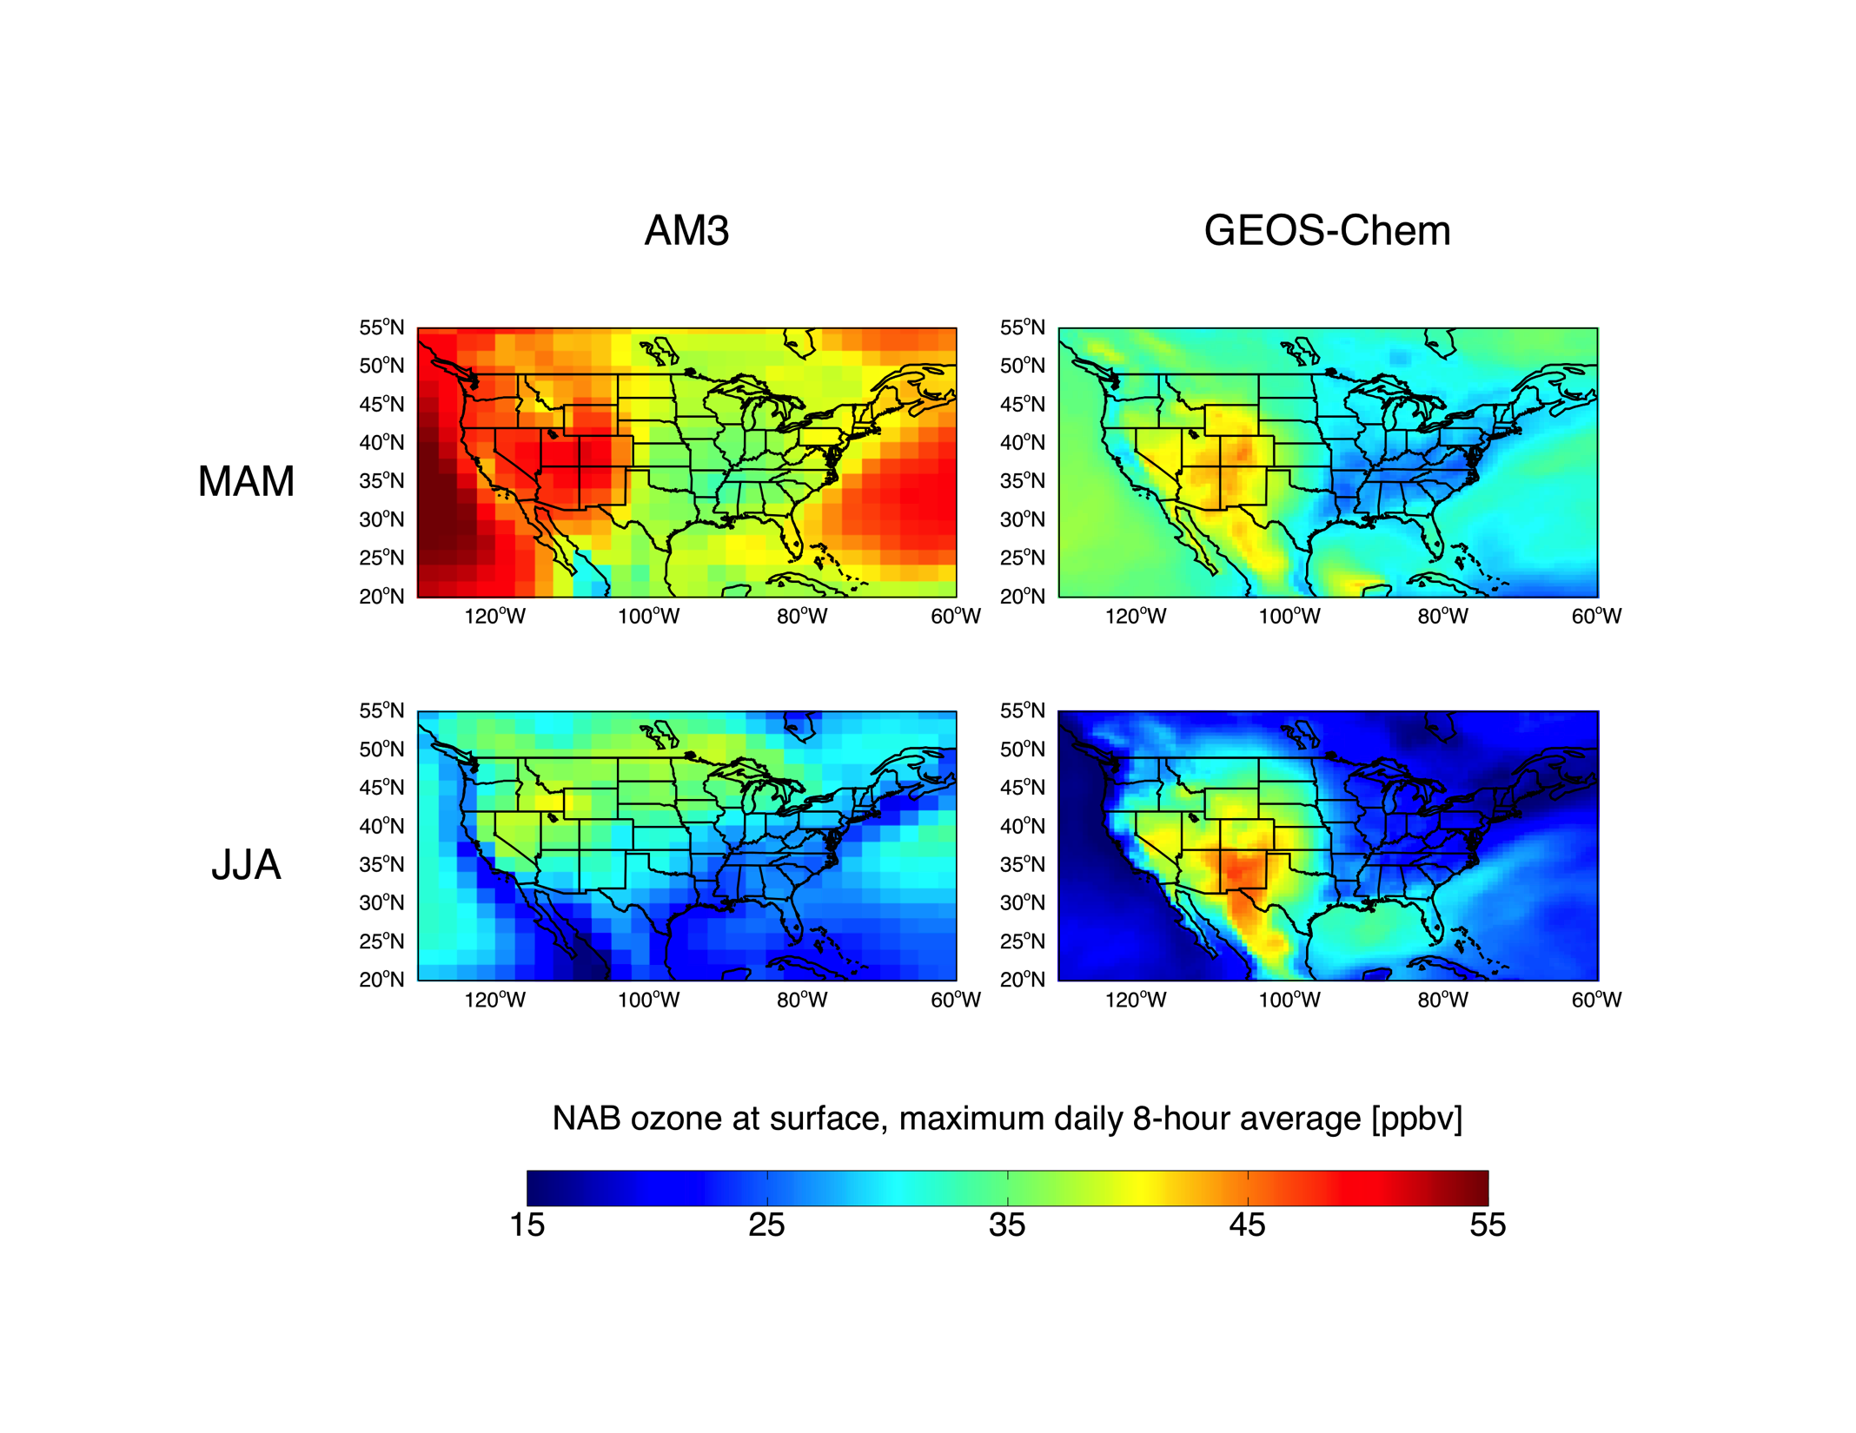
Models differ in estimates of North American background
(estimated by simulations with N. American anth. emissions set to zero)
North American background (MDA8) O₃ in model surface layer 2006
AM3 (~2°x2°)
GEOS-Chem (½°x⅔°)
AM3: More
O₃-strat +
PBL-FT
exchange?
Spring (MAM)
GC: More
lightning NO_{x}
(~10x over SWUS;
too high)
Summer (JJA)
J. Oberman
NOAA Hollings Scholar
ppb
TTP PI: Fiore
Notes:
3

Slide 4
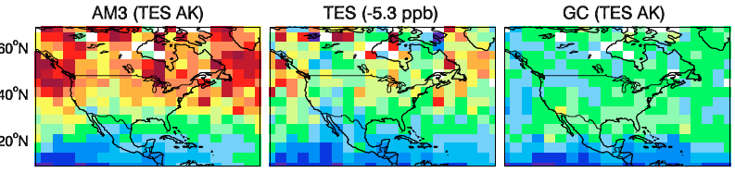
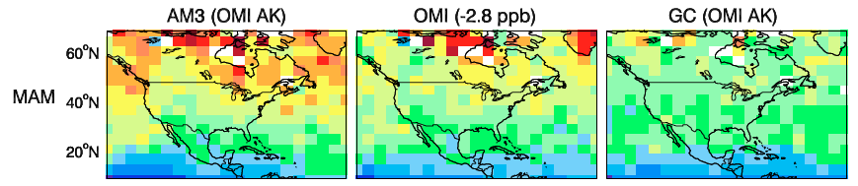
Constraints on springtime background O₃ from
OMI and TES mid-tropospheric products (2006)
Bias vs sondes subtracted from retrievals as in Zhang et al., ACP, 2010
L. Zhang, Harvard
  AM3 generally high; GEOS-Chem low
  Implies that the models bracket the true background
  Probe role of specific processes
Notes:
4

Slide 5
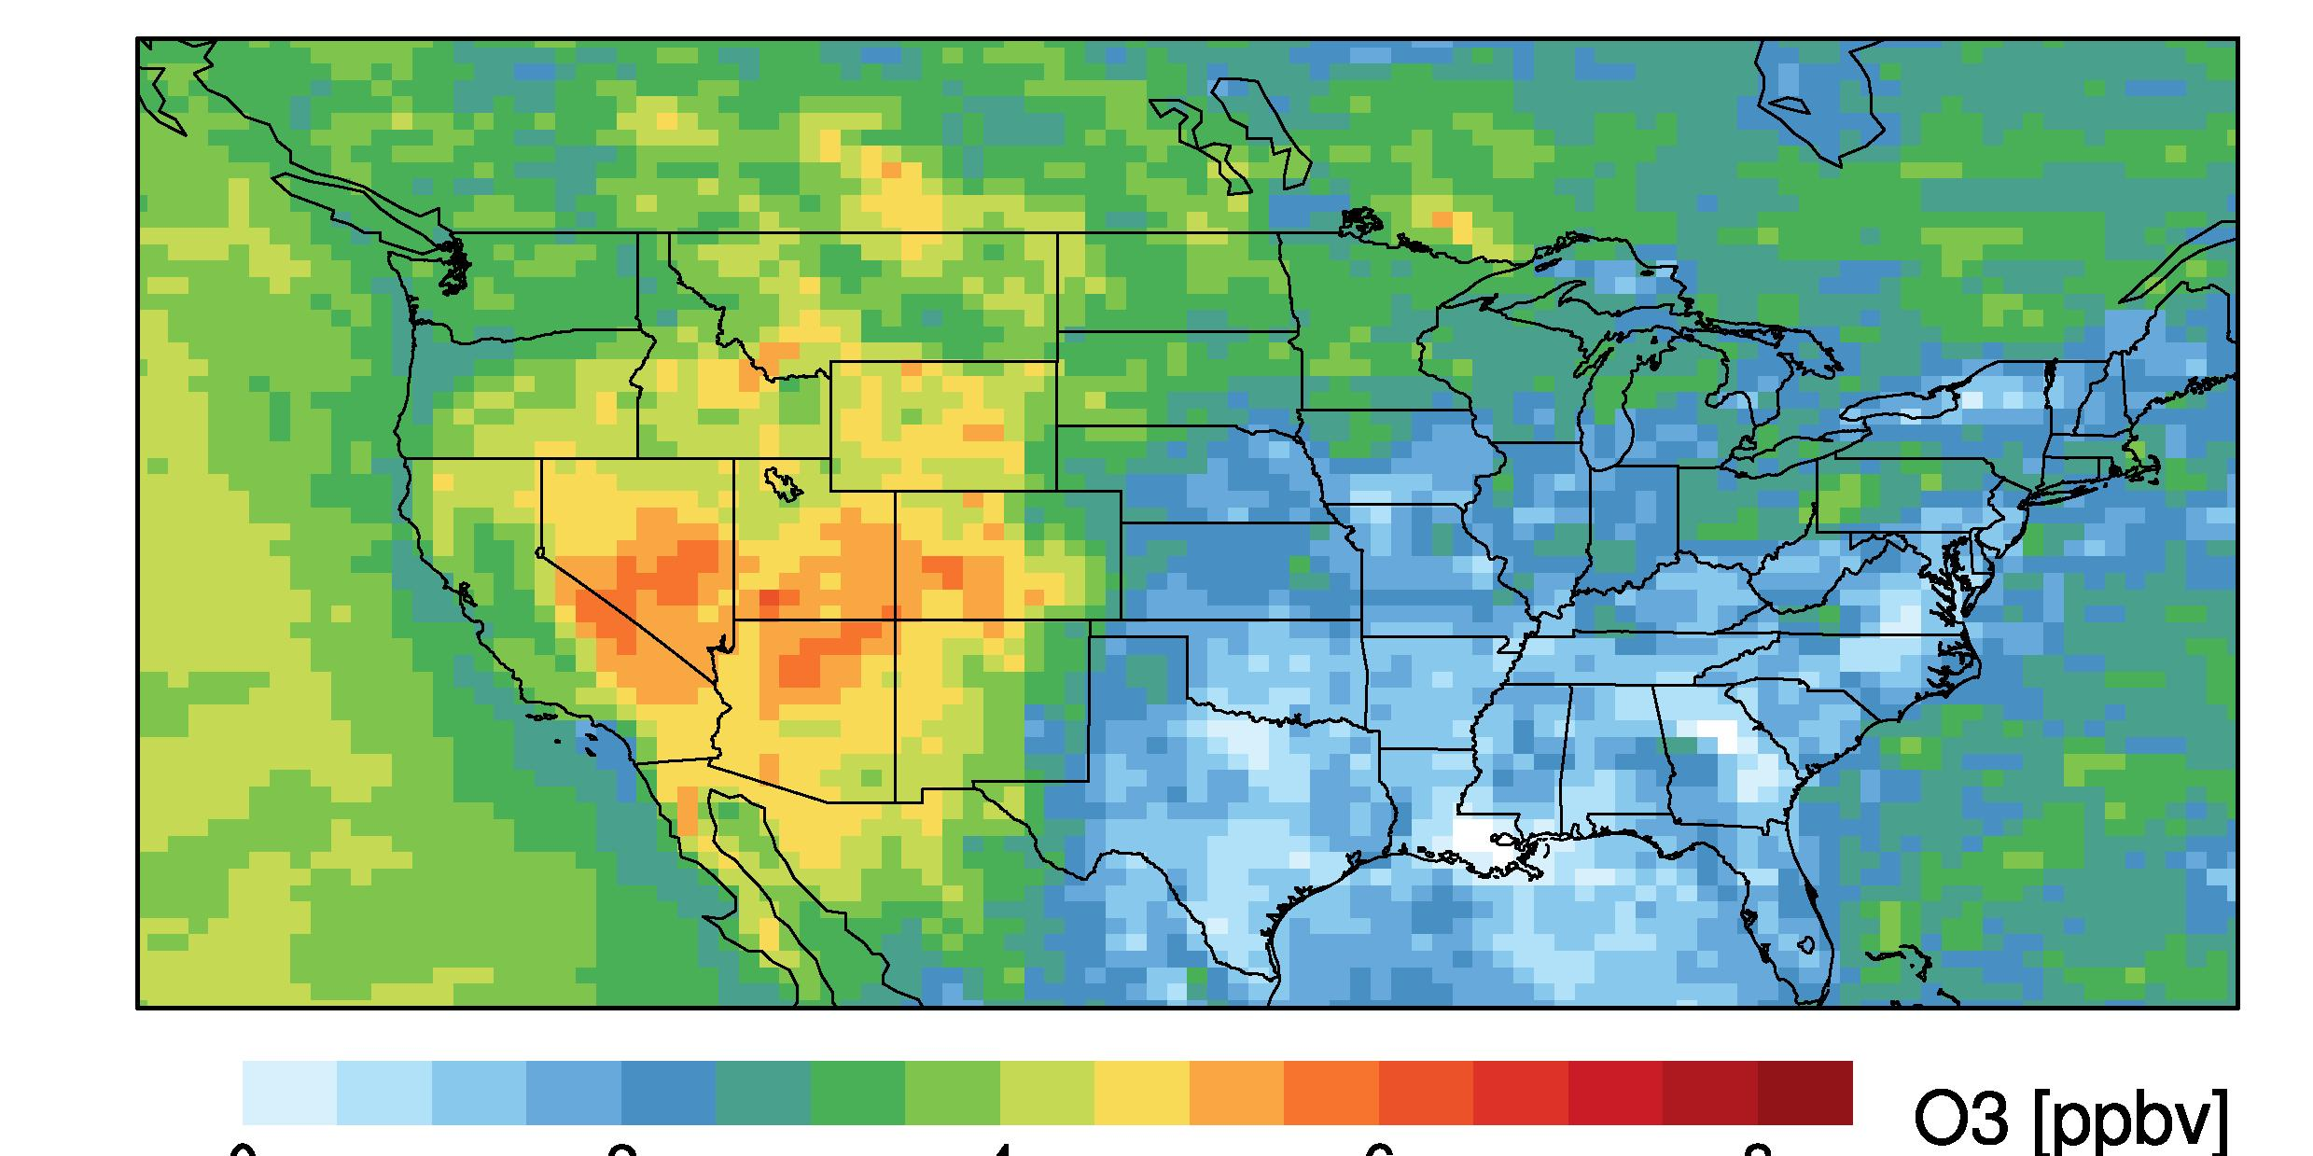
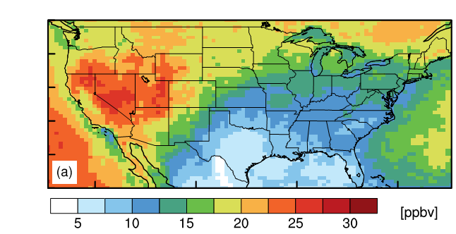
Estimates of Asian and stratospheric influence on
WUS surface ozone in spring
TOOL: GFDL AM3 chemistry-climate model [Donner et al., J. Clim. 2011]
~50x50 km² Jan-Jun 2010
Nudged to GFS winds
Fully coupled chemistry in the stratosphere and troposphere within a GCM
Mean MDA8 O₃ in surface air
Asian: May-June 2010
Stratospheric (O3S): April-June 2010
O₃ (ppb)
O₃ (ppb)
0
2
4
6
8
Base Simulation – Zero Asian
anth. emissions
Tagged above e90 tropopause [Prather et al., 2011] + subjected to same loss processes as tropospheric O₃.
[Lin et al., JGR, 2012a]
[Lin et al., JGR, 2012b]
Do they influence high-O₃ events in populated regions?
Notes:
5

Slide 6
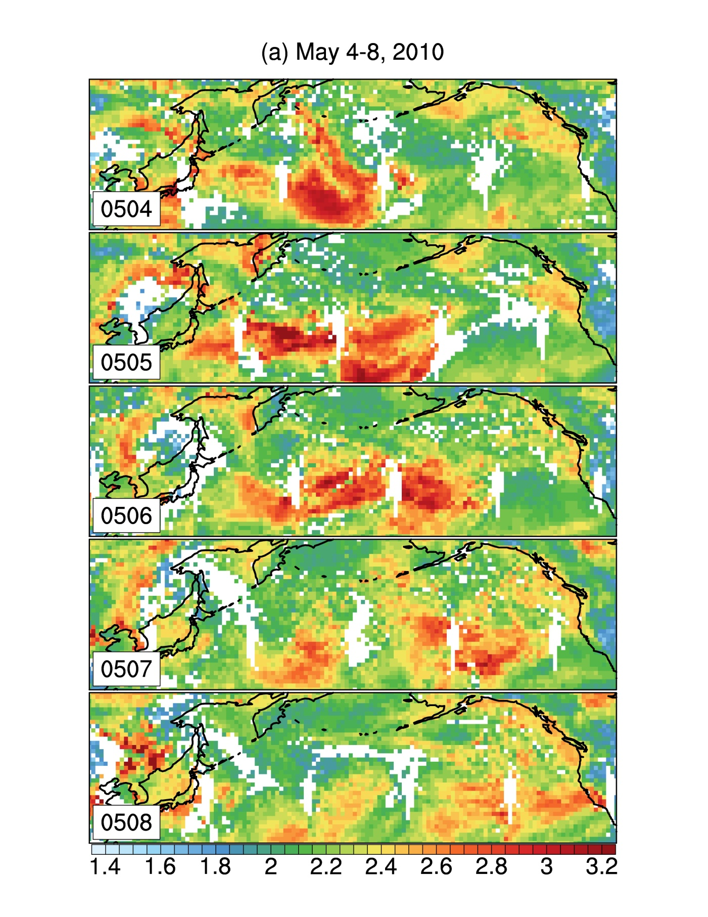
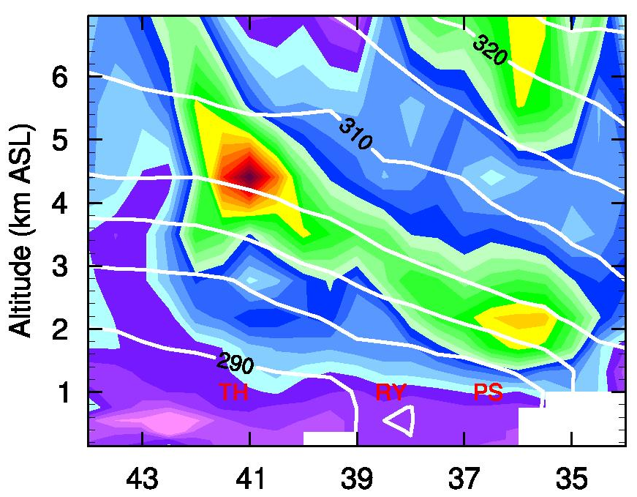

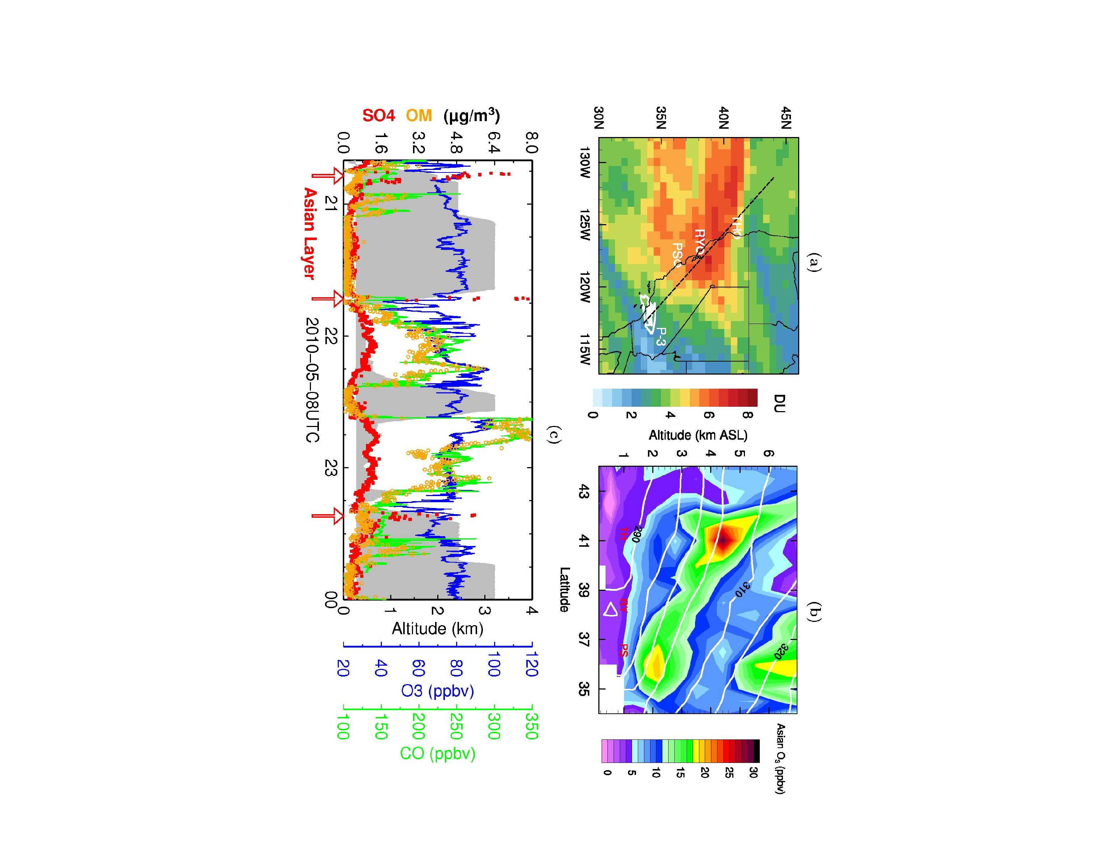
Asian O₃ pollution over S. CA: Trans-pacific transport + subsidence to lower troposphere
AIRS CO columns
GFDL AM3 Model Asian O₃
May 4
Altitude (km a.s.l.)
May 6
θ
[K]
Latitude (N→ S) along CA
[ppb]
May 8
0
10
20
30
Consistent with sonde and aircraft
[Lin et al., JGR, 2012a]
[10¹⁸ molecules cm⁻²]
Influence in surface air?

Slide 7
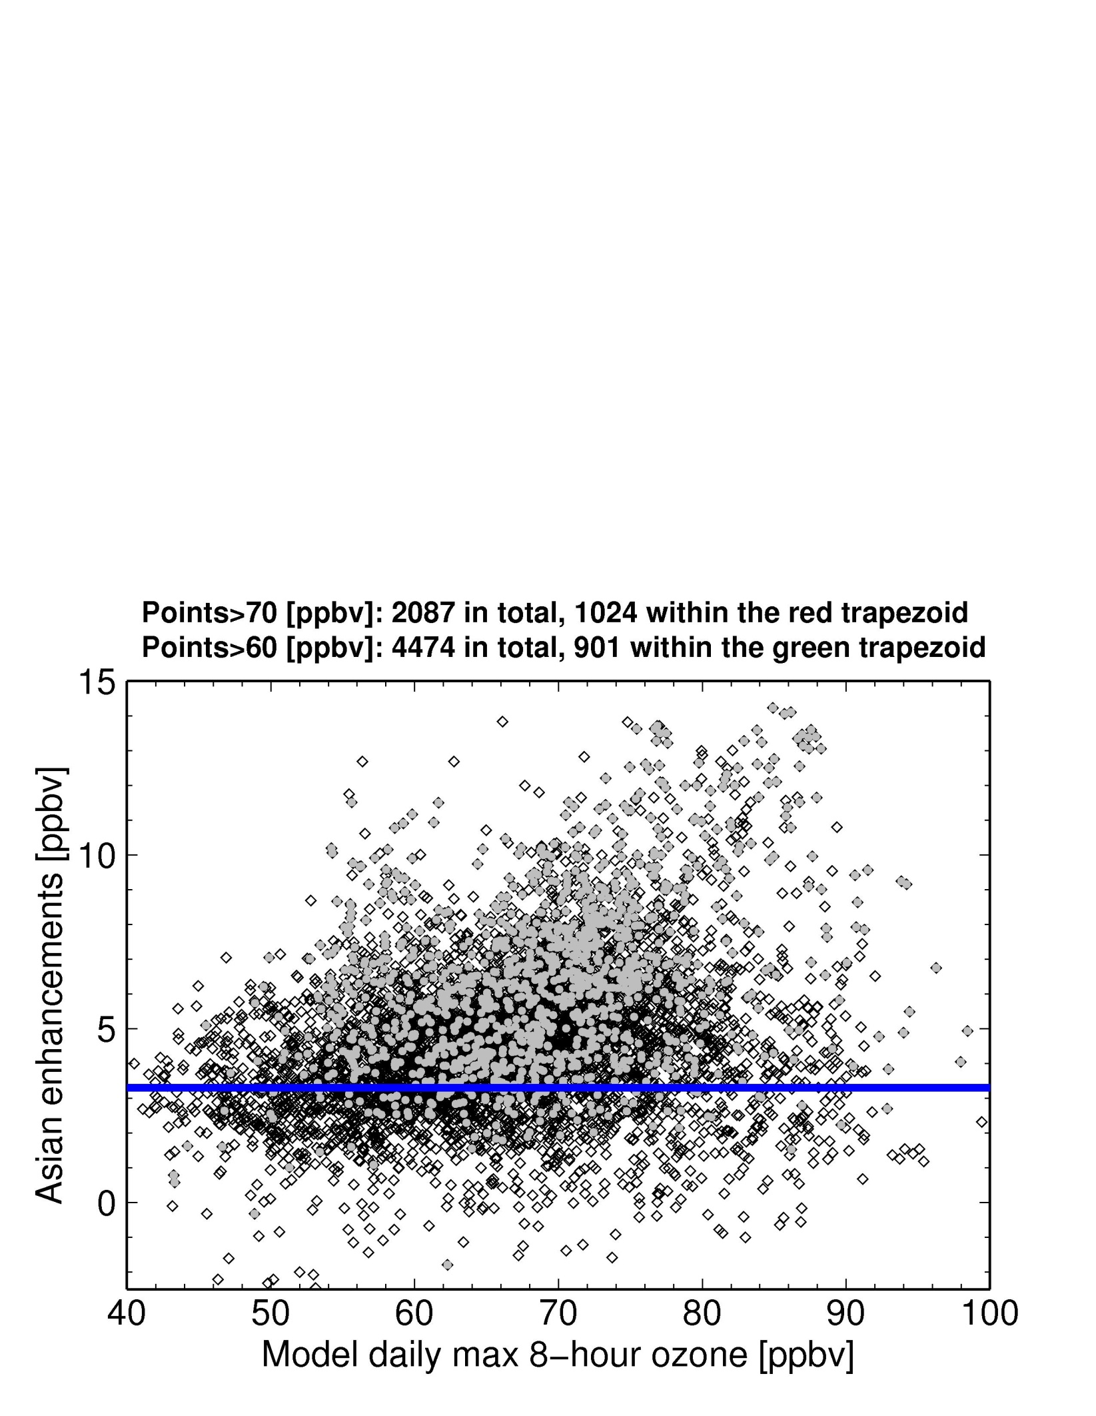

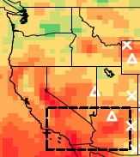
Asian pollution contributes to high-O₃ events over S. CA
in the GFDL AM3 model (~50 km² resolution)
~50% of MDA8 O₃ > 70 ppbv would not have occurred without Asian O₃
25th percentile
Asian emissions contribute ≤ 20% of total O₃ (local influence dominates)
Highest Asian enhancements for total ozone in the 70-90 ppbv range
Lin et al., 2012a, JGR – publicity: AGU Editors’ Highlight, Science Shot, Nature News
Notes:
7

Slide 8
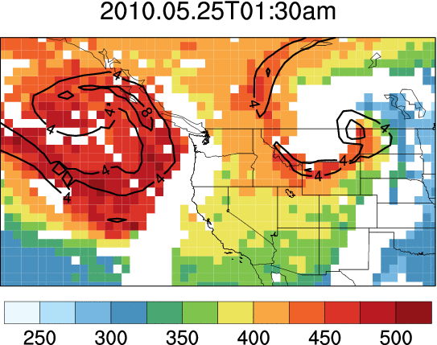
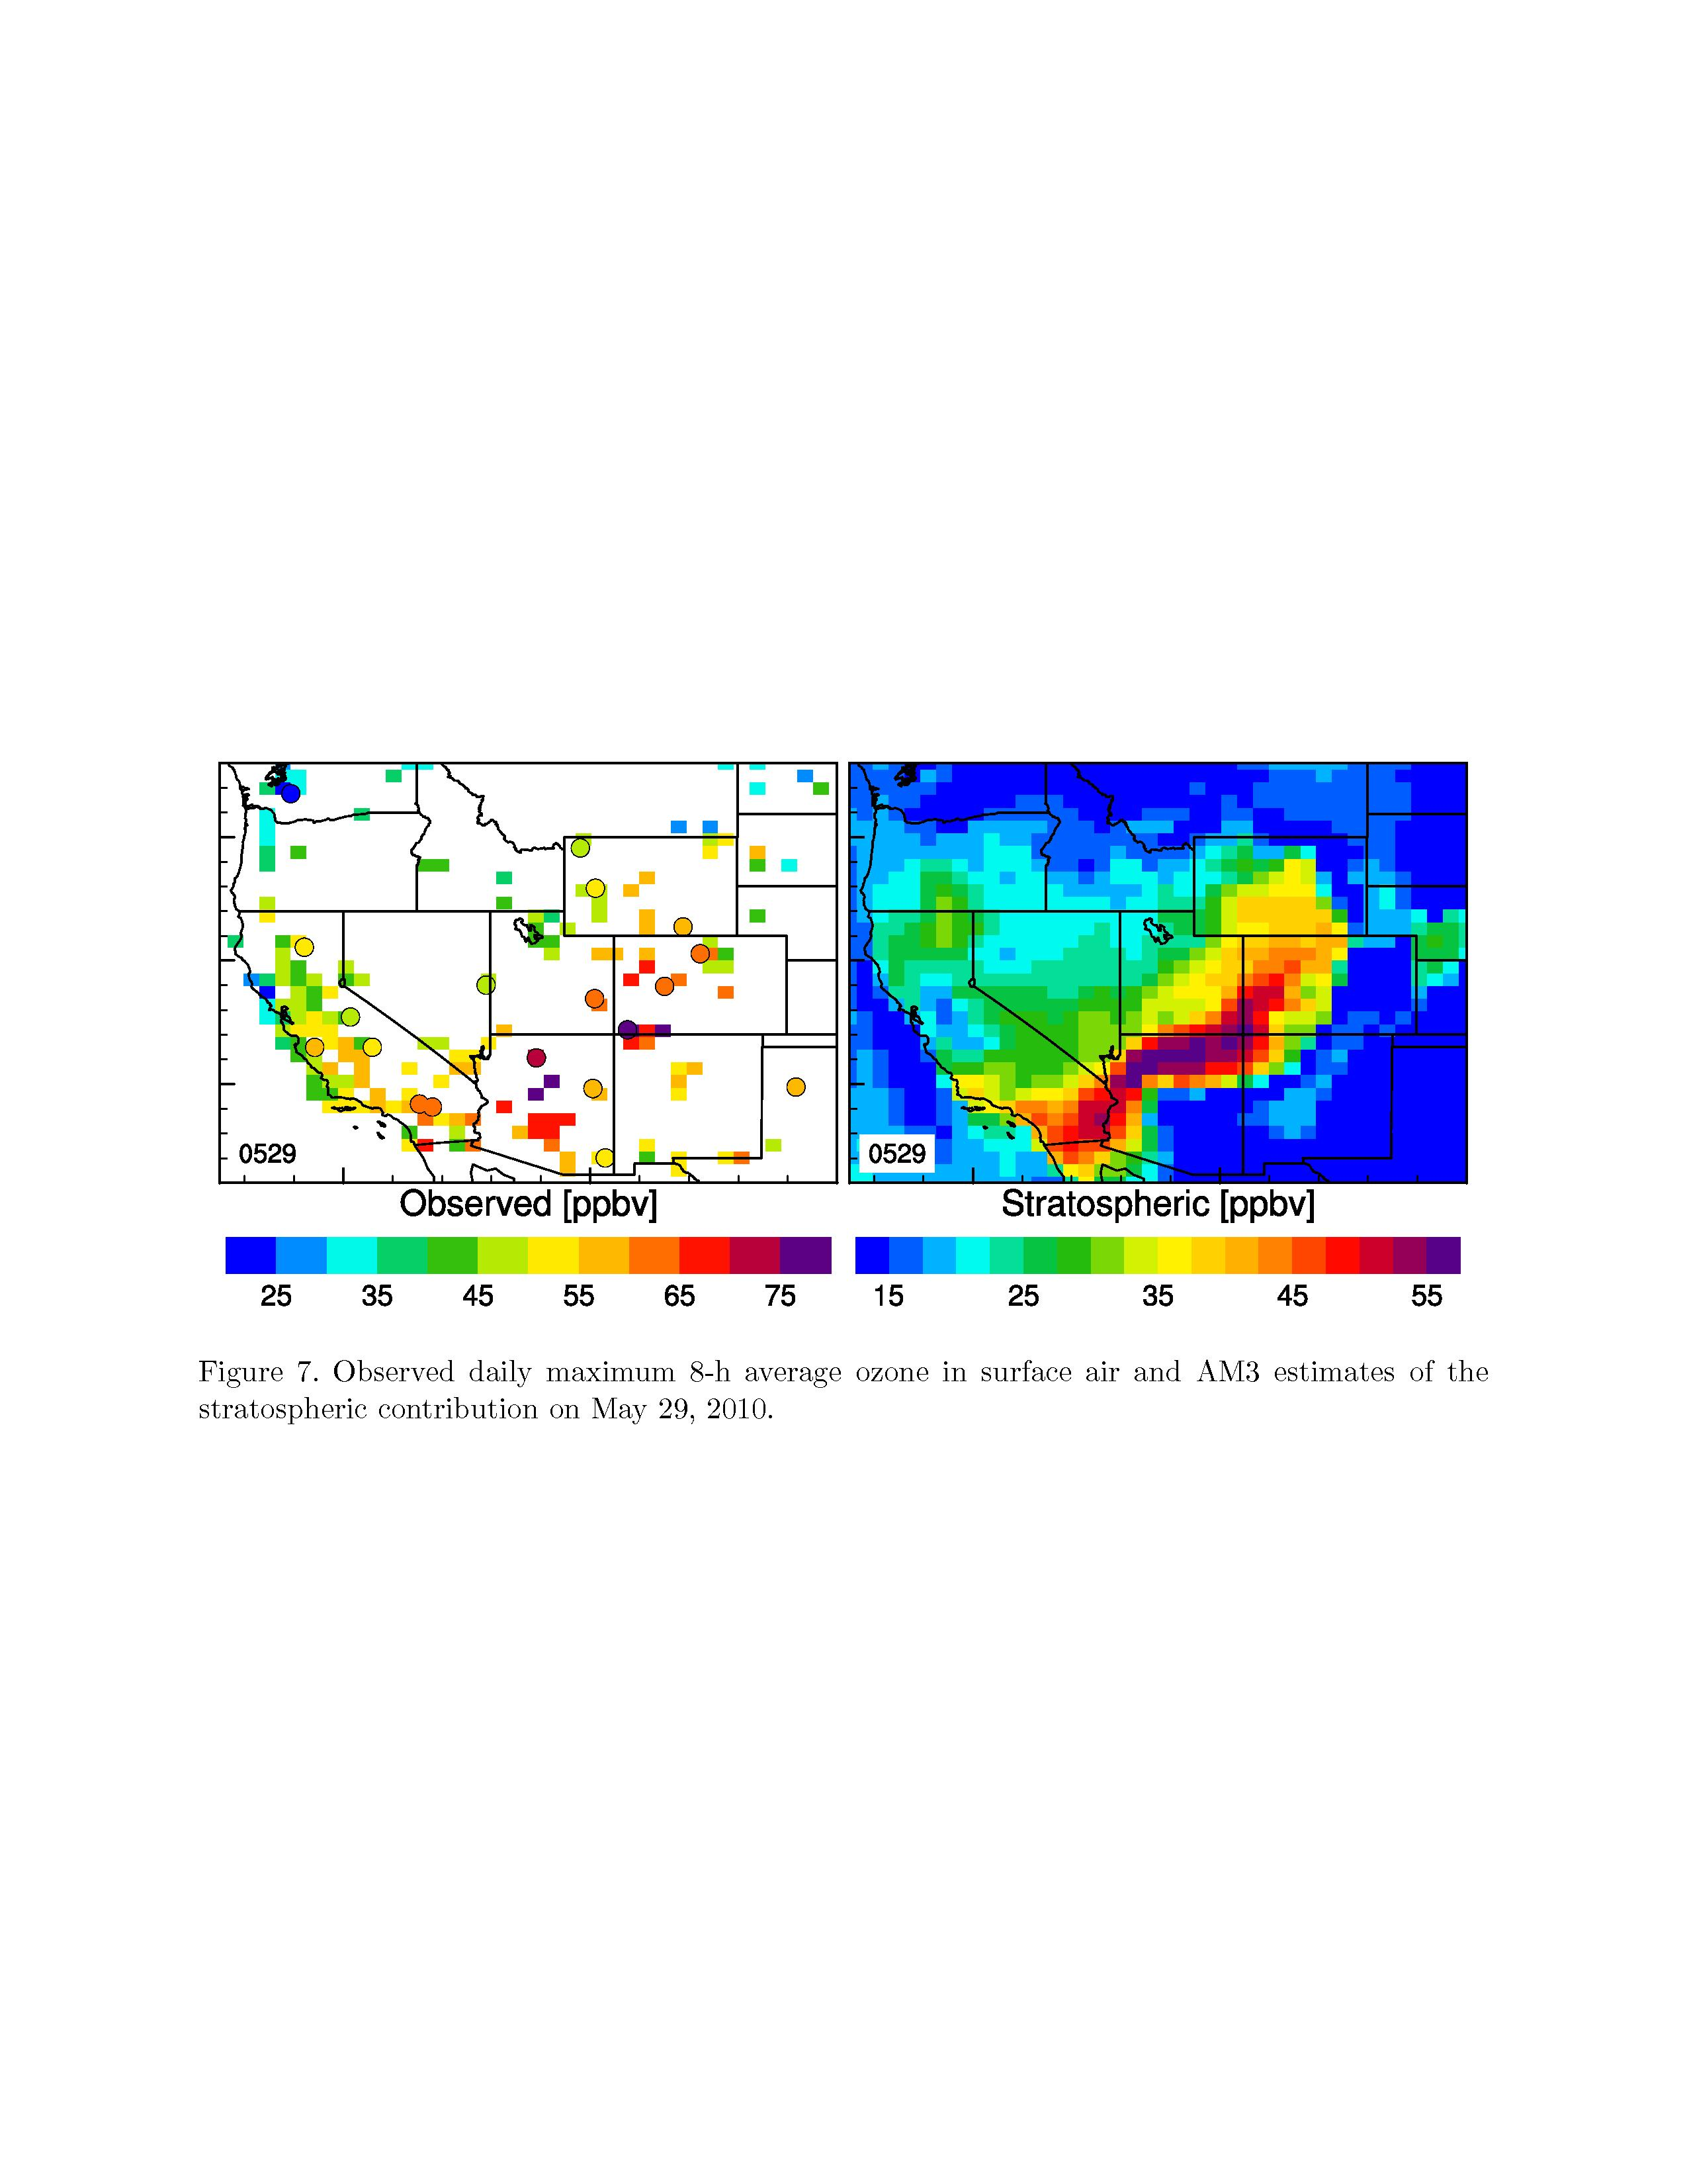
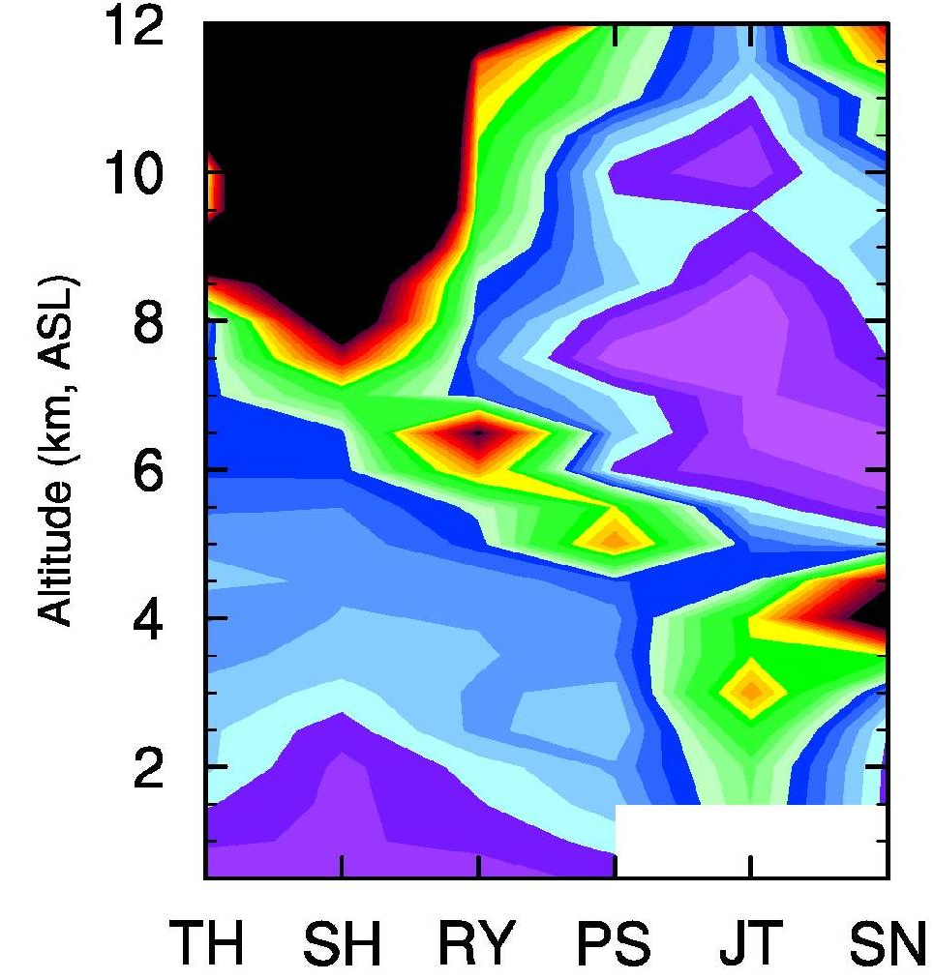
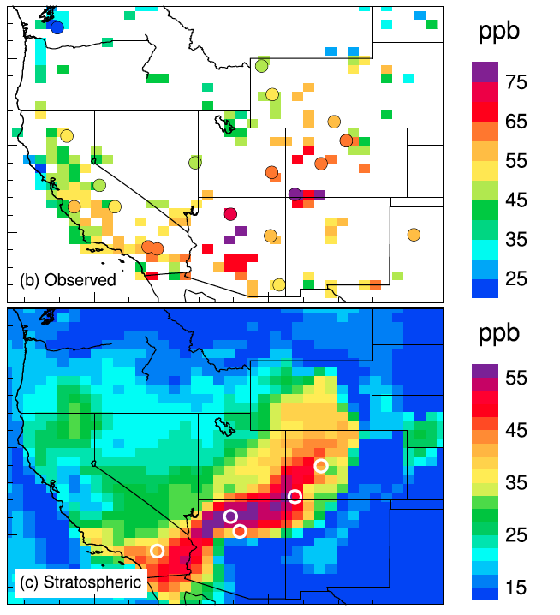
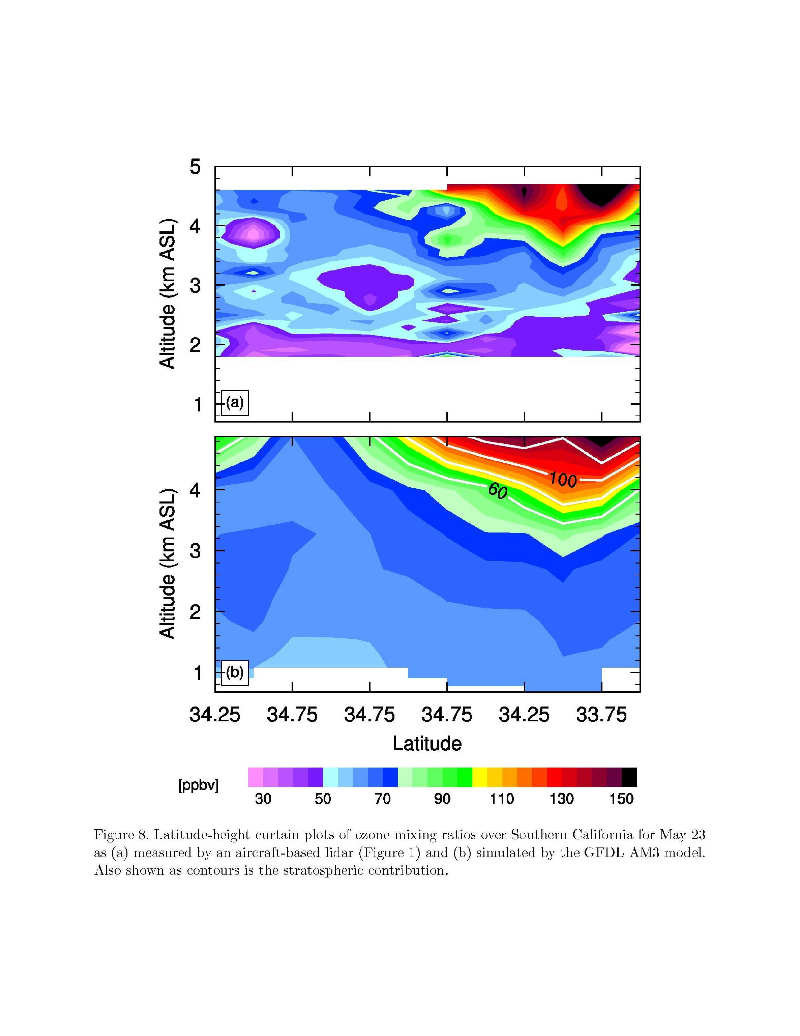
Stratosphere-to-troposphere (STT) O₃ transport influence on WUS high-O₃ events
Surface MDA8 O₃, May 29
AIRS, May 25-29
M. Lin et al., JGR, 2012b
Sonde O₃, May 28
TH
SH
RY
PS
300 hPa PV
JT
SN
Altitude (km a.s.l.)
Total column O₃ [DU]
AM3 O3S
Would STT confound attainment of tighter
standards in WUS?
Are exceptional events accurately identified?
North → South
30
60
90
120
150
15 25 35 45 55
[ppb]
[ppb]
Potential for developing space-based indicators?

Slide 9
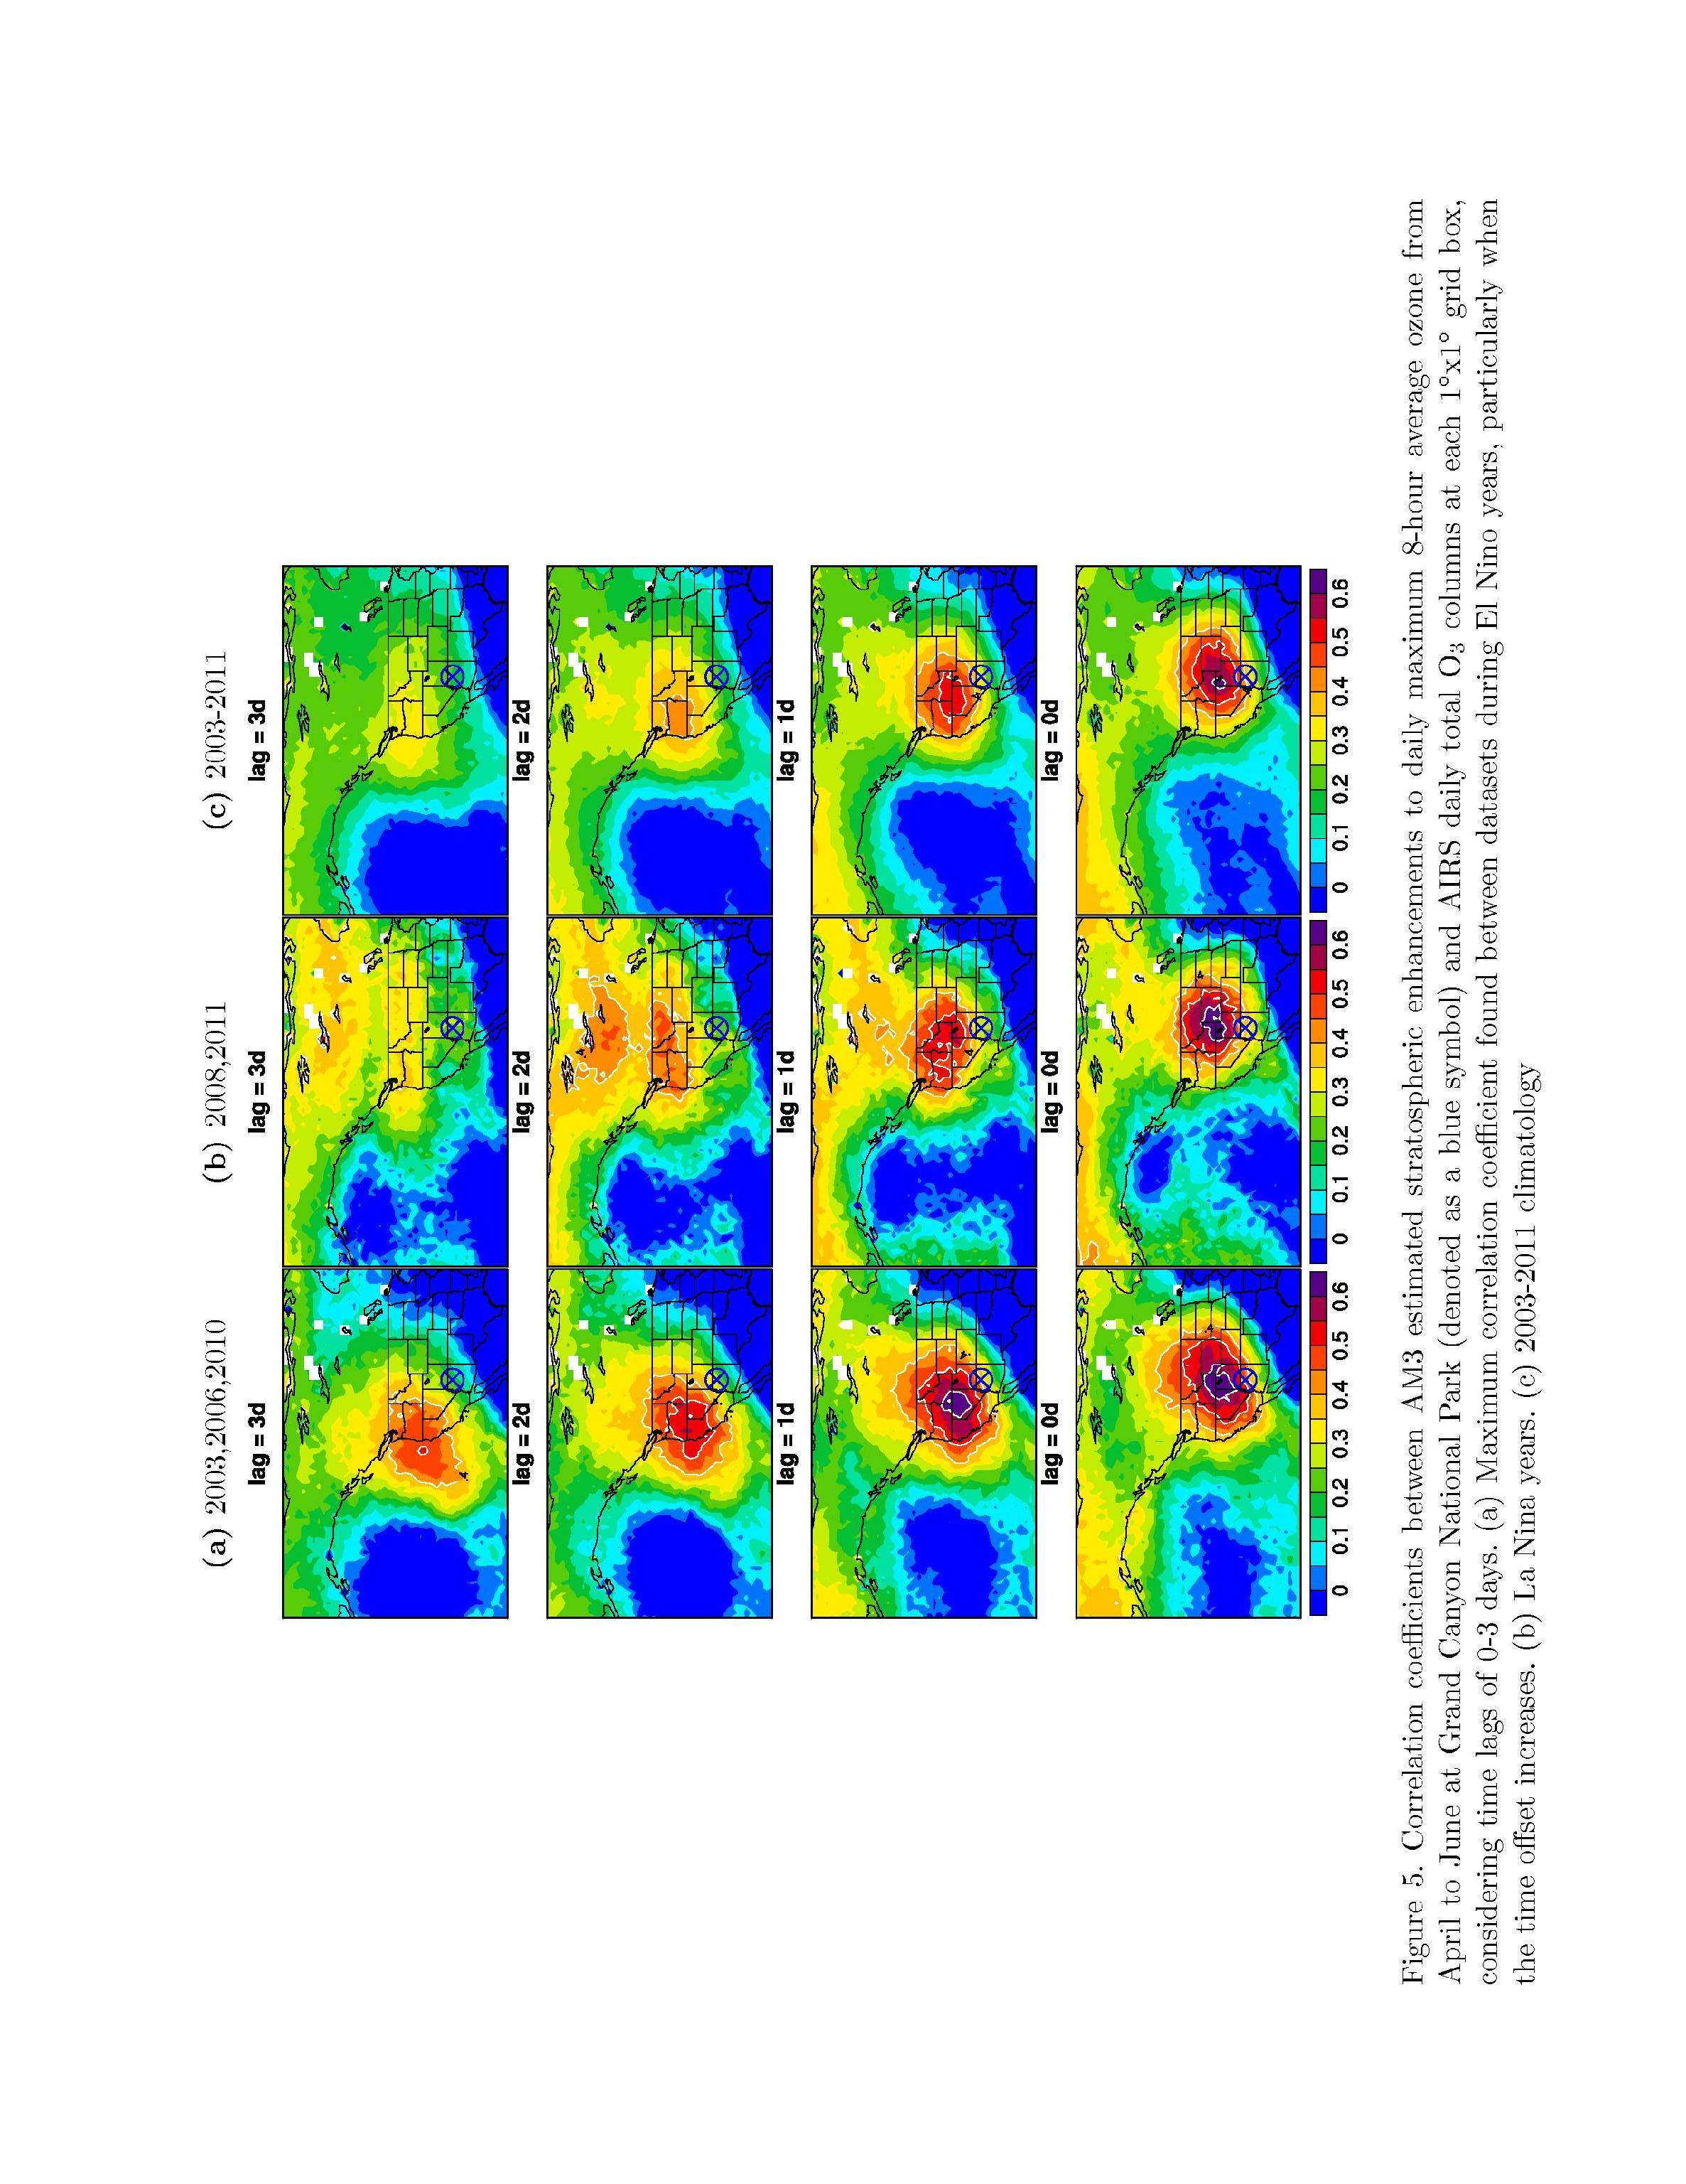
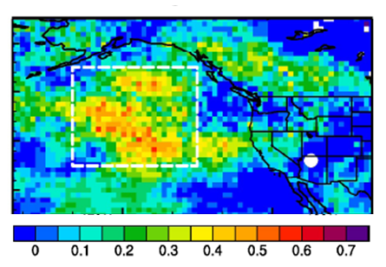
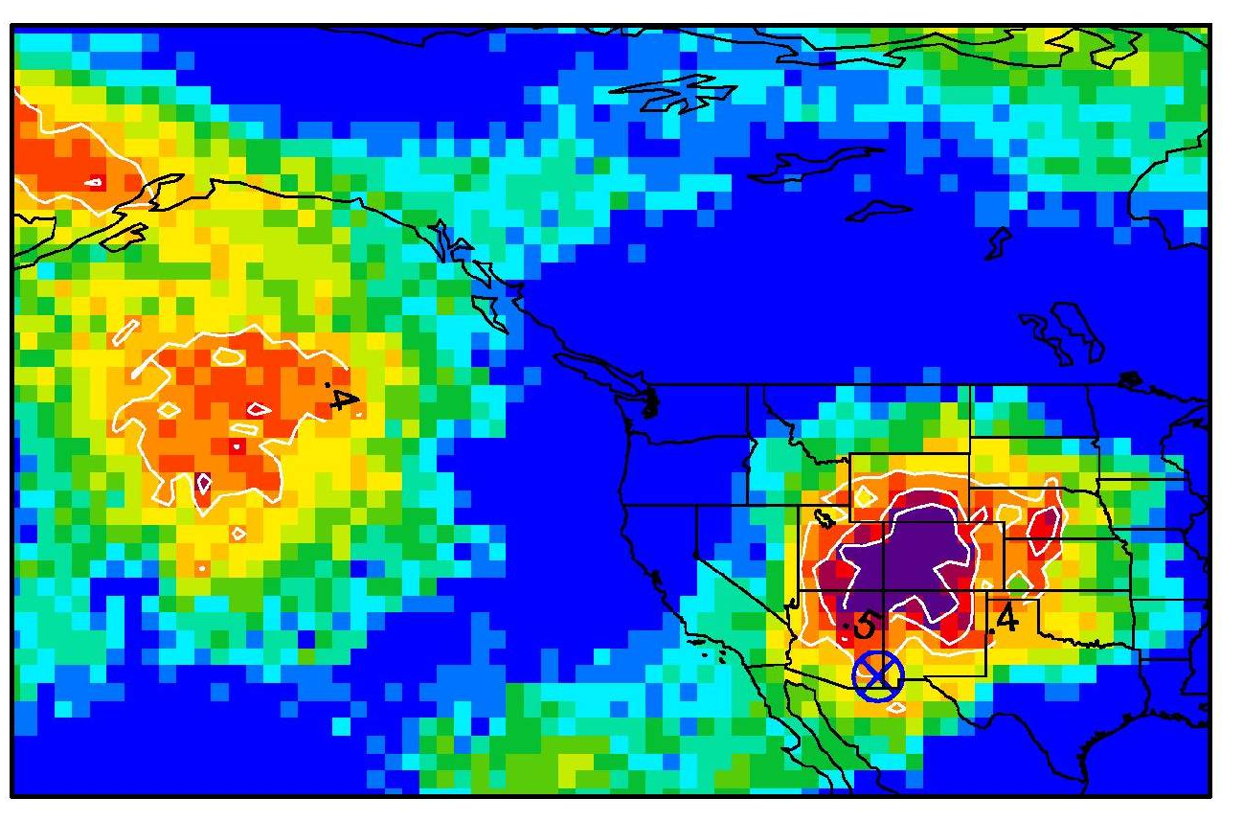
Developing space-based indicators of daily variability associated with Asian pollution and STT events
Correlation coefficients of AM3 daily Asian or Stratospheric O₃ sampled at a selected CASTNet site with AIRS products at each 1ºx1º grid
AM3 Asian O₃ at Grand Canyon NP with AIRS CO columns 2 days prior
May-June, 2010 [Lin et al., 2012a]
AM3 O3S at Chiricahua, NM
with AIRS 300 hPa O₃ (same day)
April-June 2011
r
0.6
0.5
0.4
0.3
0.2
0.1
r
0
Advanced warning of Asian/STT impacts on surface O₃ episodes in WUS?
Site-specific “source” regions for characterizing exceptional events
Analysis of STT indicator for a full decade [M. Lin, AGU talk]

Slide 10
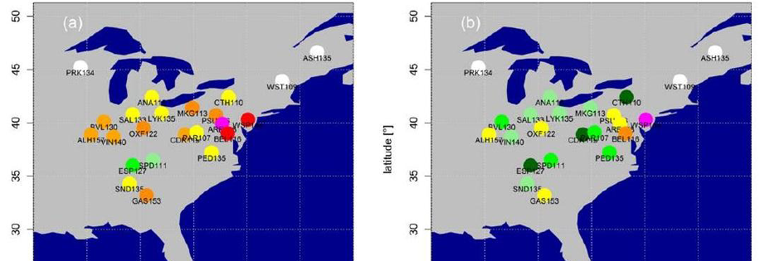


Quantifying extreme O₃ events in probabilistic terms:
Initial application to Eastern USA
1-year return O₃ values at CASTNet measurement sites
(Statistical methods from extreme value theory)
1988-1998
1999-2009
Dramatic decreases in 1-year return levels following NO_{x} SIP call
Rieder et al., in revision, Environ. Res. Lett.
How might climate warming influence extreme pollution events?
83520601

Slide 11
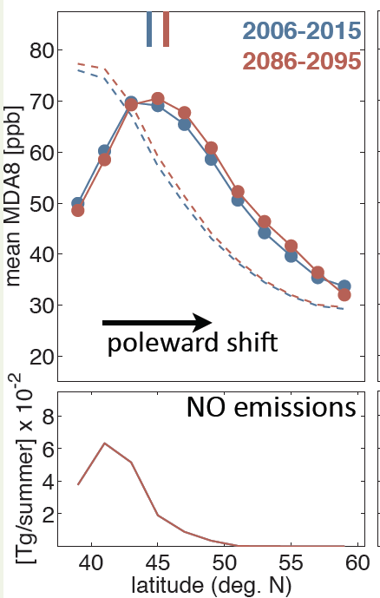
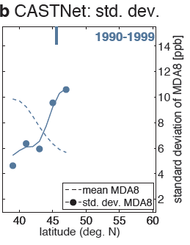
Identifying key drivers of summertime surface O₃ variability:
Jet location over Eastern N. America
GFDL CM3 Base+ Climate warming
(RCP4.5, WMGG only, +1.4K)
Observations
(CASTNET + MERRA reanalysis)
Jets
2006-2015
2086-2095
Jet
Peak in variability (σ) aligns with jet
Mean JJA MDA8,
land only (ppb)
Standard deviation (ppb)
Jet shifts N with climate warming; σ increases to N of jet (and decreases to S)
NO Emissions
NOx emissions peak south of jet where mean MDA8 O₃ highest (GFDL CM3 and CASTNET obs)
O₃-Temp. correlation also follows jet; larger shifts with larger T change
Explore role of jet location in WUS (Asian, STT events)
For more info, see Libby’s AGU poster Fri Afternoon:
Barnes & Fiore, A53D-0171 Hall A-C Moscone South
83520601

Slide 12
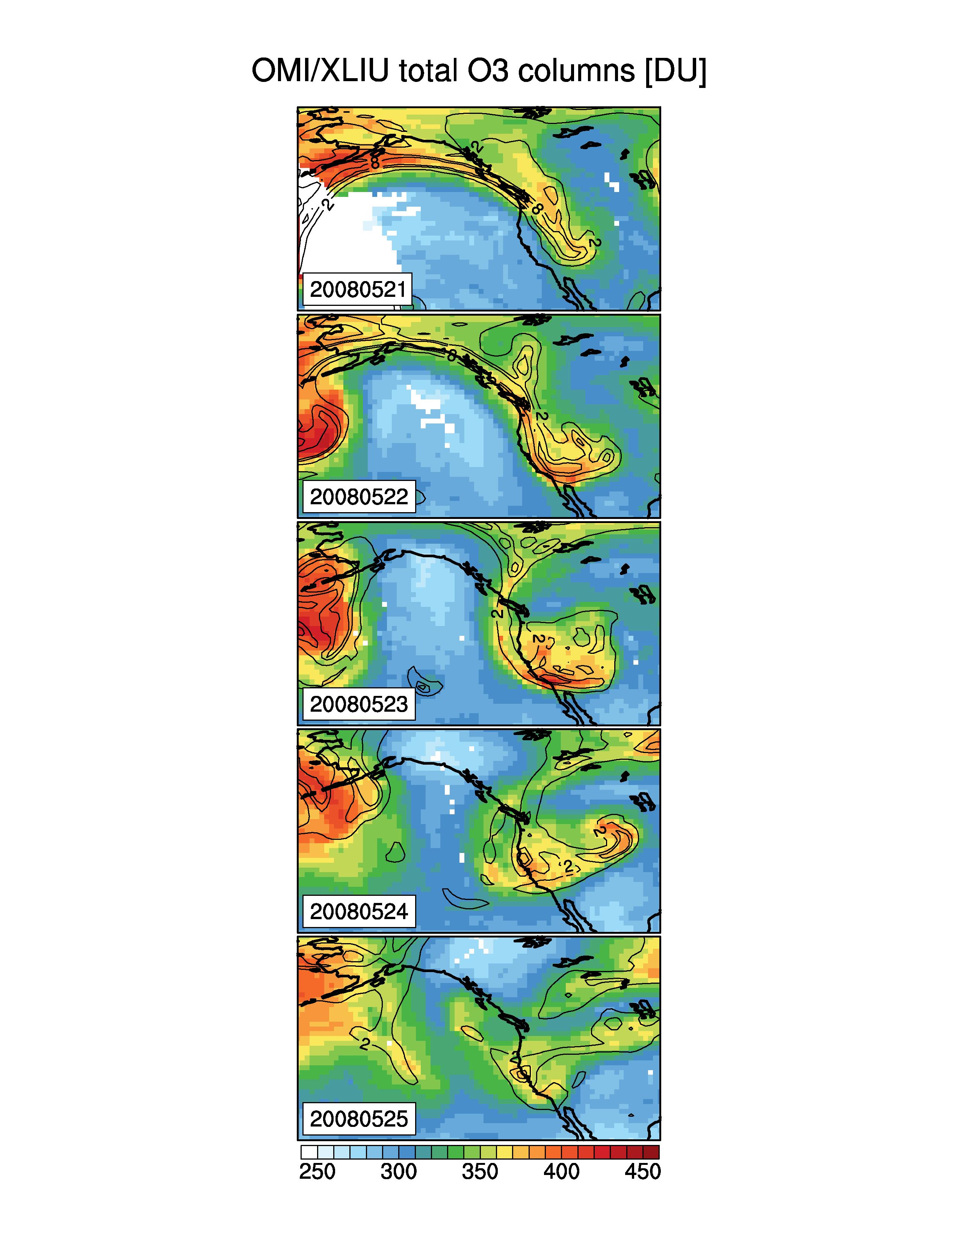
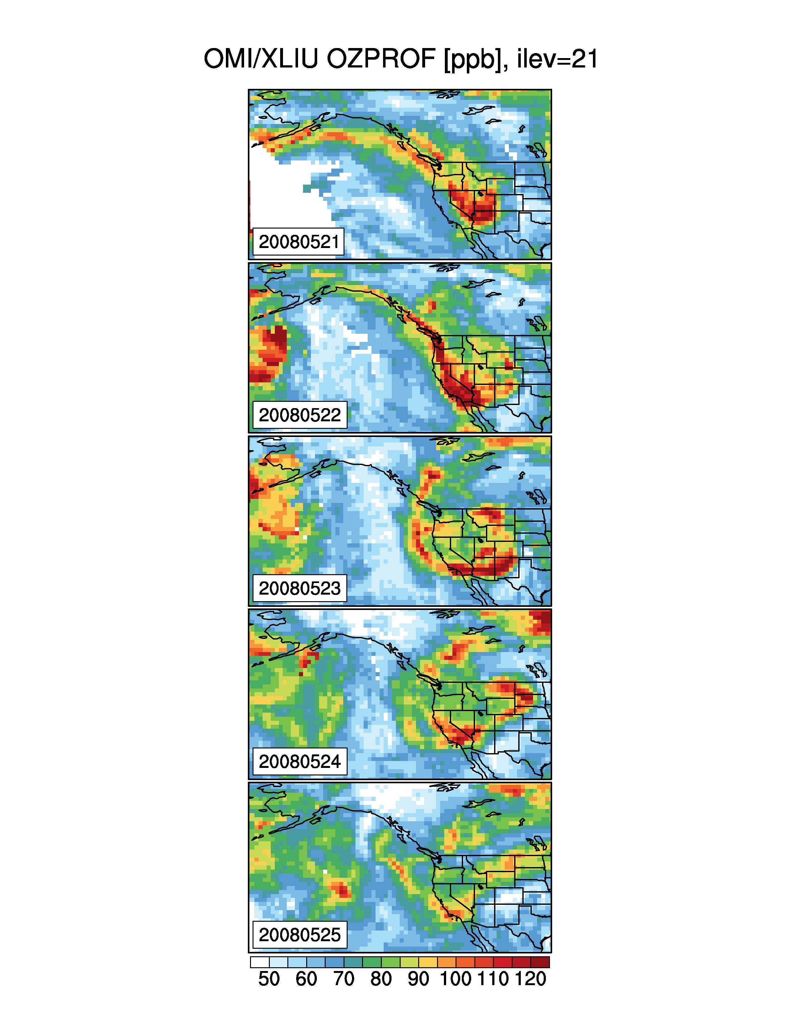
Take-away: Satellite products can indicate potential for contributions from transported “background”
Indicate potential downwind influence
Public health alerts
Identify exceptional events
Quantitative estimates require models
→ Decadal planning: expect changes in a warming climate?
Ongoing analysis of potential for space-based indicators
of stratospheric O₃ enhancements
OMI Total Column O₃
OMI ~550-350 hPa O₃
300 hPa PV
[DU]
[ppbv]
Products from X. Liu, Harvard
More information:
Meiyun Lin’s AGU talk A14B-08
Mon 5:45 Moscone West 3004
Notes:
GRC; time lag 2 days

