Slide 1







Key drivers of surface ozone variability,
from WUS background to EUS extremes
Arlene M. Fiore
Acknowledgments. O. Clifton (LDEO), M. Lin (Princeton), L. Murray (LDEO), L. Valin (LDEO), H. Rieder (U Graz), V. Naik & L. Horowitz (GFDL), J. Oberman (U WI), M. Gustin & R. Fine (U NV-Reno), A. Malone & R. Bamford (NV DEP), P. Dolwick (EPA OAQPS), T. Keating (EPA/OAR/OPAR), J. Pinto (EPA NCEA), G. Tonnesen (EPA Region 8)
AQAST6
Rice University, Houston, TX
January 15, 2014
83520601

Slide 2


Total O₃ in surface air over North America =
“N. Amer. Background” + Anthropogenic regional O₃
Today’s talk:
WUS: High background O₃ events
EUS: High total O₃ events
stratosphere
lightning
Total
ozone
intercontinental
transport
+
“North American Background” ozone
O₃
Anthropogenic
regional ozone
NMVOCs
CO
global
methane
NO_{x}
+
Natural NO_{x},
NMVOC
X
X
Human
activity
Fires
Biosphere
Biosphere,
Human
activity
Ocean
Fires
Foreign Continents
North America
Notes:
Emphasie WUS // EUS…

Slide 3
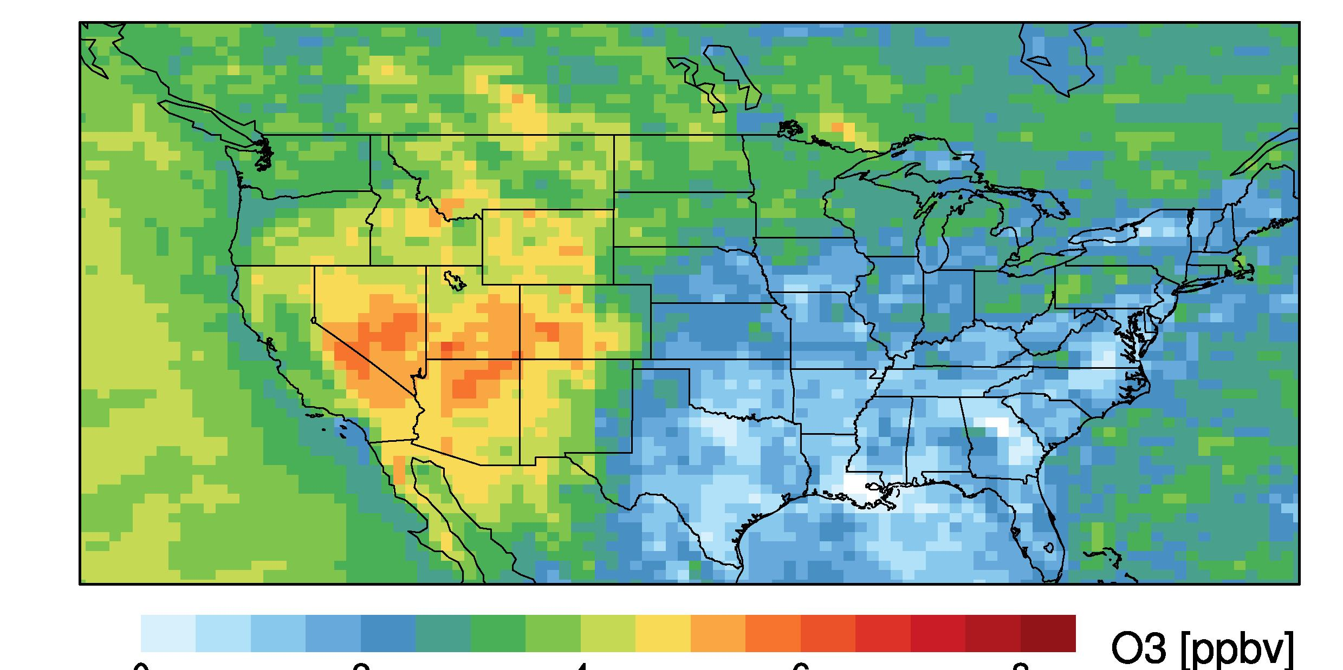
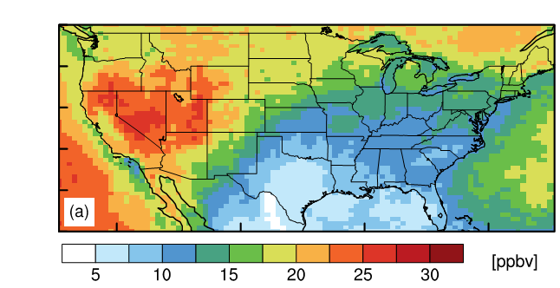
Estimates of Asian and stratospheric influence on
U.S. surface ozone (MDA8) in spring
Mean MDA8 O₃ in surface air
(GFDL AM3 model global strat-trop chemistry, 50 km², nudged)
Asian: May-June 2010
Stratospheric (O3S): April-June 2010
0
2
4
6
8
O₃ (ppb)
O₃ (ppb)
Base Simulation – Zero Asian
anth. emissions
Tagged above e90 tropopause [Prather et al., 2011] + subjected to same loss processes as tropospheric O₃.
[Lin et al., JGR, 2012a]
[Lin et al., JGR, 2012b]
Model indicates NV particularly susceptible; observations lacking
New 6-site network: Nevada Rural Ozone Initiative (NVROI)
led by M. Gustin, U NV-Reno [Gustin et al.; Fine et al., submitted]
Notes:
3

Slide 4
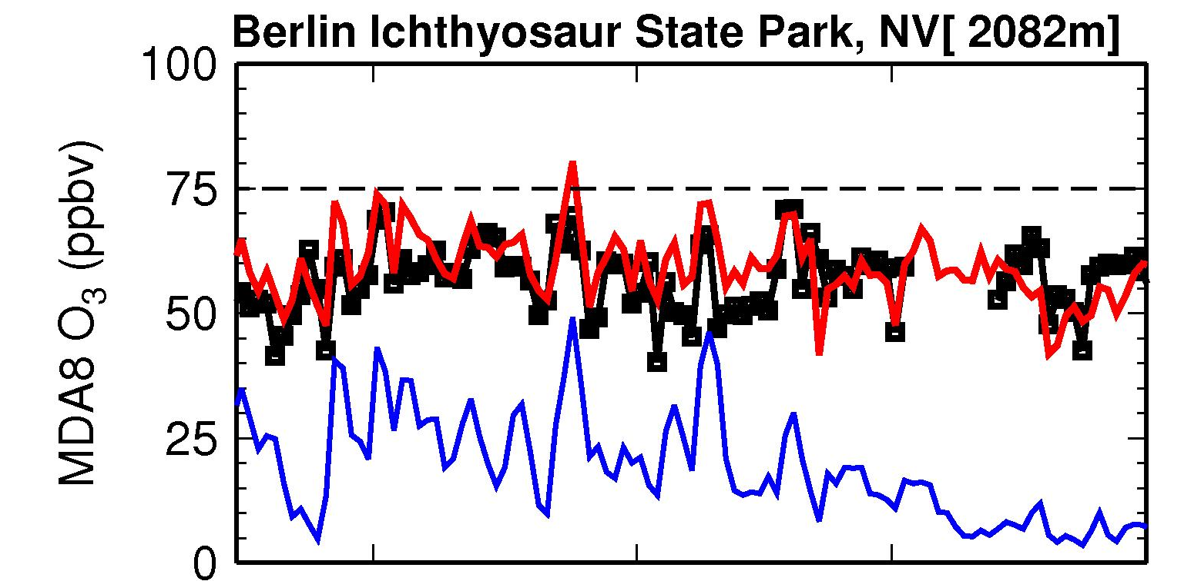
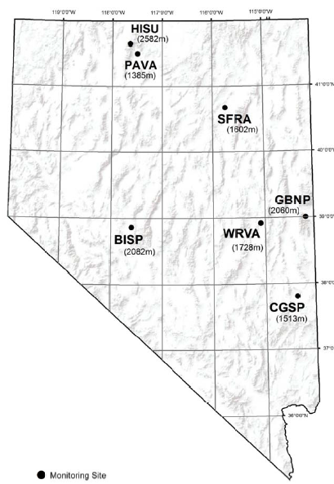
Stratospheric ozone intrusions contribute to springtime high-O₃ events observed at a new NVROI site
OBS c/o M. Gustin, R. Fine
AM3 model total surface O₃ AM3 strat. O₃ tracer
R. Fine,
U NV - Reno
4/15/12
5/1/12
6/1/12
7/1/12
7/31/12
M. Lin, Princeton/GFDL
Similar findings for other NVROI sites, consistent with earlier findings for Apr-June 2010 (based on satellite, sonde, aircraft, surface obs, AM3 [Lin et al., 2012ab])

Slide 5
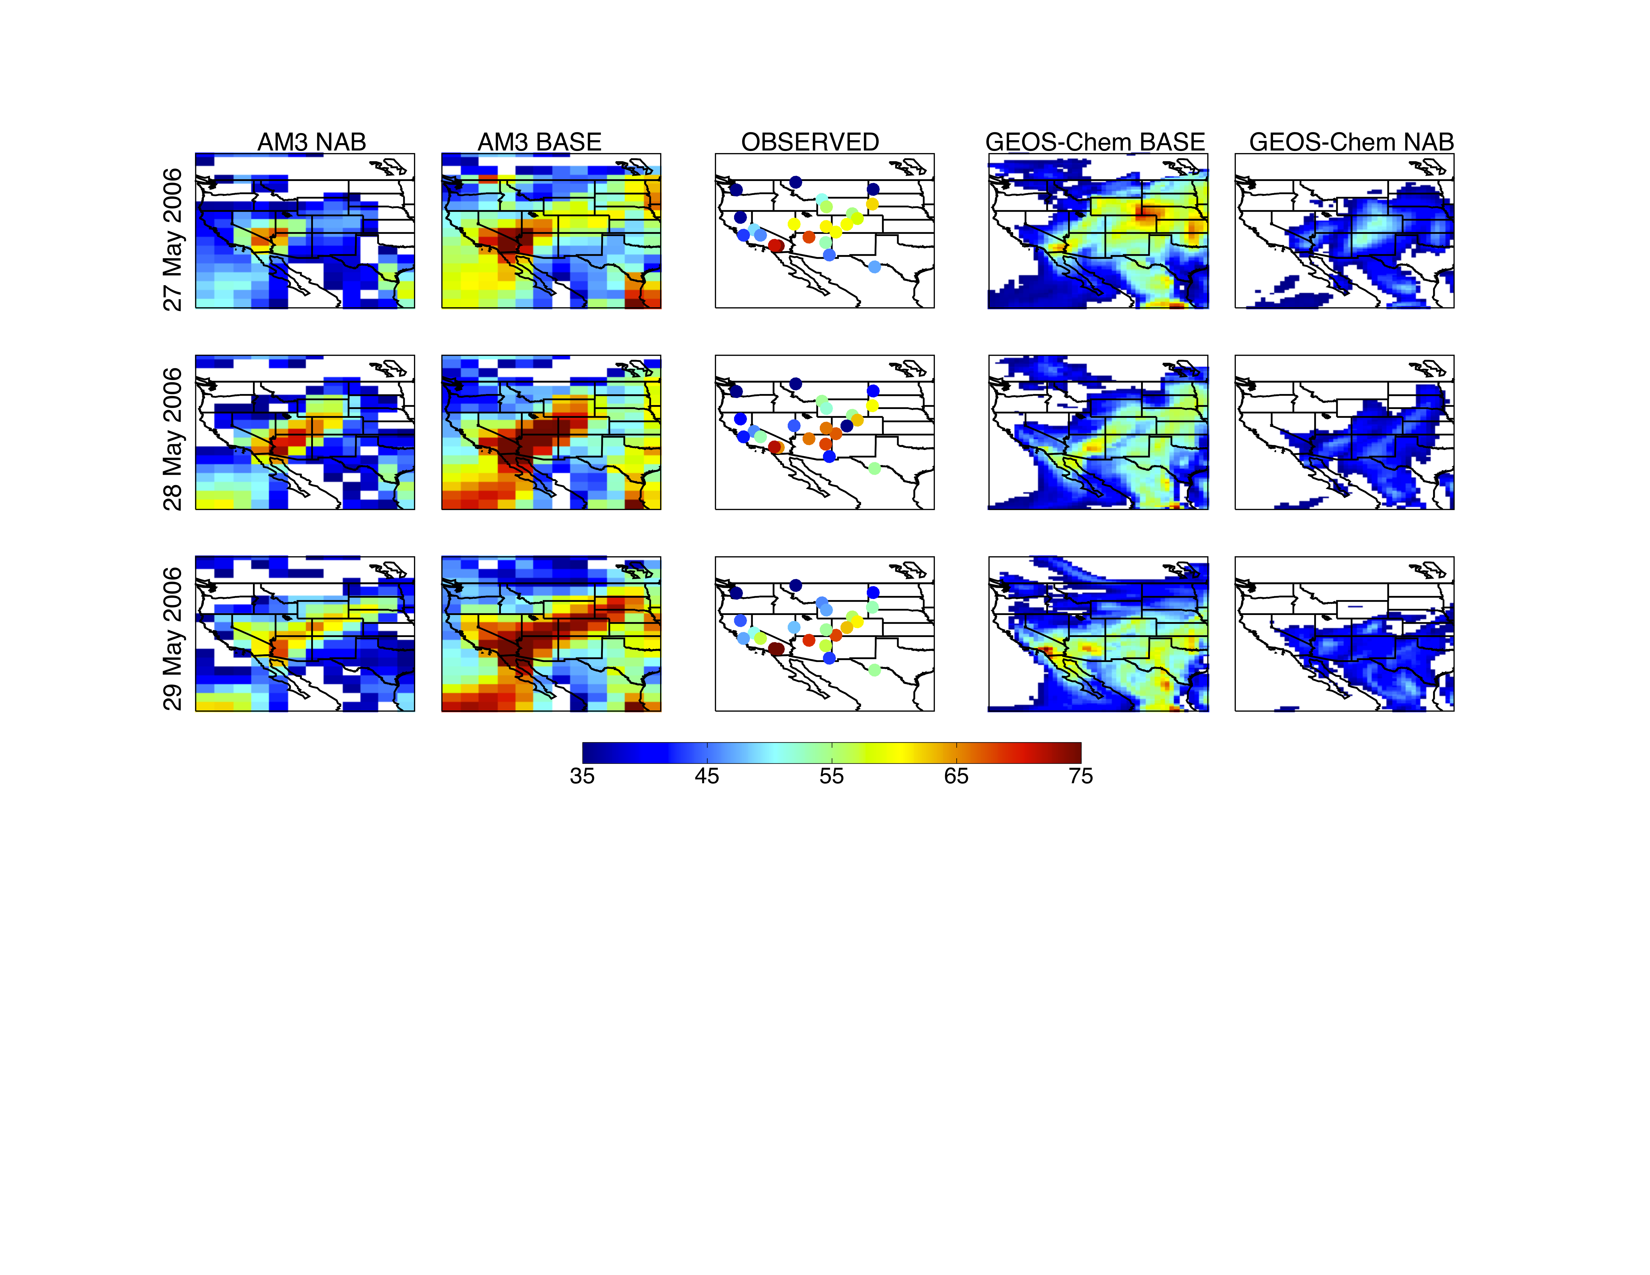
Identifying process-level differences in model estimates of N. American Background via analysis of observed daily variations
Observed high surface O₃ event in Four Corners Region on May 28, 2006
GFDL AM3
OBSERVED (CASTNet)
GEOS-Chem
TOTAL
MDA8 O₃
BACK-
GROUND
(N. Amer.
anth. emis.
set to zero
in models)
Enhanced background
coincides with enhanced
total O₃ (models + OBS)
Fiore et al., submitted to Atmos. Environ.
Attributed to strat. intrusion (OMI total column O₃ & OMI/MLS trop. O₃)
Models frequently bracket obs (not limited to WUS spring), implying value in multi-model obs-constrained approach
How best to extract useful information from biased models?
Notes:
Note AM3 looks pretty good here… turn next to expose a real wart – EUS summertime O3 simulation
5

Slide 6
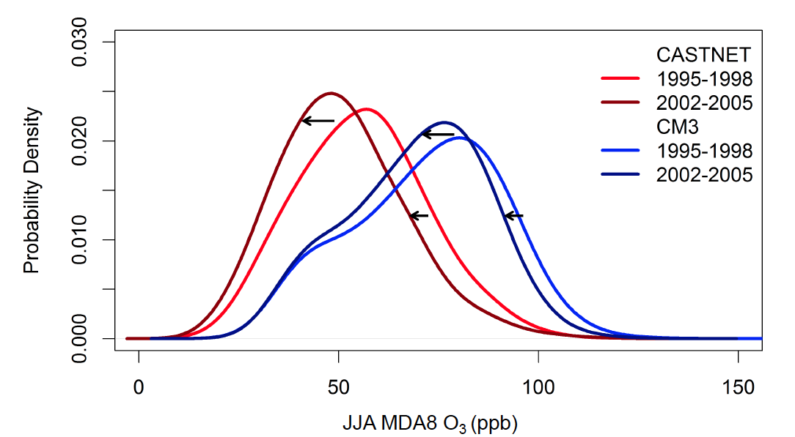
Over NE USA JJA, evaluate model processes in light of biases:
GFDL CM3 generally captures surface O₃ response to 25% decrease in regional NO_{x} emissions (early 1990s to mid-2000s)
GFDL CM3 Model
(AM3 + full ocean
& sea ice)
Observed
(CASTNet)
Relative Frequency
JJA MDA8 O₃ (ppb)
Implies bias correction based on present-day observations can be applied to scenarios with NO_{x} changes (RCPs for 21st C)
Caveat: Model response smaller than observed, worst at low tail
Rieder et al., in prep

Slide 7
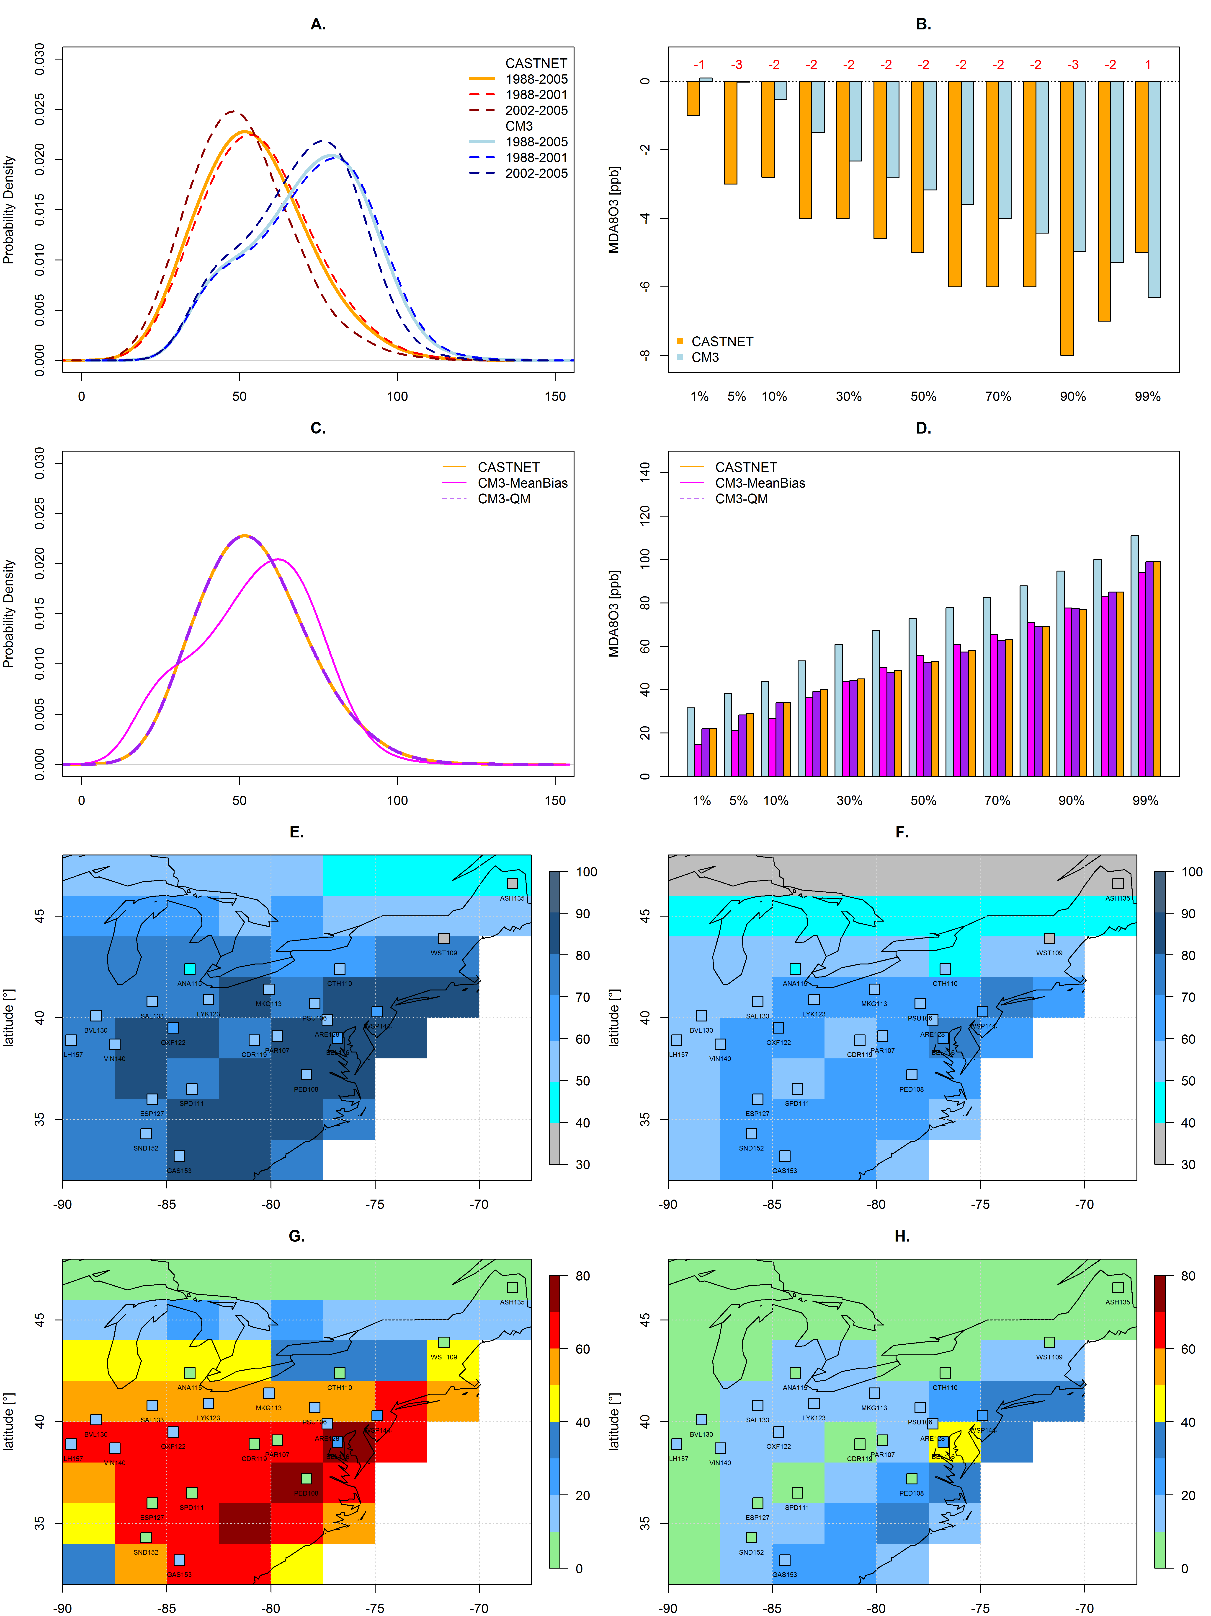
Bias correction (regional quantile mapping) for NE USA summertime high-O₃ events
Average (1988-2005) number of summer days with MDA8 O₃ > 75 ppb (NAAQS)
CM3 Historical simulation
(3 ensemble-member mean)
Corrected CM3 simulation
(3 ensemble-member mean)
80
60
40
20
0
CASTNet sites (observations)
Rieder et al., in prep
Maps raw model summertime MDA8 distribution (over all model cells in region) to observed (all sites in region)
Apply correction to 21st century projections with CM3 chemistry-climate model using Representative Concentration Pathways (RCPs)

Slide 8
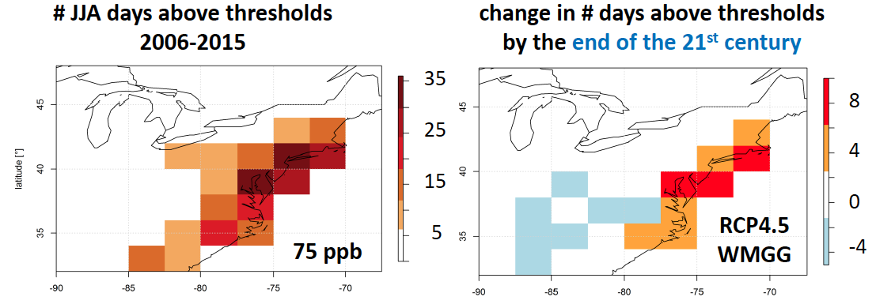
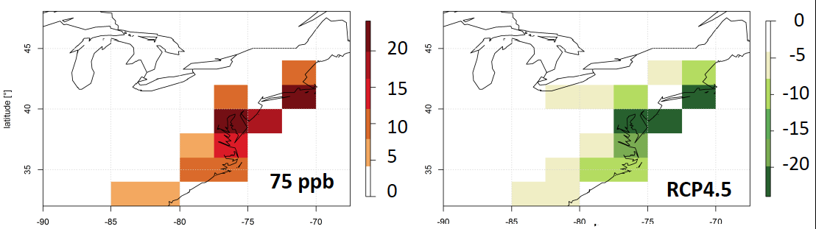
Large NO_{x} reductions offset climate penalty on O₃ extremes over the NE USA (moderate climate scenario: RCP4.5)
# days in JJA with MDA8 O₃ > 75 ppb
2006-2015
Change in # JJA days with MDA8 O₃ > 75 ppb
2091-2100
RCP4.5 but 2005 O₃ prec. emis.
RCP4.5 CLIMATE CHANGE ONLY
RCP4.5
WMGG
RCP4.5: O₃ prec. emis. change
RCP4.5 CLIMATE + EMISSIONS
2005→2100
NO_{x} ⬇ >80%
over NE USA
H. Rieder

Slide 9
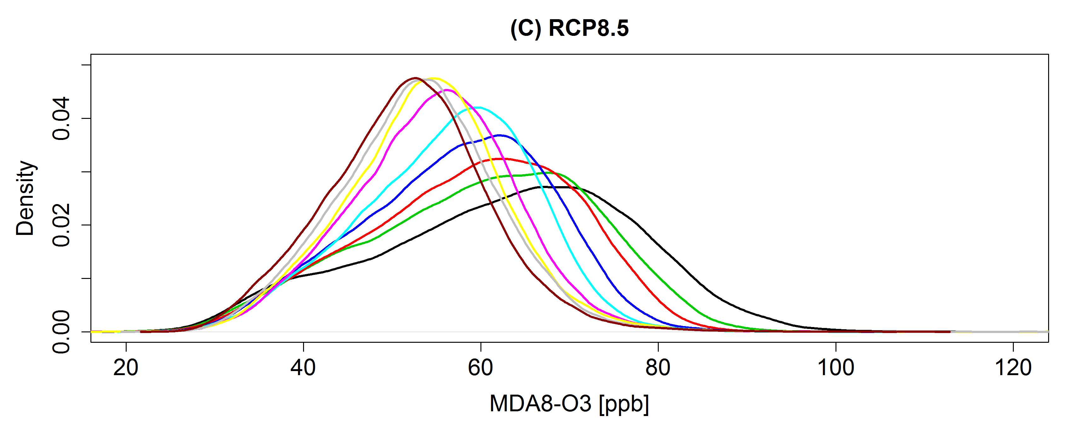
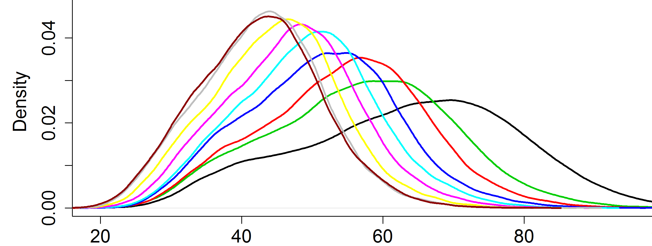
Under RCPs, NE USA high-O₃ events decrease; beware ‘penalty’ from rising methane (via background O₃)
2005 to 2100 % change
Time
RCP8.5:
Extreme
warming
NE USA
NO_{x}
Global
NO_{x}
CH₄
RCP8.5
RCP4.5
2006-2015
2016-2025
2026-2035
2036-2045
2046-2055
2056-2065
2066-2075
2076-2085
2086-2095
◆
◆
◆
◆
◆
◆
◆
◆
◆
RCP4.5:
Moderate
warming
Time
GFDL CM3 (uncorrected) MDA8 O₃ (ppb)
→ Rising CH₄ in RCP8.5 partially offsets O₃ decreases otherwise attained with regional NO_{x} controls (RCP4.5)
H. Rieder

Slide 10
Key drivers of surface ozone variability
(from WUS background to EUS extremes)
2. Can push O₃ above
NAAQS over WUS
[Lin et al., JGR, 2012ab]
1. Drives much of springtime WUS variability in observed surface O₃
[Lin et al., JGR, 2012b]
stratosphere
Asian
pollution
lightning
Constraints on oxidation from space??
[VALIN POSTER]
global
methane
Total
ozone
“North Amer. Background” ozone
+
Anthropogenic
regional ozone
4. Future EUS O₃ extremes depend on regional climate change + global and regional emission changes
[Rieder et al., in prep]
NE USA surface O₃ seasonal cycle → WUS background by end of 21st C??
[CLIFTON POSTER]
3. Processes contributing most to differences in model estimates of North American Background
[Fiore et al., submitted to Atm Env]
Natural NO_{x},
NMVOC
X
Biosphere,
Human
activity
Fires
North America

Slide 11
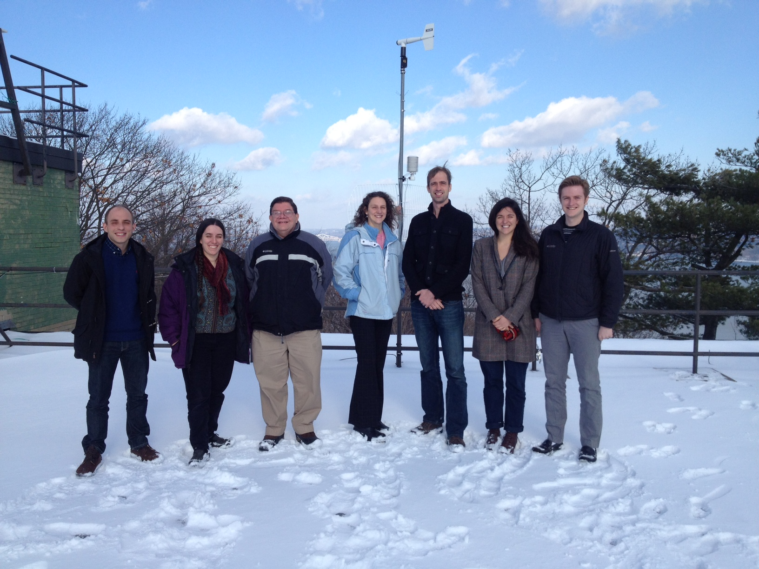
Atmospheric Chemistry Group at LDEO/CU
Nora
Gus
Arlene
Luke
Harald
Olivia
Lee
posters
On the roof of our building following mid-Dec snowfall
(missing from photo: undergraduate researcher Jean Guo)

