Slide 1


Quantifying source contributions to
O₃ and PM_{2.5} pollution episodes
across the Eastern U.S.
TT PIs: Arlene Fiore (CU/LDEO), Tracey Holloway (U WI)
AQAST TT Members: Greg Carmichael (U Iowa), Daniel Cohan (Rice U), Bryan Duncan (NASA GSFC), Daven Henze (CU-Boulder), Edward Hyer (NRL), Daniel Jacob (Harvard), Russ Dickerson (U MD), Gabriele Pfister (NCAR)
AQAST7
Harvard University, Cambridge, MA
June 18, 2014

Slide 2
Designing effective SIPs requires knowledge of source contributions to O₃ and PM_{2.5} pollution episodes
Observed pollution levels are the summation of
in-state, out-of-state, international and natural sources
AQAST can help quantify these components; how can we be most effective?
Build a framework for continued communication with the stakeholders
Request priority high-O₃ and high-PM_{2.5} episodes from AQMs (2007-2013)
AQAST
TT
Members
Air Agencies
monthly
teleconferences
MDE, MO DNR, NH DES,
NYSDEC, TX/TCEQ,
WI DNR/LADCO,
OTC, NESCAUM, US EPA…
…your agency??
Next teleconference: Monday, June 23, 2pm (EDT)

Slide 3

AQAST resources for source attribution during EUS pollution episodes
suborbital platforms
models
satellite instruments
DISCOVER-AQ
(2011; SIP Base year)
SEAC4RS/SOAS/SENEX (2013)
EPA AQS
CASTNet
CAMx
CMAQ
GEOS-Chem
GFDL AM3
STEM
OMI NO2
MOPITT CO
MODIS AOD
Transport events
Inter-state
Wildfire
International
Size of episode
Areal extent
Duration
Transport
Source attribution
Several horizontal resolutions
Forward/adjoint
HTAP simulations
Connect suborbital and space-based information
For each episode, organically determine best use of AQAST resources
(which team members, tools)

Slide 4
Deliverables & Expected AQ outcomes
1. Establishment of a stakeholder advisory committee (set priorities)
→ Build broader engagement between AQAST and state-level AQMs
2. For each episode, generate reports with technical details of approach in appendices (“the recipe” for the analysis)
→ New info / approaches to support SIP development
→ Build capacity by providing case studies for future analyses
3. Develop website archive of reports, and links to related AQAST resources, including coordination with RSIG TT activity, other web tools
→ Broader dissemination of approaches & findings
4. Online interactive graphics to facilitate exploration of model and satellite data
→ Developing user-friendly space-based and model products to provide information on contributions from transported pollution
Notes:
4

Slide 5
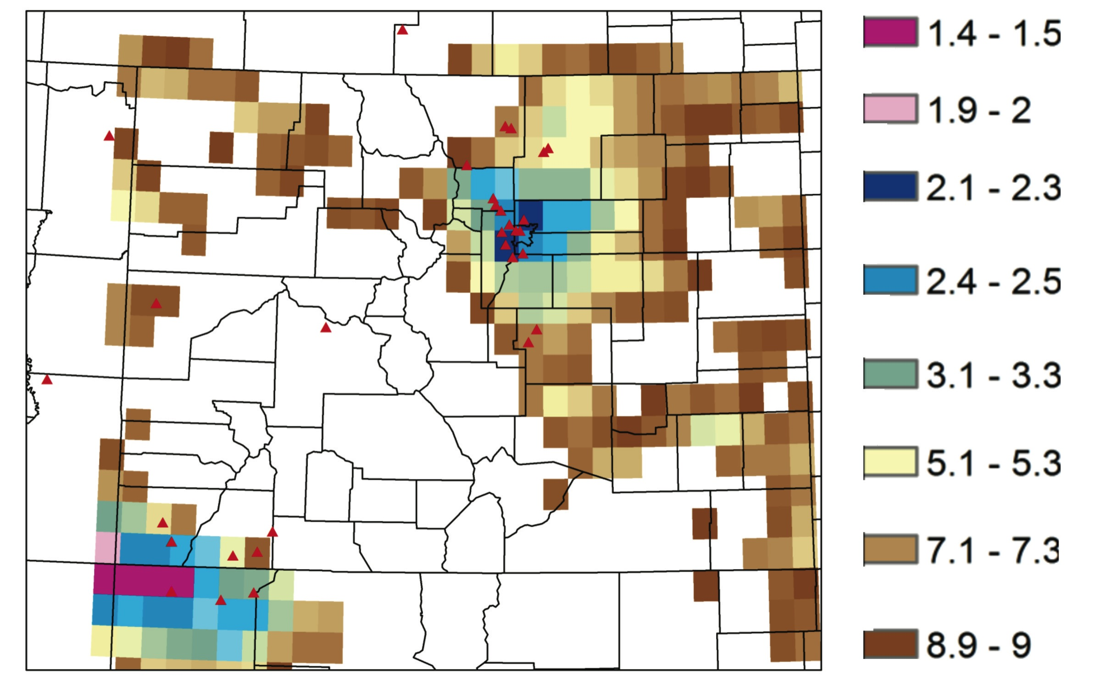
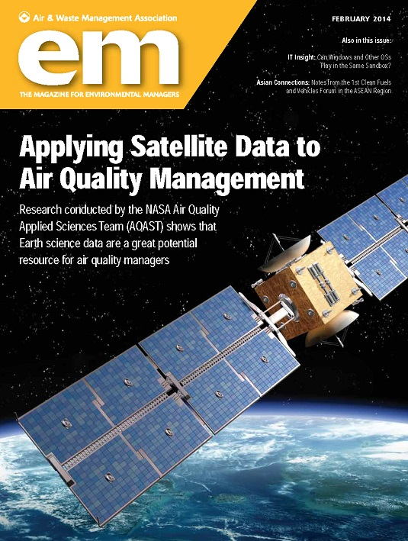
Space-based formaldehyde to NO₂ ratio indicates NOx-sensitive O₃ production over Colorado Front Range
Figure 2: Ratio of tropospheric formaldehyde (HCHO) to tropospheric nitrogen dioxide (NO₂) over the Colorado Front Range area, derived from mean GOME2 satellite measurements for July 2007 and 2008. A ratio of above 1.0 may indicate a NO_{x}-sensitive ozone production regime. All ratios in this region show ratios are above 1.0. Gridded data from KNMI TEMIS (http://www.temis.nl/airpollution/no2.html). Figure courtesy of Patrick Reddy, from presentation "2009 Ozone Season Review: Briefing to the Colorado Air Quality Control Commission," September 17, 2009
Witman, S., T. Holloway, and P. Reddy, 2013

Slide 6
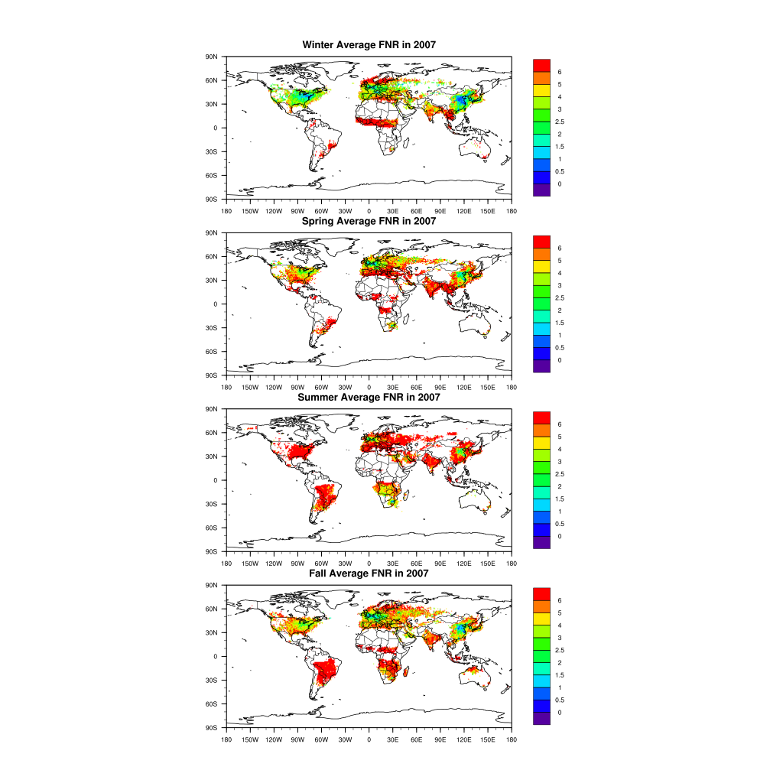
“The recipe” for estimating the sensitivity of O₃ production to NO_{x} vs. VOCs from space-based formaldehyde to NO₂ ratio
http://sage.wisc.edu/airquality_ratios
T. Holloway

Slide 7
Receptor-oriented modeling: Contributions from local and regional BC emissions to mortality in NY/PHIL (2007)
Matthew Turner, Daven Henze, University of Colorado at Boulder

Slide 8
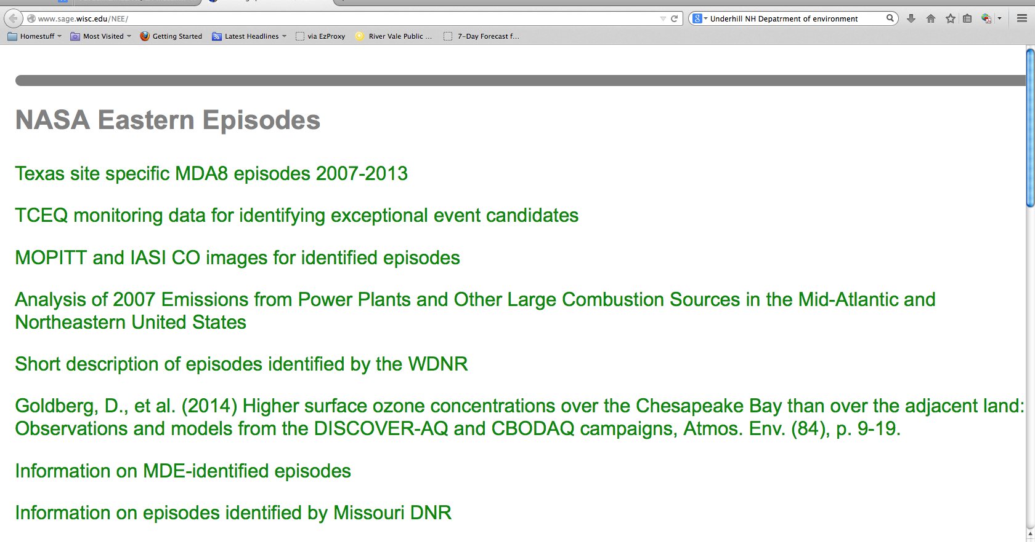
Password-protected website for sharing materials among AQAST/AQM team members

Slide 9
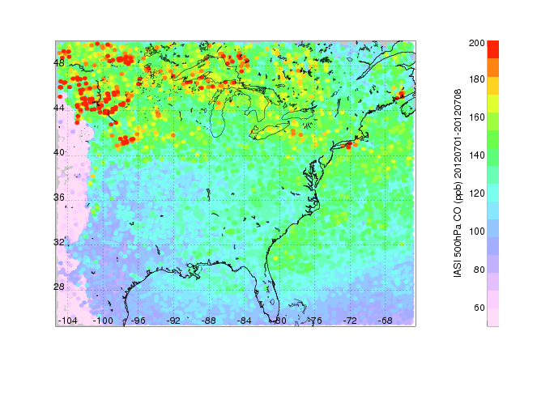
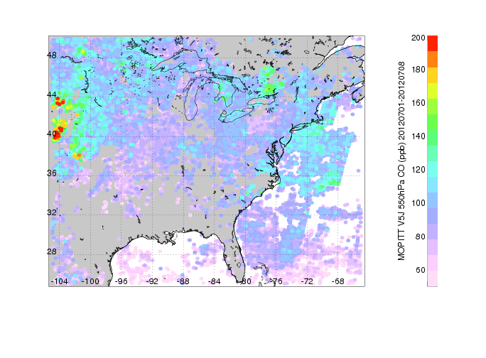
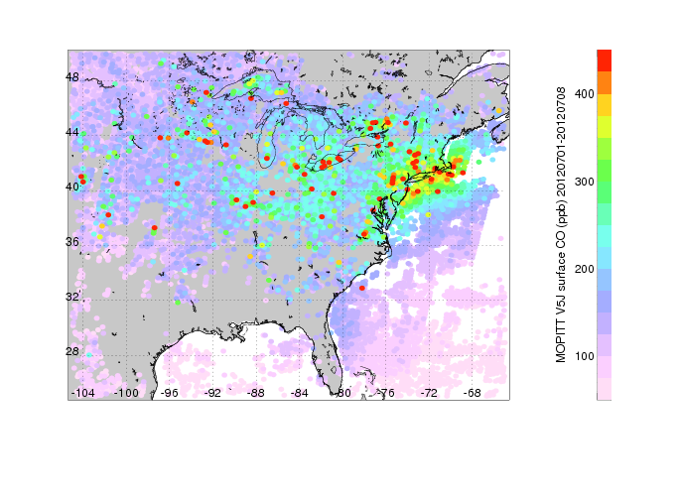
Satellite carbon monoxide composites (max value)
during selected EUS episodes
  MOPITT multi-spectral retrieval (increased sensitivity to surface)
  IASI FORLI retrieval processed at NCAR (mostly mid-trop sensitivity)
  Download maps from: ftp://acd.ucar.edu/user/pfister/AQAST/TT_EUS_Episodes/
  Further graphics and time periods available if needed
  IASI O3 Analysis is in progress
1 – 8 July 2012
IASI 550 mbar MOPITT 550 mbar MOPITT surface
David Edwards, Gabriele Pfister and Helen Worden, NCAR

Slide 10
Password-protected website for sharing materials among AQAST/AQM team members
“highest priority”: June 10-18 2007

Slide 11
A. Dickens, WDNR/LADCO

Slide 12
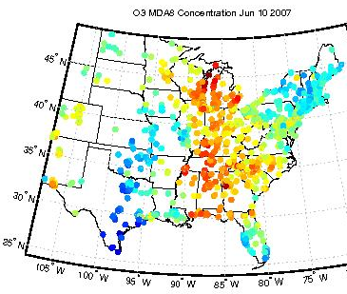
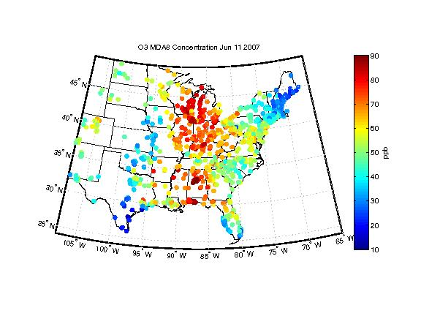
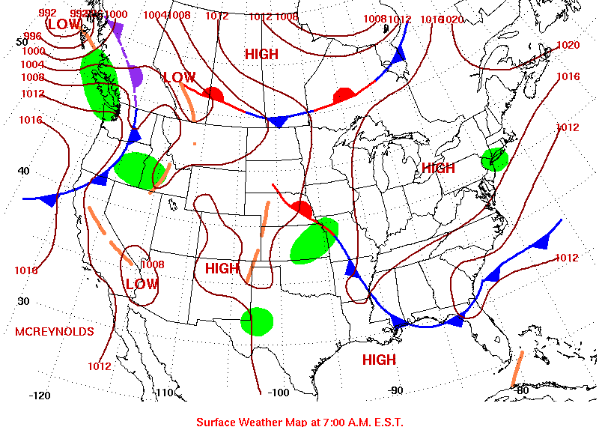
BEHR NO₂ column anomalies (L. Valin)
relative to MJJA 2005-2008 (1:30pm)
AQS MDA8 OZONE (J. Guo)
SUNDAY
NOAA Weather Maps (7am)
“highest priority O₃ episode”
from WI DNR
“started as classic lake breeze”
-A. Dickens (WI DNR/LADCO)

Slide 13
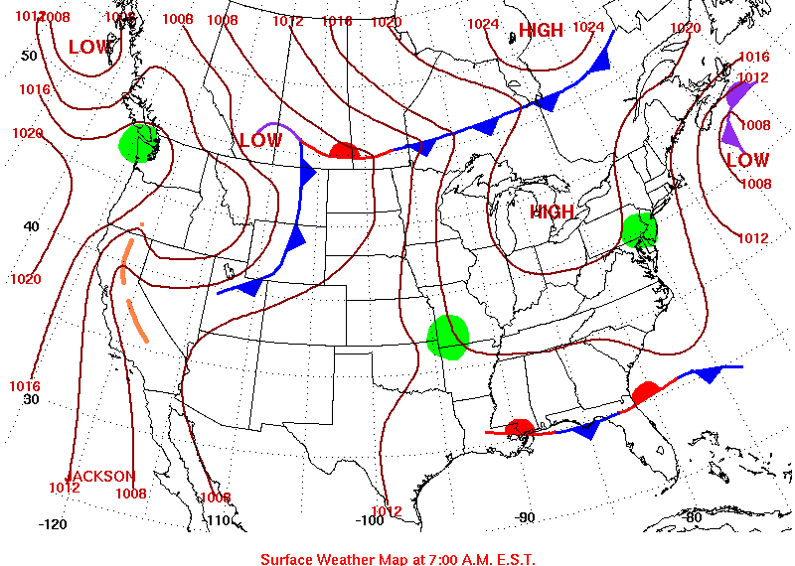
BEHR NO₂ column anomalies (L. Valin)
relative to MJJA 2005-2008 (1:30pm)
AQS MDA8 OZONE (J. Guo)
NOAA Weather Maps (7am)
“highest priority O₃ episode”
from WI DNR

Slide 14
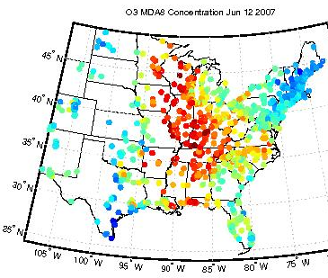
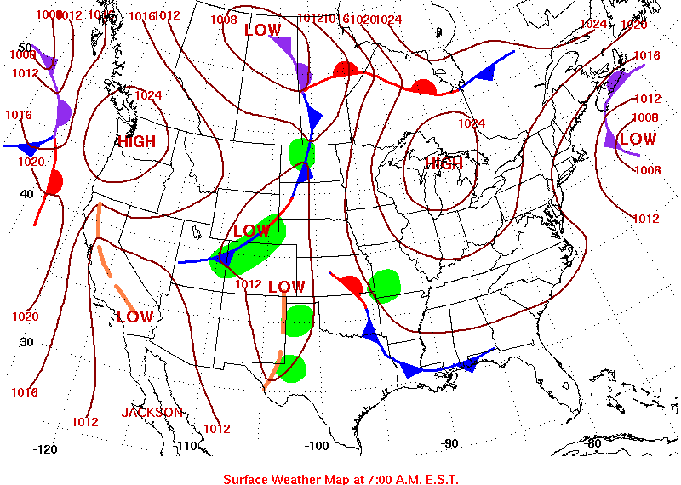
BEHR NO₂ column anomalies (L. Valin)
relative to MJJA 2005-2008 (1:30pm)
AQS MDA8 OZONE (J. Guo)
NOAA Weather Maps (7am)
“highest priority O₃ episode”
from WI DNR
“middle of episode, highest
concentrations inland…even in farthest northern stations; lower along lake; high O₃ in IL”
-A. Dickens (WI DNR/LADCO)

Slide 15
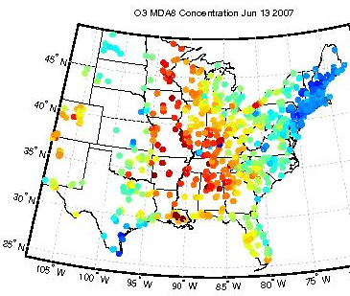
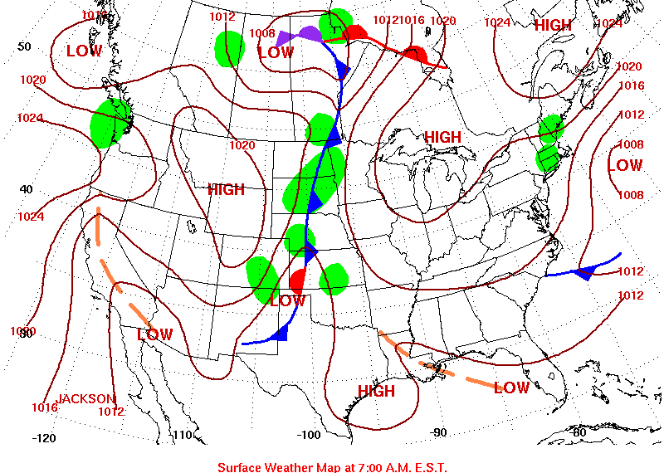
BEHR NO₂ column anomalies (L. Valin)
relative to MJJA 2005-2008 (1:30pm)
AQS MDA8 OZONE (J. Guo)
NOAA Weather Maps (7am)
“highest priority O₃ episode”
from WI DNR
“middle of episode, highest
concentrations inland;
lower along lake;
MN also highest O₃ of the year”
-A. Dickens (WI DNR/LADCO)

Slide 16
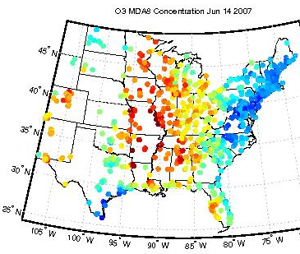
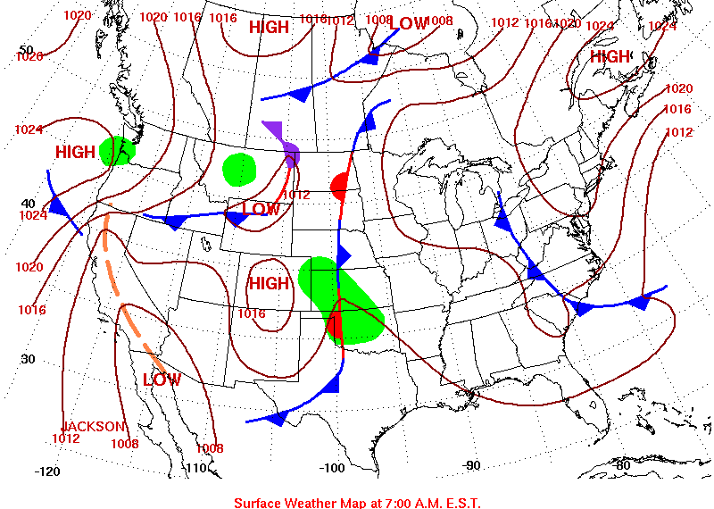
BEHR NO₂ column anomalies (L. Valin)
relative to MJJA 2005-2008 (1:30pm)
AQS MDA8 OZONE (J. Guo)
NOAA Weather Maps (7am)
“highest priority O₃ episode”
from WI DNR
“middle of episode, highest
concentrations inland;
lower along lake;
MN also highest O₃ of the year”
-A. Dickens (WI DNR/LADCO)

Slide 17
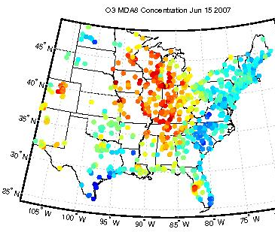
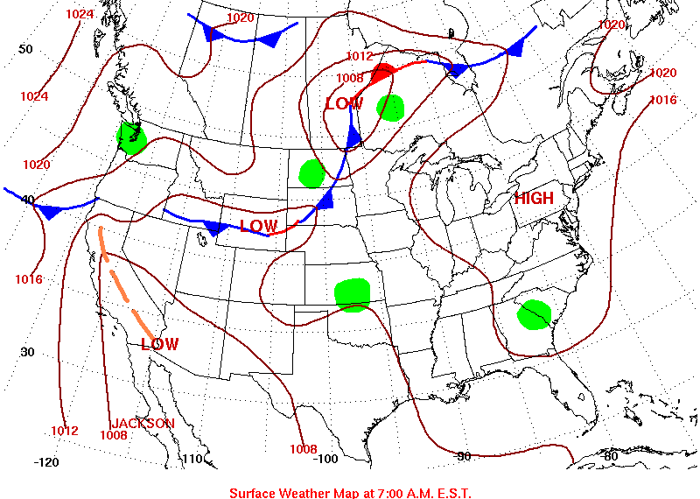
BEHR NO₂ column anomalies (L. Valin)
relative to MJJA 2005-2008 (1:30pm)
AQS MDA8 OZONE (J. Guo)
NOAA Weather Maps (7am)
“highest priority O₃ episode”
from WI DNR

Slide 18
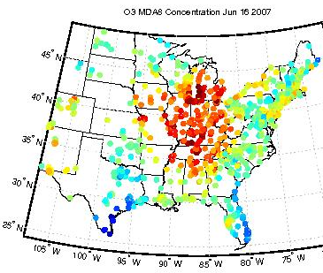
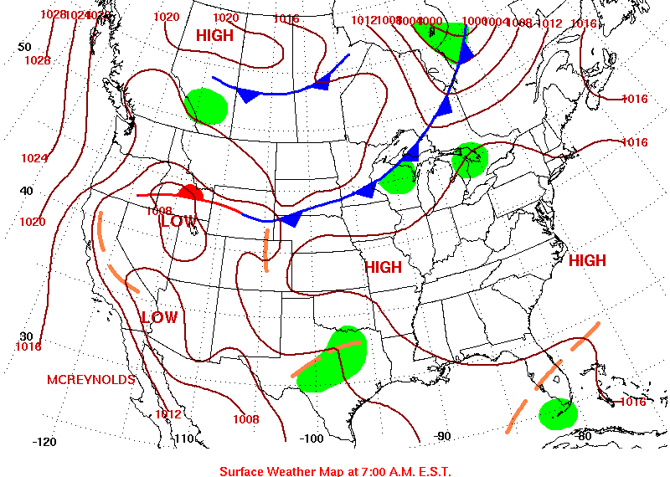
BEHR NO₂ column anomalies (L. Valin)
relative to MJJA 2005-2008 (1:30pm)
AQS MDA8 OZONE (J. Guo)
NOAA Weather Maps (7am)
“highest priority O₃ episode”
from WI DNR
“MI also observed the highest ozone concentrations of the year”
-A. Dickens (WI DNR/LADCO)

Slide 19
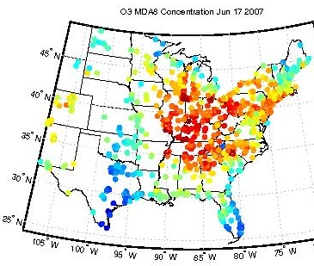
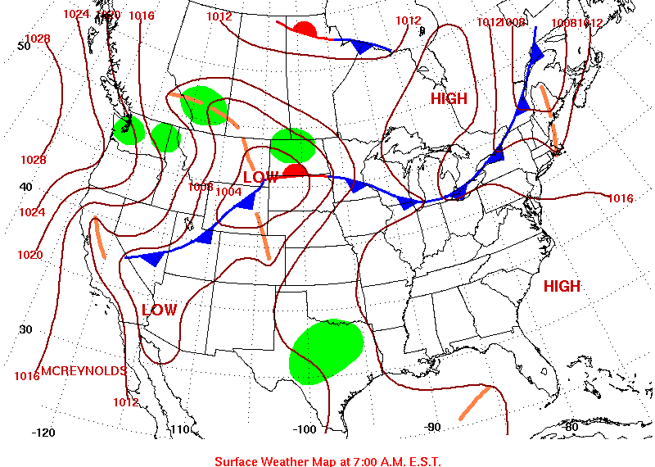
BEHR NO₂ column anomalies (L. Valin)
relative to MJJA 2005-2008 (1:30pm)
AQS MDA8 OZONE (J. Guo)
SUNDAY
NOAA Weather Maps (7am)
“highest priority O₃ episode”
from WI DNR

Slide 20
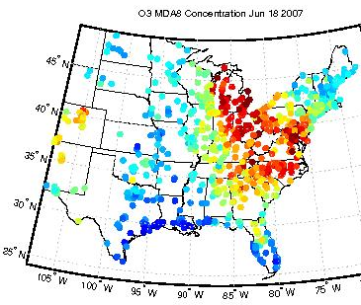
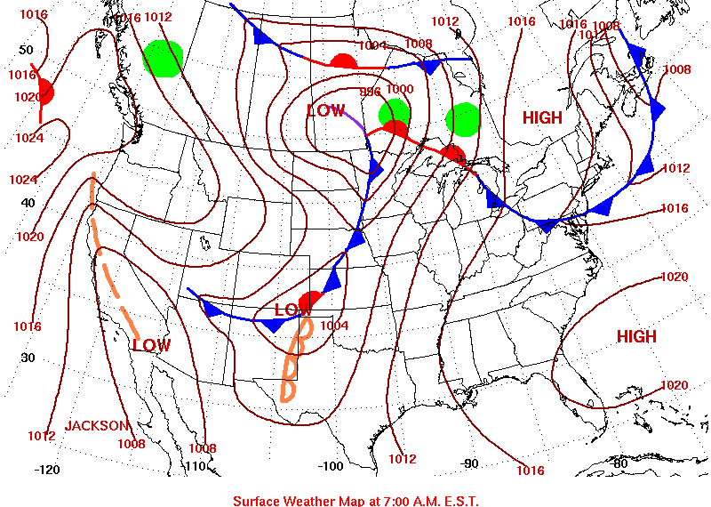
BEHR NO₂ column anomalies (L. Valin)
relative to MJJA 2005-2008 (1:30pm)
AQS MDA8 OZONE (J. Guo)
NOAA Weather Maps (7am)
Similar day-to-day variations in spatial patterns of surface O₃ and NO₂ column anomalies during this regional-scale, multi-day episode (reflects weather variability)

Slide 21
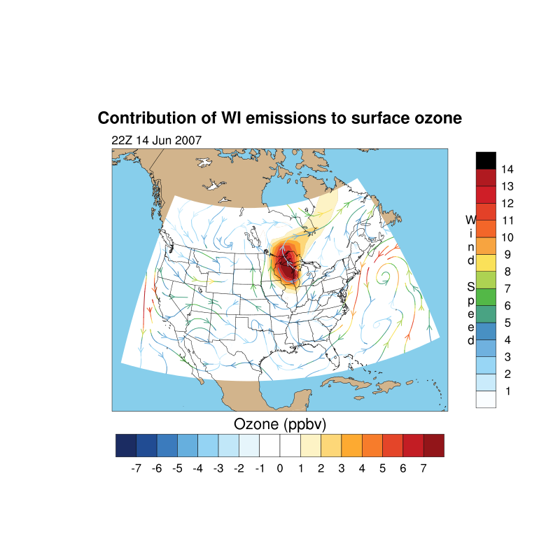
Quantifying source contributions with GEOS-Chem (v9_02):
Multi-year (2004-2012) simulations (2°x2.5°)
MERRA winds; NLDN lightning; NEI2005; CH₄ lower BCs from obs
Sample estimated contribution of WI emissions to surface O3
Sensitivity simulations:
N. Amer. Background
(zero N. Amer Anthr. Emis.)
U.S. Background
Natural Background
Zero soil NO_{x}
Zero lightning NO_{x}
Zero fires
Zero a single state’s emissions
Some archived fields:
Columns at 10:00 and 13:30
Hourly surface O₃ ; PM_{2.5}
Boundary conditions for
regional models
→ Evaluating the ability of the coarse model to provide useful rapid first-look estimates of event source attribution in advance of regional-scale modeling
L. Murray, LDEO/Columbia
Notes:
Turnaround less than 24 hours if met fields exist (2007-2012)

Slide 22
Compiling spreadsheet with O₃ and PM_{2.5} episodes requested from air agencies
 | 2012 |  |  |  | identified by
Notes |  | O₃ | PM_{2.5} | other | MARAMA | MDE | MO | NY | TCEQ | WDNR
AQAST
resources
severe widespread event | June 24 - 28 | X |  |  |  |  |  |  | X
widespread | June 24 - 30 | X |  |  |  |  | X
 | June 27 - 28 | X |  |  |  |  |  |  |  | X
 | June 28 - July 8 | X |  |  |  | X
 | July 1 - 8 |  |  | Saharan dust |  |  |  |  | X
 | July 5 - 7 | X |  |  |  |  | X
 | July 9 - 14 | X |  |  |  |  | X
MD, MO, TCEQ, WDNR all identified high-O₃ events
during the 2012 heat wave beginning late June into mid-July
Animation of EUS MDA8 O₃ (J. Guo, Columbia)
Also PM_{2.5} available
Notes:
Show movie.

Slide 23
Designing effective SIPs requires knowledge of source contributions to O₃ and PM_{2.5} pollution episodes
Observed pollution levels are the summation of
in-state, out-of-state, international and natural sources
AQAST can help quantify these components; how can we be most effective?
Build a framework for continued communication with the stakeholders
Request priority high-O₃ and high-PM_{2.5} episodes from AQMs (2007-2013)
Analyze some of these episodes & provide “recipes” for determining source contributions
AQAST
TT
Members
Air Agencies
monthly
teleconferences
MDE, MO DNR, NH DES,
NYSDEC, TX/TCEQ,
WI DNR/LADCO,
OTC, NESCAUM, US EPA…
…your agency??
Next teleconference: Monday, June 23, 2pm (EDT)
Notes:
Note – making prior call summaries + schedule available on team website.

