Slide 1




Ozone pollution extremes over the eastern USA in summer: Recent trends, future projections
Arlene M. Fiore
Project Team: Harald Rieder (LDEO), Olivia Clifton (LDEO), Gus Correa (LDEO), Nora Mascioli (Columbia), Lorenzo Polvani (Columbia), Larry Horowitz (GFDL), Jean-François Lamarque (NCAR)
Close Collaborators: Elizabeth Barnes (NOAA Postdoctoral Fellow, now at CSU), Yuanyuan Fang (Princeton, now at Carnegie Institution/Stanford), Meiyun Lin (Princeton/GFDL), Vaishali Naik (UCAR/GFDL), Alex Turner (NOAA Hollings Scholar, now at Harvard)
U.S. EPA NCER/ASD Webinar
Applied Sciences Webinar Series
August 21, 2013
83520601

Slide 2
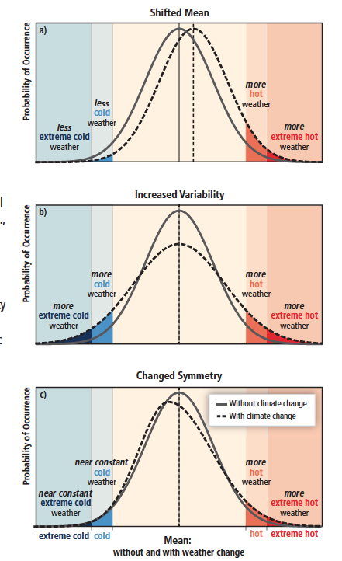


How and why might extreme air pollution events change?
Mean
shifts
Need to understand how different
processes influence the distribution
Meteorology (e.g., stagnation vs. ventilation)
Degree of mixing
Variability
increases
pollutant sources
Feedbacks (Emis, Chem, Dep)
T
Fires
OH
NO_{x}
VOCs
Symmetry
changes
Deposition
H₂O
PAN
Changing global emissions (baseline)
Changing regional emissions (episodes)
→ Shift in mean?
Figure SPM.3, IPCC SREX 2012
→ Change in symmetry?
http://ipcc-wg2.gov/SREX/
Today’s Focus

Slide 3
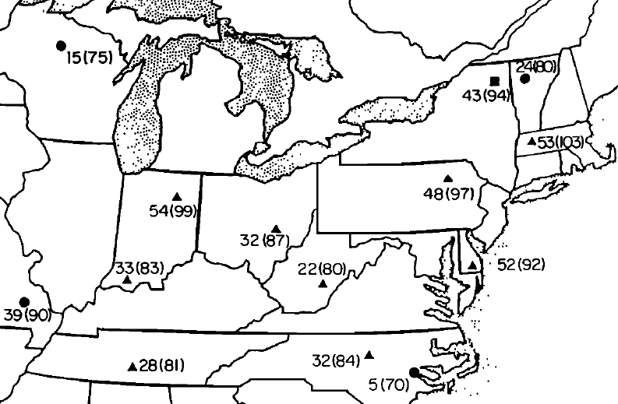
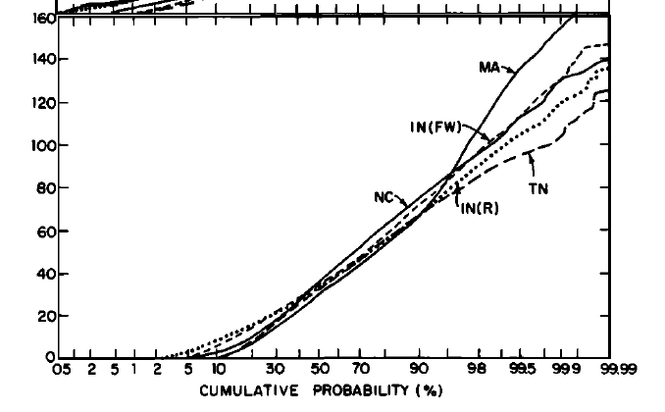
Logan, 1989: Recognized regional scale of EUS high-O₃ events; expressed urgent need for routine measurements at rural sites
SURE and NAPBN sites Apr-Sep 1979
# days with O₃ (8am-8pm) > 80 ppb
April-Sept 1978-9 O₃ cumulative probability distribution
0000-2300 LT (ppb) at SURE sites
Distribution not
well described by
Gaussian statistics,
esp. upper tail
3-8% > 80 ppb
Logan, 1989 Fig 3
(98% values: 80-103 ppb)
U.S. EPA CASTNet has now measured rural O₃ for over two decades
→ How has the O₃ distribution, including extreme events, changed?

Slide 4
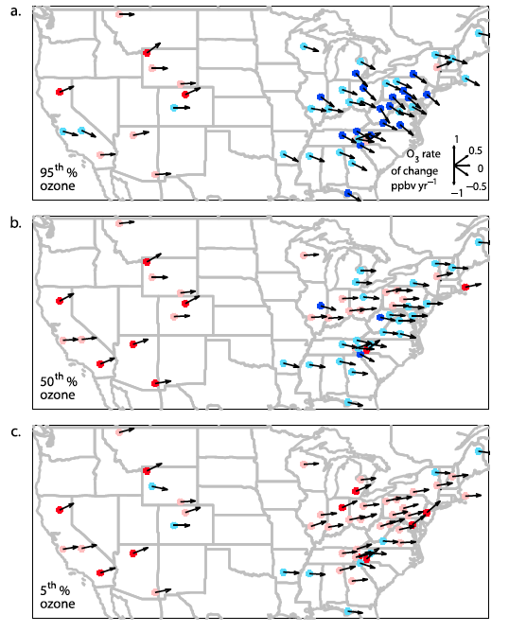
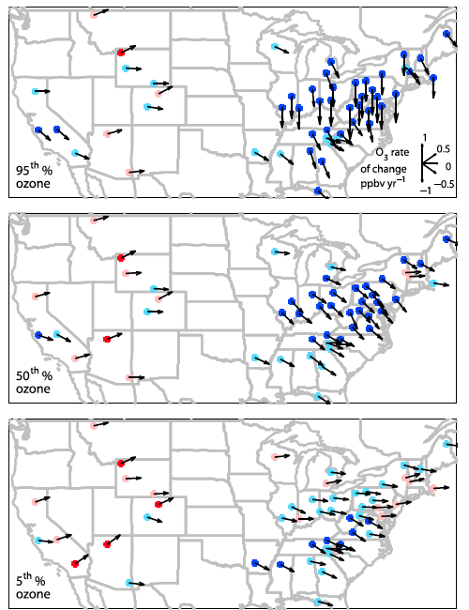
Trends in summer daytime (11am-4pm) average ozone at rural U.S. monitoring sites (CASTNet): 1990 to 2010
significant
Cooper et al., JGR, 2012
not significant
ppb yr⁻¹
5%
95%
Success in decreasing highest levels, but baseline rising (W. USA)
Decreases in EUS attributed in observations and models to NO_{x} emission
controls in late 1990s, early 2000s [e.g., Frost et al., 2006; Hudman et al., 2007; van der A. et al., 2008; Stavrakou et al., 2008; Bloomer et al., 2009, 2010; Fang et al., 2010]

Slide 5
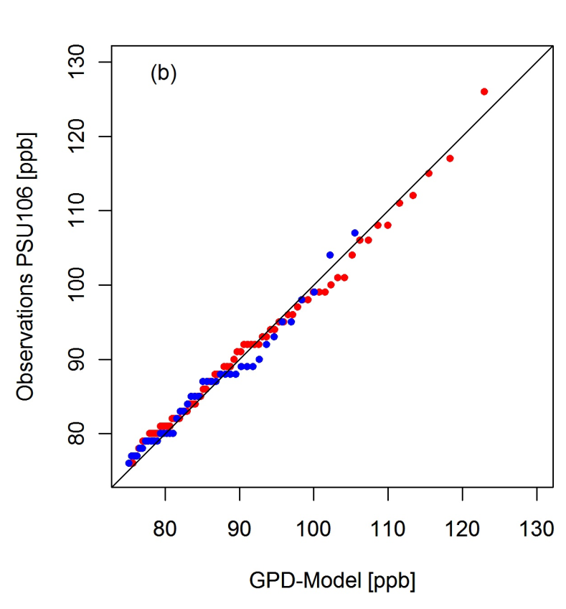
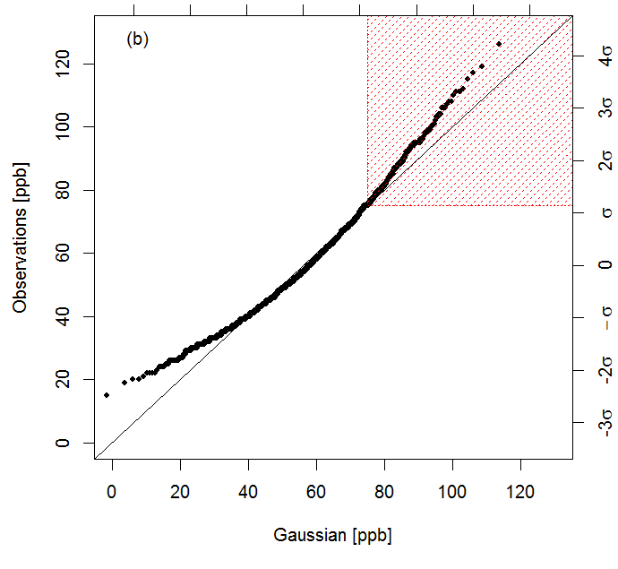
Extreme Value Theory (EVT) methods describe the high tail of the observed ozone distribution (not true for Gaussian)
JJA MDA8 O₃ 1987-2009 at CASTNet Penn State site
EVT Approach:
(Peak-over-threshold)
for MDA8 O₃>75 ppb
Gaussian:
Poor fit
for extremes
Observed MDA8 O₃ (ppb)
Observed MDA8 O₃ (ppb)
1988-1998
1999-2009
Gaussian (ppb)
Generalized Pareto Distribution Model (ppb)
Rieder et al., ERL 2013

Slide 6
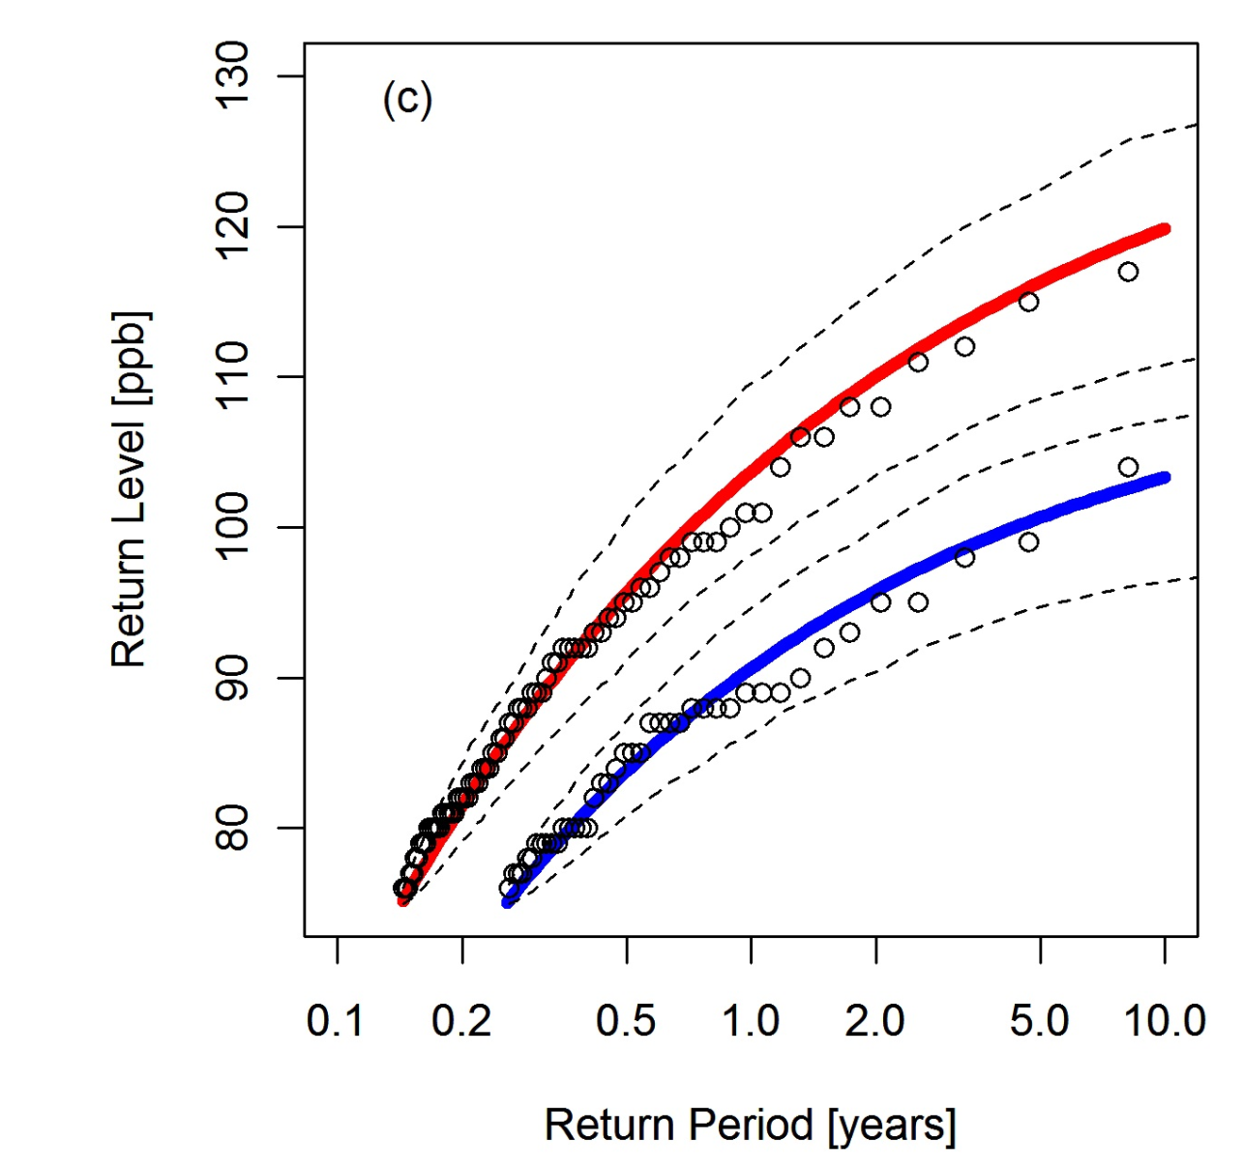
EVT methods enable derivation of “return levels” for JJA MDA8 O₃ within a given time period
Return level: describes probability of observing value x (level) within time window T (period)
CASTNet site: Penn State, PA
1988-1998
1999-2009
Sharp decline in return levels
between early and later periods
(NO_{x} SIP call)
Consistent with prior work [e.g., Frost et al., 2006; Bloomer et al., 2009, 2010]
Translates air pollution changes into
probabilistic language
Apply methods to all EUS CASTNet sites to derive
1-year and 5-year return levels
Rieder et al., ERL 2013

Slide 7
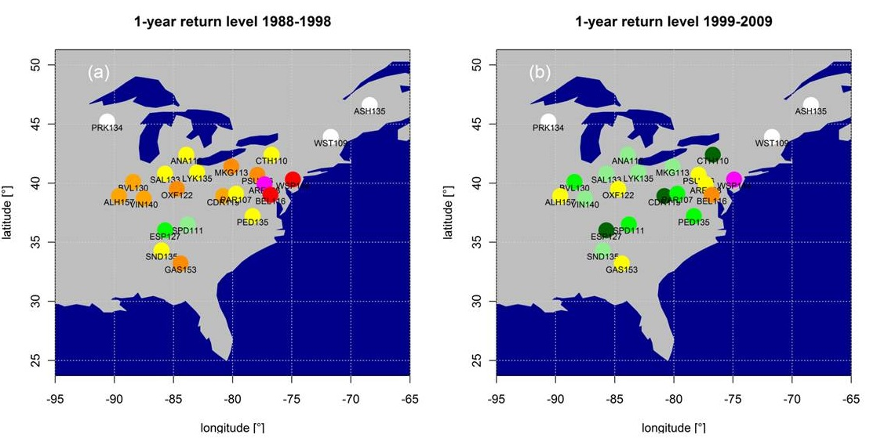
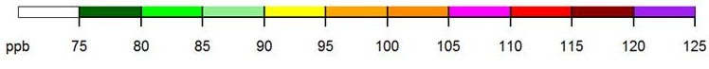
1-year return levels for JJA MDA8 O₃ over Eastern USA decrease following NO_{x} emission controls
1988-1998
1999-2009
1-yr return levels (RLs) decrease by 2-16 ppb
1-year RLs remain above the NAAQS threshold (75 ppb)
5-year RLs in 1999-2009 similar to 1-year RLs in 1988-1998
Rieder et al., ERL 2013

Slide 8
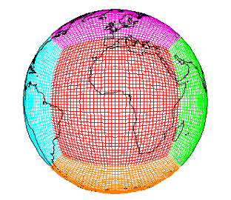


The GFDL CM3/AM3 chemistry-climate model
Donner et al., J. Climate, 2011; Golaz et al., J. Climate, 2011
Modular Ocean Model version 4 (MOM4)
&
Sea Ice Model
SSTs/SIC from observations or CM3 CMIP5 Simulations
cubed sphere grid
~2°x2°; 48 levels
GFDL-AM3
GFDL-CM3
Forcing
Solar Radiation
Well-mixed Greenhouse Gas Concentrations
Volcanic Emissions
Atmospheric Dynamics & Physics
Radiation, Convection (includes wet deposition of tropospheric species), Clouds, Vertical diffusion, and Gravity wave
Atmospheric Chemistry 86 km
0 km
Ozone–Depleting Substances (ODS)
Chemistry of O_{x}, HO_{y}, NO_{y}, Cly, Br_{y}, and Polar Clouds in the Stratosphere
6000+ years of CM3
CMIP5 simulations
[John et al., ACP, 2012
Turner et al., ACP, 2012
Levy et al., JGR, 2013
Barnes & Fiore, GRL, 2013]
Options to nudge AM3 to
reanalysis; also global
high-res (~0.5°x0.5°)
[Lin et al., JGR, 2012ab]
Chemistry of gaseous species (O₃, CO, NO_{x}, hydrocarbons) and aerosols (sulfate, carbonaceous, mineral dust, sea salt, secondary organic)
Pollutant Emissions (anthropogenic, ships, biomass burning, natural, & aircraft)
Aerosol-Cloud Interactions
Dry Deposition
Naik et al., JGR, 2013
Land Model version 3
(soil physics, canopy physics, vegetation dynamics, disturbance and land use)

Slide 9
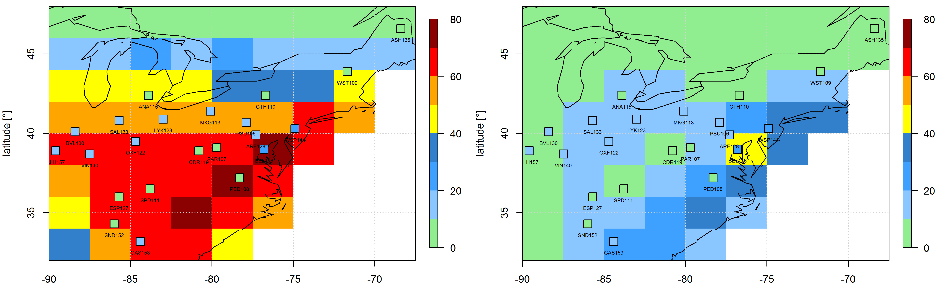
Generating policy-relevant statistics from biased models
Average (1988-2005) number of summer days with O₃ > 75 ppb
CM3 Historical simulation
(3 ensemble-member mean)
Corrected CM3 simulation
(regional remapping)
CASTNet sites (observations)
Applying correction to projected simulations assumes model
captures adequately response to emission and climate changes
Rieder et al., in prep

Slide 10
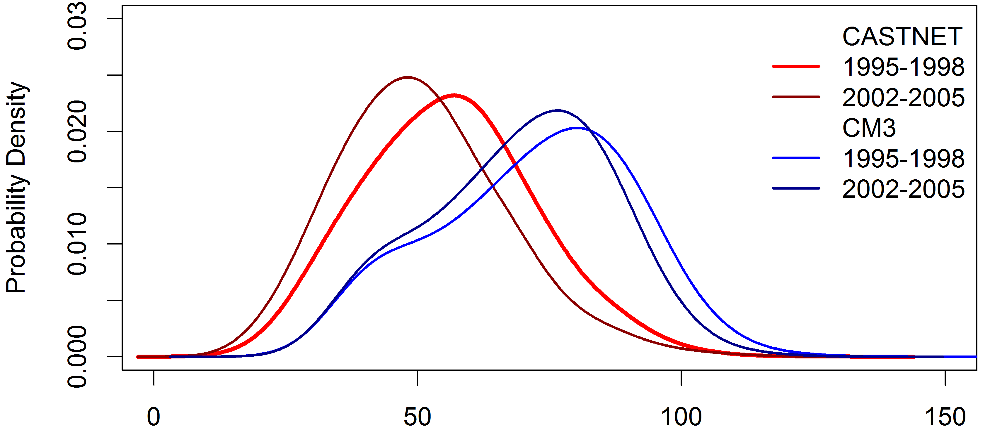
GFDL CM3 generally captures NE US JJA surface O₃ decrease following NO_{x} emission controls (-25% early 1990s to mid-2000s)
Observed
(CASTNet)
Model
(CM3)
JJA MDA8 O₃ (ppb)
Implies bias correction based on present-day observations can be applied to future scenarios with NO_{x} changes (RCPs)
Caveat: Model response on low-O₃ days smaller than observed
Rieder et al., in prep

Slide 11
Climate and Emission Scenarios for the 21st Century:
Representative Concentration Pathways (RCPs)
Percentage changes from 2005 to 2100
Enables us to
isolate role of
changing climate
RCP8.5
RCP4.5
RCP4.5_WMGG
Global
NO_{x}
NE USA
NO_{x}
Global
CO₂
Global
CH₄
Change in Global T (°C)
2006–2025 to 2081–2100
(>500 hPa) in GFDL CM3
chemistry-climate model
[John et al., ACP, 2012]
How will surface O₃ distributions over the NE US
evolve with future changes in emissions and climate?

Slide 12
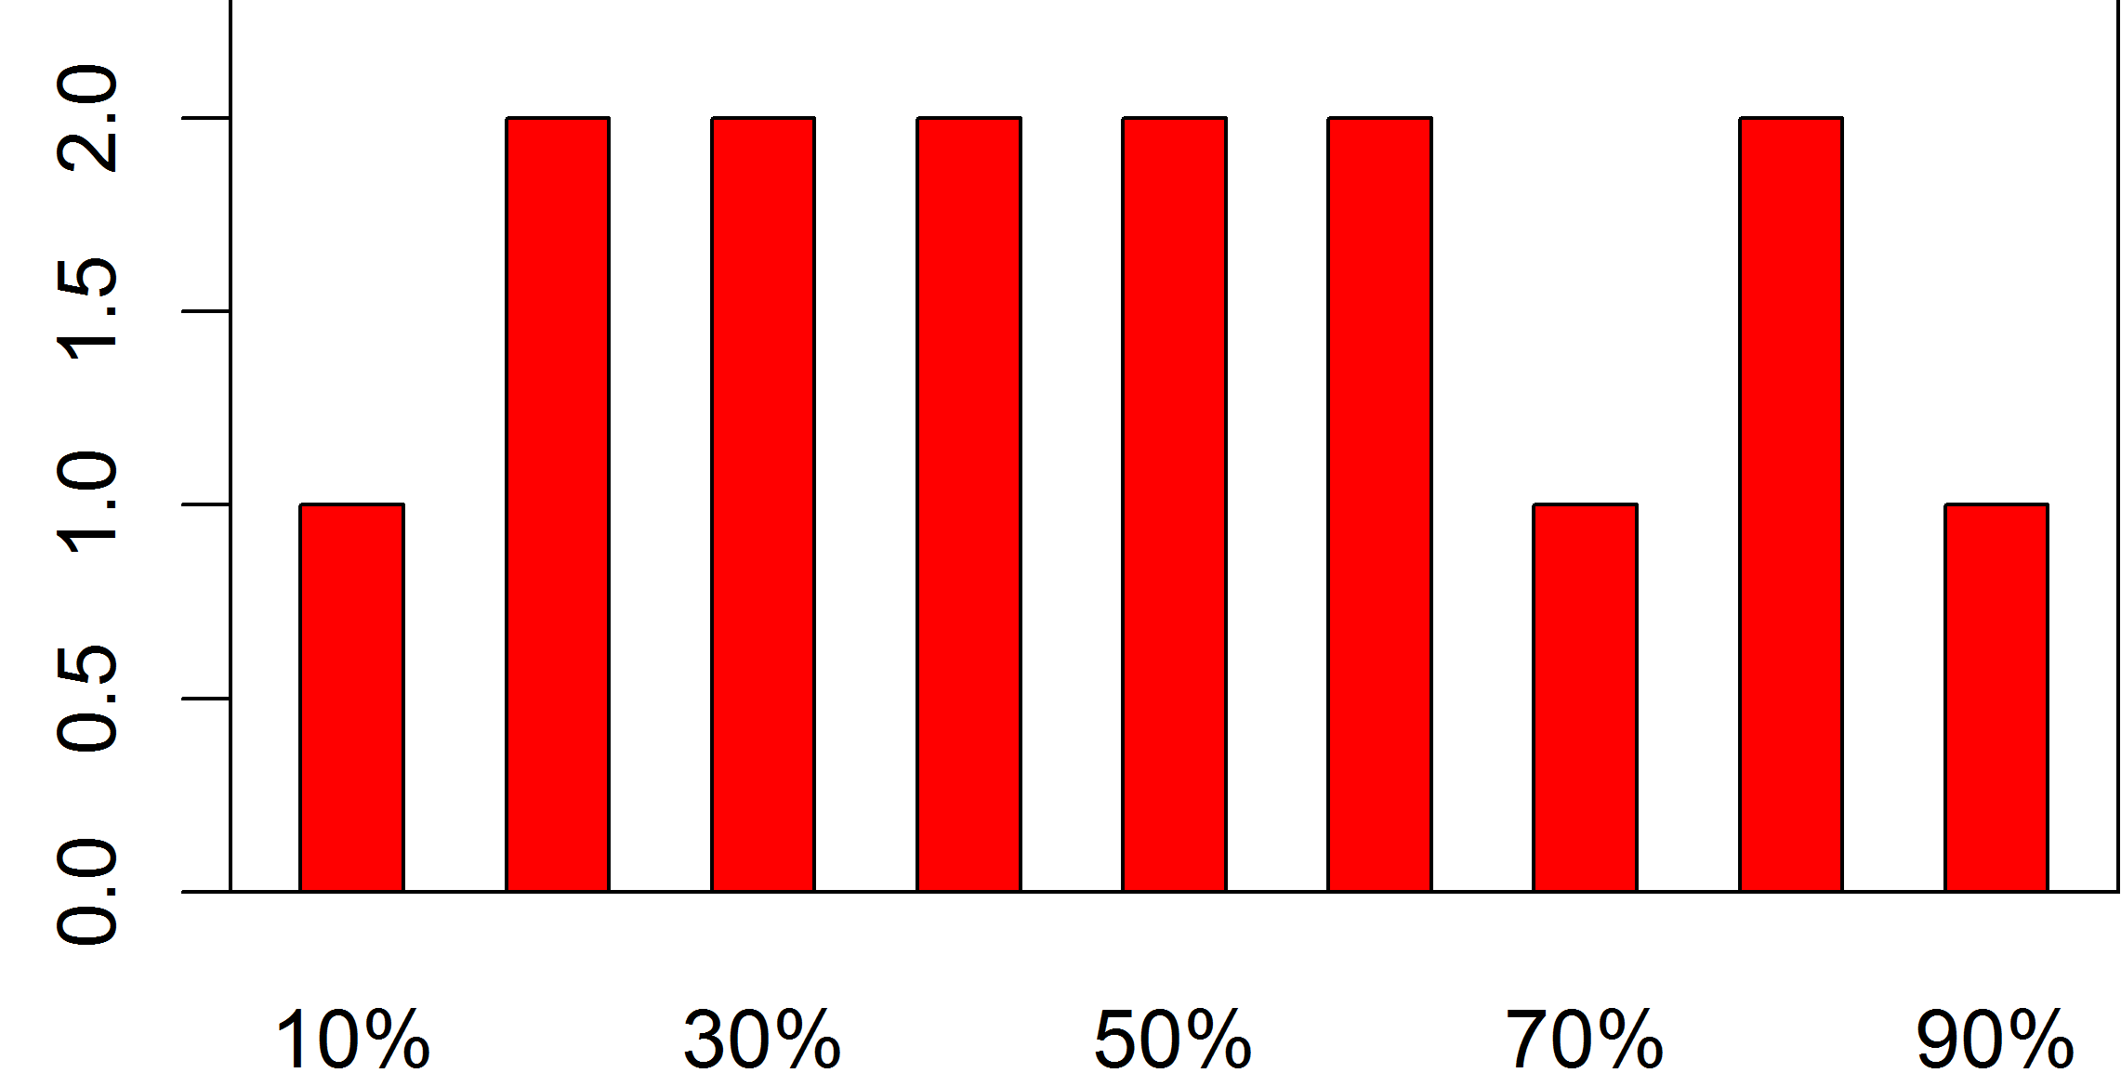
Impact of changes in climate on summertime surface O₃ under ‘moderate’ warming scenario over NE USA
Change ((2091-2100) – (2006-2015)) in mean summertime MDA8 O₃ (ppb)
in CM3 RCP4.5_WMGG simulation (3 ensemble-member average; corrected)
“Climate penalty” [Wu et al., 2008]:
Moderate climate change increases NE USA surface O₃ 1-4 ppb in JJA
(agreement in sign for this region across prior modeling studies [Weaver et al., 2009])
Similar impacts throughout the O₃ distribution
(several models find larger impacts at
high tail; e.g., 95th% [Weaver et al., 2009])
Rieder et al., in prep
Percentile

Slide 13
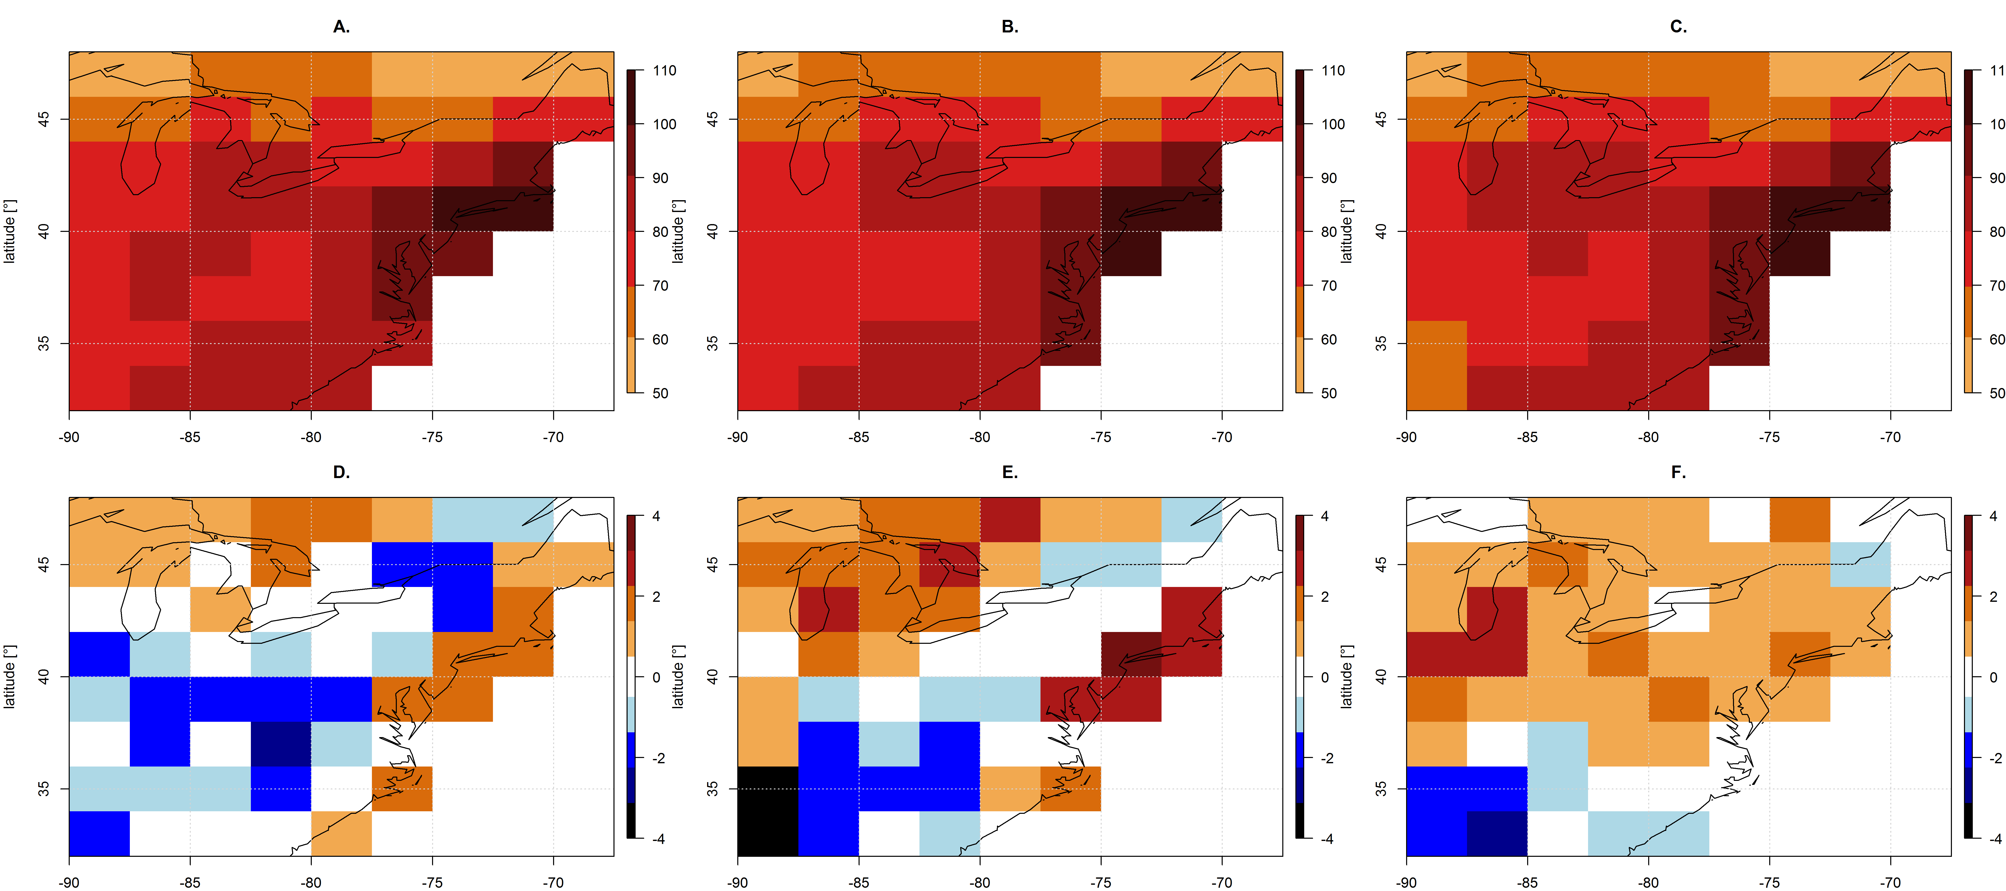
How does climate warming change extreme O₃ events over the NE USA?
1-year MDA8 O₃ Return Levels in GFDL CM3 RCP4.5_WMGG (corrected)
Change: (2091-2100) – (2006-2015)
Base Years (2006-2015)
Change: (2091-2100) – (2046-2055)
Much of region sees ‘penalty’ but also some ‘benefit’, of up to 4 ppb
→ Signal from regional ‘climate noise’ with only 3 ensemble members?
  Robust across models?
Rieder et al., in prep

Slide 14
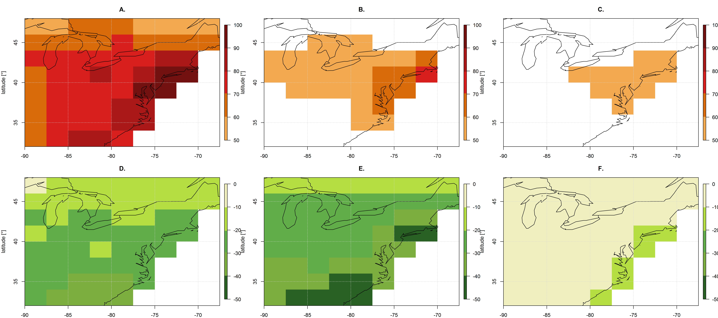
Large NO_{x} reductions offset climate penalty on O₃ extremes
1-year Return Levels in CM3 chemistry-climate model (corrected)
Summer (JJA) MDA8 Surface O₃ [Rieder et al., in prep]
2046-2055
2091-2100
RCP4.5_WMGG:
Pollutant emissions held constant (2005) +
climate warming
RCP4.5:
Large NO_{x} decreases +
climate warming
ppb
Nearly all at or below 70 ppb
All at or below 60 ppb
→ Ongoing work examining relationship between NO_{x} reductions and Return Levels

Slide 15
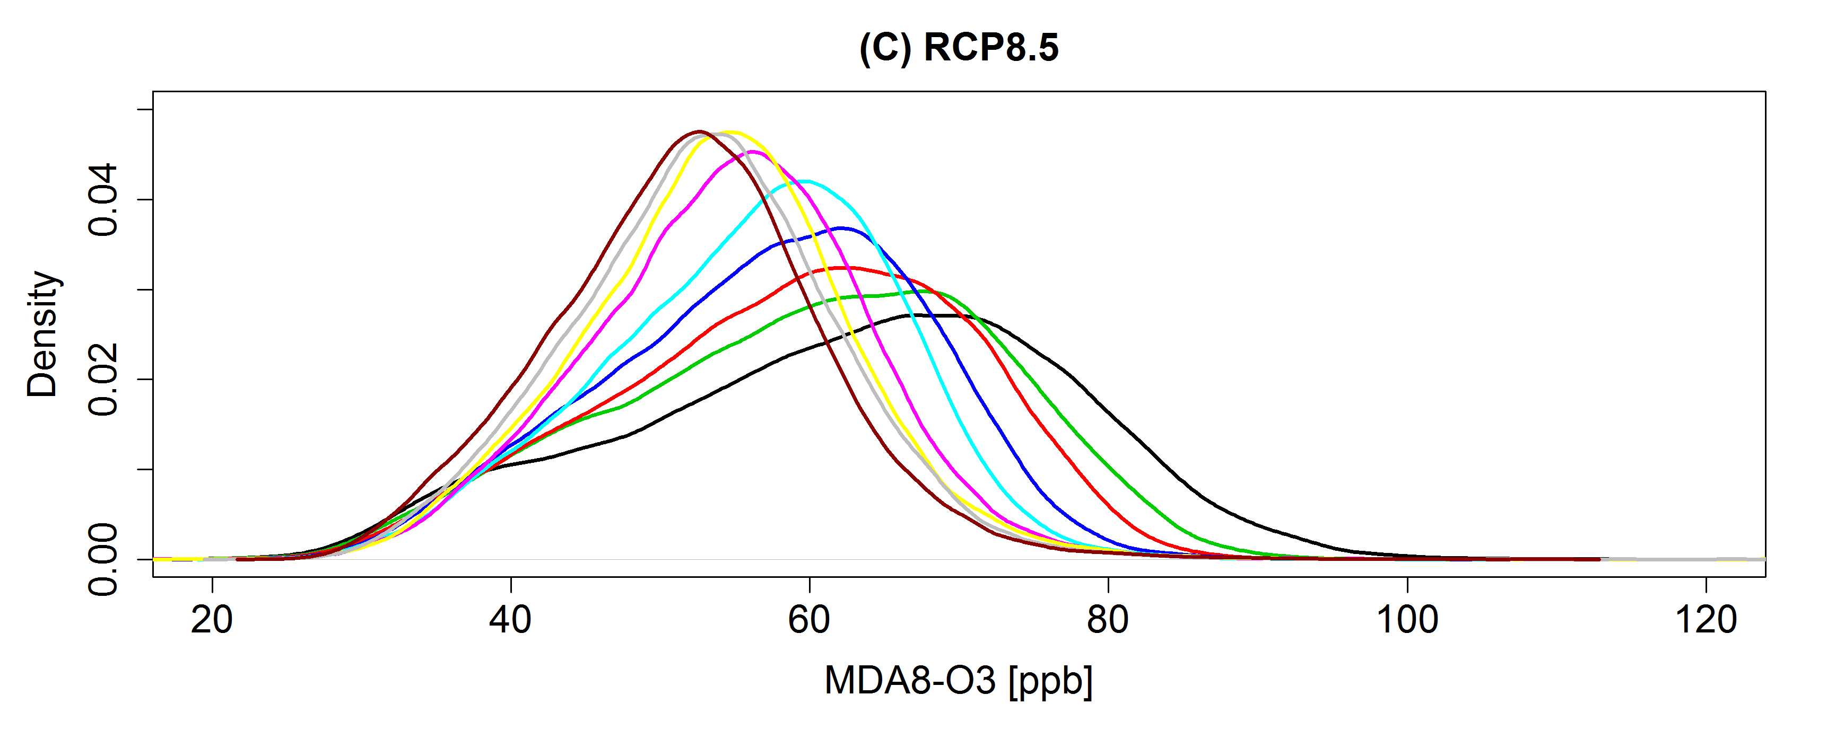
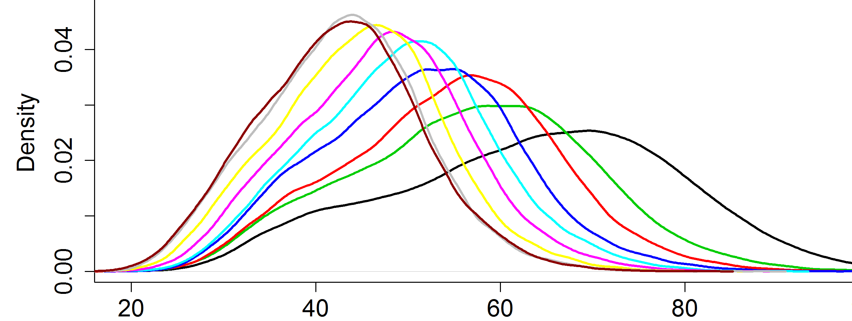
Under RCPs, NE USA high-O₃ events decrease; beware ‘penalty’ from rising methane ( via background O₃)
2005 to 2100 % change
Time
RCP8.5
NE USA
NO_{x}
Global
NO_{x}
CH₄
RCP8.5
RCP4.5
2006-2015
2016-2025
2026-2035
2036-2045
2046-2055
2056-2065
2066-2075
2076-2085
2086-2095
◆
◆
◆
◆
◆
◆
◆
◆
◆
Time
RCP4.5
GFDL CM3 (uncorrected) MDA8 O₃ (ppb)
→ Rising CH₄ in RCP8.5 partially offsets O₃ decreases otherwise attained with regional NO_{x} controls (RCP4.5)
H. Rieder

Slide 16
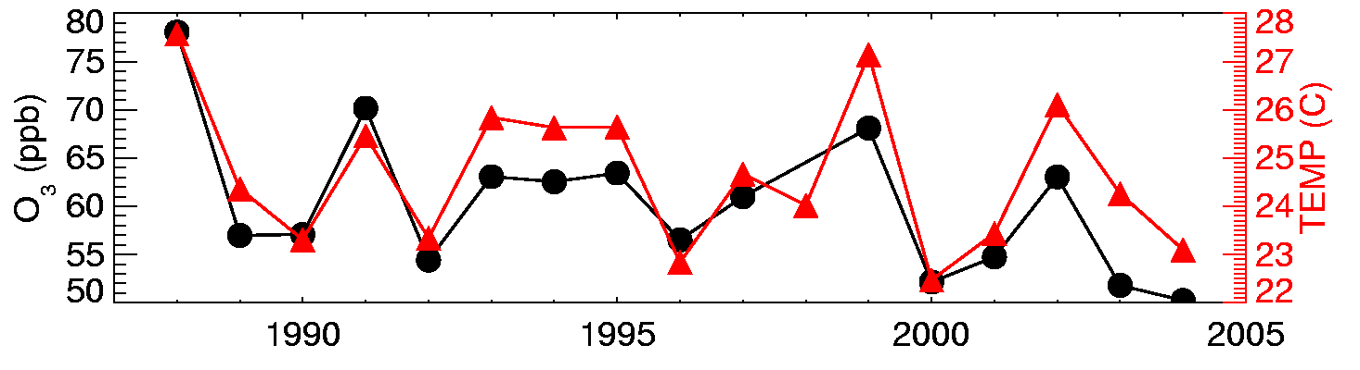
Strong correlations between surface temperature and O₃ measurements on daily to inter-annual time scales in polluted regions [e.g., Bloomer et al., 2009; Camalier et al., 2007; Cardelino and Chameides, 1990; Clark and Karl, 1982; Korsog and Wolff, 1991]
Observations at U.S. EPA CASTNet site Penn State, PA 41N, 78W, 378m
July mean MDA8 O₃ (ppb)
10am-5pm avg
Weather variability is a key driver of observed O₃-Temperature correlations
Implies worse O₃ pollution in a warmer climate… but stationarity in locally observed O₃:T relationships? (See box in Weaver et al., BAMS, 2009)
Need to understand underlying processes
  Anticorrelation between observed number of storms over SE Canada/NE US and high-O₃ events [Leibensperger et al., ACP, 2008]
  → Will storm frequency change with climate warming?

Slide 17
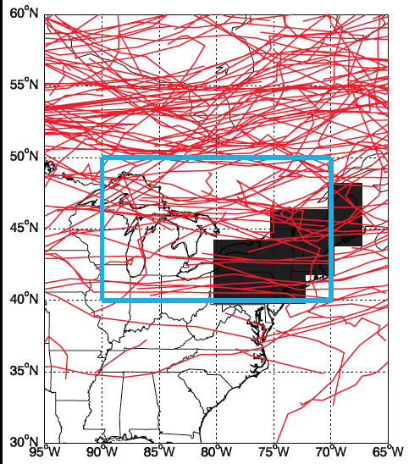
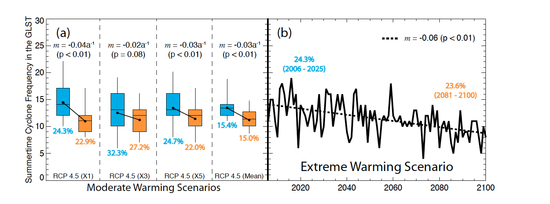
Frequency of summer migratory cyclones over NE US decreases as the planet warms…
Region for counting storms
Number of storms per summer in the GFDL CM3 model,
as determined from applying
the MCMS storm tracker [Bauer et al., 2013]
to 6-hourly sea level pressure fields
Region for counting O₃ events
RCP4.5
RCP8.5 (1 ens. member)
Turner et al., ACP, 2013
(3 ens.
members)

Slide 18
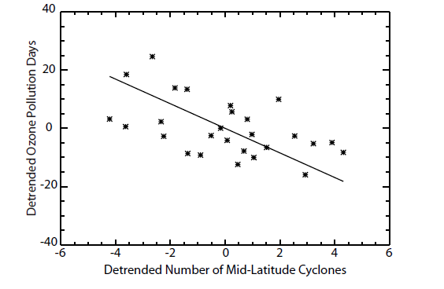
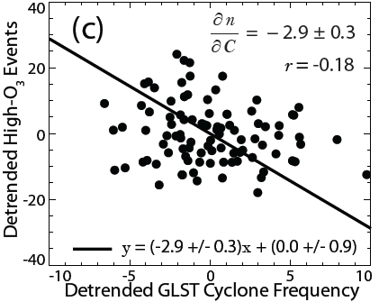
…but the storm count – O₃ event relationship is weaker than derived from observations
Observed relationship
[Leibensperger et al, ACP, 2008]
Simulated relationship (GFDL CM3)
[Turner et al., ACP, 2013]
Slope = -4.2 O₃ events/storm
Slope = -2.9 O₃ events/storm
Detrended O₃ pollution days
1980-2006:
NCEP/NCAR Reanalysis 1 & AQS ozone
RCP4.5_WMGG 2006-2100
Detrended Number of mid-latitude cyclones
→ Model problem (bias/process representation)?
Change in drivers (under warming climate)?
Decadal variability in strength of relationship?
Can we find a simpler diagnostic of large-scale circulation changes?

Slide 19
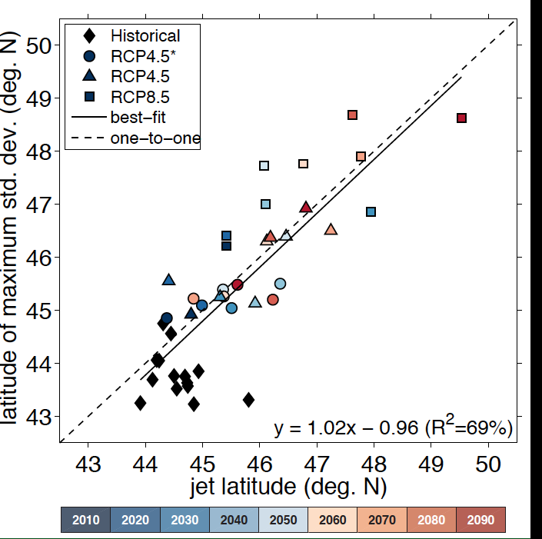
Peak latitude of summertime surface O₃ variability over Eastern N. America follows the jet (500 hPa) as climate warms
RCP4.5_WMGG
RCP8.5: most warming,
Largest jet shift
→ Decadal variability
Relevance to shorter periods (i.e., year-to-year variability?)
O₃-Temperature
relationship (not shown)
also aligns with jet latitude
Latitude of max std. dev. of JJA MDA8 O₃ (deg N)
Each point = 10 year mean (over all ensemble members where available)
→ Historically observed relationships may not hold if large-scale circulation shifts
Barnes & Fiore, GRL, 2013

Slide 20
Recent trends + future projections in surface O₃ extremes over the eastern USA in summer: Summary and Next Steps
New metric (“1-year event”) for quantifying success of NO_{x} controls
Model bias correction for estimates of threshold-based statistics
Apply to PM_{2.5}, precipitation; examine event persistence
Rieder et al., ERL, 2013
Declining NE US storm frequency in a warmer climate [Turner et al., 2013]
Zonal O₃ variability (and O₃:T) aligns with the 500 hPa jet
Decadal shifts in jet; hold on shorter timescales?
Model bias: impact on relationship with storm counts/jet latitude?
Relevant to model differences in O₃ response to climate?
[Weaver et al., 2009; Jacob & Winner, 2009; Fiore et al., 2012]
Barnes & Fiore
GRL, 2013
Change over 21st C in
mean JJA MDA8 O₃ (ppb)
“Climate penalty” over NE USA in CM3 model (cf. earlier studies)
More “noise” at regional level; need ensemble for ‘signal’
RCP4.5_
WMGG
Not just trend; consider inter-annual variability
Identify connections to meteorology + feedbacks with biosphere
H. Rieder
RCP8.5
Time
Projected regional NO_{x} reductions in RCP scenarios (-80% by 2100) lead to large decreases in high O₃ events over NE USA
Rising CH₄ + NO_{x} controls shift balance of regionally produced vs. transported O₃ (CH₄ controls a “win-win” for climate + air quality)
RCP4.5
Time
Extend to other regions, seasons, PM_{2.5}
GFDL CM3 (uncorrected)
MDA8 O₃ (ppb)
H. Rieder

Slide 21
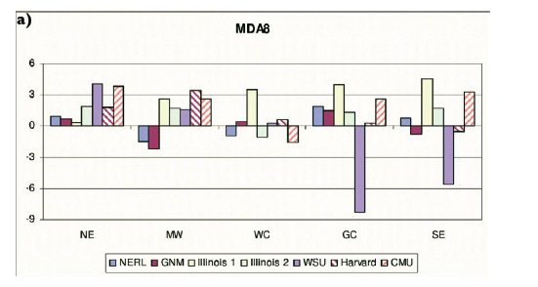
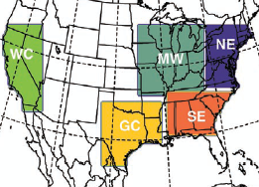
Looking beyond the NE US: Gap in analysis of climate change impacts over Mountainous West
Modeled changes in summer mean of daily max 8-hour O₃ (ppb; future – present)
All models show some increases in some U.S. regions
NE MW WC GC SE
Weaver et al., BAMS, 2009
Uncertainties in regional climate responses (and feedbacks) to global warming
Unique aspects of high-altitude Western US ozone
  → Higher background O₃; how will this change?
  (e.g., frequency of fires, strat. intrusions)
Notes:
Check on weaver paper about high tail response to climate change

