Slide 1
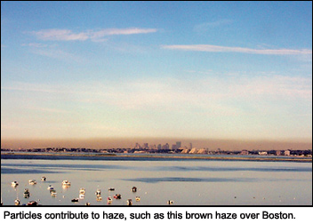








Haze over Boston, MA
http://www.airnow.gov/index.cfm?action=particle_health.page1#3
U.S. air pollution and climate:
Trends, variability, and interactions
Arlene M. Fiore
Acknowledgments: Olivia Clifton, Gus Correa, Nora Mascioli, Lee Murray, Luke Valin (CU/LDEO), Harald Rieder (U Graz, Austria), Elizabeth Barnes (CSU), Alex Turner (Harvard)
Larry Horowitz (GFDL), Vaishali Naik (UCAR/GFDL), Meiyun Lin (Princeton/GFDL)
EPS Colloquium, Harvard
Cambridge, MA
May 5, 2014
83520601

Slide 2
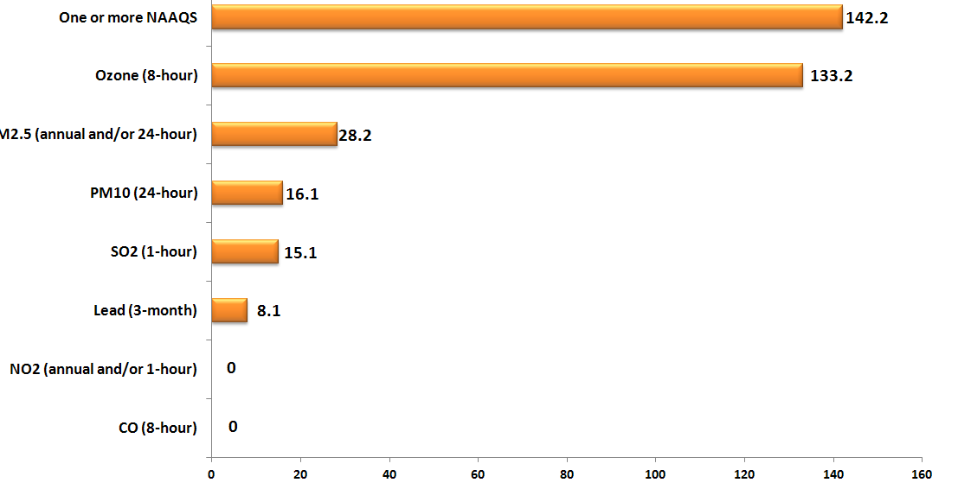
Ozone and Particulate Matter (PM)
are the top two U.S. air pollutants
One or more NAAQS
142.2
Ozone (8-hour)
133.2
PM_{2.5} (annual/24-hr)
28.2
PM₁₀ (24-hr)
PM₁₀ (24hr)
16.1
SO₂ (1-hr)
15.1
Lead (3-month)
8.1
NO₂ (annual/1-hr)
2012
CO (8-hr)
0 20 40 60 80 100 120 140 160
Millions of people living in counties with air quality concentrations above the level of the U.S. National Ambient Air Quality Standards
EPA, 2014: http://www.epa.gov/airtrends/aqtrends.html#comparison

Slide 3
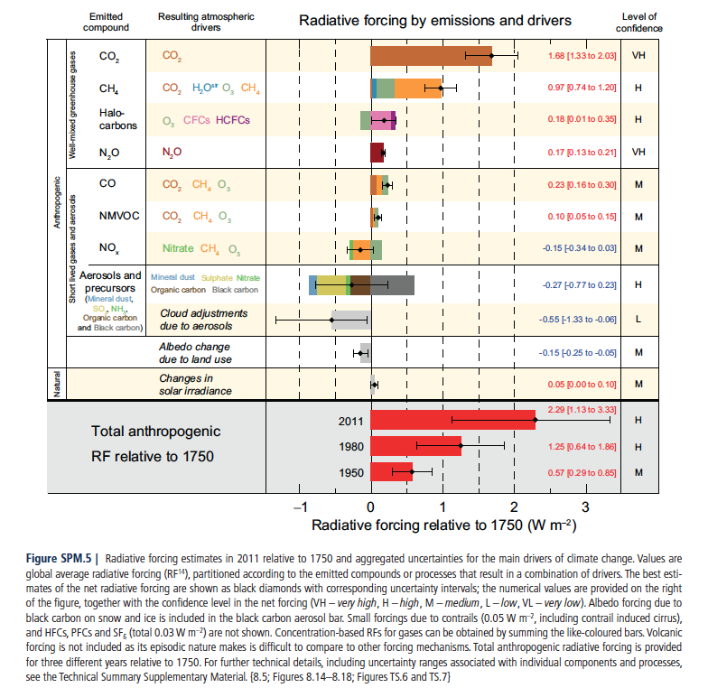
Air pollutants and their precursors contribute to climate forcing from preindustrial to present
Regulated in U.S.
as precursors
to ground-level O₃
Net cooling from aerosols opposes
GHG warming
IPCC AR5 WG1 SPM (2013)
← Cooling
Warming →
Anthropogenic greenhouse gases methane + tropospheric ozone together contribute ~1/2 (abundance) to 2/3 (emissions) of CO₂ radiative forcing
(Lifetimes must also be considered: CO₂ dominates long-term)

Slide 4

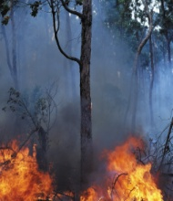
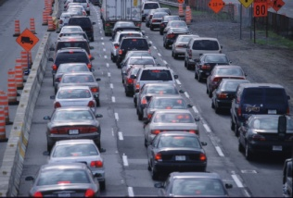
Ground-level O₃ is photochemically produced from regional sources (natural + anthrop.) that build on background levels
Raise background ozone levels
CH₄
CO
NMVOC
+
NO_{x}
O₃
Fuel local-to-regional ozone
pollution episodes

Slide 5
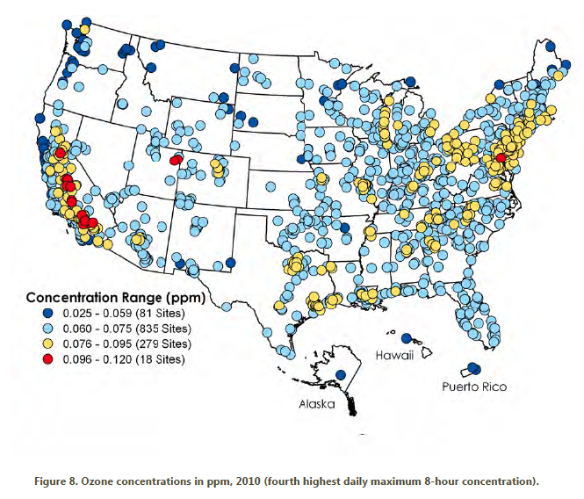
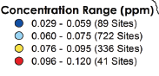
The U.S. ozone smog problem is spatially widespread
4th highest maximum daily 8-hr average (MDA8) O₃ in 2010
FUTURE?
Exceeds
standard
(24% of sites)
http://www.epa.gov/airtrends/2011/index.html
High-O₃ events typically occur in
-- densely populated areas (sources)
-- summer (favorable meteorology)
→ Lower threshold (60-70 ppb [Federal Register, 2010]) would greatly expand non-attainment regions
Estimated benefits from a ~1 ppb decrease in surface O₃:
~ $1.4 billion (agriculture, forestry, non-mortality health) within U.S. [West and Fiore, 2005]
~ 500-1000 avoided annual premature mortalities within N. America [Anenberg et al., 2009]

Slide 6
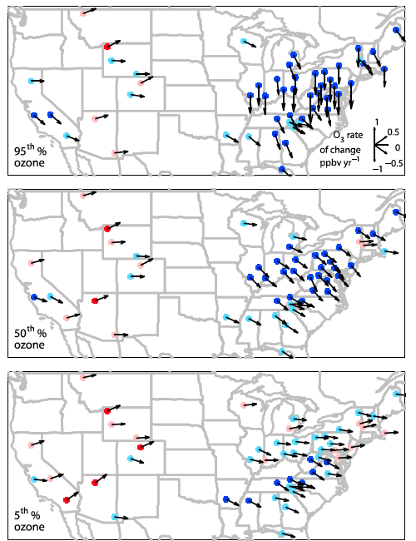
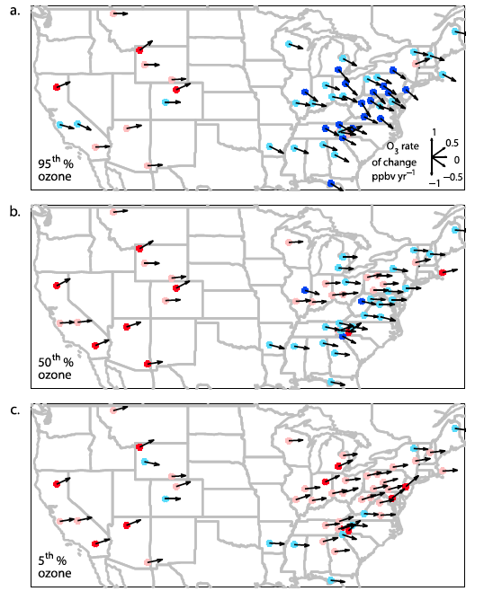
Trends in summer daytime (11am-4pm) average ozone at rural U.S. monitoring sites (CASTNet): 1990 to 2010
significant
not significant
5%
95%
ppb yr⁻¹
Cooper et al., JGR, 2012
Success in decreasing highest levels, but baseline rising (W. USA)
Decreases in EUS attributed in observations and models to NO_{x} emission
controls in late 1990s, early 2000s [e.g., Frost et al., 2006; Hudman et al., 2007; van der A. et al., 2008; Stavrakou et al., 2008; Bloomer et al., 2009, 2010; Fang et al., 2010]

Slide 7
The “tightening vise” of ozone management
Standard
Local
Ozone concentration
Regional
Hemispheric
background
Historical
Future
Future
(alternate view)
→ Future may require concerted efforts to lower background
Keating, T. J., J. J. West, and A. Farrell (2004) Prospects for international management of intercontinental air pollutant transport, in A. Stohl, Ed., Intercontinental Transport of Air Pollution, Springer, p. 295-320.

Slide 8
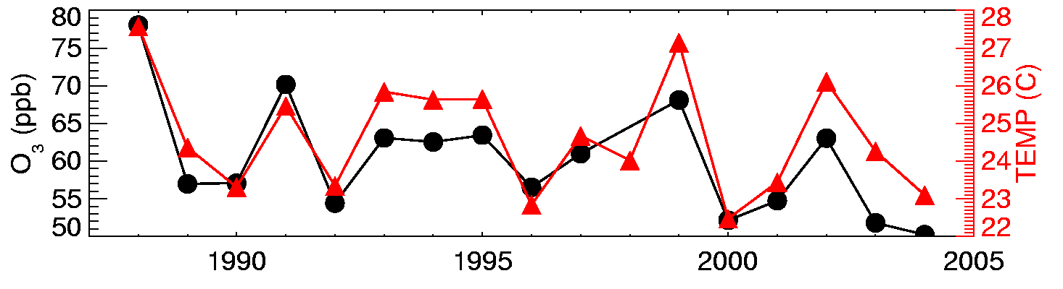

Surface temperature and O₃ are correlated on daily to inter-annual time scales in polluted regions [e.g., Bloomer et al., 2009; Camalier et al., 2007; Cardelino and Chameides, 1990; Clark and Karl, 1982; Korsog and Wolff, 1991]
Observations at U.S. EPA CASTNet site Penn State, PA 41N, 78W, 378m
July mean MDA8 O₃ (ppb)
10am-5pm avg
What drives the observed O₃-Temperature correlation?
1. Meteorology (e.g., air stagnation)
2. Feedbacks (Emis, Chem, Dep)
T
Degree of mixing
NO_{x}
NMVOCs
Deposition
T-sensitive
NO_{x} reservoir
pollutant sources
Implies that changes in climate will influence air quality

Slide 9
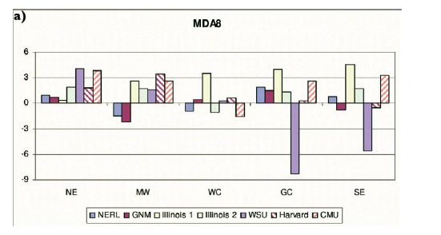
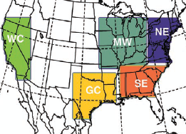
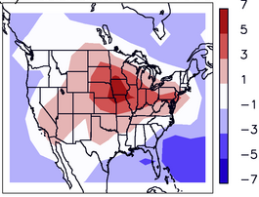
Models estimate a ‘climate change penalty’ (+2 to 8 ppb) on surface O₃ over U.S. but often disagree in sign regionally
Modeled changes in summer mean of daily max 8-hour O₃ (ppb; future – present)
NE MW WC GC SE
Weaver et al., BAMS, 2009
Uncertain regional climate responses (and feedbacks) to global warming
Model estimates typically based on a few years of present and future (often 2050s) meteorology from 1 realization of 1 GCM
Wu et al., JGR, 2008:
“Climate Penalty”
ppbv

Slide 10
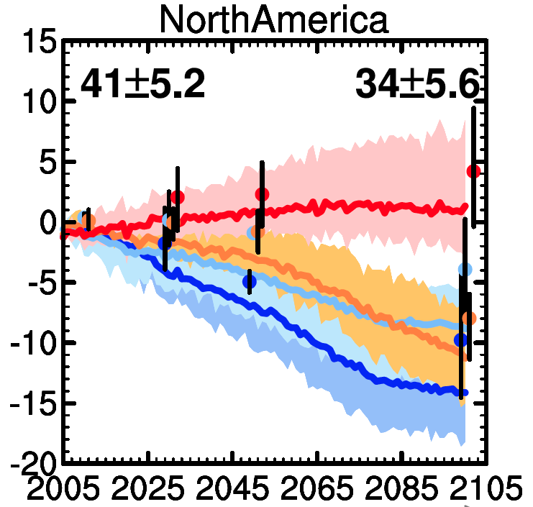

‘First-look’ future projections with current chemistry-climate models for N. Amer. Surface O₃ (emissions + climate change)
Annual mean spatially averaged (land only) O₃ in surface air
North America
Range across
ACCMIP CCMs
Multi-
model
Mean
Range across
CMIP5 CCMs
Decadal time slice simulations
(2-12 models)
Multi-model Mean
RCP8.5
RCP6.0
RCP4.5
RCP2.6
Transient simulations
(4 models)
V. Naik, adapted from Fiore et al., 2012; Kirtman et al., 2013 (IPCC WG1 Ch 11)
A major advance to have coupled atmospheric chemistry in climate models
Trends mainly reflect ozone precursor emission pathways
Annual, continental-scale means reveal little about drivers of regional change

Slide 11
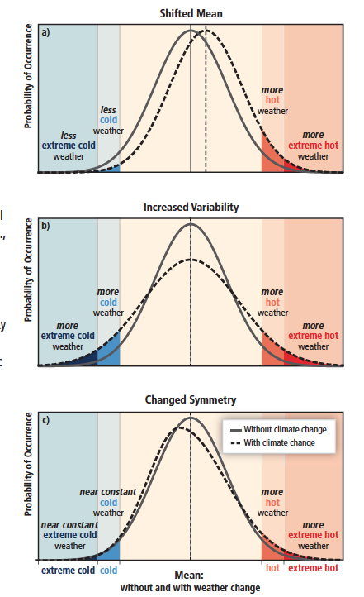
How and why might extremes change?
Mean
shifts
How do different processes influence the overall distribution?
Meteorology (e.g., stagnation vs. ventilation)
Feedbacks (Emis, Chem, Dep)
Variability
increases
Changing global emissions (baseline)
Changing regional emissions (episodes)
→ Shift in mean?
→ Change in symmetry?
How do changes in the balance of these processes alter the seasonal cycle?
Symmetry
changes
NE US: regional photochemistry (summer)
vs. transported background
Does climate forcing from air pollutants influence regional climate extremes?
Figure SPM.3, IPCC SREX 2012
Aerosols vs. greenhouse gases
http://ipcc-wg2.gov/SREX/

Slide 12
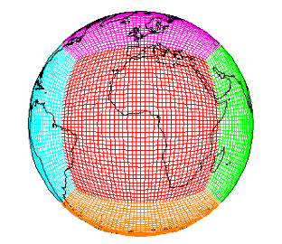
Approach: Targeted sensitivity simulations in a chemistry-climate model to examine chemistry-climate interactions
Tool: GFDL CM3 chemistry-climate model
Donner et al., J. Climate, 2011;
Golaz et al., J. Climate, 2011;
John et al., ACP, 2012
Turner et al., ACP, 2012
Levy et al., JGR, 2013
Naik et al., JGR, 2013
Barnes & Fiore, GRL, 2013
~2°x2° horizontal resn.; 48 vertical levels
Over 6000 years of climate simulations that include chemistry (air quality)
Options for nudging to re-analysis + global high-res ~50km² [Lin et al., 2012ab; 2014]
CH₄
CO
NMVOC
+
NO_{x}
O₃
Emission (CH₄ abundance) pathways prescribed
Biogenic emissions held constant
Lightning NO_{x} source tied to model meteorology
O₃, (aerosols, etc.), affect simulated climate

Slide 13
Approach: Historical + Future global change scenarios & targeted sensitivity simulations in GFDL CM3 CCM
Scenarios developed by CMIP5 [Taylor et al., BAMS, 2012] in support of IPCC AR5 [e.g., Cubasch et al., 2013; Ch 1 WG 1 IPCC (see Box 1.1)]
Preindustrial control (perpetual 1860 conditions >800 years)
(2) Historical (1860-2005) [Lamarque et al., 2010]
  All forcings (5 ensemble members)
  Greenhouse gas only (3)
  Aerosol only (3)
(3) Future (2006-2100): Representative Concentration Pathways
(+ perturbations)
→ evaluate with observations
RCP8.5 (3)
RCP4.5 (3)
Percentage change: 2005 to 2100
→ CMIP5/AR5 [van Vuuren, 2011; Lamarque et al., 2011; Meinshausen et al., 2011]
Global
NO_{x}
NE USA
NO_{x}
RCP8.5_WMGG (3)
RCP4.5_WMGG (3)
→ Isolate role of warming climate
Global
CO₂
Global
CH₄
RCP8.5_2005CH4
→ Quantify role of rising CH₄ (vs. RCP8.5)

Slide 14
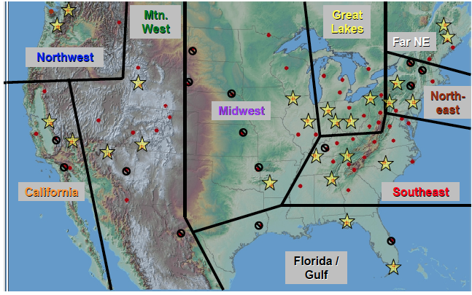
In polluted (high-NO_{x}) regions, surface O₃ typically peaks during summer
(monthly averages at 3 NE USA measurement sites)
Monthly 1991-1996 averages across 3 NE USA sites
Clean Air Status and Trends Network (CASTNET)
Regionally
Representative sites
[Reidmiller et al., ACP, 2009]
Feb Apr Jun Aug Oct Dec
O. Clifton
Notes:
Danger level

Slide 15
Shifting surface ozone seasonal cycle evident in observations over NE USA
Monthly averages across 3 NE USA sites
Clean Air Status and Trends Network (CASTNET)
1991-1996
2004-2009
Regionally
Representative sites
[Reidmiller et al., ACP, 2009]
Feb Apr Jun Aug Oct Dec
Summer ozone decreases; shift towards broad spring-summer maximum
following EUS NO_{x} controls (“NO_{x} SIP Call”)
O. Clifton
Notes:
Danger level

Slide 16
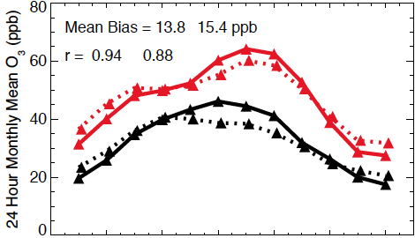
Structure of observed changes in monthly mean ozone captured by GFDL CM3 CCM (despite mean state bias)
O. Clifton et al., submitted
Monthly averages across 3 NE USA sites
1991-1996
OBS (CASTNet)
CM3 (Model)
2004-2009
Regionally
Representative sites
[Reidmiller et al., ACP, 2009]
CM3 NE US shows summer O₃ decrease, small winter increase from ~25% decrease in NO_{x} emissions
(applied year-round)
Feb Apr Jun Aug Oct Dec
[see also EPA, 2014; Parrish et al., GRL, 2013 find shifts at remote sites]
Notes:
Danger level

Slide 17
Reversal of surface O₃ seasonal cycle occurs in model under scenarios with dramatic regional NO_{x} reductions
2006-2015
2006-2015
2005 to 2100 % change
RCP4.5
RCP8.5
2091-2100
2091-2100
NE USA
NO_{x}
Global
NO_{x}
Decreasing NO_{x} emissions → lower summer O₃
CH₄
?
NE USA evolves from “polluted” to “background” over the 21st C
Reversal occurs after 2020s (not shown)
3 ensemble members for each scenario
Feb Apr Jun Aug Oct Dec
Clifton et al., submitted
Notes:
Non polluted region

Slide 18
Doubling of global CH₄ abundance (RCP8.5) raises NE USA surface ozone in model; largest impact during winter
2006-2015
RCP8.5
2006-2015
2091-2100
RCP8.5_2005CH4
2091-2100
Doubling of methane increases surface O₃ background by 6-11 ppb
Feb Apr Jun Aug Oct Dec
Clifton et al., submitted

Slide 19
“Climate penalty” on monthly mean NE USA surface O₃ as simulated with the GFDL CM3 model
2006-2015
RCP4.5_WMGG
2006-2015
2091-2100
RCP8.5_WMGG
2091-2100
JJA NE USA Temp (sfc) +2.5ºC
JJA NE USA Temp (sfc) +5.5ºC
Feb Apr Jun Aug Oct Dec
Feb Apr Jun Aug Oct Dec
“Penalty” limited to increases during warmest months
Extends into May and September in high warming scenario
Fully offset by regional precursor emission reductions under RCPs
Clifton et al., submitted
Notes:
And so we also see a broadening ..
So we conclude …

Slide 20
How and why might air pollution extremes change?
Mean
shifts
How do different processes influence the overall distribution?
Meteorology (e.g., stagnation vs. ventilation)
[
not today]
Feedbacks (Emis, Chem, Dep)
Variability
increases
Changing global emissions (baseline)
Changing regional emissions (episodes)
→ Shift in mean?
→ Change in symmetry?
How do changes in the balance of these processes alter the seasonal cycle?
Symmetry
changes
NE US: regional photochemistry (summer)
vs. transported background
Does climate forcing from air pollutants influence regional climate extremes?
Figure SPM.3, IPCC SREX 2012
Aerosols vs. greenhouse gases
http://ipcc-wg2.gov/SREX/
Notes:
Add something here on role of aerosol vs. greenhouse gas forcing.

Slide 21
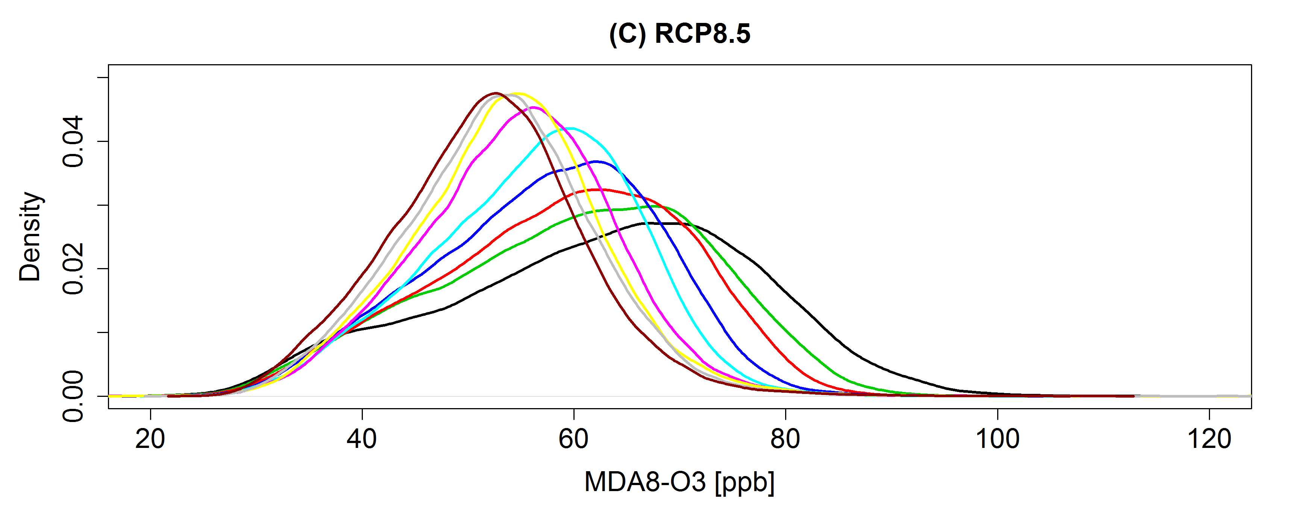
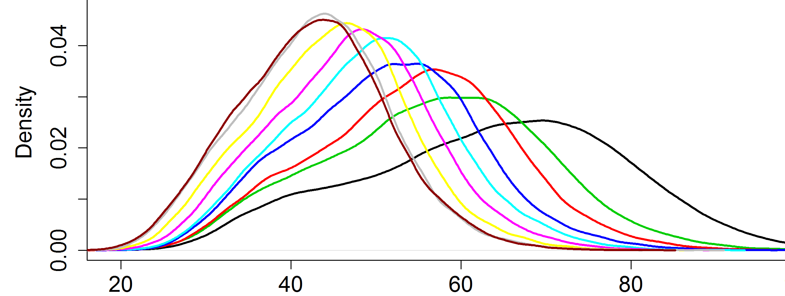
Under RCPs, NE USA high-O₃ summertime events decrease; beware ‘penalty’ from rising methane (via background O₃)
2005 to 2100 % change
Time
RCP8.5:
Extreme
warming
NE USA
NO_{x}
Global
NO_{x}
CH₄
RCP8.5
RCP4.5
2006-2015
2016-2025
2026-2035
2036-2045
2046-2055
2056-2065
2066-2075
2076-2085
2086-2095
◆
◆
◆
◆
◆
◆
◆
◆
◆
RCP4.5:
Moderate
warming
Time
June-July-August GFDL CM3 MDA8 O₃ (ppb)
→ Rising CH₄ in RCP8.5 partially offsets O₃ decreases otherwise attained with regional NO_{x} controls (RCP4.5)
H. Rieder

Slide 22
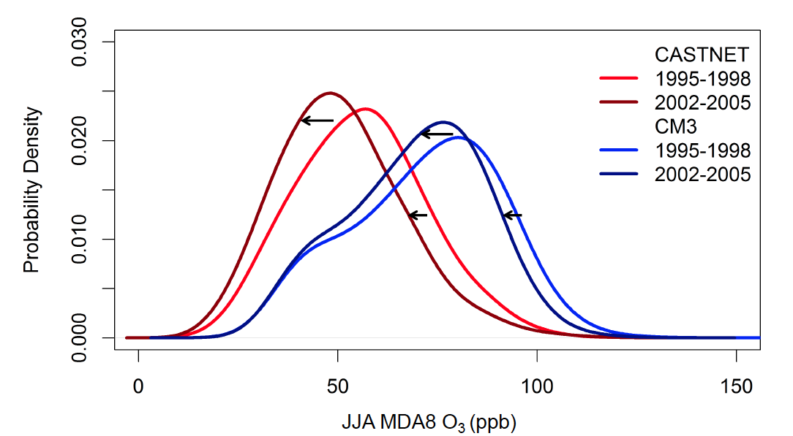
GFDL CM3 generally captures NE US JJA surface O₃ decrease following NO_{x} emission controls (-25% early 1990s to mid-2000s)
GFDL CM3 Model
Observed
(CASTNet)
Relative Frequency
JJA MDA8 O₃ (ppb)
Implies bias correction based on present-day observations can be applied to scenarios with NO_{x} changes (RCPs for 21st C)
Focus on upper half of distribution
Rieder et al., in prep

Slide 23
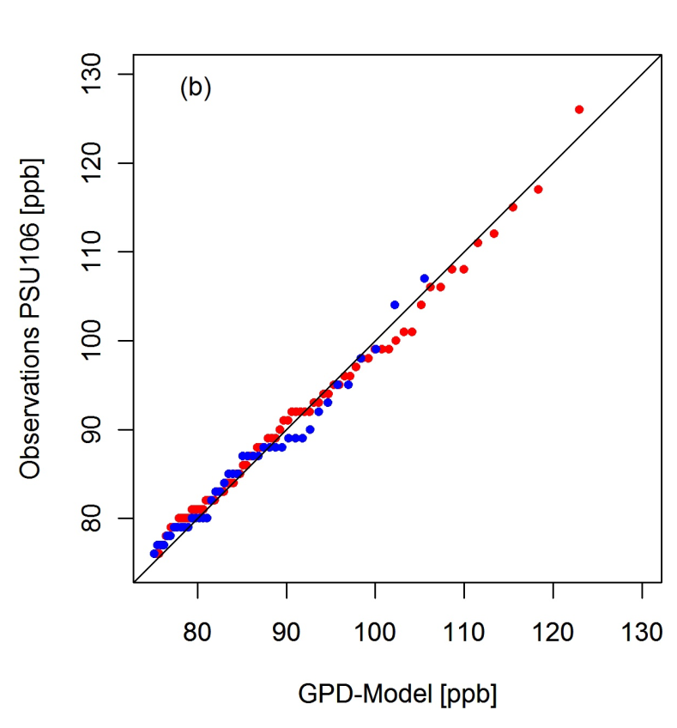
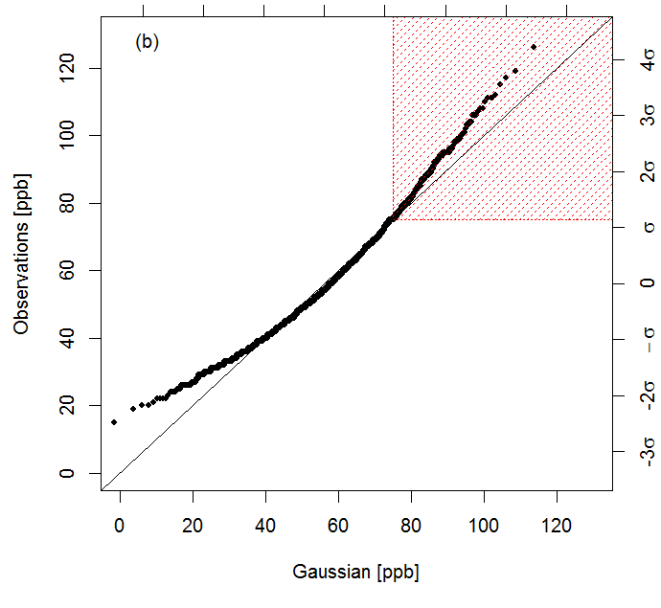
Characterizing observed ‘extreme’ ozone pollution events
JJA MDA8 O₃ 1987-2009 at CASTNet Penn State site
EVT Approach:
(Peak-over-threshold)
for MDA8 O₃>75 ppb
Gaussian:
Poor fit
for extremes
Observed MDA8 O₃ (ppb)
Observed MDA8 O₃ (ppb)
1988-1998
1999-2009
Gaussian (ppb)
Generalized Pareto Distribution Model (ppb)
→ Extreme Value Theory (EVT) methods describe the high tail of the observed ozone distribution (not true for Gaussian)
Rieder et al., ERL 2013

Slide 24
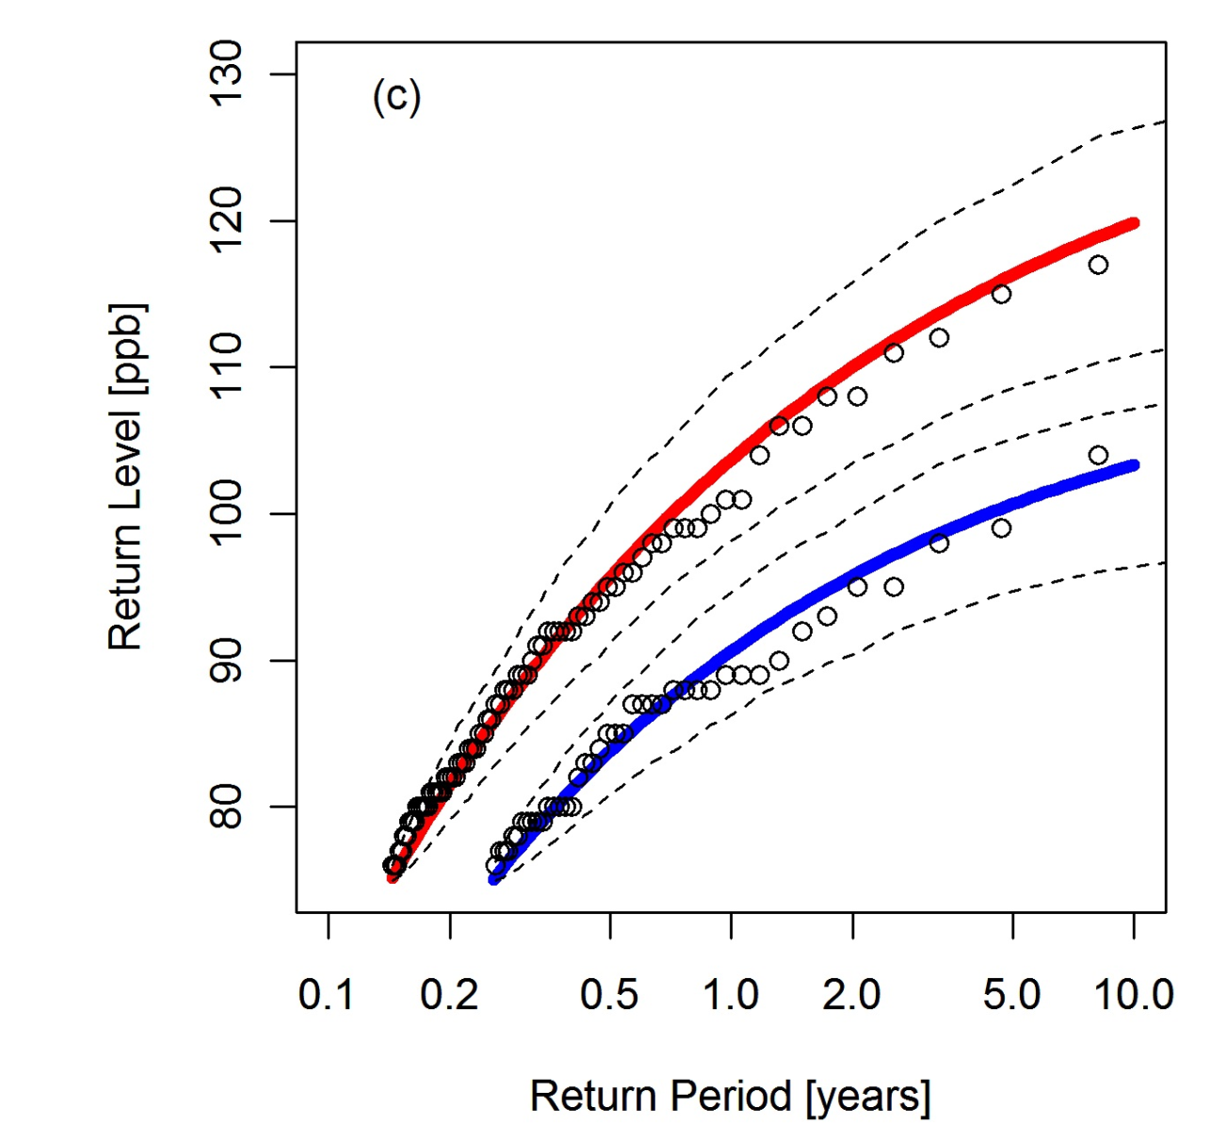
EVT methods enable derivation of probabilistic “return levels” for JJA MDA8 O₃ within a given “return period”
Sharp decline in return levels
from 1988-1998 to 1999-2009; longer return periods for a given event
(attributed to NO_{x} emission controls)
Consistent with prior work [e.g., Frost et al., 2006; Bloomer et al., 2009, 2010]
New approach to translates air pollution changes into probabilistic language
CASTNet site: Penn State, PA
1988-1998
1999-2009
Apply methods to 23 EUS CASTNet sites to derive
1-year return levels
→ Decreased by 2-16 ppb
→ Remain above 75 ppb
Rieder et al., ERL 2013
Notes:
Prep GPD // Rieder 2013

Slide 25
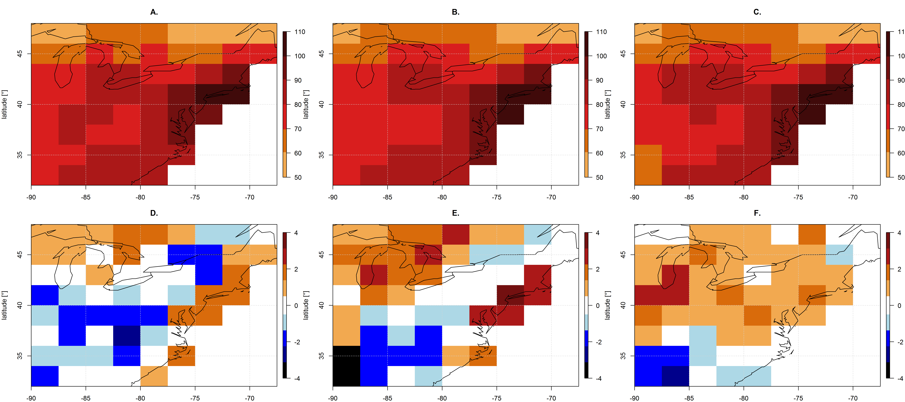
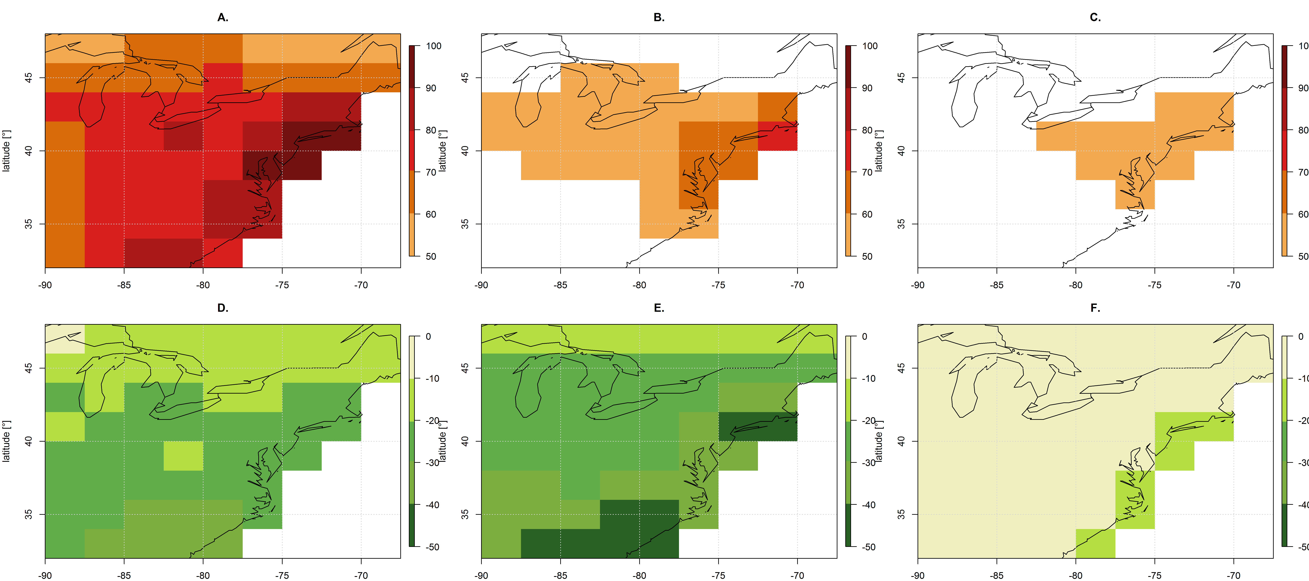
Large NO_{x} reductions offset climate penalty on O₃ extremes
1-year Return Levels in CM3 chemistry-climate model (corrected)
Summer (JJA) MDA8 Surface O₃
2046-2055
2091-2100
RCP4.5_WMGG:
Pollutant emissions held constant (2005) +
climate warming
RCP4.5:
Large NO_{x} decreases +
climate warming
ppb
Nearly all at or below 70 ppb
All at or below 60 ppb
→ We find a simple relationship between NO_{x} reductions and 1-year return levels
Rieder et al., in prep

Slide 26
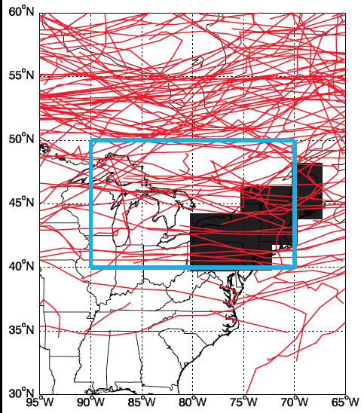
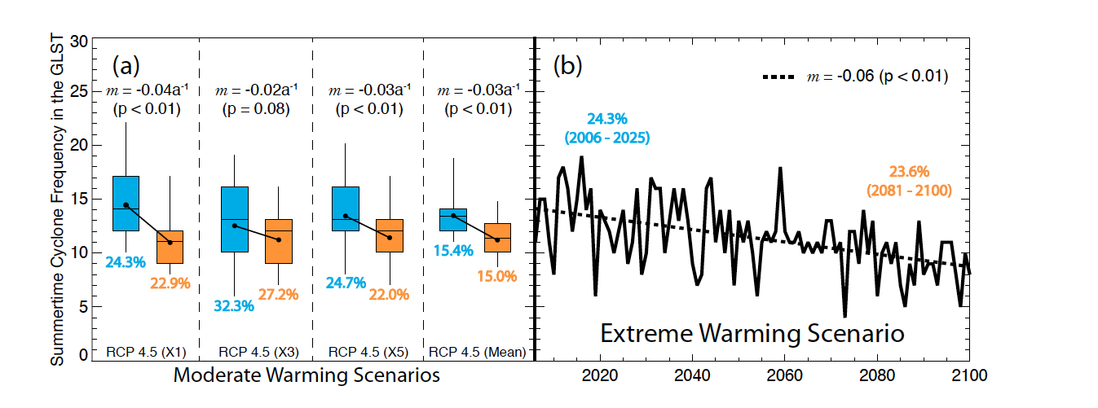
A mechanism underlying ‘climate penalty’: Frequency of NE US summer storms decreases as the planet warms…
Region for counting storms
Number of storms per summer in the GFDL CM3 model,
as determined from applying
the MCMS storm tracker [Bauer et al., 2013]
to 6-hourly sea level pressure fields
(follows approach of Leibensperger et al., 2008)
Region for counting O₃ events
RCP4.5
RCP8.5 (1 ens. member)
Turner et al., ACP, 2013
(3 ens.
members)
Trends are significant relative to variability in preindustrial control simulation

Slide 27
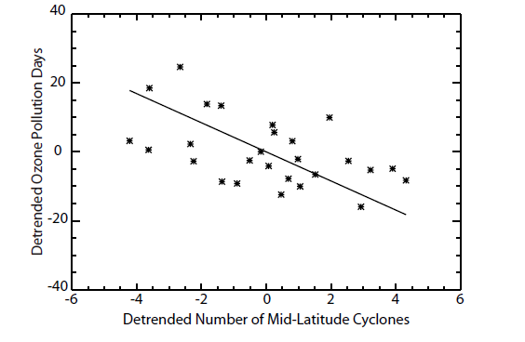
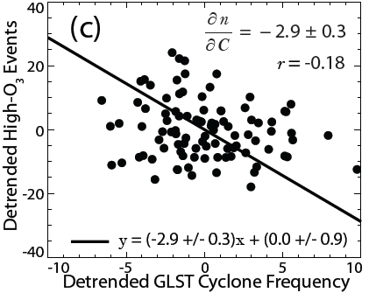
…but the storm count – O₃ event relationship is weaker than derived from observations
Observed relationship
[Leibensperger et al, ACP, 2008]
Simulated relationship (GFDL CM3)
[Turner et al., ACP, 2013]
Slope = -4.2 O₃ events/storm
Slope = -2.9 O₃ events/storm
Detrended O₃ pollution days
1980-2006:
NCEP/NCAR Reanalysis 1 & AQS ozone
RCP4.5_WMGG 2006-2100
Detrended Number of mid-latitude cyclones
→ Model problem (bias/process representation)?
Change in drivers (under warming climate)?
Decadal variability in strength of relationship?
Can we find a simpler diagnostic of large-scale circulation changes?

Slide 28
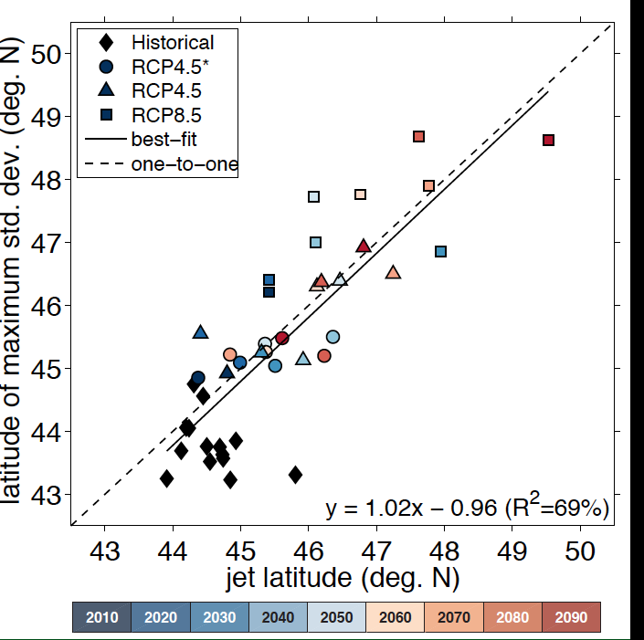
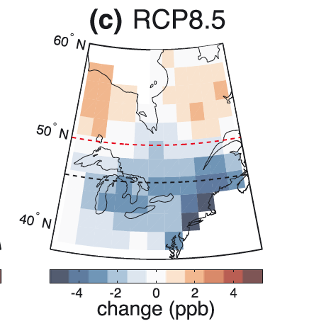
Peak latitude of summertime surface O₃ variability over Eastern N. America follows the jet (500 hPa) as climate warms
RCP8.5: most warming,
Largest jet shift
RCP4.5_WMGG
→ Decadal variability
Relevance to shorter periods?
Differences in model jet position lead to inter-model differences in AQ response?
Each point = 10 year mean (over ensemble members)
RCP8.5
Latitude of max std. dev. of JJA MDA8 O₃ (deg N)
jet: 2086-2095
jet: 2006-2015
O₃-Temperature
relationship (not shown)
also aligns with jet latitude
change in O₃ std. dev. (ppb)
→ Historically observed relationships may not hold if large-scale circulation shifts
Barnes & Fiore, GRL, 2013

Slide 29
How and why might air pollution extremes change?
Mean
shifts
How do different processes influence the overall distribution?
Meteorology (e.g., stagnation vs. ventilation)
[
not today]
Feedbacks (Emis, Chem, Dep)
Variability
increases
Changing global emissions (baseline)
Changing regional emissions (episodes)
→ Shift in mean?
→ Change in symmetry?
How do changes in the balance of these processes alter the seasonal cycle?
Symmetry
changes
NE US: regional photochemistry (summer)
vs. transported background
Does climate forcing from air pollutants influence regional climate extremes?
Figure SPM.3, IPCC SREX 2012
Aerosols vs. greenhouse gases
http://ipcc-wg2.gov/SREX/
Notes:
Add something here on role of aerosol vs. greenhouse gas forcing.

Slide 30
Offsetting impacts on extreme temperature events from greenhouse gases vs. aerosol over historical period
Single forcing historical simulations in GFDL CM3
(all other forcings held at 1860 conditions)
(1976-2005) – (1860-1889)
Greenhouse Gas Only
Aerosol Only
X = outside range of variability (95%) of differences between 30-year intervals in preind. control simulation
-4.0 -2.0 0.0 2.0 4.0
Change in Hottest Days (°C)
(annual maximum daily temperature [e.g., Sillman et al., 2013ab])
Consistent (?) patterns (spatial correlation r = 0.56 )
Pollutants → regional weather events → extreme pollution?
N. Mascioli

Slide 31
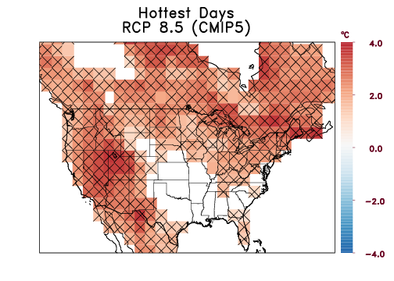
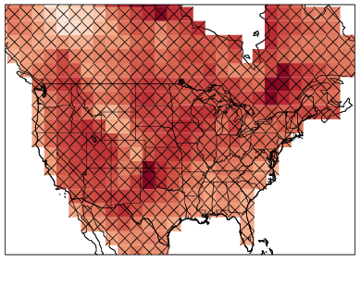
Increase in hottest days projected throughout 21st Century under extreme warming scenario
GFDL CM3 1 ensemble member, RCP8.5 scenario: aerosols decline, GHGs rise
mid-21stC: (2035-2065) – (2006-2036)
late-21stC: (2070-2100) – (2006-2036)
X = outside range of variability (95%) of differences between 30-year intervals in preind. control simulation
-4.0 -2.0 0.0 2.0 4.0
-8.0 -4.0 0.0 4.0 8.0
Change in Hottest Days (°C)
Change in Hottest Days (°C)
(annual maximum daily temperature [e.g., Sillman et al., 2013ab])
→ Amplified warming during extreme events from aerosol removal?
→ Preferred response patterns?
N. Mascioli
Notes:
Mention also looking precip

Slide 32
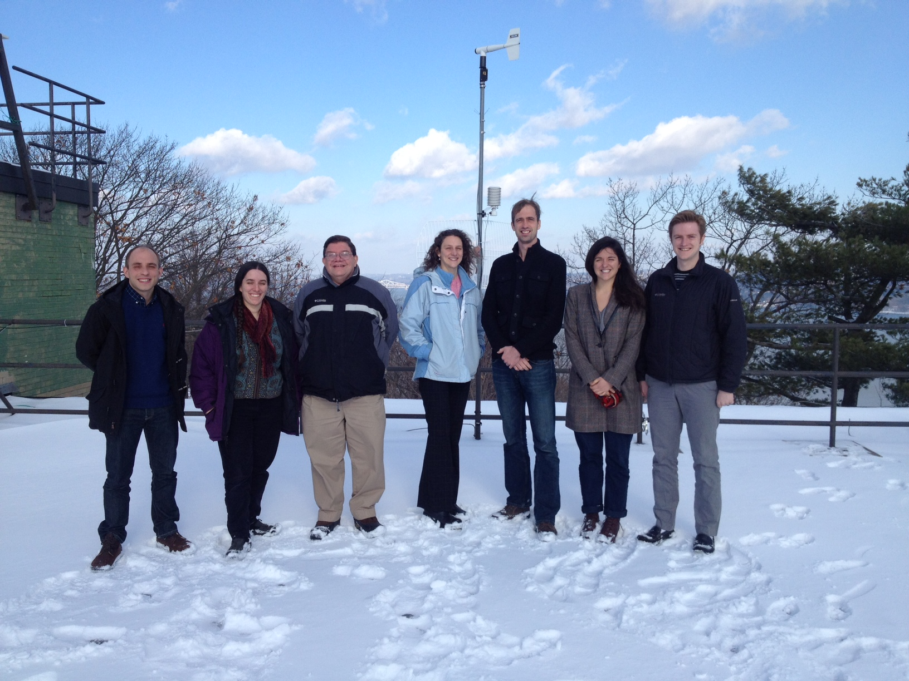
Atmospheric Chemistry Group at LDEO/CU
Nora
Gus
Arlene
Luke
Harald
Olivia
Lee
On the roof of our building following mid-Dec snowfall
(missing from photo: undergraduate researcher Jean Guo)

Slide 33
U.S. air pollution and climate: Trends, variability, and interactions
RCP8.5
Time
Rising CH₄ + decreasing NO_{x} shift balance of regionally produced vs. transported O₃
Double ‘penalty’ on NE US O₃ from climate change + rising CH₄?
RCP4.5
Time
NO_{x} reductions reverse the O₃ seasonal cycle over NE USA
Will NE US evolve to ‘background’ air quality over the 21st C?
Zonal O₃ variability aligns with the 500 hPa jet over NE NA (JJA)
Decadal jet shifts can influence O₃:T [Barnes & Fiore, 2013]
Relevant to model differences in O₃ response to climate?
[Weaver et al., 2009; Jacob & Winner, 2009; Fiore et al., 2012]
Translation to probabilistic language,”1-year event”, useful for decadal planning?
New approach to characterize pollution events [Rieder et al., 2013]
Detecting chemistry-climate interactions
Will (global) aerosol removal amplify response of U.S. climate extremes to rising GHGs?

