Slide 1
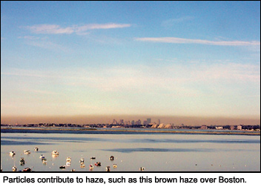








Haze over Boston, MA
http://www.airnow.gov/index.cfm?action=particle_health.page1#3
Influence of Changes in Emissions and Climate
on Background and Extreme Levels of Air Pollution
Arlene M. Fiore
Acknowledgments:
Elizabeth Barnes (NOAA/LDEO, now CSU), Olivia Clifton, Harald Rieder, Gus Correa (LDEO),
Meiyun Lin (Princeton/GFDL), Larry Horowitz (GFDL), Vaishali Naik (UCAR/GFDL)
Symposium on Abrupt Climate
Change in a Warming World
LDEO, Palisades, NY
May 23, 2013
83520601

Slide 2
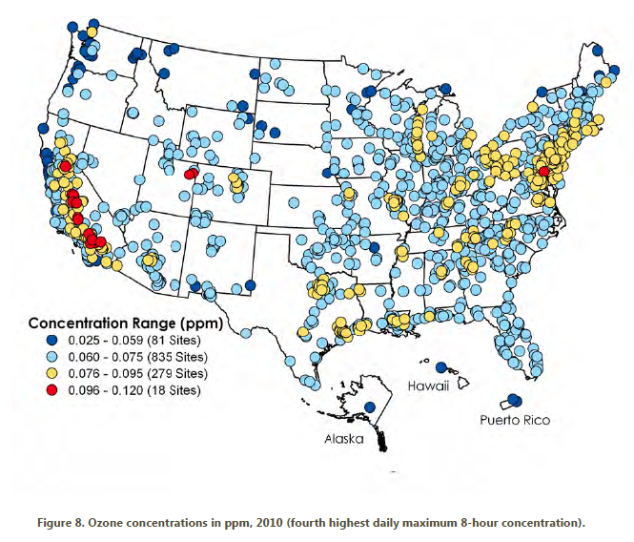
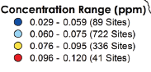
The U.S. ozone smog problem is spatially widespread, affecting ~108 million people [U.S. EPA, 2012]
4th highest maximum daily 8-hr average (MDA8) O₃ in 2010
Future?
Exceeds
standard
(24% of sites)
http://www.epa.gov/airtrends/2011/index.html
High-O₃ events typically occur in
-- densely populated areas (local sources)
-- summer (favorable meteorological conditions)
→ Lower threshold would greatly expand non-attainment regions

Slide 3


Tropospheric O₃ formation & “Background” contributions
STRATOSPHERE
lightning
O₃
intercontinental transport
“Background” ozone
NMVOCs
CO
METHANE (CH₄)
NO_{x}
+
Natural
sources
X
X
Human
activity
Fires
Land
biosphere
Ocean
Continent
Continent
Notes:
Emphasie WUS // EUS…

Slide 4
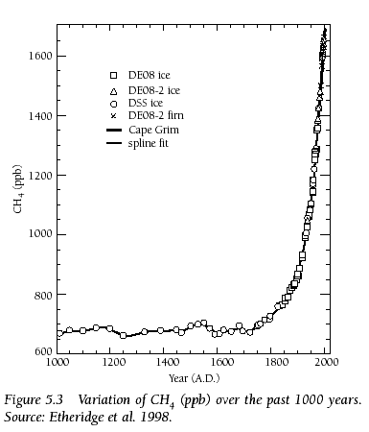
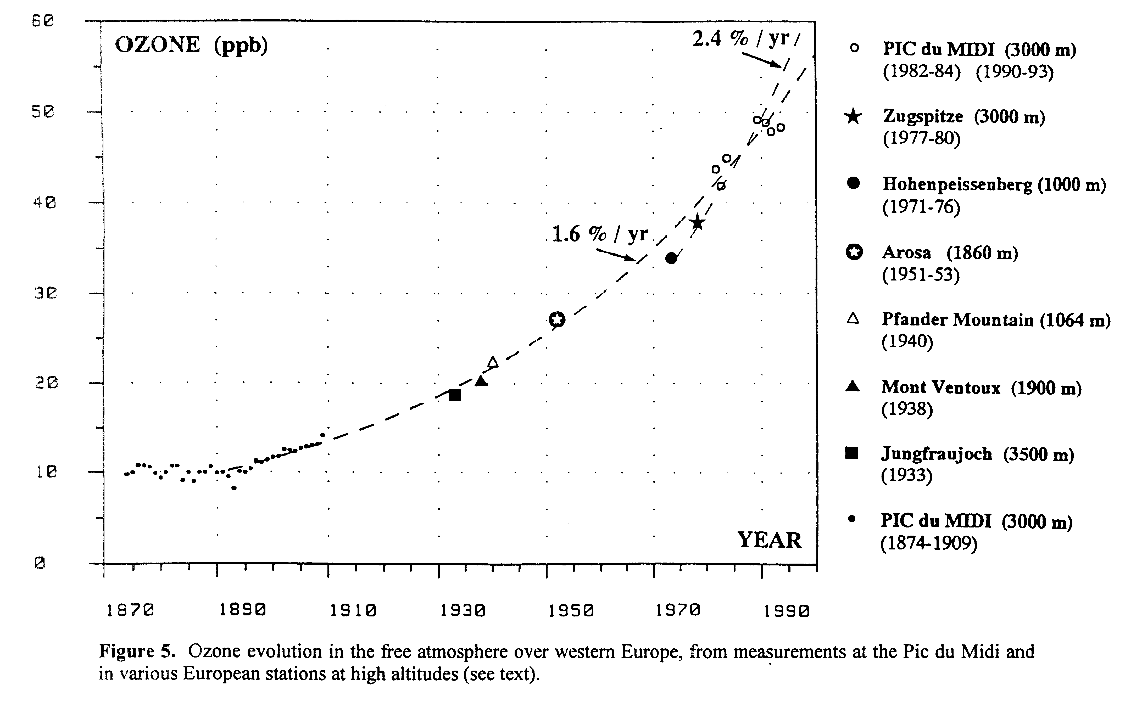
Historical increase in atmospheric methane and ozone
(#2 and #3 greenhouse gases after carbon dioxide [IPCC, 2007])
CH₄ Abundance (ppb) past 1000 years
[Etheridge et al., 1998]
Ozone at European mountain sites 1870-1990 [Marenco et al., 1994]
1600
1400
1200
1000
800
1000
1500
2000
Year
Preindustrial to present-day radiative forcing [Forster et al., (IPCC) 2007]:
+0.48 Wm⁻² from CH₄ +0.35 Wm⁻² from O₃

Slide 5
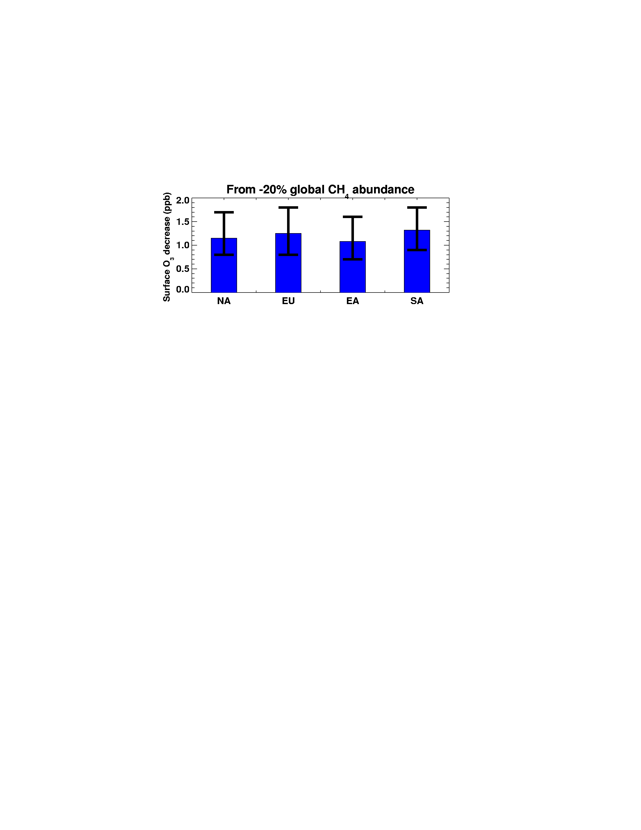
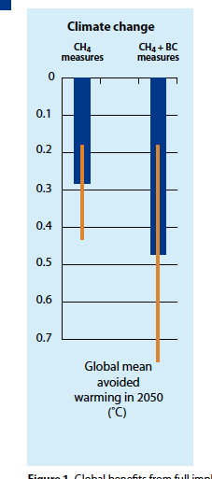
Benefits of ~25% decrease in global anthrop. CH₄ emissions
OZONE AIR QUALITY
CLIMATE
Global mean
avoided warming in 2050 (°C)
[WMO/UNEP, 2011]
Range over
18 models
N. America Europe East Asia South Asia
[Fiore et al., JGR, 2009; TF HTAP, 2007, 2010; Wild et al., ACP, 2012]
Possible at cost-savings / low-cost [West & Fiore 2005; West et al.,2012]
$1.4 billion (agriculture, forestry, non-mortality health) within U.S. alone [West and Fiore, 2005]
7700-400,000 annual avoided cardiopulmonary
premature mortalities in the N. Hemisphere
uncertainty in concentration-response relationship only [Anenberg et al., ES&T, 2009]
Notes:
Monetized co-benefits of methane mitigation for
human health are estimated to be $13–17 per ton CO2eq

Slide 6
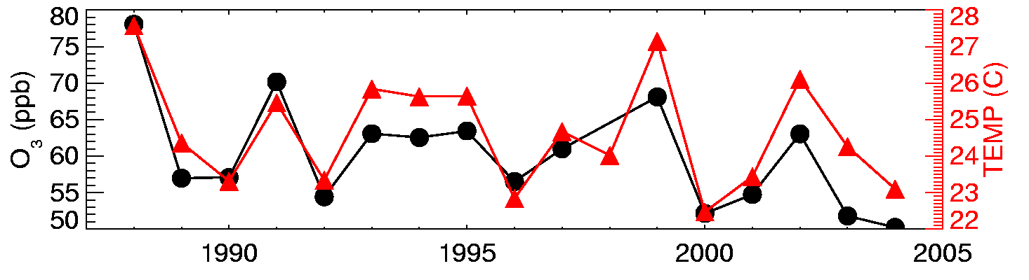
Strong correlations between surface temperature and O₃ measurements on daily to inter-annual time scales in polluted regions [e.g., Bloomer et al., 2009; Camalier et al., 2007; Cardelino and Chameides, 1990; Clark and Karl, 1982; Korsog and Wolff, 1991]
Observations at U.S. EPA CASTNet site Penn State, PA 41N, 78W, 378m
July mean MDA8 O₃ (ppb)
10am-5pm avg
What drives the observed O₃-Temperature correlation?
1. Meteorology (e.g., air stagnation)
2. Feedbacks (Emis, Chem, Dep)
T
Degree of mixing
OH
NO_{x}
VOCs
Deposition
H₂O
PAN
pollutant sources
Implies that changes in climate will influence air quality

Slide 7
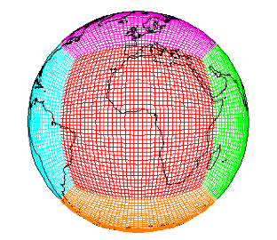
How will surface O₃ distributions evolve with future changes in emissions and climate?
Tool: GFDL CM3 chemistry-climate model
~2°x2°; 48 levels
Over 6000 years of climate simulations that include chemistry (air quality)
Options for nudging to re-analysis + global high-res ~50km² [Lin et al., JGR, 2012ab]
Donner et al., J. Climate, 2011;
Golaz et al., J. Climate, 2011;
John et al., ACP, 2012
Turner et al., ACP, 2012
Naik et al., submitted
Horowitz et al., in prep
Climate / Emission Scenarios: Representative Concentration Pathways (RCPs)
Percentage changes from 2005 to 2100
RCP8.5
RCP4.5
RCP4.5_WMGG
Enables separation of roles of changing climate from changing air pollutants
Global
NO_{x}
NE USA
NO_{x}
Global
CO₂
Global
CH₄
Global T (°C) (>500 hPa)
Notes:
Simplify – scenarios to test climate vs emissions impacts

Slide 8
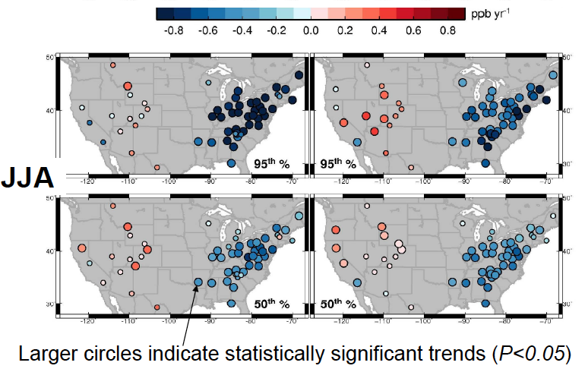
GFDL AM3 model captures key features of observed surface O₃ trends (1988-2012): larger decreases in 95% vs. 50% over EUS; increases in WUS
CASTNet Observations
GFDL AM3 model
95%
50%
Meiyun Lin, Princeton/GFDL

Slide 9
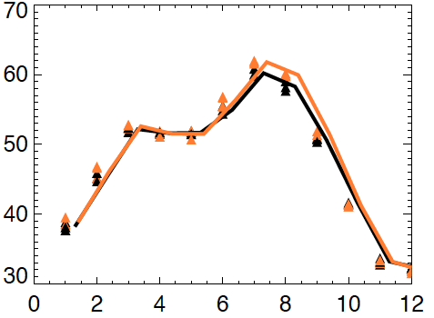
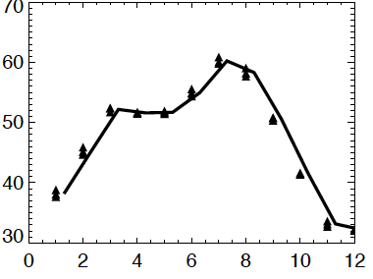
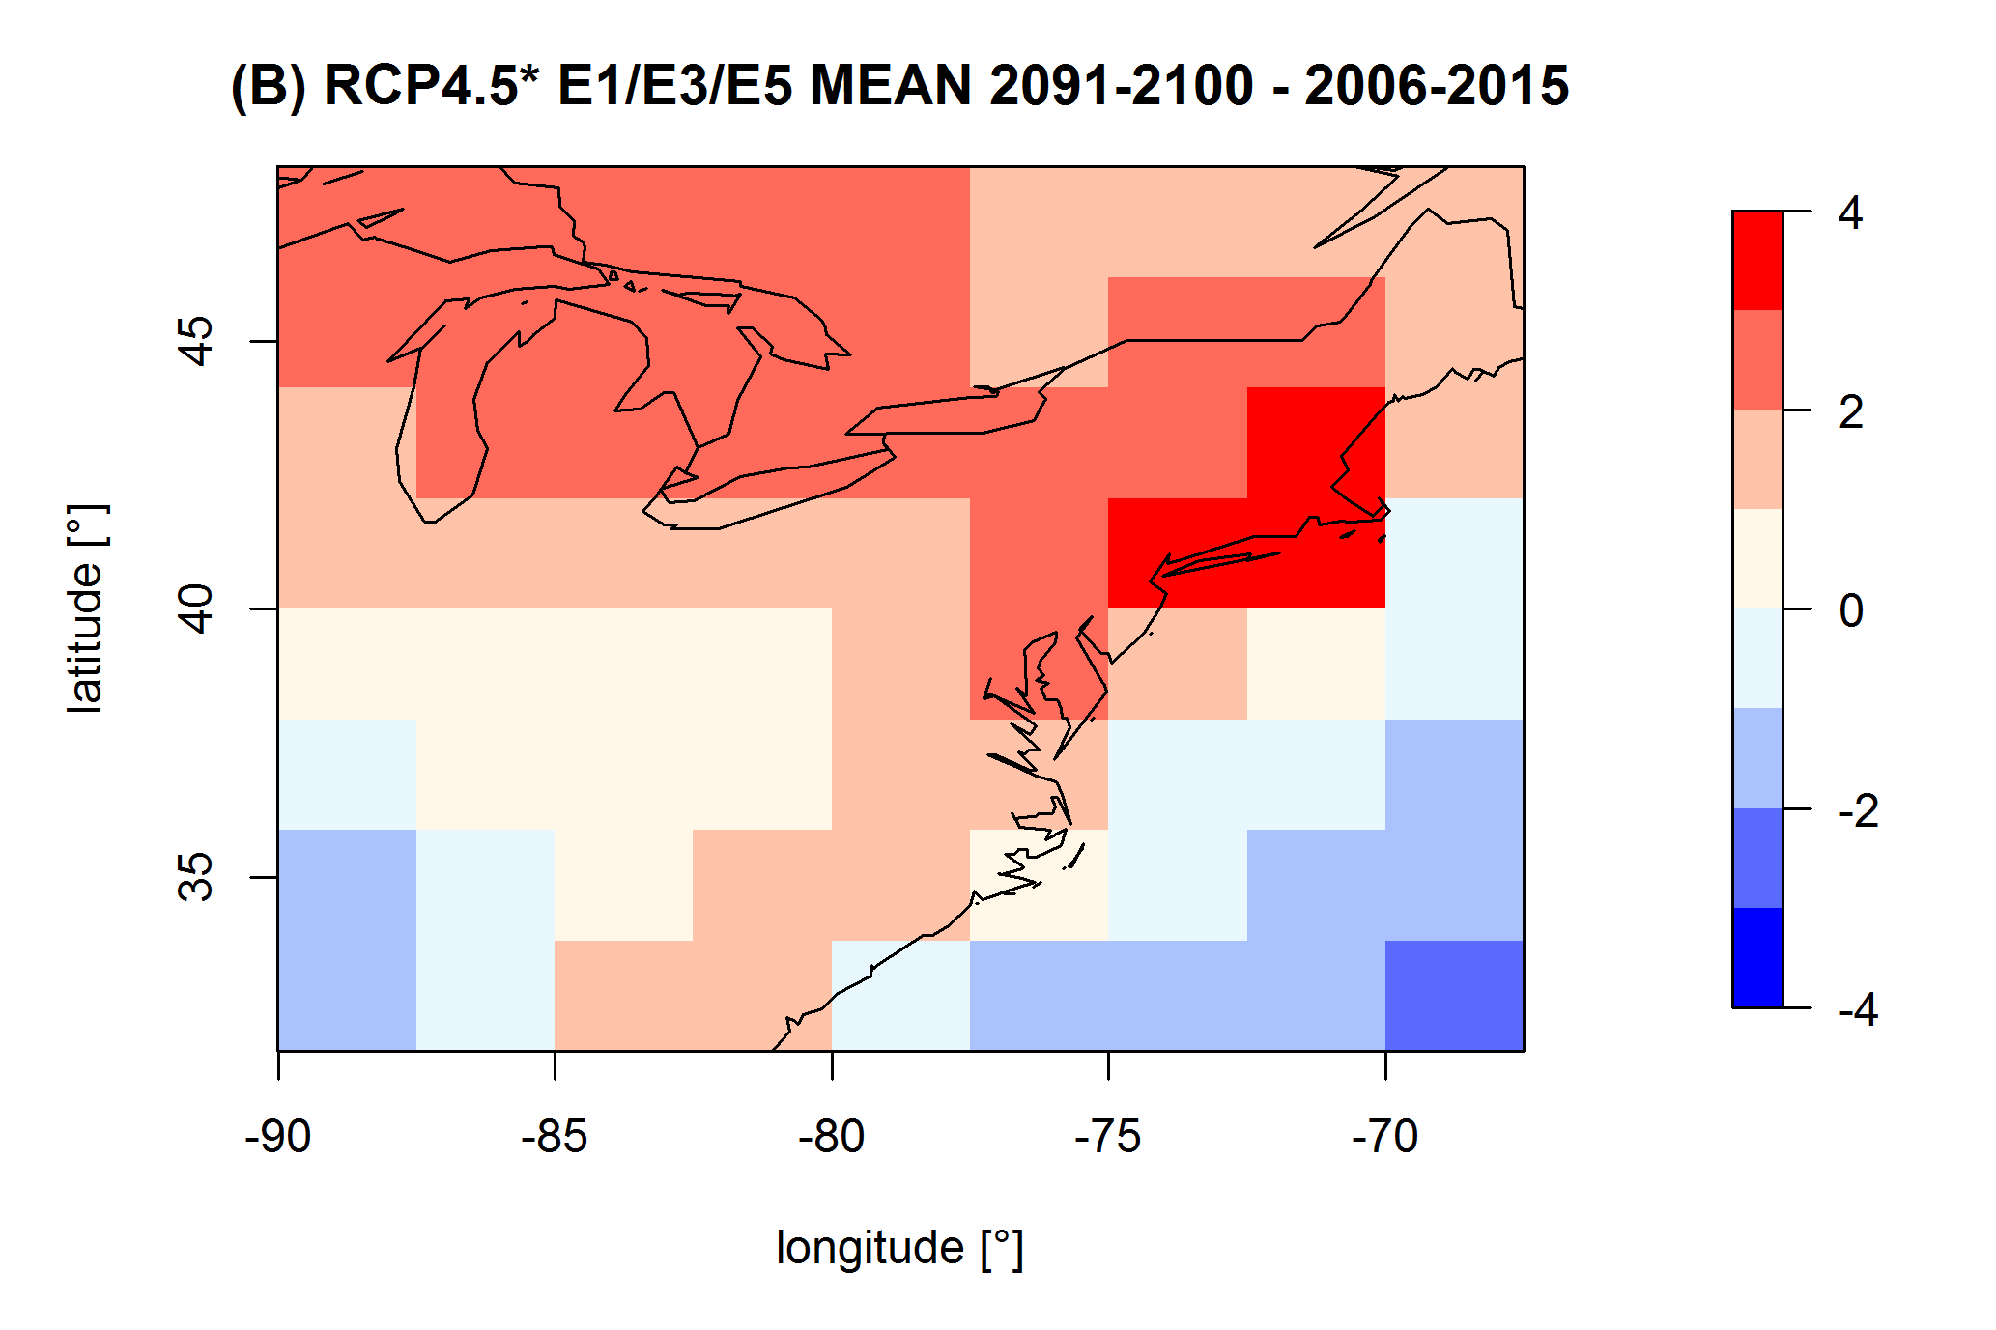
Regional climate change over the NE USA leads to higher summertime surface O₃ (“climate penalty” [Wu et al., JGR, 2008])
GFDL CM3 chemistry-climate model
Monthly mean surface O₃ over NE USA
(2091-2100) – (2006-2015)
RCP4.5_WMGG 3 ens. member mean:
RCP4.5_WMGG 2006-2015
RCP4.5_WMGG 2091-2100
3 ensemble
members for each scenario
Moderate climate change increases NE USA surface O₃ 1-4 ppb in JJA
(agreement in sign for this region across prior modeling studies)
How does NE USA O₃ respond to changing regional and global emissions?
O. Clifton/H. Rieder

Slide 10
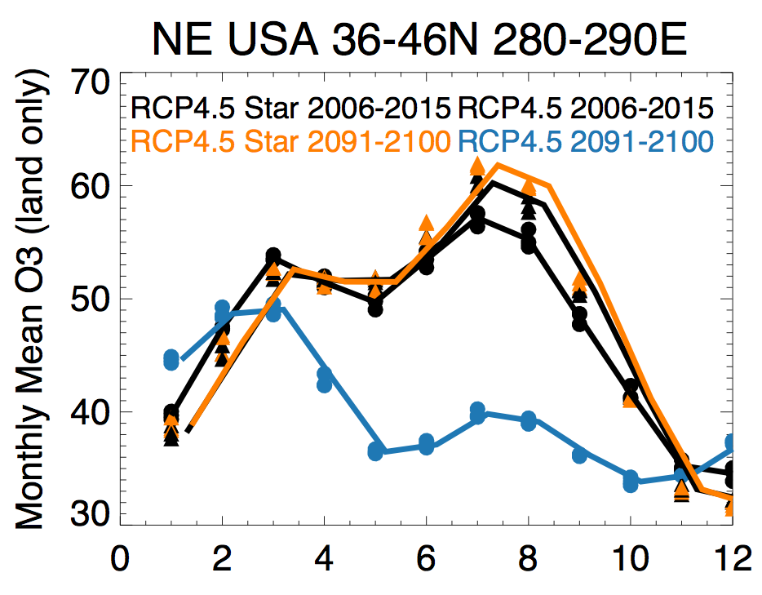
Large NO_{x} decreases fully offset any ‘climate penalty’ on surface O₃ over NE USA under moderate warming scenario
Monthly mean surface O₃ (land only) over the NE USA (36-46N, 70-80W)
in the GFDL CM3 model
RCP4.5_WMGG 2006-2015
RCP4.5_WMGG 2091-2100
RCP4.5 2006-2015
RCP4.5 2091-2100
ppb
3 ensemble
members for each scenario
→ Seasonal cycle reverses; NE US looks like a remote background site!
→ Signatures of changing emissions in observed shifts in seasonal cycles [Parrish et al., GRL, 2013]?
O. Clifton

Slide 11
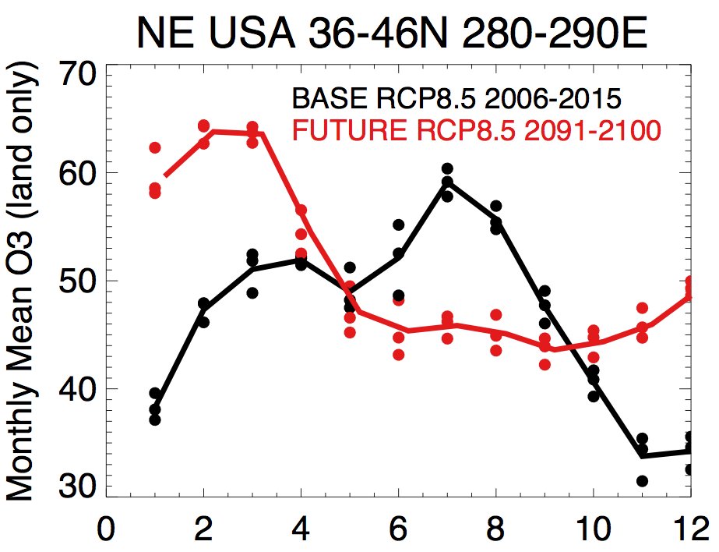
Surface O₃ seasonal cycle over NE USA reverses – cold season increases- under extreme warming scenario (RCP8.5)
Monthly mean surface O₃ (land only) over the NE USA (36-46N, 70-80W)
in the GFDL CM3 model
?
ppb
NO_{x}
decreases
month

Slide 12
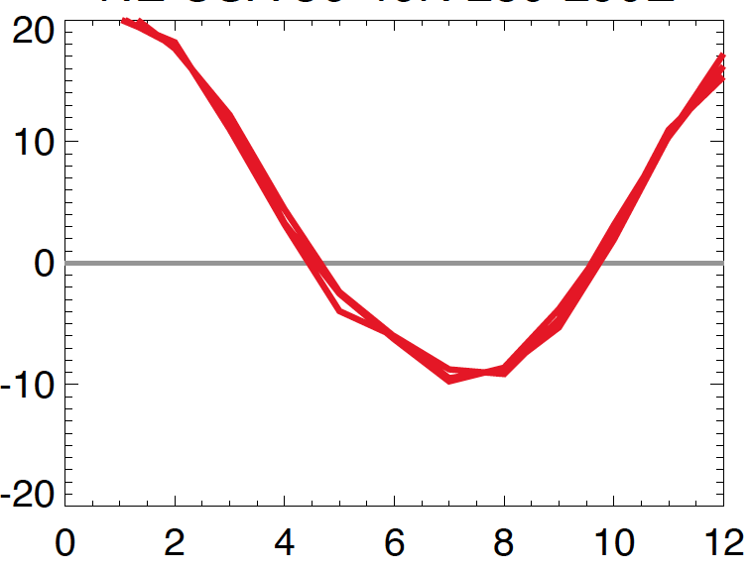
Why does surface O₃ increase in winter/spring over NE USA under RCP8.5?
Change in monthly mean surface O₃ (land only) over the NE USA (36-46N, 70-80W)
(2091-2100) – (2006-2015)
RCP8.5 (3 ensemble members)
?
NO_{x}
decreases
ppb

Slide 13
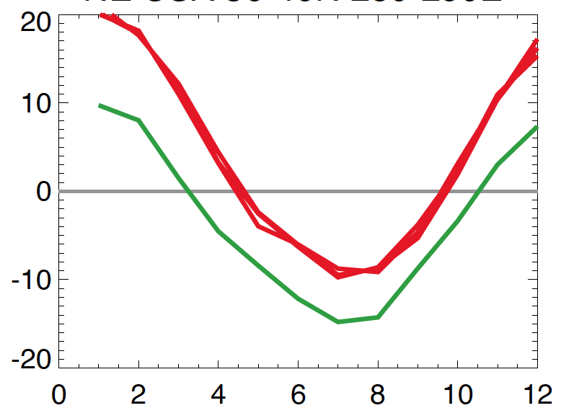
Doubling methane raises surface O₃ over NE USA ~5-10 ppb
Change in monthly mean surface O₃ (land only) over the NE USA (36-46N, 70-80W)
(2091-2100) – (2006-2015)
RCP8.5 (3 ensemble members)
RCP8.5 but chemistry sees 2005 CH₄
Doubling CH₄
does not fully explain wintertime
increase
ppb

Slide 14
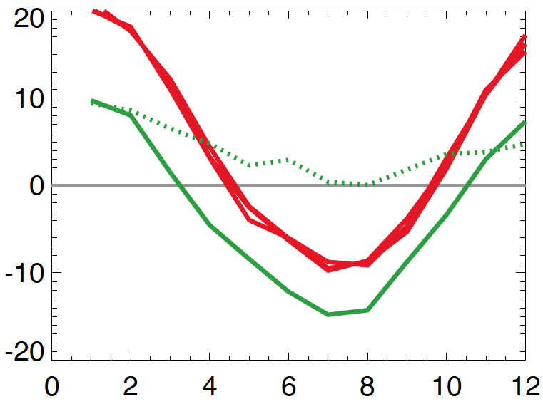
A contribution from enhanced stratosphere-to-troposphere ozone transport?
Change in monthly mean surface O₃ (land only) over the NE USA (36-46N, 70-80W)
(2091-2100) – (2006-2015)
RCP8.5 (3 ensemble members)
RCP8.5 but chemistry sees 2005 CH₄
RCP8.5 (3 ensemble members)
RCP8.5 but chemistry sees 2005 CH₄
ppb
Increase (2091-2100 – 2006-2015)
in stratospheric O₃ tracer
(qualitative indicator;
caution: non-linearities!)
Recovery + climate-driven increase in STE? [e.g.,Butchart et al., 2006; Hegglin&Shepherd, 2009; Kawase et al., 2011; Li et al., 2008; Shindell et al. 2006; Zeng et al., 2010]
Will the NE USA resemble present-day remote, high-altitude W US sites by 2100?
Notes:
NE USA becomes like remote background site in WUS?

Slide 15
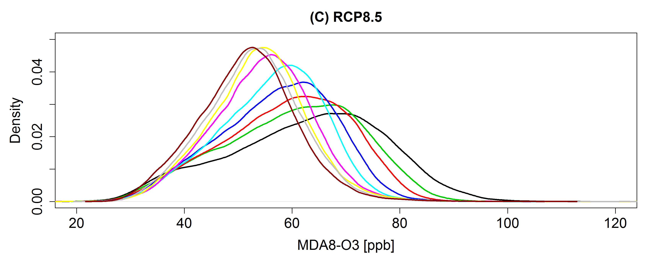
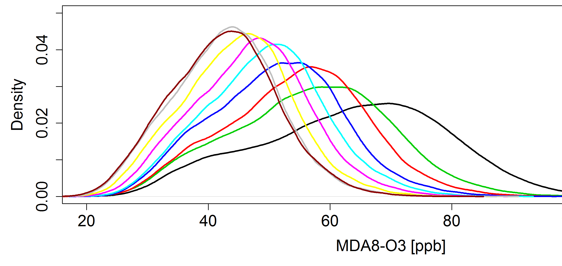
Extremes: The highest summertime surface O₃ events over NE USA decrease strongly under NO_{x} controls
2005 to 2100 % change
Time
RCP8.5
NE USA
NO_{x}
Global
NO_{x}
CH₄
RCP8.5
RCP4.5
2006-2015
2016-2025
2026-2035
2036-2045
2046-2055
2056-2065
2066-2075
2076-2085
2086-2095
◆
◆
◆
◆
◆
◆
◆
◆
◆
RCP4.5
Time
RCP8.5 vs. RCP4.5: Rising CH₄ increases surface O_{3,} at least partially offsetting gains otherwise attained via regional NO_{x} controls
H. Rieder

Slide 16
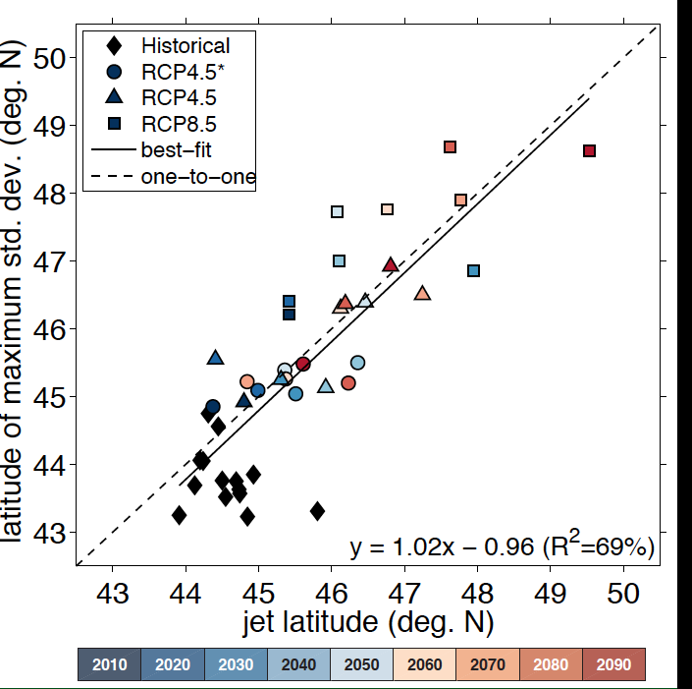
Peak latitude of summertime surface O₃ variability over Eastern N. America follows the jet as climate warms
RCP4.5_WMGG
RCP8.5: most warming,
Largest jet shift
Could different simulated jet positions explain cross-model disagreement in regional O₃ response to climate change?
Each point = 10 year mean (over all ensemble members where available)
Barnes & Fiore, GRL, in press

Slide 17
Influence of Changes in Emissions and Climate on Baseline and Extreme Levels of Air Pollution: Summary and Next Steps
Methane controls: ‘win-win’ for climate, air quality; also economic
Climate and Clean Air Coalition (http://www.unep.org/ccac/)
Observational constraints on CH₄ oxidation (and resulting O₃)?
Climate change may increase O₃ over NE USA but can be offset by NO_{x} reductions which preferentially decrease the highest O₃ events
→ Other regions, seasons, with a focus on extremes
→ Develop robust connections to changes in meteorology
NO_{x} reductions combined with rising CH₄ & strat-to-trop O₃ transport fully reverse O₃ seasonal cycle over NE USA
Ongoing evaluation of key processes (recent decades)
Long-term measurements crucial [e.g., Parrish et al., 2013]
Zonal O₃ variability aligns with the 500 hPa jet over NE N. America
Jet shifts can influence O₃:T [Barnes & Fiore, in press GRL]
Decadal shifts in jet; hold on shorter timescales?
Explore predictive power and extend beyond O₃
Relevant to model differences in O₃ response to climate?
[Weaver et al., 2009; Jacob & Winner, 2009; Fiore et al., 2012]
Notes:
Mention WUS as region where transported ozone important so changes in circulation, upwind (Asian sources) & strat-to-trop transport important
End with need for building our process understanding at regional scales on time scales from daily to decadal and CCMI effort

