Slide 1
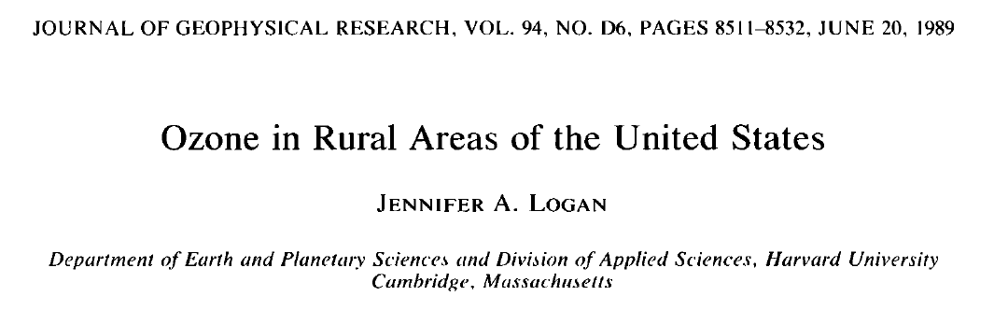








“ ”:
Recent trends, future projections
Arlene M. Fiore
Acknowledgments: Elizabeth Barnes (NOAA/LDEO, now CSU), Olivia Clifton (LDEO),
Gus Correa (LDEO), Larry Horowitz (GFDL), Jasmin John (GFDL), Vaishali Naik (UCAR/GFDL),
Lorenzo Polvani (Columbia), Harald Rieder (LDEO)
Symposium in celebration of Jennifer Logan
Harvard School of Engineering and Applied Sciences
Cambridge, MA
May 10, 2013
83520601

Slide 2
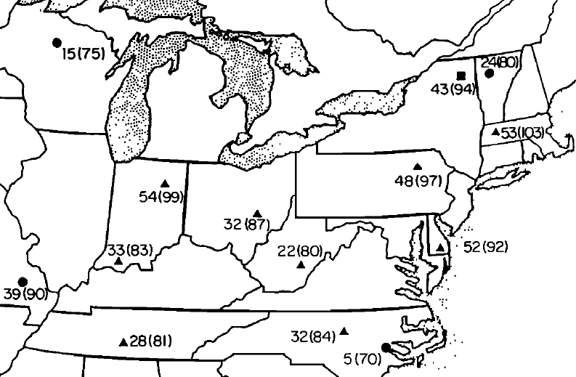
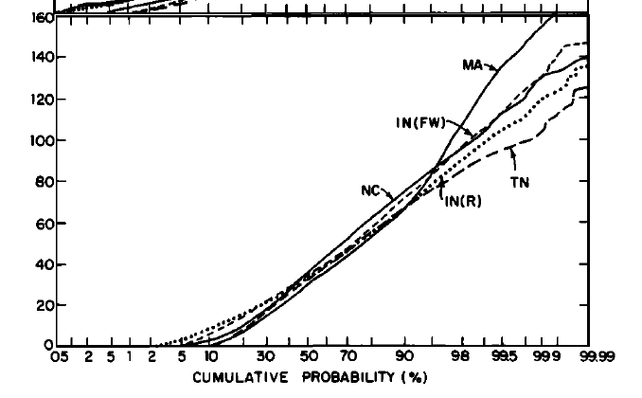
Logan, 1989: expresses urgent need for routine measurements at rural sites in the Eastern USA
SURE and NAPBN sites Apr-Sep 1979
# days with O₃ (8am-8pm) > 80 ppb
April-Sept 1978-9 O₃ cumulative probability distribution
0000-2300 LT (ppb) at SURE sites
Distribution not
well described by
Gaussian statistics,
esp. upper tail
3-8% > 80 ppb
Logan, 1989 Fig 3
(98% values: 80-103 ppb)
U.S. EPA CASTNet has now measured rural O₃ for over two decades
→ How has the O₃ distribution, including extreme events, changed?
What might the future hold?

Slide 3
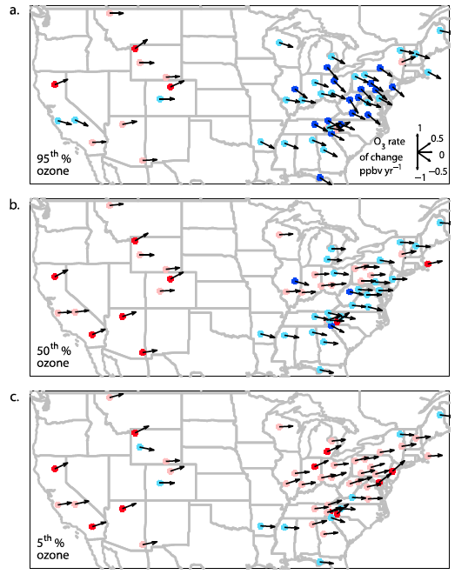
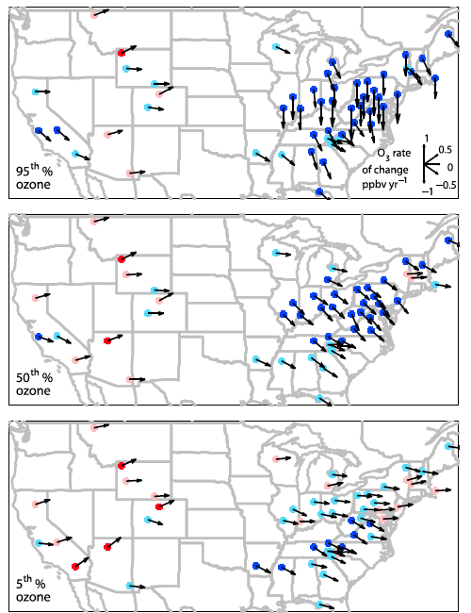
Trends in seasonal daytime (11am-4pm) average ozone at rural U.S. monitoring sites (CASTNet): 1990 to 2010
SPRING
significant
not significant
SUMMER
95%
95%
5%
5%
ppb yr⁻¹
Cooper et al., JGR, 2012
Success in decreasing highest levels, but baseline rising (W. USA)
Decreases in EUS attributed in observations and models to NO_{x} emission
controls in late 1990s, early 2000s [e.g., Frost et al., 2006; Hudman et al., 2007; van der A. et al., 2008; Stavrakou et al., 2008; Bloomer et al., 2009, 2010; Fang et al., 2010]

Slide 4
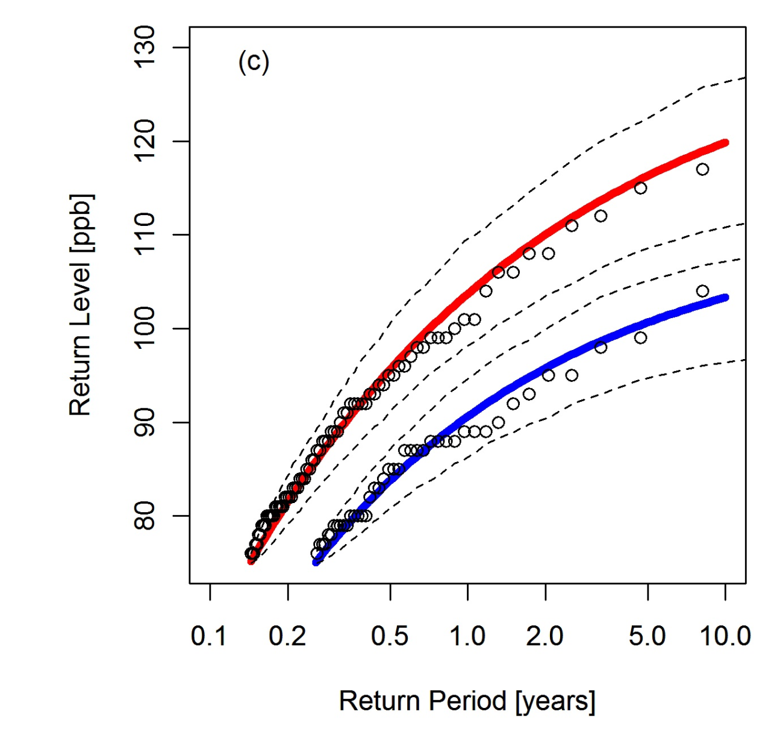
Extreme value theory statistical methods enable derivation of “return levels” for JJA MDA8 O₃ within a given time window
Return level = value (level) that occurs or is exceeded within a given time (period)
CASTNet site: Penn Station, PA
Fit using EVT methods
for MDA8 O₃>75 ppb
1988-1998
1999-2009
Observed MDA8 O₃
Sharp decline in return levels
between early and later periods
(NO_{x} SIP call)
Consistent with prior work [e.g., Frost et al., 2006; Bloomer et al., 2009, 2010]
Translates air pollution changes into
probabilistic language
Apply methods to all EUS CASTNet sites to derive
1-year return levels
Rieder et al., ERL 2013

Slide 5
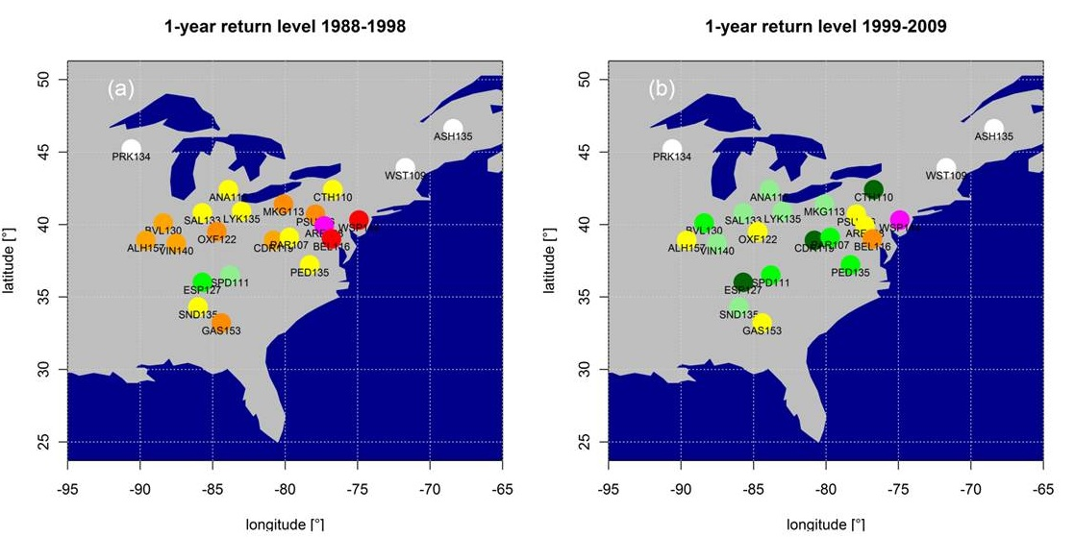
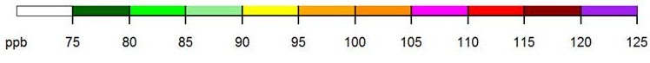
One-year return levels for JJA MDA8 O₃ over EUS decrease following NO_{x} emission controls
1988-1998
1999-2009
1-yr return level decreases by 2-16 ppb
1-year levels remain above the NAAQS threshold (75 ppb)
Rieder et al., ERL 2013

Slide 6
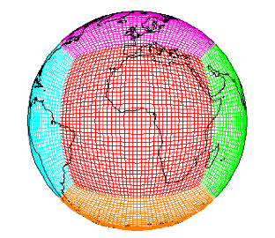
How will NE US surface O₃ distributions evolve with future changes in emissions and climate?
Tool: GFDL CM3 chemistry-climate model
~2°x2°; 48 levels
Over 6000 years of climate simulations that include chemistry (air quality)
Options for nudging to re-analysis + global high-res ~50km² [Lin et al., JGR, 2012ab]
Donner et al., J. Climate, 2011;
Golaz et al., J. Climate, 2011;
John et al., ACP, 2012
Turner et al., ACP, 2012
Naik et al., submitted
Horowitz et al., in prep
Climate / Emission Scenarios: Representative Concentration Pathways (RCPs)
Percentage changes from 2005 to 2100
RCP8.5
RCP4.5
RCP4.5_WMGG
Enables separation of roles of changing climate from changing air pollutants
Global
NO_{x}
NE USA
NO_{x}
Global
CO₂
Global
CH₄
Global T (°C) (>500 hPa)
Notes:
Simplify – scenarios to test climate vs emissions impacts

Slide 7
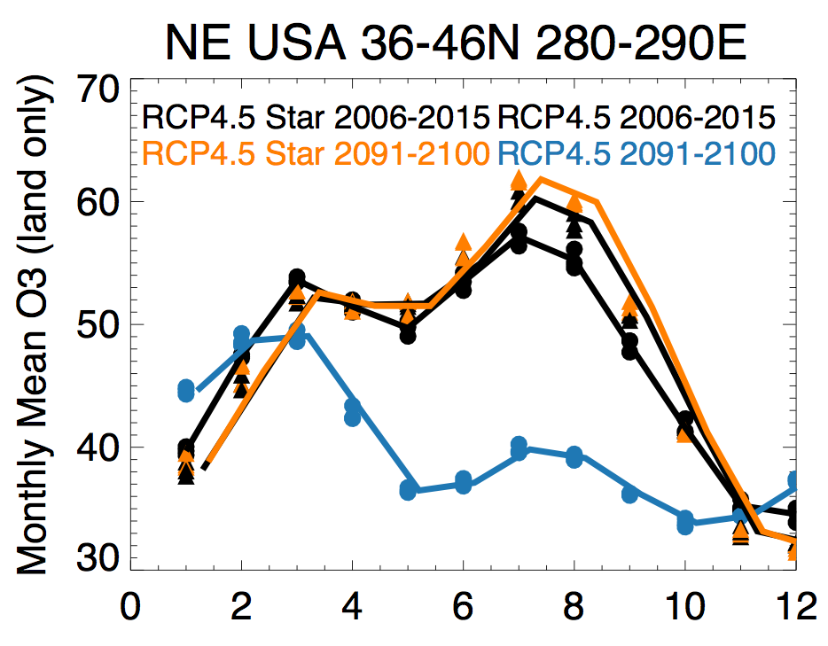
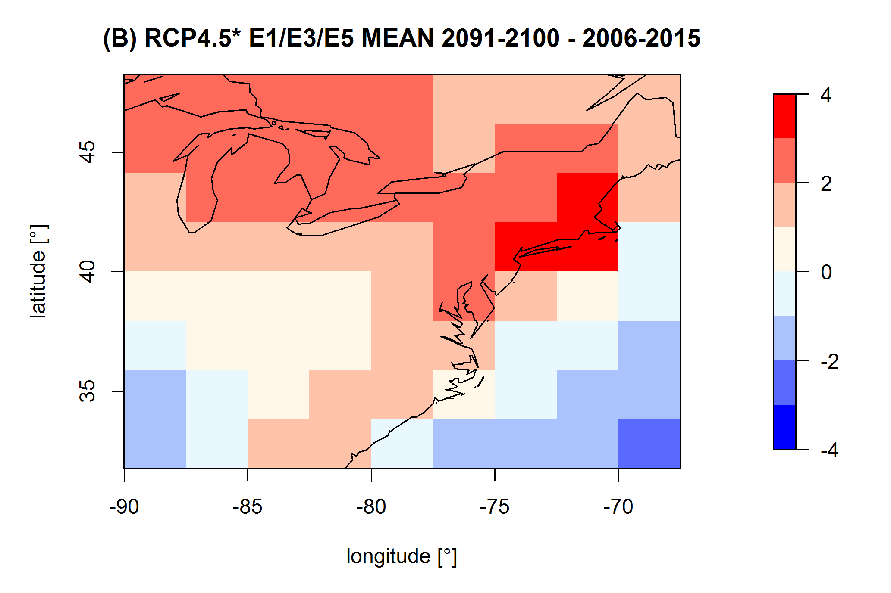
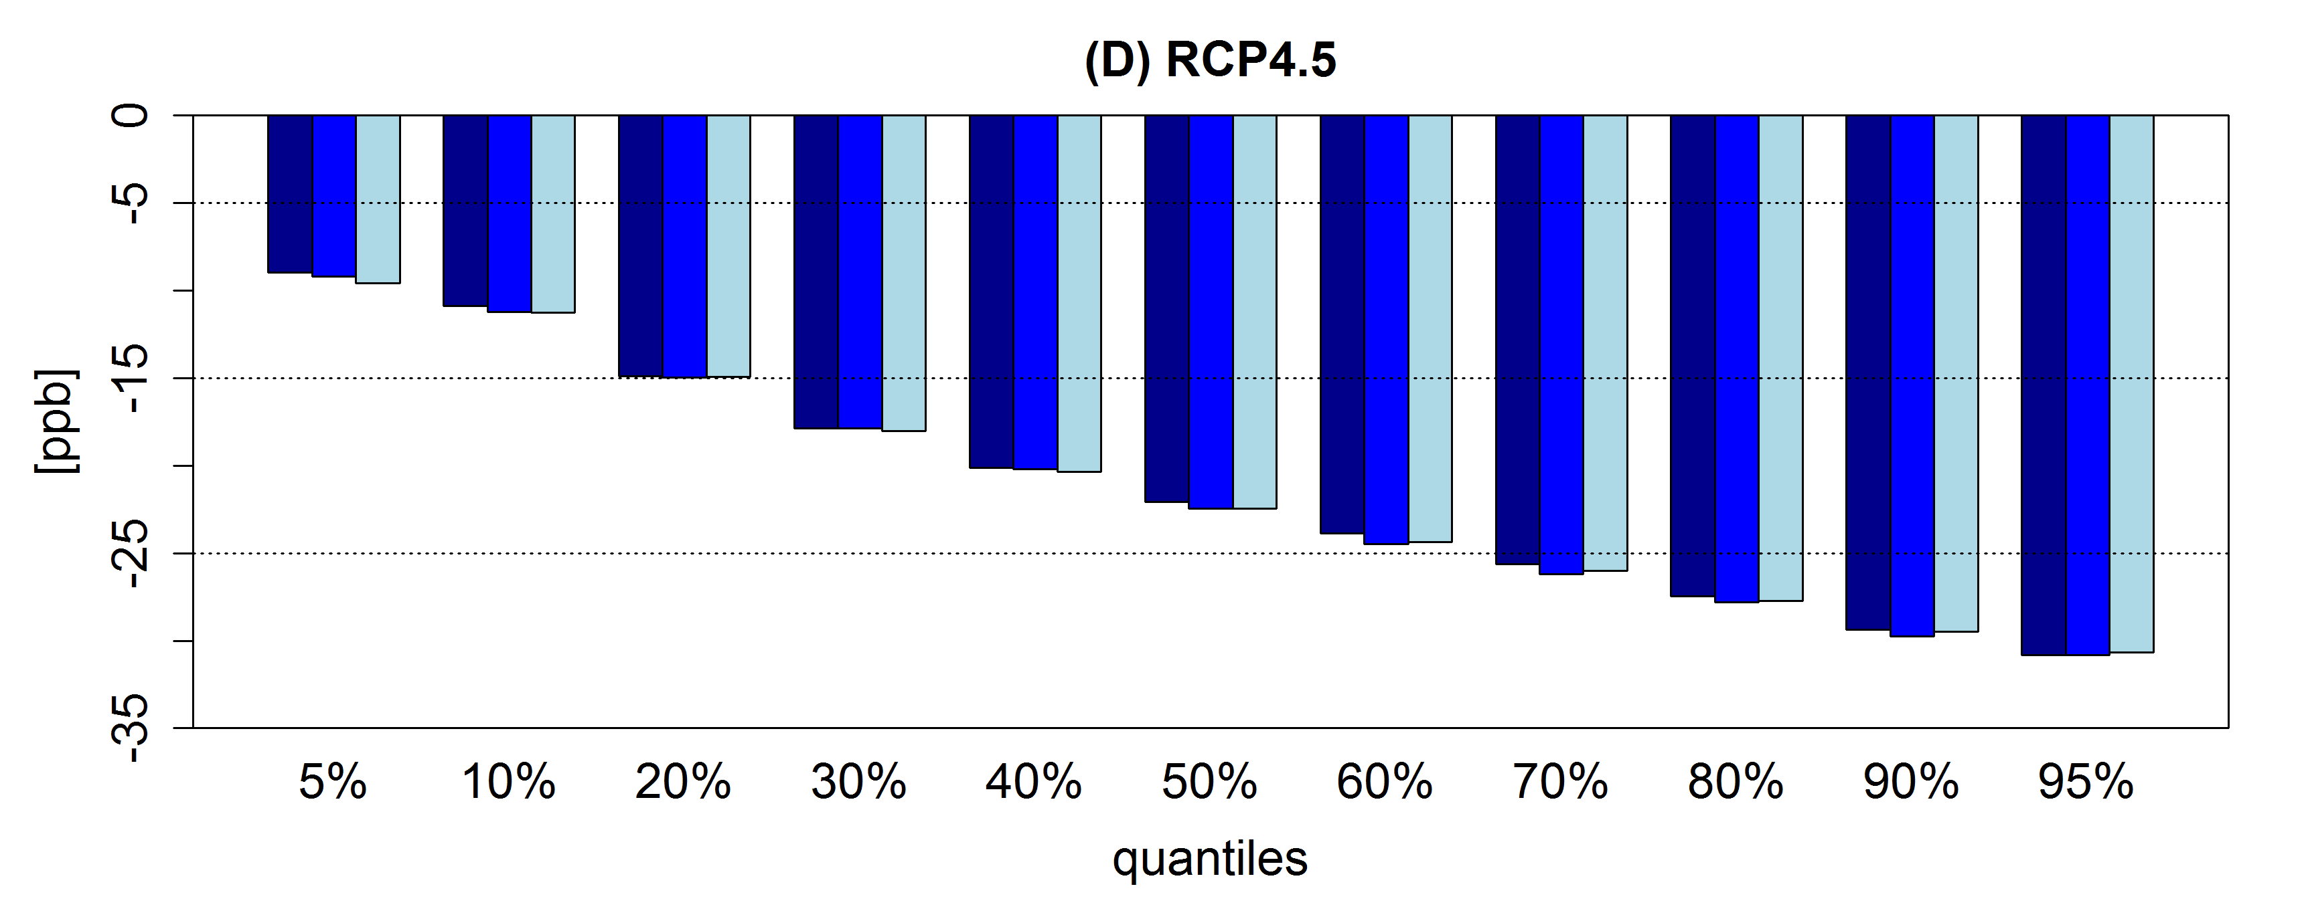
Impact of changes in climate vs. emissions on surface O₃ under moderate warming scenario over NE USA
RCP4.5_WMGG 2006-2015
RCP4.5_WMGG 2091-2100
(2091-2100) – (2006-2015)
RCP4.5_WMGG 3 ens. member mean:
RCP4.5 2006-2015
RCP4.5 2091-2100
3 ensemble
members for each scenario
Moderate climate change increases NE USA surface ozone up to 4 ppb
RCP4.5 O₃ change (ppb)(2091-2100)-(2006-2015)
-5
-15
-25
-35
But large regional NO_{x} reductions fully offset this;
O₃ decreases most for polluted conditions;
Seasonal cycle reverses
3 ensemble
members
5% 10% 20% 30% 40% 50% 60% 70% 80% 90% 95%
Percentile of JJA MDA8 O₃ distribution

Slide 8
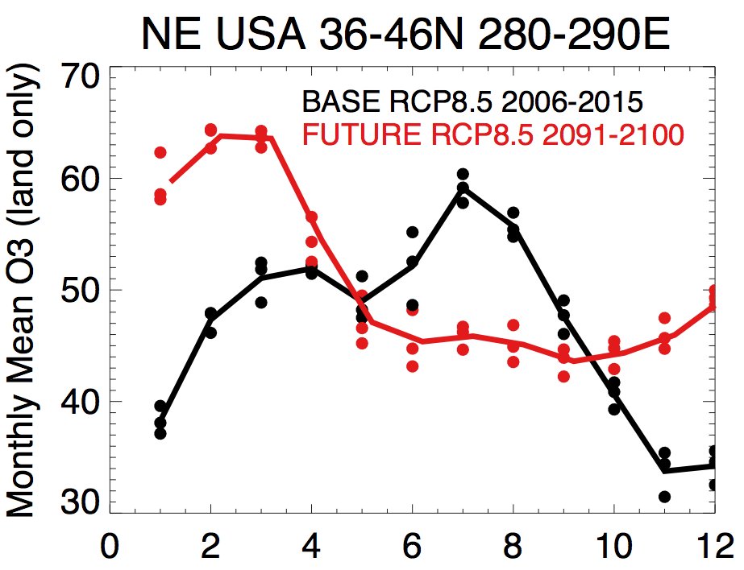
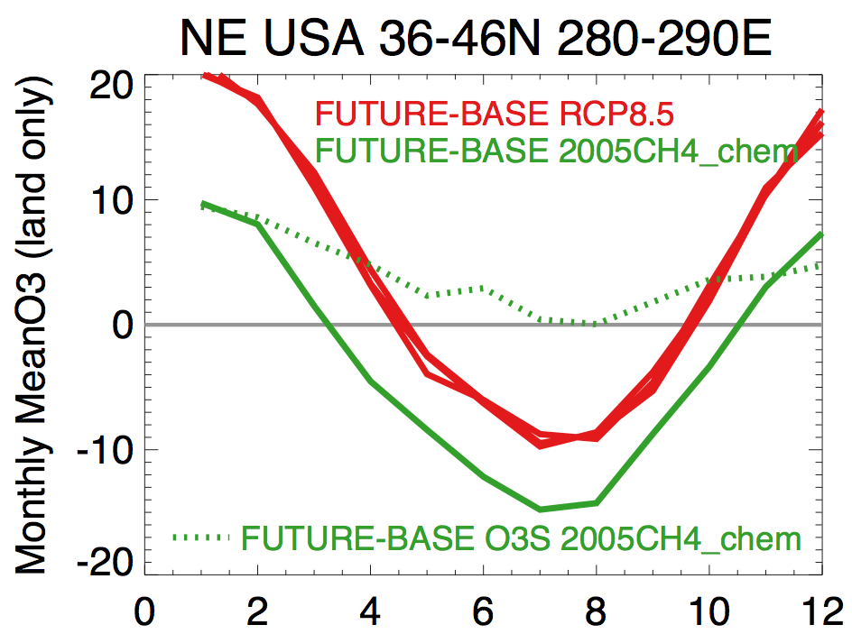
NE USA: surface O₃ seasonal cycle reverses in CM3 with large regional NO_{x} controls in RCP8.5 (extreme warming)
?
NO_{x}
decreases
Stratospheric O₃ tracer
→Difference between RCP8.5 and RCP8.5 but with CH₄ held at 2005 levels indicates that doubling CH₄ increases surface O₃ over NE by more than 5-10 ppb;
→Largest in winter
→ Tracer of strat. O₃ increases in winter-spring
→ Recovery + climate-driven increase in STE? [e.g.,Butchart et al., 2006; Hegglin&Shepherd, 2009; Kawase et al., 2011; Li et al., 2008; Shindell et al. 2006; Zeng et al., 2010]

Slide 9
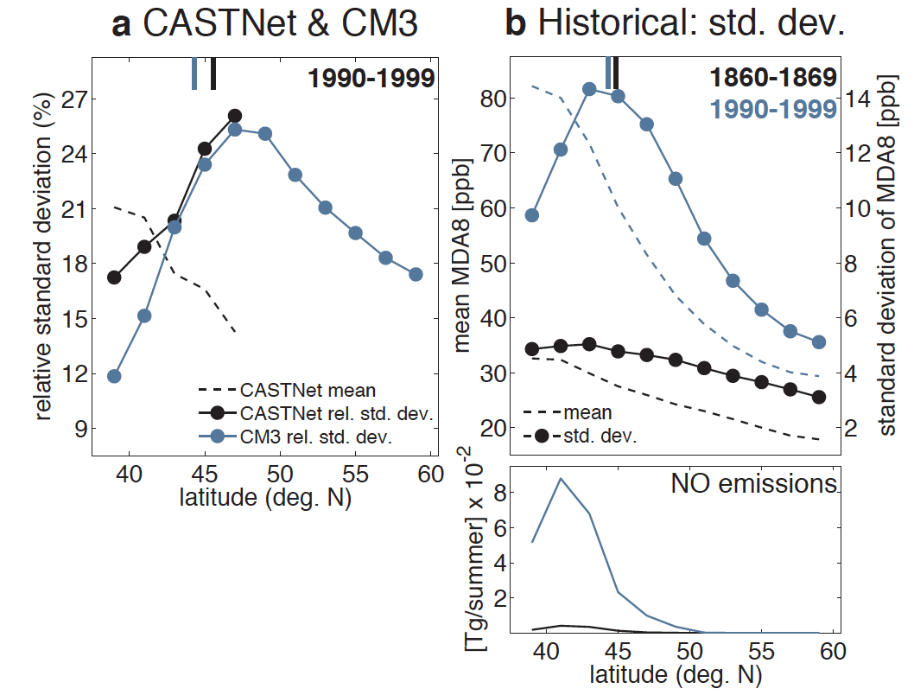
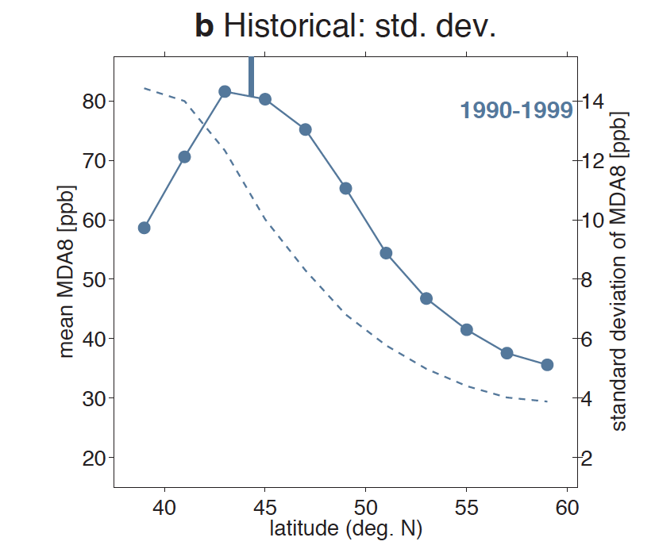
Summertime surface O₃ variability aligns with the 500 hPa
jet over Eastern N. America
JJA MDA8 O₃ and NO_{x} emissions zonally averaged over Eastern N. America
CM3
MERRA
Jet Position
GFDL CM3 model
NO_{x} emission peak aligns with highest mean observed + modeled MDA8 O₃
Relative standard deviation max at
the jet latitude
Barnes & Fiore, in press, GRL

Slide 10
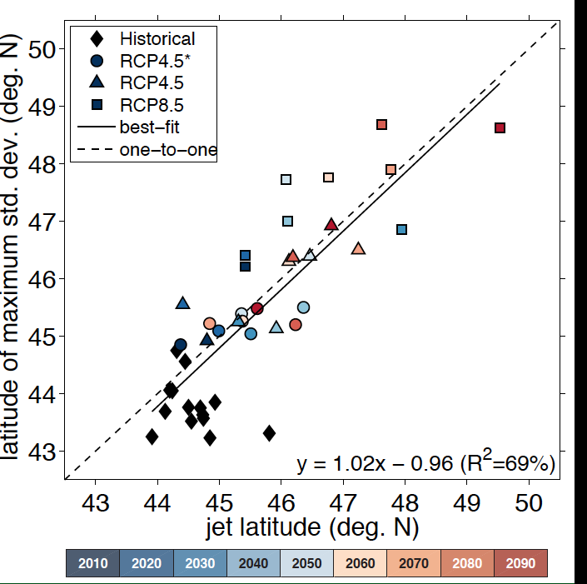
Peak latitude of summertime surface O₃ variability over Eastern N. America follows the jet as climate warms
RCP4.5_WMGG
RCP8.5: most warming,
Largest jet shift
Local O₃:T relationships also follow the jet (not shown)
observed O₃:T may not apply if large-scale circulation shifts
Each point = 10 year mean (over all ensmble members where available)
Could different simulated jet positions explain cross-model disagreement in regional O₃ response to climate change?
Barnes & Fiore, GRL, in press

Slide 11
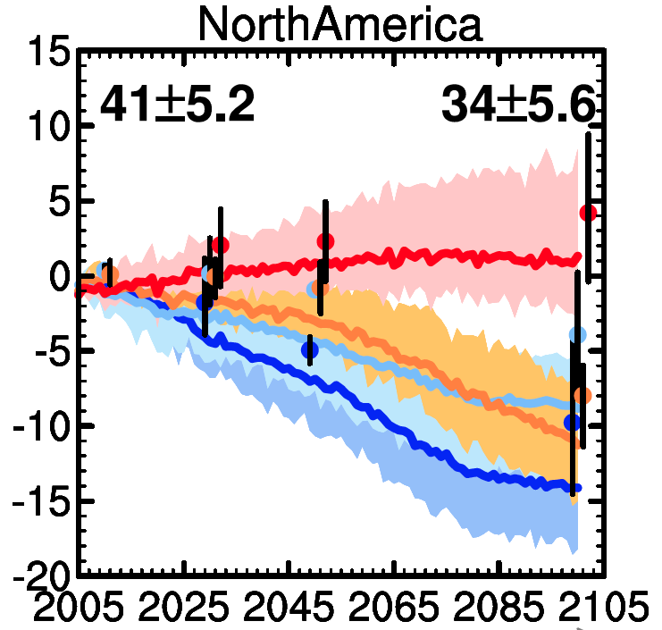

‘First-look’ future projections with current chemistry-climate models for North American Ozone Air Quality
Annual mean spatially averaged (land only) O₃ in surface air
Mean over
1986-2005 of
CMIP5 CCMs
Transient
simulations
(4 models)
1980+2000 mean of ACCMIP CCMs decadal time slice simulations
(2-12 models)
Range across
all models
Range across
all models
RCP8.5
RCP6.0
RCP4.5
RCP2.6
Multi-
model
Mean
Multi-model Mean
V. Naik, adapted from Fiore et al., 2012
Beyond annual, continental-scale means: Shifting balance of regional and baseline O₃ changes seasonal cycles and daily distributions; Role of regional climate change?
Notes:
Leave you with a pretty picture & overall conclusion in blue text

