Slide 1
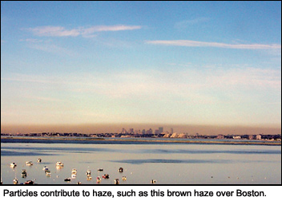








Haze over Boston, MA
http://www.airnow.gov/index.cfm?action=particle_health.page1#3
Ozone smog in surface air:
“Background” contributions and climate connections
Arlene M. Fiore
www.ldeo.columbia.edu/~amfiore
SIPA ESP MPA Program
LDEO, Palisades, NY
July 1, 2013
83520601

Slide 2
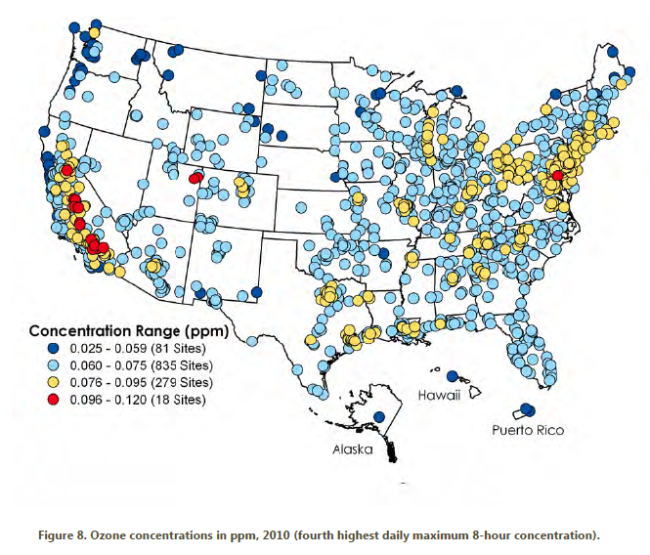
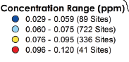
The U.S. ozone smog problem is spatially widespread, affecting ~108 million people [U.S. EPA, 2012]
4th highest maximum daily 8-hr average (MDA8) O₃ in 2010
Future?
Exceeds
standard
(24% of sites)
http://www.epa.gov/airtrends/2011/index.html
High-O₃ events typically occur in
-- densely populated areas (local sources)
-- summer (favorable meteorological conditions)
→ Lower threshold would greatly expand non-attainment regions

Slide 3


Tropospheric O₃ formation & “Background” contributions
stratosphere
lightning
O₃
intercontinental transport
“Background” ozone
NMVOCs
CO
METHANE (CH₄)
NO_{x}
+
Natural
sources
X
X
Human
activity
Fires
Biosphere
Ocean
Continent
Continent
Notes:
Emphasie WUS // EUS…

Slide 4
Setting achievable standards requires accurate knowledge of background levels
typical U.S.
“background”
(model estimates)
[Fiore et al., 2003;
Wang et al., 2009;
Zhang et al., 2011]
background
events over WUS
[Lin et al., 2012ab]
U.S. National Ambient Air Quality Standard
for O₃ has evolved over time
75 ppb
2008
8-hr
84 ppb
1997
8-hr
120 ppb
1979
1-hr avg
Future?
(proposed)
O₃ (ppbv)
20
40
60
80
100
120
Allowable O₃ produced from U.S. anthrop. sources (“cushion”)
Lowering thresholds for U.S. O₃ NAAQS implies thinning cushion between regionally produced O₃ and background
Clean Air Act has provisions for States to be exempted from pollution beyond their control but in practice may need clarification

Slide 5
Some challenges for WUS O₃ air quality management
stratosphere
Warming climate
+in polluted regions
[Jacob & Winner, 2009 review]
+ natural sources
[recent reviews: Isaksen et al., 2009; Fiore et al., 2012]
? Transport pathways
Natural events e.g., stratospheric [Langford et al [2009]; fires [Jaffe & Wigder, 2012]
lightning
methane
Rising Asian emissions
[e.g., Jacob et al., 1999;
Richter et al., 2005;
Cooper et al., 2010]
intercontinental
transport
“Background Ozone”
X
Wildfire, biogenic
Asia
Pacific
Western USA
Need process-level understanding on daily to multi-decadal time scales
Notes:
Emphasie WUS // EUS…

Slide 6
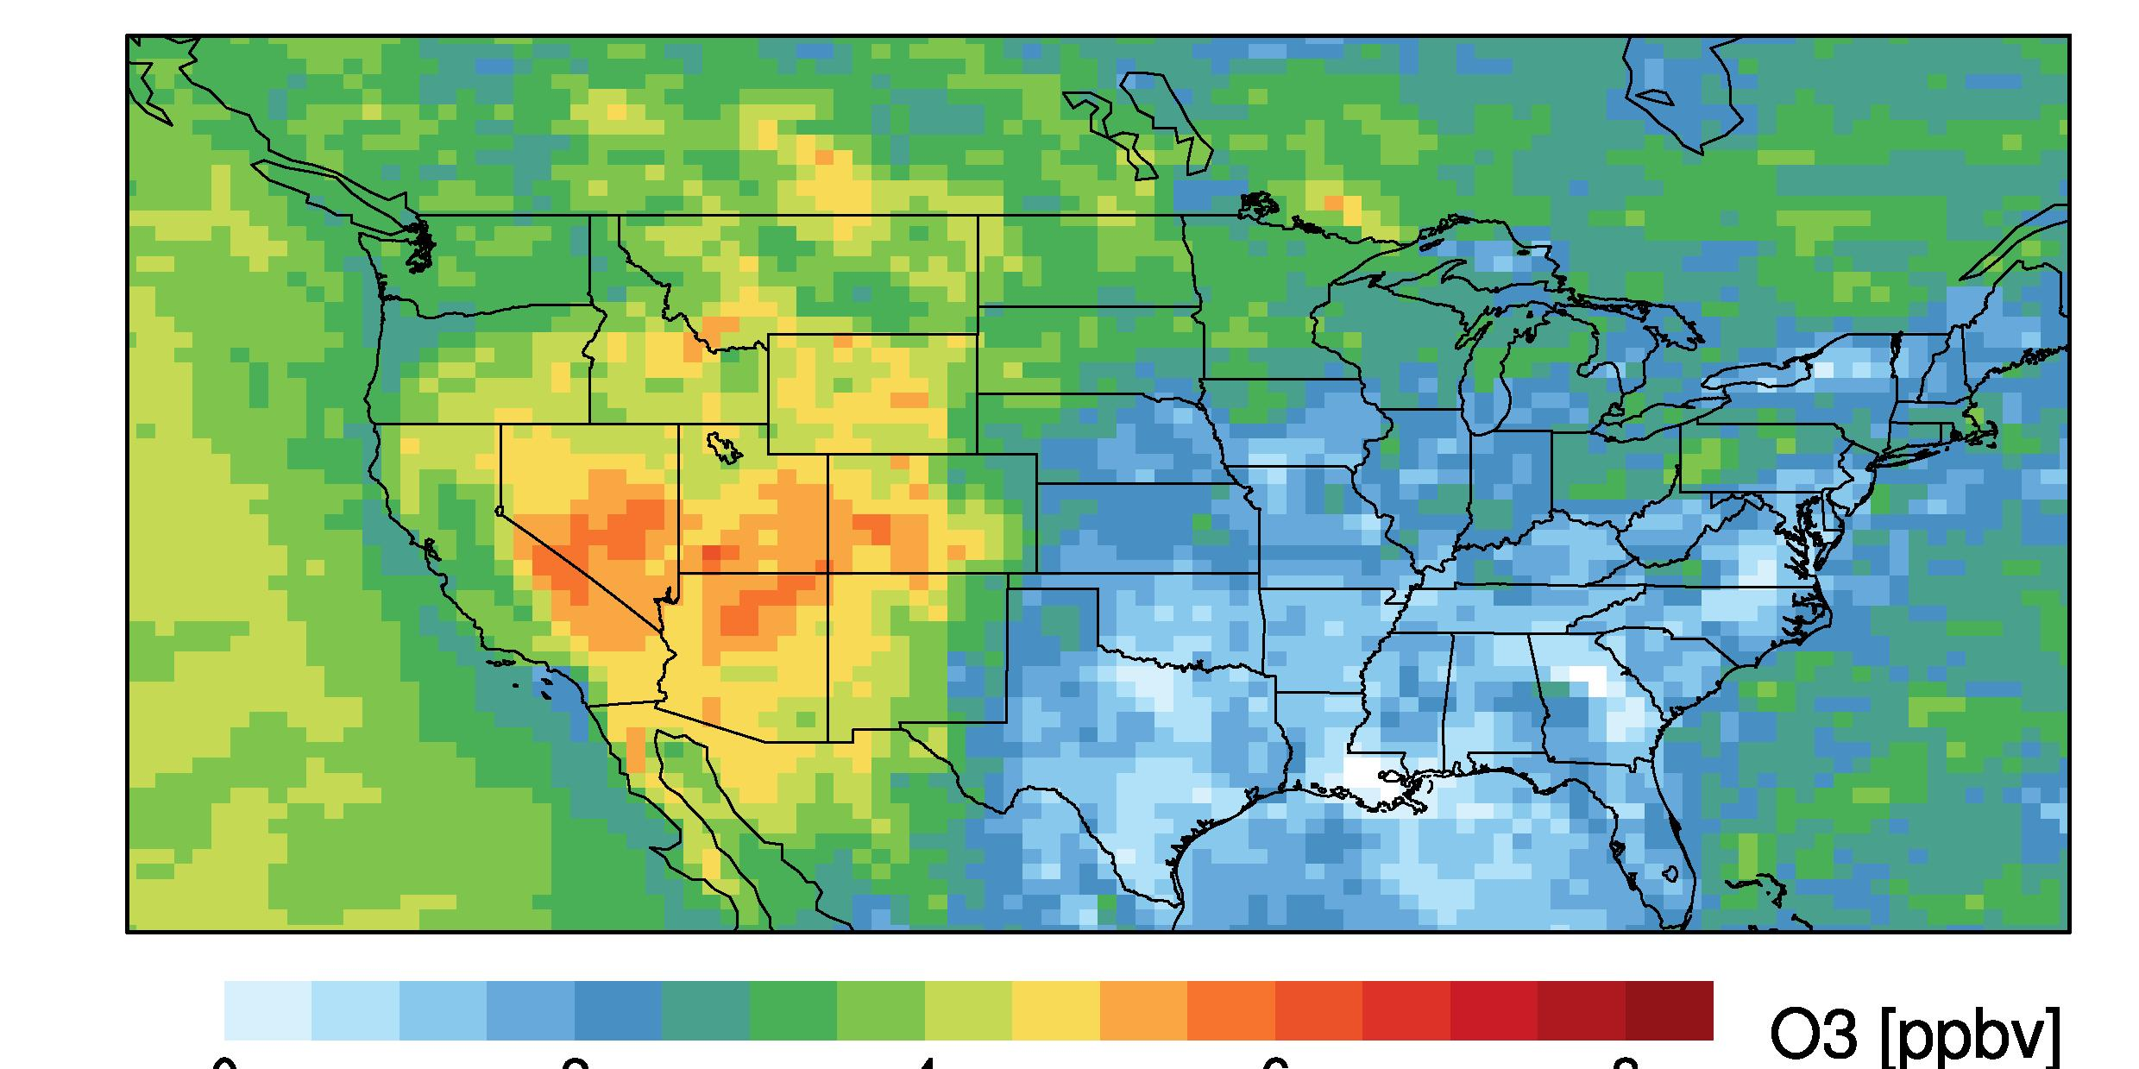
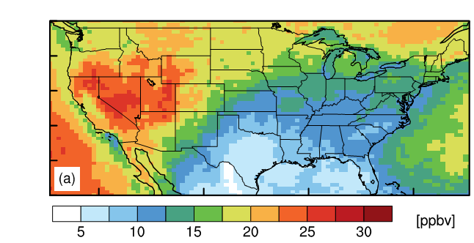
Estimates of Asian and stratospheric influence on
WUS surface ozone in spring
TOOL: GFDL AM3 chemistry-climate model [Donner et al., J. Clim. 2011]
~50x50 km² Jan-Jun 2010 – overlaps period of intensive field measurements (CalNex)
Nudged to GFS (“real”) winds – allows direct comparison with snapshot observations
Fully coupled chemistry in the stratosphere and troposphere within a climate model
Mean MDA8 O₃ in surface air
Asian: May-June 2010
Stratospheric (O3S): April-June 2010
O₃ (ppb)
O₃ (ppb)
0
2
4
6
8
Base Simulation – Zero Asian
anth. emissions
Tagged above e90 tropopause [Prather et al., 2011] + subjected to same loss processes as tropospheric O₃.
[Lin et al., JGR, 2012a]
[Lin et al., JGR, 2012b]
Do they influence high-O₃ events in populated regions?
Notes:
6

Slide 7
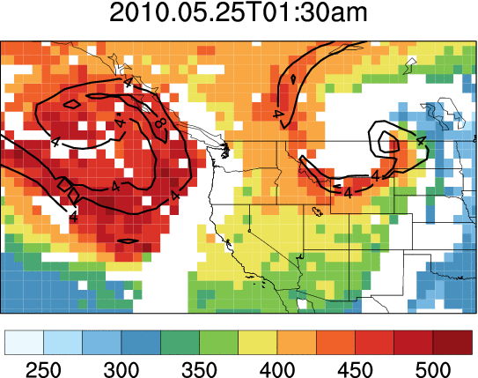
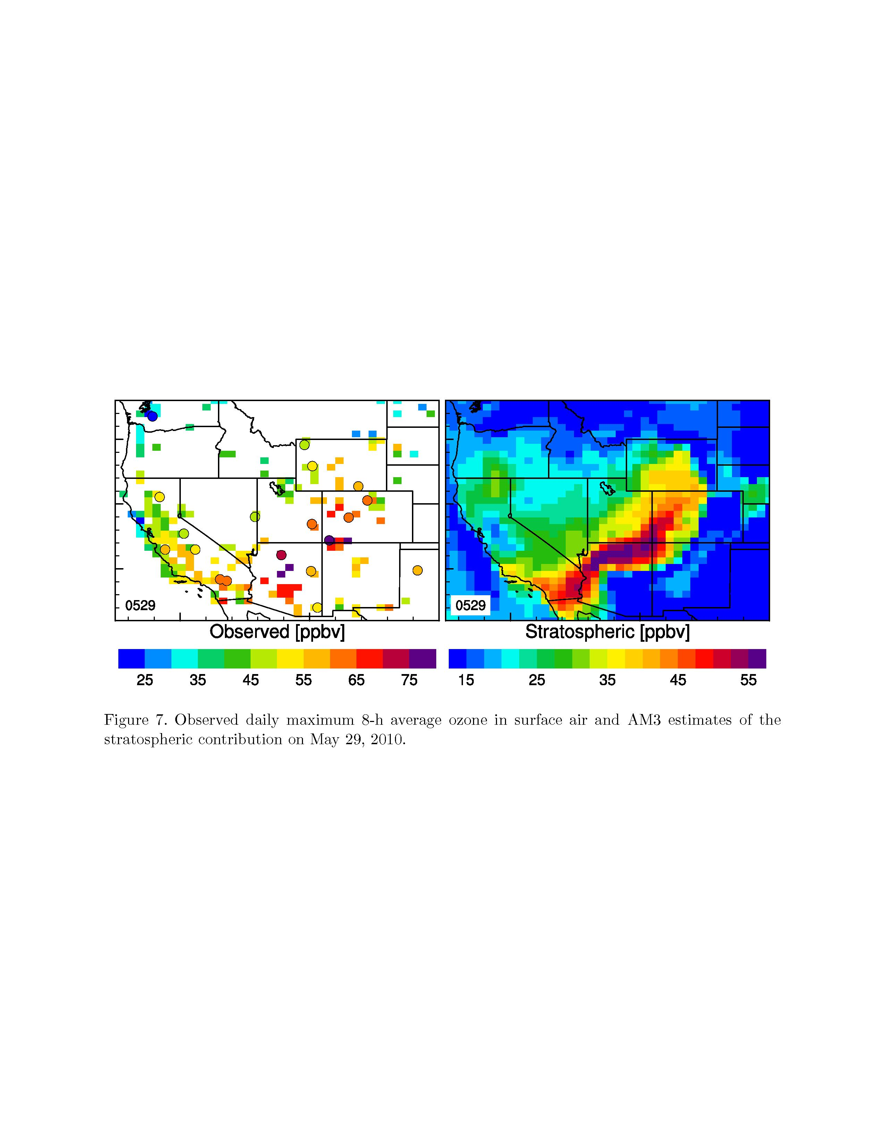
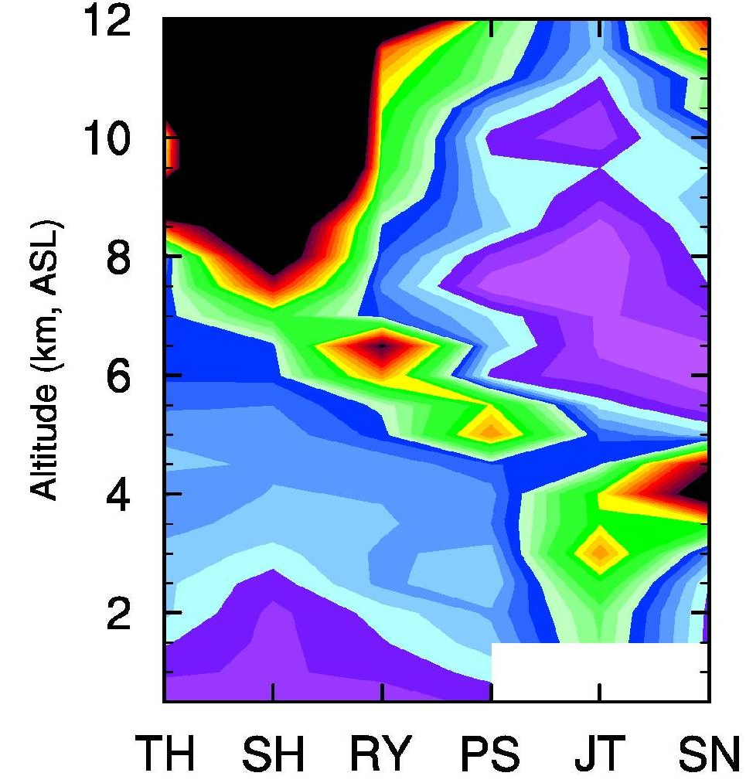
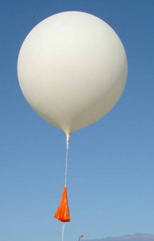
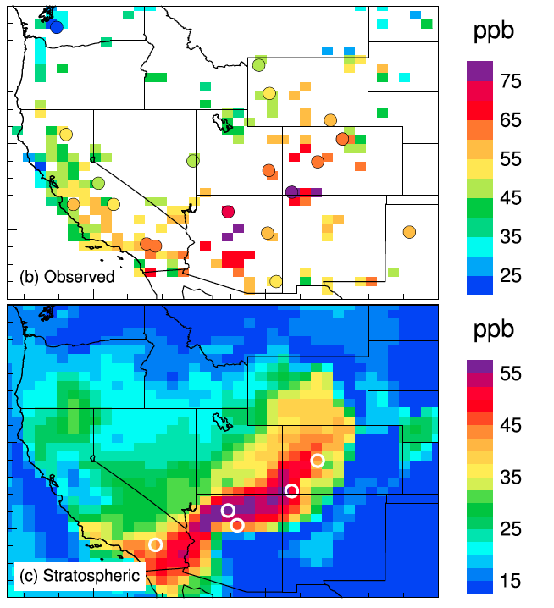
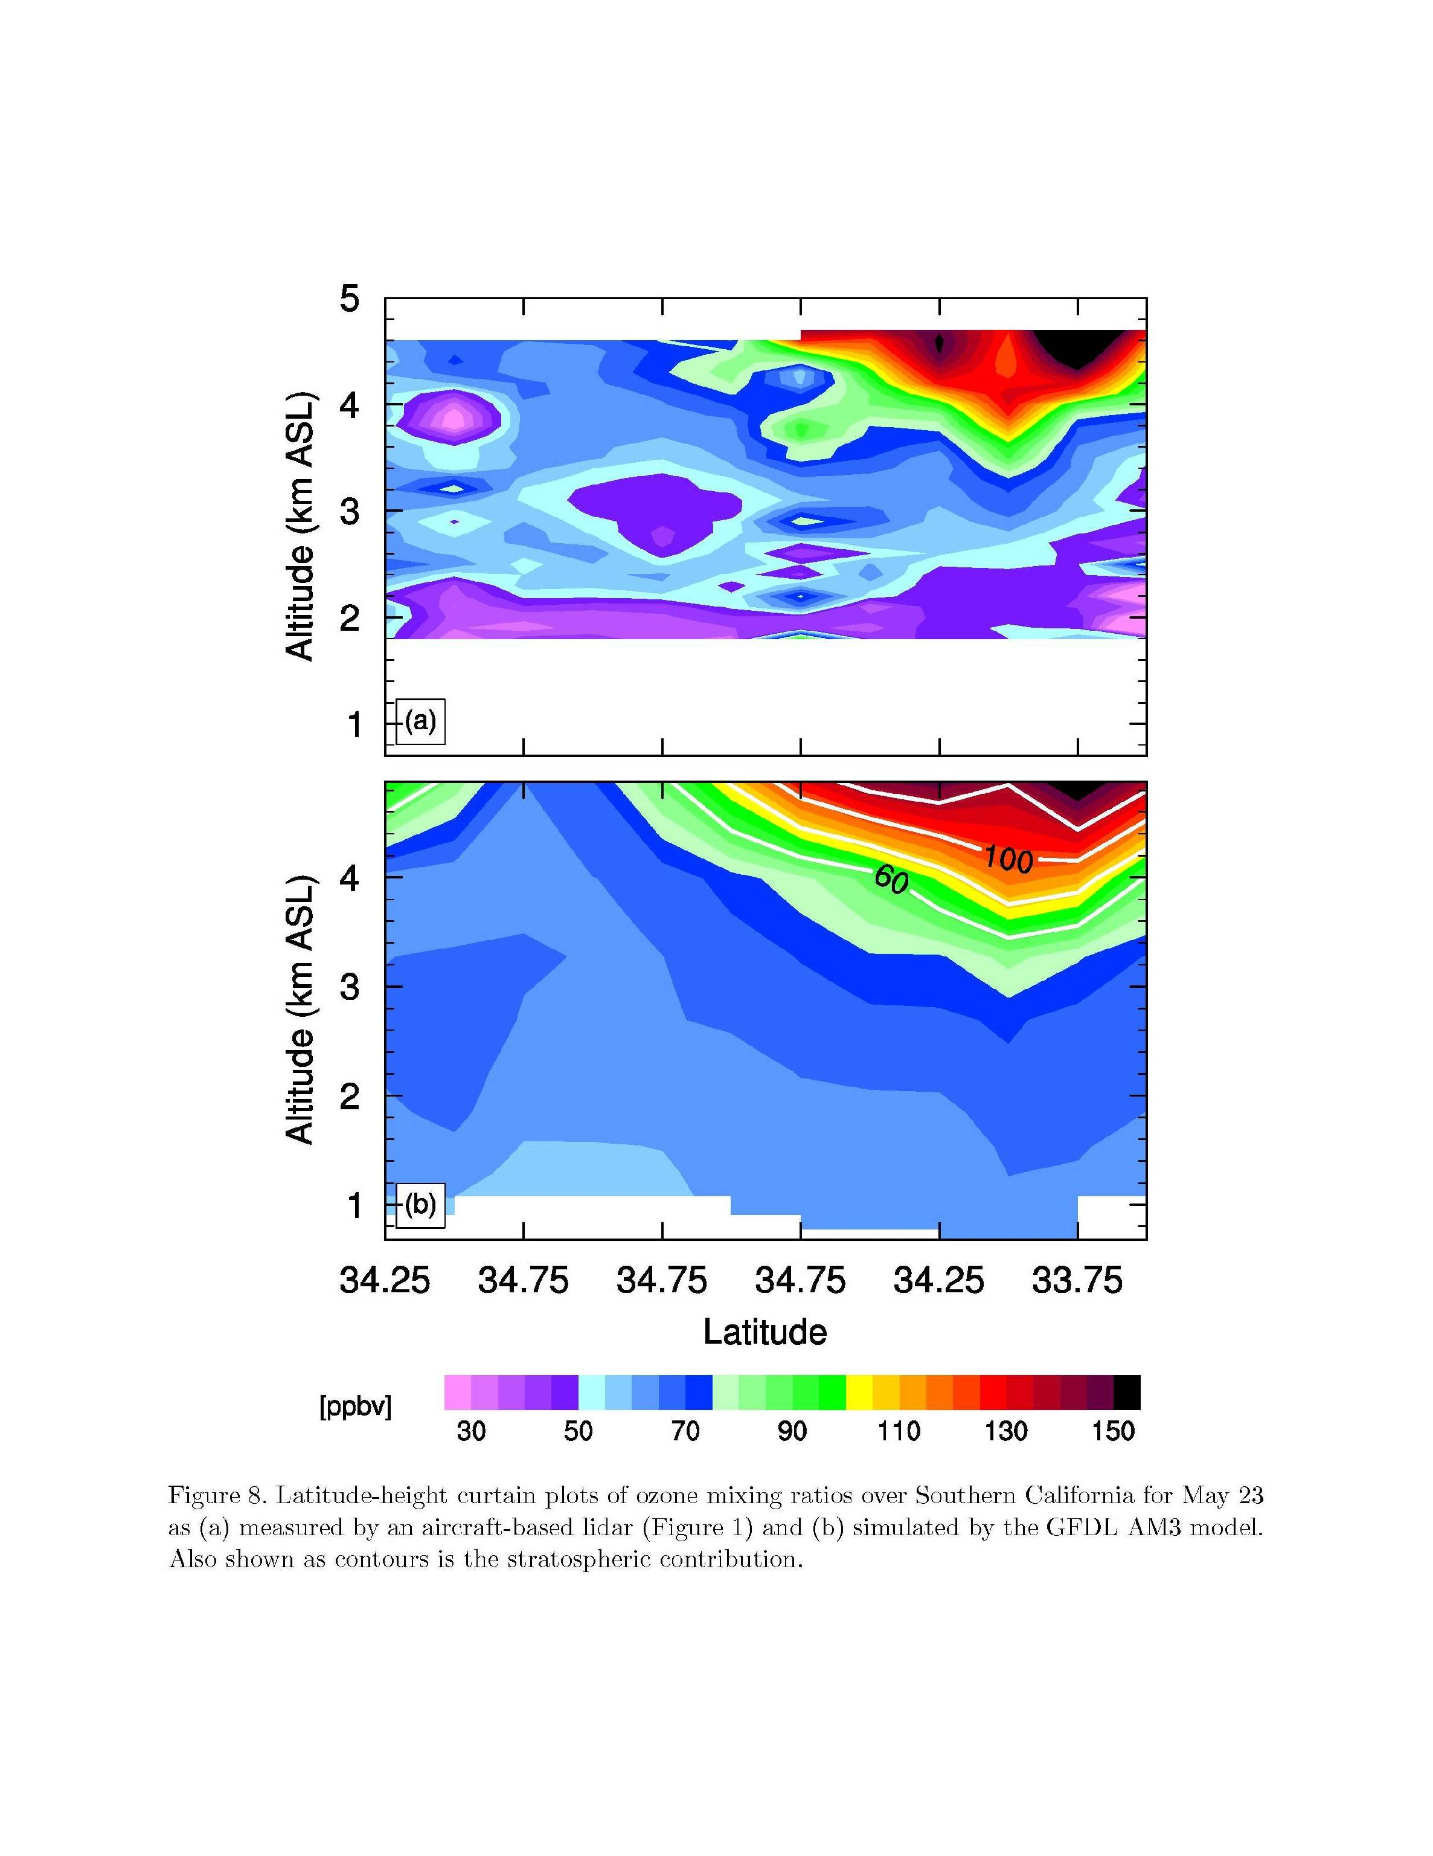
Stratosphere-to-troposphere (STT) O₃ transport influence on WUS high-O₃ events
Surface MDA8 O₃, May 29
AIRS, May 25-29
M. Lin et al., JGR, 2012b
Sonde O₃, May 28
Observed Total O₃
TH
SH
RY
300 hPa PV
PS
JT
SN
Altitude (km a.s.l.)
Total column O₃ [DU]
Model (AM3): stratospheric O₃
Would STT confound attainment of tighter
standards in WUS?
Are exceptional events accurately identified?
North → South
30
60
90
120
150
[ppb]
15 25 35 45 55
[ppb]
Ongoing work exploring development of space-based indicators
Notes:
mention that surface plots are published

Slide 8
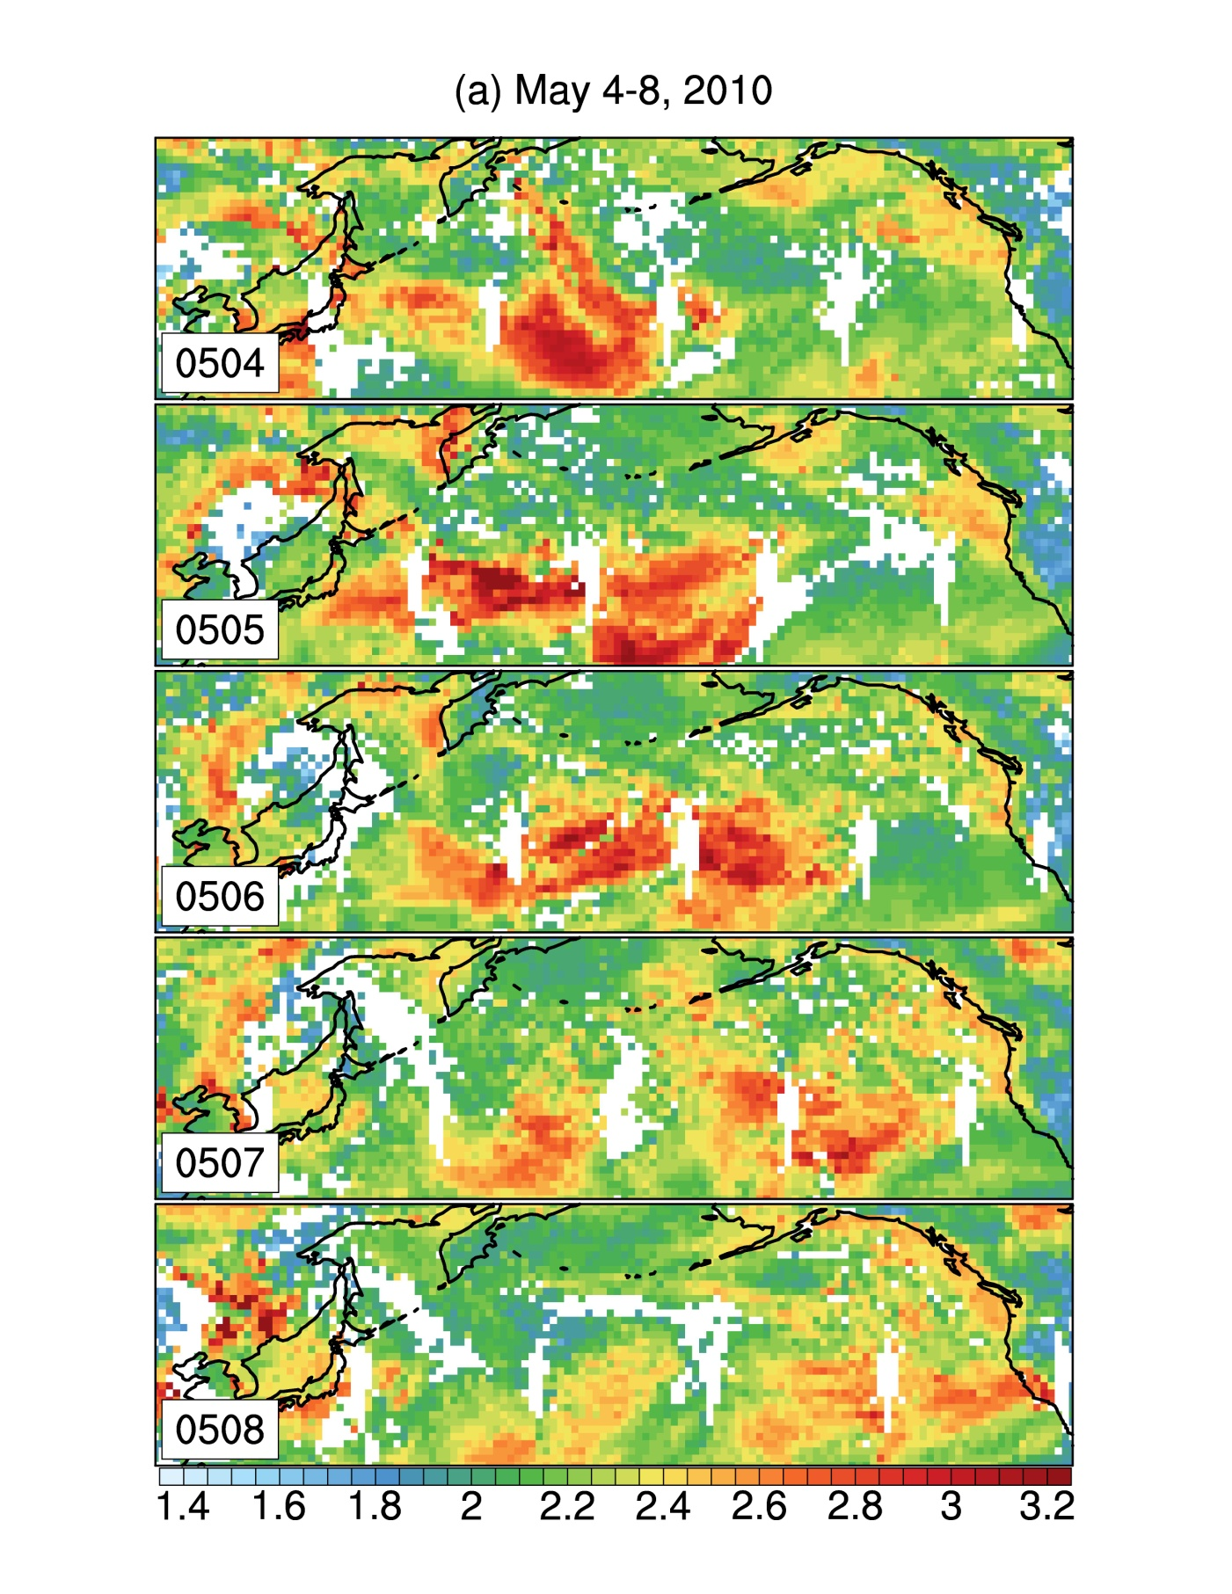
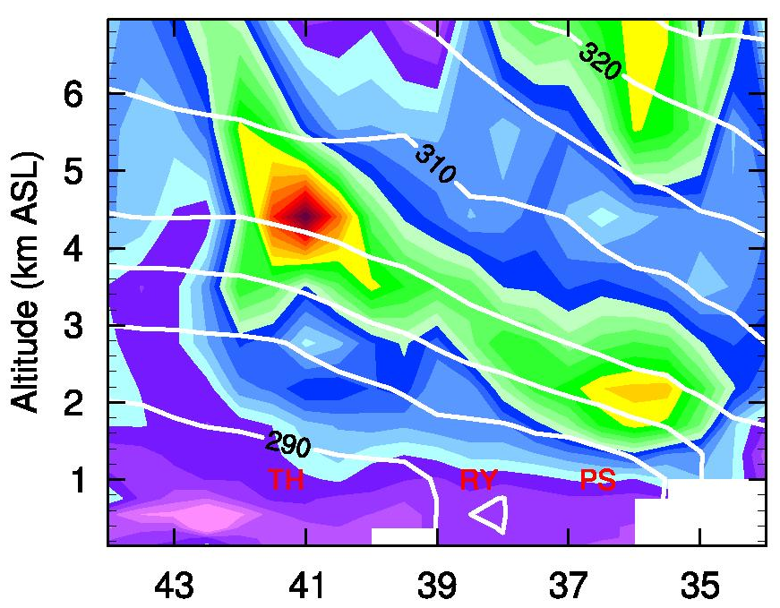

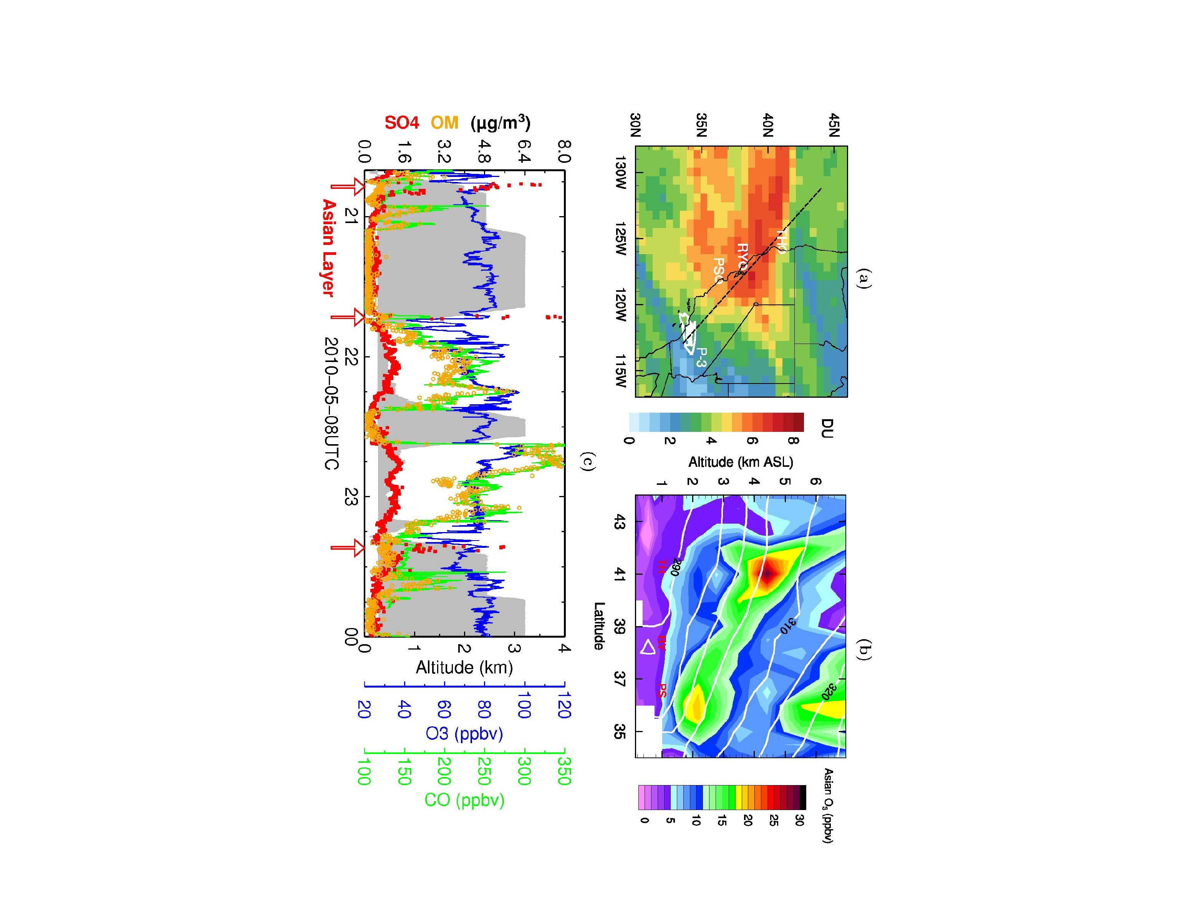
Asian O₃ pollution over S. CA: Trans-pacific transport + subsidence to lower troposphere
Satellite CO columns (AIRS)
GFDL AM3 Model Asian O₃
May 4
Altitude (km a.s.l.)
May 6
θ
[K]
Latitude (N→ S) along CA
[ppb]
May 8
0
10
20
30
Consistent with sonde and aircraft
[Lin et al., JGR, 2012a]
[10¹⁸ molecules cm⁻²]
→ We find these events sometimes contribute to ‘pushing’ O₃ in surface air above thresholds of 60 and 70 ppb [Lin et al., JGR, 2012a]

Slide 9
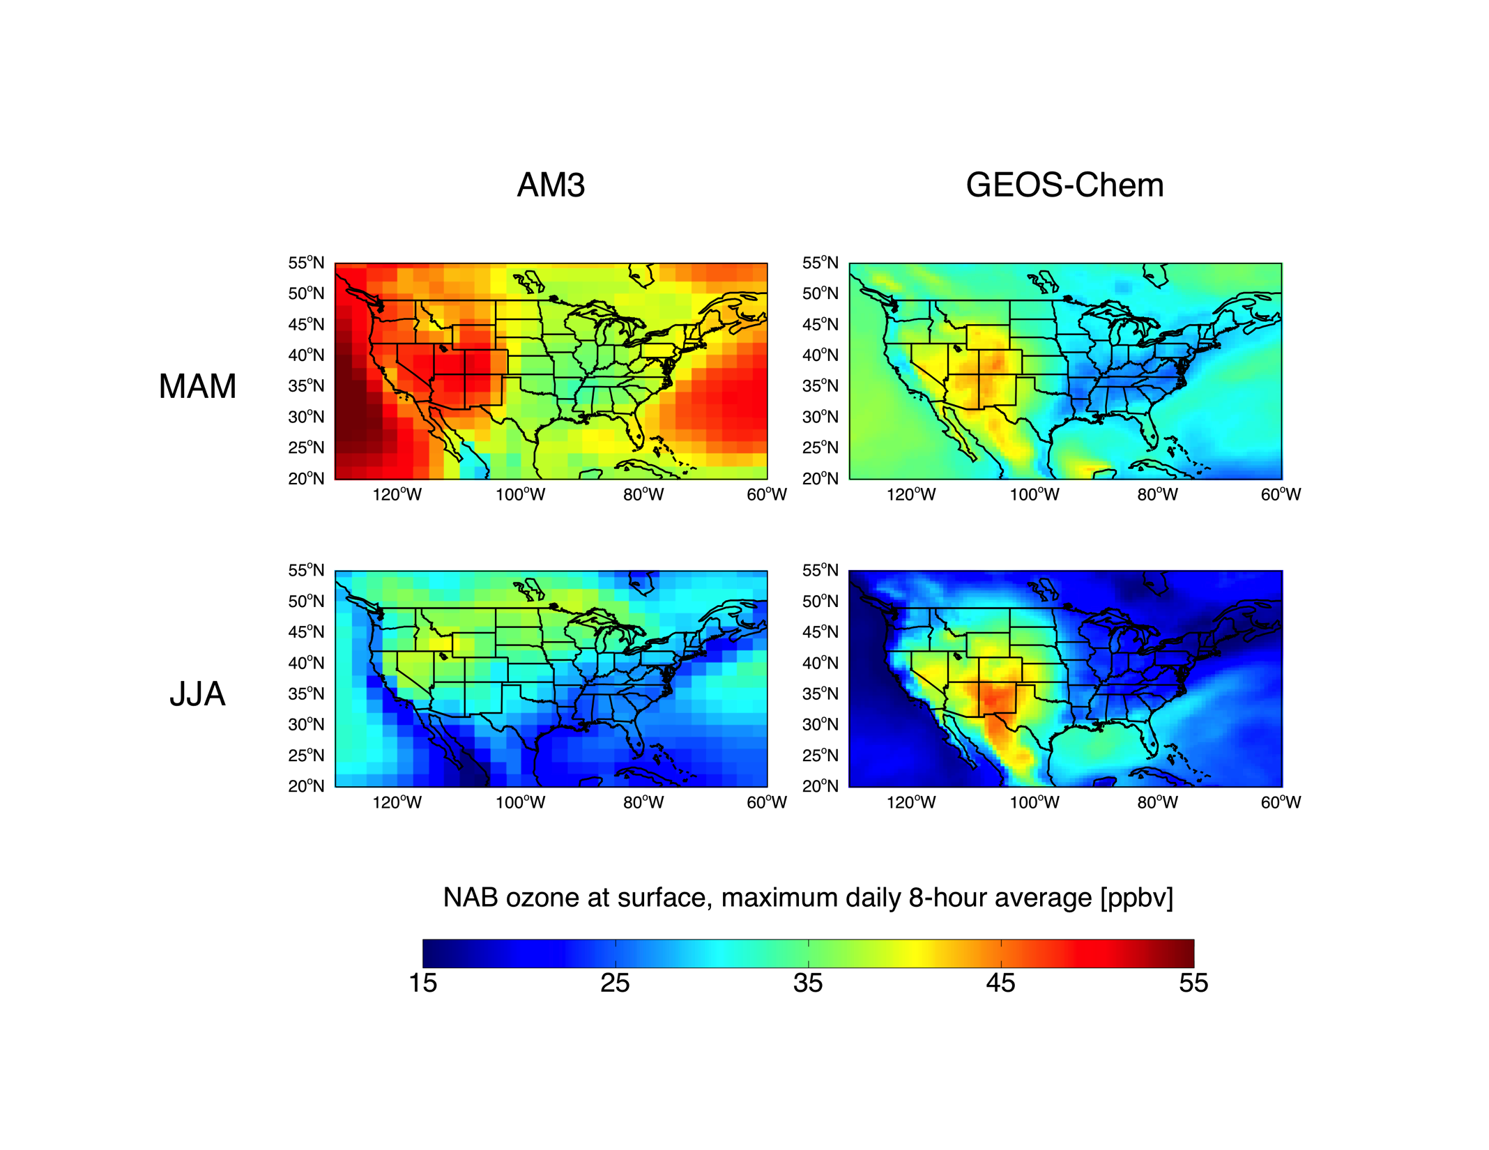
Models differ in estimates of North American background
(estimated by simulations with N. American anth. emissions set to zero)
Average Springtime (March-April-May) North American background
MDA8 O₃ in model surface layer
GFDL AM3 (~2°x2°)
GEOS-Chem (½°x⅔°)
J. Oberman
ppb
GFDL AM3: Generally more mixing of background O₃ to the surface?
Model differences provide an error estimate
Need careful, process-oriented evaluation with observations
Notes:
9

Slide 10
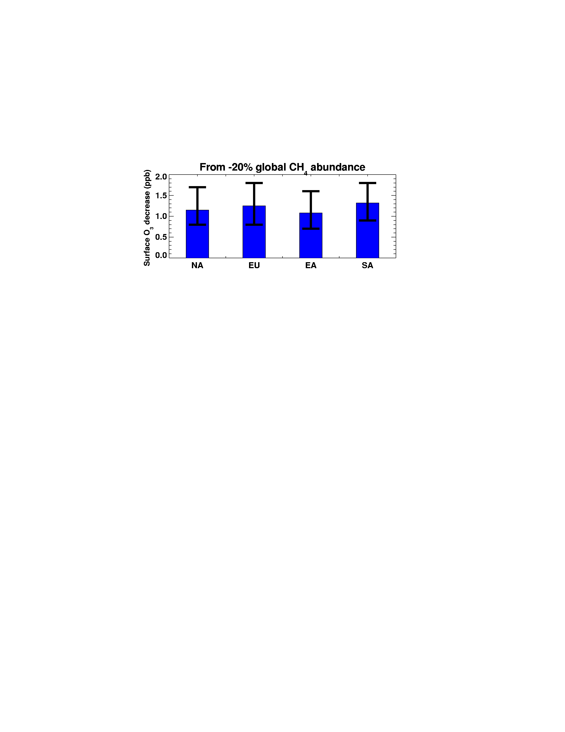
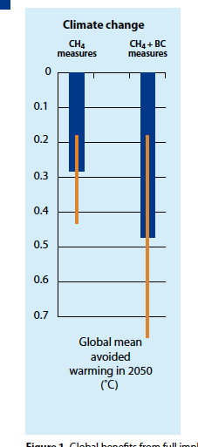
Air pollution-climate connection via methane
Benefits of ~25% decrease in global anthrop. methane emissions
OZONE AIR QUALITY
CLIMATE
Global mean
avoided warming in 2050 (°C)
[WMO/UNEP, 2011]
Range over
18 models
N. America Europe East Asia South Asia
[Fiore et al., JGR, 2009; TF HTAP, 2007, 2010; Wild et al., ACP, 2012]
Possible at cost-savings / low-cost [West & Fiore 2005; West et al.,2012]
$1.4 billion (agriculture, forestry, non-mortality health) within U.S. alone [West and Fiore, 2005]
7700-400,000 annual avoided cardiopulmonary
premature mortalities in the N. Hemisphere
uncertainty in concentration-response relationship only [Anenberg et al., ES&T, 2009]
Notes:
Monetized co-benefits of methane mitigation for
human health are estimated to be $13–17 per ton CO2eq

Slide 11
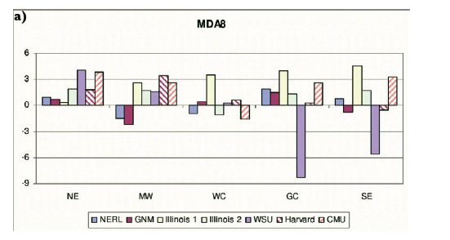
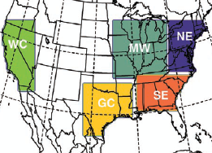
Models estimate ‘climate change penalty’ on surface O₃ over wide U.S. regions but often disagree in sign regionally
Modeled changes in summer mean of daily max 8-hour O₃ (ppb; future – present)
NE MW WC GC SE
Weaver et al., BAMS, 2009
Increases (2 to 8 ppb) in all models over large U.S. regions
Uncertain regional climate responses to global warming
Gap in analysis over much of mountainous West
How will background change? (e.g., frequency of fires, strat. intrusions)

Slide 12

Ozone smog in surface air: background and climate connections-
Summary and intersections with public policy
Background generally well below NAAQS thresholds in populated regions
High-altitude western U.S. is susceptible to natural events (stratospheric O₃ intrusions; wildfires) and international pollutant transport
→ formulation of standard (4th highest, 3 year average) allows some room
→ ‘Exceptional event’ and ‘international transport’ provisions in Clean Air Act but implementation needs clarification
→ Ongoing review (every 5 years) of science supporting O₃ NAAQS; related Congressional hearing June 12, 2013
http://science.house.gov/hearing/subcommittee-environment-background-check-achievability-new-ozone-standards
NASA Air Quality Applied Sciences Team (www.aqast.org):
Earth Science Serving Air Quality Management Needs
Methane controls: ‘win-win’ for near-term climate, air quality; also economic
Climate and Clean Air Coalition (http://www.unep.org/ccac/)
Climate warming expected to alter pollutant levels
→ increase O₃ in already polluted regions (‘climate penalty’)
→ alter natural sources (wildfires, stratospheric, biogenic emissions)
→ occur in context of future global and regional emission changes

Slide 14
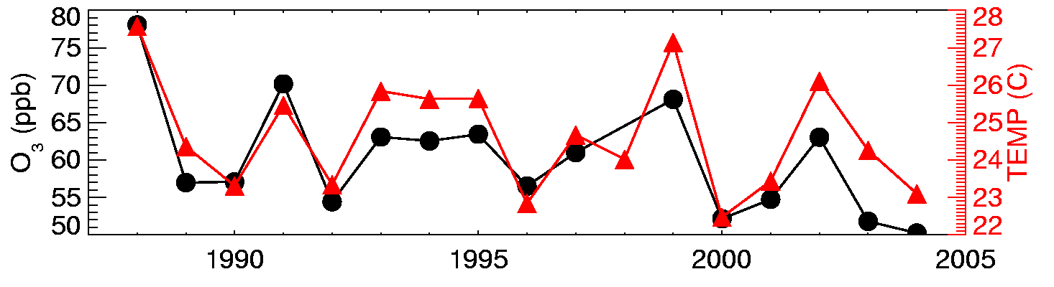
Strong correlations between surface temperature and O₃ measurements on daily to inter-annual time scales in polluted regions [e.g., Bloomer et al., 2009; Camalier et al., 2007; Cardelino and Chameides, 1990; Clark and Karl, 1982; Korsog and Wolff, 1991]
Observations at U.S. EPA CASTNet site Penn State, PA 41N, 78W, 378m
July mean MDA8 O₃ (ppb)
10am-5pm avg
What drives the observed O₃-Temperature correlation?
1. Meteorology (e.g., air stagnation)
2. Feedbacks (Emis, Chem, Dep)
T
Degree of mixing
OH
NO_{x}
VOCs
Deposition
H₂O
PAN
pollutant sources
Implies that changes in climate will influence air quality

Slide 15
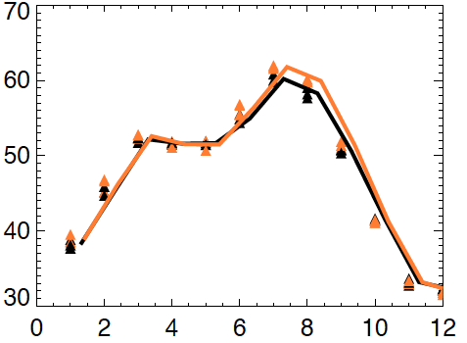
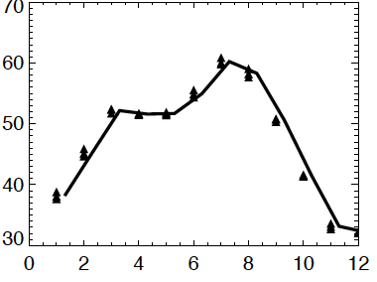
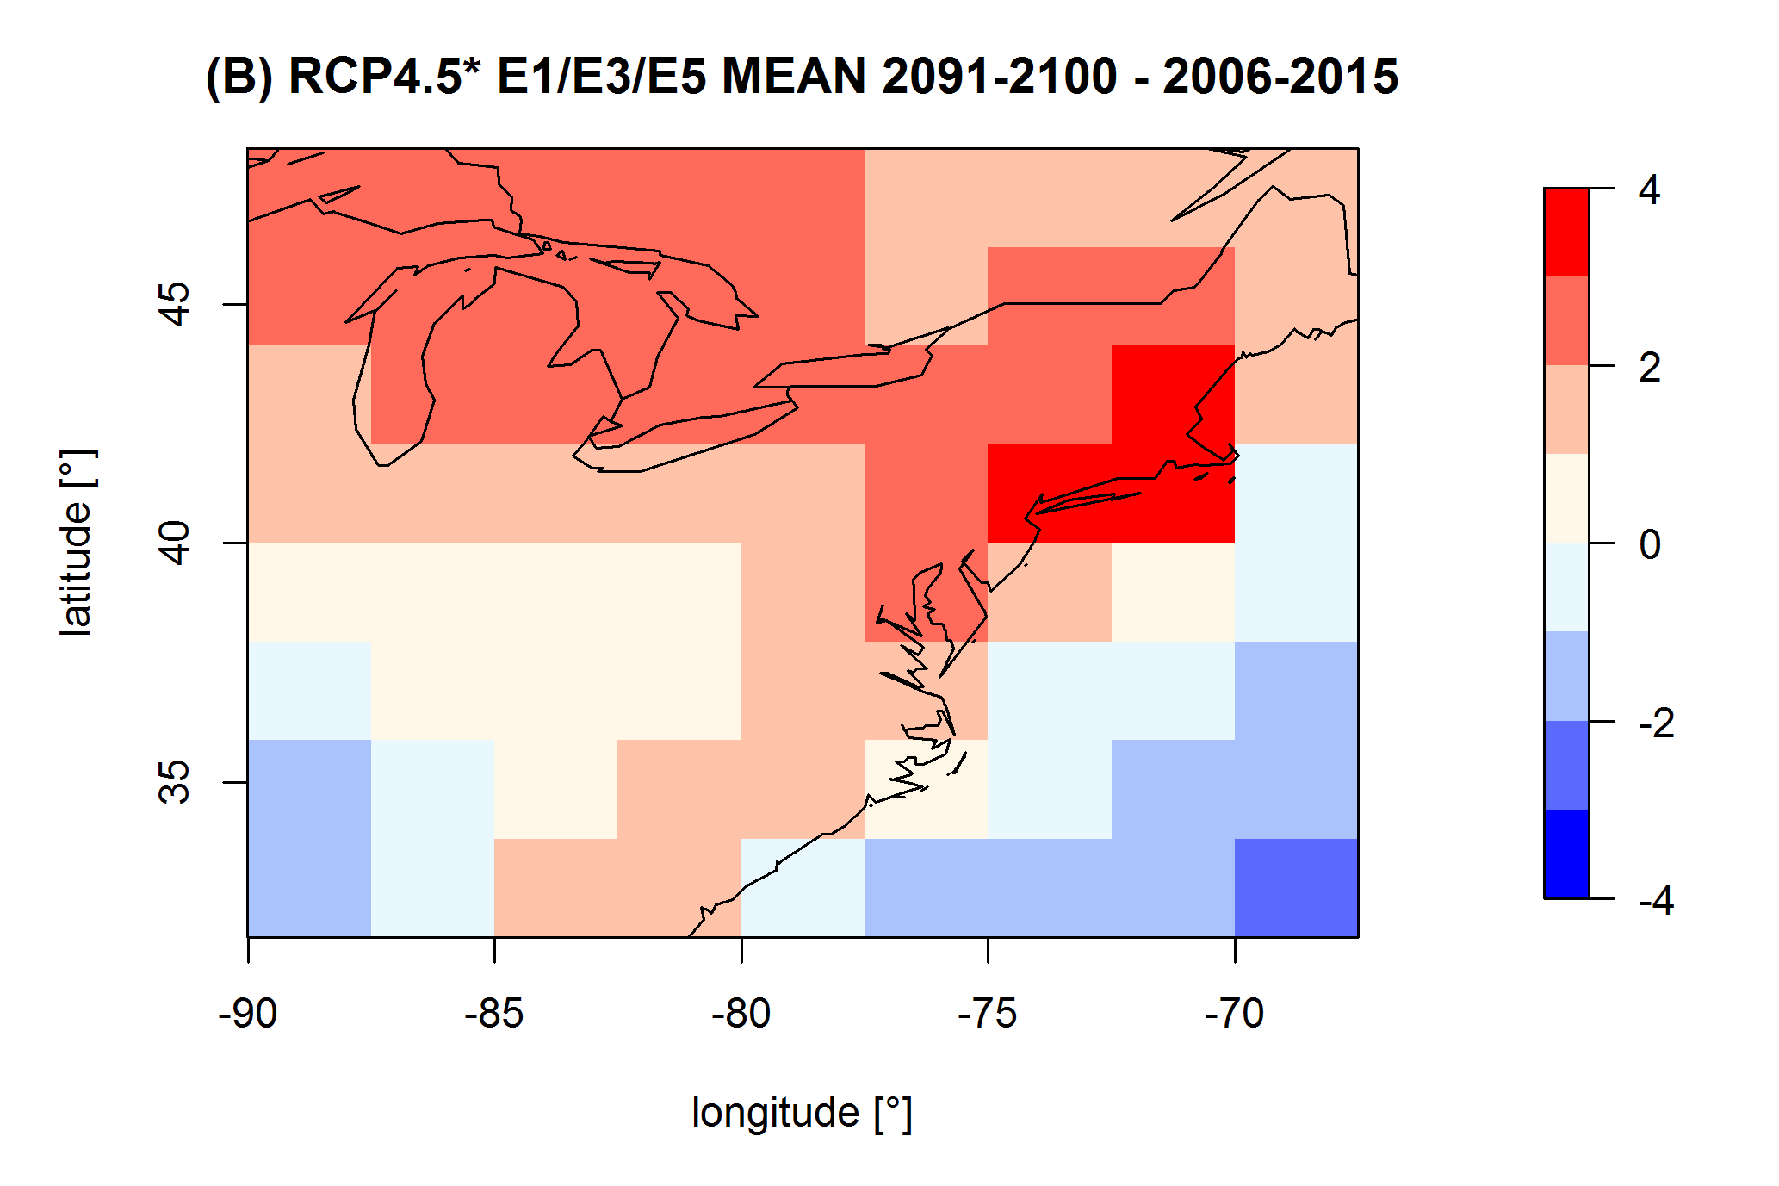
Regional climate change over the NE USA leads to higher summertime surface O₃ (“climate penalty” [Wu et al., JGR, 2008])
GFDL CM3 chemistry-climate model
Monthly mean surface O₃ over NE USA
(2091-2100) – (2006-2015)
RCP4.5_WMGG 3 ens. member mean:
RCP4.5_WMGG 2006-2015
RCP4.5_WMGG 2091-2100
3 ensemble
members for each scenario
Moderate climate change increases NE USA surface O₃ 1-4 ppb in JJA
(agreement in sign for this region across prior modeling studies)
How does NE USA O₃ respond to changing regional and global emissions?
O. Clifton/H. Rieder

Slide 16
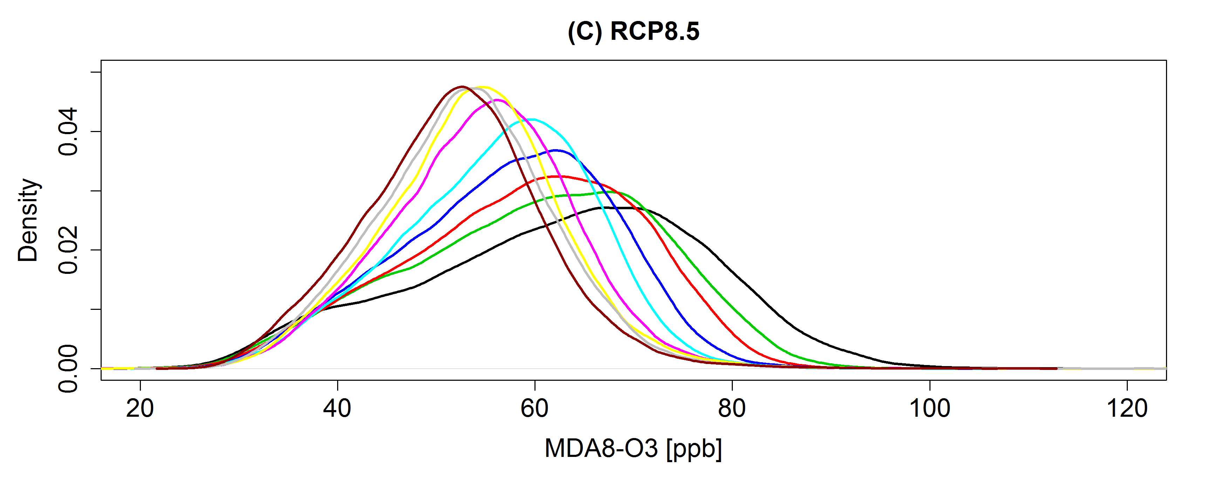
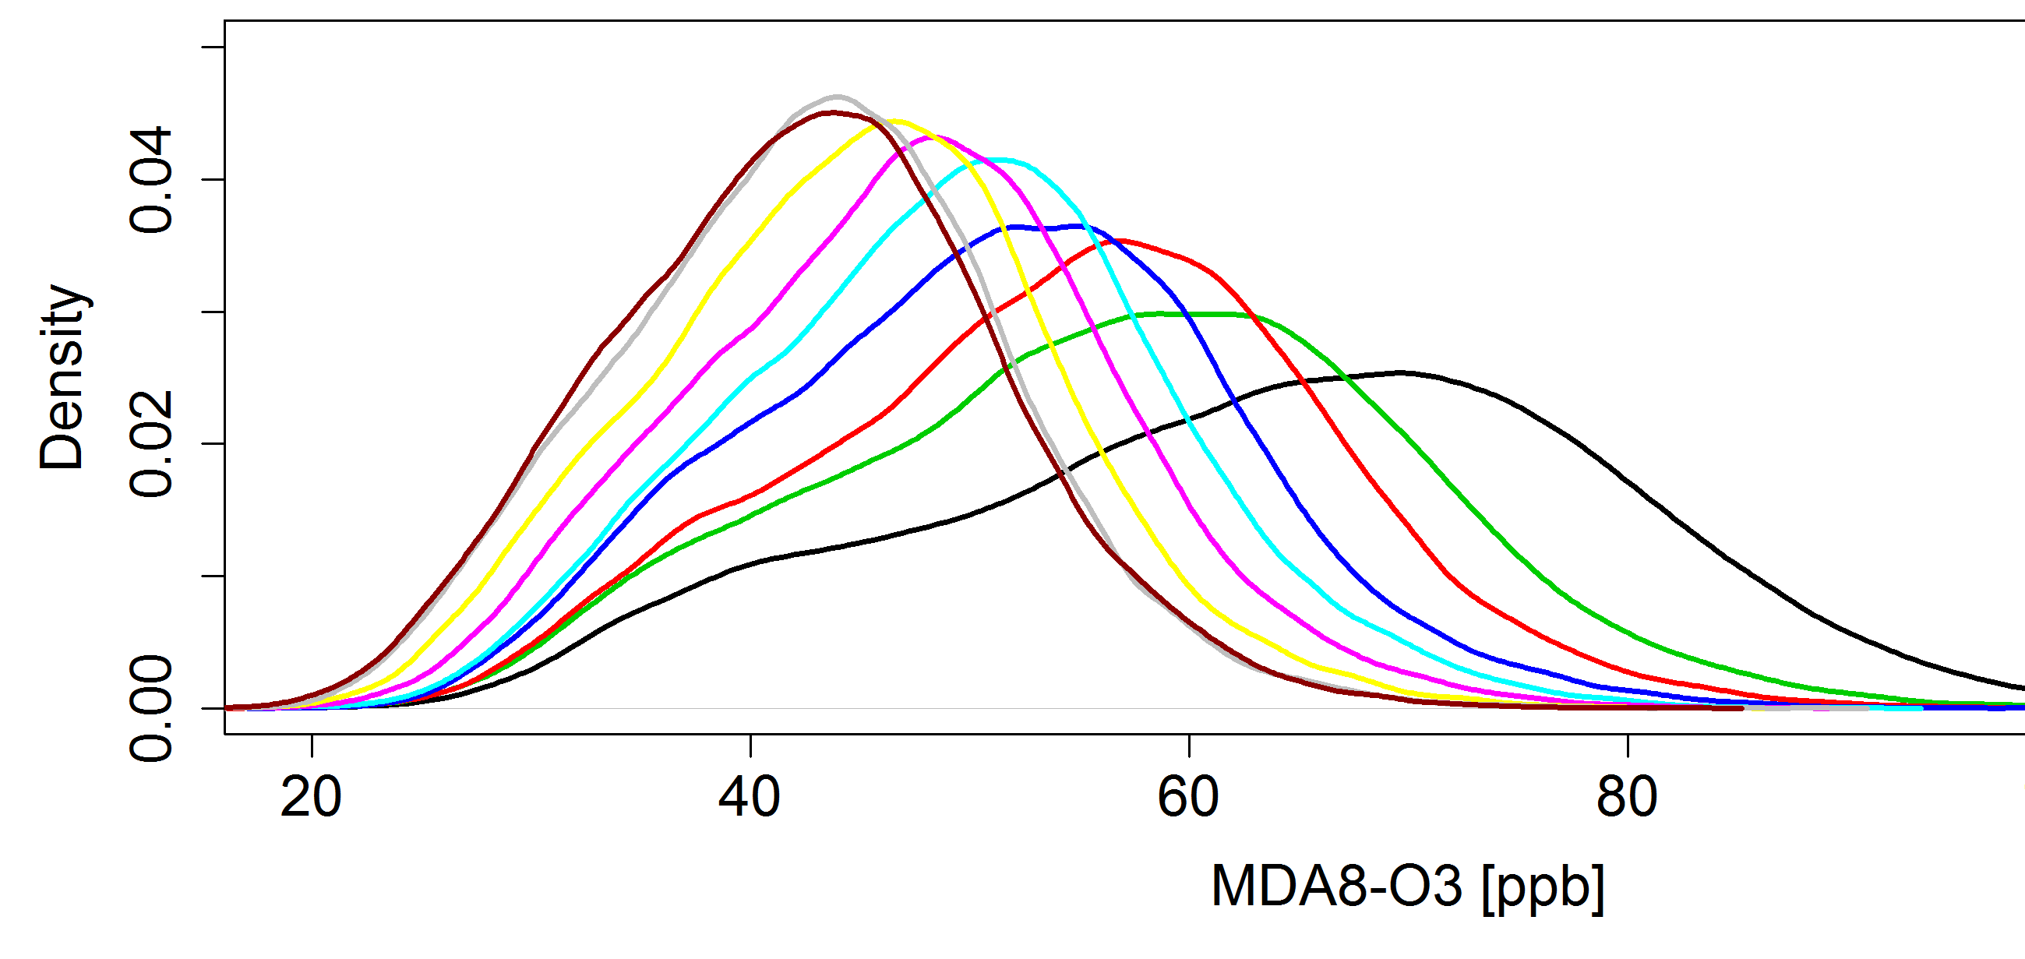
Extremes: The highest summertime surface O₃ events over NE USA decrease strongly under NO_{x} controls
2005 to 2100 % change
Time
RCP8.5
NE USA
NO_{x}
Global
NO_{x}
CH₄
RCP8.5
RCP4.5
2006-2015
2016-2025
2026-2035
2036-2045
2046-2055
2056-2065
2066-2075
2076-2085
2086-2095
◆
◆
◆
◆
◆
◆
◆
◆
◆
RCP4.5
Time
RCP8.5 vs. RCP4.5: Rising CH₄ increases surface O_{3,} at least partially offsetting gains otherwise attained via regional NO_{x} controls
H. Rieder

Slide 17
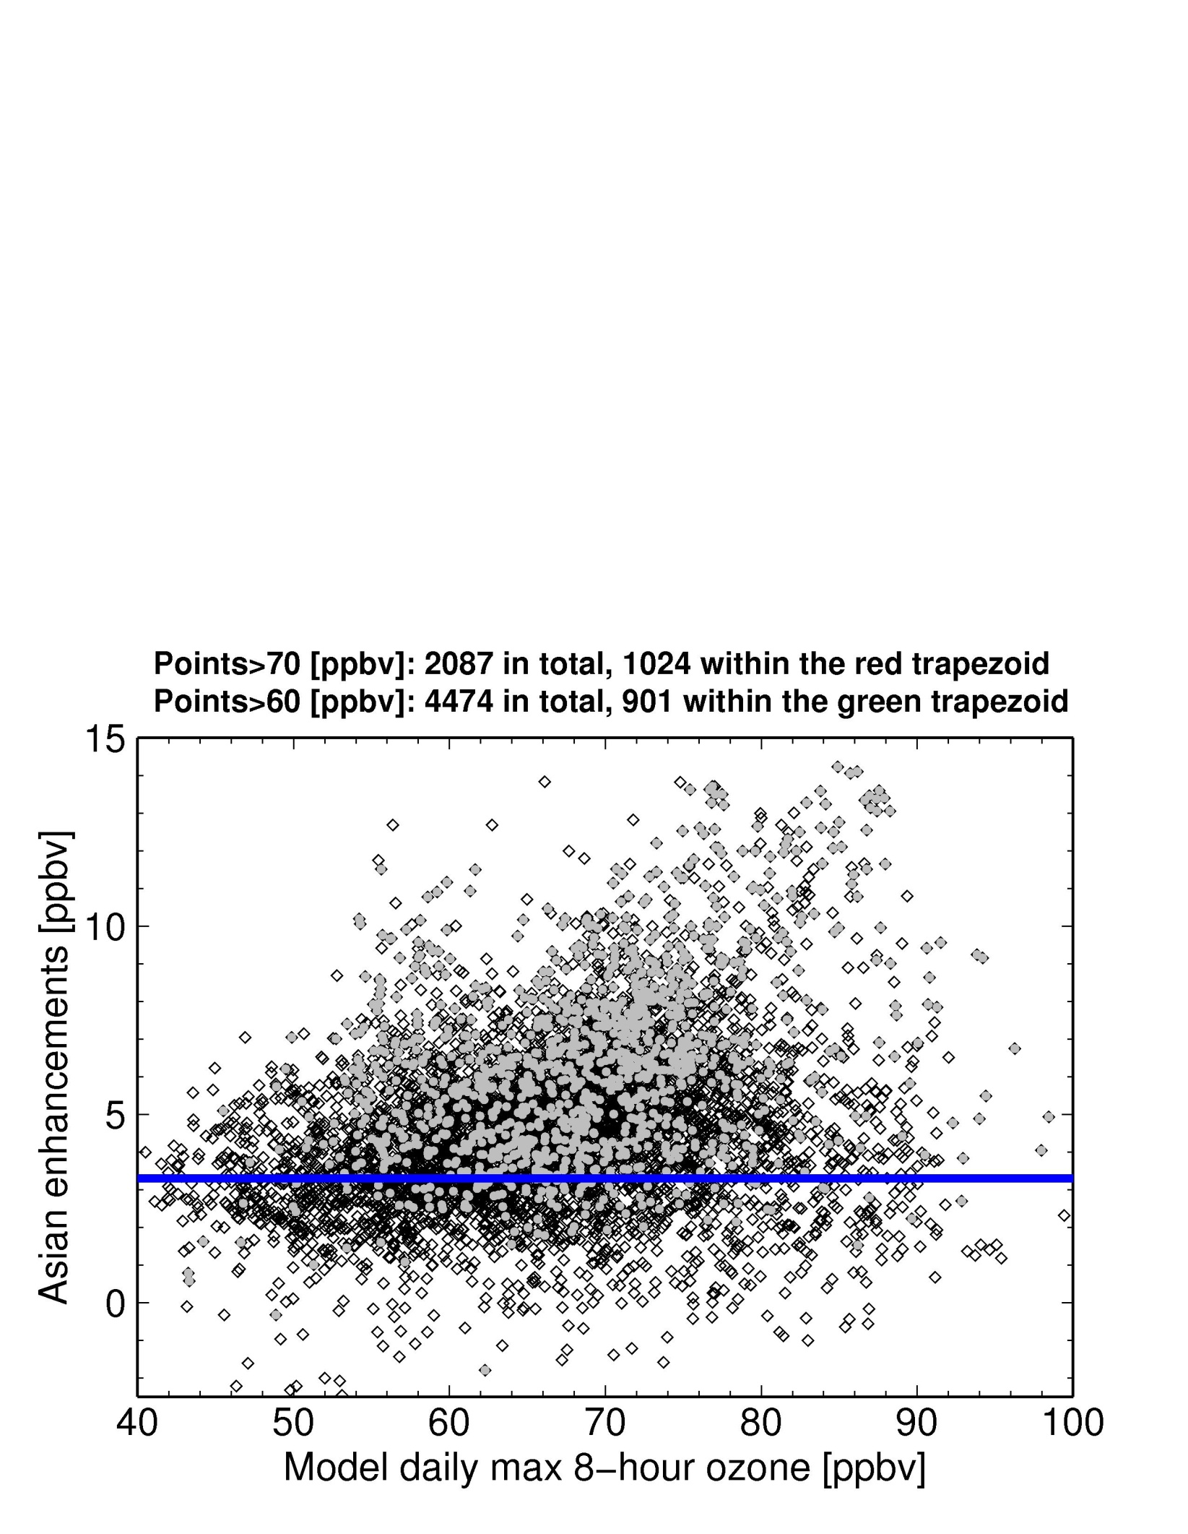

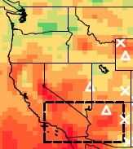
Asian pollution contributes to high-O₃ events over S. CA
in the GFDL AM3 model (~50 km² resolution)
~50% of MDA8 O₃ > 70 ppbv would not have occurred without Asian O₃
25th percentile
Asian emissions contribute ≤ 20% of total O₃ (local influence dominates)
Highest Asian enhancements for total ozone in the 70-90 ppbv range
Lin et al., 2012a, JGR –AGU Editors’ Highlight, Science Shot, Nature News
Notes:
Model bias does not have a direct relationship with Asian enhancements
for all land grids within the rectangle indicated in Figure 9a.
The blue line represents the 25th percentile value of Asian
enhancements. Points falling within the green and red trapezoids
denote values in excess of 60 and 70 ppbv, respectively,
that would not have occurred in the absence of
Asian emissions in the mode
17

Slide 18
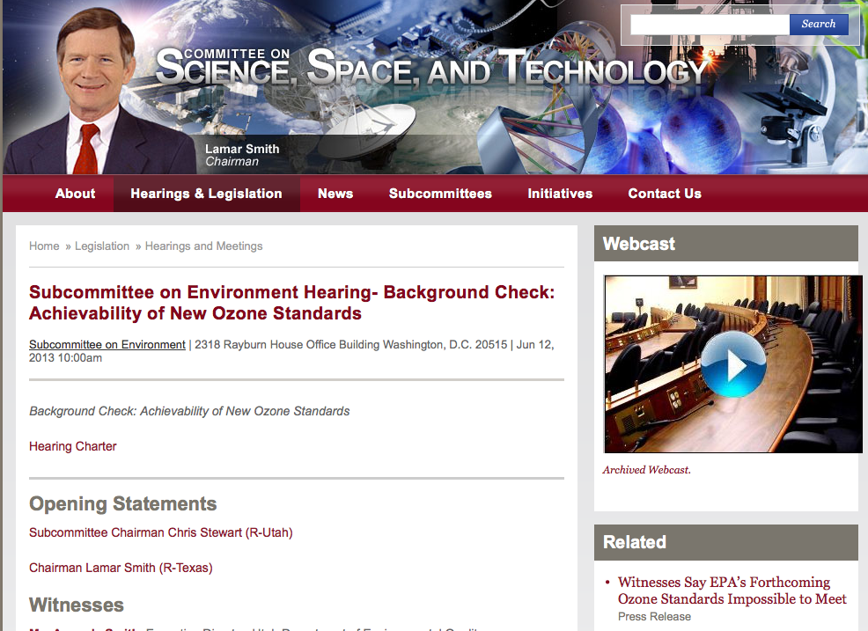
http://science.house.gov/hearing/subcommittee-environment-background-check-achievability-new-ozone-standards

Slide 19
Clean Air Act includes provisions to allow states to be exempted from pollution influences beyond their control
Section 179B covers international pollutant transport:
“that the implementation plan…would be adequate to attain and maintain the [NAAQS]…but for emissions emanating outside the US.”
Section 319 (b)(3)(B) and 107(d)(3): Exceptional Events: “avoid…designating an area as nonattainment…if a state adequately demonstrates that an exceptional event has caused an exceedance or violation of a NAAQS. EPA is also requiring States to take reasoable meausres to mitigate the impacts of an exceptional event”
c/o Michael Ling, US EPA, from
WESTAR presentation October 2012
http://www.epa.gov/glo/SIPToolkit/documents/20070322_72fr_13560-13581_exceptional_events_data.pdf
→ Requires accurate understanding of transported background events

Slide 20
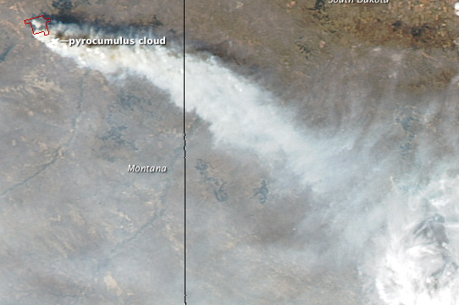
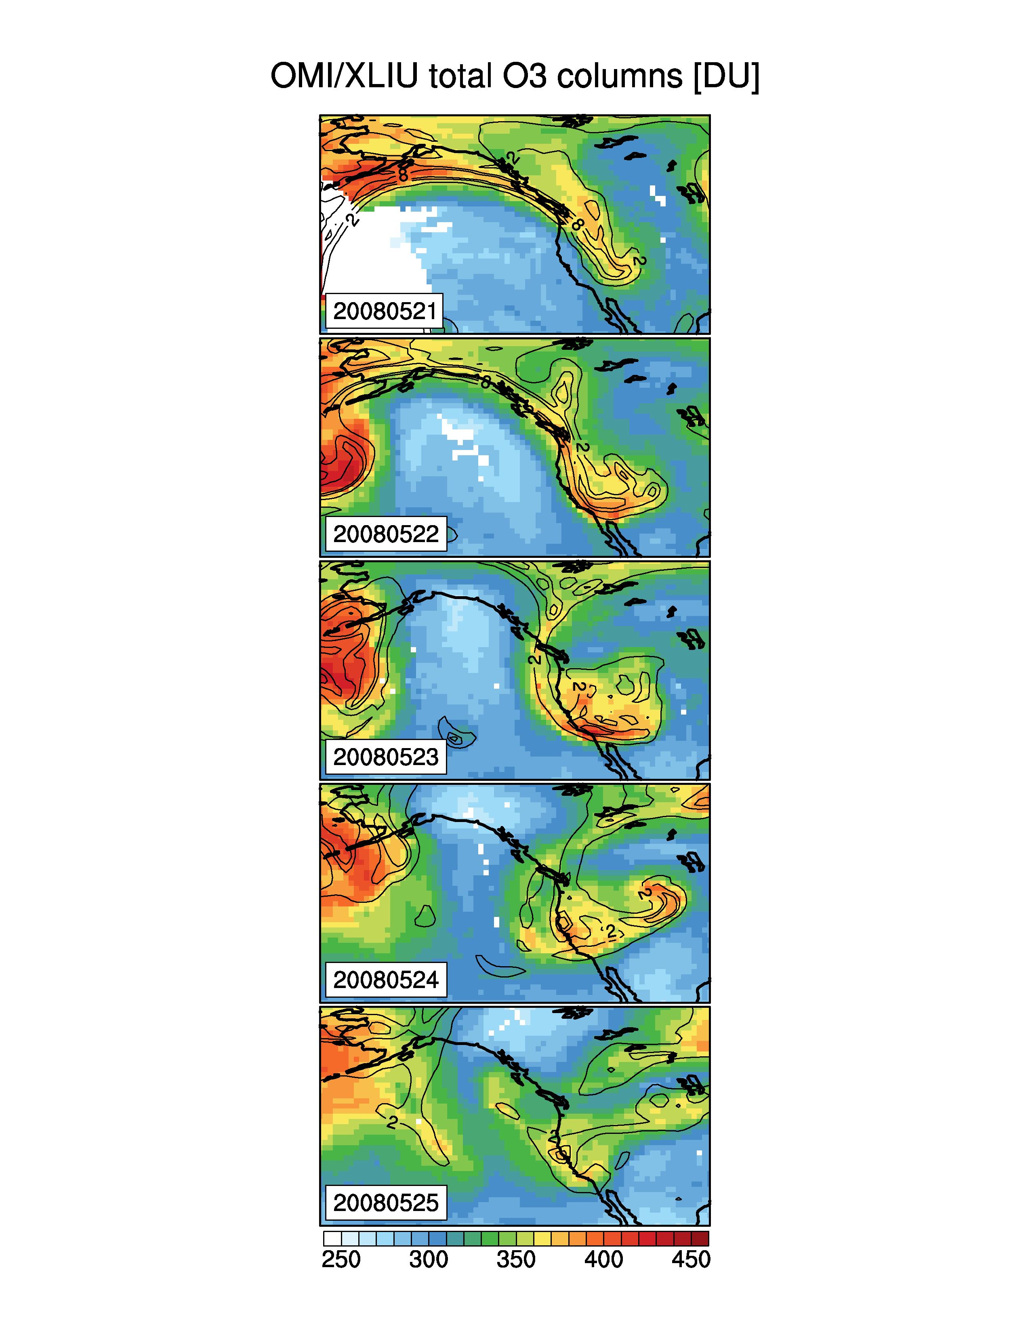
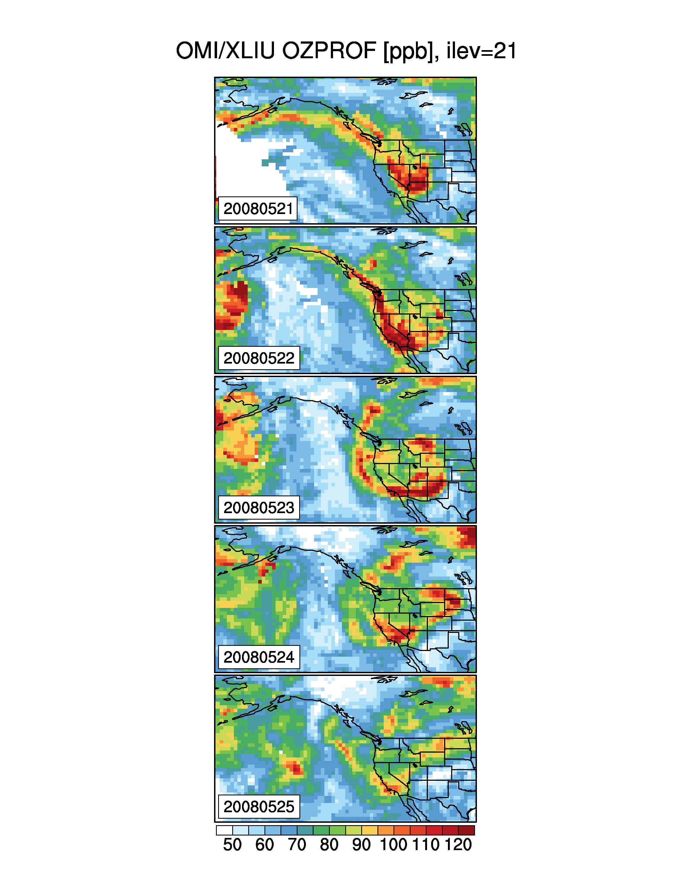
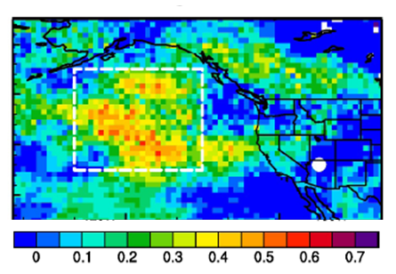
Satellite products indicate potential for contributions from transported “background”
Fires: MODIS
9/15/12
Stratospheric intrusions: OMI
9/15/12
Total Column O₃
S.Dakota
Products from X. Liu, Harvard
Dugan Fire
Montana
300 hPa PV
NASA image courtesy Jeff Schmaltz, LANCE MODIS Rapid Response Team at NASA GSFC.
[DU]
http://earthobservatory.nasa.gov/
NaturalHazards/view.php?id=79221
~550-350 hPa O₃
Intercontinental transport: AIRS
A. Fiore (CU/LDEO)
M. Lin (Princeton)
[ppbv]
Indicate potential downwind influence
Public health alerts
Identify exceptional events
Quantitative estimates require models
correlation coefficient (r)
Asian pollution forecasting with
AIRS CO columns (Lin et al., 2012a)
Notes:
GRC; time lag 2 days

Slide 21
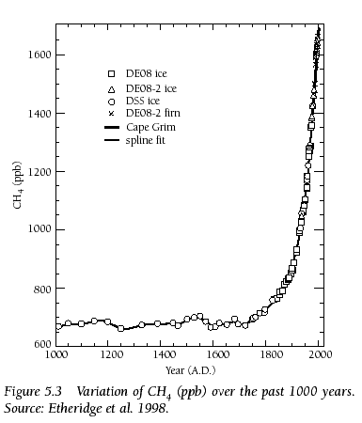
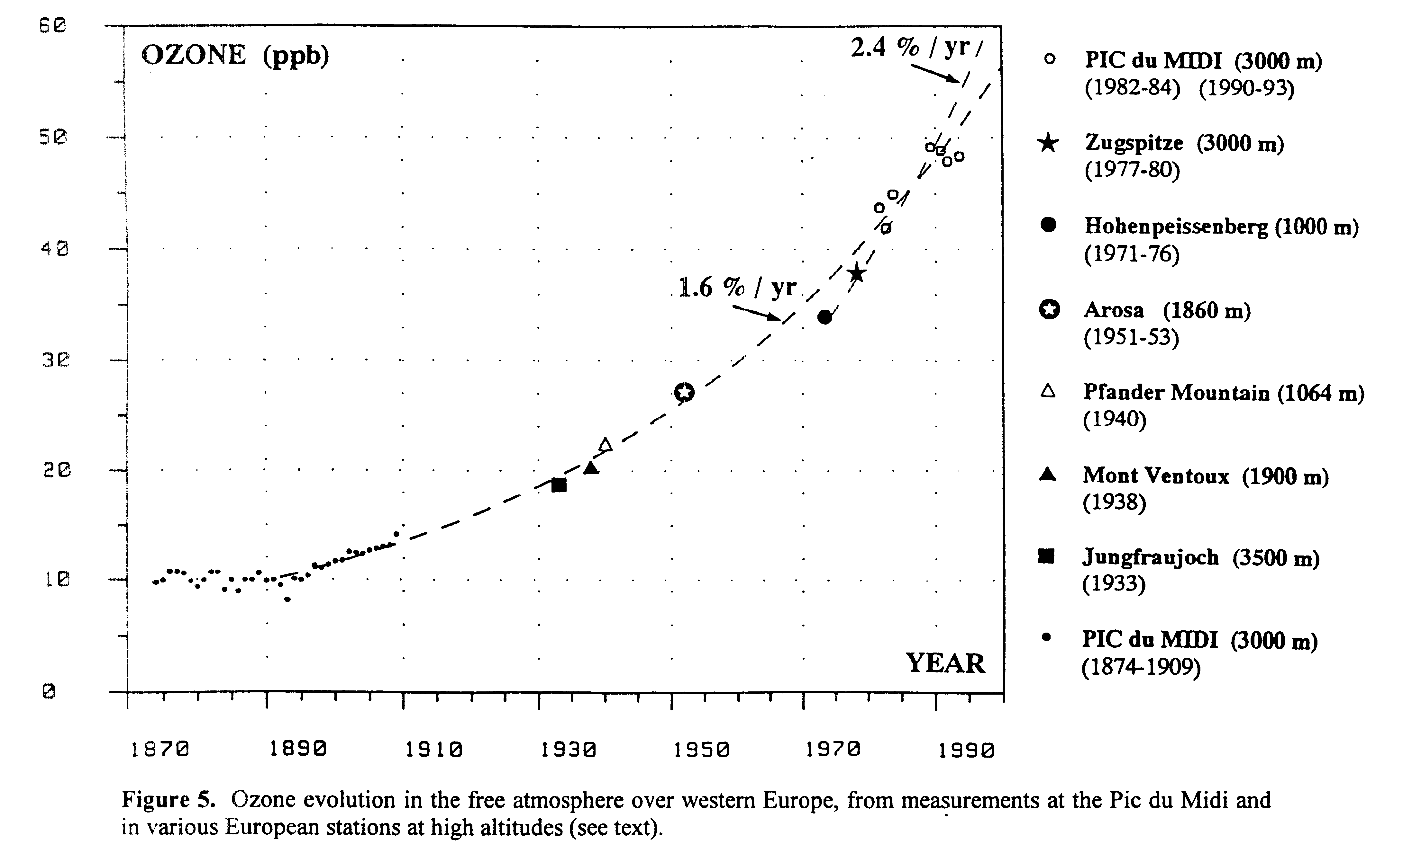
Historical increase in atmospheric methane and ozone
(#2 and #3 greenhouse gases after carbon dioxide [IPCC, 2007])
CH₄ Abundance (ppb) past 1000 years
[Etheridge et al., 1998]
Ozone at European mountain sites 1870-1990 [Marenco et al., 1994]
1600
1400
1200
1000
800
1000
1500
2000
Year
Preindustrial to present-day radiative forcing [Forster et al., (IPCC) 2007]:
+0.48 Wm⁻² from CH₄ +0.35 Wm⁻² from O₃

Slide 22
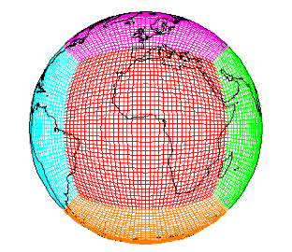
How will surface O₃ distributions evolve with future changes in emissions and climate?
Tool: GFDL CM3 chemistry-climate model
~2°x2°; 48 levels
Over 6000 years of climate simulations that include chemistry (air quality)
Options for nudging to re-analysis + global high-res ~50km² [Lin et al., JGR, 2012ab]
Donner et al., J. Climate, 2011;
Golaz et al., J. Climate, 2011;
John et al., ACP, 2012
Turner et al., ACP, 2012
Naik et al., submitted
Horowitz et al., in prep
Climate / Emission Scenarios: Representative Concentration Pathways (RCPs)
Percentage changes from 2005 to 2100
RCP8.5
RCP4.5
RCP4.5_WMGG
Enables separation of roles of changing climate from changing air pollutants
Global
NO_{x}
NE USA
NO_{x}
Global
CO₂
Global
CH₄
Global T (°C) (>500 hPa)
Notes:
Simplify – scenarios to test climate vs emissions impacts

Slide 23
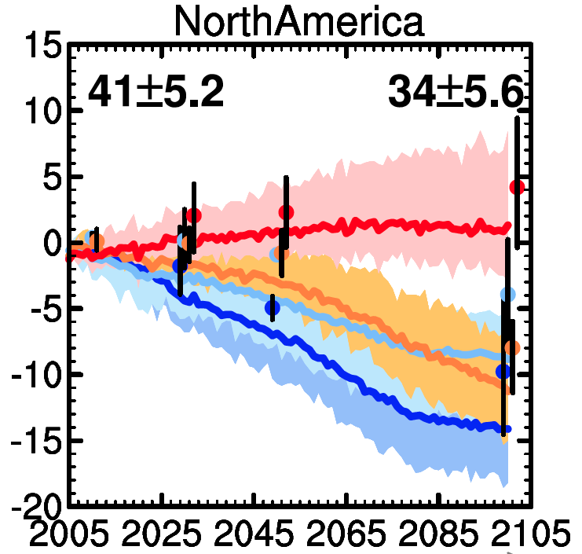

‘First-look’ future projections with current chemistry-climate models for North American Ozone Air Quality
Annual mean spatially averaged (land only) O₃ in surface air
Mean over
1986-2005 of
CMIP5 CCMs
Transient
simulations
(4 models)
1980+2000 mean of ACCMIP CCMs decadal time slice simulations
(2-12 models)
Range across
all models
Range across
all models
RCP8.5
RCP6.0
RCP4.5
RCP2.6
Multi-
model
Mean
Multi-model Mean
V. Naik, adapted from Fiore et al., 2012
Beyond annual, continental-scale means: Shifting balance of regional and baseline O₃ changes seasonal cycles and daily distributions; Role of regional climate change?
Notes:
Leave you with a pretty picture & overall conclusion in blue text

Slide 24


Pollution monitoring
Exposure assessment
AQ forecasting
Source attribution Quantifying emissions
Natural & foreign influences
AQ processes
Climate-AQ interactions
satellites
AQAST
suborbital platforms
models
AQAST

