Slide 1


Air pollutants: Drivers or riders on the climate change express?
Arlene M. Fiore
Jasmin John, Hiram Levy II, Meiyun Lin, Vaishali Naik,
Larry Horowitz, Jacob Oberman, D.J. Rasmussen,
Alex Turner, Dan Schwarzkopf, GAMDT (GFDL)
Yuanyuan Fang (Princeton)
Atmospheric Chemistry Gordon Research Conference
Mount Snow, West Dover, VT
July 25, 2011

Slide 2
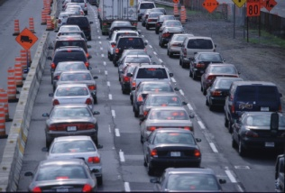
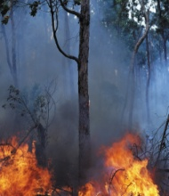
Air pollutants affect climate; changes in climate affect global atmospheric chemistry and regional air pollution
Greenhouse gases
absorb infrared radiation
Aerosols interact with sunlight
“direct” + “indirect” effects
#1: air pollutants -> climate
Smaller droplet size
clouds last longer
increase albedo
→ less precipitation
T
O₃
H₂O
T
#3: climate on
air pollution
NMVOCs
CO, CH₄
+
OH
+
NO_{x}
Black carbon
T
atmospheric cleanser
Sulfate
organic carbon
#2: chem-climate
interactions
pollutant sources
Changes to atmospheric
circulation, T, precip, etc.
influence air pollutants
(O₃ and PM in surface air)
Surface of the Earth
A.M. Fiore
Notes:
1) Mention stratosphere … On point 3) note mix of local vs. background.

Slide 3
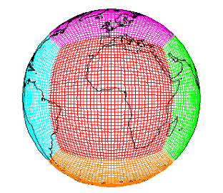
The GFDL CM3/AM3 chemistry-climate model
Donner et al., J. Climate, 2011; Golaz et al., J. Climate, 2011
Modular Ocean Model version 4 (MOM4)
&
Sea Ice Model
Observed or CM3 SSTs/SIC for CMIP5 Simulations
GFDL-AM3
GFDL-CM3
cubed sphere grid
~2°x2°; 48 levels
Forcing
Solar Radiation
Well-mixed Greenhouse Gas Concentrations
Volcanic Emissions
Atmospheric Dynamics & Physics
Radiation, Convection (includes wet deposition of tropospheric species), Clouds, Vertical diffusion, and Gravity wave
Atmospheric Chemistry 86 km
0 km
Ozone–Depleting Substances (ODS)
Chemistry of O_{x}, HO_{y}, NO_{y}, Cly, Br_{y}, and Polar Clouds in the Stratosphere
Chemistry of gaseous species (O₃, CO, NO_{x}, hydrocarbons) and aerosols (sulfate, carbonaceous, mineral dust, sea salt, secondary organic)
Pollutant Emissions (anthropogenic, ships, biomass burning, natural, & aircraft)
> 6000 years CM3 CMIP5 simulations
AM3 option to nudge to reanalysis
Aerosol-Cloud Interactions
Dry Deposition
Land Model version 3
(soil physics, canopy physics, vegetation dynamics, disturbance and land use)
Naik et al., in prep

Slide 4
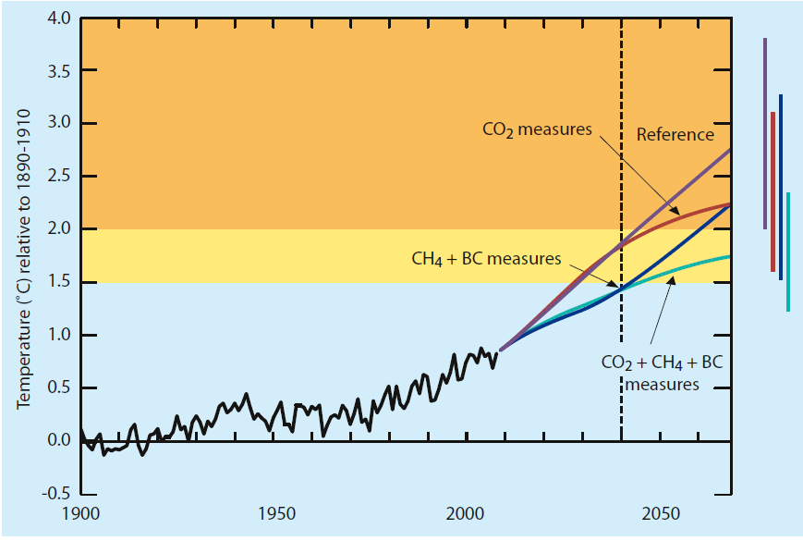
(#1: drivers) Air Pollutants as Drivers of Climate Change: Recent report emphasizes “win-win” (for air pollution and climate) by reducing black carbon and methane emissions
Fig 3 ,UNEP /WMO “Integrated Assessment of Black Carbon and Tropospheric Ozone”,
Summary for Decision Makers, June 2011
REFERENCE
CO₂ controls
CH₄ + BC controls
→ Reducing SLCFs (BC + CH₄) influences temp. in 10 years
→ Report mentions sulfate as a “win-lose”: How bad?
Notes:
0.4 degrees by 2040; 0.5 degrees total (2100)

Slide 5
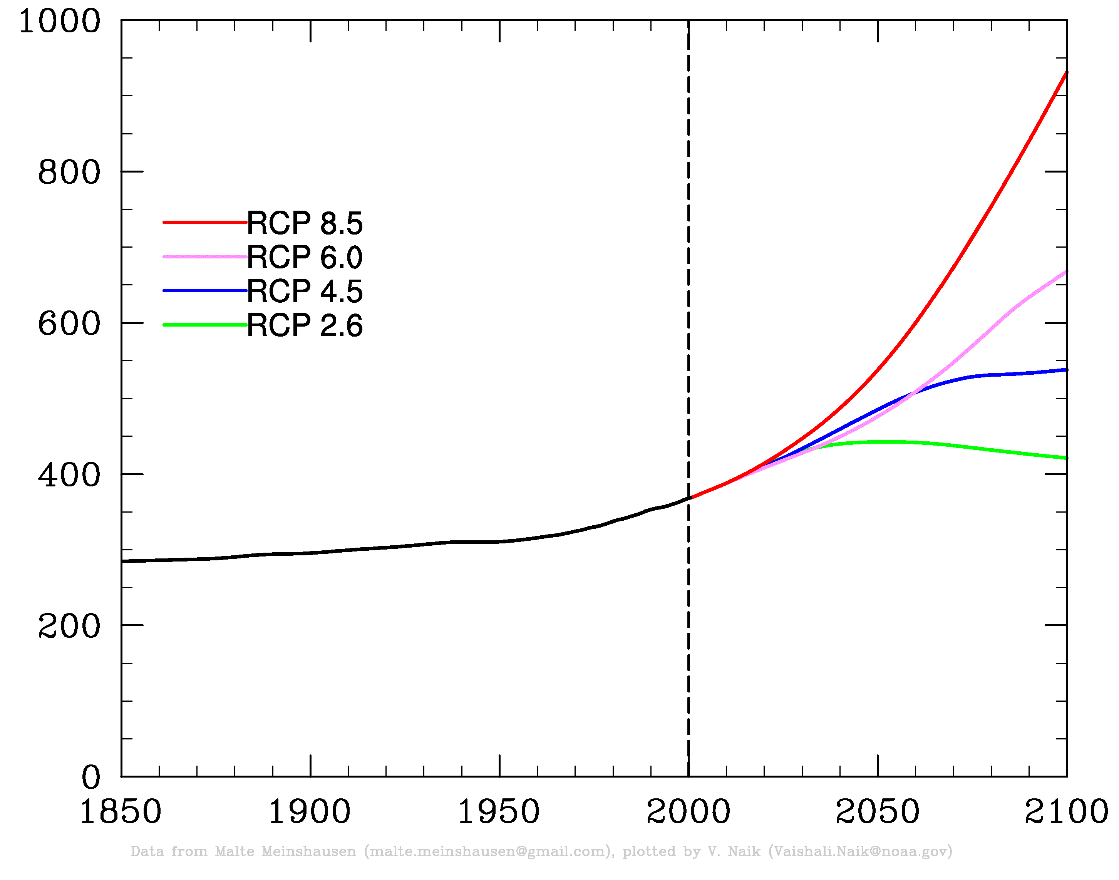
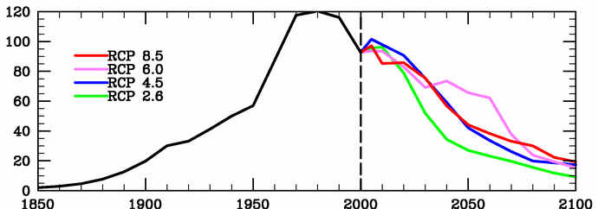
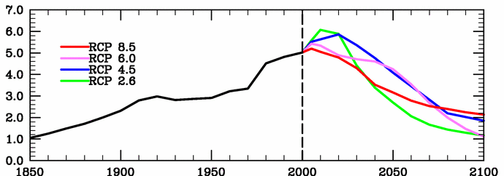
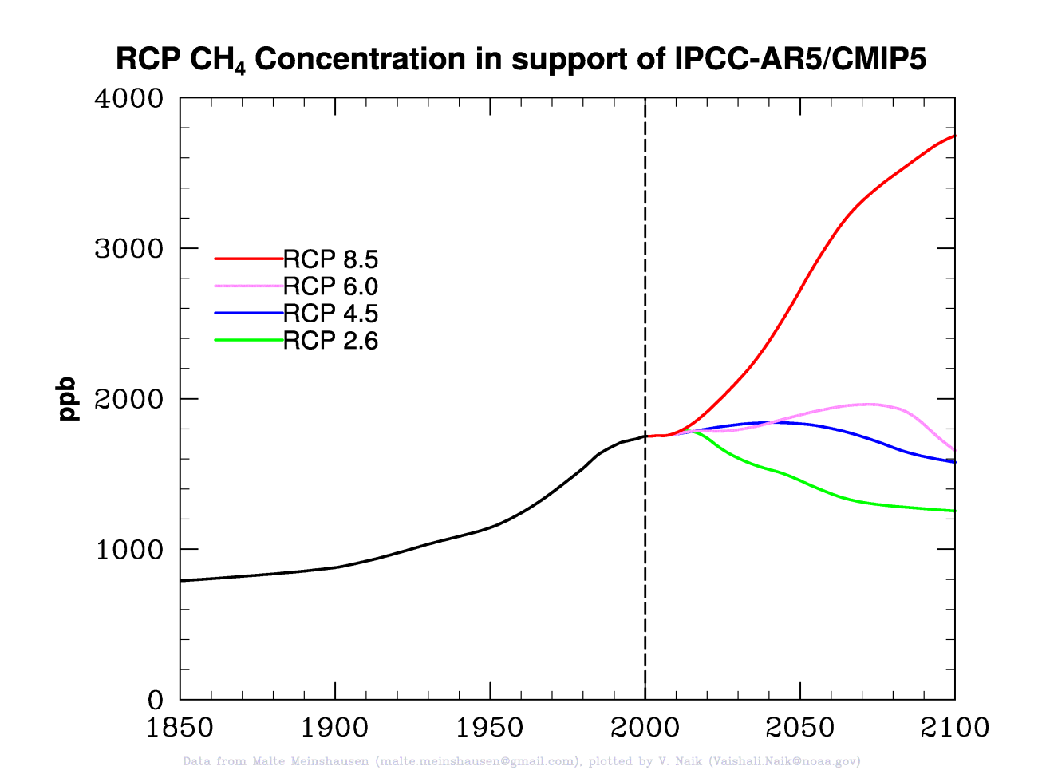
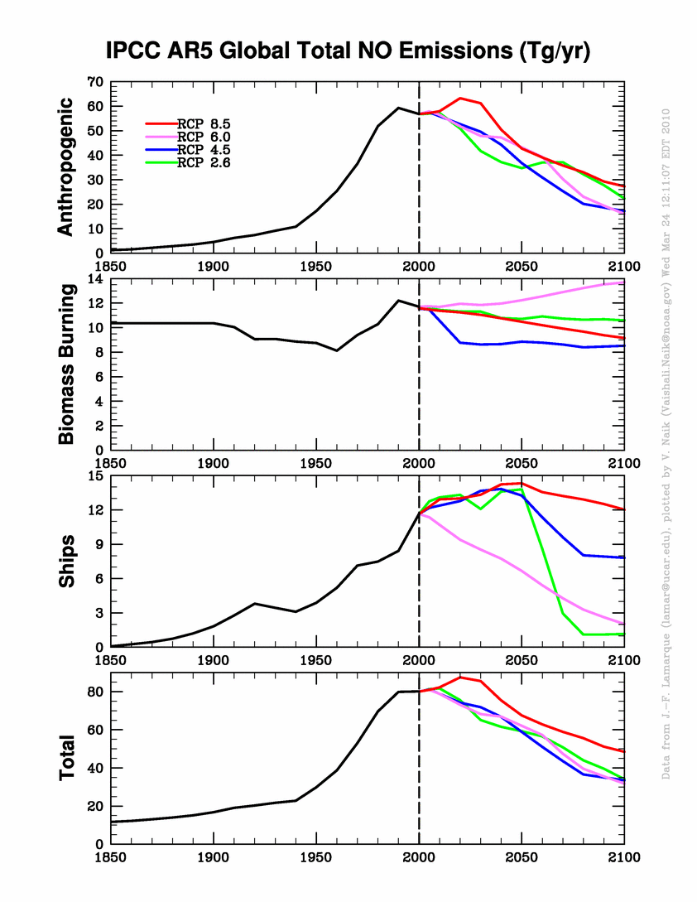
Well-mixed greenhouse gases (WMGGs) and Emissions of Short-Lived Climate Forcers (SLCFs) under “RCPs”
RCP8.5
RCP6.0
RCP4.5
RCP2.6
2050 2100
Anthrop. SO₂ (Tg yr⁻¹)
-50% -80%
-50% -80%
CO₂
abundance
(ppm)
-40% -60%
-20% -60%
Anthrop. BC (Tg yr⁻¹)
Methane
abundance
(ppb)
-25% -50%
-35% -70%
Anthrop. NO (Tg yr⁻¹)
Figures c/o V. Naik
“Moderate” RCP4.5 as baseline; sensitivity simulation where only
WMGGs change (as in Levy et al., JGR, 2008).

Slide 6
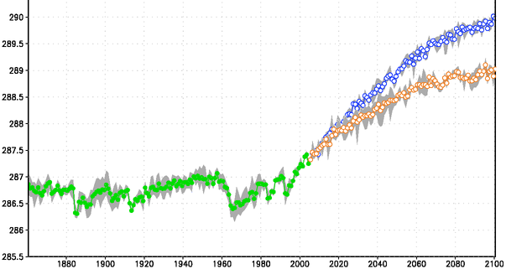
Accelerated warming in simulations with decreasing aerosol emissions (less sulfate → more warming)
GFDL CM3 Historical
GFDL CM3 RCP4.5 WMGG only
GFDL CM3 RCP4.5
Range of individual ensemble members
additional warming when aerosols are
reduced (mainly
sulfate, indirect
effect)
Global annual mean sfc temp. (K)
Signal emerges by ~2035
c/o D. Schwarzkopf
Aerosol removal could accelerate near-term (and amplify long-term) warming
[e.g., Jacobson and Streets, 2009; Kloster et al., 2010; Raes & Seinfeld, 2009; Wigley et al., 2009]
→ Need to better understand + quantify “win-lose” of sulfate (regional climate)
Notes:
discuss only WMGG run first, then transition to aerosol impact… ~1/2 degree by mid-C; >1 (1.3) degree by end of century
RCP45 = 2.3 degrees (2081-2100)-(2006-2025) . Additional degree by end of century
Potential for SO2 controls to accelerate NT climate warming has been pointed out [Raes & Seinfeld, 2009]

Slide 7
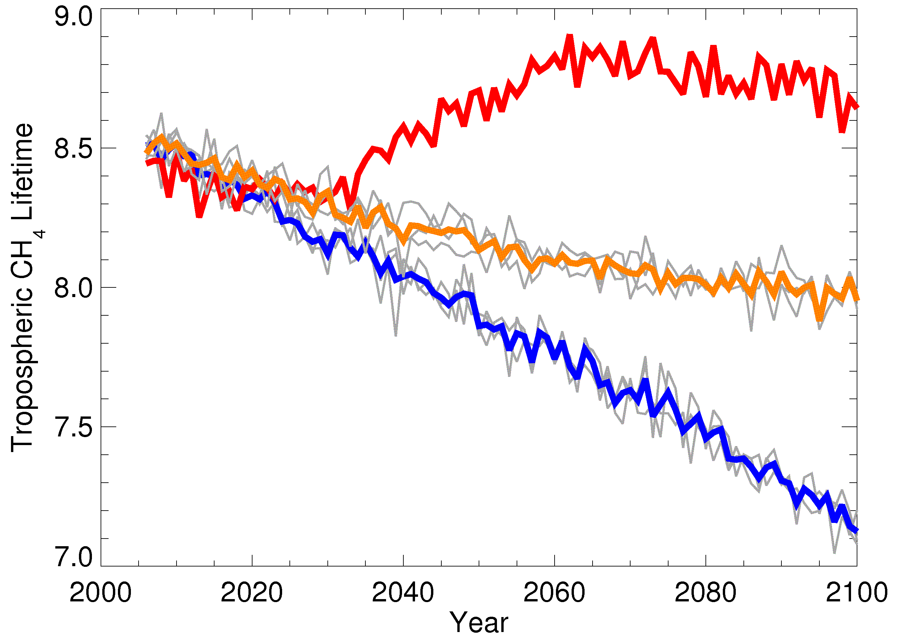
#2 (drivers + riders): Negative feedback of warming climate on methane lifetime….
τCH₄
Shortens with increasing:
temperature (by 2% K⁻¹)
[OH]
+ NO_{x} sources
+ water vapor
+ photolysis rates
- CO, NMVOC, CH₄
=
2081-2100 – 2006-2025:
+4%
-5%
-13%
… But the
lifetime increases
In the most extreme
warming scenario
(RCP8.5): WHY?
GFDL CM3 RCP8.5
GFDL CM3 RCP4.5
GFDL CM3 RCP4.5 WMGG only
individual ensemble members
J. John et al., in prep
Notes:
Temperature changes rcp4.5 2.295 rcp4.5* 1.355 rcp8.5 4.533

Slide 8
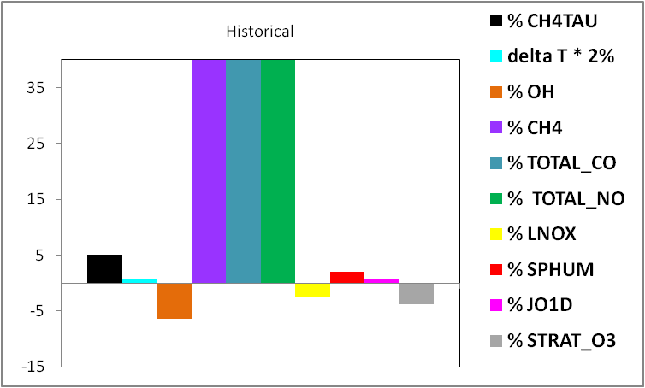
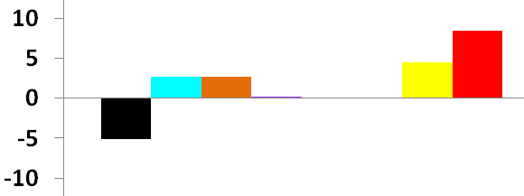
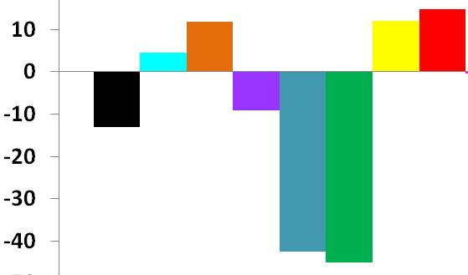
Negative feedback of warming climate on methane lifetime
Percentage changes from (2081-2100) – (2006-2025) in GFDL CM3
τ
% Δ CH₄
RCP4.5, WMGG only
Increasing T, OH (LNO_{x}, H₂O) shorten
methane lifetime
2% * ΔT
% Δ OH
% Δ CH₄
Factors increasing OH
τ
% Δ CO emis
Factors decreasing CH₄
% Δ NO emis
RCP4.5
% Δ LNO_{x}
more warming, lower CO, CH₄ shorten lifetime vs WMGG only
(larger than opposing influence of NO_{x}reductions)
% Δ H₂O
J. John et al., in prep

Slide 9
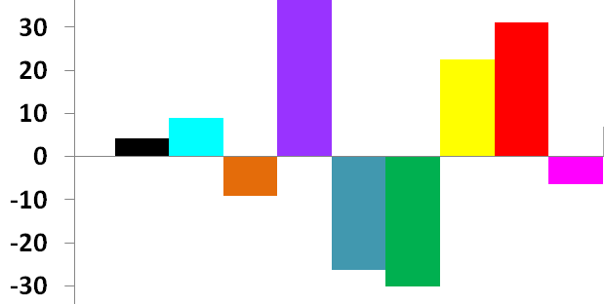
More extreme warming scenario (RCP8.5): emission changes outweigh climate influence on methane lifetime
Percentage changes from (2081-2100) – (2006-2025) in GFDL CM3
τ
+97%
% Δ CH₄
Factors decreasing OH
2% * ΔT
Factors increasing
CH₄
% Δ OH
τ
% Δ CH₄
% Δ CO emis
% Δ NO emis
% Δ LNO_{x}
RCP8.5
% Δ H₂O
% Δ JO¹D
→ Doubling CH₄ (+ lower NO_{x}, JO¹D) offsets opposing influences from rising T, H₂O, LNO_{x} and decreasing CO emissions
J. John et al., in prep
Notes:
FLIP SIGNS

Slide 10
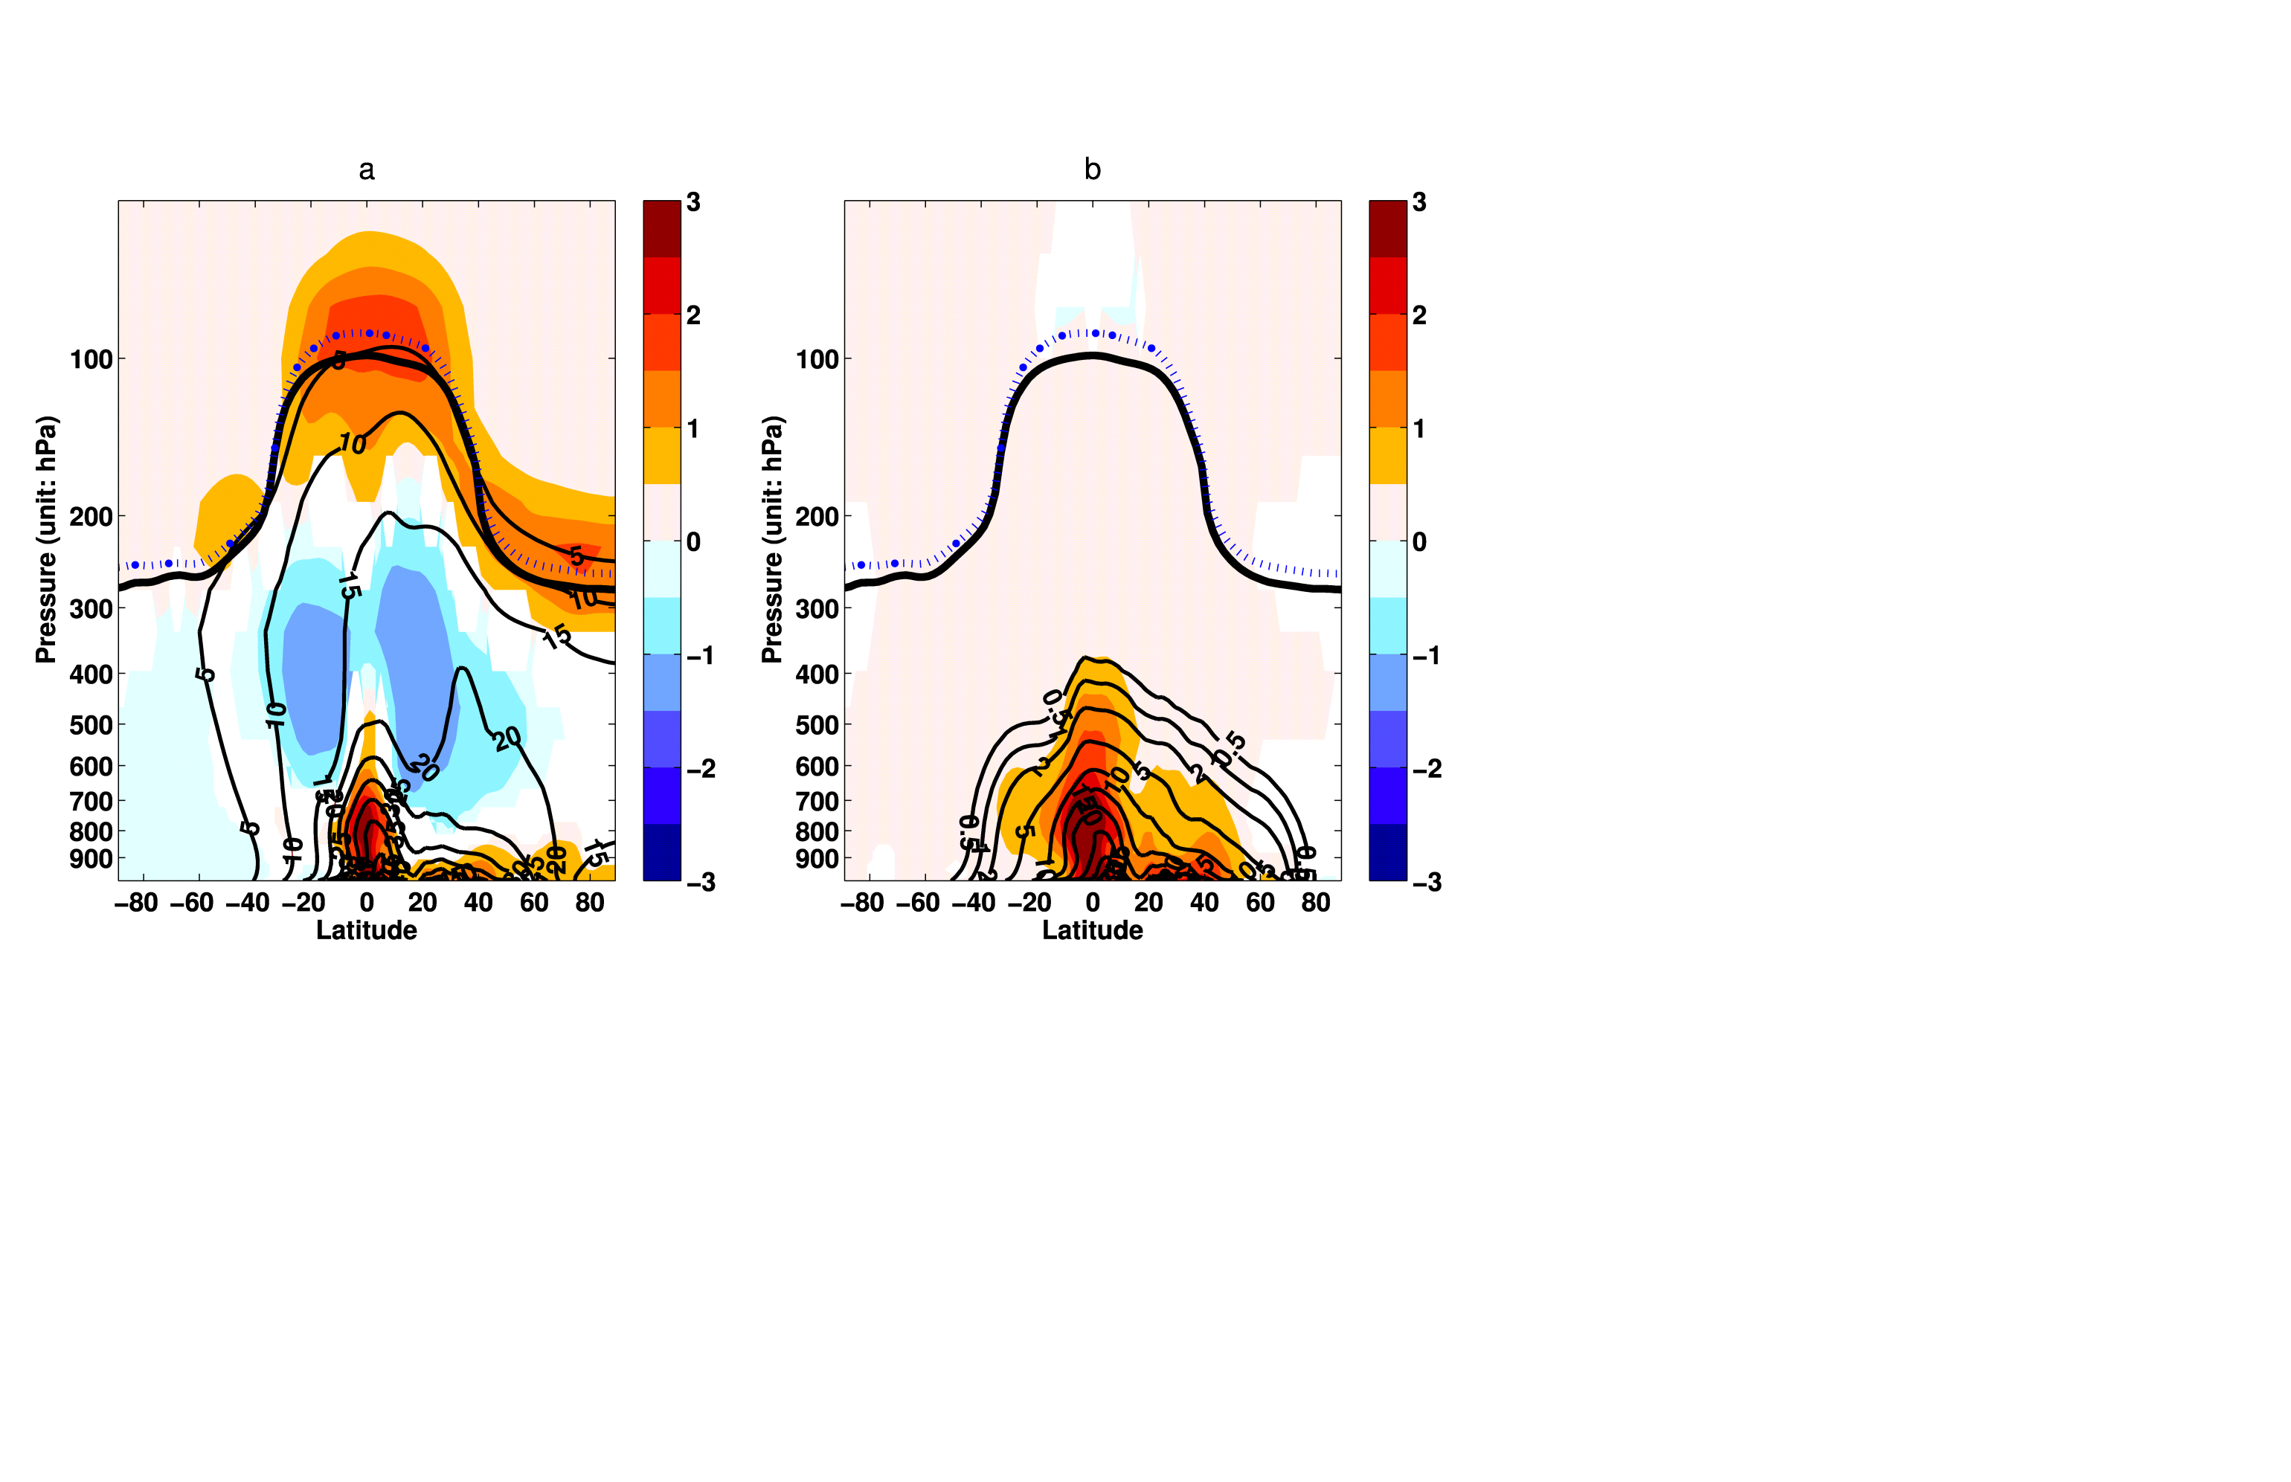
#3 (riders): Warmer, wetter world: More PM pollution?
Y. Fang et al., 2011; Y. Fang et al., in prep
CLIMATE CHANGE ONLY AM3 idealized simulations (20 years)
1990s: observed decadal average SST and sea ice monthly climatologies
2090s: 1990s + mean changes from 19 AR-4 models (A1B)
Aerosol tracer: fixed lifetime, deposits like sulfate (ONLY WET DEP CHANGES)
NE USA
Aerosol Tracer (ppb)
Aerosol Tracer (ppb)
2090s-1990s
1990s distribution
1990s
2090s
Pressure (hPa)
JJA daily regional mean
PM2.5
(ug m⁻³)
Tracer burden increases by 12%
despite 6% increase in global precip.
Role for large-scale precip vs. convective;
Seasonality of tracer burden
Tracer roughly captures PM2.5 changes
Cheaper option for AQ info from physical
climate models (e.g., high res)

Slide 11
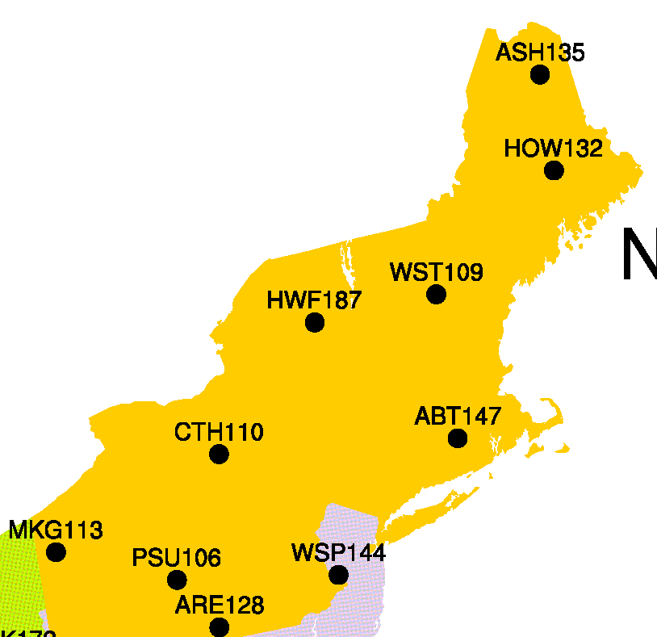
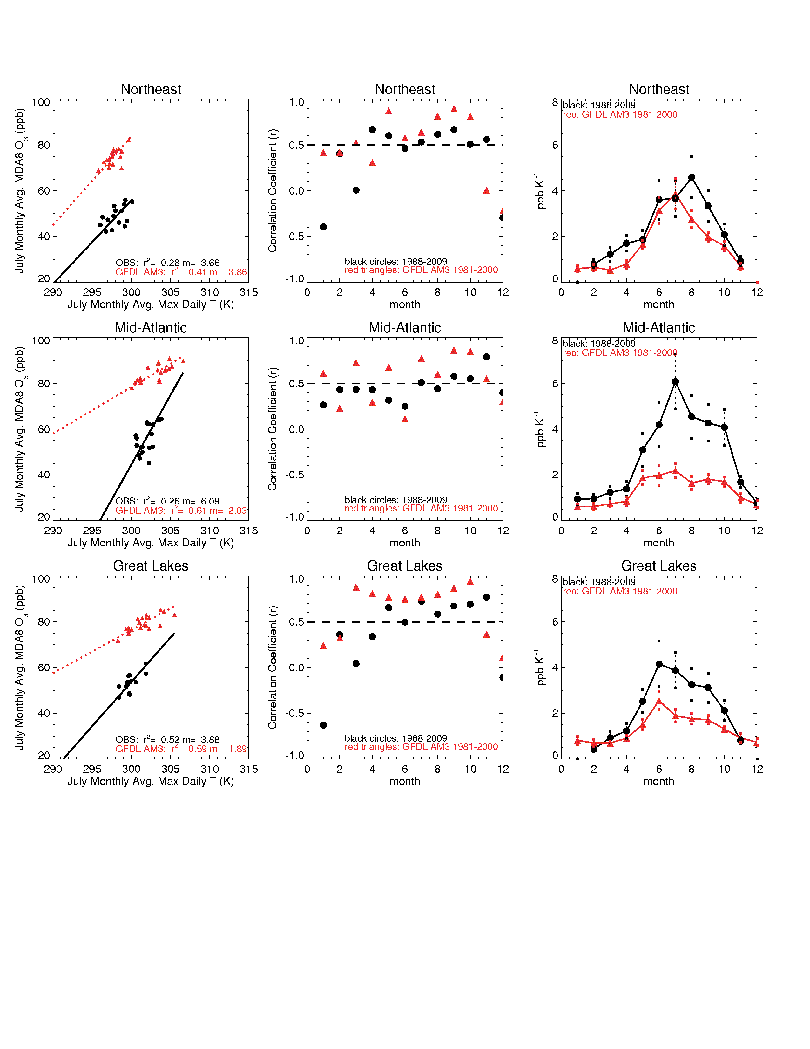
How well does a global chemistry-climate model simulate regional O₃-temperature relationships?
CASTNet sites,
NORTHEAST
USA
“Climatological” O₃-T relationships:
Monthly means of daily max T and monthly means of MDA8 O₃
AM3: 1981-2000
OBS: 1988-2009
r²=0.41, m=3.9
Slopes (ppb O₃ K⁻¹)
July Monthly avg. MDA8 O₃
r²=0.28, m=3.7
July Monthly avg. daily max T
Month
Model captures observed O₃-T relationship in NE USA in July, despite high O₃ bias
D.J .Rasmussen et al.,
submitted to Atmos. Environ.
→ Broadly represents seasonal cycle

Slide 12
Need for better understanding of underlying processes contributing to climatological O₃-T relationship
1. meteorology 2. chemistry 3. emission feedbacks …
[Jacob et al., 1993; Olszyna et al., 1997]
[Sillman and Samson, 1995]
[Meleux et al., 2007; Guenther et al., 2006]
Observational constraints?
Relative importance (regional and seasonal variability)?
Leibensperger et al. [2008] found an anticorrelation between (a) the number of migratory cyclones over Southern Canada/Northeastern U.S. and (b) the number of stagnation events and associated NE US high-O₃ events
→ 4 fewer O₃ pollution days per cyclone passage
Does this region experience declining frequency of storms in a warming climate (northward shift of storm tracks)?

Slide 13
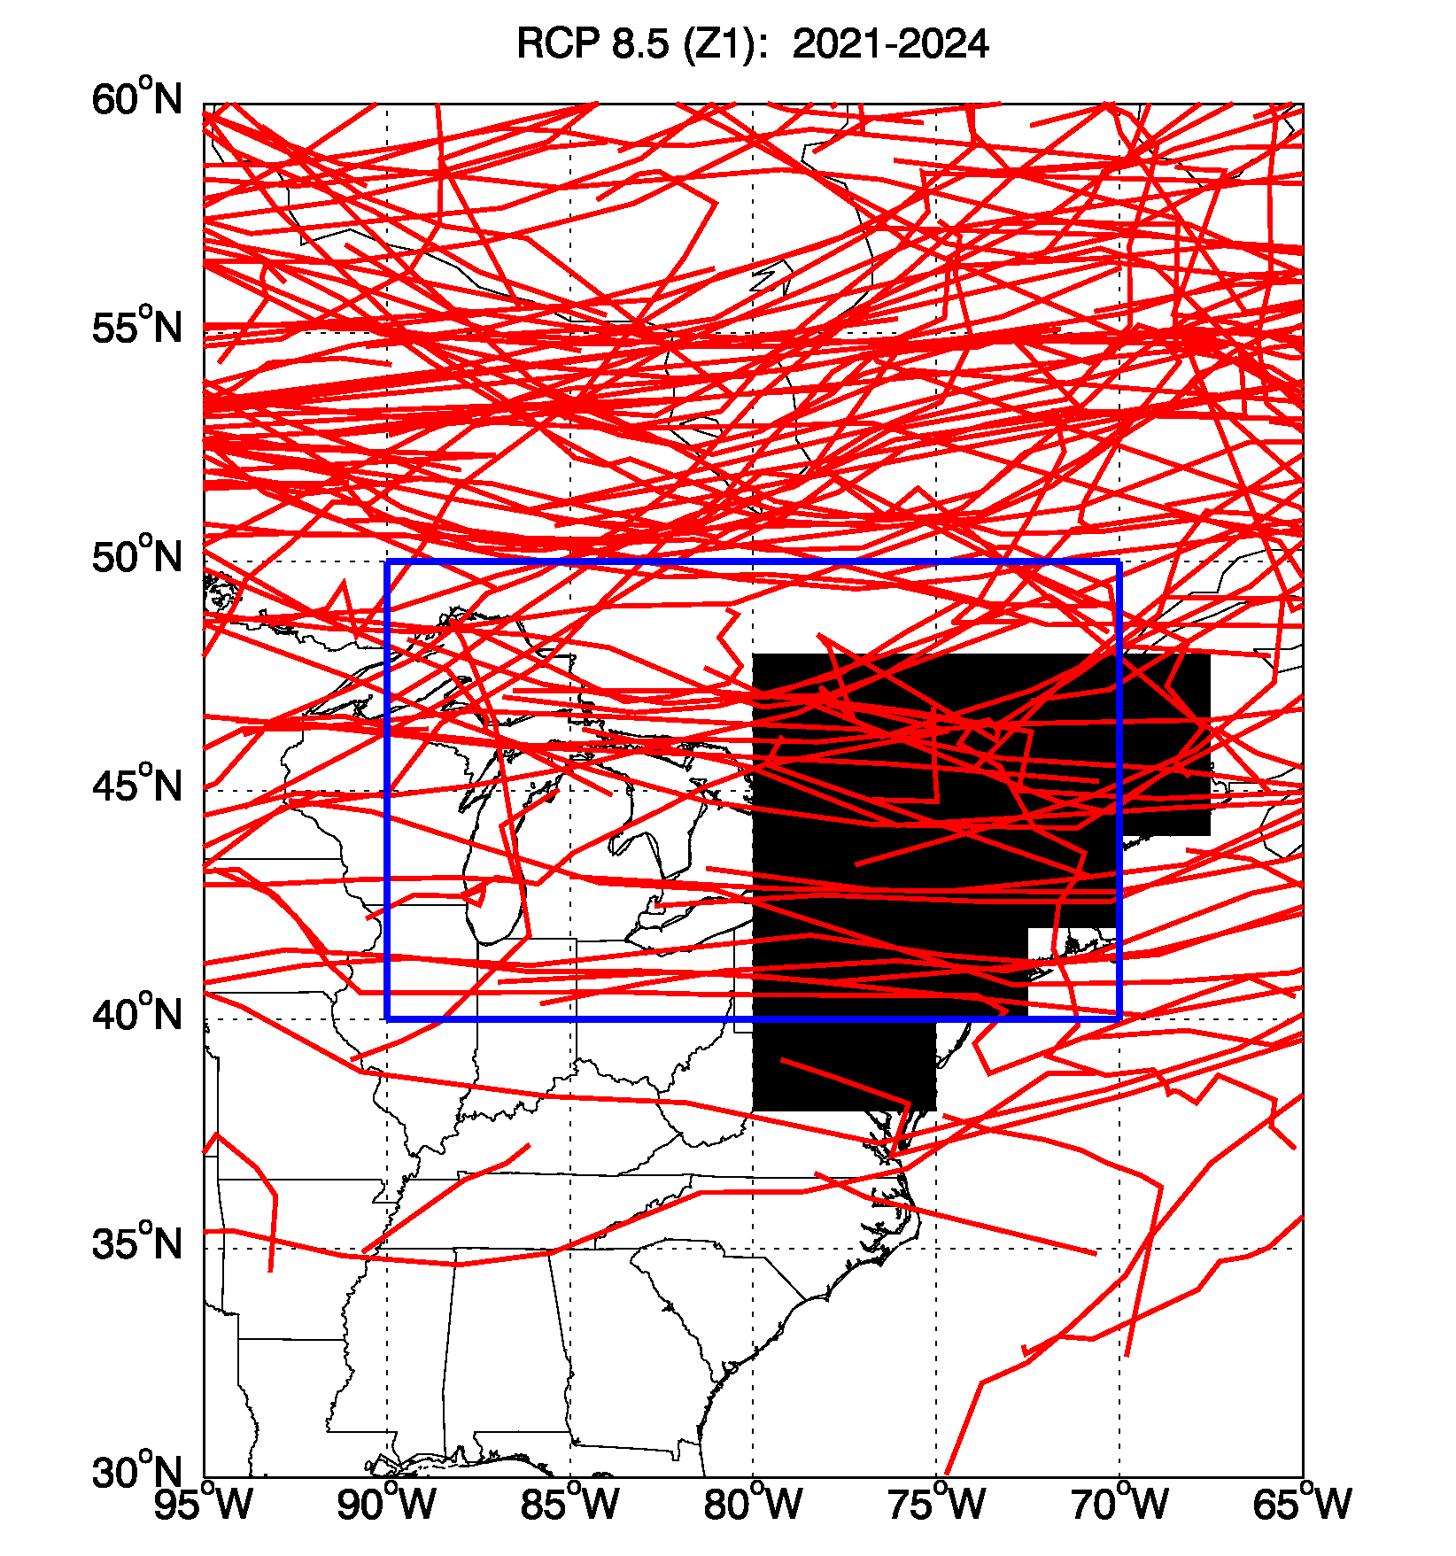
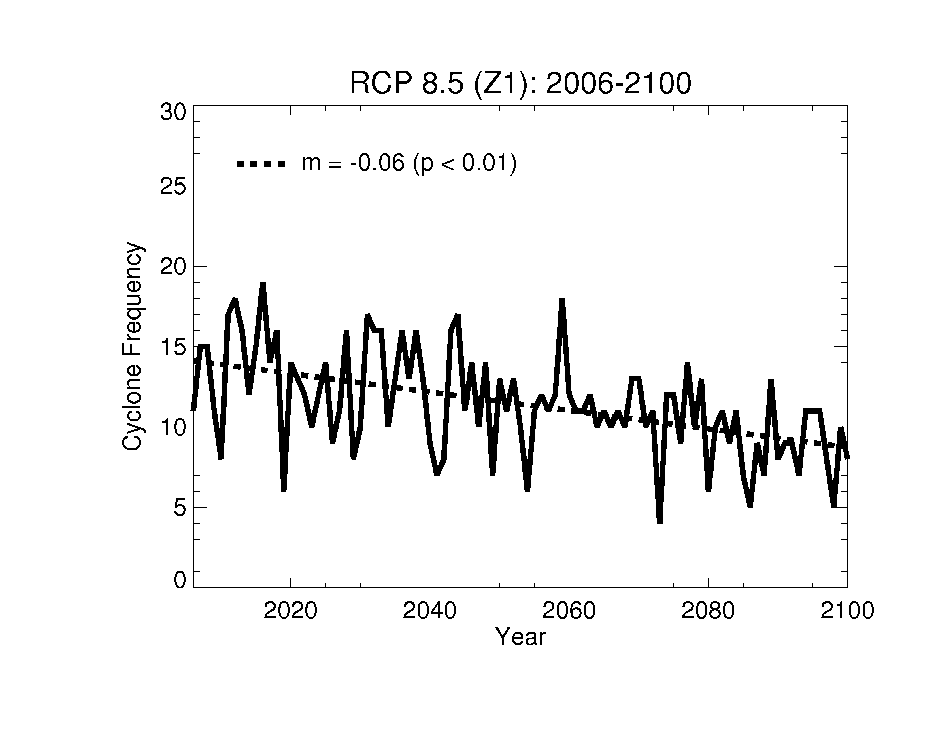
Frequency of summer migratory cyclones over NE US decreases as the planet warms (CM3 model, RCP8.5)
Individual JJA storm tracks
(2021-2024, RCP8.5)
Cylones diagnosed from 6-hourly SLP with
MCMS software from Mike Bauer, (Columbia U/GISS)
Region for counting storms
Number of storms per summer (JJA)
Region for counting O₃ events
Assume (1) no emission changes (climate only)
(2) -4 pollution days per cyclone [Leibensperger et al., 2008]
Decrease of ~5 cyclones per summer implies ~20 additional O₃ pollution days by 2100 under RCP8.5 climate scenario
Robust across models? [e.g., Lang and Waugh, 2011]
A. Turner et al.
Notes:
Move leibensperger information to previous slide.

Slide 14
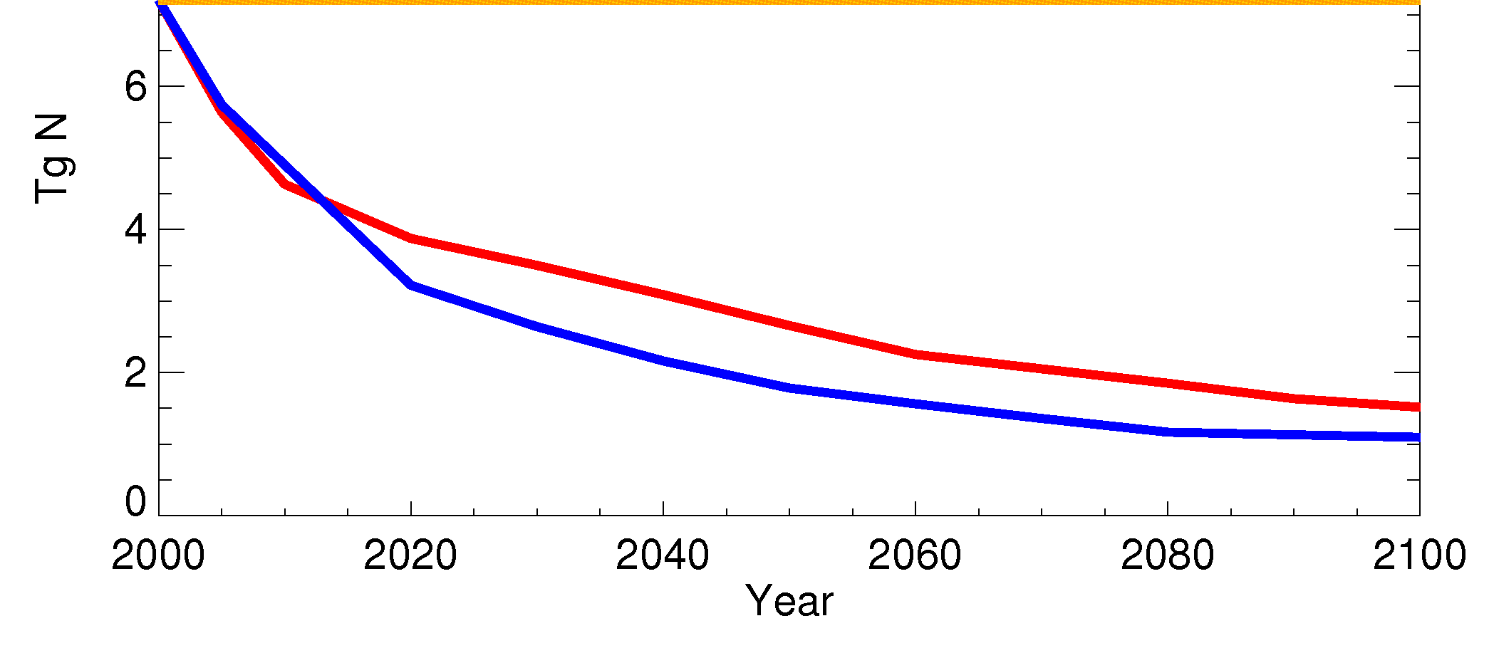
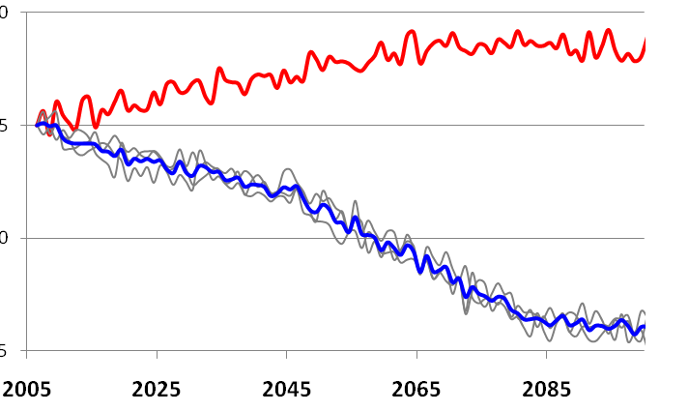
Large NO_{x} decreases under RCPs over North America:
Improved O₃ air quality?
NA Anthro NOx (Tg N yr⁻¹)
RCP8.5
RCP4.5
Why the O₃ increase in CM3 under RCP8.5 with such large NO_{x} reductions?
CH₄ rise
seasonality?
Annual mean changes in NA sfc O₃ (ppb)
GFDL CM3 (EMISSIONS + CLIMATE)
5
0
-5
-10
RCP8.5
RCP4.5 ensemble mean
Individual members
A.M. Fiore
Notes:
Nox down 50% (relative 2005) or 60% (relative to 2000) by 2050; down 70-80% by 2100 in RCP8.5
NOx down 60% (relative 2005) or 75% (relative to 2000) by 2050; down 75-85% by 2100 in RCP4.5

Slide 15
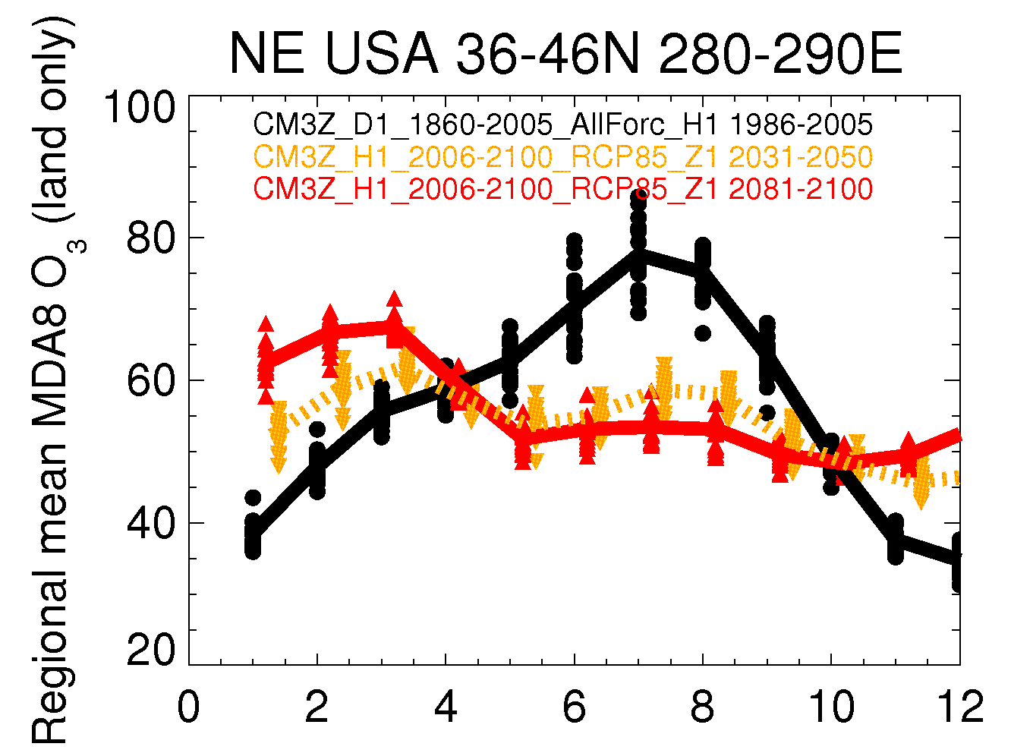
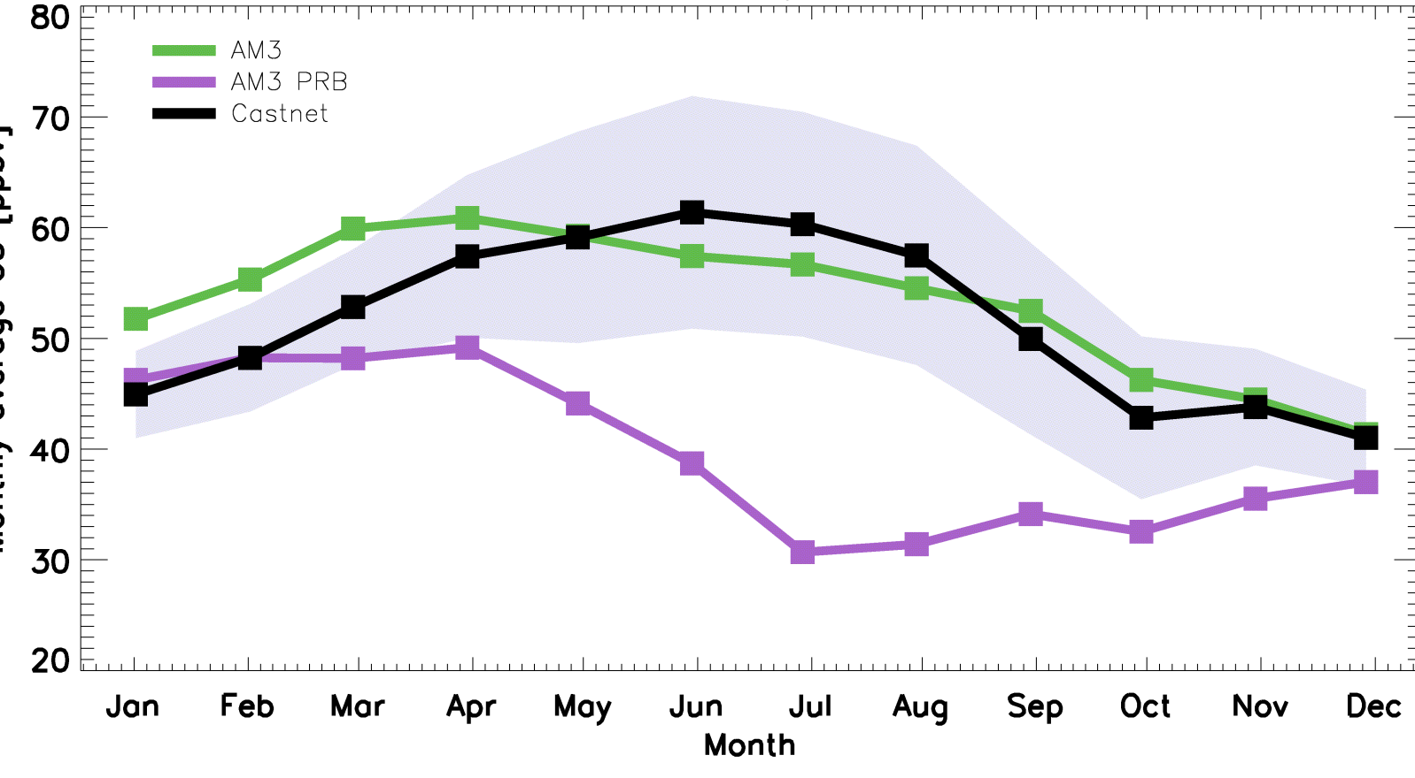
Surface ozone seasonal cycle reverses in CM3 RCP85 simulation over (e.g., USA; Europe)
U.S. CASTNet sites > 1.5 km
1986-2005
2031-2050
2081-2100
J. Oberman
2006 CASTNet obs (range)
2006 AM3 (nudged to NCEP winds)
2006 AM3 with zero N. Amer. anth. emis.
Monthly mean MDA8 O₃
?
NO_{x} decreases
Month of 2006
→What is driving wintertime increase?
2100 NE USA seasonal cycle similar to current estimates of
“background” O₃ at high-altitude sites (W US)
A.M. Fiore

Slide 16
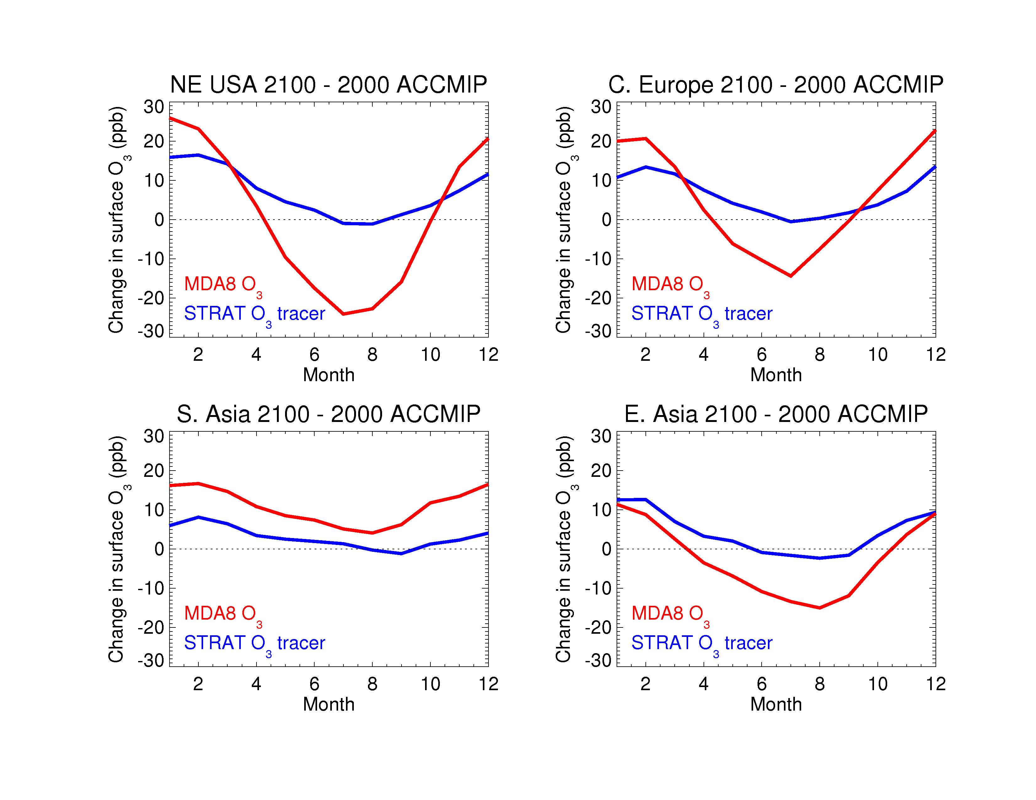
More stratospheric O₃ in surface air accounts for >50% of wintertime O₃ increase over NE USA in RCP8.5 simulation
“ACCMIP simulations” : AM3 (10 years each) with decadal average SSTs for:
2000 (+ 2000 emissions + WMGG + ODS)
2100 (+ 2100 RCP8.5emissions + WMGGs + ODS) V. Naik
Change in
surface O₃
(ppb)
2100-2000
(difference of
10-year means)
Strat. O₃ recovery+ climate-driven increase in STE (intensifying
Brewer-Dobson circulation)? [e.g., Butchart et al., 2006; Hegglin & Shepherd, 2009;
Kawase et al., 2011; Li et al., 2008; Shindell et al. 2006; Zeng et al., 2010]
Regional emissions reductions + climate change influence relative
role of regional vs. background O₃
Extreme scenario highlights strat-trop, climate-chem-AQ coupling
A.M. Fiore

Slide 17
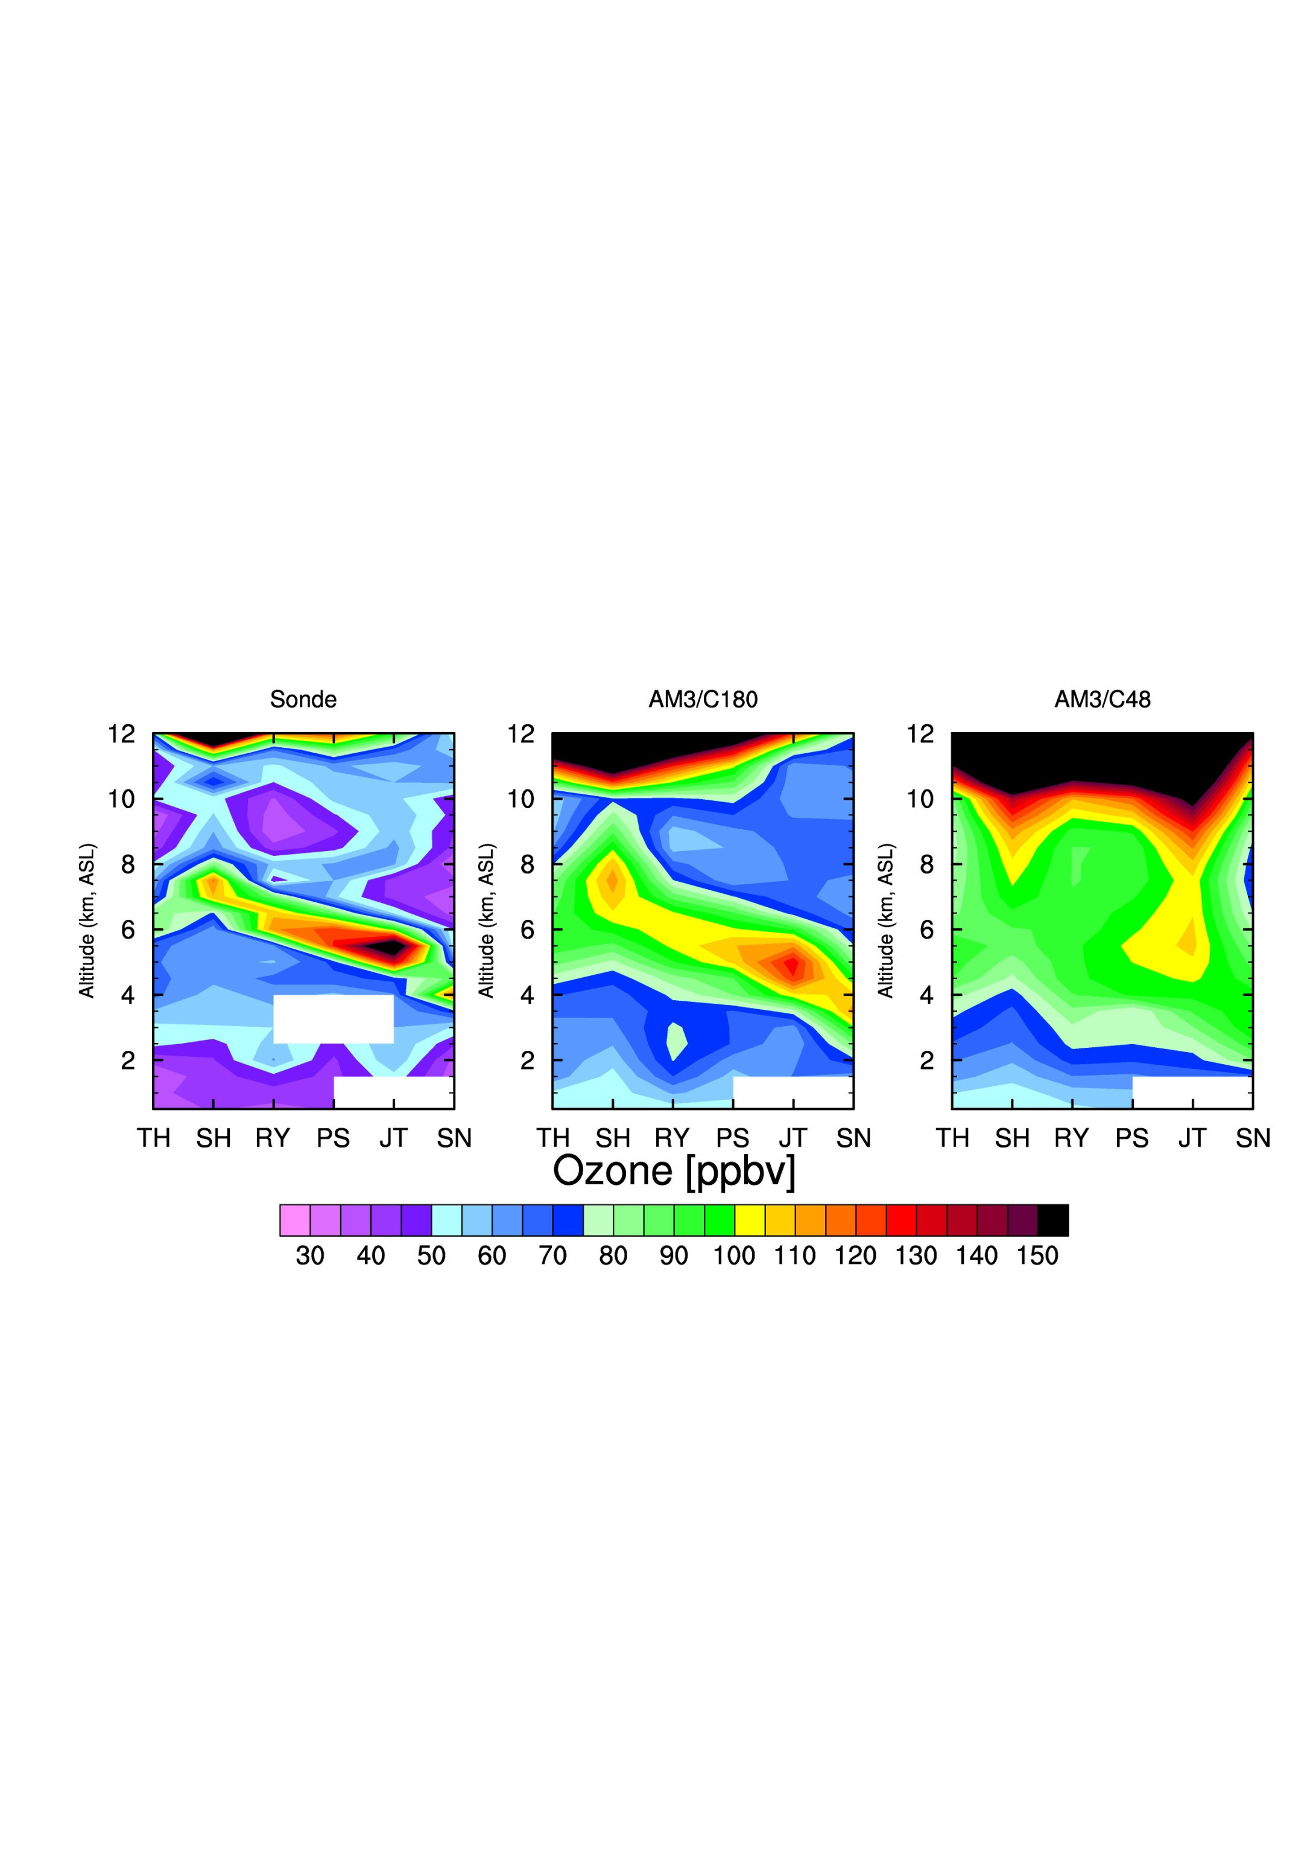
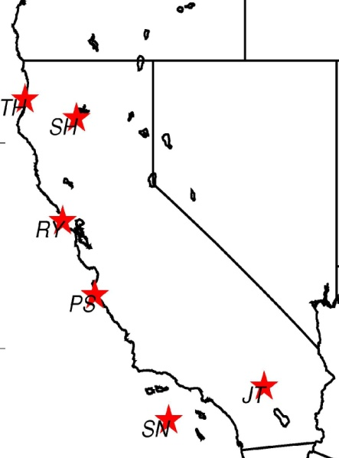
High-resolution AM3 better captures structure of stratospheric intrusions: Does resolution affect simulated trends and variability?
AM3/C180
(~50 km)
AM3/C48 (~200 km)
SONDE
Altitude (km, ASL)
model sampled at location and times of sonde launches
(NOAA CalNex campaign)
north → south
north → south
north → south
O₃ [ppbv]
Vertical cross section along California coast
(May 11 2010)
M. Lin et al., in prep
Notes:
Daily ozone sondes are launched along the California coast. Shown here are ozone vertical cross-section along the California coast for one of the intrusion during the campaign. You can clearly see the descent of strat ozone from Northern Calfironia to Southern California on the isentrope .surface. AM3 half-degree model better captures the intrusion structure than the two-degree model. The difference is intriguing. Does resolution affect simulated trends and variability? We are working to run the high-res model over multiple years.

Slide 18
Some final thoughts… Air pollutants:
Drivers AND riders on the climate change express
(Drivers) Offsetting radiative impacts from reducing air pollution
→ Consider “win-lose” (sulfate) alongside “win-win” (BC?, CH₄)
(Riders) Climate-change induced reversal of O₃ seasonal cycle and reduction of PM wet removal?
→ Process understanding (sources + sinks) at regional scale
→ AQ-relevant info w/ simple tracers in physical climate models
(Both) Complex interactions: OH-CH₄; also oxidant-aerosol; how well do we understand key feedbacks?
  Biosphere feedbacks (CH₄, N₂O, NO_{x}, CO, NMVOC… )
Implications for policy
2) Observational constraints crucial (long-term measurements)
3) Carefully designed model attribution studies (ACC-MIP)
A.M. Fiore

