Slide 1


Ozone pollution (events) in the
GFDL AM3 chemistry-climate model
Arlene M. Fiore
Yuanyuan Fang, Meiyun Lin, David Rasmussen Jr.
Larry W. Horowitz, Hiram Levy II, Vaishali Naik
NCAR CESM Chemistry-Climate
Working Group Meeting
March 17, 2010

Slide 2
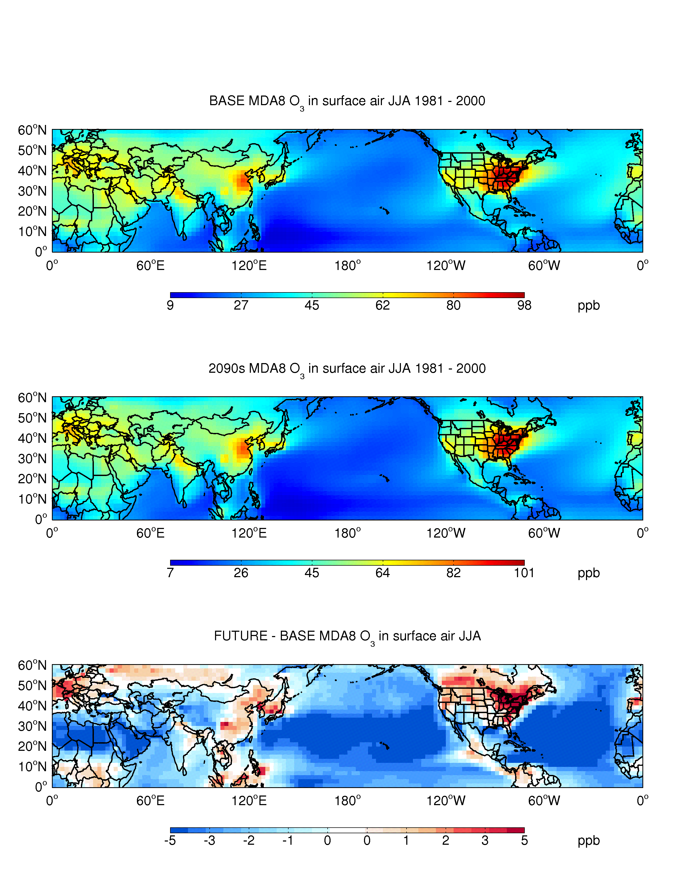
Summertime surface O₃ changes in a warmer climate in the new GFDL chemistry-climate model (AM3) [Donner et al., 2011]
Prototype version of AM3: full strat and trop (gas+aerosol) chem plus idealized tracers.
20-year simulations with annually-invariant present-day emissions of ozone and aerosol precursors [Fang et al., submitted to JGR]
Present Day Simulation (“1990s”): observed SSTs + sea ice (1981-2000 mean)
Future Simulation (“A1B 2090s”): observed SSTs + sea ice + average
2081-2100 changes from 19 IPCC AR-4 models
CHANGES IN SUMMER (JJA) MEAN DAILY MAX 8-HOUR OZONE
Previously noted degradation of summertime EUS O₃ air quality e.g., reviews of Jacob and Winner, Atmos. Environ. 2009 and Weaver et al., BAMS, 2009
Previously noted decrease of lower troposphere background O₃
e.g., Johnson et al., GRL, 2001; Stevenson et al., JGR, 2006

Slide 3
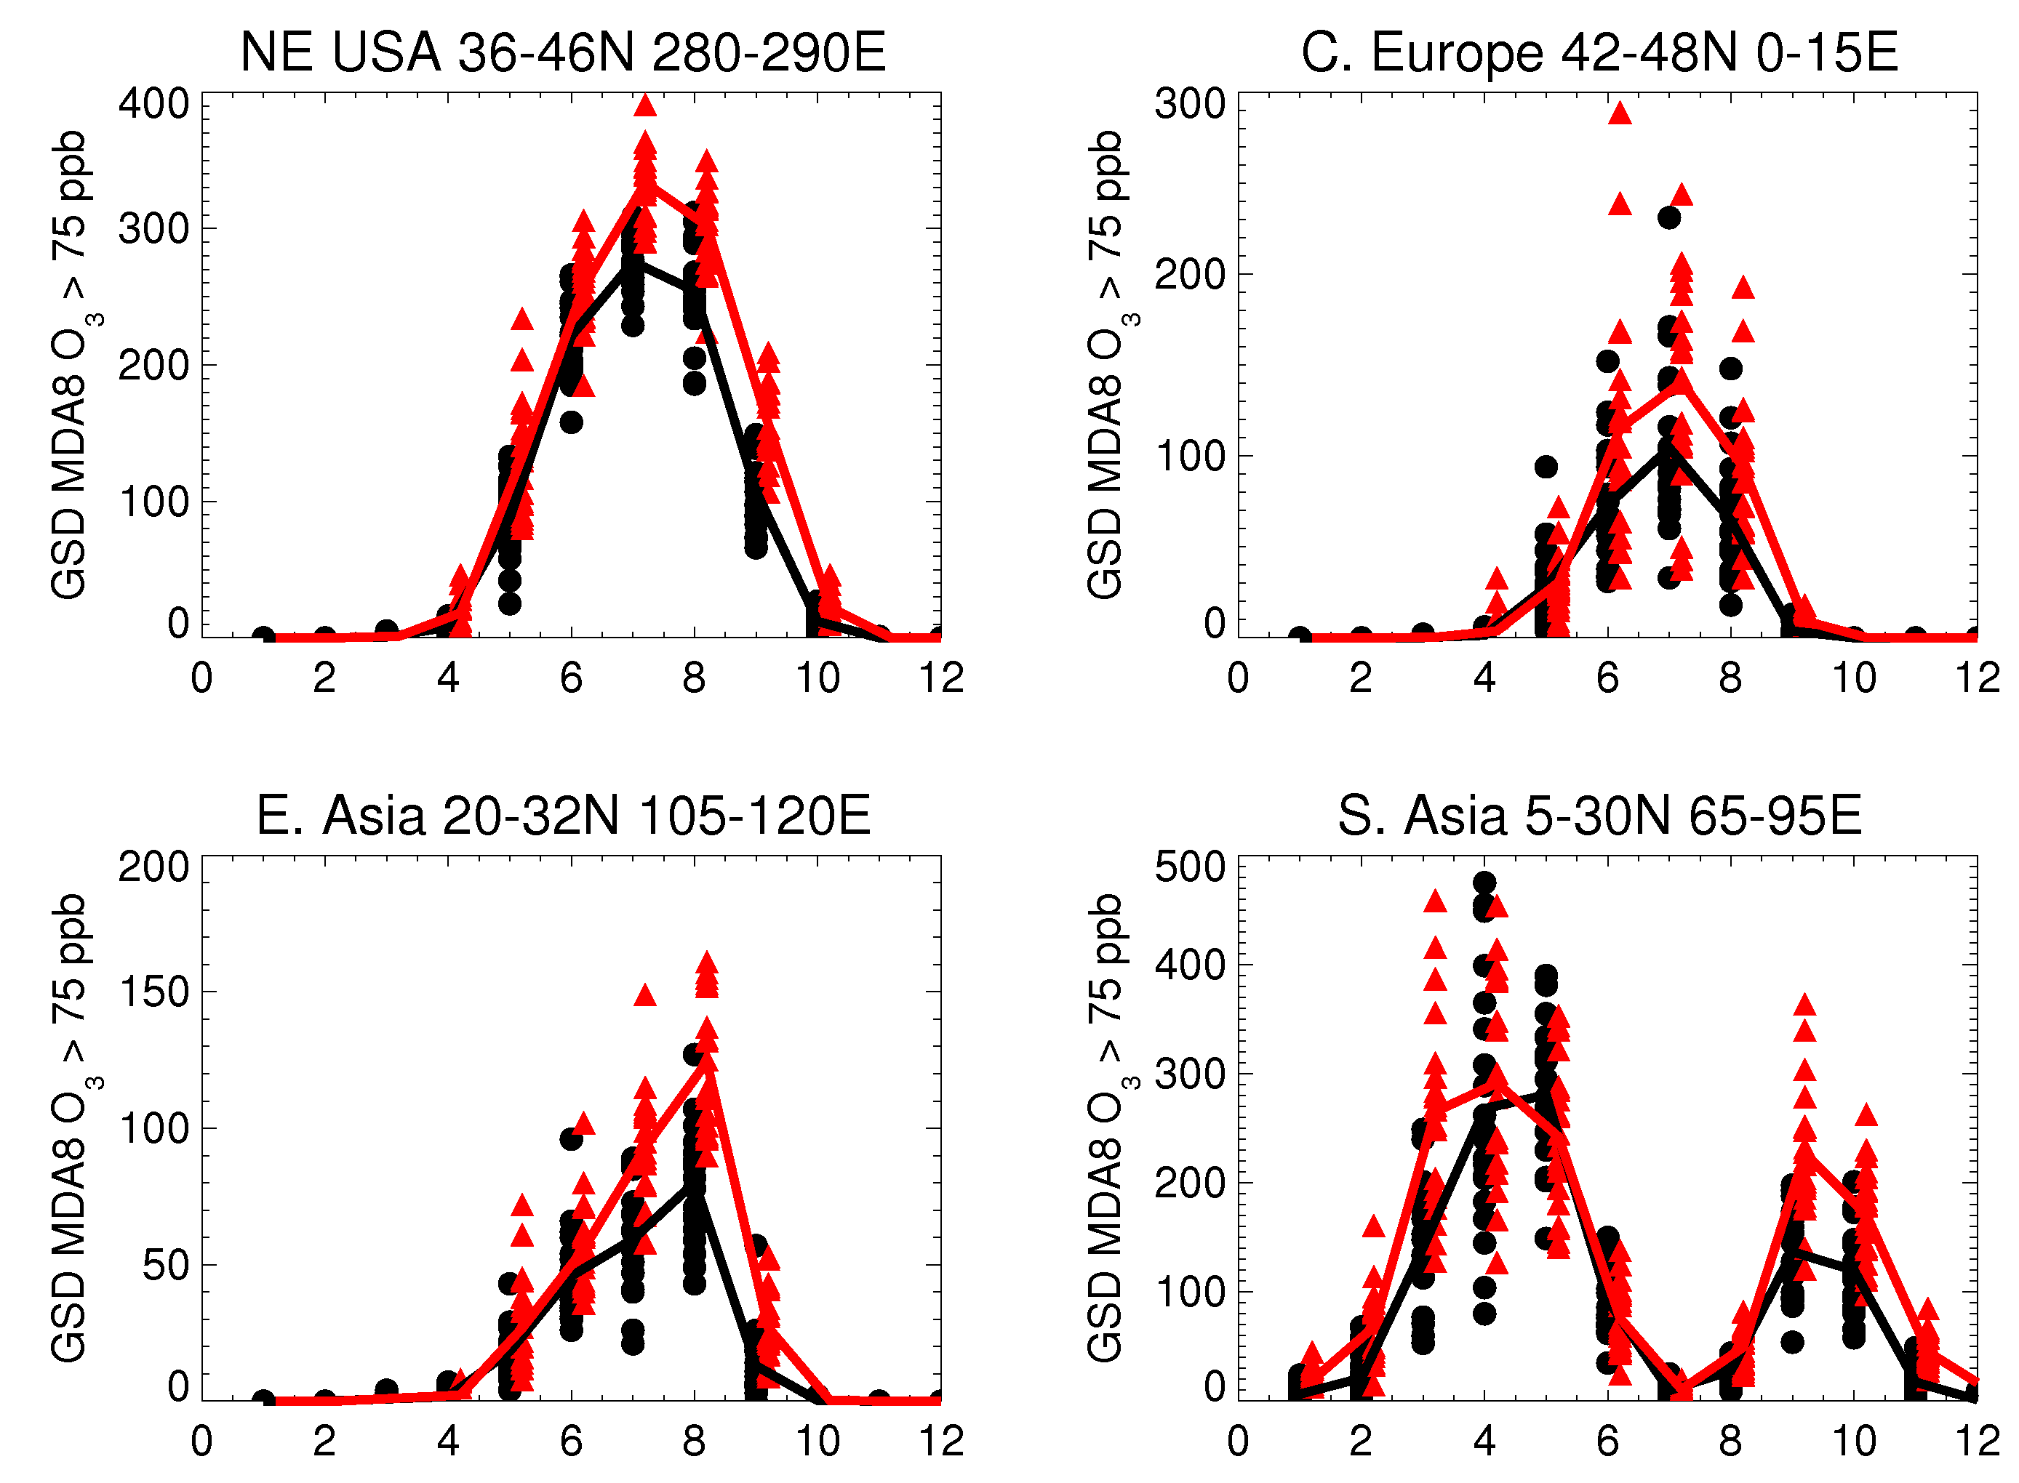
Changes in pollution events:
Incidences of daily max 8-hr O₃ > 75 ppb (land only)
FUTURE: individual years 20-yr mean
PRESENT: individual years 20-yr mean
(climate change only)
Air quality degradation
(prior studies suggest cyclones)
Two O₃ pollution
seasons in
S. Asia; climate
change impact
largest in fall: robust?
Notes:
75 ppb = current U.S. Standard

Slide 4
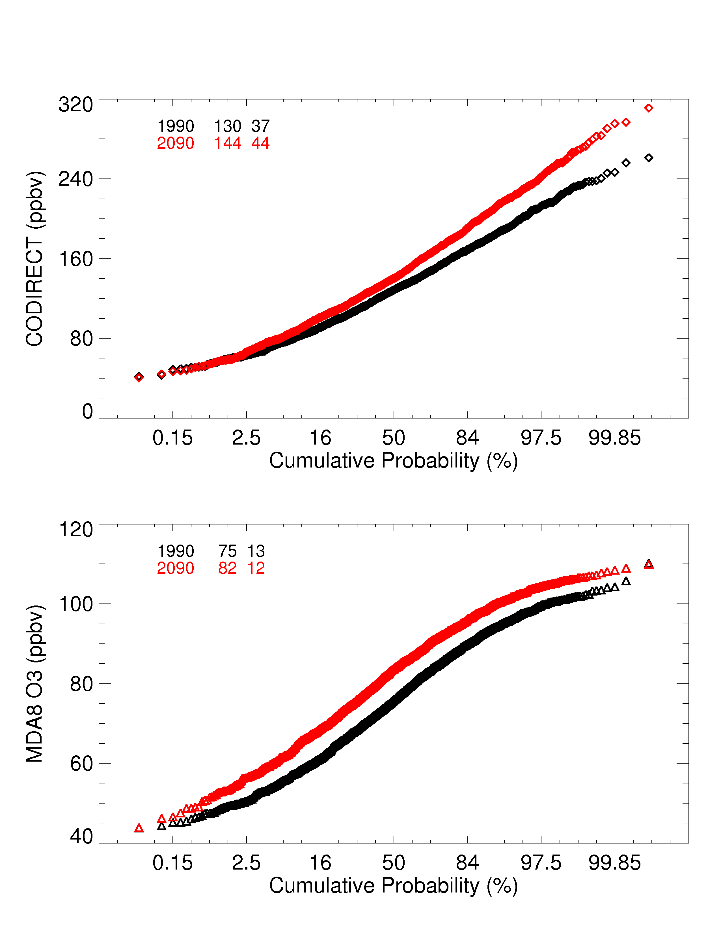
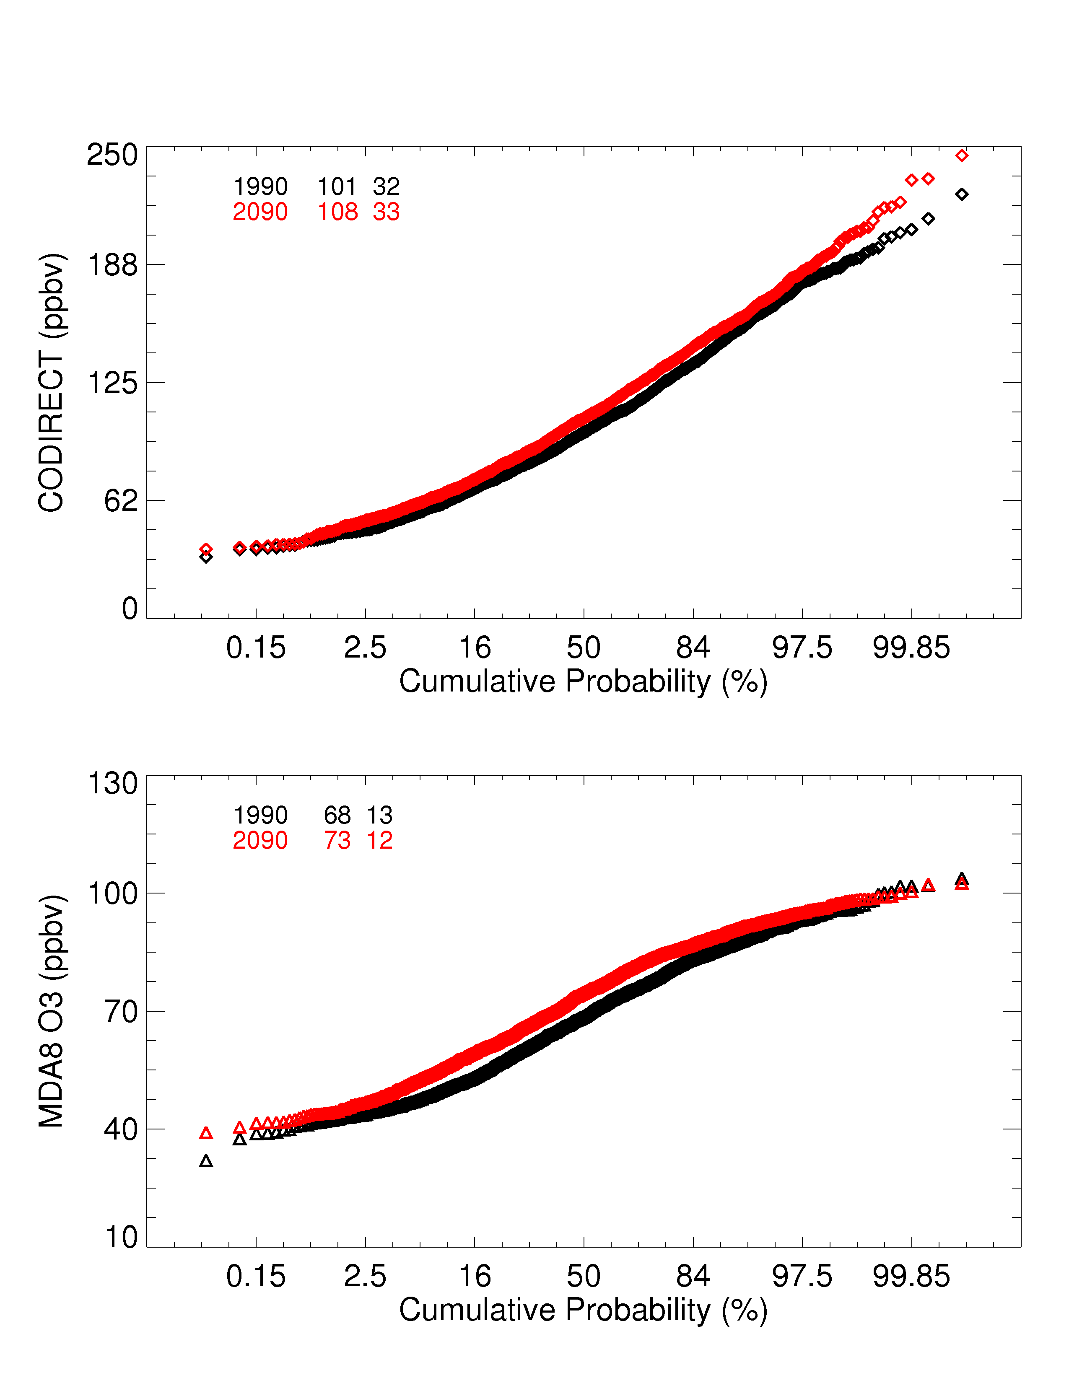
Pollution events, Present and Future (Climate change only):
Ozone vs. idealized tracers
Northeast USA
Great Lakes USA
MDA8 O₃ (ppb)
25-d ay CO tracer (ppb)
→ Shapes of present-day distributions vary by tracer and region
→ Changes in distributions (especially high extremes) differ
Y. Fang
Notes:
Check with murazaki & hess vs Wu et al vs Mickley et al. 2004

Slide 5
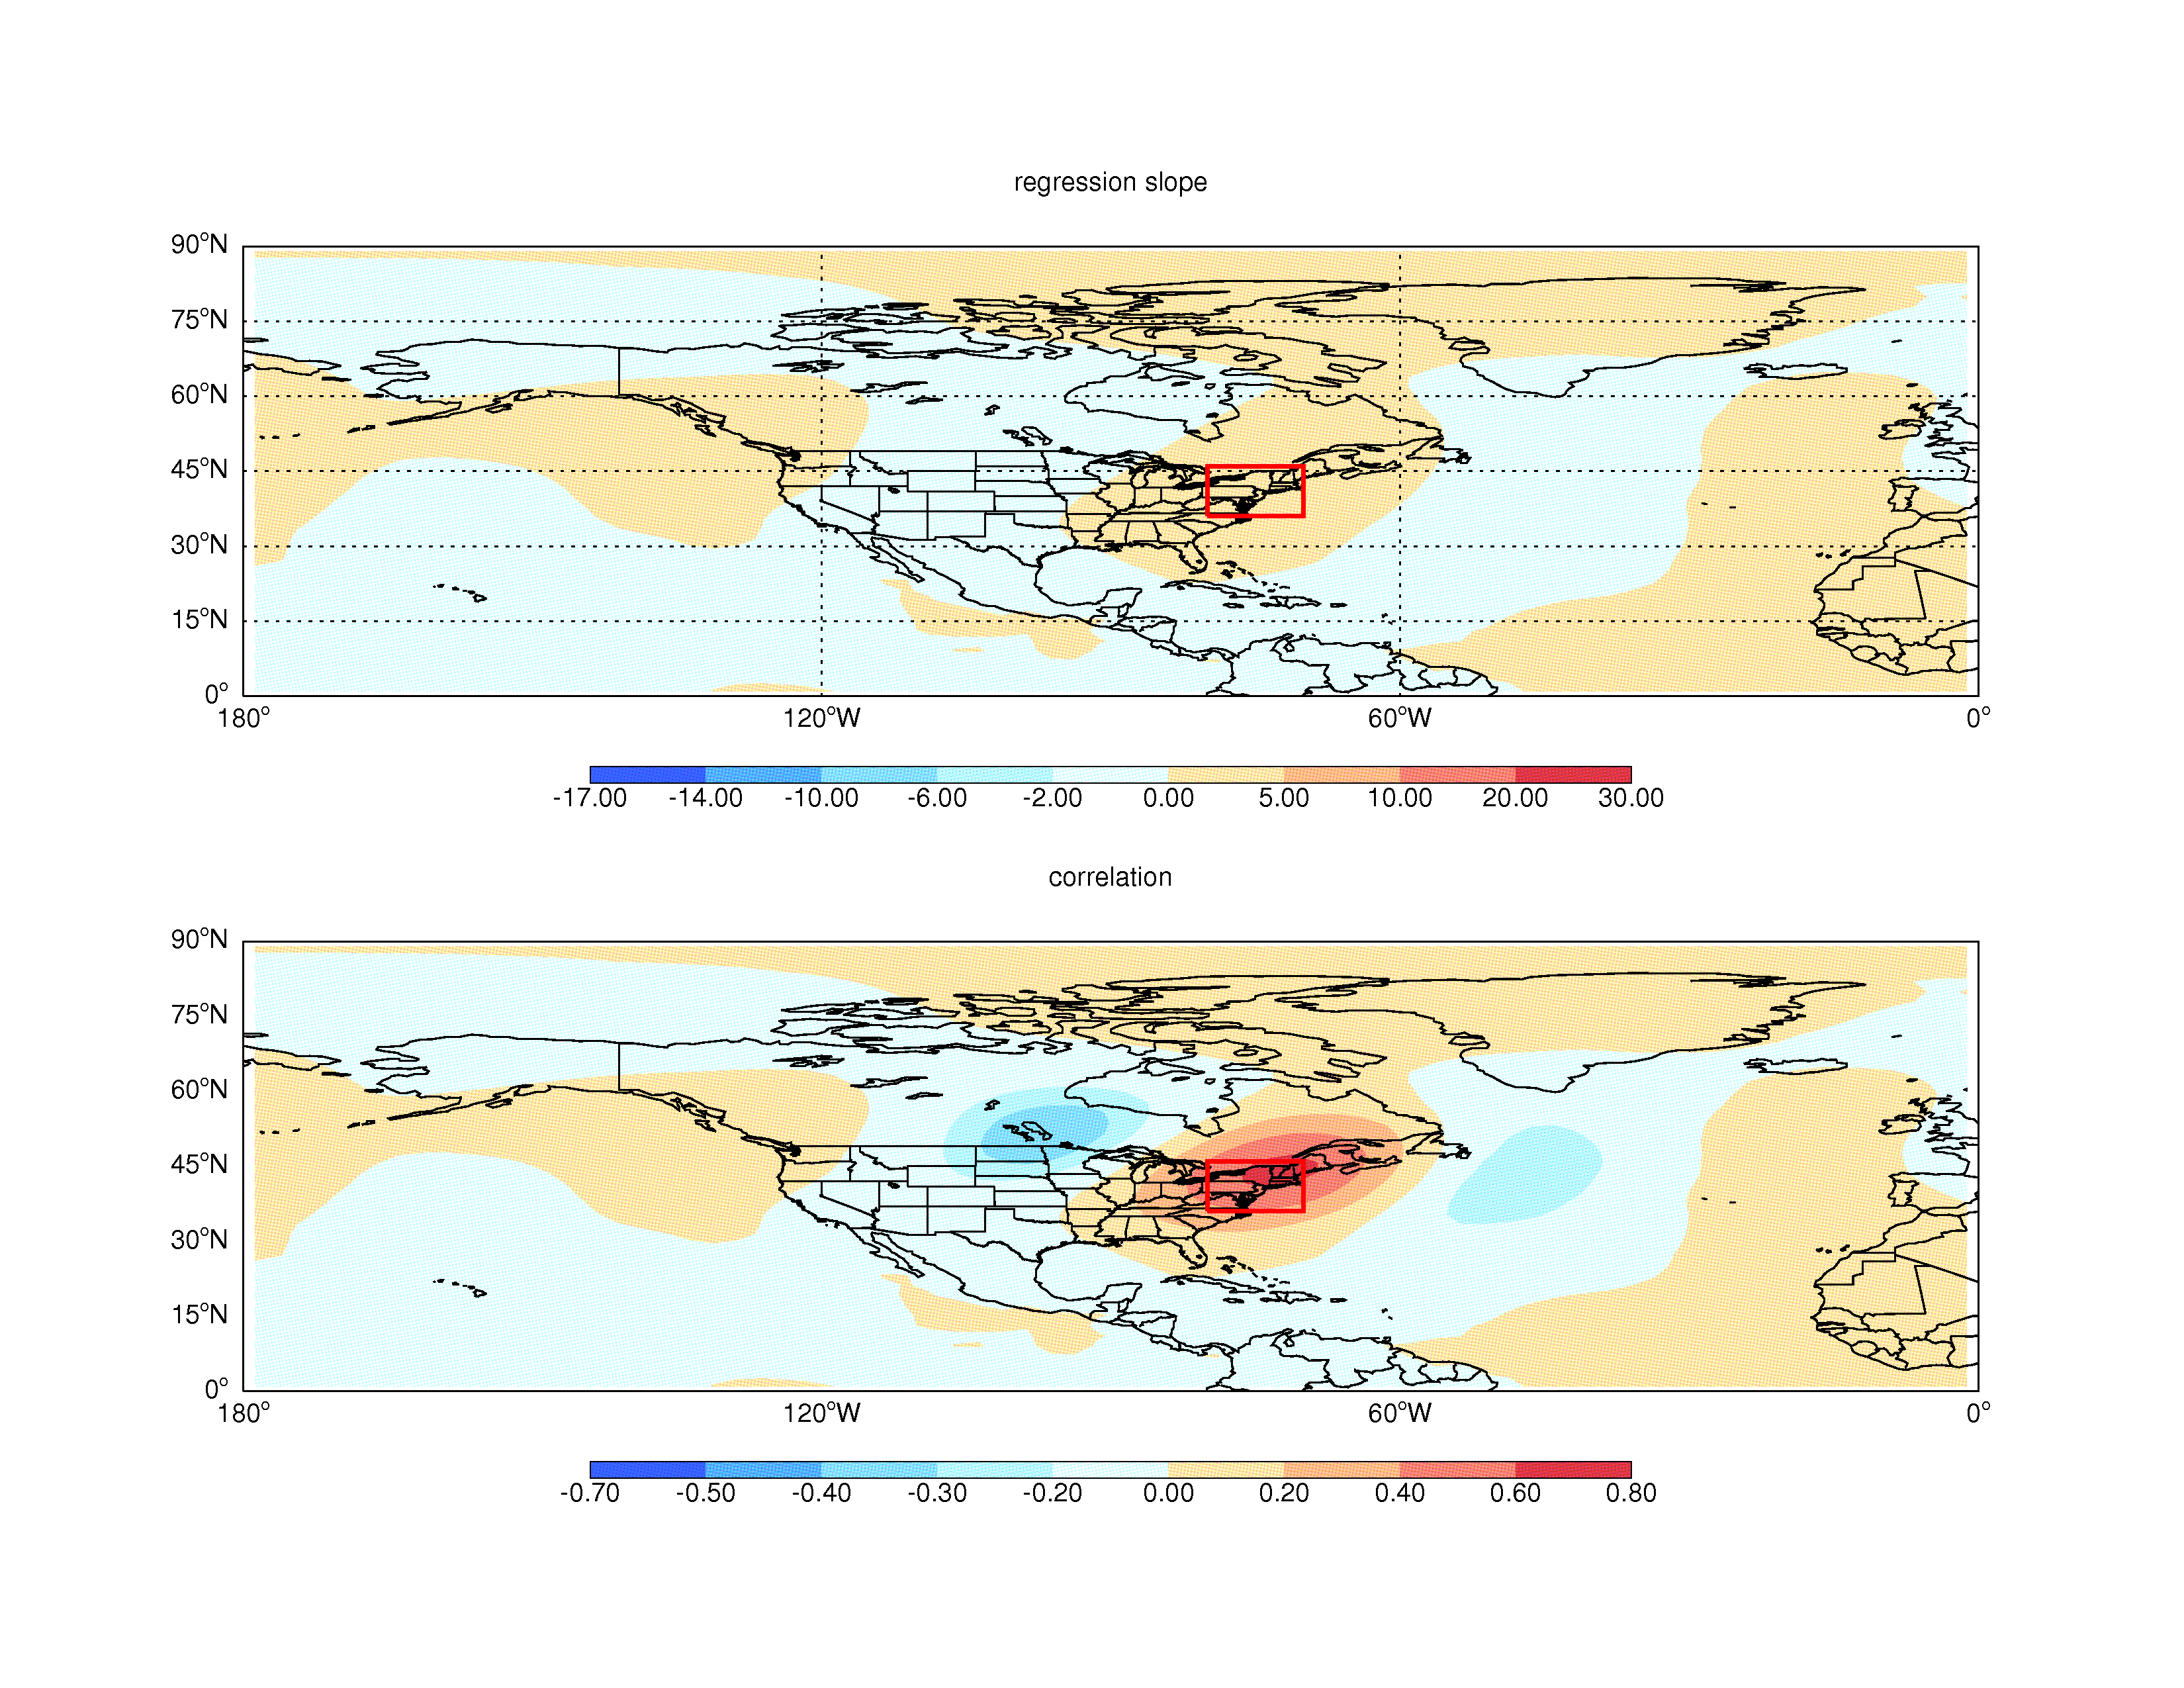
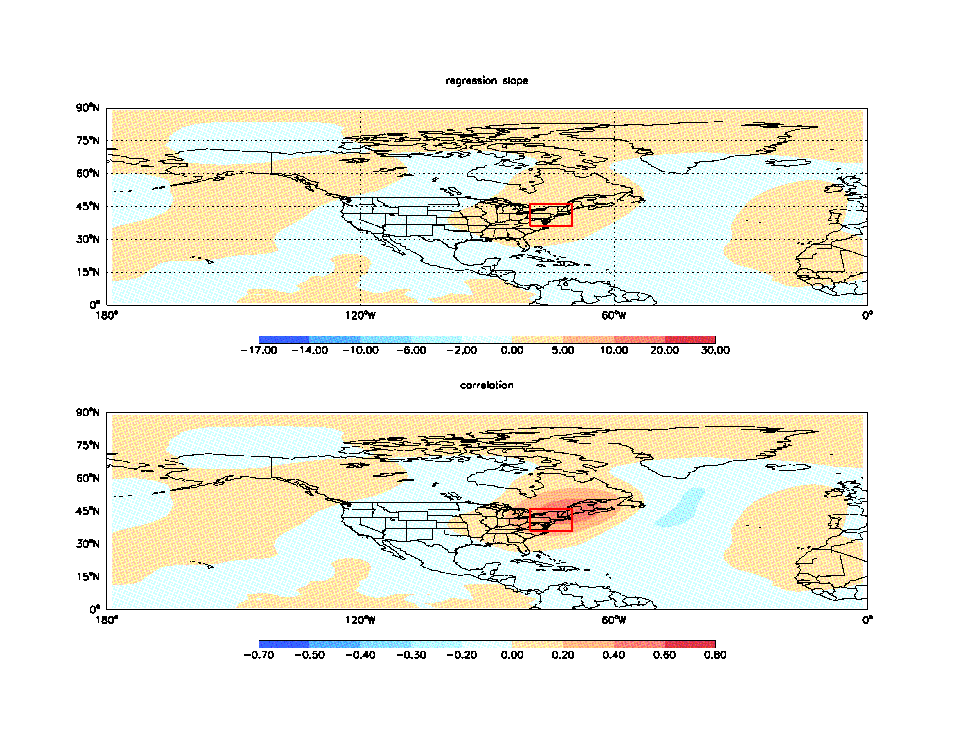
Idealized tracers (cheaper than full chemistry!) may offer insights into how pollution responds to shifts in climate
MDA8
Correlation (r) of regional
Average daily values
with 500 hPa geopotential
heights in present-day simulations
Similar patterns emerge.
→ Correlation analysis between idealized tracers and meteorological fields useful for identifying meteorological factors controlling build-up of
pollution (and how those change in the future)
25-d CO tracer
Y. Fang

Slide 6
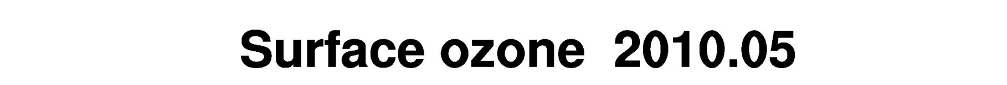
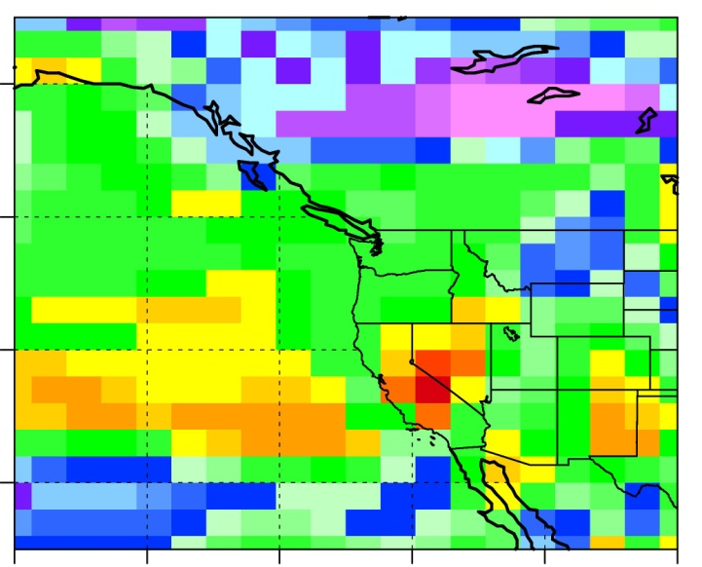
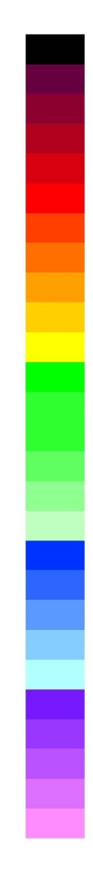
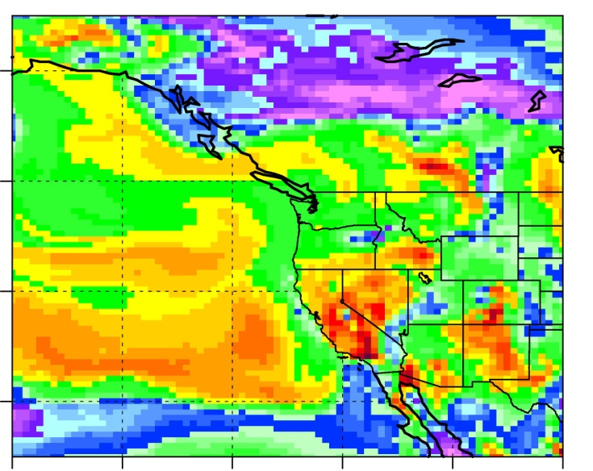
High-resolution version of GFDL AM3 global climate-chemistry model
Nudged to Global Forecasting System U and V
Up-to-date emissions
-US NEI 2005
-Asia INTEX-B scaled to 2010
-Daily resolved fire emissions
1-year coarse-res spin up with and without Asian (15-50N, 95-160E) anthropogenic emissions
High-res run for Jan-Jul 2010 (NOAA CalNex field campaign)
ppb
80
C48 ~200km
70
60
50
C180 ~50km
40
30
Surface O₃ at 2010-05-20_13:00:00
M. Lin et al., in prep.

Slide 7
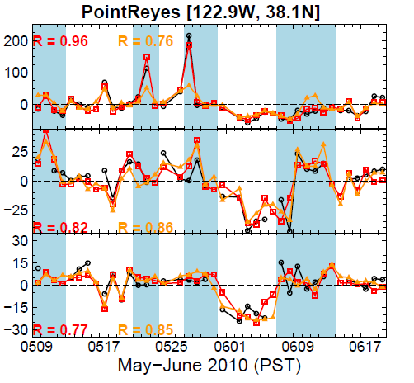

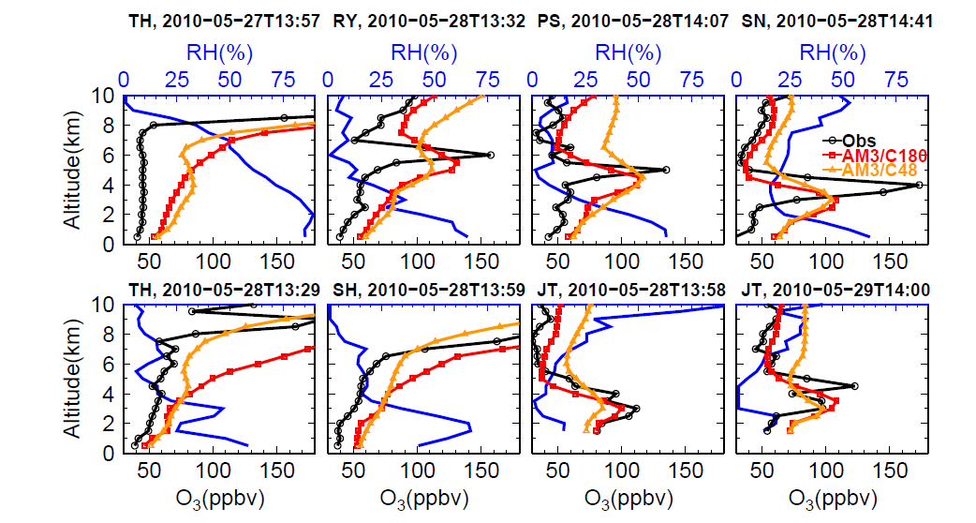
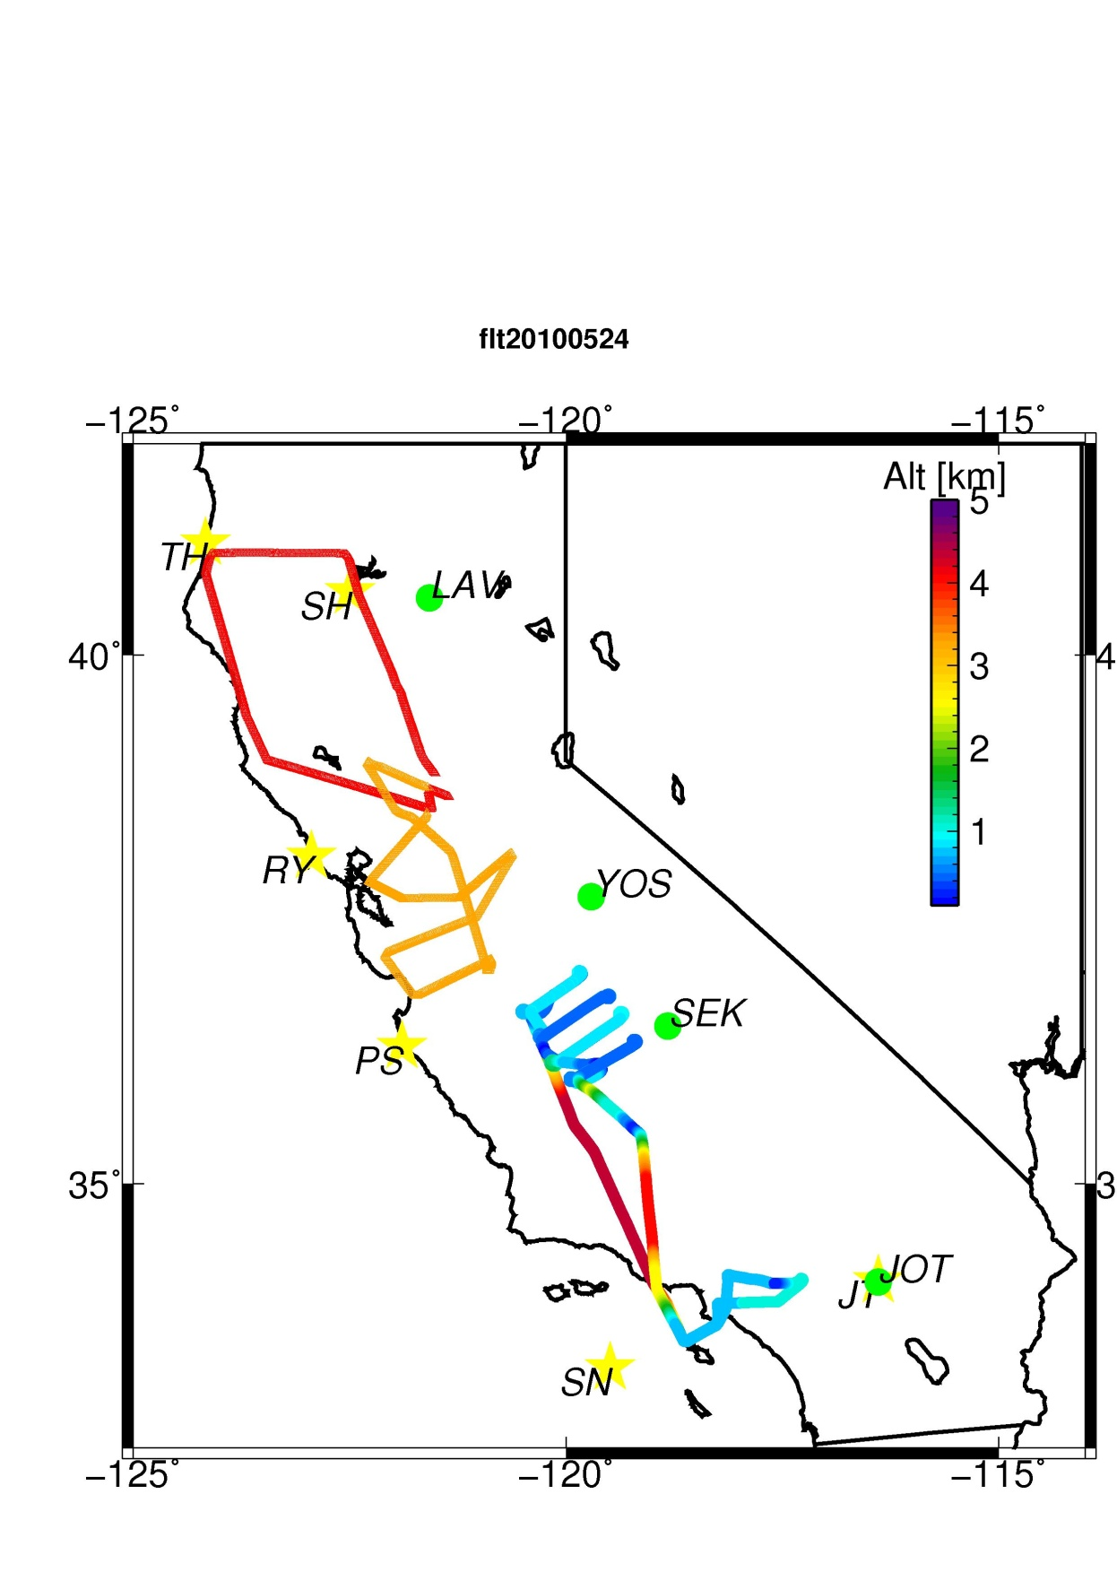
AM3 captures daily variability at sonde locations & structure of stratospheric intrusions along U.S. west coast
May 28 2010, 1:30-2:00 pm PST
6-9 km
3-6 km
RY
PS
0-3 km
SH
JT
SH
JT
Influence of this intrusion on surface ozone?
M. Lin et al., in prep

Slide 8
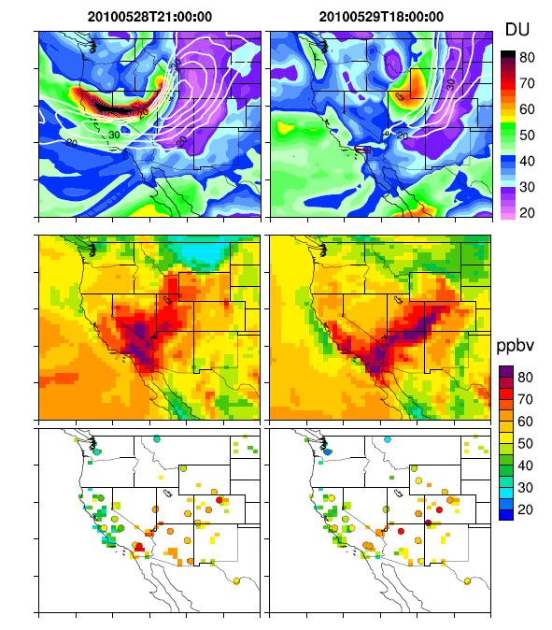
STE event associated with simulated and observed surface O₃ enhancements, May 28-29 2010
Trop. column O₃ (DU)
500 hPa wind speed (contour)
AM3 surface O₃ (ppb)
Observed O₃ (ppb)
AQS + CASTNet
May 28
May 29
Suggestive of STE influence at surface; needs further examination
with strat O₃ tracer and “background” simulations
M. Lin et al., in prep

Slide 9
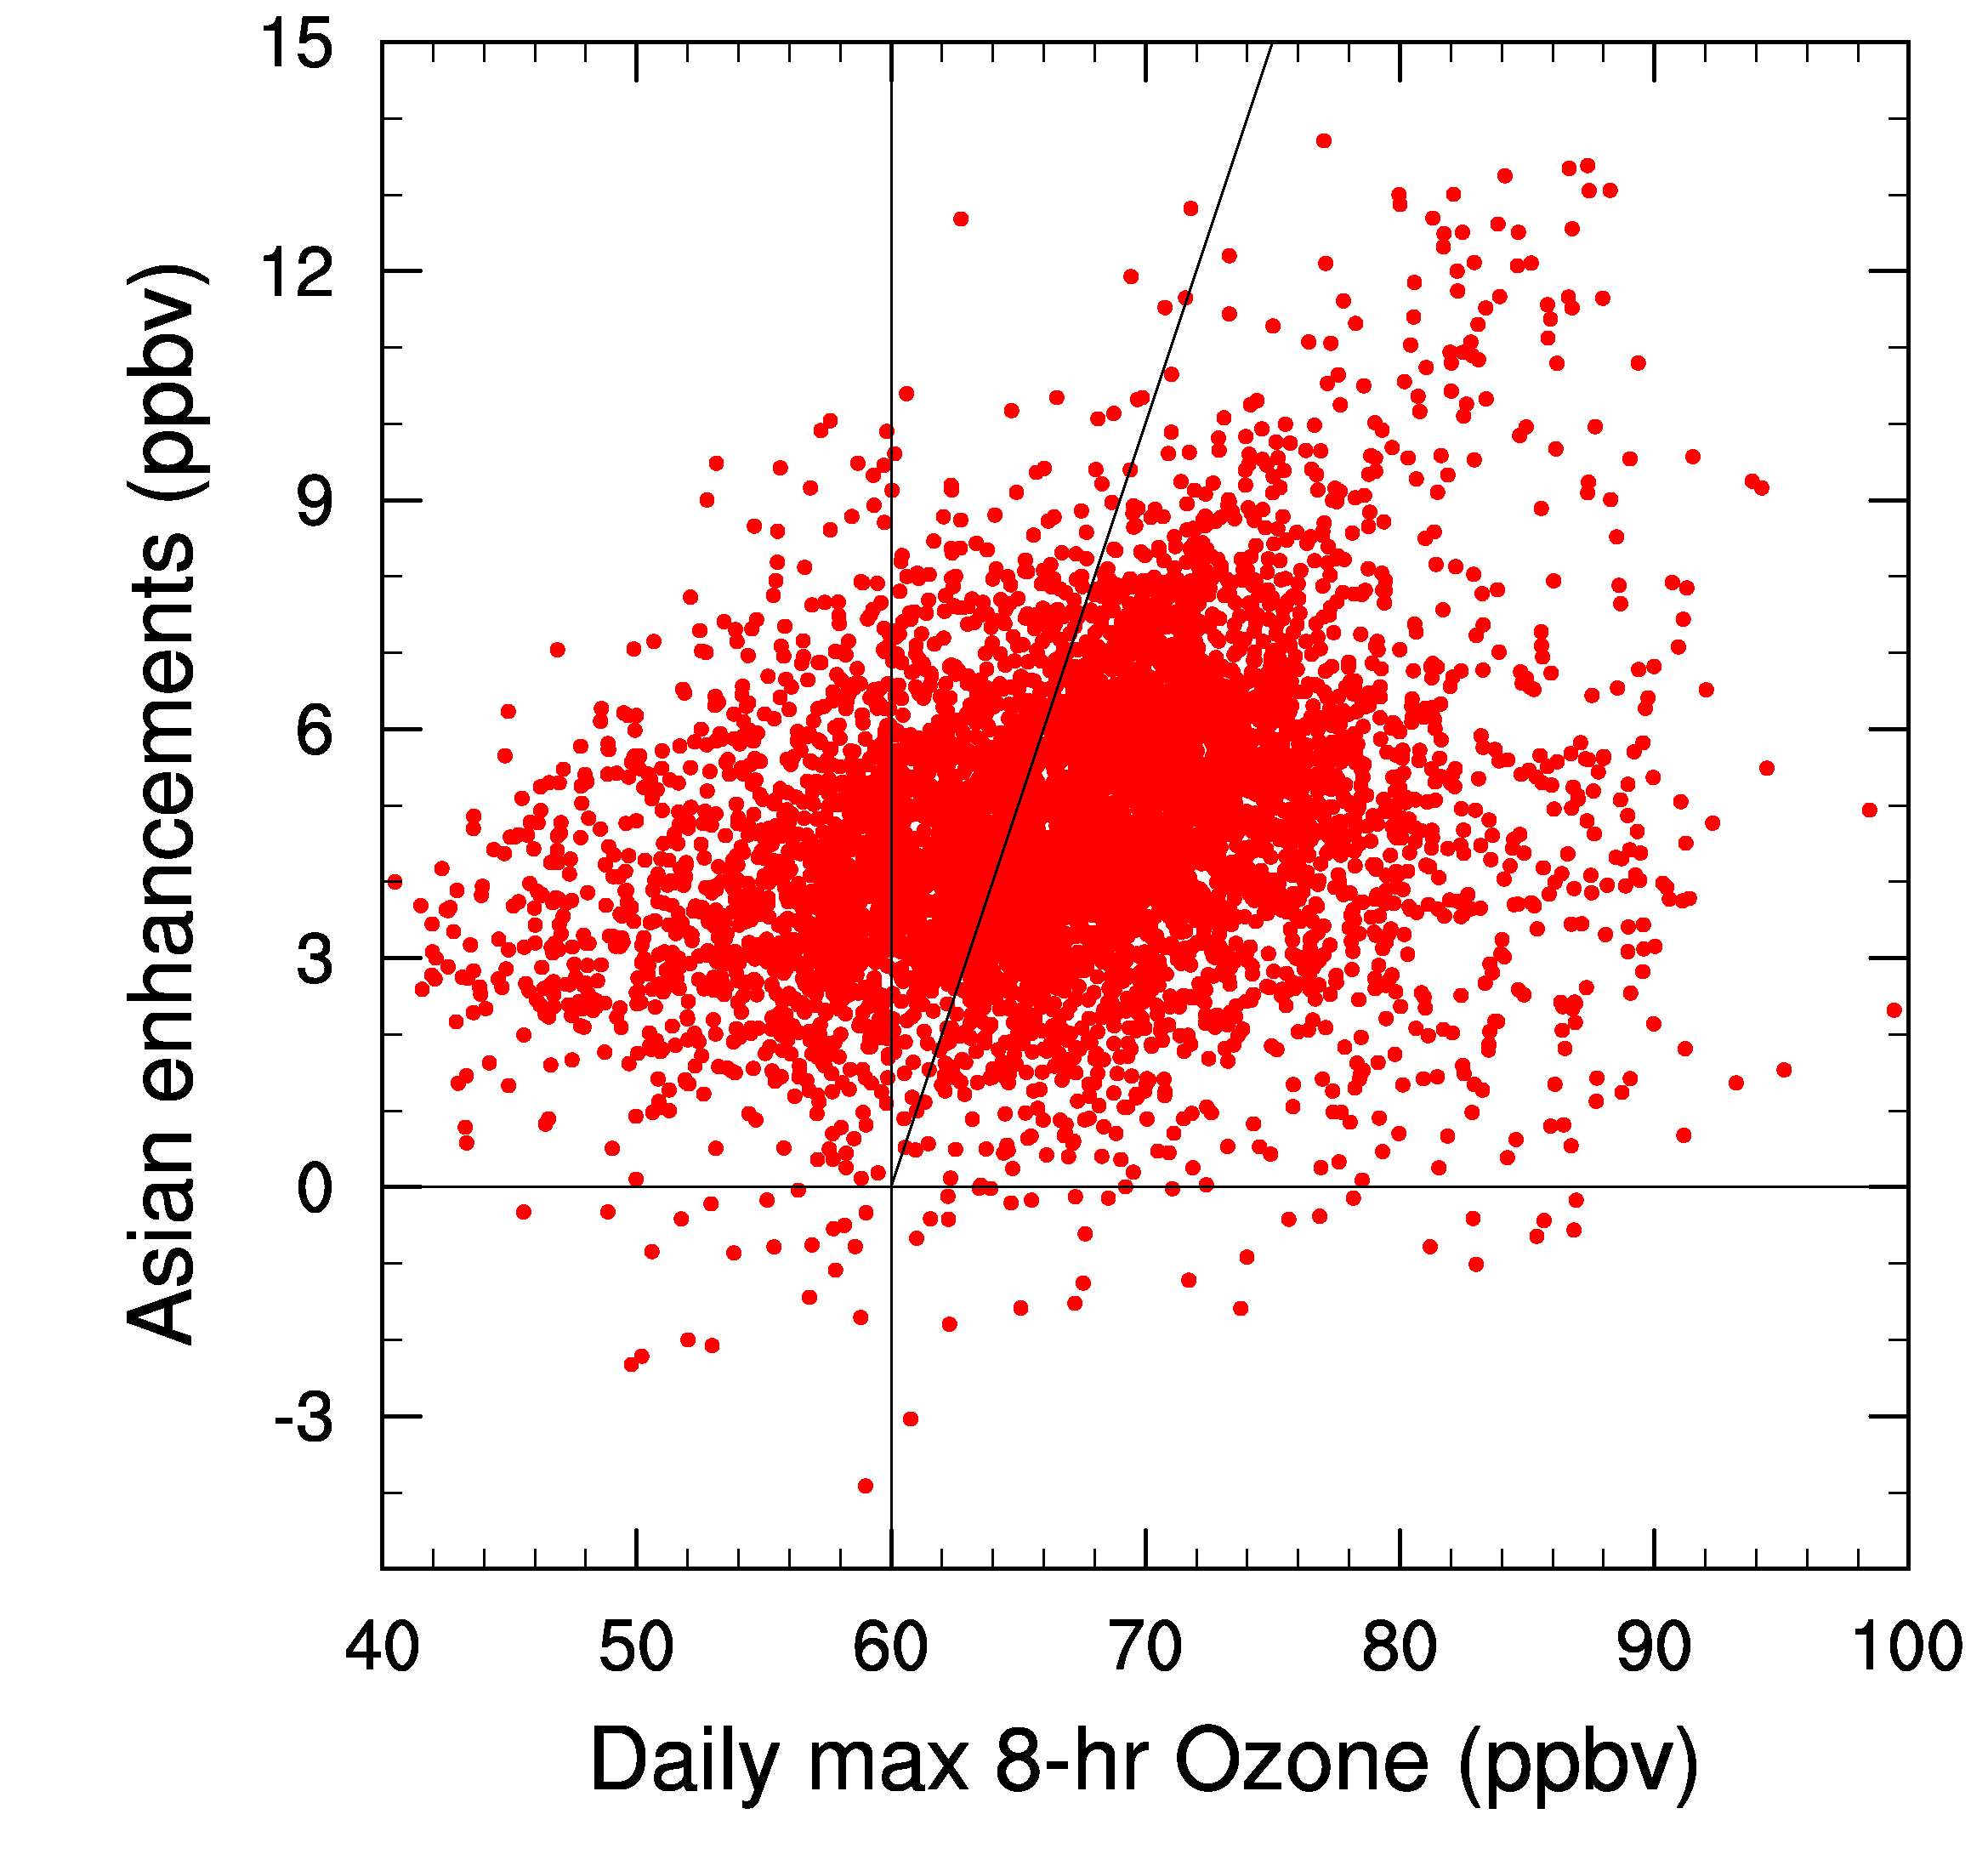
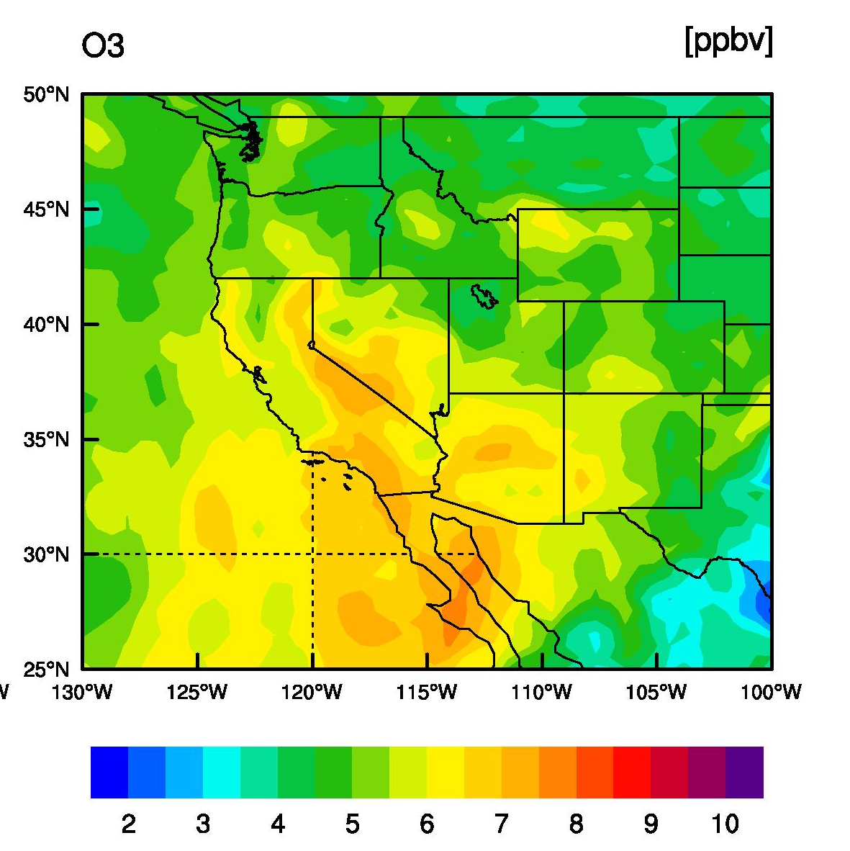
The role of Asian Emissions on
Ozone Exceedances in Southern California
Apr-Jun 2010
15
Mean Asian Ozone
at ~800hPa in May 2010
ppb
>60ppbv
22% of model MDA8 > 60 ppbv would not occur in the absence of Asian emissions
M. Lin, AGU Fall Meeting, Dec 2010

Slide 10
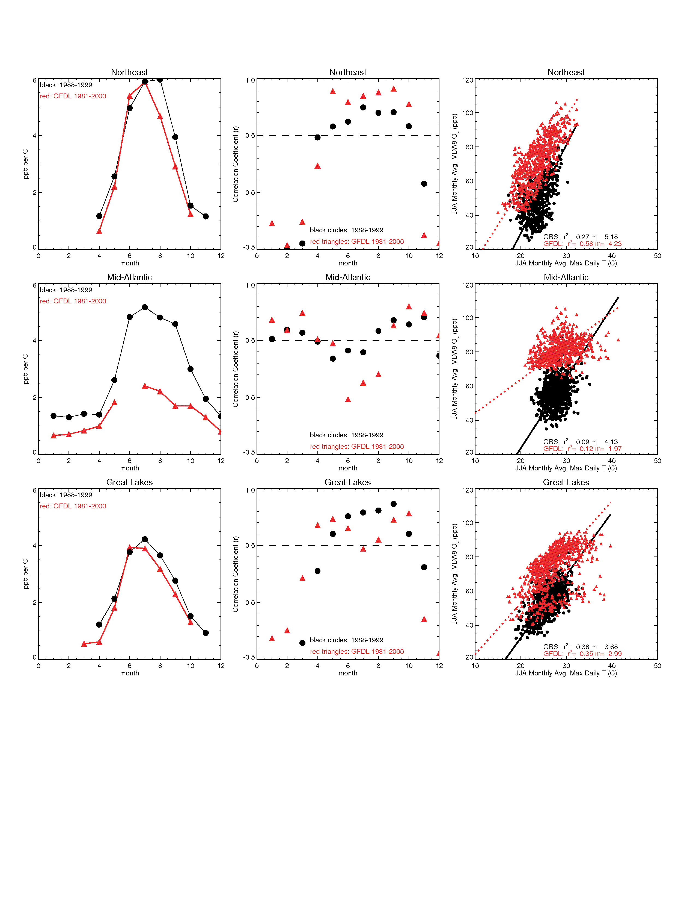
How well does a global chemistry-climate model simulate regional O₃-temperature relationships?
NORTHEAST USA:
monthly average daily max 8-hr avg (MDA8 O₃)
vs. monthly avg. daily max. T
JJA
Monthly avg. MDA8 O₃
AM3 model: 1981-2000 Observed: 1988-1999
Slopes (ppb O₃ per C)
Correlations (r)
Monthly avg. daily max T
Model generally
captures observed
O₃-T relationships
& their seasonal
transitions (despite
mean T and O₃ biases)
Month
Month
D. Rasmussen Jr. et al., in prep

Slide 11
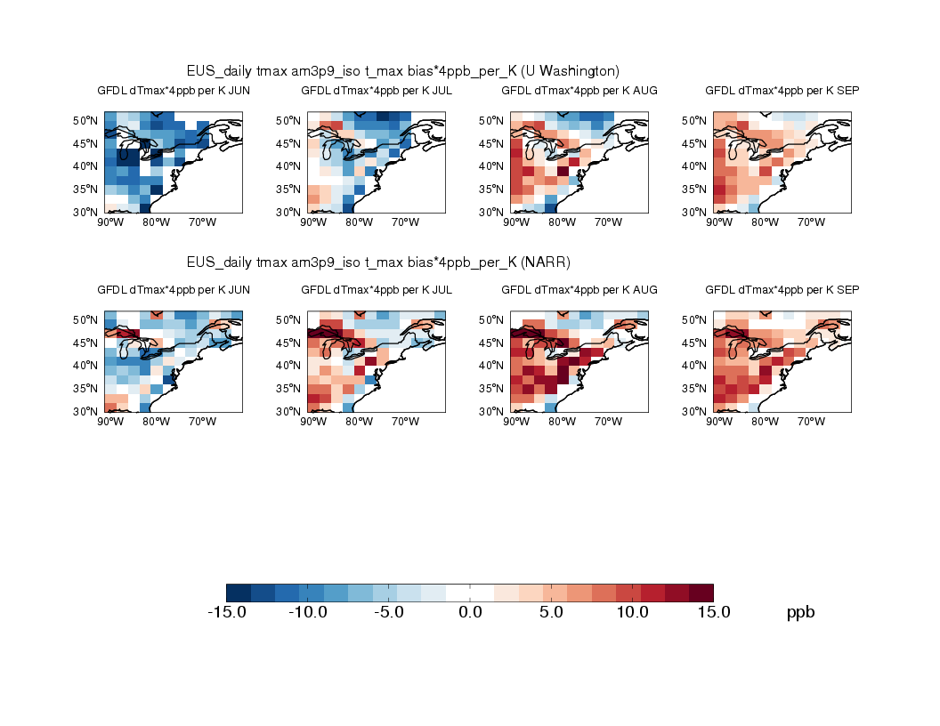
How large a contribution are temperature biases in chemistry-climate models to surface O₃ biases?
Use 2 independent datasets to assess bias in daily max temperature
Assume 4 ppb per C in Jun-Aug & 3 ppb per C in Sep applies throughout EUS
JUN
JUL
AUG
SEP
Maurer et al. 2002
NARR
May be a significant contribution in Aug/Sep, possibly Jul, not Jun
Additional factors still at play in model bias, but illustrates critical need
for accurate representation of daily T max (diurnal cycle)
D. Rasmussen Jr. et al., in prep

