Slide 1
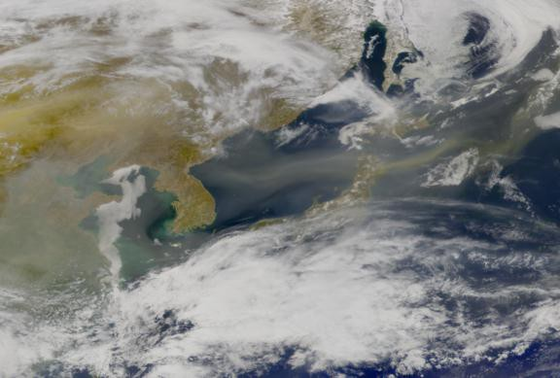
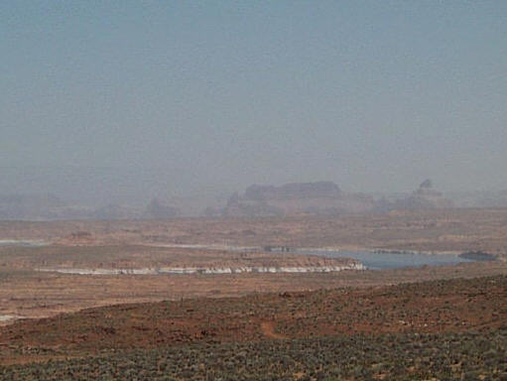





Non-local influences on U.S. air quality: Asian pollution, stratospheric exchange, and climate change
Arlene M. Fiore
Glen Canyon, AZ
April 16, 2001
April 2001, dust leaving Asian coast
Image c/o NASA SeaWiFS Project and ORBIMAGE
Acknowledgments. Meiyun Lin, Vaishali Naik, Larry Horowitz, Jacob Oberman, D.J. Rasmussen, Alex Turner, GAMDT (GFDL); Yuanyuan Fang (Princeton); Oliver Wild (U Lancaster): Mike Bauer (CU/GISS)
Atmospheric Sciences Seminar
Harvard Engineering and Applied Sciences
September 30, 2011

Slide 2
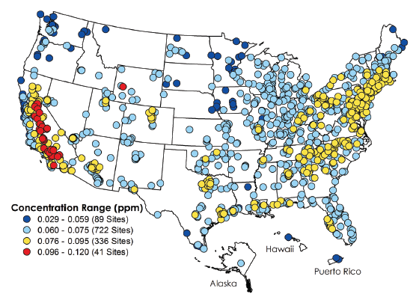
The U.S. ozone smog problem is spatially widespread, affecting ~120 million people [U.S. EPA, 2010]
4th highest maximum daily 8-hr average (MDA8) O₃ in 2008
Future?
Exceeds
standard
(325 counties)
http://www.epa.gov/air/airtrends/2010/
High-O₃ events typically occur in
-- densely populated areas (local sources)
-- summer (favorable meteorological conditions)
Lower threshold would greatly expand non-attainment regions
Estimated benefits from a ~1 ppb decrease in surface O₃:
~ $1.4 billion (agriculture, forestry, non-mortality health) within U.S. [West and Fiore, 2005]
~ 500-1000 avoided annual premature mortalities within N. America [Anenberg et al., 2009]

Slide 3


Tropospheric O₃ formation & “Background” contributions
STRATOSPHERE
O₃
lightning
INTERCONTINENTAL
TRANSPORT
“Background” ozone
NMVOCs
CO, CH₄
NO_{x}
+
Natural
sources
X
X
Human
activity
Fires
Land
biosphere
Ocean
Continent
Continent

Slide 4
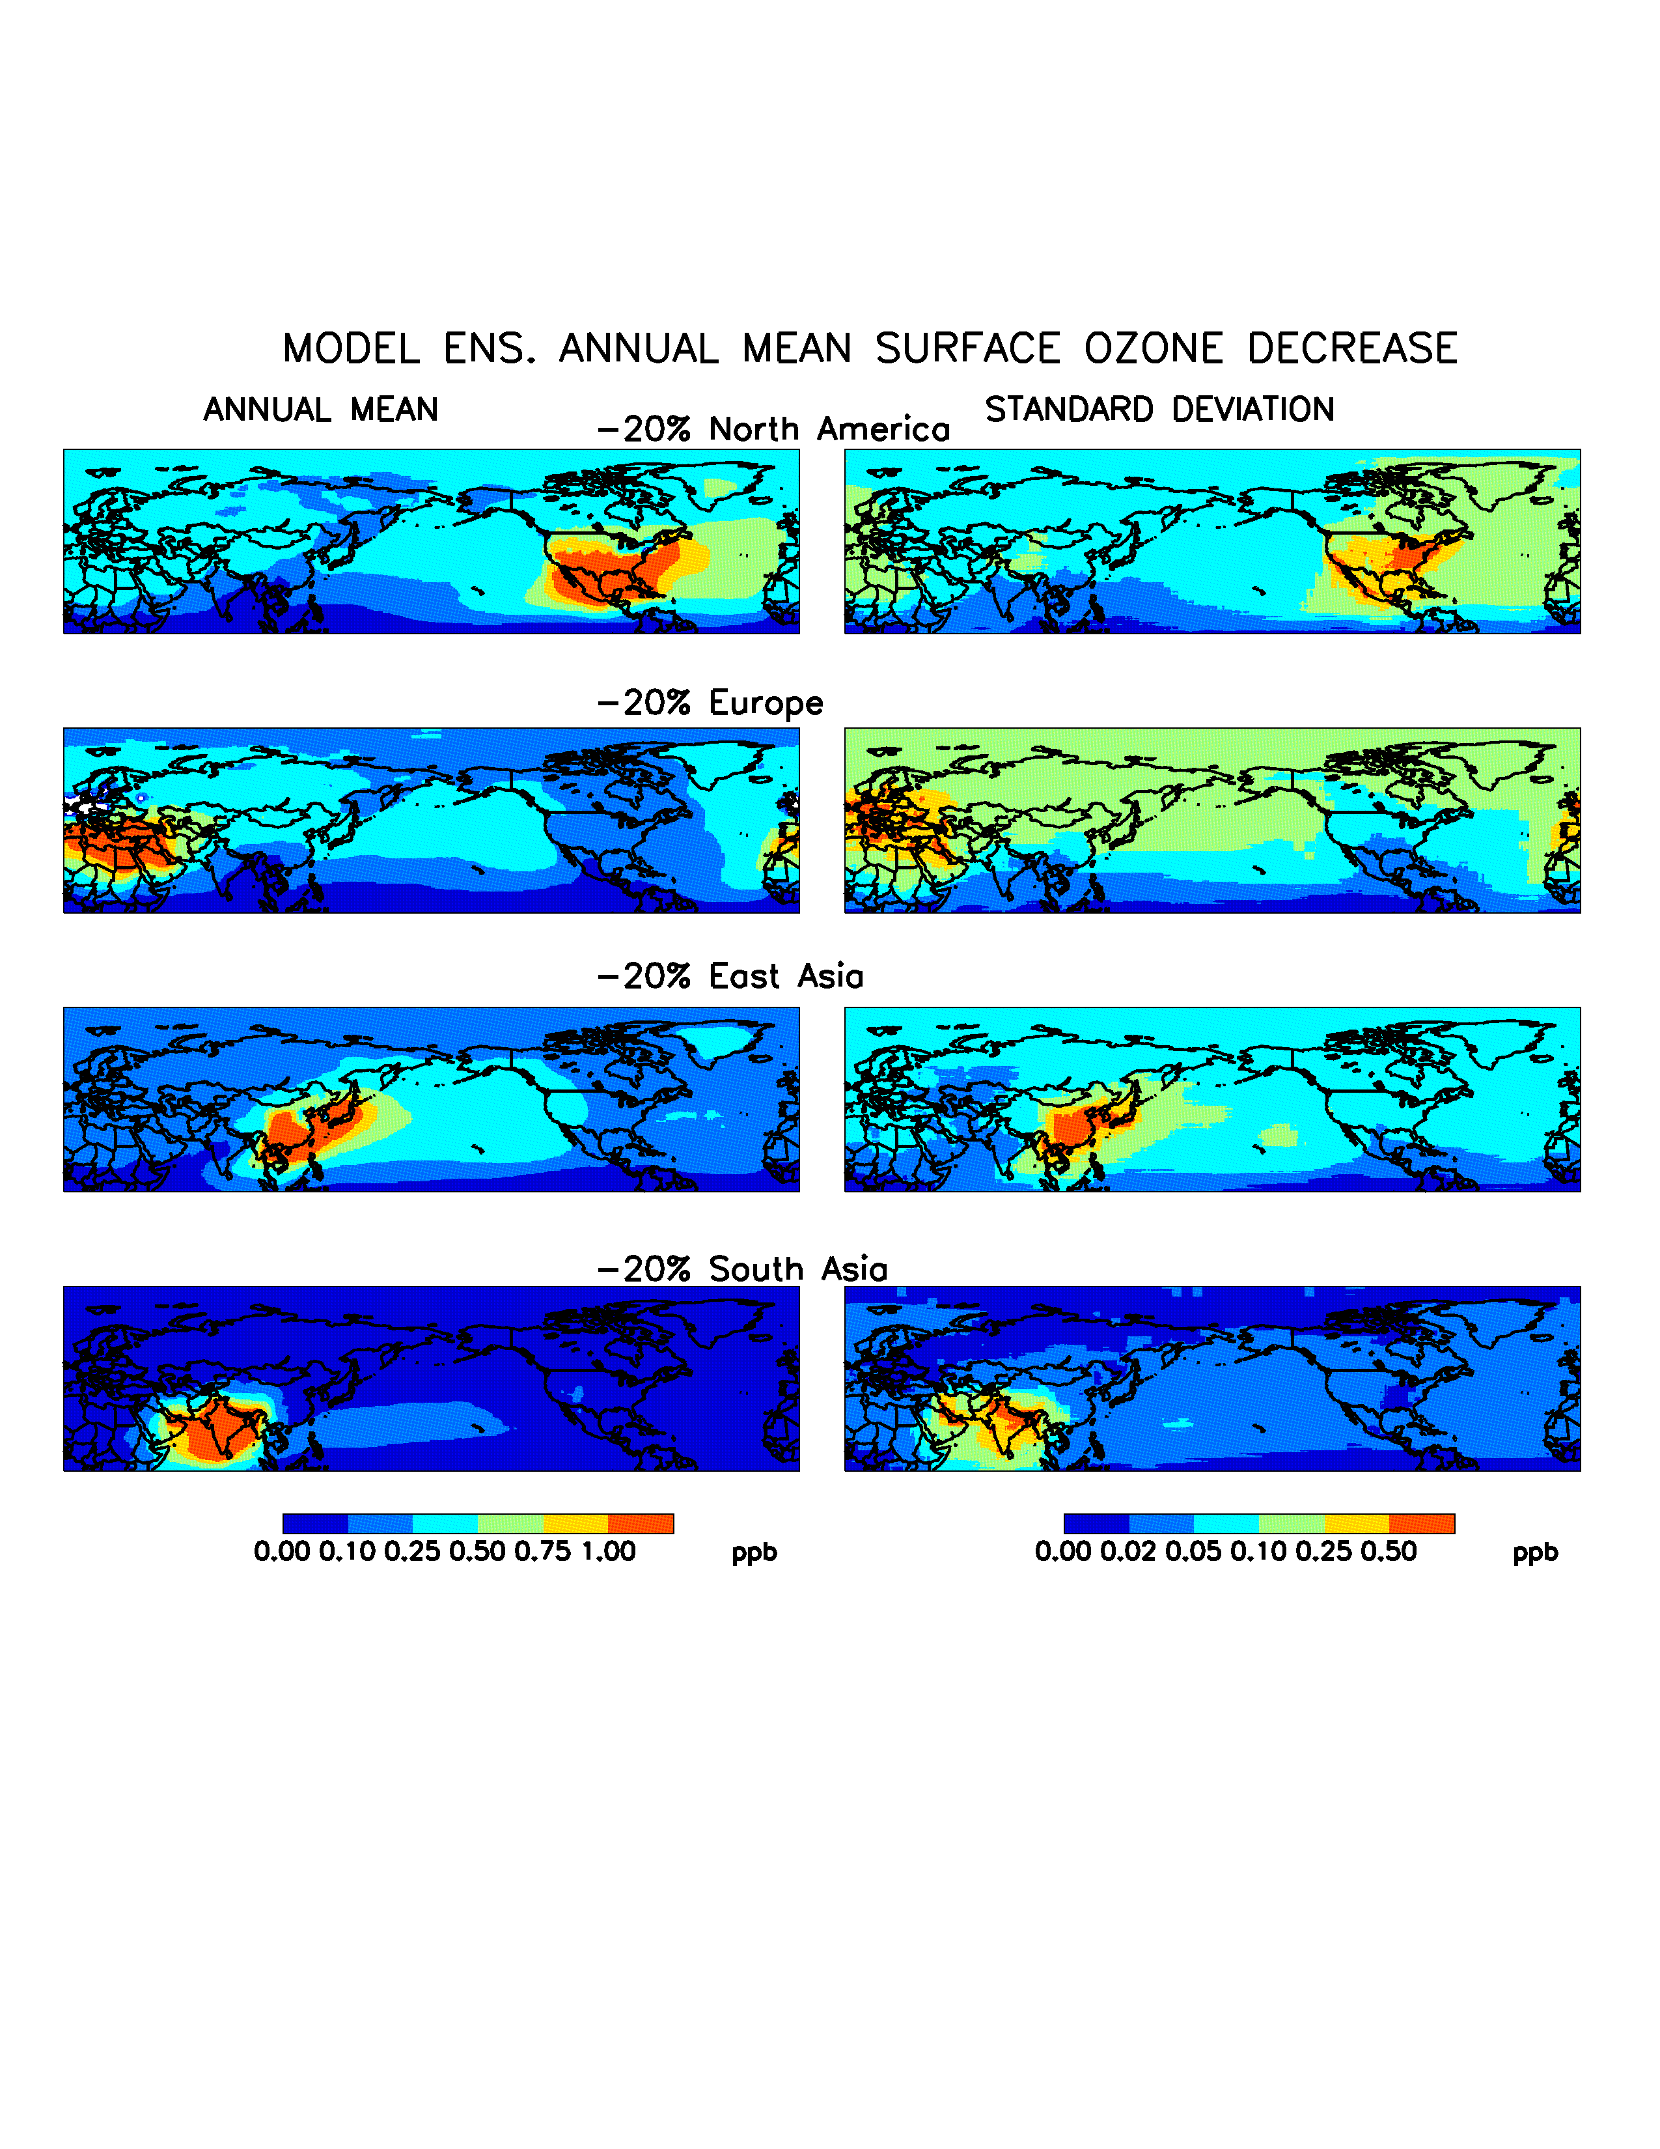
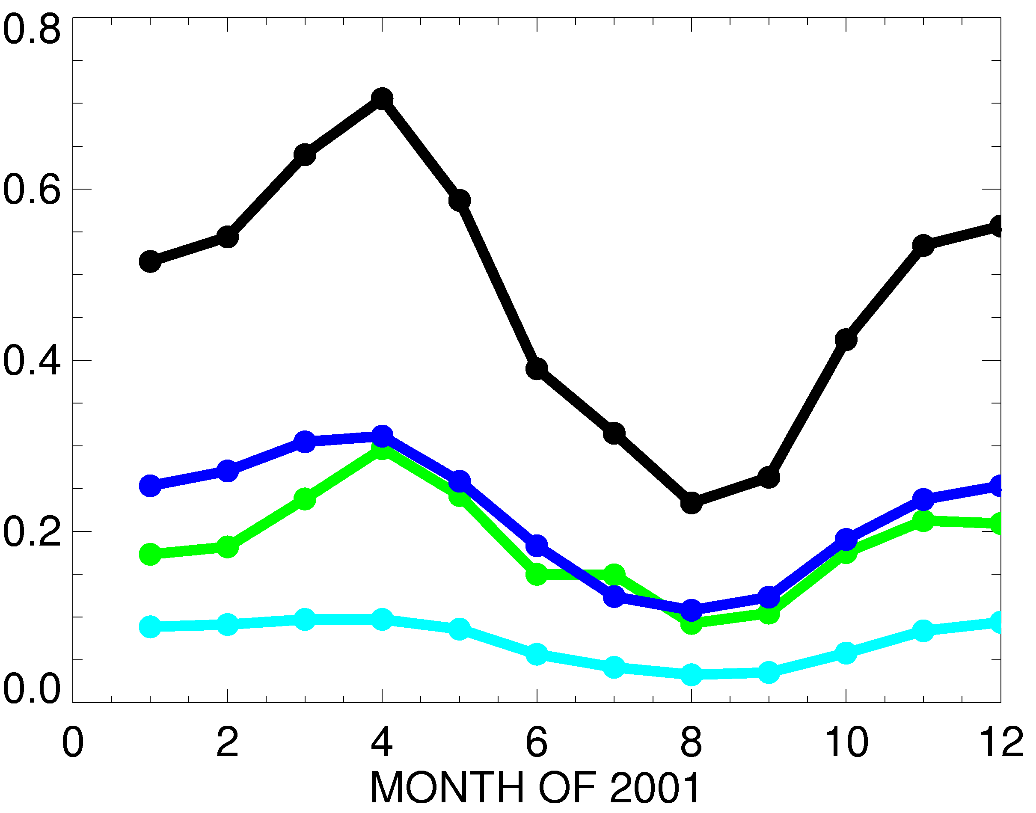
Difficult (impossible?) to observe intercontinental O₃ transport directly so estimates rely on models
15- MODEL MEAN SURFACE O₃ DECREASE (PPBV)
when regional anthrop. O₃ precursor emissions are reduced by 20%
Fiore et al., JGR, 2009; TF HTAP 2010
Source region: SUM3 EA EU SA
NA
Receptor region = NA
Annual mean (2001)
EU
EA
ppb
Spring max (longer lifetime, efficient transport ) [e.g., Wang et al., 1998; Wild and Akimoto, 2001; Stohl et al., 2002]
Spatial variability over receptor region
[also Reidmiller et al., 2009; Lin et al., 2010]
How well do models capture the key processes
(export, transport, chemical evolution, mixing to surface)?

Slide 5
Lowering thresholds for U.S. O₃ standard implies thinning “cushion” between regionally produced O₃ and background
U.S. National Ambient Air Quality Standard
for O₃ has evolved over time
typical U.S.“background”
(model estimates)
[Fiore et al., 2003;
Wang et al., 2009;
Zhang et al., 2011]
75 ppb
2008
8-hr
84 ppb
1997
8-hr
120 ppb
1979
1-hr avg
Future?
(proposed)
O₃ (ppbv)
20
40
60
80
100
120
Allowable O₃ produced from U.S. anthrop. sources (“cushion”)
MAJOR CHALLENGES:
Rising Asian emissions [e.g., Jacob et al., 1999; Richter et al., 2005; Cooper et al., 2010]
Frequency of natural events (e.g. stratospheric [Langford et al., 2009])
Warming climate: more O₃ in polluted regions [Jacob & Winner, 2009; Weaver et al., 2009]
( + enhanced strat-to-trop exchange [Collins et al., 2003; Hegglin et al., 2009]? )
→ Need for process-level understanding from daily to multi-decadal time scales

Slide 6
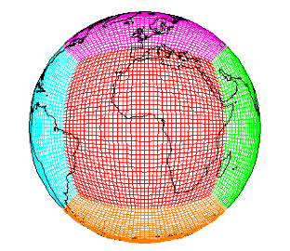
The GFDL CM3/AM3 chemistry-climate model
Donner et al., J. Climate, 2011; Golaz et al., J. Climate, 2011
Modular Ocean Model version 4 (MOM4)
&
Sea Ice Model
SSTs/SIC from observations or CM3 CMIP5 Simulations
cubed sphere grid
~2°x2°; 48 levels
GFDL-AM3
GFDL-CM3
Forcing
Solar Radiation
Well-mixed Greenhouse Gas Concentrations
Volcanic Emissions
Atmospheric Dynamics & Physics
Radiation, Convection (includes wet deposition of tropospheric species), Clouds, Vertical diffusion, and Gravity wave
Atmospheric Chemistry 86 km
0 km
Ozone–Depleting Substances (ODS)
Chemistry of O_{x}, HO_{y}, NO_{y}, Cly, Br_{y}, and Polar Clouds in the Stratosphere
> 6000 years CM3 CMIP5 simulations
AM3 option to nudge to
reanalysis (“real winds”)
High-res. ~0.5°x0.5°
for May-June 2010
(NOAA CalNex field
campaign: ground,
balloon, aircraft obs)
Chemistry of gaseous species (O₃, CO, NO_{x}, hydrocarbons) and aerosols (sulfate, carbonaceous, mineral dust, sea salt, secondary organic)
Pollutant Emissions (anthropogenic, ships, biomass burning, natural, & aircraft)
Aerosol-Cloud Interactions
Dry Deposition
Land Model version 3
(soil physics, canopy physics, vegetation dynamics, disturbance and land use)
Naik et al., in prep

Slide 7
Mean Asian impacts on U.S. surface O₃ in spring: similar estimates with 2 model resolutions (GFDL AM3)
Daily max 8-hr average O₃ in surface air, May-June 2010 average
C48 (~200x200 km)
O₃ (ppb)
C180 (~50x50 km)
8
6
4
2
0
Diagnosed as difference between pairs of simulations:
Base – Zero Asian anthrop. emissions
(Anthrop. emissions: Lamarque et al., 2010; U.S. NEI 2005; Asian 2006 [Zhang et al., 2009] but scaled to 2010 for Chinese NO_{x} & NMVOC )
Maximum in the western U.S. (4-7 ppb)
Large-scale conclusions independent of resolution, though high-res
spatially refines estimates
How much does Asian pollution contribute to surface high-O₃ events?
M. Lin et al., to be submitted to JGR

Slide 8
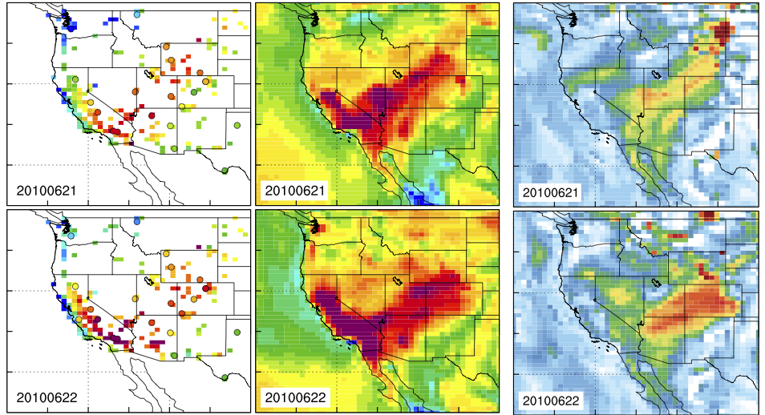
Simulated Asian pollution contribution to high-O₃ events
Obs (CASTNet/AQS)
AM3/C180 total O₃
AM3/C180 Asian ozone
June 21
2010
June 22
2010
Daily max 8-hr average
Current standard
EPA proposed for reconsideration (not adopted)
Asian influence may confound attaining tighter standards in WUS
M. Lin et al., to be submitted to JGR

Slide 9
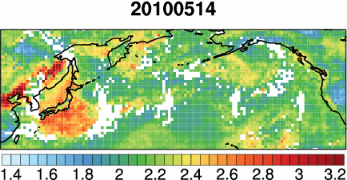
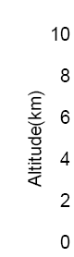
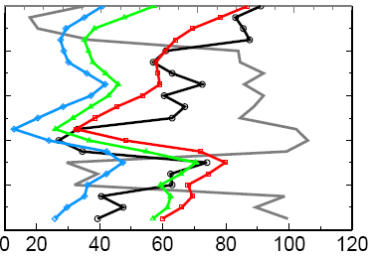
Trans-pacific transport of Asian plumes to WUS often coincides with O₃ injected from stratosphere
The view from satellites
AIRS CO columns
Point Reyes Sonde, CA
20100518
Observed RH (%)
25
50
75
20-30%
from Asia
0
~50%
from O₃-strat
(upper limit)
[10¹⁸ molecules cm⁻²]
O₃ (ppbv)
Obs
(v5.2, Level 3 daily 1°x1° [McMillan et al., 2011])
AM3/C180
AM3 noEA
AM3 model captures the interleaving structure of stratospheric (2-4 km) and Asian ozone (4-10 km)
AM3 O₃-strat
M. Lin et al., to be submitted to JGR

Slide 10
Potential for developing space-based “indicators” for day-to-day variability in Asian influence at WUS sites?
Correlations of AM3 Asian enhancement to MDA8 O₃ at WUS sites with AIRS daily CO columns ~1-2 days prior
NE Pacific AIRS CO (10¹⁸ molec cm⁻²)
NE Pacific AIRS CO (detrended)
AM3 Asian O₃ at 3 WUS sites (ppb)
Grand Canyon NP with AIRS CO column on the previous day
RANGE
Correlation coefficient
Qualitatively promising… but short data set; need a quantitative
relationship required for e.g., “early warning”
→ Extending to other years, also developing a strat-O₃ indicator
M. Lin et al., to be submitted to JGR

Slide 11
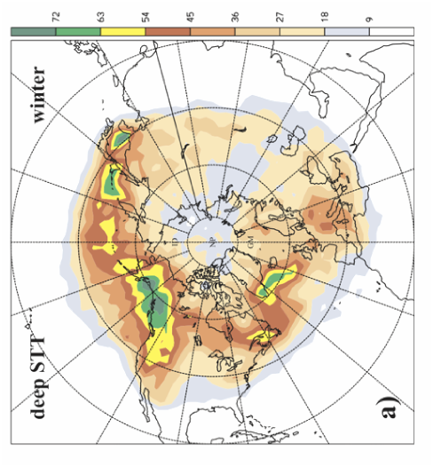
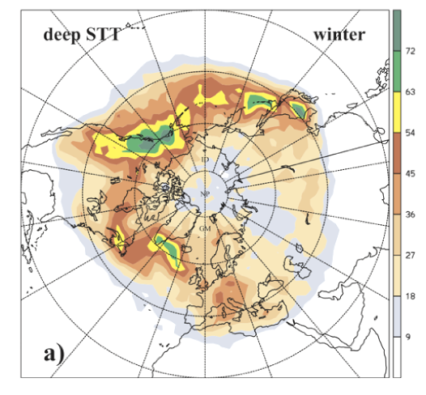
Western North America:
A hotspot for deep stratosphere-to-troposphere transport
Wintertime mass flux exchange associated with deep STT events (trajectory model, ERA-15, winters 1979-1993)
[Sprenger and Wernli, JGR, 2003]
kg km⁻² s⁻¹
72
63
54
45
36
27
18
9
→ Only “deep” (<3 km a.s.l.) intrusions are likely to influence surface ozone

Slide 12
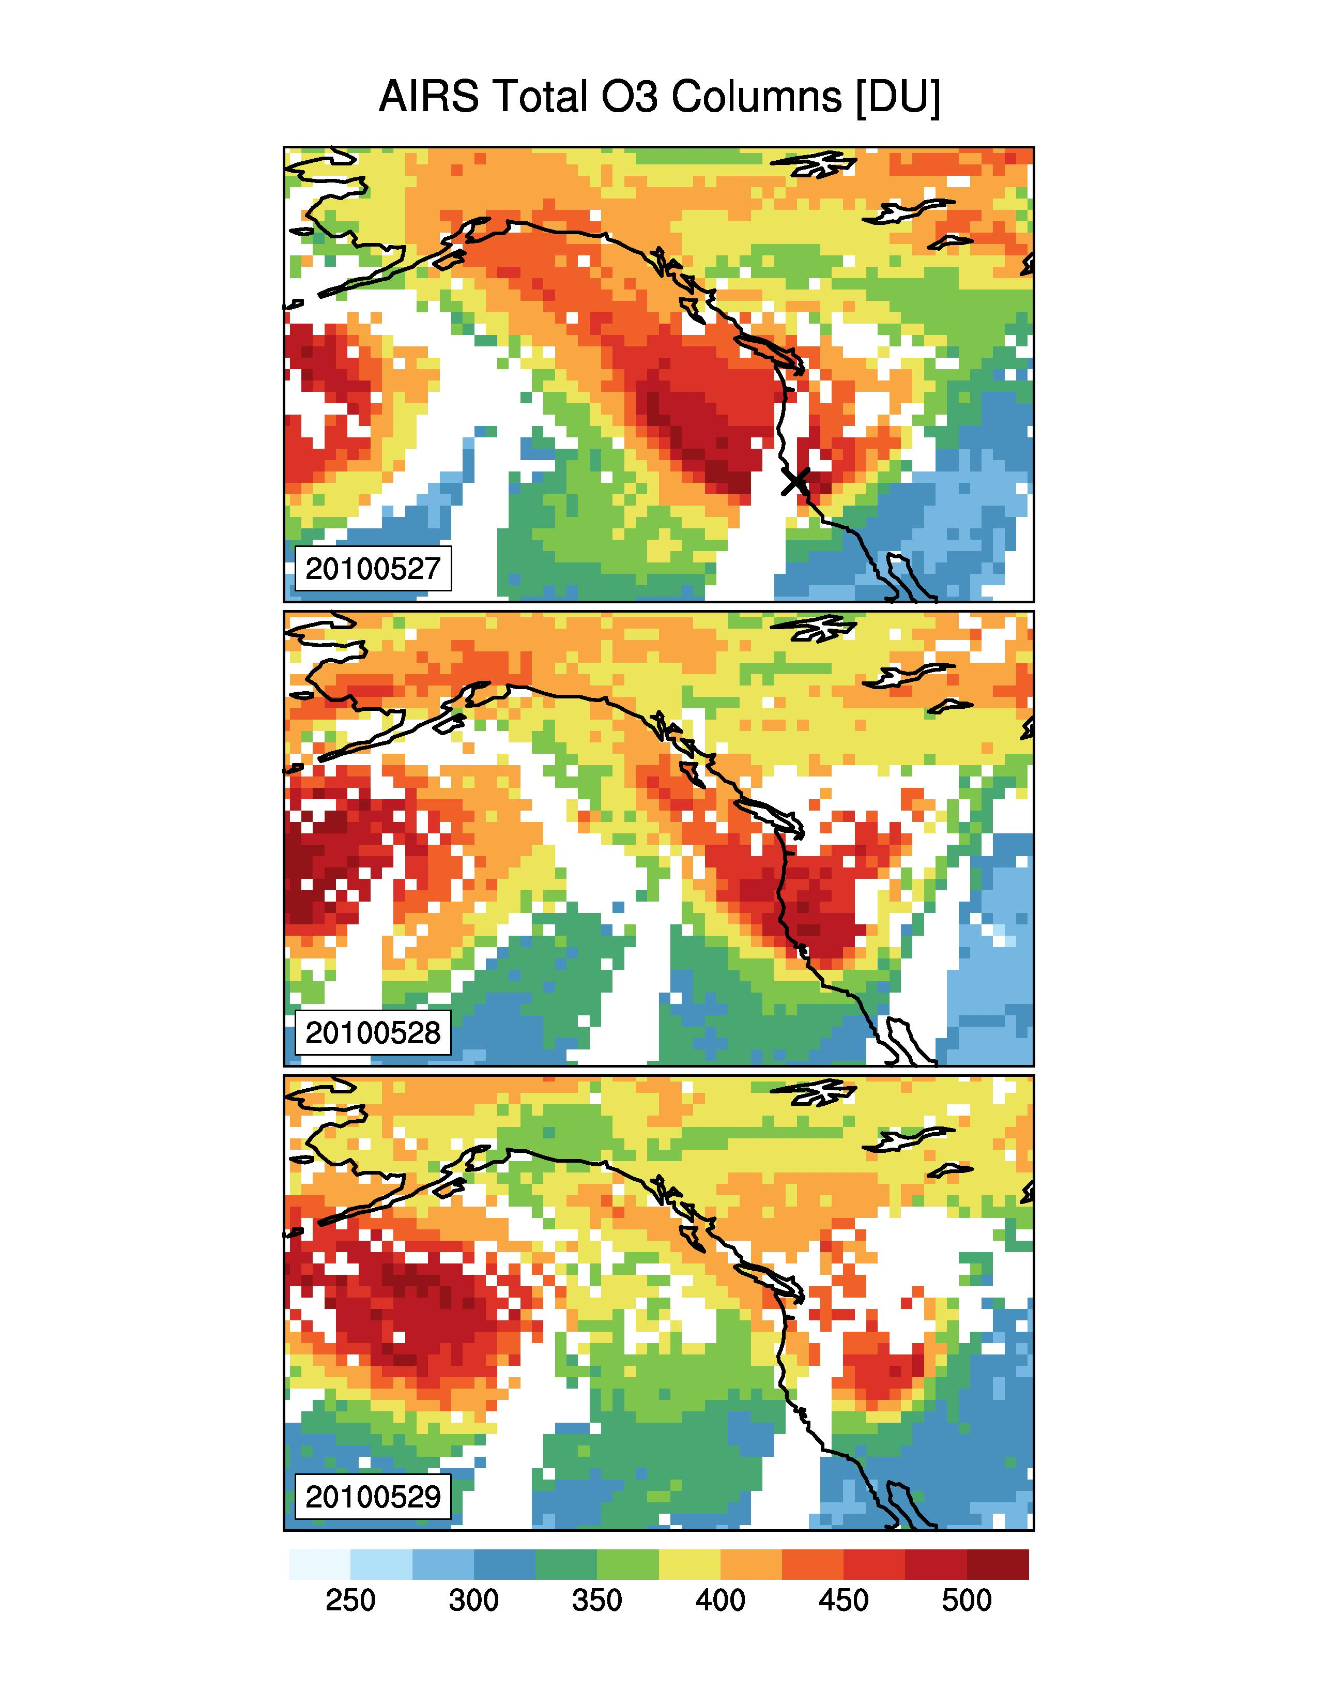
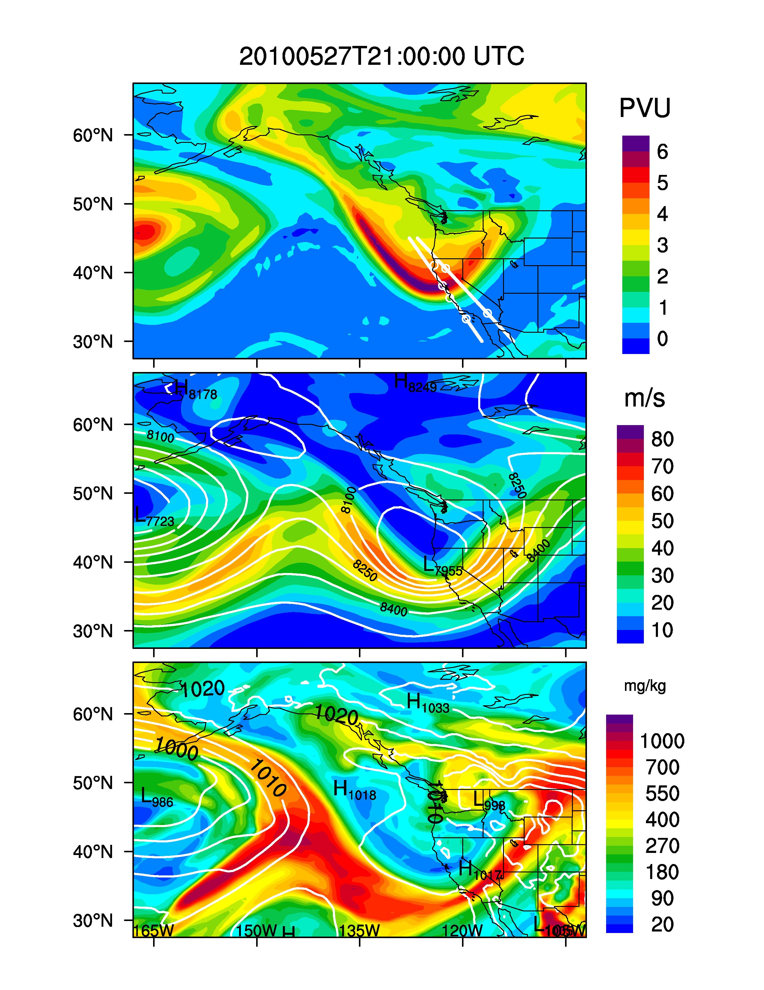
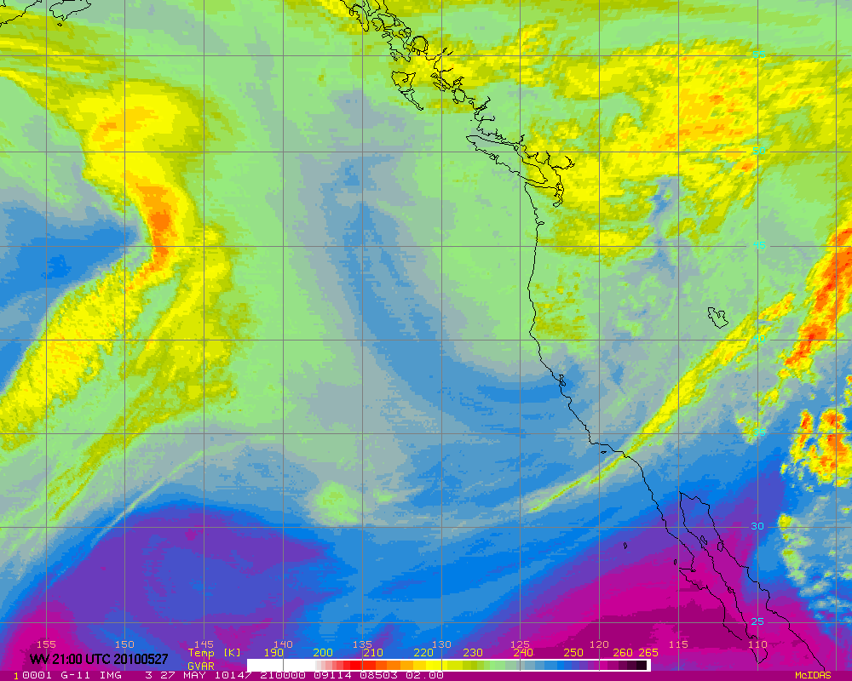
Upper level dynamics associated with a deep stratospheric ozone intrusion (21:00UTC May 27, 2010)
Satellite observations
AM3/C180 simulations
AIRS total column ozone
250 hPa potential vorticity
DU
250 hPa jet (color)
350 hPa geopotential height (contour)
GOES-West water vapor
Decreasing specific humidity →
→ AM3 resolves features consistently with satellite perspective
M. Lin et al., in prep.

Slide 13
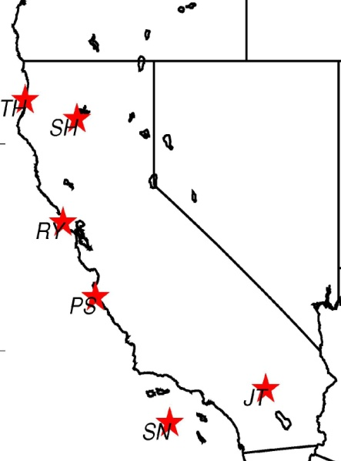
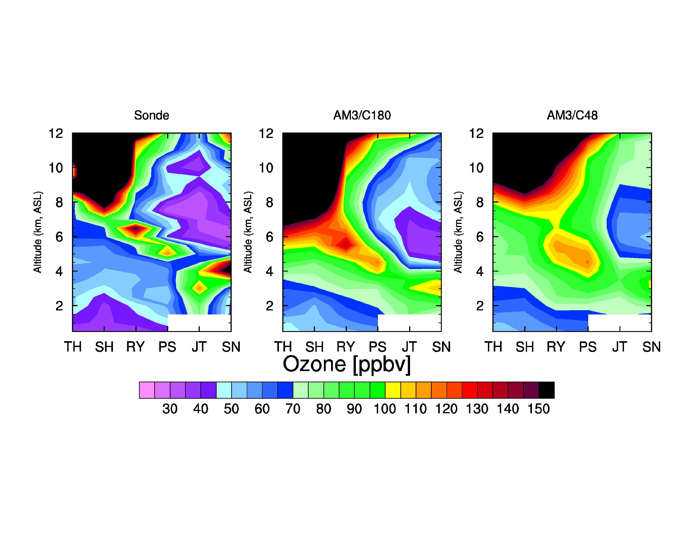
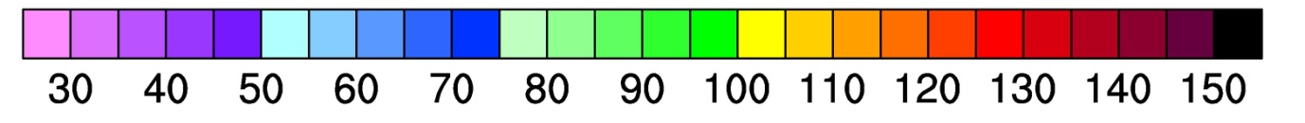
Subsidence of stratospheric ozone to the lower troposphere of southern California (May 28, 2010)
SONDE
AM3/C180 (~50 km)
AM3/C48 (~200 km)
Altitude (km a.s.l.)
model sampled at location and times of sonde launches
north → south
north → south
north → south
O₃ [ppbv]
Vertical cross section along the California coast
High ozone mixing ratios in excess of 90 ppbv between 2-4 km a.s.l
AM3/C180 better captures vertical structure
AM3/C48 reproduces the large-scale view
M. Lin et al., in prep.

Slide 14
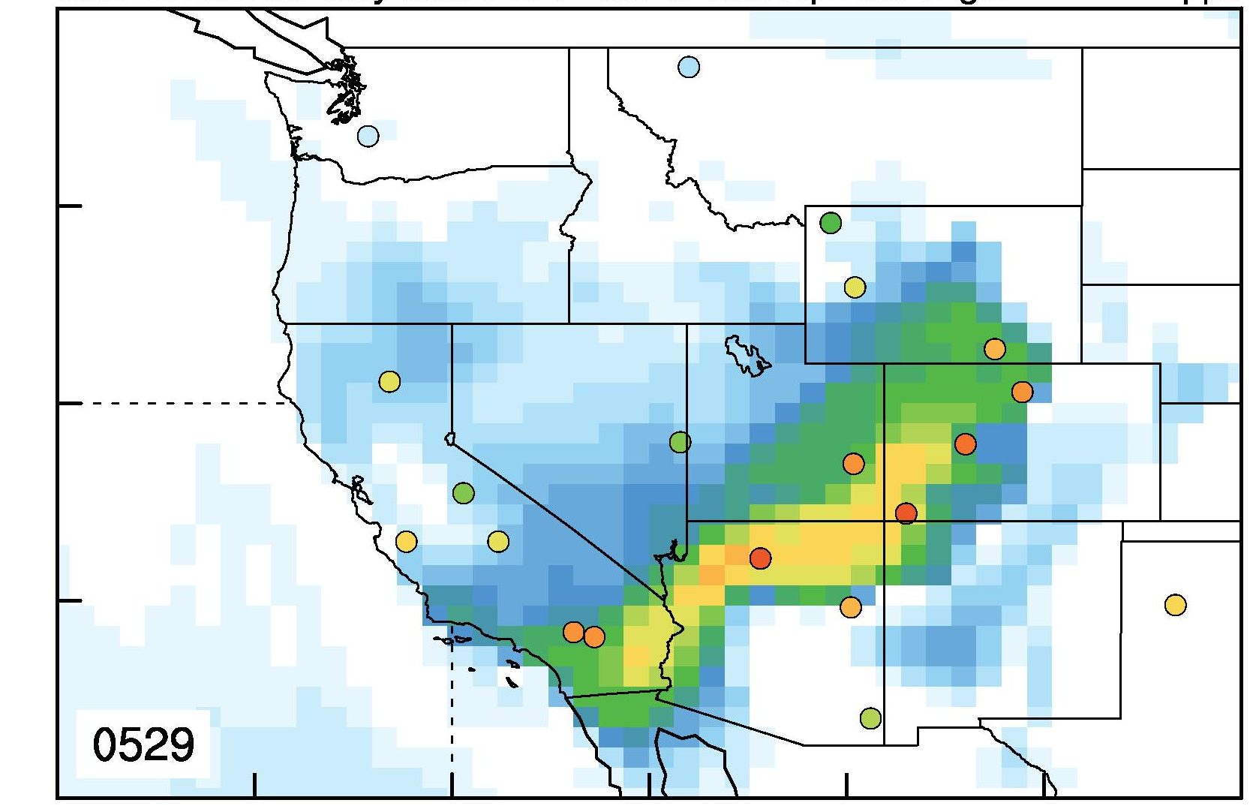
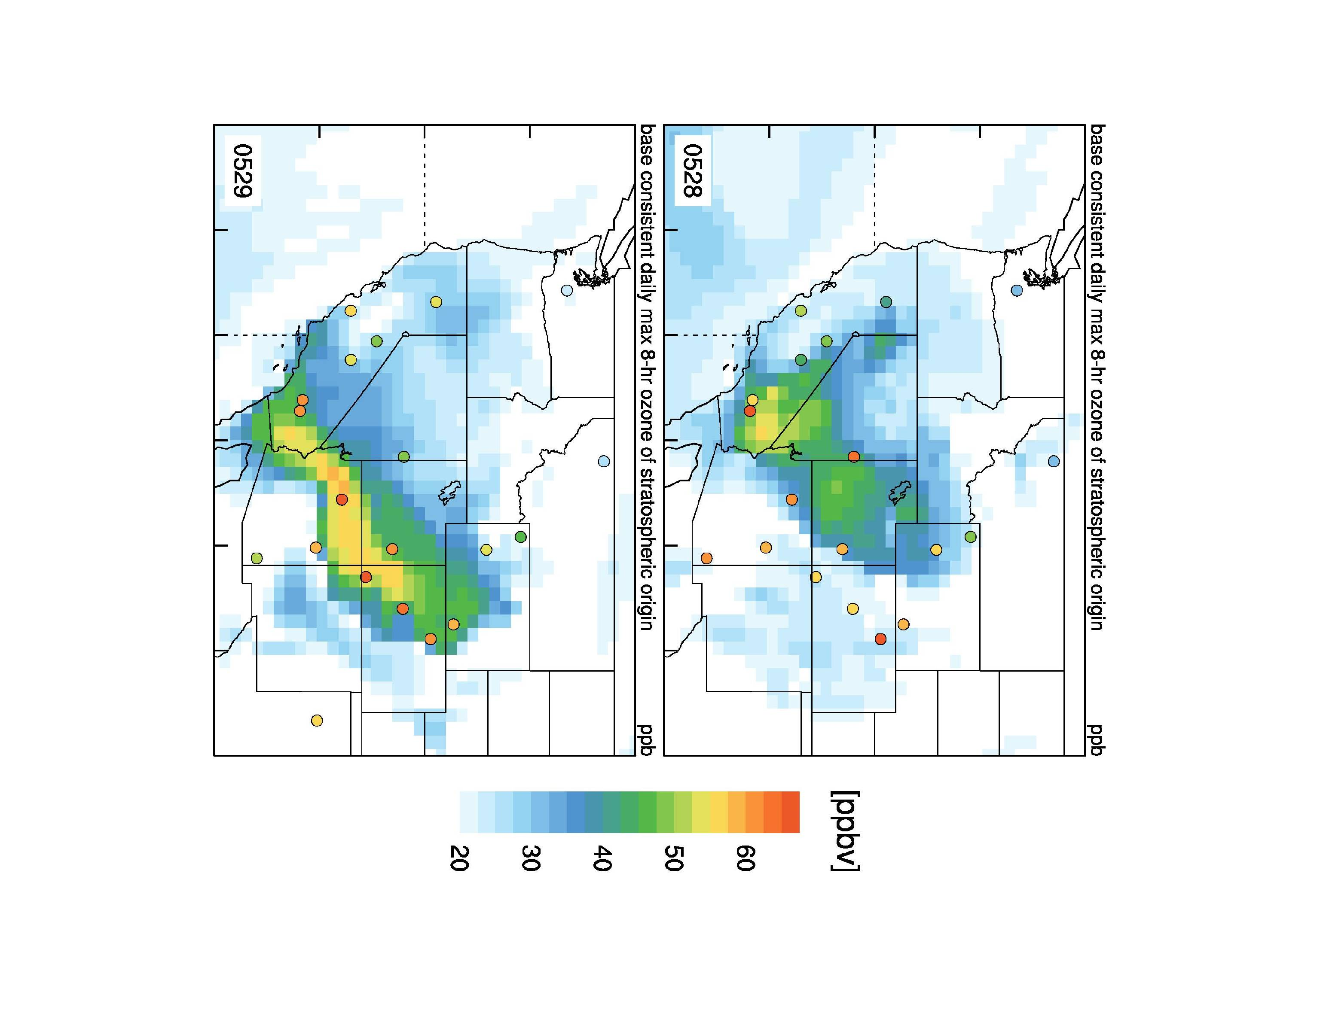
Stratospheric impacts on surface ozone air quality
(May 29, 2010)
CIRCLES: observed (total) O₃ at CASTNet sites
45N
SQUARES: O₃-strat tracer in AM3 (c180)
40N
Injected O₃-strat contributes up to 50-60% total O₃ in the model(upper limit)
6 events identified in May-June 2010 on basis of satellite imagery, O₃ sondes, model PV & jet location
35N
[ppbv]
125W
120W
115W
110W
105W
MDA8 O₃ [ppbv]
20
30
40
50
60
How typical were conditions during May-June 2010?
M. Lin et al., in prep.

Slide 15
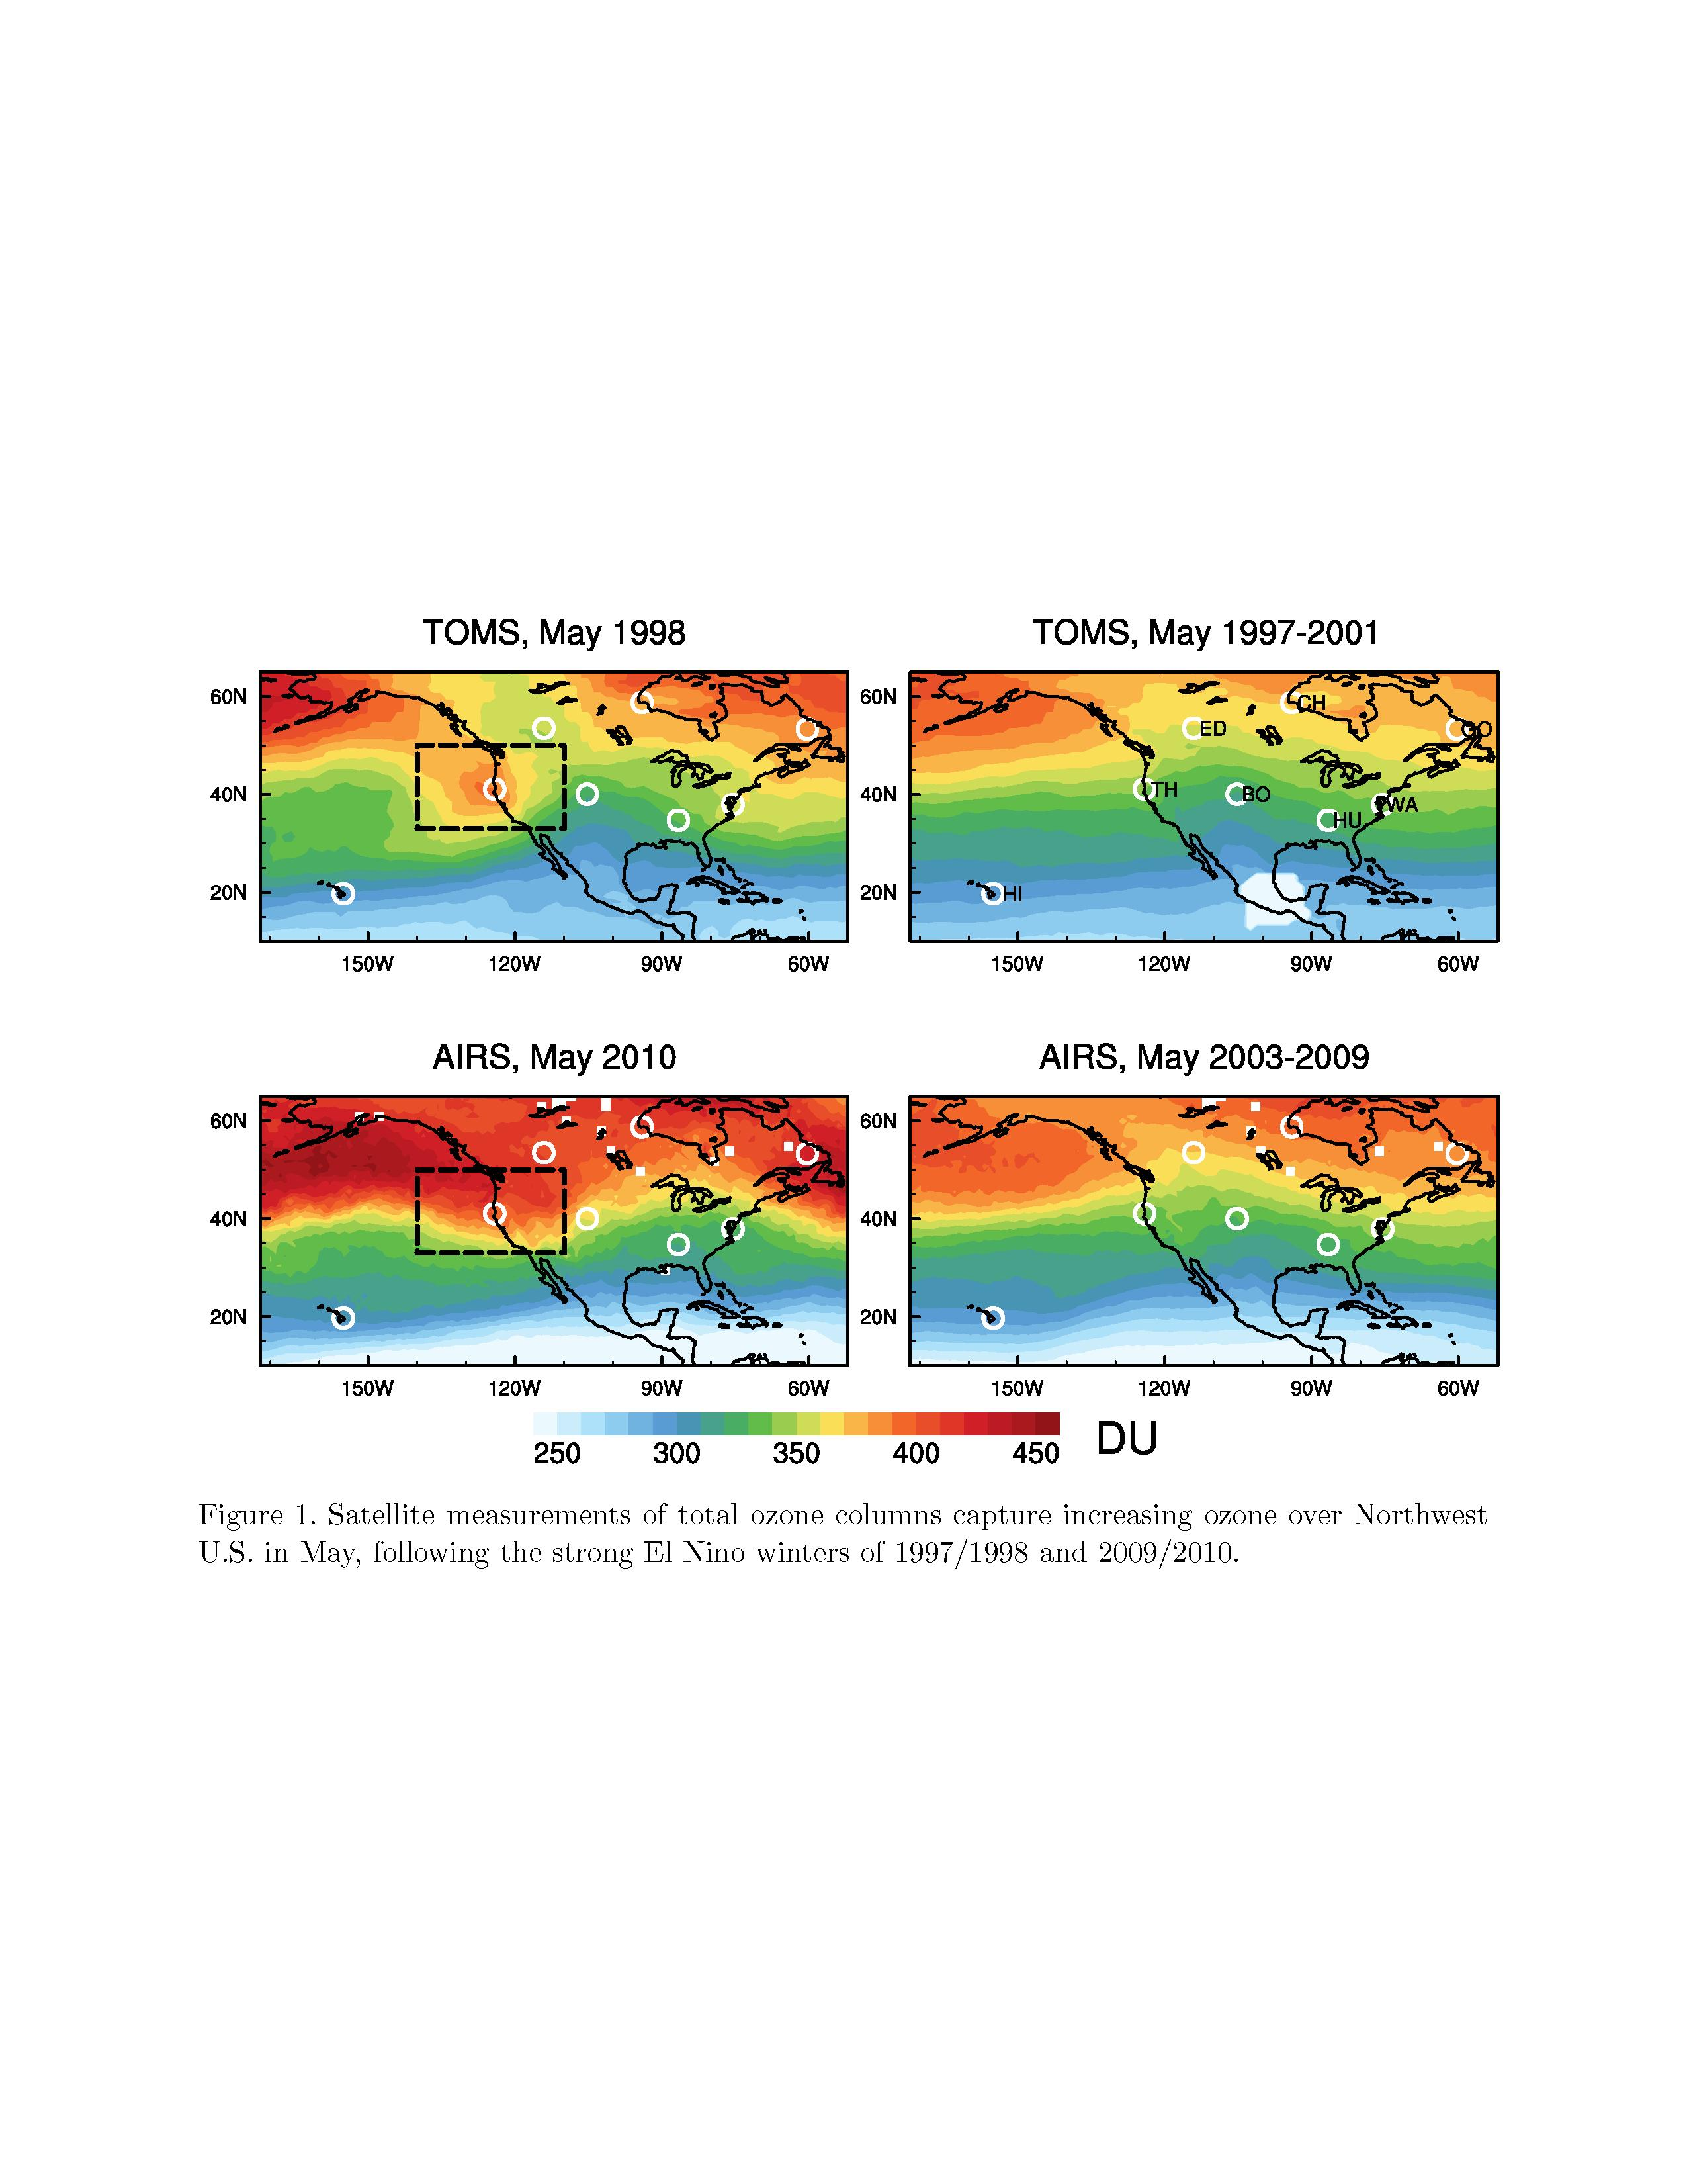
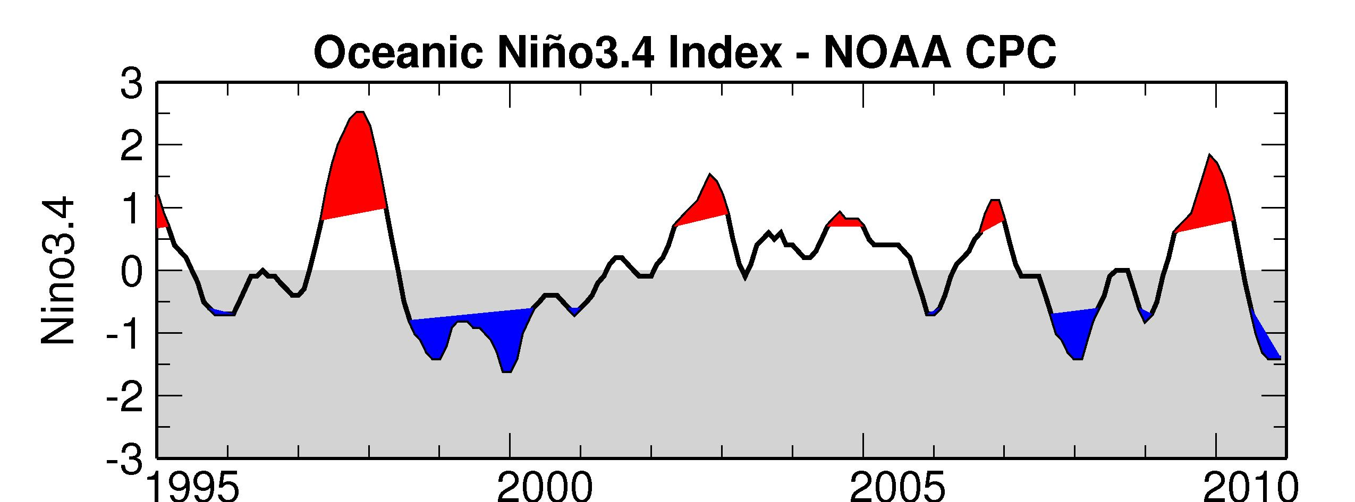
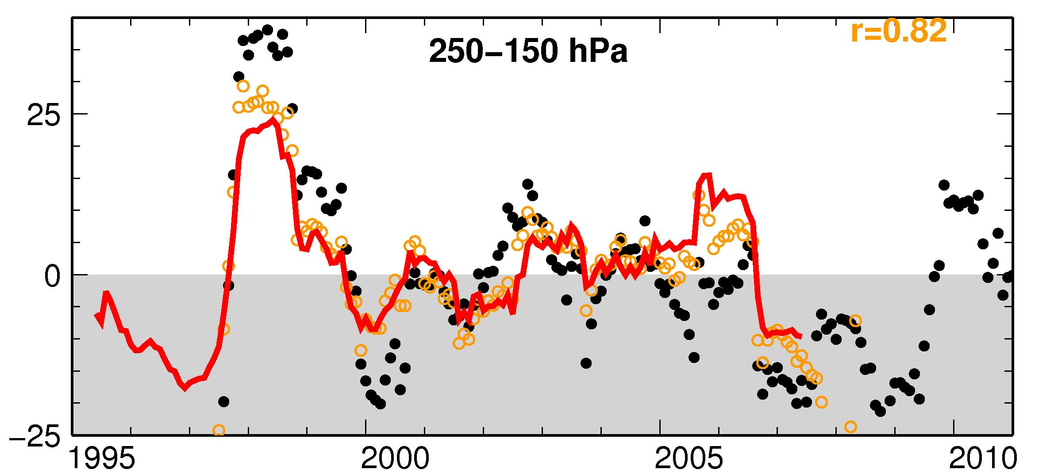
Following an El Nino winter, enhanced upper trop / lower strat ozone in late spring over Western US
CalNex
97/98
02/03
09/10
UT/LS O₃ deviation at Trinidad Head, CA
Sonde (~weekly)
AM3 sampled on sonde launch day
AM3 monthly mean
O₃ dev. (%)
Total Column O₃ [DU]
Data c/o NASA Goddard
Year
Ongoing examination of connections with modes of climate variability
M. Lin et al., in prep.

Slide 16

How does meteorology/climate affect air quality?
(1) Meteorology (stagnation vs. well-ventilated boundary layer)
Degree of mixing
strong
mixing
Boundary layer depth
pollutant sources
(2) Emissions (biogenic depend strongly on temperature; fires)
VOCs
Increase with T, drought?
T
(3) Chemistry responds to changes in temperature, humidity
T
generally faster
reaction rates
NMVOCs
CO, CH₄
O₃
+
OH
+
NO_{x}
H₂O
PAN

Slide 17
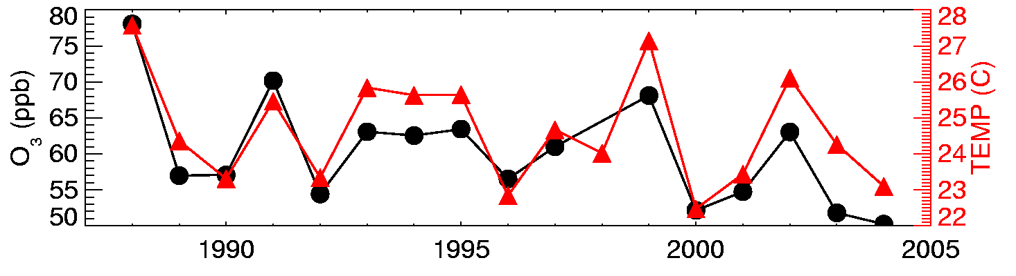
Surface O₃ strongly tied to temperature
(at least in polluted regions)
Many studies show strong correlation between surface temperature and O₃ measurements on daily to inter-annual time scales
[e.g., Bloomer et al., 2009; Camalier et al., 2007; Cardelino and Chameides, 1990; Clark and Karl, 1982; Korsog and Wolff, 1991]
Observations from U.S. EPA CASTNet site Penn State, PA 41N, 78W, 378m
July mean MDA8 O₃ (ppb)
July mean TEMP (C; 10am-5pm avg)
Year
Implies that changes in climate will influence air quality

Slide 18
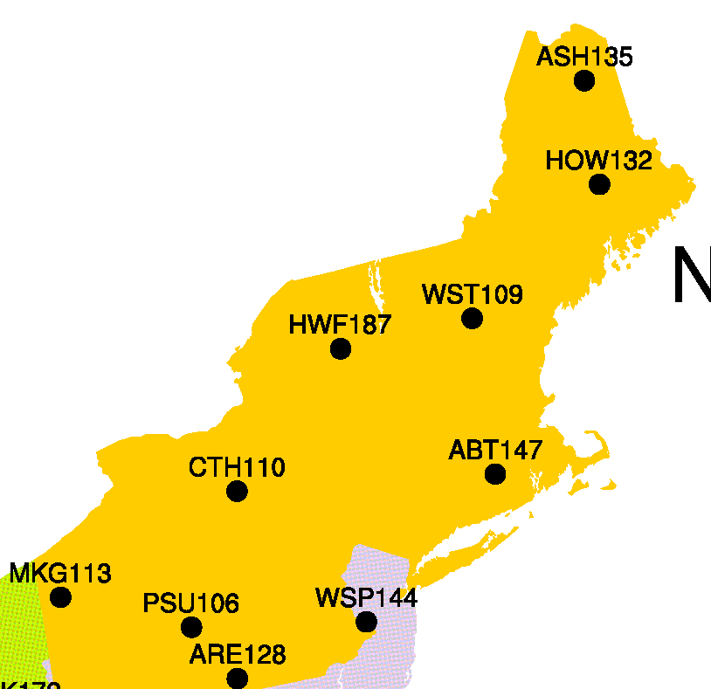
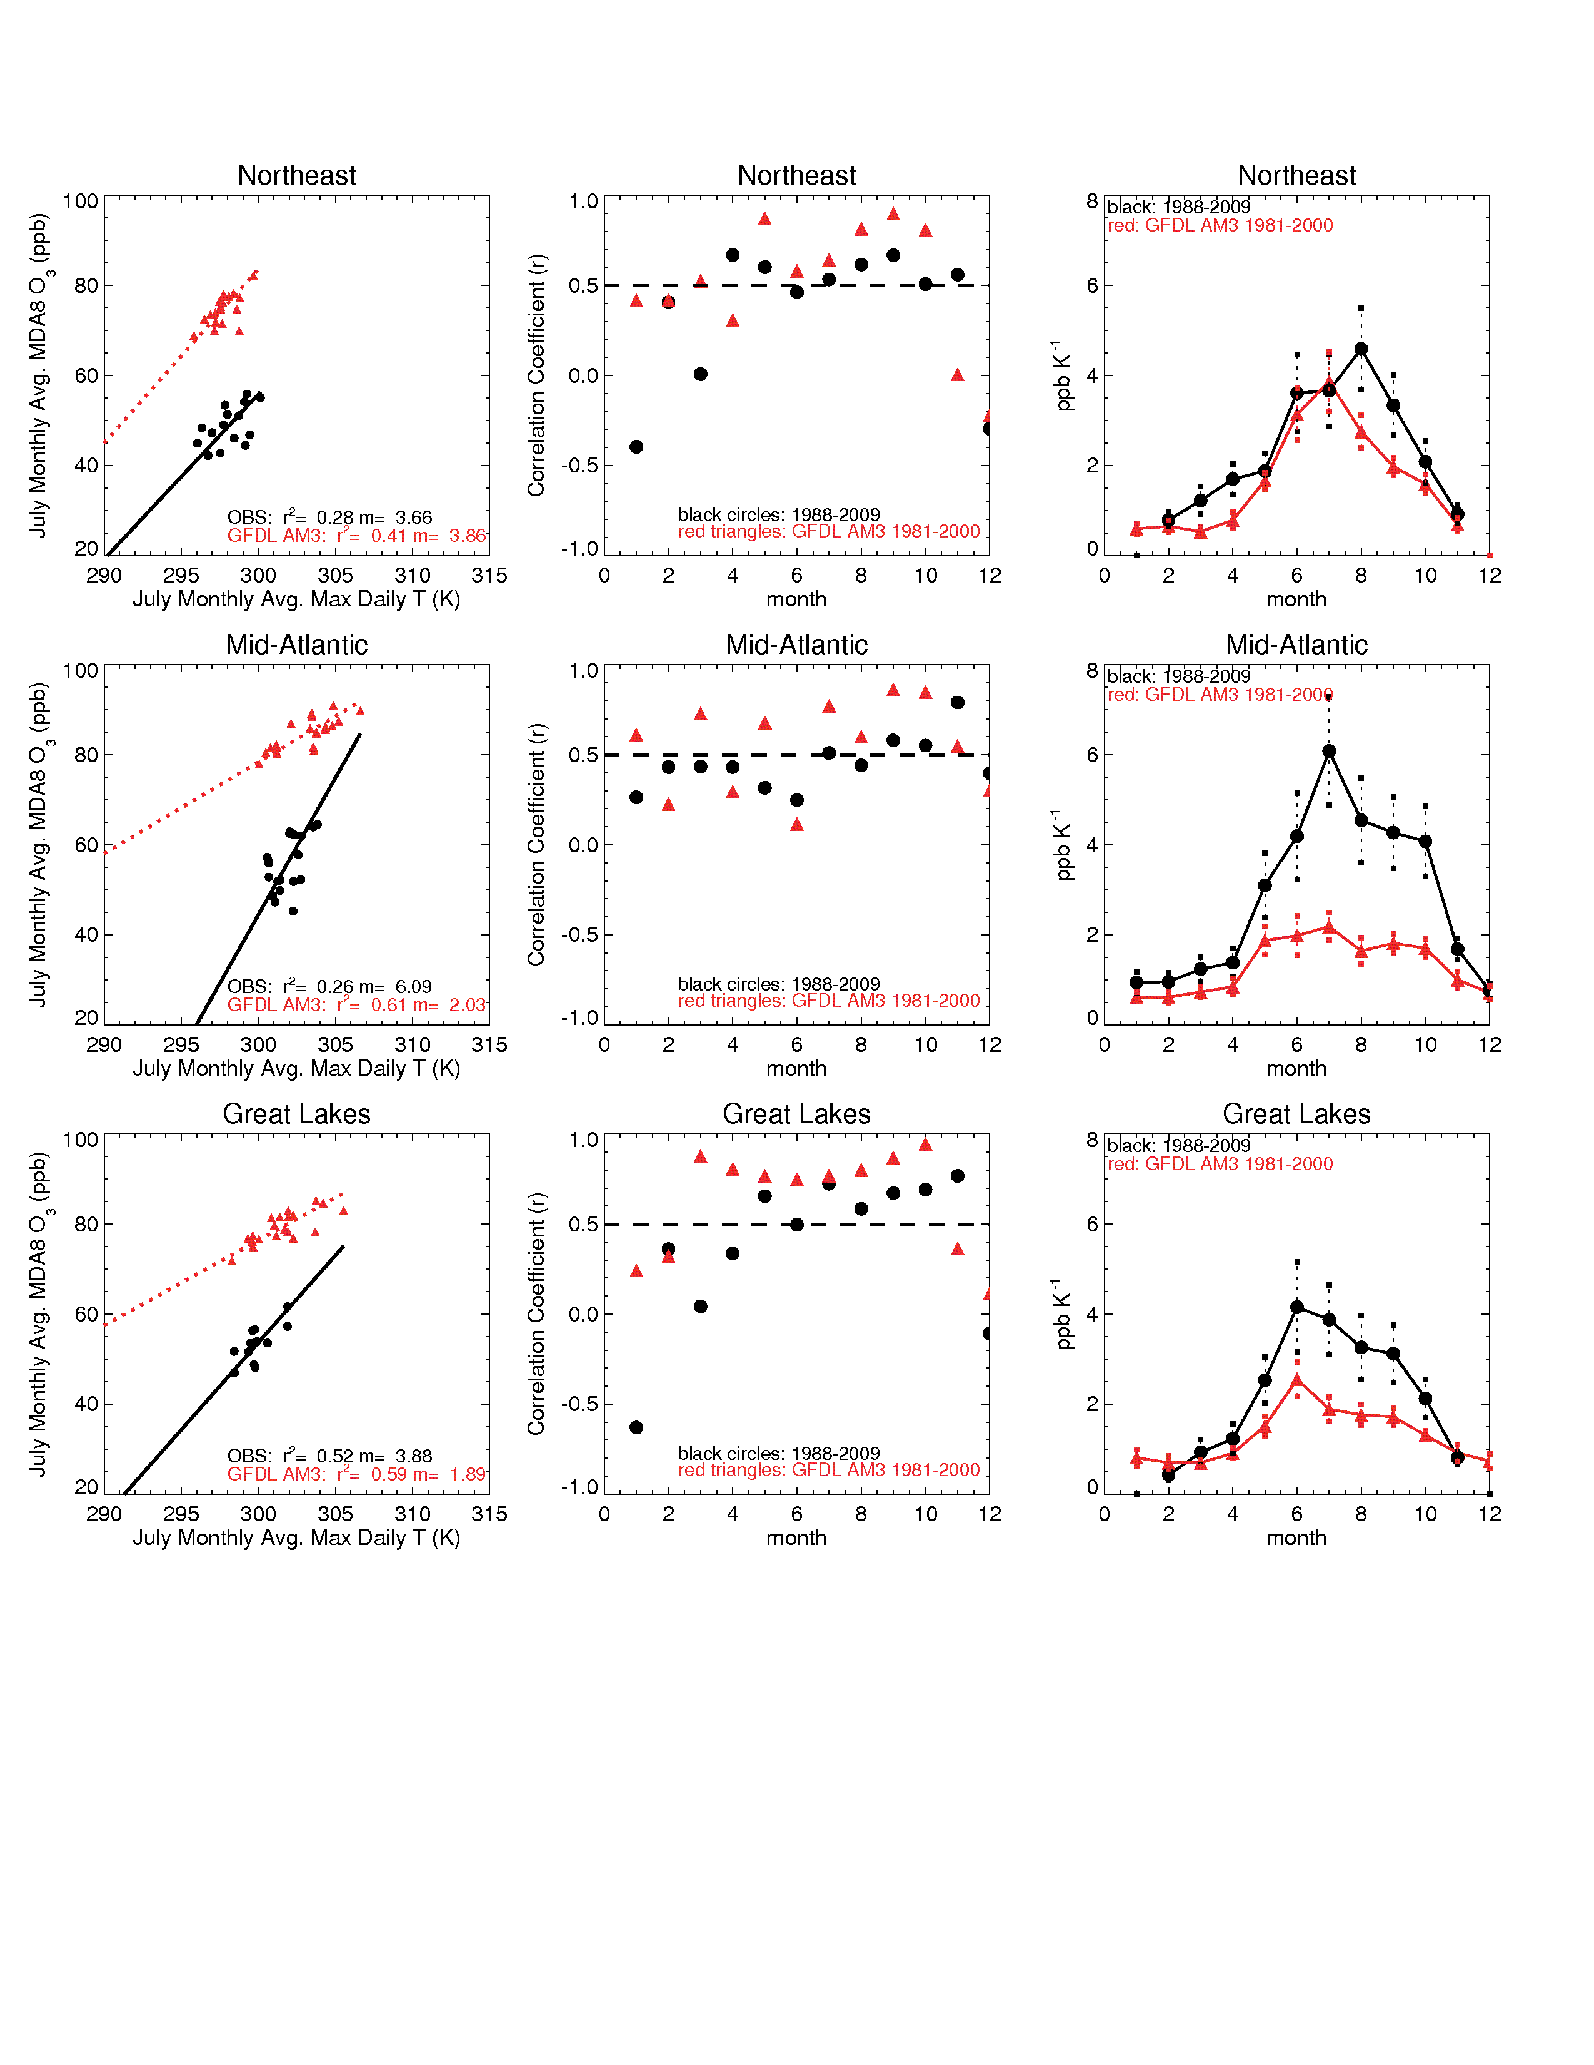
How well does a global chemistry-climate model simulate regional O₃-temperature relationships?
CASTNet sites,
NORTHEAST
USA
“Climatological” O₃-T relationships:
Monthly means of daily max T and monthly means of MDA8 O₃
AM3: 1981-2000
OBS: 1988-2009
r²=0.41, m=3.9
Slopes (ppb O₃ K⁻¹)
July Monthly avg. MDA8 O₃
r²=0.28, m=3.7
July Monthly avg. daily max T
Month
Model captures observed O₃-T relationship in NE USA in July, despite high O₃ bias
D.J .Rasmussen et al.,
submitted to Atmos. Environ.
→ Broadly represents seasonal cycle

Slide 19
Need for better understanding of underlying processes contributing to climatological O₃-T relationship
1. meteorology 2. chemistry 3. emission feedbacks …
[Jacob et al., 1993; Olszyna et al., 1997]
[Sillman and Samson, 1995]
[Meleux et al., 2007; Guenther et al., 2006]
Observational constraints?
Relative importance (regional and seasonal variability)?
Leibensperger et al. [2008] found a strong anticorrelation between
number of migratory cyclones over Southern Canada/NE U.S. and
number of stagnation events and associated NE US high-O₃ events
→ 4 fewer O₃ pollution days per cyclone passage
Does NE US summer storm frequency change in a warmer climate?

Slide 20
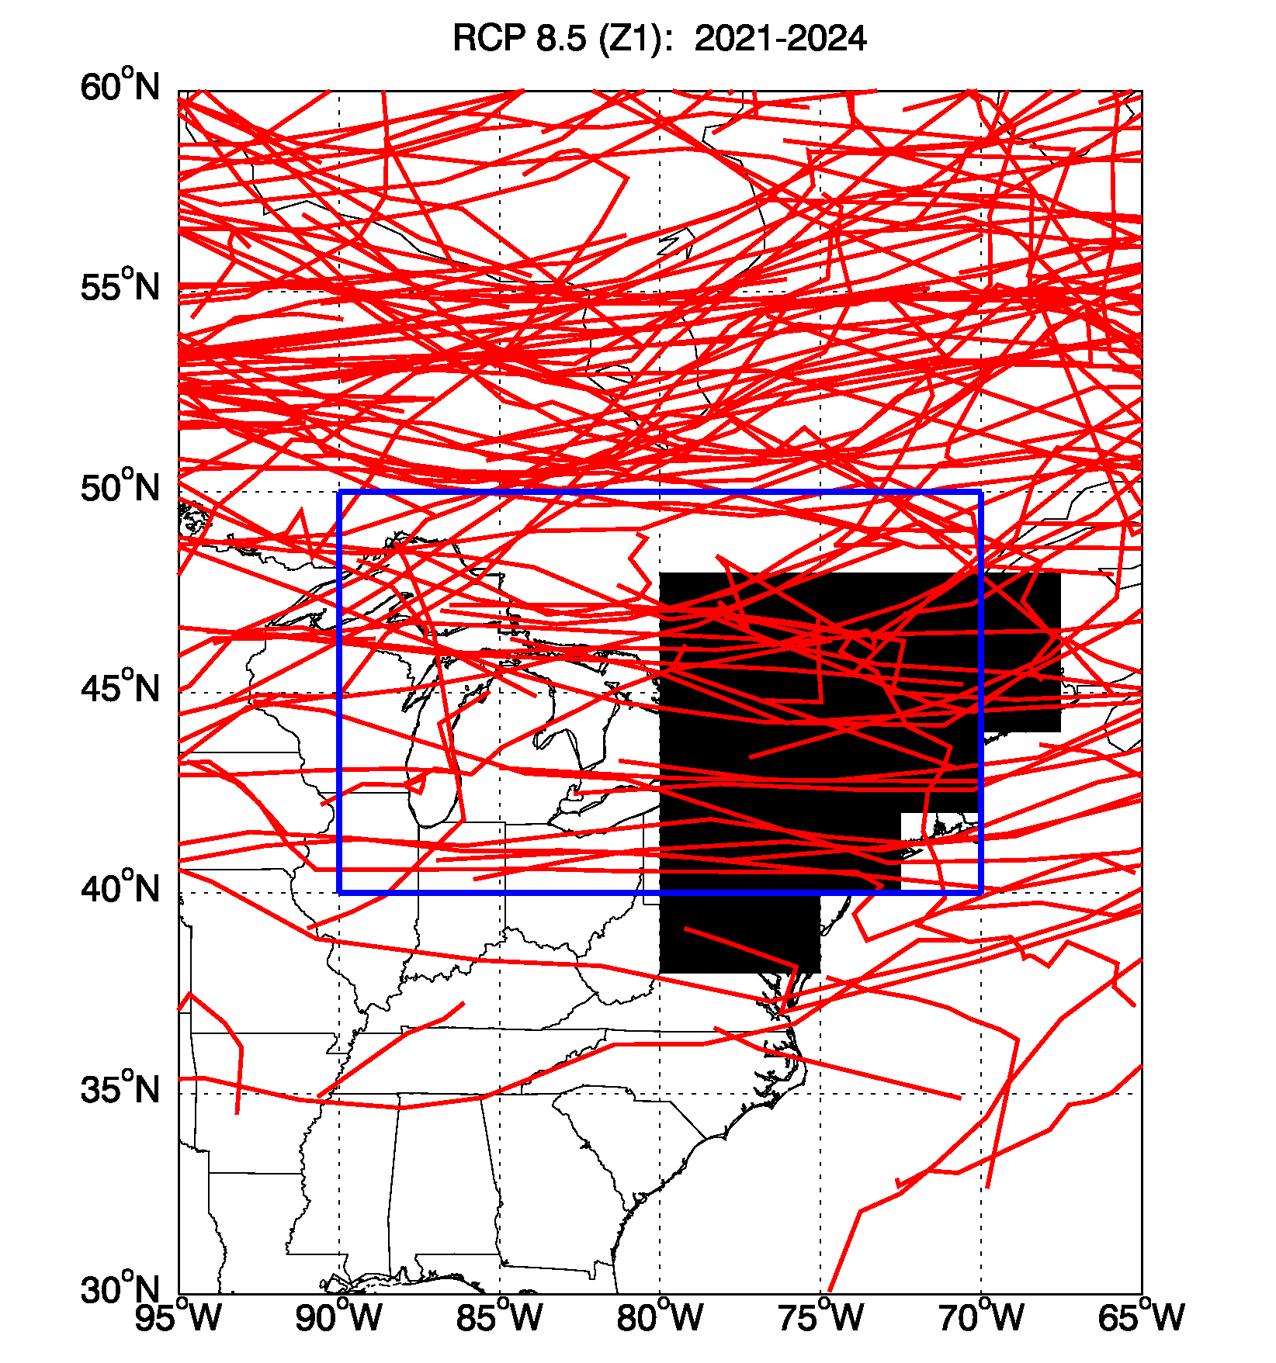
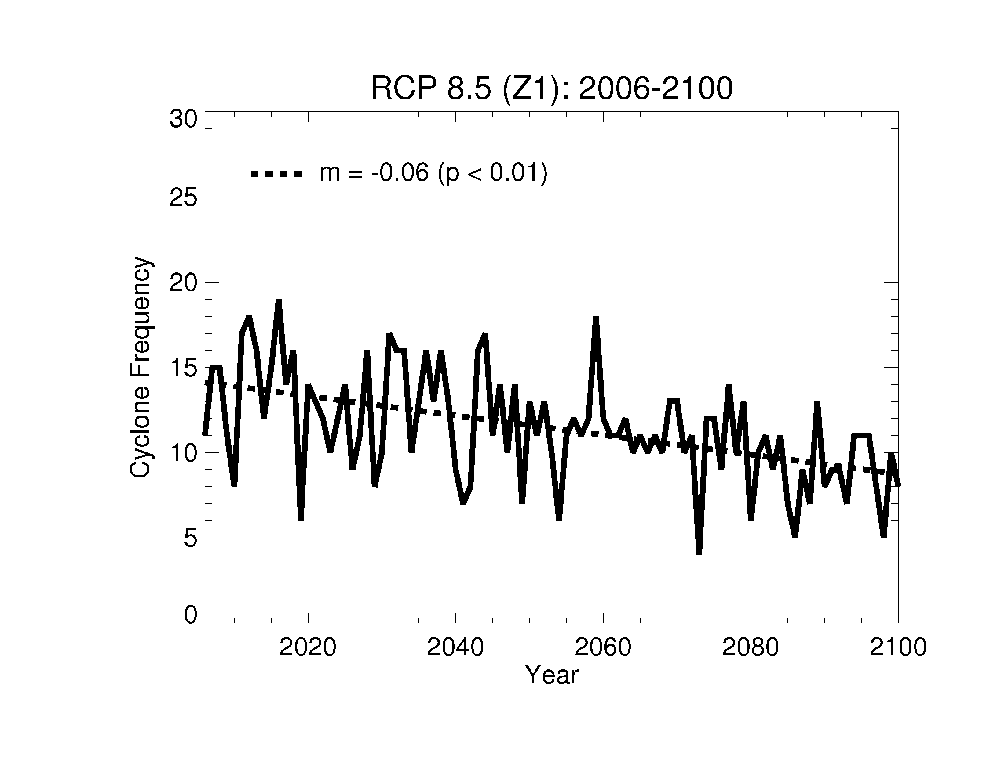
Frequency of summer migratory cyclones over NE US decreases as the planet warms (GFDL CM3 model, RCP8.5)
Individual JJA storm tracks
(2021-2024, RCP8.5)
Cylones diagnosed from 6-hourly SLP with
MCMS software from Mike Bauer, (Columbia U/GISS)
Region for counting storms
Number of storms per summer (JJA)
Region for counting O₃ events
Robust across models? [e.g., Lang and Waugh, 2011]
How do projected emissions interact with climate change?
A. Turner et al.

Slide 21
New RCP emissions suggest lower future surface O₃ than SRES scenarios, e.g., decrease in N. America
Annual mean surface O₃ change estimated from sensitivities to emissions derived from TF HTAP model ensemble
[Wild et al., submitted to ACP]
Surface O₃ changes (ppb)
Dramatic rise in CH₄ in RCP8.5 opposes NO_{x}-driven decreases
  -- factor of 2 uncertainty in model surface O₃ response to CH₄
Response to combined changes in emissions and climate in RCP 8.5?

Slide 22
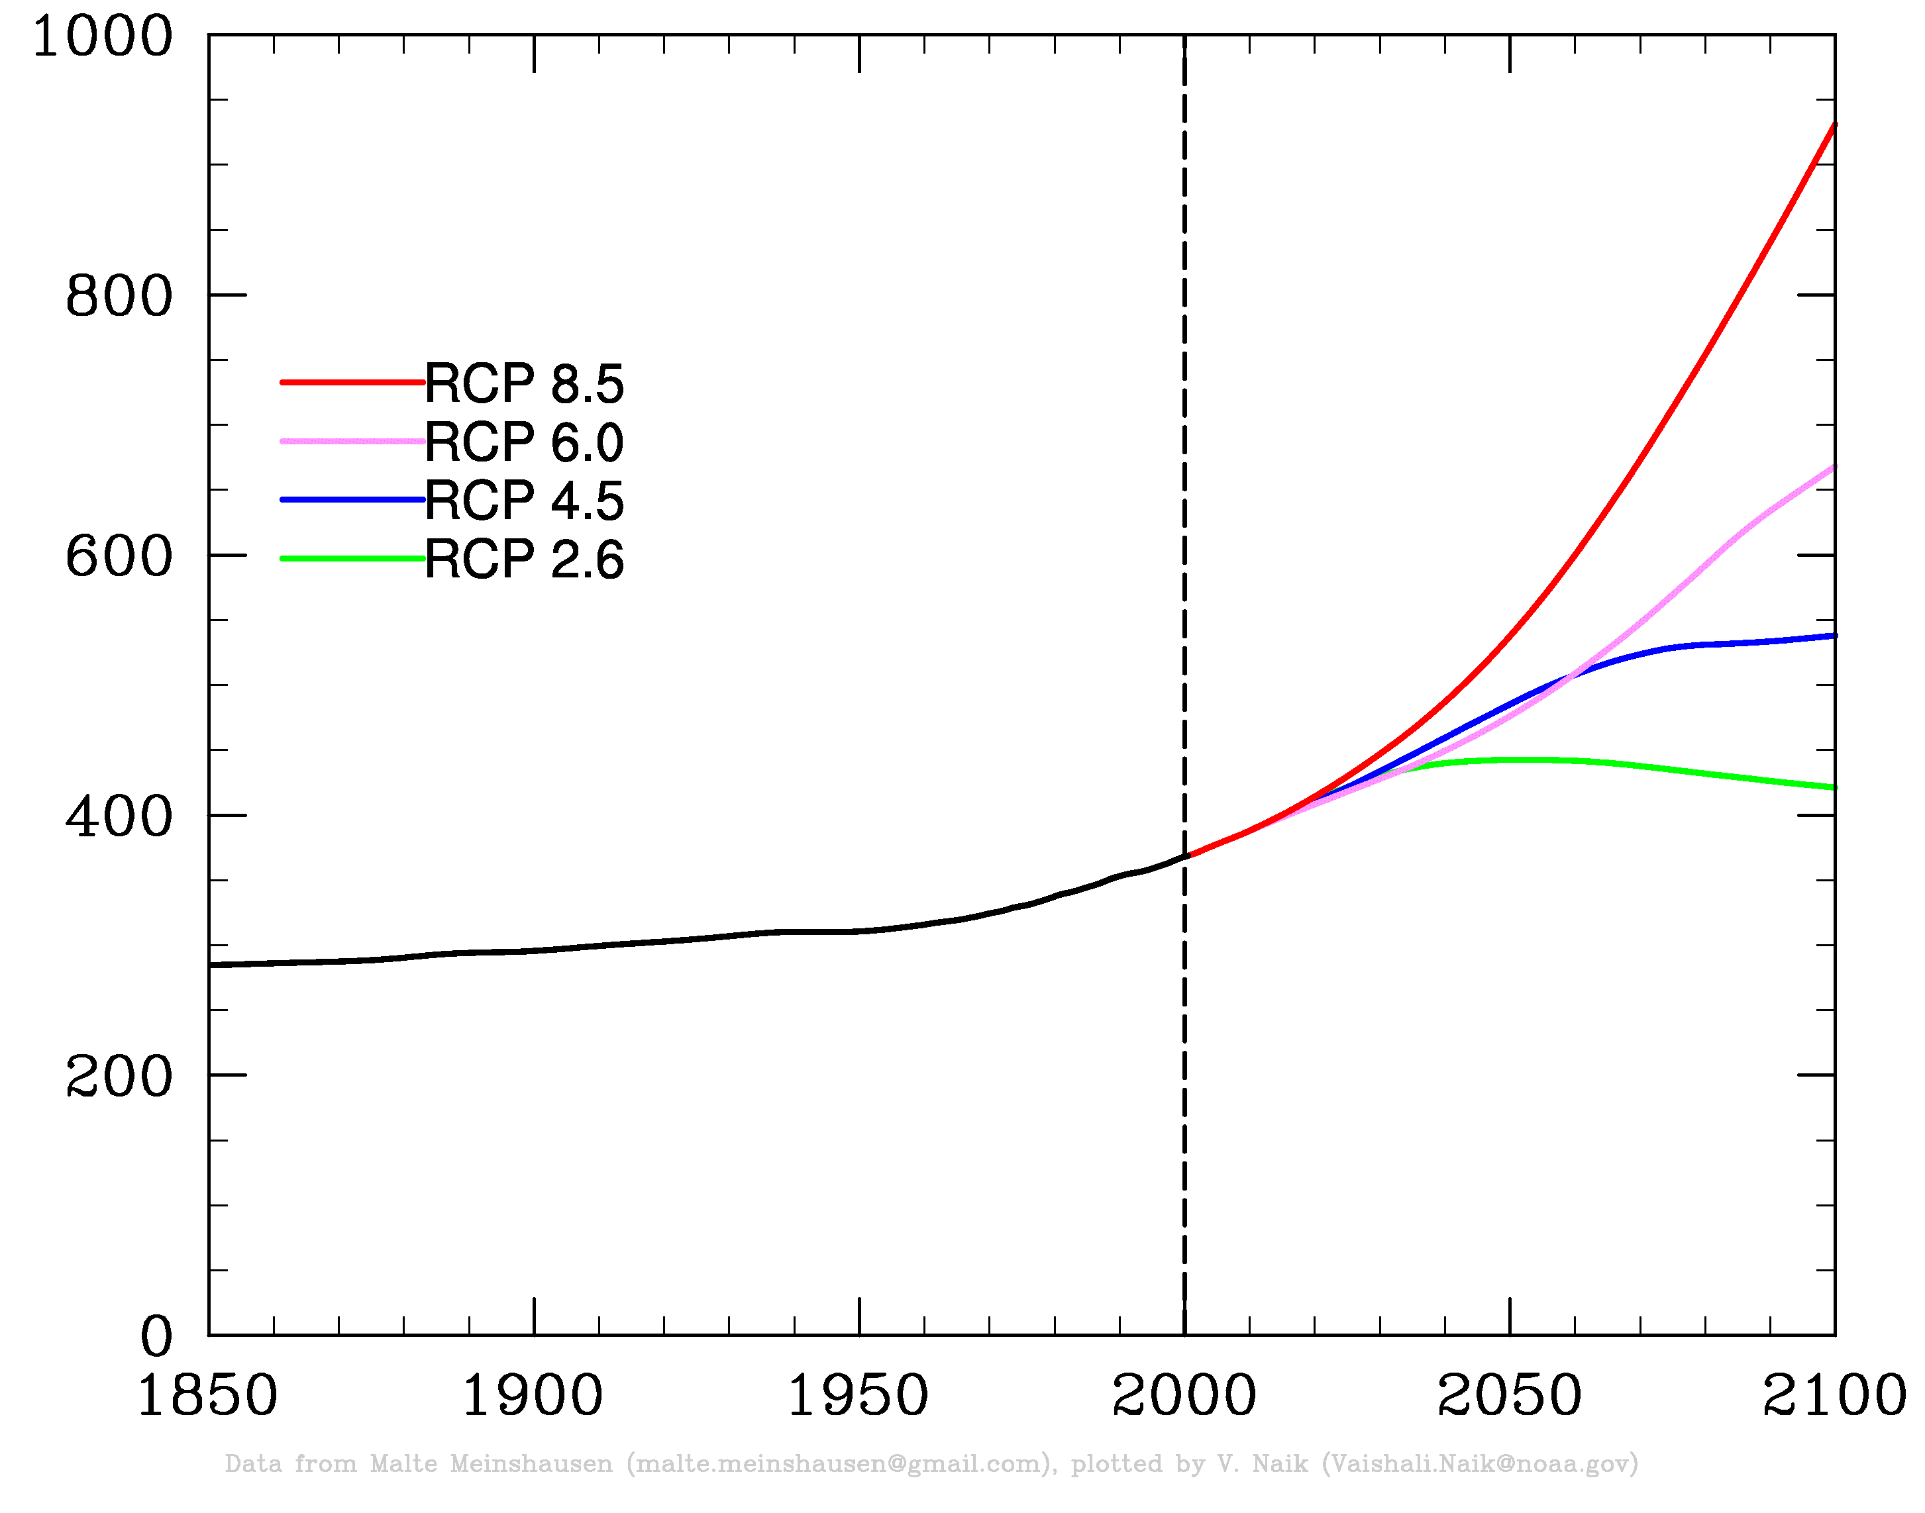
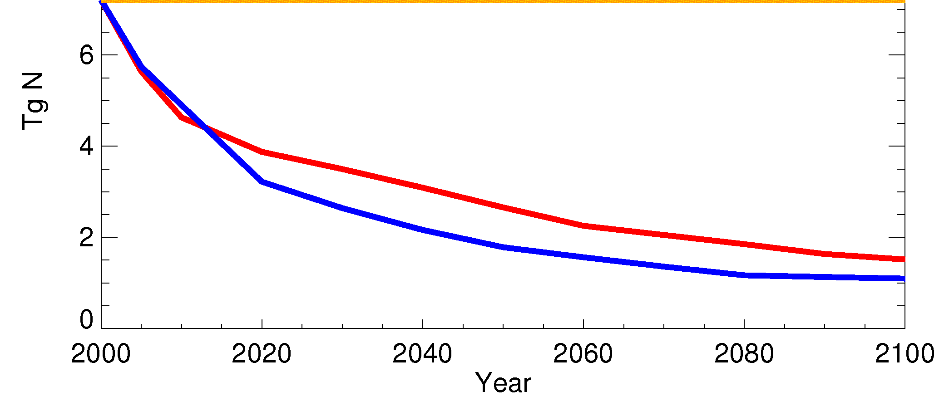
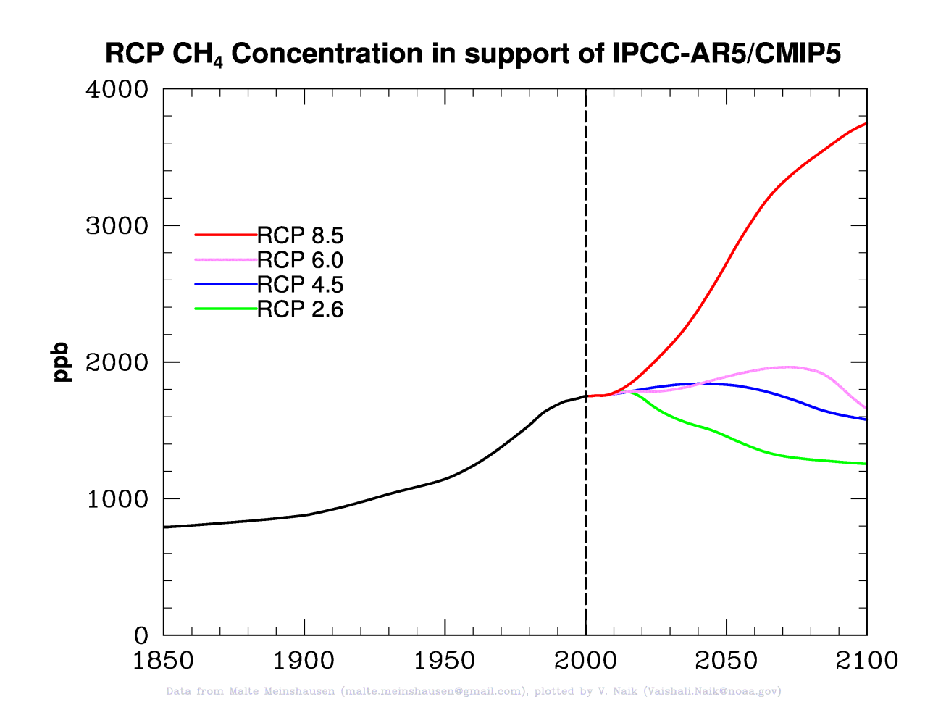
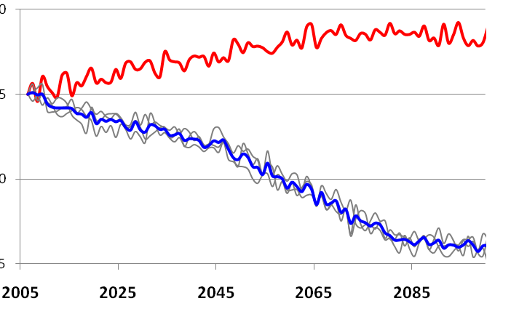
Future (RCP) scenarios: range in greenhouse gas projections but N. American NO_{x} emissions decrease in all RCPs
N. American Anthro NO_{x} (Tg N yr⁻¹)
GLOBAL
CO₂
abundance
(ppm)
RCP8.5
RCP6.0
RCP4.5
RCP2.6
RCP8.5
RCP4.5
Annual mean changes in NA sfc O₃ (ppb)
GFDL CM3 (EMISSIONS + CLIMATE)
GLOBAL
CH₄
abundance
(ppb)
5
0
-5
-10
RCP8.5
RCP4.5 ens. mean
Individual members
c/o V. Naik
Why does N. Amer. sfc O₃ increase with NO_{x} reductions in RCP8.5? CH₄?

Slide 23
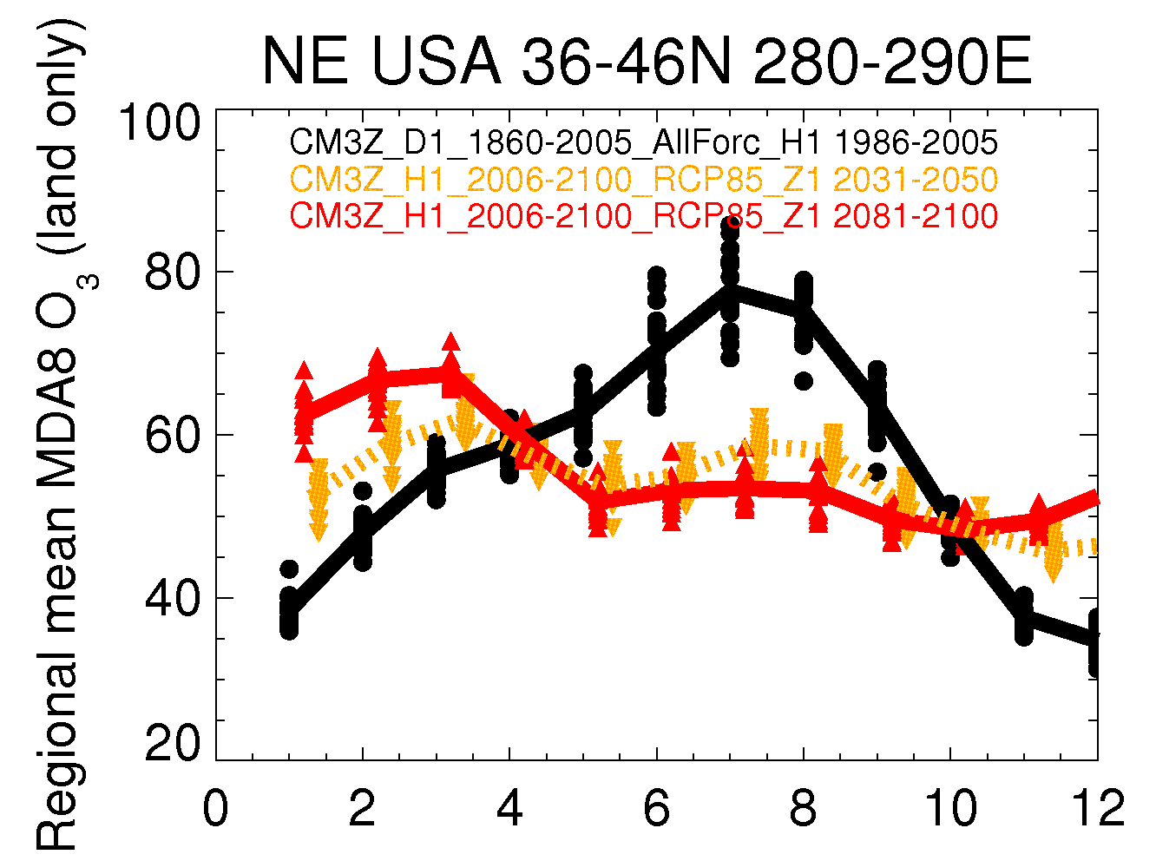
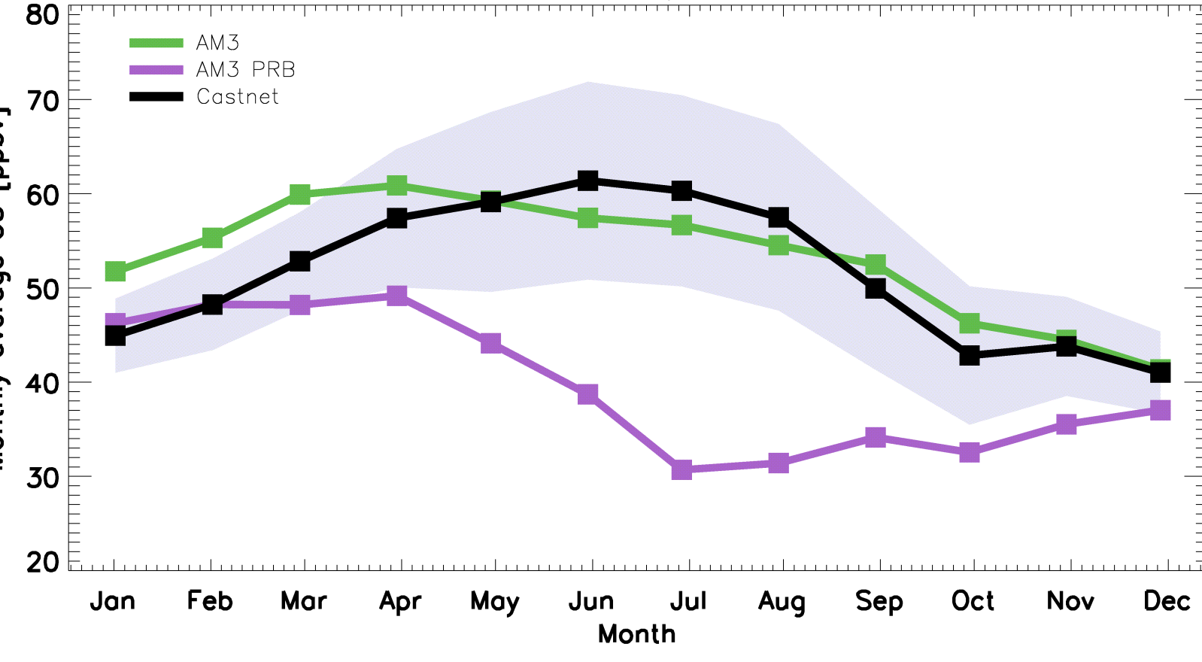
Surface ozone seasonal cycle reverses in CM3 RCP8.5 simulation over (e.g., USA; Europe)
U.S. CASTNet sites > 1.5 km
1986-2005
2031-2050
2081-2100
J. Oberman
2006 CASTNet obs (range)
2006 AM3 (nudged to NCEP winds)
2006 AM3 with zero N. Amer. anth. emis.
Monthly mean MDA8 O₃
?
NO_{x} decreases
A.M. Fiore
Month of 2006
→What is driving wintertime increase?
2100 NE USA seasonal cycle similar to current estimates of
“background” O₃ at high-altitude sites (W US)

Slide 24
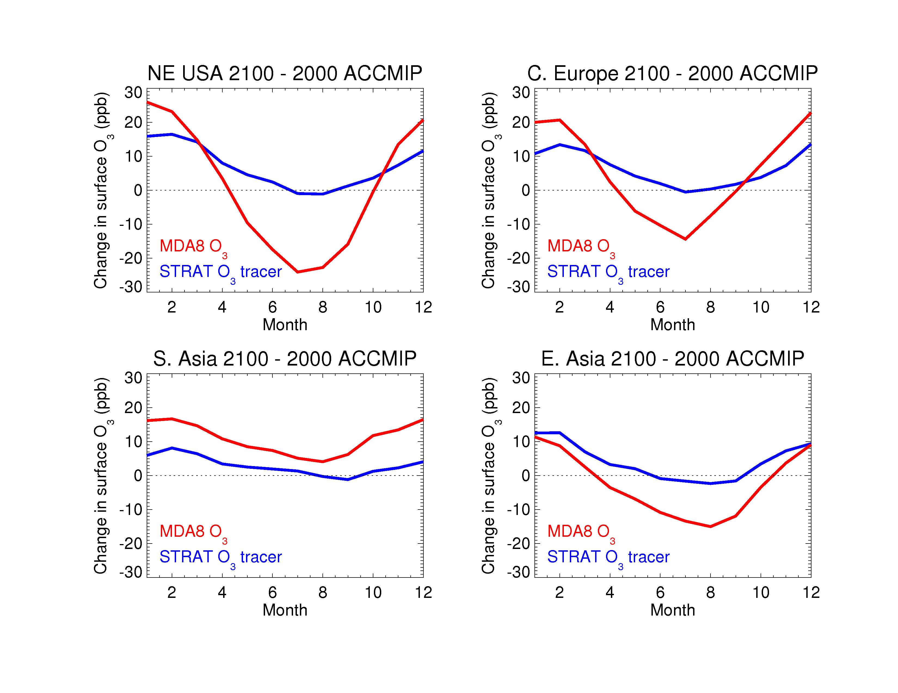
More stratospheric O₃ in surface air accounts for >50% of wintertime O₃ increase over NE USA in RCP8.5 simulation
“ACCMIP simulations” (V. Naik) : AM3 (10 years each) with decadal average SSTs for:
2000 (+ 2000 emissions + WMGG + ODS)
2100 (+ 2100 RCP8.5emissions + WMGGs + ODS)
Change in
surface O₃
(ppb)
2100-2000
(difference of
10-year means)
Strat. O₃ recovery+ climate-driven increase in STE (intensifying
Brewer-Dobson circulation)? [e.g., Butchart et al., 2006; Hegglin & Shepherd, 2009;
Kawase et al., 2011; Li et al., 2008; Shindell et al. 2006; Zeng et al., 2010]
Regional emissions reductions + climate change influence relative
role of regional vs. background O₃
Extreme scenario highlights strat-trop, climate-chem-AQ coupling
A.M. Fiore

Slide 25
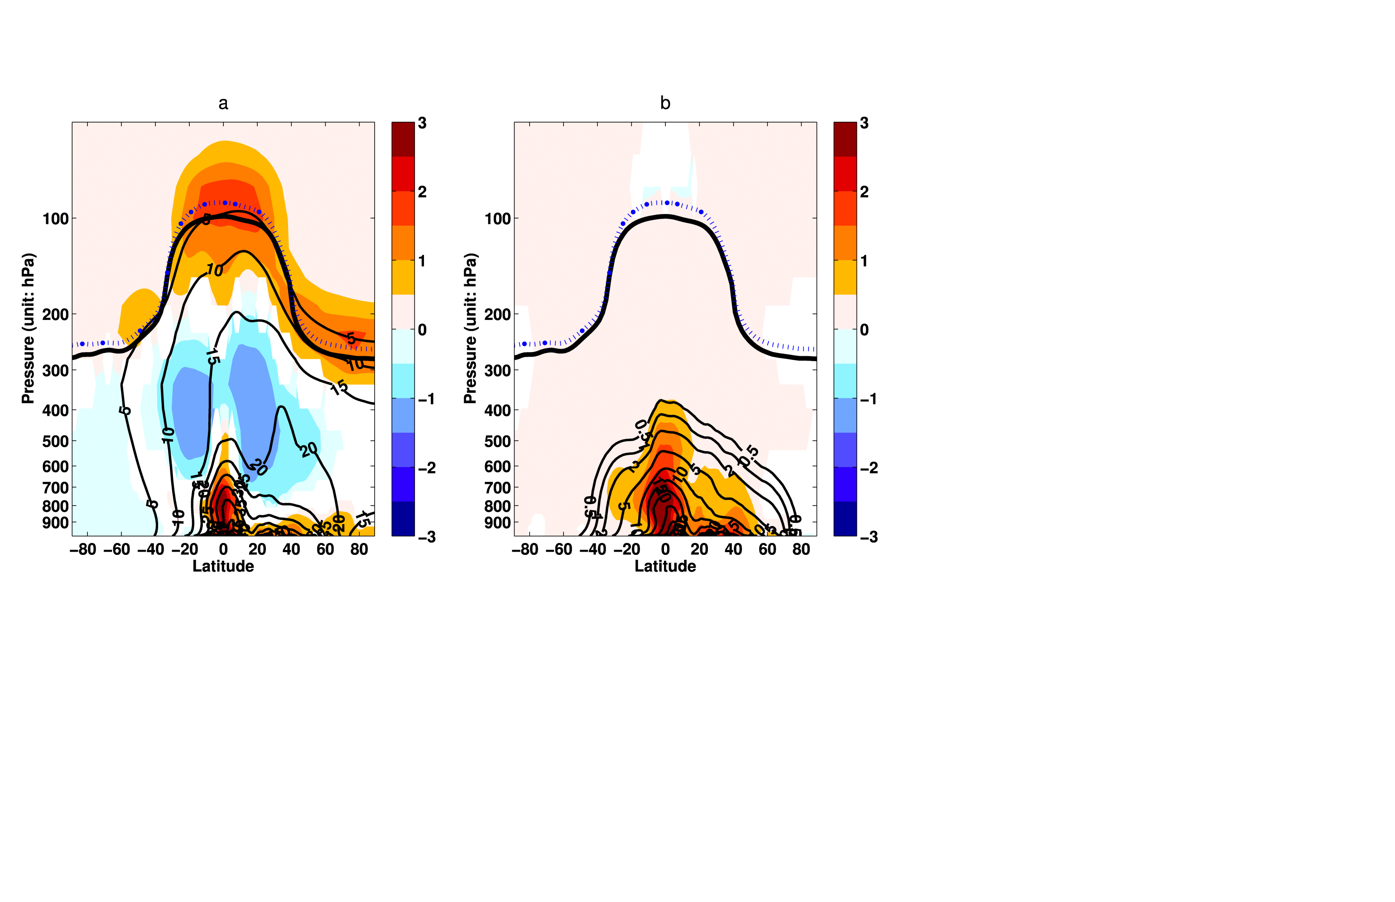
Warmer, wetter world: More PM pollution?
Y. Fang et al., 2011; Y. Fang et al., in prep
CLIMATE CHANGE ONLY AM3 idealized simulations (20 years)
1990s: observed decadal average SST and sea ice monthly climatologies
2090s: 1990s + mean changes from 19 AR-4 models (A1B)
Aerosol tracer: fixed lifetime, deposits like sulfate (ONLY WET DEP CHANGES)
NE USA
Aerosol Tracer (ppb)
Aerosol Tracer (ppb)
2090s-1990s
1990s distribution
1990s
2090s
Pressure (hPa)
JJA daily regional mean
PM2.5
(ug m⁻³)
Tracer burden increases by 12%
despite 6% increase in global precip.
Role for large-scale precip vs. convective;
Seasonality of tracer burden
Tracer roughly captures PM2.5 changes
Cheaper option for AQ info from physical
climate models (e.g., high res)

Slide 26
Some final thoughts…
Non-local influences on U.S. O₃ air quality
Asian and stratospheric components enhance U.S. “background” levels, contributing to high-O₃ events in the Western U.S. (high-altitude) in spring
Implications for attaining more stringent standards
Consistent view from ~200x200 km vs ~50x50km (spatially refined)
Analysis of long-term chemical and meteorological obs may reveal key connections between climate and air pollution
Crucial for testing models used to project future changes
→ Need to maintain long-term observational networks
Climate-change induced reversal of O₃ seasonal cycle + more PM pollution?
→ Process understanding (sources + sinks) at regional scale
→ AQ-relevant info w/ simple tracers in physical climate models

