Slide 1

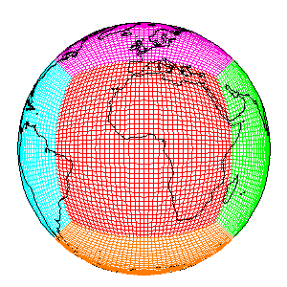





Analyzing western U.S. air quality with
models and satellite data
Arlene M. Fiore
Acknowledgments. Meiyun Lin (Princeton), Vaishali Naik (GFDL), Larry Horowitz (GFDL), Jacob Oberman (U WI), Harald Rieder (CU/LDEO)
WESTAR Council & University of Nevada
Conference on Western Ozone Transport
Reno, NV, October 11, 2012

Slide 2
The Problem
U.S. National Ambient Air Quality Standard
for O₃ has evolved over time
typical U.S.“background”
(model estimates)
[Fiore et al., 2003;
Wang et al., 2009;
Zhang et al., 2011]
75 ppb
2008
8-hr
84 ppb
1997
8-hr
120 ppb
1979
1-hr avg
Future?
(proposed)
O₃ (ppbv)
20
40
60
80
100
120
Allowable O₃ produced from U.S. anthrop. sources (“cushion”)
Lowering thresholds for U.S. O₃ NAAQS implies thinning cushion between regionally produced O₃ and background

Slide 3


Some challenges for WUS O₃ air quality management
stratosphere
Warming climate
+in polluted regions
[Jacob & Winner, 2009 review]
+ natural sources
[recent reviews: Isaksen et al., 2009; Fiore et al., 2012]
? Transport pathways
Natural events e.g., stratospheric [Langford et al [2009]; fires [Jaffe & Wigder, 2012]
lightning
Rising Asian emissions
[e.g., Jacob et al., 1999;
Richter et al., 2005;
Cooper et al., 2010]
“Background” ozone
X
Wildfire, biogenic
Asia
Pacific
Western USA
Need process-level understanding on daily to multi-decadal time scales
Today’s talk: 1) Intro: satellites + models
2) NASA AQAST Overview
3) Results for WUS from two collaborative AQAST projects
4) Air quality projections in a warming climate
Notes:
Emphasie WUS // EUS…

Slide 4
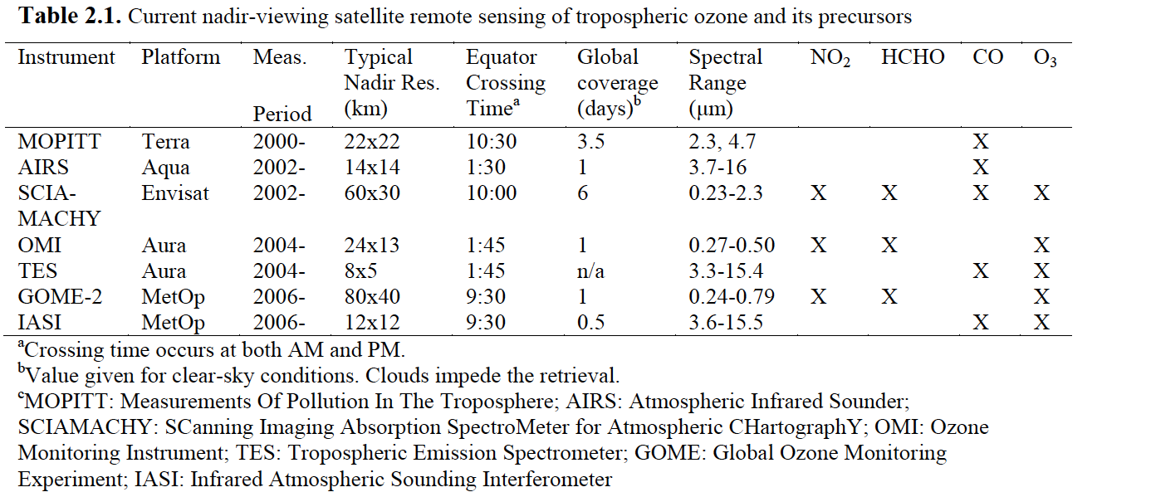
Satellite instruments for tropospheric O₃ and its precursors
Nadir viewing; near-polar, sun-synchronous, low Earth orbits
HTAP 2010, Part A
Solar backscatter
Thermal Emission
See also reviews: Martin et al., Atm. Env, 2008; Fishman et al., BAMS, 2008
Notes:
History back to late 1970s

Slide 5
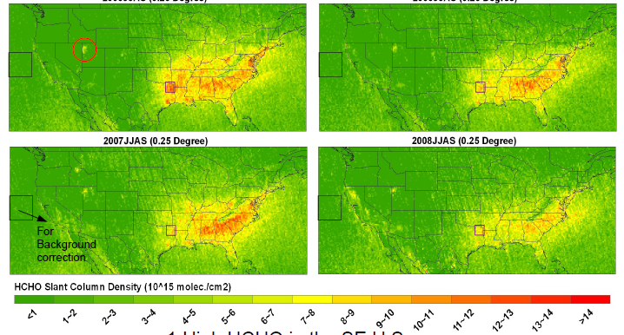
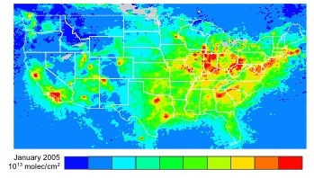

How can satellite data help address AQ challenges?
Examples: Improve regional source characterization
OMI HCHO → isoprene emissions
OMI NO₂ columns → NOx emissions
HCHO column,
Jun-Aug 2006
Freight trucks
2007
Freight rail
0 | 100 | 200 | 300 | 400 | 600 | 800 | 1100 | 1500 | 2000+
2008
Erica Bickford & Tracey Holloway, UW-Madison
AQAST PI: Holloway
→ Improved spatial & temporal source information
→ Improved emissions for SIP modeling and AQ forecasting
National NO₂ monitoring to fill in AQS gaps
5 10 15
10¹⁵ molecules cm⁻²
Lei Zhu, Harvard
AQAST PIs: Mickley, Cohan

Slide 6
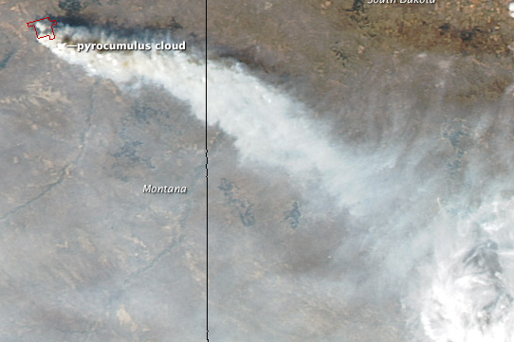
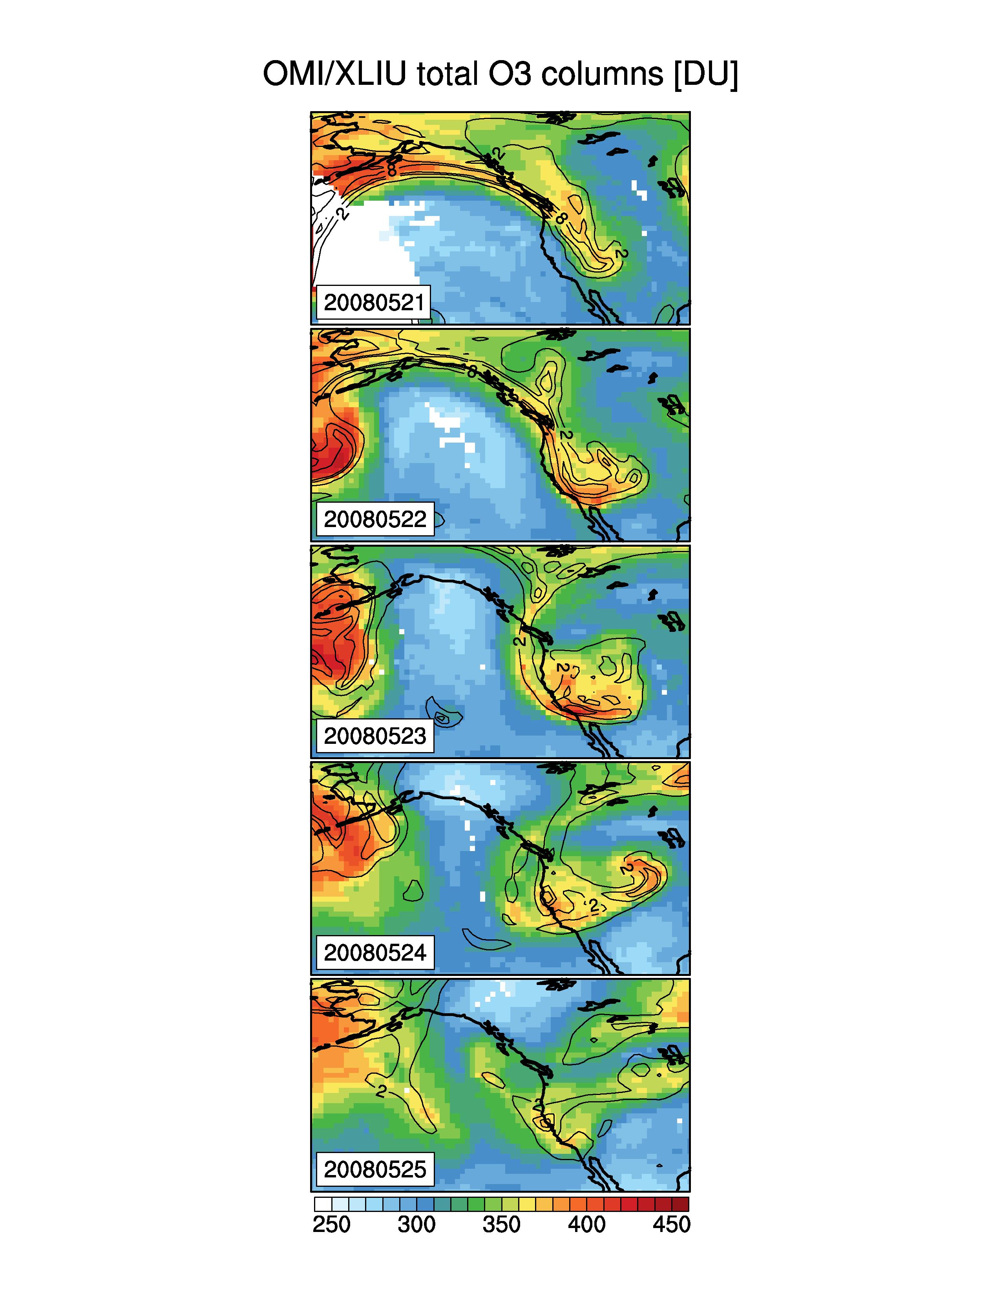
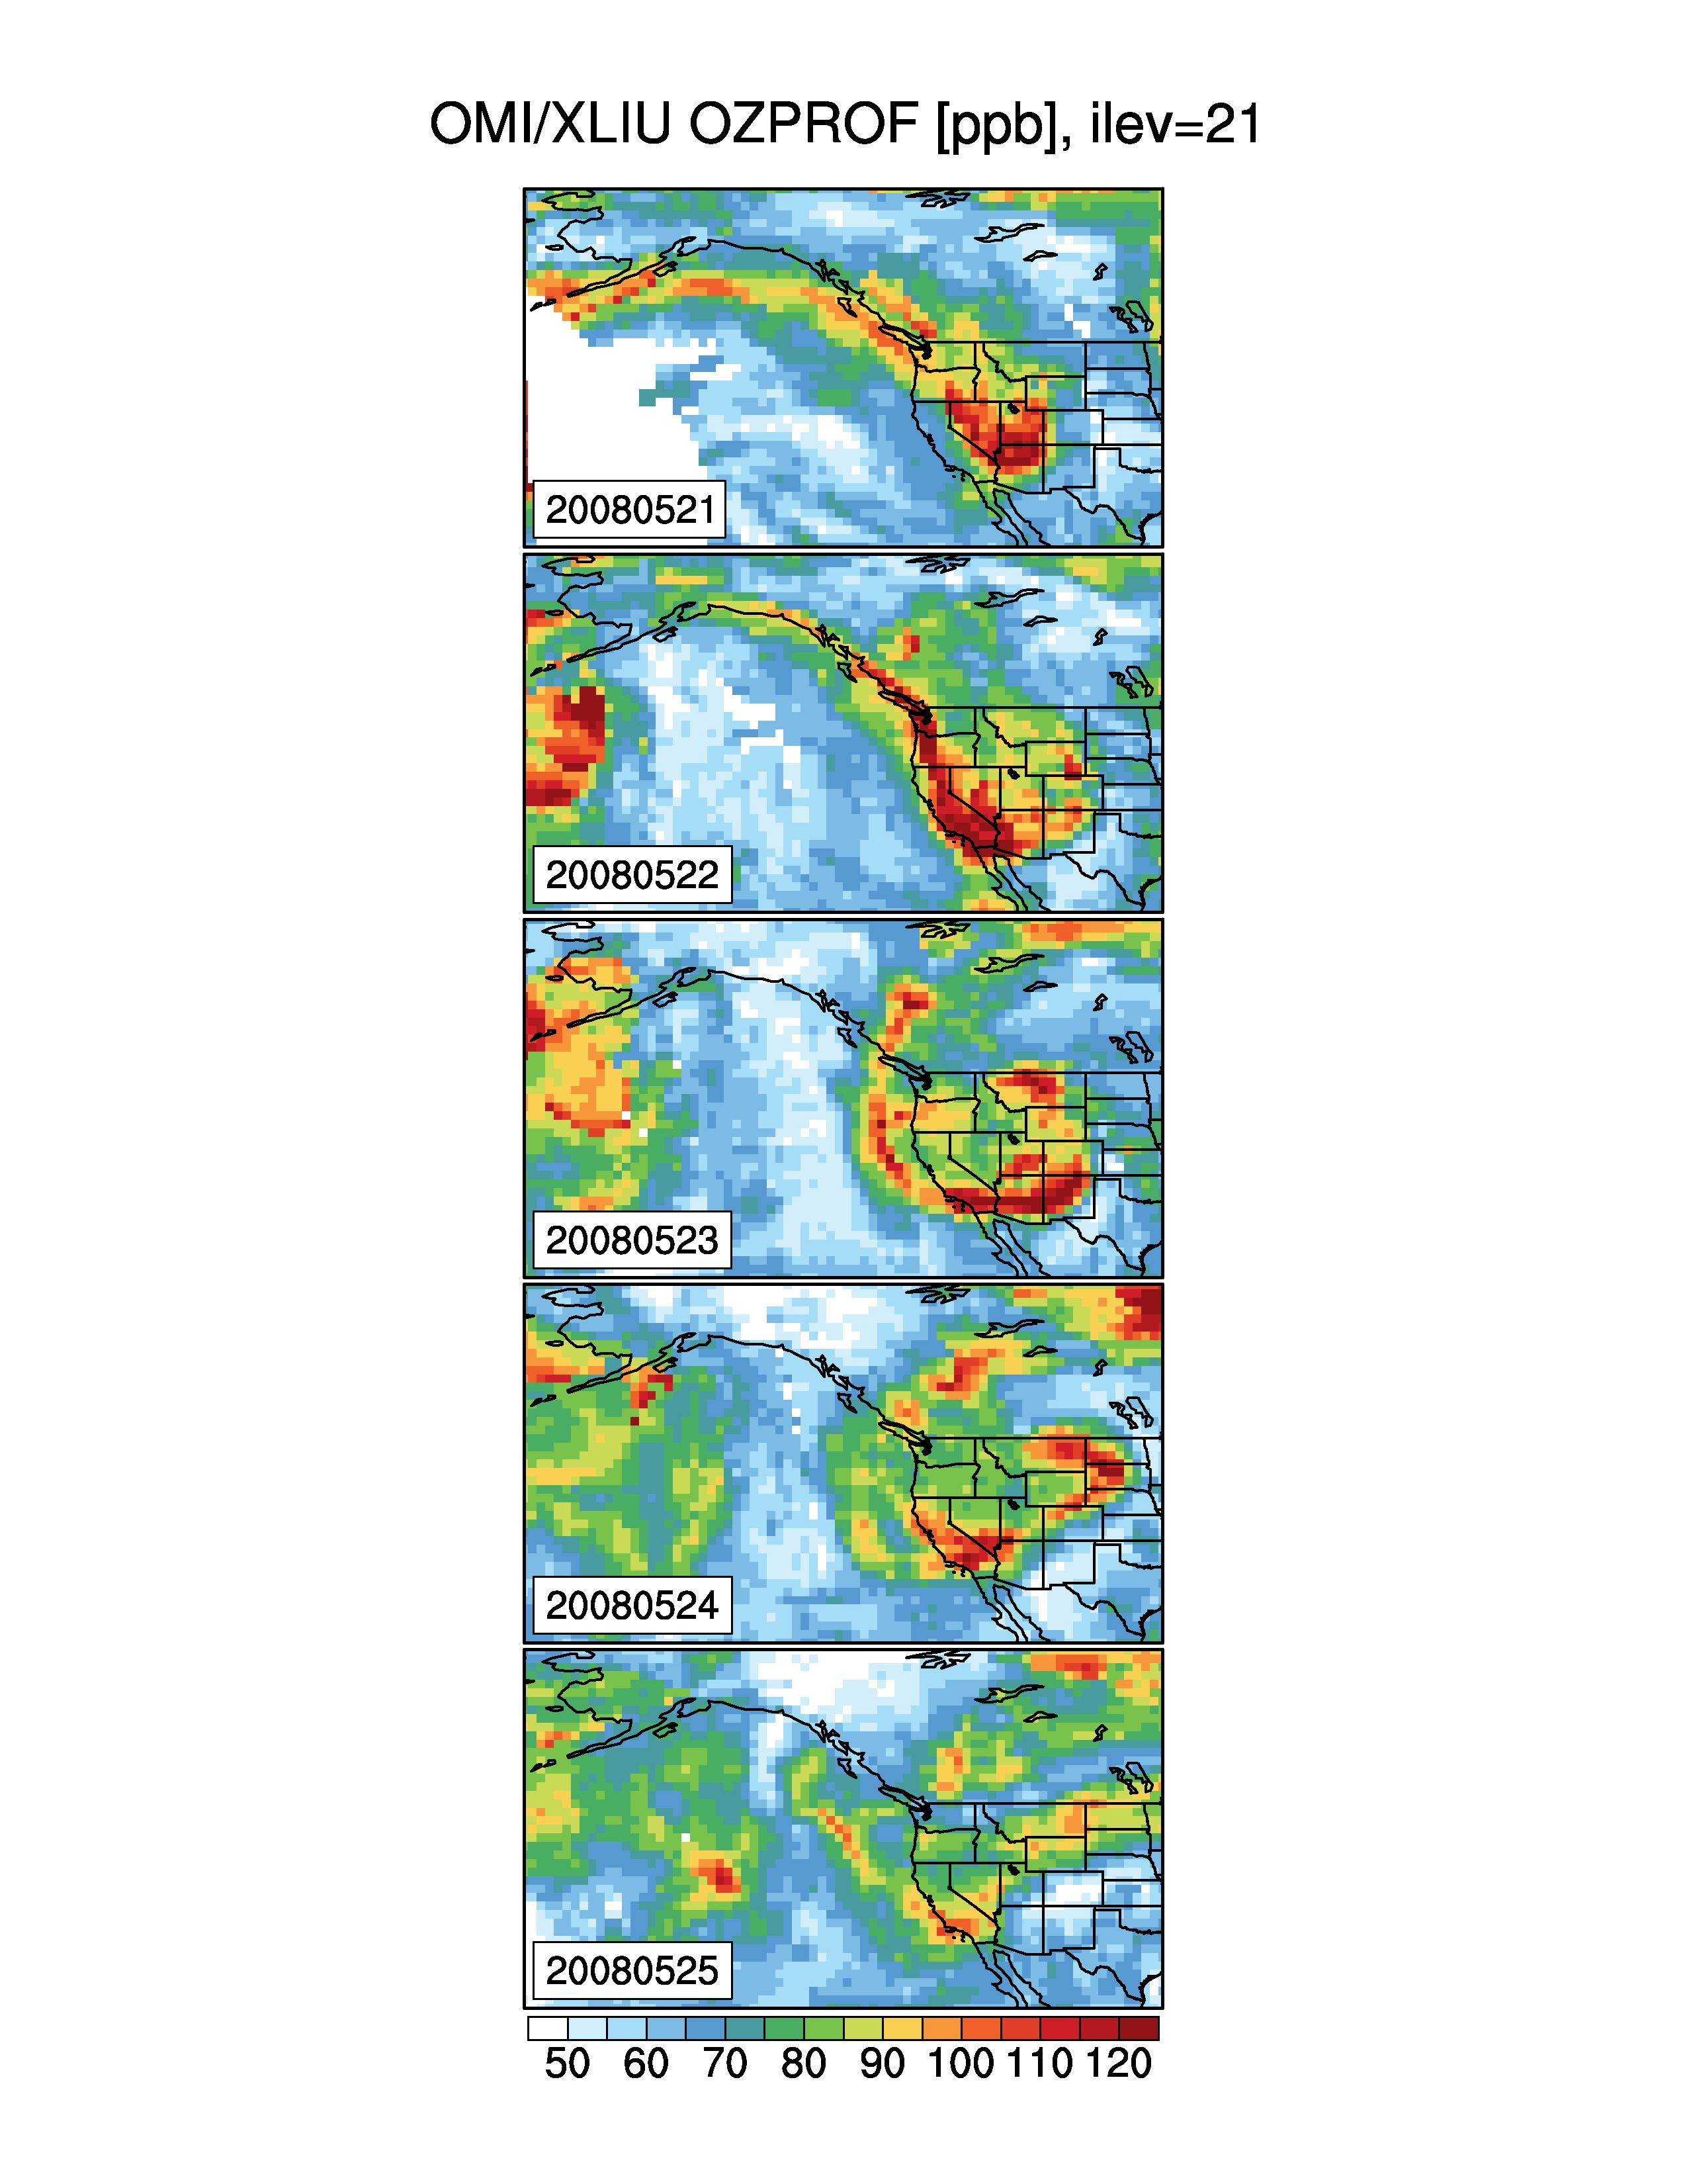
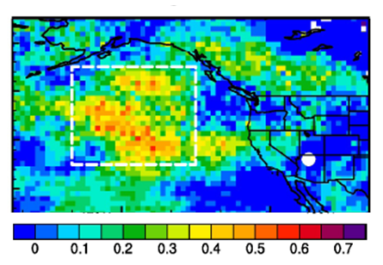
Satellite products indicate potential for contributions from transported “background”
Fires: MODIS
9/15/12
Stratospheric intrusions: OMI
9/15/12
Total Column O₃
S.Dakota
Products from X. Liu, Harvard
Dugan Fire
Montana
300 hPa PV
NASA image courtesy Jeff Schmaltz, LANCE MODIS Rapid Response Team at NASA GSFC.
[DU]
http://earthobservatory.nasa.gov/
NaturalHazards/view.php?id=79221
~550-350 hPa O₃
Intercontinental transport: AIRS
A. Fiore (CU/LDEO)
M. Lin (Princeton)
[ppbv]
Indicate potential downwind influence
Public health alerts
Identify exceptional events
Quantitative estimates require models
correlation coefficient (r)
Asian pollution forecasting with
AIRS CO columns (Lin et al., 2012a)
Notes:
GRC; time lag 2 days

Slide 7
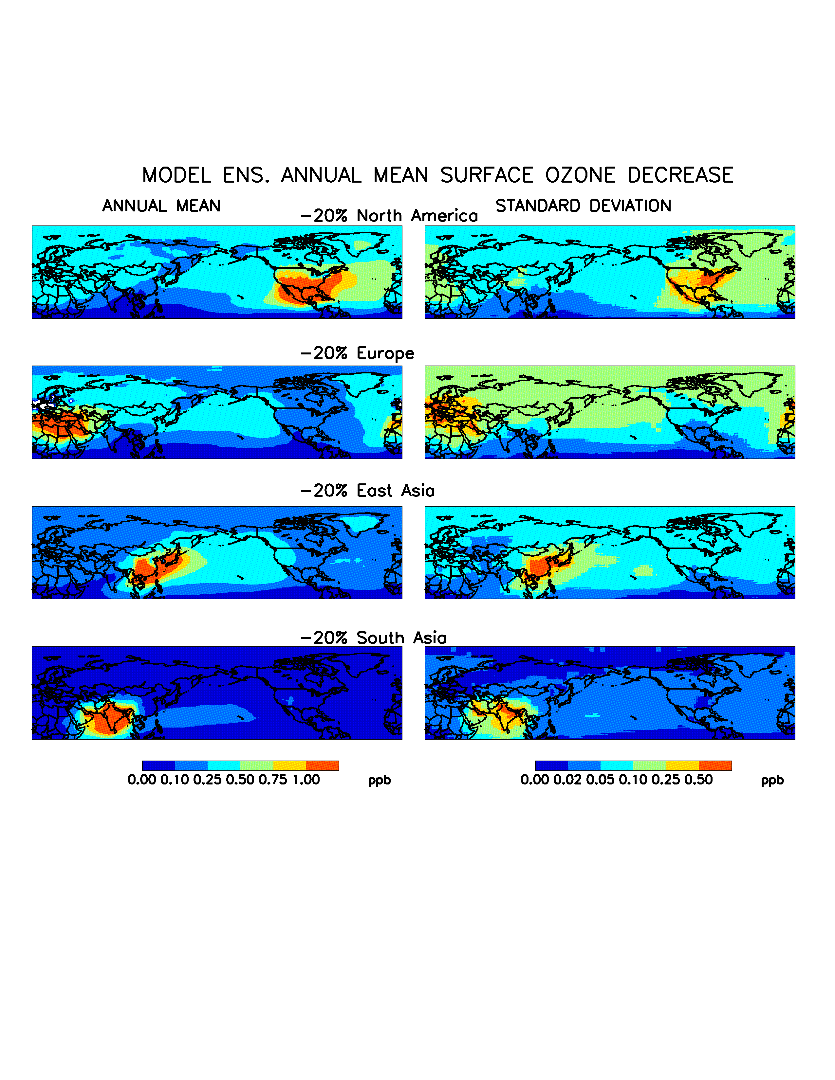
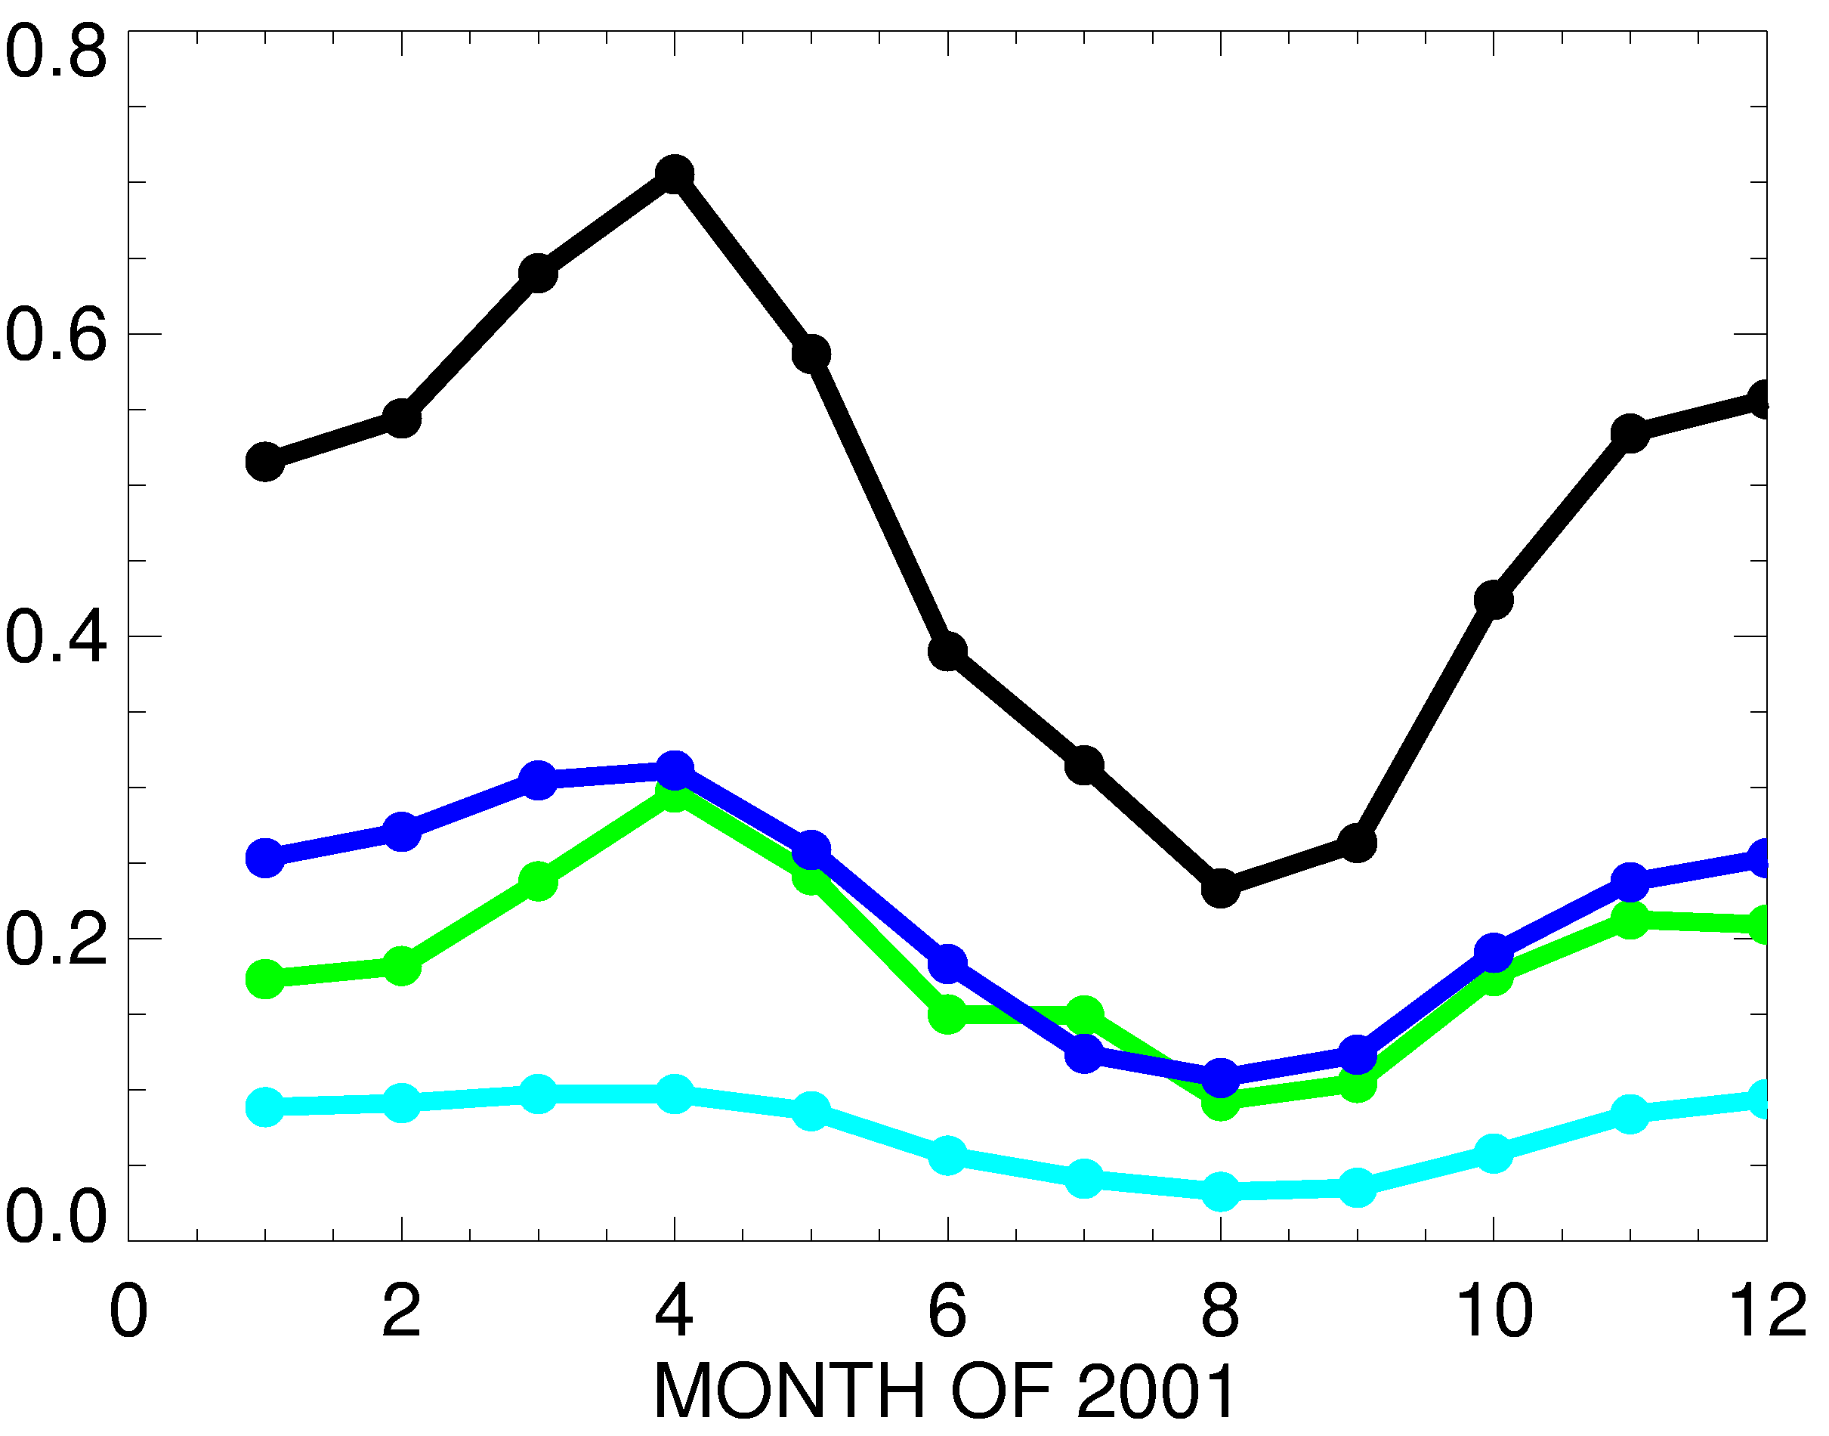

Model estimates for components of background: Intercontinental O₃ transport
15- MODEL MEAN SURFACE O₃ DECREASE (PPBV)
when regional anthrop. O₃ precursor emissions are reduced by 20%
Source region: SUM3 EA EU SA
Receptor region = NA
NA
Annual mean (2001)
EU
EA
Spring max (longer lifetime, efficient transport ) [e.g., Wang et al., 1998; Wild and Akimoto, 2001; Stohl et al., 2002]
ppb
Spatial variability over receptor region
[also Reidmiller et al., 2009; Lin et al., 2010]
Fiore et al., JGR, 2009; TF HTAP 2010

Slide 8
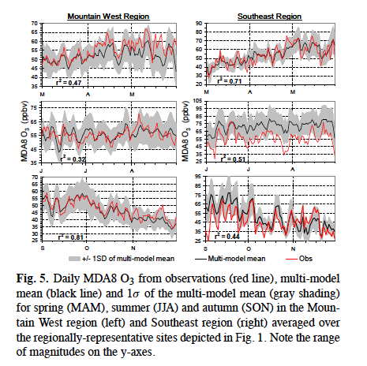
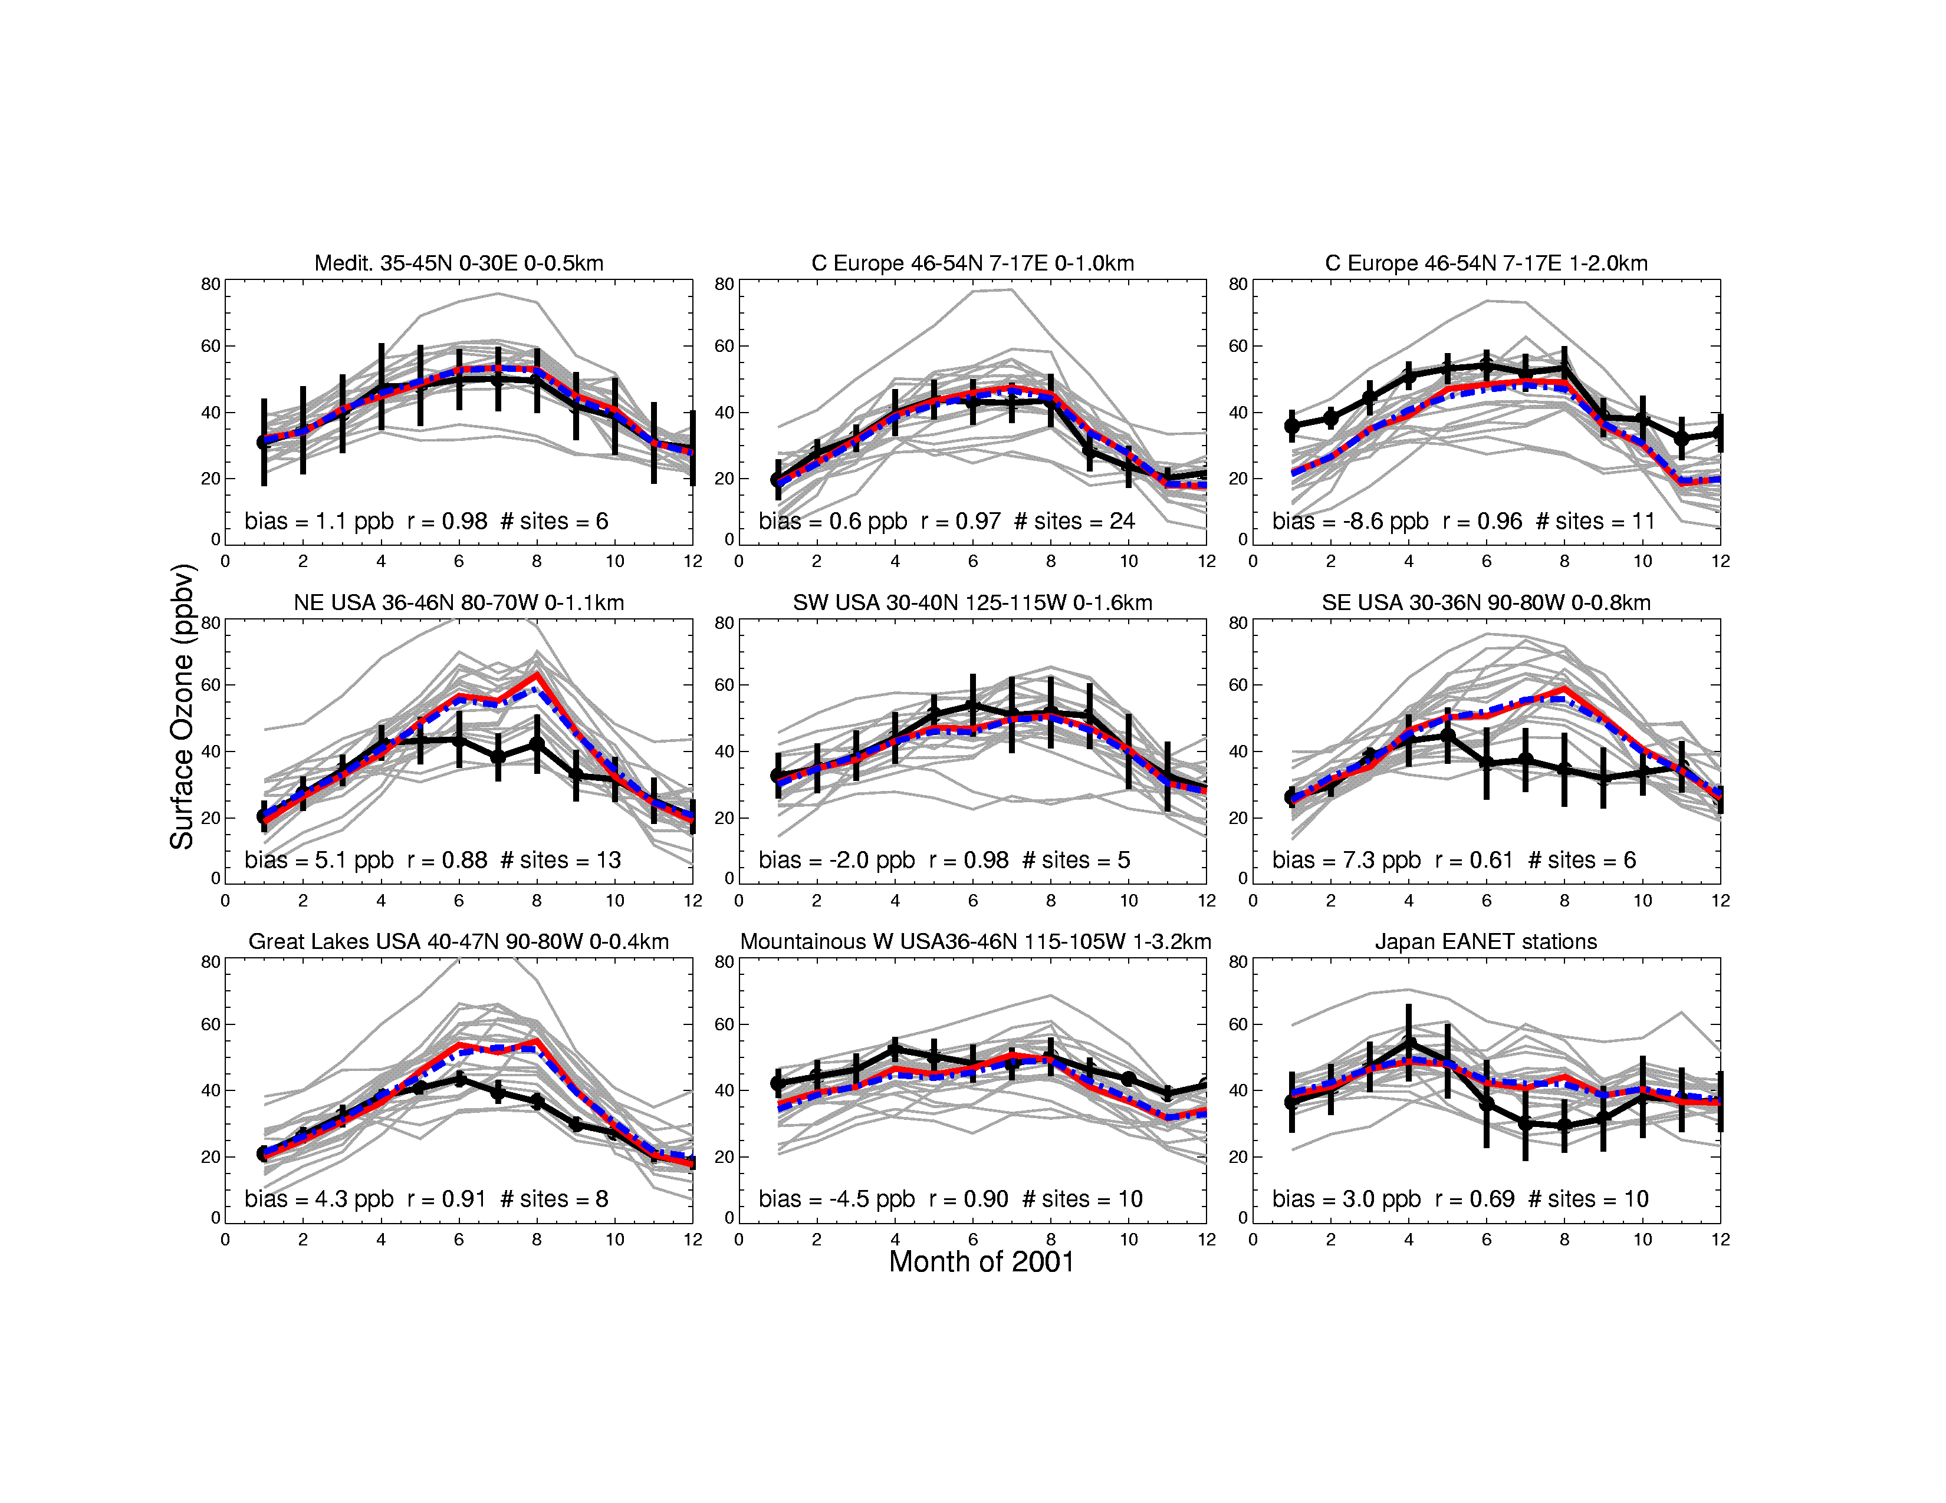
Model evaluation with obs. crucial to
identify problems/robust features
MAM
SW USA (30-40N, 115-125W)
JJA
MDA8 O₃ (ppb), 2001
Monthly Mean Surface Ozone (ppb)
Mtn W USA (36-46N, 105-115W)
SON
OBS (3 sites) 16-model mean +/- 1SD
OBS Individual models Model Median/Mean
Fiore et al., 2009
Reidmiller et al., 2009
Notes:
reidmillwe: pnd, grc, mev; spread max in summer (different scales) smallest in spring

Slide 9
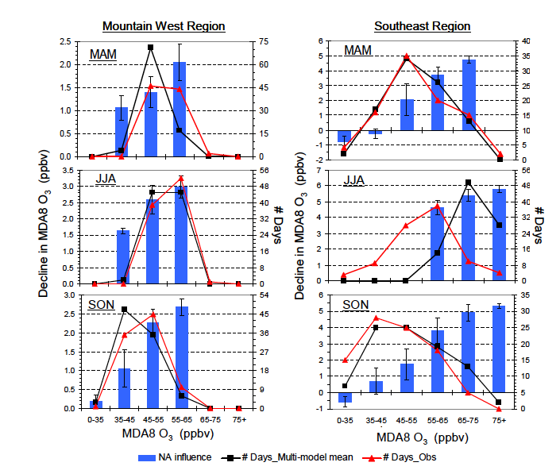
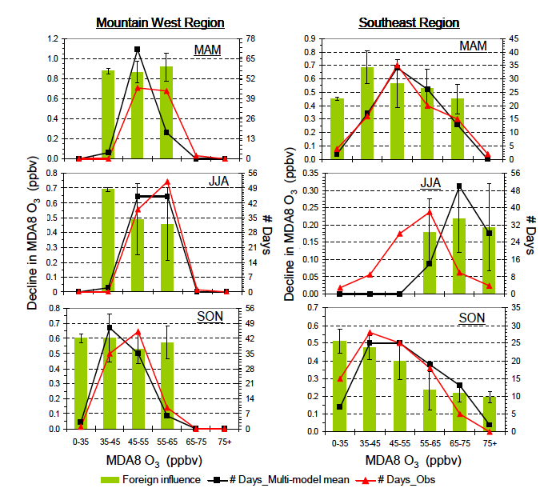
Response of surface ozone over Mountain West to foreign vs. domestic emission reductions binned by total O₃ level
Reidmiller et al., ACP, 2009
Decrease in surface O₃ (ppb) from -20% EA+EU+SA anthrop. emis
Decrease in surface O₃ (ppb) from -20% NA anthrop. emis
Response
to foreign
emissions
similar
throughout
distribution;
declines in
summer
NA influence
largest
for highest
events +
increases
spring to
summer
Need to evaluate/constrain processes
Reidmiller et al., ACP, 2009
Notes:
reidmillwe: pnd, grc, mev; spread max in summer (different scales) smallest in spring

Slide 10

Air Quality Applied Sciences Team (AQAST)
NASA initiative, begun in 2011, builds a bridge between Earth science resources and air quality management needs.
Earth science resources
Air Quality Management Needs
Pollution monitoring
Exposure assessment
AQ forecasting
Source attribution of events
Quantifying emissions
Nat & foreign influences
AQ processes
Climate-AQ interactions
satellites
suborbital platforms
models
c/o D.J. Jacob

Slide 11
AQAST members
Daniel Jacob (leader), Loretta Mickley (Harvard)
Greg Carmichael (U. Iowa)
Dan Cohan (Rice U.)
Russ Dickerson (U. Maryland)
Bryan Duncan, Yasuko Yoshida, Melanie Follette-Cook (NASA/GSFC); Jennifer Olson (NASA/LaRC)
David Edwards (NCAR)
Arlene Fiore (Columbia/LDEO); Meiyun Lin (Princeton)
Jack Fishman, Ben de Foy (Saint Louis U.)
Daven Henze, Jana Milford (U. Colorado)
Tracey Holloway, Steve Ackerman (U. Wisconsin); Bart Sponseller (Wisconsin DRC)
Edward Hyer, Jeff Reid, Doug Westphal, Kim Richardson (NRL)
Pius Lee, Tianfeng Chai (NOAA/NESDIS)
Yang Liu, Matthew Strickland (Emory U.), Bin Yu (UC Berkeley)
Richard McNider, Arastoo Biazar (U. Alabama – Huntsville)
Brad Pierce (NOAA/NESDIS)
Ted Russell, Yongtao Hu, Talat Odman (Georgia Tech); Lorraine Remer (NASA/GSFC)
David Streets (Argonne)
Jim Szykman (EPA/ORD/NERL)
Anne Thompson, William Ryan, Suellen Haupt (Penn State U.)

Slide 12
AQAST organization
AQAST members are appointed for five years (starting May 2011)
Investigator Projects (IPs) with core funding, adjusted annually to reflect AQ needs
Tiger Team Projects (TTPs) competed on annual basis to address urgent air quality management needs.
All AQAST projects involve partnerships with air quality managers and have deliverable air quality management outcomes
Biannual AQAST meetings provide forums for dialogue with air quality managers: NCAR (May 2011), EPA (Nov 2011), U. Wisconsin (Jun 2012),
Cal/EPA (Nov 2012)
AQAST workshops, AQAST representation at air quality meetings, four special sessions and Town Hall at the Fall 2012 AGU…

Slide 13
Scope of current AQAST projects
Partner agency
SIP Modeling
AQ processes
Monitoring
AQ-Climate
Background
IC/BC for AQ models
Forecasting
Emissions
Future satellites
Local: RAQC, BAAQD
State: TCEQ, MDE,
Wisconsin DNR, CARB,
Iowa DNR, GAEPD, GFC
Regional: LADCO, EPA Region 8
National: EPA, NOAA,
NPS
Theme
Satellites: MODIS, MISR, MOPITT, AIRS, OMI, TES, GOES
Suborbital: ARCTAS, DISCOVER-AQ, ozonesondes, PANDORA
Models: MOZART, GFDL AM3, GEOS-Chem, RAQMS, STEM, GISS, IPCC
Earth Science resource
c/o D.J. Jacob

Slide 14
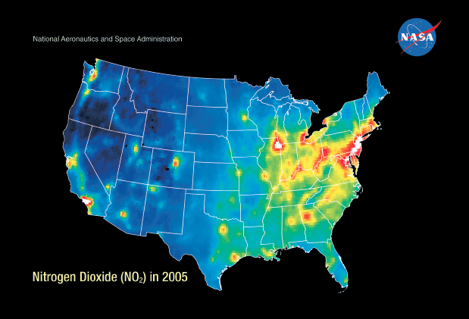
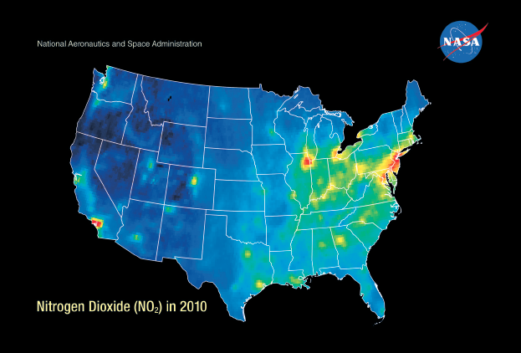
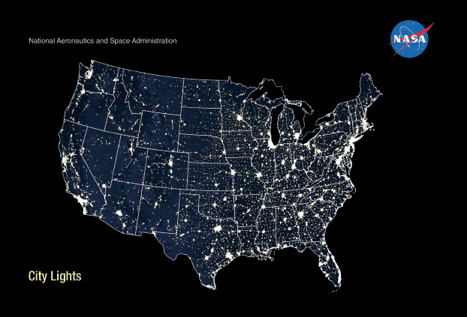
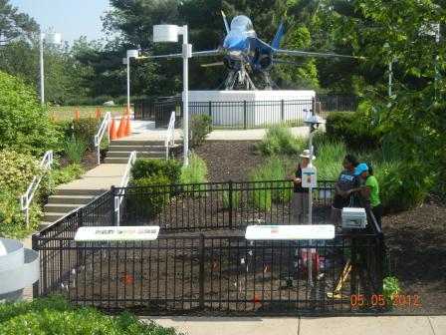
AQAST products for AQ managers & public outreach
PI: Duncan, AQAST Lenticular
1. Easily obtain useful data in familiar formats
Custom OMI NO₂ “Level 3” products on any grid in netCDF with WHIPS (Holloway)
Annual NO₂ shapefiles - OMI & CMAQ on CMAQ grids (AQAST Tiger Team)
Google Earth
2. Find easy-to-use guidance & example scripts for understanding OMI products and comparing to simulated troposphere & PBL concentrations
One-stop user portal (Holloway & AQAST Tiger Team)
OMI NO₂ & SO₂ guidance, field campaign example case studies (Spak & AQAST Tiger Team)
3. Obtain OMI observational operators for assimilation & emissions inversion in CMAQ
NO₂ in GEOS-Chem ➔ CMAQ (Henze, Pye)
SO₂ in STEM ➔ CMAQ (Spak, Kim)
O₃ in STEM ➔ CMAQ (Huang, Carmichael, Kim)
NO₂ columns 2005
NO₂ columns 2010
Intensity of city lights
PI: Jack Fishman, Ozone garden at the Missouri Botanical Gardens
AQAST PIs: Carmichael, Spak
c/o D.J. Jacob

Slide 15
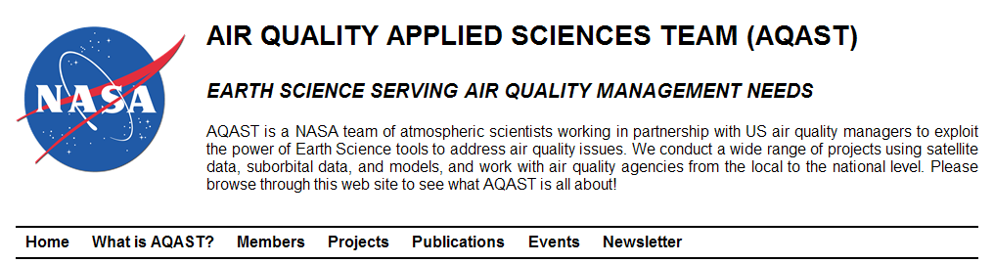
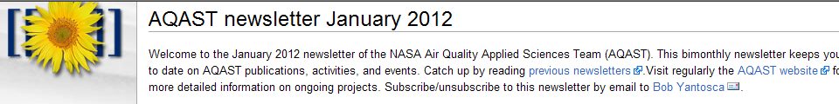
COMMUNICATION TOOLS
Website: http://acmg.seas.harvard.edu/aqast
Newsletter: subscribe through website
If you have a specific problem for which you need information or assistance please contact team leader Daniel Jacob (Harvard U).

Slide 16
Tiger Team activity: Key factors contributing to differences in model estimates for O₃ “background”
Problem: Poorly quantified errors in background distributions complicate NAAQS-setting and interpreting SIP attainment simulations
To date, EPA NAB estimates have been provided by one model.
Approach:
Compare GFDL AM3 and GEOS-Chem NAB (regional, seasonal, daily)
Process-oriented analysis of factors contributing to model differences
YEAR 2006 | GEOS-Chem | GFDL AM3
Resolution | ½°x⅔° (and 2°x2.5°) | ~2°x2°
Meteorology | Offline (GEOS-5) | Coupled, nudged to NCEP U and V
Strat. O₃ & STE | Parameterized (Linoz) | Full strat. chem & dynamics
Isoprene nitrate chemistry | 18% yield w/ zero NO_{x} recycling | 8% yield w/ 40% NO_{x} recycling (obs based; Horowitz et al, 2007)
Lightning NO_{x} | tied to model convective clouds, scaled to obs. flash climat; higher NO_{x} at N. mid-lat | tied to model convective clouds
Emissions | NEI 2005 + 2006 fires (emitted at surface) | ACCMIP historical + RCP4.5 (2005, 2010); vert. dist. climatological fires
ALL DIFFERENT!
Notes:
16

Slide 17
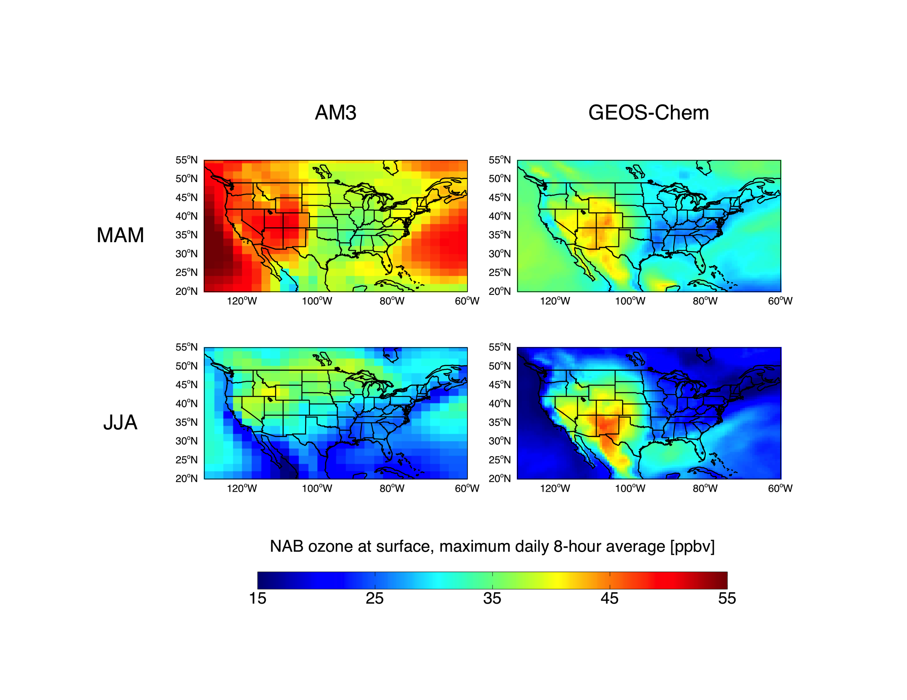
Models differ in estimates of North American background
(estimated by simulations with N. American anth. emissions set to zero)
North American background (MDA8) O₃ in model surface layer 2006
AM3 (~2°x2°)
GEOS-Chem (½°x⅔°)
AM3: More
O₃-strat +
PBL-FT
exchange?
Spring (MAM)
GC: More
lightning NO_{x}
(~10x over SWUS;
too high)
Summer (JJA)
J. Oberman
ppb
TTP PI: Fiore
Notes:
17

Slide 18
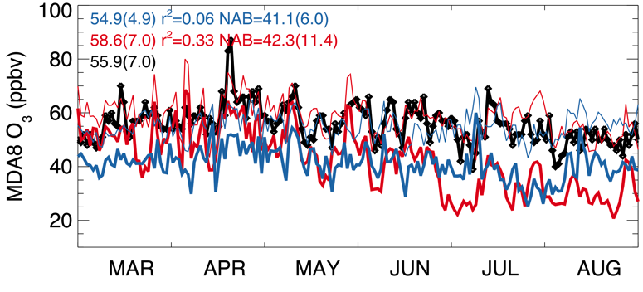
Models differ in day-to-day and seasonal variability of
N American background
Gothic, CO: 107W, 39N, 2.9km
GEOS-Chem ( ½°x⅔° ) GFDL AM3 (~2°x2°) OBS.
Mean(σ)
Total model O₃
Model NAB O₃
Fig 3-58 of EPA O₃ Integrated Science Assessment
→Models bracket OBS; similar mean N. American background
→GC N. American background ~2x smaller σ than AM3
→AM3 NAB > GC NAB in MAM (strat. O₃?); reverses in JJA (lightning)
Notes:
18

Slide 19
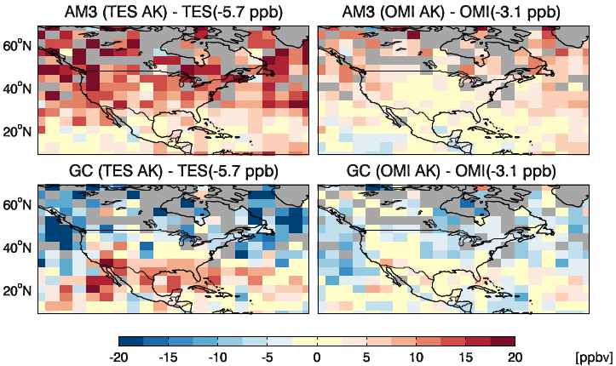
Constraints on background O₃ from
OMI and TES mid-tropospheric products
TES and OMI 500 hPa ozone for spring 2006 compared to AM-3 and GEOS-Chem
TES
OMI (X. Liu)
Bias vs. N mid-latitude sondes
subtracted from
retrievals
Zhang et al.,
ACP, 2010
Masked out
where products
disagree by
> 10 ppb
L. Zhang,
Harvard
  AM3 generally high; GEOS-Chem low
  Implies that the models bracket the background
Notes:
19

Slide 20
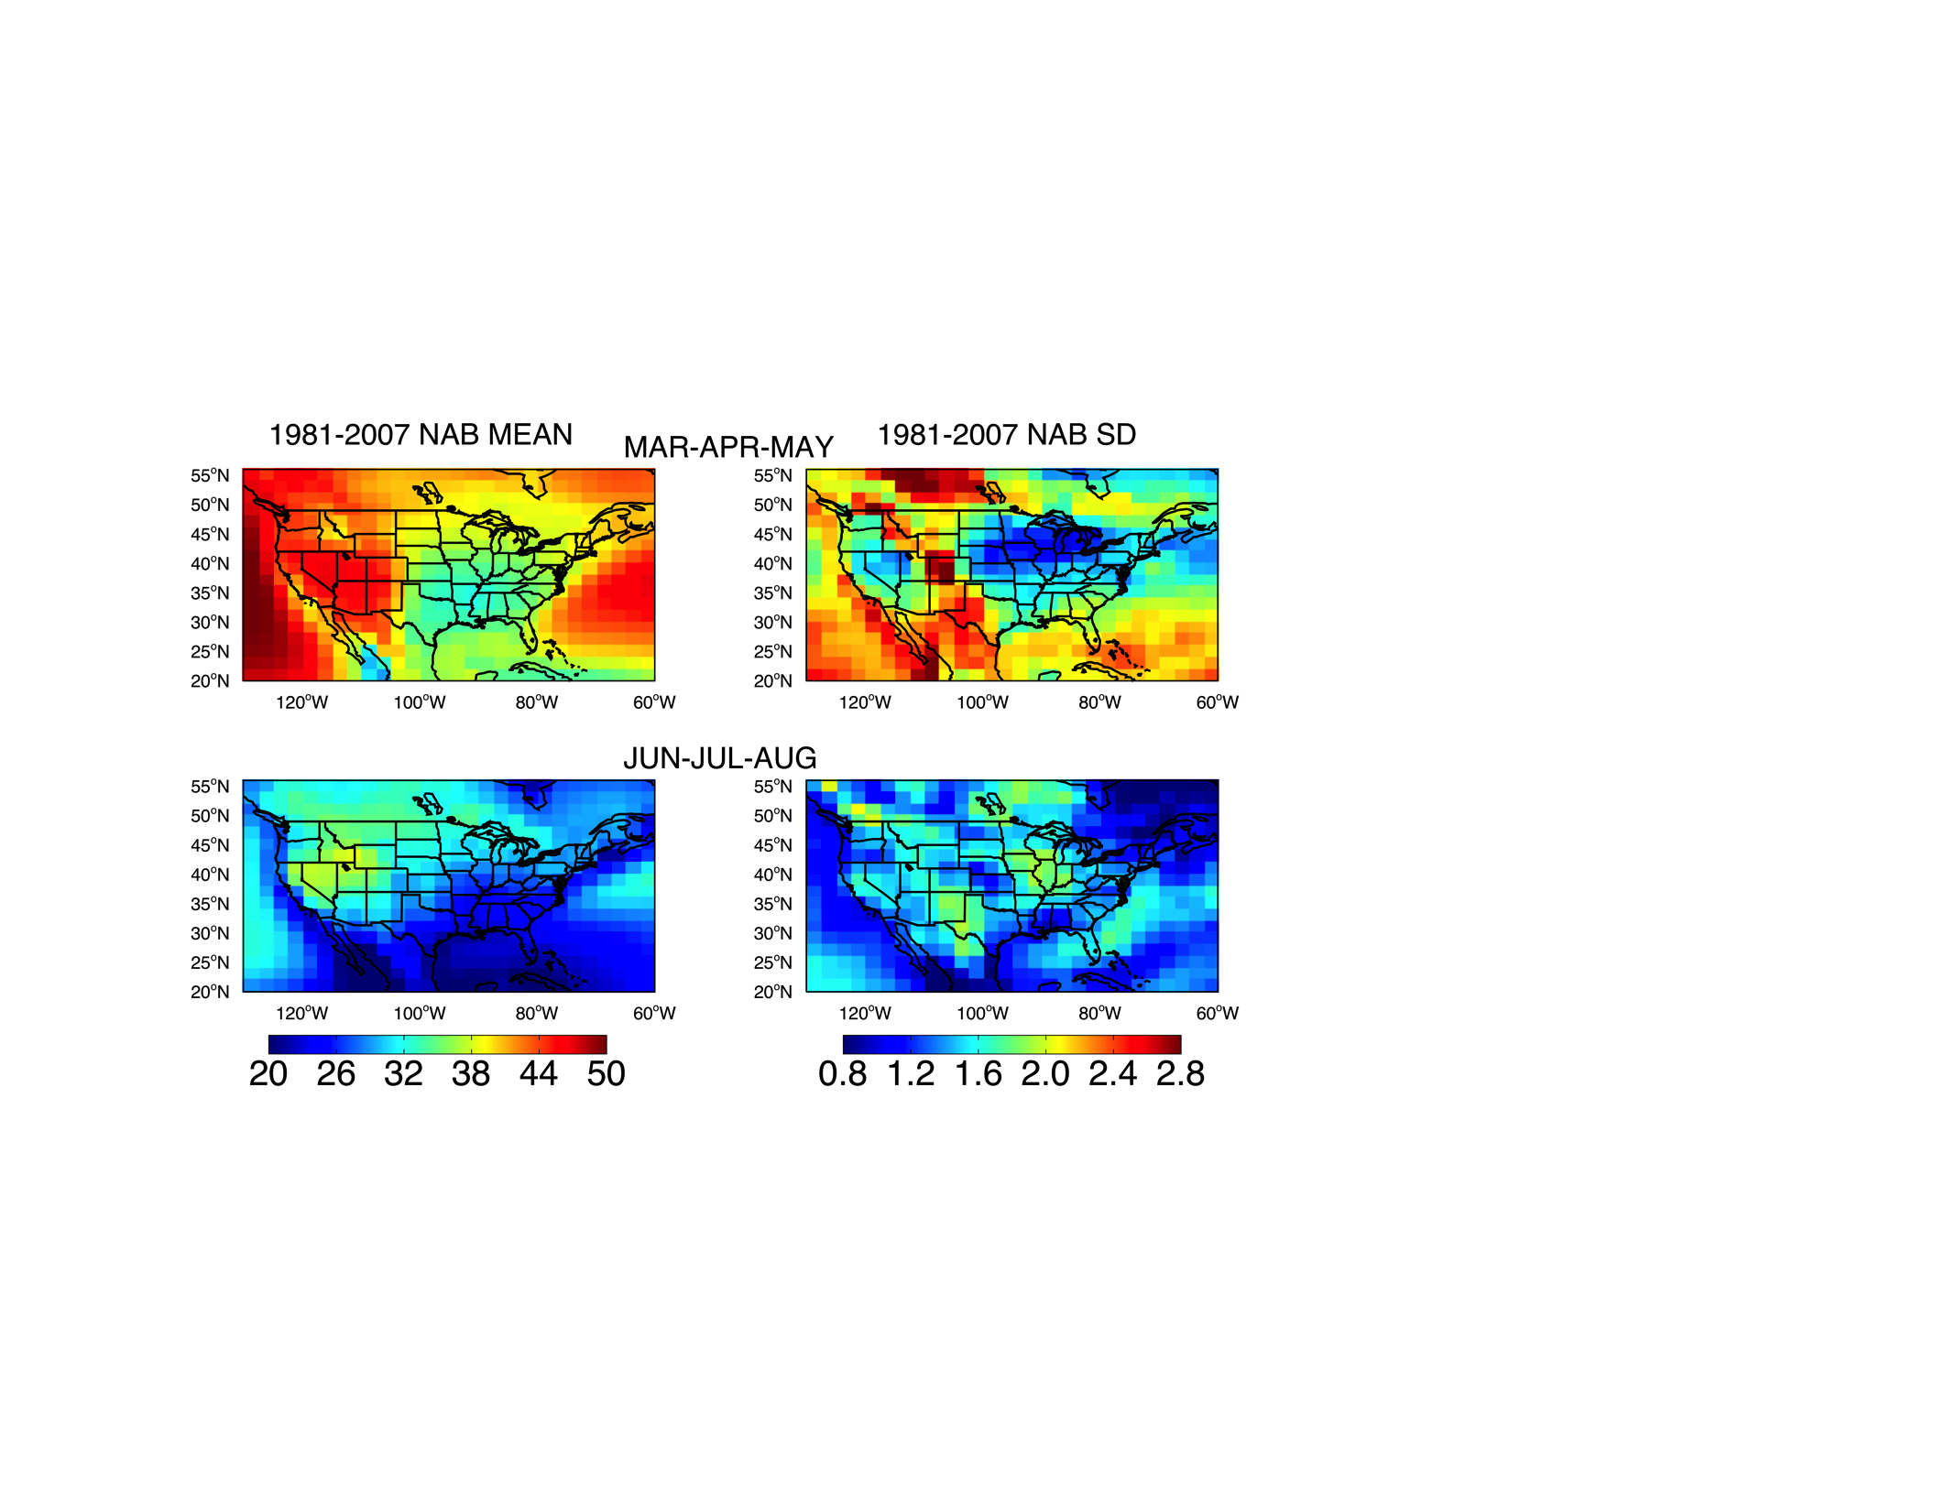
Variability in springtime O₃ background
GFDL AM3 simulation with N. American anthrop. emissions shut off (1981-2007)
MEAN OVER 27 YEARS
STANDARD DEVIATION
ppb
ppb
Notes:
20

Slide 21
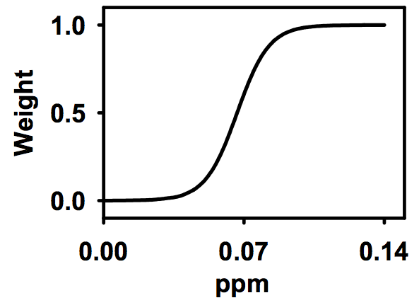
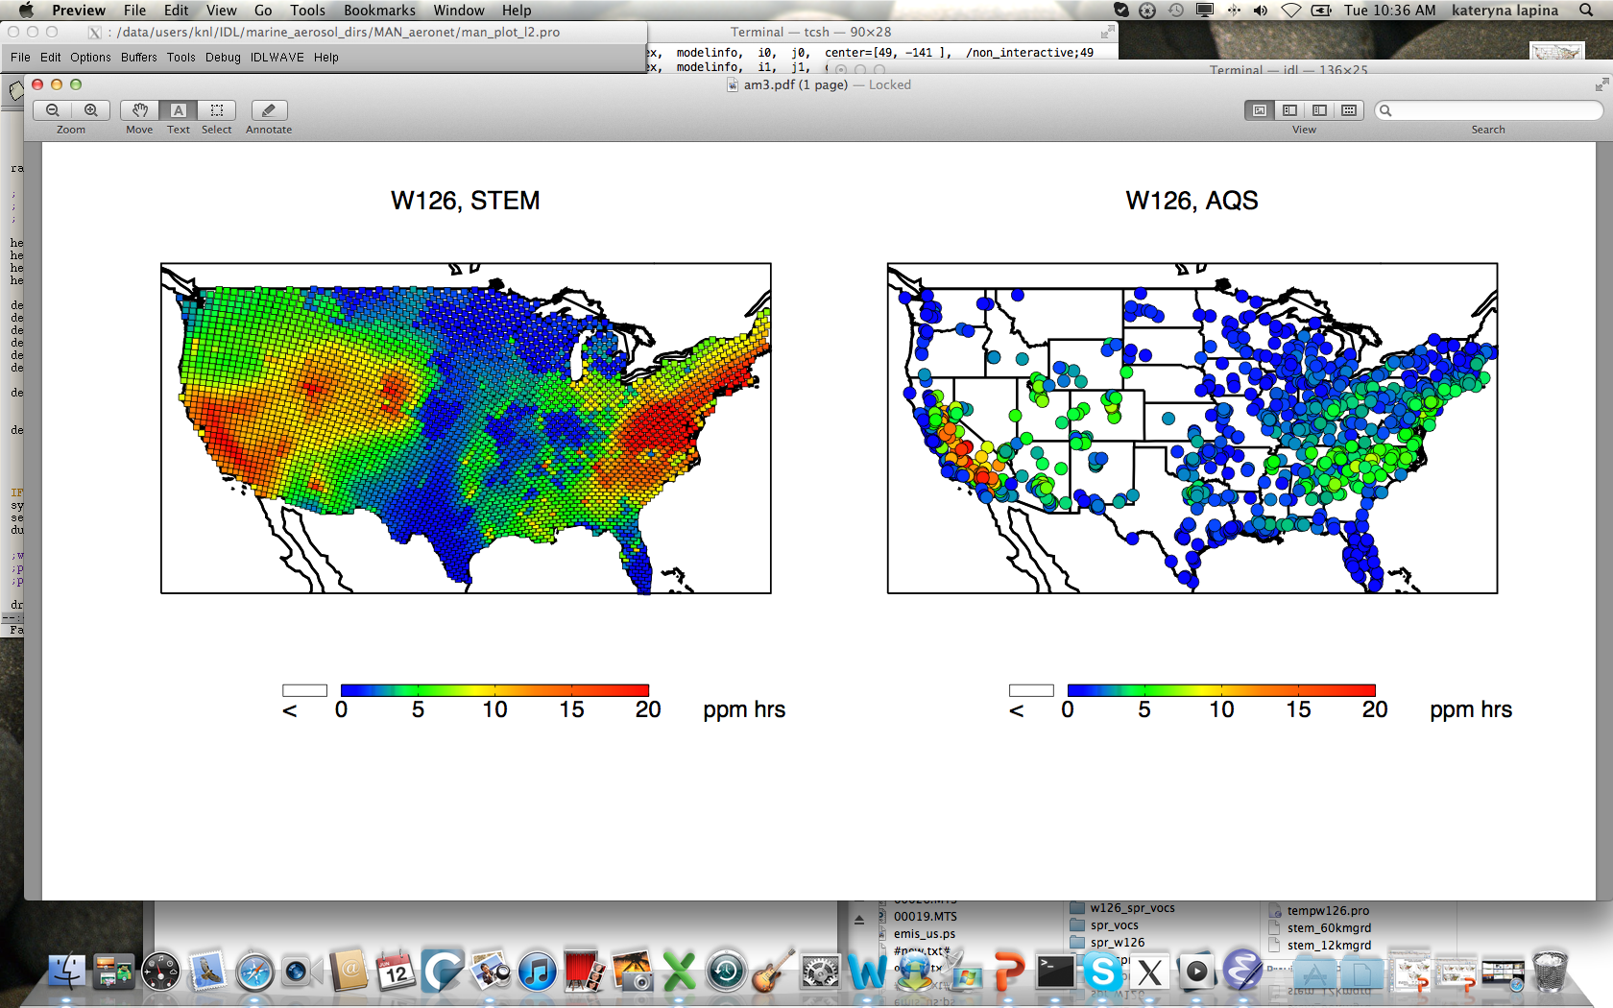
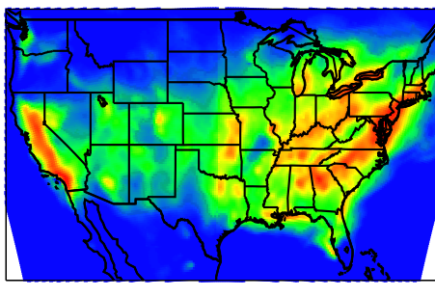
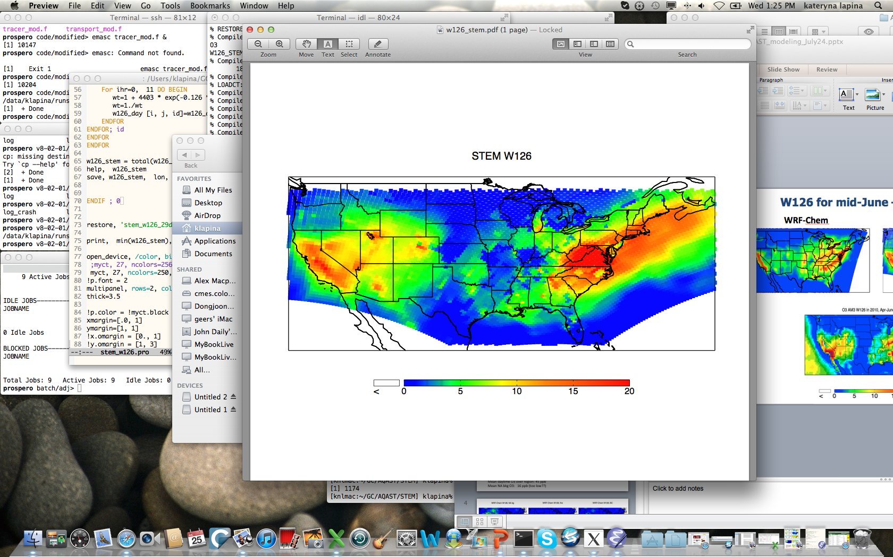
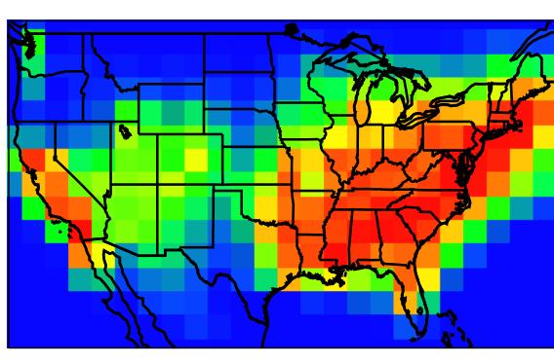
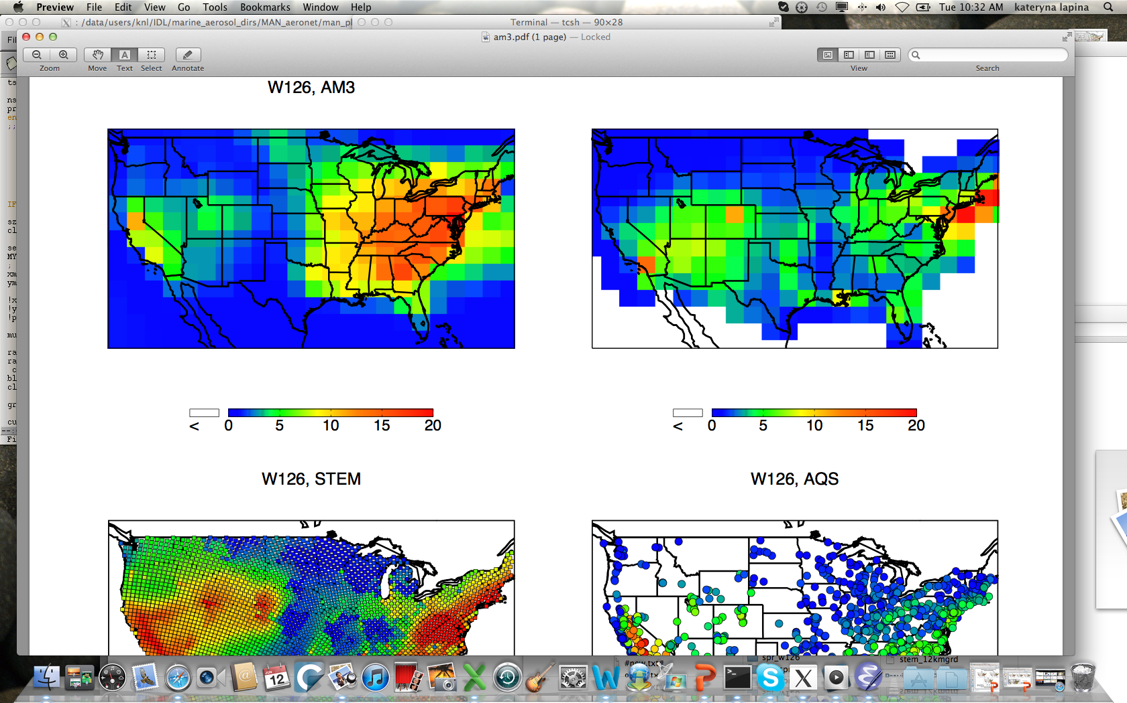
TTP: Model intercomparison of proposed secondary standard (vegetation) W126 metric
PI: Daven Henze, U Colorado
WRF-Chem STEM
AQS observations
MOZART
AM3
GEOS-Chem
W126 in mid-June – mid-July 2008
c/o Kateryna Lapina
Notes:
8am to 8pm hourly O3 over three consecutive months with a threshold in the range of 7-15 ppm-hours

Slide 22
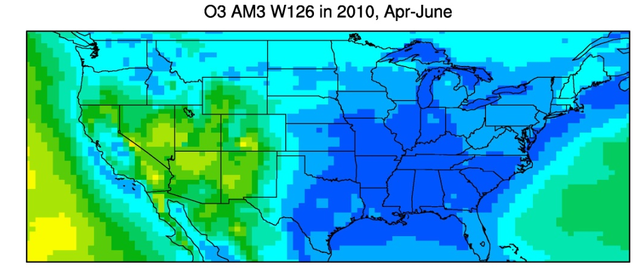
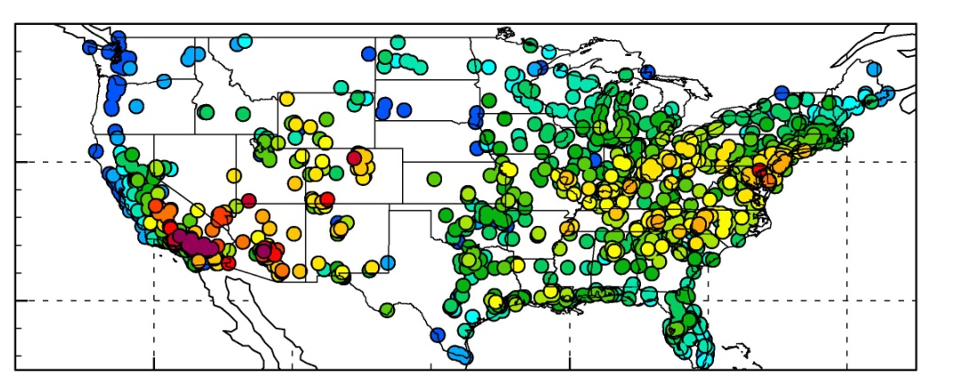
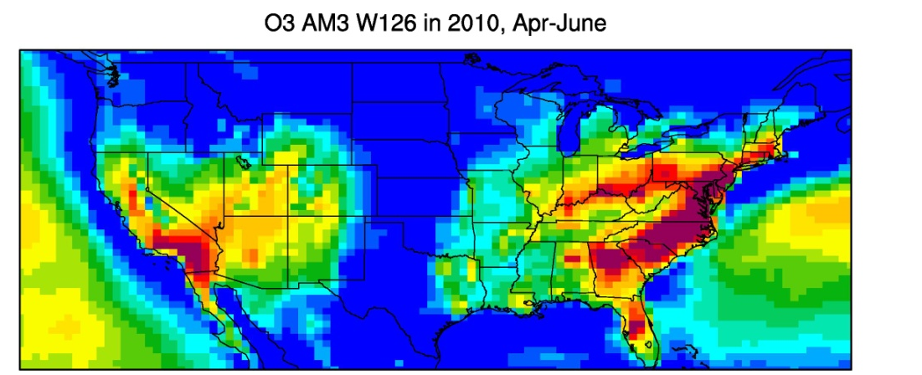
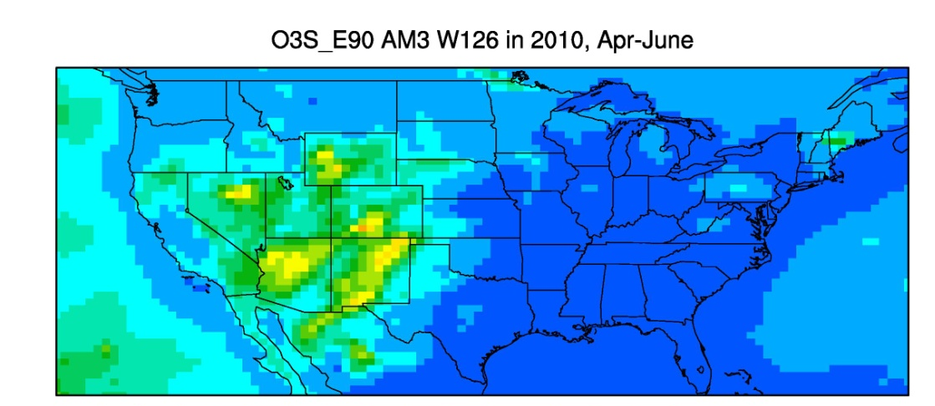

Simulated W126 Source Contributions
GFDL AM3 ~50 km² global model, April-June 2010
AM3 NA background
(NA anthrop. emis. = 0)
AQS OBSERVATIONS
AM3 (total – 10 ppm-hours)
AM3 stratospheric * e³
M. Lin, Princeton

Slide 23
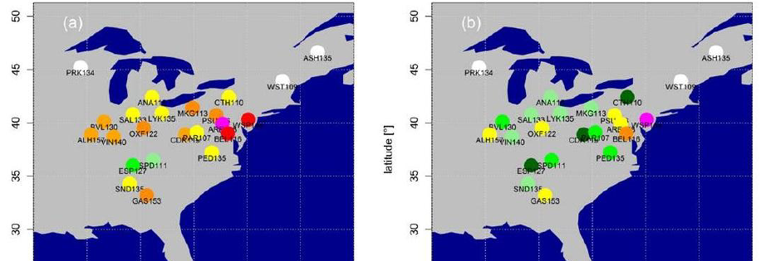


Quantifying extreme O₃ events in probabilistic terms:
Initial application to Eastern USA
1-year return O₃ values at CASTNet measurement sites
(Statistical methods from extreme value theory)
1988-1998
1999-2009
Dramatic decreases in 1-year return levels following NO_{x} SIP call
Rieder et al., submitted to ERL
How might climate warming influence extreme pollution events?
83520601

Slide 24
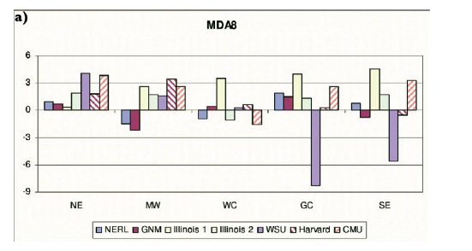
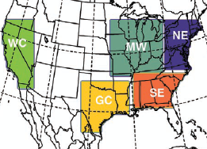
Model estimates of climate change influence on U.S. surface ozone over Western U.S. disagree in sign
Modeled changes in summer mean of daily max 8-hour O₃ (ppb; future – present)
NE MW WC GC SE
Weaver et al., BAMS, 2009
ROBUST FINDINGS:
Increased summer O₃ (2-8 ppb) over large U.S. regions
Increases are largest during peak pollution events
Gap in analysis over much of Region 8
→ Should consider changes in fire frequency, strat. intrusions
Notes:
Check in weaver – did any of these models allow fires to respond?

Slide 25
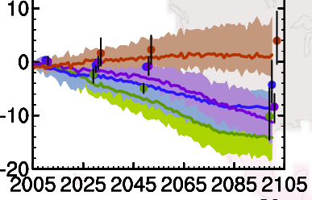
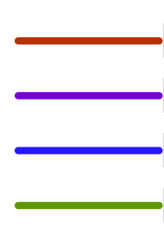
First look: 21st century AQ projections from new generation chemistry-climate models – North America
Change in O₃ (ppb) from combined changes in emissions + climate
North America (land only)
4 CMIP5 1-10 ACCMIP
models models
(transient; (Time slice;
Ref 1986-2005) Ref (1980+2000)/2 )
RCP8.5
RCP6.0
RCP4.5
RCP2.6
V. Naik, GFDL
Fiore et al., Chem. Soc. Rev., 2012
Harness statistical power (decades of simulation years) to identify robust changes in key drivers [e.g., Turner et al., ACPD, 2012]
Regional scale analyses, connect with regional chemistry-climate models
Process-oriented evaluation (long-term chemical + meteorological obs)
New CCMI initiative (watch for AGU EOS meeting summary)

Slide 26
Integrated analyses of models, satellite, in situ data yielding insights to processes controlling Western U.S. Air Quality
NASA Air Quality Applied Science Team (AQAST)
Earth science resources → AQ management needs
Advancing understanding of WUS background O₃:
  -- process-oriented approaches
  background components: Asian, strat., fires
  -- harness strengths of multiple models + obs.
  focus on AQ metrics (MDA8, W126)
  identify exceptional events, improve SIP modeling
  -- developing forecast tools
  simple correlations to chemical data assimilation
  -- impacts from climate warming
  shifting balance of local vs. transported O₃?

