Slide 1




North American isoprene influence
on intercontinental ozone pollution
Arlene M. Fiore
Hiram Levy II
Dan Jaffe
Abstract A41J-06
AGU Fall Meeting
San Francisco, CA
December 16, 2010

Slide 2
What role does isoprene play in intercontinental O₃ transport?
O₃
O₃
CO, VOC + NO_{x}
isoprene
NORTH AMERICA (NA)
OCEAN
EUROPE (EU)
KEY FINDINGS (MOZART-2 global model)
EU surface O₃ decrease from -20% NA anthrop. emissions:
1. could be offset by increases in isoprene (warmer climate, land-use)
2. shows little sensitivity to uncertain isoprene source magnitude or isoprene nitrate recycling

Slide 3

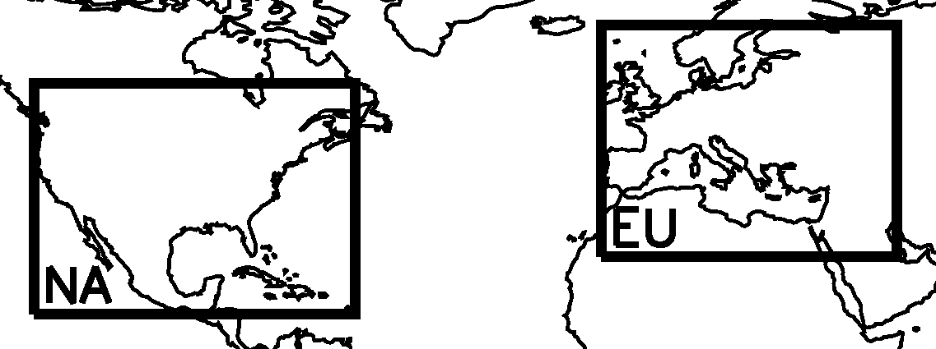
Approach: Sensitivity simulations in MOZART-2 global
CTM, expanding on TF HTAP multi-model studies
www.htap.org
TF HTAP, 2007, 2010;
Sanderson et al., GRL, 2008; Shindell et al., ACP, 2008;
Fiore et al., JGR, 2009,
Reidmiller et al. ACP, 2009;
Anenberg et al., ES&T, 2009;
Jonson et al., ACPD,2010
O₃
Isoprene
>> AVOC
1. Base Simulation in MOZART-2 global CTM:
→ 1.9°x1.9°; 2001 NCEP meteorology
→ Anthropogenic emissions as in Horowitz et al. [2003]
    GFED v2 for biomass burning [van der Werf et al.; 2006]
2. Suite of simulations changing NA emissions by:
→ -20% anthrop. NO_{x}, NMVOC, separately
→ -20% all anthrop. (NO_{x}+CO+NMVOC+aerosol)
→ +20% isoprene
    +20% isoprene and -20% all anthropogenic
3. Different baselines to estimate all NA anthrop. influence on EU O₃
→ isoprene nitrate recycling (100% vs 40%)
→ +20% isoprene emissions

Slide 4
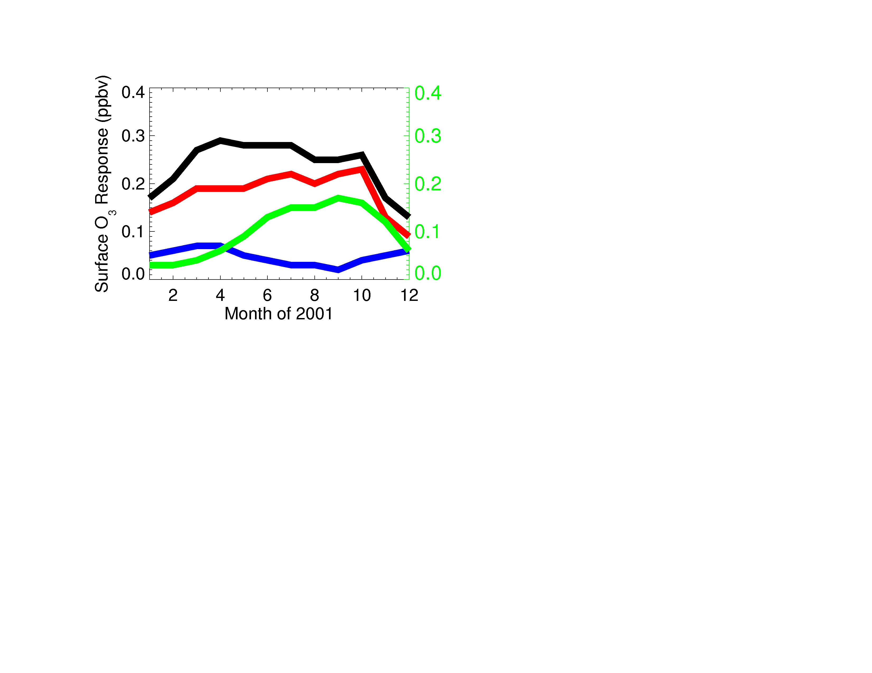
Surface O₃ response over Europe (spatial average) to North American (NA) emission perturbations
-20% NA anthrop. NO_{x}+CO+NMVOC
Surface ozone decrease
over Europe (ppb)
-20% NA anthrop. NO_{x}
Surface ozone increase
over Europe (ppb)
+20% NA isoprene
-20% NA anthrop. NMVOC
EU O₃ response to NA isoprene comparable to anthrop.
NO_{x} in summer/fall; larger than anthrop. NMVOC

Slide 5
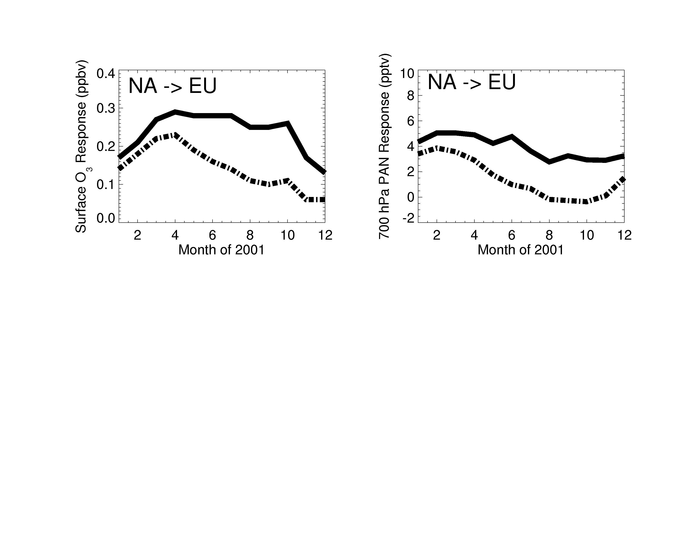
Surface O₃ over Europe (spatial average) to -20% North American emission perturbations
EU O₃ decrease is smaller by ~50% when NA isoprene increases by 20%
-20% all NA anthrop. emissions
Interannual variations in NA isoprene emissions
~ 20-30%
[Palmer et al. 2006]
Surface ozone decrease
over Europe (ppb)
-20% all NA anthrop.
AND +20% NA isoprene
Consider potential changes in isoprene (climate, land-use) in future scenarios for emission controls to lower hemispheric O₃

Slide 6
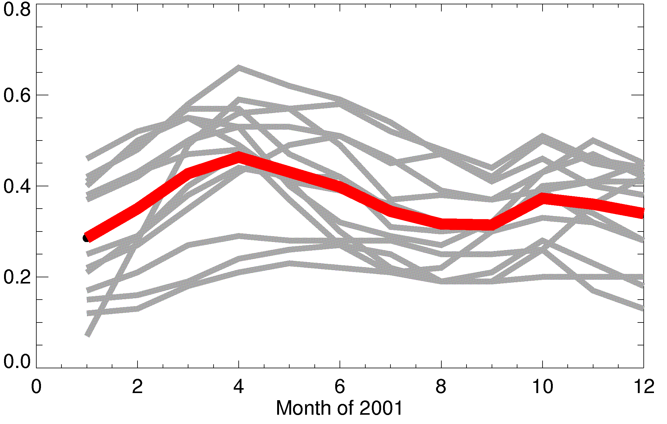
Prior studies show a wide range in model estimates of
EU surface O₃ response to NA anthrop. emissions
Multi-model mean
Generally not
associated with
model differences
in anthropogenic emissions
[Fiore et al., 2009]
Surface ozone decrease
over Europe (ppb)
Individual models, TF HTAP studies
Does the range reflect model differences in size of
isoprene source and/or isoprene nitrate chemistry?

Slide 7
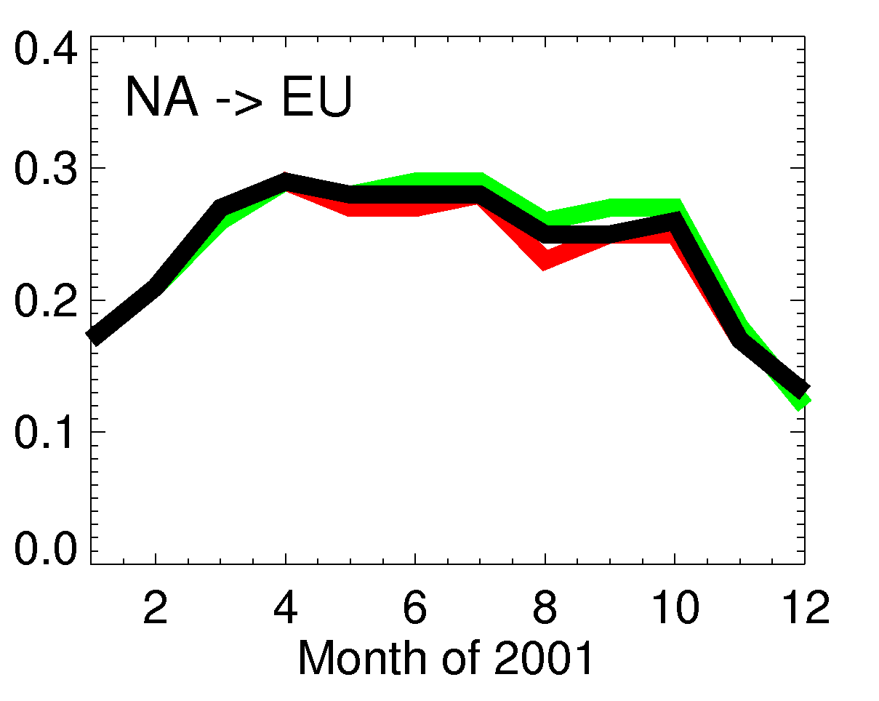
Surface O₃ response over Europe (spatial average) to -20% all North American anthropogenic emissions
Baseline (previous)
+20% NA isoprene
Surface ozone decrease
over Europe (ppb)
O₃
ISOP.
+ NO_{x}
?
Isoprene nitrates
40% NO_{x} recycling
100% NO_{x} recycling
Cross-model differences not explained by different treatments
of isoprene emission magnitude or isoprene nitrate recycling

Slide 8
PAN: A pathway (and a proxy ?) for source regions to influence foreign O₃
O₃
O₃
PAN
NMVOC + NO_{x}
PAN
isoprene
O₃
CH₃C(O)OONO₂
NORTH AMERICA (NA)
OCEAN
EUROPE (EU)
PAN as a PATHWAY: contributes to O₃ far downwind
[e.g., Moxim et al., 1996; Heald et al.,2003; Hudman et al., 2004; Zhang et al., 2008; Fischer et al., 2010; Lin et al., 2010]
PAN as a PROXY: may reflect changes in O₃ precursor sources better than O₃ itself [Jaffe et al., 2007; Fischer et al., 2010]

Slide 9
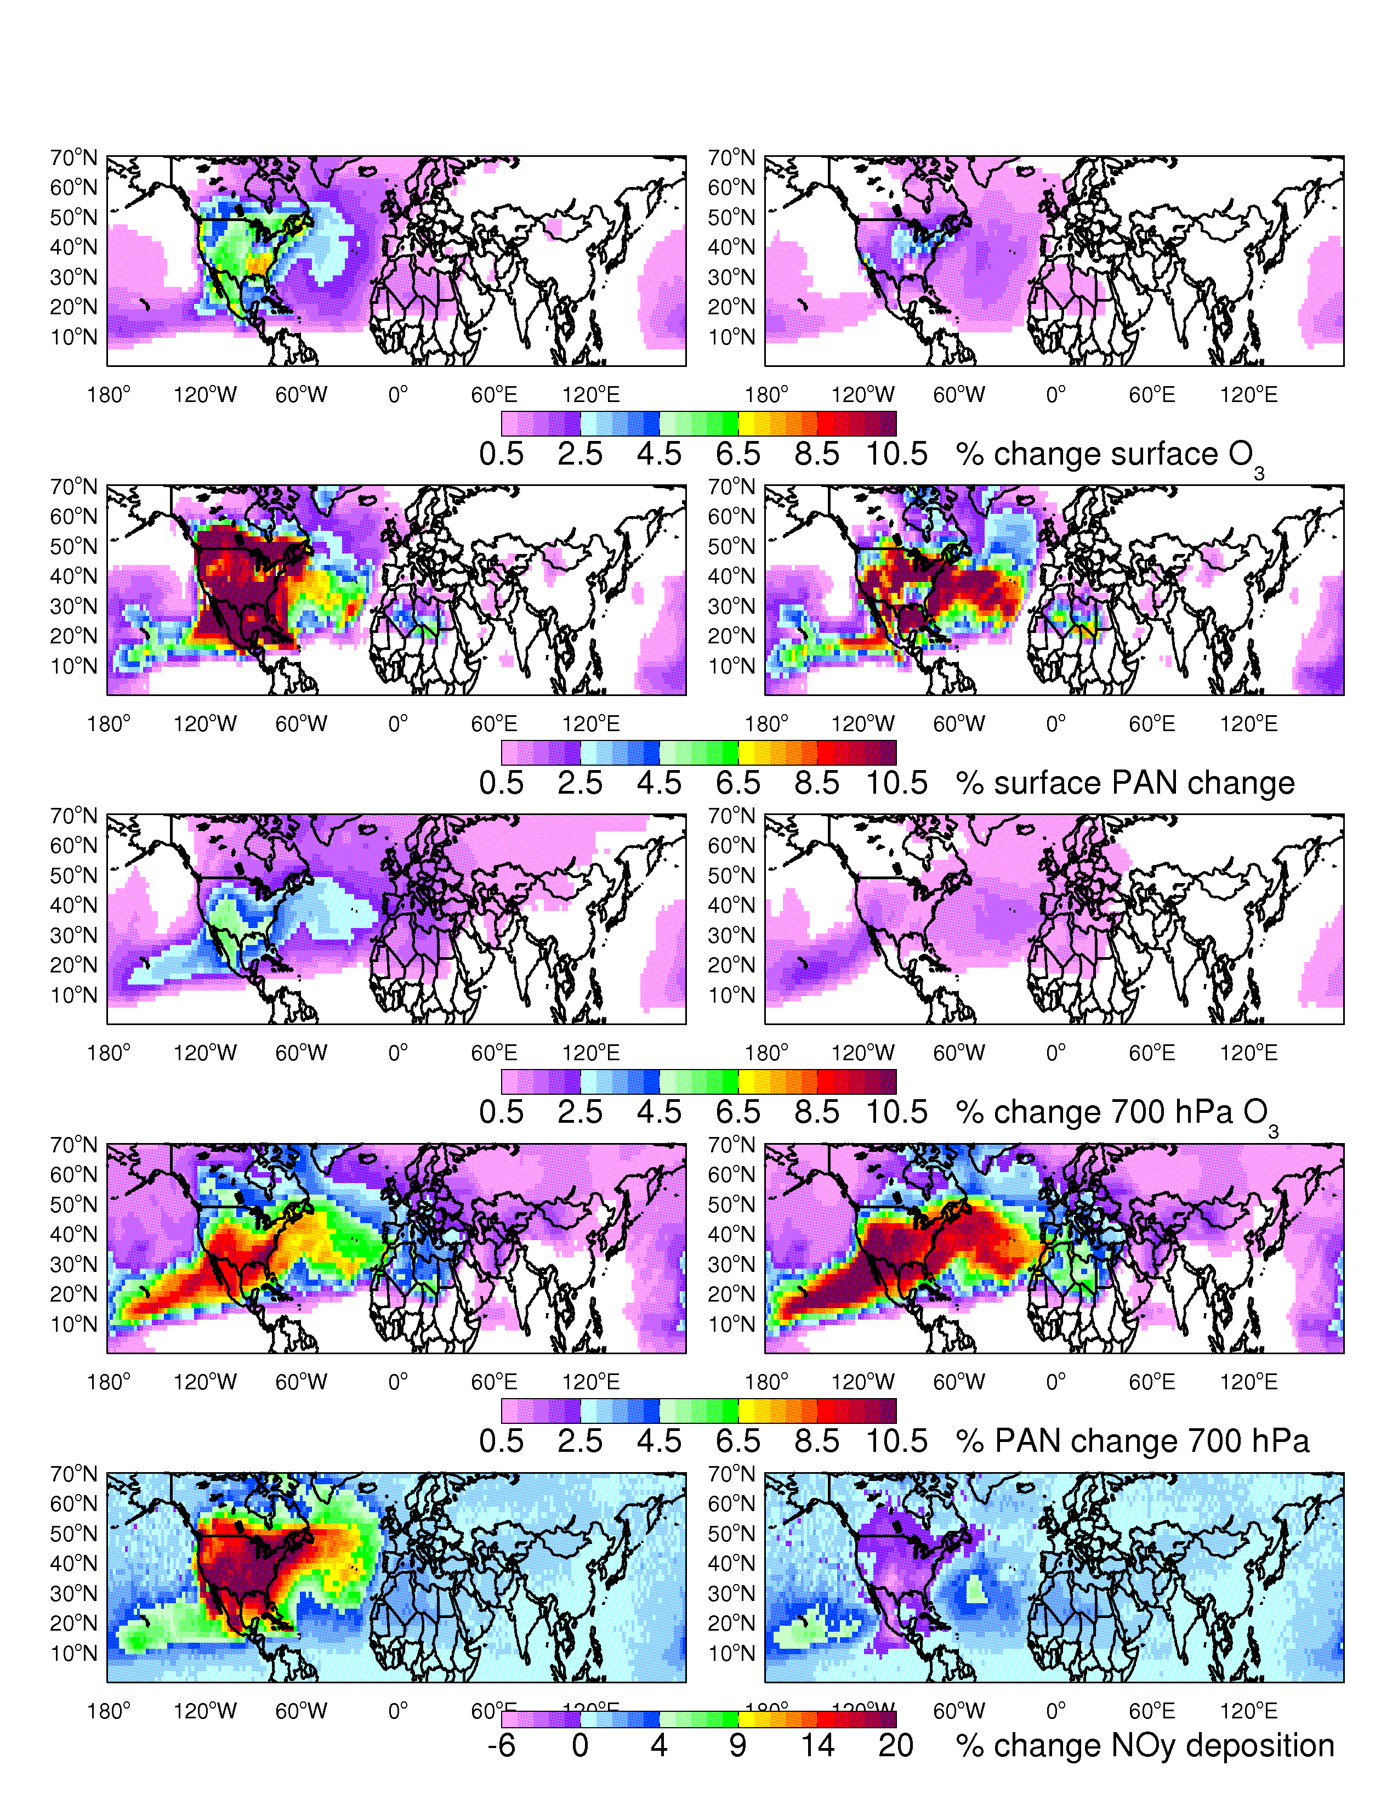
PAN is relatively more sensitive than O₃ to anthropogenic and isoprene emission changes (August)
-20% ALL NA anthrop. emissions
+20% NA isoprene emissions
OZONE at 700 hPa
PAN at 700 hPa
% change
PICO-NARE site well-positioned for sampling N. American outflow
[e.g., Honrath et al., JGR, 2004; val Martin et al., JGR, 2008.]

Slide 10
North American isoprene vs. anthropogenic influence on intercontinental O₃ pollution: Conclusions and implications
EU surface O₃ decrease from -20% NA anthrop. emissions:
1. could be offset by increases in isoprene (warmer climate, land-use)
2. shows little sensitivity to uncertain isoprene source magnitude or isoprene nitrate recycling
Include biogenics when assessing impacts of human activities (& consider as anthropogenic, e.g. land-use)?
PAN may be a proxy for regional emission changes
Establish long-term PAN observing sites in the lower free troposphere in key locations?
For more info or to join the discussion (open at ACPD through 12/20/10):
http://www.atmos-chem-phys-discuss.net/10/24821/2010/acpd-10-24821-2010-discussion.html

