Slide 1
HOW TO GET AHEAD
IN PROFESSIONAL ORGANIZATIONAL ENVIRONMENTS
BY STEVEN COHEN
COLUMBIA UNIVERSITY
SIPA & EARTH INSTITUTE
APRIL 2014

Slide 2
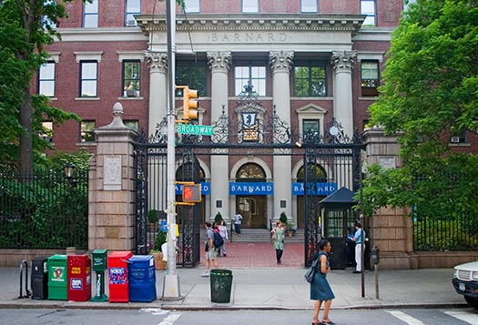
TODAY'S BRIEFING
WILL DISCUSS THE FOLLOWING ISSUES:
Moving from School to Work
Developing and Maintaining a Professional Network
Planning Your First Post-College Professional Move
Succeeding on the Job
Building Skills and Competencies
Developing a Professional Reputation
Overcoming Professional Adversity
Moving Up, Over and Around
Keeping Your Career in Perspective

Slide 3

1. MOVING FROM SCHOOL TO WORK
Work is changing.
  Less Structure, Less Security, More Mobility
Education is now constant.
  Formal education, training, and learning by doing
The culture of the workplace is different from school.
  Be careful about crossing personal and professional boundaries.

Slide 4

2. DEVELOPING AND MAINTAINING A PROFESSIONAL NETWORK
Building and using your contacts.
Staying in touch.
Nurturing an informal network.
  Beyond Facebook and LinkedIn
Professional socializing and professional civility
Using Professional associations
Using school and alumni connections
Asking for help from family, friends and friends of friends

Slide 5

3. PLANNING YOUR
FIRST POST-COLLEGE PROFESSIONAL MOVE
Networking from Columbia and Barnard
Use of adjuncts, faculty and alums
Use of speakers, student organizations, internships, research work, fellow students and volunteer work
Using career service offices
Taking advantages of your student status
Casting a wide net to develop job opportunities
Use Columbia, Barnard, and the Earth Institute as selling points
Opportunities for professional advancement: mentors, skill building, interests, values and ideals

Slide 6

4 . HOW TO APPROACH A JOB SEARCH DURING A RECESSION
Devote a substantial amount of time and effort to the search.
  Allocate about 20% of your time to the job search in the year before you leave school.
Identify your preferences and priorities.
  Retain flexibility for unforeseen opportunities.
  Develop a strategy and workplan: goals, tasks, and schedule.

Slide 7

4. How to approach a job search during a recession (Continued)
Communicate and network
  E-mail should be used to set up phone calls and visits.
  Your need to devote the extra effort to identifying openings.
  Contact classmates, alums, adjuncts, friends and family.
    This is not the time to be reserved or shy.
    Contact organizations you once worked for.
  Even organizations laying off workers continue to hire.

Slide 8
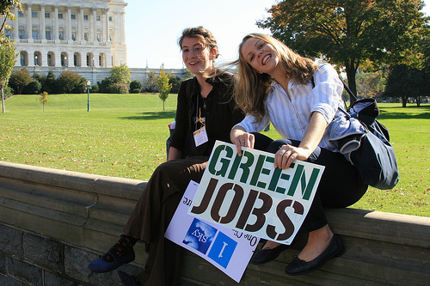
4. How to approach a job search during a recession (Continued)
Connect with the University’s adjunct faculty.
  They are important links to the “real world” and can help with contacts and information.
Use but not relay on sites such as LinkedIn, Monster, etc.
  They can provide information and speed elements of the search, but they have limits.
Use the “snowball” method:
  Always ask for the introductions to others- even people not hiring may know people who might be hiring.
Keep records of contacts,
information and progress.
Develop a basic resume, but
tailor it for specific jobs.

Slide 9
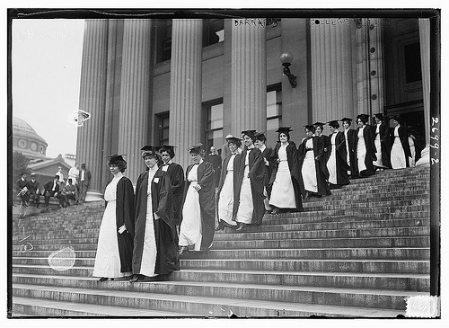
4. How to approach a job search during a recession (Continued)
Keep up with developments in the field.
  Makes you a more interesting informational interview and helps identify emerging opportunities.
Stay positive. The job search is difficult enough.
  You need to convince your potential employer that you will help them achieve their goals.
Do not be passive. Do not give up. Ask for help if you need it.
  The overall economy doesn’t matter: Even during the Great Depression, most people had jobs.

Slide 10
5. SUCCEEDING ON THE JOB
The importance of listening
The importance of informal relations
Learning to read your boss
Preserving your boss’ time
Professionalism:
  Honesty, Ethics, Communication Skills, Reliability, Punctuality, Dress, Respect for Others
Knowing what you don’t know
Learning how to ask for help
Getting along with people
Dealing with bad assignments
and getting good ones

Slide 11

6. BUILDING SKILLS AND COMPETENCIES
Finding jobs that develop new skills
Finance and accounting
Sustainability management
Environmental science and policy
  Technology for sustainable development- energy, food, water and health care
Computing, data analysis, management and geographic information systems (MIS) (GIS)

Slide 12

6. BUILDING SKILLS AND COMPETENCIES (CONT.)
Management, team building, strategy formulation
Public relations, media relations, communication skills
Lobbying and legislative relations
Research and policy analysis
Fundraising

Slide 13
7. DEVELOPING A PROFESSIONAL REPUTATION
Getting known for your competence
Getting and sharing authorship and credit
Protecting your good name
Knowing when to quit
The opportunities and dangers of politics and advocacy

Slide 14
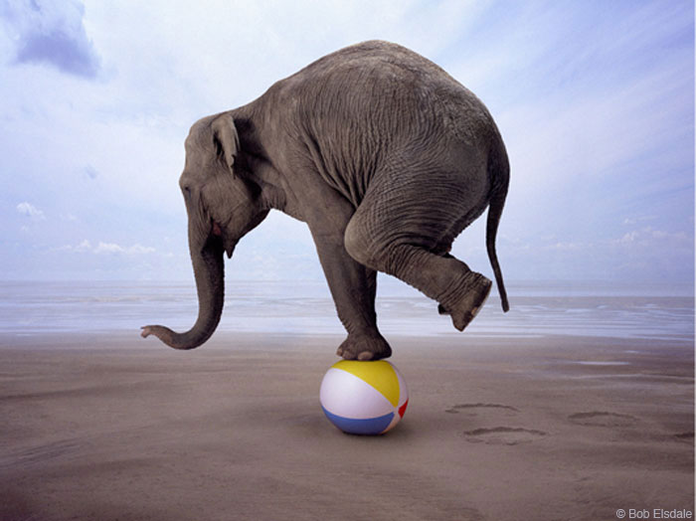
8. OVERCOMING PROFESSIONAL ADVERSITY
Everyone faces professional setbacks.
Understanding how you are perceived within your organization
Understanding your organization’s environment and the trends that affect it.
Maintaining a professional demeanor and keeping in mind your long-term professional interests
Keep professional life in perspective.

Slide 15

9. MOVING UP, OVER
AND AROUND
Determining when it is time to move
You’ve stopped learning.
  Your reputation is no longer growing.
  You’ve hit a professional ceiling or you’ve been passed over for a key promotion.
  Other options look better.
  You no longer look forward to work.
When should you look for a new job? Always.
Where and how to look for a new job from a job
Moving down to move up

Slide 16

10. KEEPING YOUR CAREER IN PERSPECTIVE
Balancing work and home
  Maintain a personal life while building a career
Preventing burnout
Remembering what you are about and who you are

