Slide 1
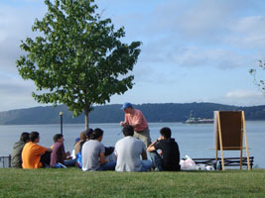
A Day in the Life of the Hudson River (Snapshot Day)
Over the summer the teachers and educators all worked hard to plan the Day in the Life of the Hudson River Event. Here is some background information to help YOU prepare. Click enter to advance the slides.
HAVE FUN!
Sponsored by the NYS DEC Hudson River Estuary Program, Lamont-Doherty Earth Observatory

Slide 2
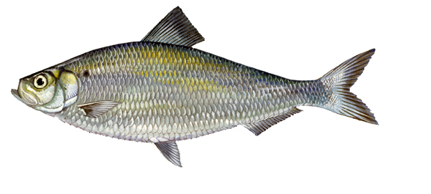
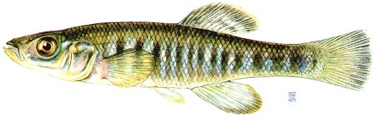
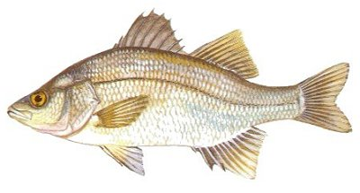
There is so much to look at in the river - so take notes and draw sketches!
Now lets see what we find…
Banded Killifish
Alewife
White Perch

Slide 3
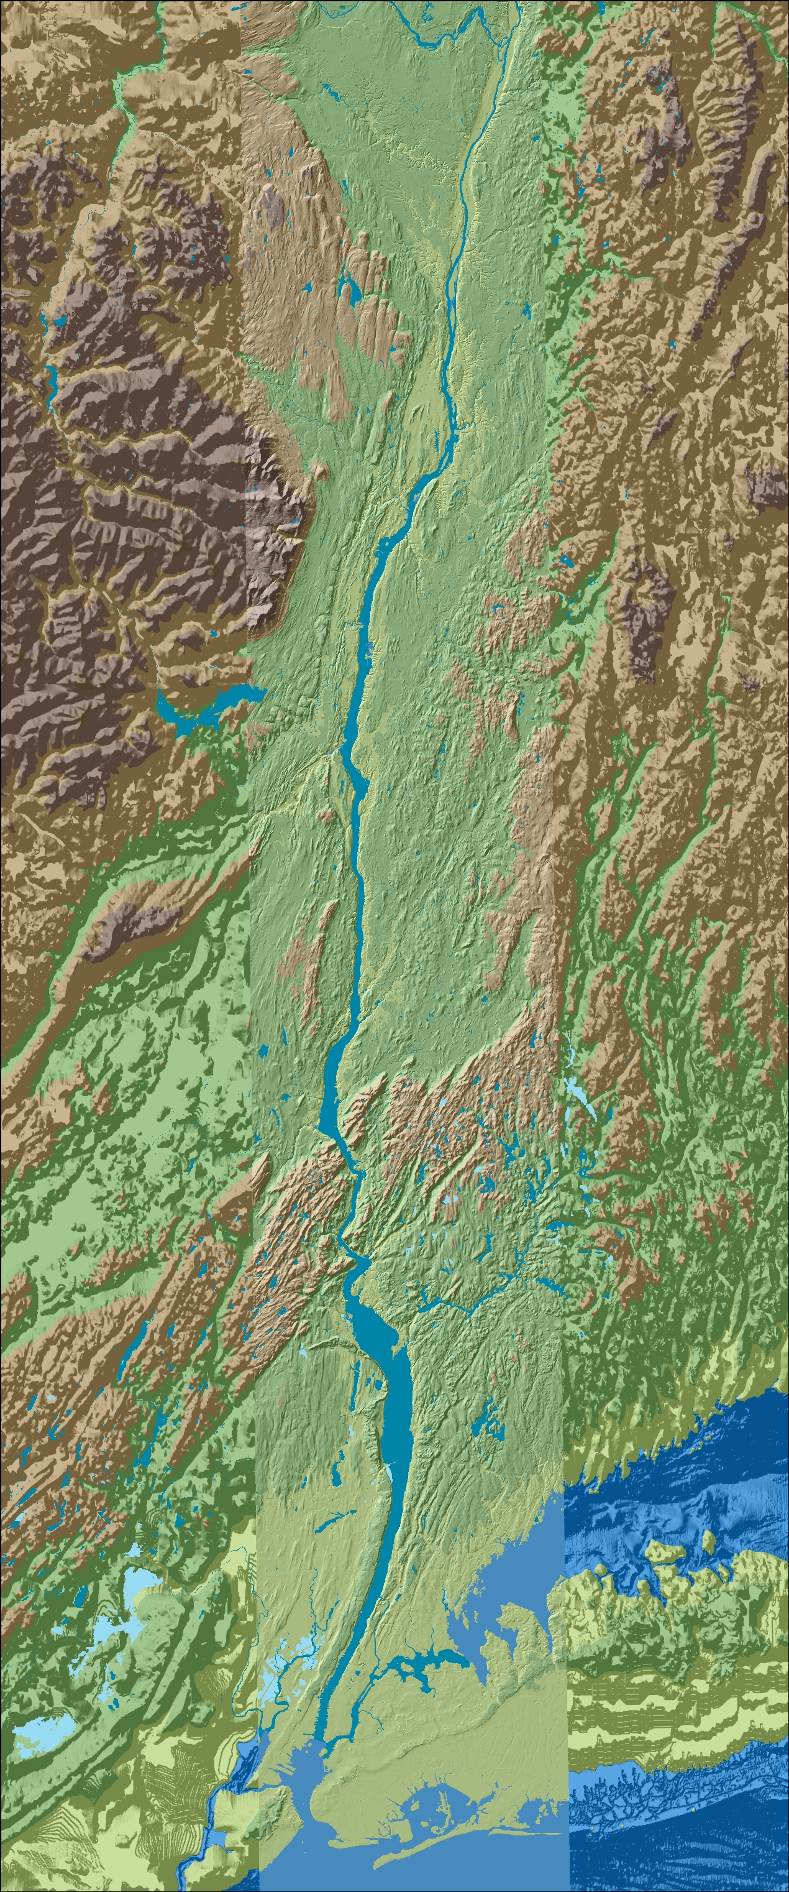
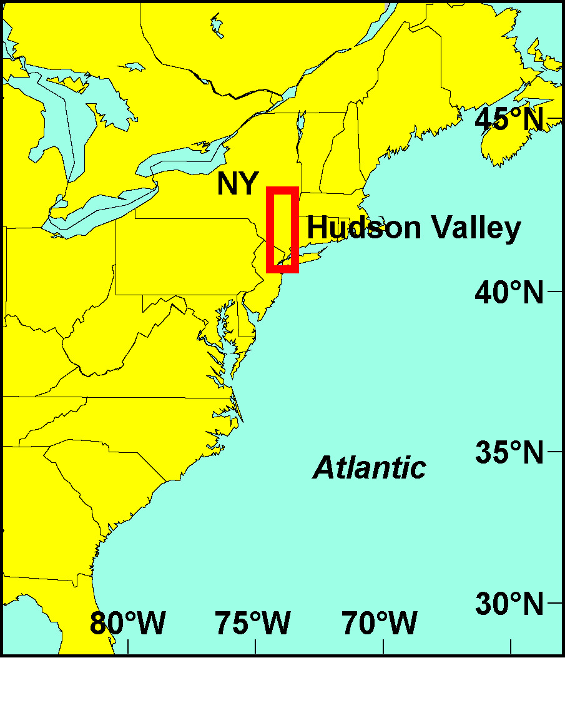
This is the Hudson River Estuary
The Hudson River Estuary is 153 River Miles-
  RM 153 is at the Troy dam, RM 0 is at the very bottom of Manhattan, below that is the Harbor and the “bight”
There are many other groups in the Estuary today doing just what you are doing – even a few above the Troy dam!
Hundreds of students - all grades & ages
Troy RM153
Here is where we are in New York State!
Cohotate RM 118
ESTUARY
Ulster Landing RM 97
Poughkeepsie RM 75
Newburgh RM 60
Use the map to find your site on the river
Croton Point RM 35
Piermont RM 25
New York City
Staten Island
Jamaica Bay
The Atlantic Ocean

Slide 4
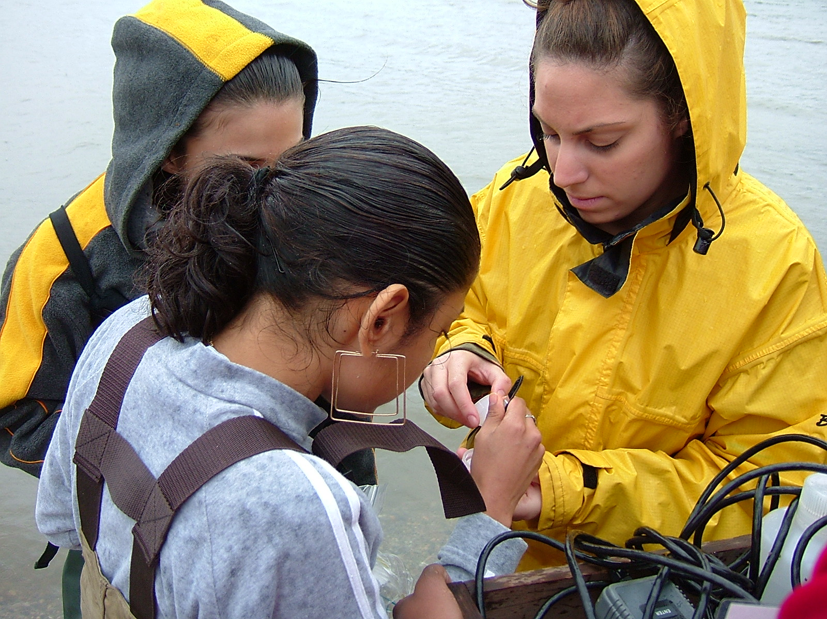
We Need Your Help Collecting
We call the information we collect “DATA”. What do you think a Snapshot of the Hudson River look in your area???
  Will the water be salty like the ocean? brackish (a mix of fresh & salty)? or fresh like rain water? What do you think?
  What does the habitat (living area) for plants and animals look like? Are there plants in the water? Piers? Riprap (big rocks)?
Let us Find Out

Slide 5
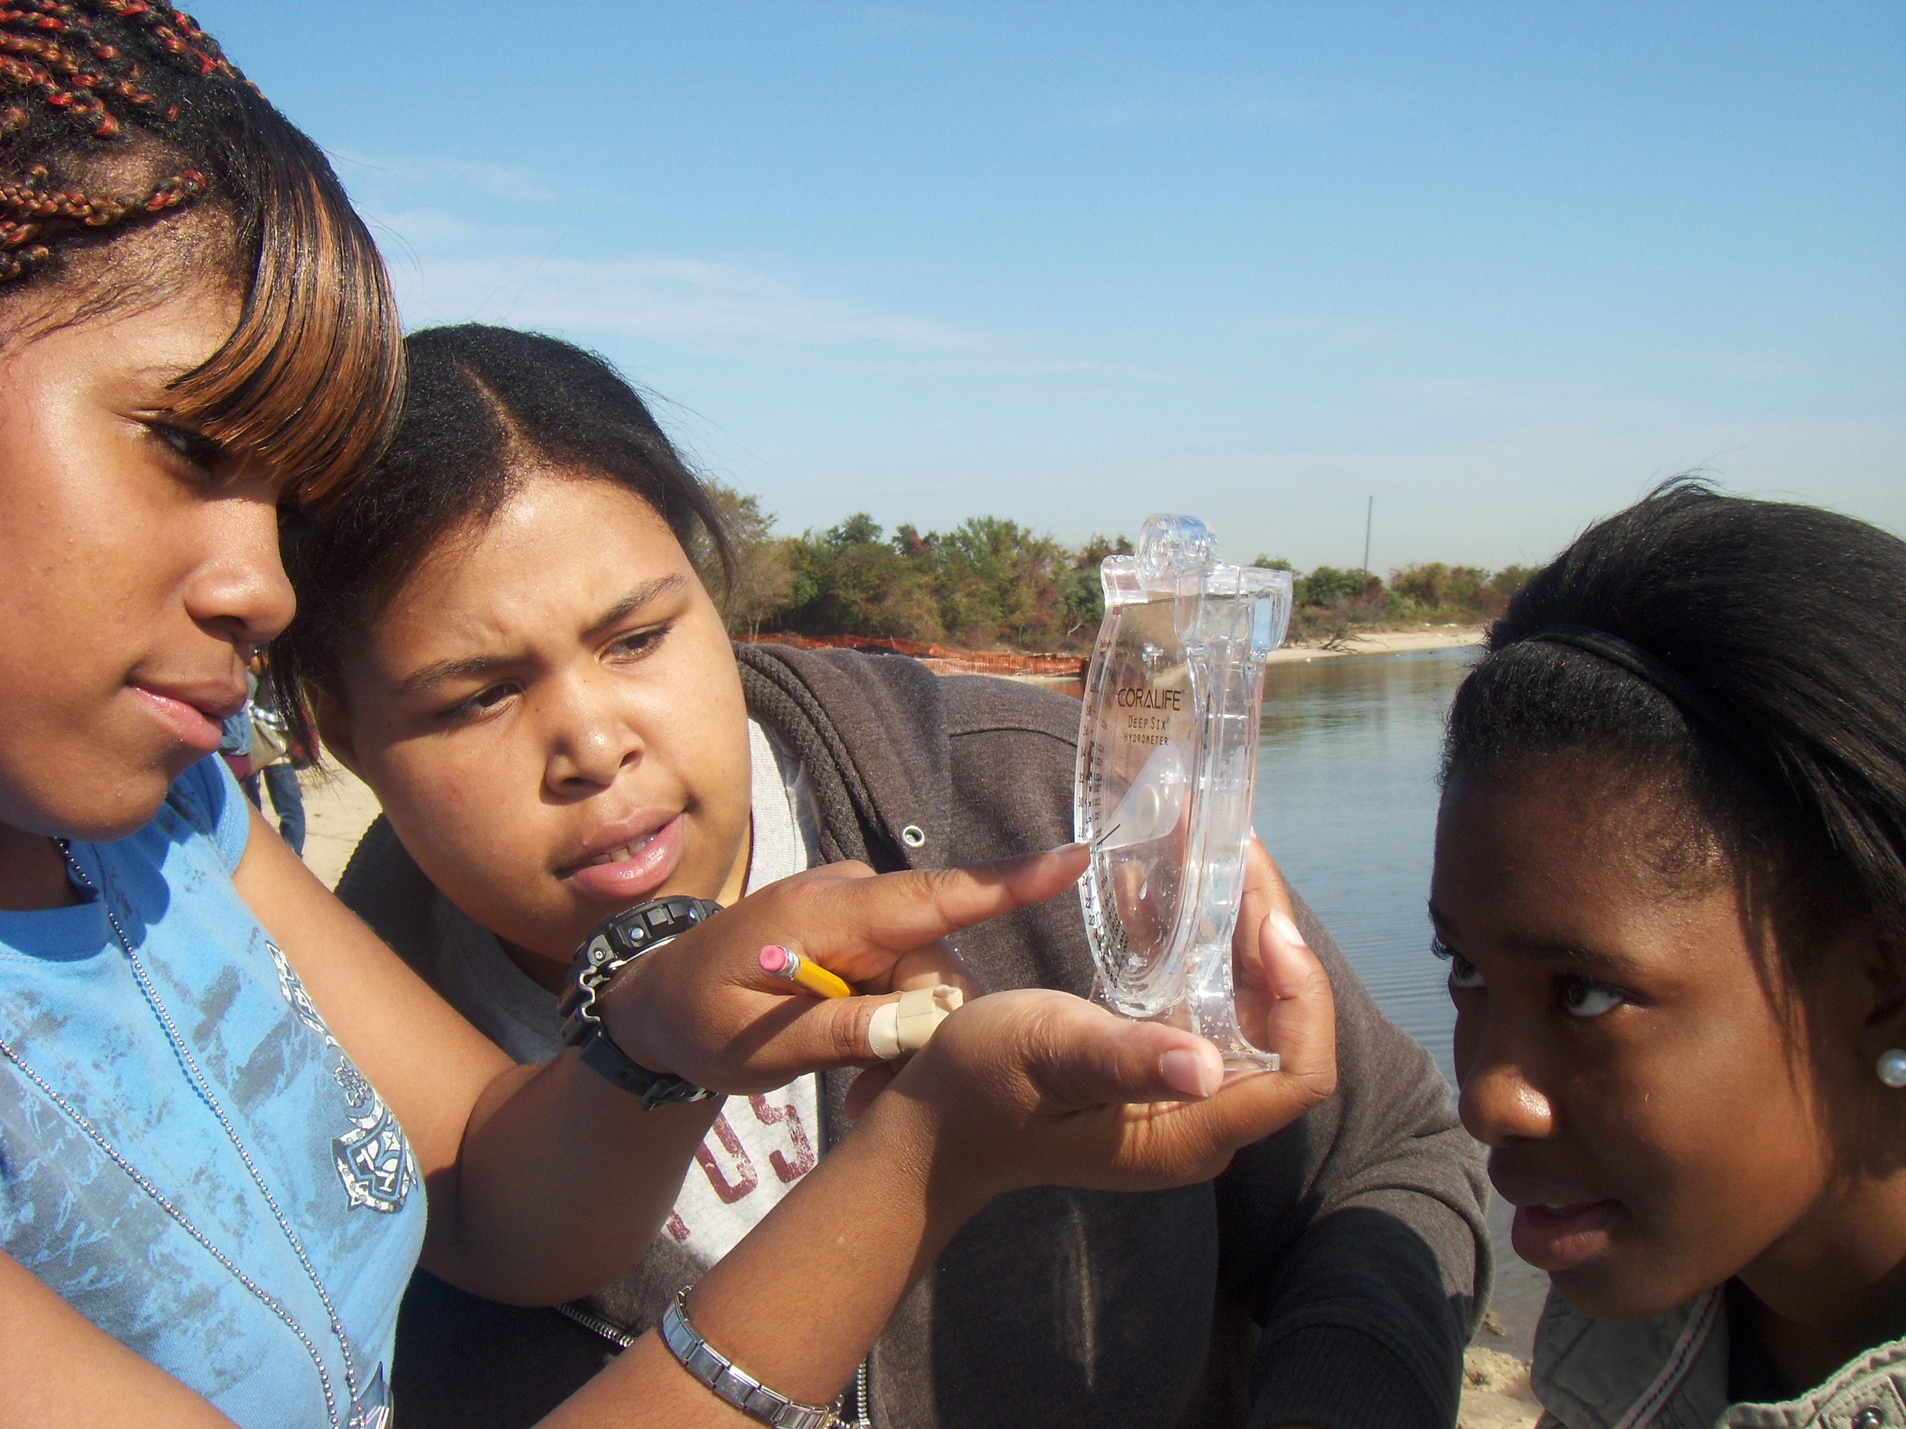
Will the information we collect at your site match information collected at the other sites on the river?
Do you think your area might be different from other areas on the river? Why? or why not?
Could your data this year be different from last years’? Why?
Careful sampling and recording of each test and the units of measurement is important when we collect and compare data.

Slide 6
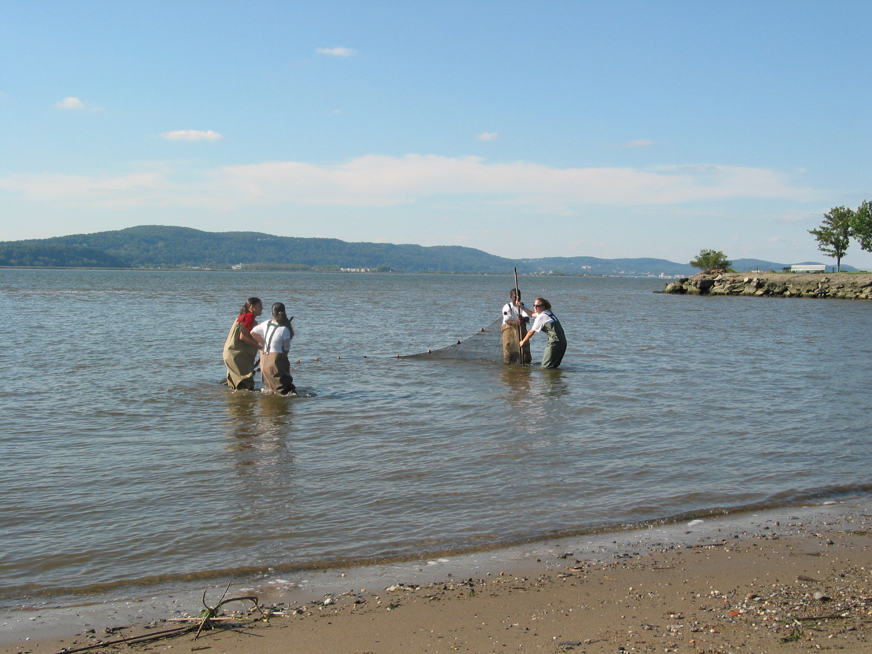
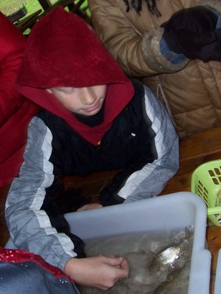
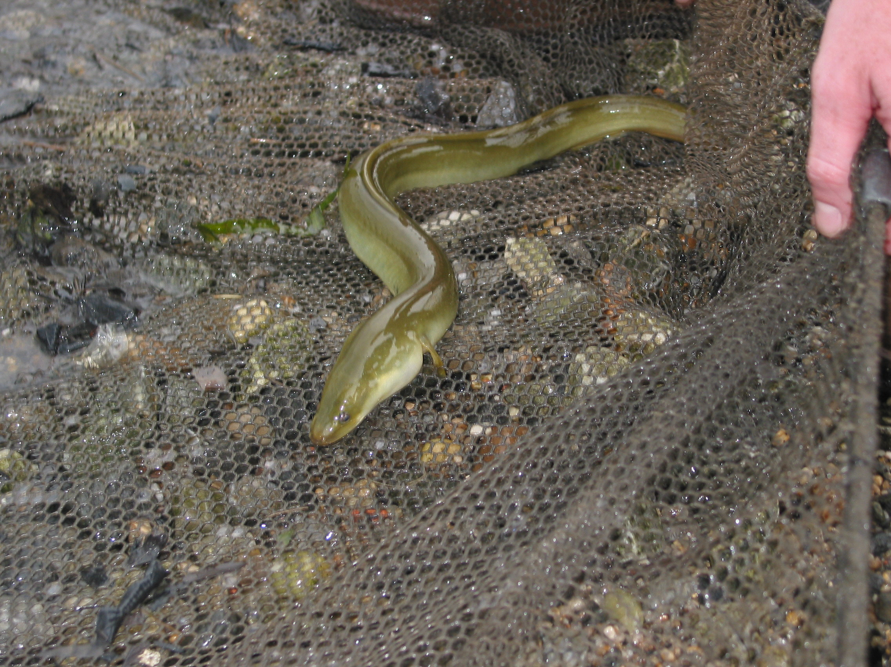
So if everyone looks at their own site then we can
compare!
    You can see what was collected at other sites!
    What makes some sites a lot like yours?
    What makes some different?
Using a seine net these students are collecting fish from the river to identify. Seine nets are a tradition going back to the Native Americans.
This eel lives in the soft sediment (sands and muds) on the bottom of the river. Native Americans fished eel using their feet in the mud! Very young eel use the currents to travel thousands of miles to the Hudson from a place called the Sargasso Sea near Bermuda. If you have ever held an eel you will know how hard it is to catch them!

Slide 7
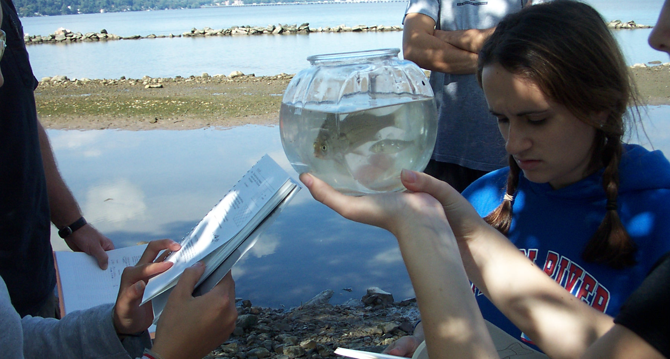
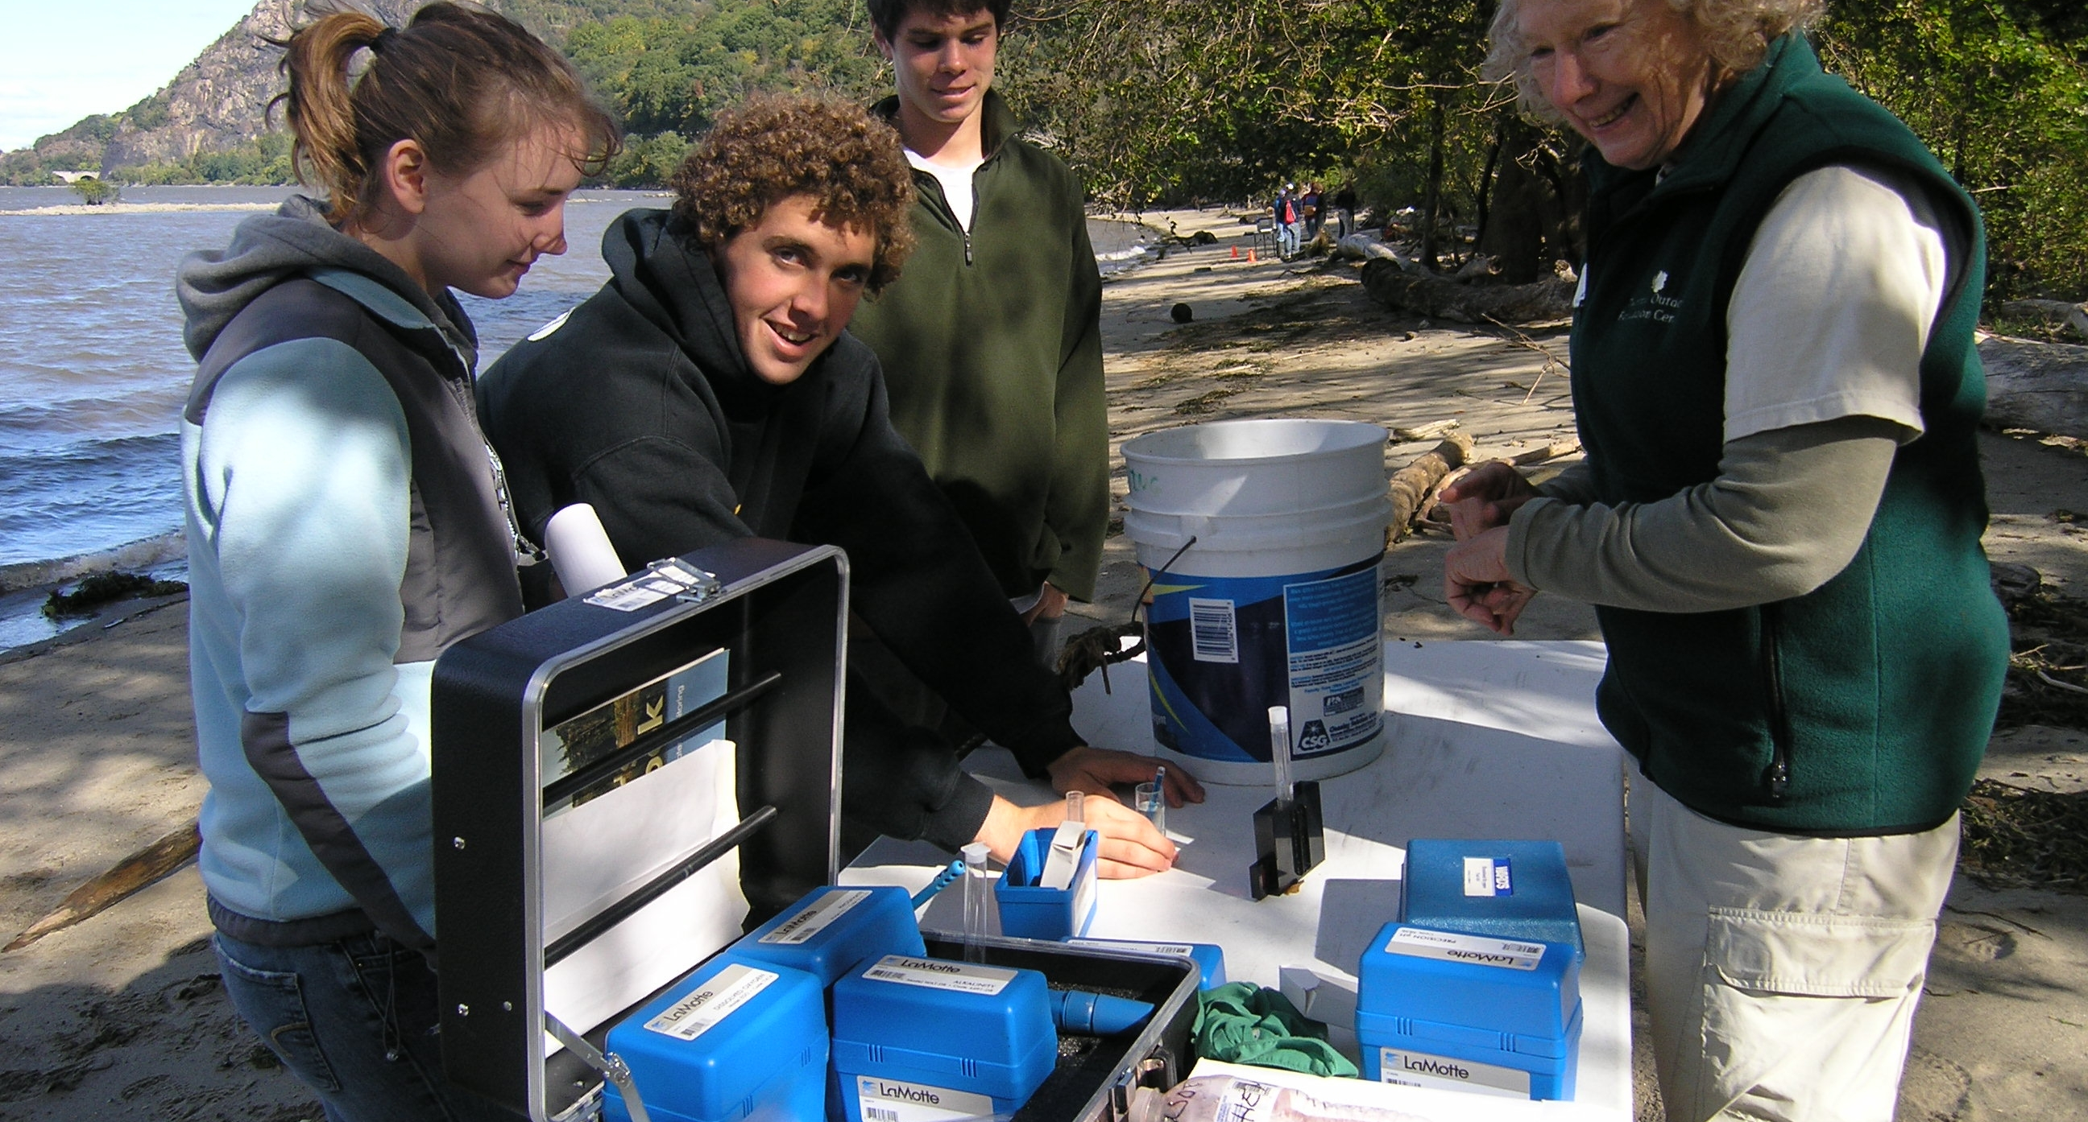
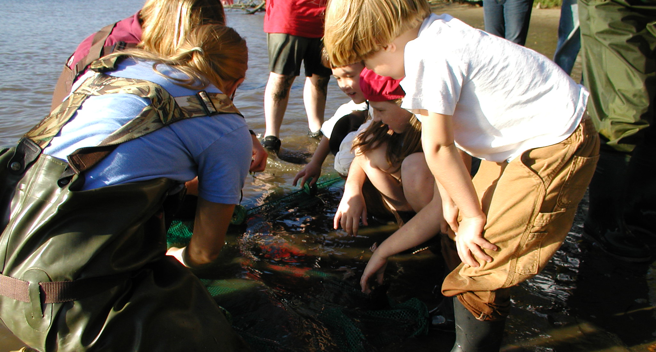
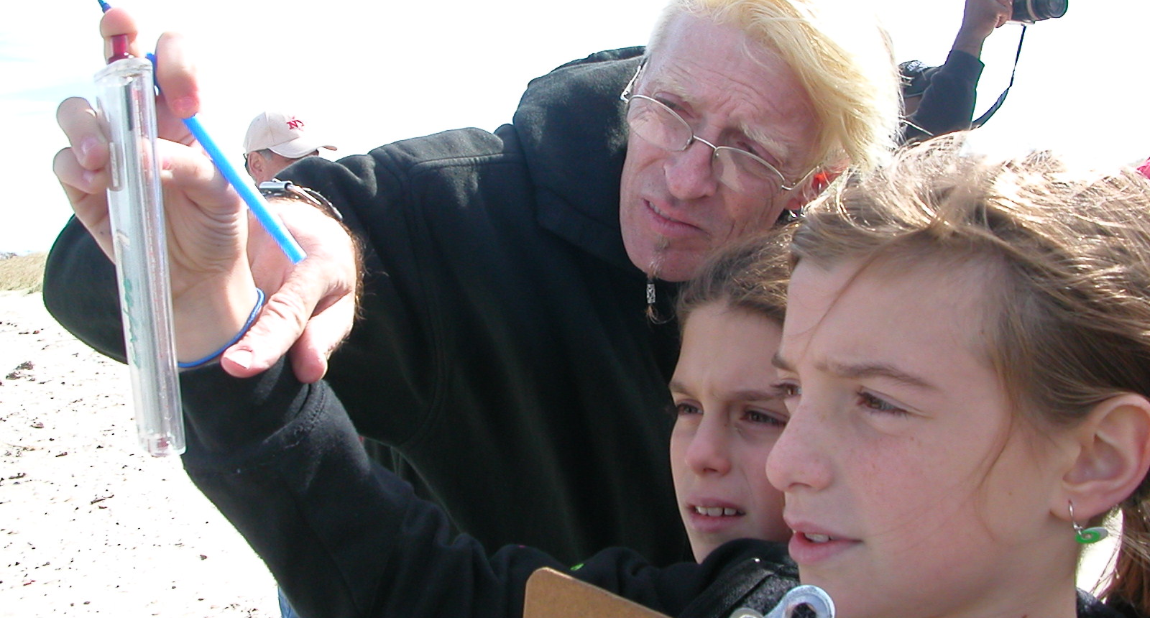
So what are we doing today?

Slide 8
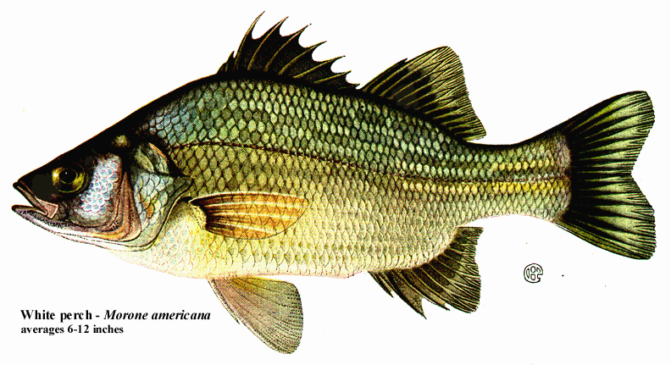
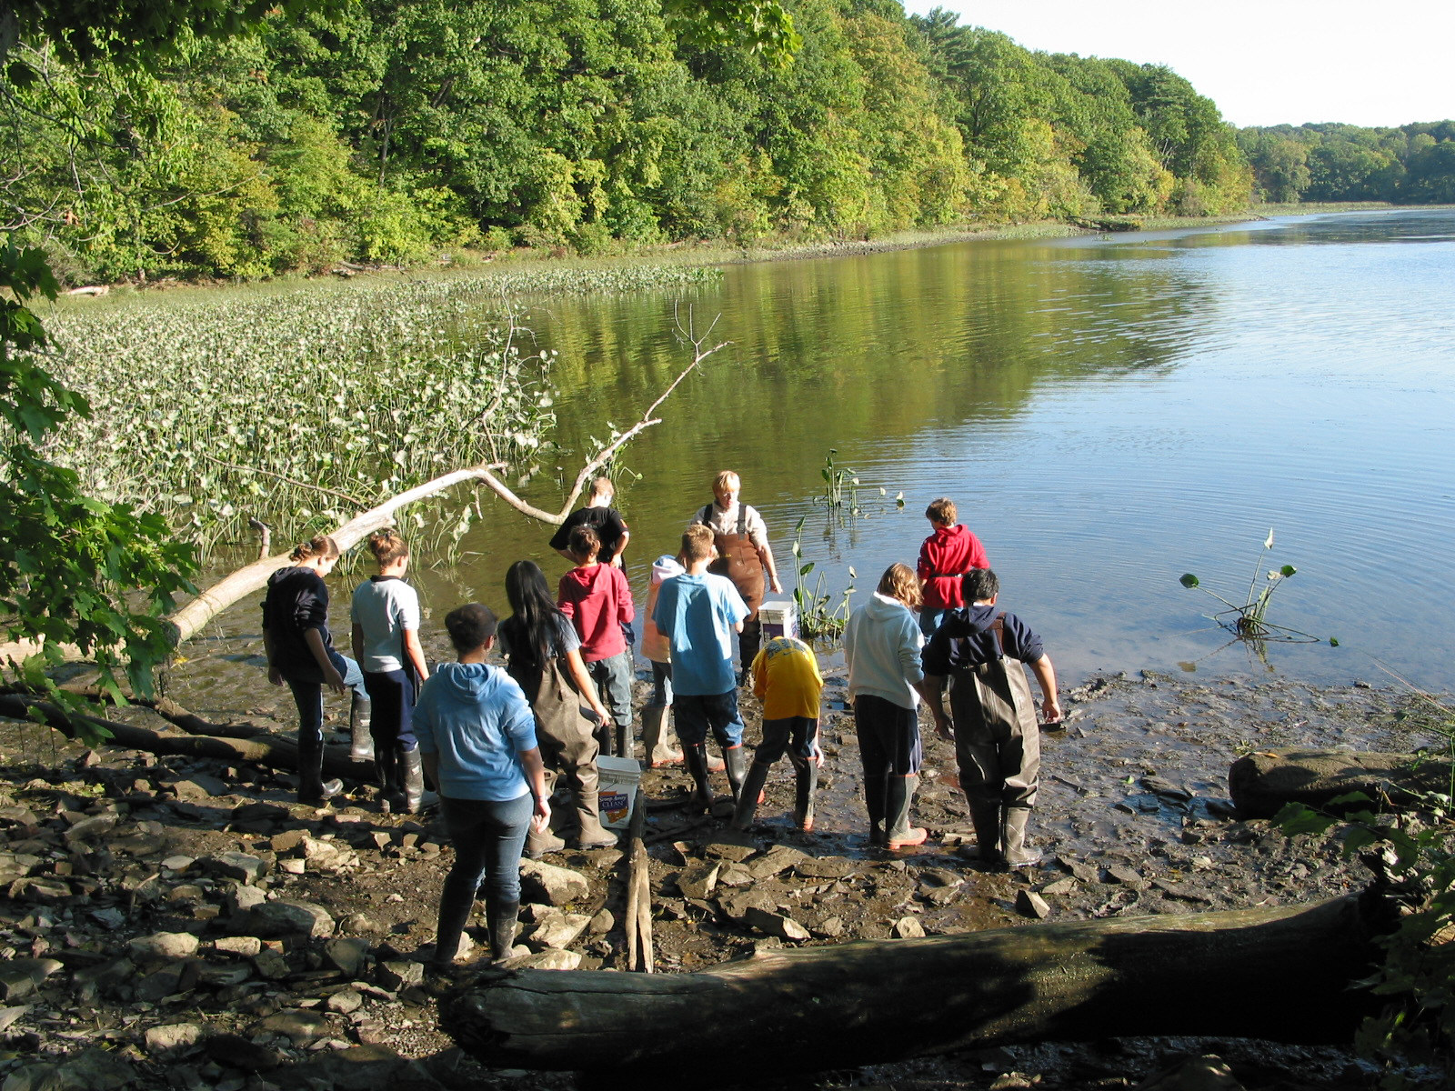
Let’s find out about the Estuary
Are there tides in the river?
How warm and deep is the estuary?
Is there enough oxygen for fish to breathe?
Are there plants where you are or is it all paved?
Chlorophyll??? What is that?
What does the bottom look like?
Are there ships using the river for work? Or for play?

Slide 9
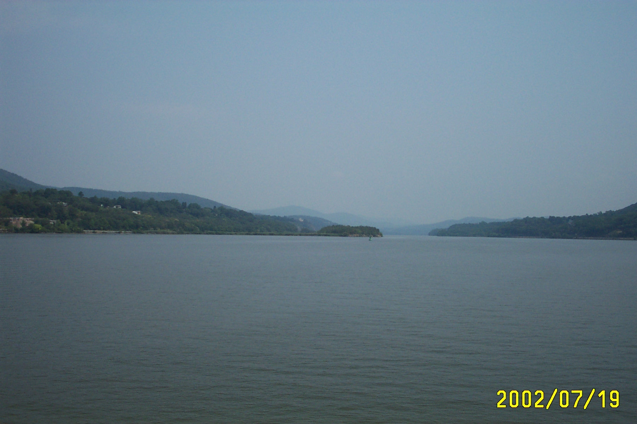
Tides
How can a river have tides? I thought tides were in the ocean?
In a large river that is flat like the Hudson the tides can push water in from the ocean raising the height of the river until is starts to fall again.
We will see if the tide is coming in or going out by measuring the height/reach of the water every half hour

Slide 10
Currents -
While tides cause a rise and fall in the water level, currents are a horizontal pull in the water -in and out from the ocean. Currents are hard to see. You can use a stick or an orange to tell whether the current is moving up the river (flood) or moving out of the river into the ocean (ebb). Toss it into the water and watch to see which way it moves.
It can take up to 4 months!
Since tides and currents keep the water moving back and forth in the Hudson, if you dropped your orange in the river how long do you think it would take to get from the top of the estuary by Albany, down to the Atlantic Ocean?

Slide 11
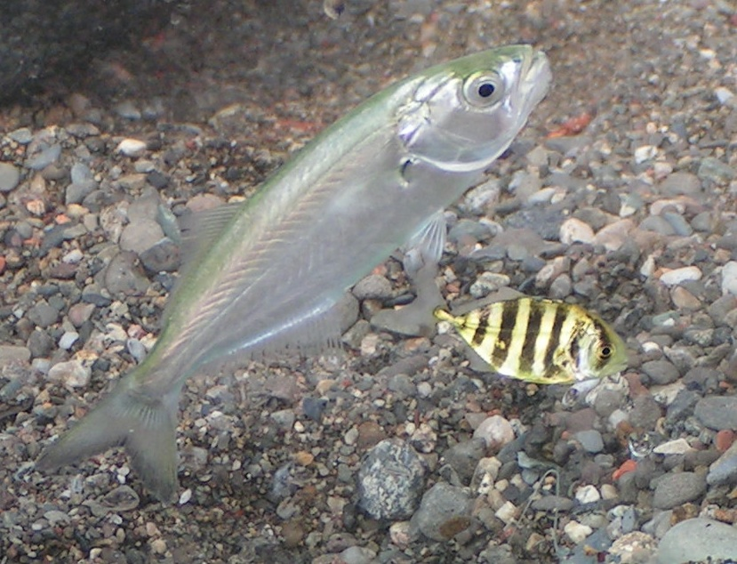
Rivers tend to run ONE direction - from their source to where they meet a larger water body. The Hudson River flows TWO ways….WHY?
The Hudson runs both down from Lake Tear of the Clouds on Mount Marcy in the Adirondacks AND
in from the ocean with the tidal influence.
How do fish know which way to go?

Slide 12
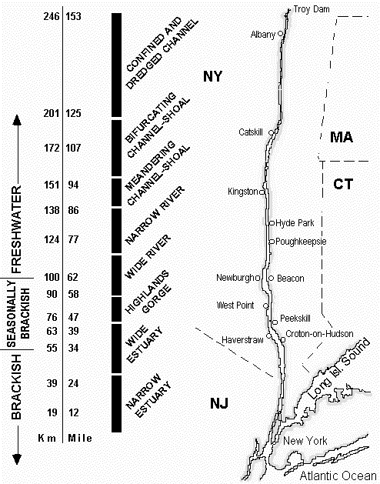
Let’s Talk SALT!
What is a Salt Front and
Where will it be this Snapshot Day?
The Salt Front is where the Hudson turns from a little bit salty to almost fresh water.
The salt front on the Hudson moves with the season
The salt front is usually by Newburgh in the summer
Spring rains and snow melt can push the salt front down below the Tappan Zee bridge

Slide 13
Predicting the Salt Front
Earlier Snapshot Days the Salt Front has been at:
2003 RIVER MILE 60
2007 RIVER MILE 78.2
2011 RIVER MILE 35.7
What about this year??? What do you think? Remember it is connected to this year’s rainfall. Write down your prediction and see if you are right! By the way, you just made a “hypothesis”!

Slide 14
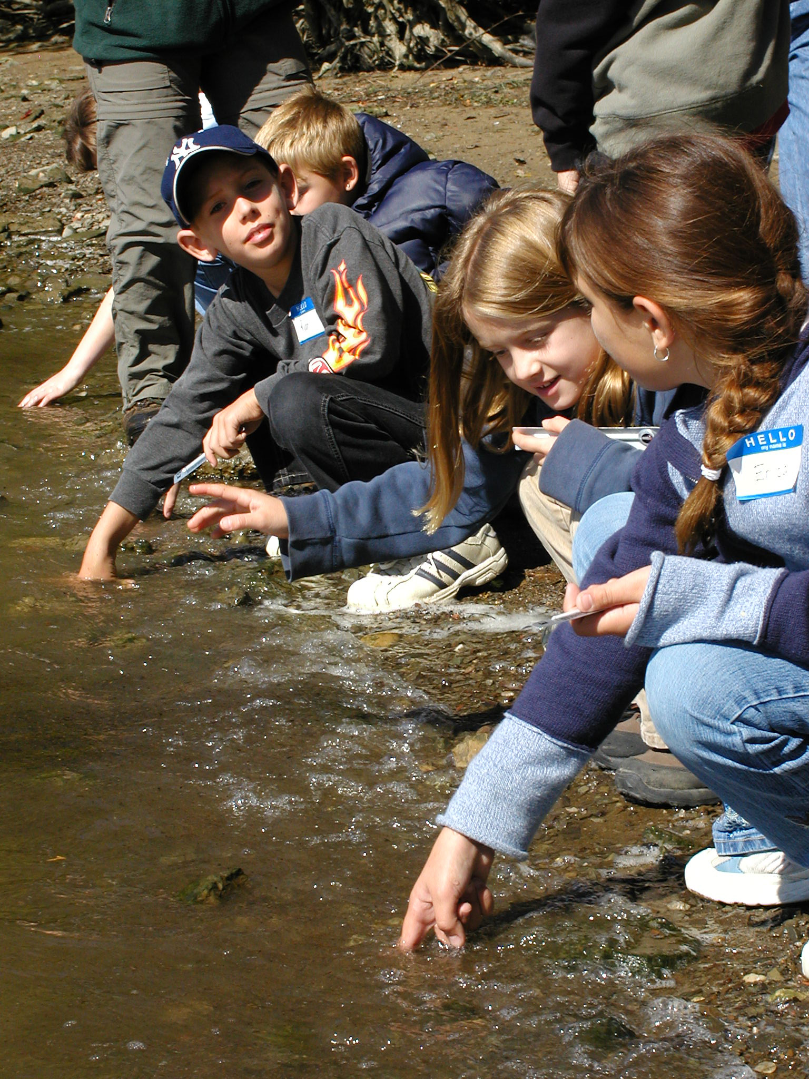
Temperature
Temperature is really important to fish and other organisms in the river. Let’s check it!
many creatures know when to migrate or spawn (reproduce) by temperature
When the water is
TOO hot the fish
can’t get enough oxygen

Slide 15
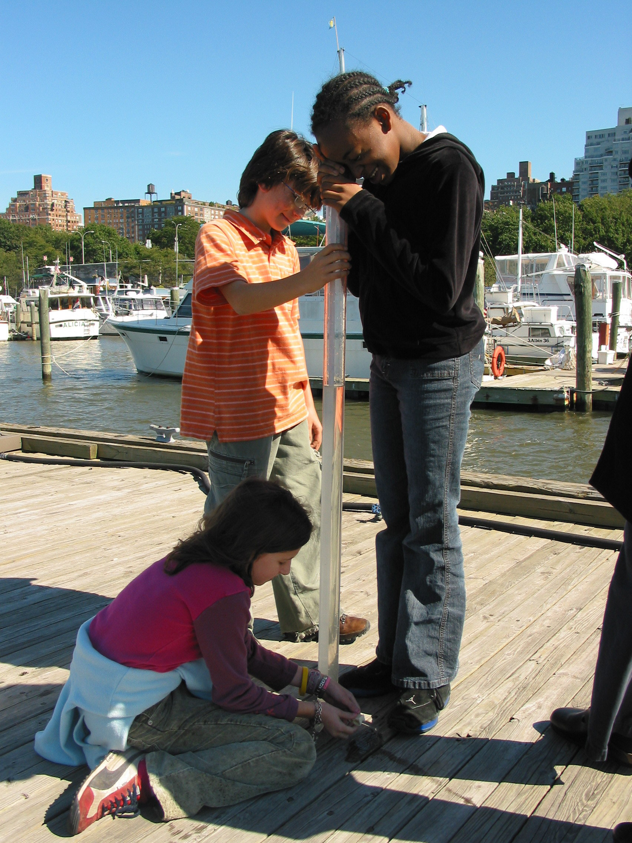
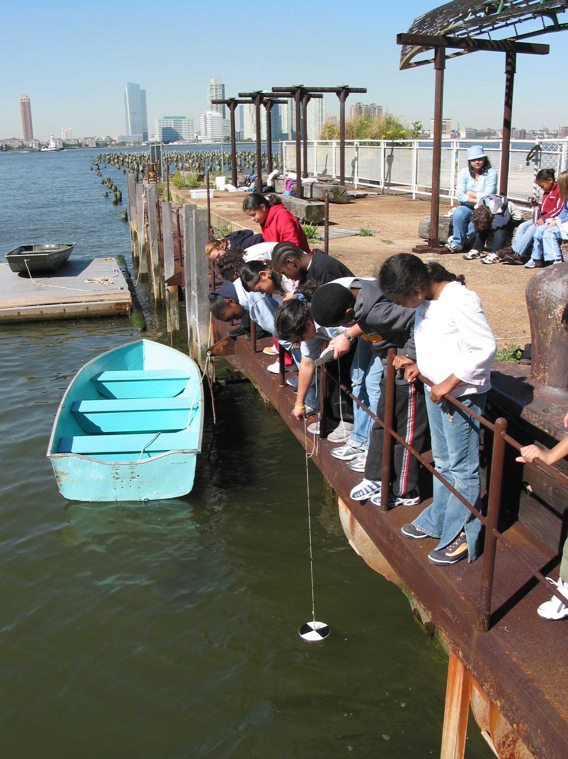
Testing Turbidity:
What are they looking at?
Sight Tube
Secchi disk

Slide 16
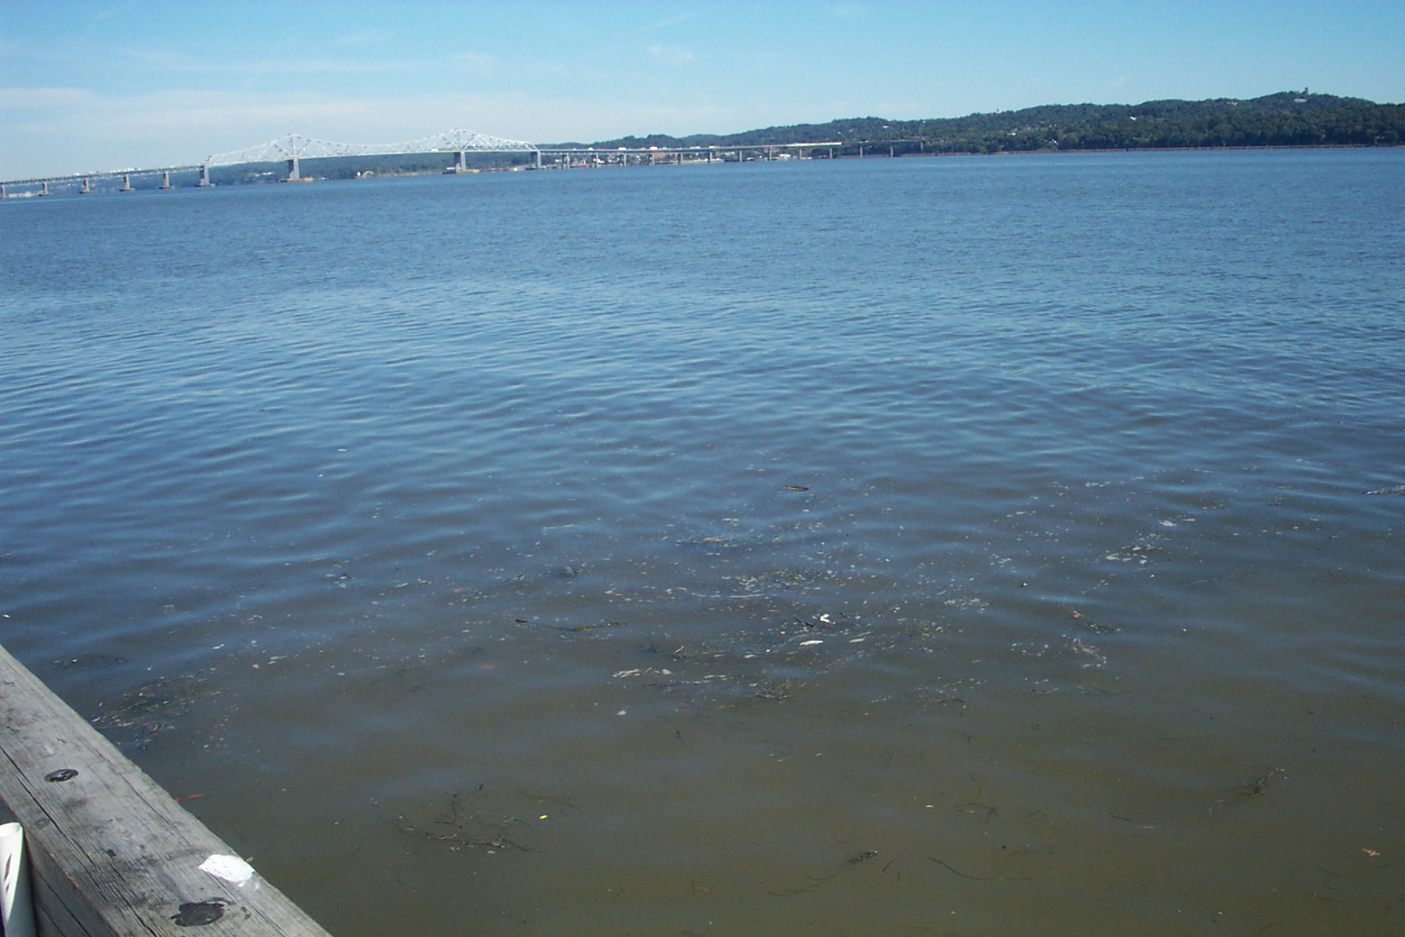
Turbidity is “water clarity”
BUT JUST BECAUSE THE WATER IS NOT CLEAR DOESN’T MEAN IT IS DIRTY
Different materials carried in the water can make it look dirty or “turbid” - EXAMPLES:
  silt or soil or sand grains
  Plankton - plants (phytoplankton) and animals (zooplankton ) that float in the water column
  Small pieces of dead plant material (called detritus) that are food for some creatures

Slide 17
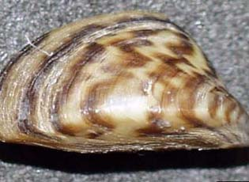
Turbidity
Zebra Mussels are small freshwater mussels that are ‘clearing up’ the water in the section of the Hudson where they live by eating HUGE amounts of phytoplankton (plant material ) that is food for other river creatures too. They eat more than their share of it!
Is the turbidity in your area affected by zebra mussels?
What do you think, is the Zebra Mussels’ clearing of the water is good or bad for the river?

Slide 18
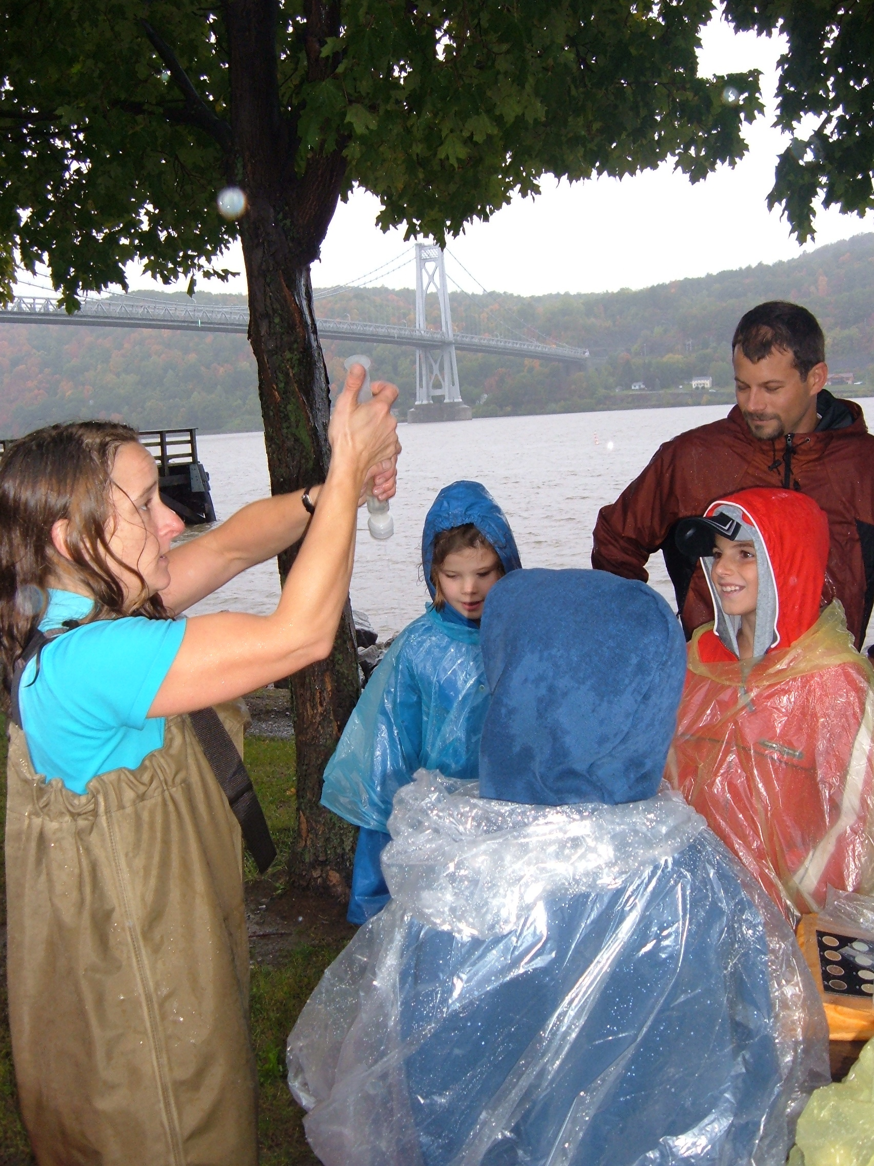
What is Chlorophyll?
It is used by plants in photosynthesis. We look at it as a way to measure productivity in the river.
Chlorophyll measures can vary with the time of day, sunlight, tide, water clarity
By pushing river water through a filter we will “catch” the chlorophyll on a filter and see how dark the filter gets.

Slide 19
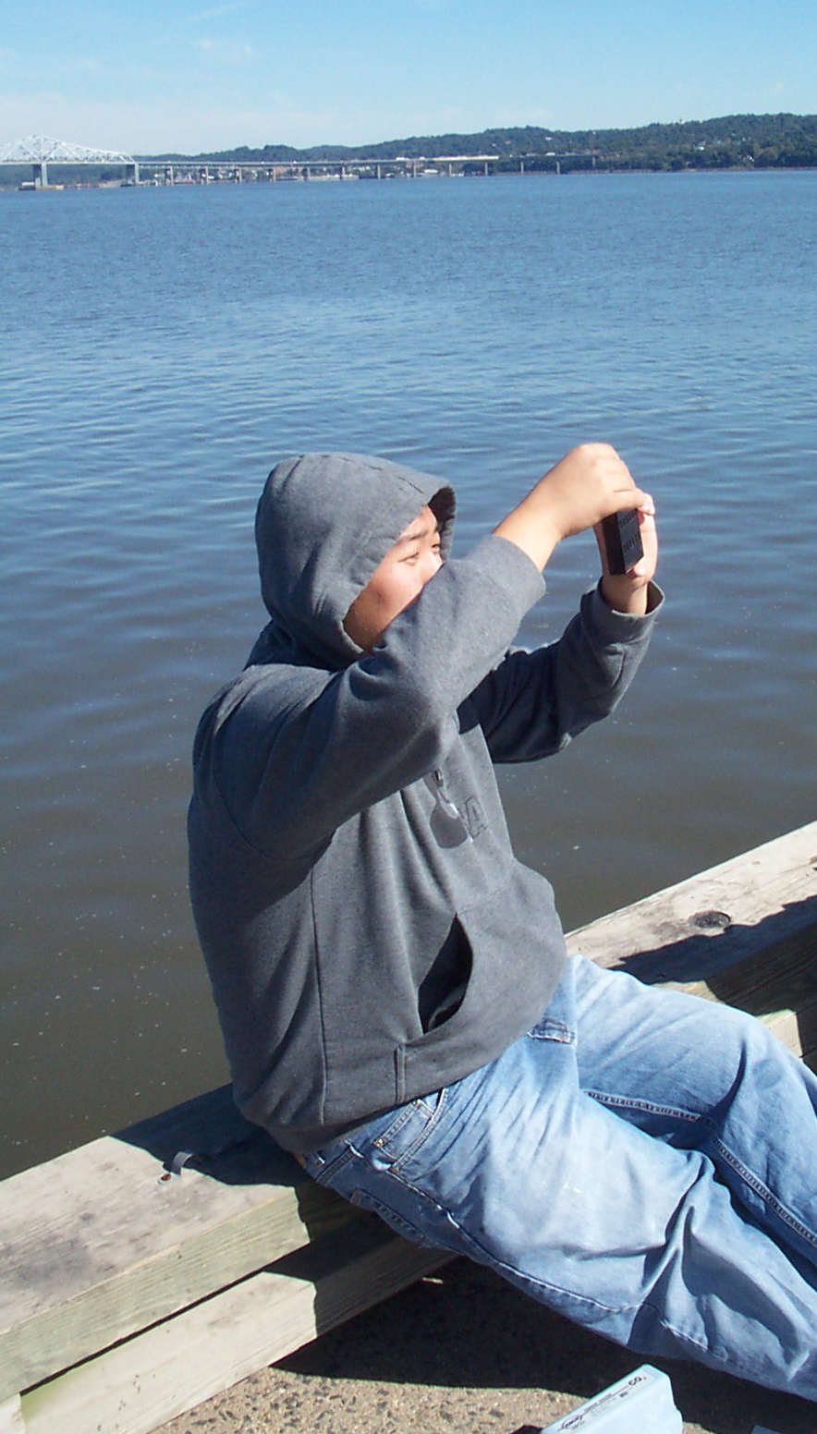
Chemistry

Slide 20
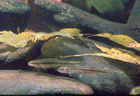
Dissolved Oxygen (DO)
DO - is needed by Fish and Animals to survive in the water.
Oxygen levels can change quickly due to:
  Wind & wave activity
  Different rates of photosynthesis by plants in the water
  Bacteria using oxygen
Good levels of D.O. are from 5 to11 mg/l
What do you predict it will be in your area?

Slide 21
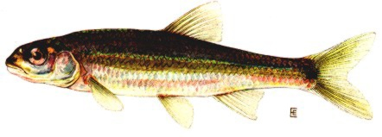
pH - how acidic or basic is the water in the river
Let’s measure the pH of the Hudson River in your area -
Is it neutral (7.0)?
more acidic (< 7.0)?
Fish are very sensitive to the pH of the water - each species has a range for their health & reproduction
or more basic (>7.0)?

Slide 22
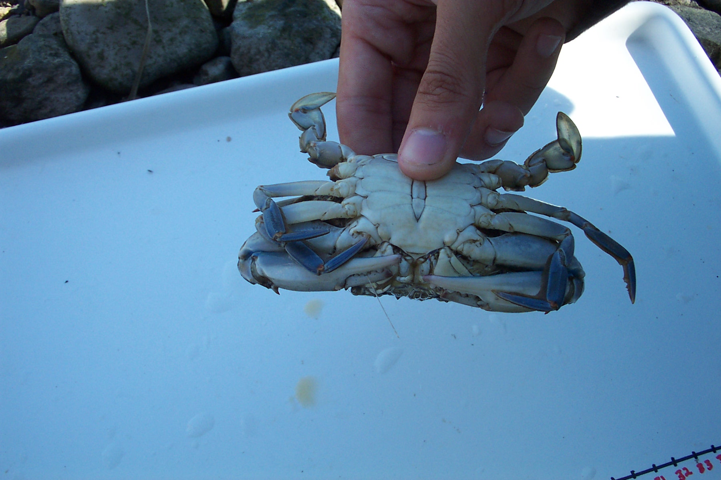
Common Catches
Will this year vary?

Slide 23
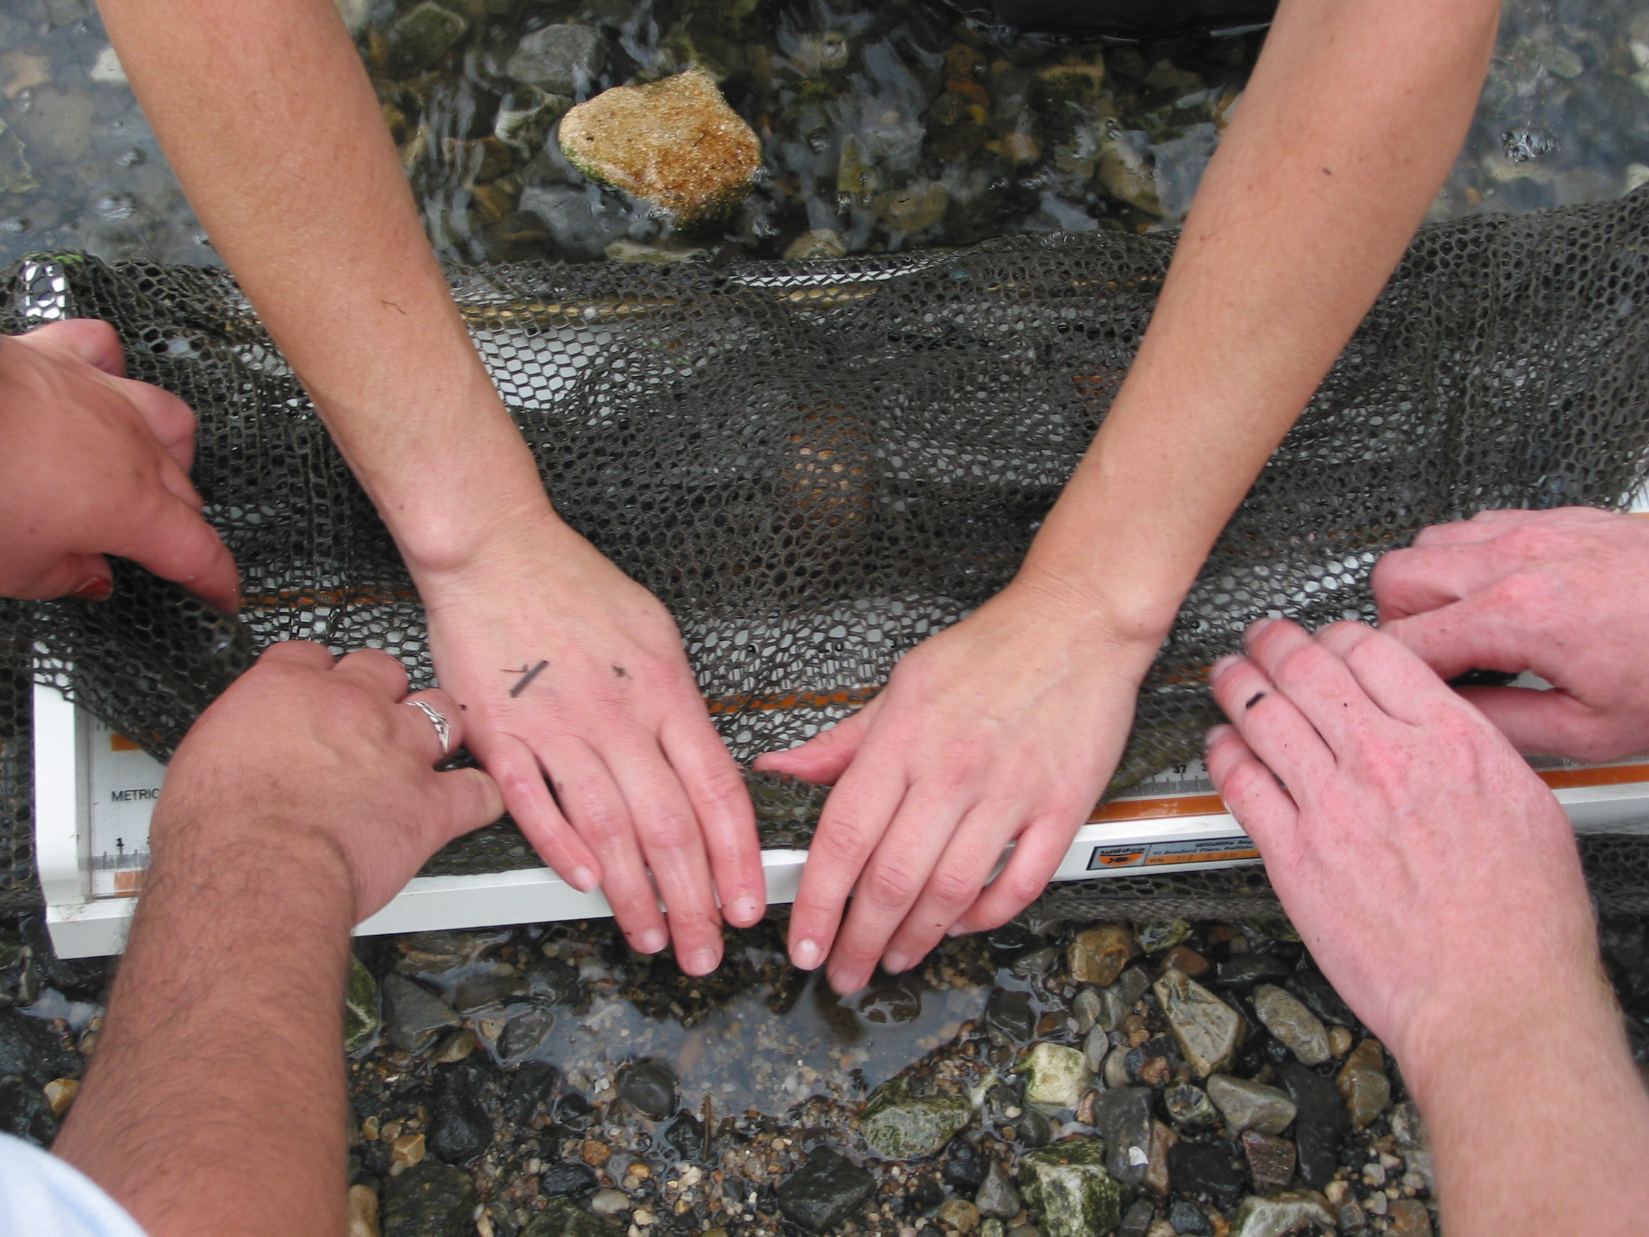
Identify, measure, count
This eel can be hard to measure so they wrapped it in the net to help stretch it out to its full length

Slide 24
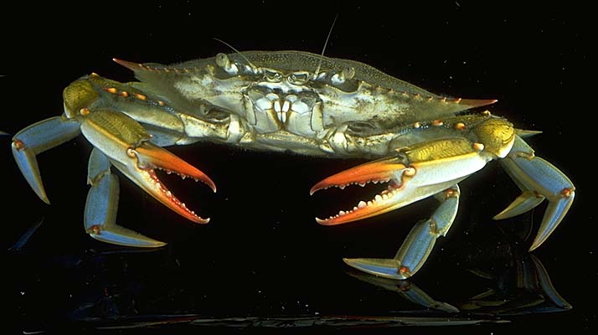
What did you catch in your section of the the River
Blue Crab - the latin name means “beautiful swimmer”. YES THEY SWIM! The Hudson is famous for its blue crabs!
Spottail Shiner - was first collected in the Hudson River by the governor at the time – Gov. Clinton. Its scientific name is Notropis hudsonius in honor of the Hudson.

Slide 25
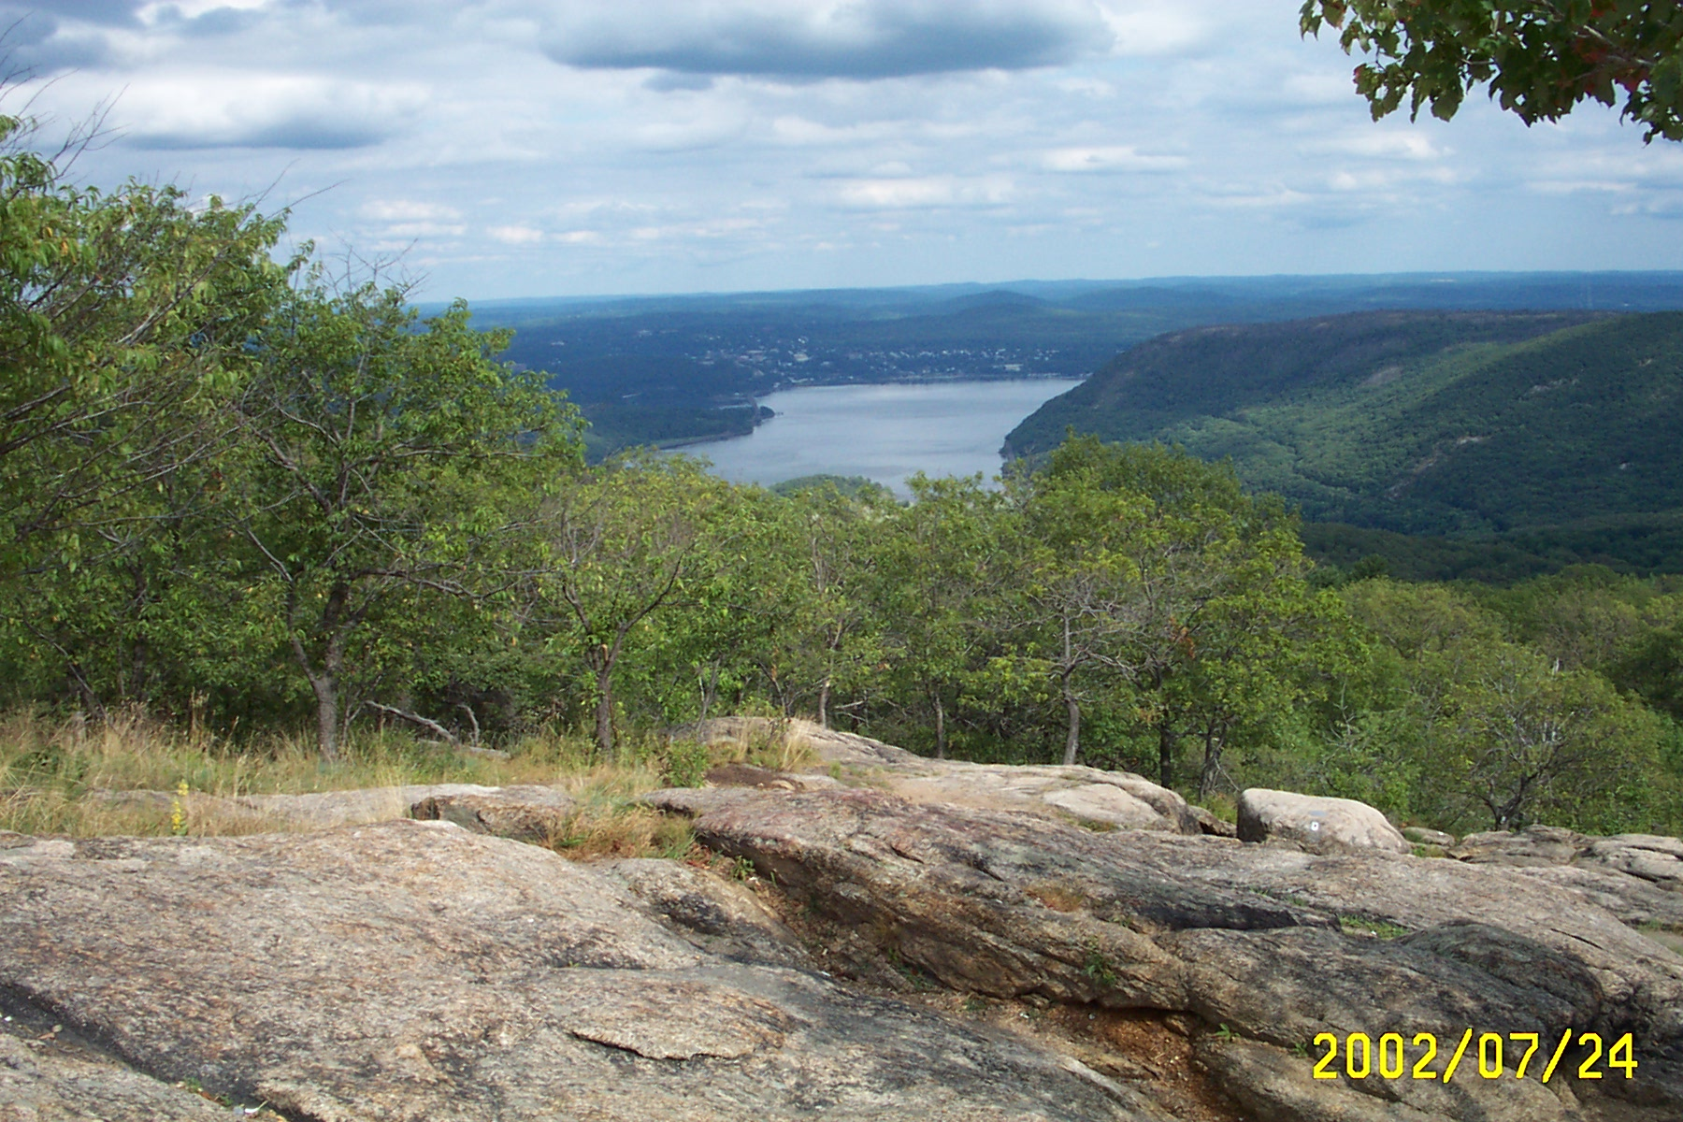
The river wasn’t always here. The trench or path for the river was carved through the rocks and hills by a giant glacier years and years and years ago. WAY BEFORE PEOPLE WERE HERE!

Slide 26
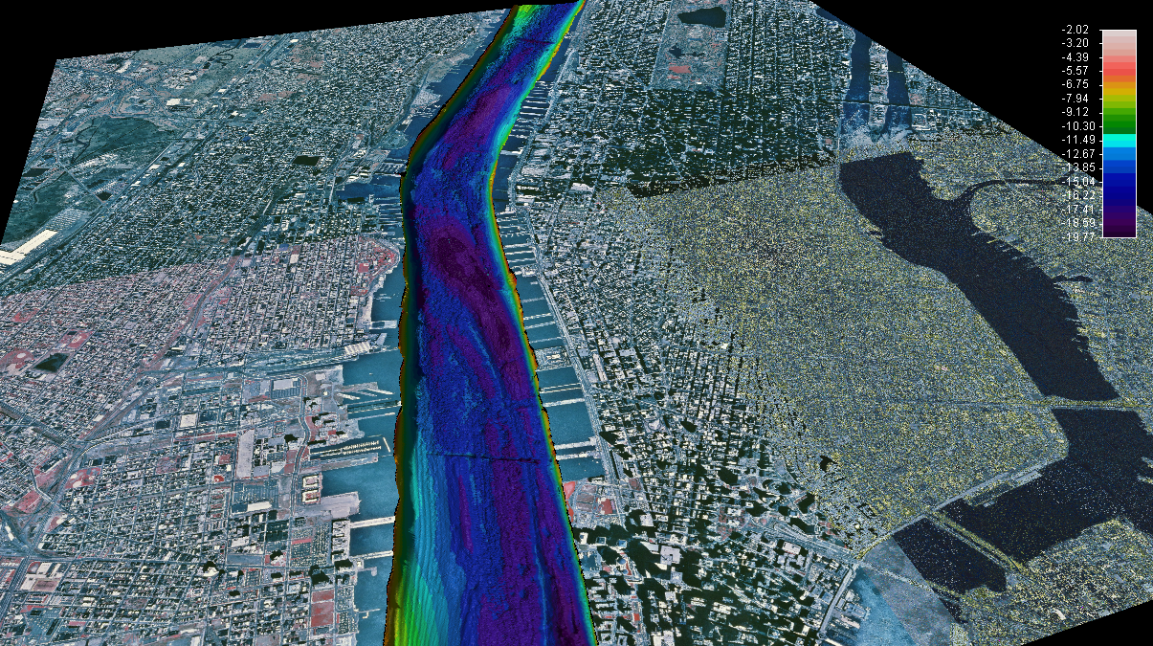



This is what the bottom of the river looks like -It isn’t flat and smooth. It has ridges and deep trenches where the glacier carved through. Lots of sediment has filled in the deepest trenches, but it is still deep. The dark blue shows deeper places in the bottom. The depth scale is in meters (a meter is just over 3 ft. long). In this part of the river the deepest places are 20 meters (or ~60 ft.)

Slide 27
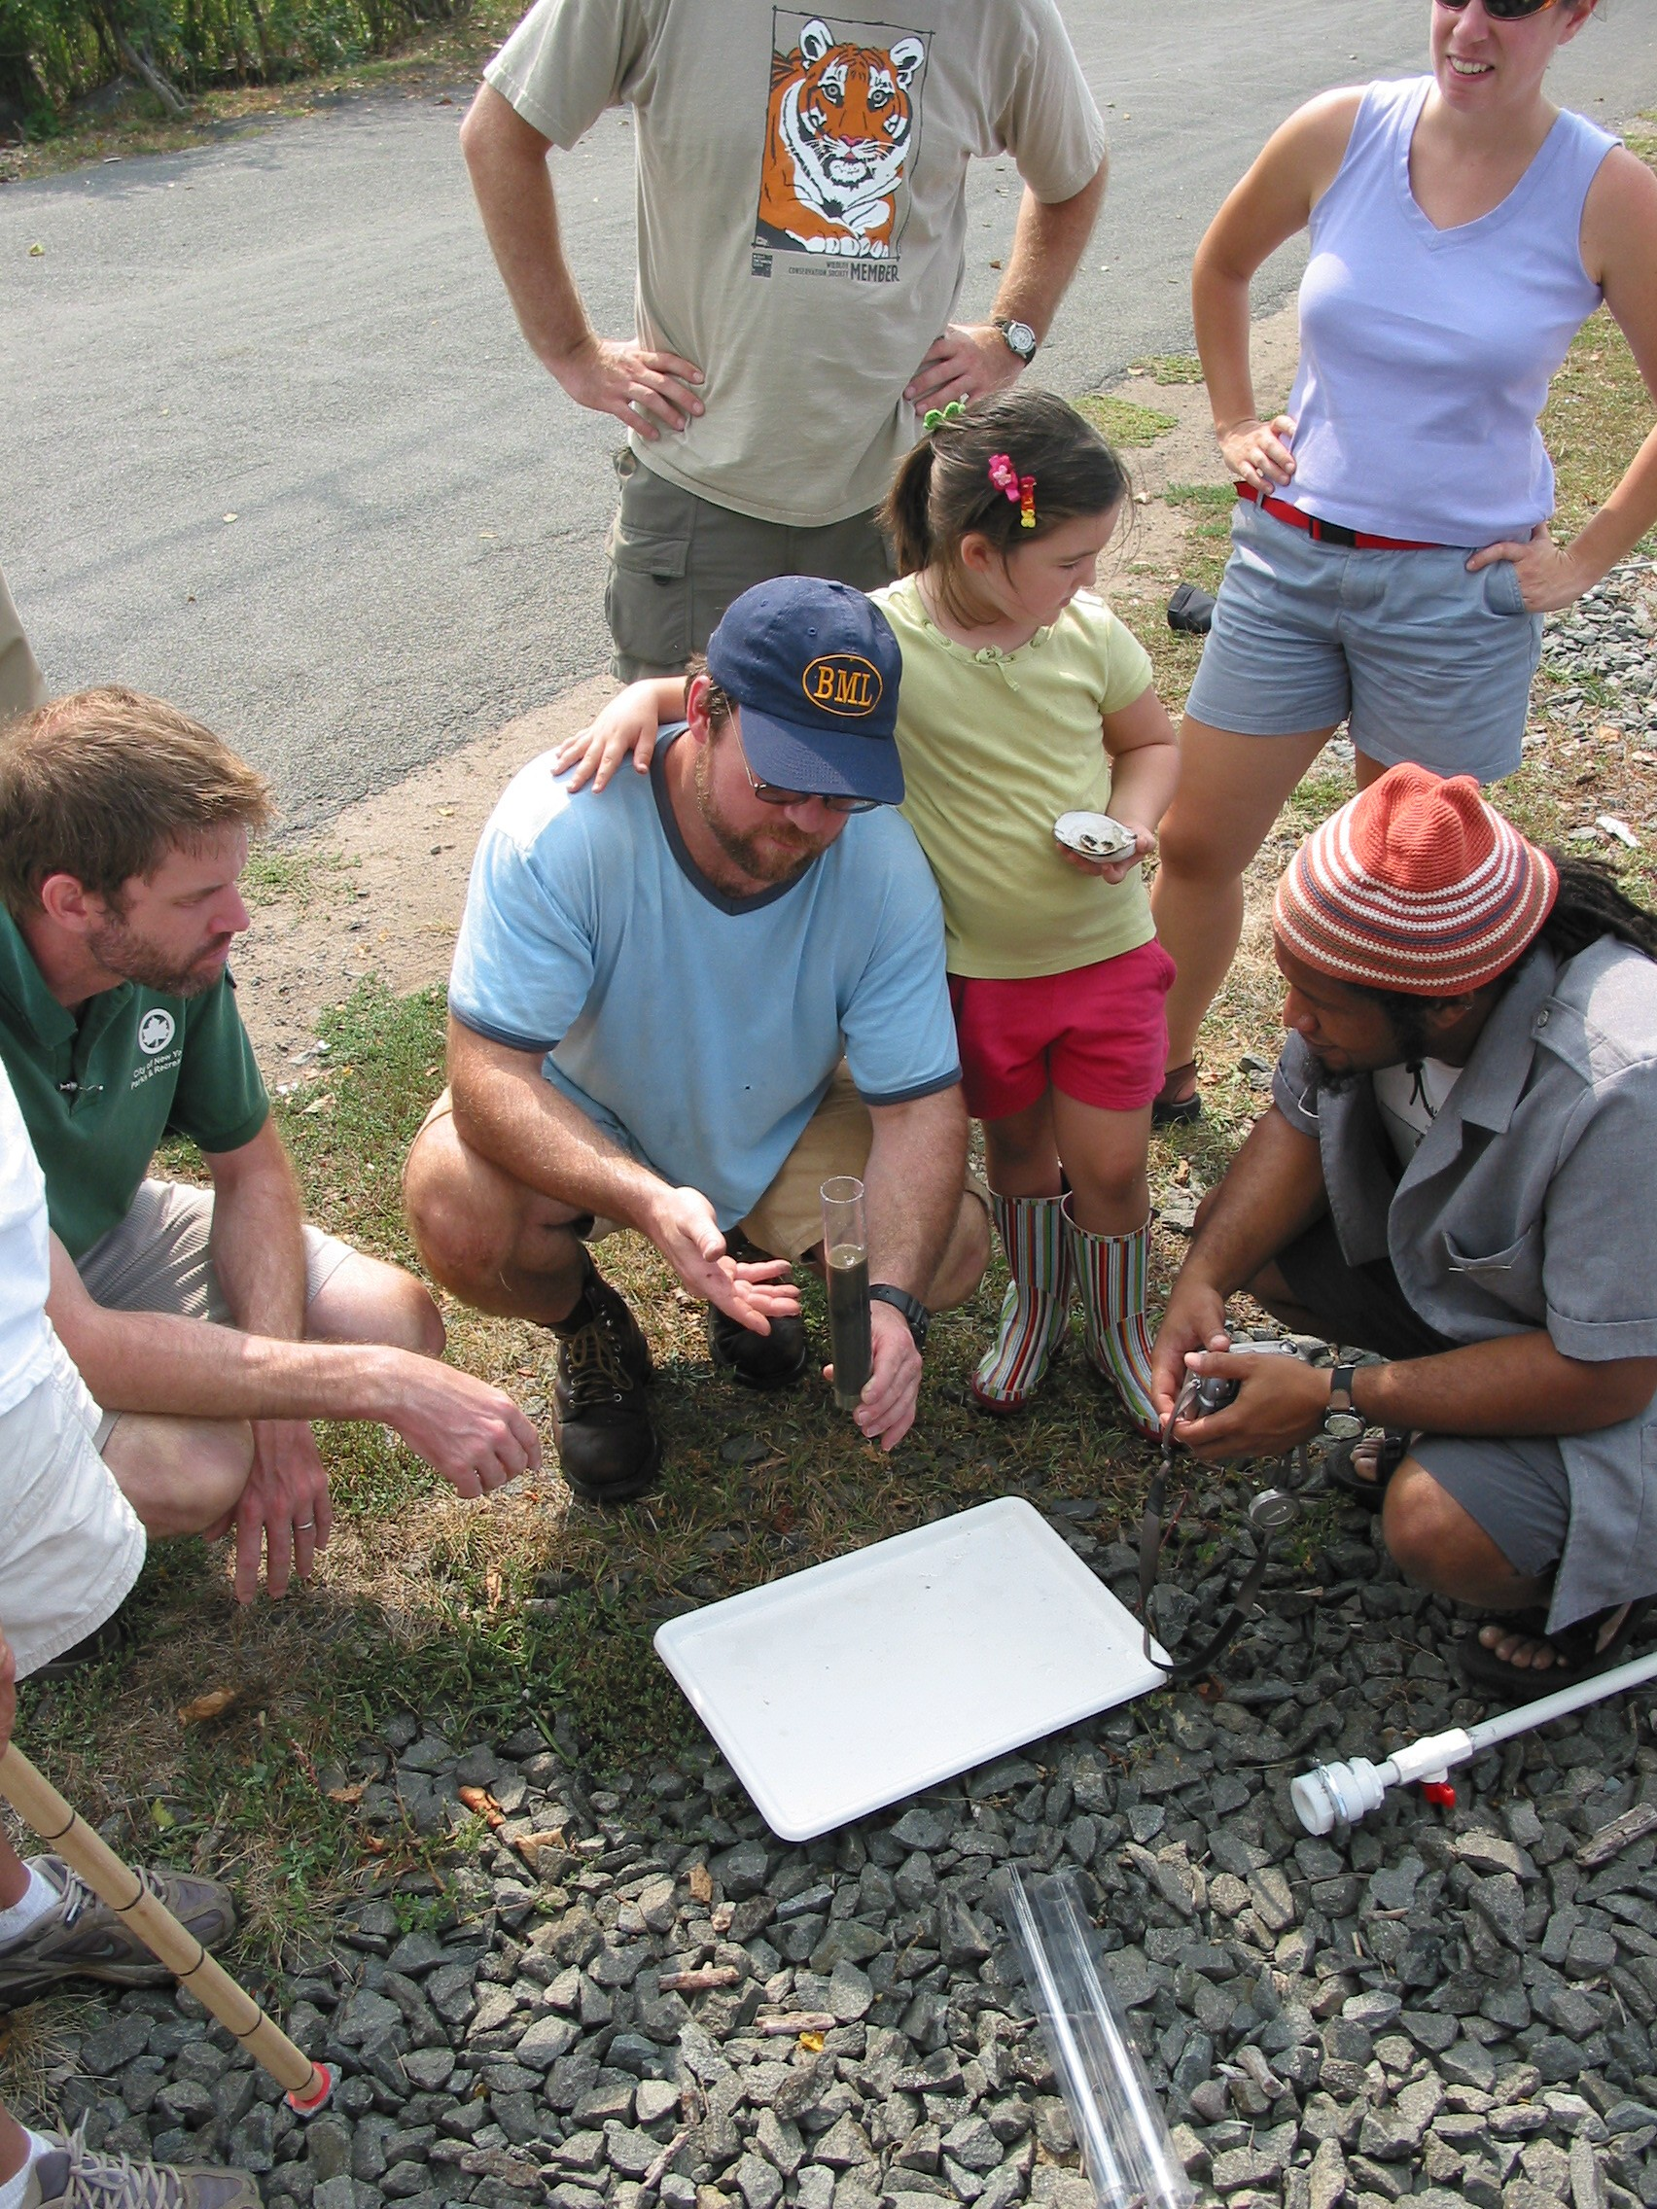
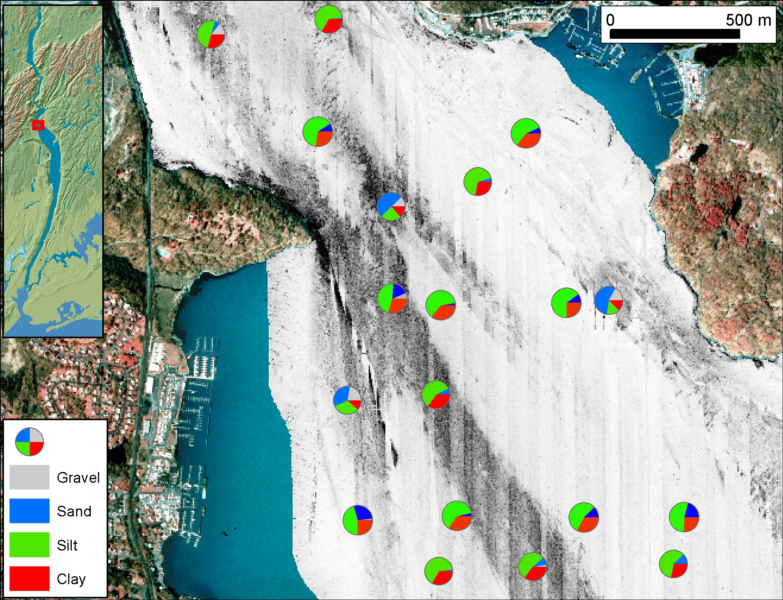
We are going to look at the bottom of the river by taking a small core
Cores are sections of sediment from the bottom of the river. They contain the history of the river bottom & can tell us about the habitats.
This is a little sediment push core (collected by pushing the corer in by hand)

Slide 28
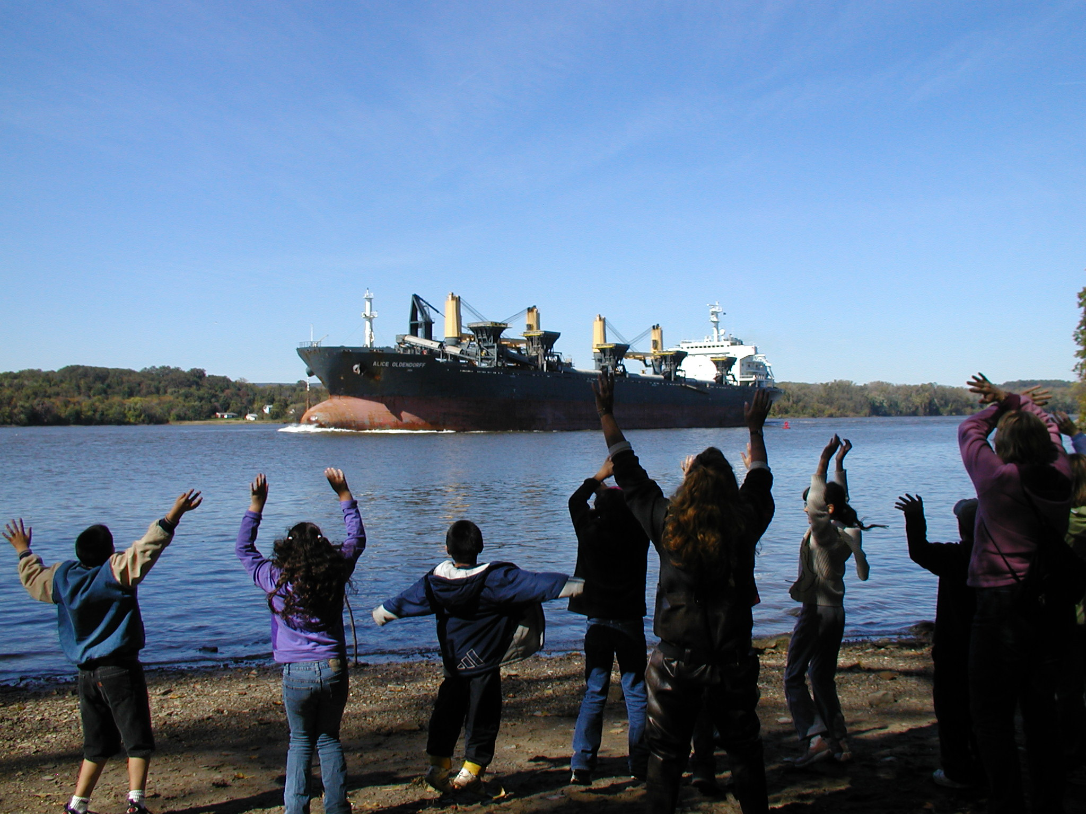
Shipping on the River
Tracking the activity
How is the river is being used today? We will track the shipping activity through the boats moving up and down the River. Record ship names, colors, direction and times!
Using basic math we can figure out the time it takes for ships to move from one sample site to another on the river

Slide 29
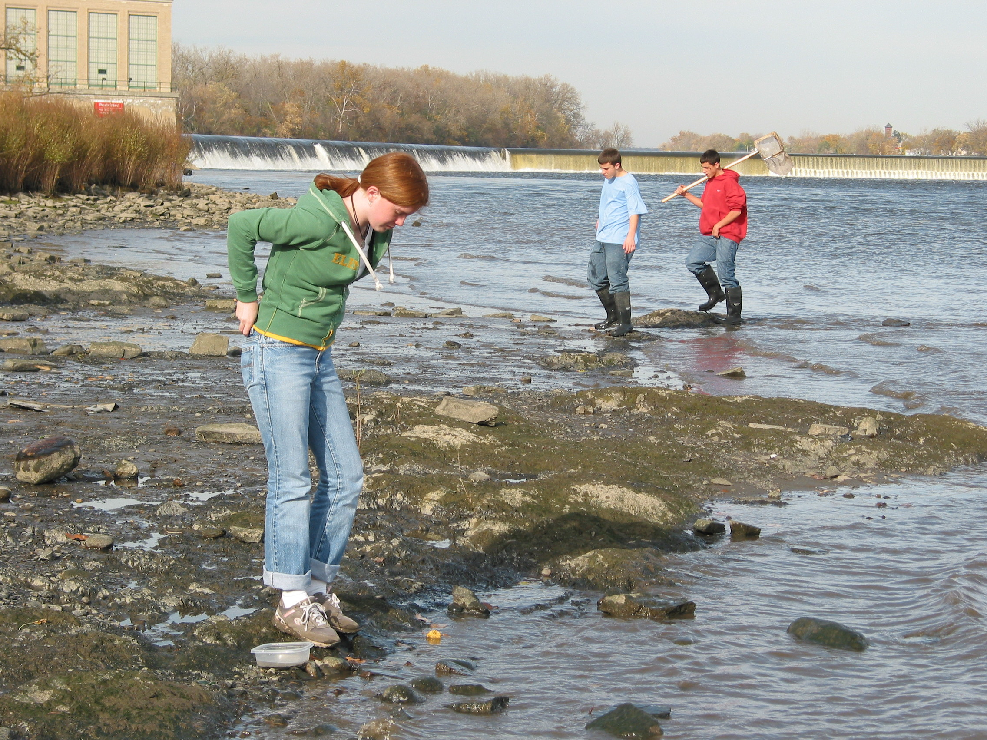
OH YES!
Be sure to describe your site so other schools will know what it looks like!
Does it look more like this?

Slide 30
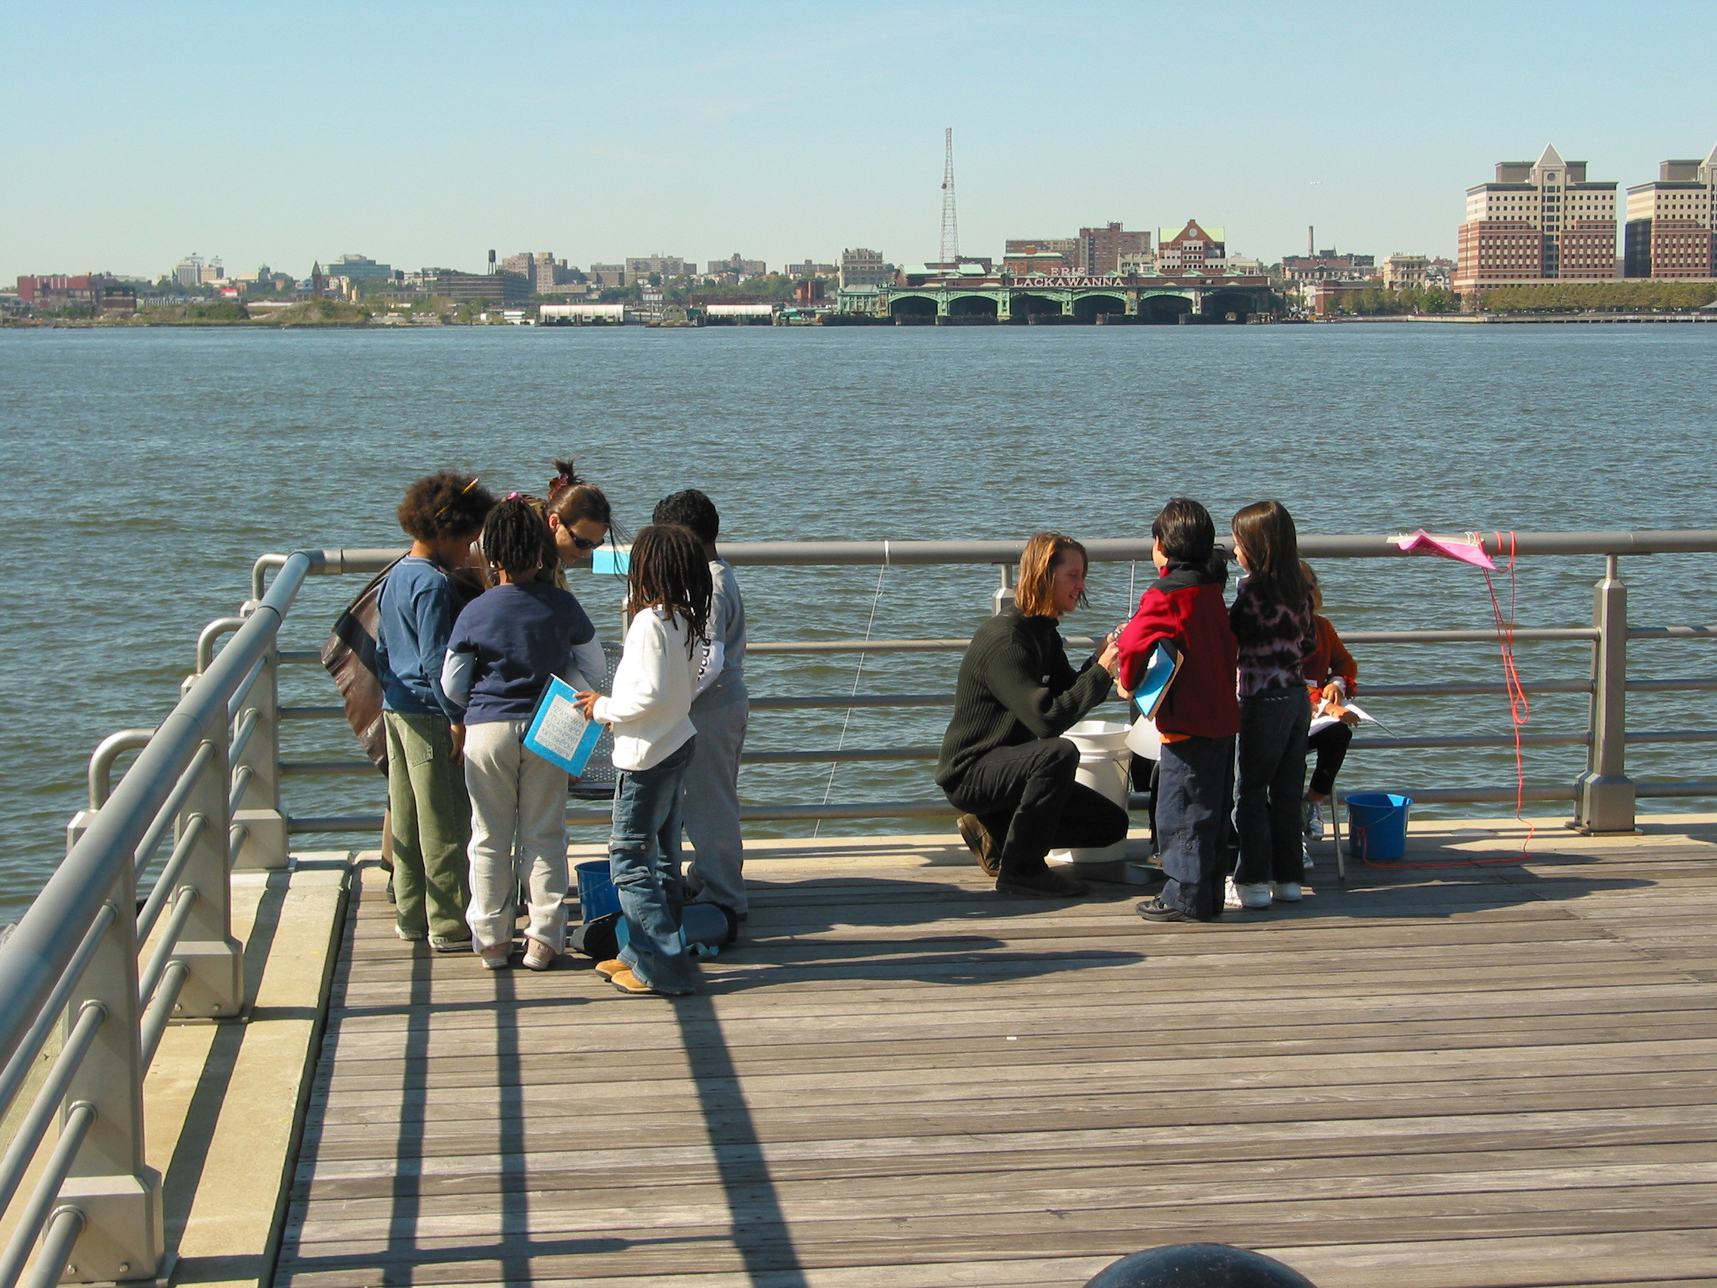
OR like this?

Slide 31
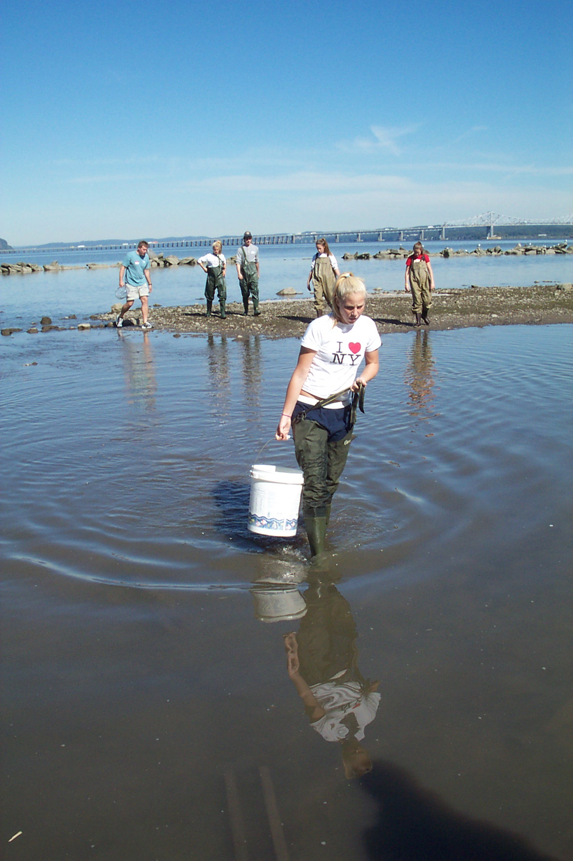
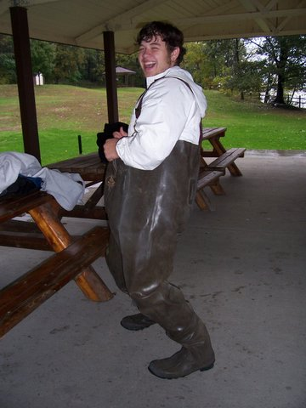
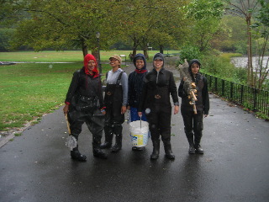
So let’s get started!
And don’t forget to send in your data so we can post it and share results!
The End.

