Slide 1
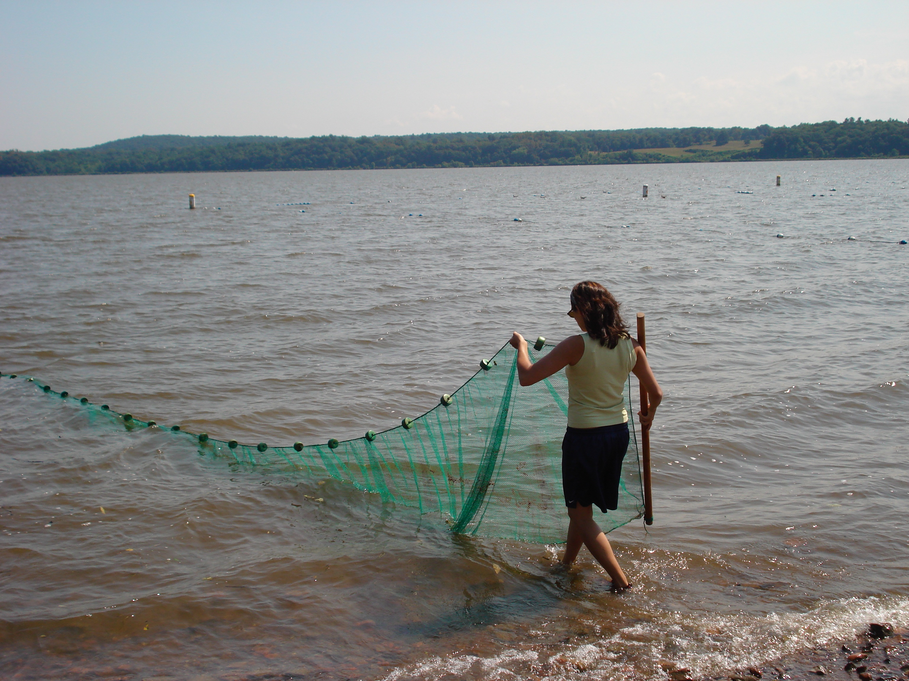
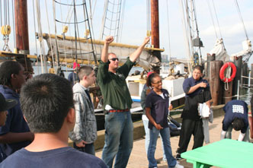
A Day in the Life of the Hudson River
(Snapshot Day)
use your mouse to advance the slides
Sponsored by the Hudson River Estuary Program, Lamont-Doherty Earth Observatory
& Hudson Basin River Watch

Slide 2
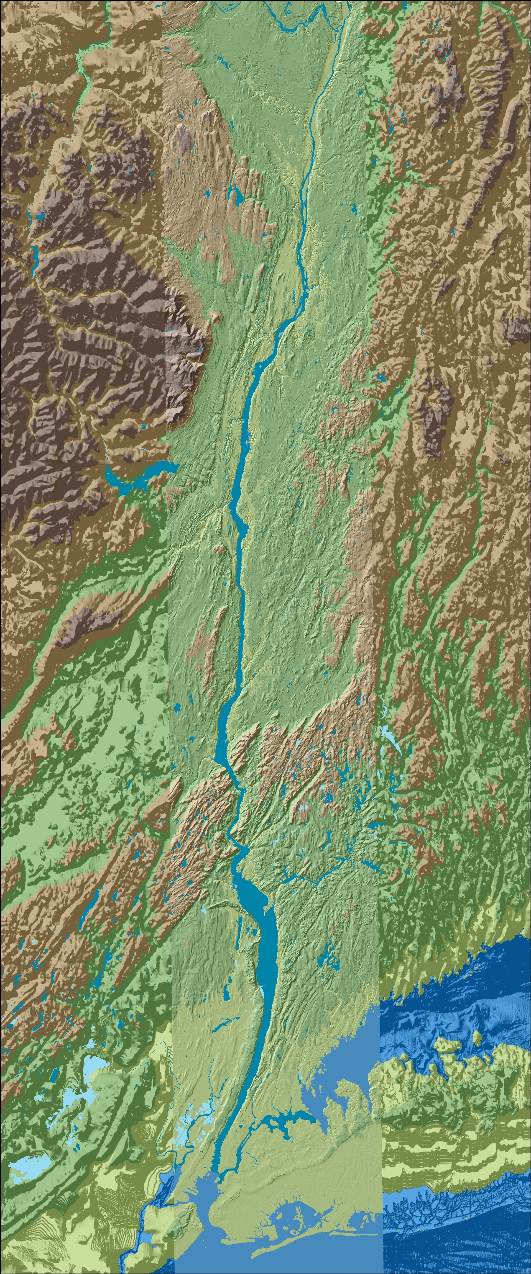
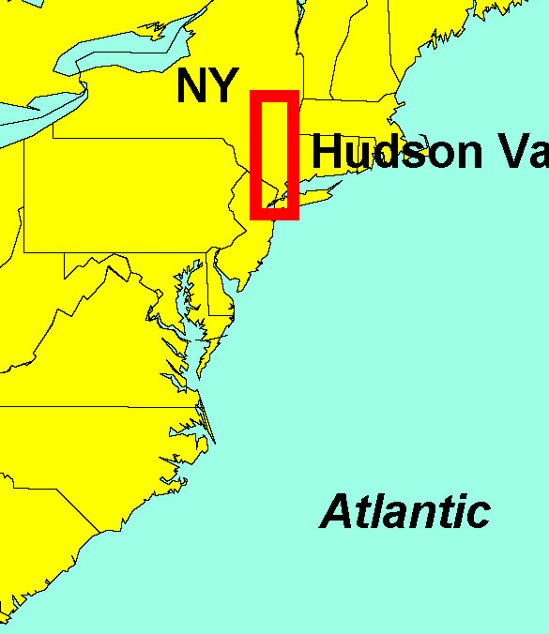
This is the Hudson River Estuary
The Hudson River Estuary is 153 River Miles-
  RM 153 is at the Troy dam, RM 0 is at the very bottom of Manhattan, below that is the Harbor and the “bight”
There are many other groups in the estuary today doing just what you are doing and even a few above the Troy Dam!
Hundreds of students are participating - all grades & ages
Troy RM153
Here is where we are in New York State!
E
S
T
U
A
R
Y
Cohotate RM 118
Ulster Landing RM 97
Poughkeepsie RM 75
Newburgh RM 60
Croton Point RM 35
Locate your sampling site on this map
What do you know about your sampling area?
Piermont RM 25
New York City
Staten Island
Jamaica Bay
The Atlantic Ocean

Slide 3
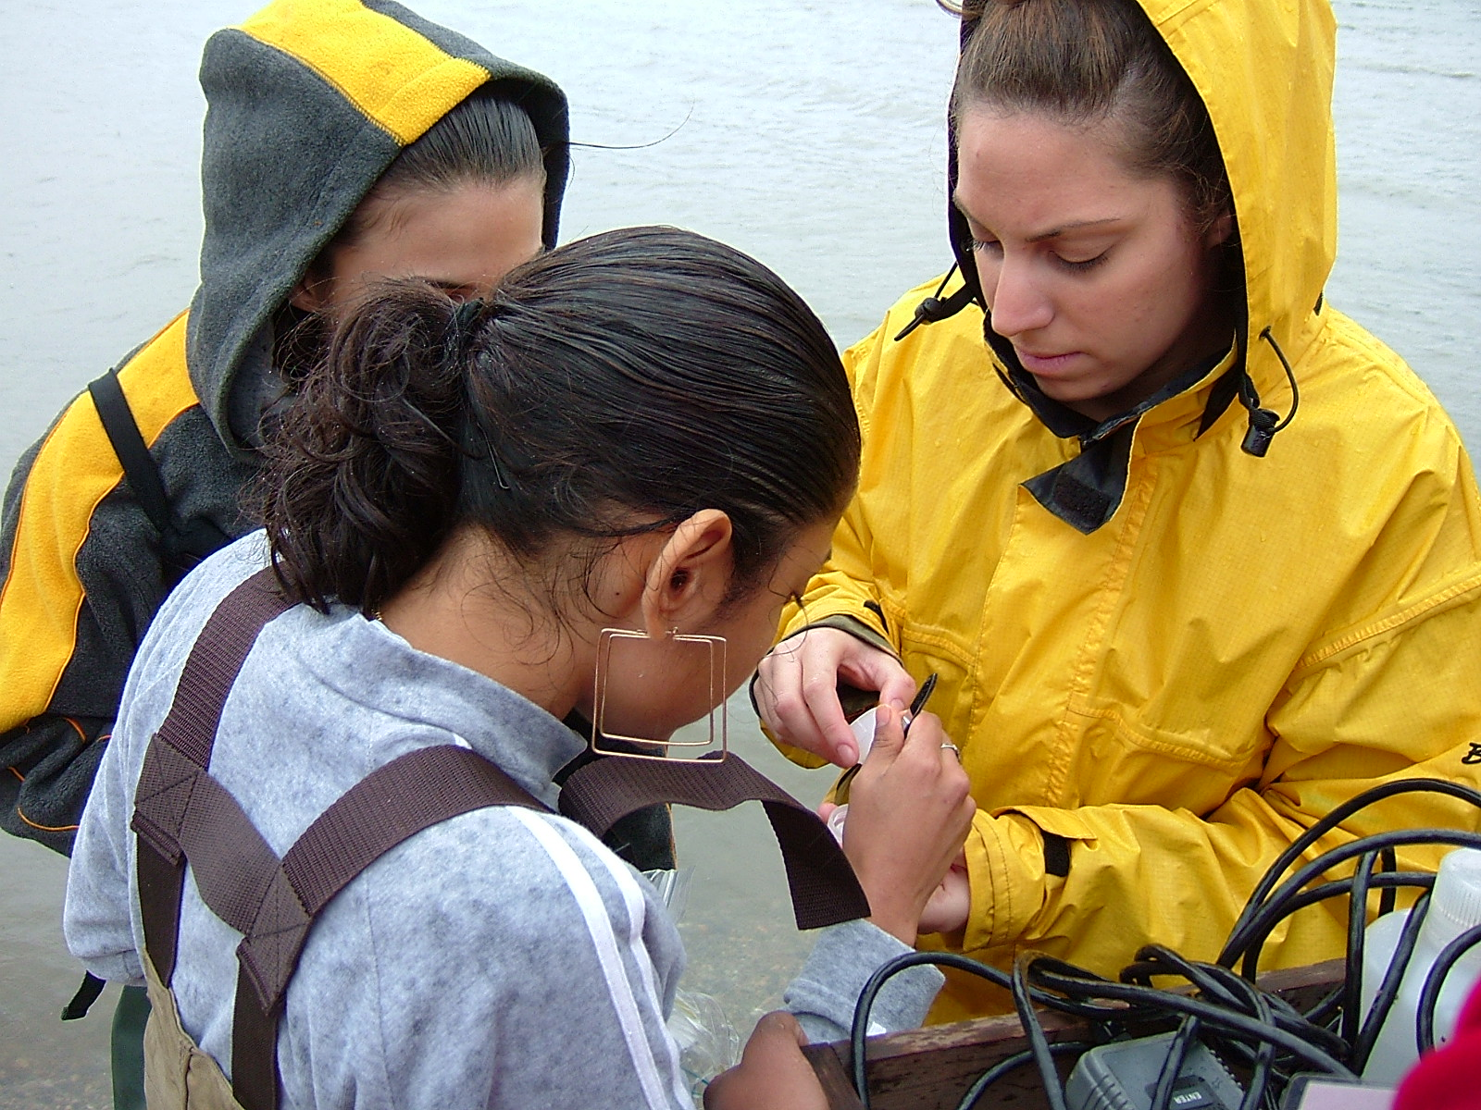
Your Analysis Is Important
Is the water at your site salty from the Atlantic ? Or is it fresh from the Adirondacks and upper tributaries? Or is it brackish (a salty and freshwater mix)?
What does the habitat look like? Are there aquatic plants? Piers? Riprap?
What will be the range of the pH and Dissolved Oxygen?
Start by developing predictions for your site:
“What will a ‘snapshot’, or a sample of the Hudson River look in your area?”

Slide 4
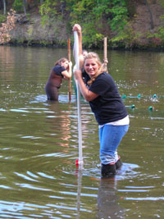
Will the data collected at your site match data from other sites on the river?
How do you think your area may differ from other areas on the river?
Do you think your data might be different this year from last year? What might be different?
These girls are collecting samples from the river for analysis. The student in front is collecting a sediment core or sample from the bottom of the river.

Slide 5
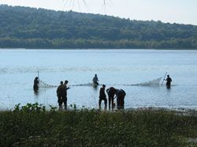
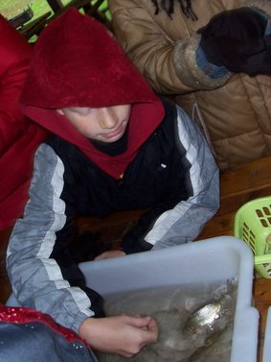
Looking for TRENDS &
Learning About A SYSTEM
You will be collecting data and comparing your predictions to:
    Current data YOU collect
    Current data collected by students at OTHER sites
    Prior data from the EARLIER years (check on the website)
    The HRECOS real time monitoring system www.hrecos.org/
These students are using a seine
net to catch fish in the Hudson.
The Native Americans used
seine nets to fish.
* Trends show patterns over time
* Systems show relationships

Slide 6
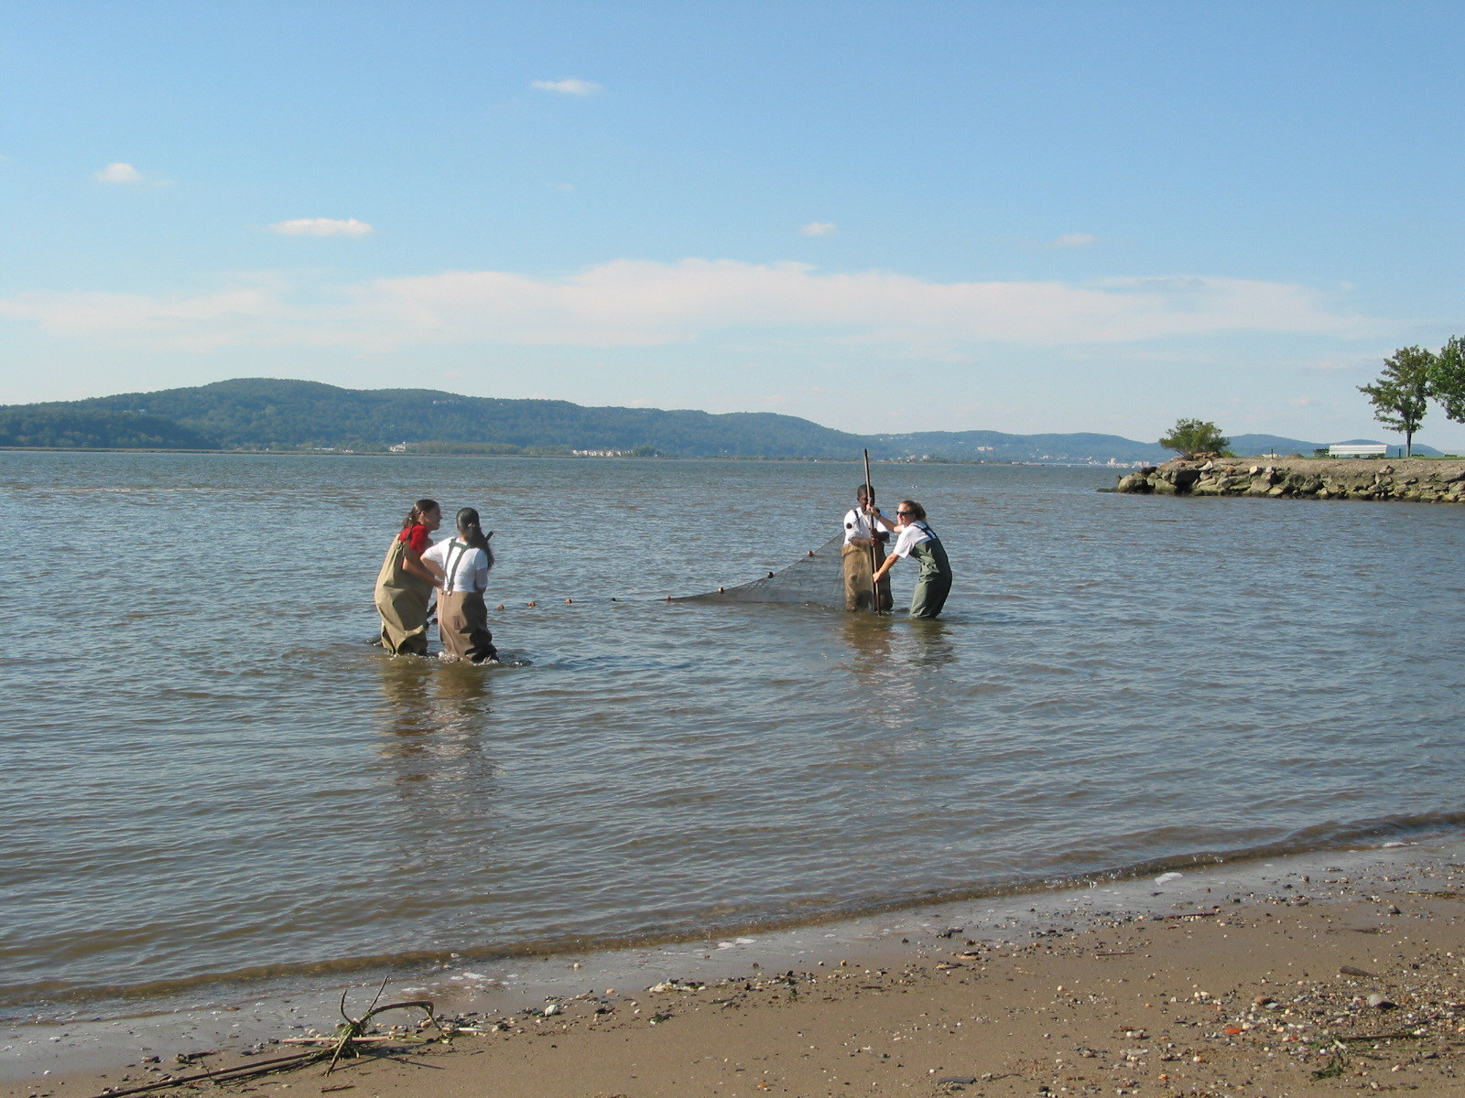
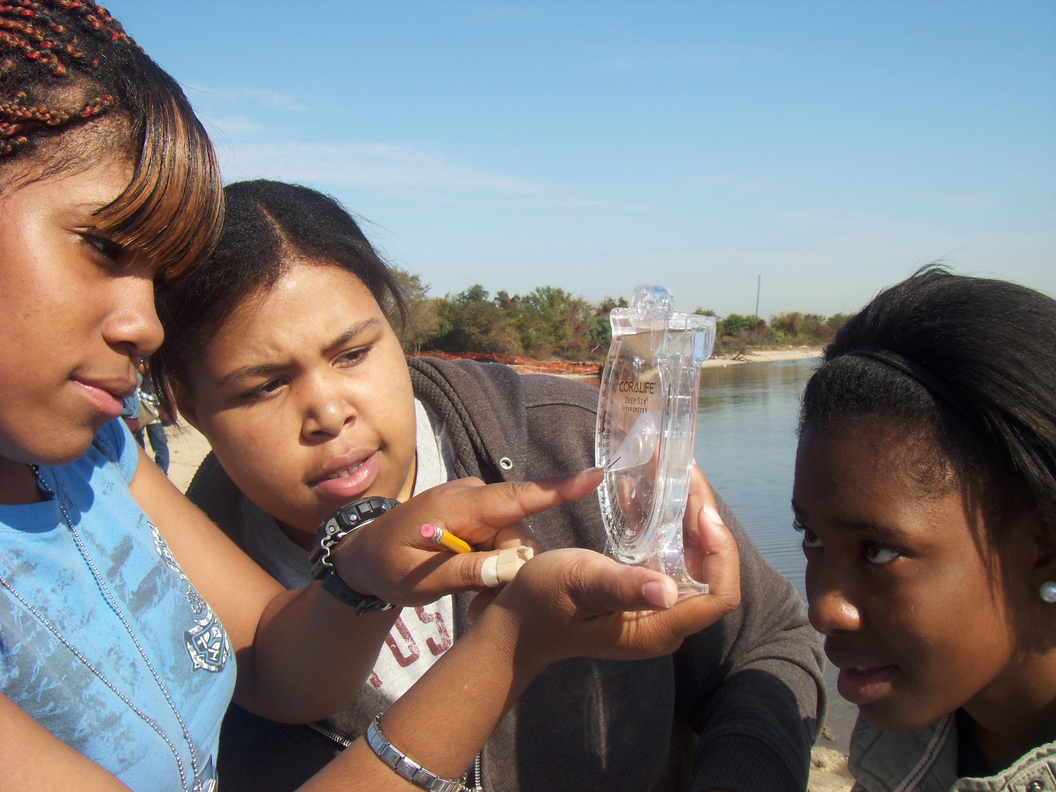
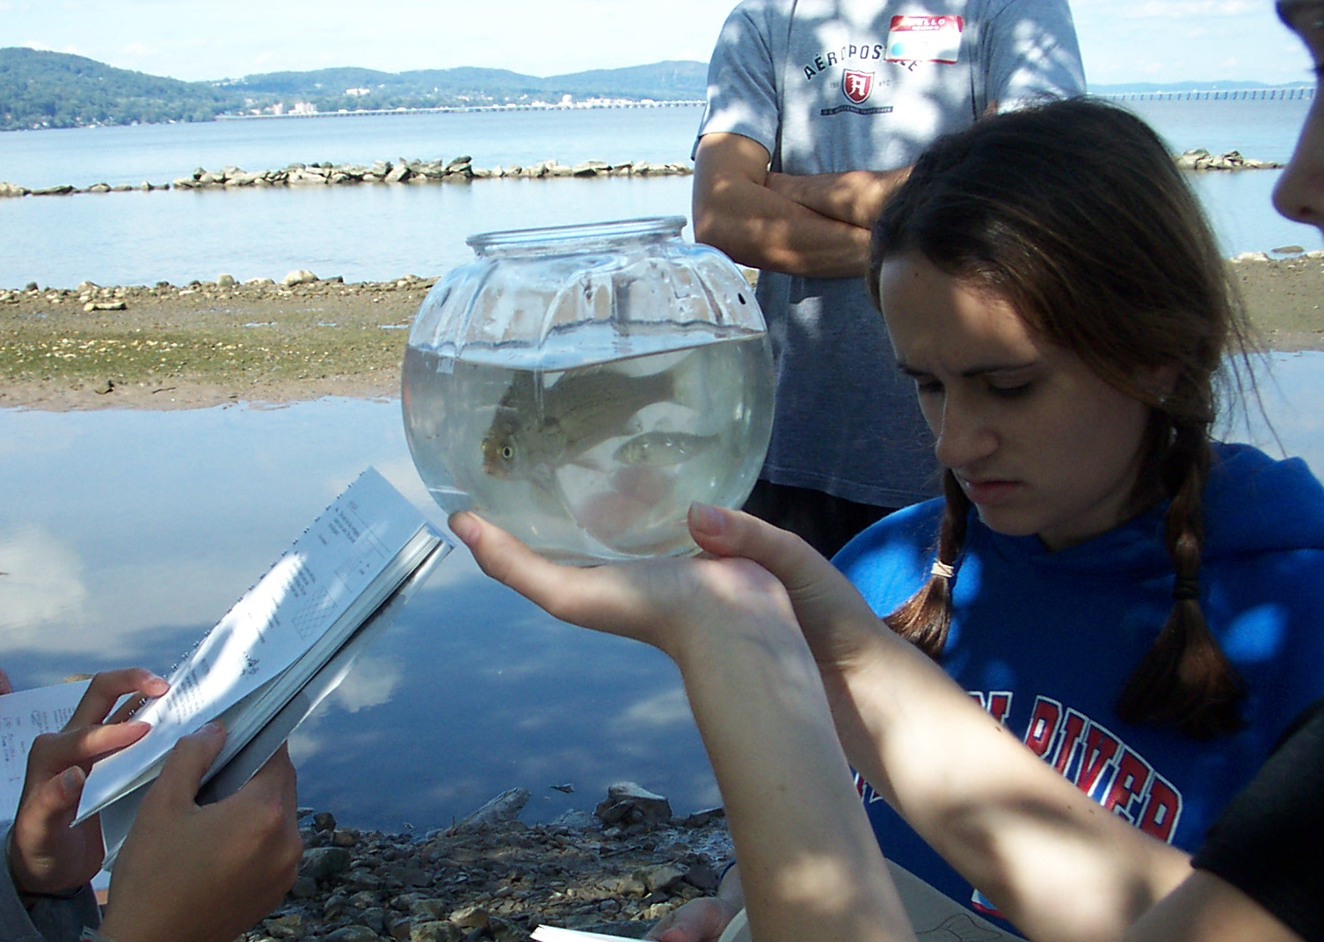
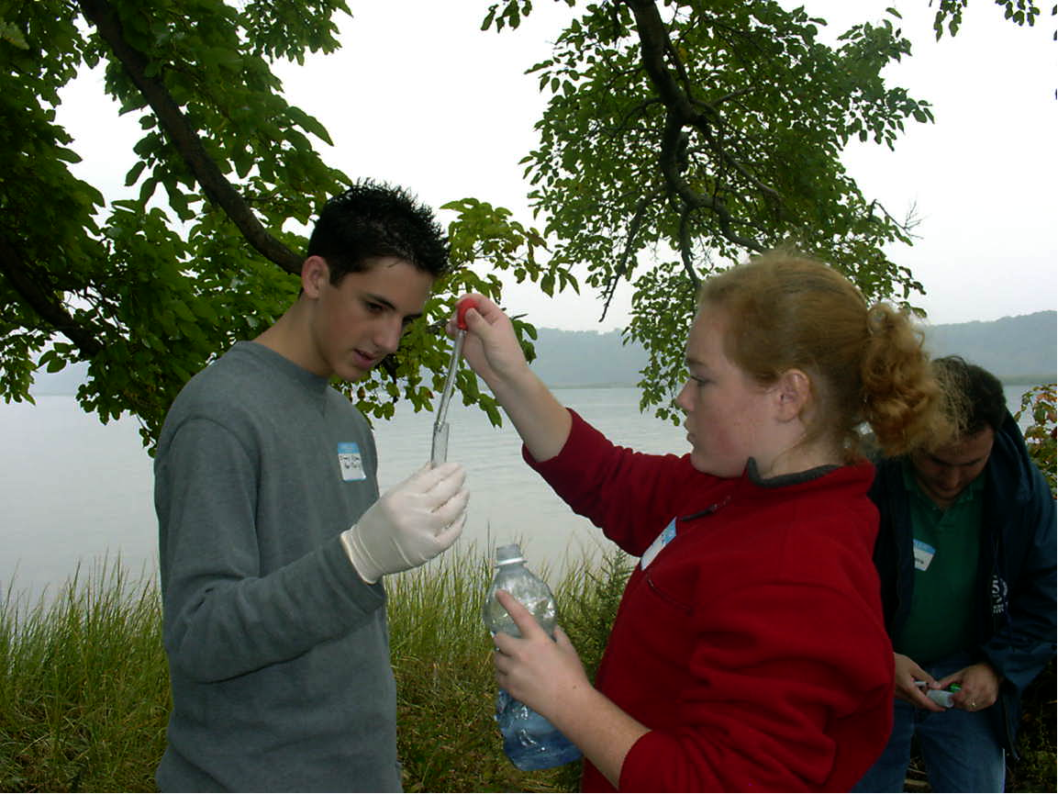
So what are we doing today?

Slide 7
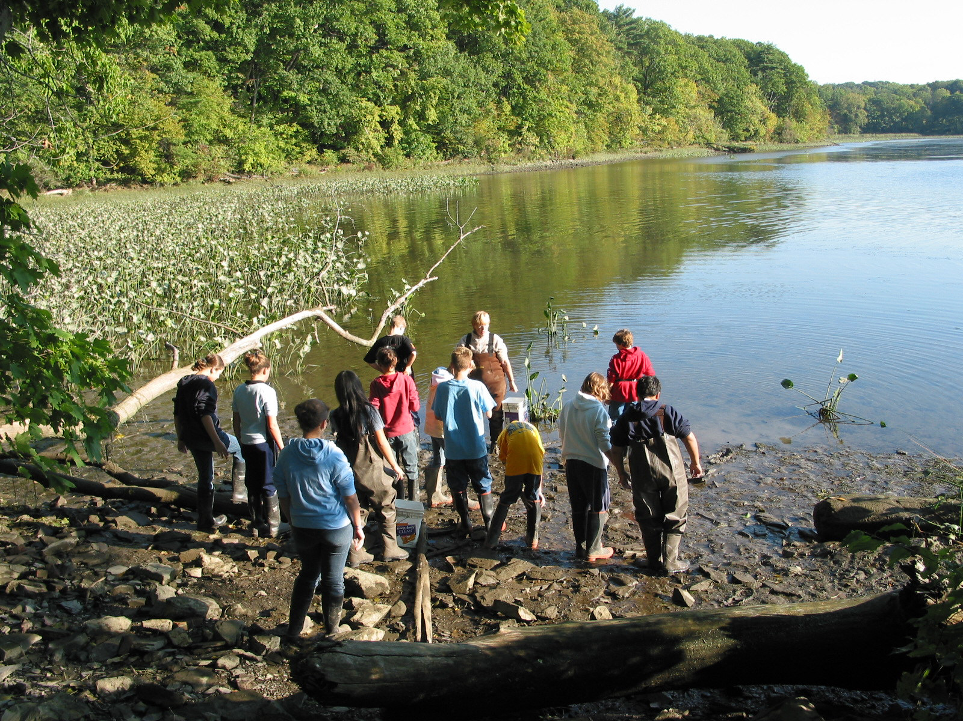
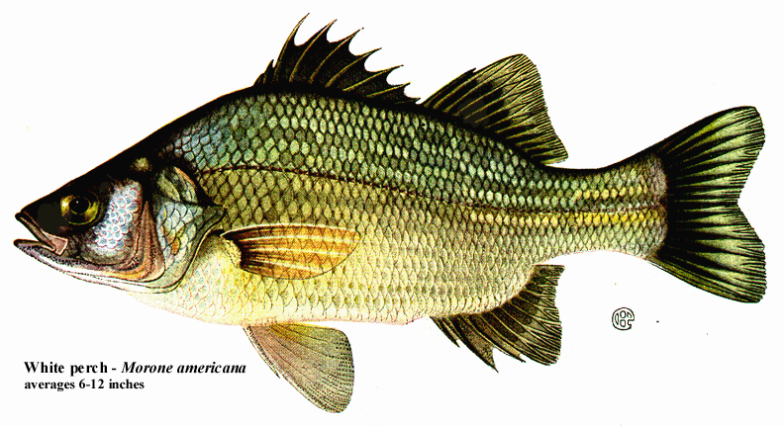
Let’s find out about the Estuary
Are there tides and currents in the estuary?
How warm and turbid (clear) is it?
Is there enough oxygen for a range of fish?
Are there plants where we are in the river?
Can we find Chlorophyll?
What does the bottom of the estuary look like at your site?
Are there any ships using the river for commerce?

Slide 8
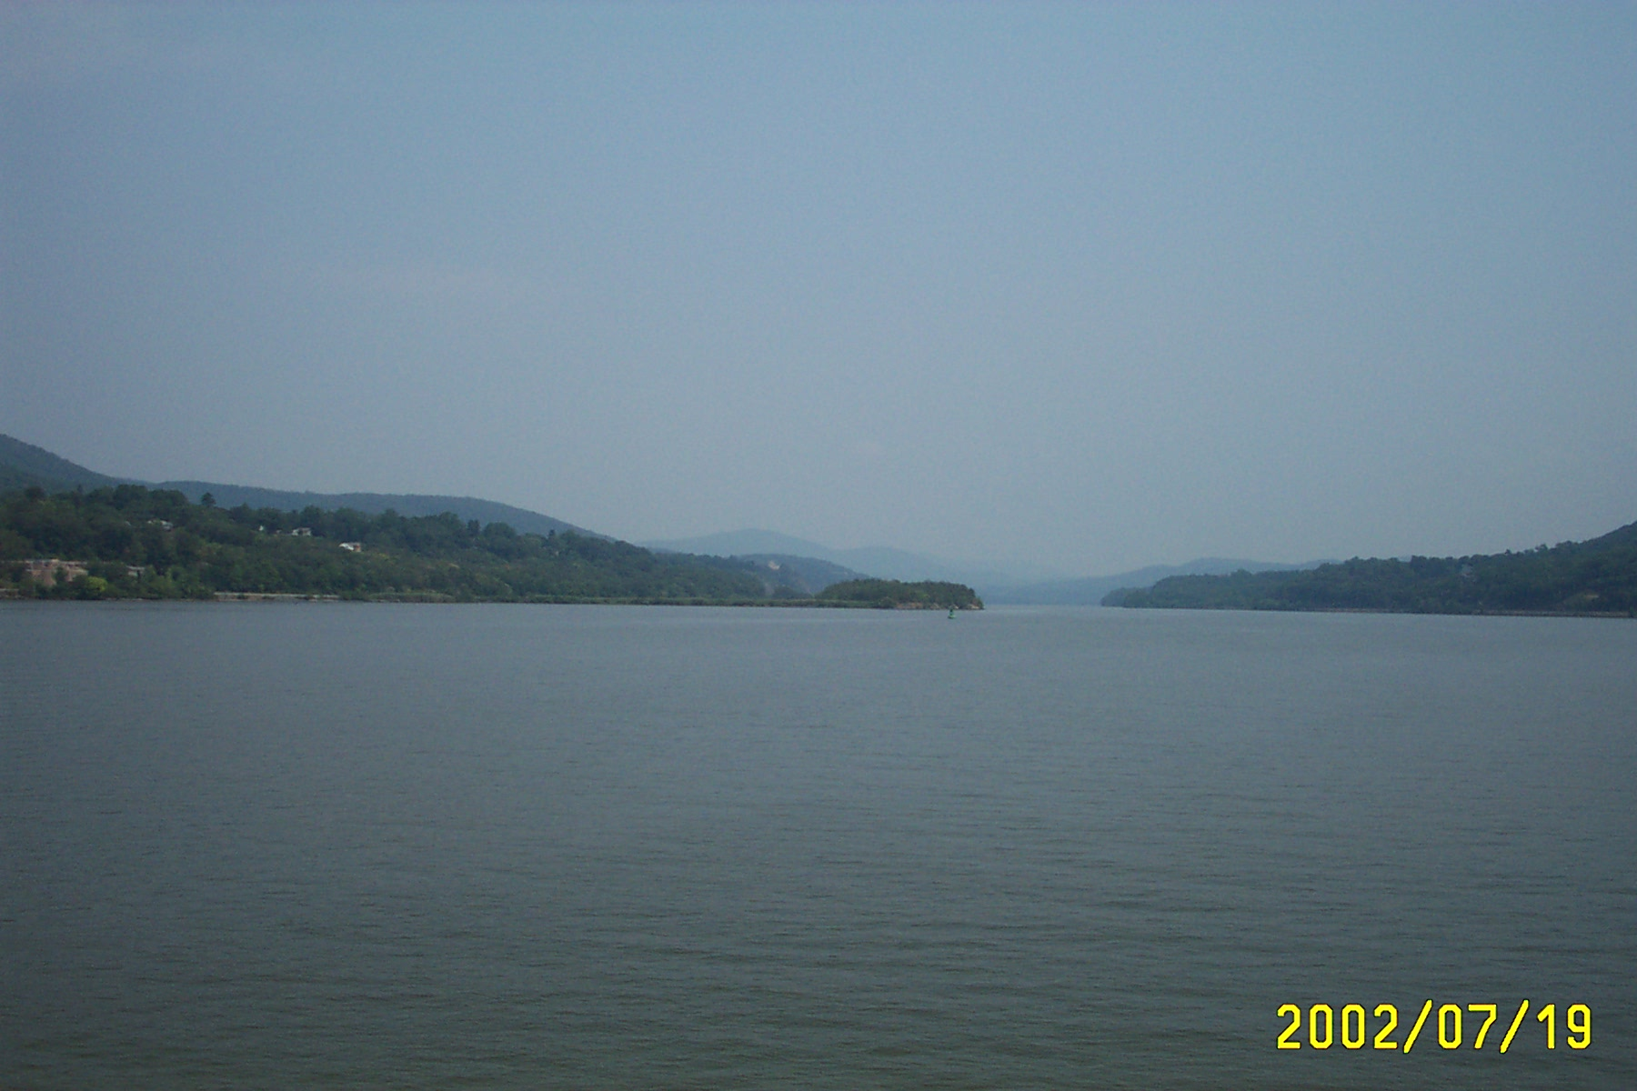
Tides
How can a river have tides? I thought tides were in the ocean?
In a long flat river like the Hudson the tides can push water in from the ocean until the bottom elevation of the river slopes too high.
Is the tide coming in (flood) or going out (ebb)? How can you tell this?
Measure the height of the tidal change over 30 minutes, 60 minutes... Is it rising or falling?
Will the tides be a factor in any of the data collected at your site? What might it affect?

Slide 9
Currents -
While tides cause a rise and fall in the water level, currents are a horizontal pull in the water -in and out from the ocean. Currents are hard to see.
You can use a stick, or an orange, to tell whether the current is moving up the river or moving out of the river into the ocean. Toss a stick or orange far out towards the center of the river and watch to see which way it moves – ebbing (downriver) or flooding (upriver).

Slide 10
More About Currents!
Since tides and currents keep the water moving back and forth in the Hudson, if you dropped your orange in the river how long do you think it would take to get from the top of the estuary (the Troy dam above Albany) to the Atlantic Ocean?
It can take 4 months!
Today we are collecting data in this same area (the estuary section of the river) so some of the water we sample in the harbor MAY have started 4 months ago up at the Troy Dam!

Slide 11
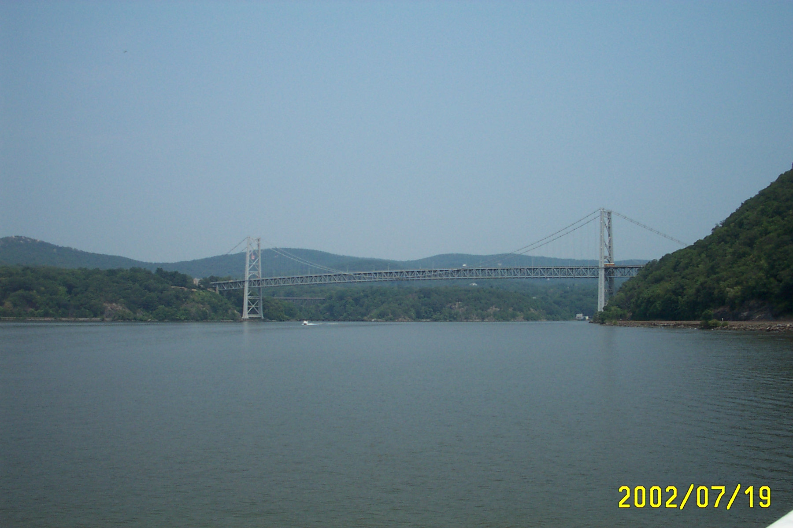
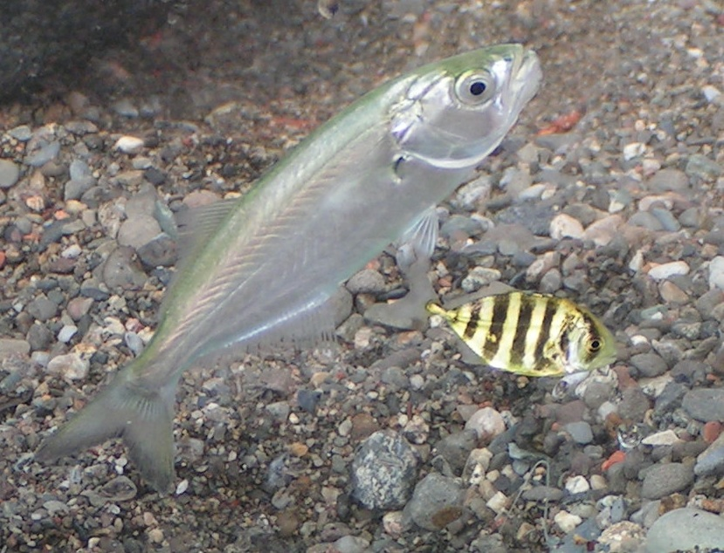
Rivers tend to run ONE direction - from their source to where they meet a larger water body. The Hudson River flows TWO ways - in fact the Native people called it ‘The River that flows both ways” or Muhheakantuck.
The Hudson runs both down from Lake Tear of the Clouds on Mount Marcy in the Adirondacks AND
in from the ocean from the tidal influence.
How do fish know which way to go?

Slide 12
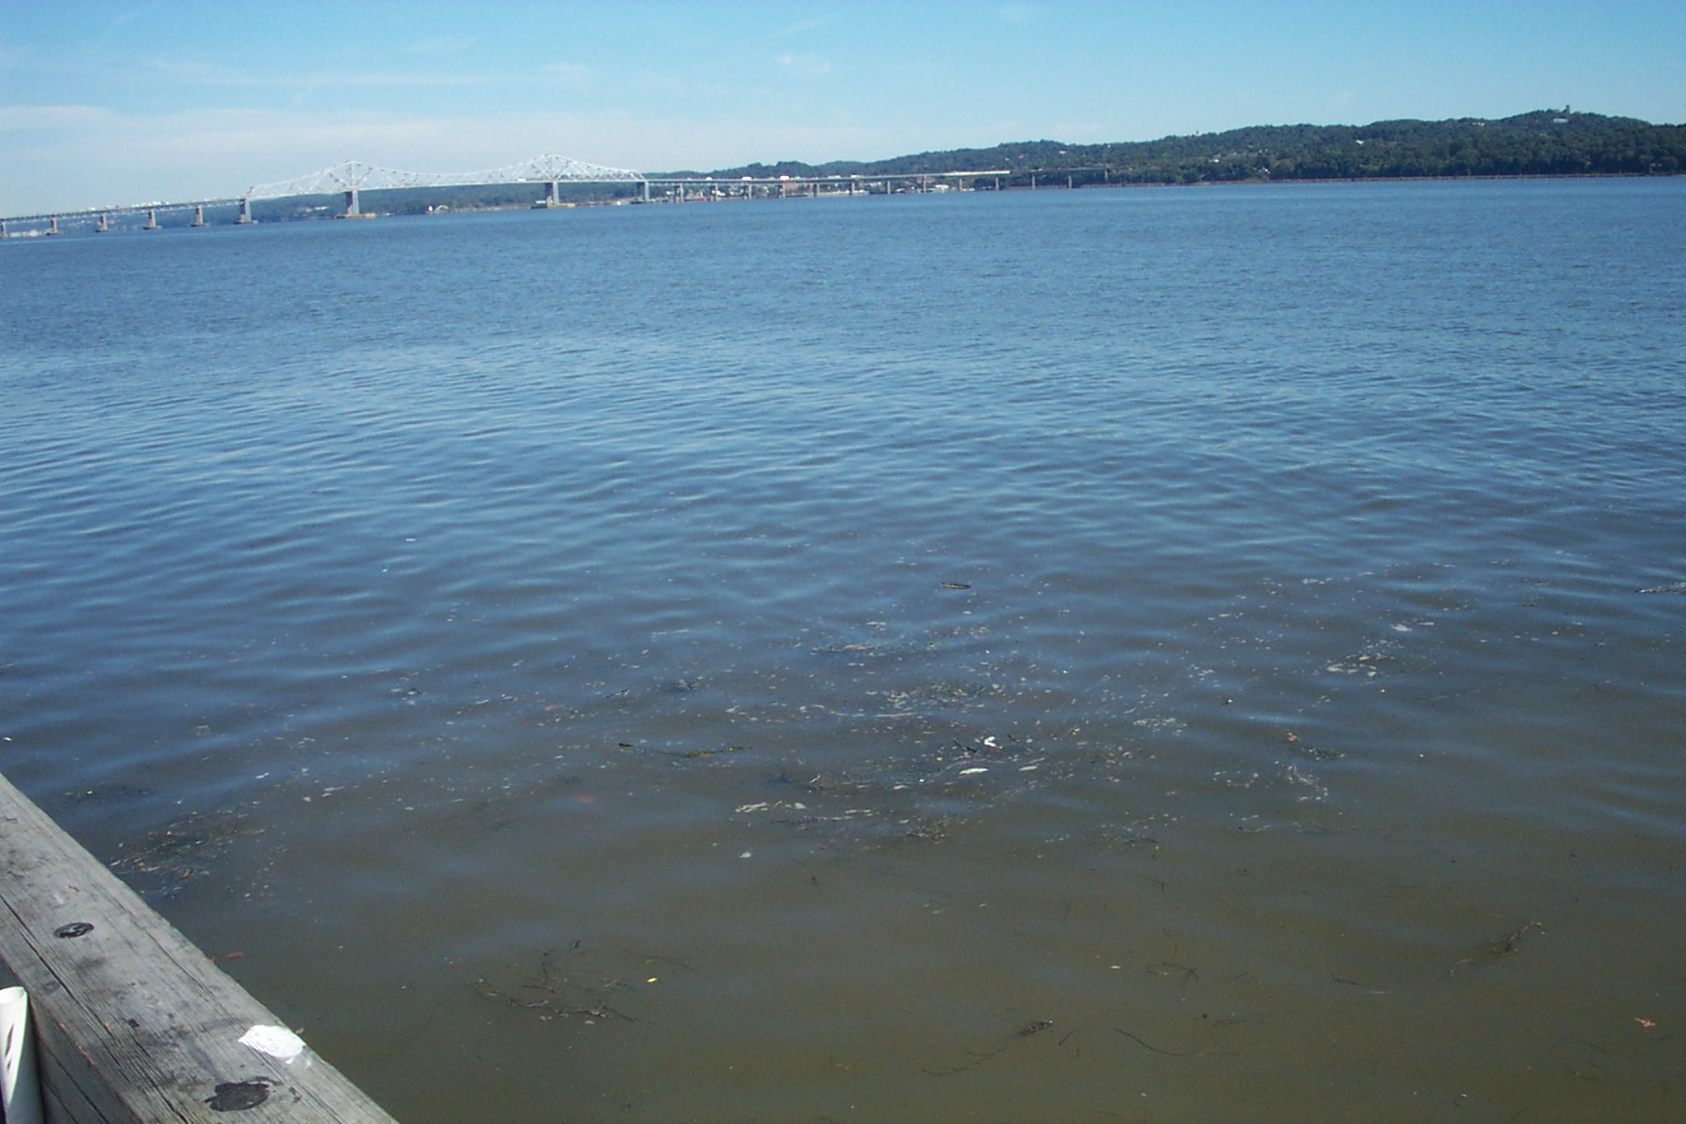
The Hudson River Almanac reported a story of the River that flows both ways. ‘A bottle was collected at RM 18 Sept. 3rd and was found to have been thrown in at RM 34 July 18th…45 days to travel 16 miles!’ On average, how far did the bottle travel South in the River each day?
Notice we said travel “South”. The “total” distance traveled would be more. Why?
(Source -Hudson River Almanac 9/3-9/10/04)

Slide 13
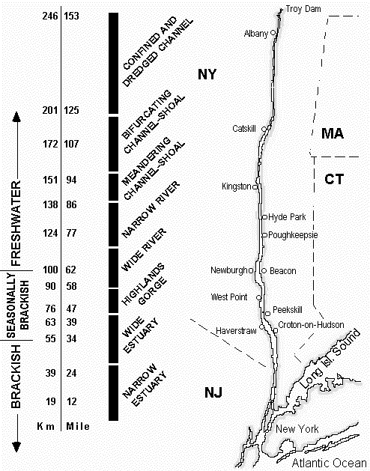
Let’s Talk SALT in the estuary!
What and where is the Salt Front?
The Salt Front is where the Hudson turns from being partly salty to almost fresh water. Scientists on the Hudson use 100 ppm chloride concentration (chloride is about half the content of total salinity).
In the Hudson the salt front moves with the season…
Generally it is near Newburgh in the summer
Spring rains and snow melt can push it down below the Tappan Zee Bridge

Slide 14
Predicting the Salt Front
Earlier Day in the Life dates the Salt Front has been located at:
2003 RIVER MILE 60
2007 RIVER MILE 78.2
2011 RIVER MILE 35.7
What about this year? Consider the weather this fall, and check the HRECOS website (www.hrecos.org) to look at the salinity in the brackish section of the river. Write down your prediction…where do you think 100 ppm chloride will fall – after the event you can check the event results online to see if you are right!

Slide 15
Measurable Physical Properties - Temperature
Temperature is REALLY IMPORTANT to fish and other processes in the river. As water temperature increases and decreases biological and chemical activity adjusts.
Dissolved Oxygen (DO) is inversely related to temperature. So can you predict when we would expect DO to be the highest and the lowest in a 24 hour period?
Winter Flounder

Slide 16
Temperature
Many creatures regulate events like reproduction & migration by temperature - changes can trigger a chain of events.
Temperature is a function of water depth, season, amount of mixing, inflow from tributaries, human influence…how many of these do you think influence your site?
Inland Lizard Fish

Slide 17
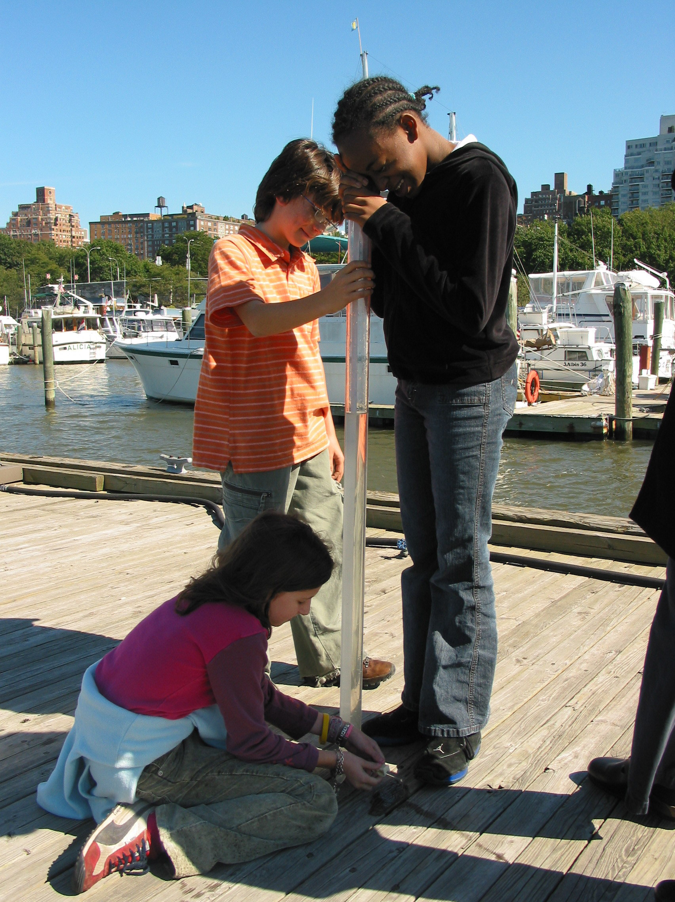
Measurable Physical Properties
Turbidity
Measured with:
• Sight Tube (pictured)
• Secchi disk
• meters

Slide 18
Turbidity is “water clarity”
BUT JUST BECAUSE THE WATER IS NOT CLEAR DOES NOT MEAN IT IS DIRTY – ESTUARIES ARE TURBID!
Suspended materials cause turbidity:
Suspended silt, clay and sand grains
Suspended phytoplankton or zooplankton
Small fragments of dead/decomposing plants and animals called detritus that are a source of nutrients in the food web
Salt in the water
The Hudson’s high turbidity can reduce photosynthesis deeper in the water, but it creates a wonderful nursery area for fish!

Slide 19
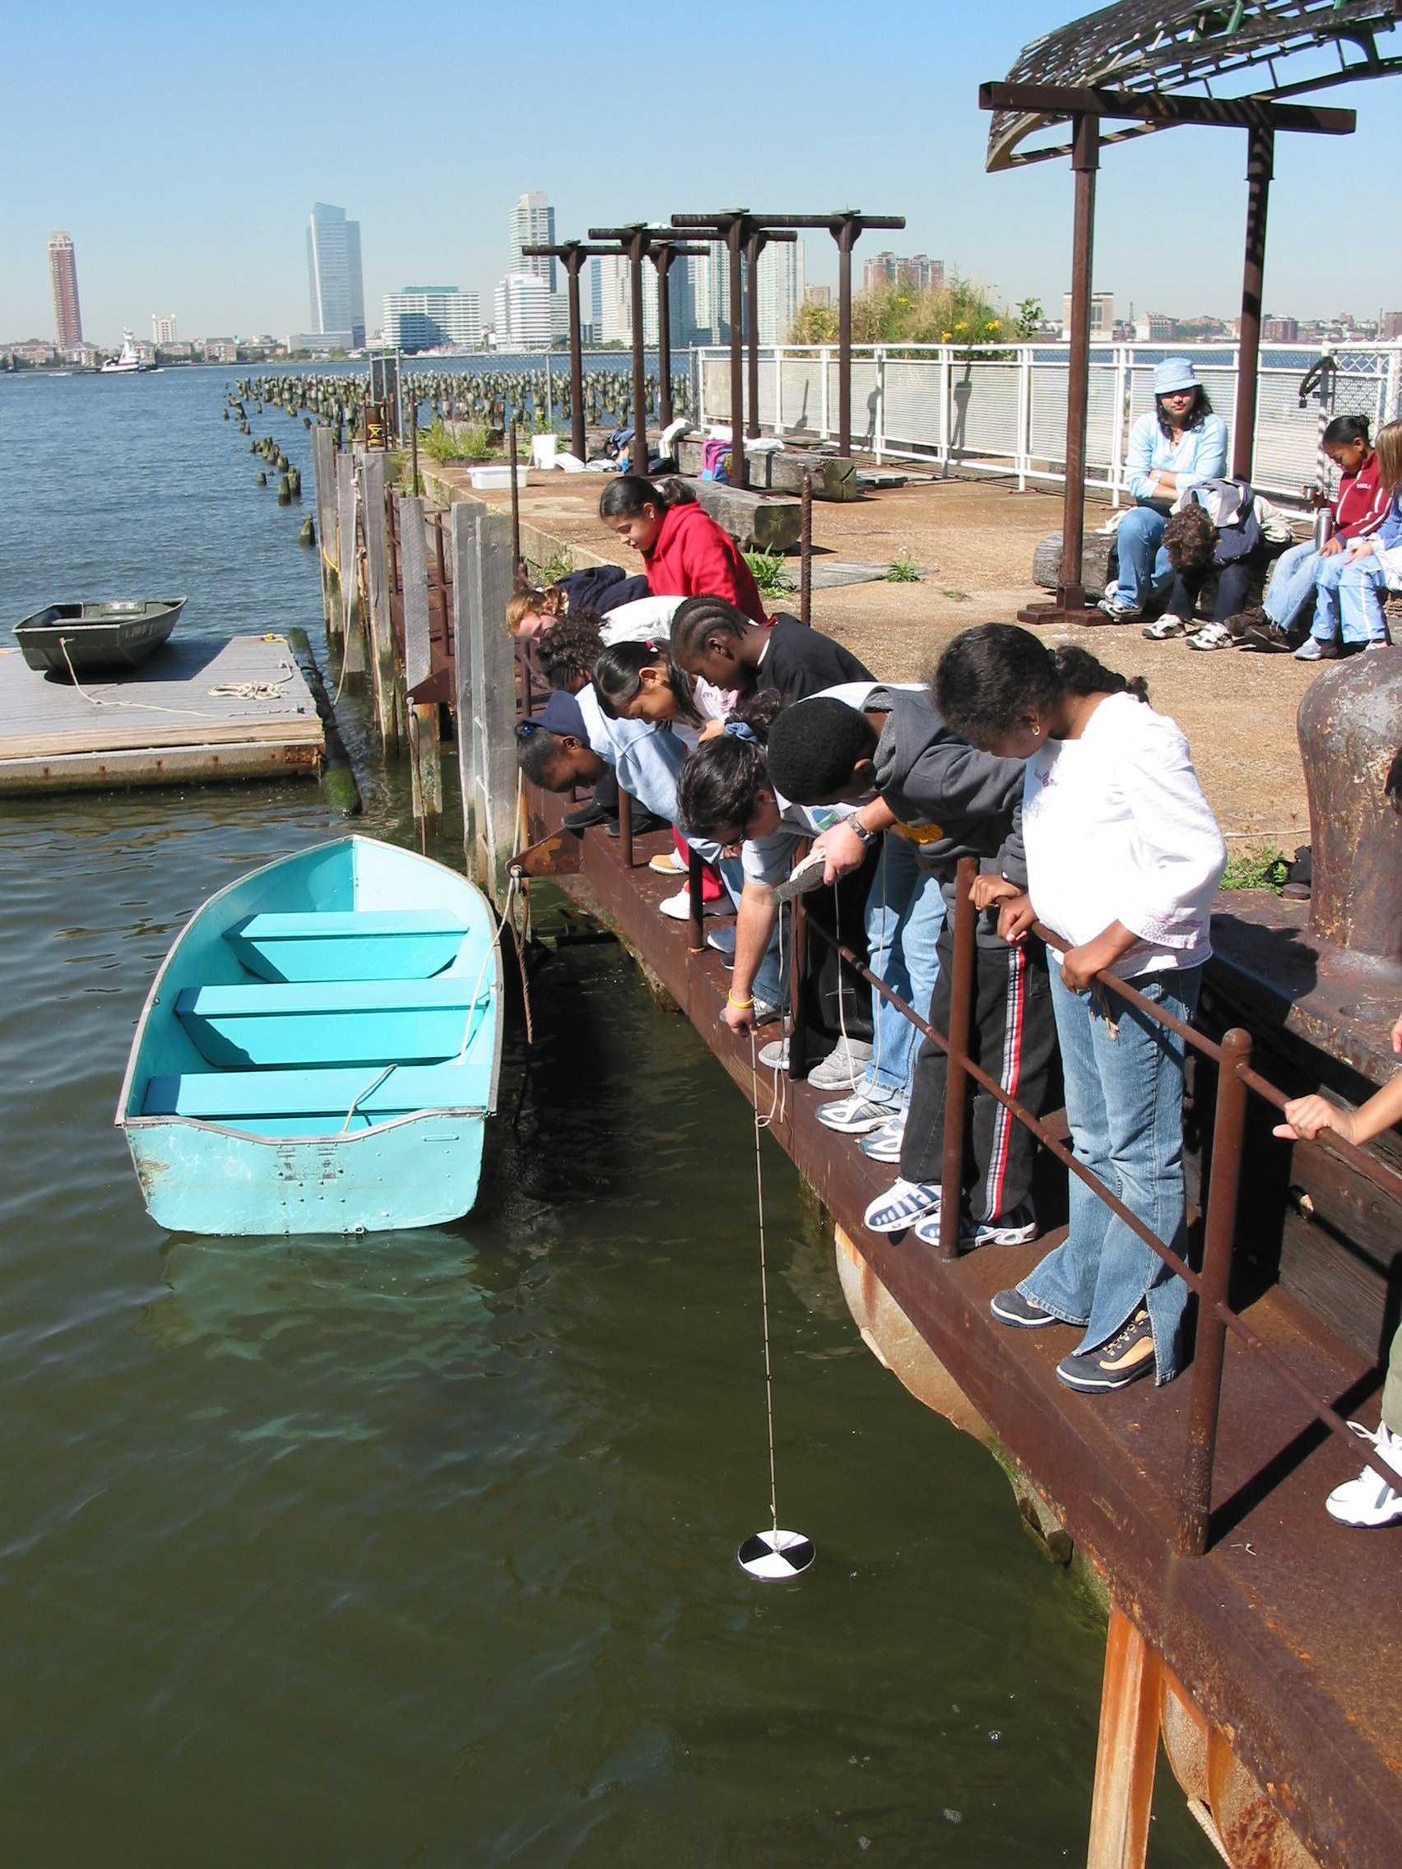
You Predict - Will the Hudson be more turbid in your location this year than last?
Does weather affect turbidity...rain? wind?
Look at last year’s data page and check the weather.
How might that have affected turbidity?
These students are using a secchi disk to determine water clarity.

Slide 20
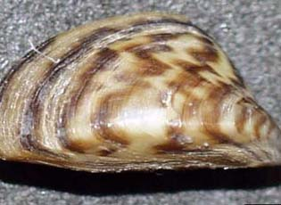
Turbidity
Zebra Mussels are small freshwater mussels that are having an impact on the freshwater section of the Hudson they inhabit by eating HUGE amounts of phytoplankton (plant material) - more than their expected share.
Is the turbidity in your area affected by zebra mussels?
What do you think – is the Zebra Mussel clearing of the water is good or bad for the river? Explain your answer.

Slide 21
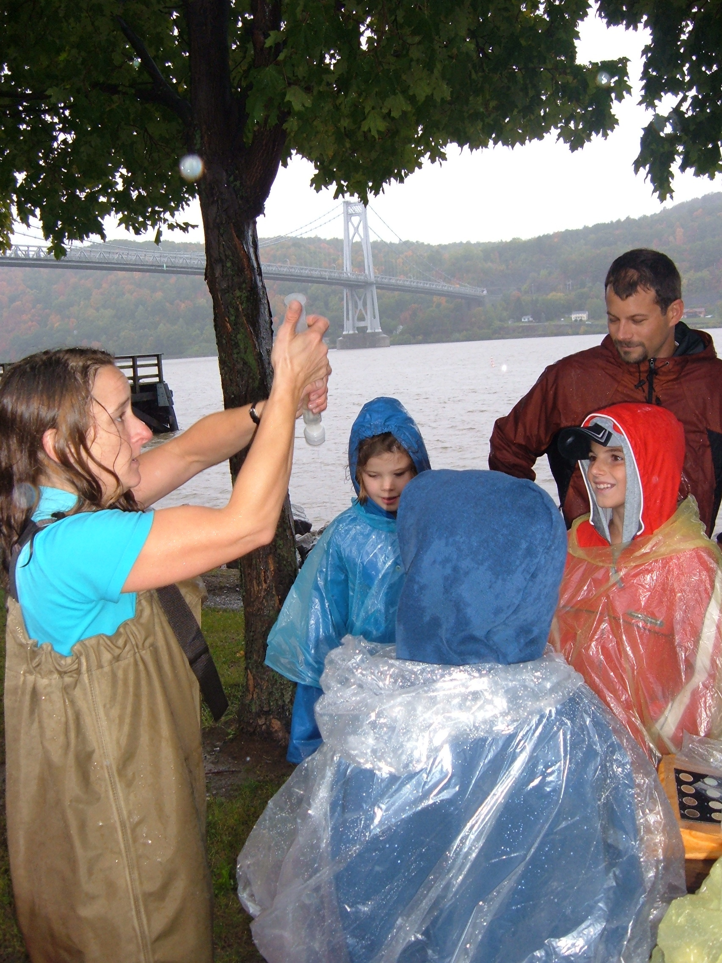
Chlorophyll
What is Chlorophyll?
.
Chlorophyll is the green pigment in plants that lets them turn sunlight into energy. We use it as a way to measure productivity in the river.
We filter the water by “catching” the chlorophyll on a filter and recording how dark the filter gets
Did you know: ‘Chloros’ in Greek means yellow-green ?

Slide 22
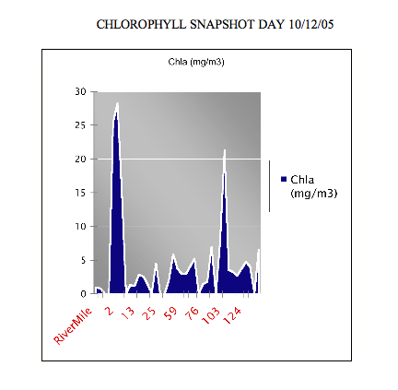
Chlorophyll in the Hudson
Chlorophyll measures can vary with time, sunlight, tide, and water clarity.
Will it matter what depth we use to collect our water samples to measure chlorophyll? What conditions might affect the amount of chlorophyll? Create a hypothesis and explain how you would test it.
You can look on the Snapshot website “Chlorophyll page” at the end of the slideshow to check your hypothesis.

Slide 23
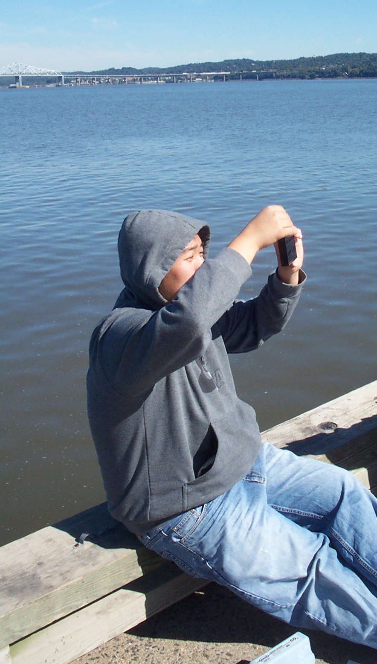
Chemistry
There are several test - select what you are able to do:
Dissolved Oxygen (DO)
pH
Alkalinity
Nitrates
Phosphates

Slide 24
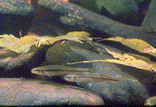
Dissolved Oxygen (D.O.)
Photosynthesis is a large source of oxygen to water.
Oxygen levels can change quickly and throughout the day – they are generally lowest in AM, highest at midday (why would you think?)
How do you think cloudy weather would affect oxygen?
How about wind?
D.O. - Water must have enough D.O. for:
Plant & Animal respiration
breakdown of organic material
…..but what is enough?

Slide 25
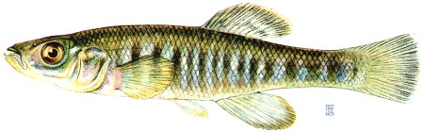
Dissolved Oxygen
Oxygen solubility in water is poor - cold fresh water only holds 14.2 mg/l when it is fully saturated. Warm water and saltwater hold less.
Optimal DO for fish respiration is 5-11 mg/l.
Below 3 mg/l many fish can’t survive.
What is your prediction for your test site on Snapshot Day?
Fun Fact: Comparing people and fish! People need ~200,000 ppm oxygen to breathe. Fish need ~5 ppm oxygen for respiration.

Slide 26
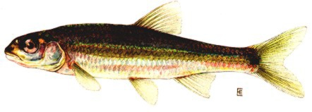
pH
Fish are very sensitive to the pH of the water - each species has a range they find acceptable for health & reproduction
Look at the pH measure of the Hudson River in your area - is it:
pH is the measure of acidity or alkalinity in the water. Water that is highly acidic OR alkaline can damage the skin, gills or eyes of fish.
neutral (7.0)?
more acidic (< 7.0)?
or more basic (>7.0)?

Slide 27
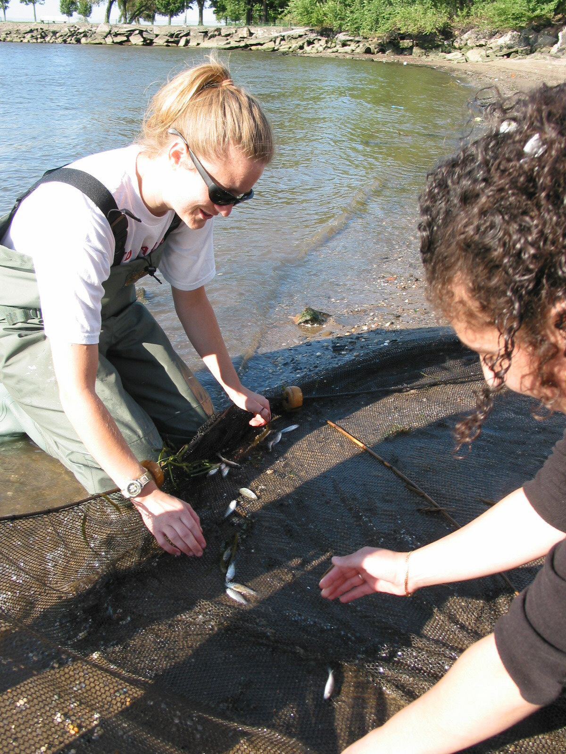
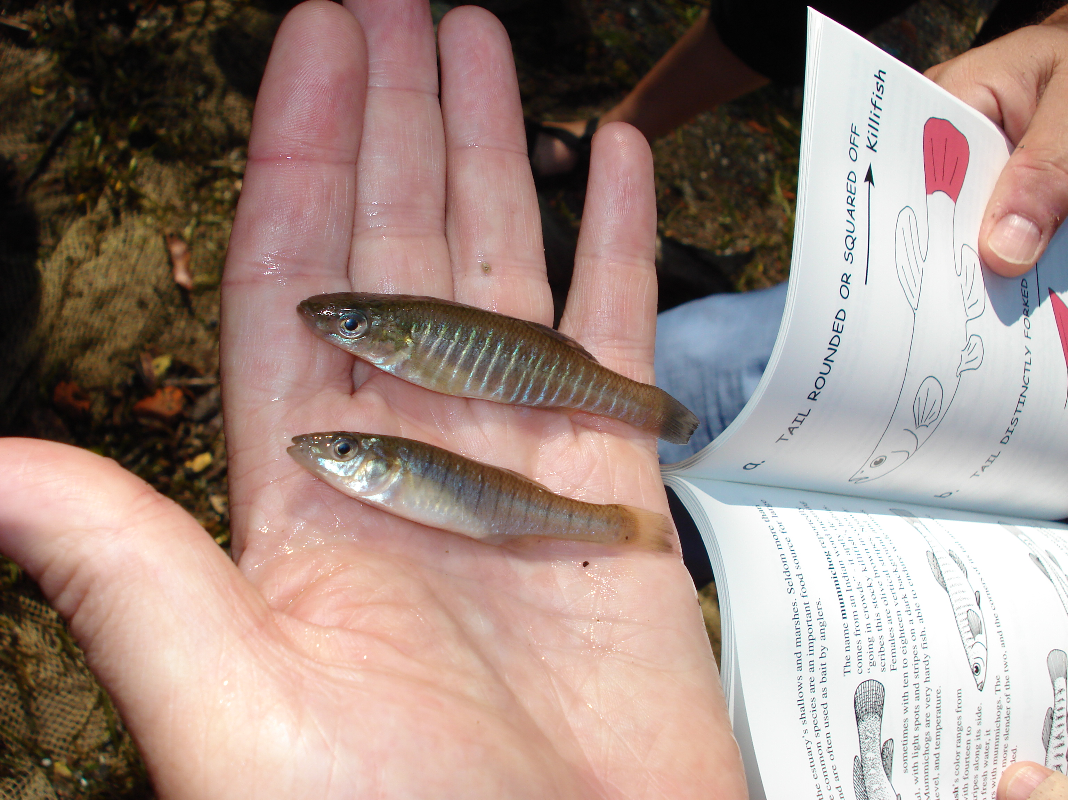
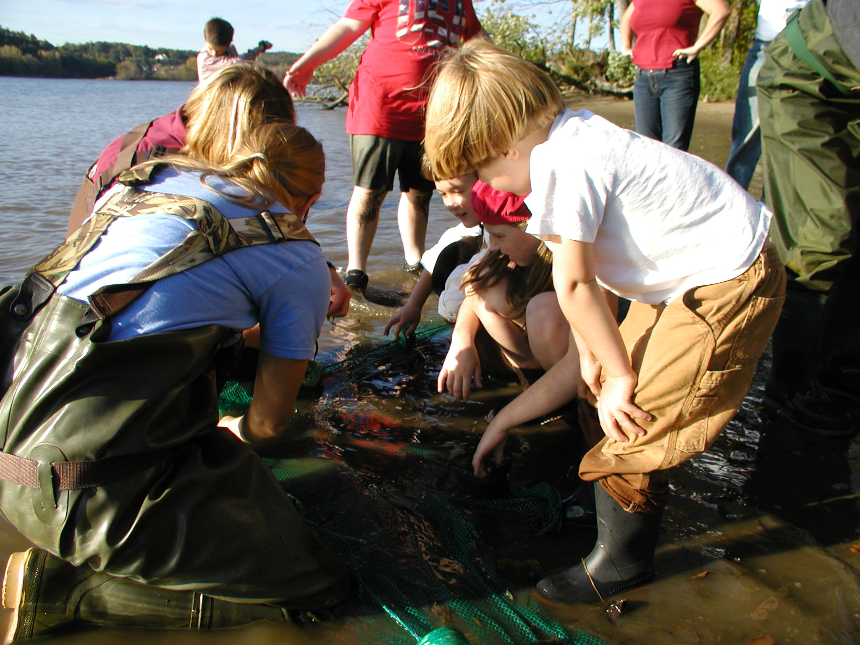
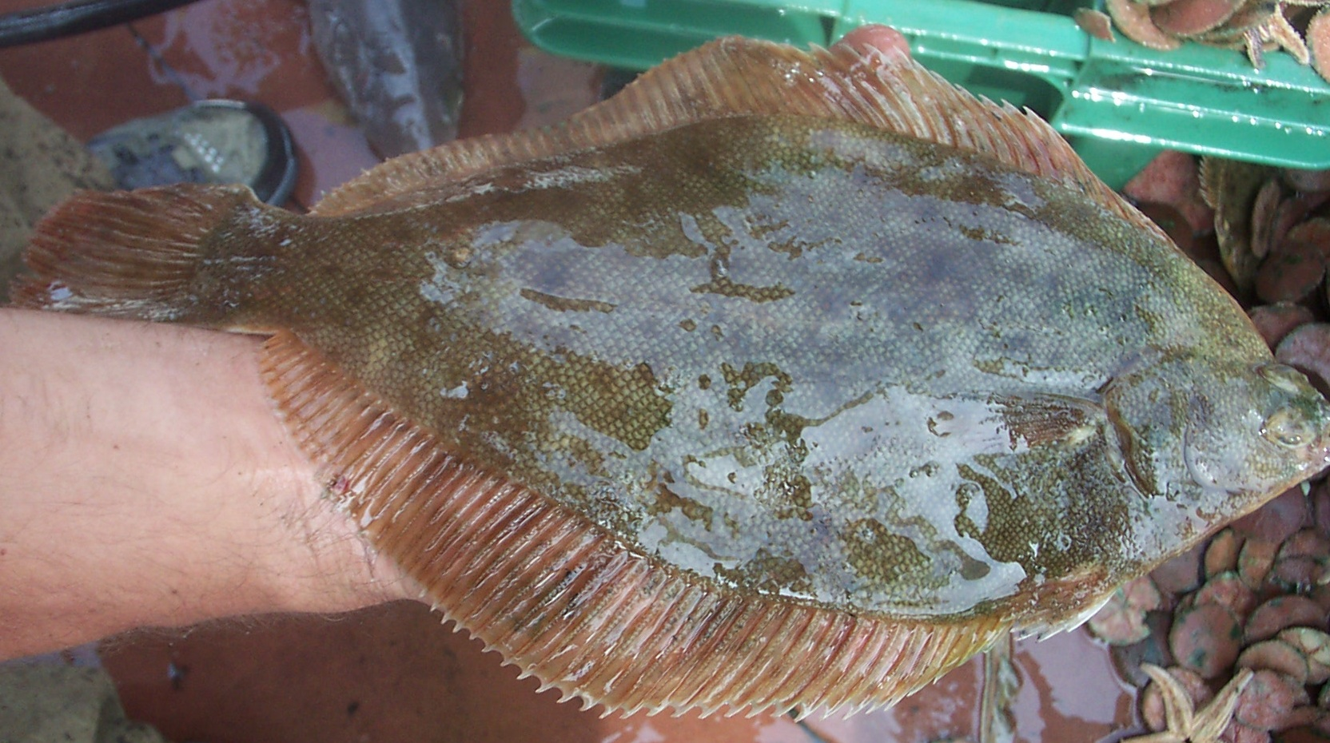
Common Catches
Will this year vary?

Slide 28
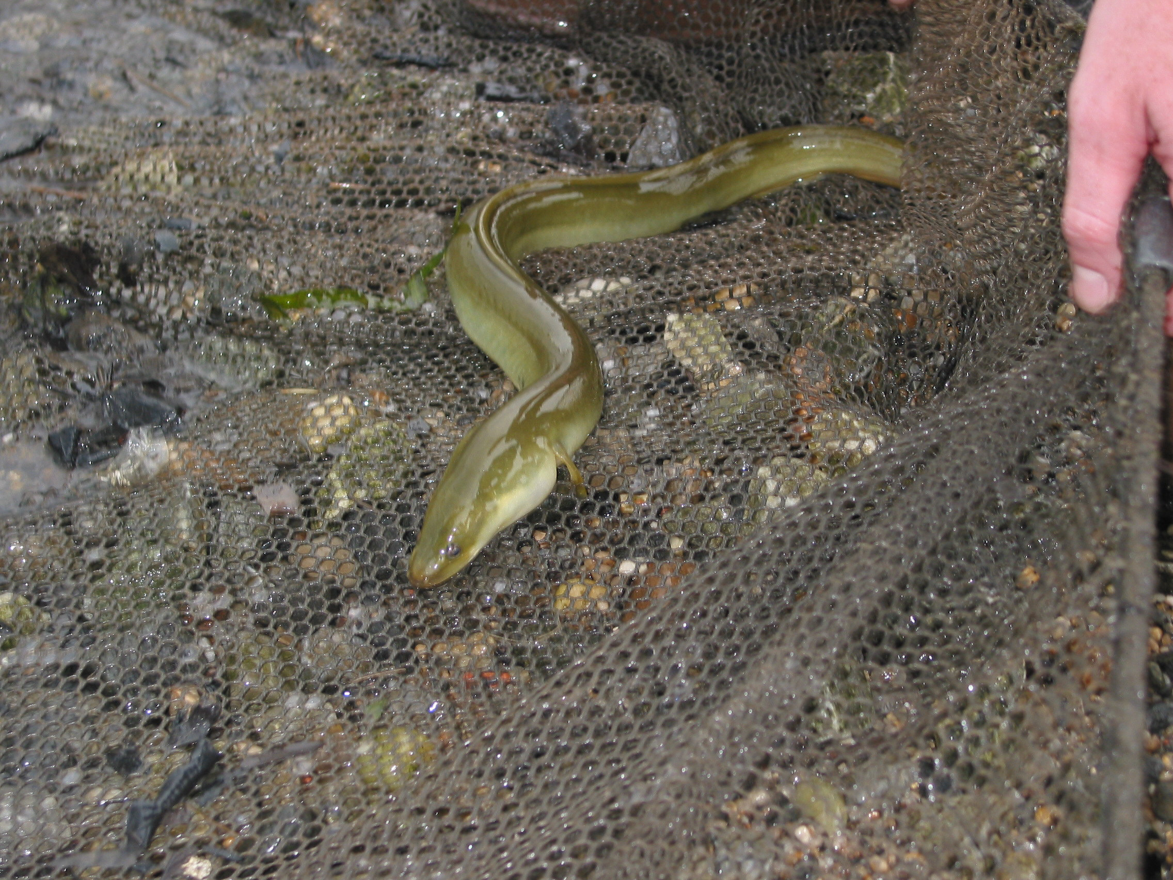
Identify, measure, count
American Eel
Striped Sea Robin

Slide 29
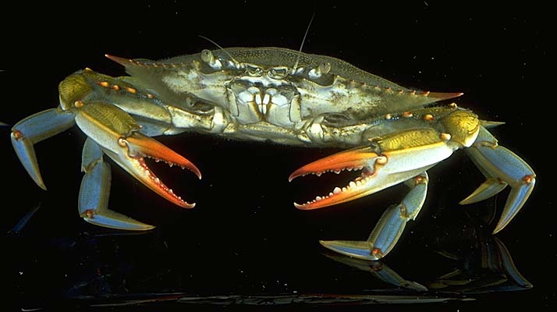
Do a little research on the variety caught in your section of the river River
Callinectus Sapidus or Blue Crab - The name means beautiful swimmer (yes they SWIM). Females carry their eggs down into saltwater section of the river to hatch and develop, males like the brackish section of the water but they can both be found up to the Troy Dam!
Notropis hudsonius or Spottail Shiner - First collected in the Hudson River - a freshwater river species.

Slide 30
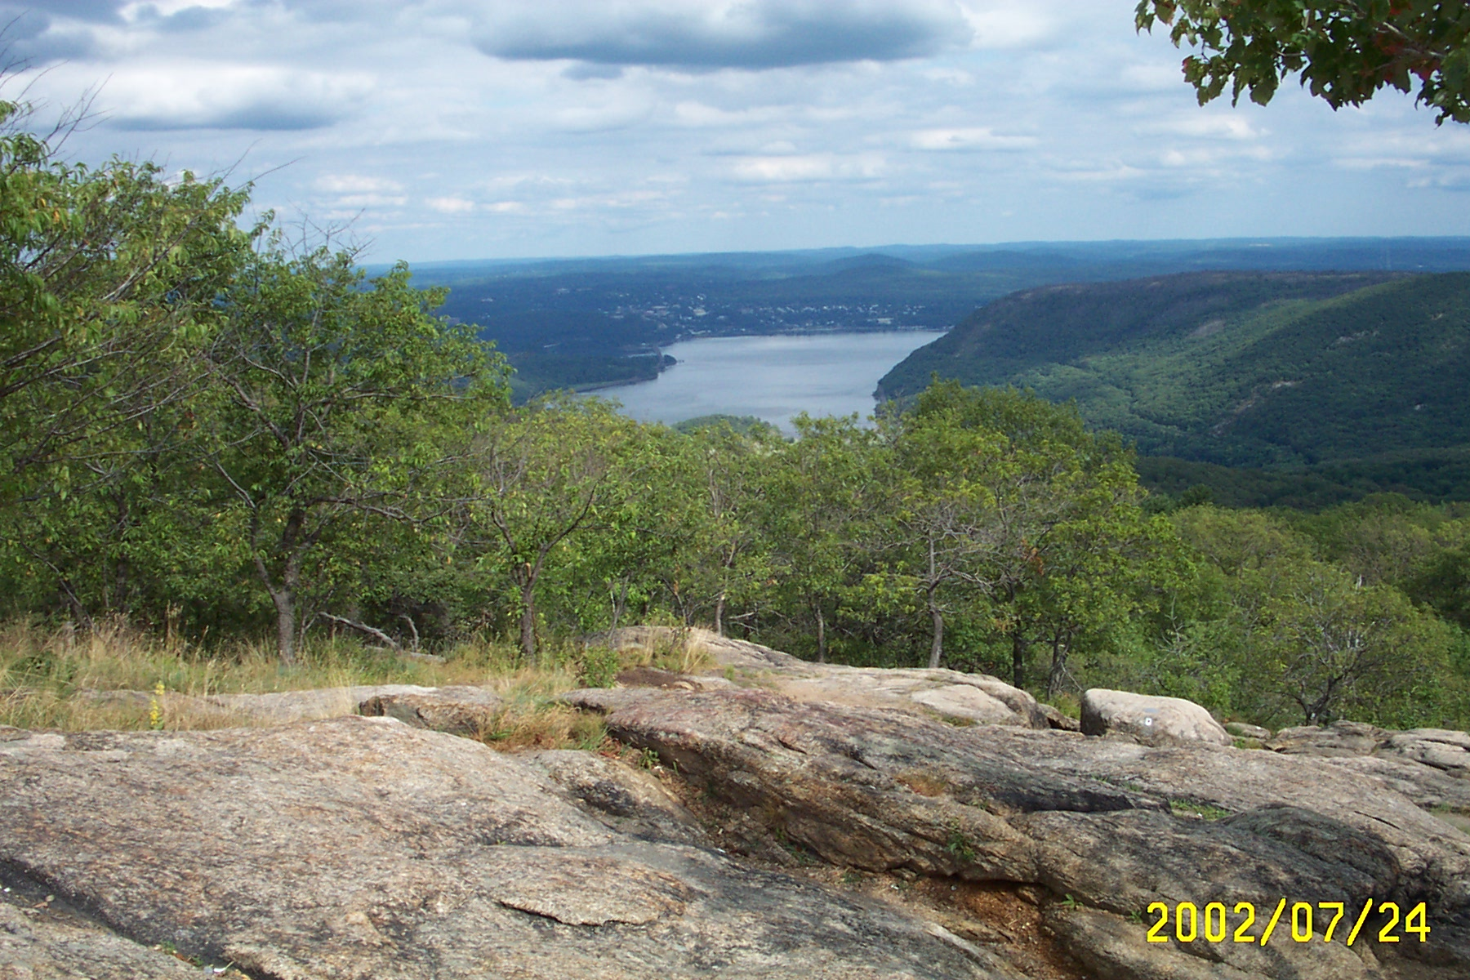
The river wasn’t always here. The trench or path for the river was carved through the rocks and hills by giant glaciers some tens of millions of years ago. The carved valley filled with water about 6,000 years ago as sea level rose and filled the low lying area.

Slide 31
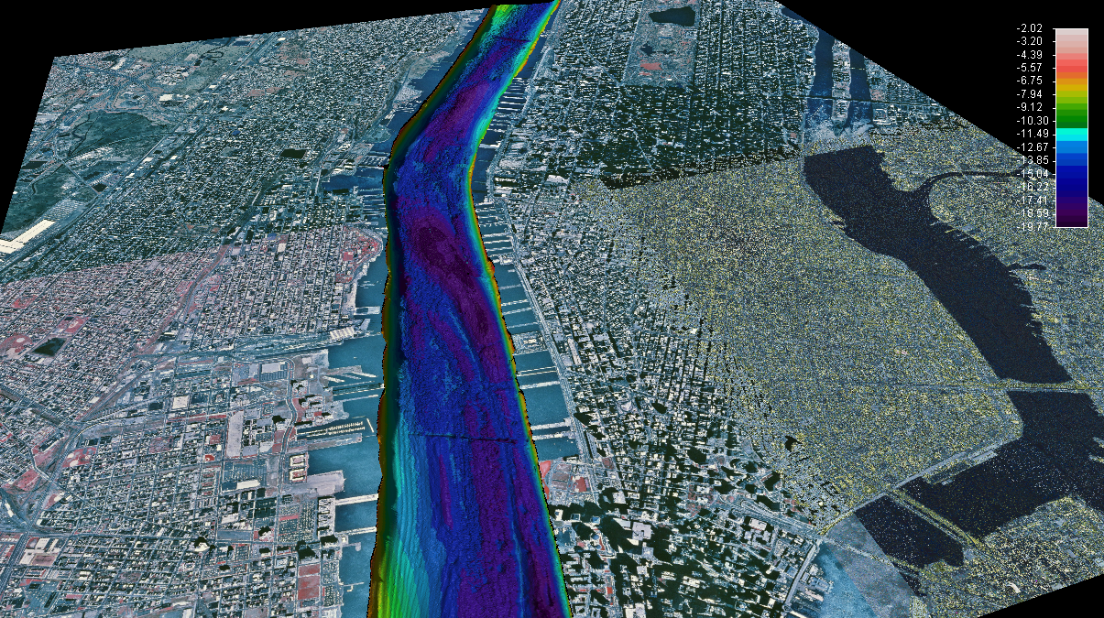



This is what the bottom of the river looks like -It isn’t flat and smooth. It has ridges and deep trenches where the glacier carved through. Now most of the river bottom is covered in soft sediments.
Man has also influenced the river bottom through dredging. The dark blue colors are deeper places in the bottom. Note the depth scale is in meters not feet. The river bottom depth and material can influence many items you will be testing. What impacts can you list?

Slide 32
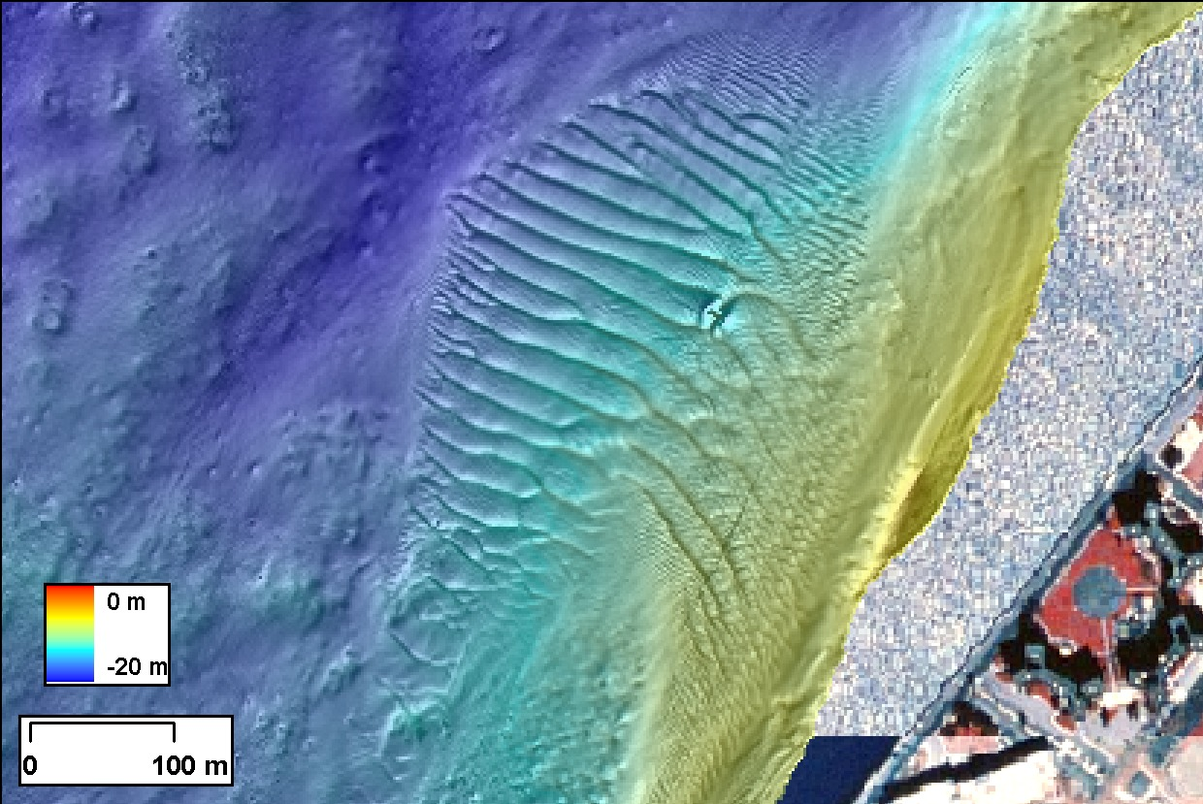
This is another image of the river bottom showing how the sediments can move like wave or sand dunes. Can you believe that many of these waves are 6 feet in height - taller than most of us!
This is a section of the Harbor. The bottom is dynamic - eroding in some areas but depositing in others. The top several centimeters of sediment can be constantly moving.

Slide 33
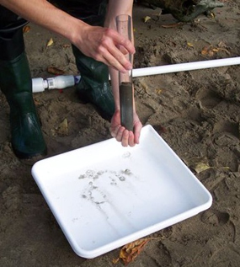
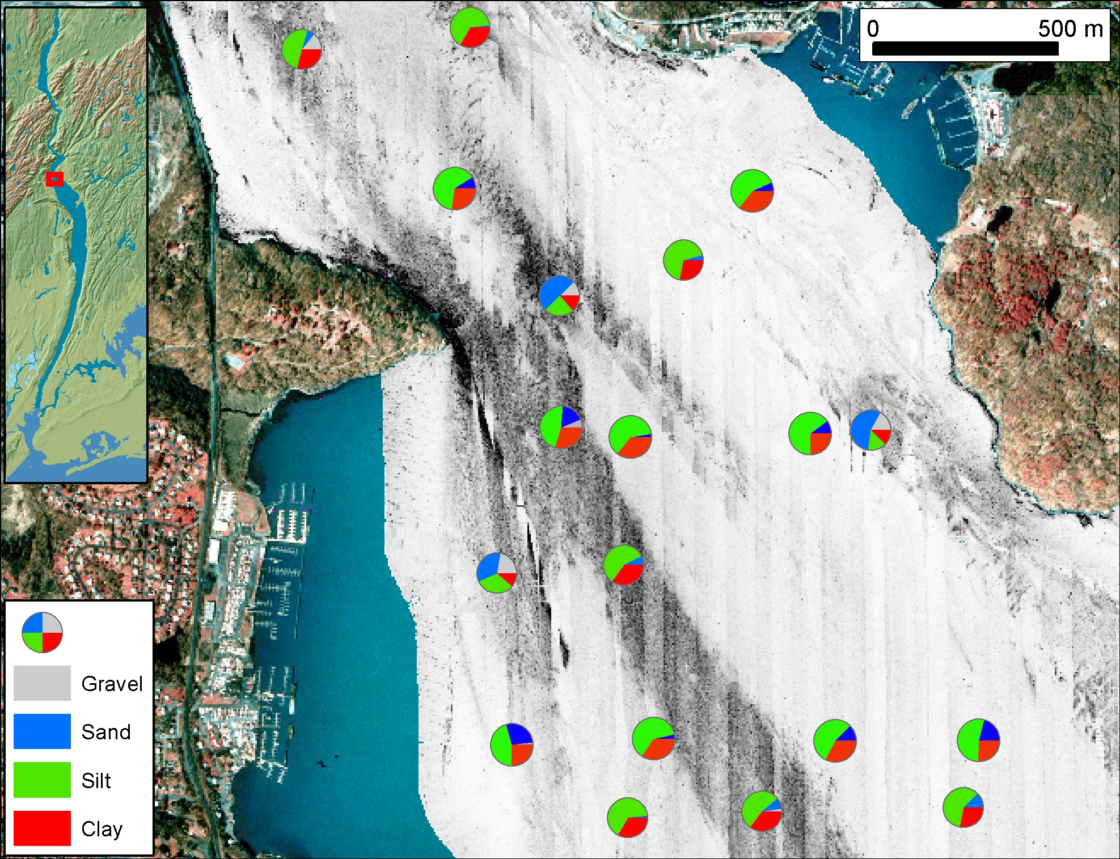
We are going to look at the bottom of the river by taking a small core
Cores are used to study the history of the river bottom & to describe habitats.
This is a little sediment core

Slide 34
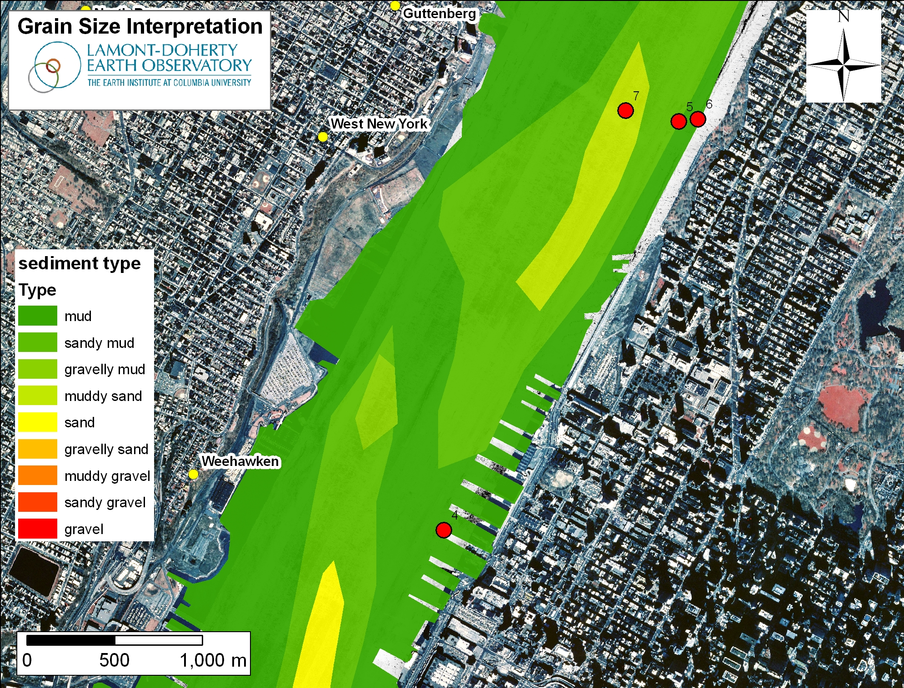
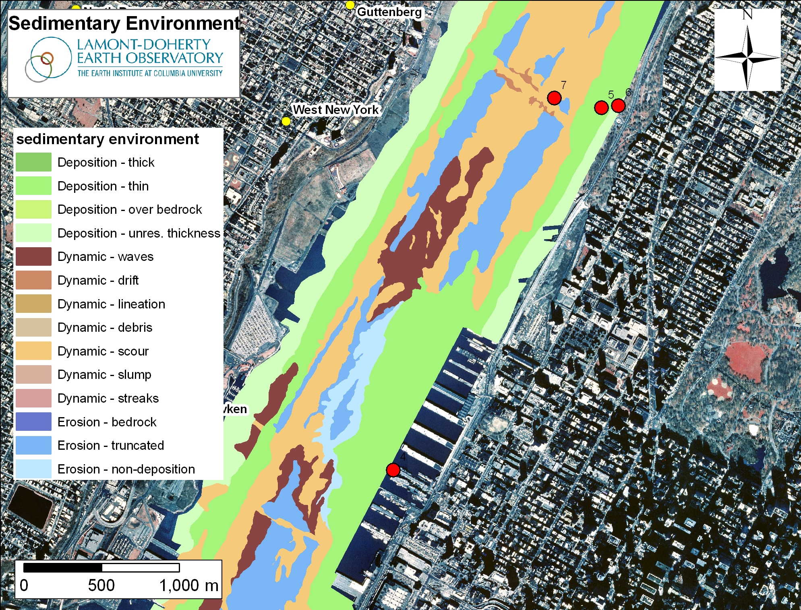
You will describe the sediments you collect.
Sediments enter the river primarily from the upper river tributaries & run off, although some comes in from the Atlantic coast.
Sediments suspend in some areas and settle & fill in other stretches.
In areas where the river slows, the sediments drop out of the water and settle making deep piles of soft sediment. Other sections erode and are hard bottomed
What about your area?

Slide 35
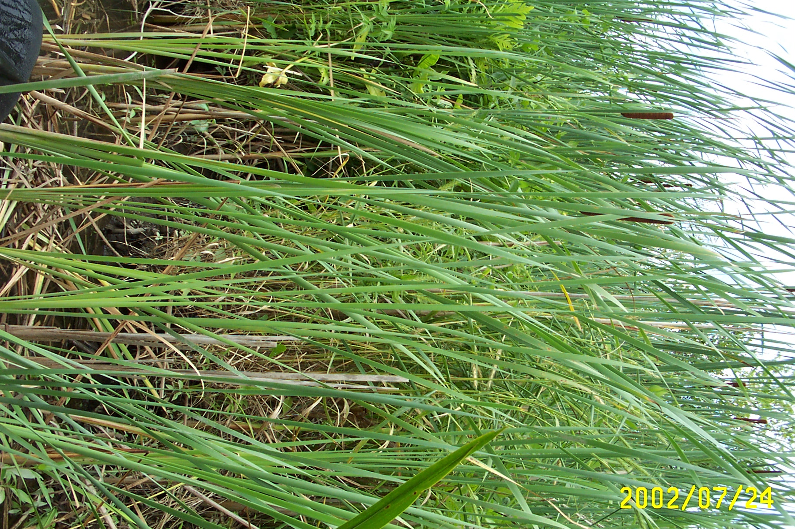
Physical Environments
Assess the Physical Conditions
• Marshes
• Docks
• Sandy Beaches

Slide 36
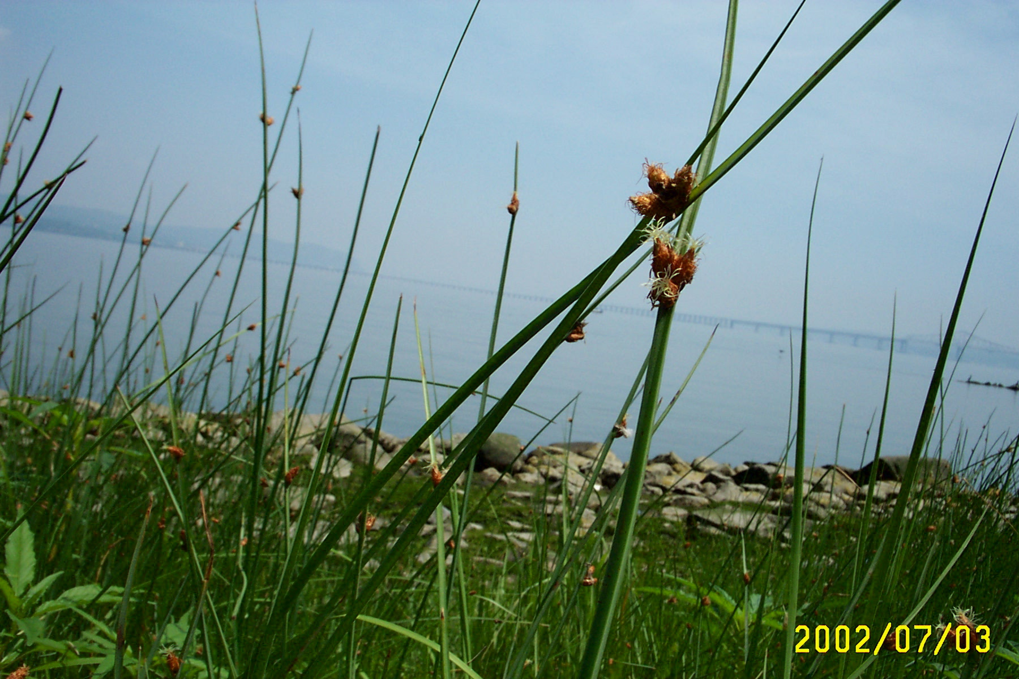
We will describe habitats and identify plants

Slide 37
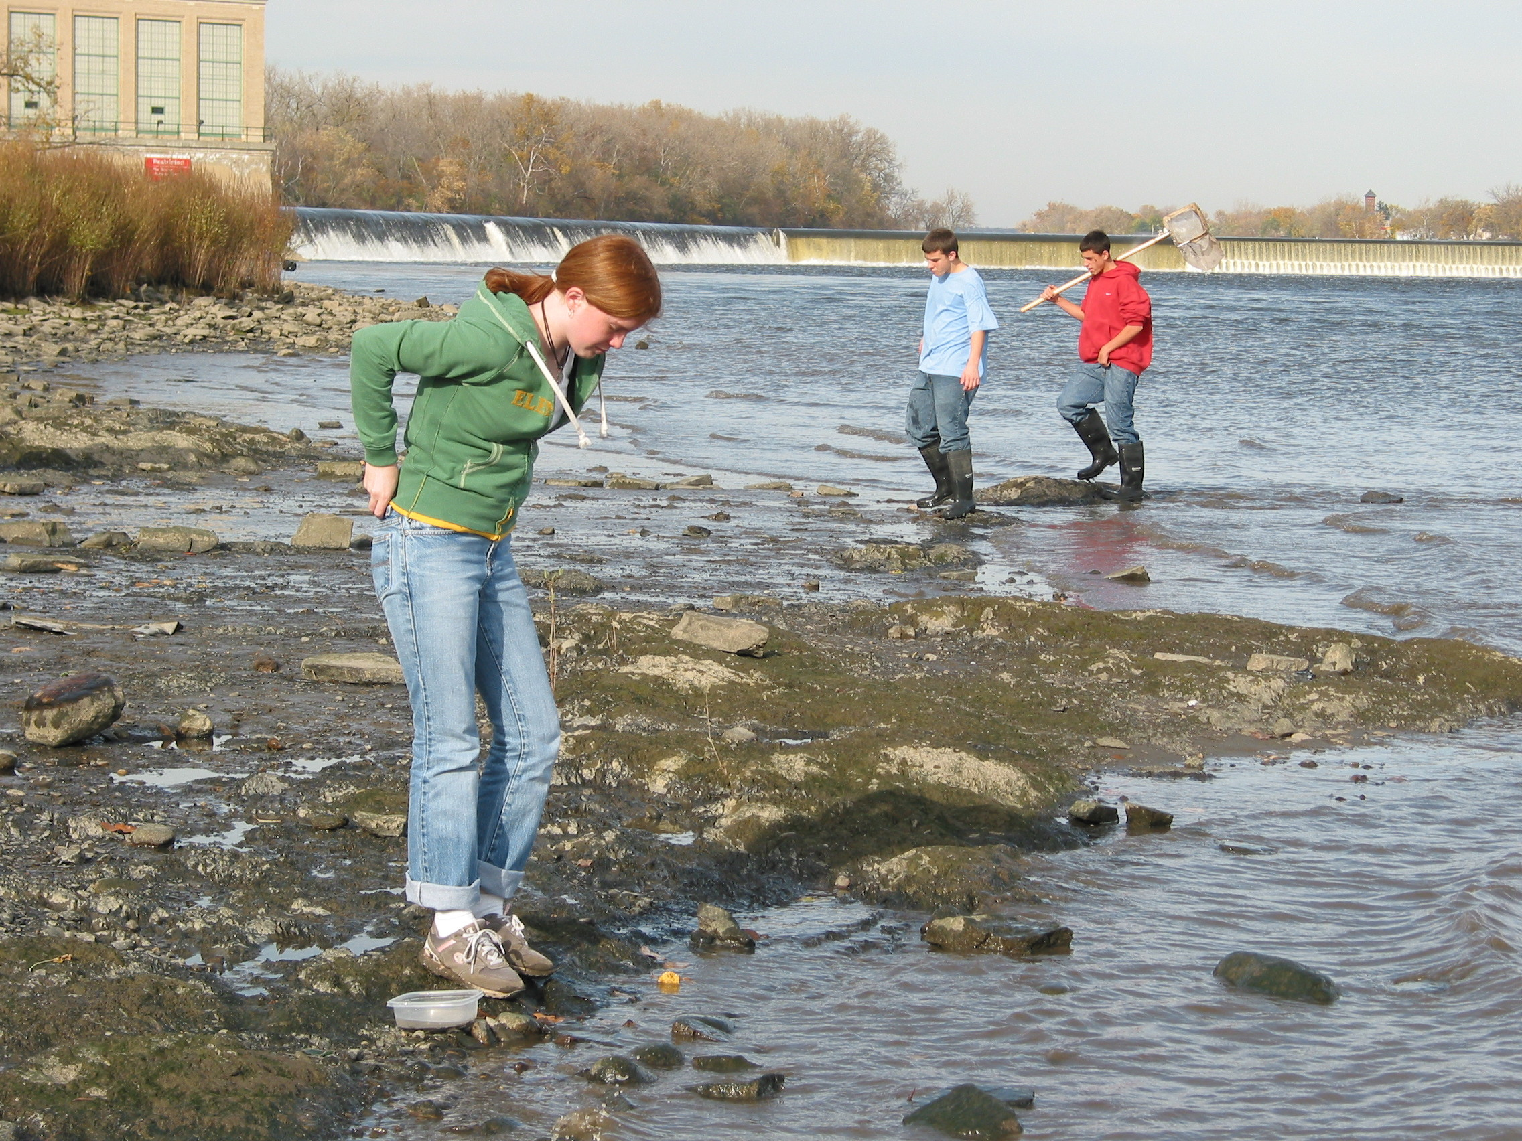
Describing your site lets other schools visualize it
It can also help in explaining some of your data.
This site is up by the Troy Dam at RM 153. Would we expect it to be salty or fresh water?

Slide 38
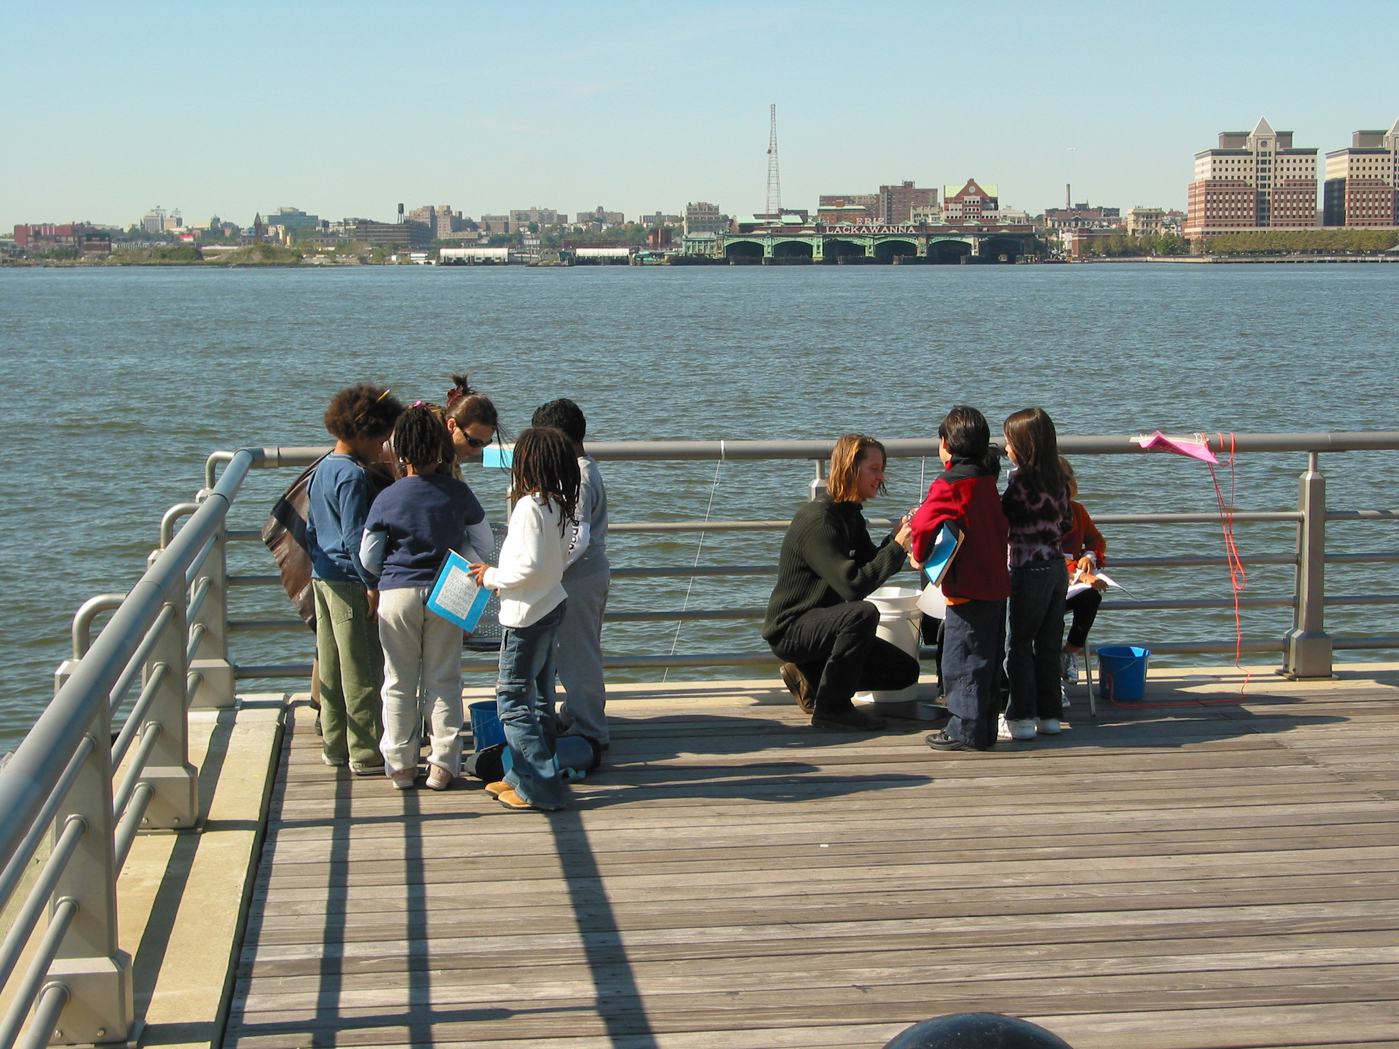
This site looks very different. This is at RM 6 in Manhattan. Would we expect this to be salty or fresh water?

Slide 39
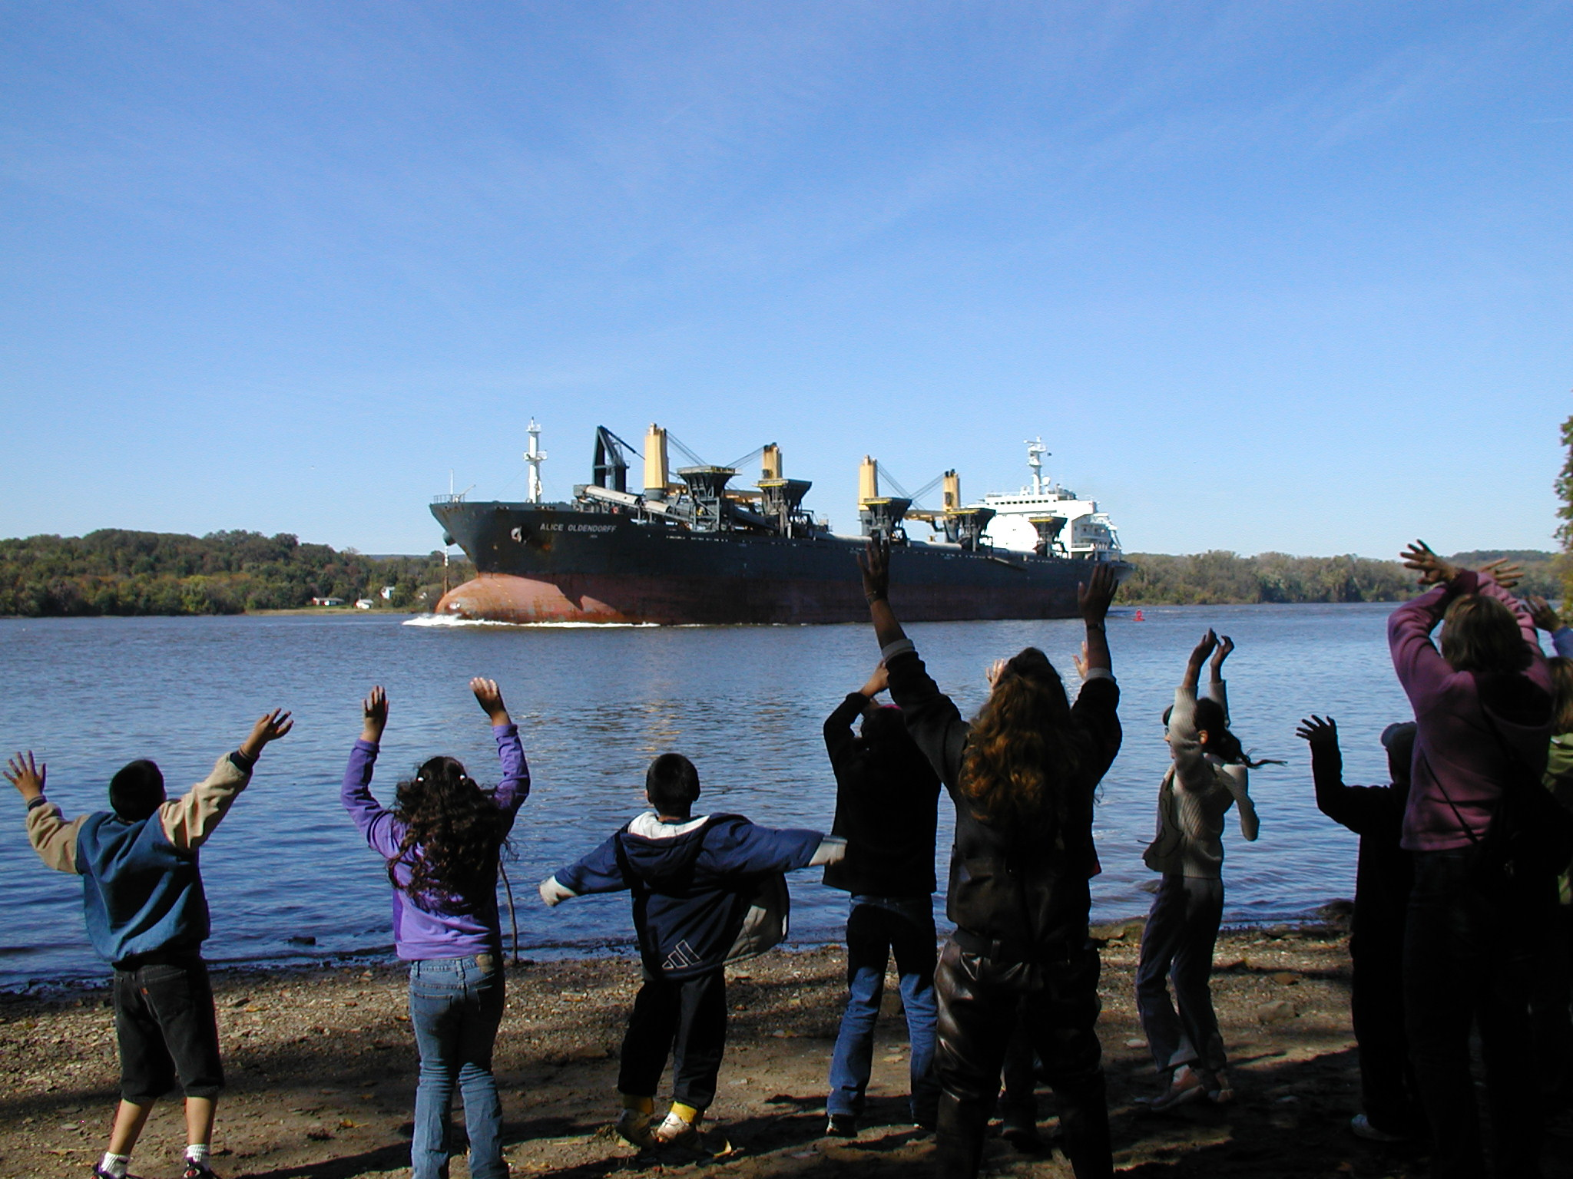
Shipping on the River
Tracking the activity
The river is still used as a main shipping channel. Track the ships as they move up and down the river.
Calculate the time it takes for a ship to move up and down the river by looking at the time it passes certain sites on the river.

Slide 40

Journaling
On your data recording sheets jot down observations about what you see and what might have influenced your findings...draw a sketch. This is scientific journaling, a key part of scientific data collection.

Slide 41
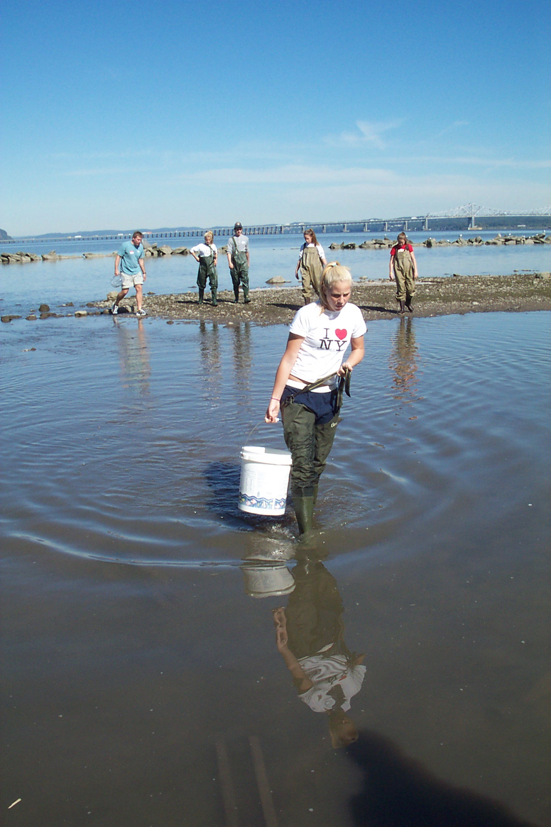
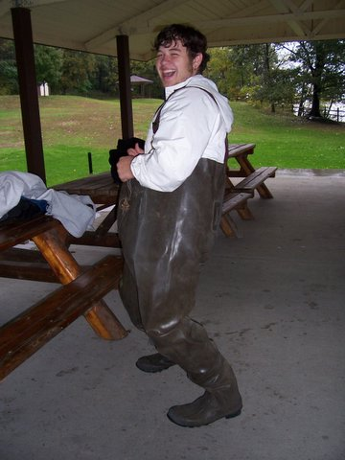
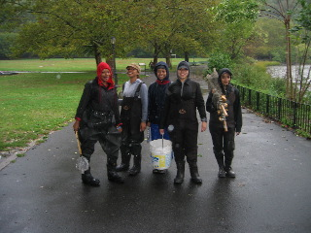
Check in and share your data!
This is the end of the slideshow. Click the back button to go back to the website..

