Slide 1
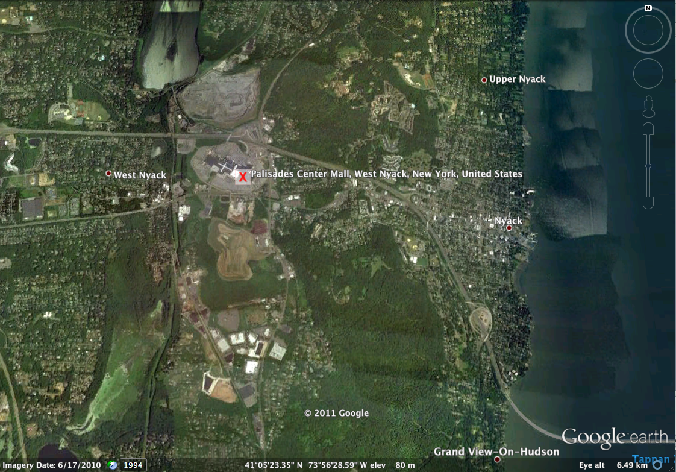
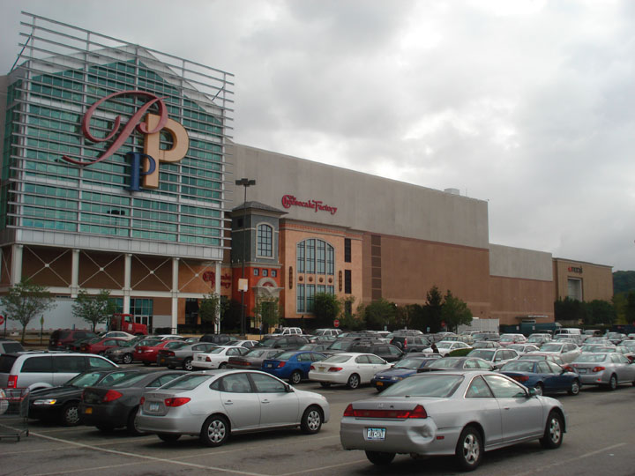
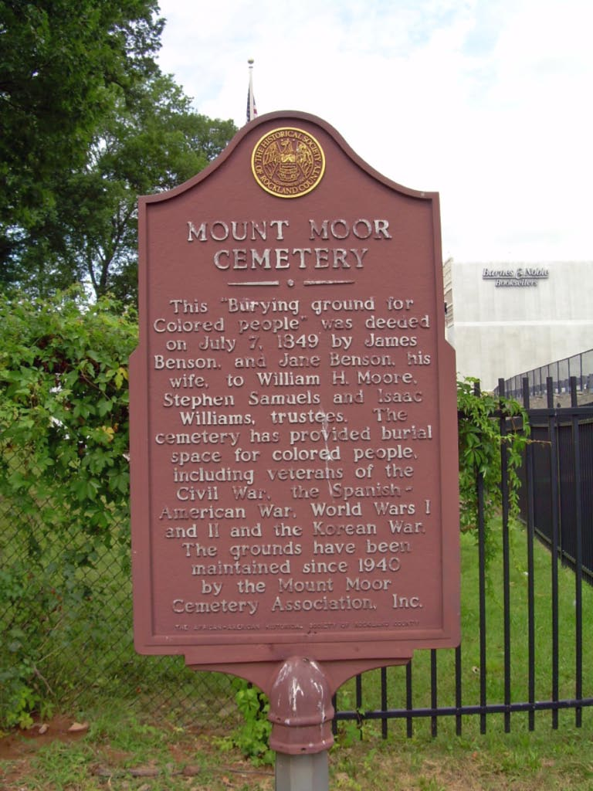
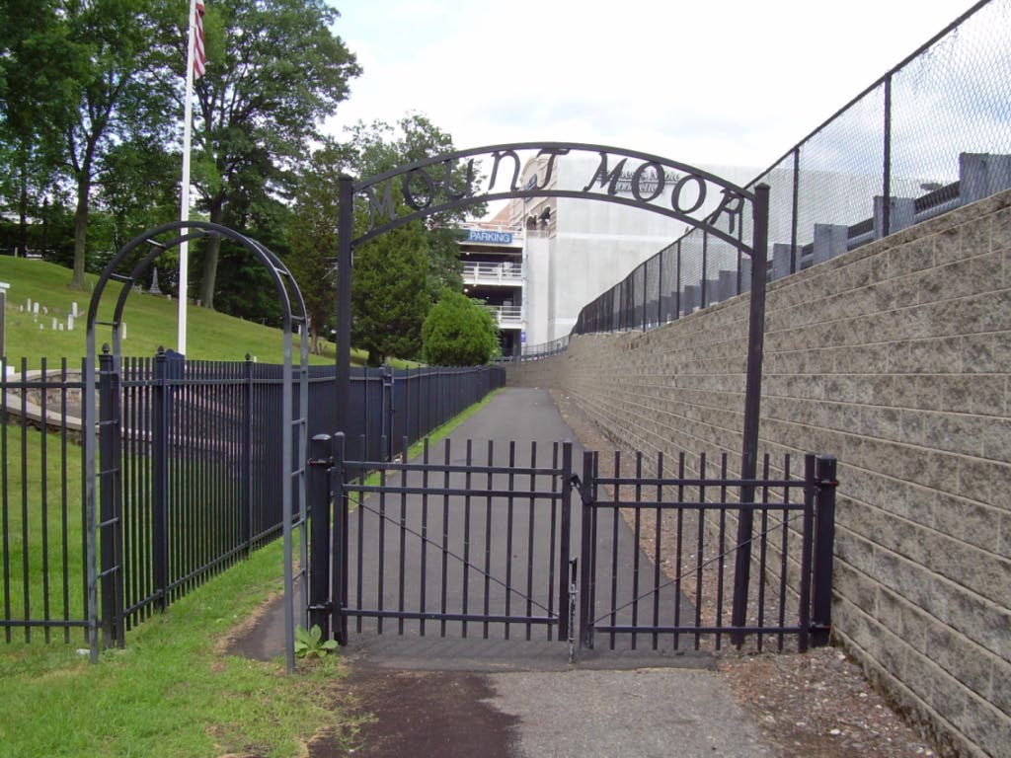
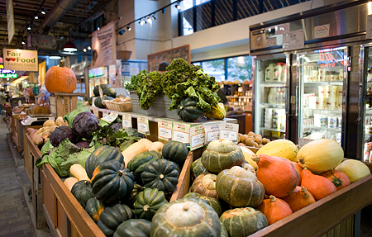
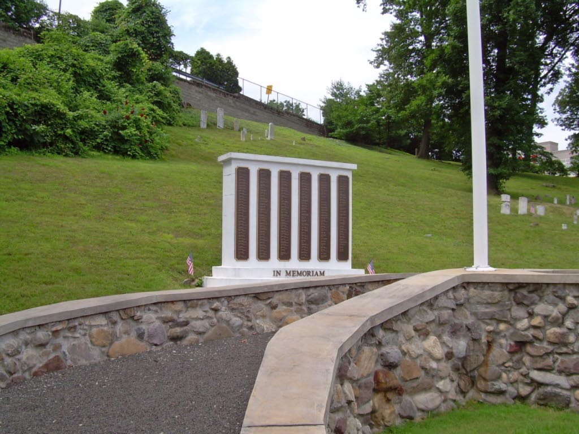
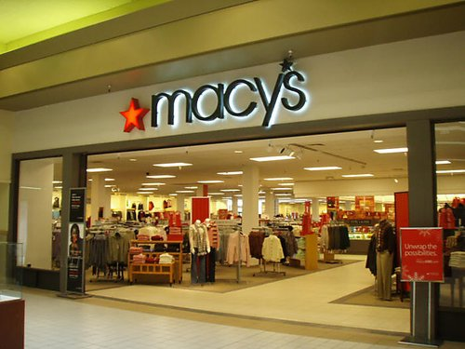
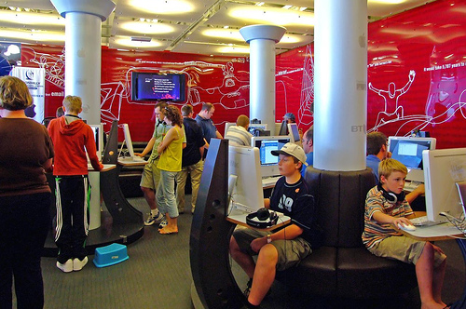
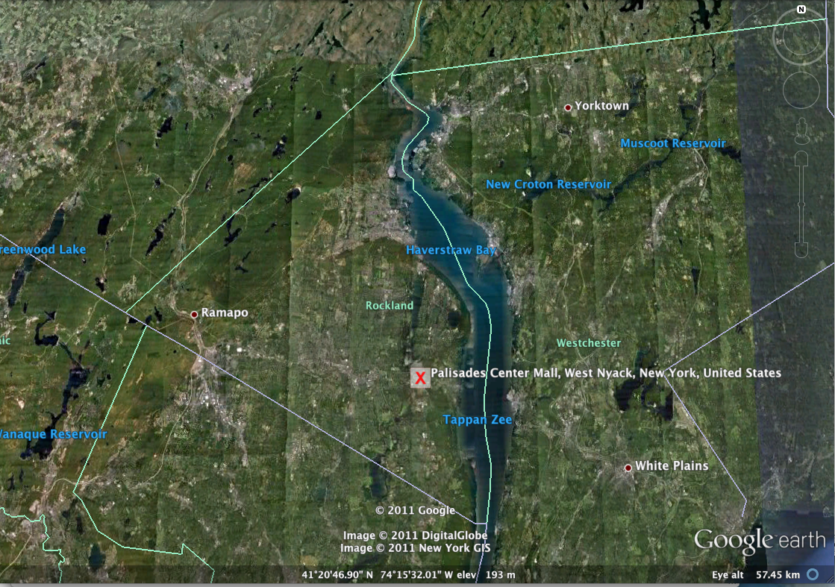
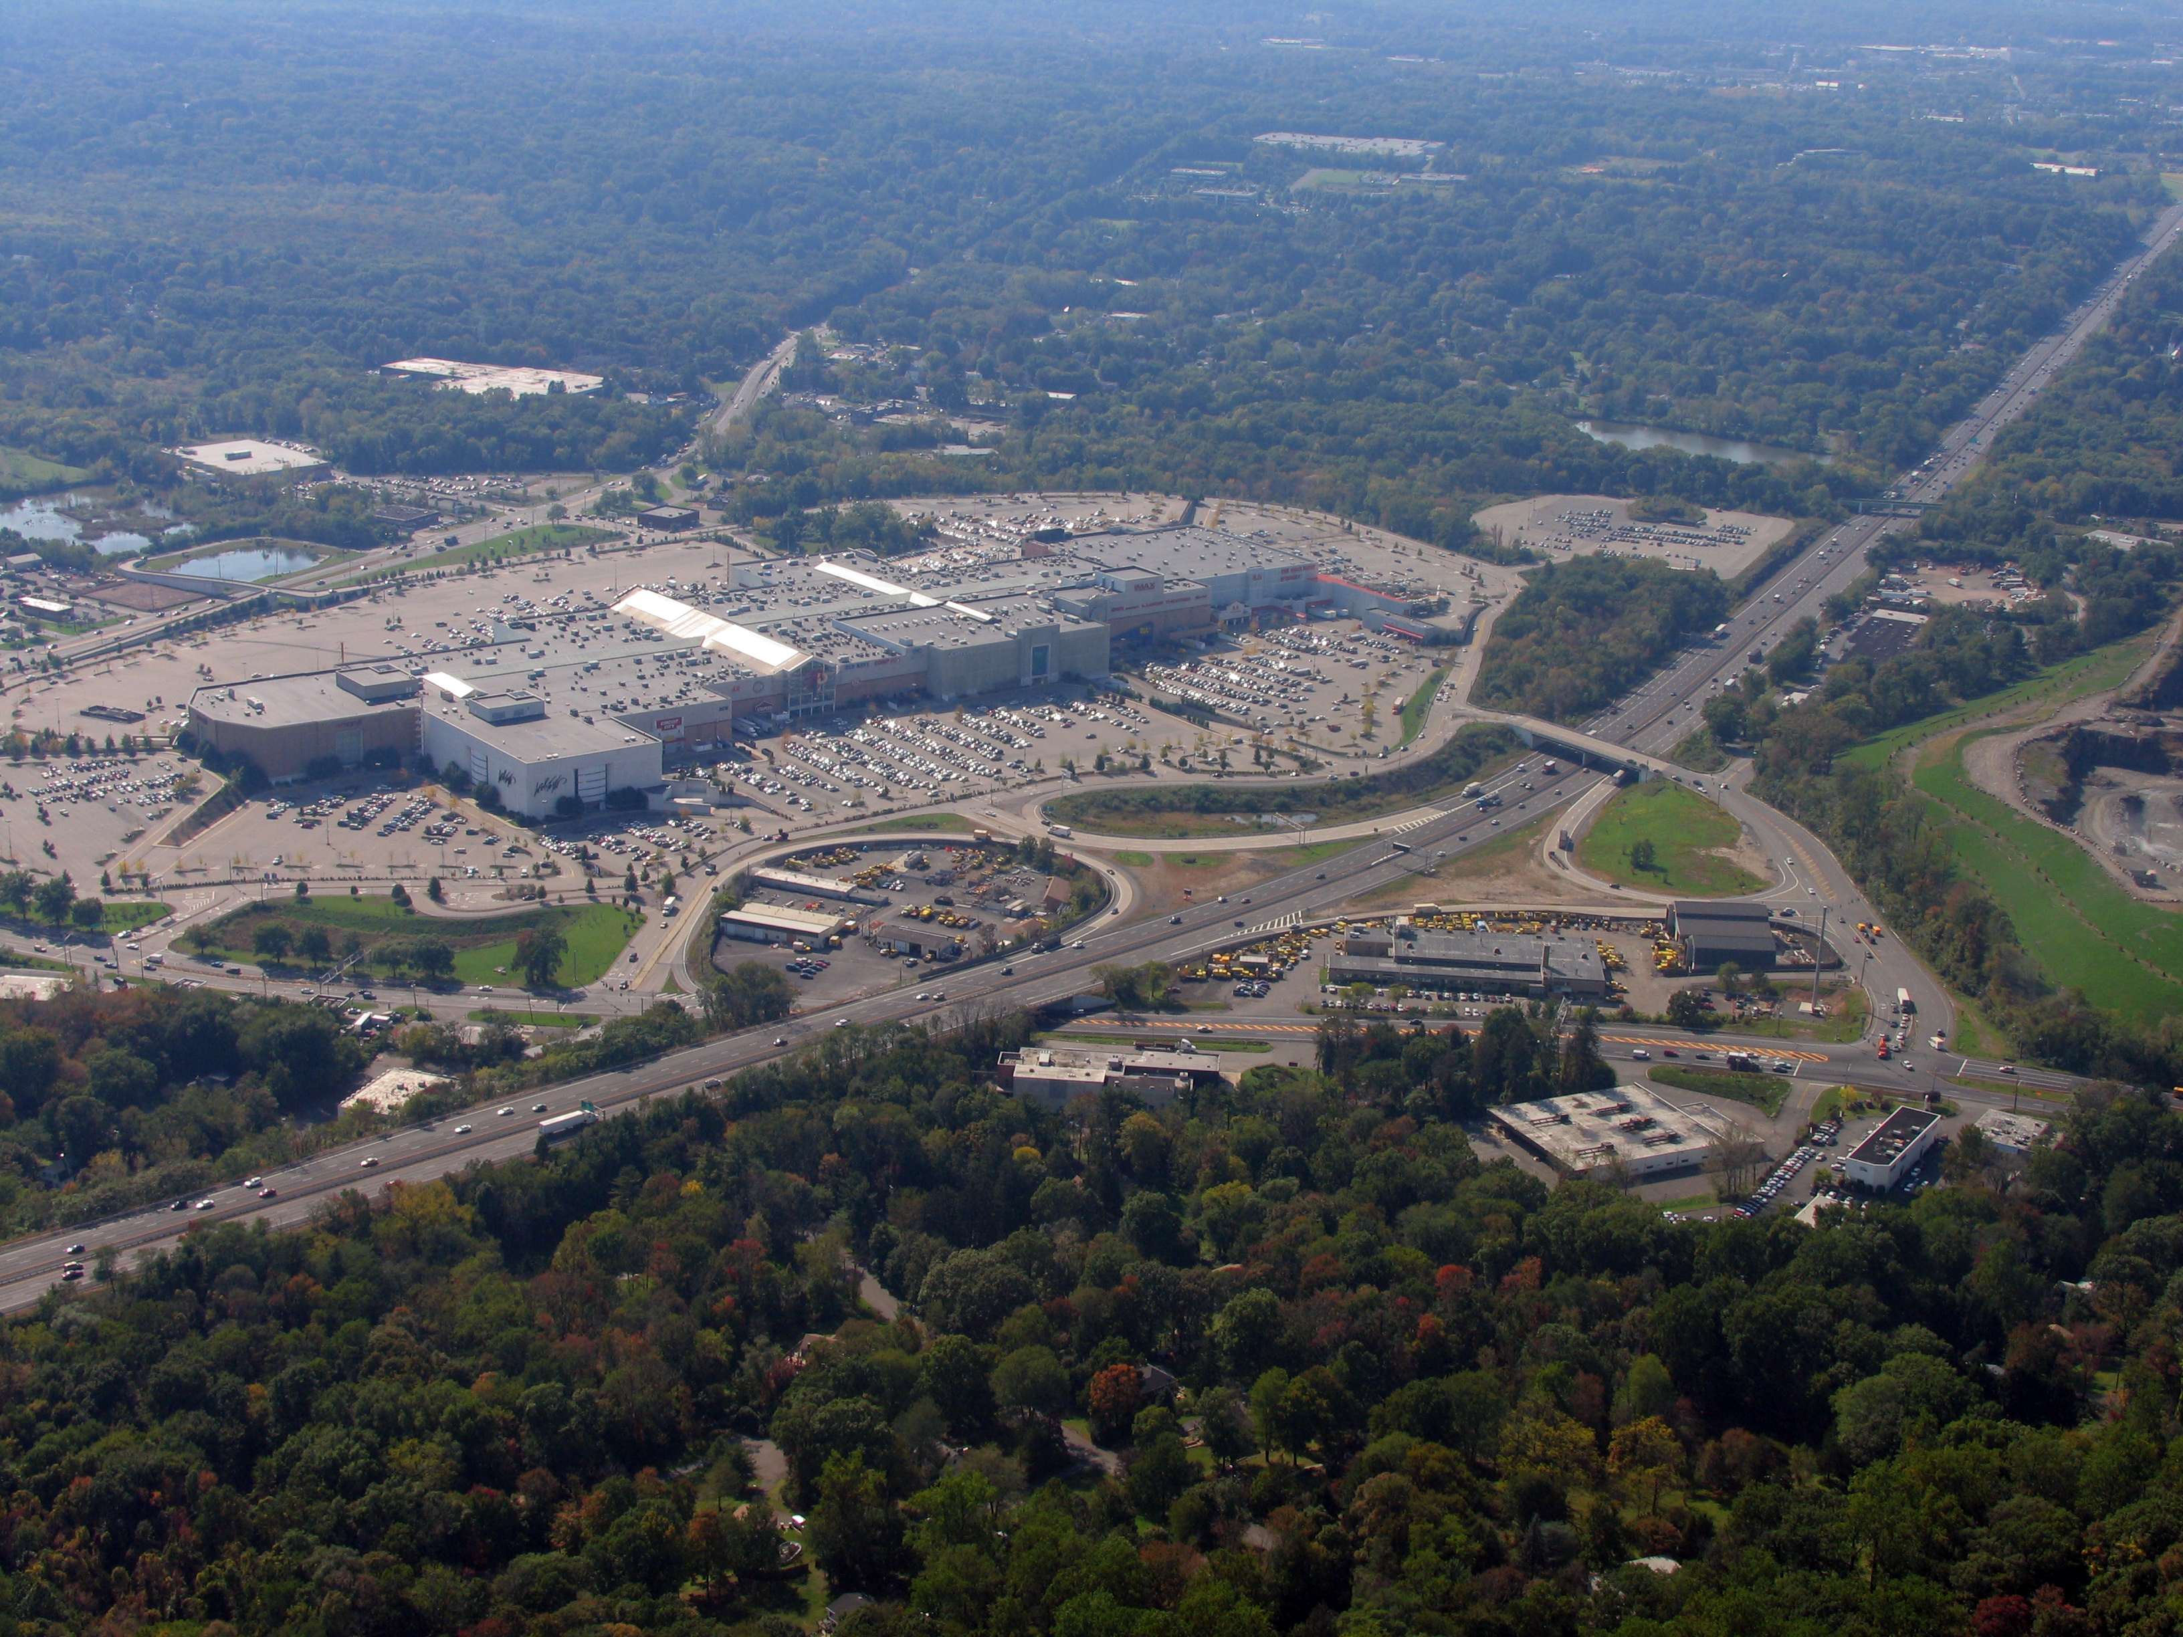
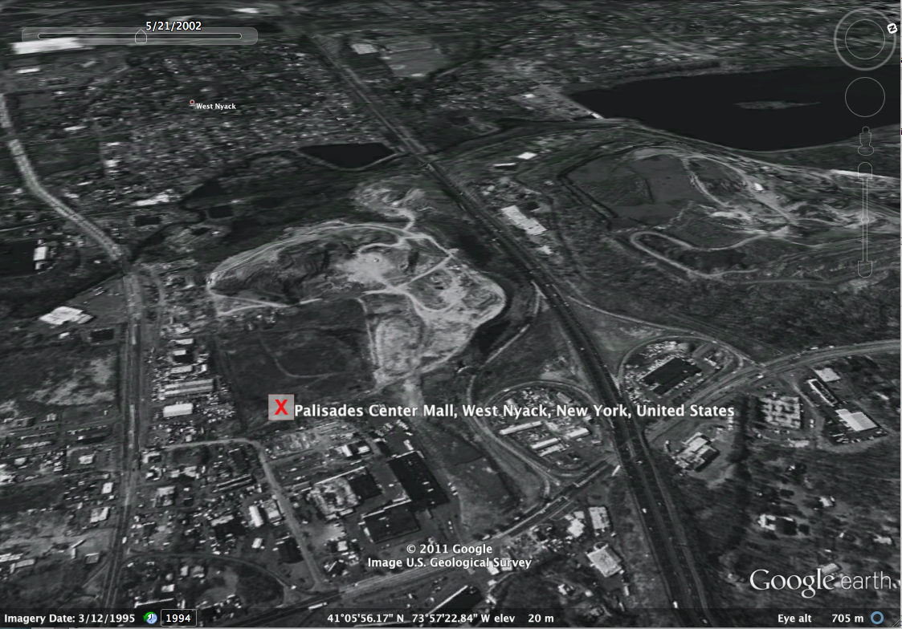
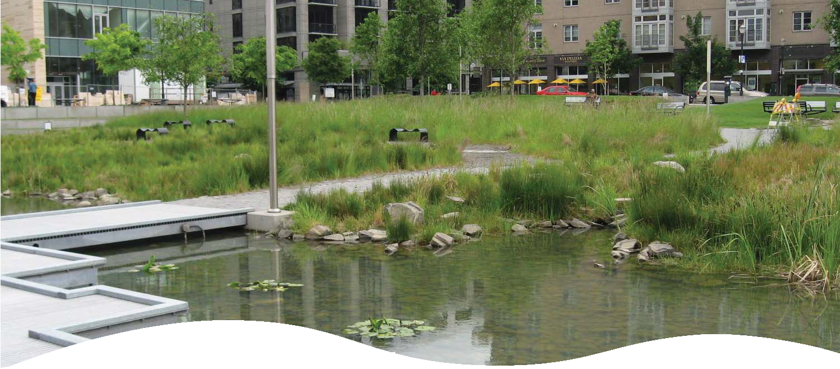
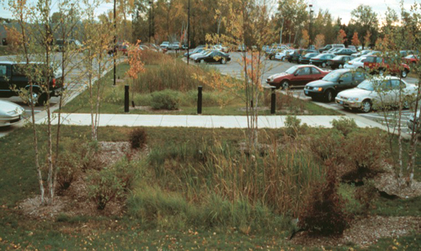
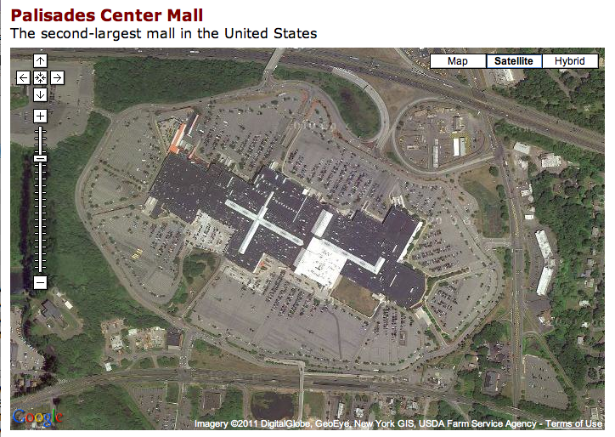
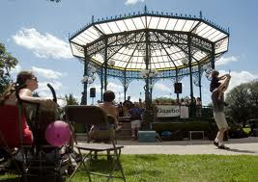
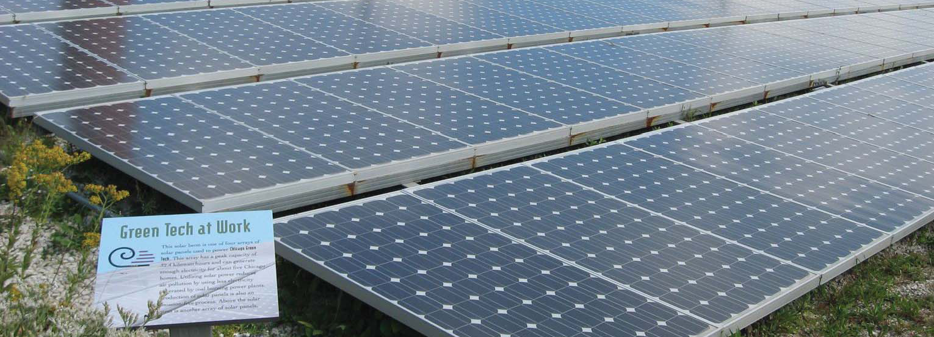
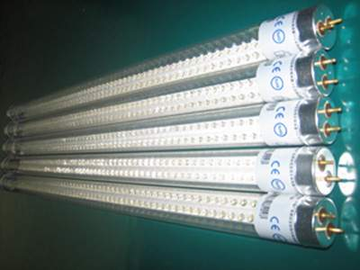
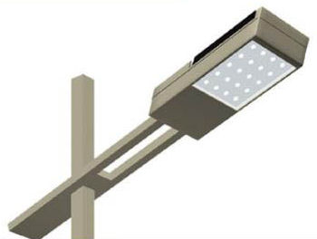
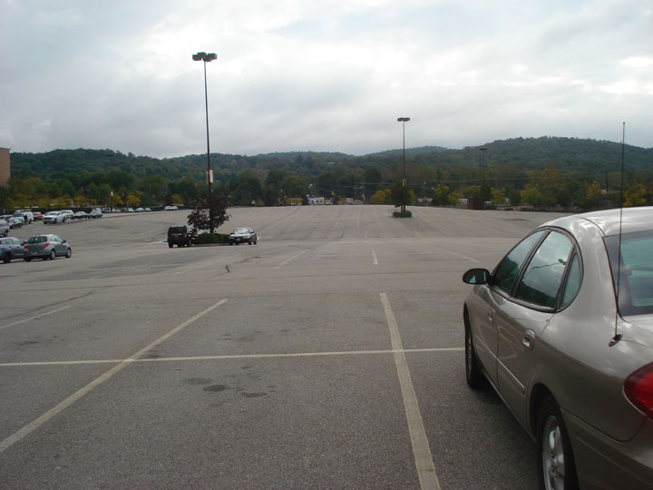
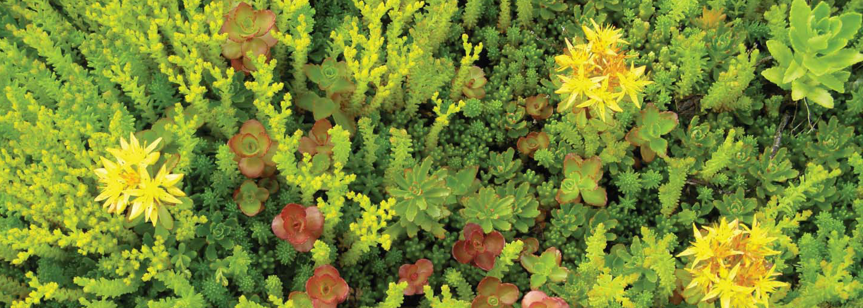
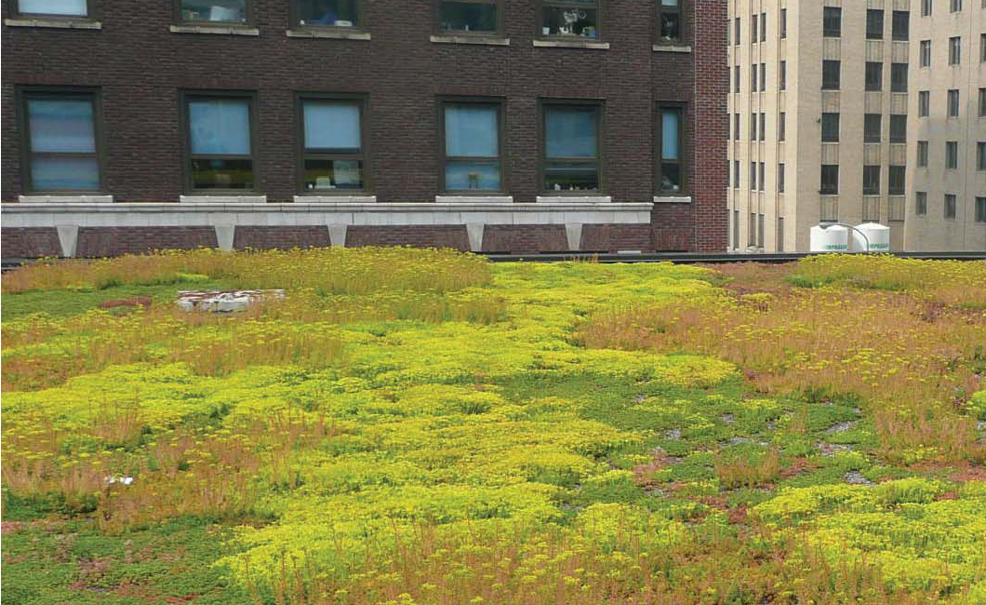
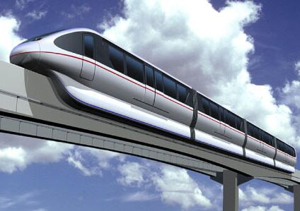
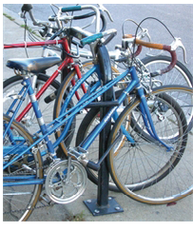
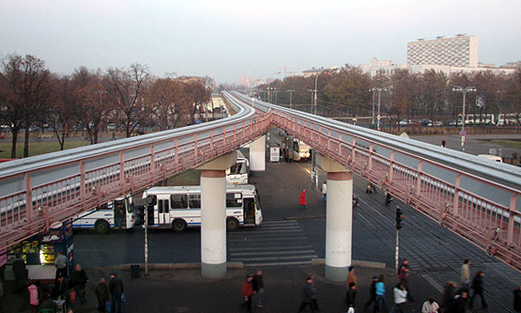
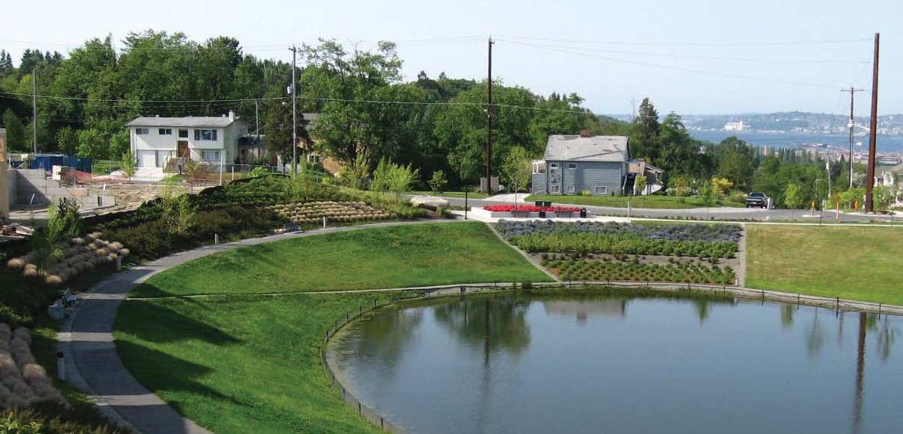
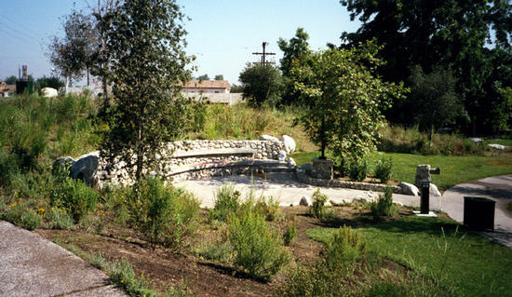
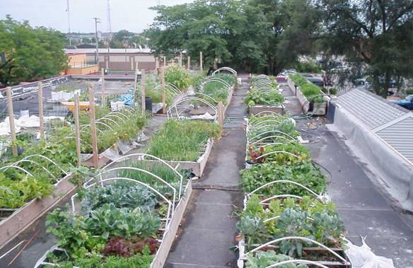
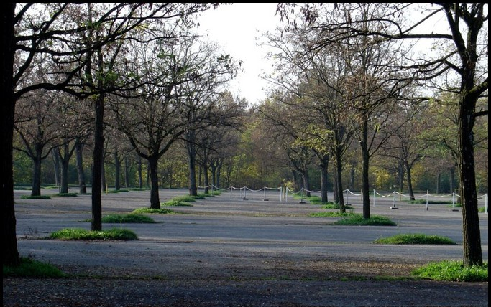
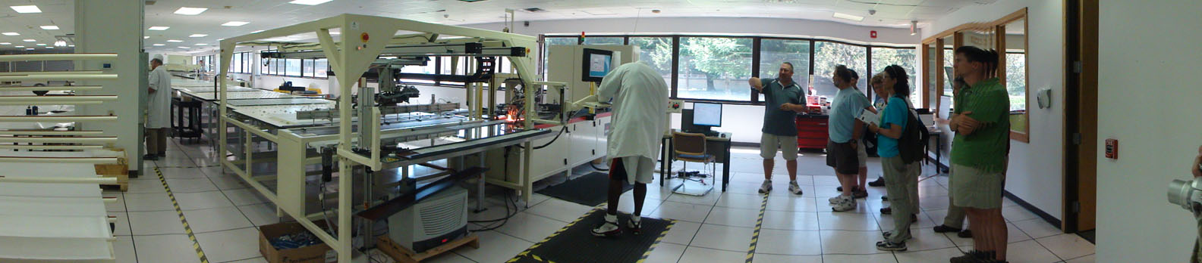
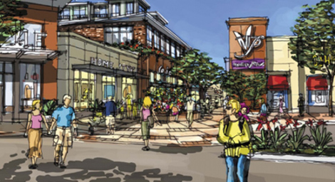
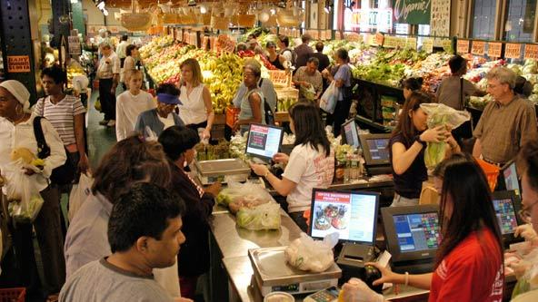
Convert Palisades Mall into the ‘Palisades Community Hub’
LDEO/KRB School
The Site Plan
DeForest Reservoir
Hudson River
1st floor – Year round farmer’s market, with local foods including dairy, honeys etc. Format like the Philadelphia Farmer’s Market
& locally owned businesses
Active Tilcon quarry site
Transfer station site
2nd floor – existing anchor stores & a selection of existing retail vendors.
IMPORTANT EXISTING SITE FEATURES: High community visibility, central location, historic Moor Cemetery, large footprint to work with, needs water treatment to assist with flooding, would benefit from outdoor greening and reduced paved areas, source of jobs, goods and taxes.
3rd floor – Mix of restaurants, somewhat like a European plaza; mix of spaces
For all ages – senior center
working with RSVP for senior
lunch program with local foods;
teen creative hang out, Americorps satellite center and a service learning center.
WHERE IS THE SITE: Palisades Mall, West Nyack, Rockland County, NY. Easily accessible in the County; and a large footprint visually. Photo # 3 is from prior usage as a dumpsite from the 1990s.
Economic
Environment
Social
Sustainable Planning Points
Light industry in old frontage space.
4th floor – residential housing with solar, skylights, rooftop gardens – 15% affordable housing.
GREEN FEATURES/LEED INCLUDED ITEMS: Energy - solar for the fourth floor units, LED lights in the parking lot and interior; Greening the parking lot with trees and outdoor features, reduce flooding with rain gardens, planter beds; Transportation – reduce car dependence and parking lot space with biking, walking trains and monorail.
STAKEHOLDERS WOULD INCLUDE: Rockland Farm Alliance, Youth Bureau & Rockland County Americorps, Town of Clarkstown, Housing Senior Corps Volunteer Group.
MITIGATIONS: Existing issues on the site mitigated through this proposal: Reduce paved area to decrease run off and flooding; Add plantings to reduce heat island; added local foods & business; Created a community hub.

