Slide 1
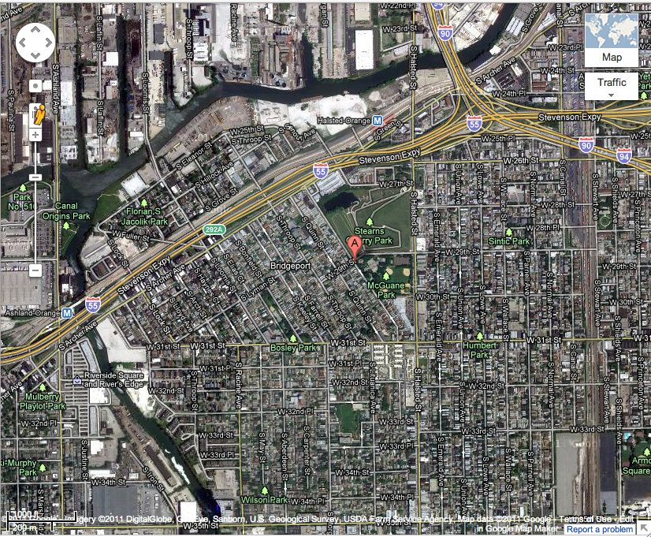
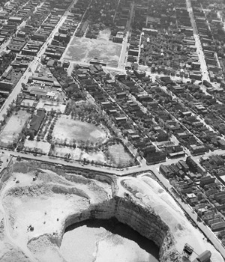
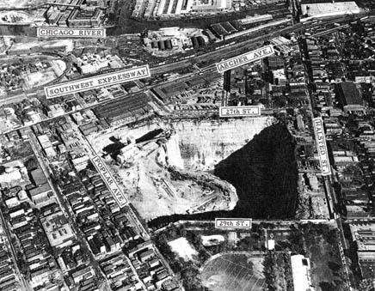
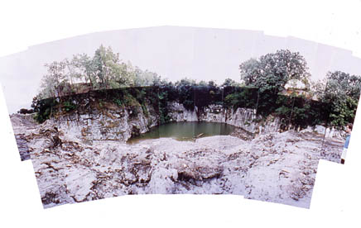
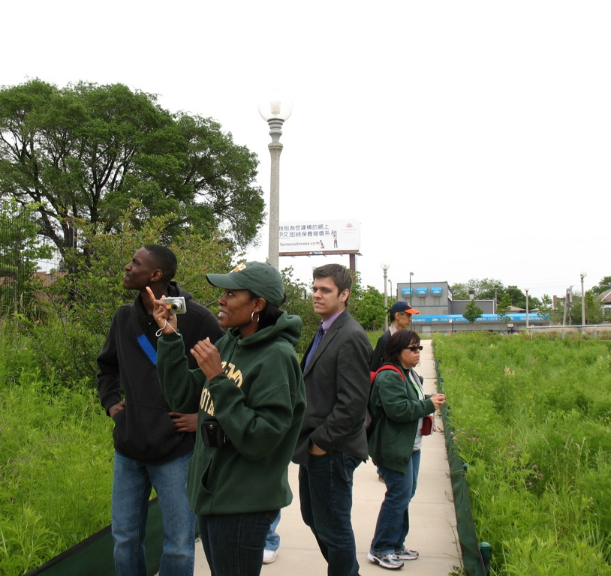
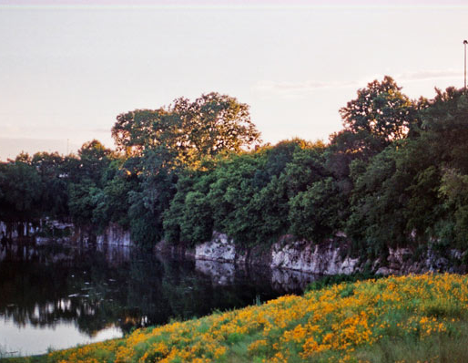
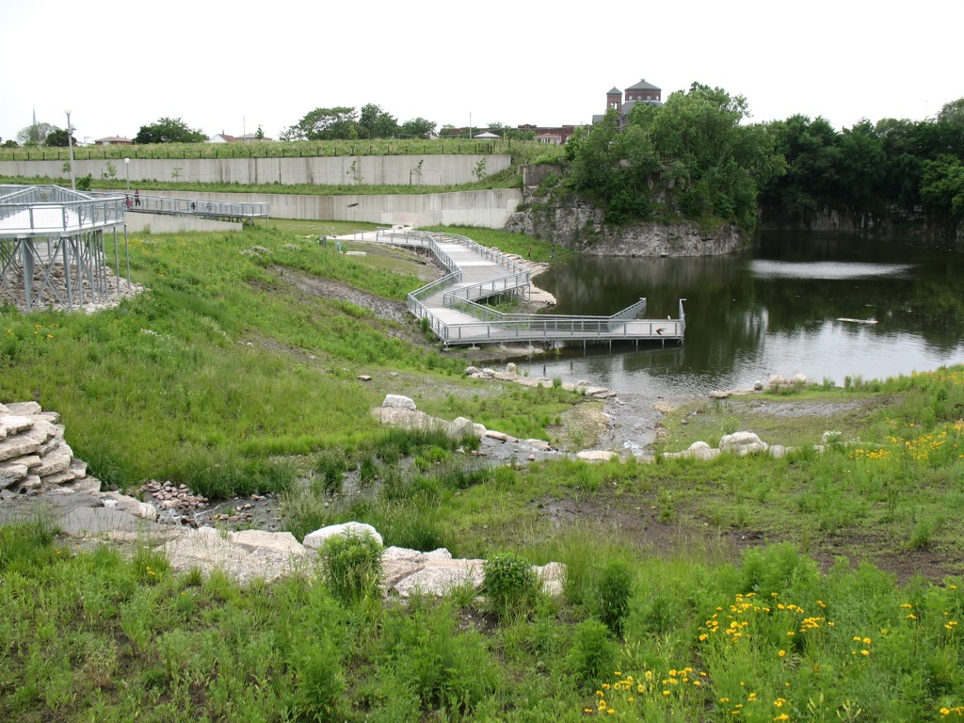
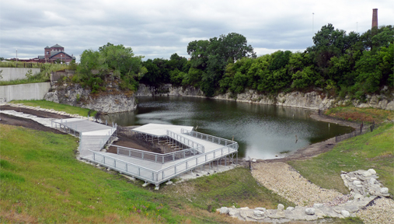
Stearns Quarry, LDEO & KRB Sample Project Poster #2
MAP: 27-acre Stearns Quarry Park opened in 2009. From 1833-1969 it operated as Illinois Stone & Lime Company, and then was a municipal landfill from 1969-1974 with brick, gravel, dirt and construction debris deposited here filling the hole excavated by the mining operations.
Sustainable Planning Points
IMPORTANT EXISTING SITE FEATURES: The quarry is part of the history of the community – part of their identity. These photos, from around 1935, shows a quarry right in the middle of a densely developed area in various stages of use and impact. Perfect placement for a wildlife or park area.
Economic
Environment
Social
GREEN FEATURES/LEED DESIGN: Walkability: The park includes walkways and bikeways throughout – with a focus on walkability. Native Plants: Native wildflowers and prairie grass plantings are included in the landscape design, improves water usage and attracts a diverse array of birds and related wildlife which supports biodiversity. Recycled Materials: Boardwalks & wetland areas were made of recycled plastic & wood.
MITIGATIONS: Since this was once a dump, 40,000 cubic yards of topsoil were needed to be brought in to the site before project development. A stormwater containment system was constructed to catch and treat water before channeling it into the park’s wetlands and pond with terracing to slow the water movement. Intensive planting was done to reestablish habitat on the site.
The park design includes a fishing pond and fountain, athletic fields, running paths, a hiking and sledding mound, public event space, native plantings and related birds and wildlife, and an exhibited collection of 400 million-year-old fossils of aquatic animals in a densely populated downtown area. Old quarry is terraced in so you walk down to its new use as a pond with ducks and geese.

