Slide 1
Temperature & heat waves (part 1)
Olivia Clifton
Sept 22, 2014
Extreme Weather and Climate
EESC G9910 Fall 2014

Slide 2
SREX 3.3.1 Observed & Projected Changes in Weather & Climate Extremes: Temperature
temp extremes (e.g. heat waves and cold spells)
related impacts: human health, physical environment, ecosystems, energy consumption
often occur on weather time scales
to assess possible changes accurately need daily or higher time scale resolution
important to distinguish among daily mean, maximum (i.e. daytime), minimum (i.e. nighttime), cold and warm extremes
different impacts

Slide 3
SREX 3.3.1 Observed & Projected Changes in Weather & Climate Extremes: Temperature
heat waves
generally caused by
quasi-stationary anticyclonic circulation anomalies
or atmospheric blocking
and/or land-atm feedbacks
can act as amplifying mechanism through reduction in evaporative cooling
can also induce enhanced persistence due to soil moisture memory
snow feedbacks and (possibly) changes in aerosols are relevant for temp. extremes
trends (obs. or proj.) in temp. extremes are sometimes different for more extreme temperatures & less extreme events

Slide 4
SREX 3.3.1: Observed Changes
reconstructed monthly & seasonal temp over central Europe back to 1500
variety of temp. proxy records used
Dubrovolny et al. [2010]
summer 2003 and july 2006 heat waves exceed +2 standard deviations associated w/ reconstruction method
summers 2003 over central Europe & 2010 over eastern Europe & Russia
both broke the 500 year long seasonal temp. record over 50% of Europe [Barriopedro et al., 2011]
strong natural variability in Mediterranean basin?
discontinuities in records limit interpretation of finding
Camuffo et al. [2010]

Slide 5
SREX 3.3.1: What did AR4 conclude about observed changes?
statistically significant increase in the # of warm nights and reduction in # of cold nights for 70-75% of land regions with data
changes in #s of warm days and cold days also show warming but less markedly than for nights
less than 1% of the area with data showed statistically significant trends in cold/warm days and nights consistent with cooling
for 1950-2004, annual trends in min. and max. land-sfc air temp. averaged over regions w/ data were 0.2 ºC and 0.14ºC per decade
for 1979-2004 0.29ºC per decade for both min. and max.

Slide 6
SREX 3.3.1 : What did AR4 conclude about observed changes ?
regions that depart from this overall behavior (more warm days & nights, fewer cold days & nights)
central N.A., EUS, s. Greenland, s. half of S. America
central N.A. & EUS
reported mean negative trend in extremes during spring to summer
“warming hole”
partly associated with change in hydrological cycle, possibly linked to soil moisture &/or aerosol feedbacks ??

Slide 7
SREX 3.3.1: What does AR5 conclude about observed changes?

Slide 8
SREX 3.3.1: What does AR5 conclude about observed changes?

Slide 9
SREX 3.3.1 What does AR5 conclude about observed changes?

Slide 10
SREX 3.3.1 What does AR5 conclude about observed changes?

Slide 11
SREX 3.3.1: What does AR5 conclude about observed changes?

Slide 12
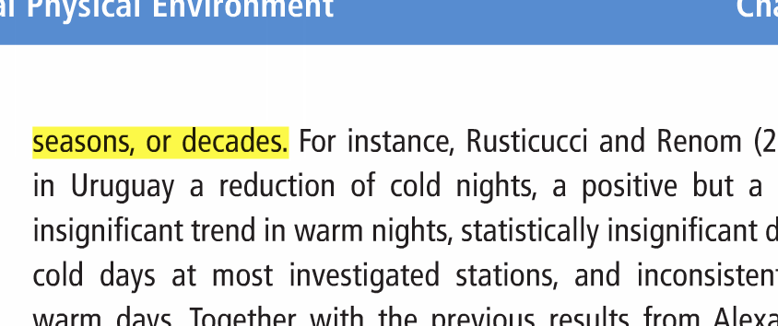
SREX 3.3.1: Summary of conclusions about observed changes from studies included in AR5?
=> generally consistent with AR4

Slide 13
SREX 3.3.1: Observed Changes Take-away
fewer studies available that investigate changes in characteristics of cold spells & warm spells or cold waves & heat waves (as opposed to looking at intensity or frequency of warm & cold days or nights)
example of a recent extreme
record-breaking heat wave over w. & c. Europe during summer 2003 [Beniston, 2004; Schär & Jendritzky, 2004]
hottest since comparable instrumental records began around 1780 & perhaps the hottest since at least 1500 [Luterbacher et al., 2004]
this event in particular associated w/ drought conditions, which can strongly enhance temperature extremes during heat waves over some regions[Andersen et al., 2005; Ciais et al., 2005]

Slide 14
SREX 3.3.1 Causes of observed changes
anthropogenic forcing may have substantially increased the risk of 2003 European heat wave
Stott et al. [2004]
available D&A studies for extreme max & min temps suggest that models overestimate changes in max temp & underestimate changes in min temp during late 20th C

Slide 15
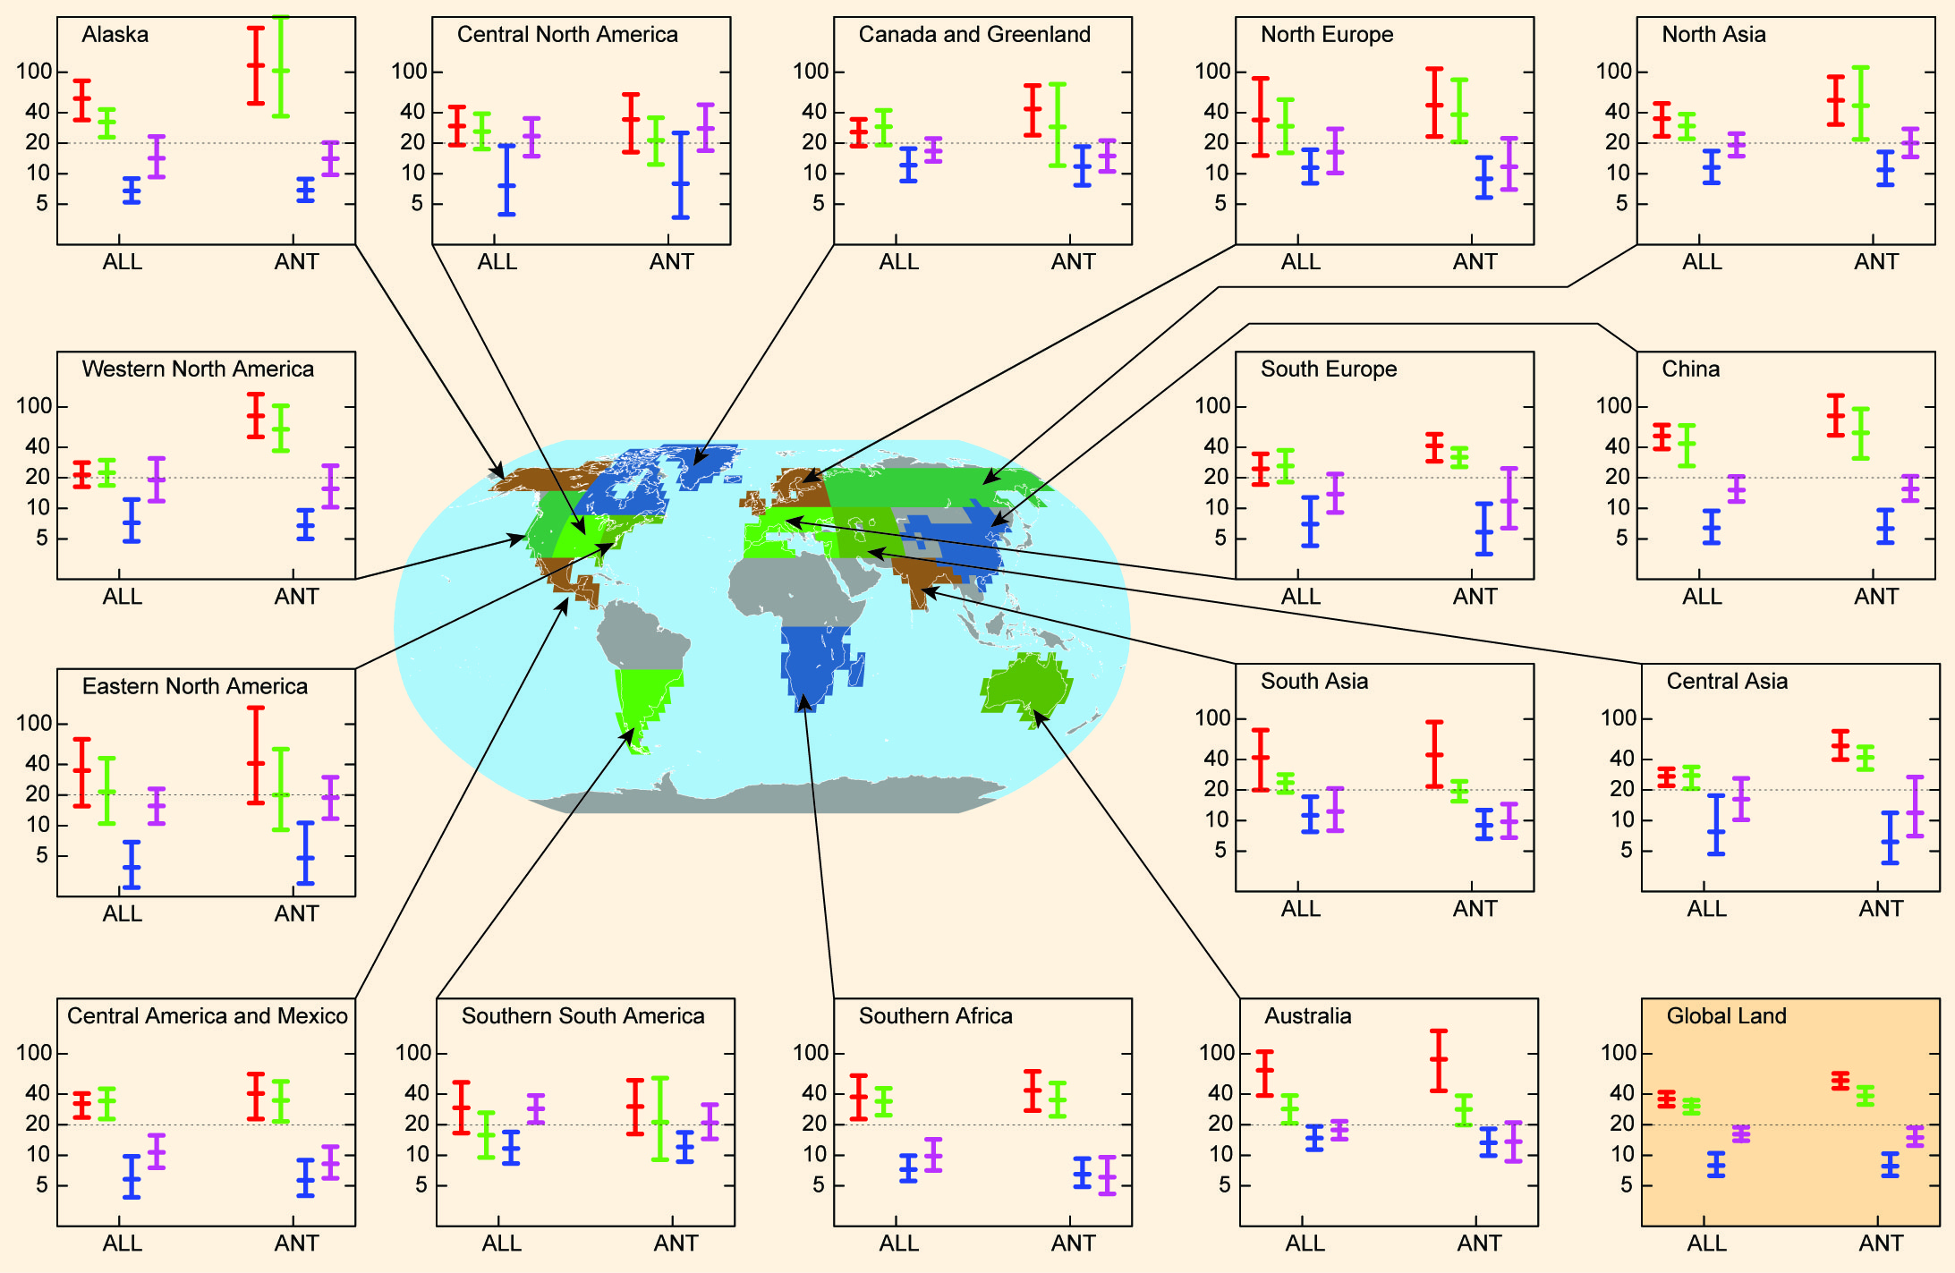

Slide 16
results from two global coupled climate models with separate ant. & nat. forcing runs indicate that observed changes are simulated with ant. forcings, but not with nat. forcings
return periods were found to have decreased to less than 10 or 15 years for annual max daily min & daily max temperatures respectively

Slide 17
SREX 3.3.1: Projected Changes & Uncertainties
post AR4 studies of temp extremes
utilized larger model ensembles
generally confirm AR4 conclusions
have more specific assessments in terms of range of considered extremes & level of regional detail
strong agreement (in terms of sign of change) b/w various GCM projections for temp-related extremes
⬆warm day occurrences & heat wave length; ⬇cold extremes
virtually certain projections at the global scale w.r.t present regional climate (1961-1990 reference period)
⬆# of warm days & nights; ⬇# of cold days & nights
very likely projections
⬆length, freq, &/or intensity of heat waves over most land areas

Slide 18
SREX 3.3.1: Projected Changes & Uncertainties
C. and e. Europe is a region where the evidence suggests that projected changes in temp. extremes result from changes in the mean & from changes in the shape of probability distributions [Schär et al., 2004]
main mechanism for widening of distribution is linked to the drying of the soil in this region
remote surface heating may induce circulation changes that modify temperature distribution [Haarsma et al., 2009]

Slide 23
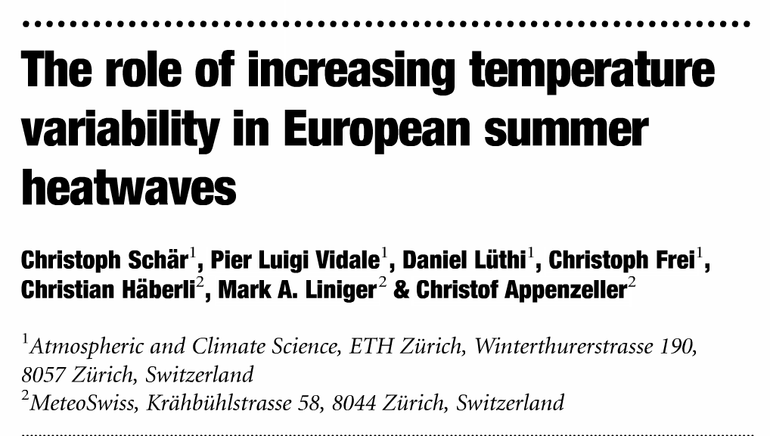
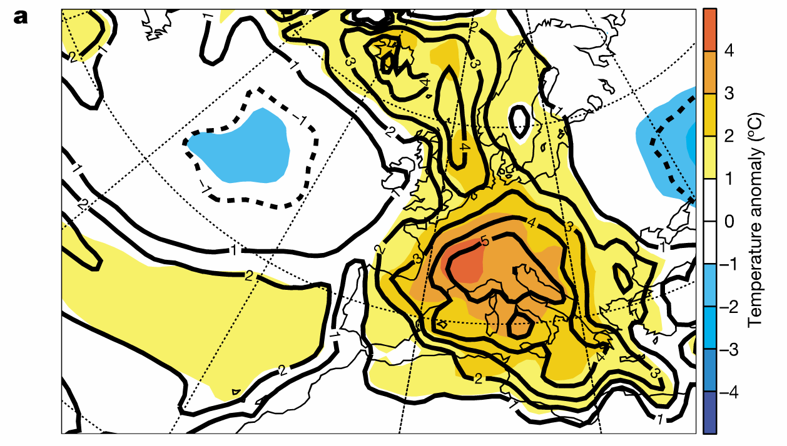

Slide 24
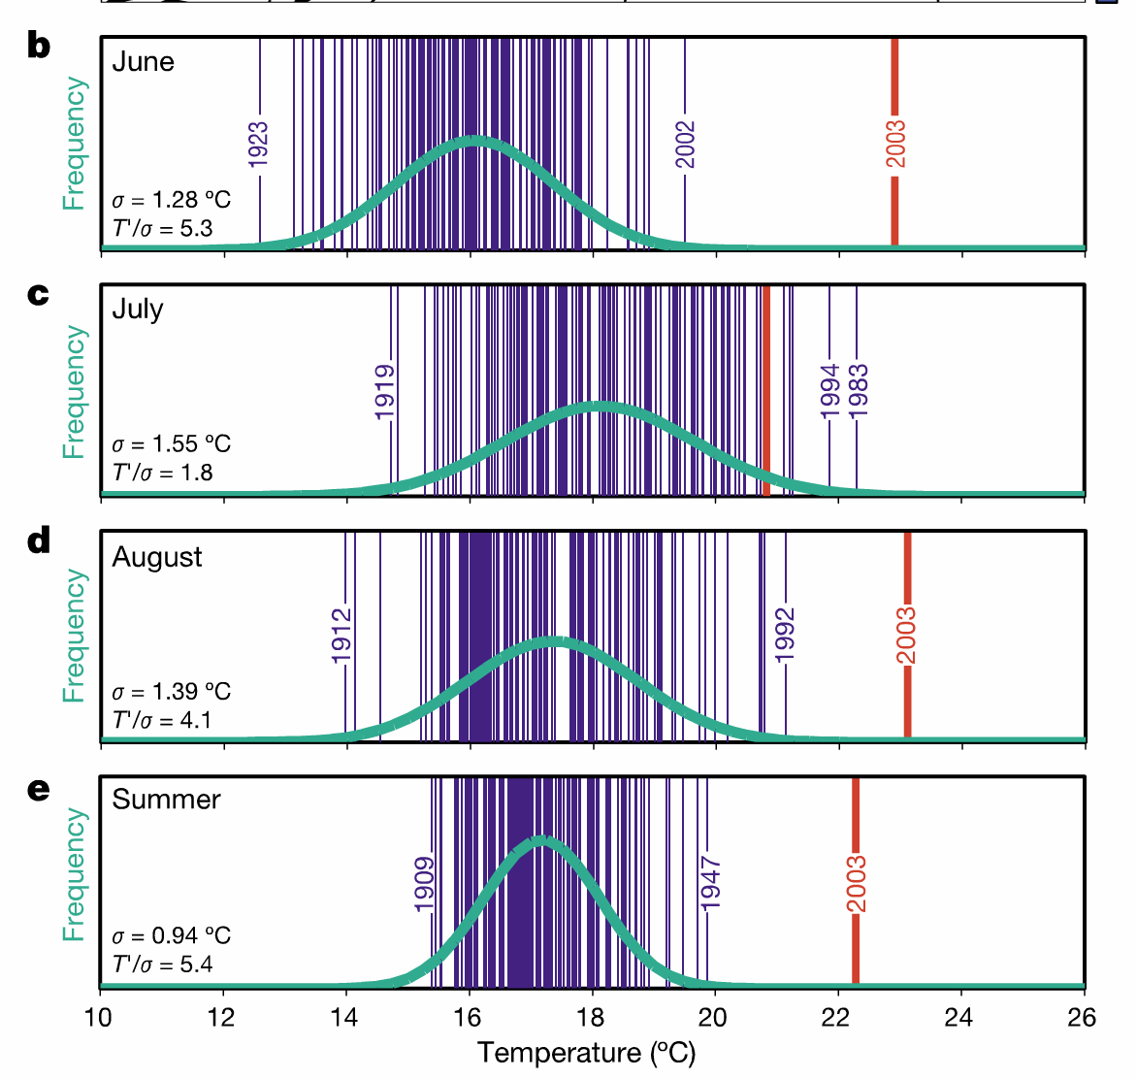
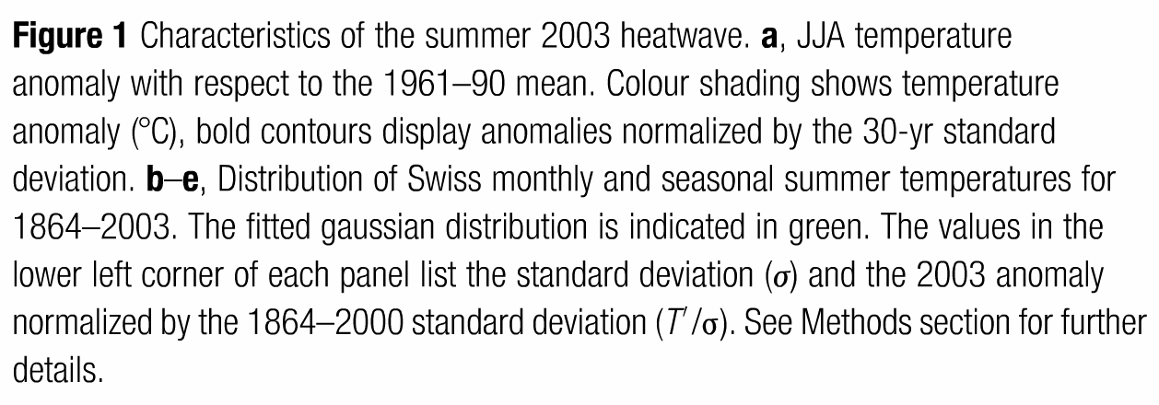
long-term temp time series from Switzerland
12 “carefully homogenized series” with daily res. since 1864
“such extremes post serious challenges to any analysis, as the statistical distribution so far away from the mean is not described by the data”

Slide 25
shift in mean warming by .0.8ºC between the two periods => change in freq. of extremes

Slide 26
shift in mean warming by .0.8ºC between the two periods => change in freq. of extremes
e.g. the frequency of the event that a month has an anomaly 3ºC increases by ~100% between the two periods (Fig 4c) => a month during 1941-2000 with anomaly 3ºC can be tied with a probability of 50% to the warming b/w the periods

Slide 27
shift in mean warming by .0.8ºC between the two periods => change in freq. of extremes
this type of analysis does not work summer 2003 because the data point that represents summer 2003 is so far away from the mean!
e.g. the frequency of the event that a month has an anomaly 3ºC increases by ~100% between the two periods (Fig 4c) => a month during 1941-2000 with anomaly 3ºC can be tied with a probability of 50% to the warming b/w the periods

Slide 28
Schär et al tries to estimate return-period
return period is an estimate of the frequency of a particular event (or its exceedance) based on a stochastic concept
obtains very large return periods
=> an event like summer 2003 does not fit into the Gaussian statistics spanned by the obs. of the reference period, but might rather be associated with a transient change of the statistical distribution
reinforces idea that small changes of statistical distribution can yield pronounced changes in the incidence of extremes
hypothesize that the heatwave might be due to a change of the distribution’s width, representing an increase in year-to-year variability

Slide 29
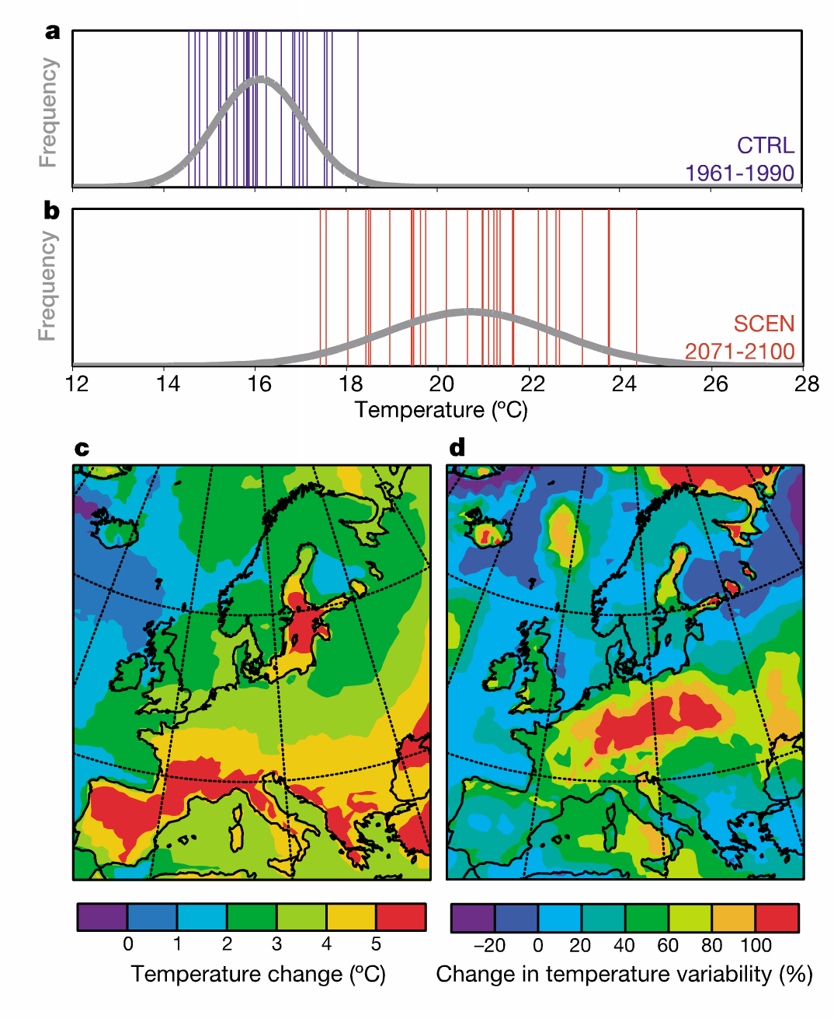
~4.6ºC shift towards warmer temps & pronounced widening
SCEN = SRES A2

Slide 30
~4.6ºC shift towards warmer temps & pronounced widening
The spatial distribution of the relative increase in variability (Fig. 3d) shows a pronounced signal throughout c. & e. Europe that is not directly linked to the simulated mean temp. change (Fig. 3c)
Wetherald & Manabe [1995] suggest that warm summers under SCEN show signs of drought
semi-arid Mediterranean climate progressing towards c. Europe
Under SCEN, c. Europe more often (not always) affected by summer droughts than under CTRL
=> increase in variability
SCEN = SRES A2

Slide 31
sequence of feedbacks associated w/ droughts are difficult to represent in climate models
such as large-scale anticyclonic forcing, radiation, soil hydrology
Schär et al. analyzed a couple of simulations from other GCM and RCMs
find that all exhibit increased level of variability over large parts of Europe
simulated increase in variability implies an increase in extremes relative to mean climatic cond’ns
“variability is more important than averages”
a recent increase in variability is thus a plausible hypothesis to explain extreme JJA 2003 cond’ns
insufficient data

Slide 32
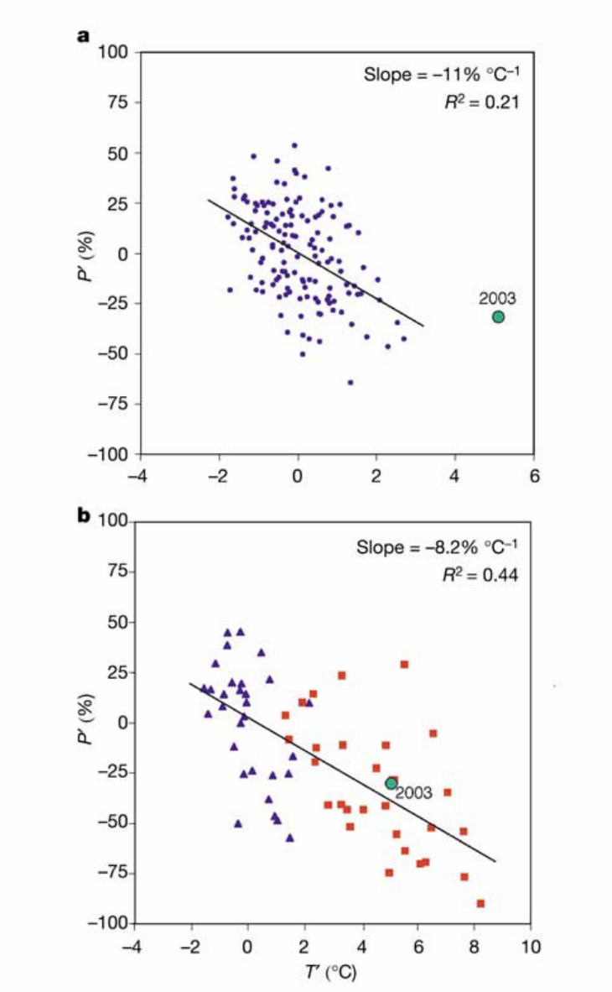

Slide 33
does the abnormal summer 2003 show similar characteristics to those simulated in the RCM runs?
we see similar (statistically significant) relationships b/w temp & precip anomalies in simulated and observed data
simulations represent observed precip sensitivity (despite some underestimate)
Fig 4b shows that temp and precip during JJA 2003 are not unlike those simulated during 2071-2100
=> about every 2nd summer could be as warm or warmer (and as dry or dryer) than 2003

Slide 34
Take-aways
European summer climate might experience a pronounced increase in year-to-year variability in response to GHG forcing
such variability might be able to explain the unusual summer 2003 and would strongly affect incidence of heat waves and droughts in future

Slide 35
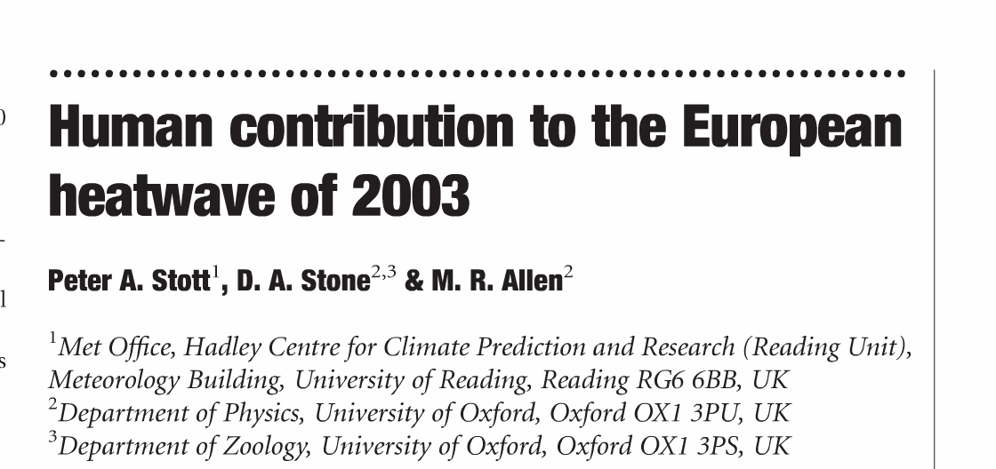
investigate origins of long-term changes in decadal-mean European JJA temp, determining the changes attributable to ant. drivers of the climate system & changes attributable to nat. drivers
estimate how the risk of mean JJA temp exceeding a particular extreme threshold in any individual summer has changed as a result of this ant. interference in the climate system

Slide 36
pre-selected climatically coherent region sufficiently large to exhibit c.c. signal above noise of natural internal variability
colorbar: how much different parts of region exceeded 1961-1990 mean (in K) during JJA 2003
yellow line = ‘NAT’
combines a simulation with solar forcing with a simulation with volcanic forcing; shows no warming in latter part of century
ALL: diff’t ICs but same combination of WMGGs, sulfate aerosols, & changes in strat and trop O3, as well as natural changes in solar output and explosive volcanic eruptions
Notes:
take-ways
history of temperature change averaged over this region is well reproduced by HadCM3 climate model when driven by both ant and nat drivers of c.c
extras
JJA temp over Europe exhibited overall increase over course of 20th C w/ distinctive temporal pattern of temp. change (including cooling during 1950s and 60s);

Slide 37
Spectral Analysis
subtract the estimate of the ALL ensemble mean forced response from the obs.
this residual (black line) is compared with HadCM3 simulated internal variability (grey shading), showing no significant discrepancy in variance on either interdecadal or 2- to 10- year timescales
=> HadCM3 provides an adequate representation of internal variability

Slide 38
Detection Analysis
Fig 3a: estimated likelihood functions for the factors by which we could scale up or down the amplitudes of the model-simulated response to ant. forcing and nat. forcing while remaining consistent w/ obs.
Fig 3b: From scaling factors and their uncertainties, Stott et al. derives likelihood functions of the 1990s temperature anomalies attributable to the combined effects of all forcings and attributable to natural factors alone
=> very likely that past ant. forcing is responsible for a significant fraction of observed European warming

Slide 39
Fig 4a shows the estimated likelihood of the risk (probability) of exceeding threshold 1.6 K in the presence of ant. c.c. (P₁) and in the absence of ant. c.c. (P₀), expressed as a frequency (bottom x-axis) and a return period (top x-axis)… X-axis labels should be flipped?
=> Even in the presence of ant. warming, the estimated probability of exceeding 1.6 K appears to be low (best estimate 1 in 250 year event)
P₀
P₁
Fraction Attributable Risk
large spread reflects uncertainties of c.c. on this spatial scale
distribution of attributable increase in risk P₁/P₀
FAR =((P₁-P₀)/P₁ )
“best estimate” of human contribution to increased risk of these very hot European summers [Allen 2003]
=> >90% chance that over ½ of the risk of European summer temps exceeding threshold 1.6 K is attributable to human influence on climate

Slide 40
Take-aways
European summers are warming owing to ant. c.c.
under SRES A2 with HadCM3, by end of 21st C, summer 2003 would be an anomalously cold summer relative to the new climate (Fig 1)
changing natural HadCM3 natural simulations changes results by less than 5%

Slide 41
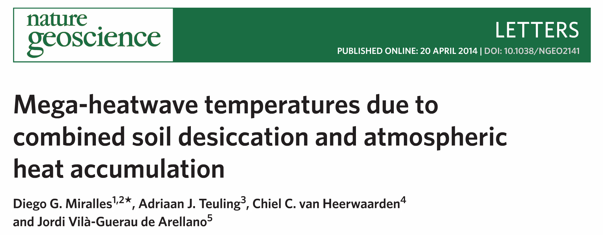
mega heat waves during summers 2003 over c. Europe and 2010 over e. Europe and Russia were associated with atm. blocking patterns, reduced cloudiness, and advection of warm air
under these persistent synoptic conditions, depletion of soil moisture and subsequent reduction in evaporative cooling may further amplify air temps (“soil moisture-temperature feedback”)
Miralles et al. combines multiscale (sfc + air) obs from both mega heat waves within a mechanistic framework to give new evidence of the land-atm. interactions and atm. boundary layer (ABL) dynamics that dominate these events

Slide 42
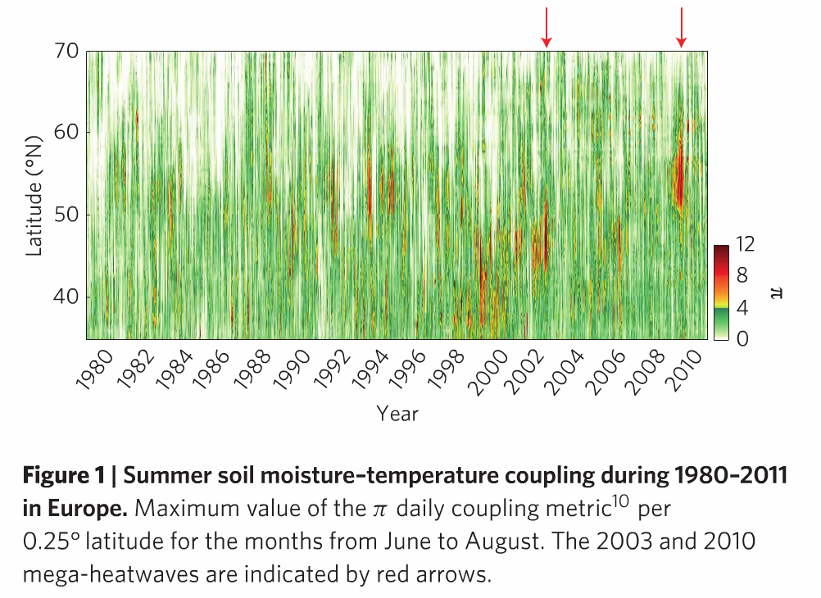
previous studies have pointed to the large variability in soil moisture in mid-latitude regions as a reason for their larger predisposition to experiencing mega heat waves
Fig 1 gives a historical perspective (1980-2011) of the statistical coupling b/w soil moisture and summer air temperatures in Europe

Slide 43
pi = coupling diagnostic that expresses the co-variability of the anomalies in afternoon air temperature (T’) and anomalies in the contribution of soil dryness to the sfc sensible heat flux (e’); derived using reanalysis and satellite data
previous studies have pointed to the large variability in soil moisture in mid-latitude regions as a reason for their larger predisposition to experiencing mega heat waves
Fig 1 gives a historical perspective (1980-2011) of the statistical coupling b/w soil moisture and summer air temperatures in Europe

Slide 44
pi = coupling diagnostic that expresses the co-variability of the anomalies in afternoon air temperature (T’) and anomalies in the contribution of soil dryness to the sfc sensible heat flux (e’); derived using reanalysis and satellite data
unprecedentedly high values of pi during the summers of 2003 and 2010 indicate that when the extreme high temps occurred, soils were extraordinarily dry and yielding a large flux of sensible heat
previous studies have pointed to the large variability in soil moisture in mid-latitude regions as a reason for their larger predisposition to experiencing mega heat waves
Fig 1 gives a historical perspective (1980-2011) of the statistical coupling b/w soil moisture and summer air temperatures in Europe

Slide 45
pi = coupling diagnostic that expresses the co-variability of the anomalies in afternoon air temperature (T’) and anomalies in the contribution of soil dryness to the sfc sensible heat flux (e’); derived using reanalysis and satellite data
unprecedentedly high values of pi during the summers of 2003 and 2010 indicate that when the extreme high temps occurred, soils were extraordinarily dry and yielding a large flux of sensible heat
previous studies have pointed to the large variability in soil moisture in mid-latitude regions as a reason for their larger predisposition to experiencing mega heat waves
Fig 1 gives a historical perspective (1980-2011) of the statistical coupling b/w soil moisture and summer air temperatures in Europe
strength of the coupling is similar for heat waves of 2003 and 2010, suggesting an analogous role of soil moisture in the intensification of temperatures in both heat waves
coupling extended over a longer period and over a larger area in 2010, indicating a more persistent synoptic situation

Slide 46
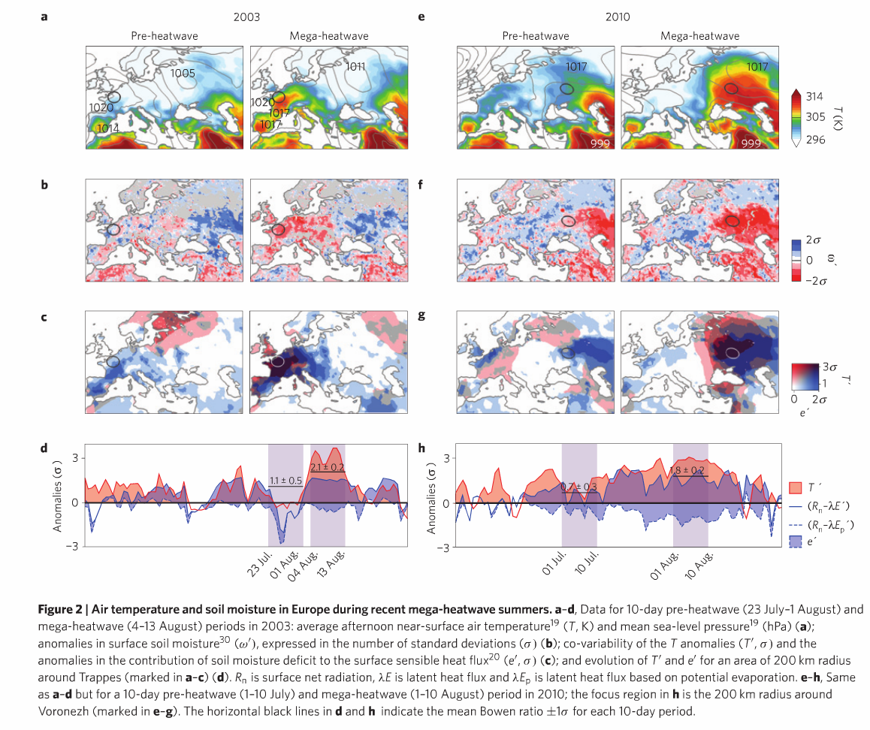
Notes:
Just explain layout of the figure --- rows

Slide 47
Fig. 2a & e: Average afternoon near surface temperature (T, K) and mean sea-level pressure (contours, hPa)
blocking synoptic conditions are more dominant in 2010, allowing a continuous southerly advection of warm air
during 2003 the wind direction and strength of the convection affected by formation of mesoscale thermal lows (low-pressure areas characteristic of very dry soils and intense ABL growth; Iberian peninsula and southern France in Fig 2a)
max temps developed between high and low pressure systems
combination of clear skies, low levels of subsidence, warm air advection

Slide 48
Fig. 2b & f: anomalies in surface soil moisture (ω’) expressed in the number of standard deviations (σ)
soil desiccation intensities due to high atmospheric demand for water
local land-atm feedbacks strengthen progressively

Slide 49
Fig. 2c & g: co-variability of the temperature anomalies (T’, σ) and the anomalies in the contribution of soil moisture deficit to the surface sensible heat flux (e’, σ)
the regions where soil dryness had a strong effect on the surface energy balance (high e’) -- already before the events -- recorded the highest absolute temperatures during the events
-> need to disentangle these land atm interactions and examine their impact in greater detail; focus on two locations with routine balloon sounding stations and are representative of the daily dynamics of T’ and e’ – Trappes and Voronezh

Slide 50
Fig. 2c & g: co-variability of the temperature anomalies (T’, σ) and the anomalies in the contribution of soil moisture deficit to the surface sensible heat flux (e’, σ)
the regions where soil dryness had a strong effect on the surface energy balance (high e’) -- already before the events -- recorded the highest absolute temperatures during the events

Slide 51
Fig. 2d & h: evolution of T’ and e’ for an area of 200km radius around Trappes (2003) and Voronezh (2010) anomalies in surface soil moisture (ω’) expressed in the number of standard deviations (σ)
During summer 2003 (Trappes), there is coinciding peak in daily dynamics of T’ and e’
same occurs during summer 2010 (Voronezh), but w/ a more prolonged & steady increase in both variables

Slide 52
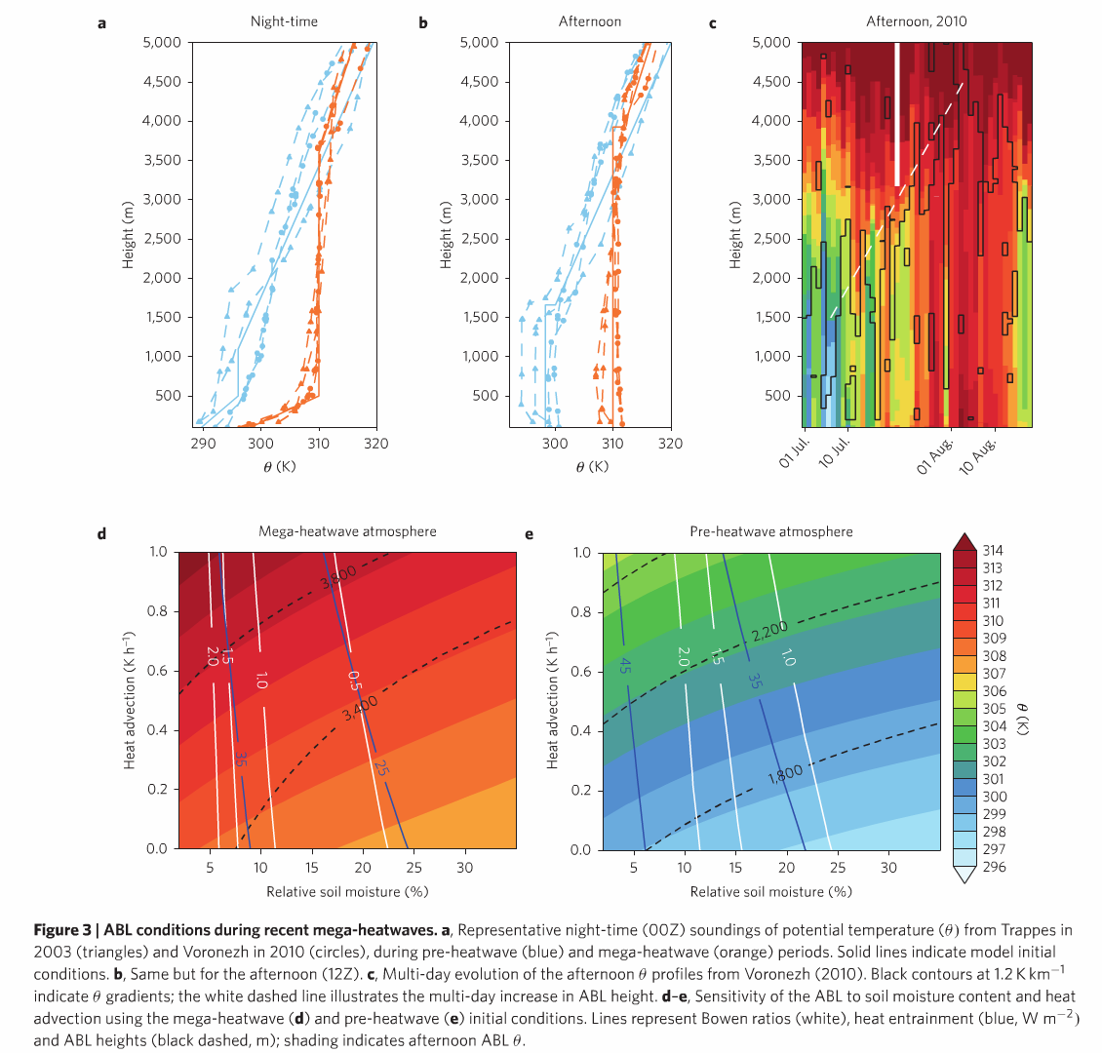
Fig 3: ABL conditions during recent mega heat waves

Slide 53
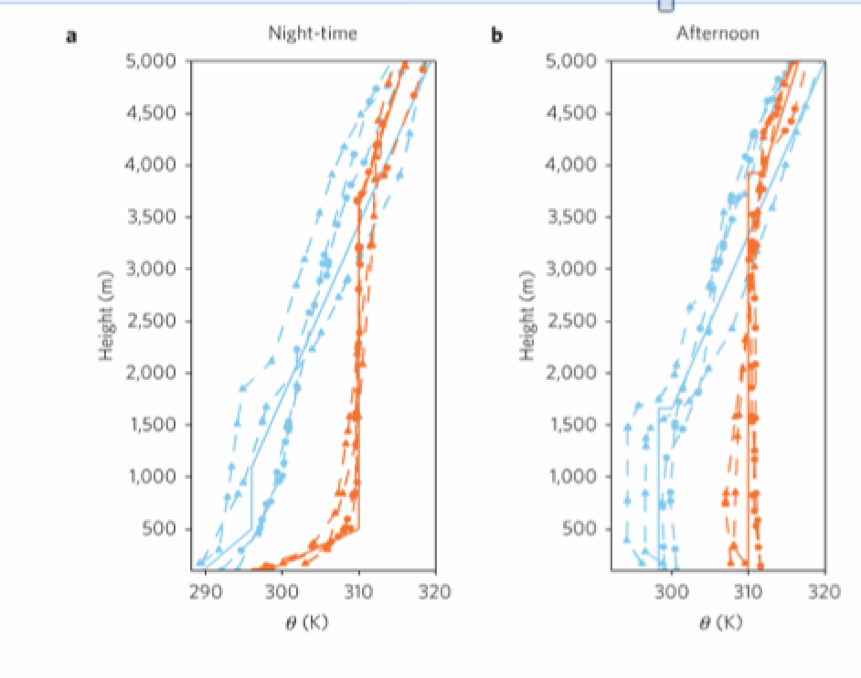
periods before the heat waves show show steady nocturnal lapse rates of ~ 4 K/km
during the heat waves, deep & warm nocturnal residual layers form, remaining decoupled from the surface by a strong ground thermal inversion
this can happen over very dry soils & can be further enhanced by mesoscale thermal lows
potential to intensify diurnal temperatures by storing heat from one day to the next – not really been studied
strong diurnal ABL anomaly (Fig. 3b)
although chatacteristic afternoon ABL heights at the latitudes of Trappes and Voronez are below 2km
during mega heat waves 4km
typical of semi-arid cond’ns
Fig 3: ABL conditions during recent mega heat waves: a) Representative night-time (00Z) soundings of potential temperature (Θ) from Trappes in 2003 (trianges) and Voronezh in 2010 (circles), during pre-heat wave and during mega-heat wave periods. Solid lines indicate model initial cond’ns. b) same but for afternoon (12Z).

Slide 54
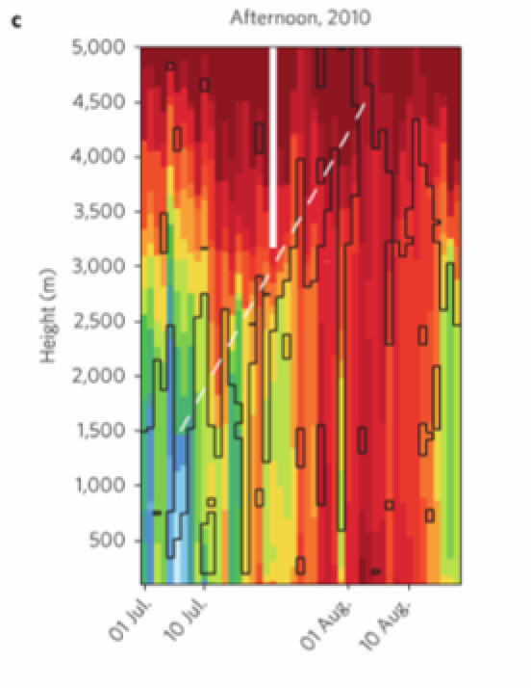
monotonic multi-day increase in afternoon Θ and ABL heights as the 2010 mega-heat wave strengthened
Fig 3: ABL conditions during recent mega heat waves: c) Multi-day evolution of the afternoon Θ profiles from Voronezh (201). Black contours at 1.2 K/km indicate Θ gradients; the white dashed line illustrates the multi-day increase in ABL height.

Slide 55
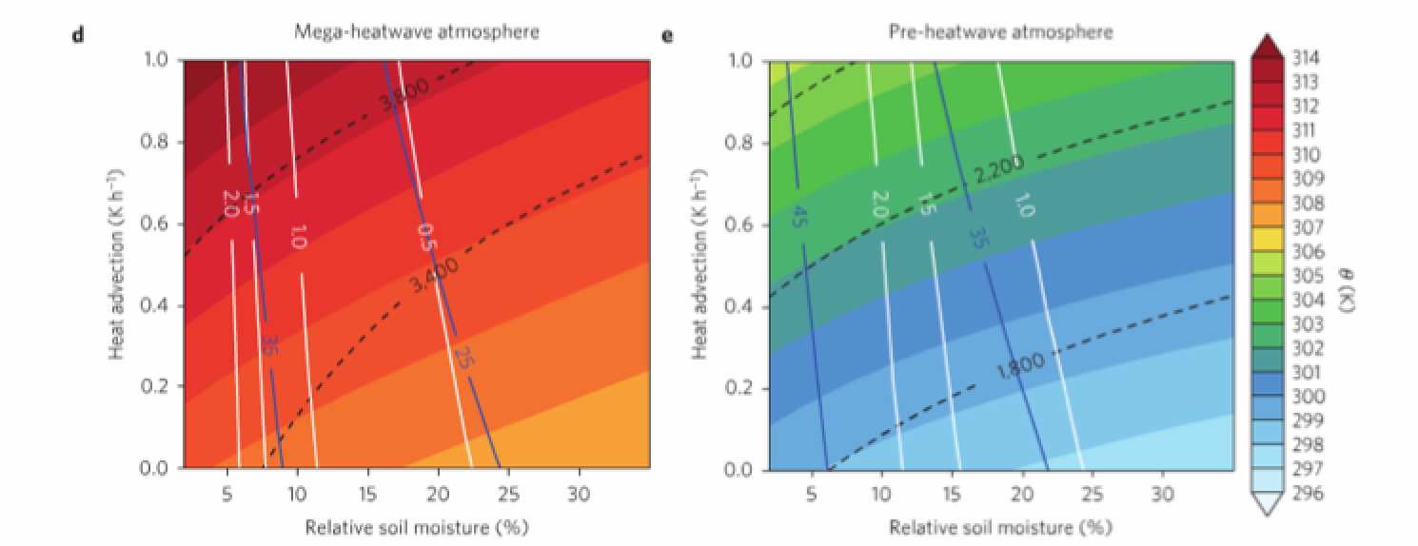
Fig 3: ABL conditions during recent mega heat waves: d-e) Sensitivity of the ABL to soil moisture content and heat advection using the mega heat waved (d) and pre heat wave (e) initial conditions. Lines represent Bowen ratios (white), heat entrainment (blue, W/m²) and ABL heights (black dashed, m); shading indicates Θ

Slide 56
a purely observational analysis cannot reveal the extent that extreme mega-heat wave temperatures occur as a result of coinciding deficits in soil moisture & multi-day storage of heat in the ABL
use a mechanistic model of soil water-atm. column
initialized based on representative night-time balloon sounds of Θ & q for pre-heat wave & mega heat wave cond’ns
modeled fluxes are constrained using satellite based estimates of Bowen ratios (sensible to latent heat flux)
doubling of Bowen ratios found under mega heat wave cond’ns
consistent w/ eddy covariance measurements during 2003 heat wave
model reproduces diurnal evolution of the ABL both for pre heat wave and mega heat wave (Fig 3b)
confident with model’s ability to quantify heat budget during mega heat waves

Slide 57
find that observed afternoon temperatures exceeding 40ºC at mid-latitudes can occur only under the cumulative effects of low soil moisture and high heat advection (Fig 3d)
under these cond’ns, convection is intensified and growth of ABL is enhanced
=> further entrainment of warm air
by initializing model using pre- heat wave night-time sounding conditions (blue line in Fig 3a), we find that afternoon temps are ~10 K lower (Fig 3e)
storage of heat in persistent nocturnal residual layer is key to explaining escalation of temperatures during mega heat waves
without multi-day accumulation of atmospheric heat, temps cannot escalate to reach the observed extremes

Slide 58
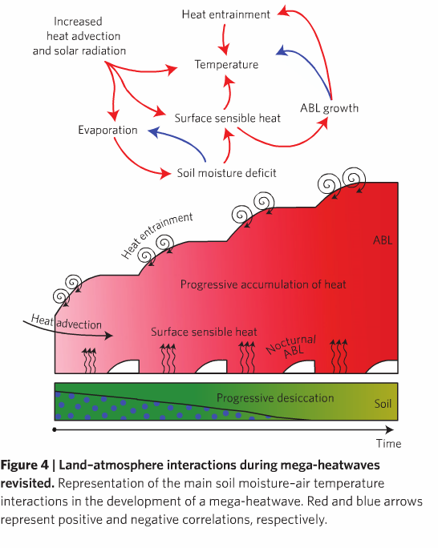
Miralles et al. results indicate that the record high temps of 2003 & 2010 occurred as a result of a combination of factors
the prevailing persistent synoptic patterns led to warm air advection and clear skies,
the high atmospheric demand intensified soil desiccation (causing a strong sfc sensible heat flux),
the subsequent diurnal convection favored the entrainment of warm air,
& the formation of deep & warm nocturnal residual layers allowed the heat to re-enter the mixed layer in the following days
Soil moisture deficits have both direct and indirect effects in all these processes – need more research on separate effects & what happens during mega heat waves

Slide 59
results suggest: a seasonal history of rainfall deficits is not a necessary requirement & the soil desiccation does not play an important role in the event duration (ultimately governed by synoptic conditions)
on the other hand, results indicate that the escalation of temps during mega heat waves can only be explained by considering the multi-day memory of land sfc and ABL
improving climate model representation of land-atm interactions crucial to increasing predictability

