Slide 1
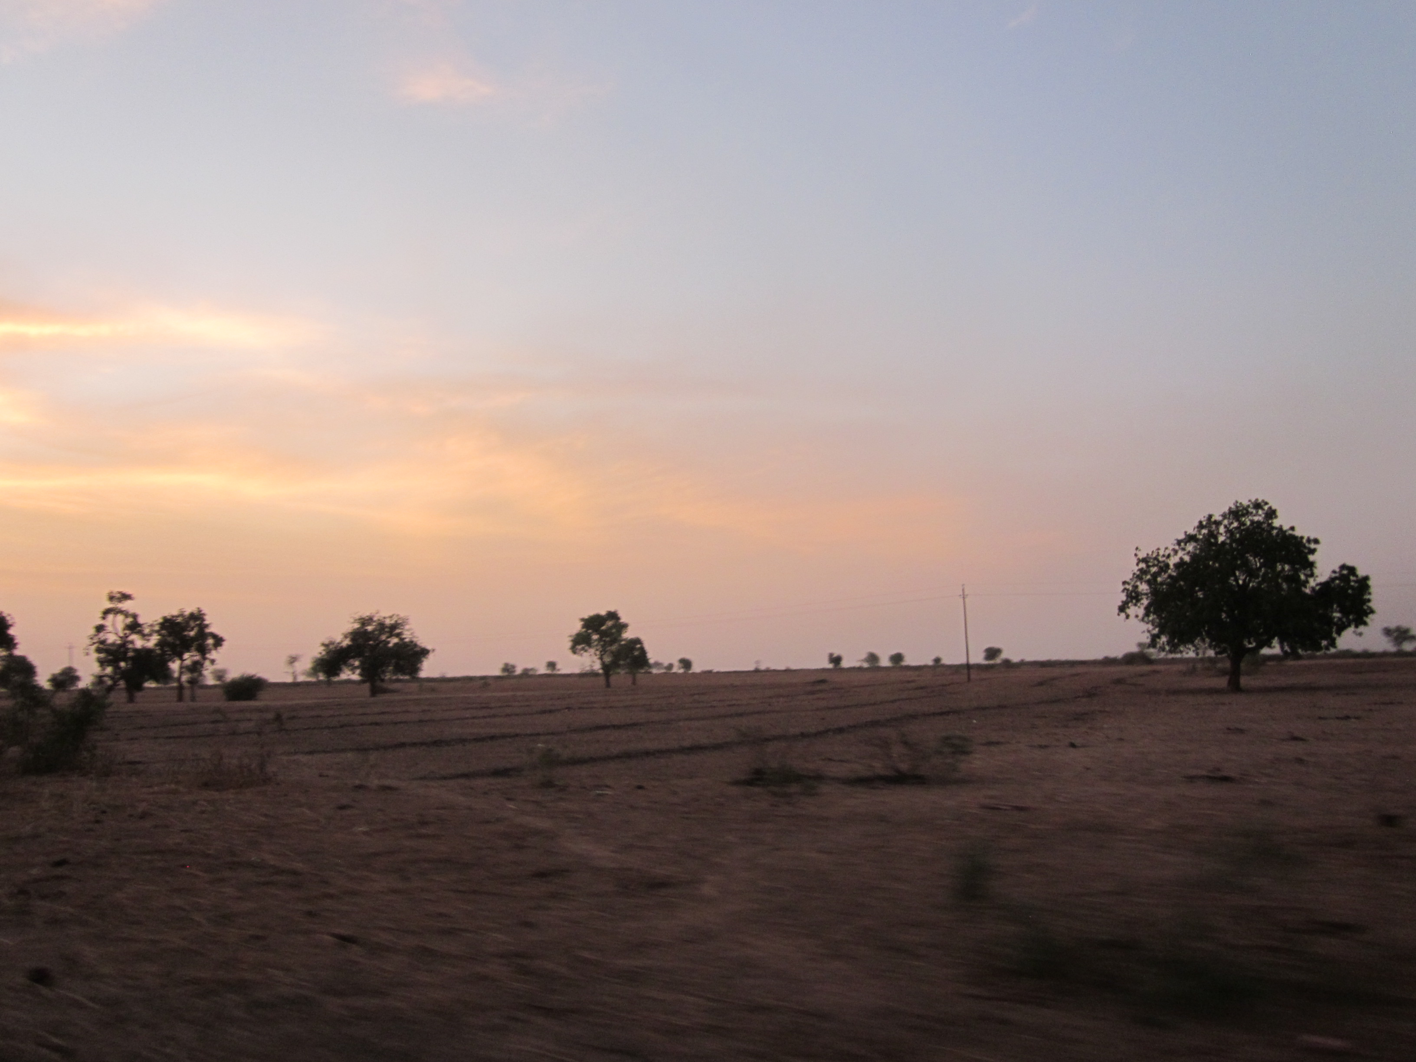
Extremes Seminar: Drought
October 27th, 2014

Slide 2
SREX 3.5.1: Droughts
Drought: “a period of abnormally dry weather long enough to cause a serious hydrological imbalance” (pg 167)
Drought ≠ aridity
Drought effects are nonlinear: the same precipitation deficit or radiation excess relative to normal will not affect different regions equally
Meteorological drought: a period with abnormal precipitation deficit
Megadrought: a very lengthy and pervasive drought, lasting much longer than normal, usually a decade or more
Soil moisture drought: deficit of soil moisture
Hydrological drought: negative anomalies in streamflow, lake, and/or groundwater levels

Slide 3
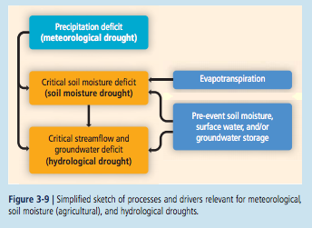
Drivers of Drought
Soil moisture/hydrological droughts: usually driven by reduced precipitation and/or increased evapotranspiration
Notes:
Drought has a different persistence depending on the affected system and it is also sensitive to pre-conditioning. Figure shows the different aspects important for various types of droughts. Effects of pre-conditioning also explain the possible occurrence of multi-year droughts, whereby soil moisture anomalies can be carried over from one year to the next.

Slide 4
Drought indices
Indices can be used to identify droughts
Standard Precipitation Index (SPI): fit and transform long-term precip records into a normal distribution
Above/below a certain threshold can define mild/moderate/severe/extreme droughts
Consecutive Dry Days (CDD)
Considers the maximum consecutive number of days without rain within a considered period
Palmer Drought Severity Index (PDSI)
Measures the departure of moisture balance from normal conditions using a simple water balance model
Standardized Precipitation-Evapotranspiration Index (SPEI)
Blue: based solely on precipitation data
Red: reflect both precipitation and estimates of actual or potential evapotranspiration
Notes:
Blue: based solely on precipitation data
Red: reflect both precipitation and estimates of actual or potential evapotranspiration

Slide 5
Observed Changes
Large uncertainties
AR4: very dry areas more than doubled in extent since 1970 (PDSI)
Sheffield and Wood (2008): trends in drought duration, intensity, and severity predominantly decreased and a moistening occurred until about 1970 when drying trend takes over (based on soil moisture simulations)
But, a lot of regional variations to consider

Slide 6
Changes throughout the 20th Century
Region | Confidence | Change
North America | Medium confidence | Less drying
Europe | Medium confidence | Increased drying
South America | Low confidence | ?
Asian monsoon region | Low confidence | ?
East Asia | Medium confidence | Increased drying
Sahel | Low to medium confidence | ?
Australia | Low confidence | Increased drying
1930s Dust Bowl & 1950s drought
Exceptional 2003 summer heatwave

Slide 7
Causes of changes
AR4: “more likely than not that anthropogenic influence has contributed to the increase in the droughts observed in the second half of the 20th century”
Land-atmosphere feedbacks
SST forcing
Potential impacts of land use changes
Medium confidence that anthropogenic influence has contributed to some changes in the drought patterns observed in the second half of the 20th century; low confidence in the attribution of changes in droughts at the level of individual regions

Slide 8
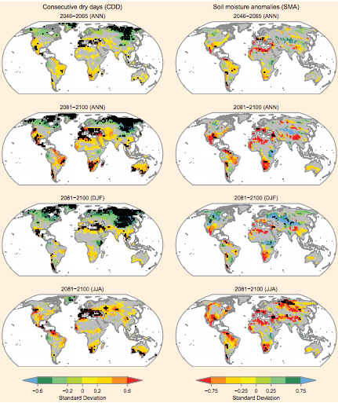
Projected annual and seasonal changes in dryness assessed from two indices (CDD, left & SMA, right) for 2081-2100 (bottom 3 rows) and 2046-2065 (top)

Slide 9
Uncertainties for projections
Uncertainty exists in projections for drought in the coming century due to:
Development of the ocean circulation
Feedbacks between land surface and atmospheric processes
Effects of drought on vegetation physiology and dynamics with resulting feedbacks to precipitation formation
Feedbacks between droughts fires and aerosols

Slide 10
Conclusions
Medium confidence that since the 1950s some regions of the world have experienced trends toward more intense and longer droughts
West Africa, southern Europe
Droughts have become less frequent, less intense, or shorter in other regions
Central North America, northwestern Australia
Medium confidence that anthropogenic influence has contributed
Low confidence in the attribution of changes in droughts at the level of single regions due to inconsistent or insufficient evidence

Slide 11
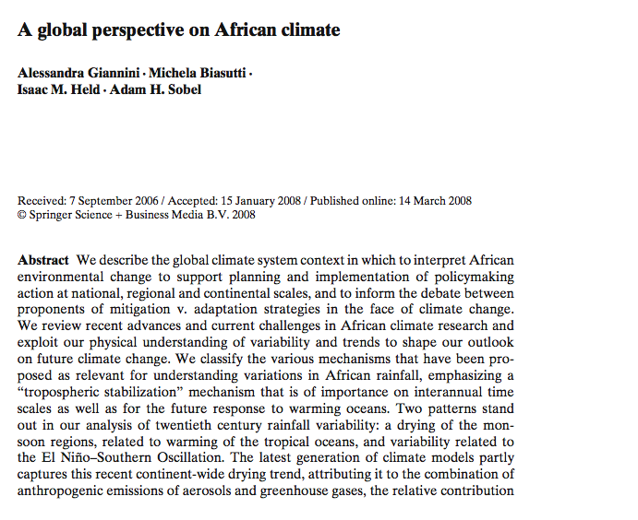

Slide 12
1. Introduction
Local nature of causes of environmental degradation and drought in the Sahel mostly disproven
Vegetation has been shown to recover from drought at both seasonal and interannual time-scales and thus cannot have forced the decadal drought in the region
Climate models can reproduce the historical record of Sahel rainfall when forced only with global SSTs

Slide 13
Study goals and questions
Focuses on external cause of environmental change: climate
Focus on the recent observational record of continental-scale tropical African climate variability and on simulations of future change
Are there current trends?
Is it wise to linearly extrapolate them into the future?

Slide 14
2. Dynamics of tropical rainfall and seasonality of African climate
Deep convection: surface air is warmed and moistened, potentially light enough to ascend through depth of troposphere
Tropical precipitation is a response to this instability
Two mechanisms are used to understand precipitation changes in Africa
Stabilization: warming of the tropical atmosphere, efficiently distributed across the tropics reduces the instability of a boundary layer parcel and inhibits precipitation
Moisture Supply: supply of moisture (and moisture convergence) changes as a result of factors such as gradients in SST or land/ocean temperature contrasts, leading to a change in rainfall

Slide 15
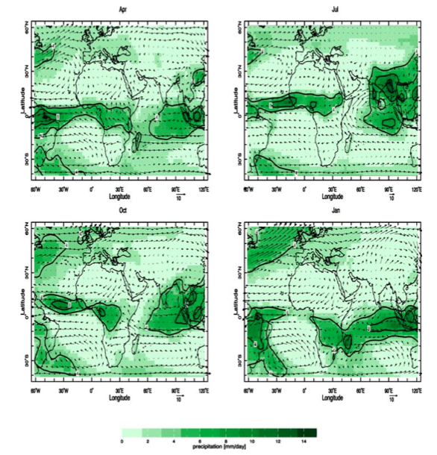
Precipitation climatology and 850 mb winds for April, July, October, January 1979-2004
-deep convection and precipitation spatially confined
-seasonal reversal of winds (monsoon) apparent when comparing Jan/July panels

Slide 16
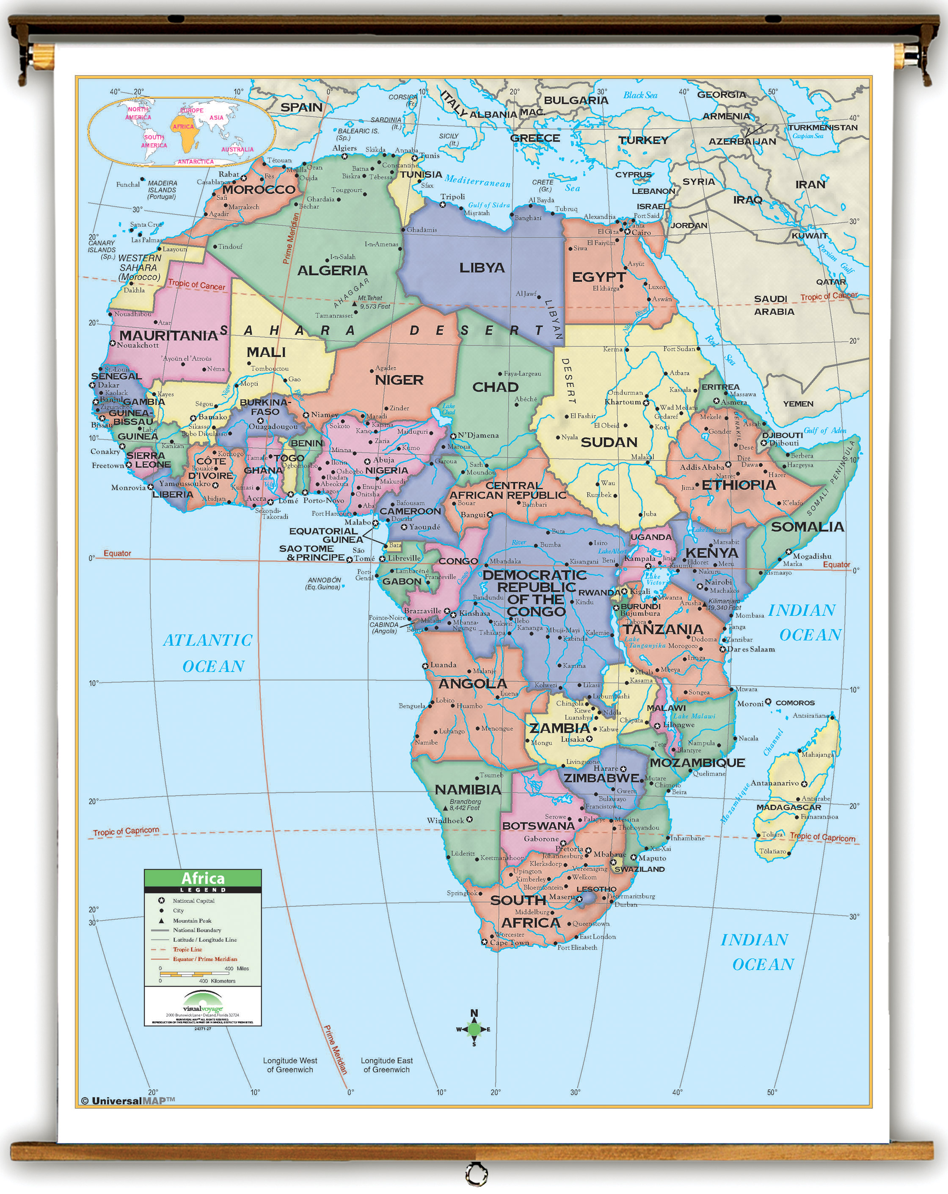
African climate of the twentieth century
3 regions considered based on considerations of seasonality:
Western Africa (0°-20°N, 20°W to 20°E)
Eastern Equatorial Africa (10°S to 10°N, 20°E to 50°E)
Southern Africa (25°S to 10°S, 20°E to 40°E)

Slide 17
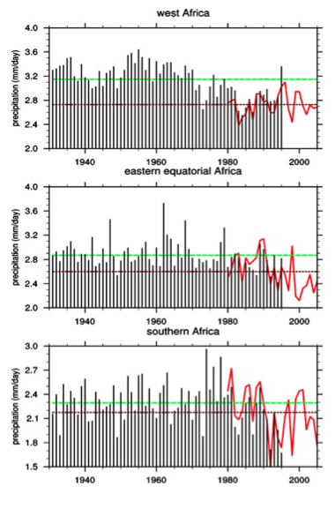
Regional variability in time (1930-2005)
-West African rainfall is characterized by a high degree of persistence of anomalously wet and dry years (unparalleled globally)
-Equatorial and southern Africa have more interannual variability, more frequently anomalously dry events
-Clear trend towards dry conditions, particularly for eastern equatorial Africa
-”greening trend” and recovery of rainfall in West African Sahel is suggested by the above but debated
Notes:
Figure description: Regional averages of annual mean (July–June) precipitation over 1930–2005; the three regions are western (0◦N to 20◦N, 20◦W to 20◦E), eastern equatorial (10◦S to 10◦N, 20◦E to 50◦E), and southern Africa (25◦S to 10◦S, 20◦E to 40◦E). CRU data is depicted in black bars, GPCP in the solid red line. The CRU climatology over 1930–1995
is depicted in the green horizontal line, that of GPCP, over 1979-2005, is depicted in the brown horizontal line

Slide 18
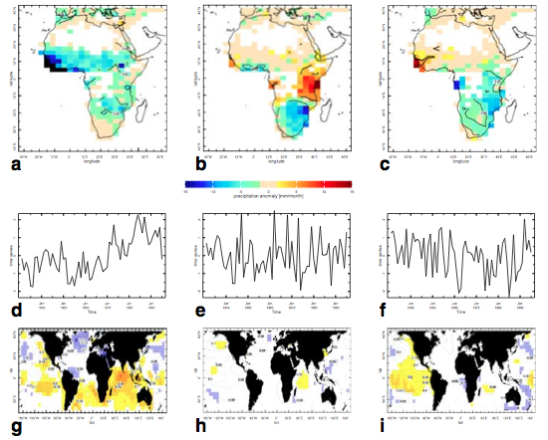
Spatio-temporal patterns of African climate variability: two major patterns: 1. continental-scale drying related to enhanced warming in southern tropics compared to northern 2. impact of ENSO on the tropical atmosphere and Africa
Notes:
Fig. 3 The three leading patterns of a principal component analysis performed on annual mean (July–June) precipitation over Africa during 1930–1995. a, b, c The spatial patterns, obtained by linear regression of the time series in (d), (e), and (f) onto precipitation—anomalies are in color, in millimeters/month, while the contours delimit regions where regression is statistically significant at the 5% level. d, e, f The associated time series (in units of standard deviation). Note that the upward trend in (d) indicates increasingly stronger values of the negative anomalies in the pattern in (a), i.e. a drying trend. g, h, i Regression patterns of the time series in (d), (e), and (f) with sea surface temperature (Kaplan et al. 1998). Anomalies are in contour, spaced every 0.05◦C, and dashed in the case of negative values; the presence of color represents their statistical significance at a level of 5% or higher

Slide 19
Leading Mode: Continental Scale Drying
stronger values in N. Hem/Sahel but weaker and significant through tropics
related to global SSTs with drying related to a warmer tropical Pacific, Indian and South Atlantic Oceans and cooler North Atlantic basin

Slide 20
Modes 2 & 3: Interannual Variability driven by ENSO
h: horseshoe pattern in W. Pacific
Combines effects of remote tropical Pacific and Indian Ocean
Increased moisture transport due to warmer Indian Ocean leads to positive anomalies in E. Africa
i: signature in E. Trop Pacific
Purely atmospheric influence,
Tropical Pacific SSTs dwarf signal in any other basin; force drying that is strongest in E. Africa
Overall precipitation changes will be determined based on which of these forcings dominate

Slide 21
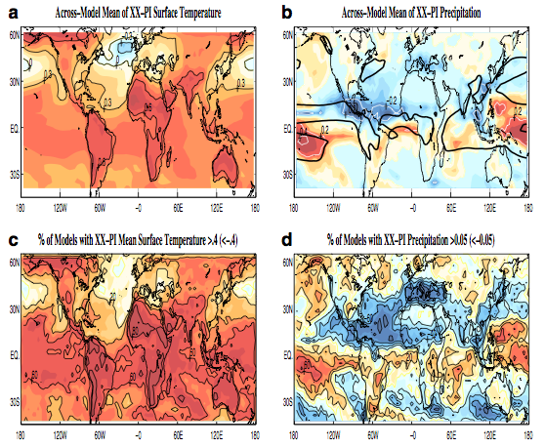
Late 20th Century climate change in recent simulations: 20th Century-PI surface temperature and precipitation changes and model agreement
-temperature increases less in mid-lat. extratropics than deep tropics; cooling of mid-lat. Northern hem. oceans
-decrease of precip across trop. Atl ITCZ and into the Sahel
-anthropogenic forcings played a non negligible role (~30%) in the late 20th century drying of Sahel but a large fraction was generated by SST variability

Slide 22
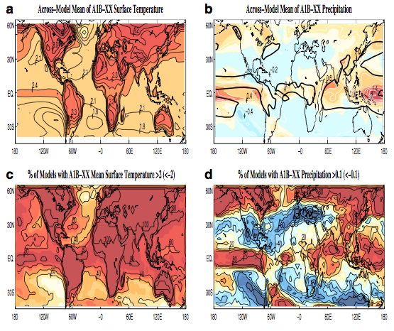
Uncertain future: A global warming scenario simulation
Change in temperature and precipitation for late 21st Century (A1B) – 20th Century
-warming of tropical oceans, more El Nino like warming, more pronounced land-sea contrasts, warming of continents that surpasses oceans
-precip signal is less clear: more intense rainfall in equatorial regions and drier conditions elsewhere (scatter among models also apparent)
-models do not consistently dry the Sahel into 21st century suggesting that the moisture supply mechanism and not the stabilization mechanism dominates

Slide 23
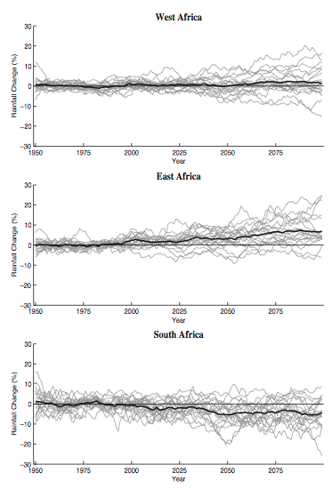
Averages for 3 regions’ 1950-2100 precipitation estimates
-scatter among models apparent
-uniform warming will increase specific humidity
-regional precipitation changes determined by the humidity change (rather than circulation) should result in an increase in currently rain-rich regions and a decrease in semi-arid regions
-El Nino like climate change could lead to telecononections as seen in previous figure, generally resulting in a drier African continent
-enhanced land-sea temperature contrast could lead to intensification of monsoonal circulations
**challenge: determining which of the various mechanisms are more/less important in various regions of Africa
Notes:
Fig.6 Regional averages of precipitation in the IPCC 4AR model simulations; twentieth century simulations from 1950 to 2000, and A1B scenario 10 simulations from 2000 to 2100. Regions are defined as in
Fig. 2. Each grey line represents one model, and the thicker black line is the multi-model mean

Slide 24
Conclusions
Human-induced change in land use or land cover as driving African rainfall changes has now been largely discounted
Two mechanisms can be used to understand African rainfall changes of the recent past and future: moisture supply and stabilization mechanism
Competition between them in the future may explain uncertainty of projections
Trend towards drier conditions for the monsoon regions of Africa over the late 20th Century consistent with tropical ocean warming
This relationship does not continue to hold into the future

Slide 25
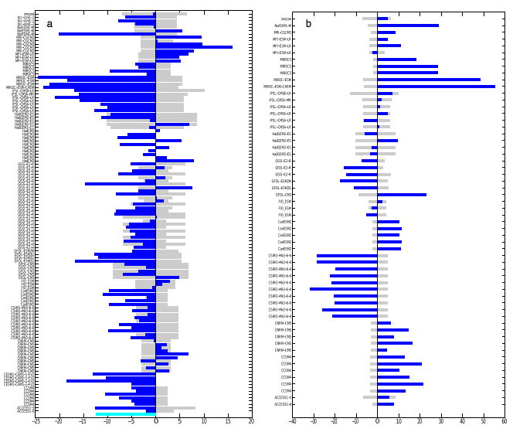
West African rainfall in CMIP5 Biasutti 2013, JGR
Rainy season more feeble at start, more abundant at core
Direct effect of CO2 enhances the monsoon while warmer SSTs induce drying over the Sahel
Figure description: Centennial-scale trends in summertime Sahel rainfall for (1900-2005 (left) and 2006-2099 (right) for individual models

