Slide 1
Source Attribution Using Satellite Products and Models to Inform Air Quality Planning and Health Accountability
PI: Arlene M. Fiore Co-I: Pat Kinney
Xiaomeng Jin (CU/LDEO graduate student)
Collaborators: Joe Pinto, Pat Dolwick, Luke Valin (U.S. EPA)
Tabassum Insaf (NYSDOH), Mike Ku (NYSDEC),
Randall Martin & Aaron van Donkelaar (Dalhousie),
Bryan Duncan & Lok Lamsal (NASA GSFC)
HAQAST1
Emory University
Atlanta, GA
November 4, 2016

Slide 2
OMI satellite products indicate continued efficacy of ground-level ozone abatement via regional NO_{x} emission controls
May OMI HCHO:NO₂
Column-diagnosed transitional regime values vary in space and time;
estimated here with GEOS-Chem
AQM Partners: Kurt Kebschull (CT DEEP), Gail Tonnesen (EPA Region 8)
2005
2015
2005-2015 monthly HCHO:NO₂ over New York City
NO_{x}-limited
Transitional
OMI HCHO/NO₂
VOC-limited
X. Jin
Notes:
Data source: NASA Level-3 tropospheric nitrogen dioxide (NO2) and TEMIS Level-3 formaldehyde (HCHO)

Slide 3
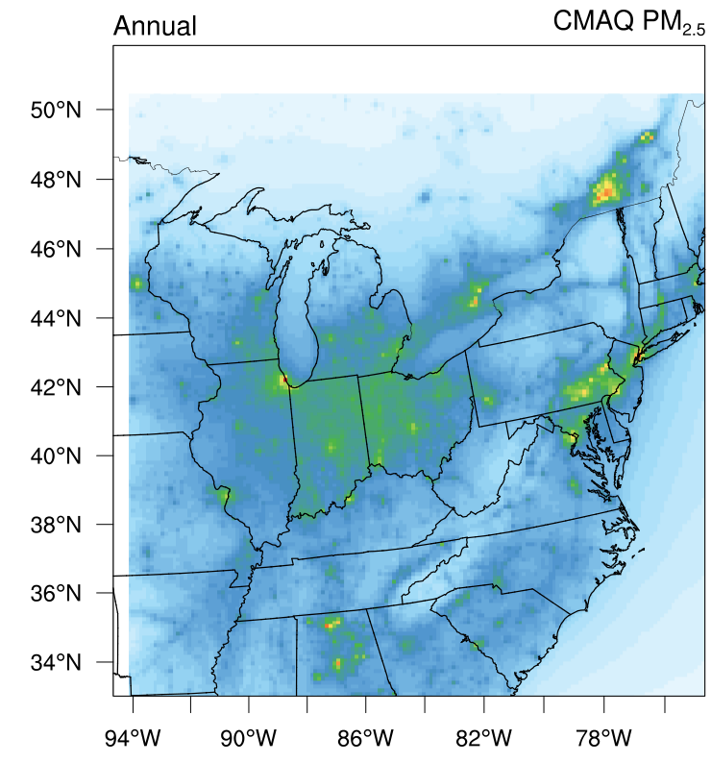
Evaluating existing and newly derived annual mean PM_{2.5} products for the NE U.S.A. (2011)
Multi-satellite/in situ/model fusion
(van Donkelaar et al., 2016)
MODIS-derived
via GC AOD:PM
(X. Jin, HAQAST)
MODIS-derived via CMAQ AOD:PM
(X. Jin, HAQAST)
CMAQ
(c/o NYSDEC)
PM_{2.5} μg/m³
0 5 10 15 20 25
Gauge uncertainties via different approaches
Determine ‘best estimate’ for NYS health impacts studies; try seasonal/daily exposure maps
→ New tool: with Gabriele Curci (University of L'Aquila), adapted GEOS-Chem FlexAOD to calculate CMAQ AOD
Notes:
On a daily basis, evaluation with ground-level PM_{2.5} observations suggests GEOS-Chem matches better temporally but CMAQ matches better spatially

Slide 4
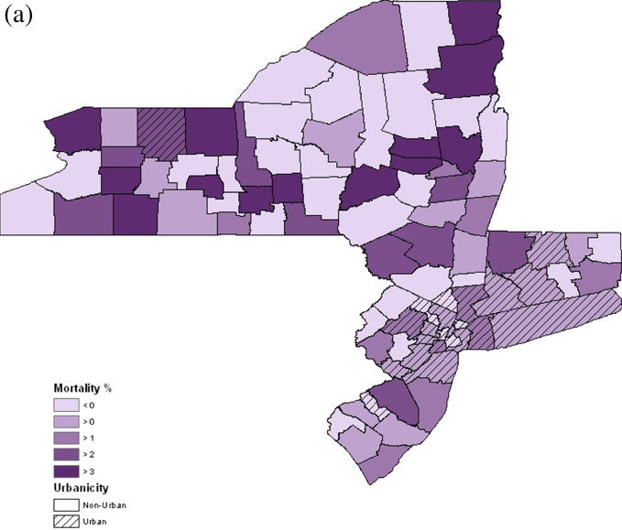
Health Impact Analyses
Quantitative risk assessments for multiple health outcomes in response to modeled/measured changes in (source-specific) PM_{2.5} and O₃.
Determine empirical associations between air pollution and hospital admissions and emergency department visits using time series regression methods.
% Change in Mortality per 10 ppb Change in MD8 Ozone
From: Madrigano, Jack, Anderson, Bell and Kinney, Temperature, ozone and mortality in urban and non-urban counties of the northeastern U.S., Environmental Health, 2015
c/o P. Kinney

Slide 5
Objectives of our proposed core activities
Conduct a multi-pollutant health impact analysis for at least the past decade over NYS
Attribute background vs. U.S. anthropogenic sources of pollution for linkage to health analyses on inter-annual to daily (where possible) time scales
Estimate uncertainties in satellite-based and modeling approaches to source attribution and to exposure mapping at multiple time and space scales

