Slide 1






NASA Air Quality
Applied Sciences Team:
Investigating processes affecting Western U.S. air quality
Arlene M. Fiore
amfiore@ldeo.columbia.edu
Acknowledgments. Olivia Clifton (CU/LDEO), Gus Correa (CU/LDEO),
Larry Horowitz (GFDL), Daniel Jacob (Harvard), Meiyun Lin (Princeton), Vaishali Naik (GFDL), Jacob Oberman (U WI), Lin Zhang (Peking University)
Western Air Quality Modeling Workshop
Boulder, CO, July 11, 2013

Slide 2


Pollution monitoring
Exposure assessment
AQ forecasting
Source attribution Quantifying emissions
Natural & foreign influences
AQ processes
Climate-AQ interactions
satellites
AQAST
suborbital platforms
models
AQAST

Slide 3
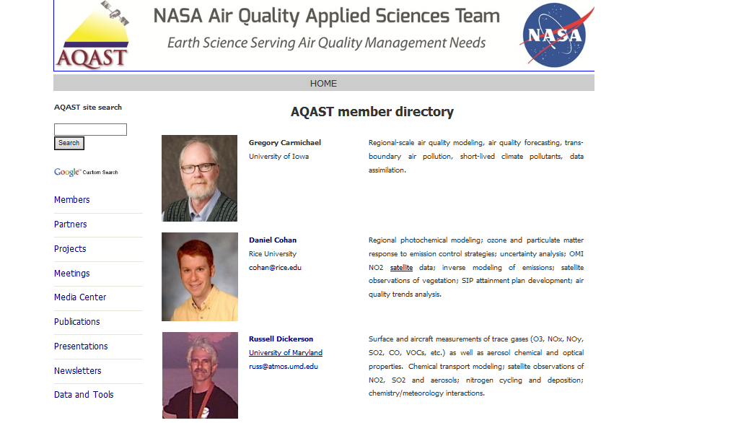
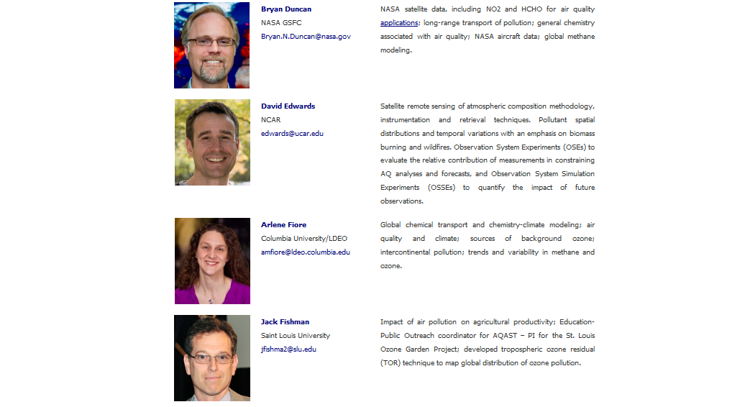
On AQAST website (google AQAST),
click on “members” for list of 19 members and areas of expertise

Slide 4
What makes AQAST unique?
All AQAST projects connect Earth Science and air quality management:
  active partnerships with air quality managers with deliverables/outcomes
  self-organizing to respond quickly to demands
  flexibility in how it allocates its resources
  INVESTIGATOR PROJECTS (IPs): members adjust work plans each year to meet evolving AQ needs
  “TIGER TEAM” PROJECTS (TTs): multi-member efforts to address emerging, pressing problems requiring coordinated activity
www.aqast.org: click on “projects” for brief descriptions + link to pdf describing each project
Tiger Team proposals currently under development (Y3, review in Sept) include:
Web-enabled AQ management tools
AQ reanalysis
Ensemble based AQ forecasting
Emissions & Processes for AQ models
Source attribution for high-O₃ events over EUS
Quantifying oil & gas emissions
Satellite-derived NO_{x} emissions and trends

Slide 5

Some challenges for WUS O₃ air quality management
Warming climate
+in polluted regions
[Jacob & Winner, 2009 review]
+ natural sources
[recent reviews: Isaksen et al., 2009; Fiore et al., 2012]
? Transport pathways
Natural events e.g., stratospheric [Langford et al [2009]; fires [Jaffe & Wigder, 2012]
stratosphere
lightning
methane
Rising Asian emissions
[e.g., Jacob et al., 1999;
Richter et al., 2005;
Cooper et al., 2010]
intercontinental
transport
“Background Ozone”
X
Wildfire, biogenic
Asia
Pacific
Western USA
Need process-level understanding on daily to multi-decadal time scales

Slide 6
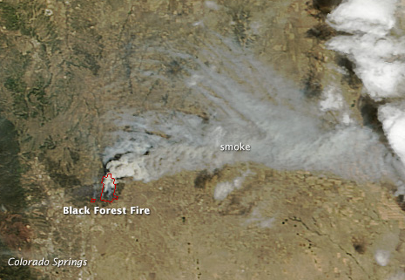
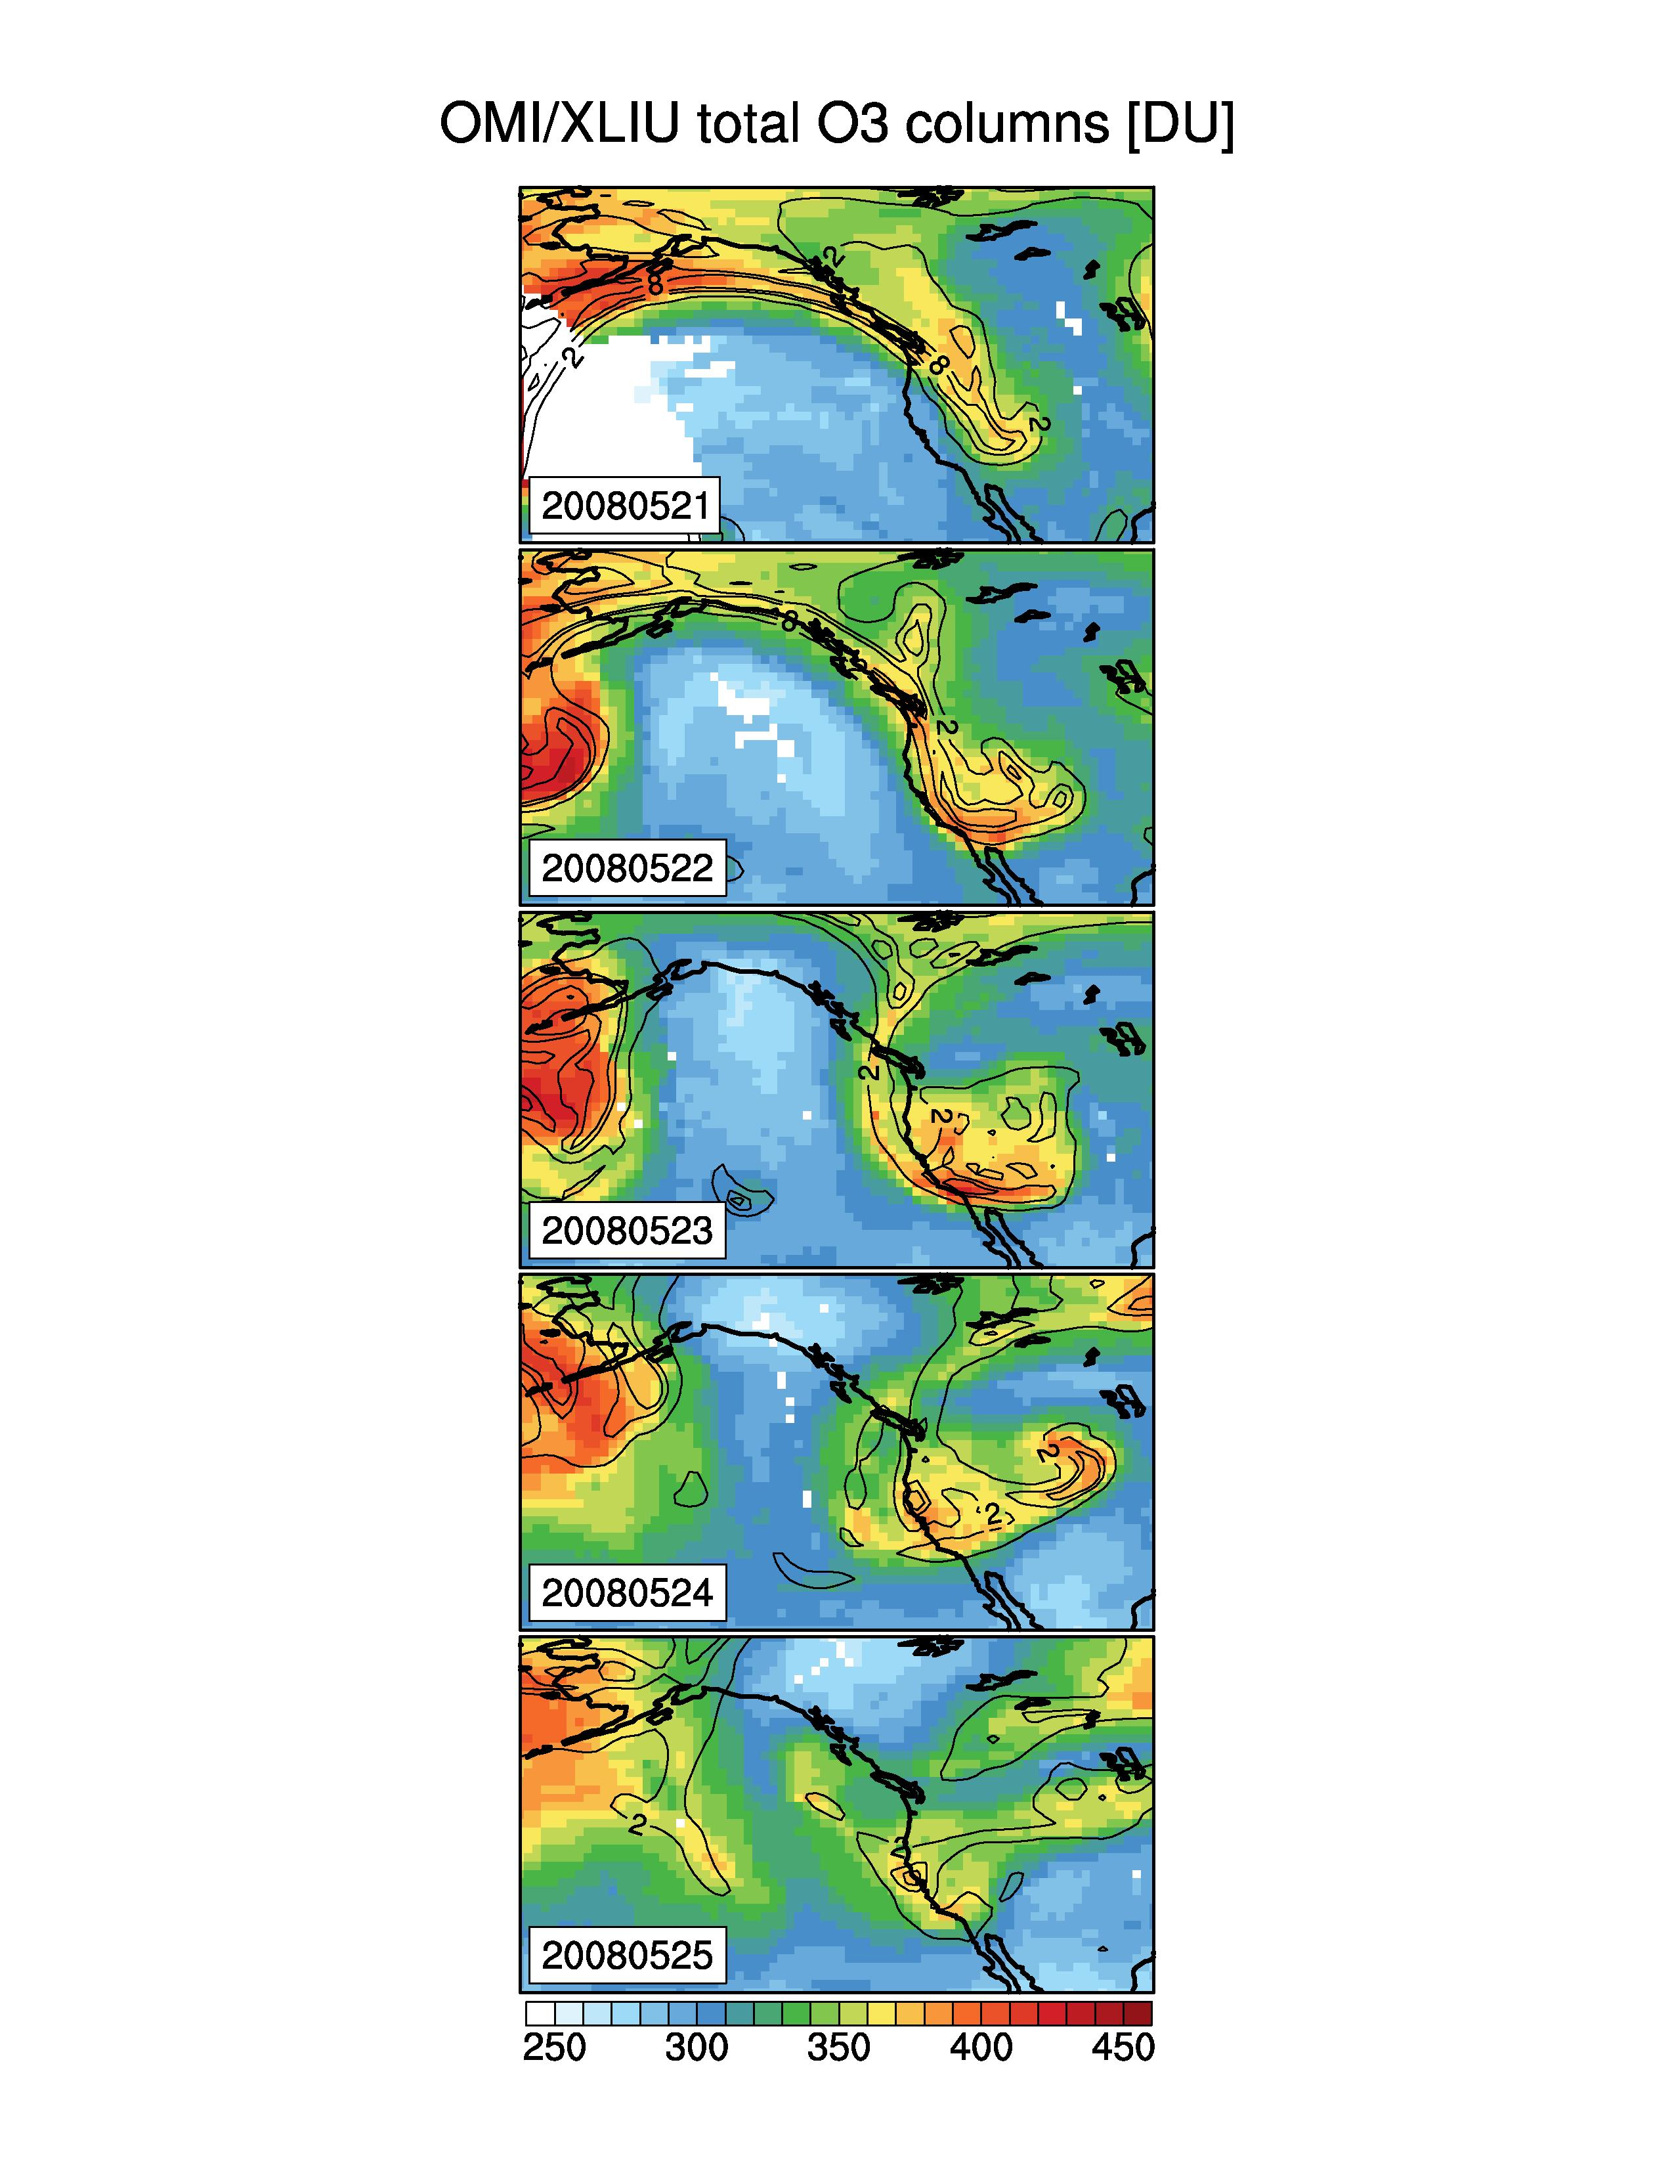
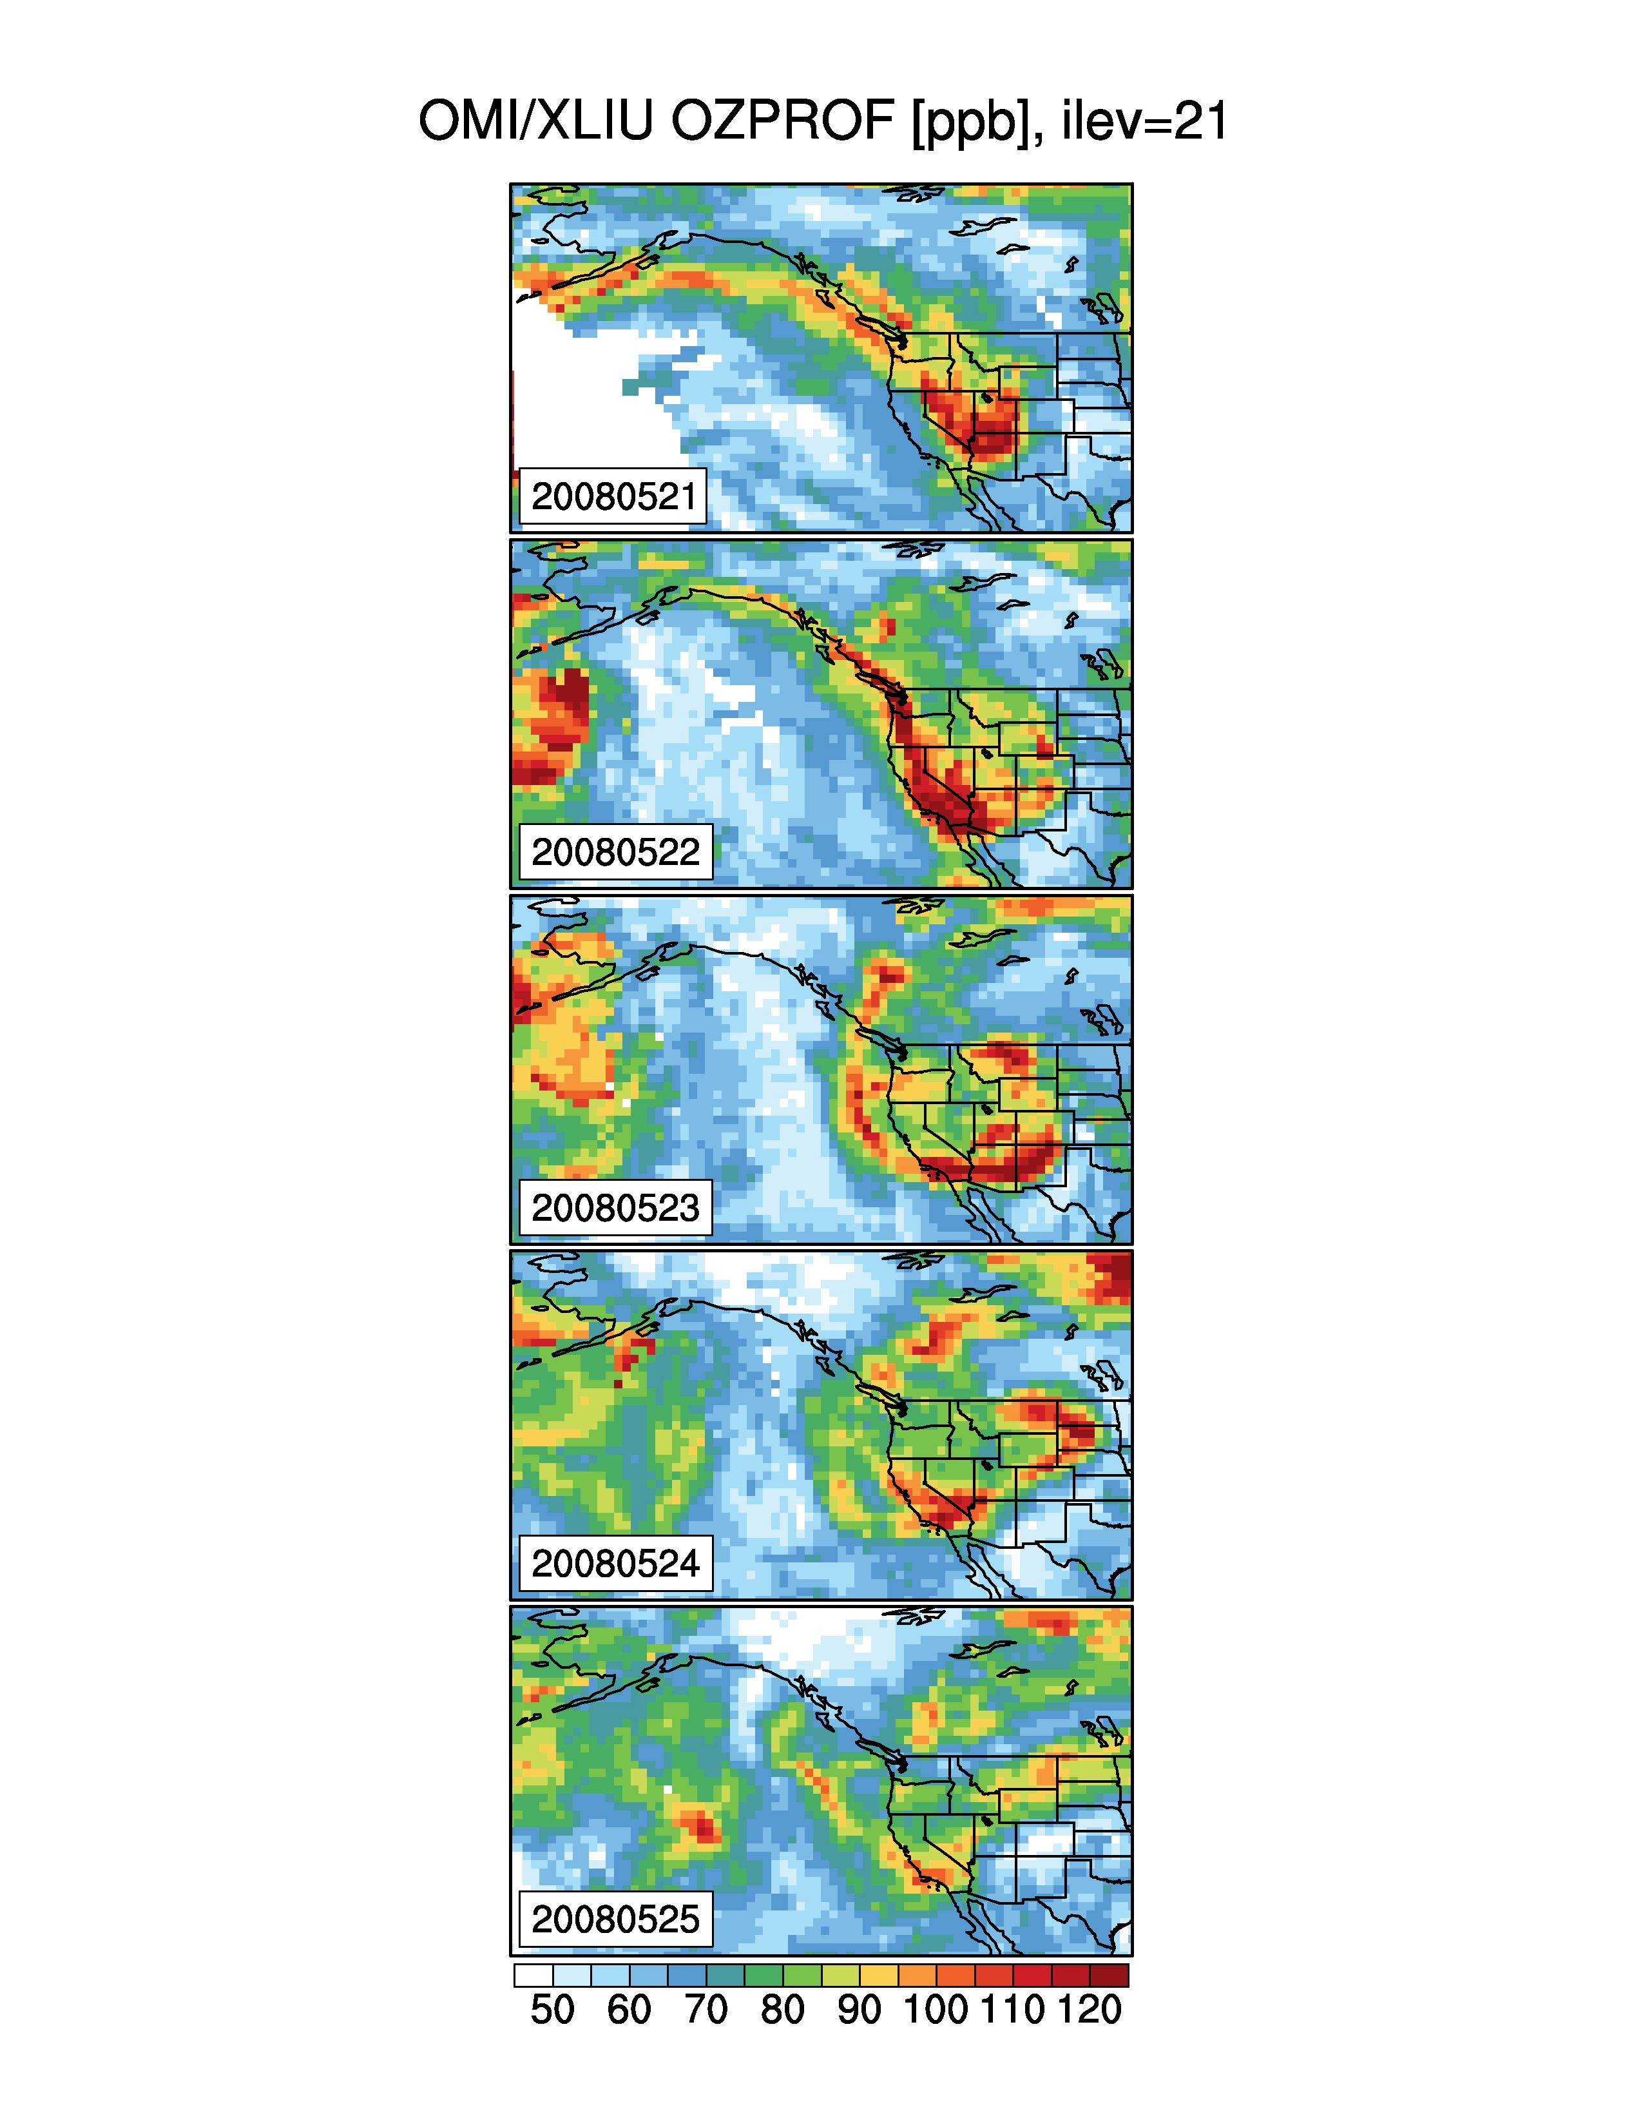
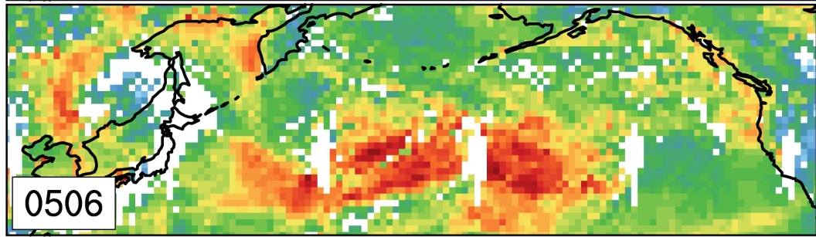
Satellite products indicate potential for contributions from transported “background”
Fires: MODIS
9/15/12
Stratospheric intrusions: OMI
http://earthobservatory.nasa.gov/IOTD/view.php?id=81396
NASA image courtesy Jeff Schmaltz,
LANCE MODIS Rapid Response Team at NASA GSFC.
Total Column O₃
Products from X. Liu, Harvard
c/o M. Lin
Montana
300 hPa PV
[DU]
Black Forest Fire, CO
June 2013
~550-350 hPa O₃
Intercontinental transport: AIRS CO
[ppbv]
May 6, 2010
(Lin et al., 2012a)
Identify exceptional events
→ Estimates of individual background components (with models)
Notes:
GRC; time lag 2 days

Slide 7
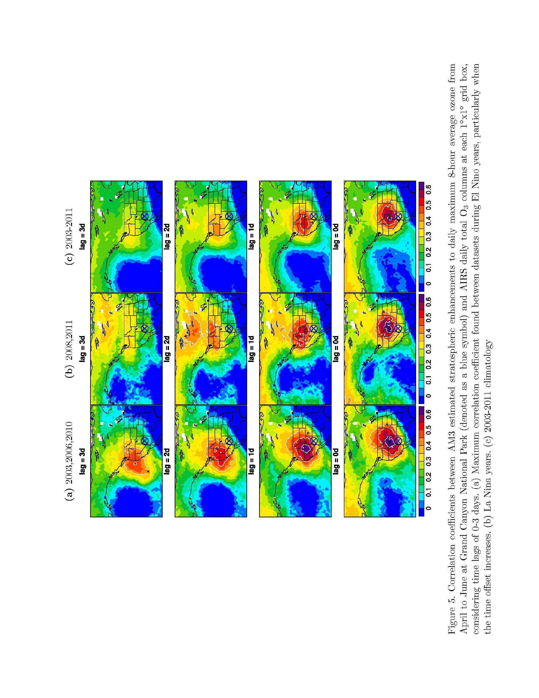
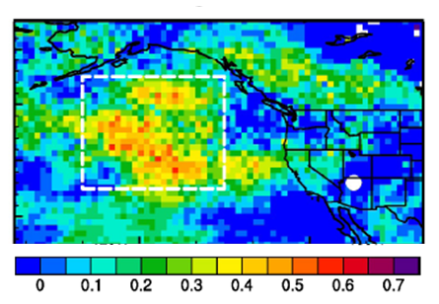
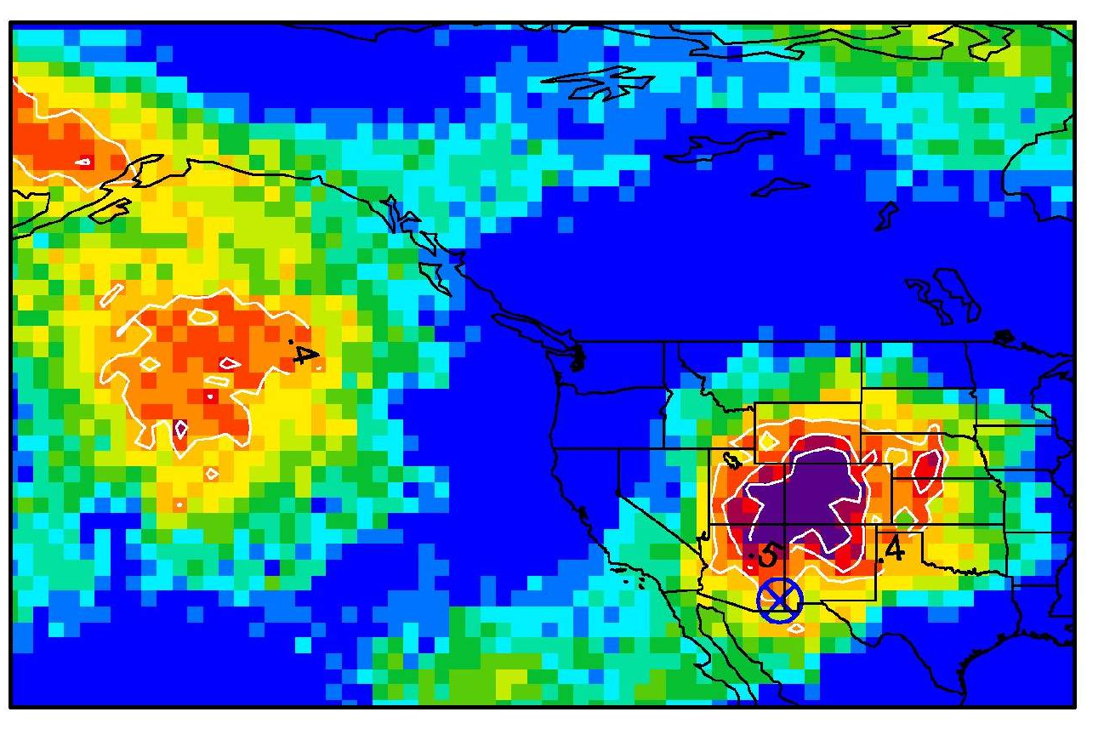
Developing space-based indicators of daily variability associated with Asian pollution and STT events
Correlation coefficients of AM3 daily Asian or Stratospheric O₃ sampled at a selected CASTNet site with AIRS products at each 1ºx1º grid
AM3 Asian O₃ at Grand Canyon NP with AIRS CO columns 2 days prior
May-June, 2010 [Lin et al., 2012a]
AM3 O3S at Chiricahua, NM
with AIRS 300 hPa O₃ (same day)
April-June 2011 [M. Lin]
r
0.6
0.5
0.4
0.3
0.2
0.1
r
0
Site-specific “source” regions for characterizing exceptional events
Ongoing analysis to extend over decades
Advanced warning of Asian/STT impacts?
--e.g., trajectory-based tools from Brad Pierce and colleagues

Slide 8
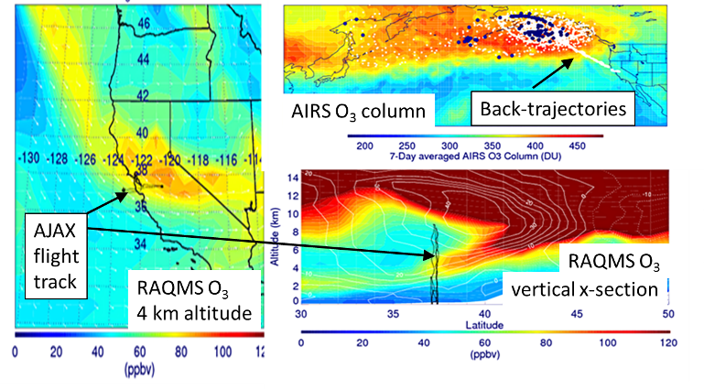
AQAST Highlight: Wyoming Exceptional Event Demonstration
Wyoming DEQ/AQD used AQAST resources to issue an exceptional event demonstration package for an ozone exceedance at Thunder Basin, June 6, 2012
R.B. Pierce et al.

Slide 9
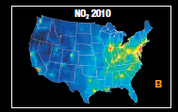
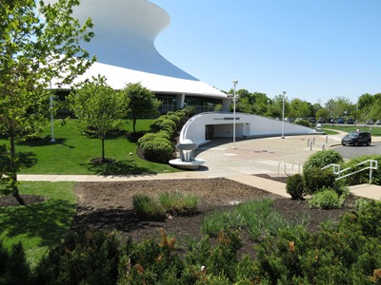
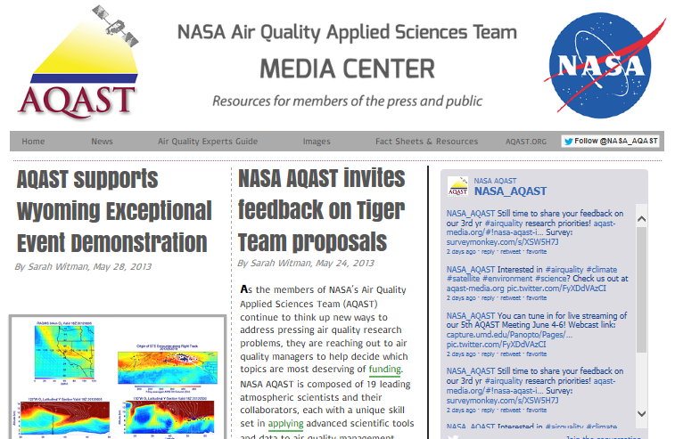
AQAST progress towards an
OMI AQ management toolkit
Communications
and outreach
1. Easily obtain useful data in familiar formats
Custom OMI NO₂ “Level 3” products on any grid in netCDF with WHIPS (Holloway)
Annual NO₂ shapefiles - OMI & CMAQ on CMAQ grids (AQAST Tiger Team)
Google Earth
2. Find easy-to-use guidance & example scripts for understanding OMI products and comparing to simulated troposphere & PBL concentrations
One-stop user portal (Holloway & AQAST Tiger Team)
OMI NO₂ & SO₂ guidance, field campaign example case studies (Spak & AQAST Tiger Team)
3. Obtain OMI observational operators for assimilation & emissions inversion in CMAQ
NO₂ in GEOS-Chem ➔ CMAQ (Henze, Pye)
SO₂ in STEM ➔ CMAQ (Spak, Kim)
O₃ in STEM ➔ CMAQ (Huang, Carmichael, Kim)
PI: Duncan
NO₂ trends lenticular
PI: Fishman
St. Louis ozone garden
AQAST PIs: Carmichael, Spak
Notes:
WHIPS = Wisconsin Horizontal Interpolation

Slide 10
Tiger Team activity: Key factors contributing to differences in model estimates for O₃ “background”
Problem: Poorly quantified errors in background distributions complicate NAAQS-setting and interpreting SIP attainment simulations
To date, EPA N. American Background estimates provided by one model.
Approach:
Compare GFDL AM3 and GEOS-Chem NAB (Mar-Aug 2006)
Process-oriented analysis of factors contributing to model differences
YEAR 2006 | GEOS-Chem | GFDL AM3
Resolution | ½°x⅔° (and 2°x2.5°) | ~2°x2°
Meteorology | Offline (GEOS-5) | Coupled, nudged to NCEP U and V
Strat. O₃ & STE | Parameterized (Linoz) | Full strat. chem & dynamics
Isoprene nitrate chemistry | 18% yield w/ zero NO_{x} recycling | 8% yield w/ 40% NO_{x} recycling (obs based; Horowitz et al, 2007)
Lightning NO_{x} | tied to model convective clouds, scaled to obs. flash climat; higher NO_{x} at N. mid-lat | tied to model convective clouds
Emissions | NEI 2005 + 2006 fires (emitted at surface) | ACCMIP historical + RCP4.5 (2005, 2010); vert. dist. climatological fires
ALL DIFFERENT!
Notes:
10

Slide 11
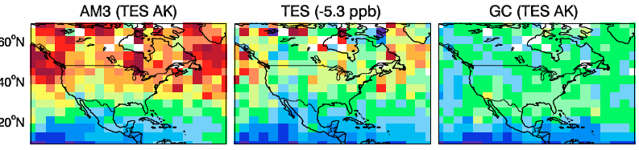
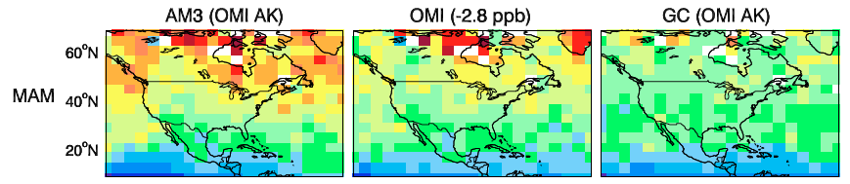
Constraints on springtime background O₃ from
mid-tropospheric satellite (OMI, TES) products (2006)
Bias vs sondes subtracted from retrievals as in Zhang et al., ACP, 2010
L. Zhang, Harvard
  AM3 generally high; GEOS-Chem low
  Implies that the models bracket the true background
  Probe role of specific processes
Notes:
11

Slide 12
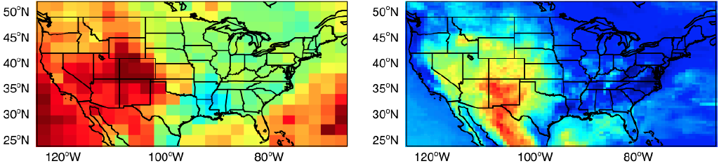
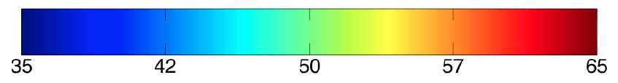
Estimates of North American background in 2 models
(simulations with N. American anth. emissions set to zero)
Fourth-highest North American background MDA8 O₃
in model surface layer between Mar 1 and Aug 31, 2006
AM3 (~2°x2°)
GEOS-Chem (½°x⅔°)
35 42 50 57 65
ppb
J. Oberman
Higher background:
More exchange with surface?
Larger stratospheric influence?
High AM3 bias in EUS;
caution on N. Amer. Background here!
Excessive lightning NO_{x} in summer
Models robustly agree N. American background is higher at altitude in WUS
Multi-model enables error estimates, in context of observational constraints
Notes:
12

Slide 13
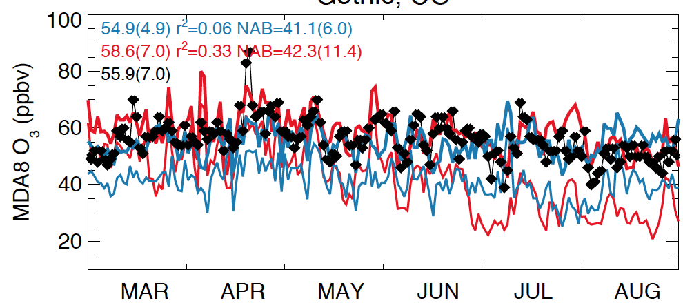
Models differ in day-to-day and seasonal variability of
North American background: Gothic, CO (107W, 39N, 2.9 km)
Fig 3-58 of EPA O₃ Integrated Science Assessment
GEOS-Chem ( ½°x⅔° ) GFDL AM3 (~2°x2°) OBS.
Mean(σ)
Total model O₃
Model NAB O₃
→ Models bracket OBS; similar mean N. American background (NAB)
→ GC NAB variability (σ) ~2x smaller than in AM3
→ AM3 NAB > GC NAB in MAM; reverses in JJA (lightning)
Impact of model biases on 4th highest NAB (AM3 in March; GC in August)
Notes:
Show 2 western US sites?
13

Slide 14
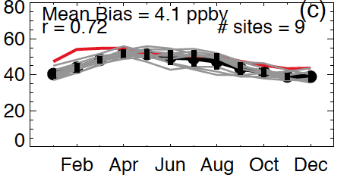
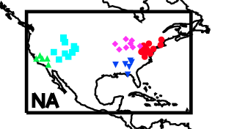
GFDL CM3 chemistry-climate model roughly captures decadal mean seasonal cycle over the Mountainous West
Monthly mean ozone (ppb)
GFDL CM3 1995-2005 mean
Individual CASTNet sites (1998-2009)
Regional mean at CASTNet sites
O. Clifton
Notes:
Swap out RCP8.5 with new version from Olivia

Slide 15
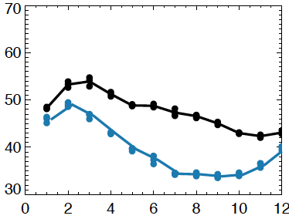
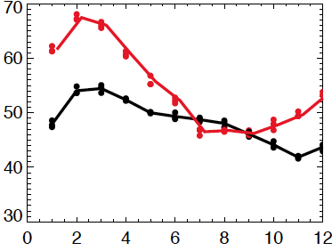
Mtn. West (36-46N, 105-115W) surface O₃ 21st C Projections
Transient simulations (climate + emissions) with GFDL CM3 model
EMISSION PROJECTIONS
2005 to 2100 % change
2006-2015
2091-2100 RCP4.5
RCP8.5
extreme
RCP4.5
moderate
NO_{x}
decreases
Global
NO_{x}
USA NO_{x}
WUS NO_{x}
CO₂
CH₄
2006-2015
2091-2100 RCP8.5
NO_{x} reductions decrease O₃ in all months under RCP4.5
Higher O₃ in RCP8.5 in cooler months despite NO_{x} decreases
WHY?
O. Clifton
Notes:
Swap out RCP8.5 with new version from Olivia

Slide 16
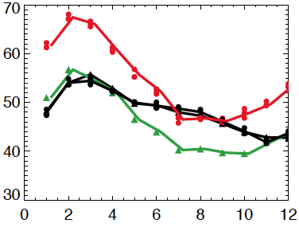
Mtn. West (36-46N, 105-115W) surface O₃ 21st C Projections
Transient simulations (climate + emissions) with GFDL CM3 model
EMISSION PROJECTIONS
2005 to 2100 % change
2006-2015
2091-2100 RCP4.5
RCP8.5
extreme
RCP4.5
moderate
NO_{x}
decreases
Global
NO_{x}
USA NO_{x}
WUS NO_{x}
CO₂
CH₄
2006-2015
2091-2100 RCP8.5
NO_{x} reductions decrease O₃ in all months under RCP4.5
Higher O₃ in RCP8.5 in cooler months despite NO_{x} decreases
More-than-doubling of global CH₄ offsets NO_{x}-driven decreases
→ Shifting balance of
regional-vs-global sources
2091-2100 RCP8.5
but 2005 CH₄
Notes:
Swap out RCP8.5 with new version from Olivia

Slide 17

How does climate affect air quality?
(1) Meteorology (stagnation vs. well-ventilated boundary layer)
Degree of mixing
strong
mixing
Boundary layer depth
pollutant sources
(2) Feedbacks from Emissions, Deposition, Chemistry
T
Increase with
T, drought?
NO_{x}
OH
Not included
in results on
previous slide
VOCs
Deposition
PAN
H₂O
CONSIDERATIONS FOR FUTURE SCENARIOS
Land-use change influences emissions from the biosphere
  Driving datasets for biogenic VOC, NO_{x}, CH₄, fires, deposition?
Regional climate responses not robust across modeling systems
  Not just climate change: how does climate variability influence air pollution?

Slide 18
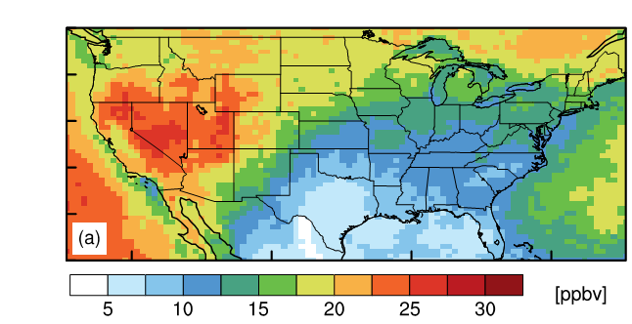
Insights into processes affecting Western U.S. Air Quality from integrated analyses (models, satellite, in situ data)
NASA Air Quality Applied Science Team: www.aqast.org
Earth Science Resources → AQ management needs
AQAST members want to hear from you!
Addressing WUS background O₃:
  -- quantifying components: Asian, strat, fires
  -- harness strengths of multiple models + obs.
  error characterization for AQ metrics (MDA8, W126)
  contribute to SIP modeling (BCs, input datasets)
  -- developing tools for exceptional event analysis
  simple correlations to chemical data assimilation
  -- impacts from global change in 21st C
  shifting balance of local vs. transported O₃ (methane)
  -- climate change, variability and predictability
AM3 model stratospheric O3 (ppb): Apr-Jun 2010 [Lin et al., 2012b]
Estimates of N Amer. Background (Gothic, CO) from 2 models
Asian pollution ‘forecasting’ [Lin et al., 2012a]
Monthly surface O₃ over Mtn West
2006-2015
2091-2100 RCP8.5
2091-2100 RCP8.5
but 2005 CH₄
amfiore@ldeo.columbia.edu

