Slide 1


Anthropogenic and biogenic contributions to intercontinental transport of ozone pollution
at northern mid-latitudes
Arlene M. Fiore
Arlene.Fiore@noaa.gov
Acknowledgments:
Yuanyuan Fang, Larry Horowitz, Chip Levy,
Meiyun Lin, Vaishali Naik (NOAA GFDL)
Emily Fischer, Dan Jaffe (U Washington)
Shubha Pandey, Johannes Staehelin (ETH Zurich)
TF HTAP Modeling Team & Many Measuring PAN
Topics in Atmospheric and Oceanic Sciences Seminar
Stony Brook University, NY
September 22, 2010

Slide 2
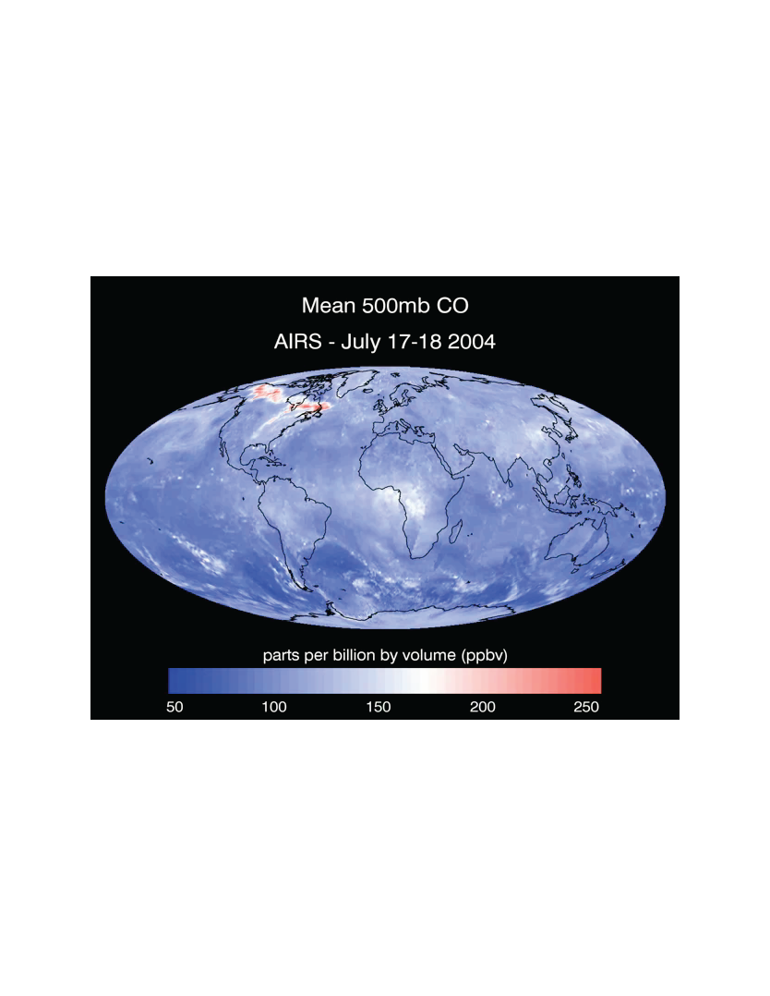
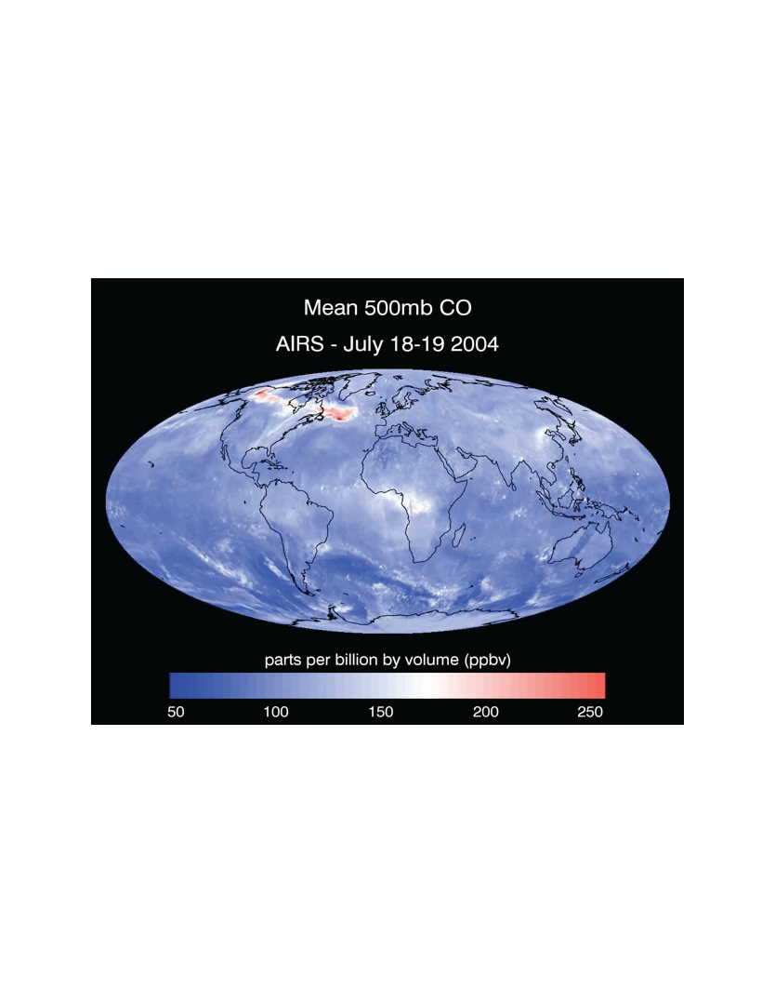
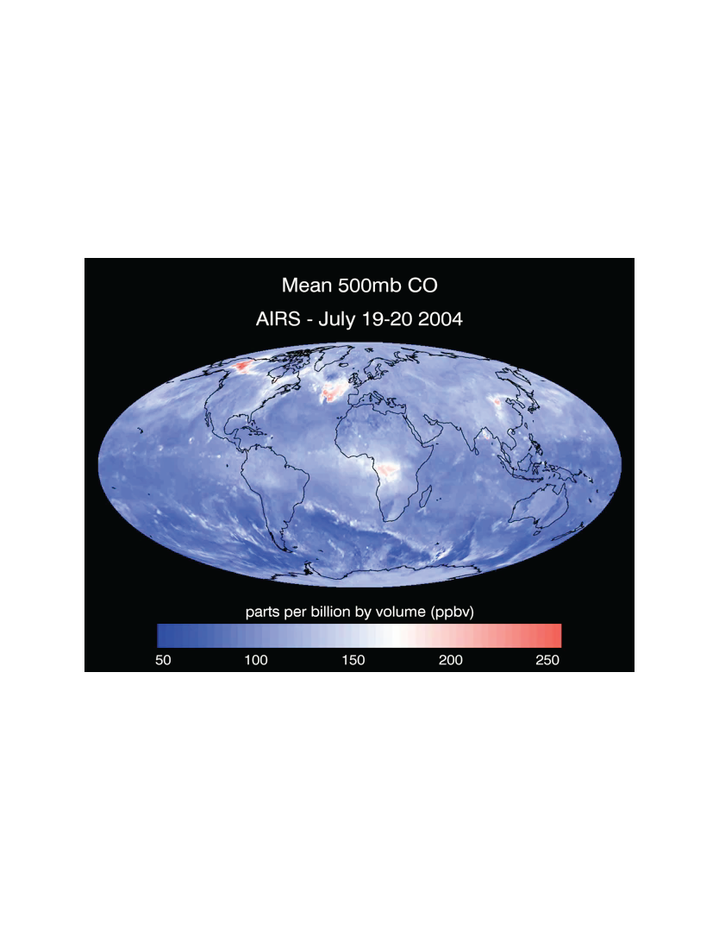
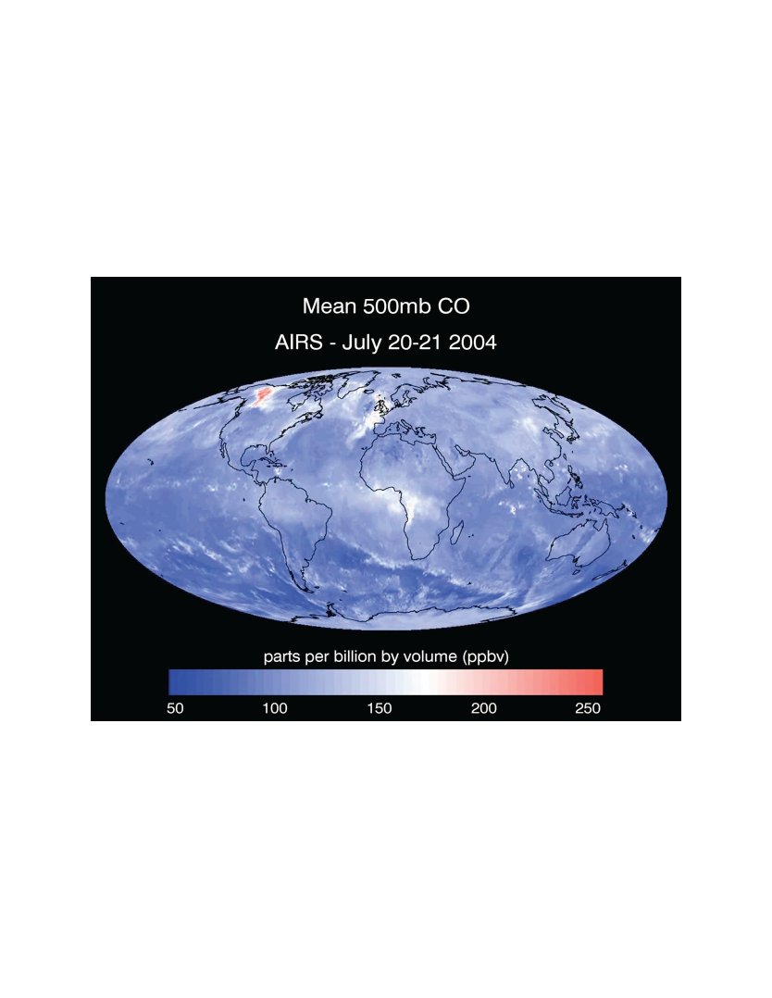
Observing intercontinental transport at northern mid-latitudes: July 2004 Alaskan and Canadian Fires
Mean 500 mb carbon monoxide (combustion effluent)
retrieved from the AIRS instrument (http://airs.jpl.nasa.gov)
Image credit: NASA/JPL; http://photojournal.jpl.nasa.gov/catalog/PIA11034
Frames c/o Yuanyuan Fang, Princeton/GFDL

Slide 3
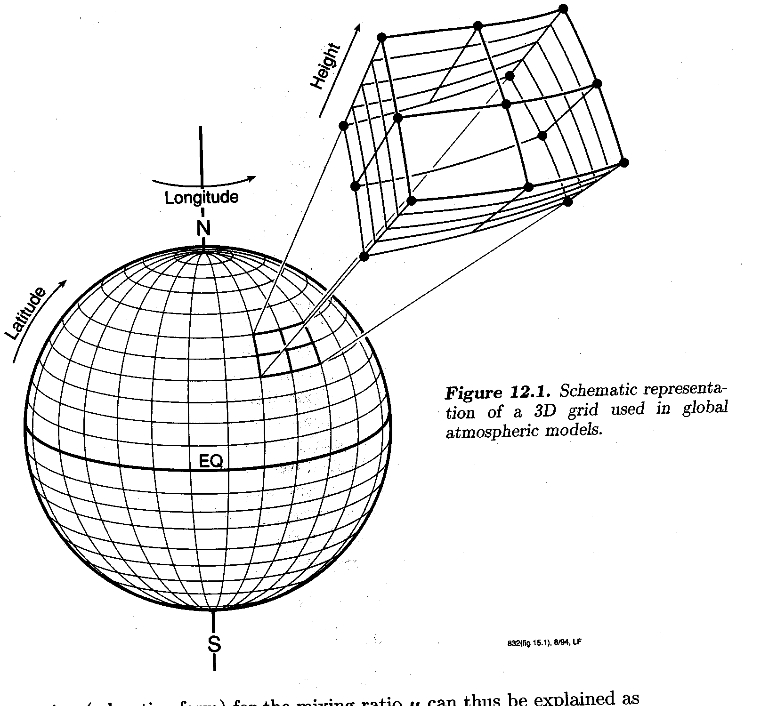
Intercontinental influence on surface ozone may occur mainly through “hemispheric background”
Intercontinental ozone transport is difficult (impossible?) to observe directly at surface [e.g., Derwent et al., 2003; Fiore et al., 2003; Goldstein et al., 2004; Jonson et al., 2005]
Estimates rely on models (evaluated with observations)
3D Model Structure
Long-term measurements should contain information on tropospheric (and surface) O₃ response to trends in emissions (key tests for models?)

Slide 4
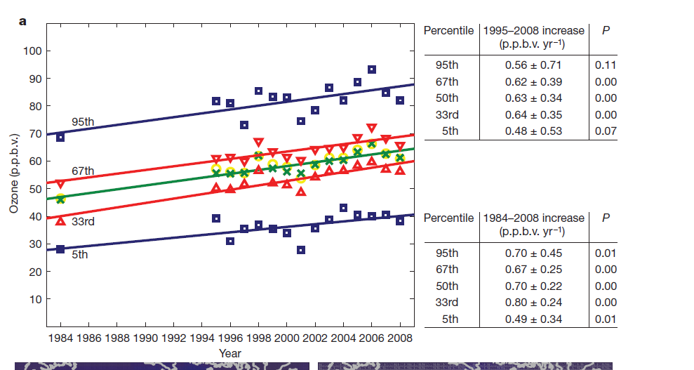
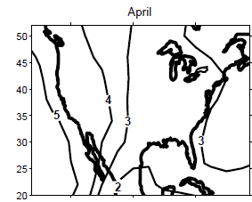
Observational and modeling evidence indicates rising baseline tropospheric O₃ from human activities
Observed free tropospheric O₃ (3-8km)
over the western U.S. in spring
[Cooper et al., Nature, 2010]
Modeled increase in surface O₃ due to tripling Asian anthropogenic emissions from 1985 to 2010
[Jacob et al., GRL, 1999]
How much free tropospheric Asian pollution mixes into surface air?

Slide 5
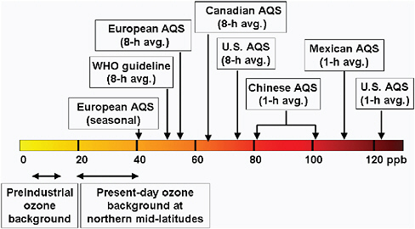
Rising background O₃ has implications
for attaining ever-tightening air quality standards
Figure 2.1 from NRC 2009 report,
“Global sources of local pollution”;
original content from D.J. Jacob
Observational evidence for increasing surface O₃ background [e.g. Lin et al., 2000; Jaffe et al., 2003, 2005; Vingarzan, 2004; EMEP/CCC-Report 1/2005 ; Derwent et al., 2007; Jaffe and Ray, 2007; Royal Society, 2008; NRC, 2009 ]

Slide 6
Human activities and “natural” sources influence intercontinental O₃ transport
CH₃C(O)OONO₂
O₃, PAN
O₃
PAN
lightning
NO_{x}+ NMVOC
O₃
OCEAN
Fires
Biosphere
Human
activity
OCEAN
CONTINENT
CONTINENT
2.
1.
PAN as a PATHWAY: contributes to O₃ formation far from source region [e.g., Moxim et al., 1996; Heald et al., JGR, 2003; Hudman et al., JGR, 2004;Zhang et al., 2008; Fischer et al., 2010]
→ PAN as a PROXY: may reflect changing O₃ precursor sources better than O₃ itself [Jaffe et al., 2007; Fischer et al., 2010]
A. Fiore

Slide 7
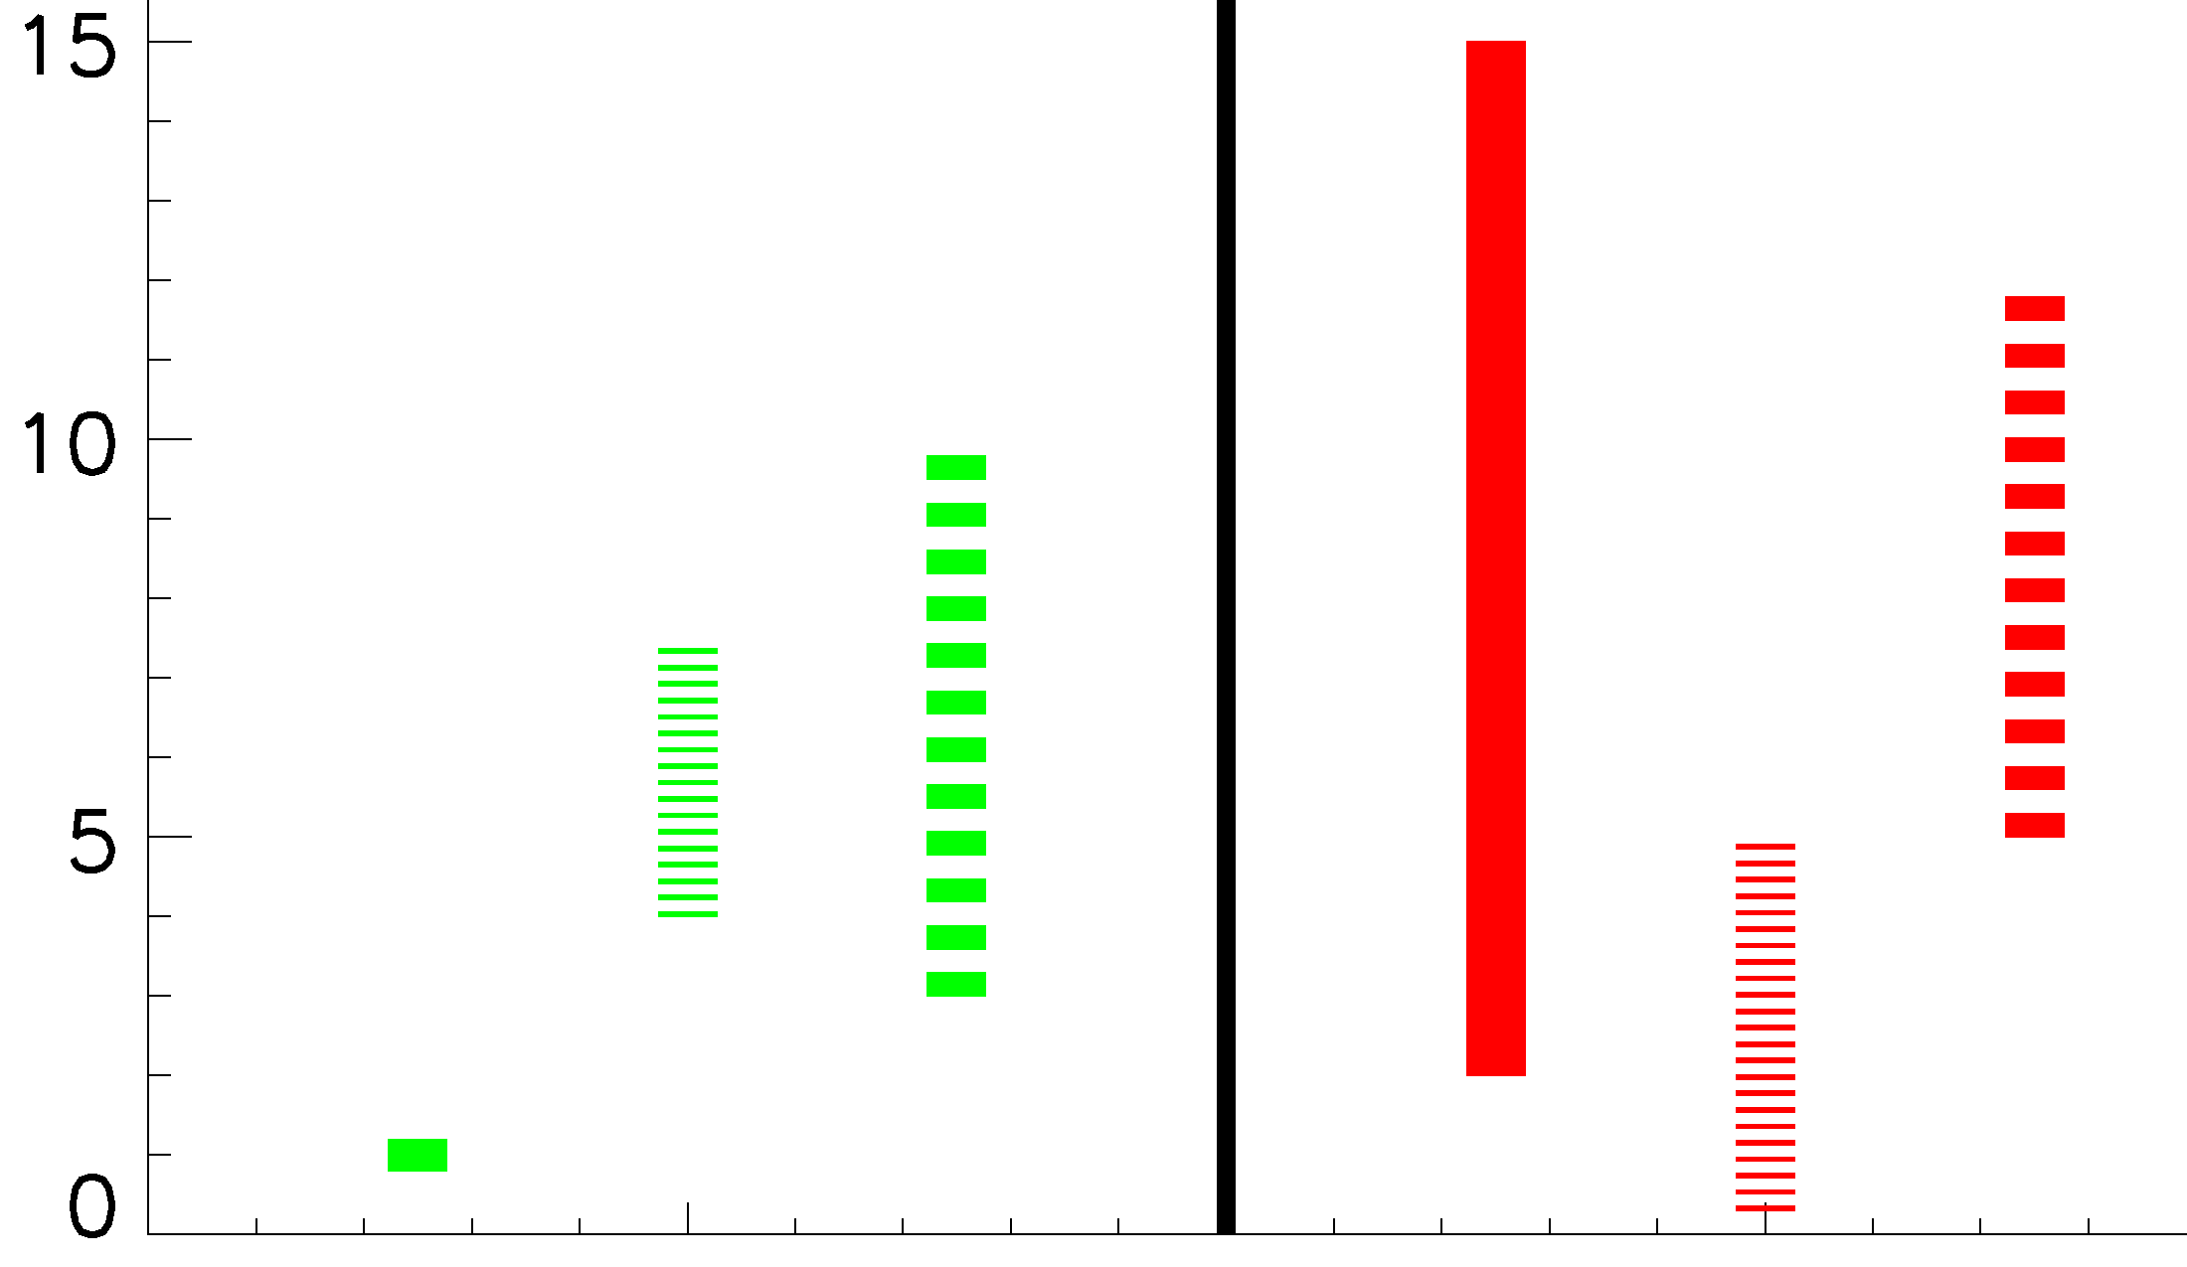
Wide range in prior estimates of intercontinental surface ozone source-receptor (S-R) relationships
ASIA → NORTH AMERICA
NORTH AMERICA → EUROPE
annual mean
events
events
seasonal
mean
Surface O₃ contribution
from foreign region (ppbv)
seasonal
mean
annual mean
Studies in TF HTAP [2007] + Holloway et al., 2008; Duncan et al., 2008; Lin et al., 2008
Assessment hindered by different (1) methods, (2) reported metrics, (3) meteorological years, (4) regional definitions
Few studies examined all seasons
A. Fiore

Slide 8
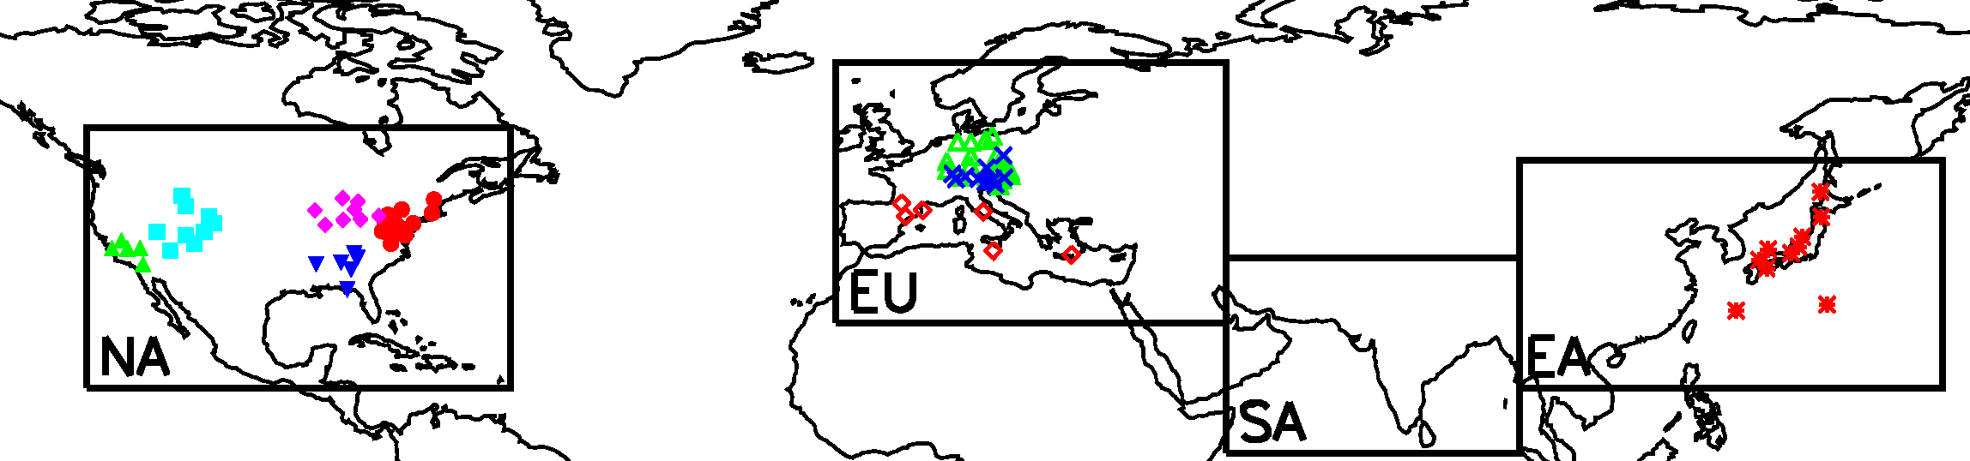
Multi-model effort to quantify & assess uncertainties in N. mid-latitude hemispheric O₃ transport (www.htap.org)
Task Force on Hemispheric Transport of Air Pollution
(TF HTAP) to inform policy negotiations under CLRTAP
CASTNet
EMEP
EANET
BASE SIMULATION (21 models):
→ horizontal resolution of 5°x5° or finer
→ 2001 meteorology
→ each group’s best estimate for 2001 emissions
→ methane set to 1760 ppb
SENSITIVITY SIMULATIONS (13-18 models):
→ -20% regional anthrop. NO_{x}, CO, NMVOC emissions,
individually + all together (=16 simulations)
TF HTAP, 2007, 2010; Sanderson et al., GRL, 2008; Shindell et al., ACP, 2008; Fiore et al., JGR, 2009,
Reidmiller et al. ACP, 2009; Casper Anenberg et al., ES&T, 2009; Jonson et al., ACPD,2010
A. Fiore

Slide 9
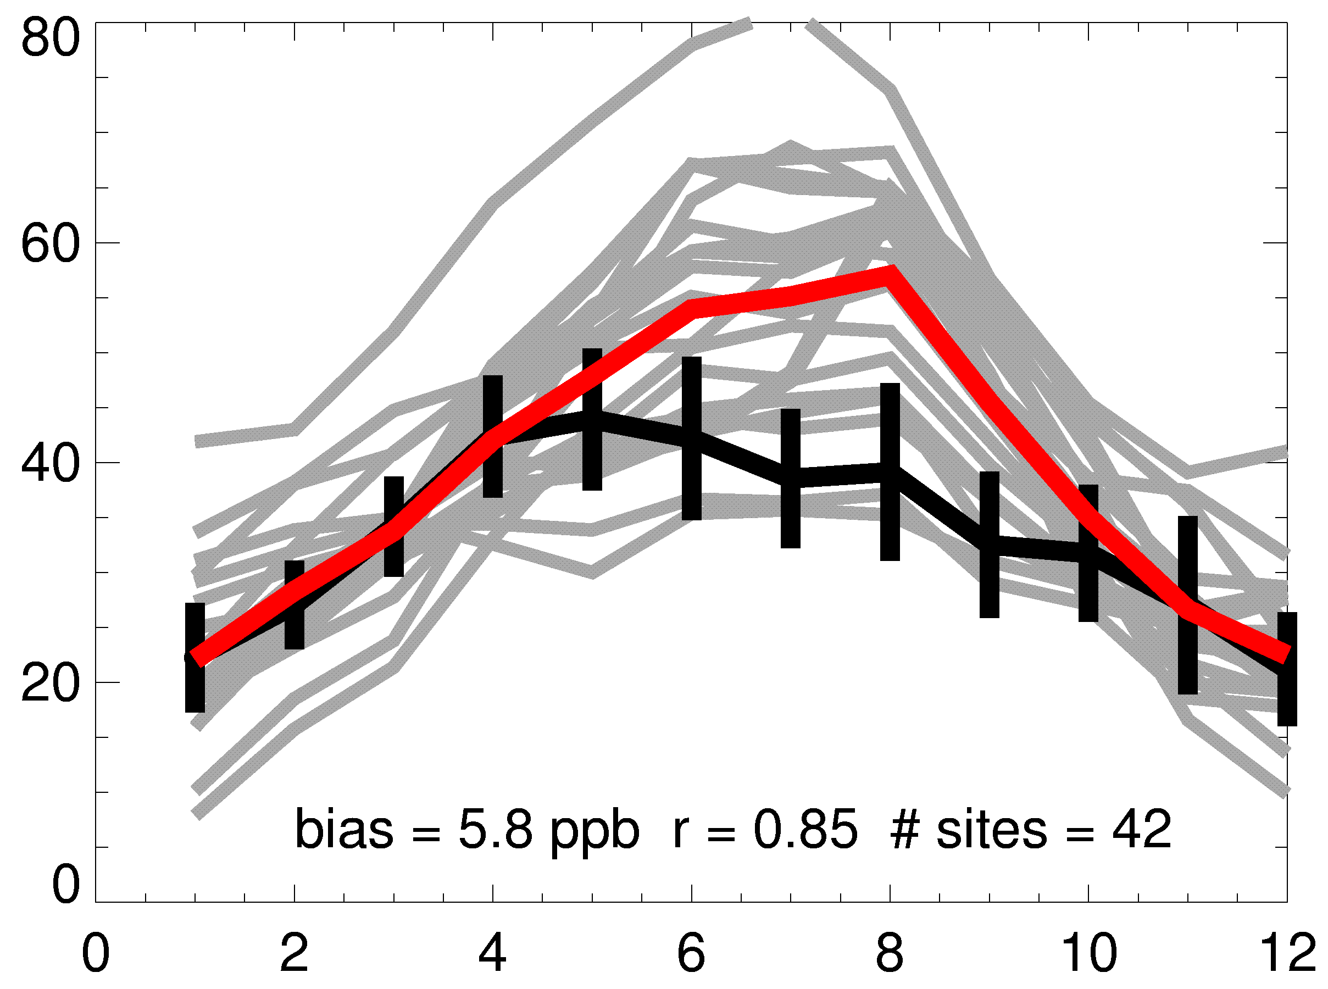
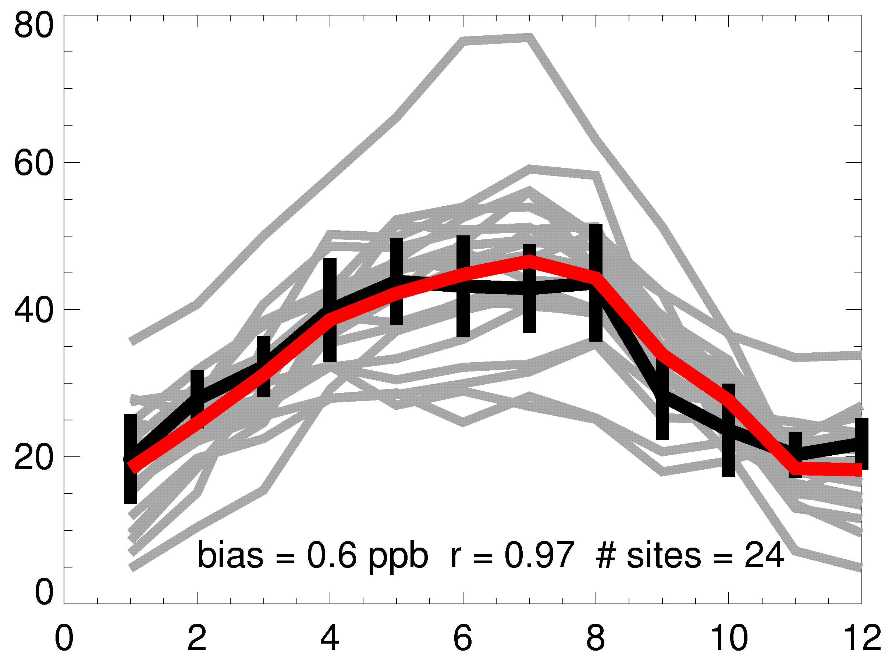
Multi-model mean captures obs in spring, when hemispheric transport at N. mid-latitudes peaks
Monthly mean surface O₃
EASTERN USA
CENTRAL EUROPE
INDIVIDUAL
MODELS
OBS (EMEP)
MODEL ENS. MEAN
Surface Ozone (ppb)
OBS (CASTNet)
High bias over EUS
in summer and early fall
Month of 2001
Seasonal cycle
captured over Europe
What observational constraints would best test model suitability for intercontinental transport?
A. Fiore

Slide 10
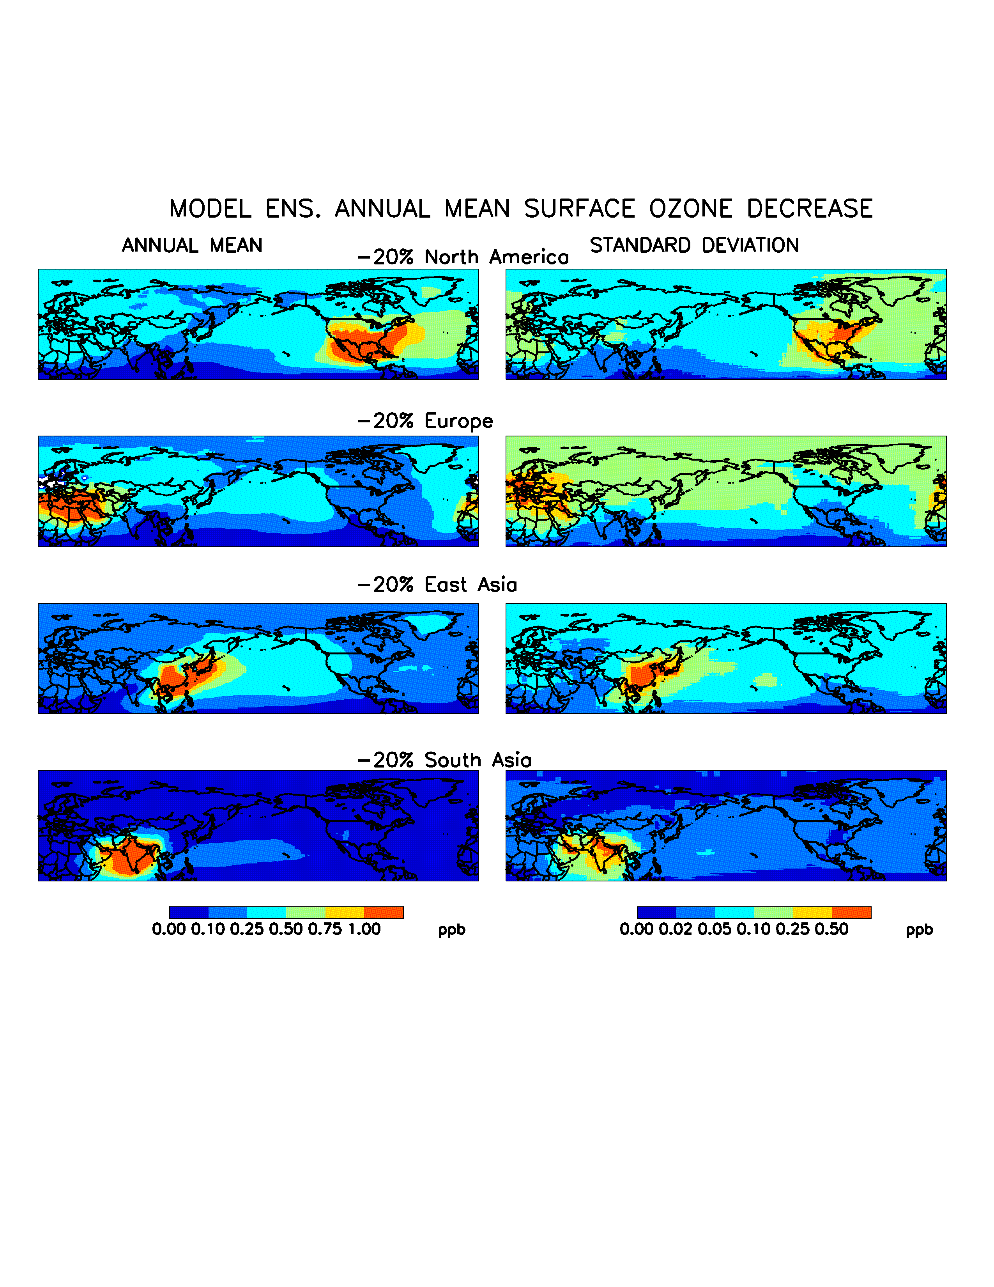
Model ensemble annual mean decrease in surface O₃ from 20% reductions of regional anthrop. O₃ precursors
Foreign vs. “domestic” influence over NA:
(1.64)
Full range of
15 individual
models
NA
EU
ppbv
“domestic”
“sum 3 foreign”
EA
Source region: NA EU EA SA EU+EA+SA
Spatial variability
over continental-
scale receptor
region (NA)
(see also Reidmiller
et al, 2009;
Lin et al., 2010)
∑ 3 foreign
= 0.45
domestic
SA
“import sensitivity”
ppbv
Fiore et al., JGR, 2009

Slide 11
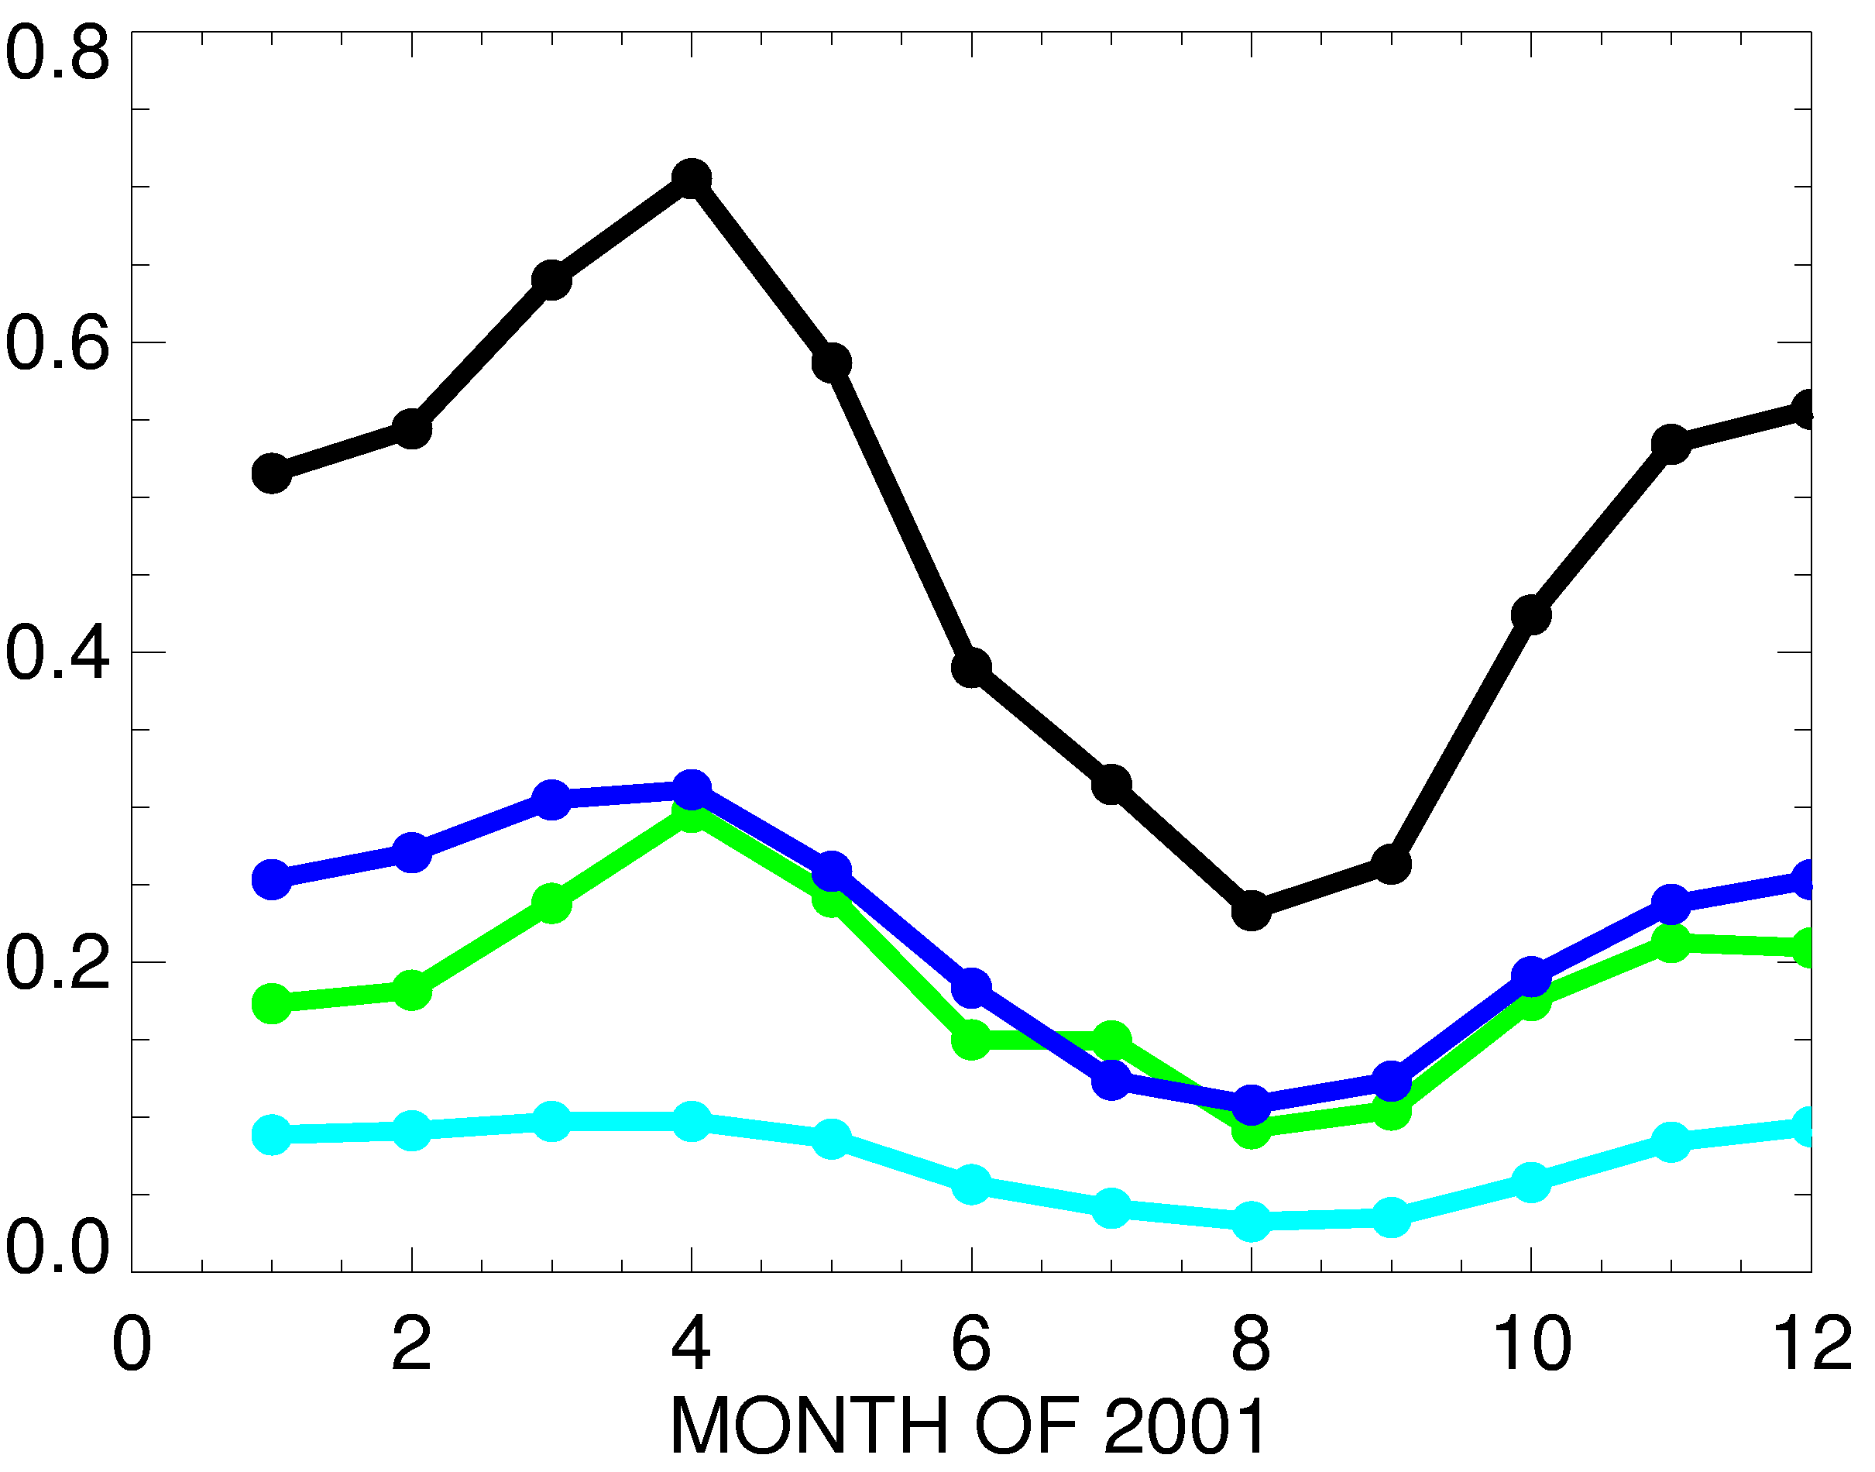
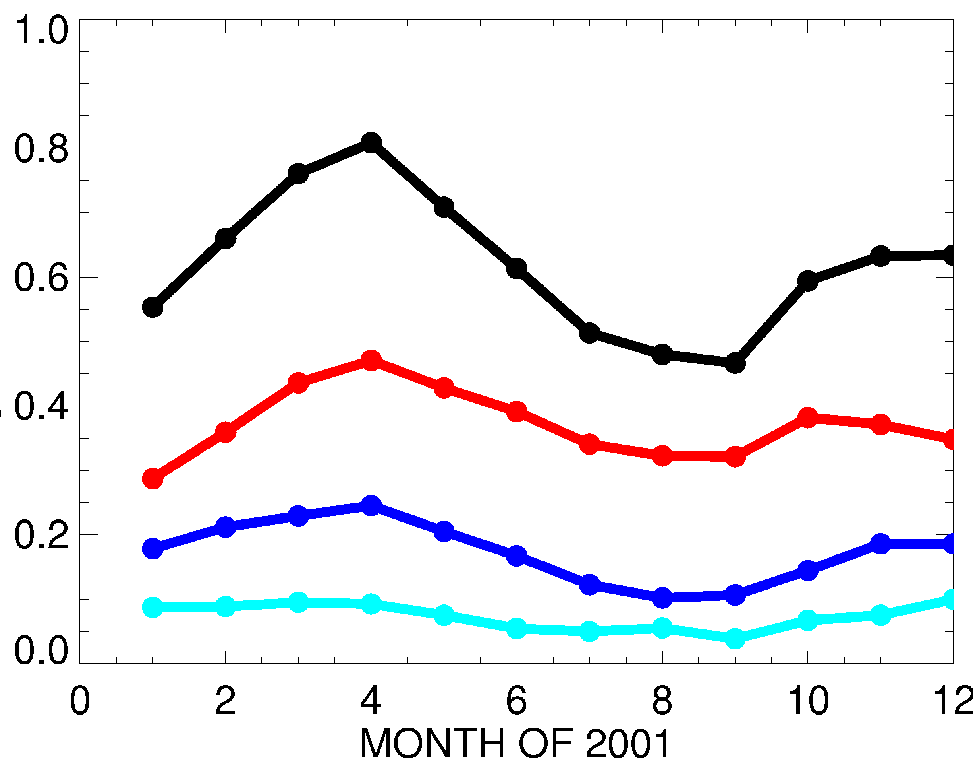
Seasonality of surface ozone response over North America and Europe to -20% foreign anthrop. emissions
Source region: SUM3 NA EA EU SA
Receptor = NA
Receptor = EU
15- MODEL MEAN SURFACE
O₃ DECREASE (PPBV)
Spring max due to longer O₃ lifetime, efficient transport [e.g., Wang et al., 1998; Wild and Akimoto, 2001; Stohl et al., 2002; TF HTAP 2007]
Response typically smallest to SA emissions (robust across models)
Similar response to EU& EA emissions over NA Apr-Nov (varies by model)
NA>EA>SA over EU (robust across models)
Fiore et al., JGR, 2009

Slide 12
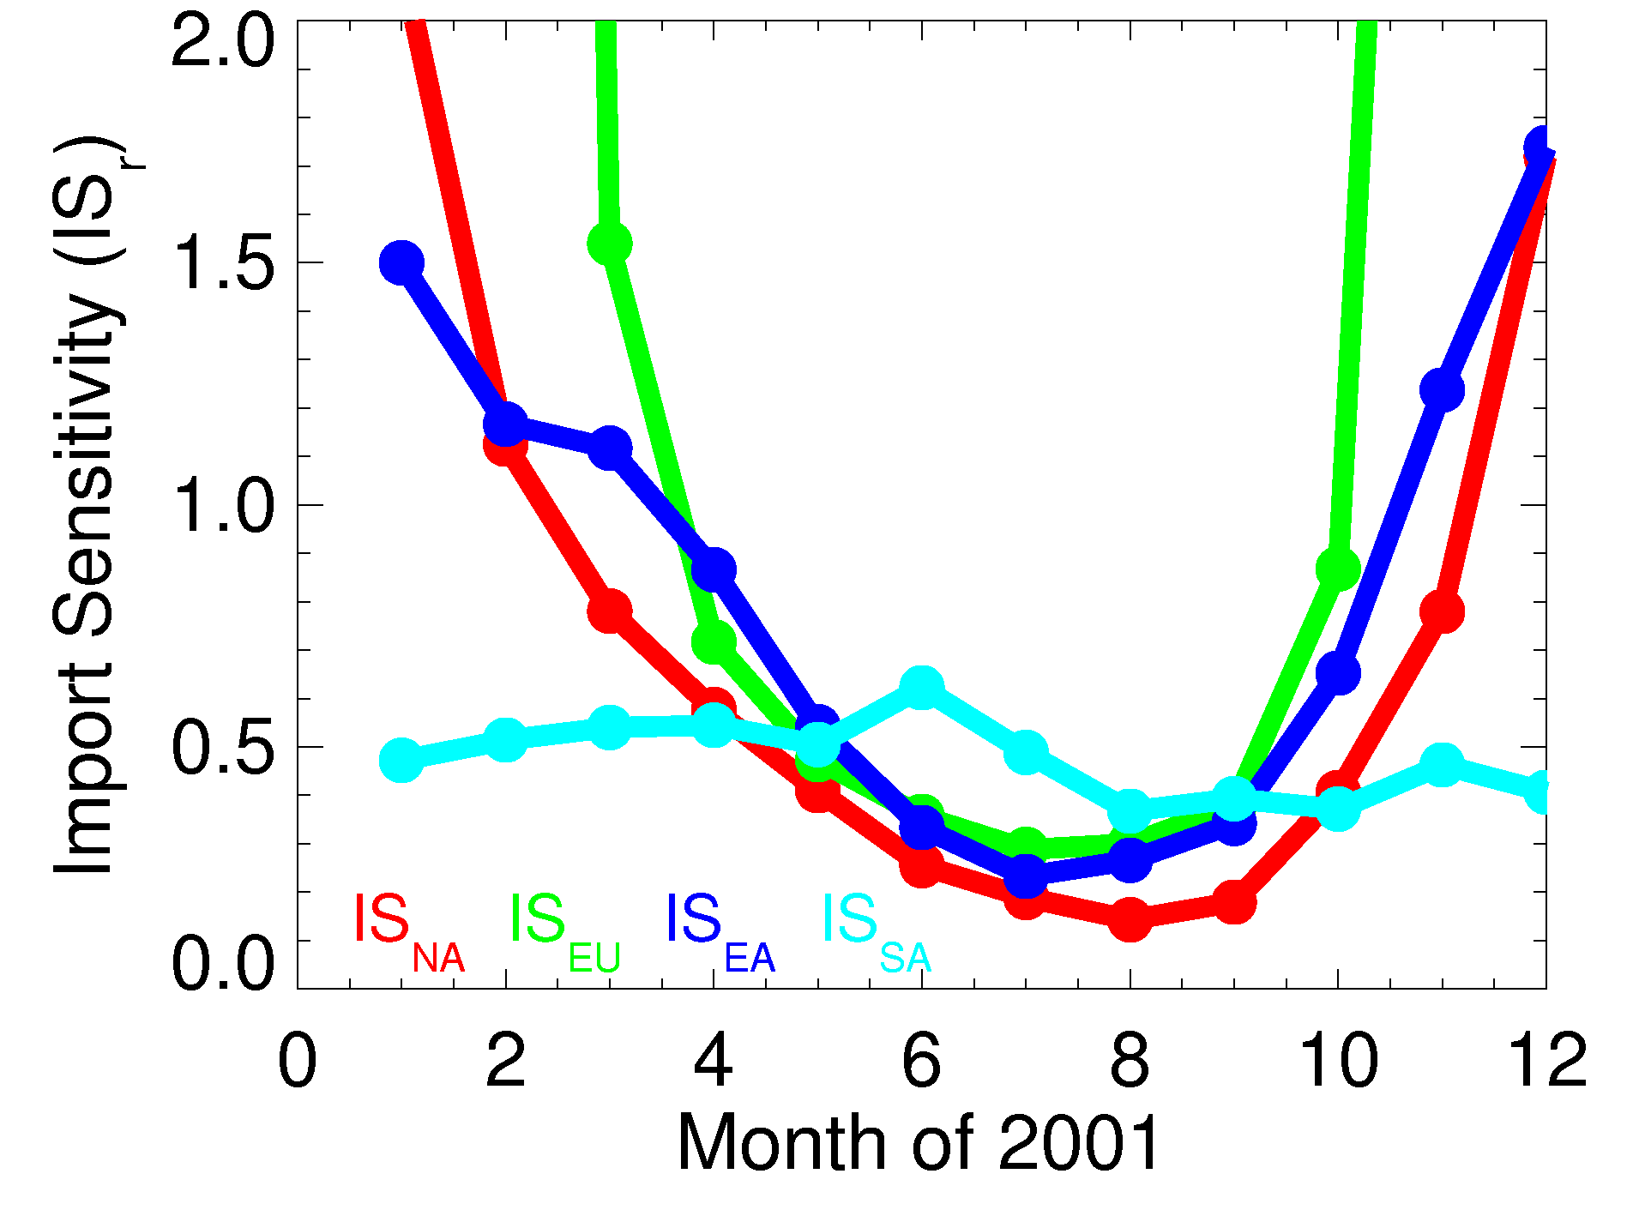
Monthly mean import sensitivities
(surface O₃ response to foreign vs. domestic emissions)
SA fairly
constant ~0.5
1.1 (EA), 0.7 (EU) during
month with max response
to foreign emissions
0.2-0.3 during month
of max response to
domestic emissions
Fiore et al., JGR, 2009

Slide 13
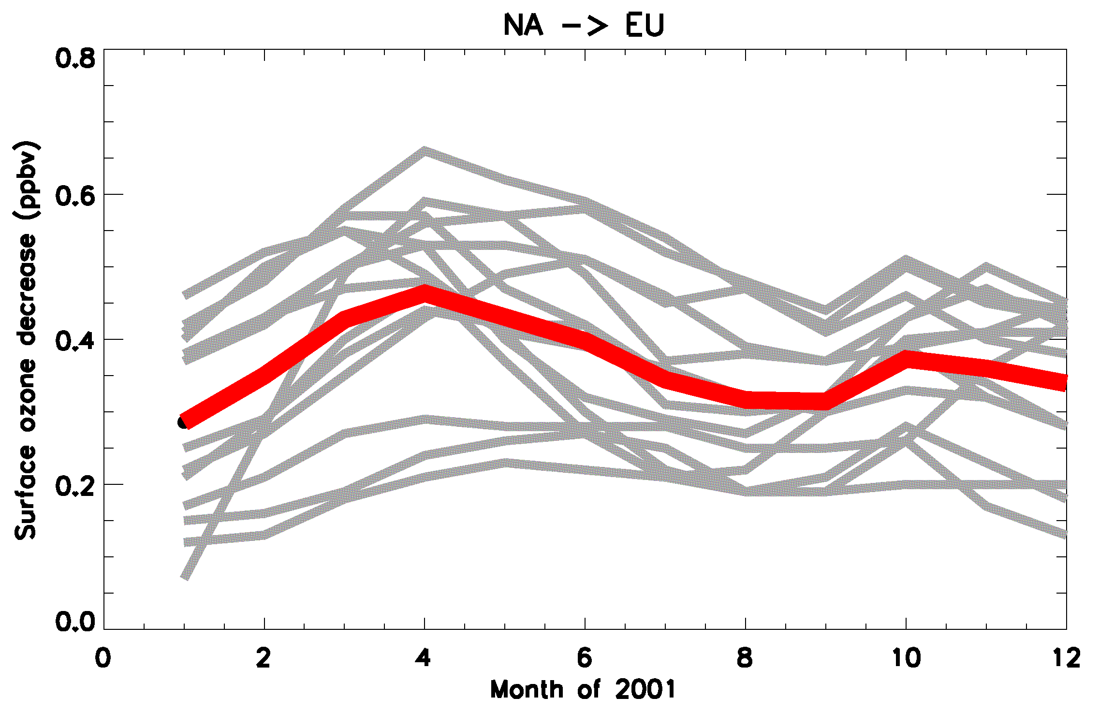
UNCERTAINTIES IN ESTIMATES:
Surface O₃ response to foreign anthrop. emissions varies widely across individual models
Multi-model mean
Individual models
No obvious correlation of strength of foreign influence with individual model biases relative to O₃ observations [Fiore et al., JGR, 2009; Reidmiller et al., ACP 2009;Jonson et al, ACPD 2010 ]
→ Generally not due to model differences in anthropogenic emissions (one exception)
A. Fiore

Slide 14
Strong sensitivity of exported EU O₃ to large spread in EU NMVOC inventories (anthrop. NO_{x} fairly similar across models)
Annual mean
surface O₃
decrease
over NA
(ppb) from
20% decreases
in anthrop.
EU NMVOC
Individual models
EU Anthrop. NMVOC Emissions (Tg C)
Fiore et al., JGR, 2009

Slide 15
Models likely differ in export of O₃ + precursors, downwind chemistry (PAN [Emmerson and Evans, ACP, 2009]), and transport to receptor region
PAN
CH₃C(O)OONO₂
NO_{x}
O₃
NOx+VOC →
PAN, O₃
NO_{y}
N₂O₅
O₃
other
organic nitrates HNO₃
Ocean
Fires
Land
biosphere
Human
activity
Ocean
Continent
Continent
NO_{y} partitioning (e.g., PAN vs. HNO₃) influences
O₃ formation potential far from source region
How well do the models used to estimate intercontinental O₃ transport
simulate observed distributions of PAN?
A. Fiore

Slide 16
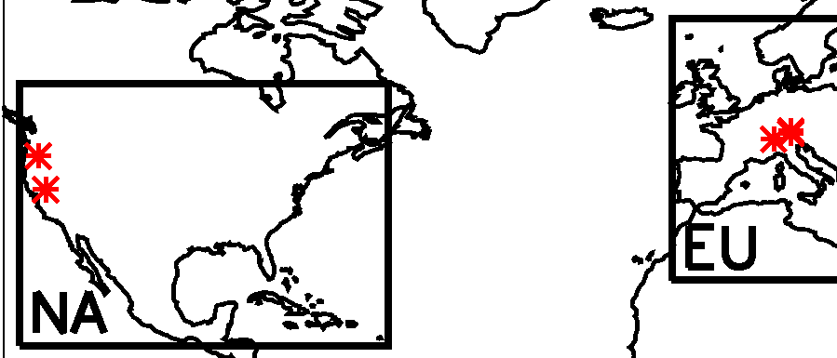
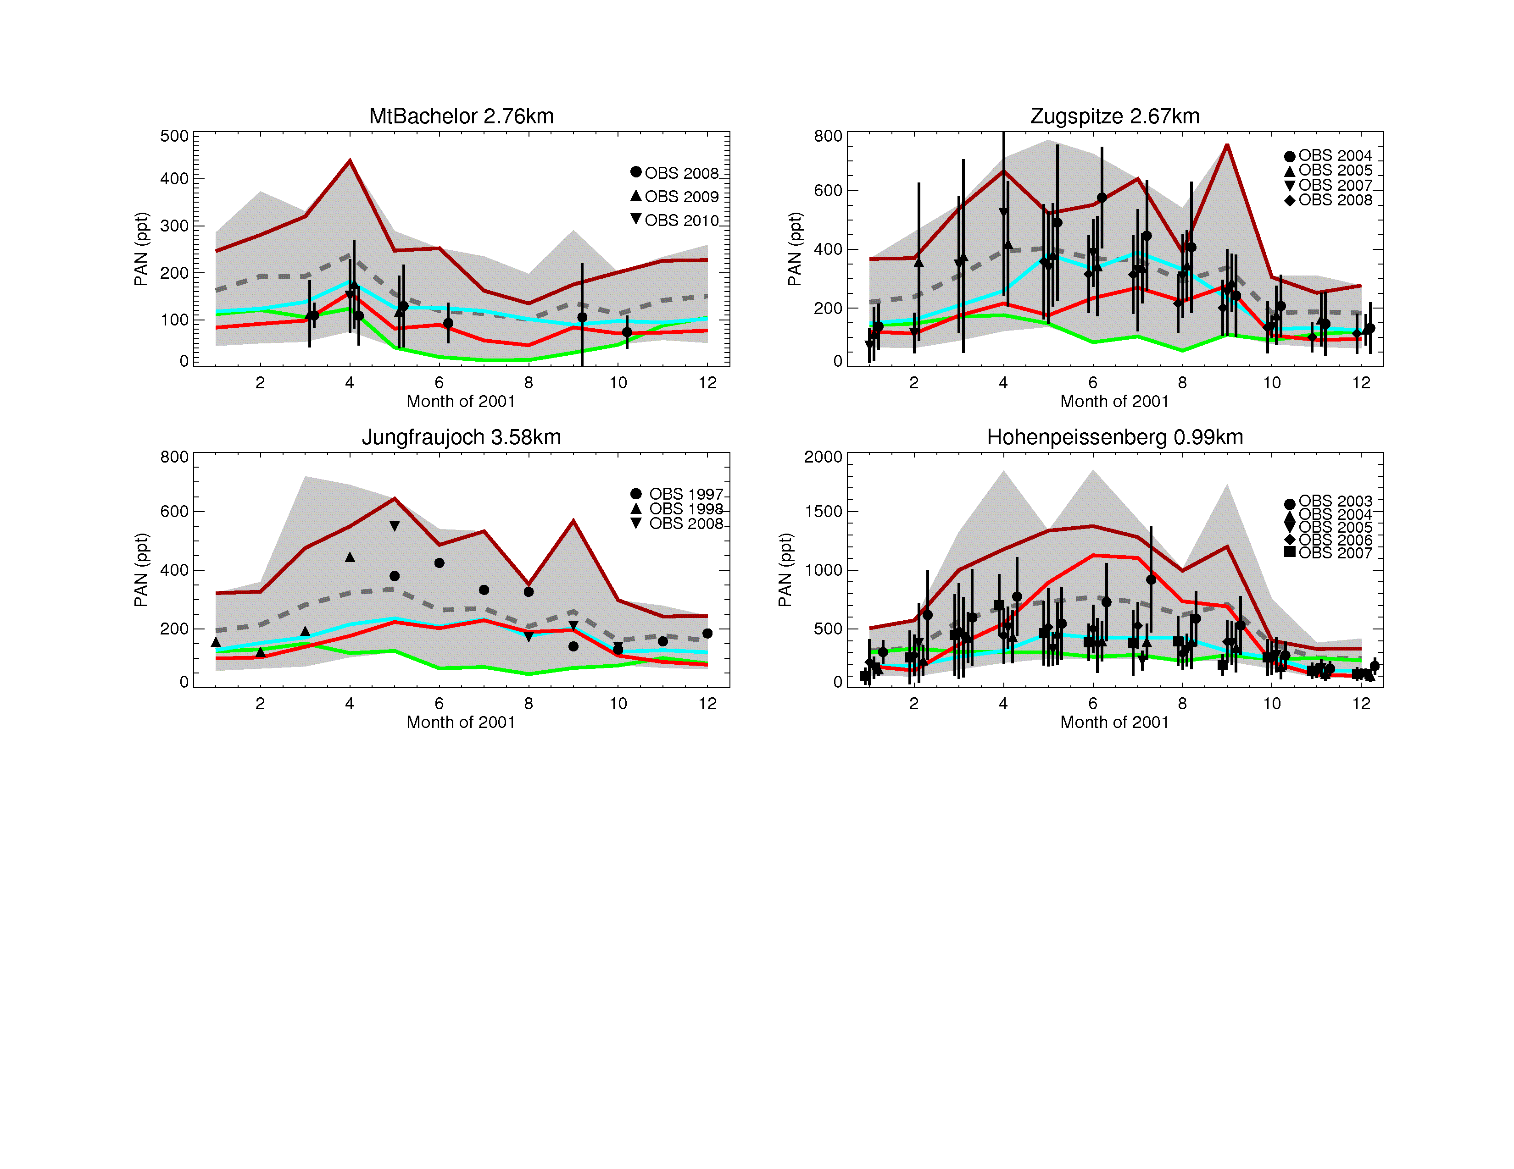
Comparison of models with PAN measurements at mountain sites in Europe and Western USA
Zugspitze (2.67 km)
Mt. Bachelor (2.76 km)
PAN (ppt)
Range across
models
Multi-model
mean
Jungfraujoch (3.58 km)
PAN (ppt)
Selected
individual models
No measurements for year 2001; observed interannual variability precludes definitive conclusions as to which models are best
Multi-model mean generally within range of observations
Some models consistently high/low; others vary site to site
A. Fiore

Slide 17
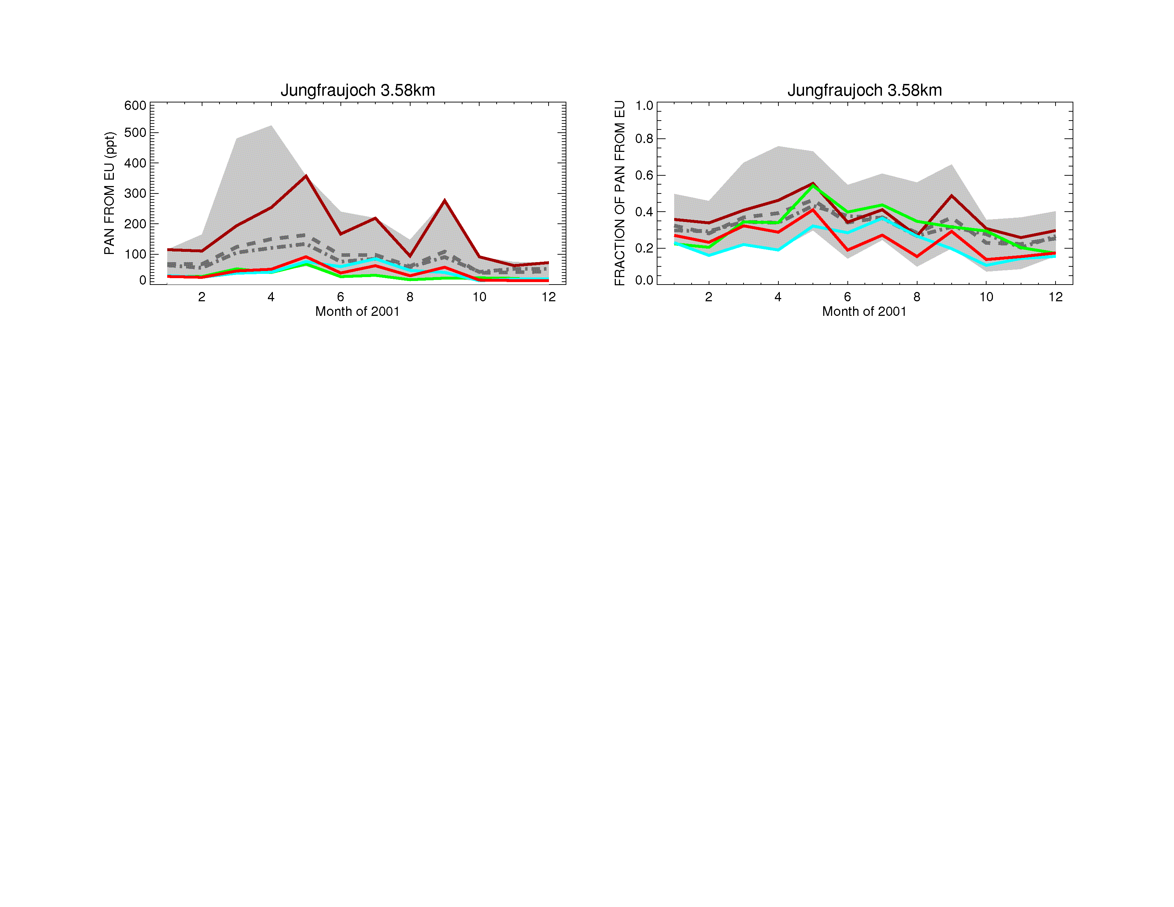
Individual models rank differently in terms of absolute vs. relative source attribution
Determined by differencing
simulations with
-20% EU anthrop. emissions
from the base case, then x5
PAN FROM EU (ppt)
Range across
models
Multi-model
mean
Relative attribution matters
from a policy perspective.
Evaluating models with
total observed PAN won’t
address relative importance.
Observational constraints?
FRACTION OF PAN FROM EU
A. Fiore

Slide 18
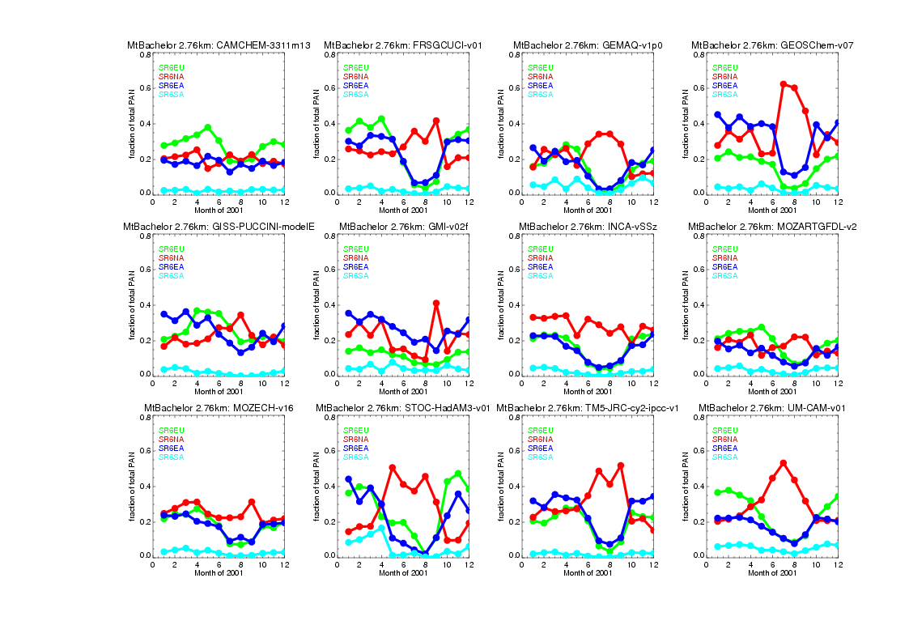
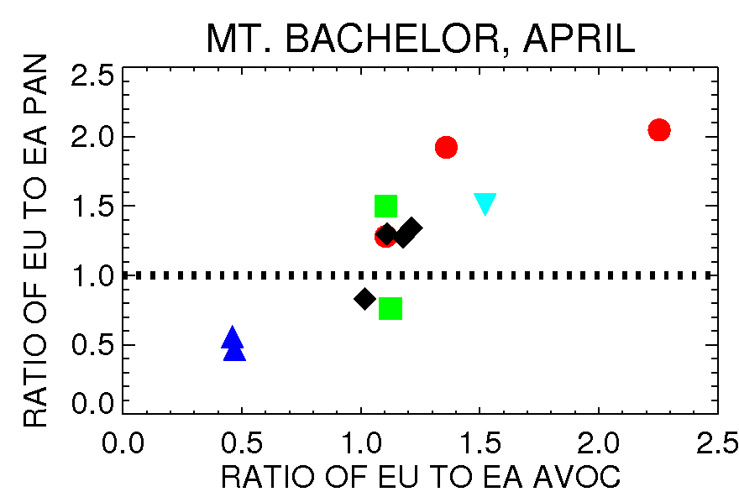
Relative influence of regional O₃ precursors on PAN at Mount Bachelor (OR), as estimated by the models
4 example HTAP models sampled at Mount Bachelor
0.8
0.6
0.4
0.2
0.0
Fraction of
total PAN from
source region
EU NA EA SA
MOZART
More EU
influence
NCEP
ECMWF
GEOS
CMC
GCM
EU/EA PAN influence correlates with EA/EU AVOC emissions;
Individual
models
…Or meteorology?
More EA
influence
r²=0.85
A. Fiore

Slide 19
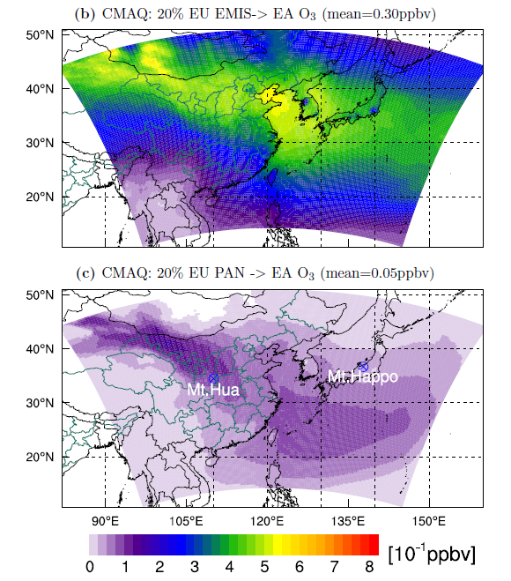
PAN as a pathway for intercontinental O₃ transport:
How important?
MARCH 2001 SURFACE O₃ DECREASE (from Base simulation) in CMAQ regional model with boundary conditions (BCs) from the global MOZART-2 model:
BCs for all species reflect -20%
EU anthropogenic emissions
Only PAN BCs reflect -20%
EU anthropogenic emissions
Large spatial gradients within continental-scale “HTAP” regions
PAN decomposition contributes ~20% of spatial average total O₃
response; up to ~50% in subsiding plumes at mountain sites
[Lin et al., ACP, 2010]
A. Fiore

Slide 20
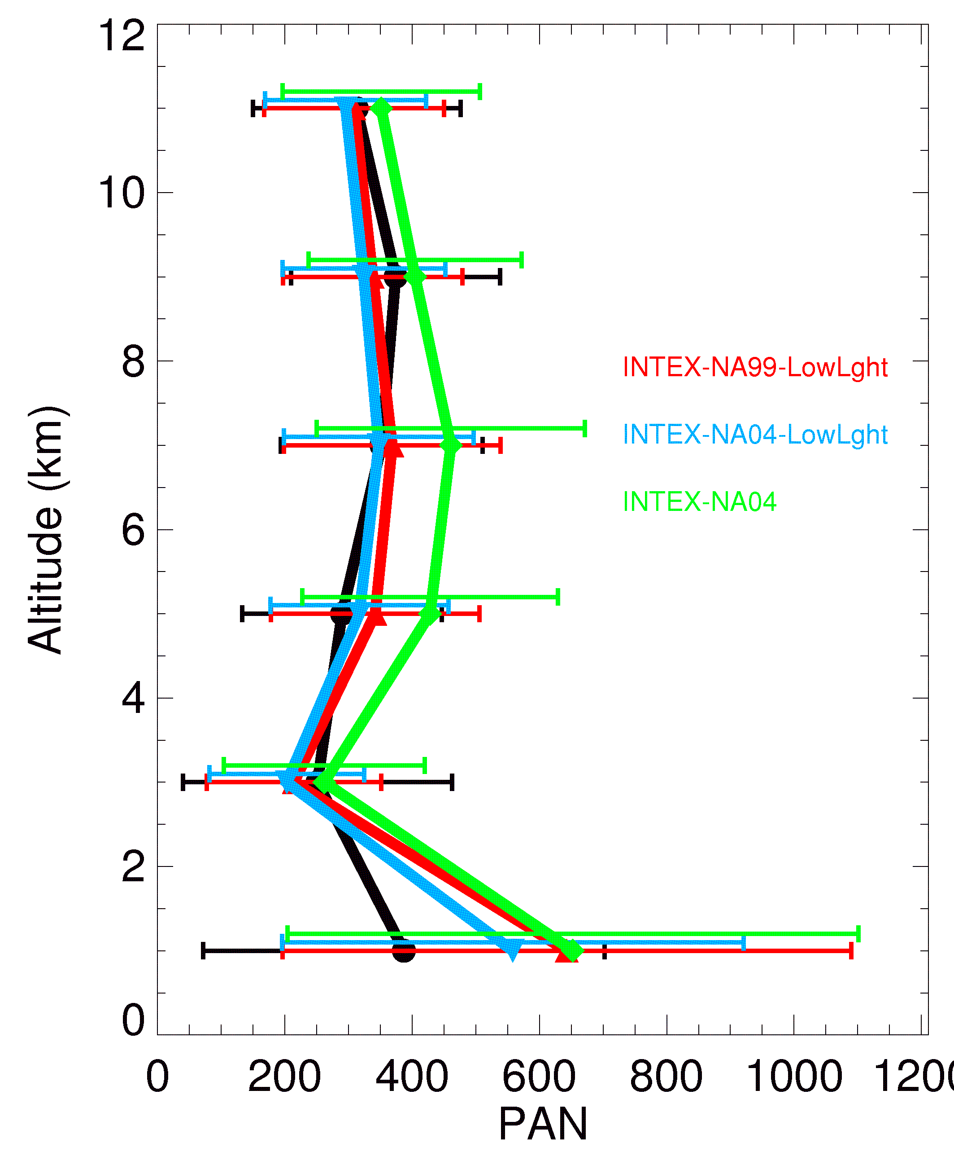
PAN as a proxy: Contributions to PAN from anthropogenic versus lightning NO_{x} sources [Fang et al., JGR, in press]
PAN over the eastern U.S. during summer 2004 (INTEX-NA field campaign)
July MOZART-4 simulations with:
1999 U.S. Anthro NO_{x}; “low” lightning
2004 U.S. Anthro NO_{x} (-23%); “low” lightning
2004 U.S. Anthro NO_{x}; “high” lightning (10x)
(anthro and lightning NO_{x} perturbations are
equivalent, in each case changed by 0.16 Tg N)
Model (MOZART-4) is sampled along flight tracks
Cross-model differences in lightning NOx may contribute to differences in PAN in
The middle and upper troposphere;
Little lightning influence in lower troposphere where PAN is more sensitive to anthropogenic NO_{x} changes
A. Fiore

Slide 21
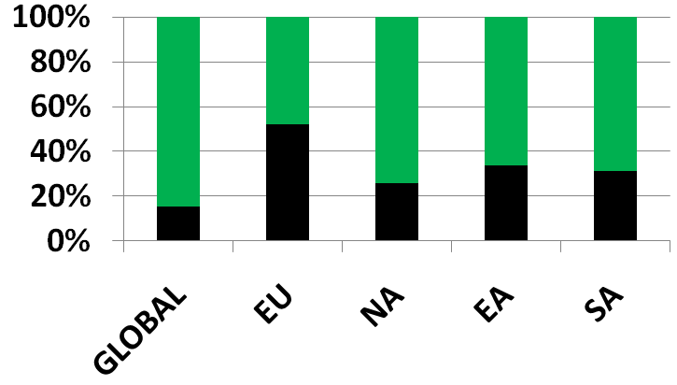
What is the role of BVOC in hemispheric transport of ozone and PAN?
Percent of total NMVOC emissions
multi-model mean values
from HTAP study
NON-ANTHROPOGENIC
(mainly biogenic NMVOC)
ANTHROPOGENIC
“the treatment of isoprene in global models can only be seen as a first order estimate at present, and points towards specific processes in need of focused future work” [von Kuhlmann et al., 2004]
→ Rapidly evolving knowledge from lab and field studies
[e.g., Lelieveld et al., 2008; Hofzumahaus et al., 2009; Paulot et al., 2009ab;
Perring et al., 2009; Brown et al., 2009; and many, many others!]
A. Fiore

Slide 22
Explore role of isoprene vs. anthropogenic emission changes in North America with MOZART-2 global model
BASE SIMULATION:
→ horizontal resolution of 1.9°x1.9°
→ 2001 meteorology
→ best estimate for 2001 emissions
→ methane set to 1760 ppb
SENSITIVITY SIMULATIONS:
→ -20% regional anthrop. NO_{x}, CO, NMVOC emissions,
individually + all together (FOCUS ON NA)
→ +20% NA isoprene emissions
Interannual variation in NA isoprene emissions ~20-30% [Palmer et al. 2006]
A. Fiore

Slide 23
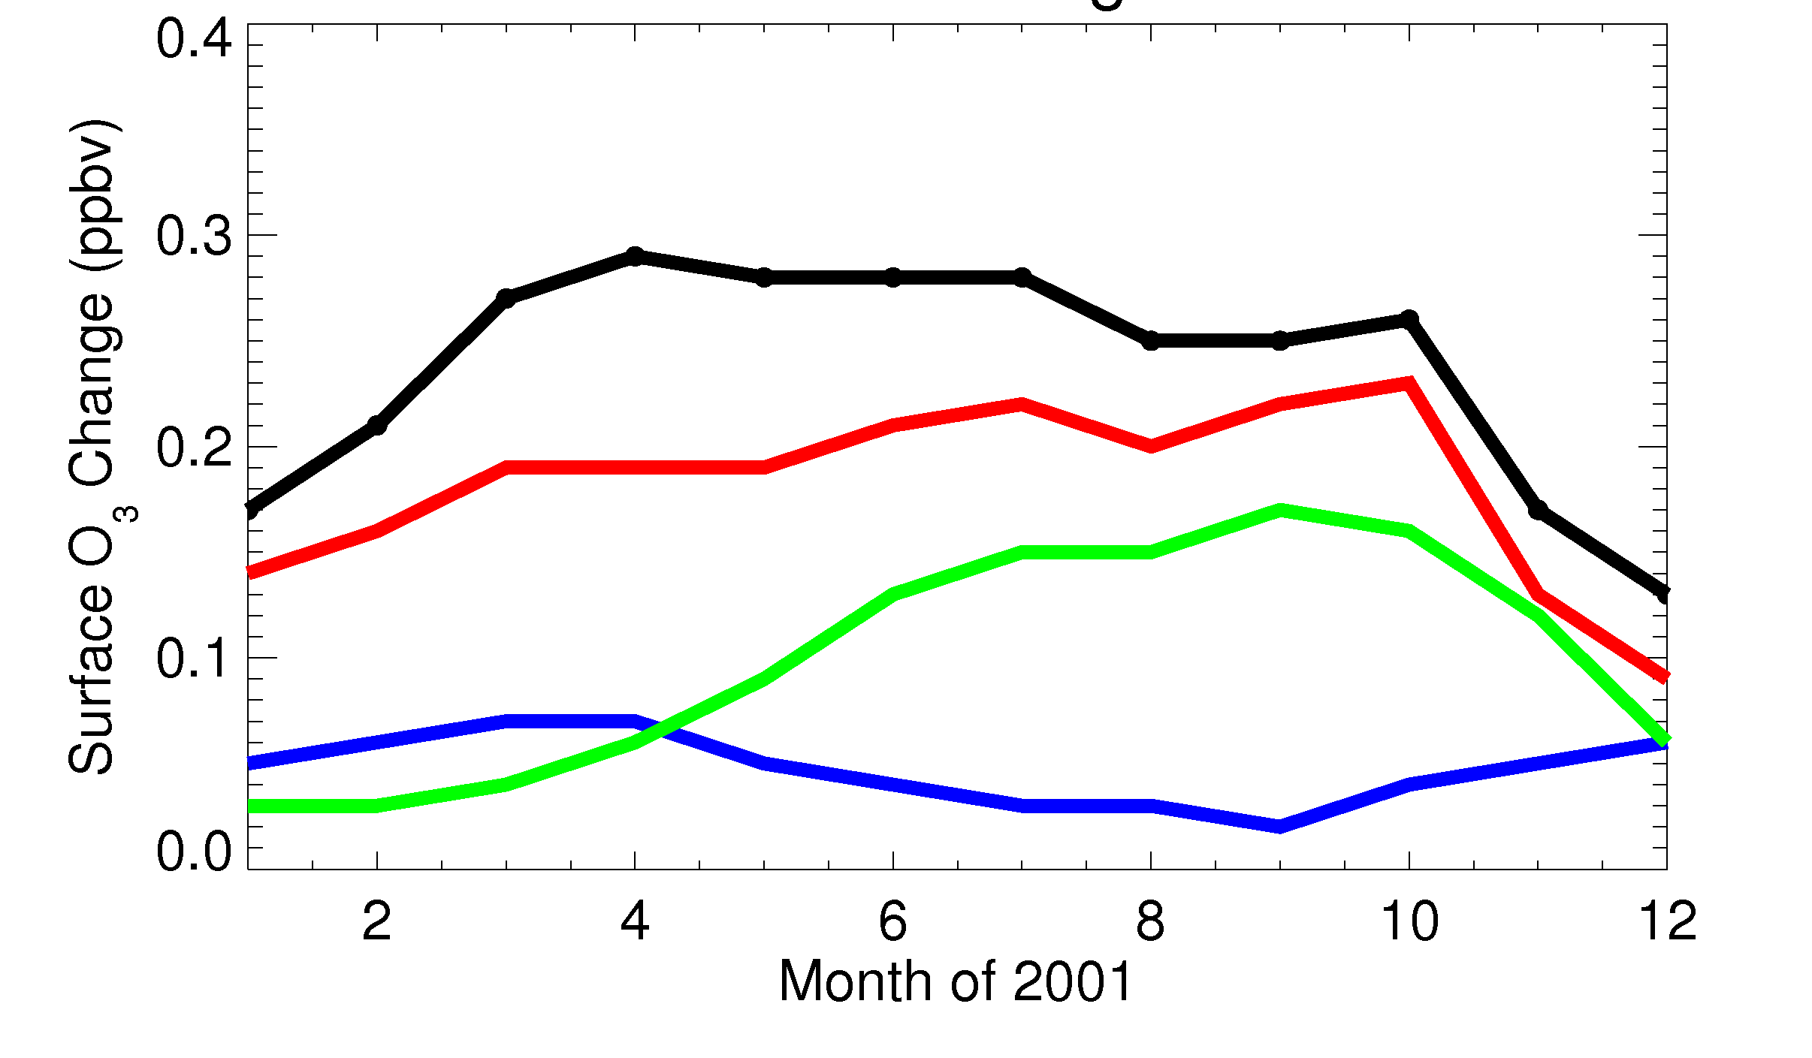
Surface O₃ response over Europe (spatial average) to North American emission perturbations
Variation across models?
-20% NA anthrop. NOx+CO+NMVOC
-20% NA anthrop. NOx
-20% NA anthrop. NMVOC
+20% NA isoprene
Surface ozone response
over Europe (ppb)
O₃ response over EU to NA isoprene comparable to NA anth. NO_{x} in summer/fall; larger than NA anth. NMVOC
A. Fiore

Slide 24
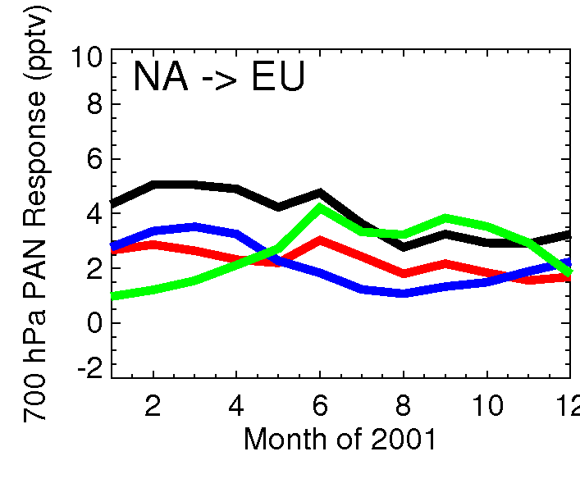
PAN (700 hPa) response over Europe (spatial average) to North American emission perturbations
-20% NA anthrop. NOx+CO+NMVOC
-20% NA anthrop. NOx
-20% NA anthrop. NMVOC
+20% NA isoprene
PAN response over EU to NA isoprene comparable to that to all NA anthrop. emissions in summer and fall
A. Fiore

Slide 25
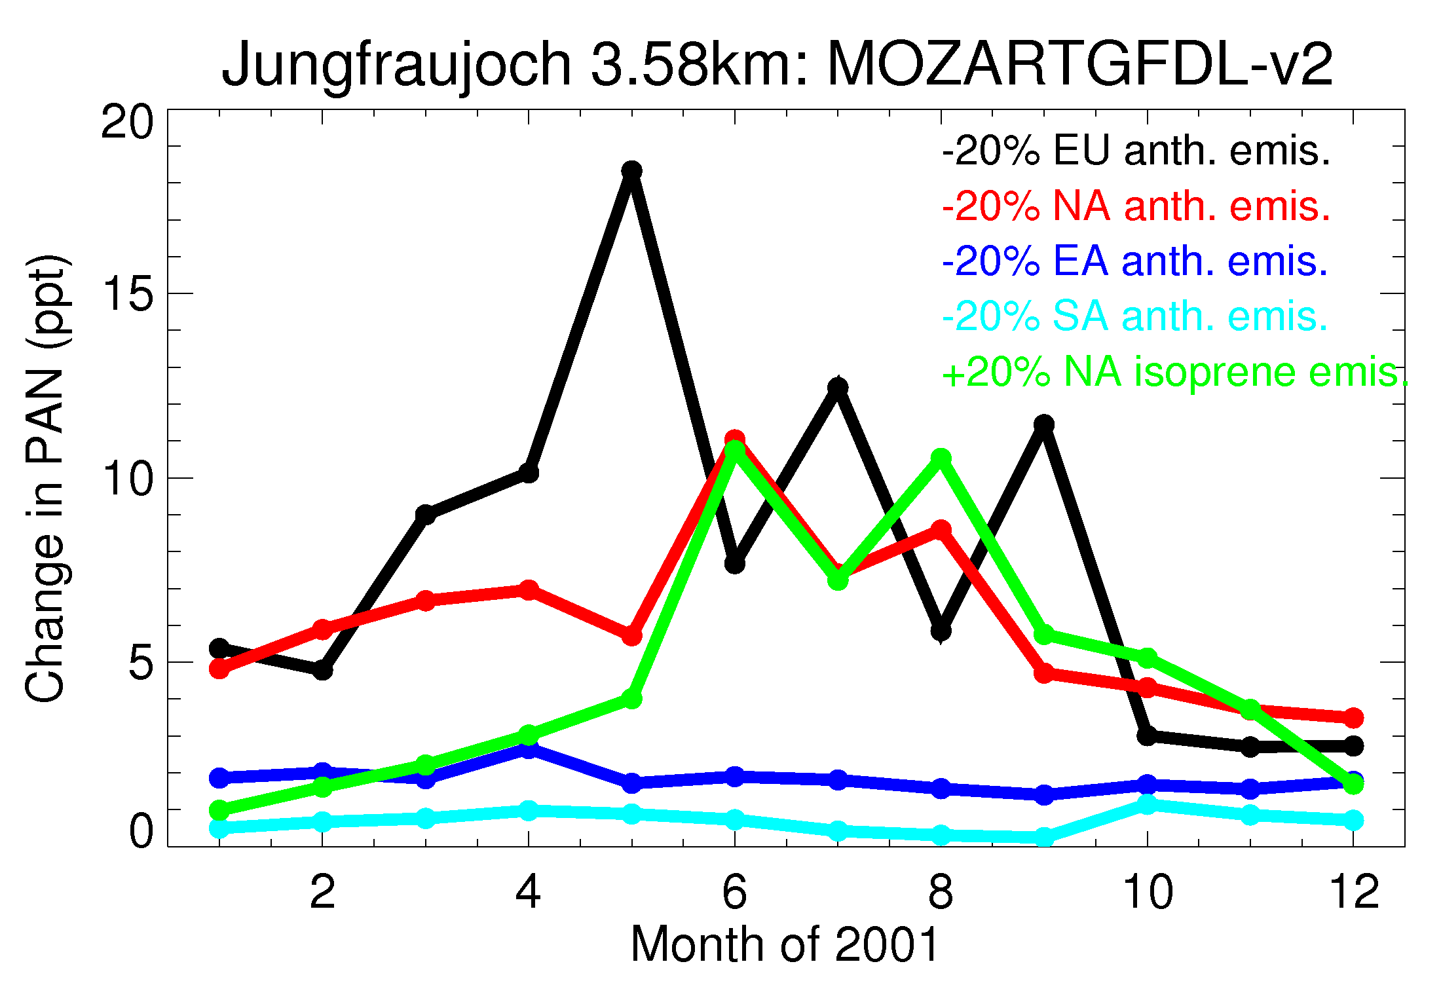
PAN response to regional precursor emission changes at a European mountain site (model is sampled at the site)
May peak in
European anthrop.
influence
NA isoprene influence on PAN at European mountain site
similar to that from NA or EU anth. emissions in summer
A. Fiore

Slide 26
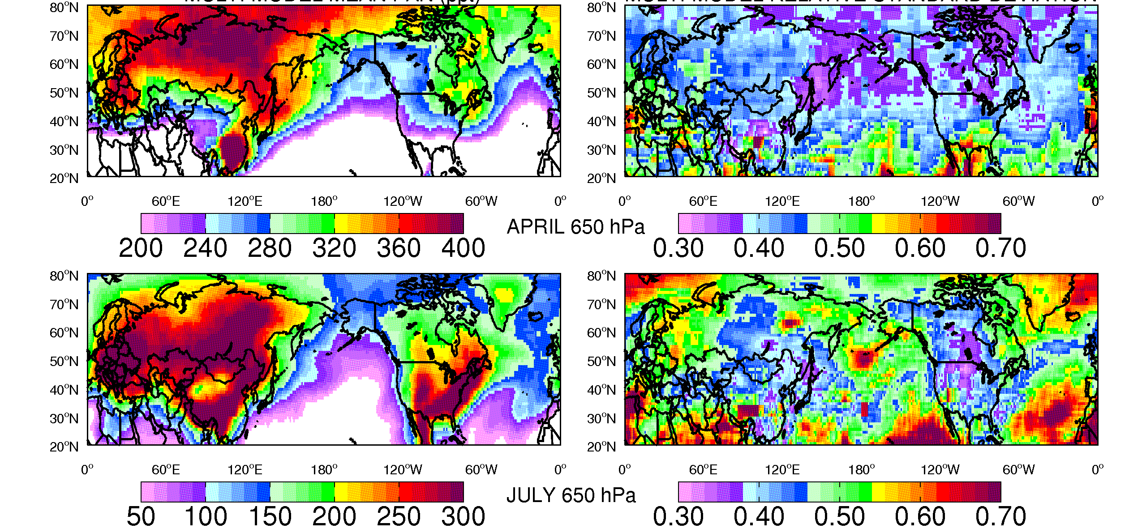
Returning to multi-model ensemble… where do models show largest relative discrepancies in PAN?
PAN AT 650 hPa
14-MODEL MEAN (ppt)
RELATIVE STD DEV (σ/μ)
APRIL
JULY
Observations at PICO-NARE [e.g., Honrath et al., JGR, 2004] may help in
identifying “most useful” models for NA → EU intercontinental transport
A. Fiore

Slide 27
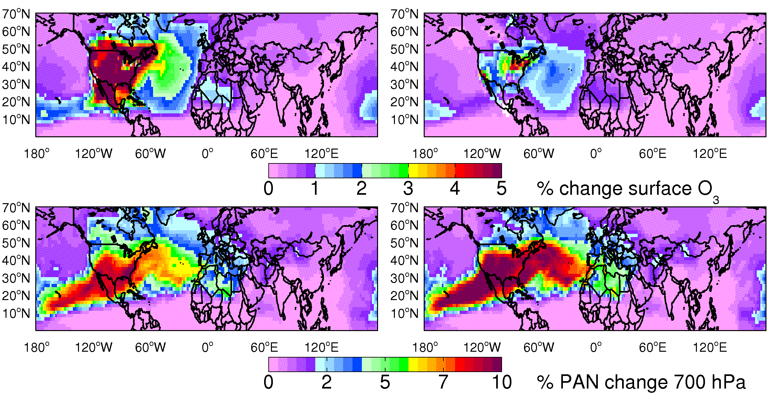
PAN is relatively more sensitive than ozone to anthropogenic and isoprene emission changes
Sensitivity simulations in the global MOZART-2 model:
-20% NA anthropogenic emissions
-20% NA isoprene emissions
Percent change in surface Ozone
Percent Change in PAN at 700 hPa
PICO-NARE site in the Azores well-positioned for sampling N. American outflow
[e.g., Honrath et al., JGR, 2004; val Martin et al., JGR, 2008.]
A. Fiore

Slide 28
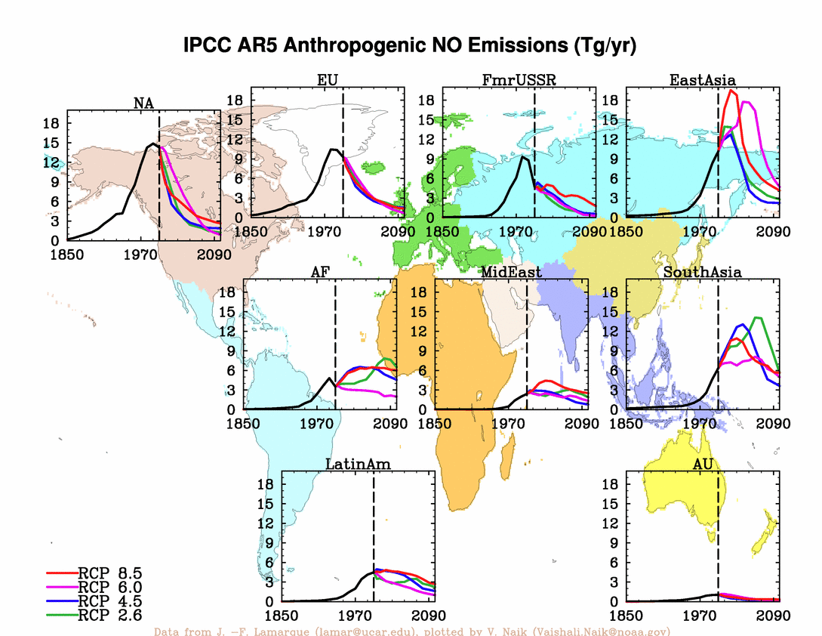
How will global emissions (and intercontinental O₃ transport) change in the future?
Implications
for U.S.
background
O₃ and
attainment
of standards?
c/o Vaishali Naik, GFDL
What about climate change?
A. Fiore

Slide 29
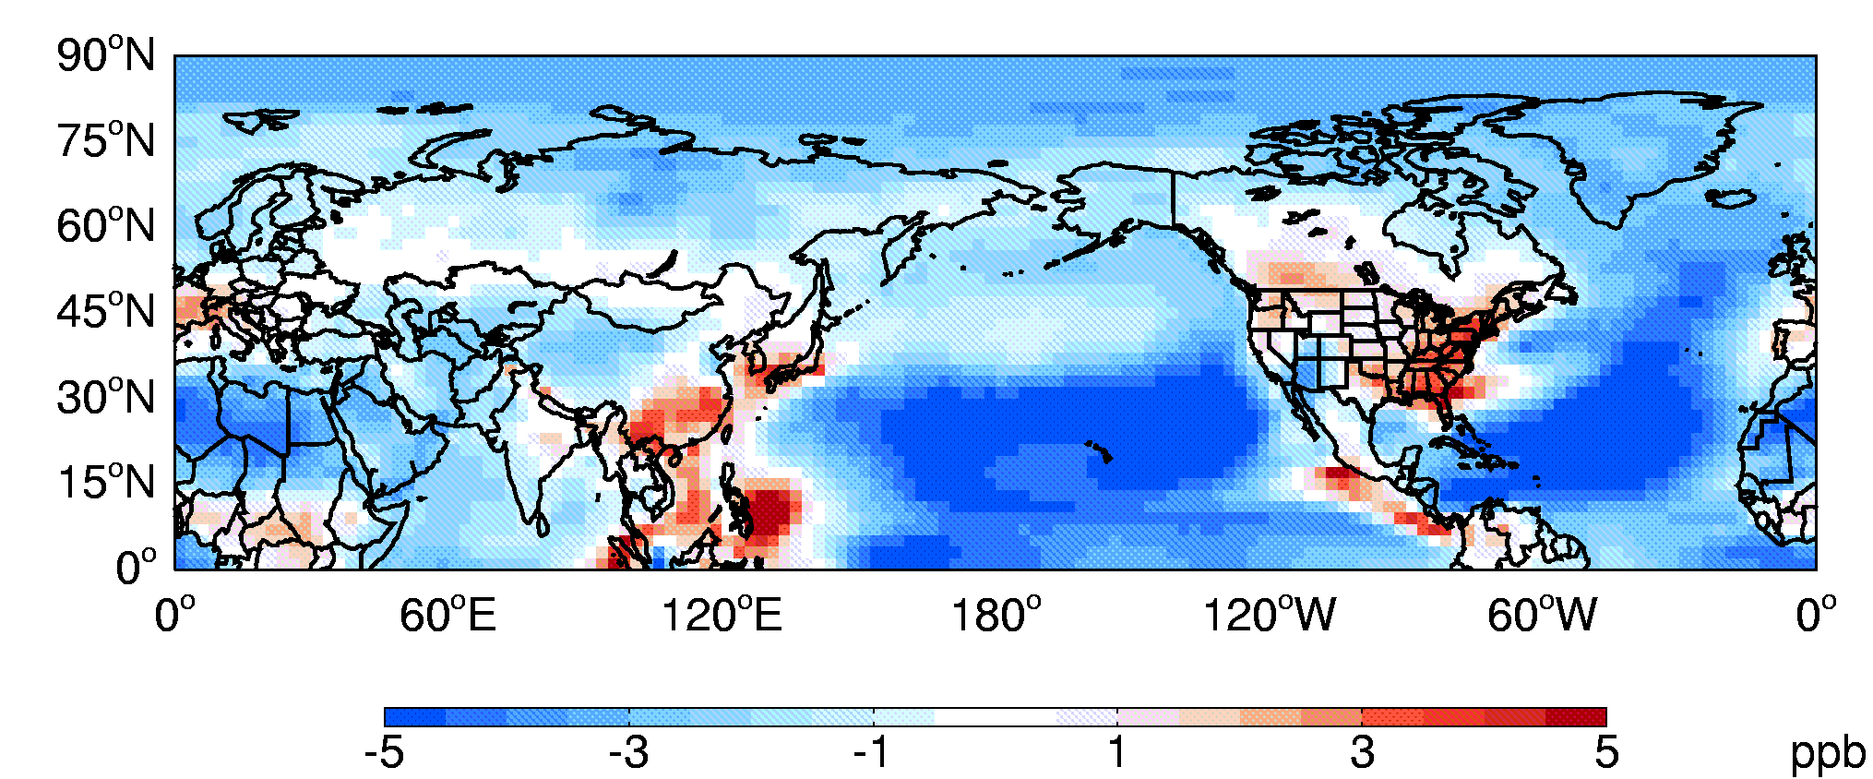
Summertime surface O₃ changes in a warmer climate in the new GFDL chemistry-climate model (AM3)
20-year simulations with annually-invariant emissions of ozone and aerosol precursors
Present Day Simulation (“1990s”): observed SSTs + sea ice (1981-2000 mean)
Future Simulation (“A1B 2090s”): observed SSTs + sea ice + average
2081-2100 changes from 19 IPCC AR-4 models
CHANGES IN SUMMER (JJA) MEAN DAILY MAX 8-HOUR OZONE
Previously noted degradation of summertime EUS O₃ air quality e.g., reviews of Jacob and Winner, Atmos. Environ. 2009 and Weaver et al., BAMS, 2009
Previously noted decrease of lower troposphere background O₃
e.g., Johnson et al., GRL, 2001; Stevenson et al., JGR, 2006
Climate change expected to reduce intercontinental influence, though
net effect determined by climate plus emission changes (human + natural)
A. Fiore

Slide 30
Anthropogenic and biogenic influence on intercontinental surface O₃:
Concluding thoughts and some questions raised
Benchmark multi-model effort: wide cross-model and spatiotemporal variability in intercontinental influence
What is the role of mesoscale (i.e., sub-grid) processes in
mixing air between the free troposphere and the surface?
PAN: Pathway and Proxy for intercontinental O₃ pollution
Exploit differences across model ensembles to help guide observational sampling strategies?
Potential for constraints on O₃ source attribution via PAN?
NA isoprene influence on EU surface O₃ comparable to NA anthrop. NO_{x} in summer and fall
Pay more attention to role of biogenic sources when assessing
impacts of human activities on climate and air quality?
A. Fiore

