Slide 1
Arctic ecosystem example
Concept Mapping

Slide 2
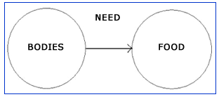
Concept Maps
Visual road maps that depict known or suggested relationships between ideas.
Idea/info
relationship
Idea/info
examples
For
example
Dairy products
Meat/Fish
REQUIRE
CAUSE
CONTRIBUTES
Fruits/Veges
Notes:
typically represents ideas and information as boxes or circles, which it connects with labeled arrows

Slide 3
Concept Maps can help you:
You have a broad interest
1. Hone in on your scientific question
2. Provide context for your scientific question,
and organize and structure your Introduction
3. Develop hypotheses to test
4. Determine methodology required to test hypotheses
You need a question
You have a question
You need broad context

Slide 4
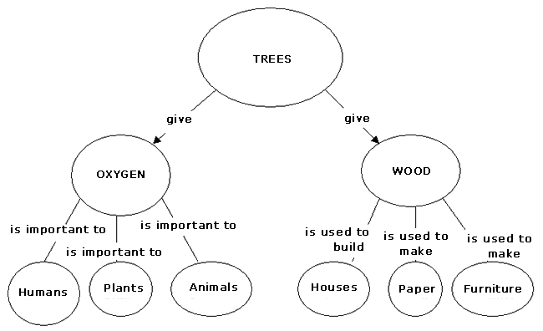
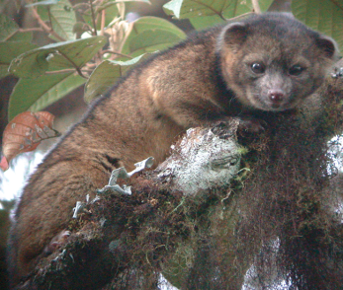
1. Honing in on your scientific question
AMAZONIAN RAINFORESTS
Birds
HABITAT
critical to
give
Arthropods
AMAZONIAN
RAINFOREST
Mammals
?
+/-
such as
Olinguito
!!!

Slide 5
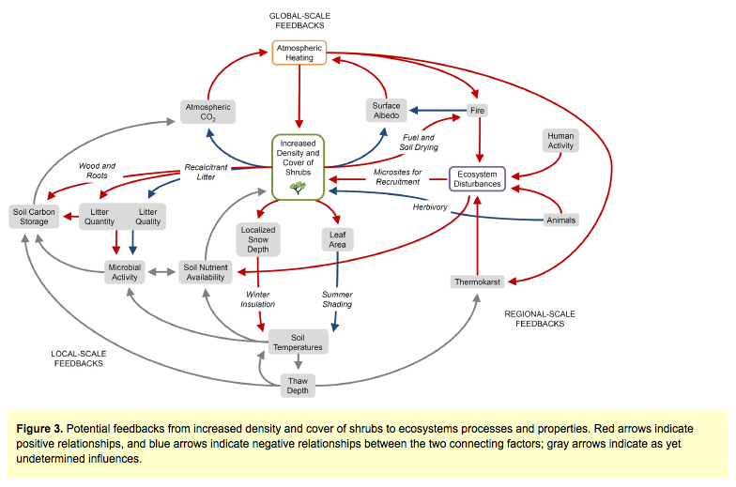
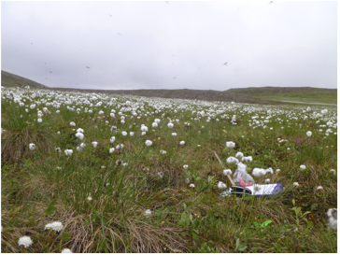
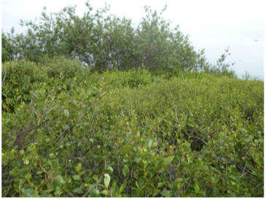
2. Honing in on your scientific question
(another approach)
Arctic tundra is becoming Shrubbier!
+
-
Arctic tundra is becoming shrubbier!
???
(taken from Myers-Smith et al. 2011)
Notes:
Missing grey arrows of relationships other people didn’t even think about!

Slide 6
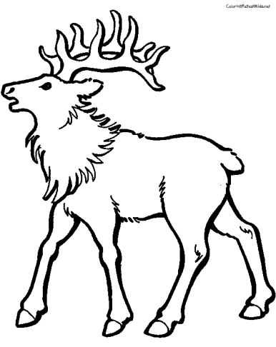
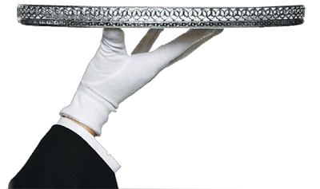
2. Providing context for your scientific question
(for your Introduction)
Does the presence of
caribou inhibit/promote
shrub dominance in
Arctic tundra?
Who cares ?
(start reading!)
Notes:
Question on a silver platter or you happen to have one
Why on EARTH should any body care
You need broader context to justify your study, but also to provide relevant background information.

Slide 7
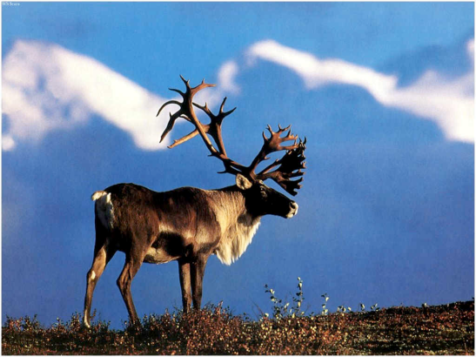
Arctic climate warming fast
Abiotic & biotic responses are acute
thermokarst fire regimes growing season length
veg productivity woody shrub dominance
energy balance carbon sink/source alters wildlife habitat
nutrient cycling thaw depth snow distribution
Feeds back to
causing
for example
Climate
Forcing!
contribute to
which impacts
impacts
+/- ?
Trample Forage Fertilize
Does the presence of caribou inhibit/promote
shrub dominance in Arctic tundra?
Caribou are the main large
herbivore in northern Alaska

Slide 8
3. Development of Hypotheses
+/- ?
Shrub dominance
damage
forage
fertilize
understory
vegetation
shrub
branches
shrub
species
understory
species
Increase nutrient
availability for
all species
4. Determine Methods

