Slide 1
Concept Mapping
List the key concepts
  Write the most important ideas related to each concept on a Postit -- Include relevant terms and details in the list
    Who, what, where, why, when, how, how much
    Processes
    Drivers
    Relationships – cause and effect, etc.
    Characteristics
Number the concepts in order of importance
Group closely related concepts
Connect the concepts by drawing lines. Add verbs, verb phrases or prepositions to describe how the concepts are related.
Review the concept map
  Check for accuracy -- fix errors , delete any redundancies, add missing concepts
  Rearrange the concepts and relationships as needed
  Add emphasis to key concepts and relationships: size, color, pictures
http://www.ehow.com/how_4469347_make-concept-map.html

Slide 2
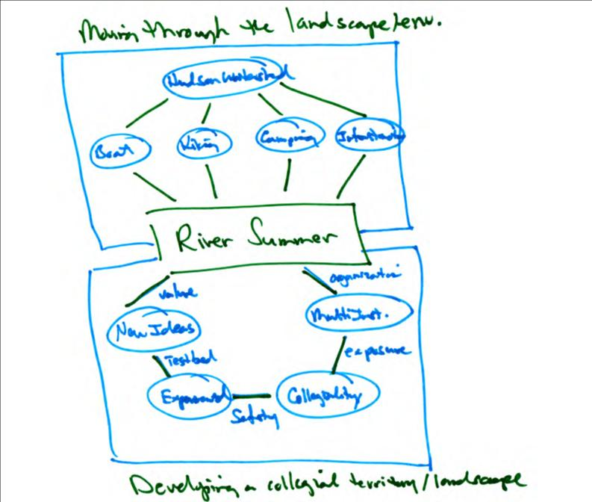

Slide 3
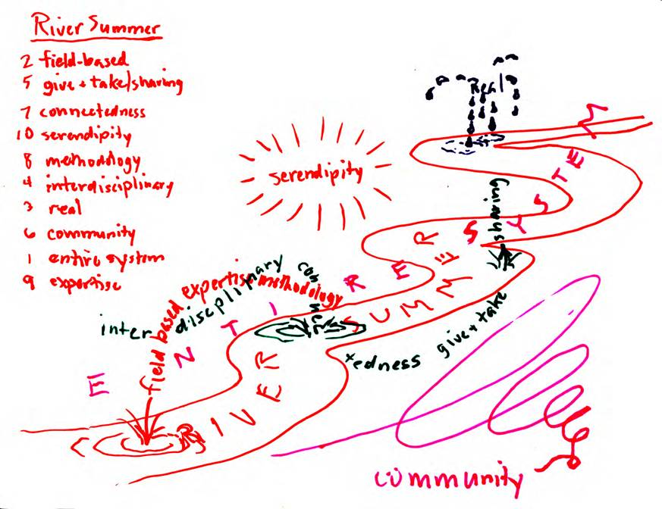
Numbered List of Concepts

Slide 5
Free Concept/Mind Mapping
Tools Online
Cmap
  http://cmap.ihmc.us/
Edraw
  http://www.edrawsoft.com/
Concise learning
  www.conciselearning.com
  http://www.conciselearning.com/mindmapping.html
  The most popular free mind mapping programs are XMind (desktop), FreeMind (web-based), Mind42 (web-based), WisdoMap (web-based), Wisemapping (web-based), Bubbl.us (web-based),and IHMC CmapTools (concept mapping). They offer robust feature menus, are easy to use, and are compatible with other mapping programs.

Slide 6
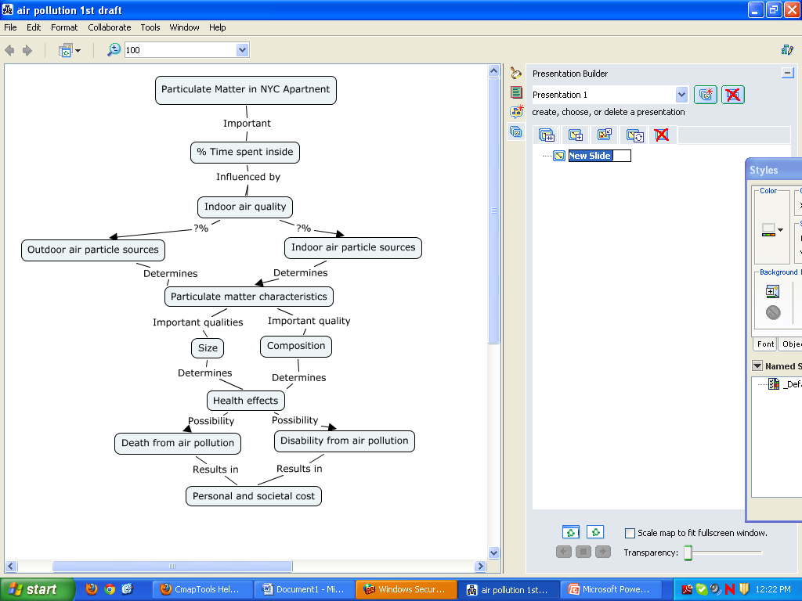

Slide 7
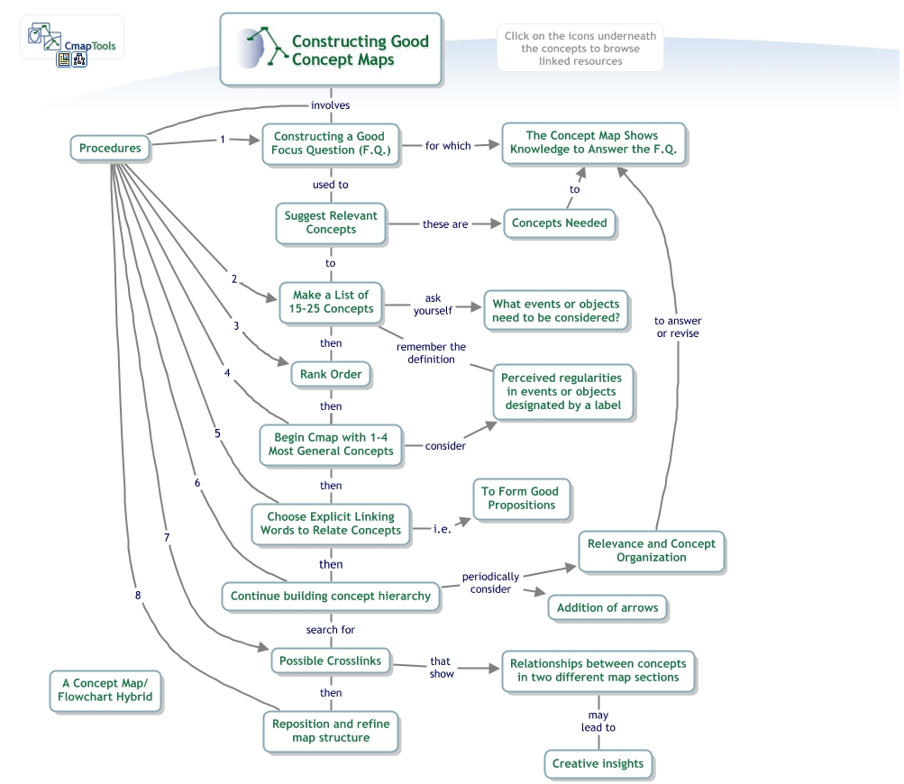

Slide 8
Value of Collaboratively Developed Conceptual Models
“Jointly developing a model not only helped the participants to formulate questions, clarify system boundaries, and identify gaps in existing data, but also revealed the thoughts and assumptions … the process of model building can help scientists, policy makers, and resource managers discuss applied problems and theory among themselves and with those in other areas.
  “Conceptual Models as Tools for Communication Across Disciplines” Heemskerk et al. 2003
“People were willing to listen to everybody else, ‘but what about this issue or that issue, can we put that in?’ It wasn’t a case of, ‘Oh I don’t think so.’ It was a case of where will it fit and then once the subject matter was up there, then pretty much everyone in the group were able to add what effects what.’
  “Evaluating participatory modeling” Jones et al. 2008

