Slide 1
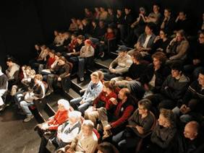
Giving Research Presentations
Martin Stute
Barnard College & Lamont-Doherty Earth Observatory
10/29/2015
Notes:
Points to make in addition:
- No reference slide!

Slide 2
Acknowledgements
Stephanie Pfirman, Barnard College
Brian Mailloux, Barnard College
Natalie Boelman, Lamont-Doherty Earth Observatory
Jeff Shaman, Mailman School of Public Health
Students in the joint Columbia/Barnard Environmental Science Senior Seminar

Slide 3
Outline
Introduction-Why give talks
Structuring your story
Preparing your data/information
Preparing and giving the presentation
Concluding your presentation
Example
What can go wrong?
Handling questions and answers
Notes:
Don’t just state the obvious: Introduction, methods, results, discussion, conclusions

Slide 4
Why give presentations
“If you don’t kick things around with people,
you are out of it.
Nobody, I always say, can be anybody
without somebody around.”
Physicist John Wheeler
“Your thinking improves, the more you talk about it.
You need to be seen and heard, to be known and read.”
Psychologist Mihaly Csikszentmihalyi
Notes:
You have really only understood something after you have successfully explained it to somebody who knows nothing about it

Slide 5
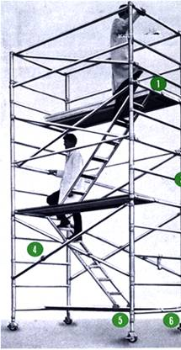
How to Give an Effective Presentation: Structure
Basic rule
  Say what you are going to say
    1-3 main points in the introduction
  Say it
    Give the talk
  Then say what you said
    Summarize main points in the conclusion
http://www.safetyoffice.uwaterloo.ca/hspm/tools/images/scaffold_stair.png

Slide 6

Tell a Story
http://battellemedia.com/images/book_open.jpg
Prepare your material so that it tells a story logically
  Title, authors, acknowledgements
  Introduction/overview
  Thesis statement/project goals
  Methods/approach
  Results/information/analysis
  Conclusion/summary
Why and to whom are you giving this presentation?
  What do you want the audience to learn?
  Taylor your slides to the audience
http://www.cgd.ucar.edu/cms/agu/scientific_talk.html

Slide 7
Presenting Your Methods, Data, and Results
Methods, Instrumentation
  For most talks, only present the minimum
  People can ask more if they are interested.
  Pictures!
Data Presentation
  Tables are useful for a small amount of data
  Include units
  Indicate data source if they are not your own
  But tables are often used badly …
  Use figures instead of tables whenever possible!

Slide 8
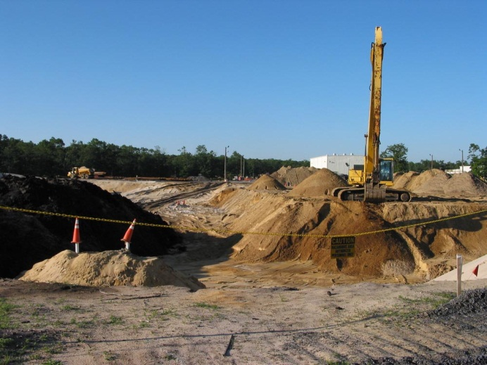
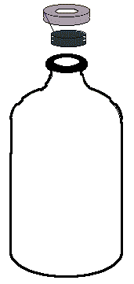
Methods
Vineland Chemical, Co Superfund Site
Trimming, Alignment and Tree
Sequencing
ATGGCTCAATGCTT
Microcosm
Extraction
PCR
Groundwater with Acetate + Arsenate
Elemental analysis and arsenic speciation
Sediment
Notes:
The polymerase chain reaction (PCR) is a technology in molecular biology used to amplify a single copy or a few copies of a piece of DNA across several orders of magnitude, generating thousands to millions of copies of a particular DNA sequence

Slide 9
Esopus Creek Hydrology
Discharge of the Esopus Creek (Coldbrook, NY) and precipitation at Slide Mountain, NY (source: USGS & NCDC)

Slide 10
Esopus Creek Hydrology
Discharge of the Esopus Creek (Coldbrook, NY) and
precipitation at Slide Mountain, NY (source: USGS/NCDC)
Notes:
Explain axes on the figure

Slide 11
Figures
‘1 figure ≈ 1000 words’
Figures should be readable, understandable, uncluttered
Keep figures simple, use color logically for clarification
  Blue = cold, red = warm, dark = little, bright = a lot
  Invisible color
  Meaning attached to colors (~10% of population is color blind)
Explain axes and variables
Include reference for data and images on figure
http://www.cs.aau.dk/~luca/SLIDES/howtotalk-ru.pdf

Slide 12
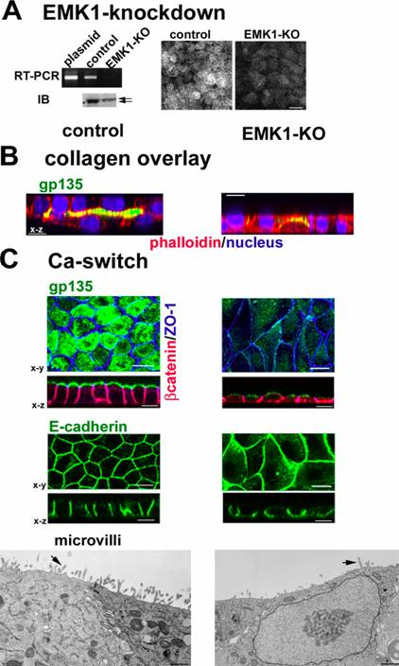
Emk1 knockdown inhibits lumen formation in MDCK cells:
RT-PCR: EMK1 is effectively knocked down in MDCK cells 24 hours after transfection with P-SUPER (control) or P-SUPER-siEMK1 plasmid; knockdown confirmed on the right with antibodies to EMK1.
Collagen overlay assay: cells cultured 24 h on collagen I before being overlaid with additional collagen on the apical surface, analyzed 24 h later. Note the lack of lumen in EMK1-KO cultures.
Ca switch: control or EMK1-KO cells were plated in low Ca medium 24 h upon transfection with pSUPER or pSUPER-KO. After 12 h, cultures were switched to normal medium for 24 h. Transmission EM of cells sectioned perpendicular to the substratum shows lack of microvilli in EMK1-KO cells.
WAY TOO BUSY!!!!
http://www.fw.msu.edu/orgs/gso/documents/GSOWorkshopDocsSp2006/PresentationTipsinPowerPoint.ppt#428,1,Tips for Preparing and Giving an Effective Scientific Presentation using Powerpoint

Slide 13

Cartoons
Domestic
use
irrigation
As
As
As
As
Create a summary cartoon, flow chart or concept map with major findings, or an illustration of the processes or problem
  Consider showing it at the beginning and the end
You can use web sources for figures
  Include reference!

Slide 14
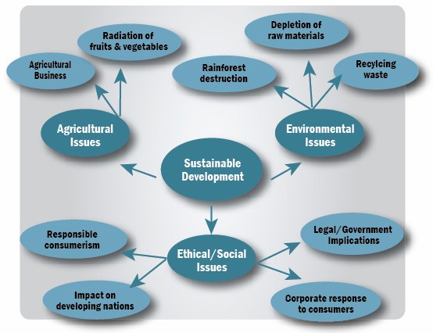
Some Aspects of Sustainable Development

Slide 15
Animations
first rain
ocean water
second rain
evaporation
third rain
evaporation of surface water
kinetic frac.
first vapor, equilibrium

Slide 16
Preparing the Presentation
Average not more than 1 slide per minute
Powerpoint, PDF are standard
  Avoid others, convert Keynote to PDF files
  Prezi causes nausea!
No sounds! Some logical animations can be good
Use 3-7 bullets per page
  Avoid writing out, and especially reading, long and complete sentences on slides because it is really boring to the audience
Slide appearance (font, colors) should be consistent
Speelcheck
Notes:
Technical side of things

Slide 17
What Font to Use
Serif
Sans Serif
annoying
Type size should be 18 points or larger:
18 point
20 point
24 point
28 point
36 point
AVOID USING ALL CAPITAL LETTERS BECAUSE IT’S MUCH HARDER TO READ
* References can be in 12-14 point font
http://www.fw.msu.edu/orgs/gso/documents/GSOWorkshopDocsSp2006/PresentationTipsinPowerPoint.ppt#307,6,Powerpoint basics: 1. What font to use

Slide 18
Color
Dark letters against a light background work
best for smaller rooms, especially when
lights are on
http://www.fw.msu.edu/orgs/gso/documents/GSOWorkshopDocsSp2006/PresentationTipsinPowerPoint.ppt#302,5,Powerpoint basics: 1. What font to use

Slide 19
Color
Light letters against a dark background
also work
Many experts feel that a dark blue or black background works best for talks in a large room
http://www.fw.msu.edu/orgs/gso/documents/GSOWorkshopDocsSp2006/PresentationTipsinPowerPoint.ppt#302,5,Powerpoint basics: 1. What font to use

Slide 20
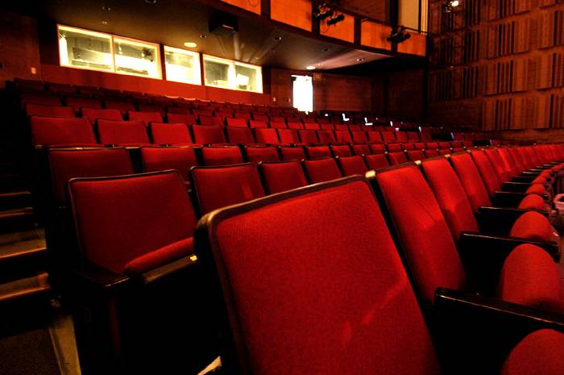
Preparing Yourself
Immerse yourself in subject
  Web of Science/Google it: use the latest news
Familiar with the projection equipment, remote control …
  Memory stick (AND a laptop WITH power supply)
Bring copies of your slides (‘handouts’)
  Annotate and use as notes
  Review as you’re waiting
  Helps if everything crashes, the bulb blows
www.terryfoxtheatre.com/theatre_specification...

Slide 21

Rehearsing
www.thomas.edu/facilities/auditorium/index.htm
Practice – actually stand up and say the words out loud
  Discover what you don’t understand
  Develop a natural flow and come up with better phrasings and ways to describe things – no uptalk!
  Stay within the time limit
  Try speaking too loud to get a feeling where the upper limit is
Don’t over rehearse or memorize the talk
http://www.fw.msu.edu/orgs/gso/documents/GSOWorkshopDocsSp2006/TipsforGivingaScientificPresentation.pdf

Slide 22
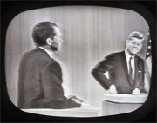
What to Wear …
Dress up – maybe wear a jacket?
  More formal attire makes you appear more authoritative and you show you care enough to try to look nice
  “Snappy Casual”
  Dark clothes are more powerful than light clothes
  Shirts or blouses with collars are better than collarless ones
  Clothes with pressed creases (!) are signs of power
“Ask Dr. Marty” AnimalLabNews (Jan-Feb 2007)
Notes:
Depends on customs in the field, Earth scientists are viewed with suspicion if they wear a tie

Slide 23
Starting
Starting out is the hardest part of the talk
  Memorize the first few lines …
  “Hello, I’m Martin Stute. The title of my presentation is, ‘How to give a scientific talk.’ By the end of this talk you should be able to give a scientific talk….
http://www.fw.msu.edu/orgs/gso/documents/GSOWorkshopDocsSp2006/TipsforGivingaScientificPresentation.pdf

Slide 24
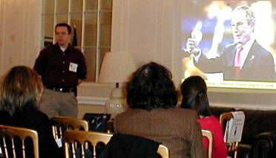
Eye Contact
Experienced speakers:
  Speak freely and look directly at audience
  Remember to roam around the room – don’t lock onto 1 person!
Inexperienced speakers:
  Put outline and key points of your presentation on your slides
  This procedure helps you be more comfortable
    You don’t have to remember what to say
    Eyes are on the slide not on you
    Key points are there in case you forget to say something and also for people who weren’t listening or who are visual learners
http://www.metclubnyc.org/slide%20show.jpg

Slide 25
Presenting the Presentation
Stand where the figures can be seen
Track your talk using the monitor (not the screen)
Pace yourself
  Figure out which slide is your half-way mark and use that to check your time
Pause between slides to capture your thoughts.
http://www.dvd-photo-slideshow.com/screenshot/01.gif

Slide 26
Some “Don’ts”
Don’t apologize or make comments about yourself
  “I hope you’re not bored”
  Never say “sorry”
  “I was working on this ‘til 3 am”
Don’t overuse the pointer
Don’t try to be cute and don’t force being funny
  Stay formal
Don’t forget acknowledgements, always give proper credit
  Tip: Everyone in the audience has come to listen to your lecture with the secret hope of hearing their work mentioned
Don’t raise your voice at the end of sentences
  Don’t try to build suspense and then unveil a surprise ending

Slide 27
Concluding
Have only a few concluding statements
Come back to the big picture and summarize the significance of your work
  Extend logically beyond your limited study – but don’t overreach
Open up new perspectives
  Describe future work, raise questions, potential implications
Leave your conclusion slide up during questions
Don’t end with a slide of references!
http://www.cs.aau.dk/~luca/SLIDES/howtotalk-ru.pdf

Slide 28
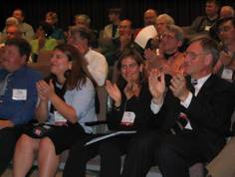
Finishing
Think carefully about your final words and how to finish your presentation strongly
  Don’t just drift off … “I guess that’s all I have to say …”
  You may want to actually memorize your ending lines, just as you do your starting points
Ending your talk
  Say “Thank You” … pause for applause … then
  Say “Any questions?”
http://international.internet2.edu/images/CLARA-I2-MoU/i2-clara-applause.JPG

Slide 29
An Example

Slide 30
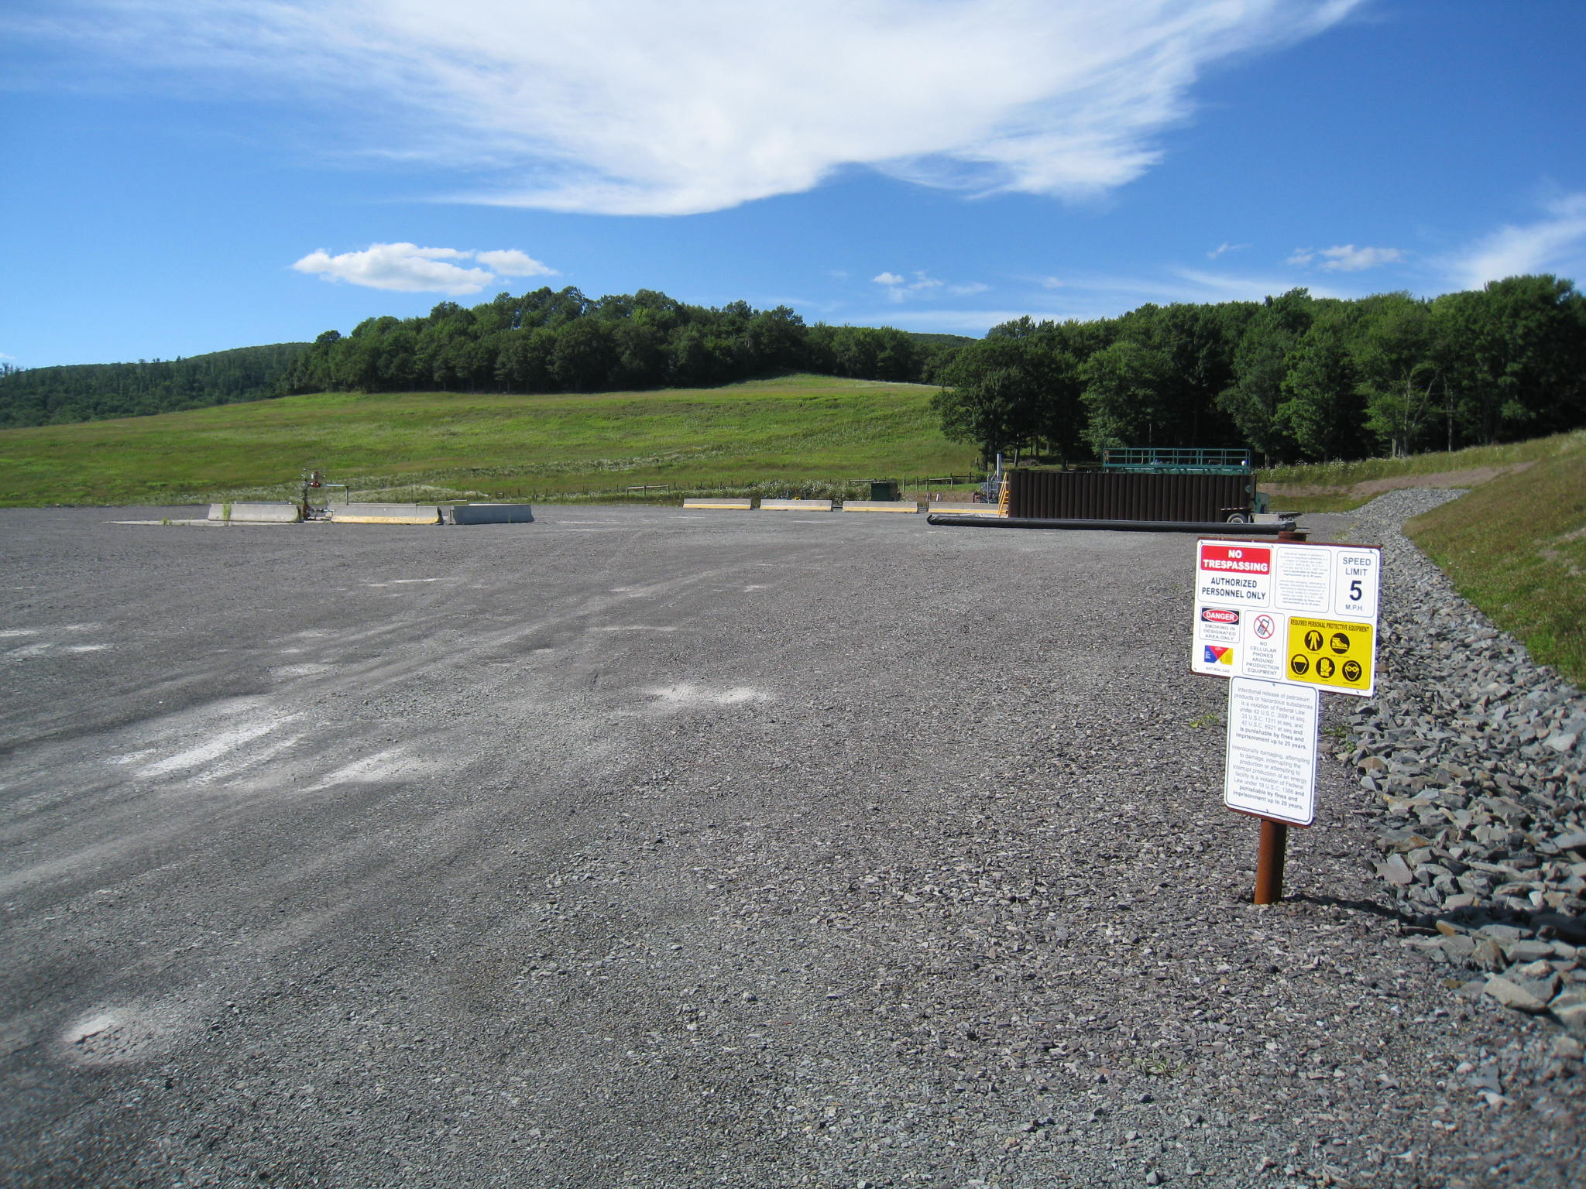
Contrasting groundwater quality in areas with and without gas production by hydraulic fracturing near the PA/NY border
Martin Stute
Environmental Science, Barnard College
Mentor: Beizhan Yan & Steve Chillrud
Lamont-Doherty Earth Observatory
Advisor: Stephanie Pfirman
Environmental Science, Barnard College
,
Thanks to: USGS (Albany office), NIEHS Center for Environmental Health In
Northern Manhattan, NIEHS Center of Excellence in Environmental Toxicology,
Notes:
Shale gas development, including drilling and hydraulic fracturing, is rapidly increasing throughout the United States and, indeed, the rest of the world. Systematic surveys of water quality both pre- and post drilling/production are sparse. To examine the impacts of shale gas production on water quality, pilot studies are being conducted in adjacent counties of western NY (Chemung, Tioga, Broome, and Delaware) and northern PA (Bradford, Susquehanna, and Wayne). These 7 counties along the border of NY and PA share similar geology and demographic compositions and have been identified as a key area to develop shale gas with the key difference that active fracking is occurring in PA but there is no fracking yet in NY due to the current moratorium in that state. Measurements include a suite of volatile organic compounds (VOCs), major and trace elements, methane and its stable isotopes, noble gases and tritium for dating purposes, and the primary radioactive elements of potential concern, radon and radium. We found elevated methane levels on both sides of the border, and some wells show elemental fingerprints characteristic for shale fluids. Several wells near drill sites in PA have high levels of organics, and certain elements characteristic for hydraulic fracturing activities.

Slide 31
Outline
Introduction
  What is hydraulic fracturing?
  Potential environmental effects
Thesis statement
Methods
  Sampling
  Measurements
Preliminary results and discussion
  Methane concentrations
  Major anions
Next steps

Slide 32
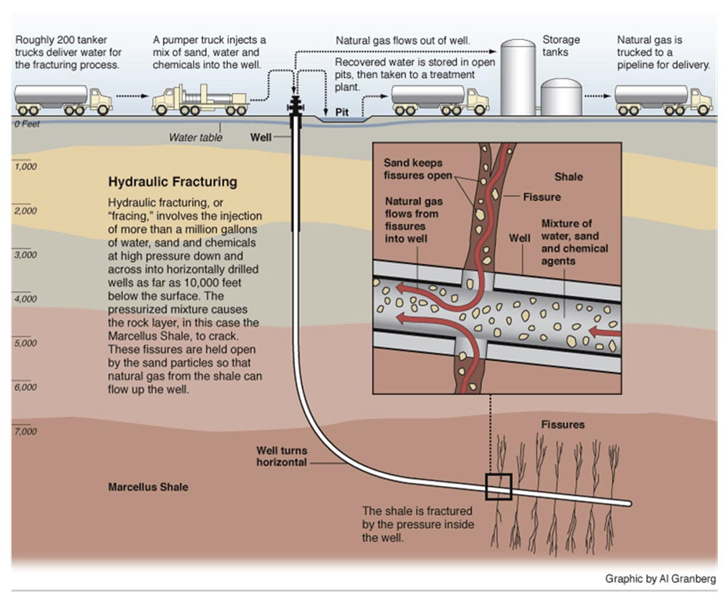
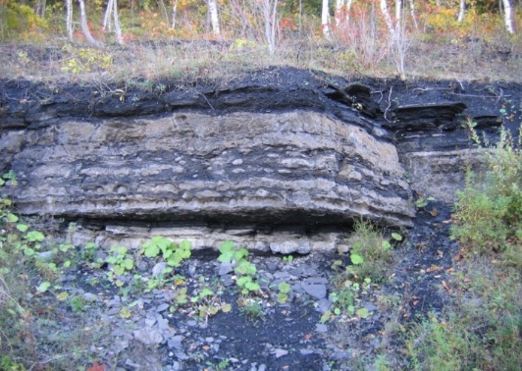
hydraulic fracturing (‘fracking’)
NY Times animation
Notes:
http://www.youtube.com/watch?v=fFUxq9UolN4
Pressure

Slide 33
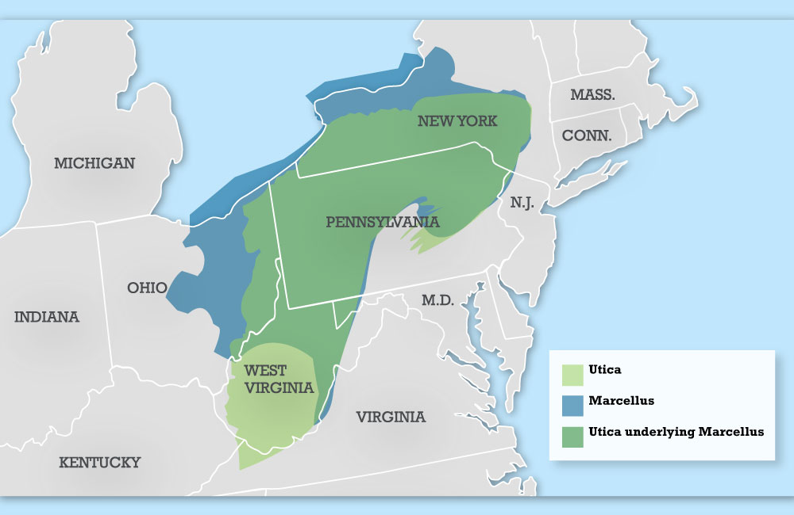
Marcellus and Utica Shales
marcelluscoalition.org
Notes:
Map of Marcellus Shale with wells? Harvard Maps? Point is the contrast

Slide 34
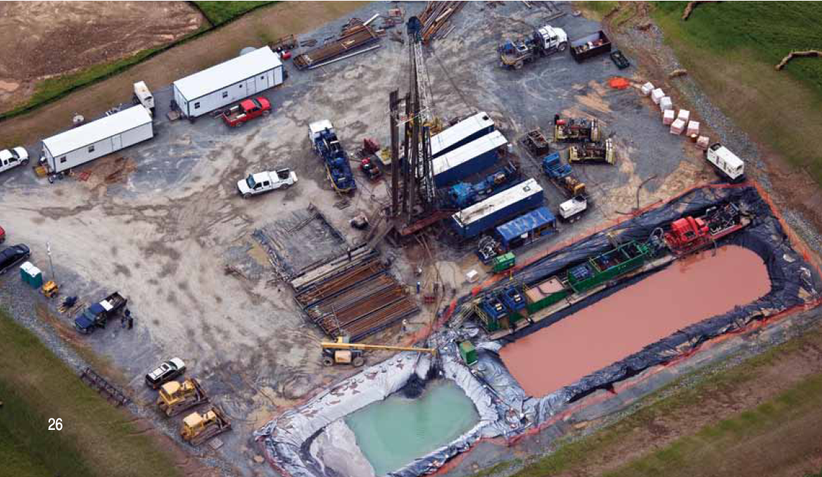
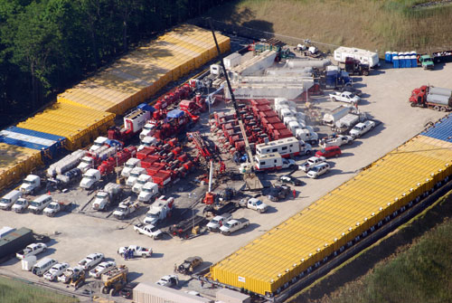
Potential Environmental Effects
Water quality
  Surface spillage
  Well leakage
  Waste water disposal
Air quality
  Increased traffic
  Flaring
  Other site emissions
Climate change
  Methane emissions
Noise
Earthquakes
Fracking site in West-Virginia
http://www.marcellus-shale.us/MARCELLUS-AIR-V.htm

Slide 35
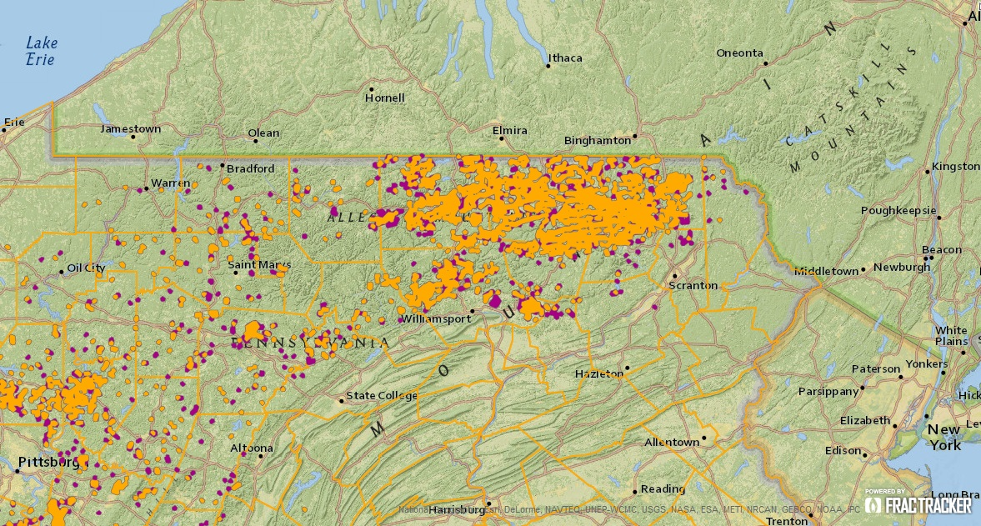
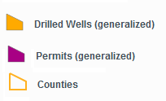
Goal of study
Is there a difference in water quality in areas with and without hydraulic fracturing activity?
NY (~10 wells)
7 counties
PA (7315 wells)
(1/2000-11/2013)
http://maps.fractracker.org

Slide 36
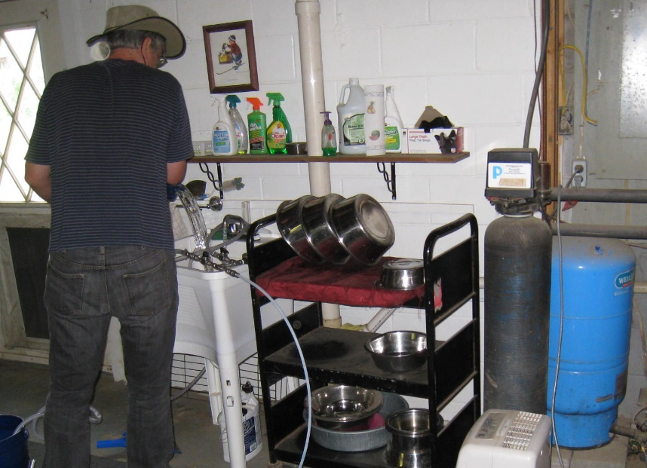
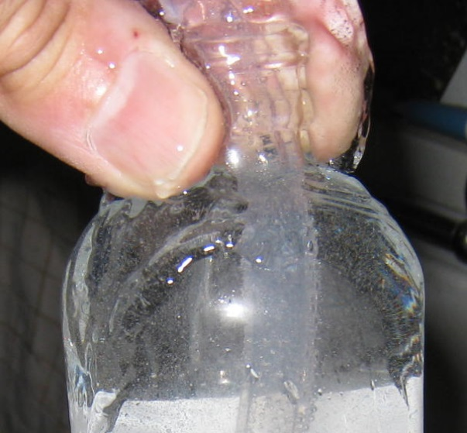
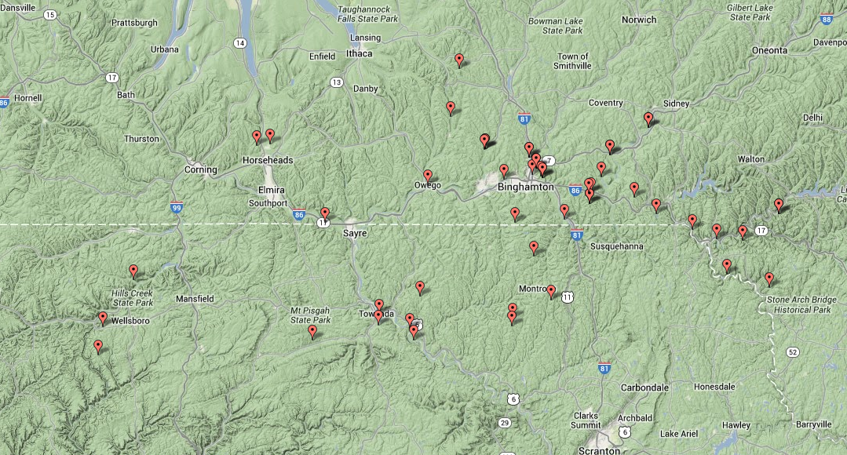
Samples collected during summer 2015
NY
(n=32)
PA
(n=13)

Slide 37
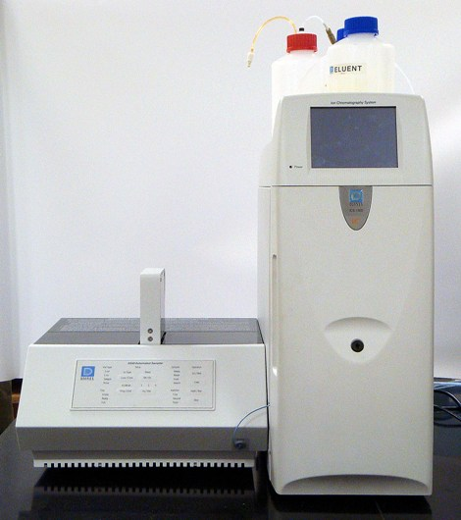
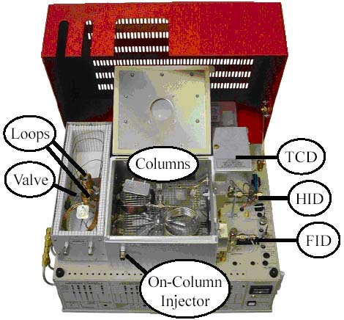
Measurement
Gas chromatography Ion Chromatography
http://www.sri-instruments-europe.com

Slide 38
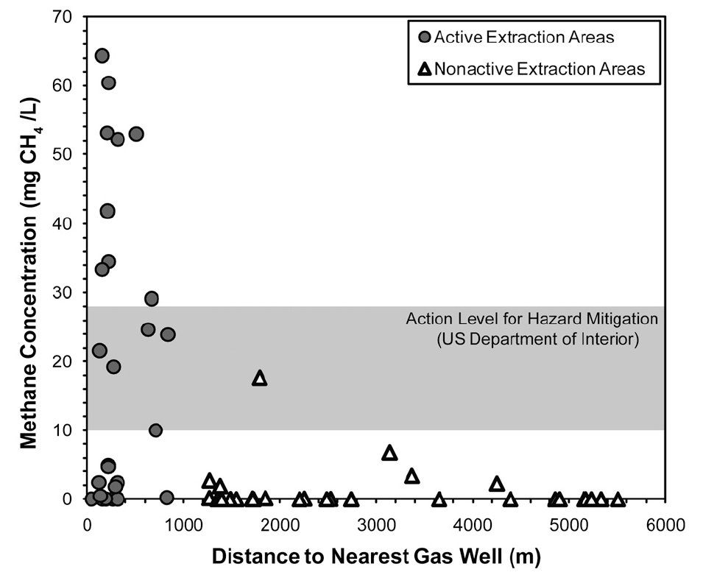
Preliminary results & Discussion:
Methane as function of distance from gas well
,this study
,this study
Osborn et al., PNAS, 2011

Slide 39
Summary
No systematic CH₄ concentration differences
(so far) between NY and PA that can be linked to unconventional gas production
  Do we really have CH₄ contamination in groundwater?
  Caveat: small dataset, slow groundwater velocities
Measurement of anions and cations and trace elements
Next steps

Slide 40

What Can Go Wrong?
Uncertainty about material
Interruptions
Running out of slides
Running out of time
www.rcpsych.ac.uk/.../ anxiety/images/grap6.jpg
http://www.cs.aau.dk/~luca/SLIDES/howtotalk-ru.pdf

Slide 41
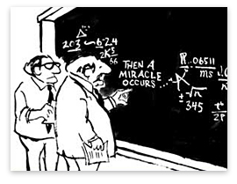
Uncertainty About the Material
Best is if you are sure about the material you present
  Trim the other parts out – if possible
If you have to address something important that you are unsure of …
  Acknowledge the gap in your understanding
    “I’m working on this part” or “I’m looking into it”
  Pose the issue in the future research section at the end
  Or raise it as a question yourself …
  From What's so Funny About Science? by Sidney Harris (1977)

Slide 42

Interruptions
During Your Presentation
www.rscni.ac.uk/.../netmanage/networkindex.htm
Don’t look irritated or rushed
Answer – briefly – just enough to straighten it out
  Then carry on with your presentation without checking back
A question that you will answer later in your talk?
  Say “Good point; just wait two slides”
Requires a long answer and is not critical understanding?
  Say “Good point; I’ll come back to it at the end of the talk”
http://www.cs.aau.dk/~luca/SLIDES/howtotalk-ru.pdf

Slide 43
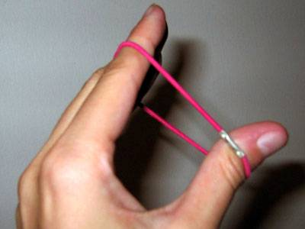
Finishing Too Fast
http://photolog.icyshard.com/archives/26things3/stretch.jpg
Short talks are better than long ones
What to do:
  Don’t make a personal comment
    “hum, I’m running out of slides …”
  Stretch it a little -- see if you can think of an example, or story, to bolster your points
  Conclude unhurriedly, summarizing your main points, but don’t be repetitious
http://www.cs.aau.dk/~luca/SLIDES/howtotalk-ru.pdf
Notes:
Go to 49 then back to 43

Slide 44
Running Out of Time
“He cannot speak well that cannot hold his tongue”
Thomas Fuller, 1732, Gnomologia
Avoid this – impolite to other speakers and the audience: if it happens …
  Do not assume that you can carry on past your time
  Do not skip all of your slides looking for the right one to put on next
  Conclude – on time wherever you are in your talk -- by making your main points
    In Powerpoint you can just type the number of your concluding slide and press Enter to skip right to it
http://www.cs.aau.dk/~luca/SLIDES/howtotalk-ru.pdf
http://www.fw.msu.edu/orgs/gso/documents/GSOWorkshopDocsSp2006/CairnsSpeakingAtLength.pdf

Slide 45

Questions
Questions after your talk help you in writing up your research
  Identifies parts the audience did not understand
  Focuses and adds dimension to your analysis
You can repeat the question – but don’t check back “Did I get it right?”
  This gives you time to think
  The rest of the audience may not have heard the question
  (If you heard the question incorrectly, it presents an opportunity for clarification)
http://www.erp.wisc.edu/profdev/Talkhandout05.doc
http://www.firekills.gov.uk/seniors/cool/howstart/images/howstart.gif

Slide 46
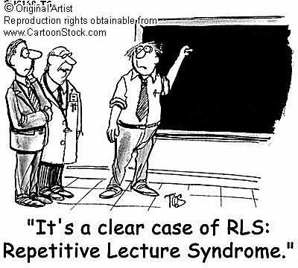
Preparing for Answers
Usually you have thought more about the material than anyone else -- this puts you in a stronger position than you may think
Keep your answers short and to the point -- don’t respond with another lecture
Anticipate typical questions and prepare for them
  Generalizability of your findings to other times? Other places? Other conditions?
  Methodological bias? Uncertainties? Exceptions? Priorities?
Still concerned about questions?
  Make extra slides – perhaps on details of instrumentation or methodology
http://www.regislasvegas.org/images/class-pic-hand-raised.jpg

Slide 47

Difficult Questions
If you really don't know the answer
  Don't feel that you have to invent an answer on the fly -- you are only human and you can't have thought of everything
  Say “That’s a good point, let’s discuss it afterwards”
If the questioner disagrees with you and it looks like there will be an argument then defuse the situation
  "We clearly don't agree on this point, let's go on to other questions and you and I can talk about this later"
http://www.erp.wisc.edu/profdev/Talkhandout05.doc

Slide 48
Conclusions
Presenting your research is critically important in advancing both your ideas and your reputation
Structure your content in a way that is comfortable for you and understandable by your audience
  Use your own style to your advantage
Think ahead about where you might encounter difficulties and figure out ways to overcome it

Slide 49
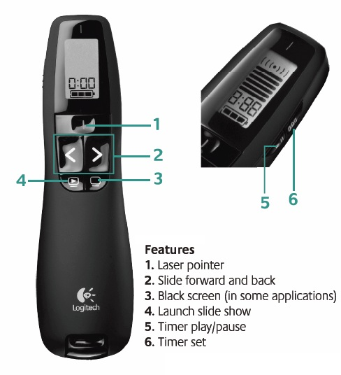
Logistics
Let us know if you have a conflict on a presentation day
Schedule posted on website
Upload files before class on courseworks (pptx or pdf)
Make comments during the presentation
Summary of comments will be sent by advisor
Be there!

