Slide 1
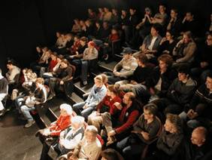
Giving
Research Presentations
Jenna Lawrence & Joerg Schaefer
Modified after
Stephanie Pfirman

Slide 2
Outline
How to give a good talk –technically
- Structuring your story
- Preparing your data/information
- Present
How to give a good talk – performance
What can go wrong

Slide 3
Different talks – different animals
10 minute conference talk
45 minute seminar talk of your project
45 minute overview talk of your field
(to non-experts)
45 minute application talk (to the committee)

Slide 4
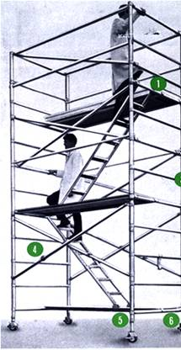
How to Give an Effective Presentation: Structure
Basic rule
  Say what you are going to say
    1-3 main points in the introduction
  Say it
    Give the talk
  Then say what you said
    Summarize main points in the conclusion
http://www.safetyoffice.uwaterloo.ca/hspm/tools/images/scaffold_stair.png

Slide 5
Audience
Why and to whom are you giving this presentation?
What do you want the audience to learn?
  Think about this as you construct your talk
  Edit your slides -- delete what is unnecessary, distracting, confusing, off point

Slide 6

Tell a Story
http://battellemedia.com/images/book_open.jpg
Prepare your material so that it tells a story logically
  Subject: title, authors, acknowledgements
  Introduction/overview
  Method/approach
  Results/information/analysis
  Conclusion/summary
Use examples and anecdotes
Create continuity so that your slides flow smoothly
  Guide the audience through your story
  Your last point on one slide can anticipate the next slide
http://www.cgd.ucar.edu/cms/agu/scientific_talk.html

Slide 7
Examples, anectdotes, analoges

Slide 8
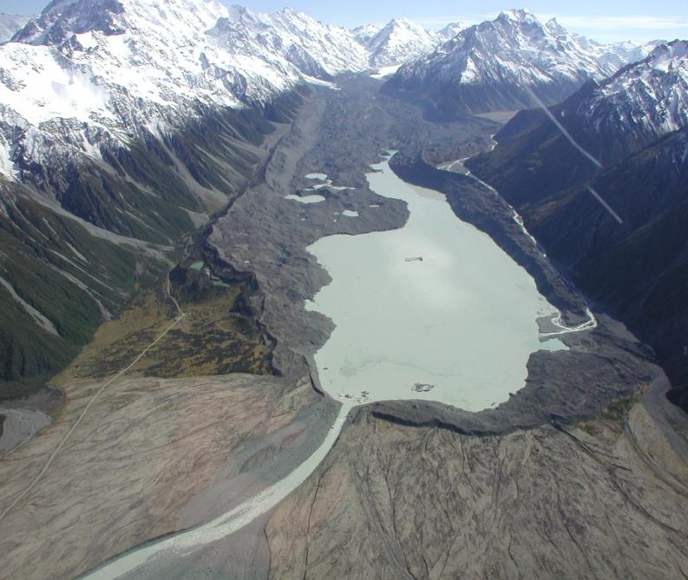
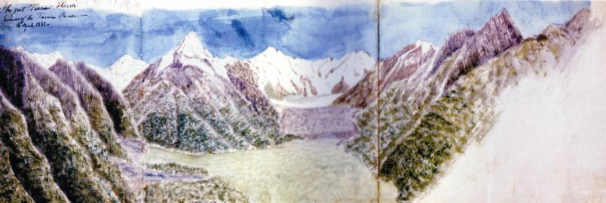
Illustrate
(e.g. ‘climate change’)
Climate change over the last 150 yr
1860 AD
Glaciers and Climate Change
Drawing by
Julius Haast
1863
Notes:
relevance glaciations in general: probably most significant manifestation of climate changes on continents. Although not continuous record, glacial records have other unique strenghts:
This slide shows you a dramatic climate signal, namely the glacial retreat over the last 150 years. This example is from NZ, but I could show you similar slides from almost every glacial record world-wide! Glaciers everywhere reacted to this small signal of about 0.7oC warming since 1850 AD, which is a key argument that glaciers primarily respond on temperature changes on longer timescales. You will have a rather hard time to find this climate signal in other climate records, which illustrates the main strength of glaciers as paleo-archive: their unmatched sensititivity. On the downside: Glaciers leave a non-continuous event-record.
Glacier Events reflect changes in the hydrological cycle, I.e. climate changes on continents! As an expample, in many areas glaciers dominate the drinkwater water supply.
Glaciers and moraines wide-spread on earth in principle allowing near-global experiments → value as calibration for global climate models;
Glaciers and Ice Sheet active players in climate system (freshwater forcing of ocean circulation; albedo etc)
The problem so far was: There was no reliable dating tool and consequently no chronologies! I would claim that we have this universal tool now.

Slide 9
Presenting Your Methods, Data, and Results
Methods, Instrumentation
  For most talks, only present the minimum
Data Tables
  Tables are useful for a small amount of data
  Include units
  Indicate data source if they are not your own
  But tables are often used badly …

Slide 10
Esopus Creek
Discharge of the Esopus Creek (Coldbrook, NY) and precipitation at Slide Mountain, NY (source: USGS/NCDC)

Slide 11
Esopus Creek
Discharge of the Esopus Creek (Coldbrook, NY) and
precipitation at Slide Mountain, NY (source: USGS/NCDC)

Slide 12
Preparing Your Data, continued
Figures
  ‘1 figure ≈ 1000 words’
  Figures should be readable, understandable, uncluttered
  Keep figures simple, use color logically for clarification
    Blue = cold, red = warm, dark = little, bright = a lot
    Invisible color
    Meaning attached to colors (color blindness is more common than you think
  Explain axes and variables
  Include reference on figure
http://www.cs.aau.dk/~luca/SLIDES/howtotalk-ru.pdf

Slide 13
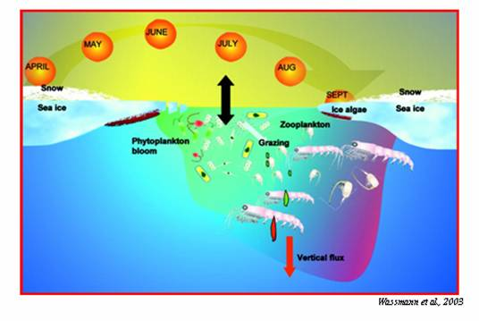
Figures continued ...
Create a summary cartoon with major findings, or an illustration of the processes or problem
  Consider showing it at the beginning and the end
You can use web sources for figures
  Include reference

Slide 14

Preparing the Presentation
Average not more than 1 slide per minute
MS Powerpoint is now standard
  If you use something else, be careful to check it in advance
No sounds! Some logical animations good
Use 3-7 bullets per page
  Avoid writing out, and especially reading, long and complete sentences on slides because it is really boring to the audience
Slide appearance (font, colors) should be consistent
Speelcheck

Slide 15
What Font to Use
Type size should be 18 points or larger:
18 point
20 point
24 point
28 point
36 point
AVOID USING ALL CAPITAL LETTERS BECAUSE IT’S MUCH HARDER TO READ
* References can be in 12-14 point font
http://www.fw.msu.edu/orgs/gso/documents/GSOWorkshopDocsSp2006/PresentationTipsinPowerPoint.ppt#307,6,Powerpoint basics: 1. What font to use

Slide 16
Color
Dark letters against a light background work
Dark letters against a light background
are best for smaller rooms, especially when the lights are on for teaching
http://www.fw.msu.edu/orgs/gso/documents/GSOWorkshopDocsSp2006/PresentationTipsinPowerPoint.ppt#302,5,Powerpoint basics: 1. What font to use

Slide 17
Color
Light letters against a dark background
also work
Many experts feel that a dark blue or black background works best for talks in a large room
http://www.fw.msu.edu/orgs/gso/documents/GSOWorkshopDocsSp2006/PresentationTipsinPowerPoint.ppt#302,5,Powerpoint basics: 1. What font to use

Slide 18
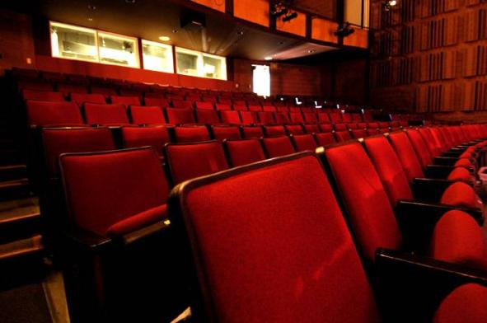
Preparing Yourself...
Immerse yourself in what you are going to say
  Web of Science/Google it: use the latest news
Make sure you are familiar with the projection equipment, remote control and Powerpoint
  Bring your presentation on a memory stick AND a laptop with power supply AND an extension cord …
www.terryfoxtheatre.com/theatre_specification...

Slide 19
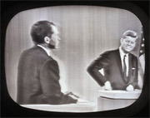

What to Wear …
Dress up – maybe wear a jacket?
  More formal attire makes you appear more authoritative and you show you care enough to try to look nice
From “Ask Dr. Marty” AnimalLabNews (Jan-Feb 2007)
  Dark clothes are more powerful than light clothes
  Shirts or blouses with collars are better than collarless ones
  Clothes with pressed creases (!) are signs of power

Slide 20
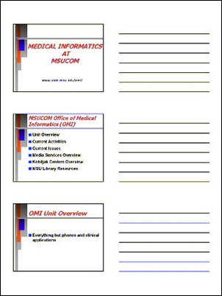
Print Your Slides
www.com.msu.edu/.../powerpoint/printing.htm
Don’t read the presentation
Print out copies of your slides (‘handouts’)
  You can annotate them and use them as notes
  You can review them as you’re waiting
  If everything crashes – the bulb blows, you can still make your main points in a logical way

Slide 21
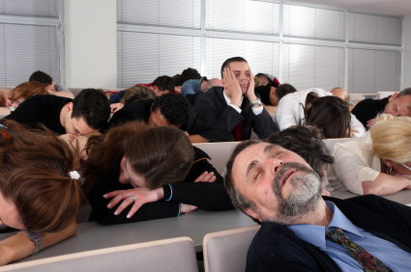
Giving a good talk - performance
www.thomas.edu/facilities/auditorium/index.htm
A technically perfect talk can still be BORING!!

Slide 22

Rehearsing
www.thomas.edu/facilities/auditorium/index.htm
Practice – actually stand up and say the words out loud
  You discover what you don’t understand
  You develop a natural flow
  You come up with better phrasings and ways to describe things
    It is harder to explain things than you think, practicing helps you find the words
  Stay within the time limit
  The more rehearsing, the better!
http://www.fw.msu.edu/orgs/gso/documents/GSOWorkshopDocsSp2006/TipsforGivingaScientificPresentation.pdf
Notes:
Preferrably in front of at least one other person
…controversial point
WOMEN

Slide 23

Notes:
No excuse -- uh, um, you know (NO< WE DON’T KNOW), and certainly no LIKEs
Embrace the silence

Slide 24
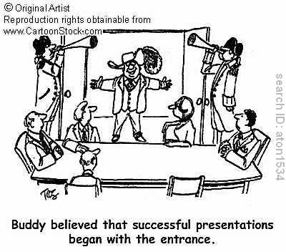
Giving the Presentation
Starting out is the hardest part of the talk
  To get going, memorize the first few lines
http://www.fw.msu.edu/orgs/gso/documents/GSOWorkshopDocsSp2006/TipsforGivingaScientificPresentation.pdf
Notes:
Good morning. Today I’ll be talking about the pair bond in brown titi moneys in Peru.
-Specifically, I investigated why one male and one female might form an exclusive and enduring attachment. Generally explanations for the occurrence of PB have centered on three categories of potential reproductive benefits.

Slide 25

Giving the Presentation
Experienced speakers:
  Speak freely and look directly at audience
Inexperienced speakers:
  Put outline and key points of your presentation on your slides
http://soroptimistofgreaterdavis.org/documents/images/photos/speaker.gif
Notes:
BUT

Slide 26
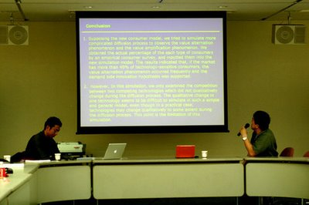
Giving the Presentation
Look at people, not slides, during presentation
Stand where the figures can be seen
Be enthusiastic
Don’t worry about stopping to think
Don’t rush
  Figure out which slide is your half-way mark and use that to check your time
www.clarityrules.org
Notes:
slides are for your audience, and not for you -- if you’re using the slides to prompt you what to say next, then there is too much text!
Don’t let the slides replace you -- the audience will be reading and not listening (esp if have to take notes!)
These slide have more text then I would recommend - but this presentation will have a second life as as online reference tool.
…just no UM!
…so know if need to speed up or slow down

Slide 27
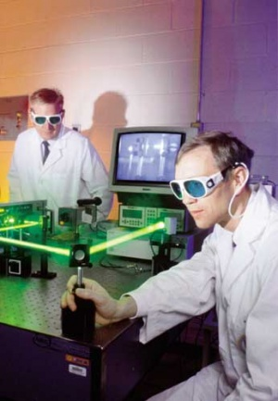
Giving the Presentation
Don’t apologize
  “I hope you’re not bored”
  “I was working on this ‘til 3 am”
Don’t overuse the pointer
Don’t forget acknowledgements; always give proper credit
www.laylaland.org
Notes:
…or make comments about yourself
Tip: Everyone in the audience has come to listen to your lecture with the secret hope of hearing their work mentioned

Slide 28
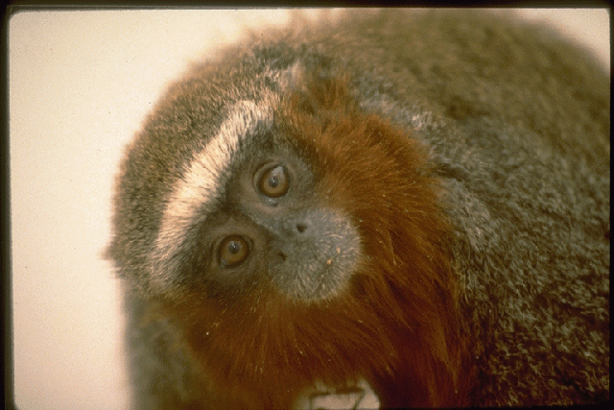
Concluding Your Content
Announce the ending so that people are prepared
  For example, with a slide titled “Conclusions”
Have only a few concluding statements
Come back to the big picture and summarize the significance of your work in that context
Open up new perspective
  Describe future work, potential implications
http://www.cs.aau.dk/~luca/SLIDES/howtotalk-ru.pdf
Notes:
Or by saying, “In my final slide …” or “My final point is …”
…so what DID I learn about the pair bond in titi monkeys?
…how did my results contribute to general debate on the evolutionary function of pair bonds (in primates and other mammals)?

Slide 29
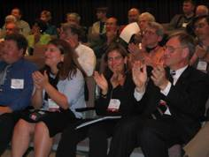
Finishing Your Presentation
Think carefully about your final words and how to finish your presentation strongly
  Don’t just drift off … “I guess that’s all I have to say …”
  You may want to actually memorize your ending lines, just as you do your starting points
Ending your talk
  Say “Thank You” … pause for applause … then
  Say: “Any questions?”
http://international.internet2.edu/images/CLARA-I2-MoU/i2-clara-applause.JPG

Slide 30
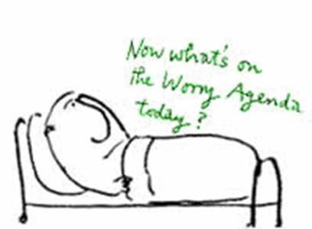
What Can Go Wrong?
www.rcpsych.ac.uk/.../ anxiety/images/grap6.jpg
RUNNING OUT OF TIME
Uncertainty about material
Interruptions
Running out of slides
http://www.cs.aau.dk/~luca/SLIDES/howtotalk-ru.pdf

Slide 31
Running Out of
Time
“He cannot speak well that cannot hold his tongue”
Thomas Fuller, 1732, Gnomologia
Avoid this – impolite to other speakers and the audience: if it happens …
  Do not assume that you can carry on past your time
  Do not skip all of your slides looking for the right one to put on next
  Conclude – on time wherever you are in your talk -- by making your main points
    In Powerpoint you can just type the number of your concluding slide and press Enter to skip right to it
http://www.cs.aau.dk/~luca/SLIDES/howtotalk-ru.pdf
http://www.fw.msu.edu/orgs/gso/documents/GSOWorkshopDocsSp2006/CairnsSpeakingAtLength.pdf

Slide 32
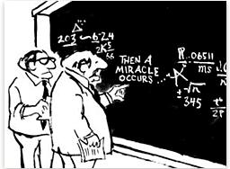
Uncertainty About the Material
Try to structure your talk so that you are sure about the material you present
If you have to address something important that you are unsure of
  Acknowledge the gap in your understanding
    “I’m working on it” or “I’m looking into it”
  Better than being pressed to admit something
  From What's so Funny About Science? by Sidney Harris (1977)
Notes:
If there was a part of your project that weren’t too clear on -- ex, particular statistical analysis -- skip right over it and hope no one asks a question about it.

Slide 33
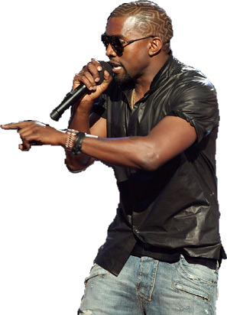
Interruptions
During Your Presentation
www.neoseeker.com
Don’t look irritated or rushed
Answer – briefly – just enough to straighten it out
  Then carry on with your presentation without checking back
A question that you will answer later in your talk?
  Say “Good point; just wait two slides”
Requires a long answer and is not critical understanding?
  Say “Good point; I’ll come back to it at the end of the talk.”
http://www.cs.aau.dk/~luca/SLIDES/howtotalk-ru.pdf
Notes:
…or we can discuss it after my talk

Slide 34
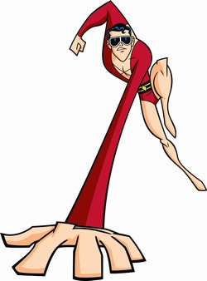
Running Out of
Slides
www.poeghostal.com
Short talks are better than ones that are too long
What to do:
  Don’t make a personal comment
    “hmm, I’m running out of slides …”
  Stretch it a little -- see if you can think of an example, or story, to bolster your points
  Conclude unhurriedly, summarizing your main points, but don’t be repetitious
http://www.cs.aau.dk/~luca/SLIDES/howtotalk-ru.pdf
Notes:
…have stories ready that are relevant to your points -- eg, I love it when I have an excuse to talk about the scandalous saga of death and divorce with y titis -- shows that pair bonds weren’t quite as permanent as previously thought.
…should be prepared to stretch if got to your half-way point too quickly -- and will have timer

Slide 35

Questions and Answers
Questions after your talk can be difficult but they definitely help you in writing up your research
  Identifies parts the audience did not understand
  Focuses and adds dimension to your analysis
You can repeat the question
  This gives you time to think
  The rest of the audience may not have heard the question
  Also, if you heard the question incorrectly, it gives you an opportunity for clarification
http://www.erp.wisc.edu/profdev/Talkhandout05.doc
http://www.firekills.gov.uk/seniors/cool/howstart/images/howstart.gif
Notes:
..helps you see something in a new way.

Slide 36
Questions and Answers, continued
Keep your answers short and to the point – don’t respond with another lecture
Anticipate typical questions and prepare for them
Make extra slides – perhaps on details of instrumentation or methodology
If you really don't know the answer
  Say "Interesting, I will look into that" or “That’s a good point, let’s discuss it afterward”
  Don't feel that you have to invent an answer on the fly -- you are only human and you can't have thought of everything
Notes:
..Why, I’m so glad you asked
Generalizability of your findings to other places? Other conditions?
Methodological bias? Uncertainties? Exceptions?
…after I’ve disappeared
…don’t BS!

Slide 37

Conclusions
Structure your content in a way that is comfortable for you
Practice!
Think ahead about where you might encounter difficulties and figure out ways to overcome them

