Slide 1
HOW TO GET AHEAD IN PROFESSIONAL ORGANIZATIONAL ENVIRONMENTS
BY STEVEN COHEN
COLUMBIA UNIVERSITY
SIPA & EARTH INSTITUTE
May 2019

Slide 2
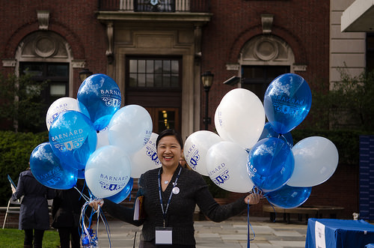
TODAY'S BRIEFING WILL DISCUSS THE FOLLOWING ISSUES:
Moving from School to Work
Developing and Maintaining a Professional Network
Planning Your First Post-College Professional Move
Succeeding on the Job
Building Skills and Competencies
Developing a Professional Reputation
Overcoming Professional Adversity
Moving Up, Over and Around
Keeping Your Career in Perspective

Slide 3
1. MOVING FROM SCHOOL TO WORK
Work is changing.
Less Structure, Less Security, More Mobility
The Gig economy
Education is now constant.
Formal education, training, and learning by doing
The culture of the workplace is different from school.
Be careful about crossing personal and professional boundaries.

Slide 4
2. DEVELOPING AND MAINTAINING A PROFESSIONAL NETWORK
Building and using your contacts.
Staying in touch.
Nurturing an informal network.
Beyond Social Media
Professional socializing and professional civility
Using professional associations
Using school and alumni connections
Asking for help from family, friends and friends of friends

Slide 5
3. PLANNING YOUR FIRST POST-COLLEGE PROFESSIONAL MOVE
Networking from Columbia and Barnard
Use of adjuncts, faculty and alums
Use of speakers, student organizations, internships, research work, fellow students and volunteer work
Using career service offices
Taking advantage of your student status
Casting a wide net to develop job opportunities
Use Columbia, Barnard, and the Earth Institute as selling points
Opportunities for professional advancement: mentors, skill building, interests, values and ideals

Slide 6
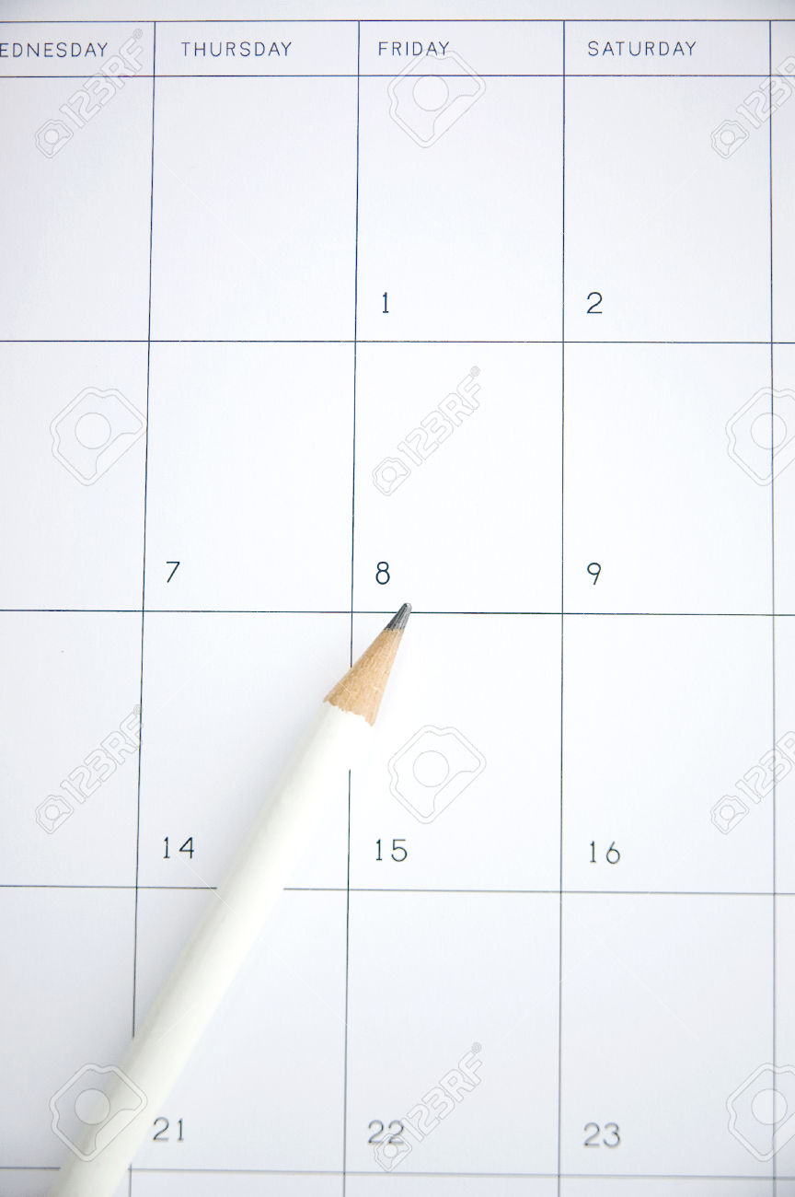
3. PLANNING YOUR FIRST POST-COLLEGE PROFESSIONAL MOVE
Devote a substantial amount of time and effort to the search.
Allocate about 20% of your time to the job search in the year before you leave school.
Identify your preferences and priorities.
Retain flexibility for unforeseen opportunities.
Cast a wide net
Develop a strategy and workplan: goals, tasks, and schedule.

Slide 7
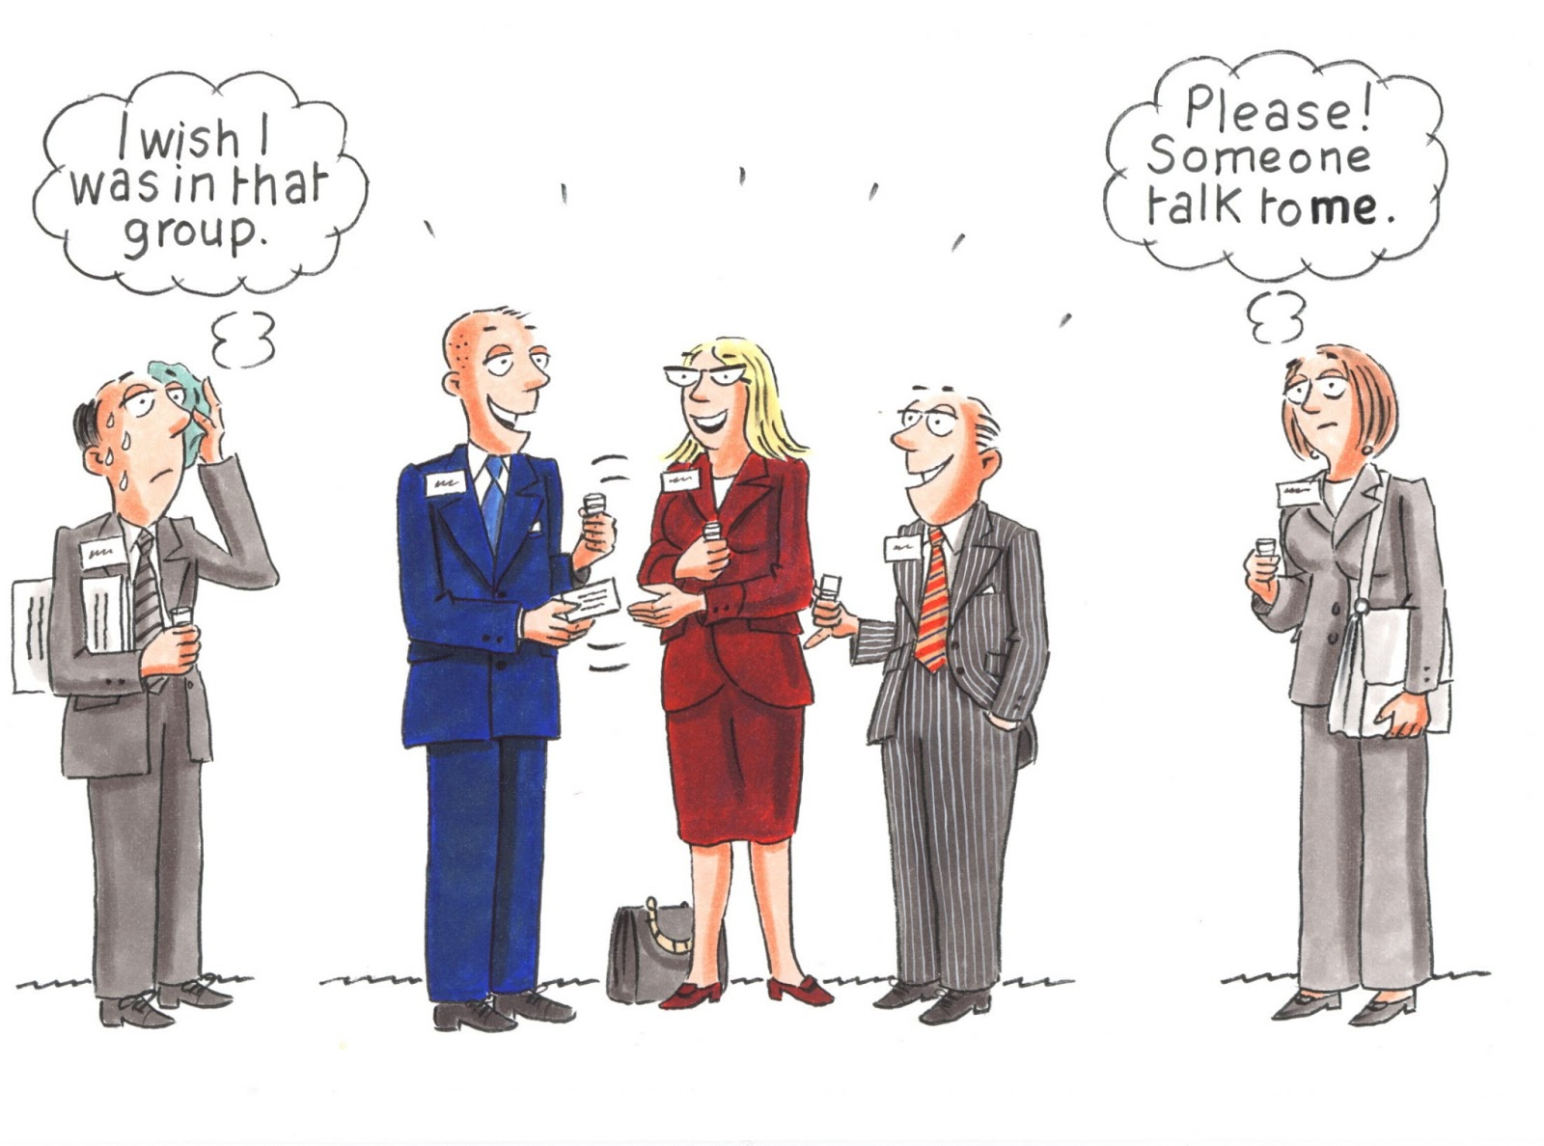
3. PLANNING YOUR FIRST POST-COLLEGE PROFESSIONAL MOVE
Communicate and network
E-mail and texts should be used to set up phone calls and visits.
Your need to devote the extra effort to identifying openings.
Contact classmates, alums, adjuncts, friends and family.
This is not the time to be reserved or shy.
Contact organizations you once worked for.

Slide 8
3. PLANNING YOUR FIRST POST-COLLEGE PROFESSIONAL MOVE
Connect with the University’s adjunct faculty.
They are important links to the “real world” and can help with contacts and information.
Use but do not rely on sites such as LinkedIn, Monster, etc.
They can provide information and speed elements of the search, but they have limits.
Use the “snowball” method:
Always ask for the introductions to others- even people not hiring may know people who might be hiring.
Keep records of contacts, information and progress.
Develop a basic resume, but tailor it for specific jobs.

Slide 9
3. PLANNING YOUR FIRST POST-COLLEGE PROFESSIONAL MOVE
Keep up with developments in the field.
Makes you a more interesting informational interview and helps identify emerging opportunities.
Stay positive. The job search is difficult enough.
You need to convince your potential employer that you will help them achieve their goals.
Do not be passive. Do not give up. Ask for help if you need it.
The overall economy doesn’t matter: Even during the Great Depression, most people had jobs.

Slide 10
4. SUCCEEDING ON THE JOB
The importance of listening
The importance of informal relations
Learning to read your boss
Preserving your boss’ time
Professionalism:
Honesty, Ethics, Communication Skills, Reliability, Punctuality, Dress, Respect for Others
Knowing what you don’t know
Learning how to ask for help
Getting along with people
Dealing with bad assignments and getting good ones

Slide 11
5. BUILDING SKILLS AND COMPETENCIES
Finding jobs that develop new skills
Finance and accounting
Sustainability management
Environmental science and policy
Technology for sustainable development- energy, food, water and health care
Computing, data analysis, coding, management and geographic information systems (MIS) (GIS)

Slide 12
5. BUILDING SKILLS AND COMPETENCIES
Management, team building, strategy formulation
Public relations, media relations, communication skills
Lobbying and legislative relations
Research and policy analysis
Fundraising

Slide 13
6. DEVELOPING A PROFESSIONAL REPUTATION
Getting known for your competence
Getting and sharing authorship and credit
Protecting your good name
Knowing when to quit
The opportunities and dangers of politics and advocacy

Slide 14
7. OVERCOMING PROFESSIONAL ADVERSITY
Everyone faces professional setbacks.
Understanding how you are perceived within your organization
Understanding your organization’s environment and the trends that affect it.
Maintaining a professional demeanor and keeping in mind your long-term professional interests
Keep professional life in perspective.

Slide 15
8. MOVING UP, OVER AND AROUND
Determining when it is time to move
You’ve stopped learning.
Your reputation is no longer growing.
You’ve hit a professional ceiling or you’ve been passed over for a key promotion.
Other options look better.
You no longer look forward to work.
When should you look for a new job? Always.
Where and how to look for a new job from a job
Moving down to move up

Slide 16
9. KEEPING YOUR CAREER IN PERSPECTIVE
Balancing work and home
Maintain a personal life while building a career
Work can follow you anywhere- learn how to turn it off
Preventing burnout
Remembering what you are about and who you are

