Slide 1
Proposal: Preliminary Results and Discussion
Notes:
JA 2018

Slide 2
Dos and Don’ts
Do
Don’t
Include initial results if you have them
You can also conduct and report on informal pilot studies
Anticipate results
Maybe make graphs to show potential relationships
Potentially include results from a related project
And discuss how your results may be the same or differ
Write text before citing figure
Write captions for each figure
Insert figures without explanatory text or captions
Leave this section blank because you have not yet generated formal results

Slide 3
Making effective plots
Don’t use default Excel plots!
Figure should highlight the key relationships in the data.
Should be clear - no extraneous legends, lines, only use annotations when they add real explanatory value.
Don’t use bells and whistles like 3-D when they don’t improve clarity.
Make sure fonts are large enough to be read both in print and on screen.

Slide 4
Line plots
What’s wrong here?
Notes:
Grey background
No axis label
Markers too small, no errorbars
Vertical lines might help orient

Slide 5
Line plots
Chart for presentation

Slide 6
Line plots
Chart for a paper

Slide 7
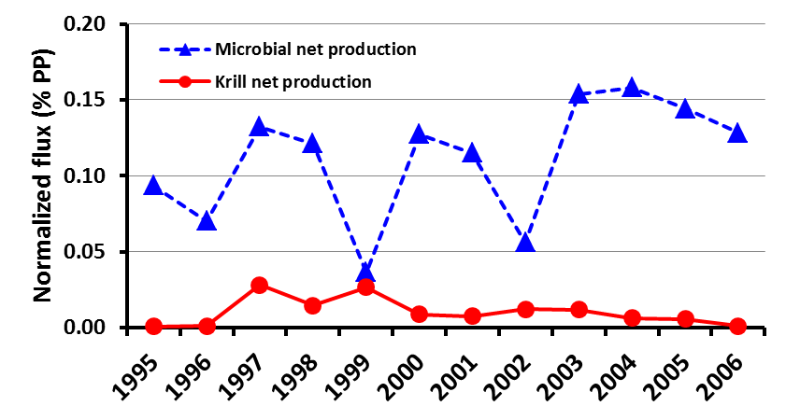
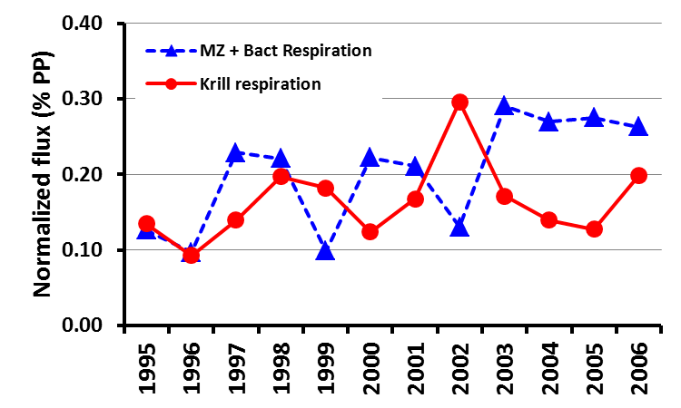
Line plots
For presentations, use color, make thick lines, larger fonts

Slide 8
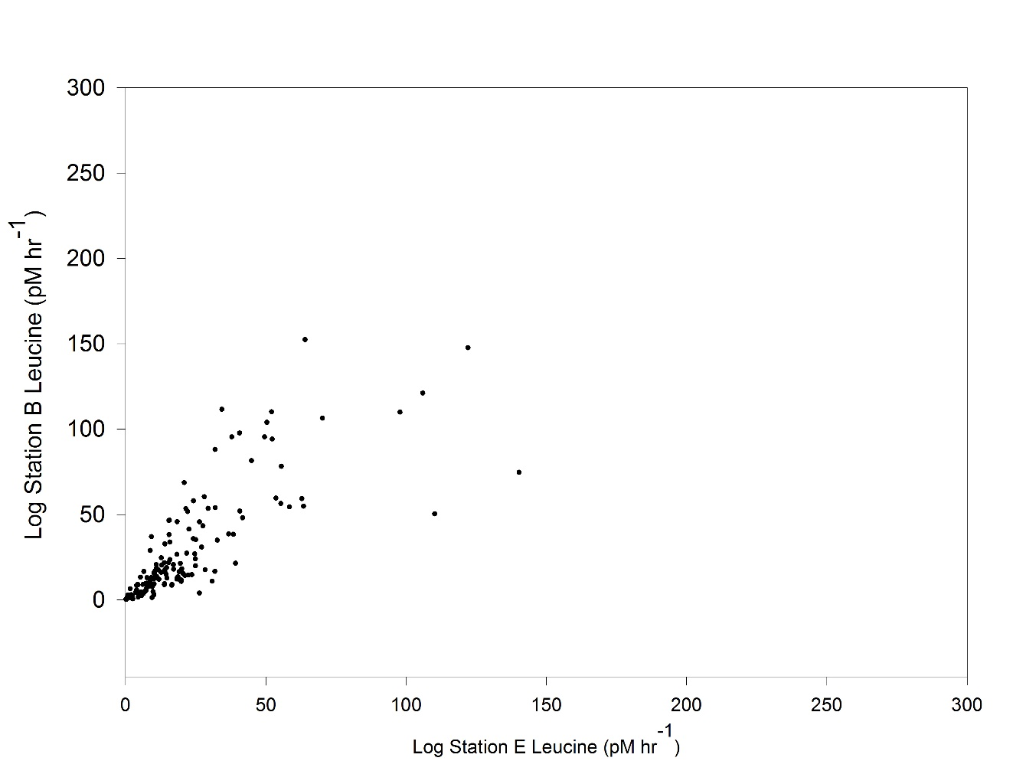
Scatter plots
What’s wrong with this graph?

Slide 9
Scatter plots
What’s wrong with this graph?
Lines too thin
Symbols pretty small
Axis labels too small, not uniform size
Poor choice of axis scales
Zero on Y-axis is off graph origin

Slide 10
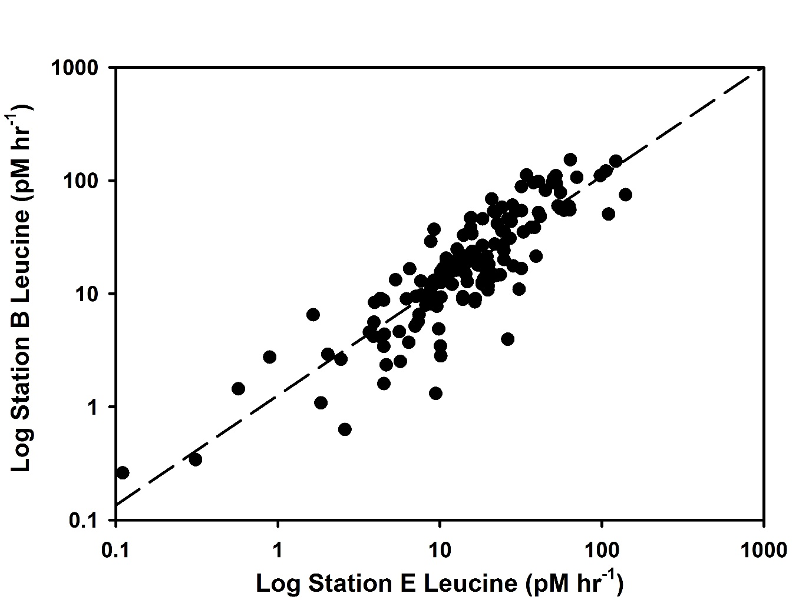
Scatter plots
Improvements:
Lines thicker
Symbols bigger
Axis bigger font, bold, uniform
Axis scales match data range, changed to log scales
Added regression line and equation
Y = 0.97X + 0.10, R2 = 0.745, n = 145

Slide 11
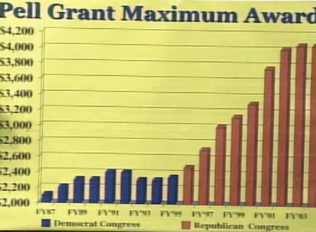
Bar plots
What’s wrong here?
Notes:
Y-axis scaling is misleading. By having minimum value of $2000, the relationship between early and later years is exaggerated.
The fake 3-D on the bar charts obscure the true height of the bar, and the height of the bar is the most important part
The y-axis labels could be simpler. For example, it could be in units of “Thousands of $US” with values from 0 to 4.2.

Slide 12
Bar plots
What’s wrong here?

Slide 13
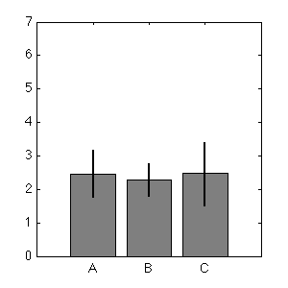
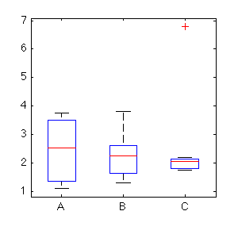
Bar plots & box plots
Appropriate for counts without variation
Emphasis on comparing means
Error bars show some variation (if included)
Shows rough distribution of data, including outliers
Conveys much more information in same amount of space (customizable, but usually median, quartiles, 95% range, outliers)

Slide 14
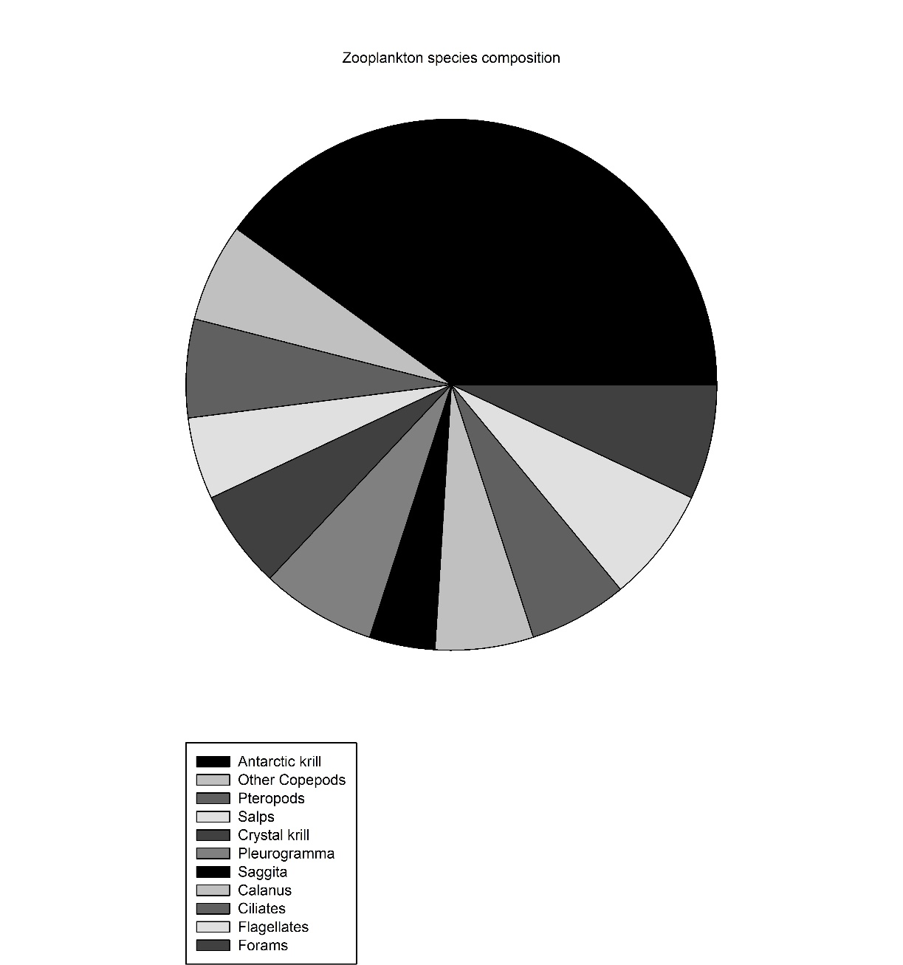
Pie chart
The much-abused Pie Graph
(try to avoid them)
(consider (stacked) bar graphs)
Fonts too small
Bad color choices: slices not distinguished by shading
Too many data groups (categories)

Slide 15
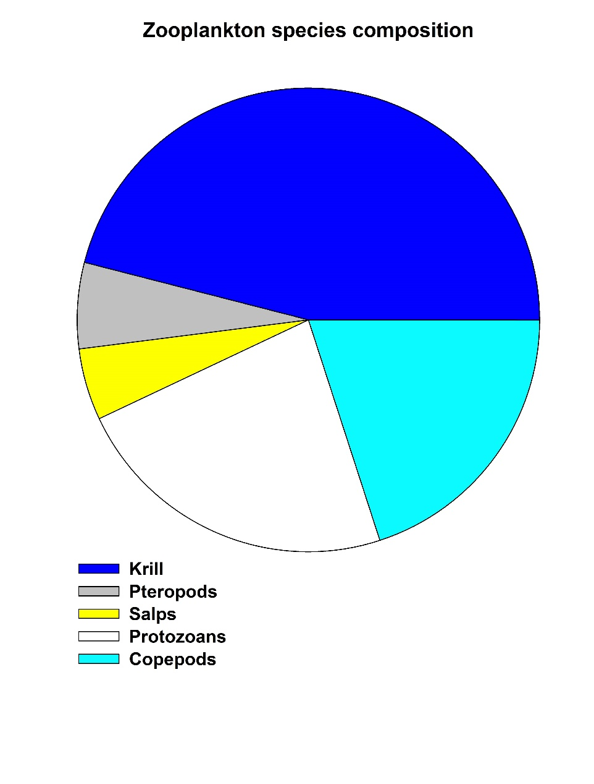
Pie chart
Improvements:
Combined categories
Better shading / color scheme
Enlarged fonts
Unboxed the legend (remove excess ink)

Slide 16
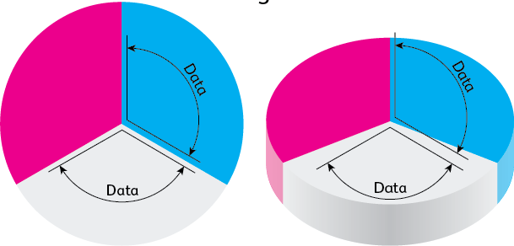
Pie chart
What’s wrong here?
Notes:
Using 3-D for a pie chart is an especially bad idea. The illusion of depth actually obscures the relationships in the data. In the figure on the right, the slices are the same size but the fact that the white slice is in the front makes it look bigger than the others. Both the angle and the amount of the plot area are out of proportion with the underlying data.

Slide 17
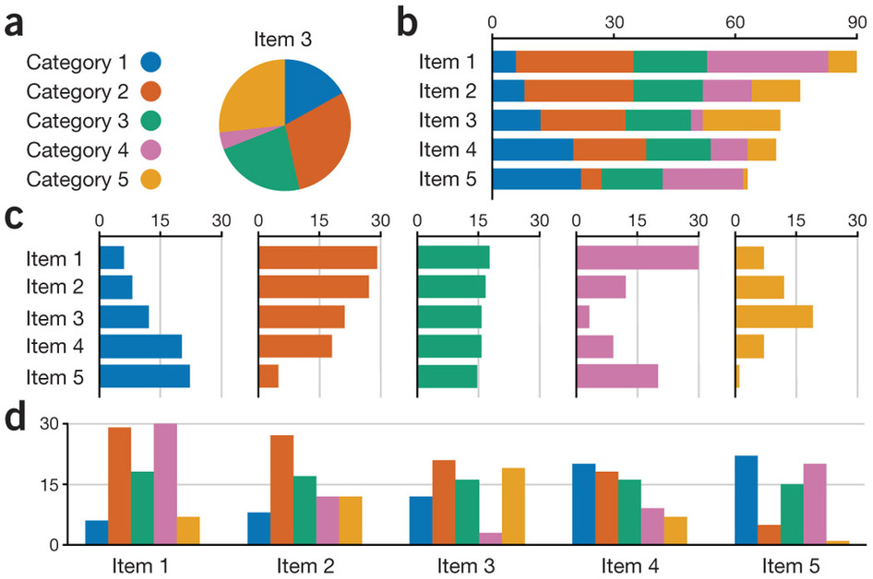
What is effective from these variations?
Notes:
Pie chart – shows composition of categories for one sample, but this is hard to compare to other samples (not shown here)
Stacked bar chart – allows comparison of the composition of multiple samples (called items here). This also allows you to compare the totals across samples easily.
Layered bar charts – facilitate comparison of each category, but makes it harder to compare the individual samples (for example, it’s essentially impossible to see which item has the largest sum from this variant)
Grouped bar charts – This takes a bit more time to process visually, but conveys information about both the distribution of categories within a sample and comparison of categories across samples. As in the layered bar chart, you can’t really see how totals compare across samples.

Slide 18
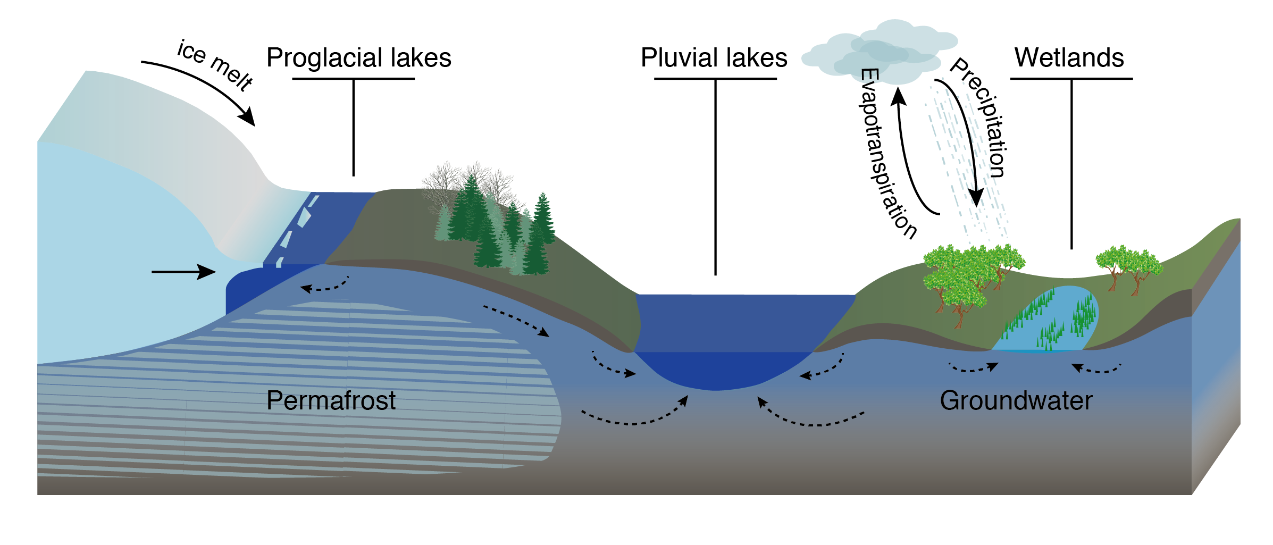
Diagrams and cartoons
Use diagrams and cartoons to illustrate concepts and describe methods

Slide 19
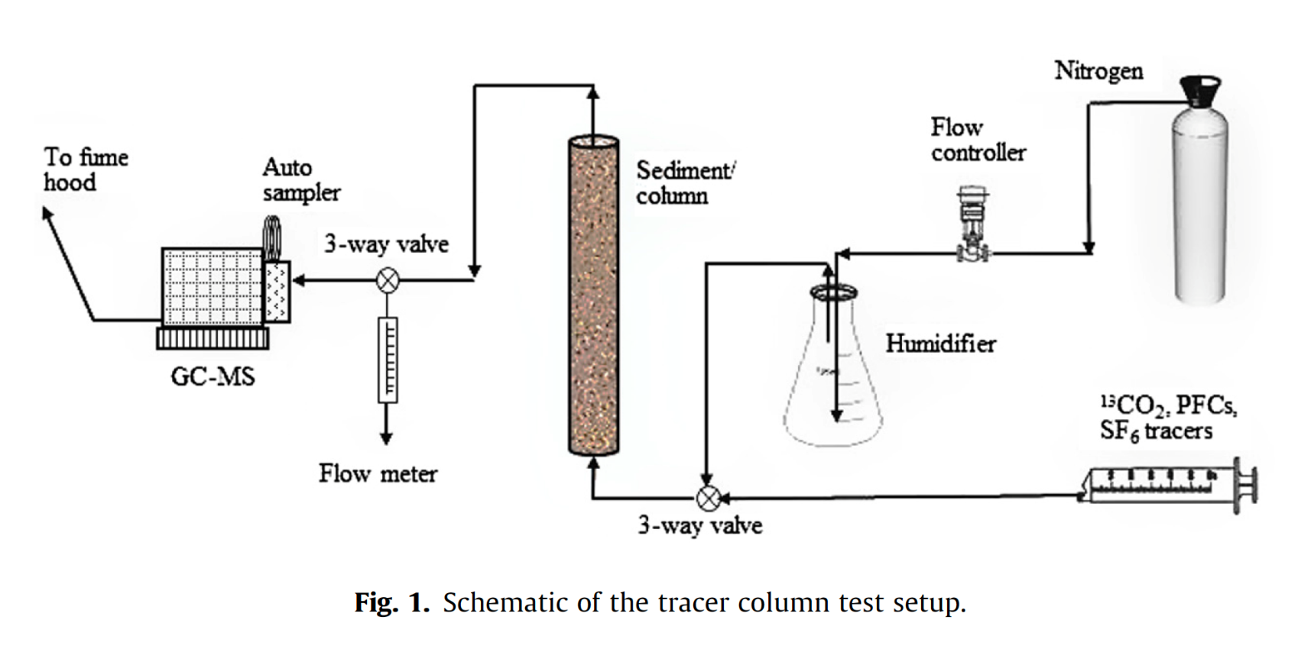
Diagrams and cartoons
Use diagrams and cartoons to illustrate concepts and describe methods

Slide 20
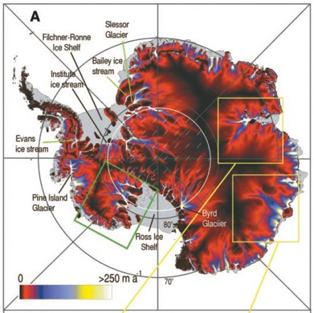
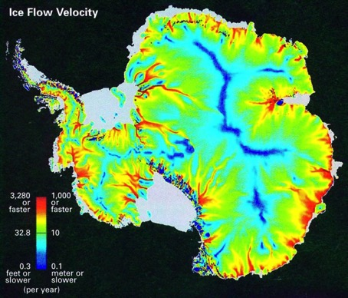
Choice of color
Important information should be emphasized, but the colorscale should not introduce artifacts into visual perception of the data
Bamber et al., 2000
National Geographic, 2002
Notes:
Colors should be clearly distinguishable
Colormaps should highlight the important information
If you use colors, try to use high contrasts that are still useful if printed in black and white

Slide 21
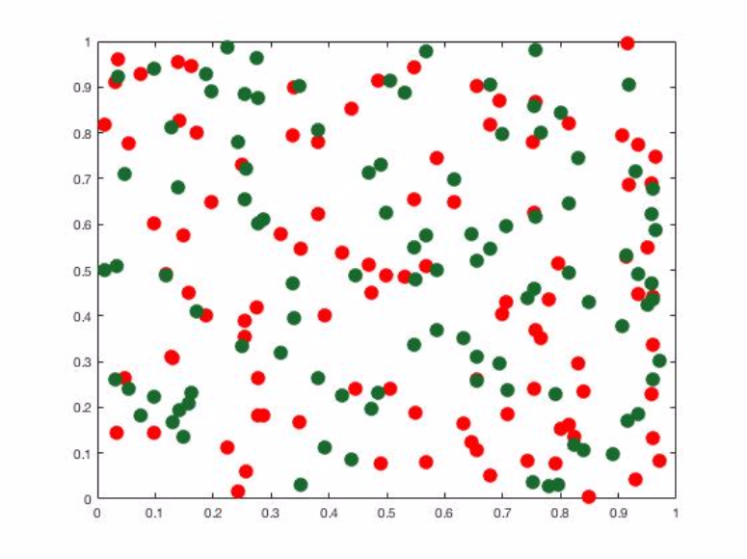
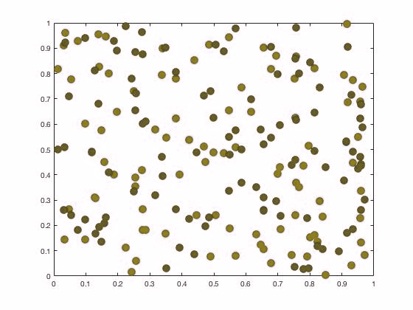
Choice of color
If you use colors, try to use high contrasts that are still useful if printed in black and white
Be aware of how your color choices look to someone who is color blind
Normal
Color Blind

Slide 22
Tools to make good figures
Excel (don’t use the default!)
Computational environments: Matlab, python (Matplotlib), R, …
Vector graphics: Adobe illustrator, Inkscape, …
Earth science specific tools: GMT, GeoMapApp, m_map (for matlab), …

Slide 23
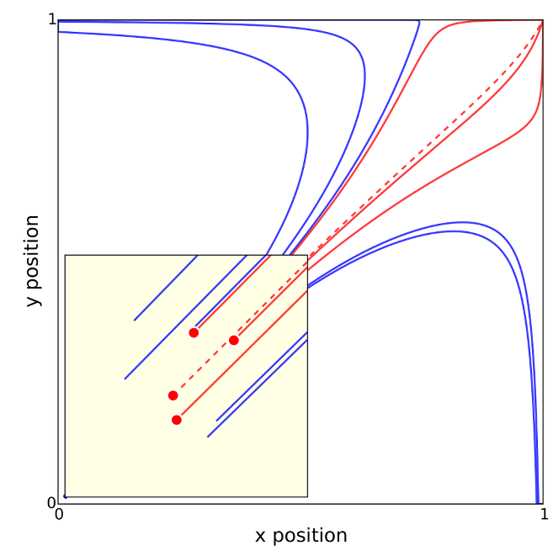
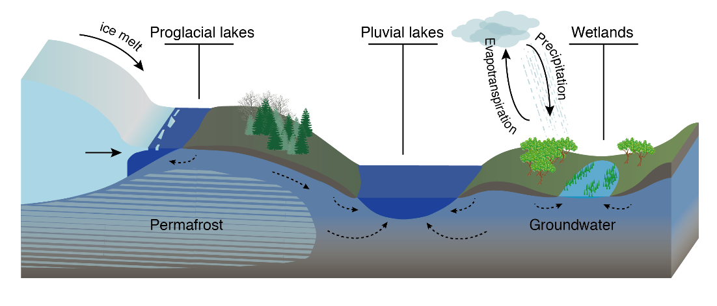
Excel
Python
Adobe Illustrator
GMT

