Slide 1
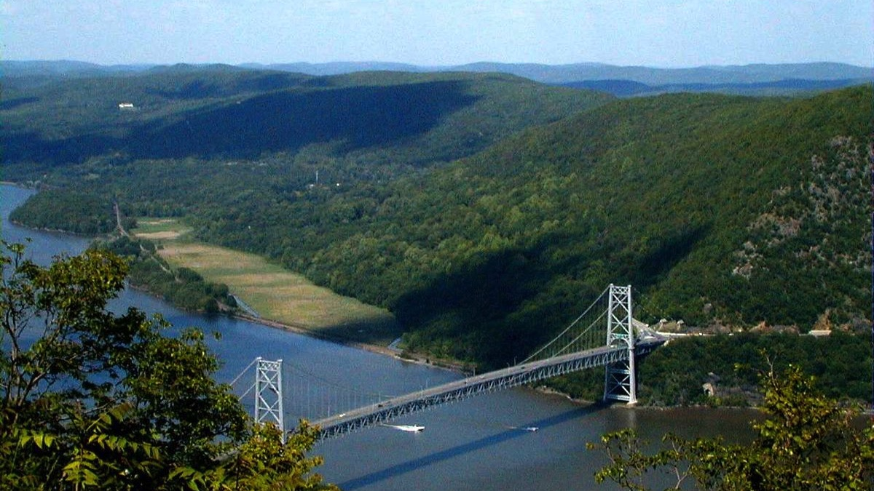



Is the Hudson a River or an Estuary – Investigation #3
A Day in the Life of the Hudson and Harbor ‘Investigation’
Notes:
Teaching STEM through the Hudson River as our teaching tool because this is a local feature for us. MARGIE orient slide
Lamont is located just North of NYC and our field station in Piermont is located right on the Hudson River
This image is of Bear Mountain Bridge looking north on to Manitou Marsh an important nursery area for several Hudson River fish including striped bass
WHAT YOU’LL NEED:
Pen and Paper to jot down some important facts to help in our investigation
***Don’t need to print anything out. Instead of having the students printing and drawing on their own maps, we can have them write down the answers and we can post it on our shared screen
https://www.dec.ny.gov/animals/94603.html
https://www.dec.ny.gov/animals/94601.html

Slide 2
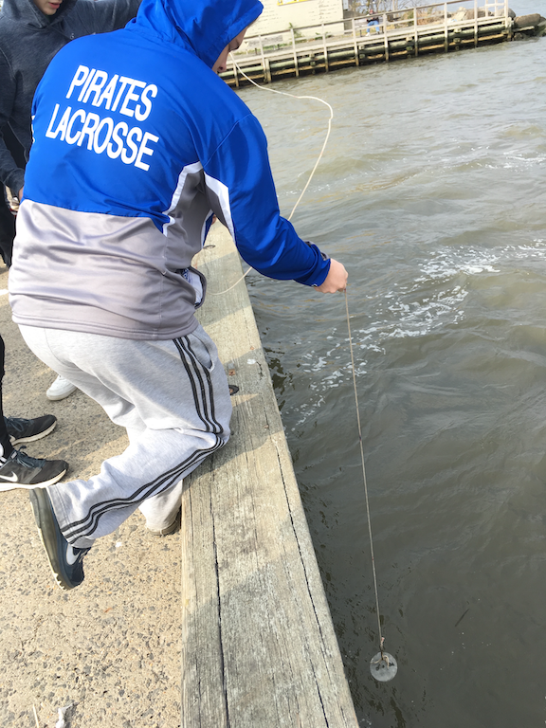
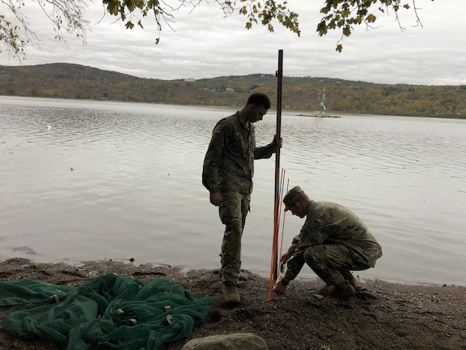
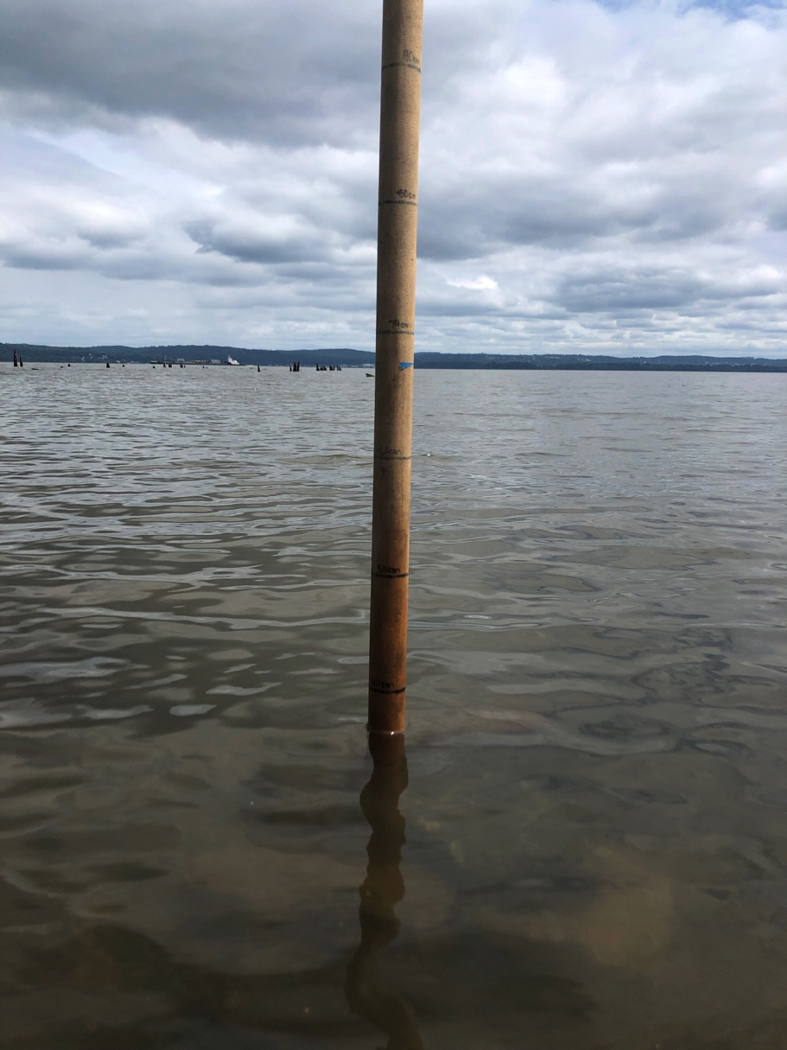
Investigation #3: One last piece of evidence & the most powerful driver in whether the Hudson is a river or an estuary
Our tools for investigation #3
Notes:
There is one large concept we have not talked about directly – we can use 3 different methods or tools – what are we measuring here?
Water level change….

Slide 3
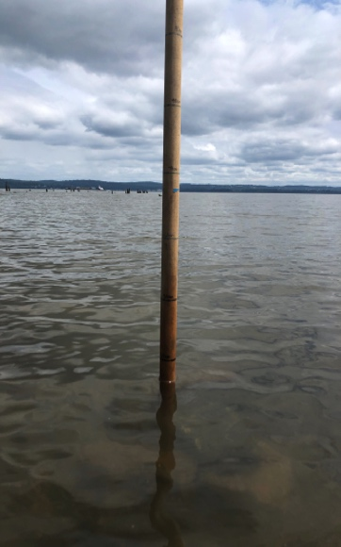
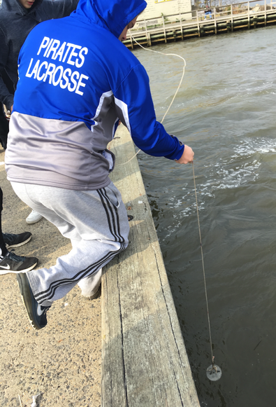
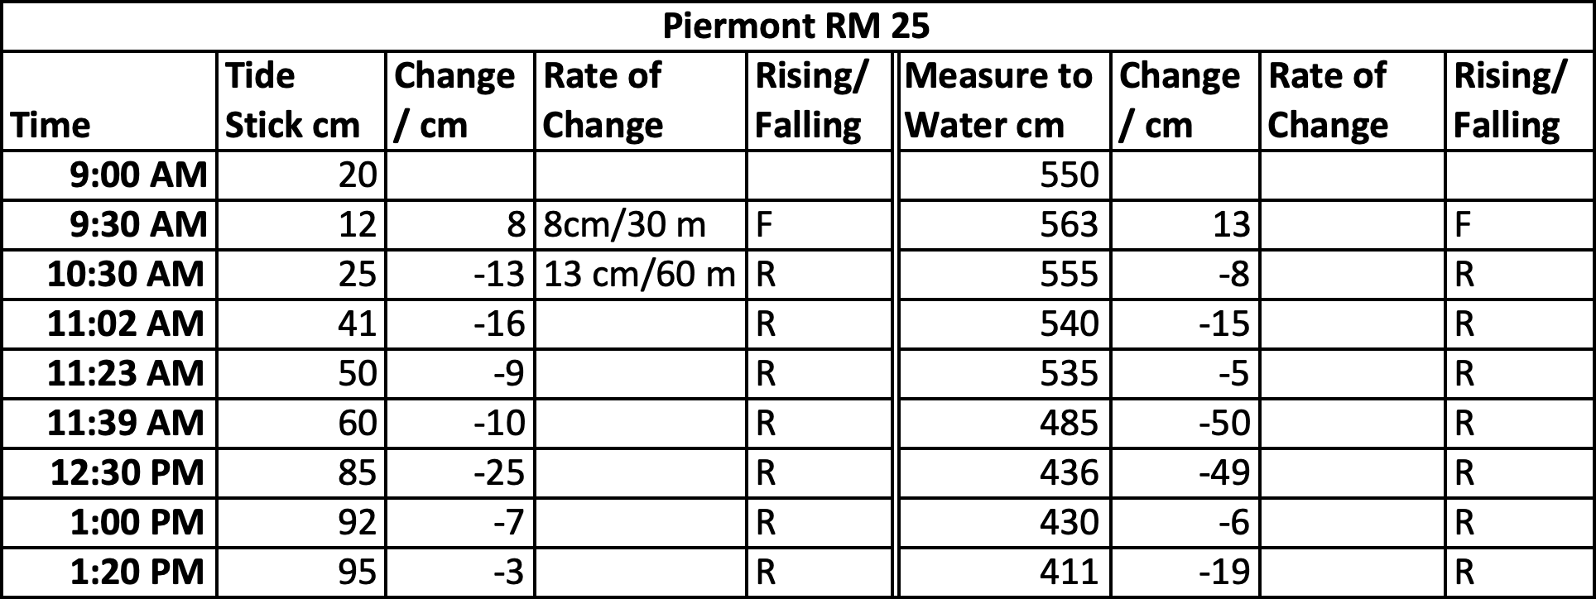
Water level change at Piermont, ~RM 25 over a 4.5 hr. period of DITL sampling
Notes:
Starting point is our baseline at 9AM. 9:30 AM tide changes…Falling then 10:30 AM we see it shifts and is rising.
These methods allow us to calculate change over time.

Slide 4
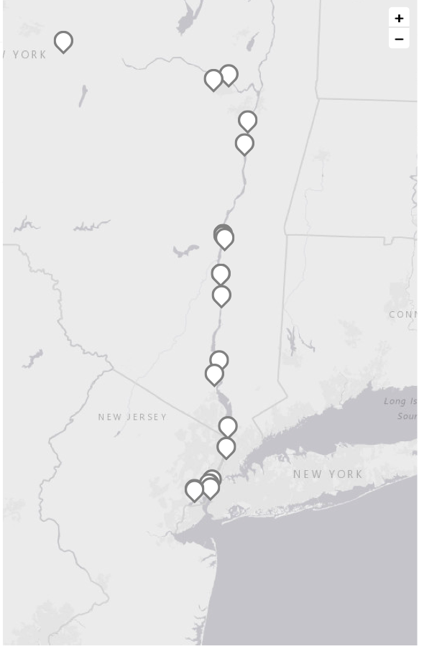
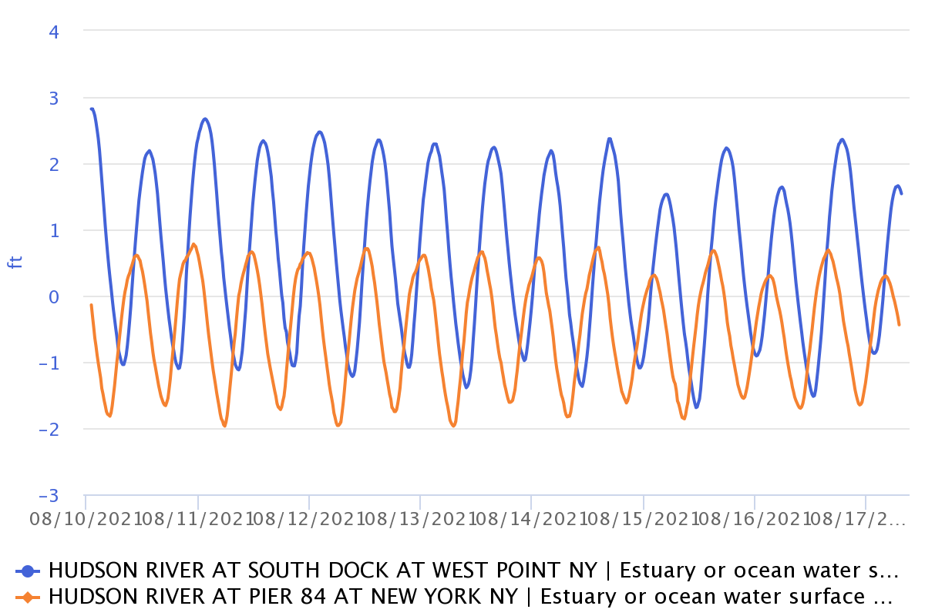
Using HRECOS data to investigate tides http://hrecos.org
Mohawk
Troy Dam
Hudson
Notes:
We also have a set of linked instruments in the Hudson that let’s us measure different parameters.
Data collected from 8/10/21 to 8/17/21
In the chat jot down what observations can you make in this data graph?
Regular pattern of up and down – you can even count them to see how many there are in a day.
Time offset
Different amplitude in the tidal range – more amplitude further away from the Harbor - due to width of the river
Both measurements are on the Hudson

Slide 5
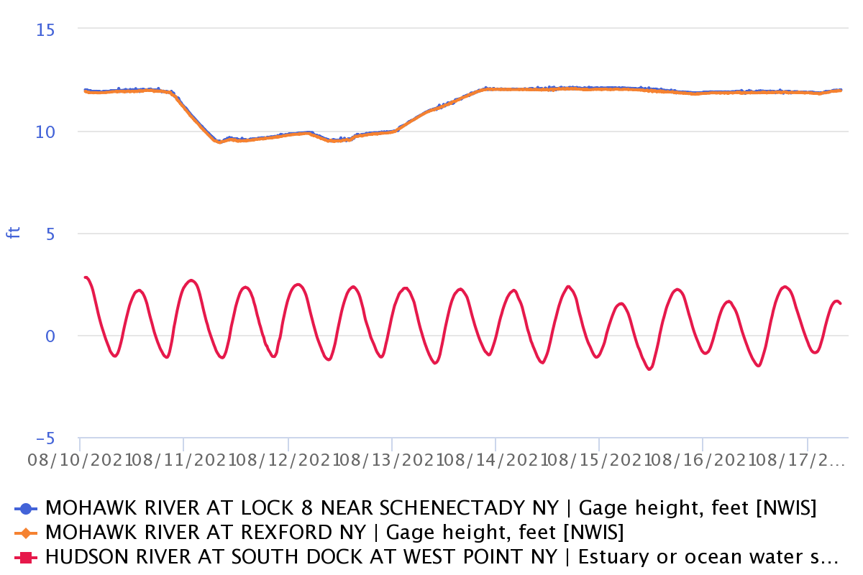
Using HRECOS data to investigate tides http://hrecos.org
Mohawk
Troy Dam
Hudson
Notes:
Margie
We also have a set of linked instruments in the Hudson that let’s us measure different parameters.
Data collected from 8/10/21 to 8/17/21
What observations can you make in this data graph? Your activity sheet will gather this information.
Top measures are flat – two stations close together but lie pretty much on top of each other – no 6 hr. fluctuation – presents a single directional flow
Bottom measurement is showing influence of tides – with 2 high and 2 low each day.

Slide 6

It’s time to check your models of what defines a river and what defines an estuary, and to update it them any new input!
Be sure to use a different color of ink so you can see how your model develops!
Image Source: San Diego County Office of Education
Notes:
What has changed in your model?
What has stayed the same?

Slide 7
What do you think, is the Hudson a River or an Estuary?
ESTUARIES | RIVERS
Connect directly to the ocean so water is both salty & fresh | A large body of fresh flowing water
Flow two ways due to tides | Flow one way –from higher to lower elevation
Depth determined by tides | Depth determined by flow
Ocean connection makes them very dynamic | Generally consistent waterways
Highly complex with varied habitats | Less complex with fewer habitats
Species include freshwater, saltwater & estuarine (brackish) | Species are freshwater
People rely on them for the many things they provide | People rely on them for the many things they provide
Notes:
Remember our estuary/river concepts – which ones have we talked about?
All arrows point to an ESTUARY! Which is why people call it the Hudson River Estuary!

Slide 8
There are different types of estuaries.
How would you define the Hudson estuary?
Estuary Types
Fjord – steep walled river valleys created by glacial advance (Alaska)
Drowned River Valley (or Coastal Plain Estuaries) – rising sea levels flood existing river valleys (Chesapeake Bay)
Tectonic – tectonic plate collide or fold together (San Francisco Bay)
Bar Built – barrier beaches or coastal parallel islands (North Carolina)
Notes:
OK the Lower Hudson is an estuary, but what kind?
4 different types of estuary – We started with discussing our watershed address let’s end with what is our estuary address?
Waterfall in the chat what do you think?
We are both 1 and 2 - thinking of the impressive Hudson Highlands and those wonderful chiseled cliffs carved out by the ice, and then lower in the harbor area the water levels rose flooding the area about 7000 years ago and covering the NY bight.

Slide 9
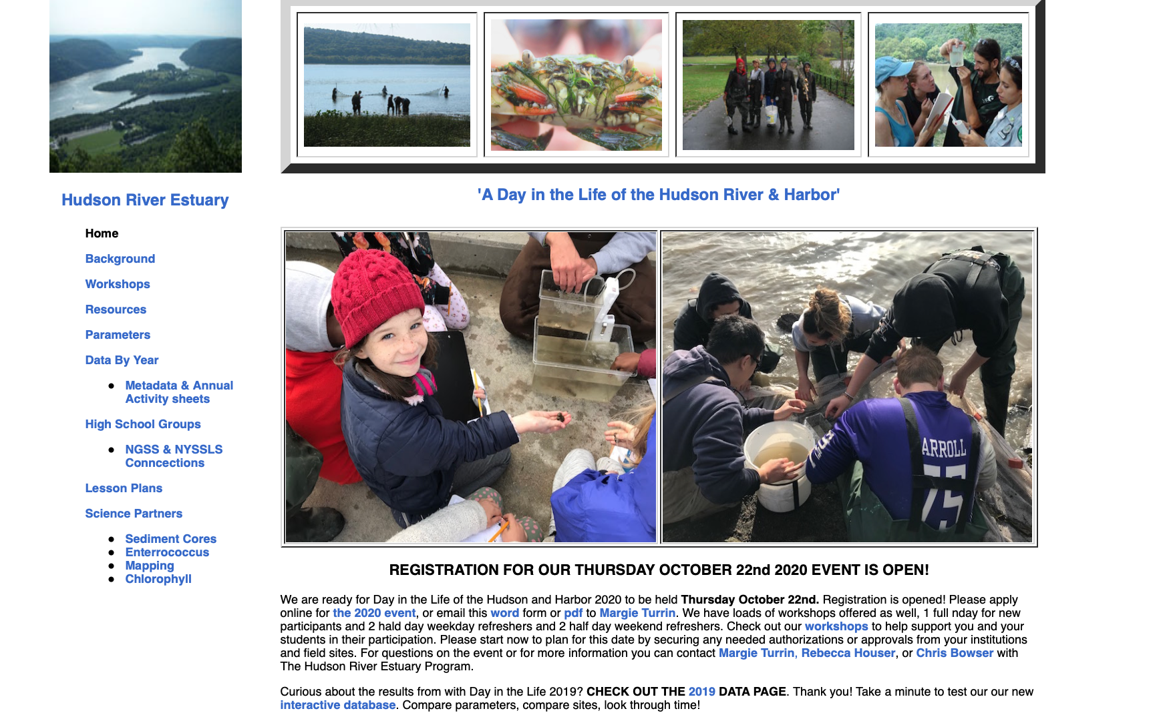
For more opportunities to explore student collected data from the Hudson visit…
https://www.ldeo.columbia.edu/dayinthelife/
Notes:
If you want to explore more about the Hudson with data or activities, visit our Day in the Life website.

Slide 10
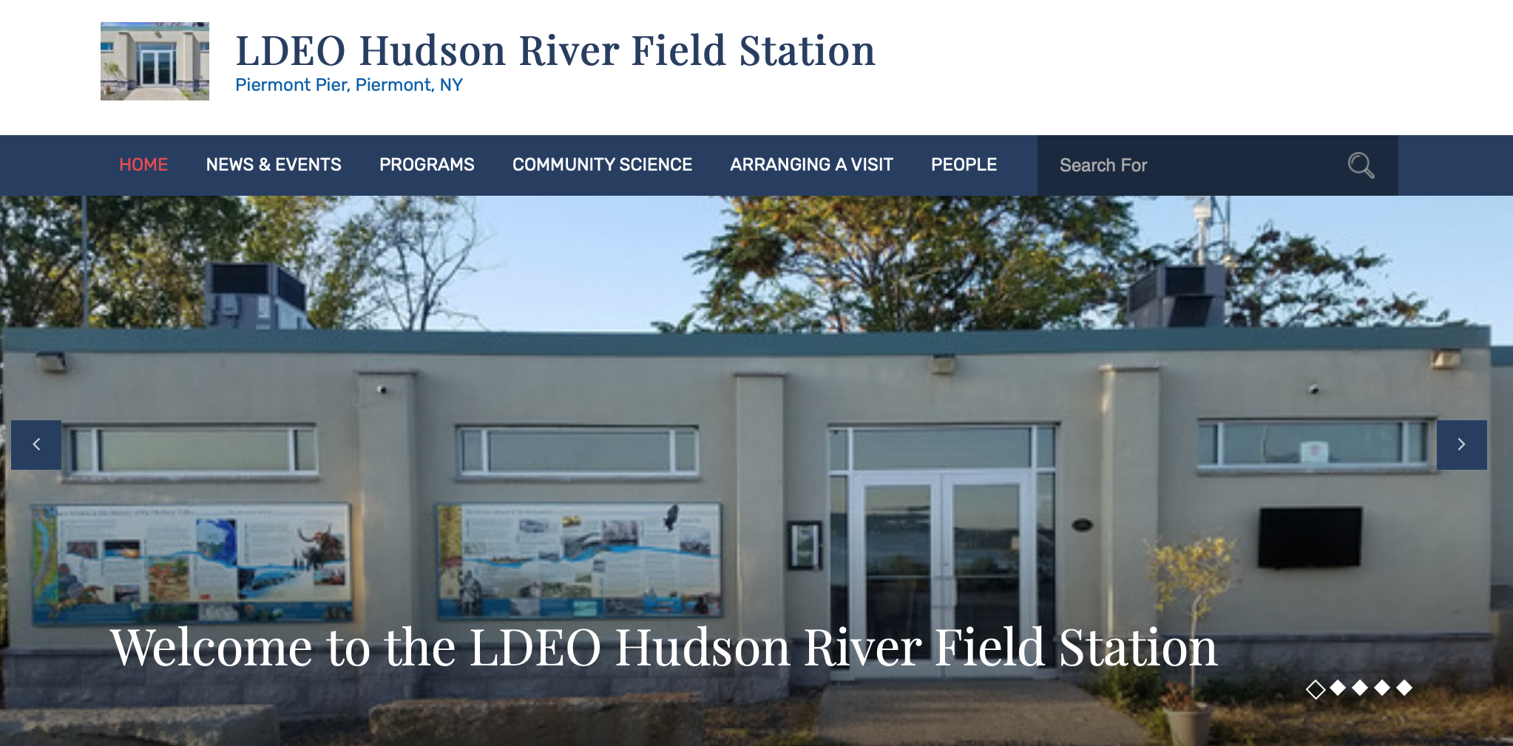
We would love you to visit our Field Station website!
https://blog.ldeo.columbia.edu/piermont/
Notes:
Come visit us in person or virtual at the Field Station!
Check out our online lessons, videos, and activities throughout the summer!
You can follow us on IG if you have one or follow our IG pictures on the website and you don’t even need an account!

