Slide 1
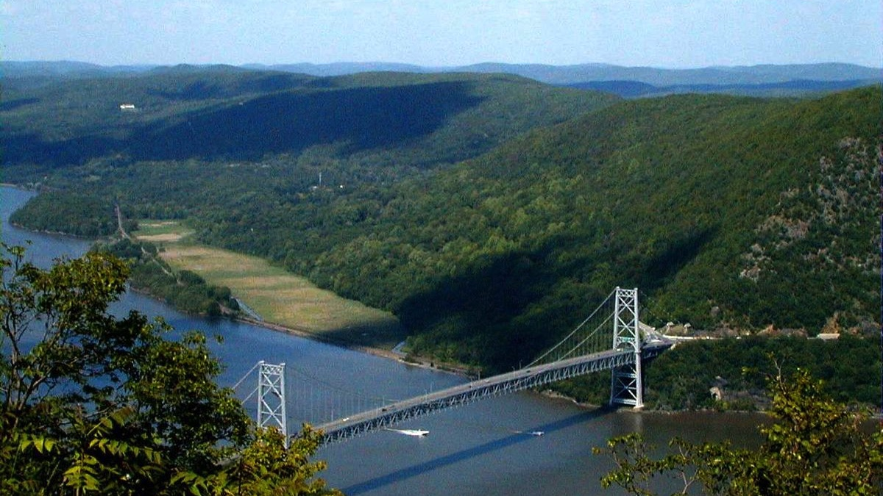



Is the Hudson a River or an Estuary - Investigations #1 & #2
A Day in the Life of the Hudson and Harbor ‘Investigation’
Notes:
Teaching STEM through the Hudson River as our teaching tool because this is a local feature for us. MARGIE orient slide
Lamont is located just North of NYC and our field station in Piermont is located right on the Hudson River
This image is of Bear Mountain Bridge looking north on to Manitou Marsh an important nursery area for several Hudson River fish including striped bass
WHAT YOU’LL NEED:
Pen and Paper to jot down some important facts to help in our investigation
***Don’t need to print anything out. Instead of having the students printing and drawing on their own maps, we can have them write down the answers and we can post it on our shared screen
https://www.dec.ny.gov/animals/94603.html
https://www.dec.ny.gov/animals/94601.html

Slide 2
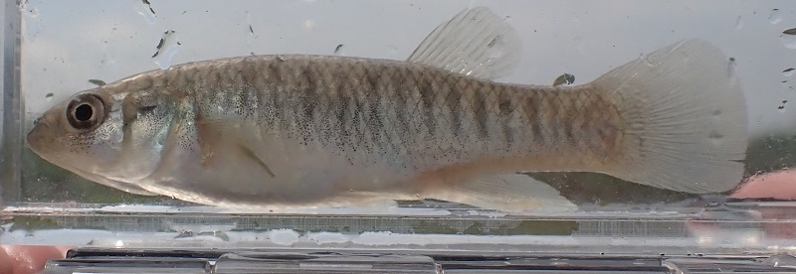
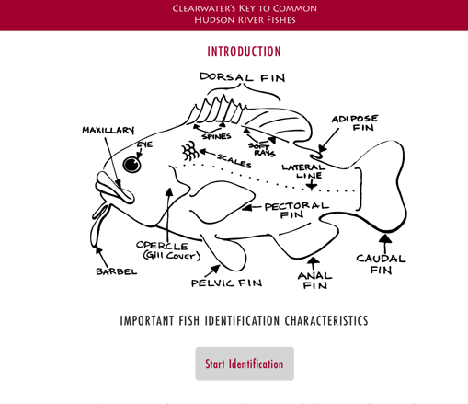
Investigation #1: checking in with some Hudson residents!
REFRESHER:
Do you recall what fish this is?
Notes:
Notice we have the fish in water in a viewing case while we do this ID – sometimes we even use a ziplock bag to hold the fish in!!!
Use the dichotomous key and identify this fish. Talk through each step - http://clearwater.org/fishkey/
The dichotomous key STEP BY STEP: What are the eyes like?
What is the mouth like?
Does it have a pelvic fin?
What does its chin look like – clean or does it have whiskers hanging down?
How many dorsal fins does it have?
What does its nose or snout look like – long and pointy like a duck’s bill or rounded?
What does its tail look like – rounded or square or forked?
Notice they all have the same genus name: Fundulus!

Slide 3
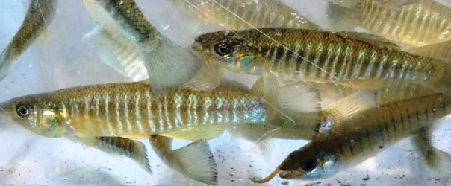
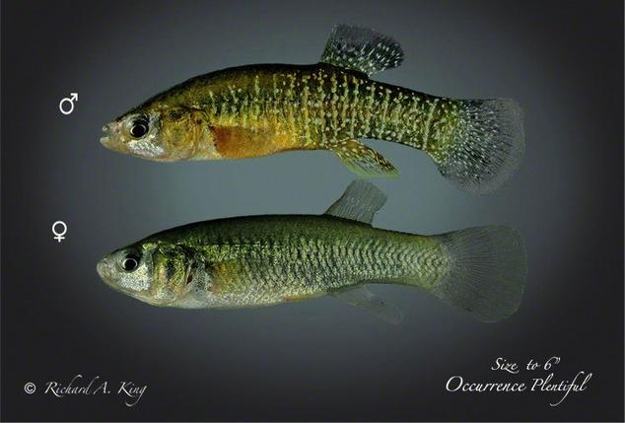
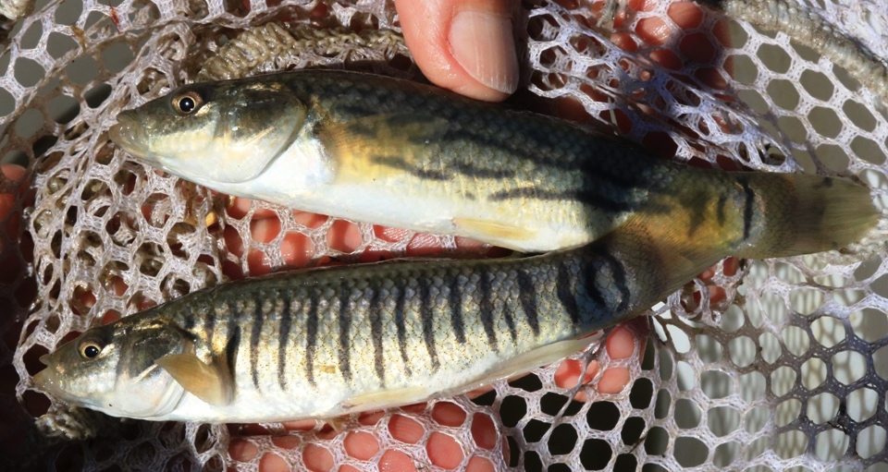
3 Different types of Killifish in the Hudson:
Each Different, but also Alike!
BANDED: (fundulus diaphanus)
Males silver banding
Females darker bands
MUMMICHOG: (fundulus heteroclitus)
Males darker bands & silver striped
Females dusky banding
(HR Almanac)
(Richard A. King)
STRIPED: (fundulus majalis)
Male vertical bands & Females horizontal bands with few vertical @ tail
Notes:
Fundulus means bottom - diaphanus is transparent – heteroclitus means irregular or unusual – majalis means May
Killi from Dutch Kilde for small creek or puddle
Immature female striped killi have vertical bands – transition to horizontal but a few vertical remain as adults.
Go through male and female on two banded and then ask about the top one –
BANDED: This is a Male Banded on the left and this is a Female Banded on the bottom right. Now which one do you think the top fish is?
POLL QUESTION: IT’S A MALE!

Slide 4
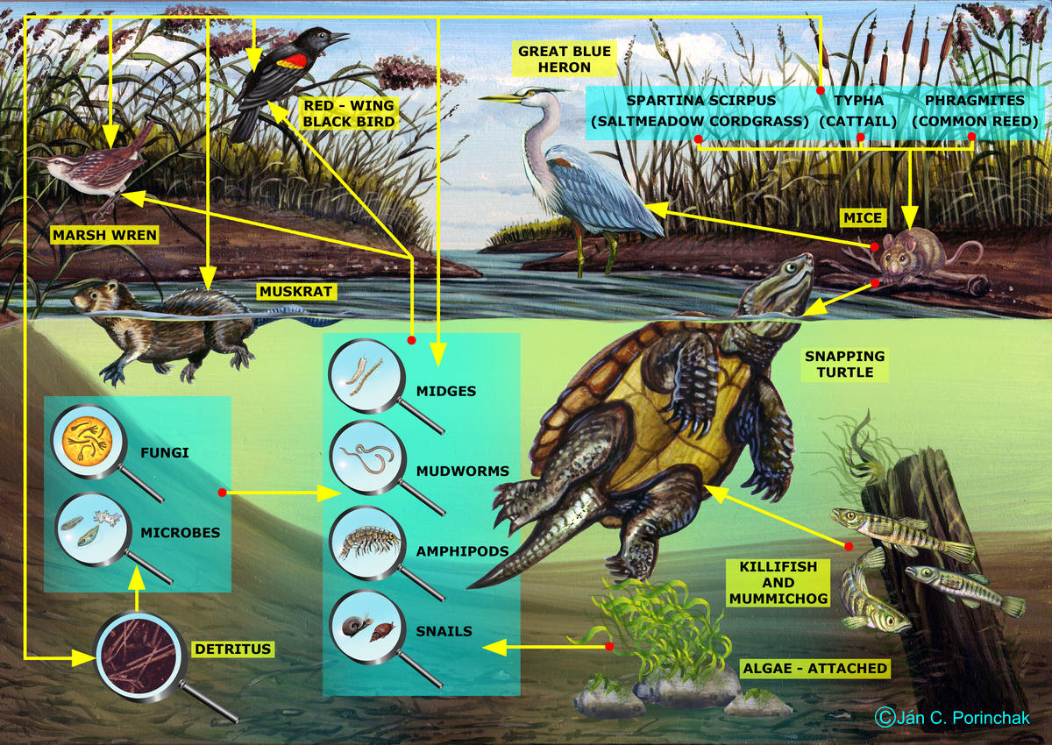
3 Different types of Killifish in the Hudson:
Each Different, but also Alike!
Place in the Food Web
Live close to shore <100 ft
Counter Shading
Disruptive Camouflage
Mouth & Eye Positioning
Coloration Difference between Males & Females
Native to the Hudson
What can you Identify in this picture that all Killis share?
Hudson River Food Web
Notes:
There are many ways that these species are all alike, many shown in this picture. What can you ID about this picture that all killis share?
Write in chat, let’s see how it stacks up!
Ways that they are all alike:
Place on the food chain
Counter shading
Stripes as disruptive camouflage
Mouth position, eye position
Difference in coloration between males and females- something it is harder to tell the difference between the male and female
Live close to shore- within 100 feet
All Native to the Hudson

Slide 5
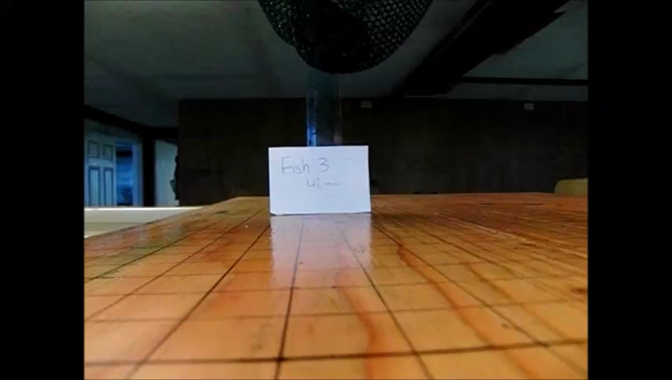
Mummichogs can ”jump” to the closest water source!
water
Notes:
Mummichogs can jump across land and navigate from one tide pool to another VIDEO is (13 secs)
Also note about Striped Killi and their ability to water seek with tidal change and their getting left in tide pools and chasing the ebb tide out
Eyes identify the shininess of the water so they can flop to the reflectivity to find water! Therefore, they need the sunlight to see the reflectivity
Use their tails to pop/flop to their water body.
Once airborne, the fish put their heads straight up to get a better look around and search for nearby pools

Slide 6
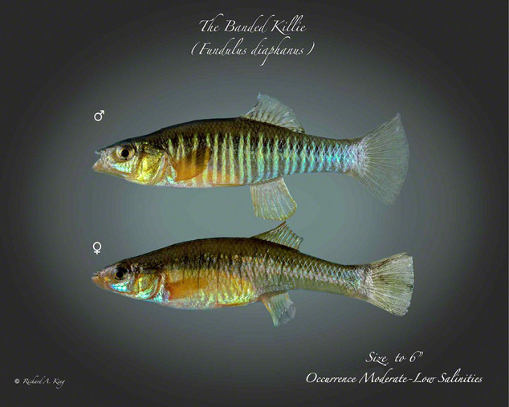
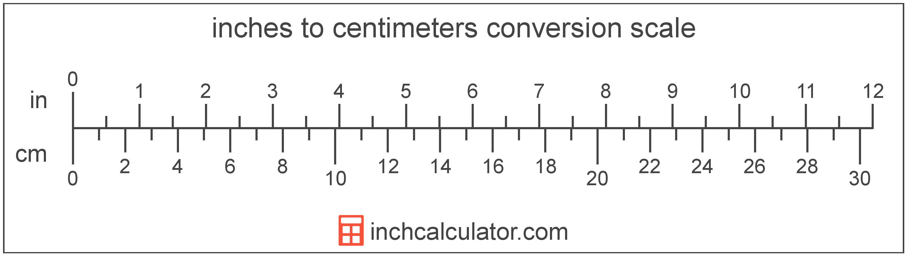
Banded Killifish
Most slender/tapered Hudson killi
Squared tail
Head somewhat flattened on top
Small mouth, turned up for surface feeding
Spawn in aquatic plant beds using external fertilzation
Eggs have adhesive threads to hold onto plants
During mating, males develop a bright blue patch near their anal fin & their belly turns bright blue!
BANDED KILLIFISH
(Richard A. King)
2-4 inches – live 2-3 yrs
5-10 cm
Notes:
Learned about the killi as a group – now lets focus in on them each a bit more and how the adaptations and rolls in the ecosystem Laurel mentioned work for each species
Feed on insects, nymphs, small crustaceans etc.

Slide 7
Mummichog
Name is native for ‘going in crowds’
Great mosquito control - eat up to 2,000 larvae a day!
Head rounded (more than the striped) and plump shape – torpedo or cigar like
Rounded tail
Marsh loving ‘Mud minnow’- burrows in mud/sediment
During mating, males have yellow pectorals, and blue and orange markings. Often bulls eye on dorsal fin.
Very tolerant of low oxygen & can be shipped wrapped in weeds.
Sent to space!
(Richard A. King)
MUMMICHOG KILLIFISH
5-6 inches long – live up to 3 yrs
13-15 cm
Notes:
While different killis are similar they vary in several ways…their size and lifespan...
What does their size and life span have to do with their role in the ecosystem?
Call out answer?
We are going to focus in a bit on their differences and what that can tell us about the overall ecosystem.

Slide 8
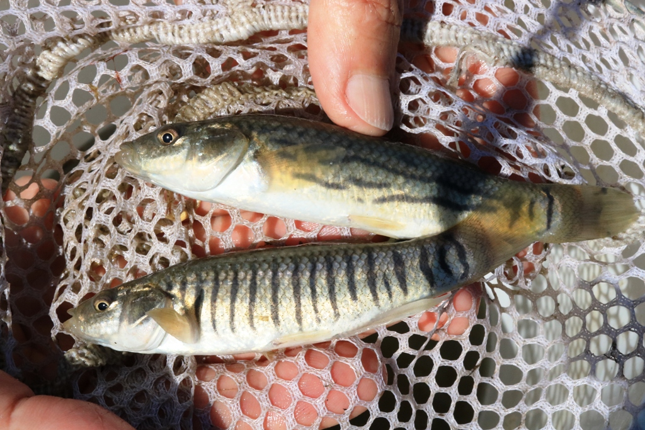
Striped Killifish
Head rounded
Corners of tail are rounded
More tolerant of sandy environments than other killi
During mating, males sides are black with golden orange, and fins bright yellow
M
F
STRIPED KILLIFISH
6 -8 inches – live 3-5 yrs.
15-20 cm

Slide 9

Notes:
2015 DITL and WSF data
Write it down on their piece of paper:
Between what river miles did we find Striped Killifish (~RM -10 to RM 15) - estimates since they will not be able to tell
Between what river miles did we find Mummichog (RM 15 to RM 98)
Between what river miles did we find Banded killifish (RM 15 to RM 155)
Which one was found in the most locations?

Slide 10

Let’s mark where the killifish live in the Hudson
Striped
Mummichog
Banded
Why do you think we found these fish in different areas of the Hudson?
Notes:
Let’s visualize the habitat range of each fish is!
Between what river miles did we find Striped Killifish (~RM -10 to RM 15)
Between what river miles did we find Mummichog (RM 15 to RM 98)
Between what river miles did we find Banded killifish (RM 15 to RM 155)
Why do you think these fish are found in different areas of the Hudson?
Hopefully they say HABITAT- then move on to the different site pictures.

Slide 11
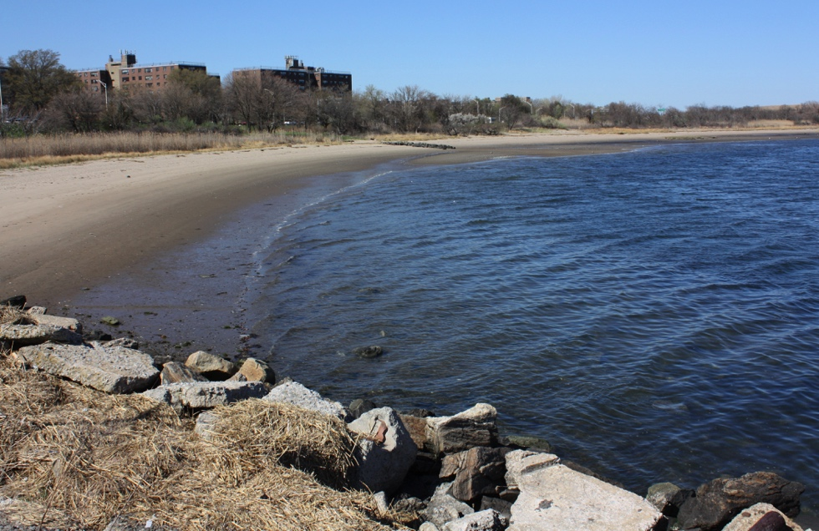
Let’s mark where the killifish live in the Hudson
Striped
Mummichog
Banded
Canarsie Pier
Why do you think we found these fish in different areas of the Hudson?
Notes:
Why do you think these fish are found in different areas of the Hudson?
One thing you will notice about each one of these sites is that they are all in a protected area, off of the main stem Hudson. Quiet waters which is important for all killis!
Canarsie: Sandy beach with few rocks

Slide 12
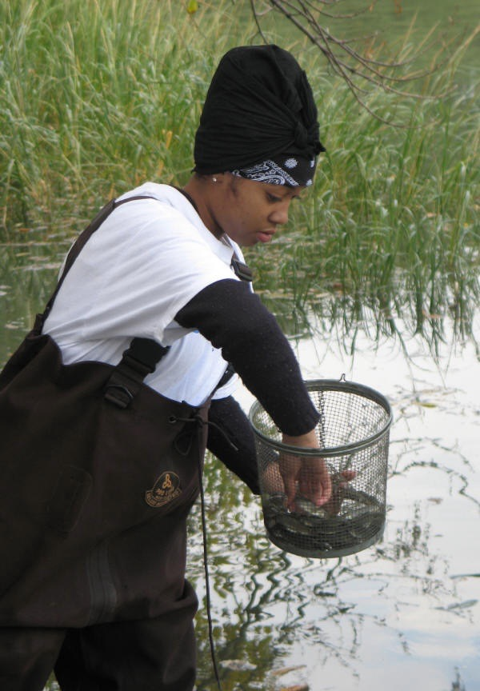
Let’s mark where the killifish live in the Hudson
Striped
Mummichog
Banded
Inwood
Why do you think we found these fish in different areas of the Hudson?
Notes:
Why do you think these fish are found in different areas of the Hudson?
One thing you will notice about each one of these sites is that they are all in a protected area, off of the main stem Hudson. Quiet waters which is important for all killis!
Inwood: Very protected, located where the Harlem River and Hudson River. Marshy environment as you can see behind this young scientist. Very mucky, lots of mud/sediments

Slide 13
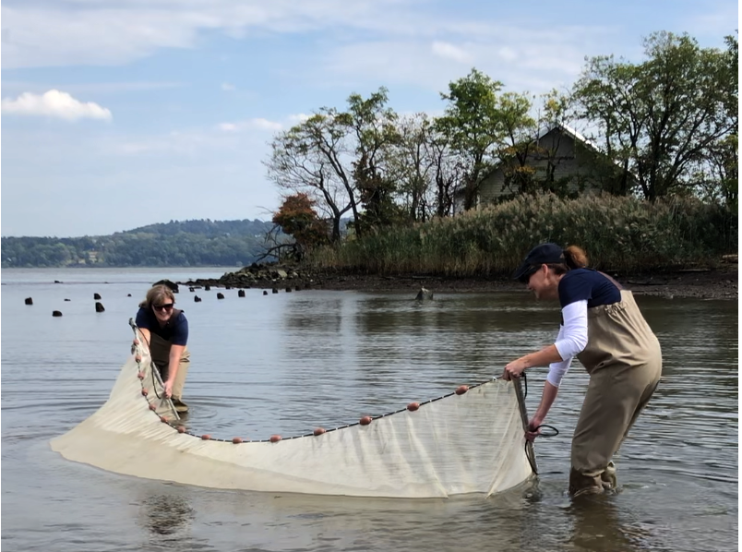
Let’s mark where the killifish live in the Hudson
Striped
Mummichog
Banded
Piermont Pier
Why do you think we found these fish in different areas of the Hudson?
Notes:
Why do you think these fish are found in different areas of the Hudson?
One thing you will notice about each one of these sites is that they are all in a protected area, off of the main stem Hudson. Quiet waters which is important for all killis!
Piermont Pier: Our seining location is protected by the pier structure. We are very close to the Piermont Marsh and you can see we have some marshy environment behind the seiners. Mucky, lots of mud/sediments

Slide 14
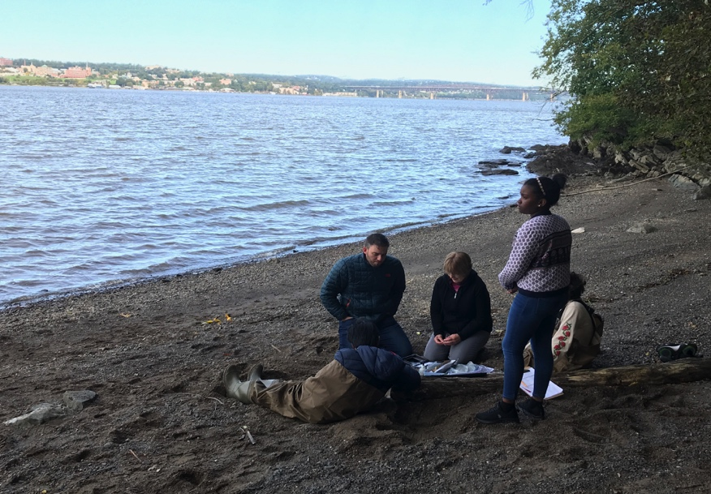
Let’s mark where the killifish live in the Hudson
Striped
Mummichog
Banded
Denning’s Point
Why do you think we found these fish in different areas of the Hudson?
Notes:
Why do you think these fish are found in different areas of the Hudson?
One thing you will notice about each one of these sites is that they are all in a protected area, off of the main stem Hudson. Quiet waters which is important for all killis!
Denning’s Point: Protected by a peninsula of Denning’s Point, a sandy beach with some shrubbery near the water’s edge

Slide 15
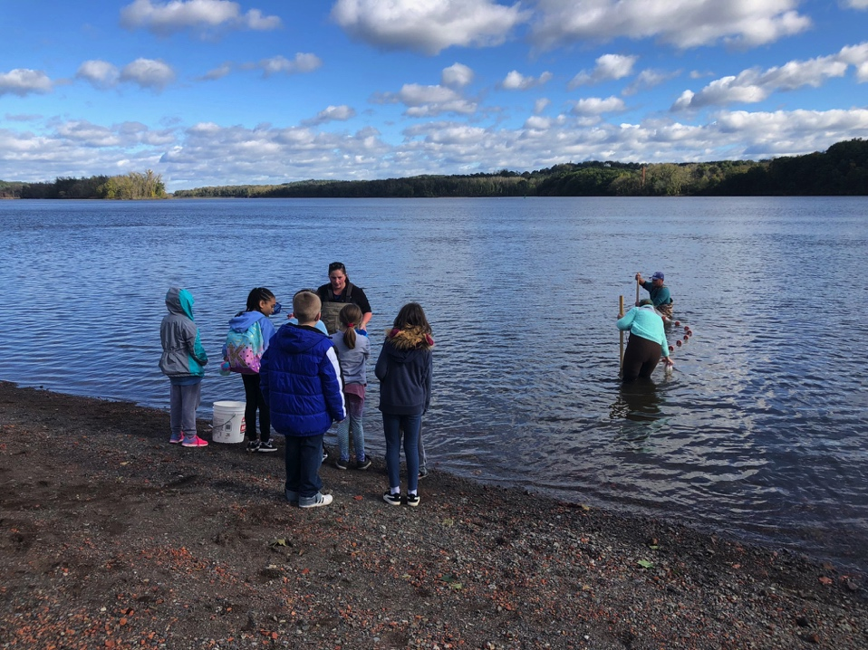
Let’s mark where the killifish live in the Hudson
Coxsackie
Striped
Mummichog
Banded
Why do you think we found these fish in different areas of the Hudson?
Notes:
Why do you think these fish are found in different areas of the Hudson?
One thing you will notice about each one of these sites is that they are all in a protected area, off of the main stem Hudson. Quiet waters which is important for all killis!
Coxsackie: Protected as well with quiet waters. A sandy/rocky beach
We have just compared the locations of the 3 Killifish to different regions of the Hudson. Let’s take look at our Estuary and River concepts to see what we have tackled.

Slide 16

It’s time to check your models of what defines a river and what defines an estuary, and to update it them any new input!
Be sure to use a different color of ink so you can see how your model develops!
Image Source: San Diego County Office of Education

Slide 17
Remember our estuary/river concepts
ESTUARIES | RIVERS
Connect directly to the ocean so water is both salty & fresh | A large body of fresh flowing water
Flow two ways due to tides | Flow one way –from higher to lower elevation
Depth determined by tides | Depth determined by flow
Ocean connection makes them very dynamic | Generally consistent waterways
Highly complex with varied habitats | Less complex with fewer habitats
Species include freshwater, saltwater & estuarine (brackish) | Species are freshwater
People rely on them for the many things they provide | People rely on them for the many things they provide
Notes:
Remember our estuary/river concepts – which ones have we talked about?

Slide 18
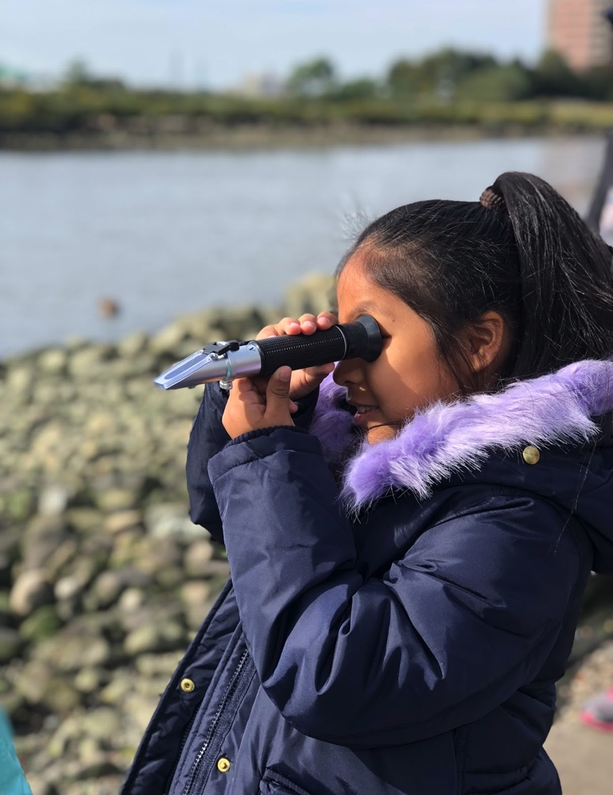
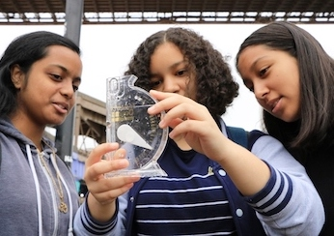
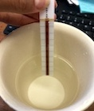
Investigation #2 – Let’s check the salinity of the water in different parts of the Hudson
Our tools for investigation #2
Hydrometer - density
Refractometer - light
Quantab Strips - chloride
Notes:
We have different tools that we can use to tell us about the salinity of the Hudson
Why would there be salt in the Hudson?

Slide 19
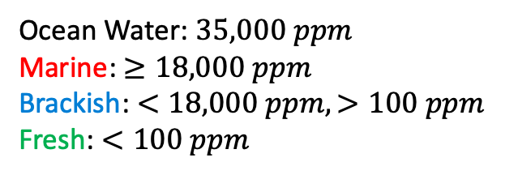
Ocean Water: $35,000 ppm$
Marine: $≥18,000 ppm$
Brackish: $<18,000 ppm, >100 ppm$
Fresh: $<100 ppm$
Notes:
We use the amount of salt or salinity to tell if a section of water is marine (ocean environment), brackish (a mix of fresh and salty) or fresh
Marine: > 18000 ppm
Brackish: < 18000 ppm and > 100 ppm
Fresh: > 100 ppm
Ocean Water = 35000 ppm
Identify the large, thick lines 30,000 ppm → 25,000 ppm (going by 5,000ppm), but the little lines go by 1,000 ppm. If we’re looking for 18,000 ppm for our divider it isn’t going to be a thick line, it will be between.
Write on your piece of paper:
Where do you find the most salinity?
Where do you find the least salinity?
What section takes up most of the river? Marine, brackish, fresh?
Why do you think the salinity changes in different sections of the Hudson?
NOW, let’s identify the Marine, Brackish, and Fresh sections of the Hudson.

Slide 20
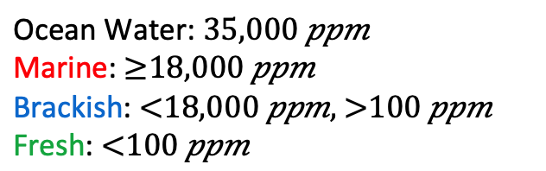
Now let’s mark where the Hudson was Marine, Brackish or Fresh
Ocean Water: $35,000 ppm$
Marine: $≥18,000 ppm$
Brackish: $<18,000 ppm, >100 ppm$
Fresh: $<100 ppm$
Marine
Brackish
Fresh
19,000 ppm
10,000 ppm
70 ppm
70 ppm
70 ppm
266 ppm
27,000 ppm
14,500 ppm
988 ppm
70 ppm
Notes:
ANSWER KEY
Write on your piece of paper:
Where are the Marine, Brackish, and Fresh Sections of the Hudson on this map identifying them via data points?

Slide 21
Killifish VS. Salinity VS. Location
Striped
Mummichog
Banded
Marine
Brackish
Fresh
Putting together data from two different investigations…
Can you say anything about the preferences of a Striped Killifish?
What about the preferences of a Mummichog?
What about the preferences of a Banded Killifish?
Notes:
Fish vs salinity vs location to tie it all together with the Estuary River concepts
Think about each species individually in comparison to the salt we mapped out and the topics that we discussed.
Answer: Fish have preferences but they have a wider tolerance.
Mummichog likes marsh so they are extremely tolerate of salt concentrations
Banded prefers fresh, but can tolerate brackish
Striped prefer salty. They can venture into the brackish section but remain pretty salty

Slide 22
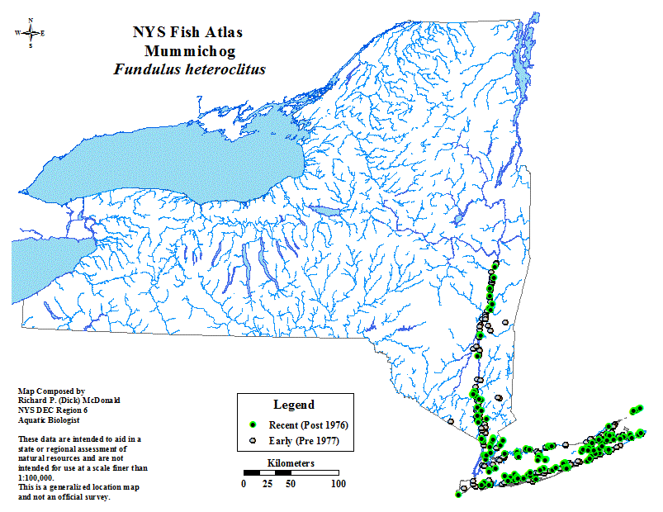
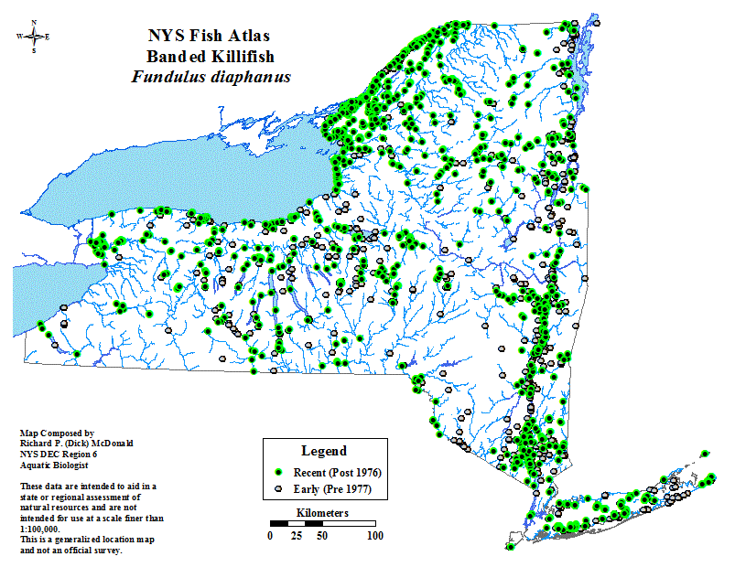
Mummichog vs. Banded Distribution
What differences are there between the NYS distribution between these two species?
Notes:
Mummichog are linked to the estuary and the ocean
Banded are widely distributed in freshwater streams and creeks.

Slide 23
It’s time to check your models of what defines a river and what defines an estuary, and to update it them any new input!
Be sure to use a different color of ink so you can see how your model develops!
Image Source: San Diego County Office of Education

Slide 24
What do you think, is the Hudson a River or an Estuary?
ESTUARIES | RIVERS
Connect directly to the ocean so water is both salty & fresh | A large body of fresh flowing water
Flow two ways due to tides | Flow one way –from higher to lower elevation
Depth determined by tides | Depth determined by flow
Ocean connection makes them very dynamic | Generally consistent waterways
Highly complex with varied habitats | Less complex with fewer habitats
Species include freshwater, saltwater & estuarine (brackish) | Species are freshwater
People rely on them for the many things they provide | People rely on them for the many things they provide
Notes:
Remember our estuary/river concepts – which ones have we talked about?
So far, all arrows point to an ESTUARY!
*We have not discussed tides in the Hudson but they are certainly a critical part of the Hudson – with tidal ranges varying from 3 to 6 ft. depending on where you are in the estuary. This is an investigation you can have with your student group using data you collect or looking at data you find online.

Slide 25
This is the end of Investigations #1 & 2
Be sure to check out investigation #3! www.ldeo.columbia.edu/dayinthelife/
Notes:
We finished lesson 1 now move on to lesson 2 and then 3

