Slide 1
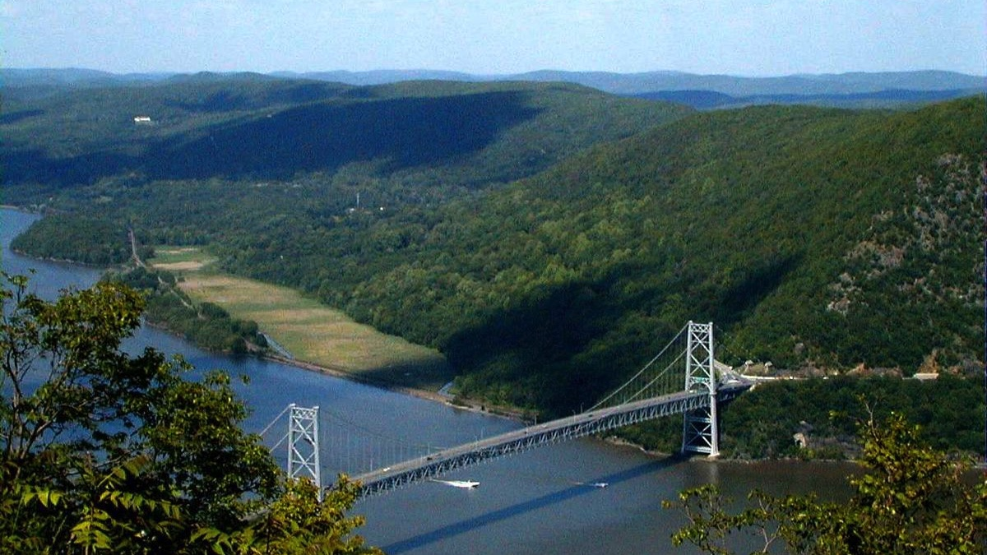



Is the Hudson a River or an Estuary – An Introduction
A Day in the Life of the Hudson and Harbor ‘Investigation’
Notes:
Teaching STEM through the Hudson River as our favorite teaching tool because this is a local feature for us.
This image is of Bear Mountain Bridge looking north on to Manitou Marsh an important nursery area for several Hudson River fish including striped bass
WHAT YOU’LL NEED:
The worksheets that go with this ppt.
Teacher workpacket

Slide 2
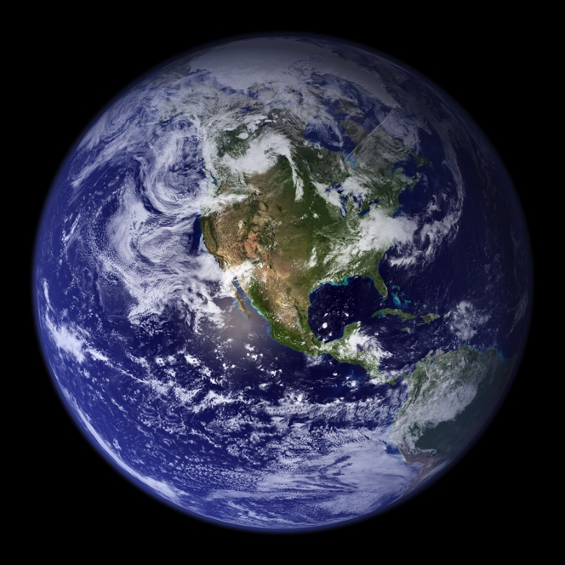
We all have a ‘Water Address’!
What is yours?
Can you name the closest waterbody to your home?
There are many types of water bodies - ocean, lake, river, stream, estuaries...
NASA
Notes:
Discuss as a class what the students believe are the differences between these water bodies. The River versus Estuary is the main thrust of the activity so do not get into a definition at this point just gather ideas.
Oceans
Lakes
Rivers
Streams
Estuaries

Slide 3
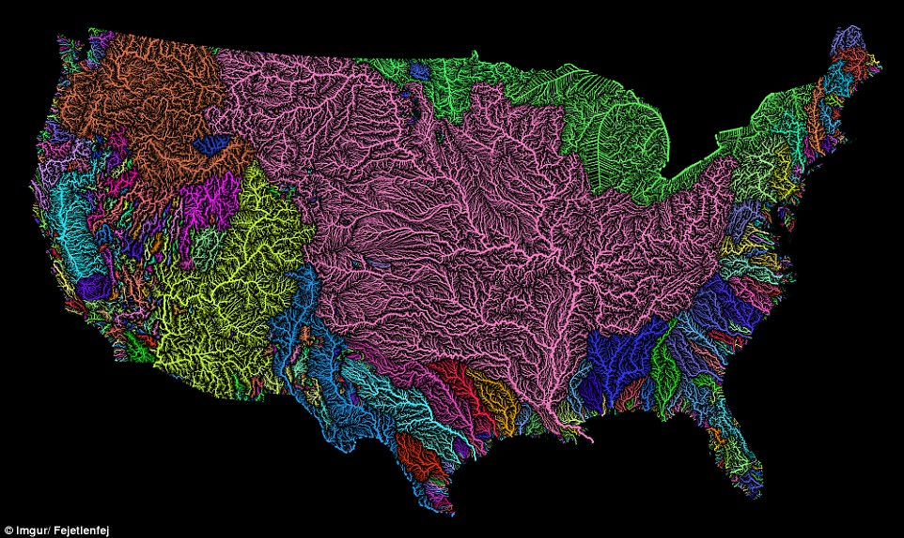
Here is a watershed map of the U.S.
Here is our watershed
Can you tell us what a watershed is?
Notes:
Everyone is connected through water. And we think the best way to think about water is through watersheds Each color represents a different watershed
WHAT IS A WATERSHED: land area that channels rainfall snowmelt to creeks, streams, and rivers, and eventually to outflow points such as reservoirs, bays and ocean
Rivers and streams are like our arteries and veins, moving nutrients around water.
These watersheds are FULL OF LIFE!
Eventually these watersheds connect to the ocean
CLICK – this is our watershed – The Hudson River watershed!

Slide 4
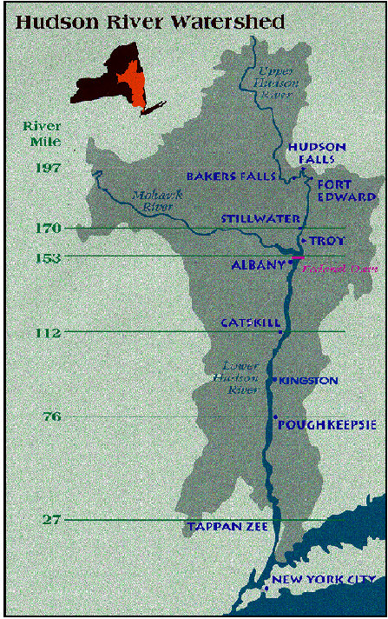
What is your ‘Water Address’?
Hudson River Watershed:
  Drains into the Atlantic Ocean
  Starts at many different locations!
  The highest point in our watershed: Mount Marcy in the Adirondacks
  Where are you in the watershed?
Notes:
Students can find themselves in the watershed

Slide 5
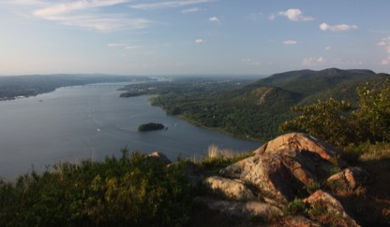
Is the Hudson a River or an Estuary?
Some call the Hudson a River while others call the Hudson an Estuary… Which is it?
    What defines a River?
    What defines an Estuary?
STOP in your packets
develop a model for each!
Notes:
This is where the students begin to develop a model for the two types of water features.

Slide 6

Develop your model of what are the critical pieces that define a river and define an estuary?
Image Source: San Diego County Office of Education

Slide 7
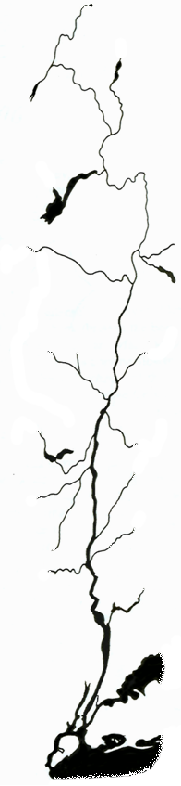


Hudson Geography
Some call the Hudson a River while others call the Hudson an Estuary… We are going to begin an investigation to decide!
What defines a River?
What defines an Estuary?
Albany
Poughkeepsie
New York
Poughkeepsie
Albany
New York
Notes:
Look at the entire Hudson River: The part that is sometimes referred to as an estuary is not the whole Hudson just the part that runs from the Atlantic Ocean to the Troy dam – 153 Miles - But that's only about half of the full Hudson. The Hudson extends for a total of 315 miles from the Atlantic Ocean up to its highest point - Lake Tear of the Clouds.
Introduce RM, new map to show RMs (horizontal map along the bottom)

Slide 8

Estuary VS. River Principles & Concepts
ESTUARIES | RIVERS
Connect directly to the ocean so water is both salty & fresh | A large body of fresh flowing water
Flow two ways due to tides | Flow one way –from higher to lower elevation
Depth determined by tides | Depth determined by flow
Ocean connection makes them very dynamic | Generally consistent water conditions
Highly complex with varied habitats | Less complex with fewer habitats
Species include freshwater, saltwater & estuarine (brackish) | Species are freshwater
People rely on them for the many things they provide | People rely on them for the many things they provide
Notes:
MARGIE
Review each of them. These are identified by NOAA as Estuary versus River principles and concepts. We are going to explore this question today using student collected date from a program we are partners in running with the NYS DEC Hudson River Estuary Program called “A day in the life of the Hudson and Harbor”
Estuaries:
1) connect directly to the ocean.
2) constantly changing and differ between sections or areas
3) have different types of habitats, and support lots of species
4) because they change a lot they can be hard to understand so we need to study them
5) people rely on them for things they can provide
6) people can damage estuaries. We must protect them as we depend on them

Slide 9
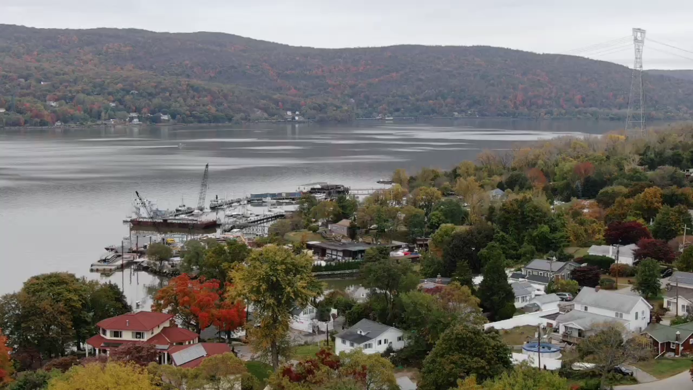
This is a view of our area
Notes:
Hard to tell by looking at it if it is a river or an estuary!
Video is embedded and is (32 secs)
This was shot from a drone by one of our Hudson River high school classes – Mahopac High School in Verplanck NY about 20 miles from us.

Slide 10
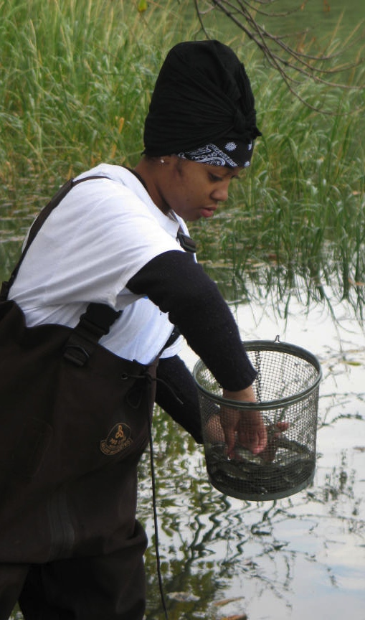
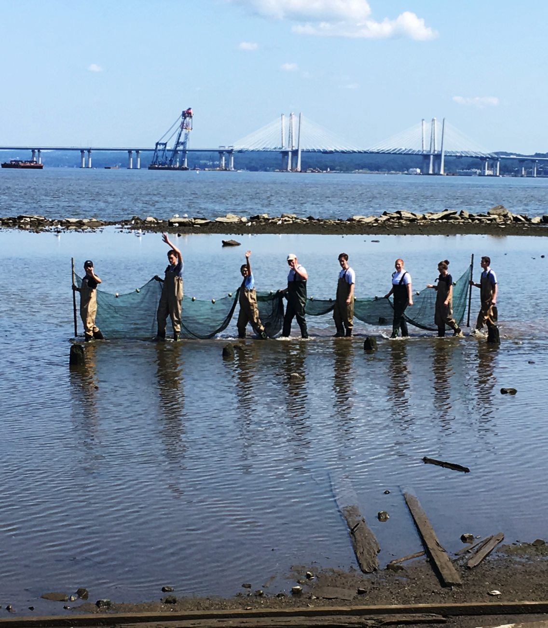
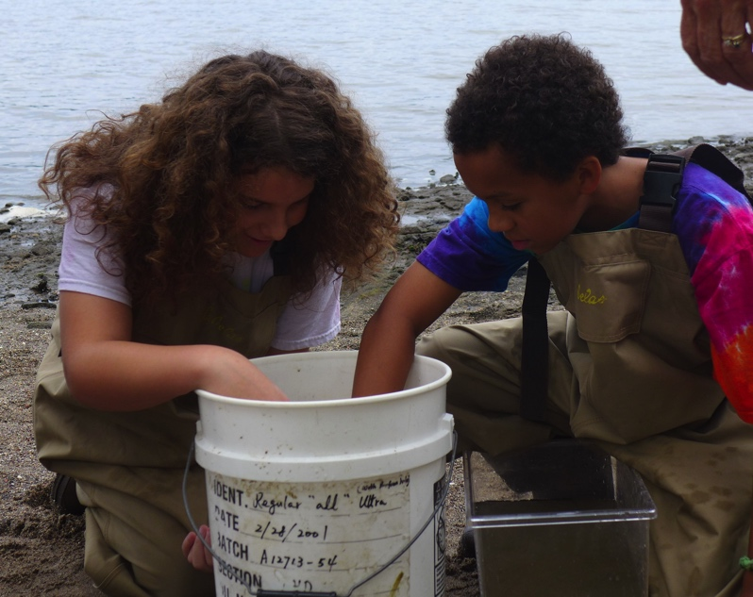
Let’s Lay the Groundwork for Investigation #1 by checking in with some Hudson residents!
Tools for
investigation #1
Notes:
These are two favorite ways to see what lives in the river – left is setting fish pots in the water and on the right we are seining!
This is a method used by the Native Americans who once lived in this area. In the lower Hudson the native population was called the Lenne Lenape.
Tools needed to seine include a net, some waders if the weather is cool or just boots or water shoes otherwise, buckets and bubblers

Slide 11
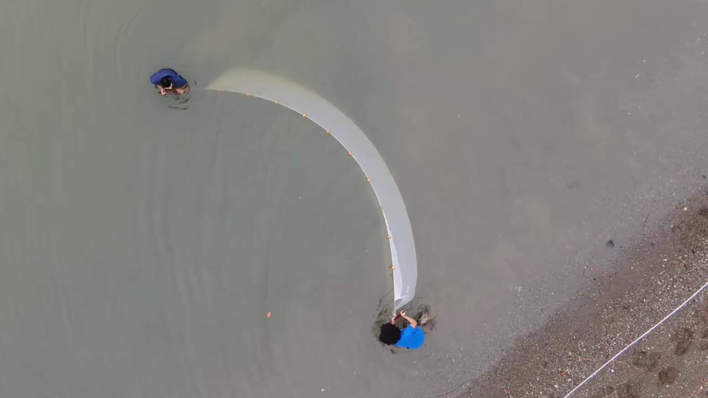
Notes:
Seining – video is (23 secs)

Slide 12
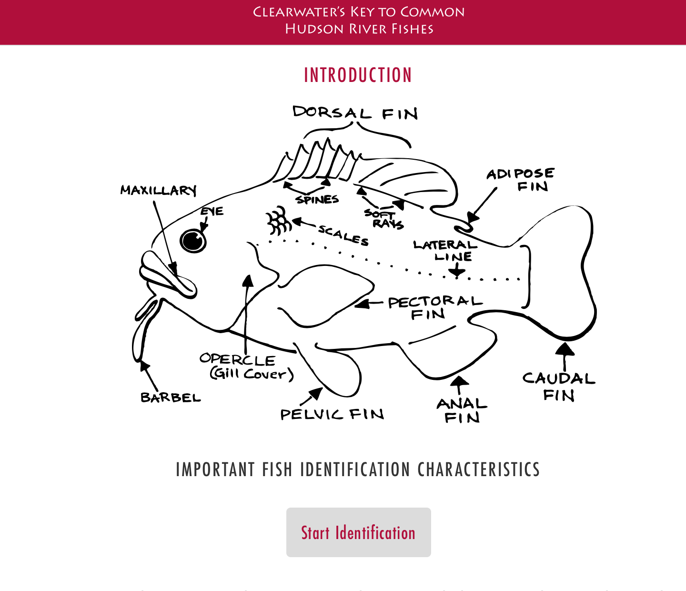
How will we know what we catch?
Tool # 2
We can use a
DICHOTOMOUS KEY
Based on a series of questions…
is it A or B
Notes:
Briefly review some key features we will be discussing: Pelvic fin, dorsal, caudal fin, mouth, eyes

Slide 13
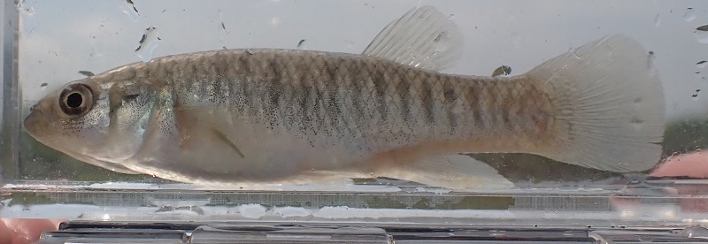
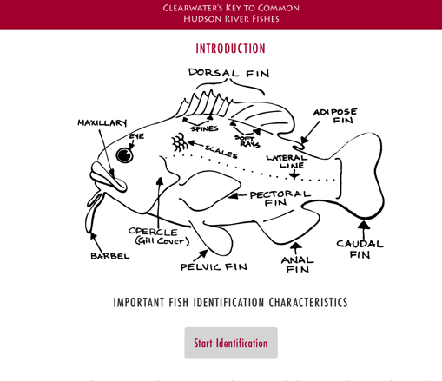
Let’s try it out together…here is our fish
First let’s describe our fish and then check out the fish key
Notes:
Notice we have the fish in water in a viewing case while we do this ID – sometimes we even use a ziplock bag to hold the fish in!!!
Use the dichotomous key and identify this fish. Talk through each step - http://clearwater.org/fishkey/
The dichotomous key STEP BY STEP: What are the eyes like?
What is the mouth like?
Does it have a pelvic fin?
What does its chin look like – clean or does it have whiskers hanging down?
How many dorsal fins does it have?
What does its nose or snout look like – long and pointy like a duck’s bill or rounded?
What does its tail look like – rounded or square or forked?
Notice they all have the same genus name: Fundulus!

Slide 14
This is the end of Lesson 1 and we are prepared for the investigation #1
Be sure to check out investigations #2 and #3 after that! www.ldeo.columbia.edu/dayinthelife/
Notes:
We finished lesson 1 now move on to lesson 2 and then 3

