Slide 1
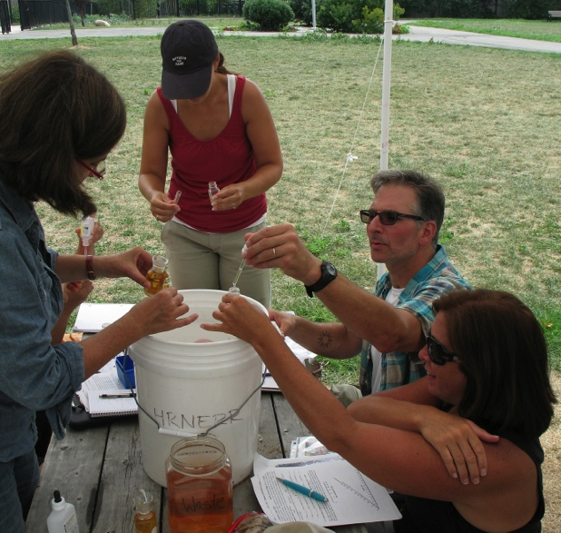
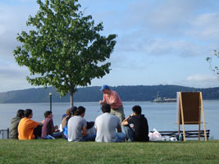



A Day in the Life of the Hudson River (Snapshot Day)
Over the summer, teachers have worked hard to plan the Day in the Life of the Hudson River event. This show will help YOU prepare. Click enter to advance the slides. HAVE FUN!
Sponsored by the Hudson River Estuary Program of the
New York State Department of Environmental Conservation,
In partnership with
the Lamont-Doherty Earth Observatory of Columbia University

Slide 2
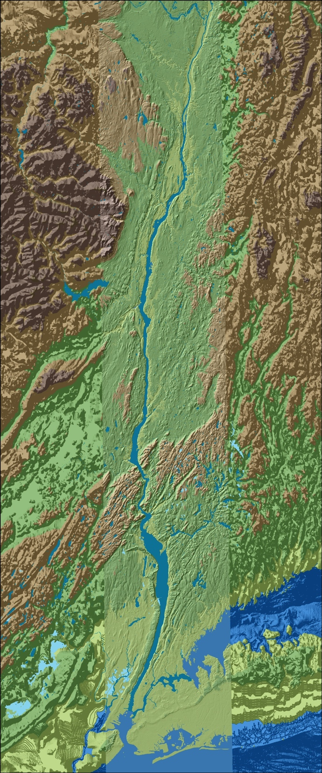
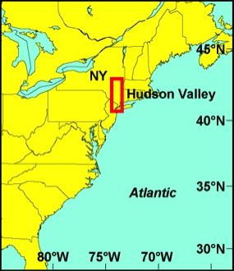
This is the Hudson River Estuary
Troy RM153
Here is where we are in New York State!
Cohotate/Athens RM 118
The Hudson River Estuary is 153 River Miles long.
  RM 153 is at Troy.
  RM 0 is at the very tip of Manhattan; below that is New York Harbor.
On Day in the Life there will be many other groups along the Hudson doing just what you are doing – even a few above the Troy dam!
Thousands participate – students of all grades & ages.
Ulster Landing RM 97
ESTUARY
Poughkeepsie RM 75
Use the map to find your site on the river.
Newburgh RM 60
Croton Point RM 35
Piermont RM 25
New York City
Staten Island
Atlantic Ocean

Slide 3
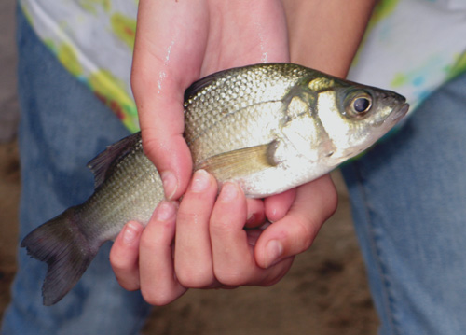
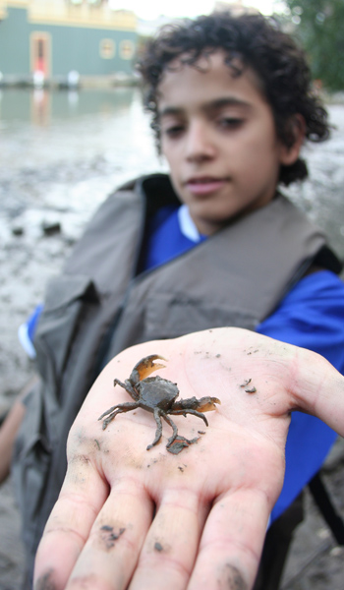
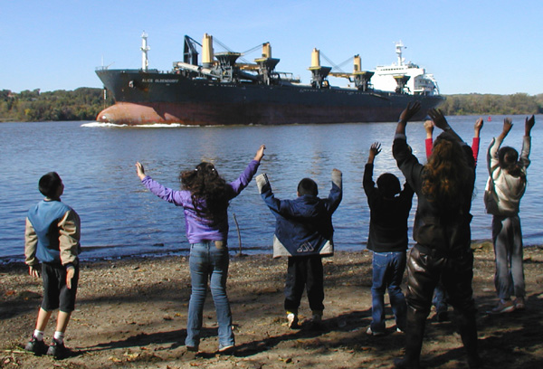
There is so much to look at in the river. Take notes and draw sketches!
Mud Crab
White Perch
Passing Ship

Slide 4
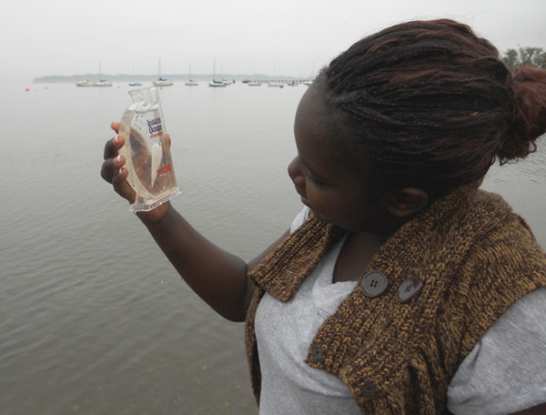
We need your help collecting
We call the information we collect “data.” What do you think a snapshot of the Hudson River might look like at your site?
Will the water be salty like the ocean? Brackish (a mix of fresh & salty)? Fresh like rain water? What do you think?
What does the habitat (living area) for plants and animals look like? Are there plants in the water? Piers? Riprap (big rocks)?
Let’s Find Out!

Slide 5
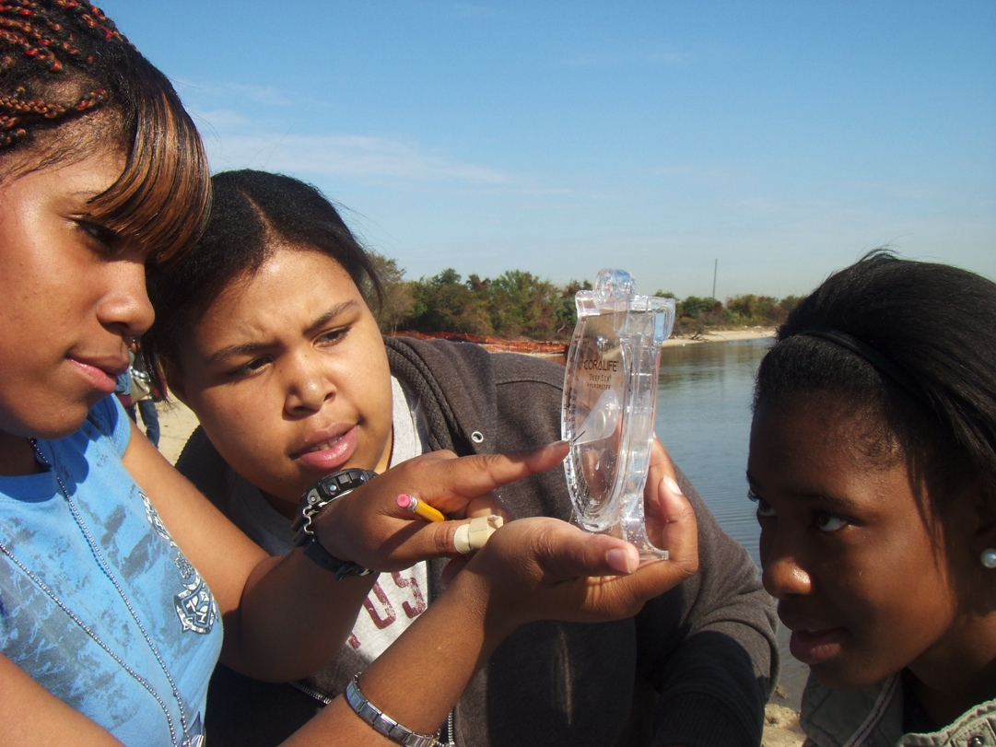
Will the information you collect match information collected at other sites on the river?
Do you think your area might be different from other areas on the river? Why or why not?
Could your data this year be different from last year’s? Why?
Careful sampling and recording of each test and its units of measurement is important when collecting and comparing data.

Slide 6
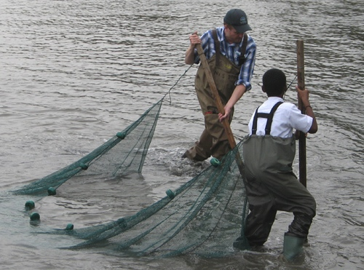
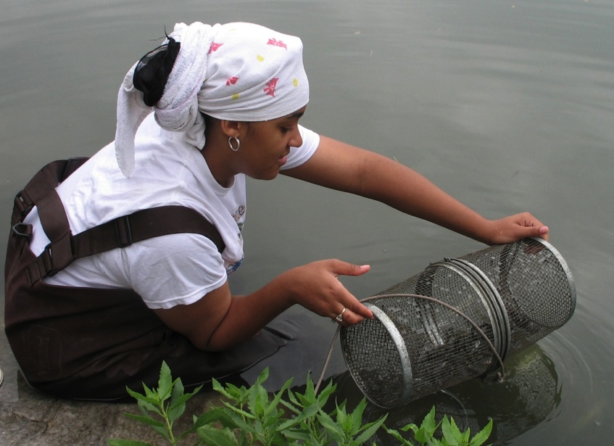

Data from all Day in the Life sites will be shared and compared!
  You can see what was collected at other sites!
  What makes some sites a lot like yours?
  What makes some different?
At many sites, fish are collected with a seine net.
At sites where wading isn’t possible, students use minnow traps or fishing poles.

Slide 7
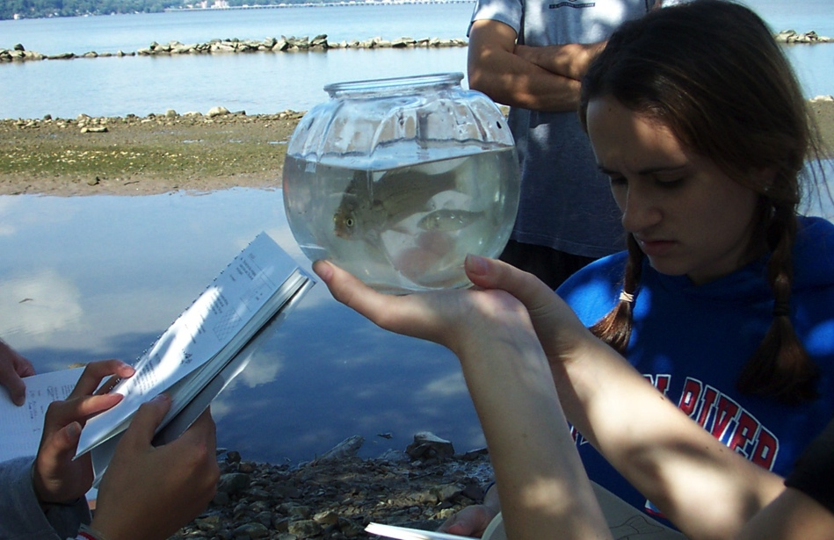
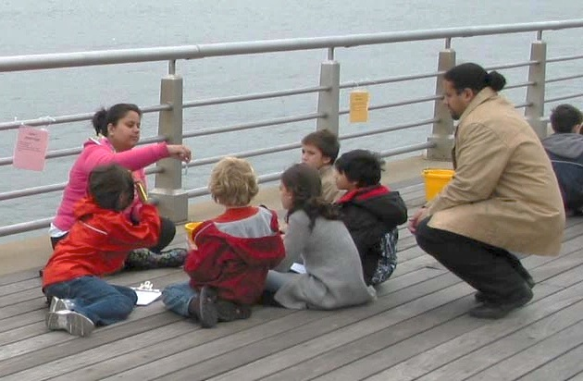
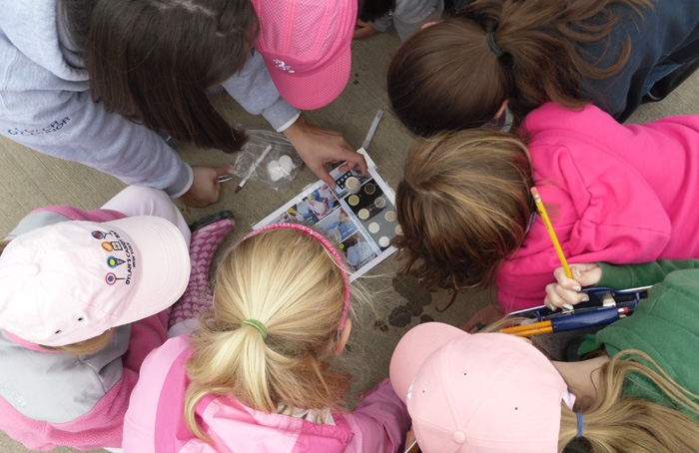
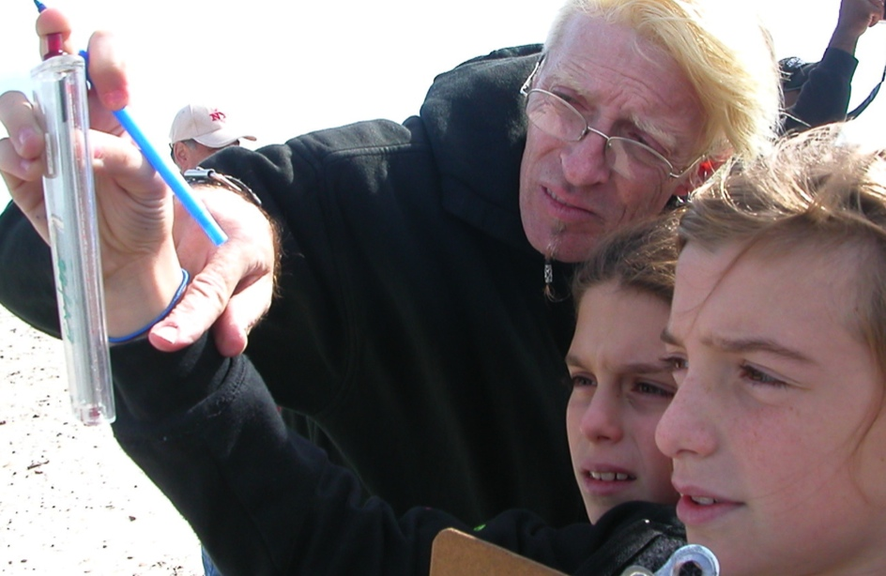
So what will you be doing?

Slide 8
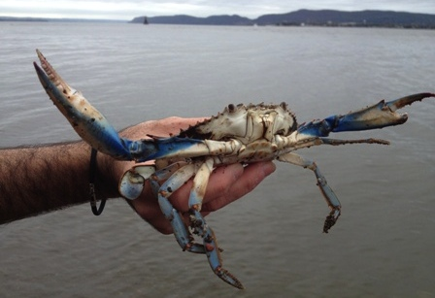
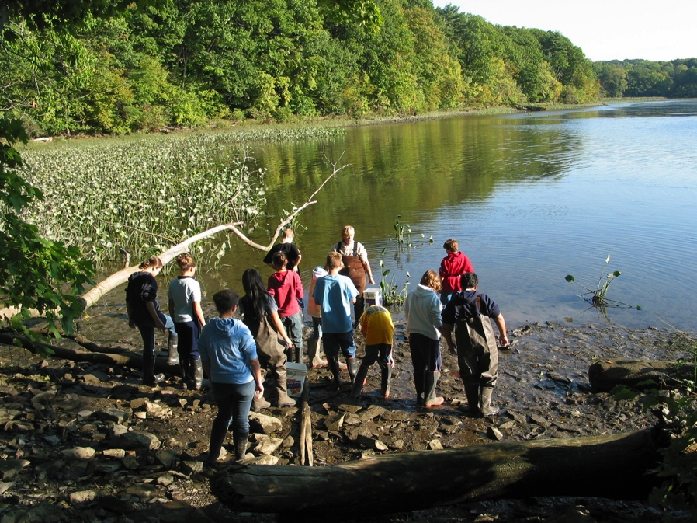
Let’s find out about the Estuary
Are there tides in the river?
How warm and deep is the estuary?
Is there enough oxygen for fish to breathe?
Are there plants along the river edge where you are or is it all paved?
What does the river bottom look like?
Are there ships using the river for work or for play?

Slide 9
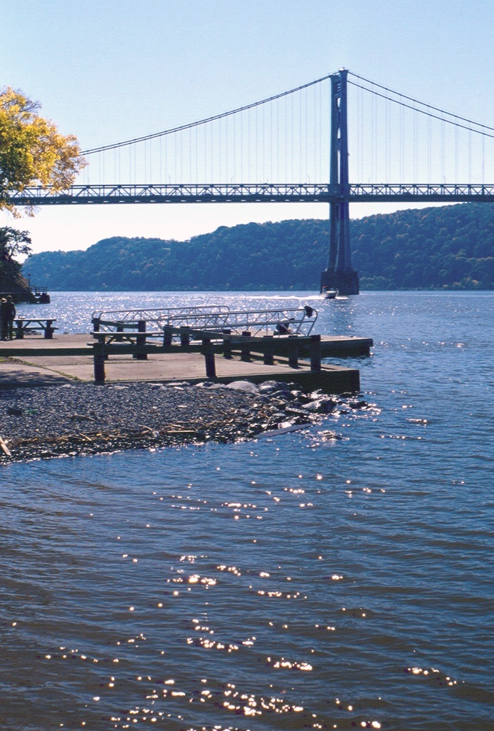
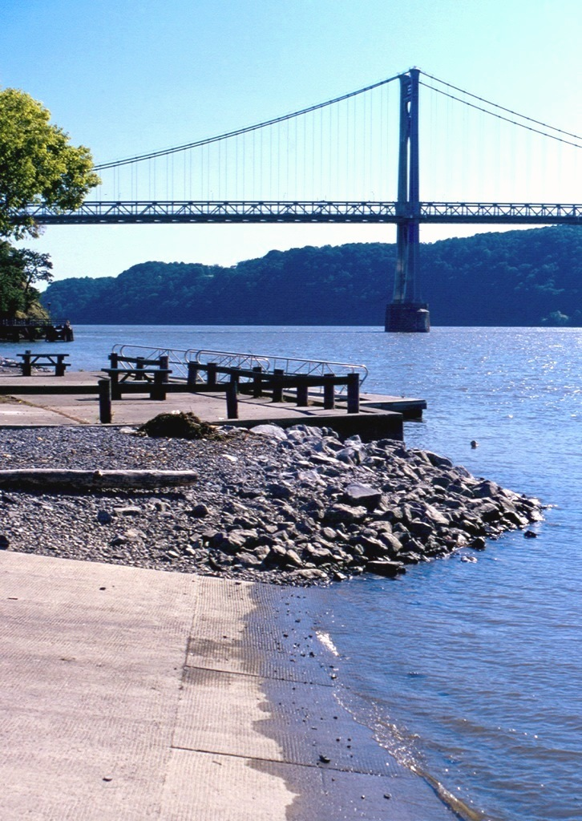
Tides
Can a river have tides? Aren’t tides just in the ocean?
Tides make the water level in the ocean rise and fall. In a river that is flat and open to the sea, like the Hudson, these ocean tides make the river water rise and fall too.
We will see if the tide is rising or falling by measuring the height of the water every half hour.

Slide 10
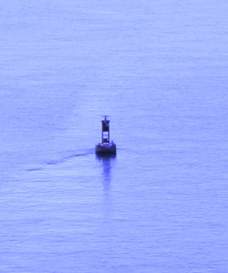
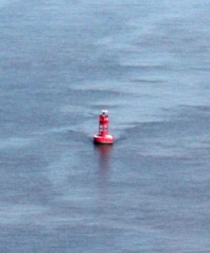
Tidal currents
Tides make the water level go up and down. Tides also create currents that move river water back and forth. Use a stick or an orange to see whether the current is moving in from the ocean (a flood current) or towards the ocean (an ebb current). Toss it in and watch which way it moves.
It can take up to 4 months!
If you threw an orange in at the top of the estuary near Albany, how long might it take – moving back and forth on the currents – to get to the ocean?

Slide 11
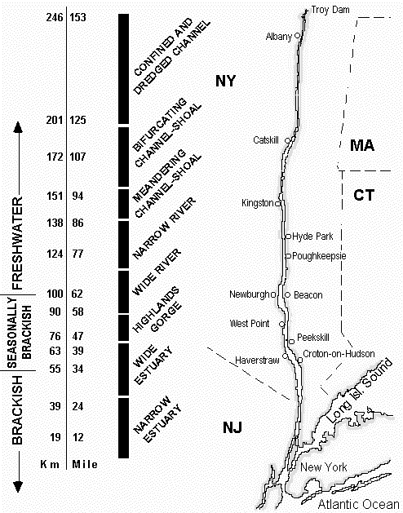
Let’s talk SALT!
What is a salt front?
Where will it be on Day in the Life?
The salt front is the leading edge of salty seawater entering the Hudson.
The salt front on the Hudson moves with the seasons:
The salt front usually moves up the river to Newburgh in the summer.
Spring rains and snow melt can push the salt front down below the Tappan Zee bridge.

Slide 12
Predicting the salt front’s position
On past Days in the Life, the salt front has been at:
  2003 - RIVER MILE 60
  2007 - RIVER MILE 78.2
  2011 - RIVER MILE 35.7
  What about this year? What do you think? Remember: the salt front’s position is influenced by rainfall. Write down your prediction and see if you are right! By the way, you just made a “hypothesis”!

Slide 13
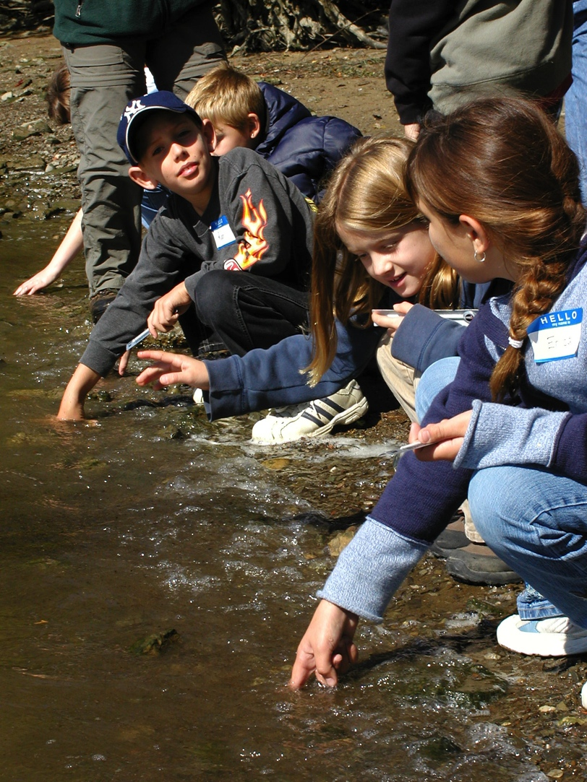
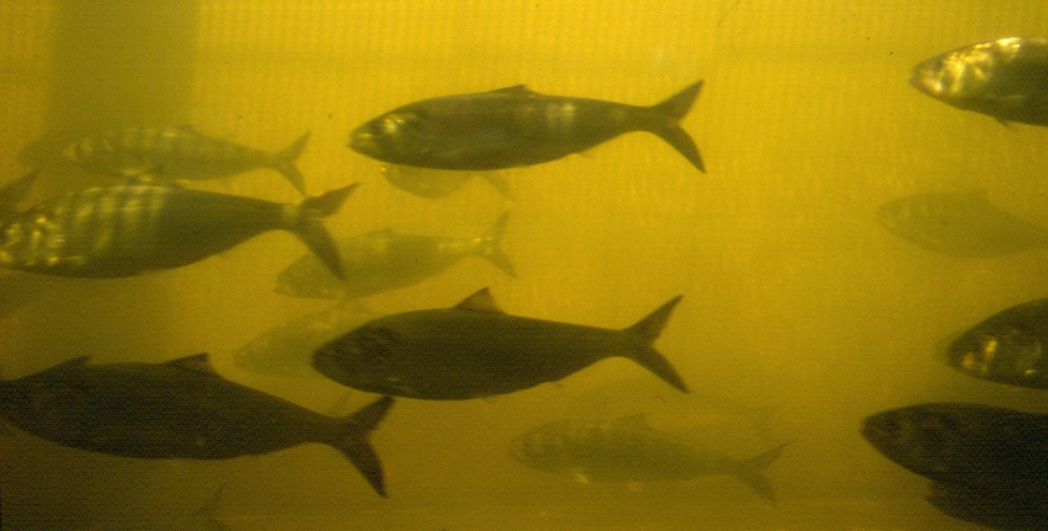
Temperature
Temperature is really important to fish and other organisms in the river. Let’s check it!
Many creatures use temperature to know when to migrate or spawn (reproduce).
When the water is TOO hot, some fish can’t get enough oxygen.

Slide 14
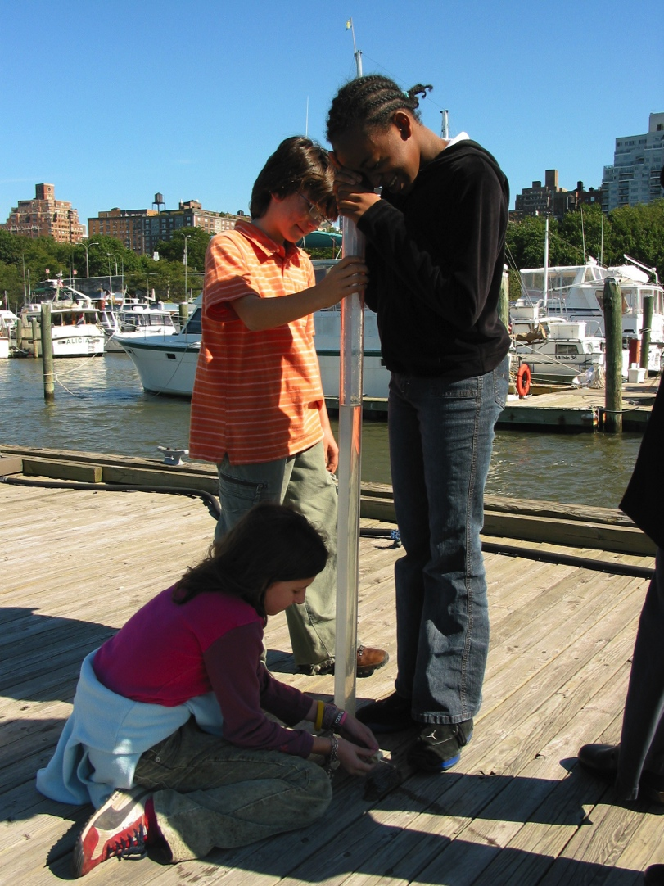
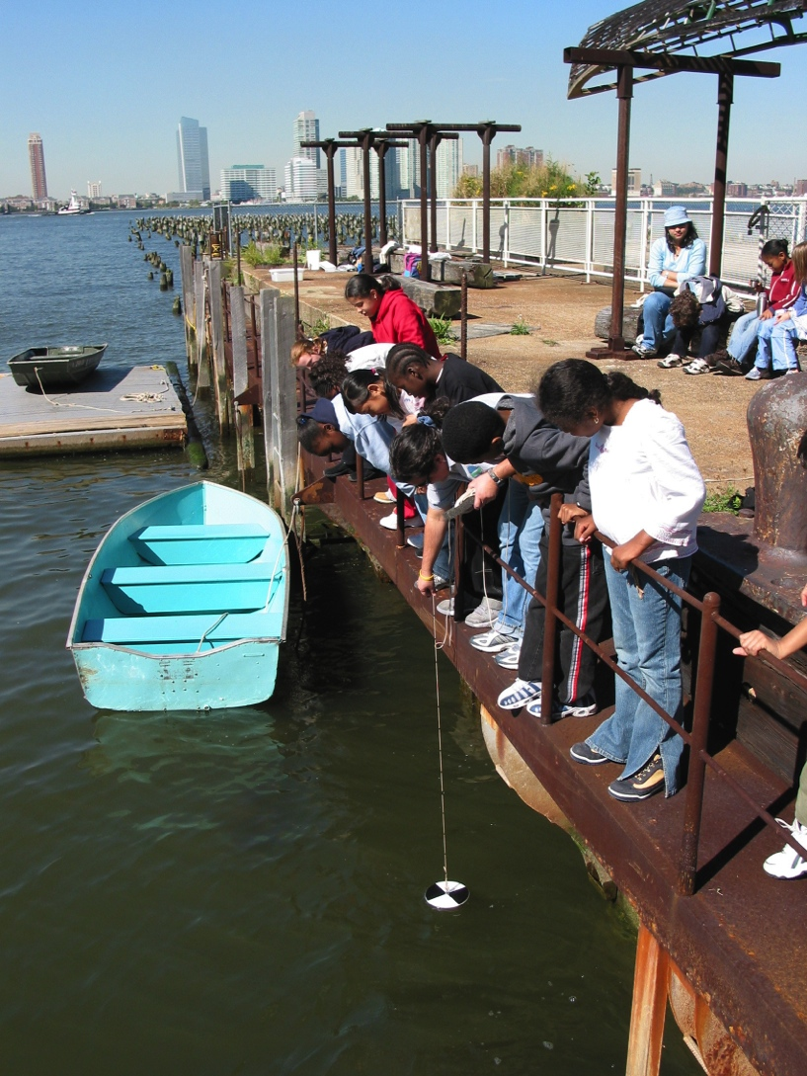
Testing turbidity
What are they looking at?
Sight tube
Secchi disk

Slide 15
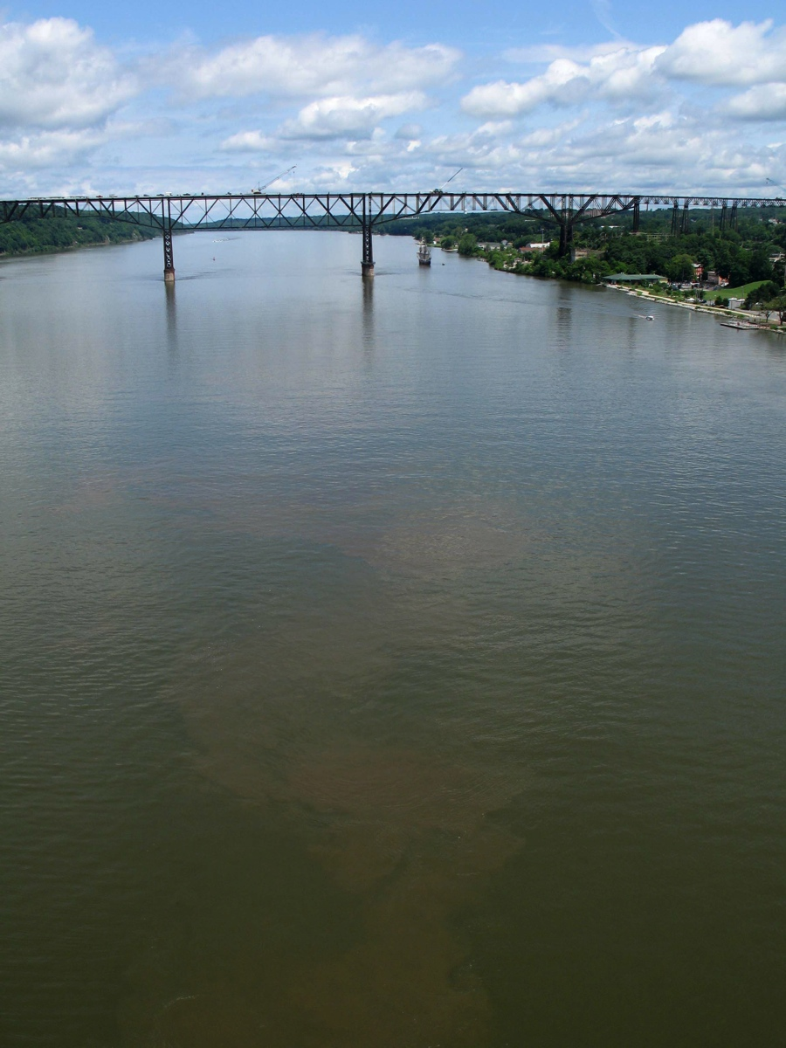
Turbidity is “water clarity”
But, water that is not clear may or may not be dirty.
Different materials carried in water can make it look dirty or “turbid.” Here are some examples:
    silt, soil, or sand grains
    plankton: plants (phytoplankton) and animals (zooplankton ) that drift in the water column
    small pieces of dead plant material (called detritus) that are food for some creatures

Slide 16
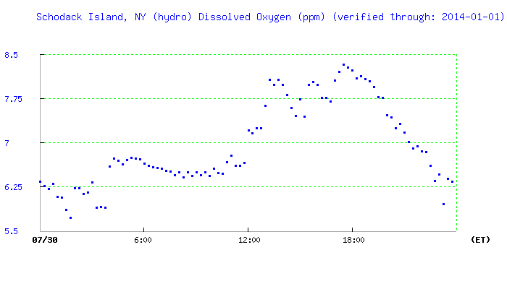
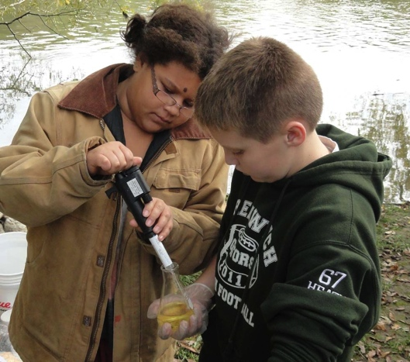
Water chemistry: dissolved oxygen (DO)
Fish and other aquatic organisms need DO to survive. DO levels of 5-11 milligrams per liter (mg/L)* are good.
Oxygen levels can change quickly due to:
Wind & wave activity
Photosynthesis by plants in the water
Bacteria using oxygen
This graph shows DO levels rising in the afternoon on August 30. Why?
What do you predict DO levels will be at your site?
*Mg/L is the same as parts per million (ppm).

Slide 17
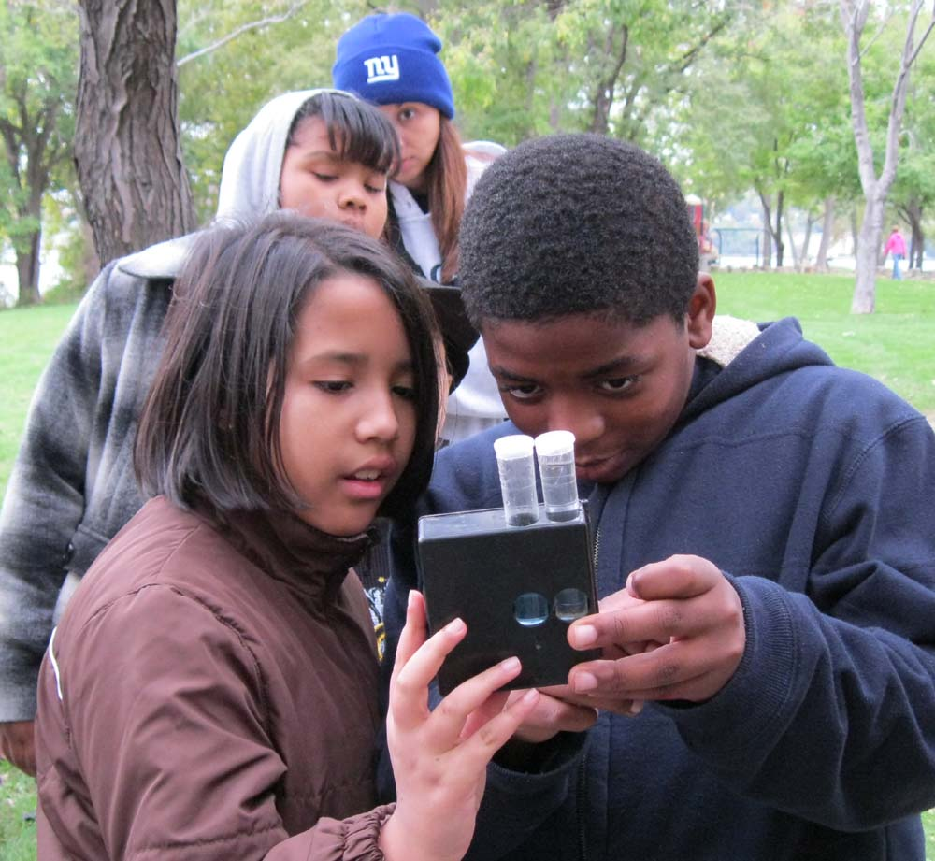
Water chemistry: pH
You will measure pH to find out whether river water at your site is acidic, basic (alkaline), or neutral.
A pH of 7.0 is neutral.
A pH greater than 7.0 is basic (alkaline).
A pH lower than 7.0 is acidic.
Fish are very sensitive to the pH of the water – for reproduction and health, each species requires that pH be within a certain range.

Slide 18
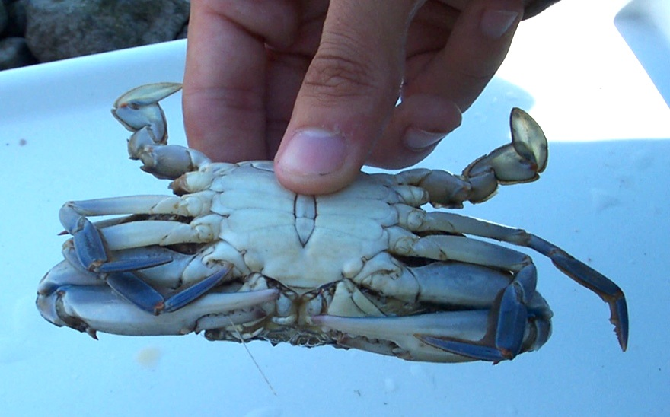
What kinds of fish and other creatures will you catch this year?

Slide 19
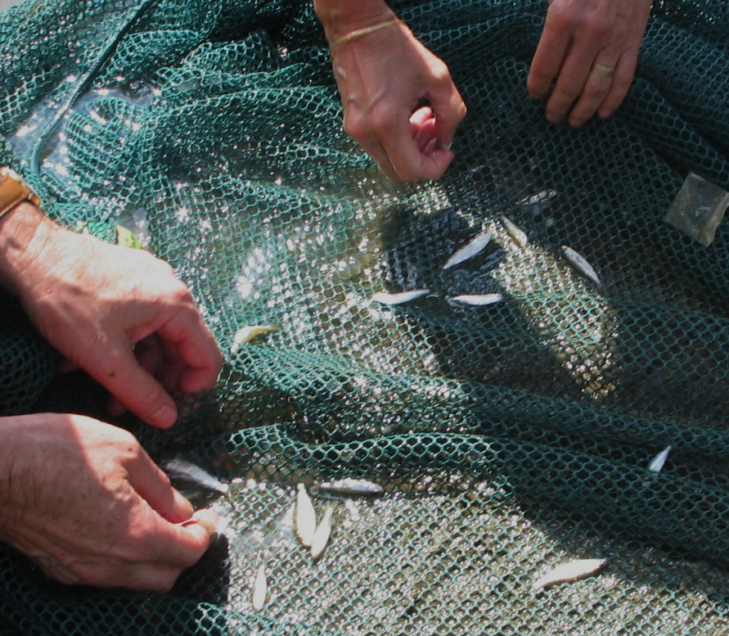
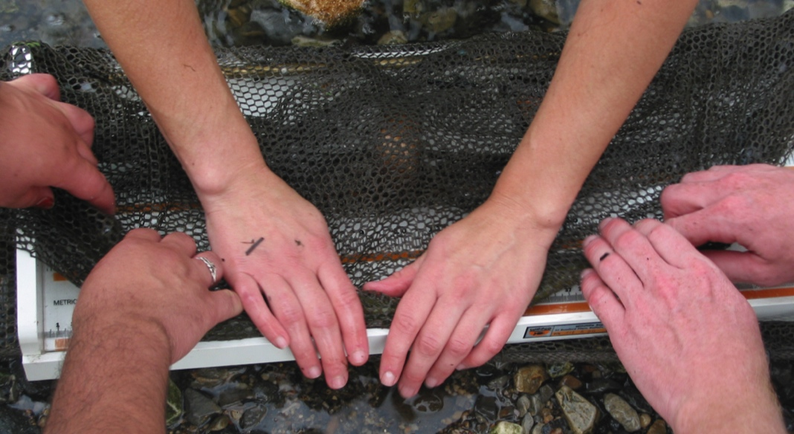
Identify, measure, count!
Slippery eels can be hard to measure; students wrapped this one in a net to help stretch it out to its full length

Slide 20
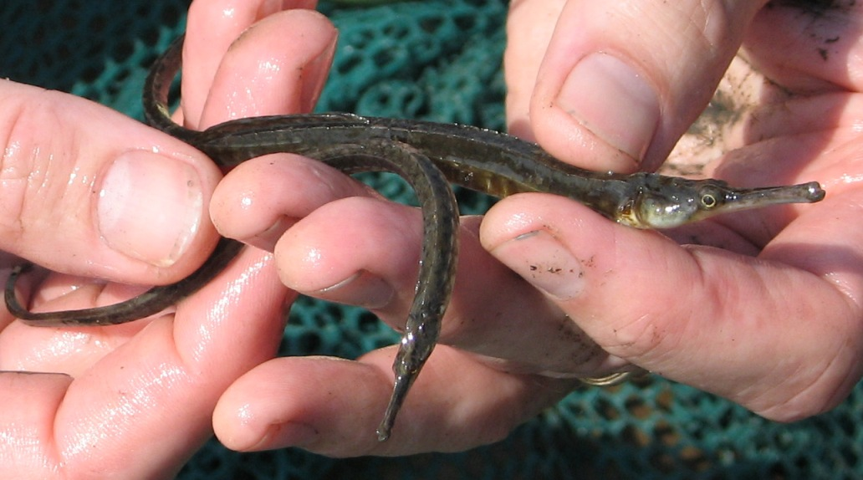
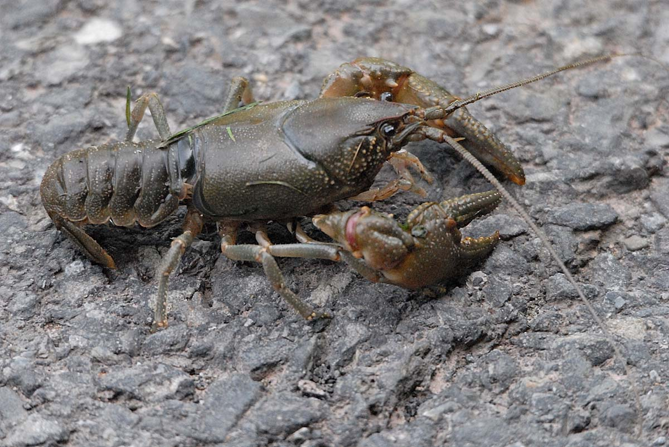
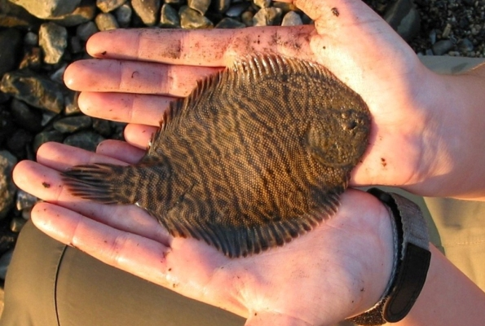
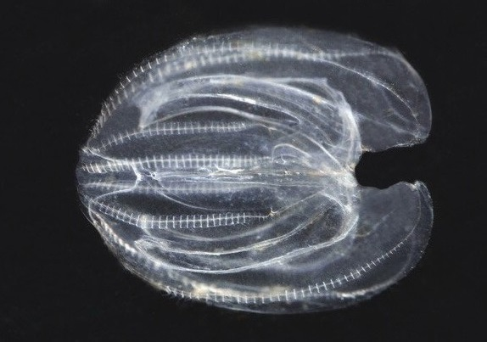
Depending on where you are, you might catch some odd creatures!
Pipefish
Crayfish
Hogchoker
Comb jelly

Slide 21
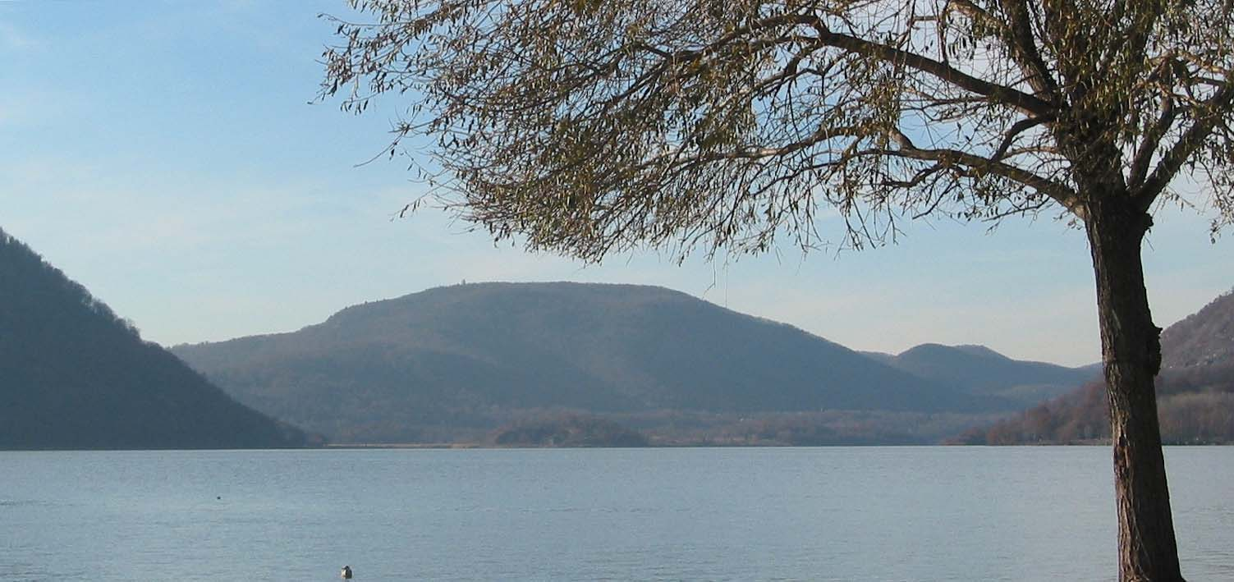
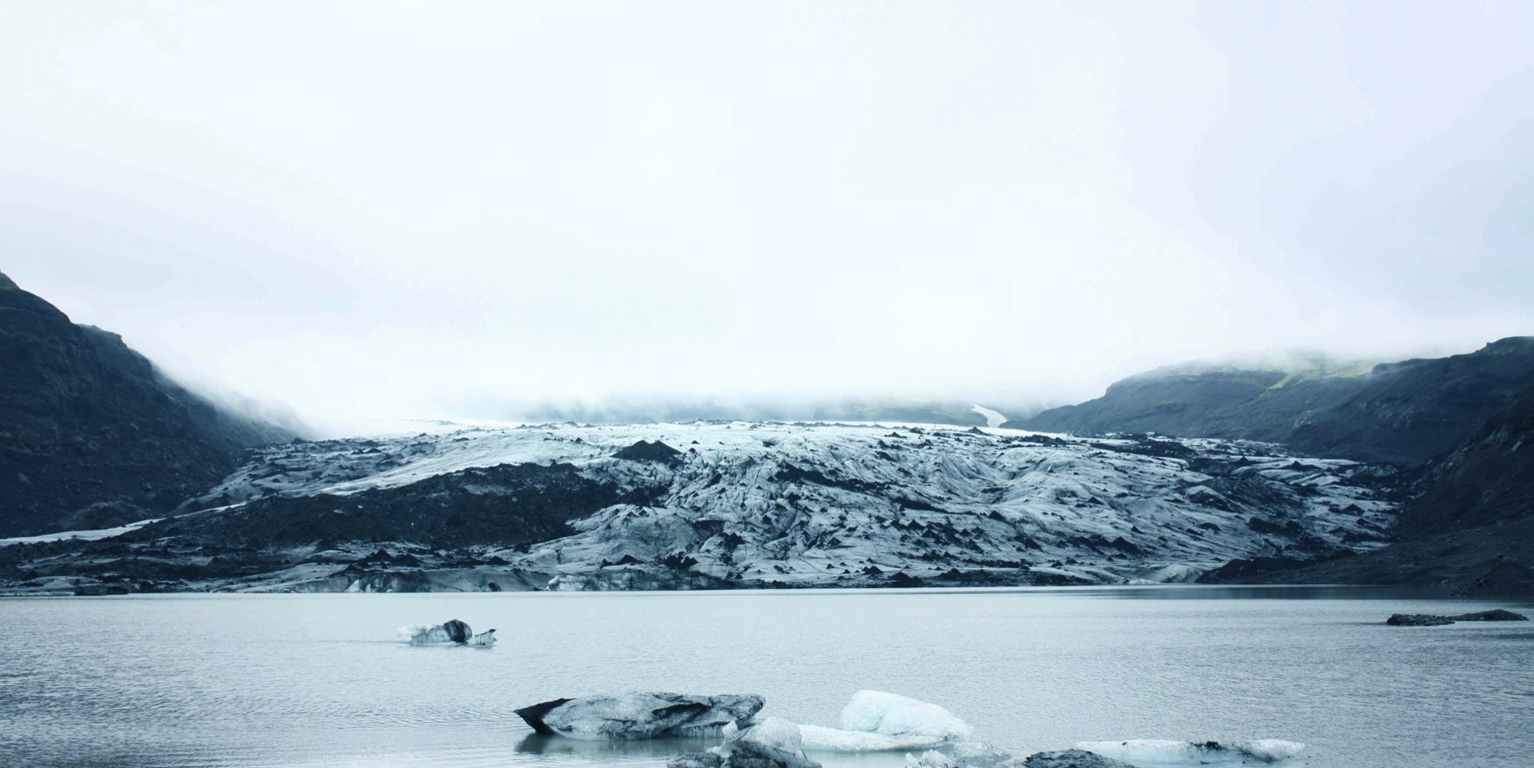
What’s at the bottom of the Hudson?
The Hudson has been around for many millions of years, but it hasn’t always looked the way it does now.
For example, glaciers once filled the river channel. These powerful sheets of ice carved the river bottom and shoreline.
Notes:
Click to fade from shot of glacier-filled valley to shot of Hudson north of Peekskill.

Slide 22
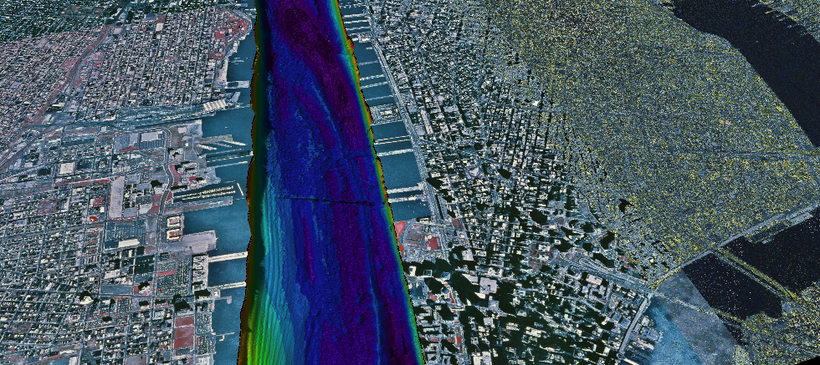



Mapping the Hudson’s bottom
The river bottom has ridges and trenches carved by the glaciers. Sediment has partly filled in the trenches, but the river is still deep. The deepest places are dark blue; the shallowest yellow and red. Off Manhattan, the river is 20 meters or about 60 feet deep.

Slide 23
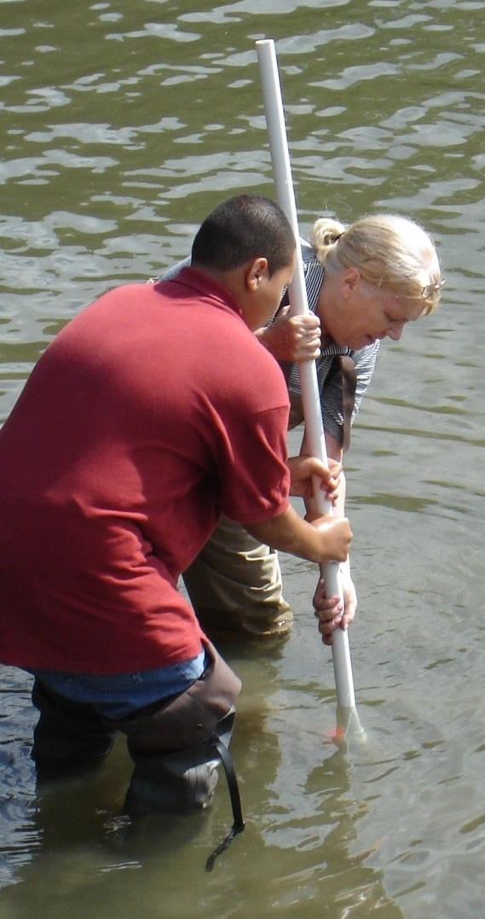
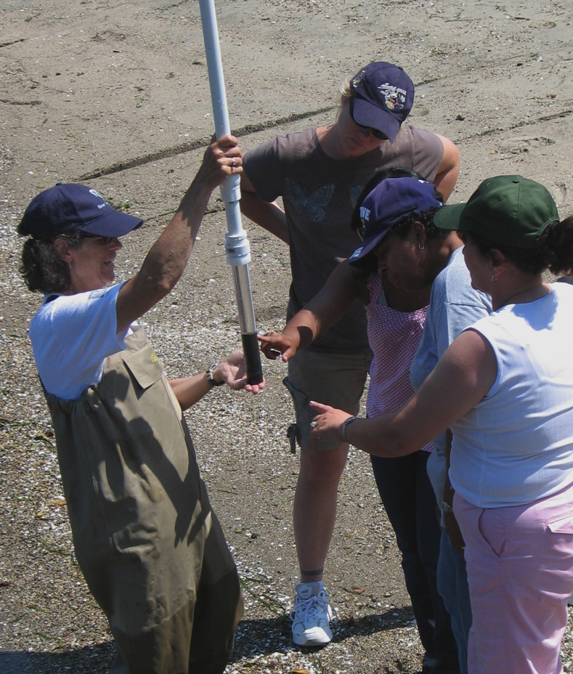
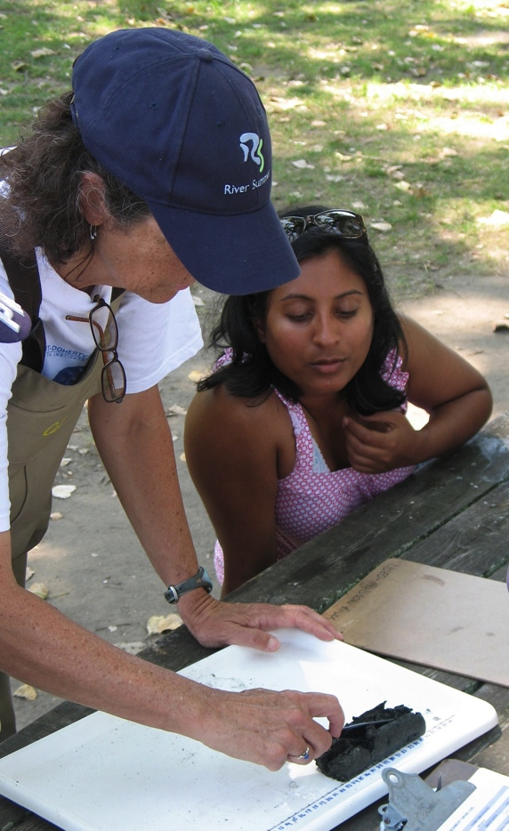
We are going to look at the bottom of the river by taking a small core
Cores are sections of sediment from the river bottom. They reveal the history of the bottom and the habitats found there.
You may use a simple push corer to collect a core sample.

Slide 24
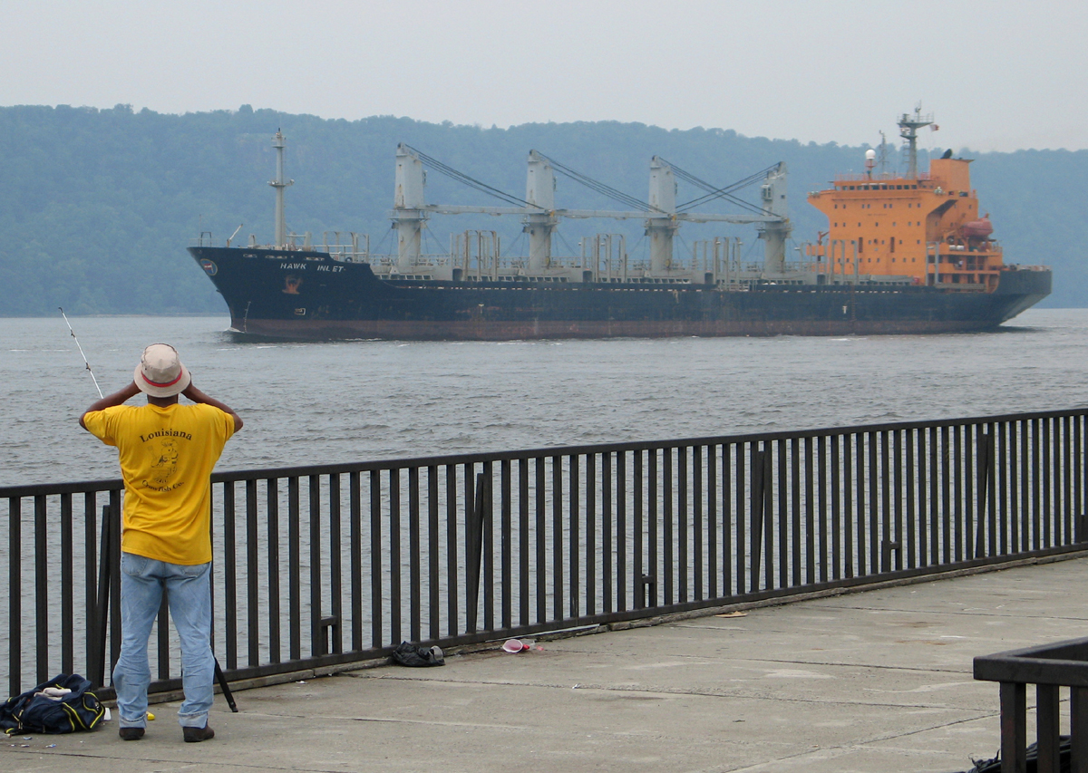
How is the river is being used today?
We will track shipping moving up and down the river. Record ship names, colors, direction, and times!
Using basic math we can figure out the time it takes for ships to move from one sampling site to another on the river.

Slide 25
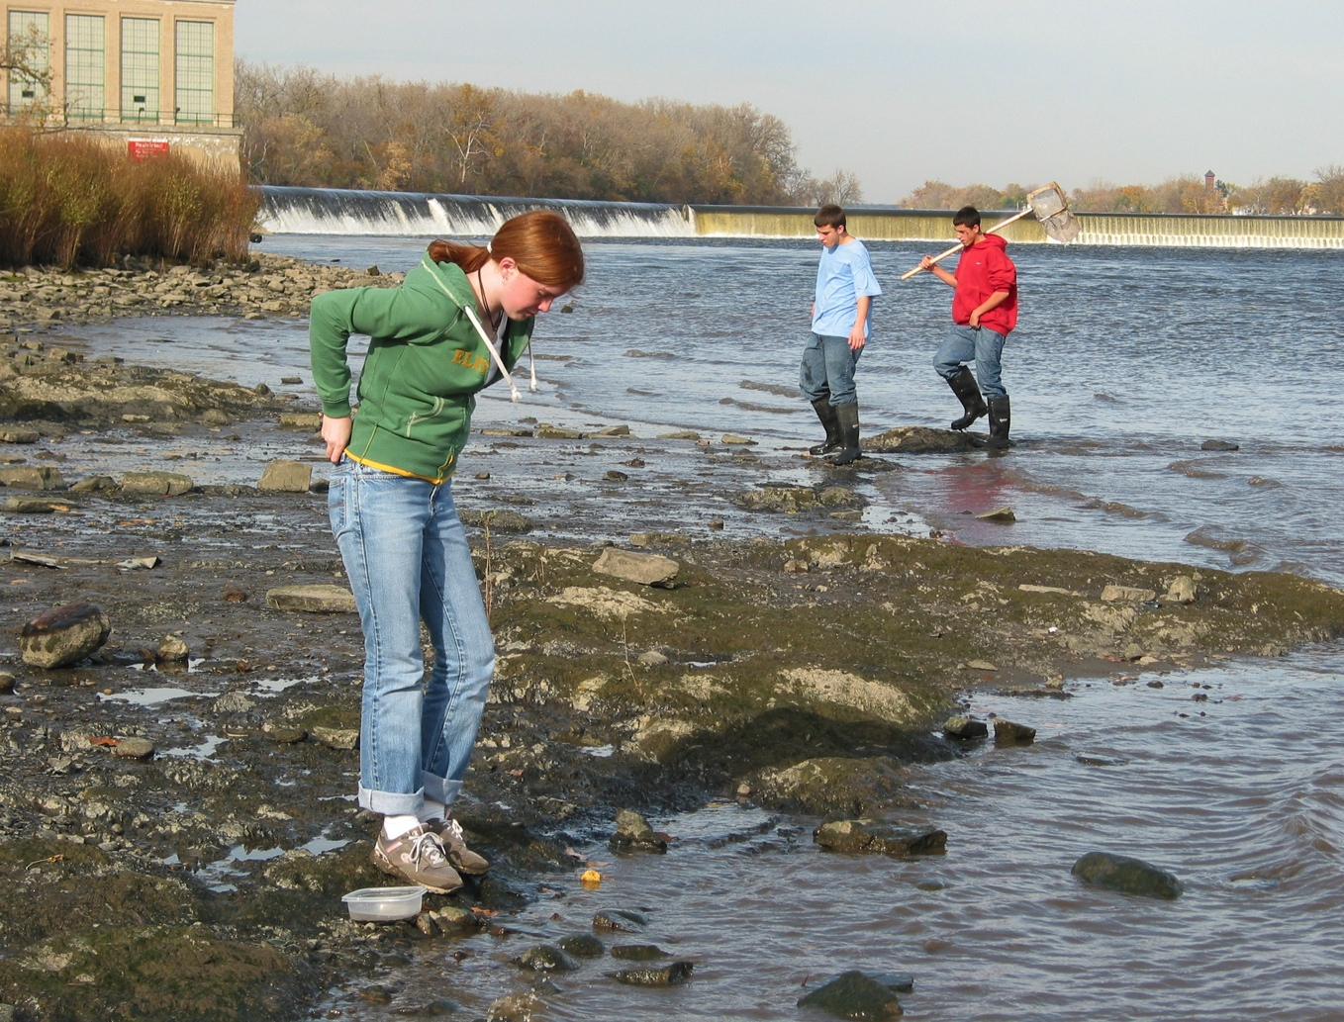
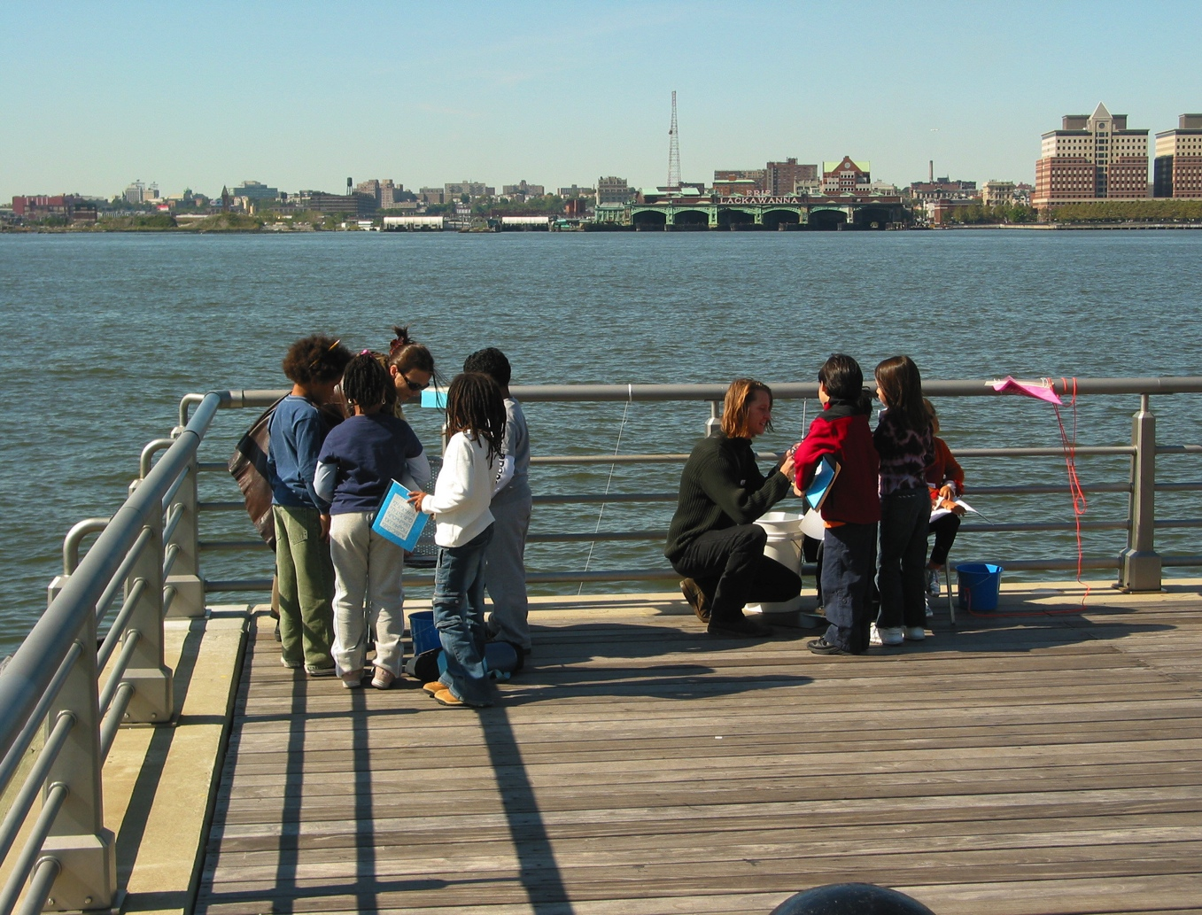
Describe your site so other schools will know what it looks like!
Does it look like this…
…or more like this?

Slide 26
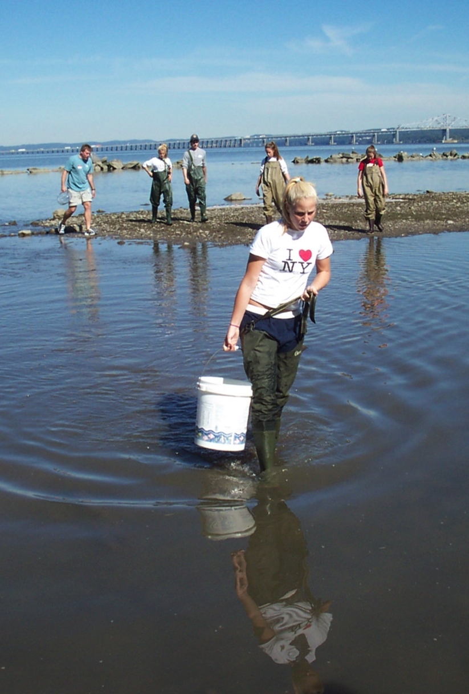
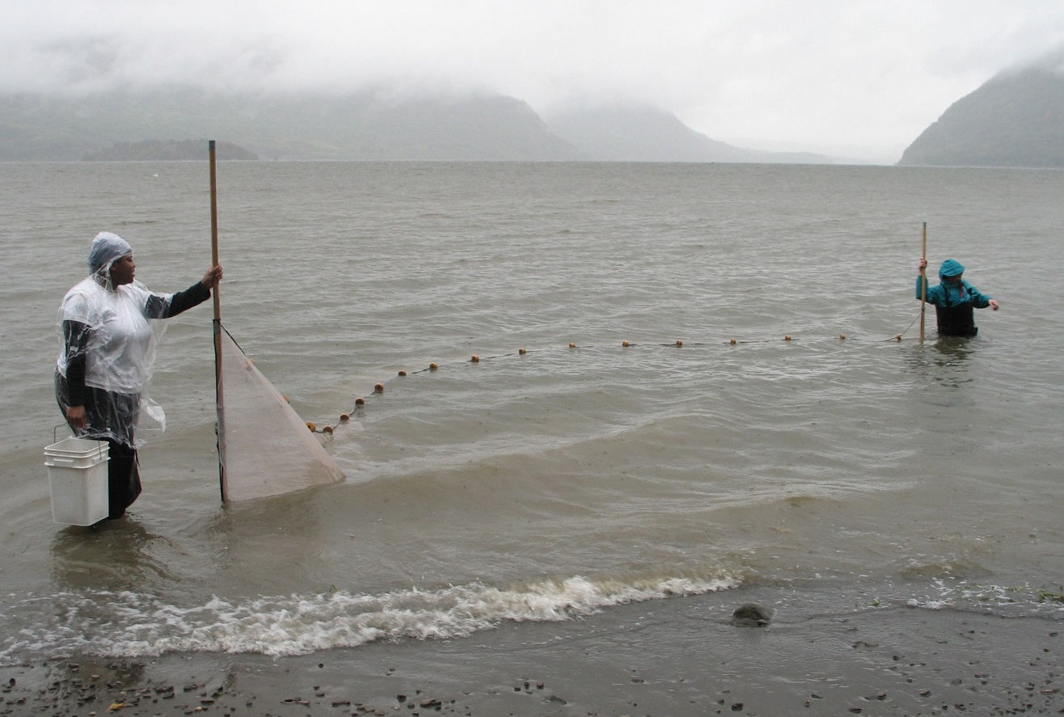
Be prepared for the weather – rain or shine!

Slide 27
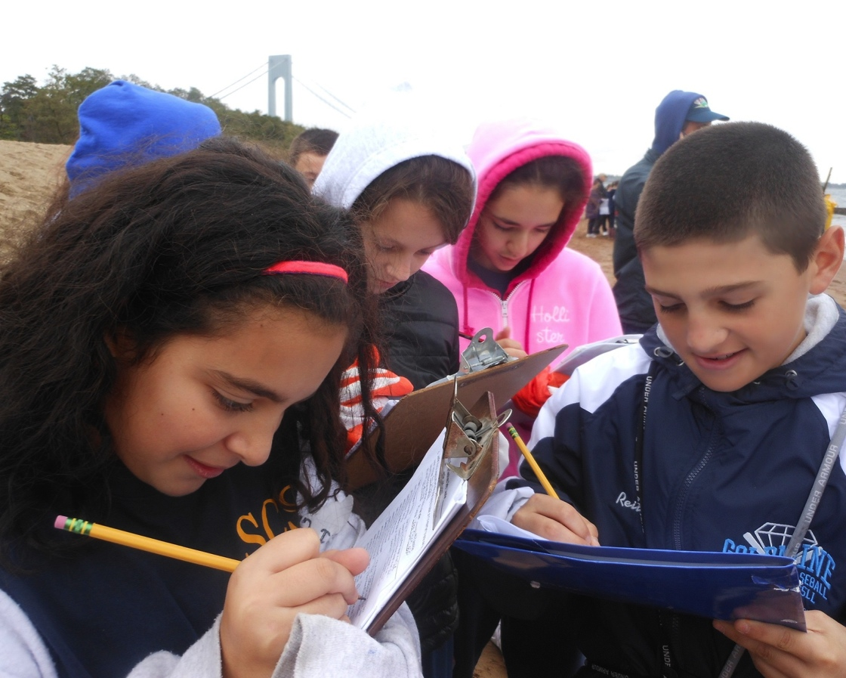
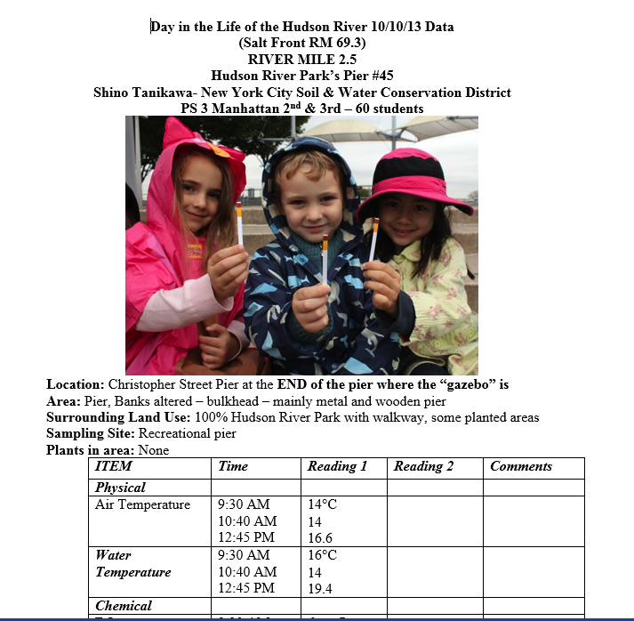
When the field trip is over, be sure to send your results in.
We want to share data collected by all the students who participate.

Slide 28

Last of all, on Day in the Life…
Have Fun!

