Slide 1
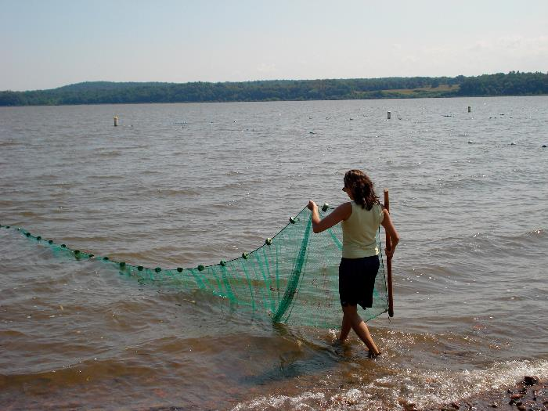

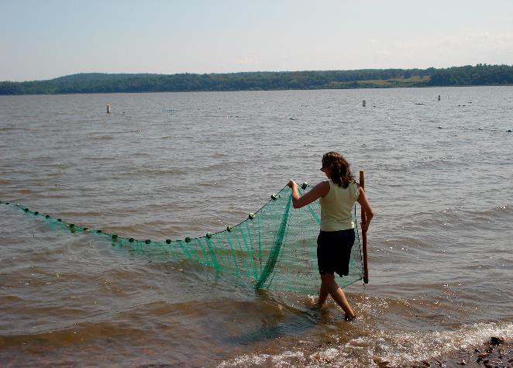



A Day in the Life of the Hudson River
(Snapshot Day)
Sponsored by the Hudson River Estuary Program
of the New York State Department of Environmental Conservation
in partnership with the
Lamont-Doherty Earth Observatory of Columbia University

Slide 2
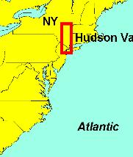
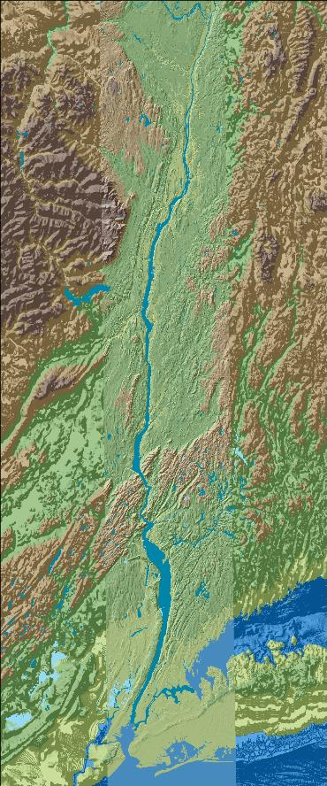
This is the Hudson River estuary
Here is where we are in New York State!
The Hudson River Estuary is 153 River Miles long
    RM 153 is at the Troy dam, RM 0 is at the very bottom of Manhattan. Below that is New York Harbor and the New York “bight”
There are many other groups in the estuary today doing just what you are doing - even a few above the Troy Dam!
Hundreds of students are participating - all grades & ages
Troy RM 153
E
S
T
U
A
R
Y
Cohotate RM 118
Ulster Landing
RM 97
Use the map to find your site on the river
Poughkeepsie RM 75
Newburgh RM 60
Croton Point RM 35
Piermont RM 25
New York City
Staten Island
Jamaica Bay
Atlantic Ocean

Slide 3
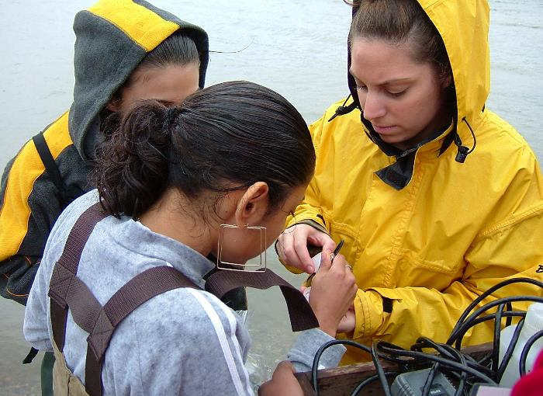
Your analysis is important
Is the water at your site salty from the Atlantic ? Fresh from the Adirondacks and upper tributaries? Or is it brackish (a mix of salt and freshwater)?
What does the habitat look like? Are there aquatic plants? Piers? Riprap?
What will be the range of pH and Dissolved Oxygen?
Start by developing predictions for your site:
What will a ‘snapshot’, or a sample of the Hudson River look in your area?

Slide 4
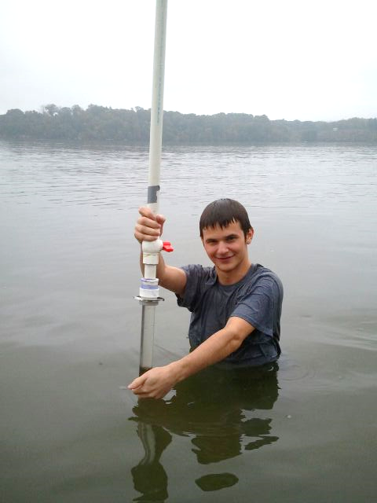
Will data from your site match data from other sites on the river?
How do you think your area may differ from other areas on the river?
Do you think your data might be different this year from last year? What might be different?
This student is collecting a sediment core or sample from the bottom of the river.

Slide 5
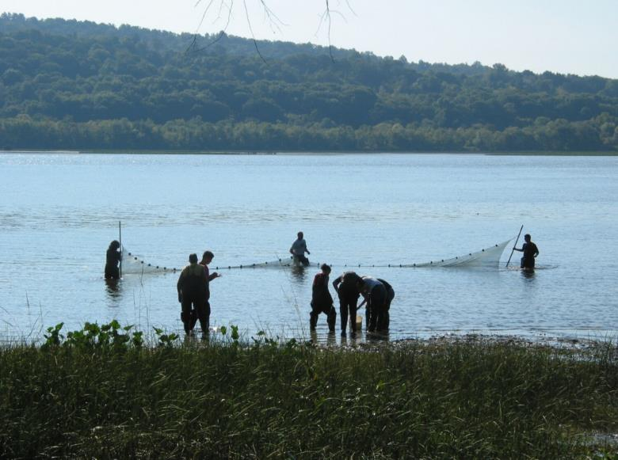
Looking for TRENDS &
learning about a SYSTEM
* Trends show patterns over time
* Systems show relationships
You will be collecting data and comparing your predictions to:
Current data YOU collect
Current data collected by students at OTHER sites
Prior data from the EARLIER years www.ldeo.columbia.edu/dayinthelife
The HRECOS real time monitoring system www.hrecos.org/
These students are using a seine
net to catch fish in the Hudson.

Slide 6
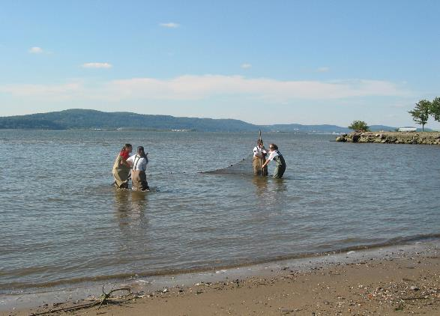
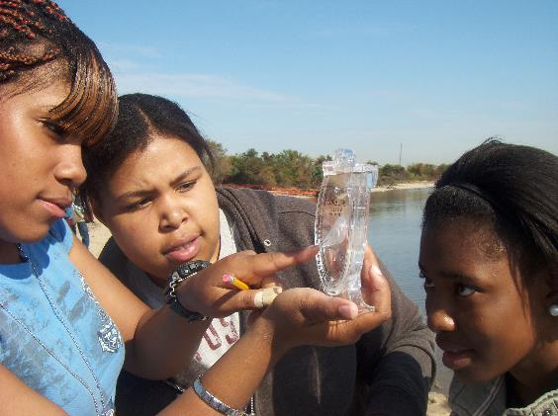
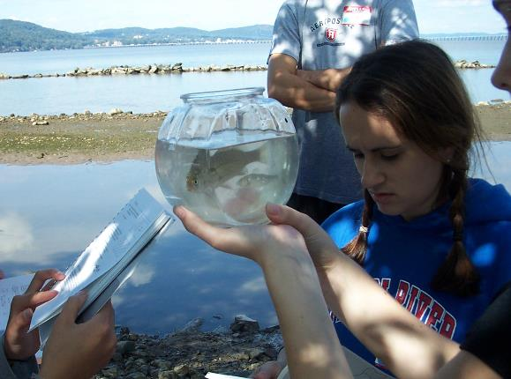
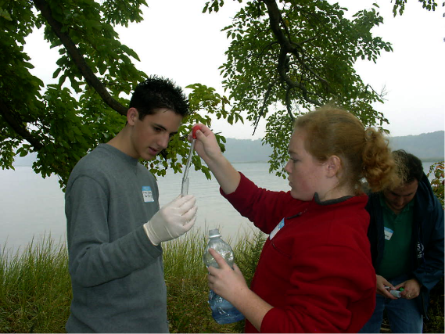
So what are we doing today?

Slide 7
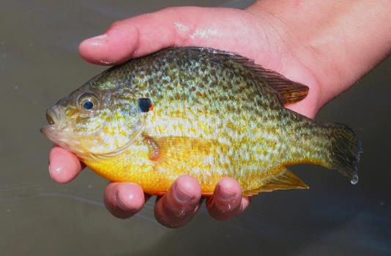
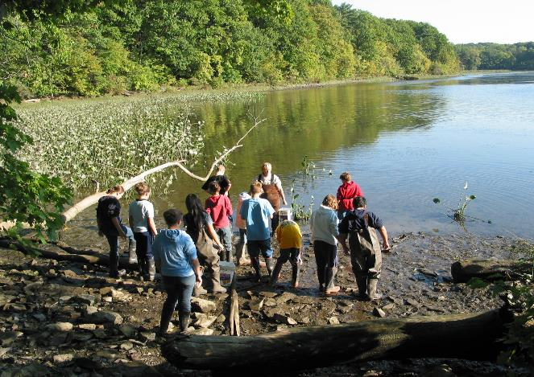
Let’s find out about the Estuary
Are there tides and currents in the estuary?
How warm and turbid (clear) is it?
Is there enough oxygen for a range of fish?
Are there plants where we are in the river?
What does the bottom of the estuary look like at your site?
Are there any ships using the river for commerce?
pumpkinseed sunfish

Slide 8
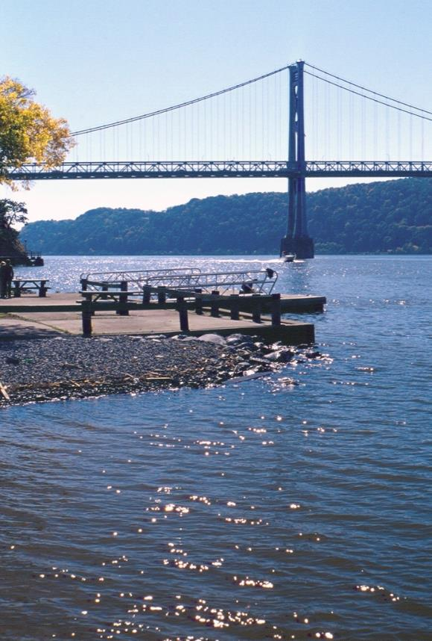
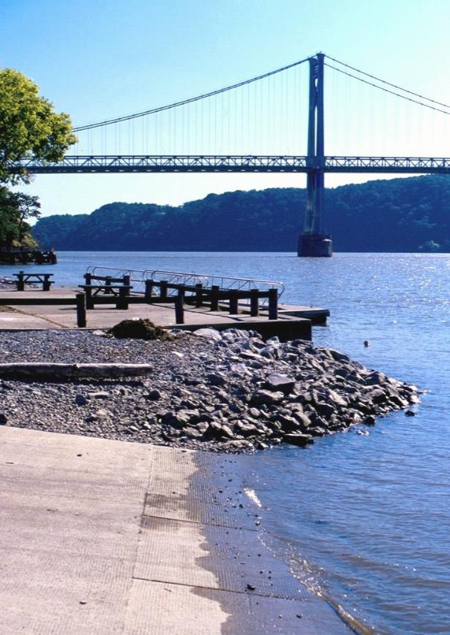
Tides
Can a river have tides? Aren’t tides just in the ocean?
Tides make the water level in the ocean rise and fall. In a river that is flat and open to the sea, like the Hudson, these ocean tides make the river water rise and fall too.
We will see if the tide is rising or falling by measuring the height of the water every half hour.

Slide 9
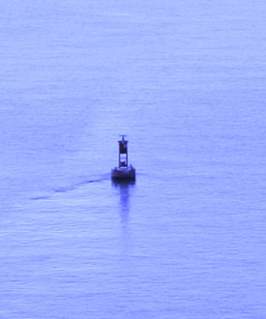
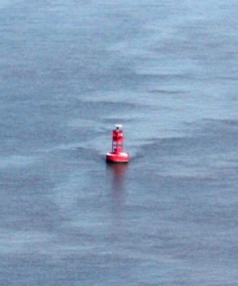
Tidal currents
Tides make the water level rise and fall. Tides also create currents that move river water back and forth. Use a stick or an orange to see whether the current is moving in from the ocean (a flood current) or towards the ocean (an ebb current). Toss it in and watch which way it moves.
It can take up to 4 months!
If you threw an orange in at the top of the estuary near Albany, how long might it take – moving back and forth on the currents – to get to the ocean?

Slide 10
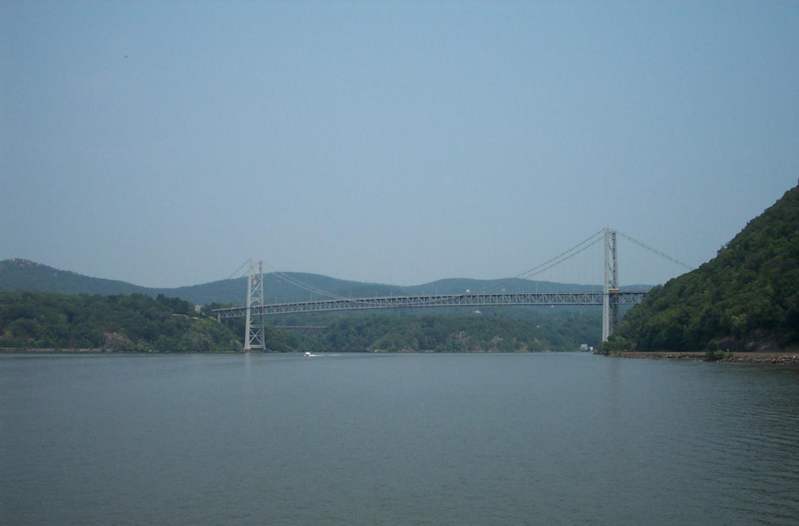
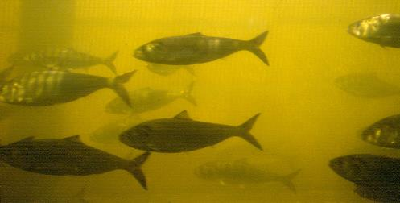
Muhheahkantuck
Rivers tend to run ONE direction - from their source to where they meet a larger water body. The Hudson River flows TWO ways - in fact the Native people called it Muhheakantuck - “river that flows both ways.”
The Hudson runs both down from Lake Tear of the Clouds in the Adirondacks AND in from the Atlantic Ocean due to tides.
How do fish know which way to go?

Slide 11
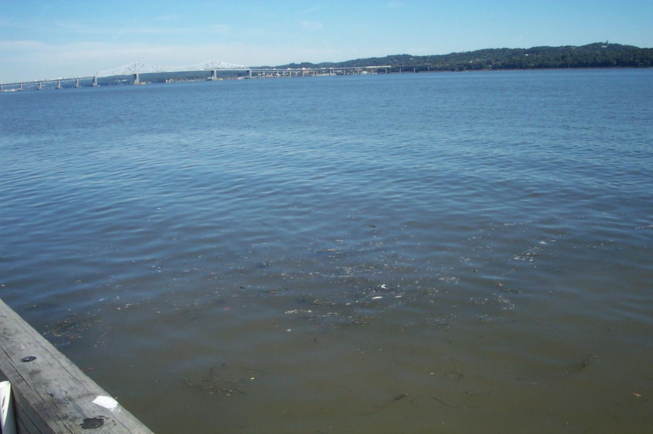
The Hudson River Almanac reported a story of the river that flows both ways.
A bottle was collected at RM 18 September 3 and was found to have been thrown in at RM 34 July 18…45 days to travel 16 miles!
On average, how far south did the bottle travel each day?
Notice we said travel “south.” The total distance traveled would be more. Why?
(Source: Hudson River Almanac 9/3/04-9/10/04)

Slide 12
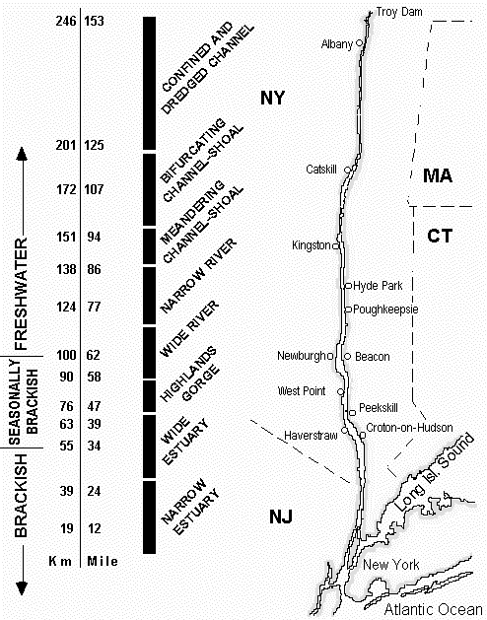
Let’s talk SALT!
What is the salt front?
The salt front is the leading edge of dilute seawater. It is defined as the point where the chloride [Cl⁻] concentration is 100 mg/L.
The salt front moves in response to seasonal precipitation patterns.
The salt front usually moves up the river to Newburgh in the summer.
Spring rains and snow melt can push the salt front down below the Tappan Zee bridge.

Slide 13
Where will the salt front be on
Day in the Life?
On past Days in the Life the salt front has been located at:
2003 - RIVER MILE 60
2007 - RIVER MILE 78.2
2011 - RIVER MILE 35.7
What about this year? Consider the weather this fall, and visit the HRECOS website to check salinity in the brackish section of the river.
Write down your prediction of where Cl⁻ levels will reach 100 mg/L. After Day in the Life results are posted you can check the results online to see if you are right!

Slide 14
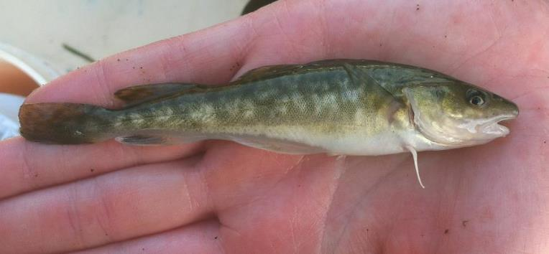
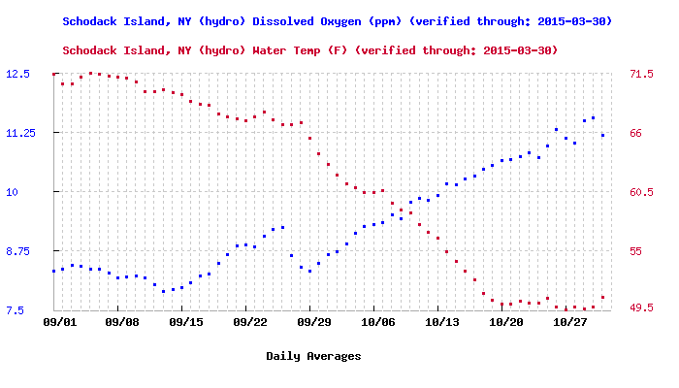
Measurable Physical Properties: Temperature
Temperature is VERY IMPORTANT to fish and to water chemistry. As water temperature rises and falls, biological and chemical activity adjusts.
Atlantic tomcod, also called “frostfish” for their winter spawning
Dissolved Oxygen (DO) levels are inversely related to temperature. Can you predict what happens to DO in fall, around the time of Day in the Life?
Data for 2009 from HRECOS

Slide 15
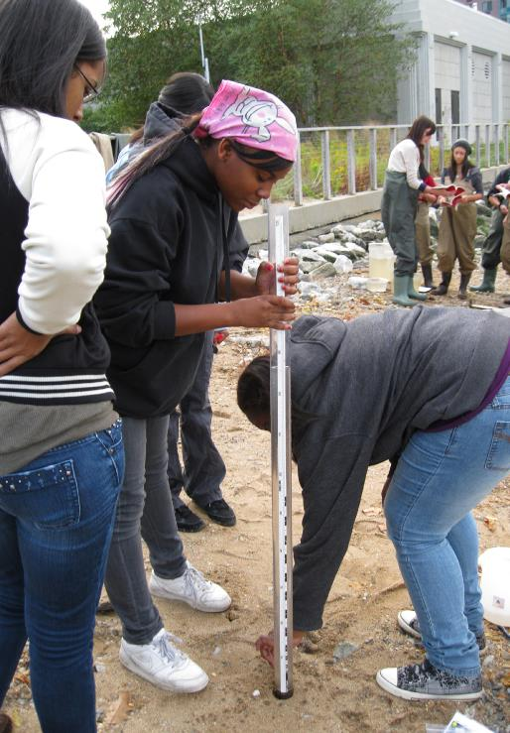
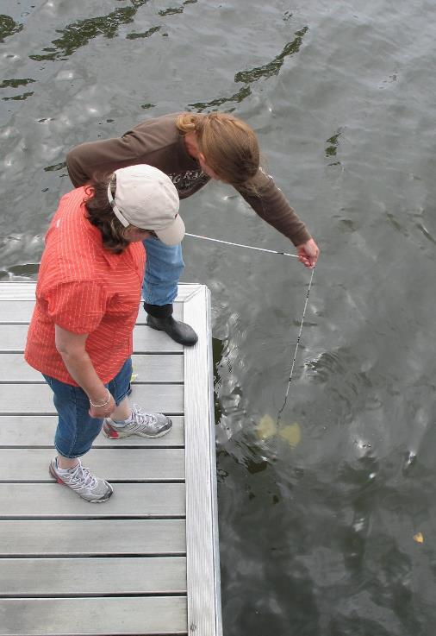
Measurable Physical Properties: Turbidity
Sight tube
Secchi disk

Slide 16
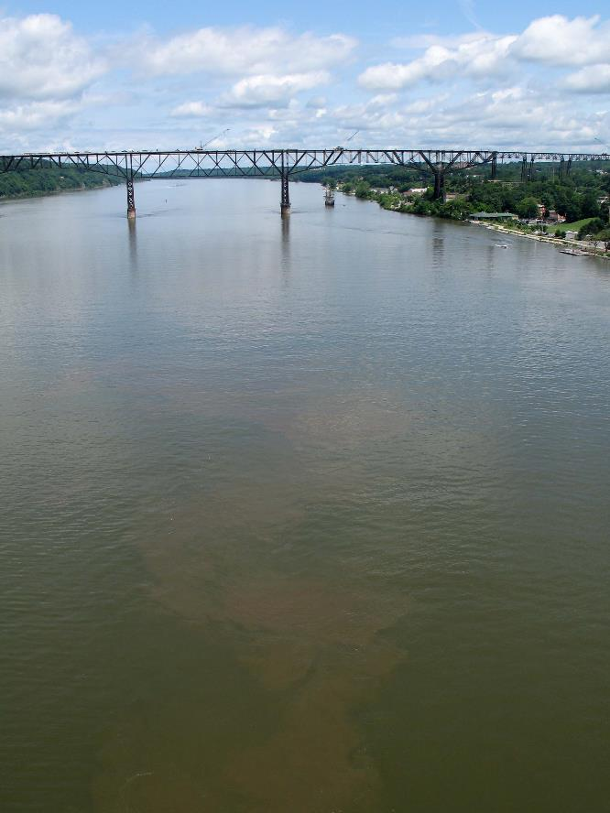
Turbidity is “water clarity”
But, water that is not clear may or may not be dirty.
Estuaries are naturally turbid.
Materials suspended in water can make it look dirty or “turbid.”
Examples include:
    silt, soil, or sand grains
    plankton: plants (phytoplankton) and animals (zooplankton ) that drift in the water column
    detritus: small pieces of dead plant material that are food for some creatures
    Even salt where it meets the freshwater can add to the river’s turbidity
The Hudson’s high turbidity limits photosynthesis in deeper water, but creates nursery habitat for young fish, hiding them from predators.

Slide 17
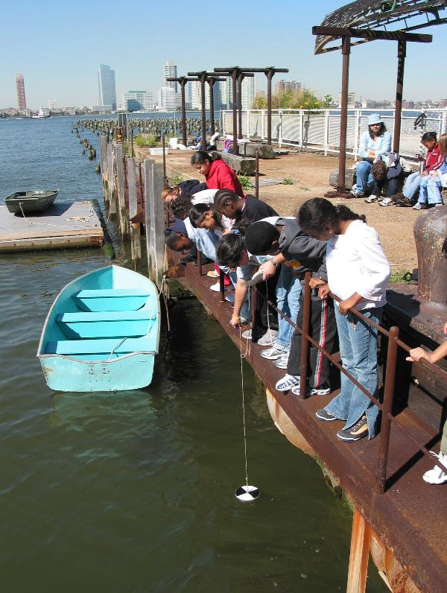
You Predict.
Will the Hudson be more turbid in your location this year than last?
Does weather affect turbidity...rain? wind?
Look at data from 2011 and check the weather.
How might that have affected turbidity?
These students are using a secchi disk to determine water clarity.

Slide 18

Water Chemistry
There are several tests to choose from, depending on the equipment you have available:
Dissolved Oxygen (DO)
pH
Alkalinity
Nitrates
Phosphates

Slide 19
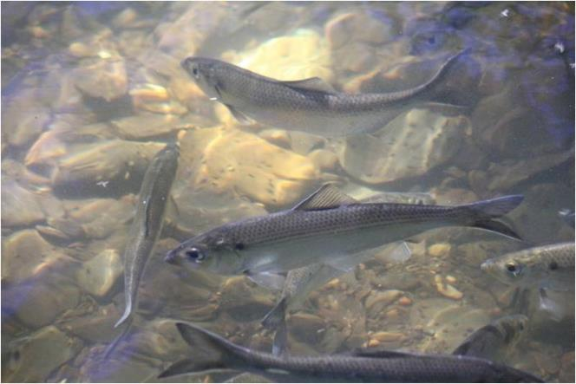
Dissolved Oxygen (D.O.)
Photosynthesis by aquatic plants contributes dissolved oxygen to water.
DO levels can change quickly and throughout the day – they are generally lowest in AM, highest at midday (why?).
How do you think cloudy weather would affect DO concentrations?
How about wind?
alewives – a species of river herring
DO is needed for:
  Respiration by animals, plants & bacteria
  Breakdown of organic material
…but how much is enough?

Slide 20
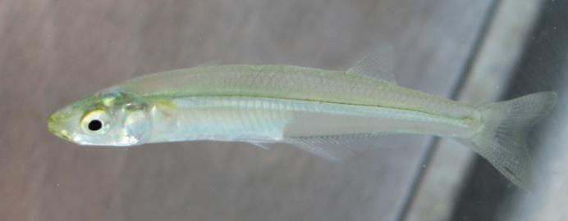
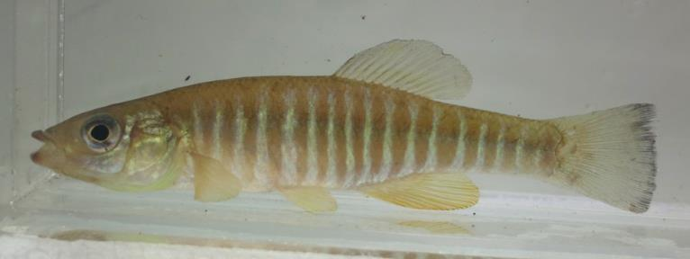
Dissolved Oxygen
Oxygen solubility in water is poor - cold fresh water only holds 14.2 mg/L when it is fully saturated. Warm water and saltwater hold less.
Atlantic silverside
Optimal DO for fish respiration is 5-11 mg/L.
With DO below 3 mg/L many fish can’t survive.
What is your prediction for your test site on Day in the Life?
banded killifish
Fun Fact: Comparing people and fish! People need ~200,000 mg/L of oxygen to breathe. Fish need ~5 mg/L.

Slide 21
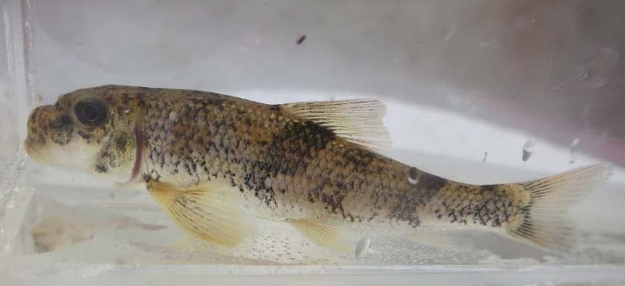
pH
Fish are very sensitive to pH - each species has an acceptable range for health & reproduction.
white sucker
Look at the pH of the Hudson River at your site. Is it:
neutral (7.0)?
pH measures how acid or alkaline (basic) a solution is. Water that is highly acidic OR highly alkaline can damage the skin, gills or eyes of fish.
acidic (<7.0)?
or alkaline (>7.0)?

Slide 22
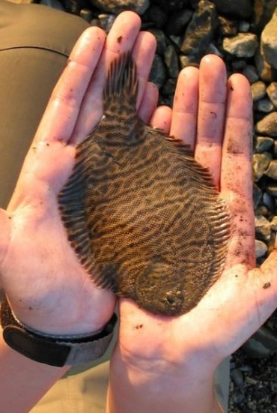
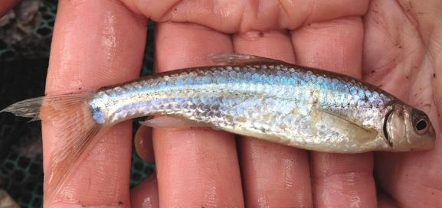
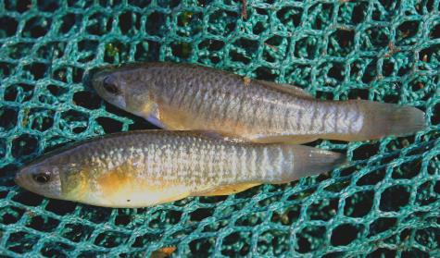
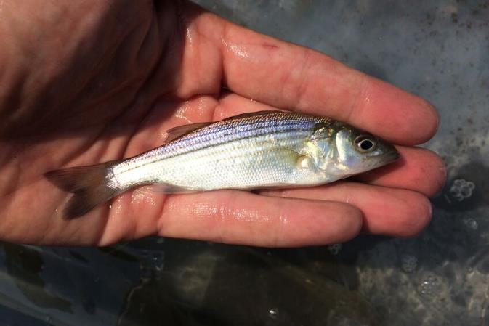
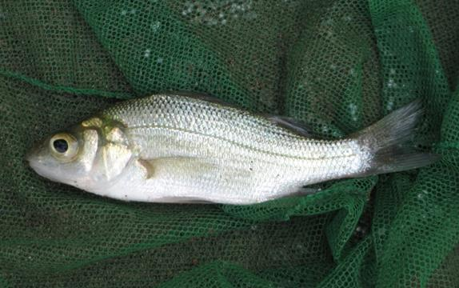
Fish: identify, measure, count.
spottail shiner
mummichog
hogchoker
striped bass
white perch

Slide 23
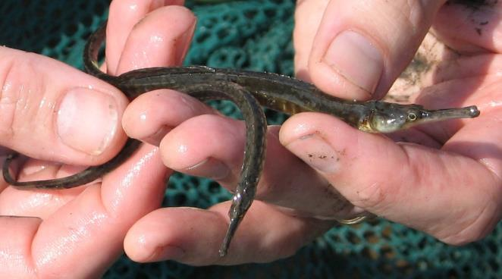
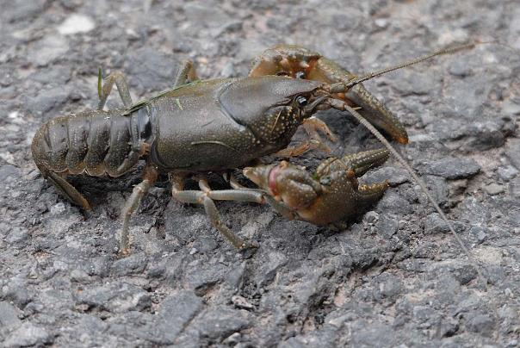
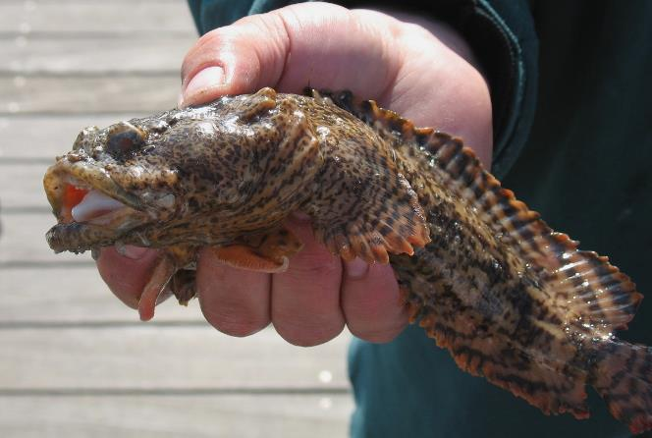
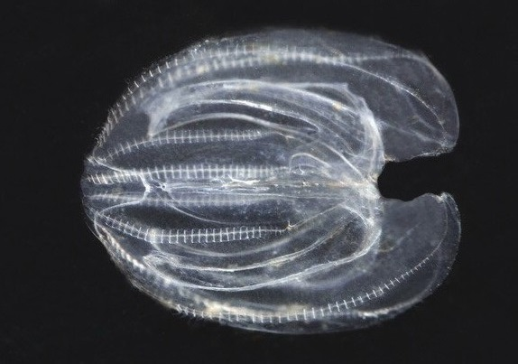
Depending on where you are, you might catch some odd creatures!
northern pipefish
crayfish
oyster toadfish
comb jelly

Slide 24
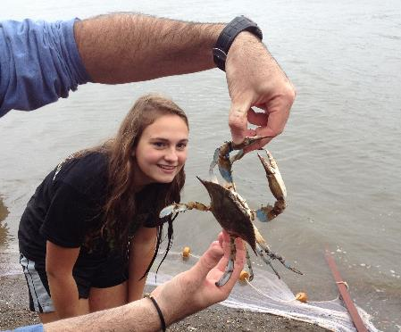
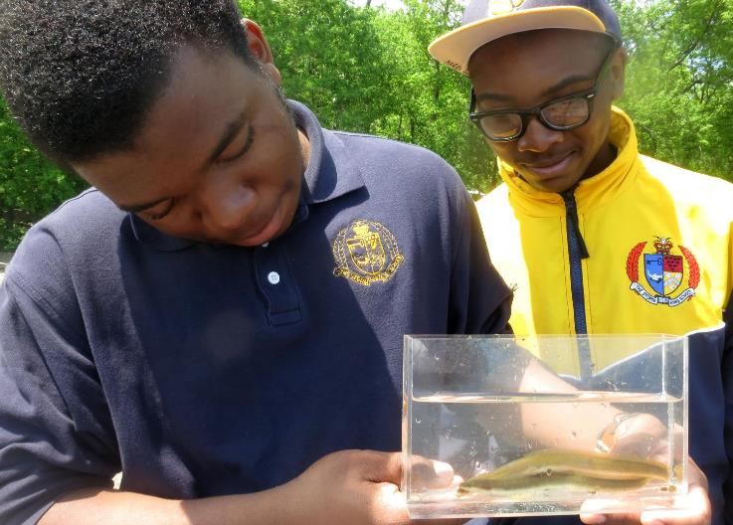
Look up information about species caught at your site
Blue crab (Callinectes sapidus – “beautiful swimmer”) Females are most common in the salty lower estuary; their eggs need salt water to hatch and develop. Males swim further upriver, sometimes all the way to the Troy Dam!
American eel (Anguilla rostrata) Born in the Atlantic Ocean, these fish swim into the freshwater Hudson and its tributaries to grow, then migrate back to the sea to spawn.

Slide 25
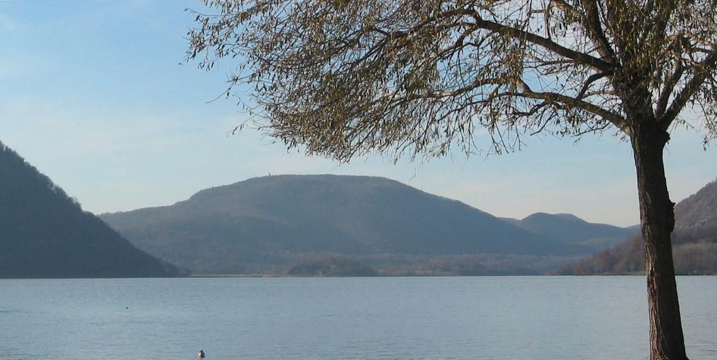
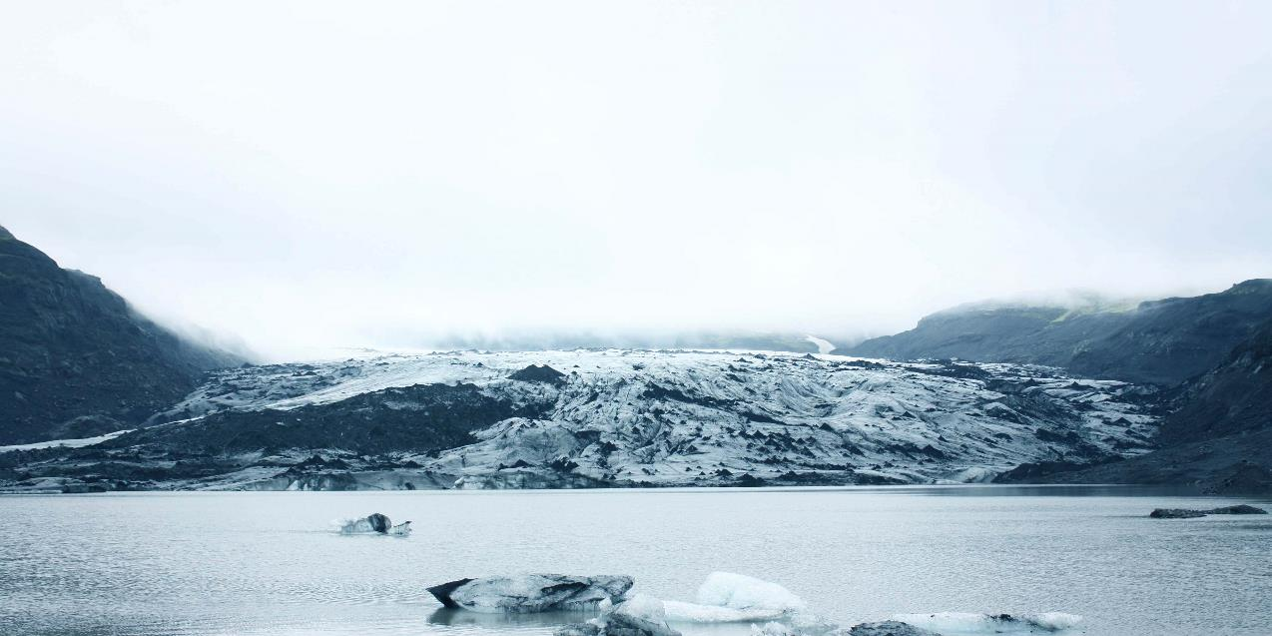
What’s at the Hudson’s bottom?
The Hudson has been around for many millions of years, but it hasn’t always looked the way it does now.
For example, glaciers once filled the river channel. These powerful sheets of ice carved the river bottom and shoreline.
Notes:
Click to fade from shot of glacier-filled valley to shot of Hudson north of Peekskill.

Slide 26
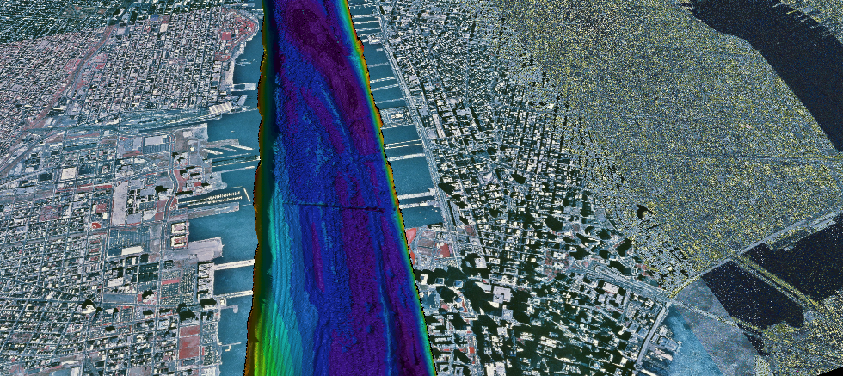



Mapping the Hudson’s bottom
The river bottom has ridges and trenches carved by the glaciers. Sediment has partly filled them in, but the river is still deep. The deepest places are dark blue; the shallowest yellow and red. Off Manhattan, the river is 20 meters or about 60 feet deep.

Slide 27
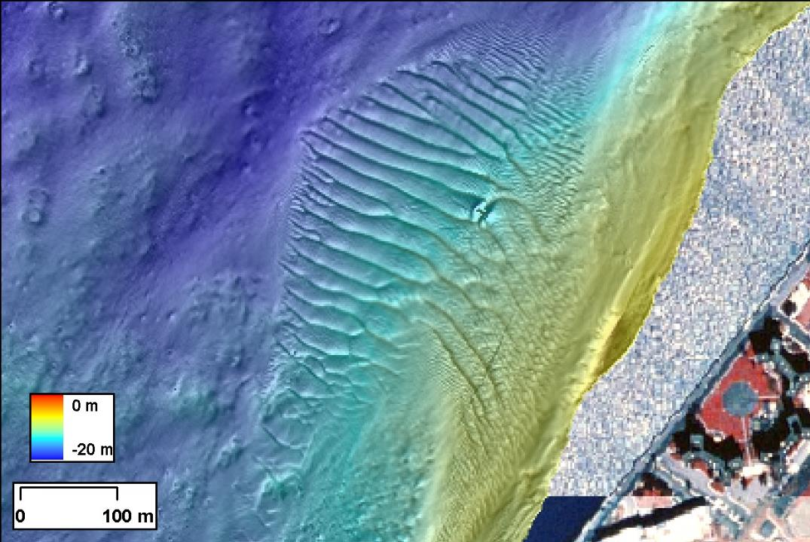
In this portion of New York Harbor, the bottom is dynamic - eroding in some areas, accumulating sediment in others. The top several centimeters of sediment can be constantly moving.
Sediments sometimes move like waves or sand dunes. Many of the waves shown here are 6 feet high - taller than most of us!

Slide 28
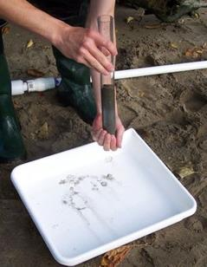
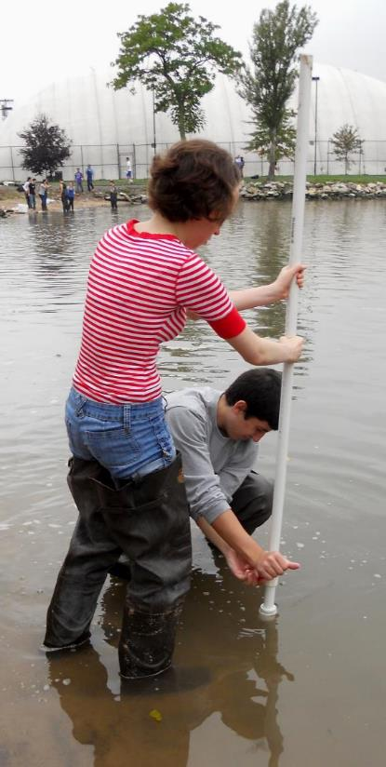
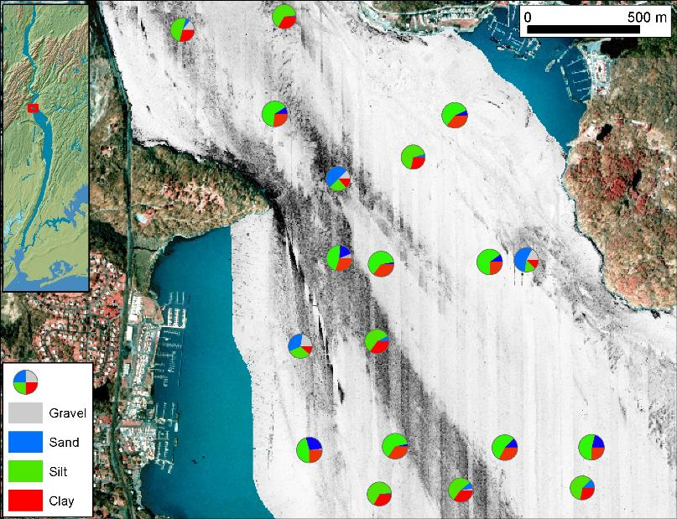
We will examine the bottom of the river by taking a small core
Cores are used to study the history of the river bottom & describe habitats.

Slide 29
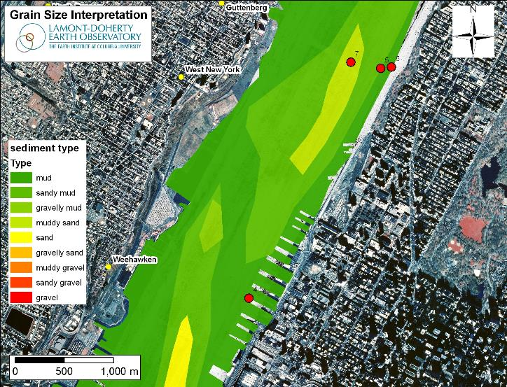

Sediments enter the estuary mainly from the upper river, tributaries, & runoff. Some also enters from the ocean.
You will describe the sediments you collect.
Sediments suspend in some areas, settle & fill in others.
In areas with slow currents, sediments drop out of the water, settling into deep piles of soft mud.
Areas subject to swift currents or wave action erode and are hard bottomed or gravelly.
What is your site like?

Slide 30




Physical Environments
Assess physical conditions at your site. Is it:
a marsh?
a pier?
a sandy beach?
lined with rip-rap?

Slide 31

We will describe habitats and identify plants

Slide 32


Describing your site so that other classes can visualize it
Your description can help explain some of your data.
This site is on the Harlem River in Manhattan. Would the water be salty or fresh? How might salinity and the presence of marsh plants influence the species of fish found here?
Lots of mummichogs!

Slide 33


spottail shiners
This is the beach at Kowawese, located at River Mile 58 near Newburgh. How would this site be different from the one in the previous slide? What might be caught here?

Slide 34

Shipping on the River
The river is used by large ships, tugboats, and barges. Record their passage by your site.
If other sites report the same vessels, you will be able to calculate how fast they were going.

Slide 35

Journaling
Write down observations about what you see and what might have influenced your findings. Make a sketch. This is scientific journaling, a key part of scientific data collection.

Slide 36


After all your hard work, make sure your results are sent in to be shared with other classes!
Report your data!

Slide 37

Compare your results to data from HRECOS
Hudson River Environmental Conditions Observing System

Slide 38


HRECOS Current Conditions page
Use dropdown menus to choose station, parameter, etc. Choose Units and whether to plot Continous readings or Daily averages. Use Start Date/End Date or Set Start/Set End to choose dates (within limits - click ? for more details). Plot one parameter or compare two in one graph.

Slide 39

And one last piece about the day…
HAVE FUN!!

