Slide 1
Asian Monsoon Variability over the Past Millennium Reconstructed from Long Tree-Ring Records: the Monsoon Asia Drought Atlas, version 2 (MADAv2)
Edward R. Cook
Tree-Ring Laboratory
Lamont-Doherty Earth Observatory
of Columbia University, New York
AGU Chapman Conference
Evolution of the Asian Monsoon and its Impact
on Landscape, Environment and Society:
Using the Past as the Key to the Future
Hong Kong SAR, China
June 14-18, 2015

Slide 2
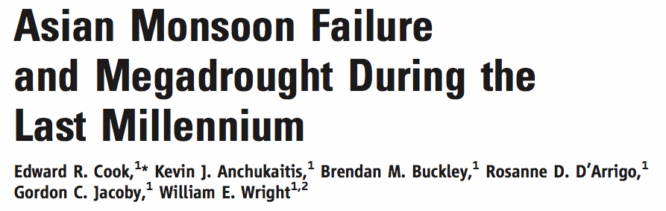
Reconstructing Asian Monsoon Climate Dynamics:
Monsoon Asia Drought Atlas (MADAv1)
A U.S. National Science Foundation sponsored project “Tree-Ring Reconstructions of Asian Monsoon Climate Dynamics” began in August, 2004 and finished in 2009. It resulted in a paper published in Science:

Slide 3
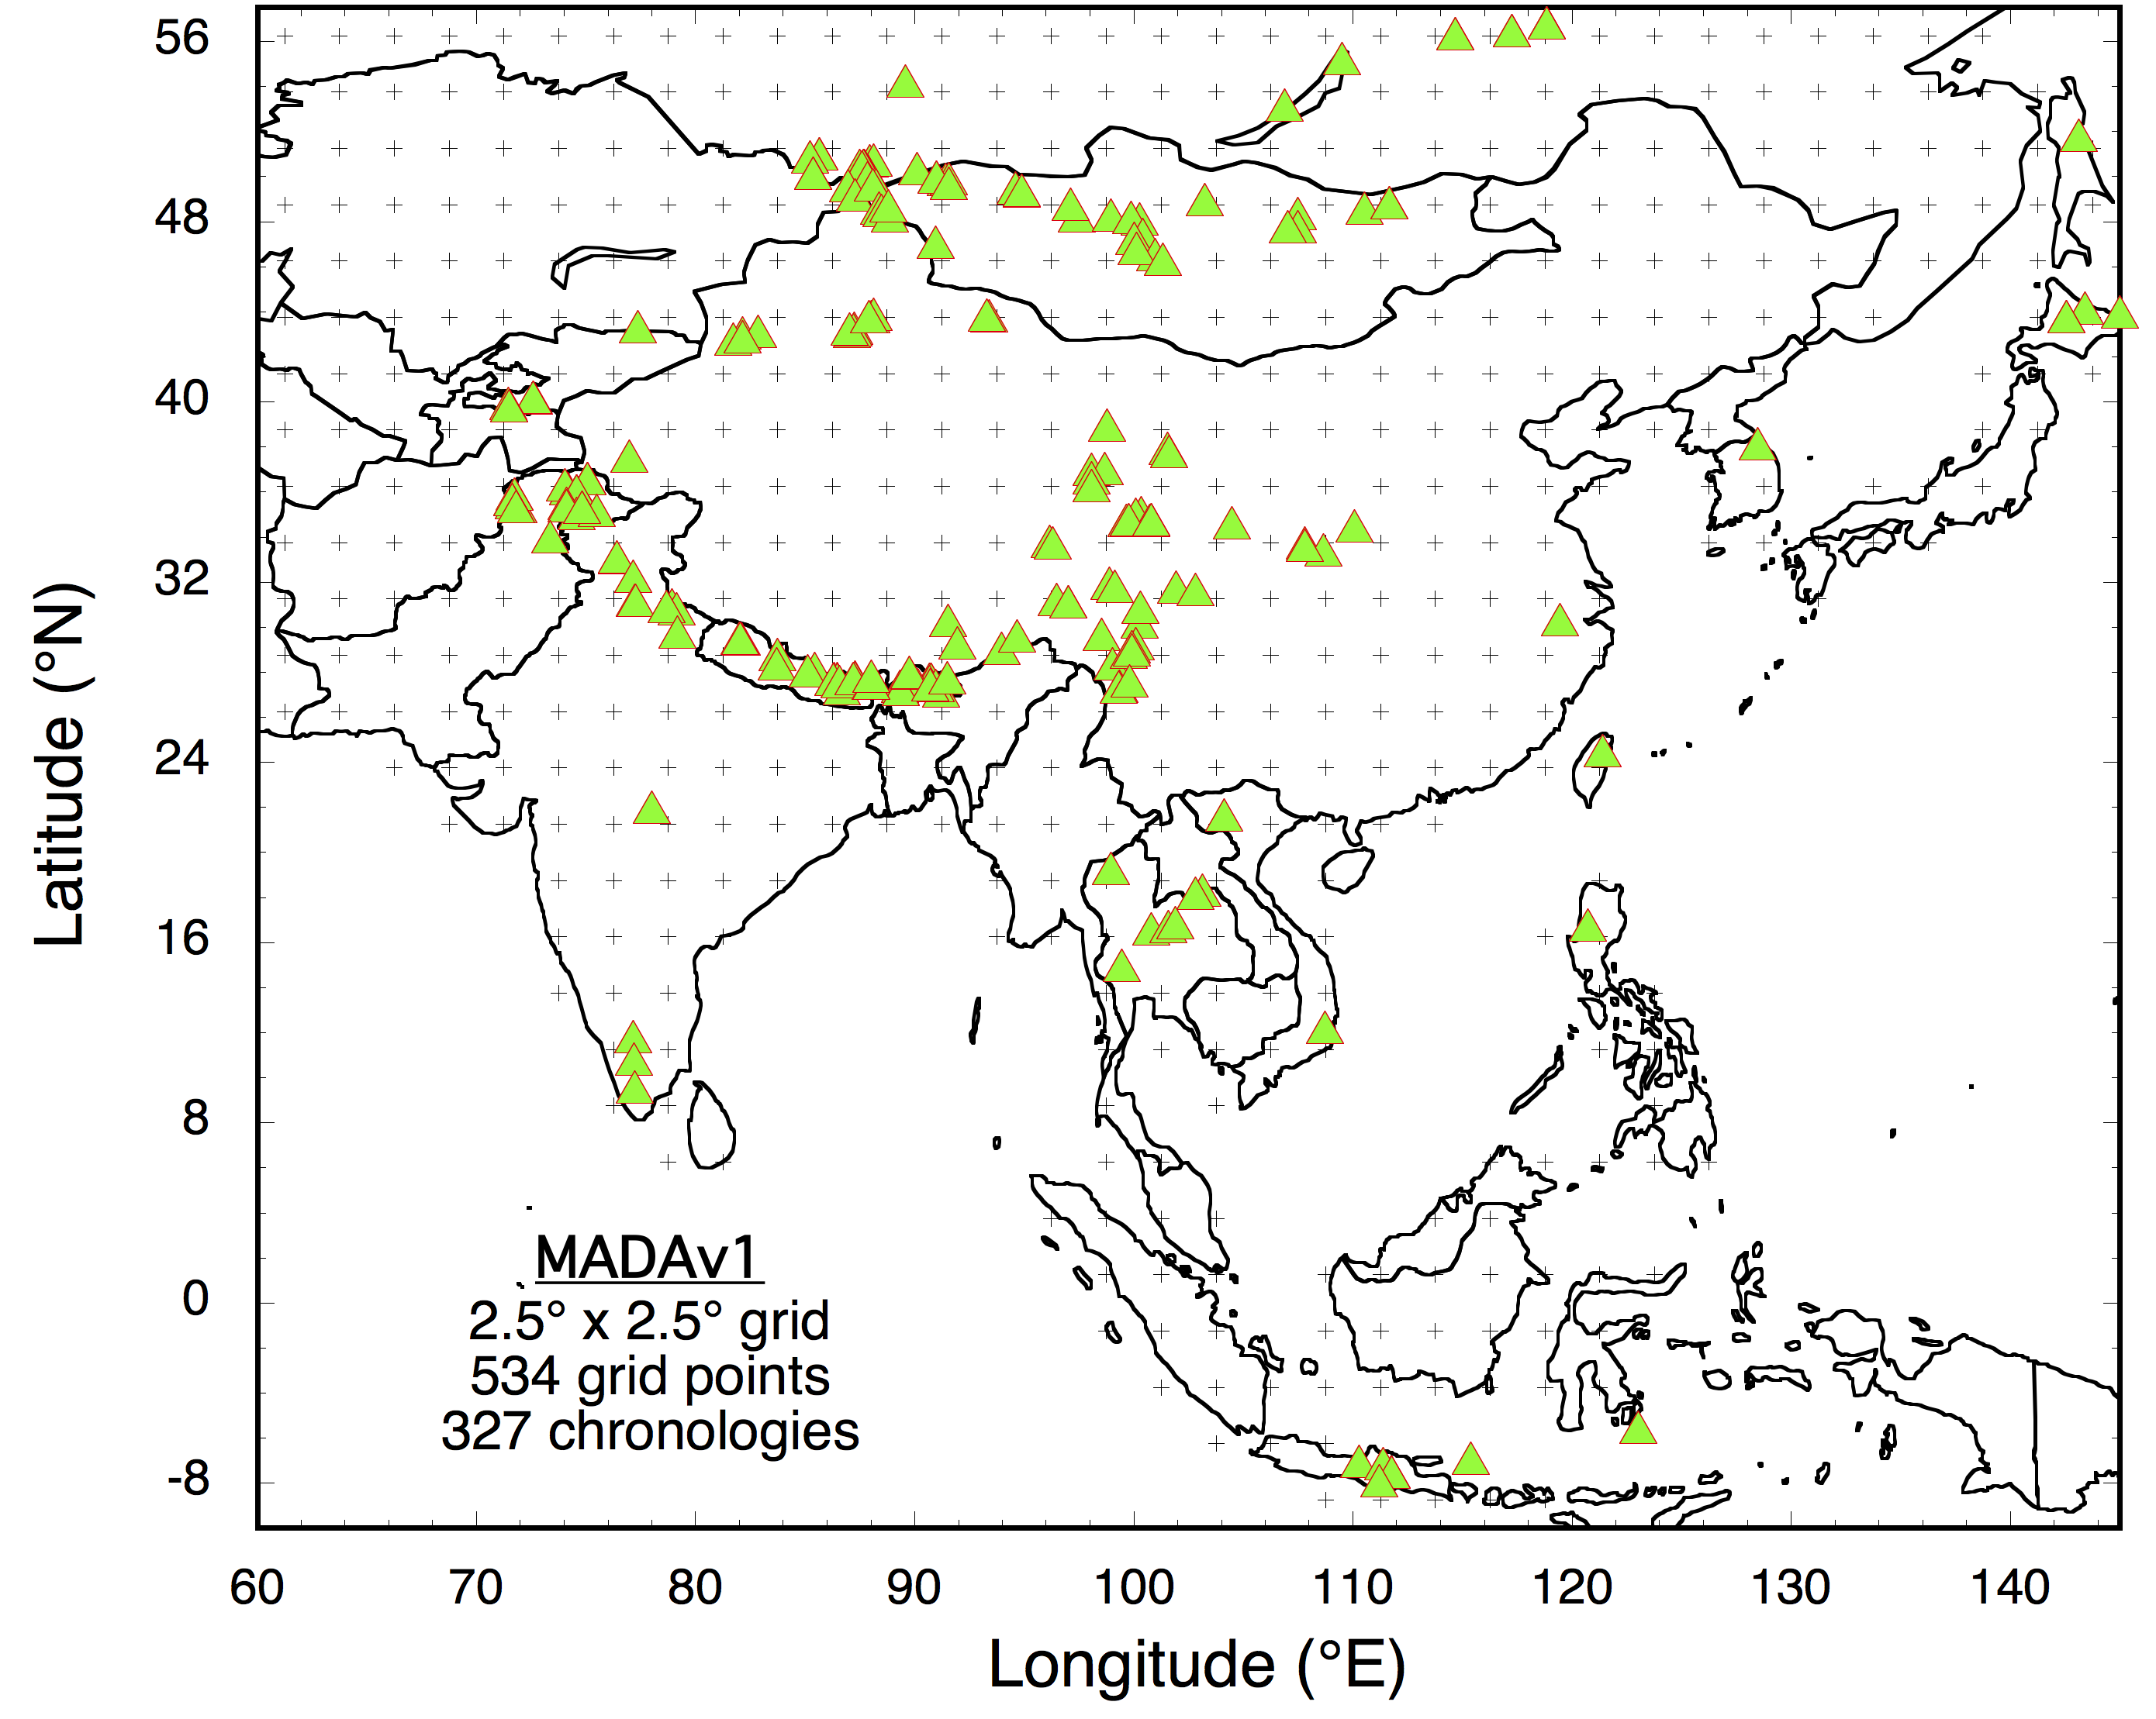
MADAv1
Patterned after the highly successful North American Drought Atlas (NADA; Cook and Krusic, 2004);
Gridded monsoon season (JJA) Palmer Drought Severity Index (PDSI) reconstructed on a 534 point 2.5° x 2.5° grid from 327 tree-ring chronologies over Asian monsoon land areas;

Slide 4
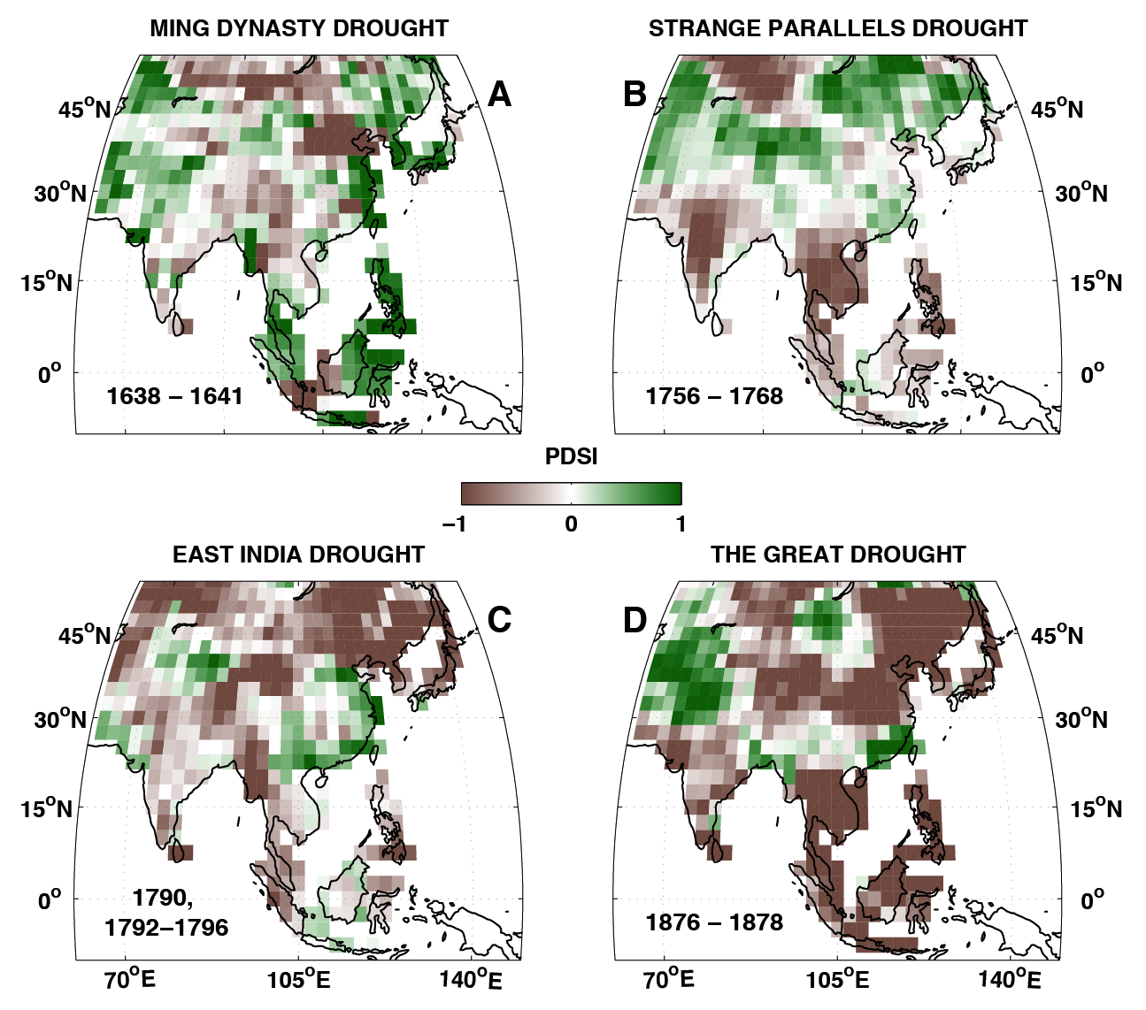
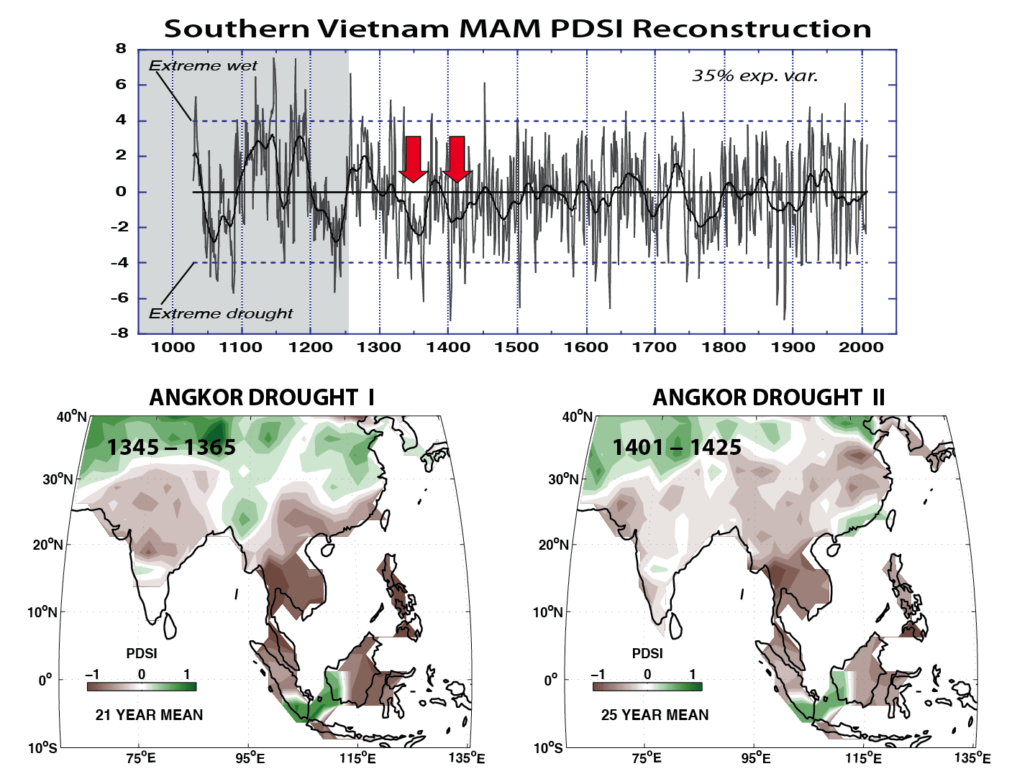
MADAv1
Historical droughts reconstructed in full spatial detail (Cook et al., 2010); previously unknown culturally important droughts were discovered and described (e.g. Buckley et al., 2010).
Cook et al. 2010. Science.
Buckley et al. 2010. PNAS.

Slide 5
MADAv1
Large-scale forcing of Asian monsoon climate by explosive volcanism was identified; climate model deficiencies revealed.
Superposed Epoch Analysis Results
Anchukaitis et al. 2010. GRL.

Slide 6
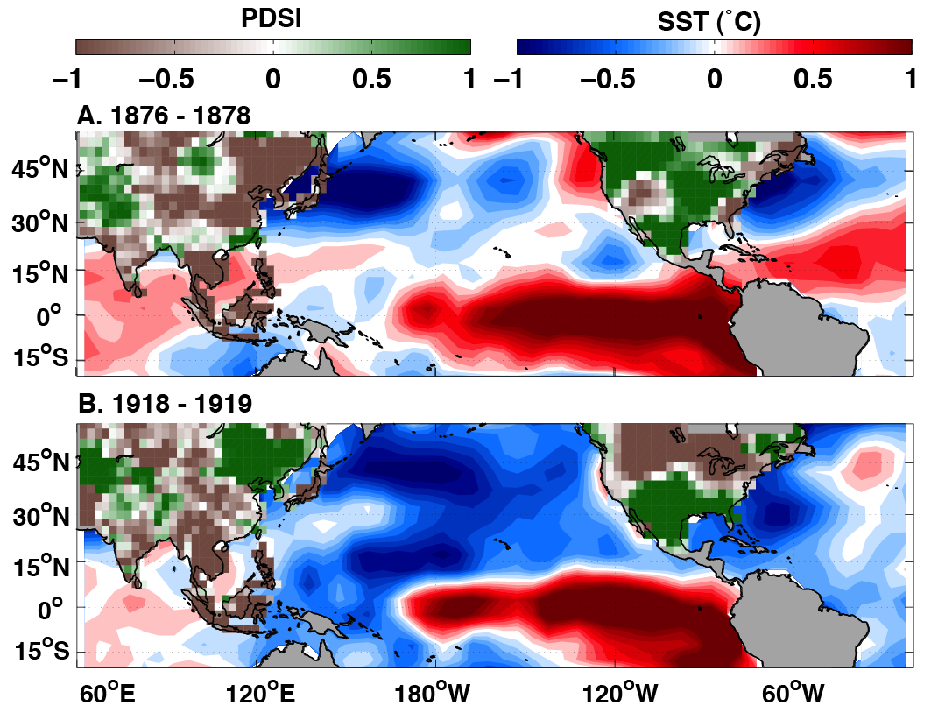
MADAv1
Trans-Pacific basin ocean-atmosphere teleconnections between continents due to ENSO were revealed in two known El Niños.
Cook et al. 2010. Science

Slide 7
Now on to the Monsoon Asia Drought Atlas, version 2 (MADAv2)

Slide 8
MADAv2
The Asian monsoon metric reconstructed: the monsoon season (JJA) self-calibrating Palmer Drought Severity Index (scPDSI);
scPDSI data source: van der Schrier, G., et al. 2013. A scPDSI-based global data set of dry and wet spells for 1901–2009. JGR Atmospheres 118:4025–4048. [updated to 2012]
The target field: June-July-August (JJA) average scPDSI on a 2732 point 1.0° x 1.0° grid; >5x the resolution of MADAv1
Proxy data set: 444 tree-ring chronologies – 327 from MADAv1 and most others from PAGES Asia2k project;
The method of reconstruction: Ensemble Point-by-Point Regression (EPPR) – a total of 32 ensemble members.
Calibration period: 1951-1989, Validation period: 1920-1950.

Slide 9
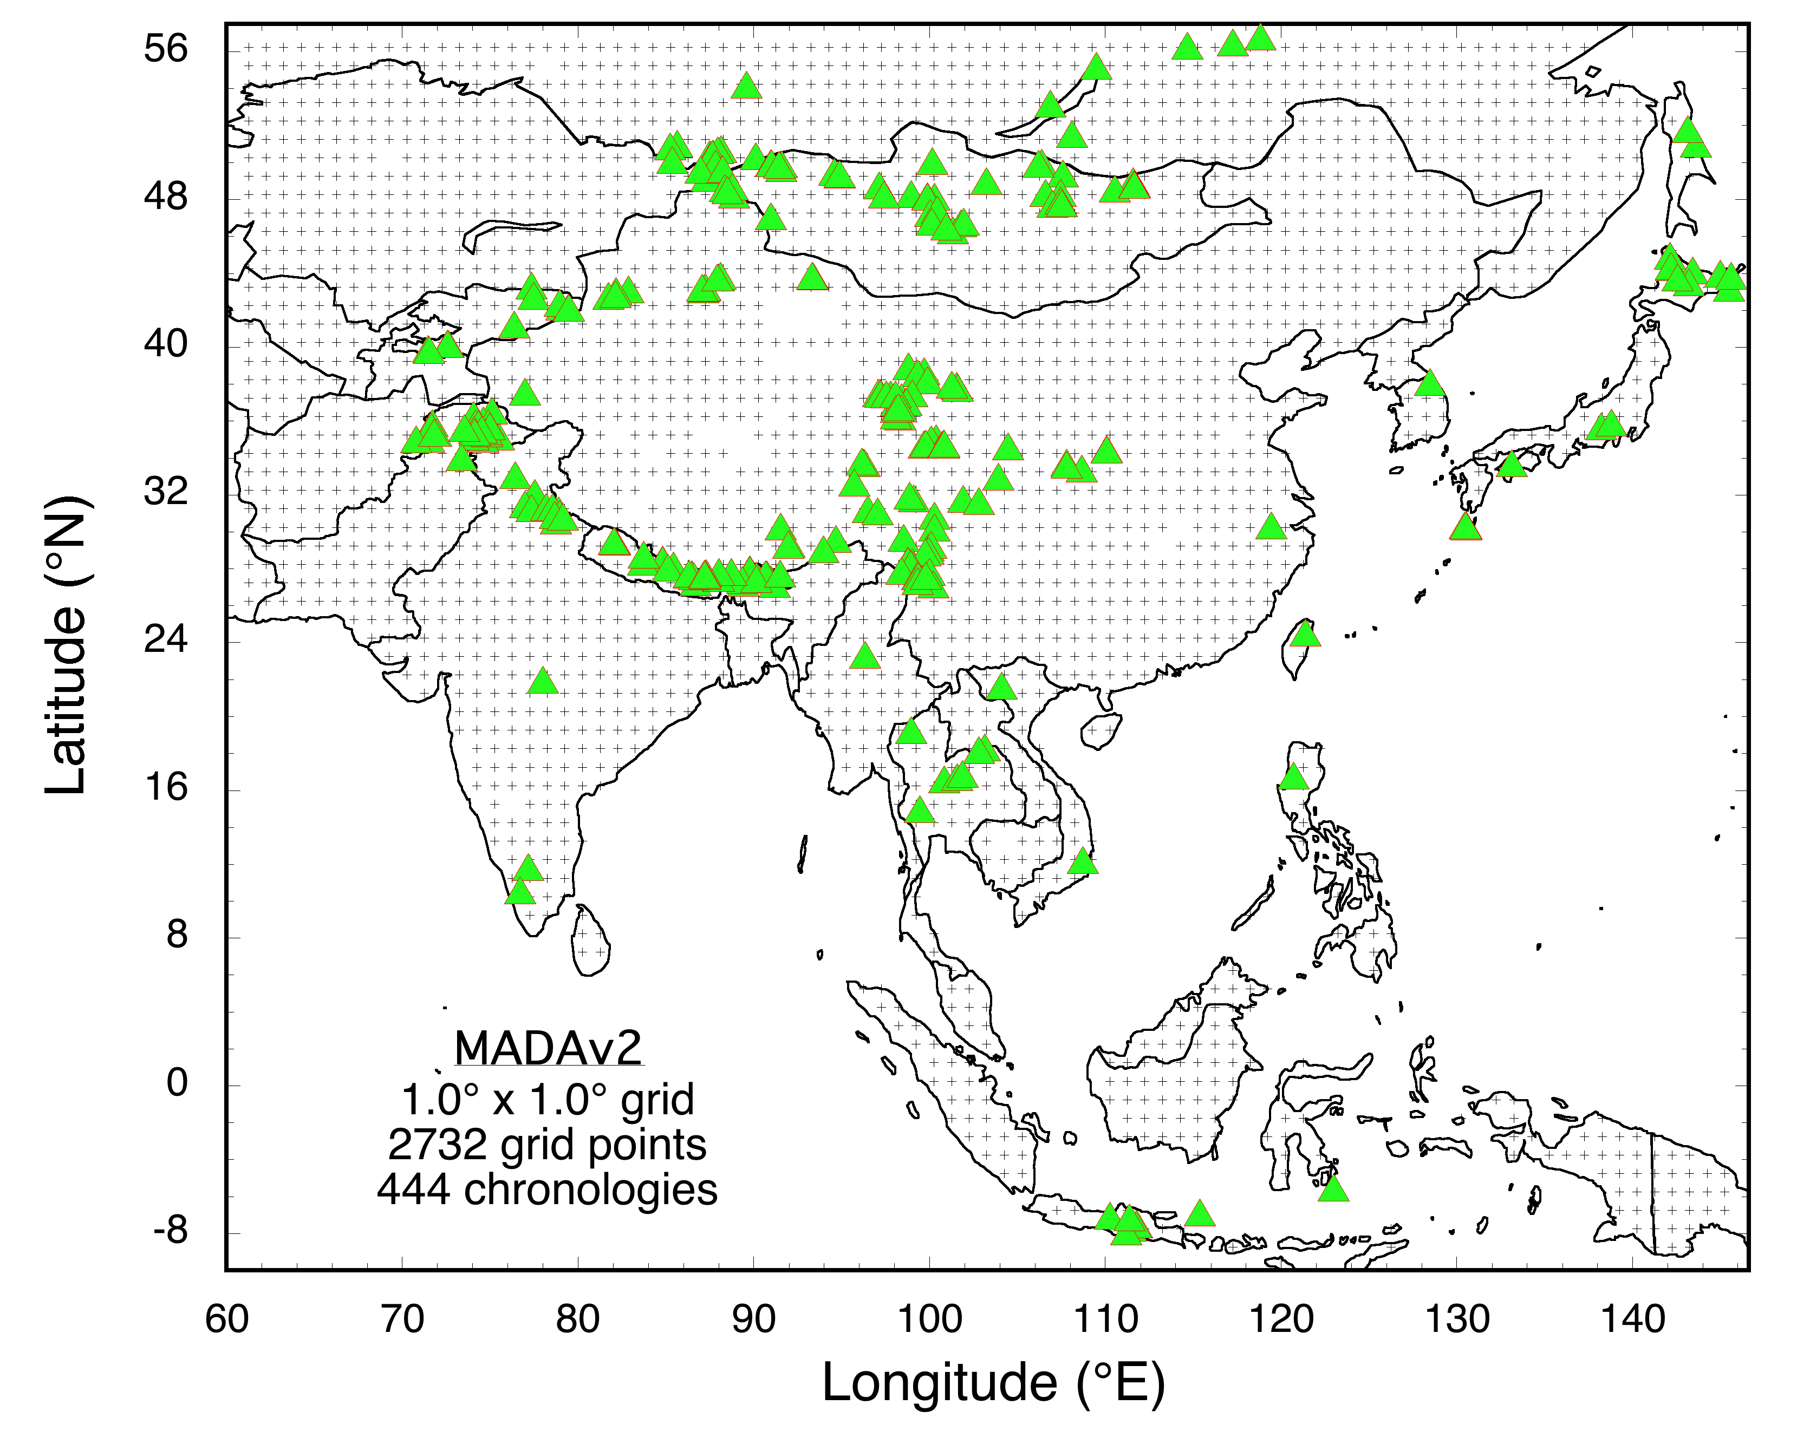
A New Monsoon Asia Drought Atlas: MADAv2

Slide 10
32-Member Ensemble Mean Calibration/Validation Statistics:
Comparable to MADAv1

Slide 11
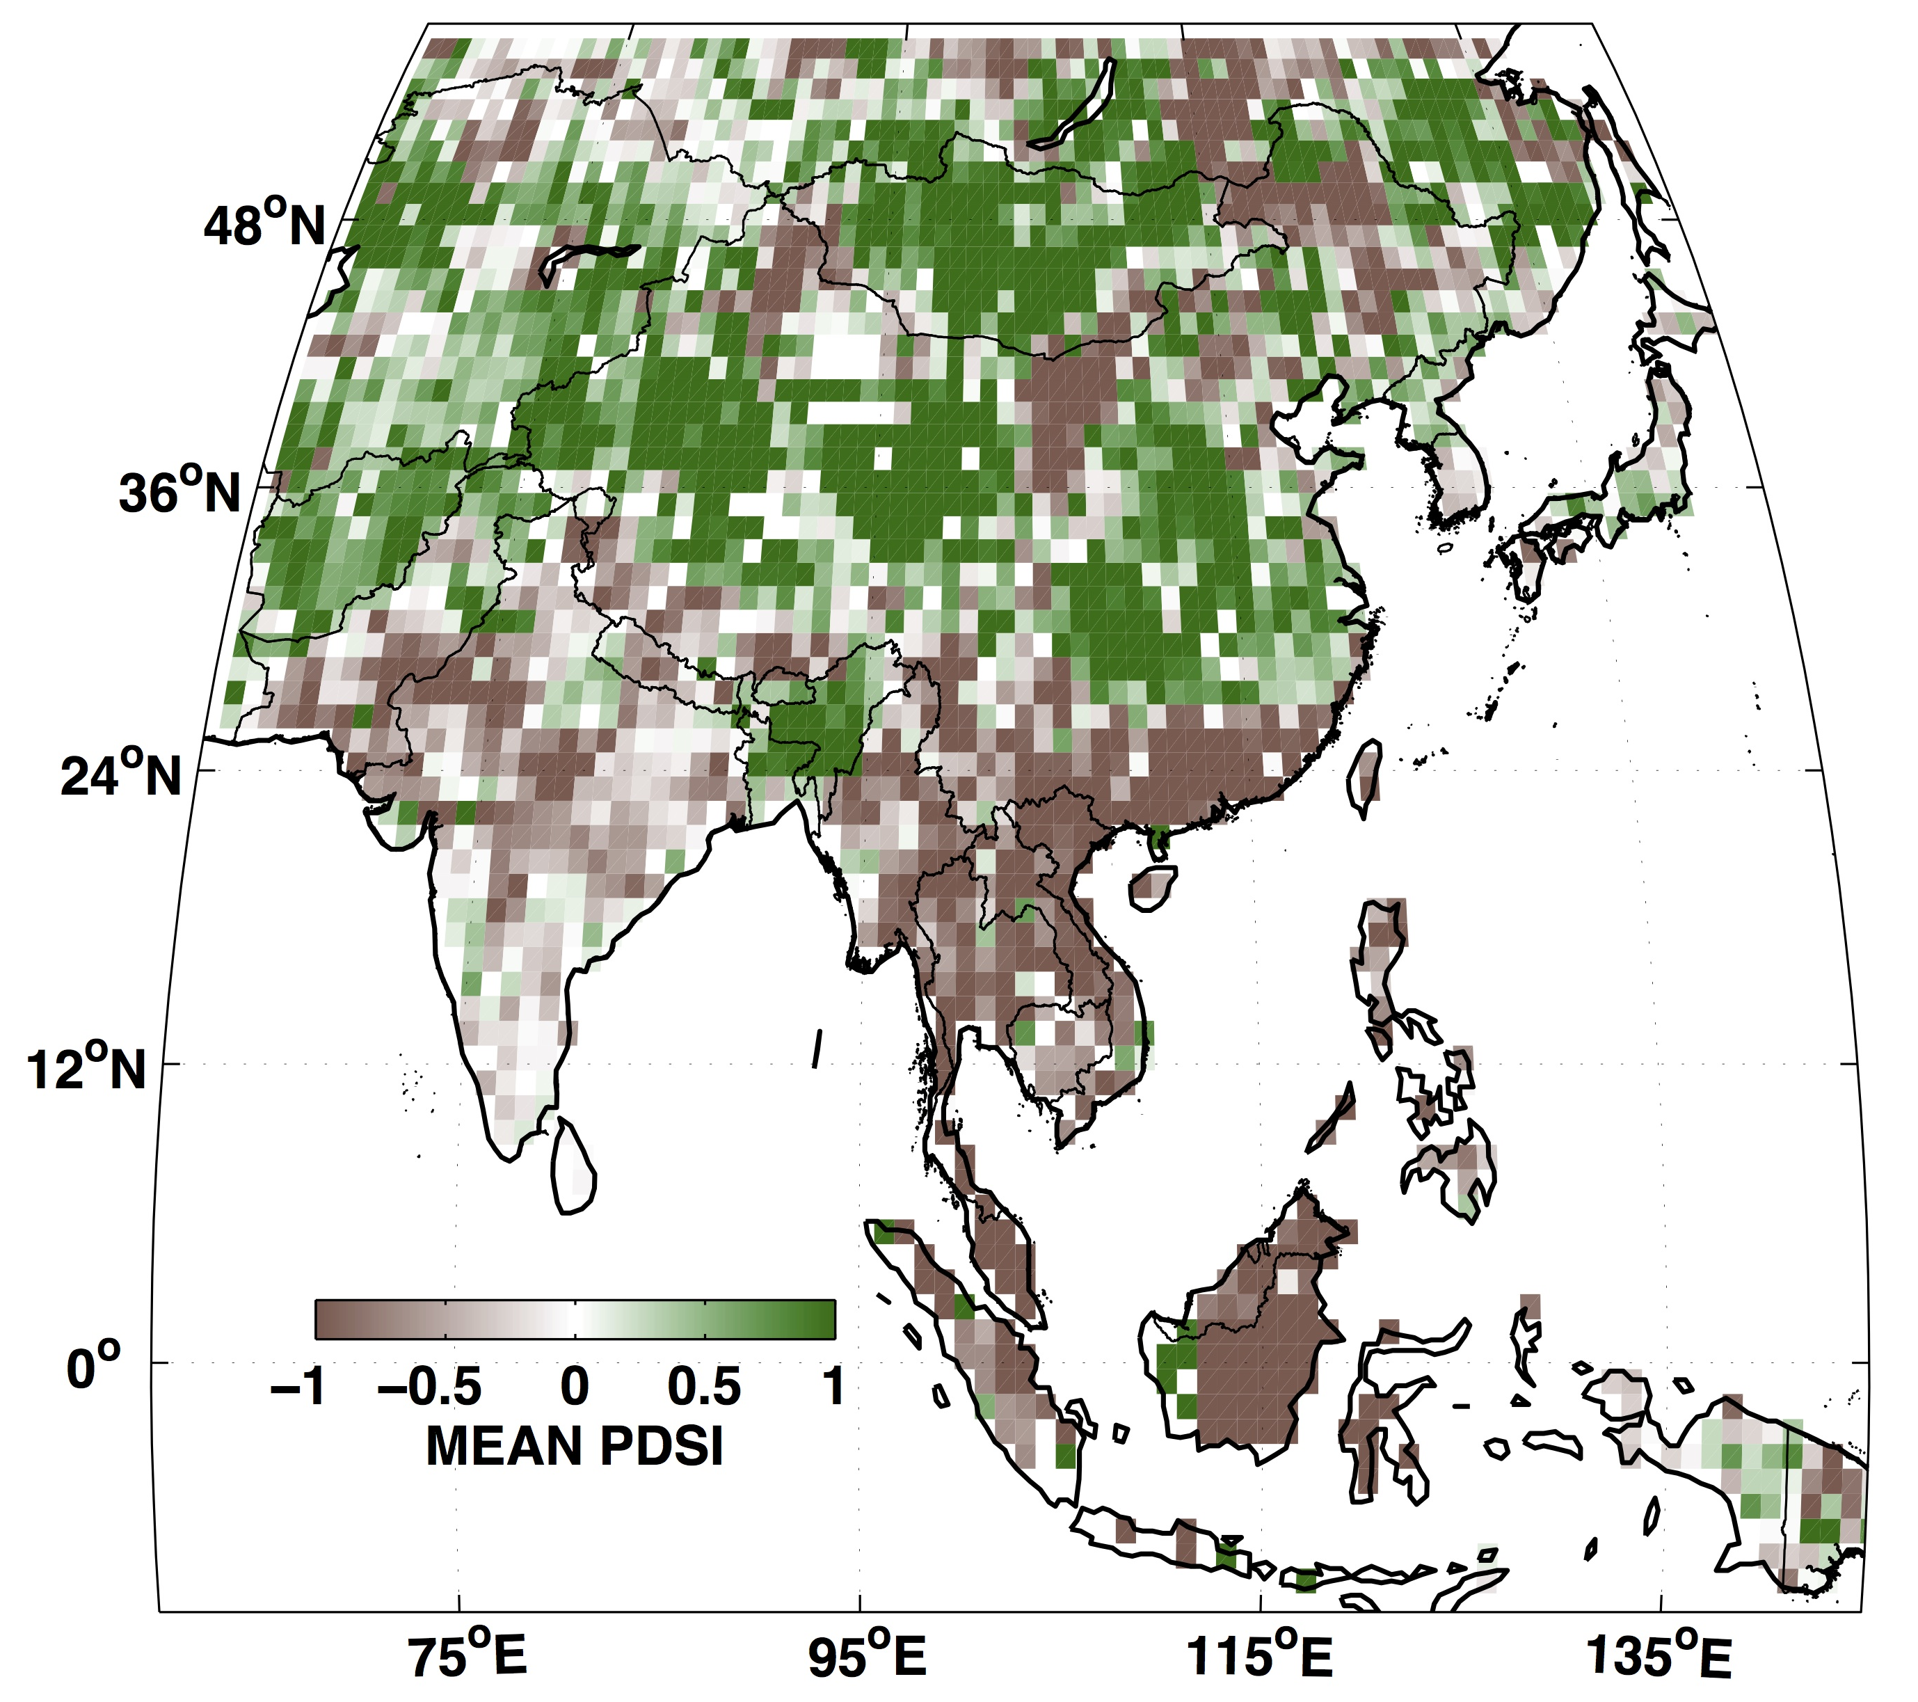
MADAv2 replicates MADAv1 droughts
but in more spatial detail
Example: Angkor Drought 1: 1345-1365 CE
MADAv1
MADAv2
Buckley, B.M., Anchukaitis, K.J., Penny, D., Fletcher, R., Cook, E.R., Sano, M., Nam, L.C., Wichienkeeo, A., Minh, T.T. and Hong, T.M. 2010. Climate as a factor in
the demise of Angkor. PNAS 107(15):6748-6752.

Slide 12
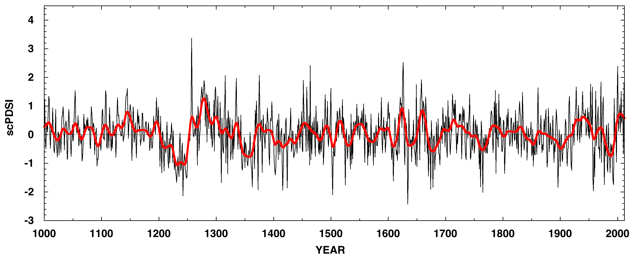
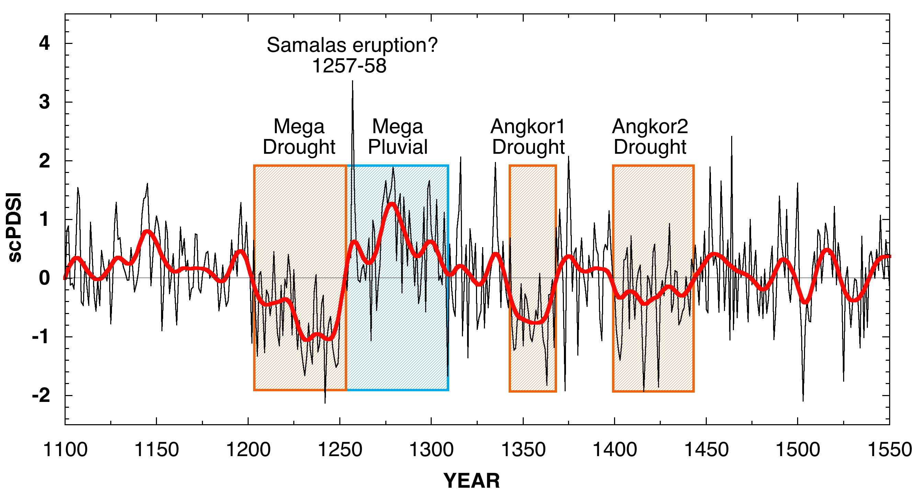
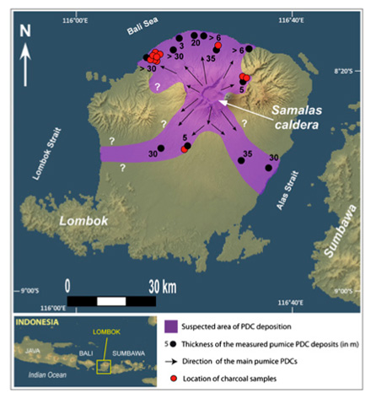
Southeast Asia drought reconstructed by MADAv2
*First described in
Buckley et al. 2010
*Buckley et al. 2010. Climate as a factor in the demise of Angkor. PNAS Supporting Information.

Slide 13
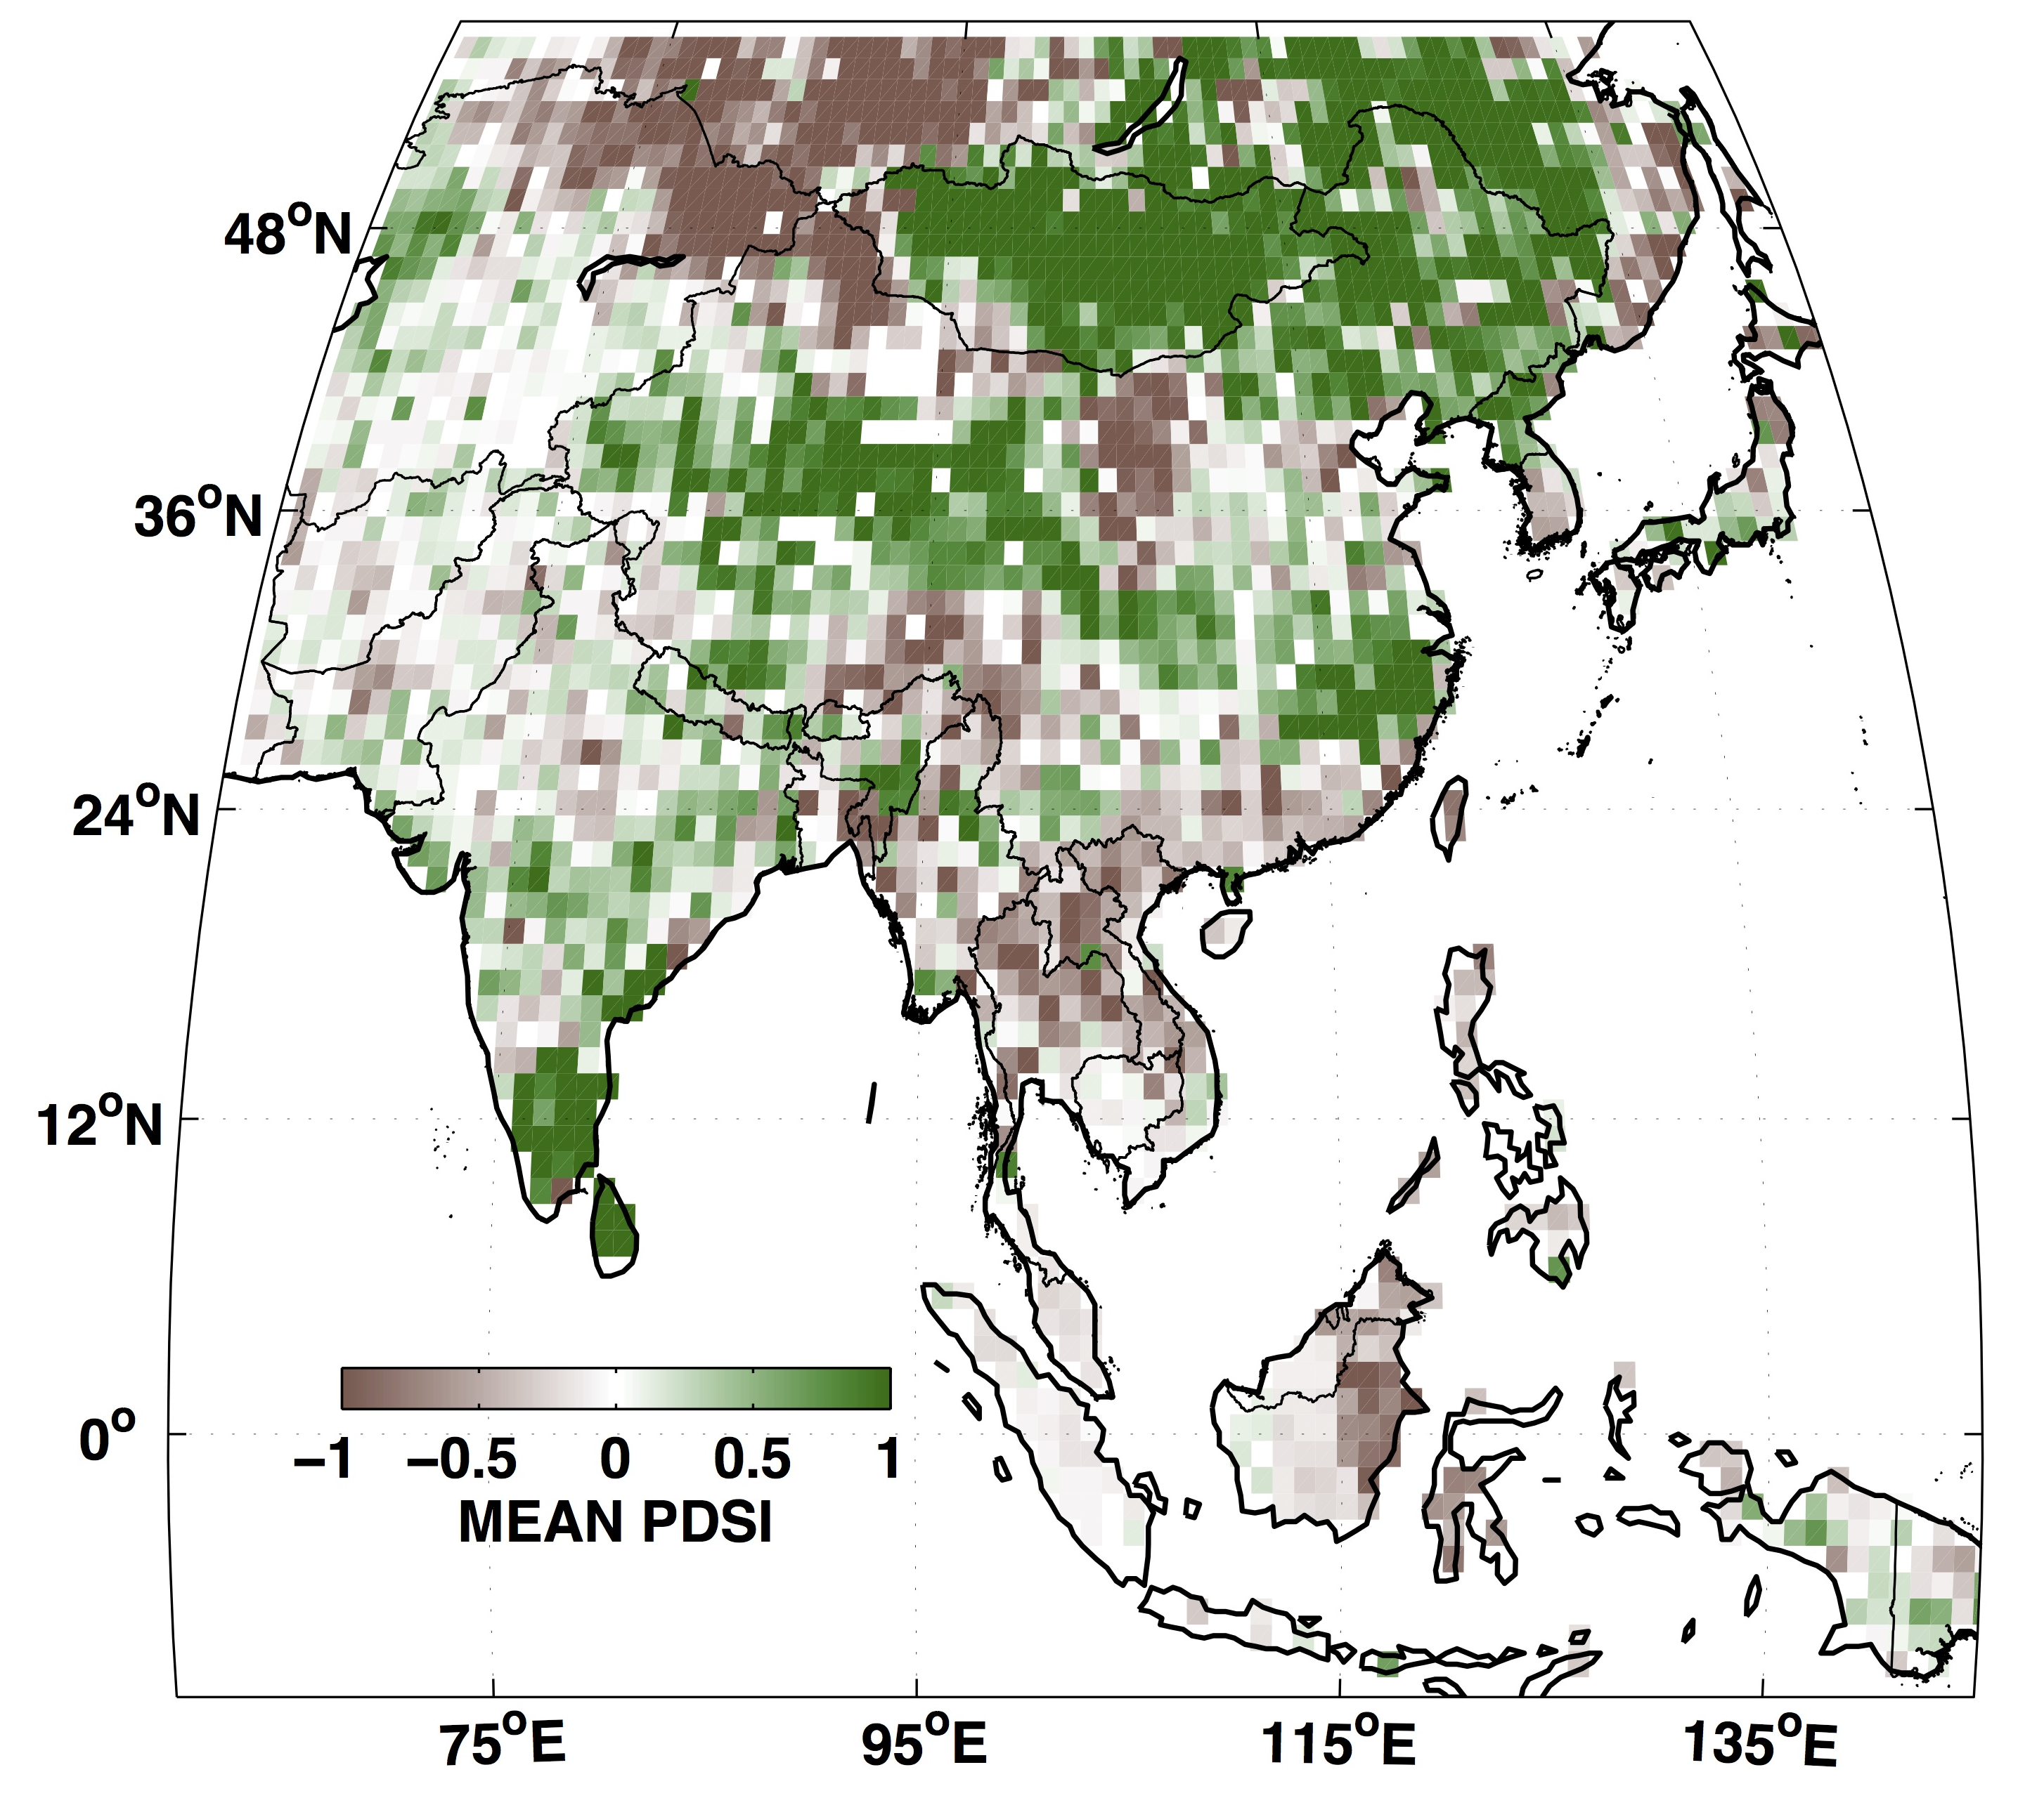

Pederson/Hessl Mongol Pluvial: 1211-1225 CE
MADAv2 puts it in more complete spatial context
Ghengis Khan
Pederson, N., Hessl, A.E., Baatarbileg, N., Anchukaitis, K.J. and Cosmo, N.D. 2014. Pluvials, droughts, the Mongol Empire, and modern Mongolia. PNAS 111(12):4375-4379.

Slide 14
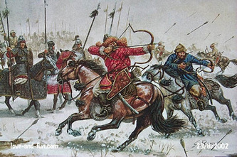
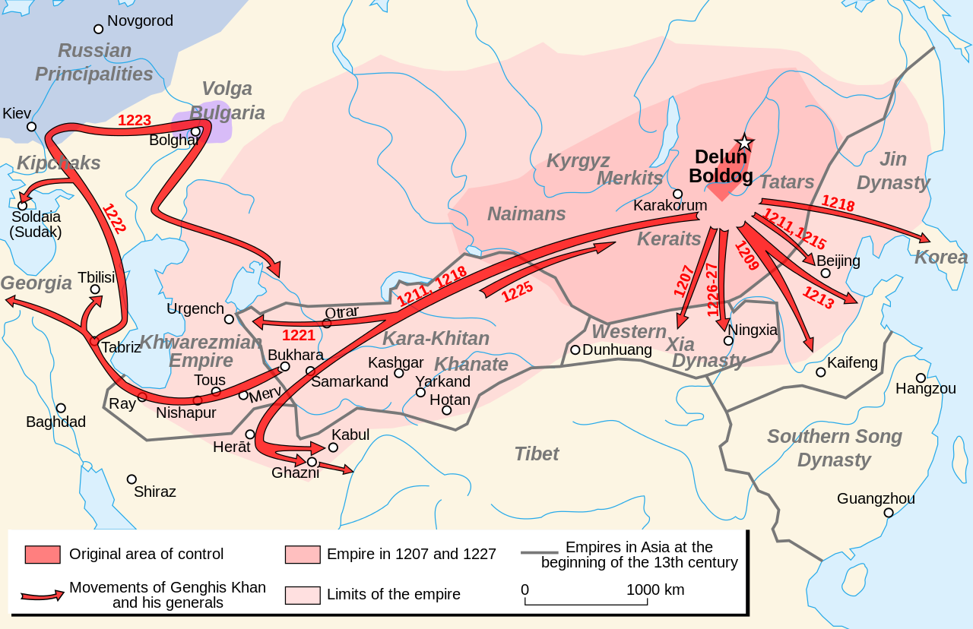
Pederson/Hessl Mongol Pluvial: 1211-1225 CE
MADAv2 puts it in more complete spatial context
Ghengis Khan
Take the wetter route.
The horses like it!
Pederson, N., Hessl, A.E., Baatarbileg, N., Anchukaitis, K.J. and Cosmo, N.D. 2014. Pluvials, droughts, the Mongol Empire, and modern Mongolia. PNAS 111(12):4375-4379.

Slide 15
Now for Some Climatological Analyses of MADAv2

Slide 16
EOF analysis indicates large-scale patterns in MADAv2:
EOF1 – very robust North-South dipole structure
LOADINGS
PC1 10%
Wet
India
Dry
India
EOF1
(a) MADAv1
EOF1
EOF1
EOF1
From Fallah, B. and U. Cubasch. 2015. A comparison of model simulations of Asian mega-droughts
during the past millennium with proxy reconstructions. Climate of the Past 11:253-263.

Slide 17
EOF analysis indicates large-scale patterns in MADAv2:
EOF1 – associations with SST Forcing
LOADINGS
PC1 10%
Wet
India
Dry
India
EOF1
JFM SSTs
MAM SSTs
JJA SSTs
Stronger
Weaker
Correlation
Correlation
Correlation
Figures courtesy of Kevin Anchukaitis

Slide 18
EOF analysis indicates large-scale patterns in MADAv2:
EOF5 – associations with SST Forcing
LOADINGS
PC5 3.4%
Wet
SE Asia
Dry
SE Asia
EOF5
JFM SSTs
MAM SSTs
JJA SSTs
Weaker
Stronger
Correlation
Correlation
Correlation
Figures courtesy of Kevin Anchukaitis

Slide 19
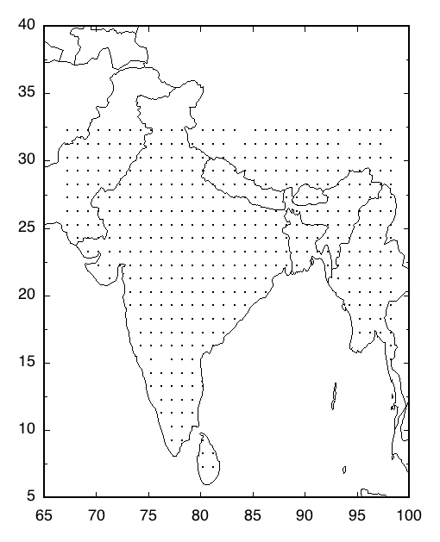
Regionally, how does MADAv2 relate to rainfall over India by
monsoon: Southwest (Jun-Aug) and Northeast (Oct-Dec)?
Five regions
plus All India

Slide 20
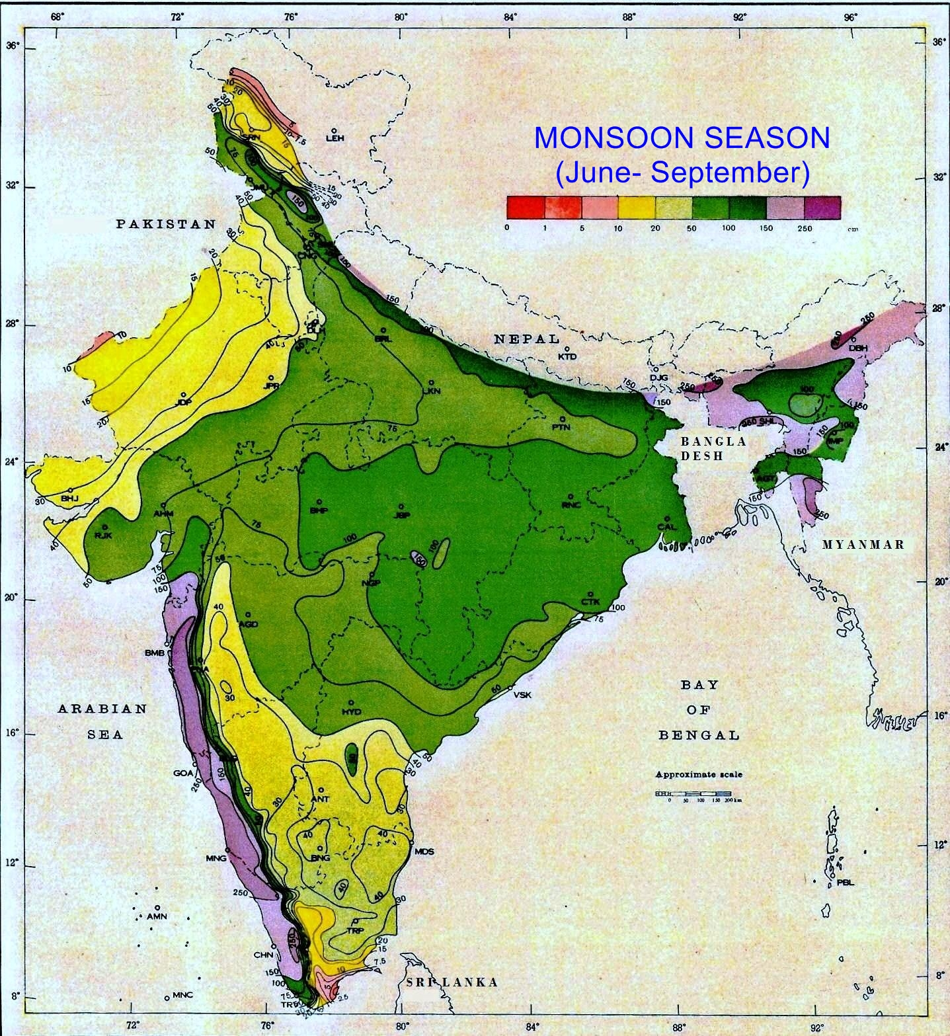
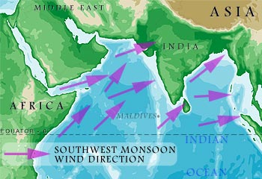
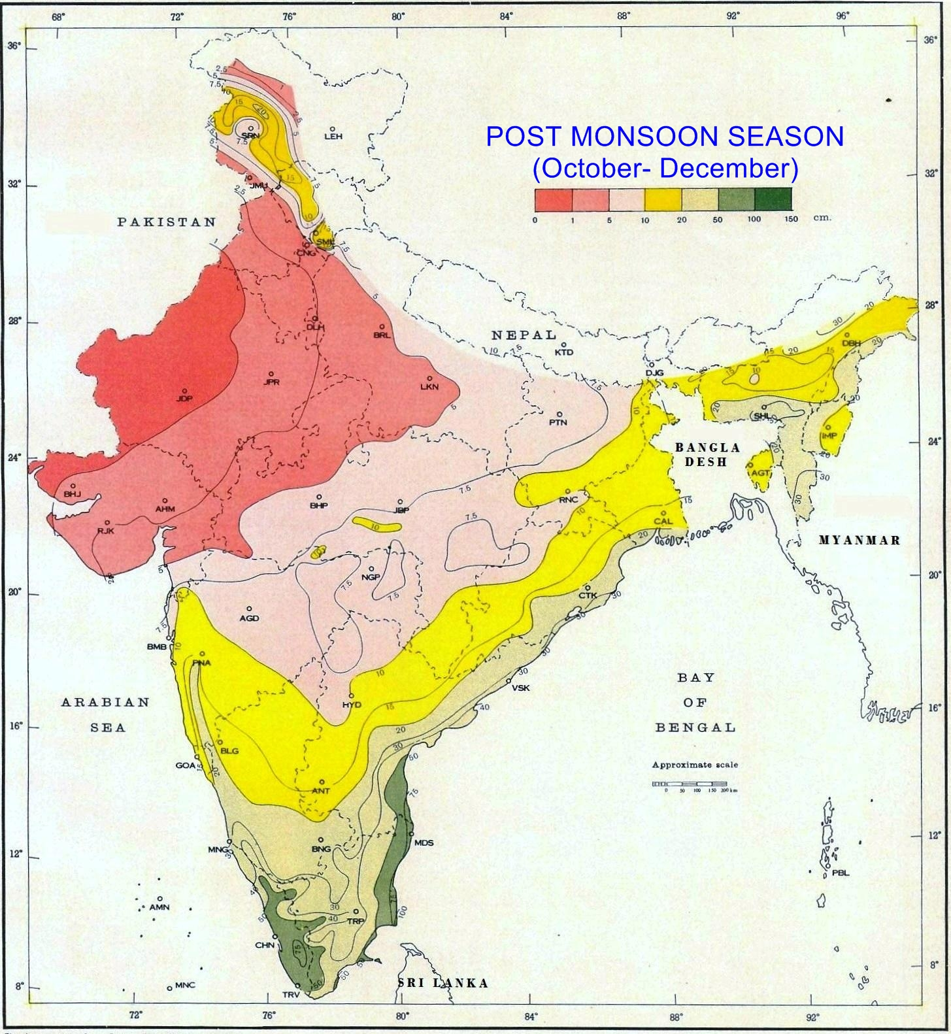
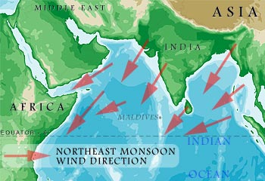
Southwest and Northeast Monsoons
Distinctly different rainfall patterns over India

Slide 21
Correlations presented now between MADAv2 and rainfall over India: All India and Five Regions
Northeast Monsoon: Previous Oct-Dec (OND) rainfall over India is correlated to make it causally associated with following year JJA scPDSI – soil moisture carryover;
Southwest Monsoon: Current Jun-Aug (JJA) rainfall is correlated to match its season with JJA scPDSI;
Monsoon combined (OND and JJA) rainfall with the intervening months added is correlated: Previous Oct to current Aug (OtA) rainfall more closely mimics the slower changes in soil moisture that are part of the PDSI algorithm – prescribed month-to-month Markovian persistence in it is 0.897.
All correlations are based on data from 1871 to 1950 – completely independent of any calibration period fitting bias.

Slide 22
Correlations between gridded JJA scPDSI Recons and India Rainfall
Pre-calibration 1871-1950, OND, JJA, OtA Correlated Over All Regions
All
India
corrs
r with
1-tailed
p<0.10
shown
Five
Regions
corrs
Correlation

Slide 23
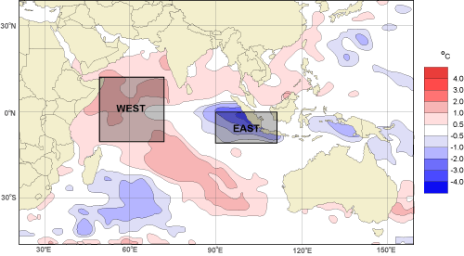
The Indian Ocean Dipole (IOD) and Its East-West SST Poles:
How much does it show up in MADAv2?
WIO
SEIO
IOD = WIO - SEIO
From http://www.bom.gov.au/climate/IOD/about_IOD.shtml

Slide 24
Correlations between MADAv2 Recons and the Indian Ocean Dipole
Pre-calibration 1871-1950, WIO SSTs, SEIO SSTs, IOD (WIO-SEIO)
OND
r with
1-tailed
p<0.10
shown
JJA
Correlation

Slide 25
Correlations between MADAv2 Recons and the Indian Ocean Dipole
Pre-calibration 1871-1950, WIO SSTs, SEIO SSTs, IOD (WIO-SEIO)
OtA
r with
1-tailed
p<0.10
shown
Correlation
The western SST pole of the IOD* appears to more
consistently influence monsoon drought over the Indian
peninsula, but there may be more to it than that.
*If it even exists! See: Zhao, Y. and S. Nigam. 2015. The Indian Ocean Dipole:
A Monopole in SST. Journal of Climate 28:3-19.

Slide 26
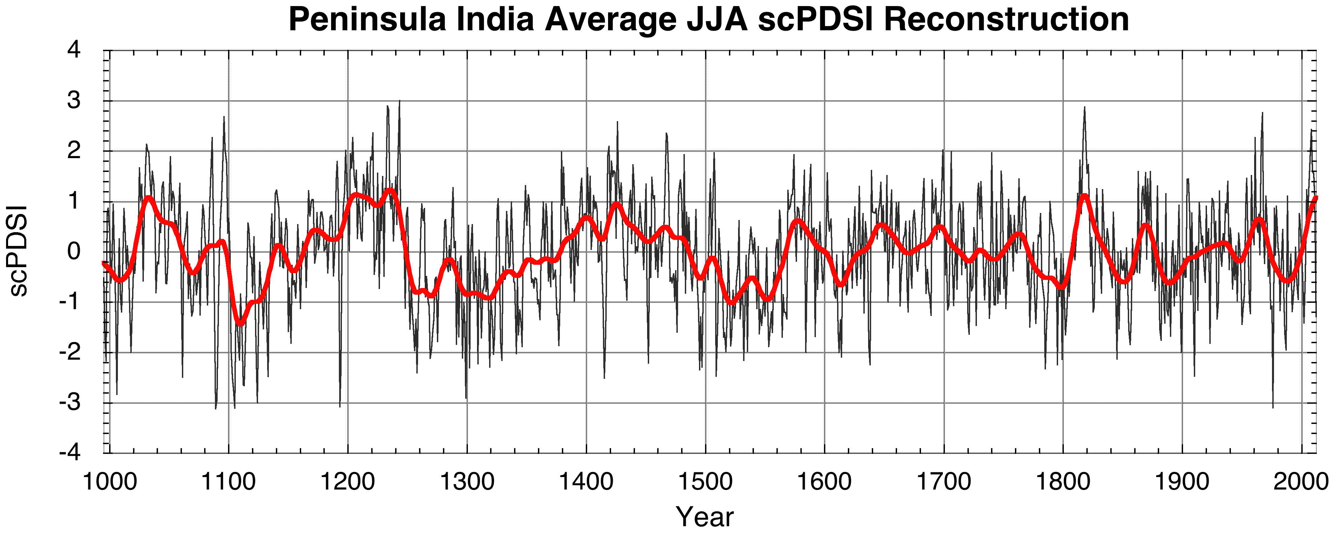
Peninsula India scPDSI Correlations with Indian Ocean SSTs: 1871-1950
OND
JJA
OtA
Correlation

Slide 27
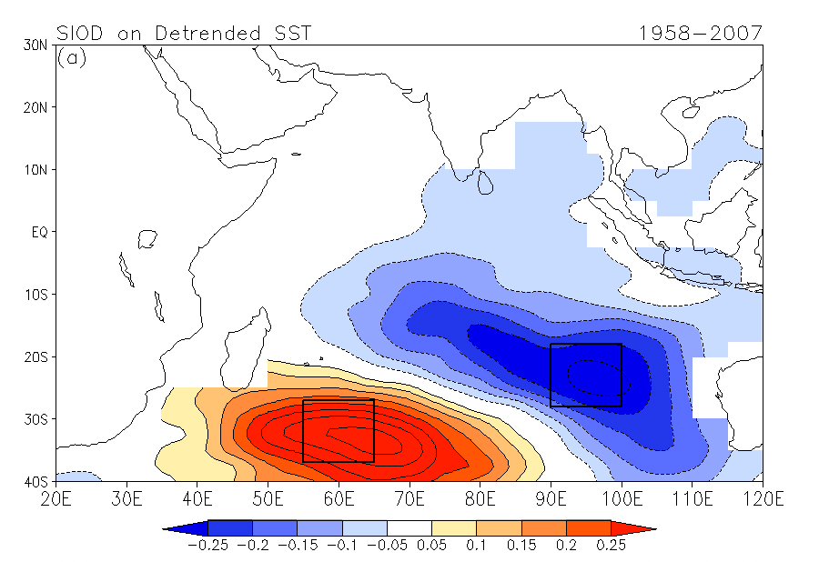
There appears to be some dipole
structure, but it looks more like the
Subtropical Indian Ocean Dipole
Peninsula India scPDSI Correlations with Indian Ocean SSTs: 1871-1950
OND
JJA
OtA
Correlation

Slide 28
Let’s move over to China now.
How well does the MADAv2 capture severe decadal
droughts in eastern China (east of 105°E, 25–40°N)?
Six historical droughts are listed and successfully modeled in: Peng et al. 2014. Modeling of severe persistent droughts over eastern China during the last millennium. Climate of the Past 10:1079–1091.
From their Table 1, these droughts occurred in:
1123-1152
1197-1223
1353-1363
1428-1449
1479-1513
1632-1645

Slide 29
Decadal Droughts in the MADAv2 over Eastern China
scPDSI

Slide 30
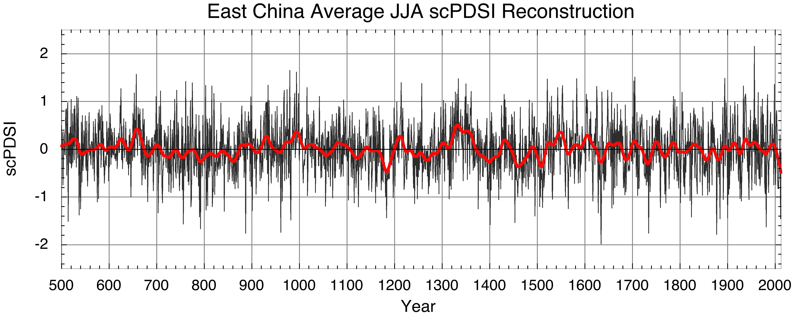
Collectively, the six droughts are successfully reconstructed by MADAv2
scPDSI
Wettest and Driest Periods
of the past 1500 years

Slide 31
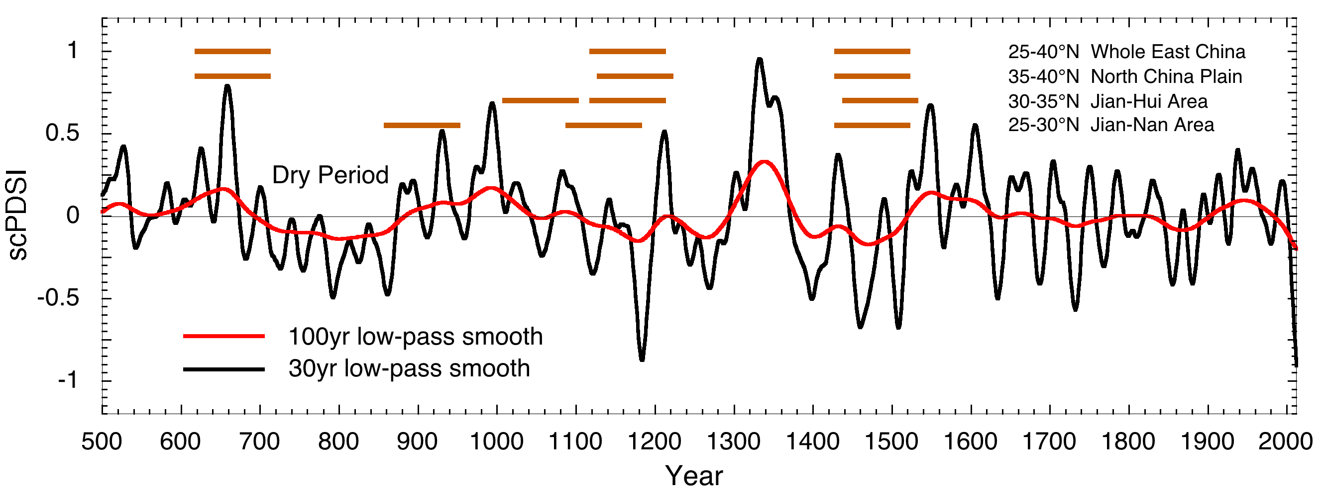
Multi-decadal to centennial dry periods in Eastern China and
three sub-regions* are also reconstructed by the MADAv2
Whole Eastern China
North China Plain
*Drought periods from Table 1 in Zheng et al. 2006. Precipitation variability and extreme events in eastern China during the past 1500 years. Terrestrial, Atmospheric and Ocean Science 17(3):579-592. Periods are approximate, e.g. “1120s-1210s” for whole eastern China.
Jiang-Hui Area
Jiang-Nan Area
??
Zheng drought periods

Slide 32
Multi-decadal to centennial dry periods in Eastern China and
three sub-regions* are also reconstructed by the MADAv2
Whole Eastern China
*From: Zheng et al. 2006. Precipitation variability and extreme events in eastern China during the past 1500 years. Terrestrial, Atmospheric and Ocean Science 17(3):579-592.
North China Plain
*Drought periods from Table 1 in Zheng et al. 2006. Precipitation variability and extreme events in eastern China during the past 1500 years. Terrestrial, Atmospheric and Ocean Science 17(3):579-592. Periods are approximate, e.g. “1120s-1210s” for whole eastern China.
Jiang-Hui Area
Jiang-Nan Area
??
Dry
Zheng drought periods

Slide 33
Historical precipitation reconstructions in eastern China also
show North-South regional differences suggestive of a dipole*
What does MADAv2 say?
Sometimes out-of-phase
from North to South
*e.g. Han, J. and R. Zhang. 2009. The dipole mode of the summer rainfall over East China during 1958–2001. Advances in Atmospheric Sciences 26(4):727-735.

Slide 34
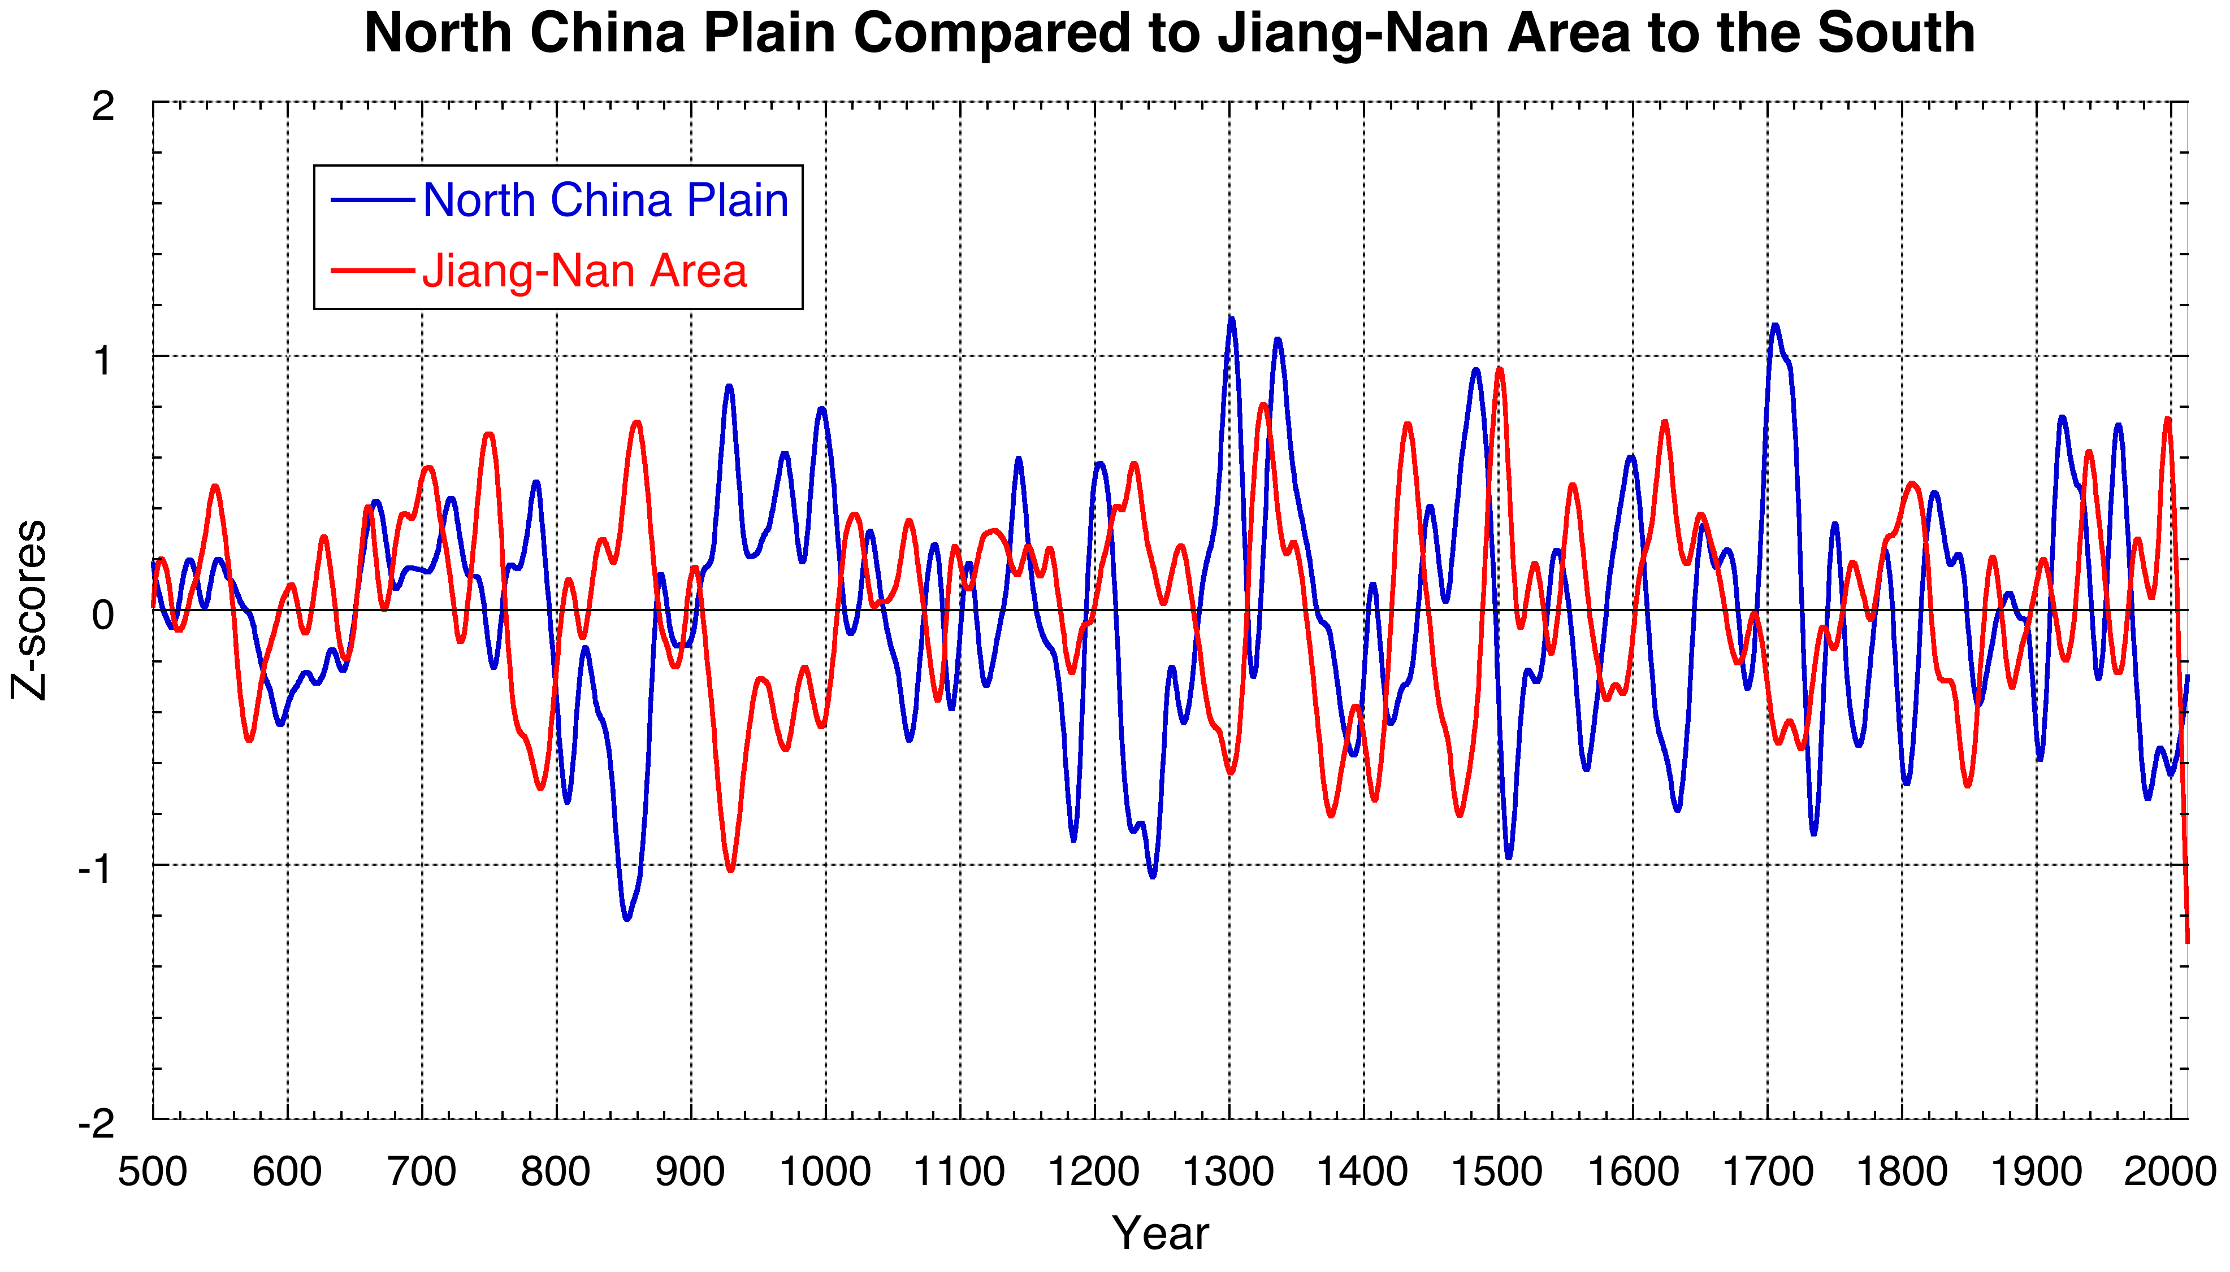
MADAv2 reconstructions in eastern China also show strong
North-South differences again suggestive of a dipole
71 MADAv2
gridpoints
Correlation
North China Plain Compared to Jiang-Nan Area
77 MADAv2
gridpoints
30yr low-pass smooth

Slide 35
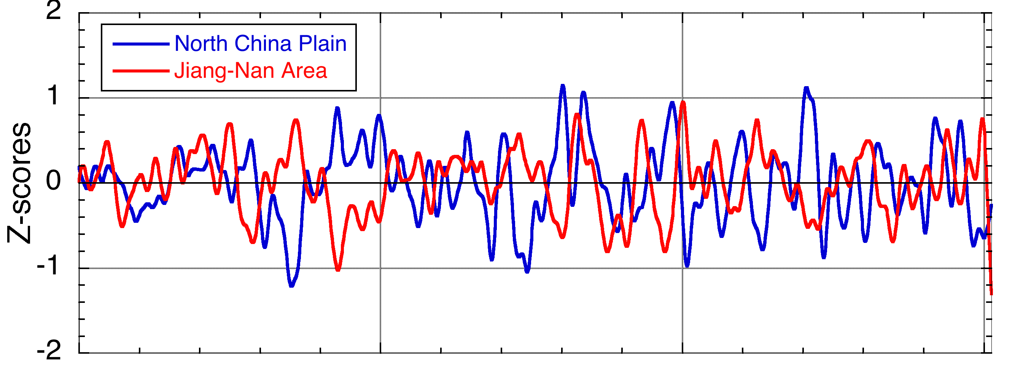
The dipole appears to operate at multi-decadal time scales
North China Plain compared to Jiang-Nan Area
30yr low-pass smooth
Wavelet Coherence of Unfiltered North-South Series

Slide 36
The dipole appears to operate at multi-decadal time scales
North China Plain compared to Jiang-Nan Area
30yr low-pass smooth
Wavelet Coherence of Unfiltered North-South Series
Out-of-Phase at Multi-Decadal Periods
In-Phase at ENSO-like Periods

Slide 37
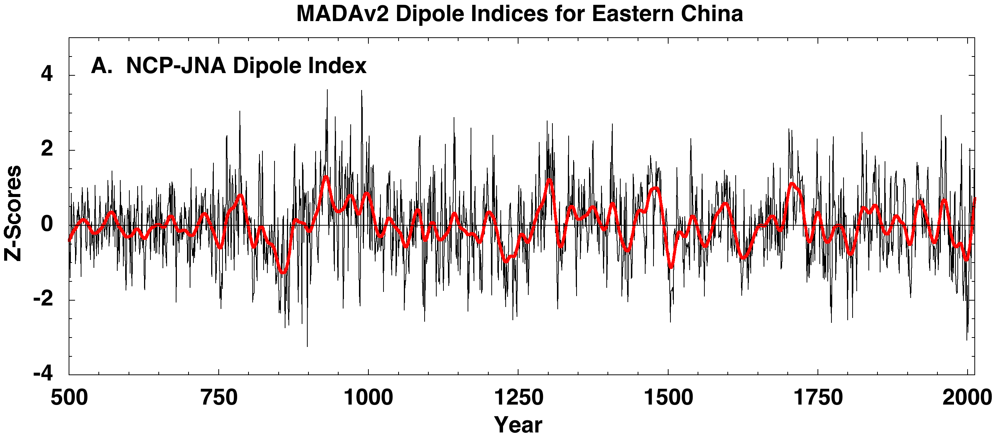
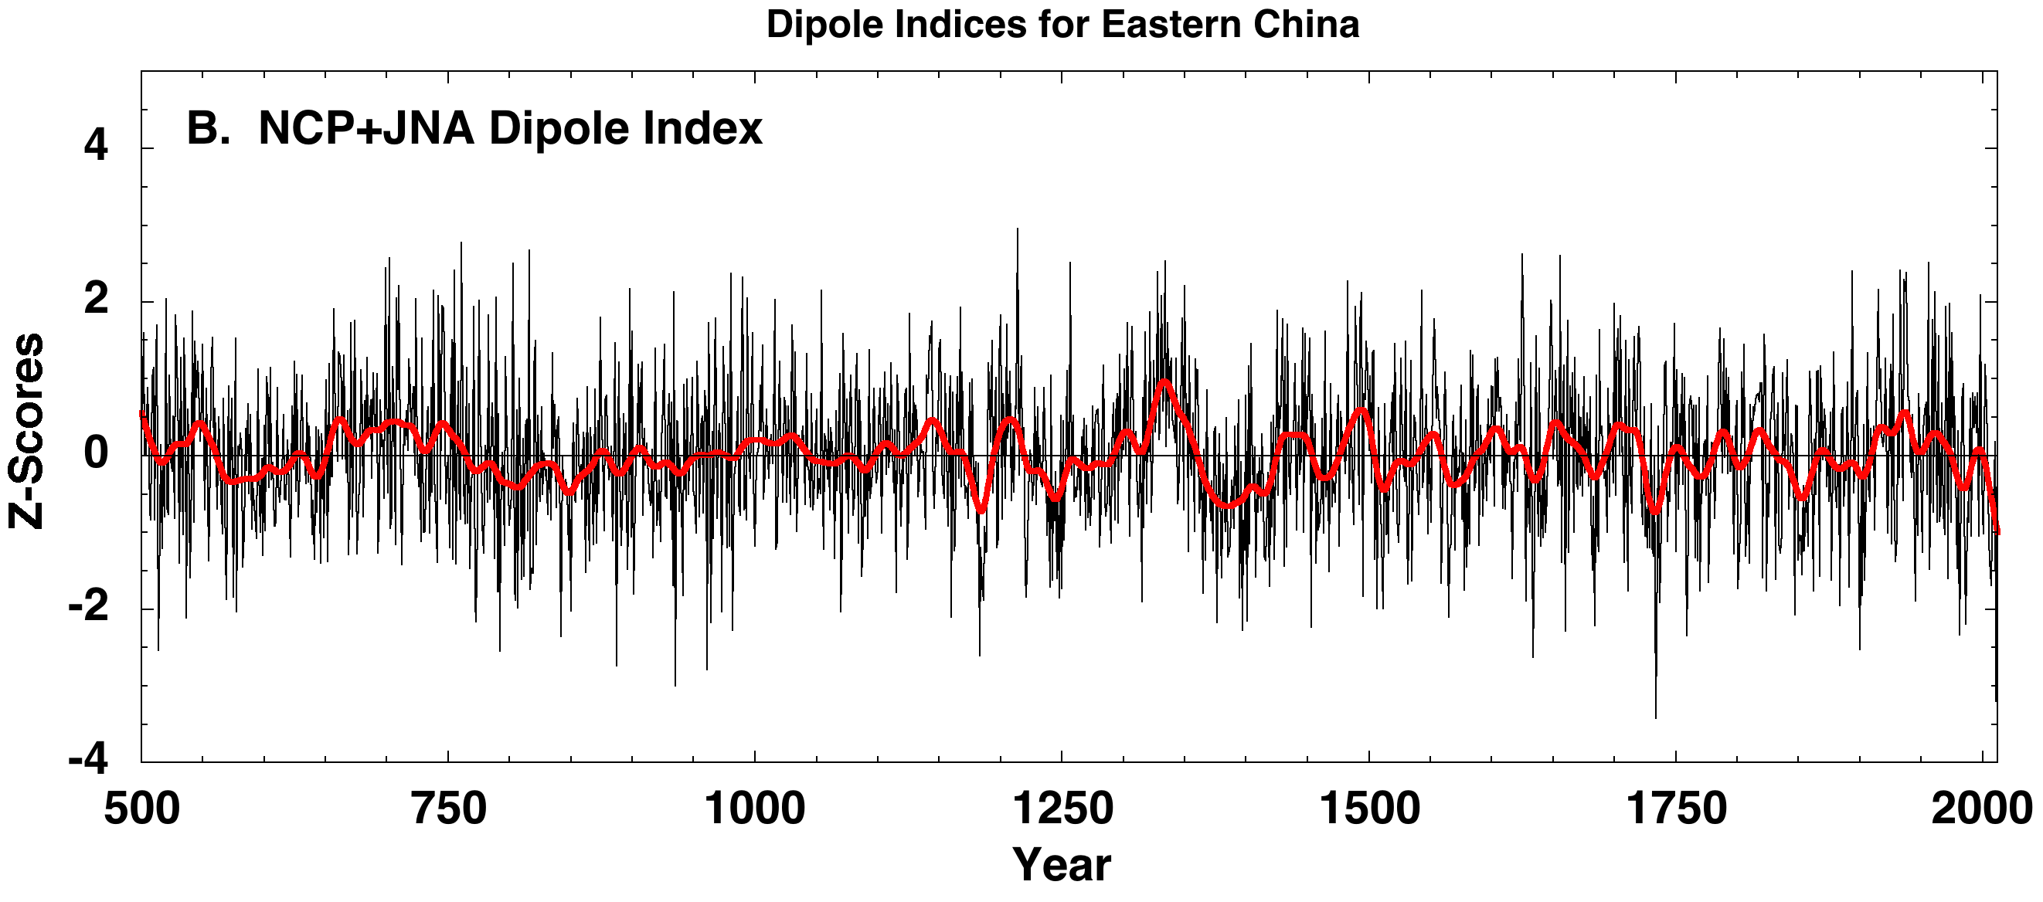
From these results it is reasonable to construct provisional Dipole Indices for Eastern China: NCP-JNA and NCP+JNA
Lower-Frequency Dominated
NCP-JNA
Correlation
Higher-Frequency Dominated
NCP+JNA
Correlation

Slide 38
Provisional Dipole Indices for Eastern China
NCP-JNA Wavelet Spectrum
NCP-JNA
NCP+JNA Wavelet Spectrum
Correlation
NCP+JNA
Correlation

Slide 39
Provisional Dipole Indices for Eastern China
-- Some Summer SST Associations --
NCP-JNA Correlations with Detrended JJA SSTs – 1872-1989
*
NCP-JNA
NCP+JNA Correlations with Detrended JJA SSTs – 1872-1989
Correlation
NCP+JNA
*cf. Fig. 8 in Nigam et al. 2013. The South-Flood North Drought Pattern over Eastern China and the Drying of the Gangetic Plain. Chapter in Climate Change: Multidecadal and Beyond (Editors: M. Ghil, M. Latif, M. Wallace and C.P. Chang)
Correlation

Slide 40
Concluding Remarks
MADAv2 is a significant improvement over MADAv1 in terms of spatial resolution (1°x1°), temporal coverage (back 1,000+ years over most of the domain), higher quality scPDSI target field, and more tree-ring data.
EOF analysis indicates that MADAv2 has significant large-scale structure that is strongly coupled to SSTs in the tropical Pacific ENSO region, but seasonality of SST forcing varies by region.
Evaluations of MADAv2 show that it matches previously reported droughts in MADAv1 and has significant skill when compared to regional patterns of rainfall over India and to historical droughts in eastern China.
North-South variations in drought and wetness in MADAv2 over eastern China behave as a dipole that has been active since 500 CE. The dipole appears to be driven by multi-decadal variability in the coupled climate system, perhaps related to North Pacific SSTs.
MADAv2 will be an official PAGES Asia2k product. It will be written up for publication sometime later this year, at which time it will be released to the public through NOAA NCDC Paleo.

Slide 41
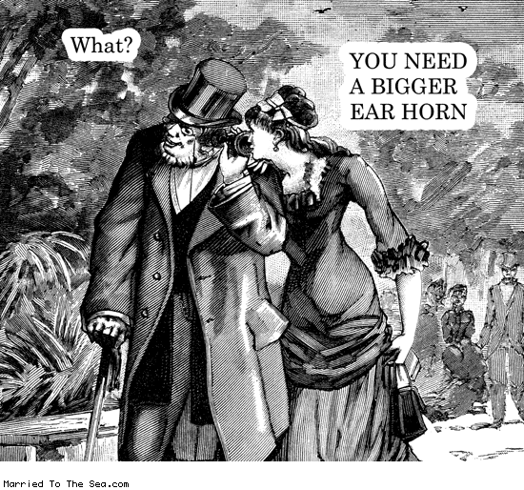
Concluding Remarks
MADAv2 is a significant improvement over MADAv1 in terms of spatial resolution (1°x1°), temporal coverage (back 1,000+ years over most of the domain), higher quality scPDSI target field, and more tree-ring data.
EOF analysis indicates that MADAv2 has significant large-scale structure that is strongly coupled to SSTs in the tropical Pacific ENSO region, but seasonality of SST forcing varies by region.
Evaluations of MADAv2 show that it matches previously reported droughts in MADAv1 and has significant skill when compared to regional patterns of rainfall over India and to historical droughts in eastern China.
North-South variations in drought and wetness in MADAv2 over eastern China behave as a dipole that has been active since 500 CE. The dipole appears to be driven by multi-decadal variability in the coupled climate system, perhaps related to North Pacific SSTs.
MADAv2 will be an official PAGES Asia2k product. It will be written up for publication sometime later this year, at which time it will be released to the public through NOAA NCDC Paleo.
Questions?
Please speak up. I am a
little hard of hearing.

