Slide 1
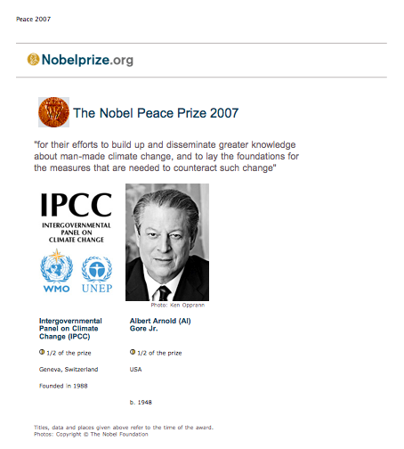
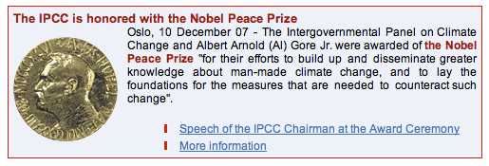

So what was my part in this?

Slide 2
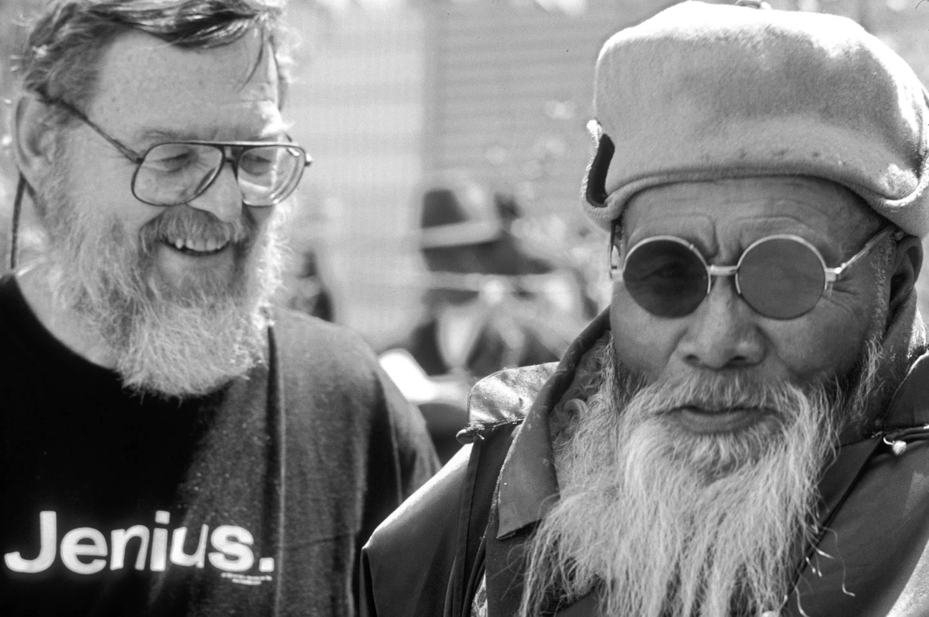

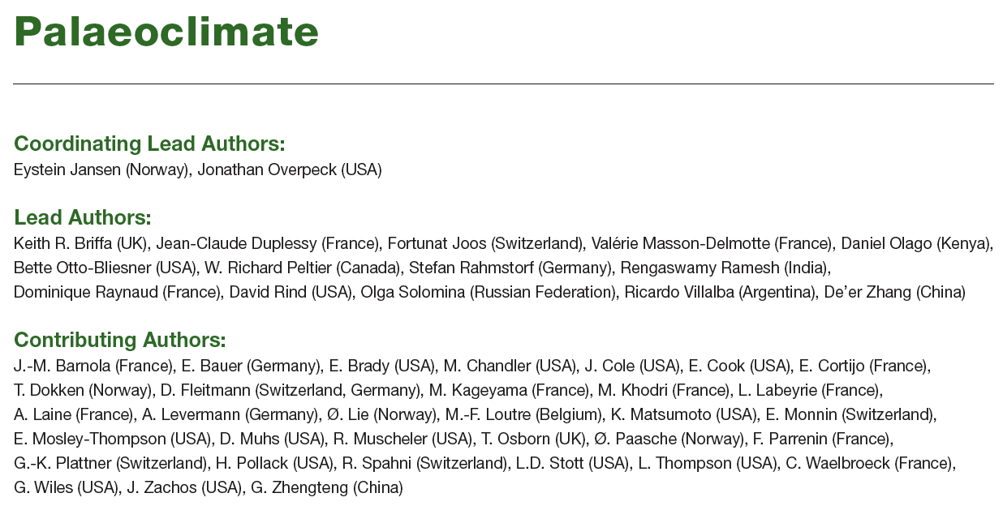
Oops . . .
Where’s Ed?
So . . .
Here I am! One of 48 authors
of the Palaeoclimate Chapter!

Slide 3
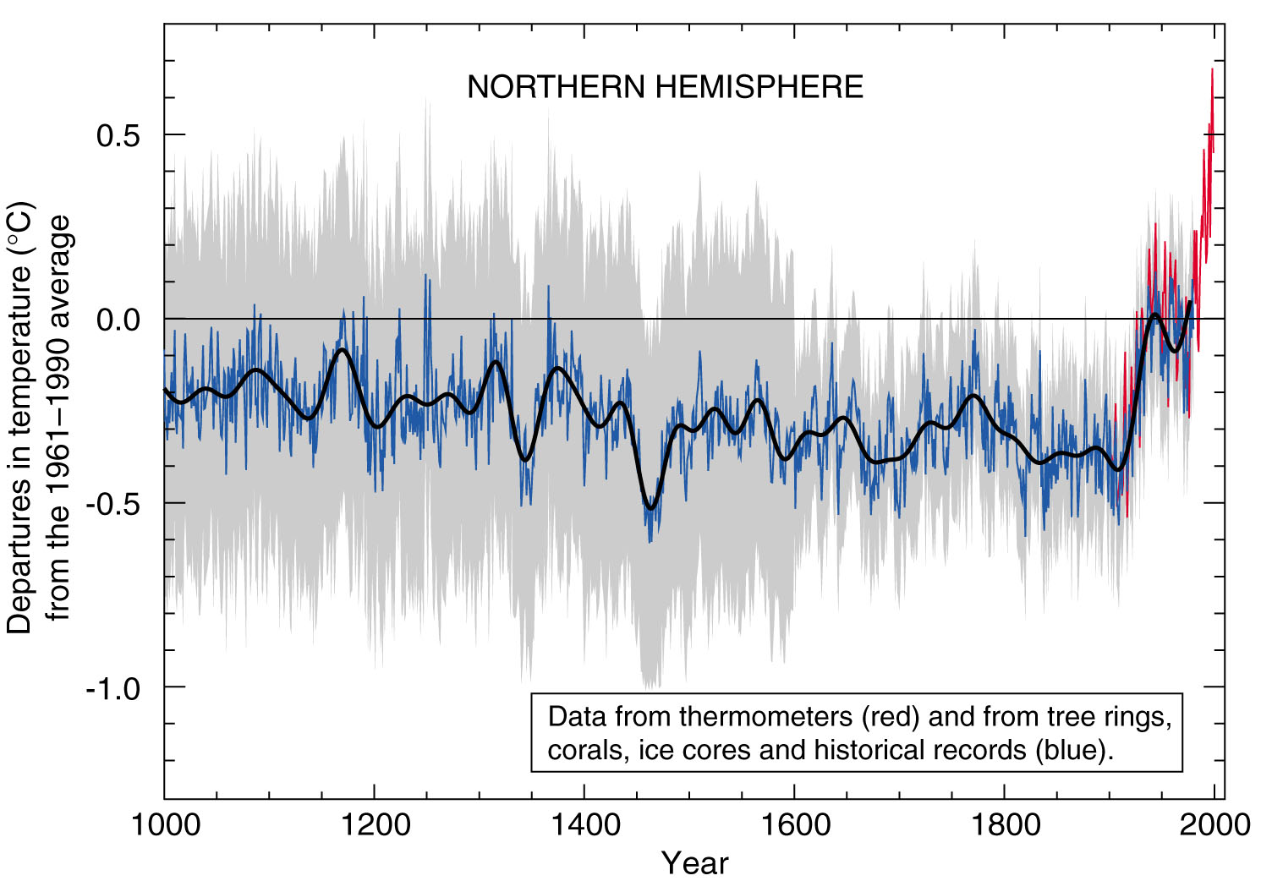
The “Hockey Stick”
-- So What Is All The Controversy About? --
Edward R. Cook
Tree-Ring Laboratory
Lamont-Doherty Earth Observatory

Slide 4
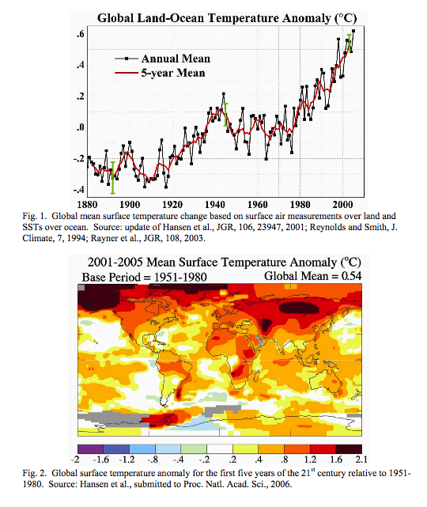
The Current Situation:
The Earth Appears To Be Warming Rapidly.

Slide 5
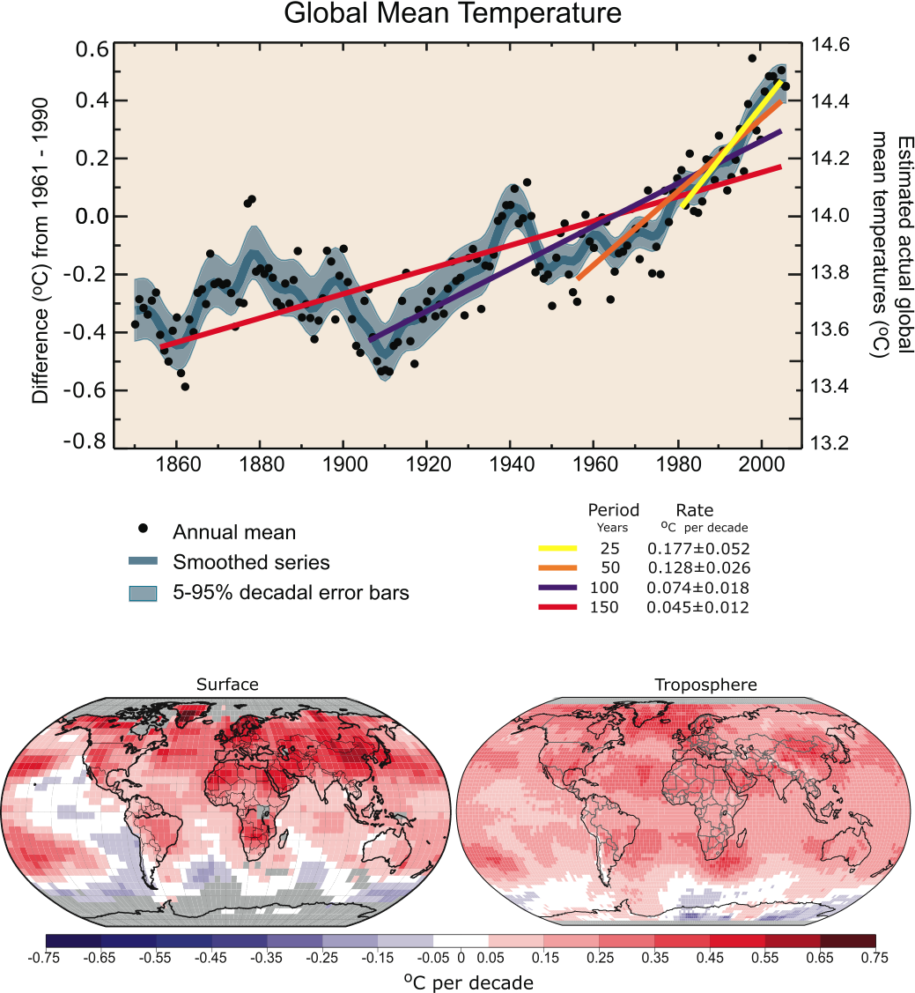
With The Most Rapid Warming Since About 1970
Notes:
FAQ 3.1, Figure 1. (Top) Annual global mean observed temperatures¹ (black dots) along with simple fits to the data. The left hand axis shows anomalies relative to the 1961 to 1990 average and the right hand axis shows the estimated actual temperature (°C). Linear trend fits to the last 25 (yellow), 50 (orange), 100 (purple) and 150 years (red) are shown, and correspond to 1981 to 2005, 1956 to 2005, 1906 to 2005, and 1856 to 2005, respectively. Note that for shorter recent periods, the slope is greater, indicating accelerated warming. The blue curve is a smoothed depiction to capture the decadal variations. To give an idea of whether the fluctuations are meaningful, decadal 5% to 95% (light grey) error ranges about that line are given (accordingly, annual values do exceed those limits). Results from climate models driven by estimated radiative forcings for the 20th century (Chapter 9) suggest that there was little change prior to about 1915, and that a substantial fraction of the early 20th-century change was contributed by naturally occurring influences including solar radiation changes, volcanism and natural variability. From about 1940 to 1970 the increasing industrialisation following World War II increased pollution in the Northern Hemisphere, contributing to cooling, and increases in carbon dioxide and other greenhouse gases dominate the observed warming after the mid-1970s. (Bottom) Patterns of linear global temperature trends from 1979 to 2005 estimated at the surface (left), and for the troposphere (right) from the surface to about 10 km altitude, from satellite records. Grey areas indicate incomplete data. Note the more spatially uniform warming in the satellite tropospheric record while the surface temperature changes more clearly relate to land and ocean.
¹ From the HadCRUT3 data set.

Slide 6
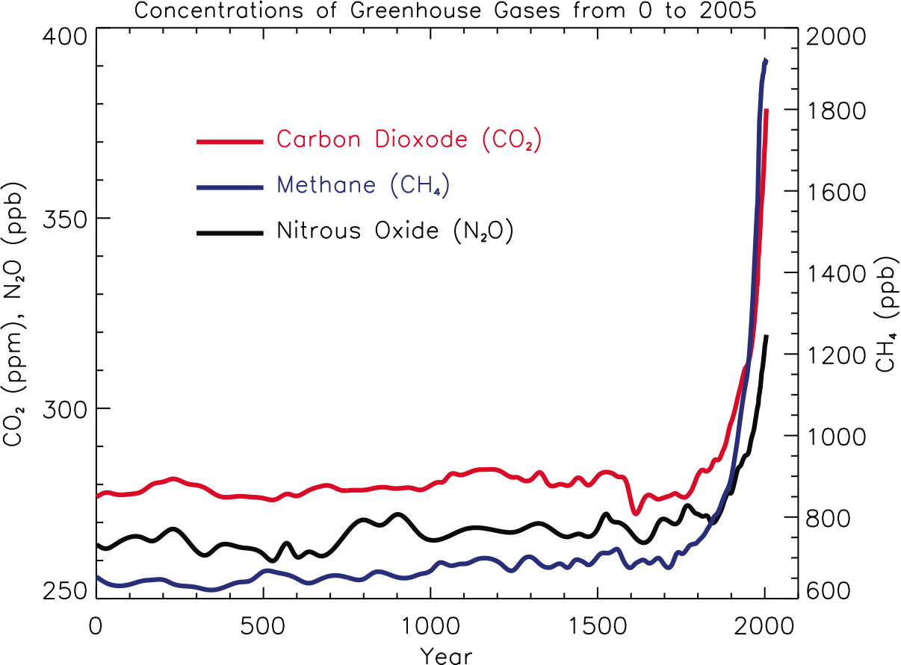
At The Same Time, Greenhouse Gas Levels In
The Atmosphere Have Been Rising Rapidly
Notes:
FAQ 2.1, Figure 1. Atmospheric concentrations of important long-lived greenhouse gases over the last 2,000 years. Increases since about 1750 are attributed to human activities in the industrial era. Concentration units are parts per million (ppm) or parts per billion (ppb), indicating the number of molecules of the greenhouse gas per million or billion air molecules, respectively, in an atmospheric sample. (Data combined and simplified from Chapters 6 and 2 of this report.)

Slide 7
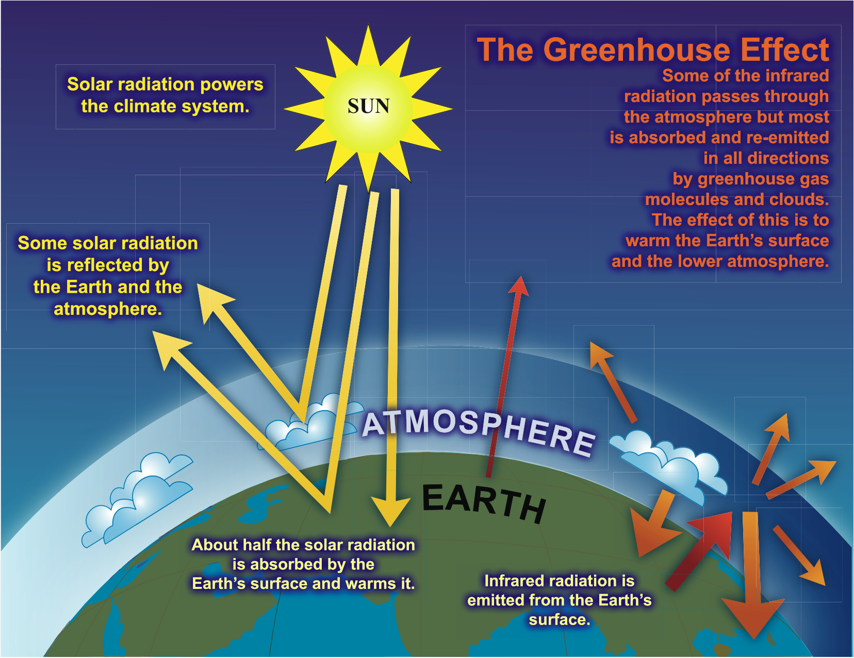
FAQ 1.3, Figure 1
Notes:
FAQ 1.3, Figure 1. An idealised model of the natural greenhouse effect. See text for explanation.

Slide 8
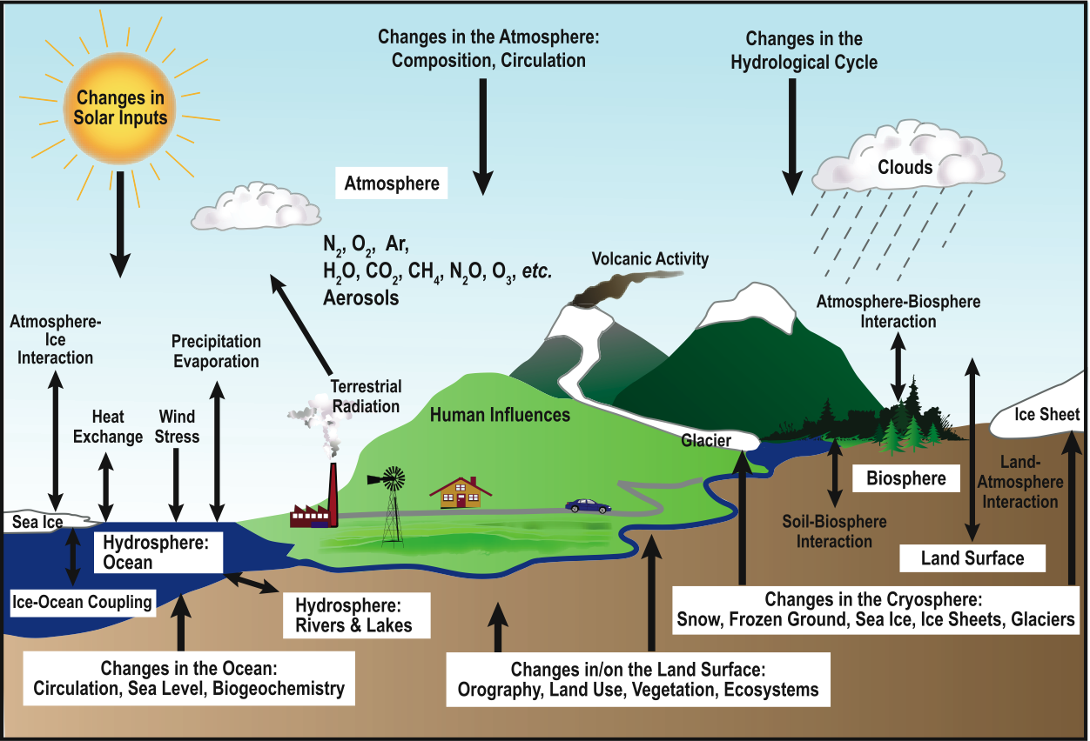
The ‘Greenhouse Effect’ May Sound Simple, But
The Understanding Global Warming Is Not So Easy
Notes:
FAQ 1.2, Figure 1. Schematic view of the components of the climate system, their processes and interactions.

Slide 9
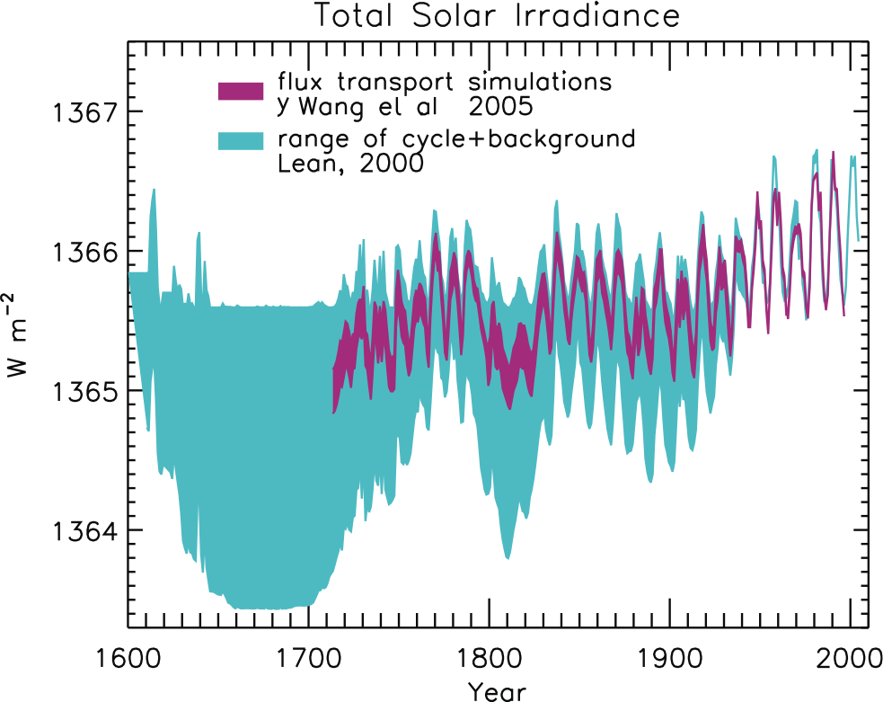
Figure 2.17
Because Natural Factors Like Changes In Solar Output
May Also Be Contributing To Global Warming
Notes:
Figure 2.17. Reconstructions of the total solar irradiance time series starting as early as 1600. The upper envelope of the shaded regions shows irradiance variations arising from the 11-year activity cycle. The lower envelope is the total irradiance reconstructed by Lean (2000), in which the long-term trend was inferred from brightness changes in Sun-like stars. In comparison, the recent reconstruction of Y. Wang et al. (2005) is based on solar considerations alone, using a flux transport model to simulate the long-term evolution of the closed flux that generates bright faculae.

Slide 10
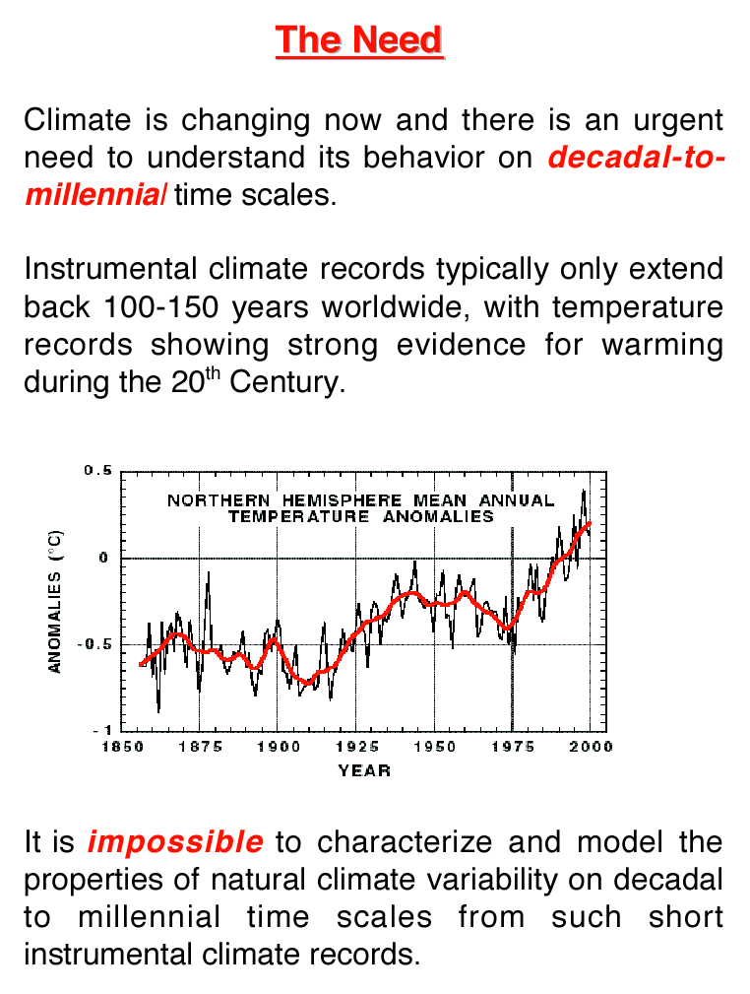

Slide 11
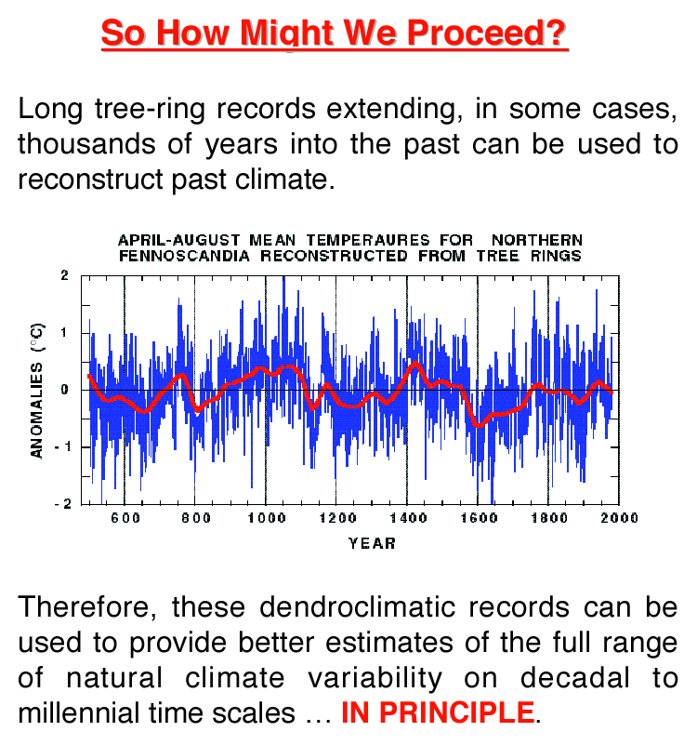

Slide 12
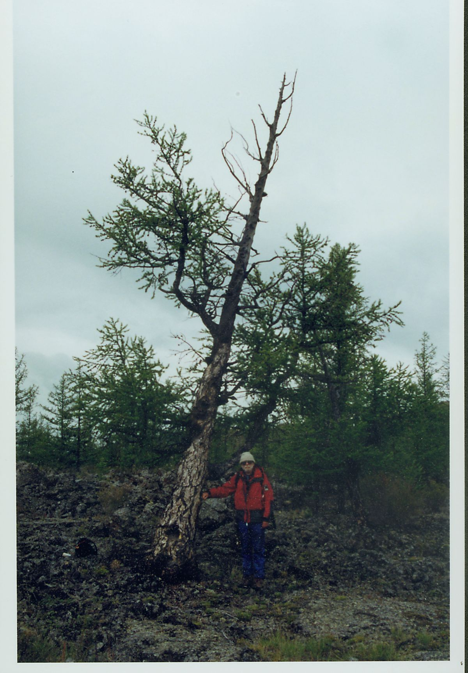
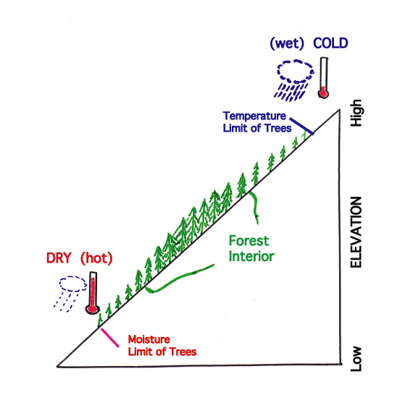
Temperature Reconstructions From Tree Rings -- Finding The Right Trees.
Gordon Jacoby by an ancient temperature-sensitive tree from a Northern Hemisphere timberline location.

Slide 13
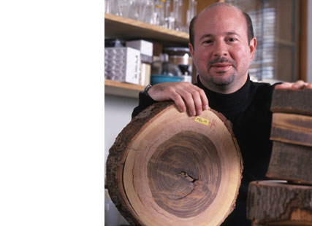
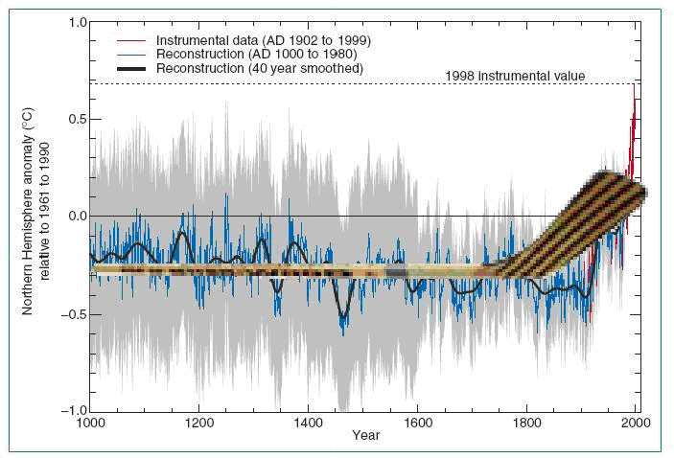
Enter Mike Mann And The Hockey Stick

Slide 14
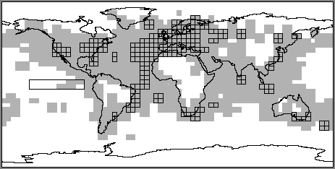
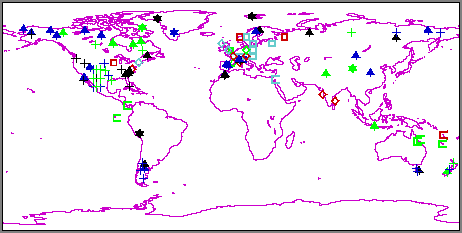
Annual Resolution Proxy Climate Indicators
INSTRUMENTAL TEMPERATURE RECORD
GLOBAL PROXY CLIMATE RECORDS

Slide 15
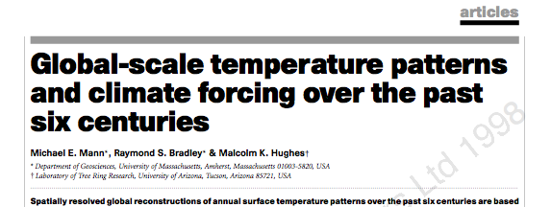

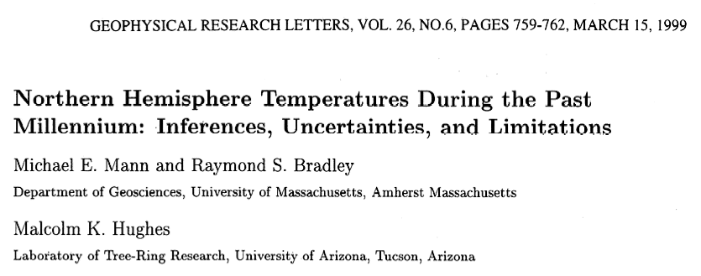
Reconstructing Surface Temperatures

Slide 16
Reconstructed Surface Temperatures
A.K.A. The “Hockey Stick”

Slide 17
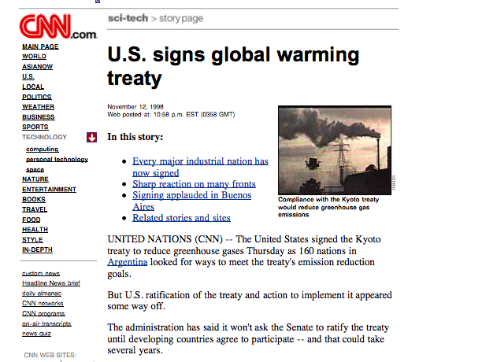
The Politics Of Global Warming

Slide 18
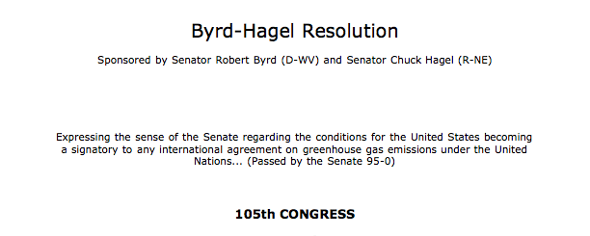
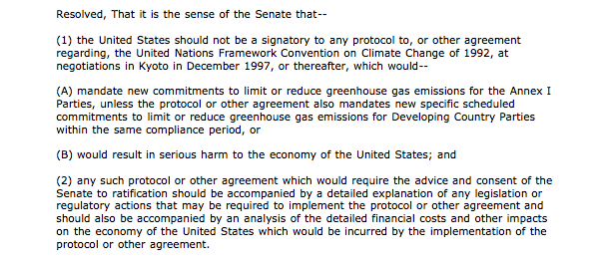
The Politics Of Global Warming

Slide 19
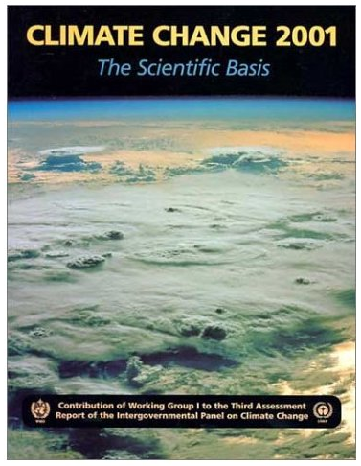
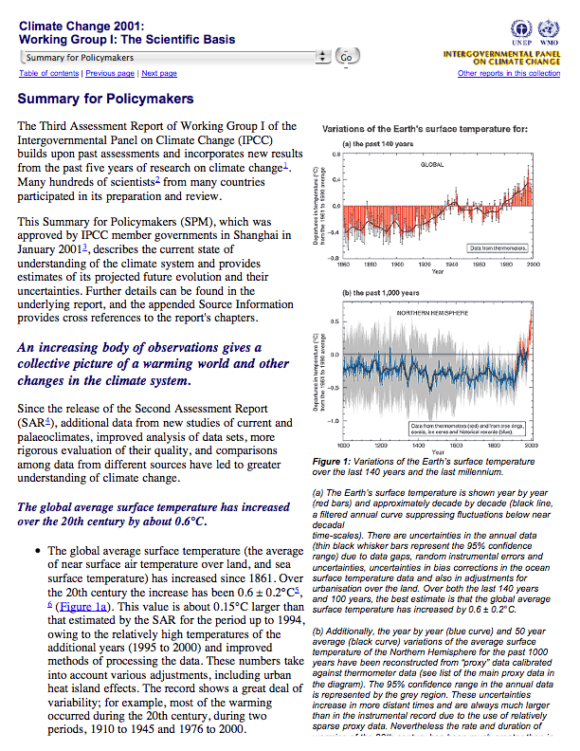
The Politics Of Global Warming
The Poster Child Of Global Warming

Slide 20
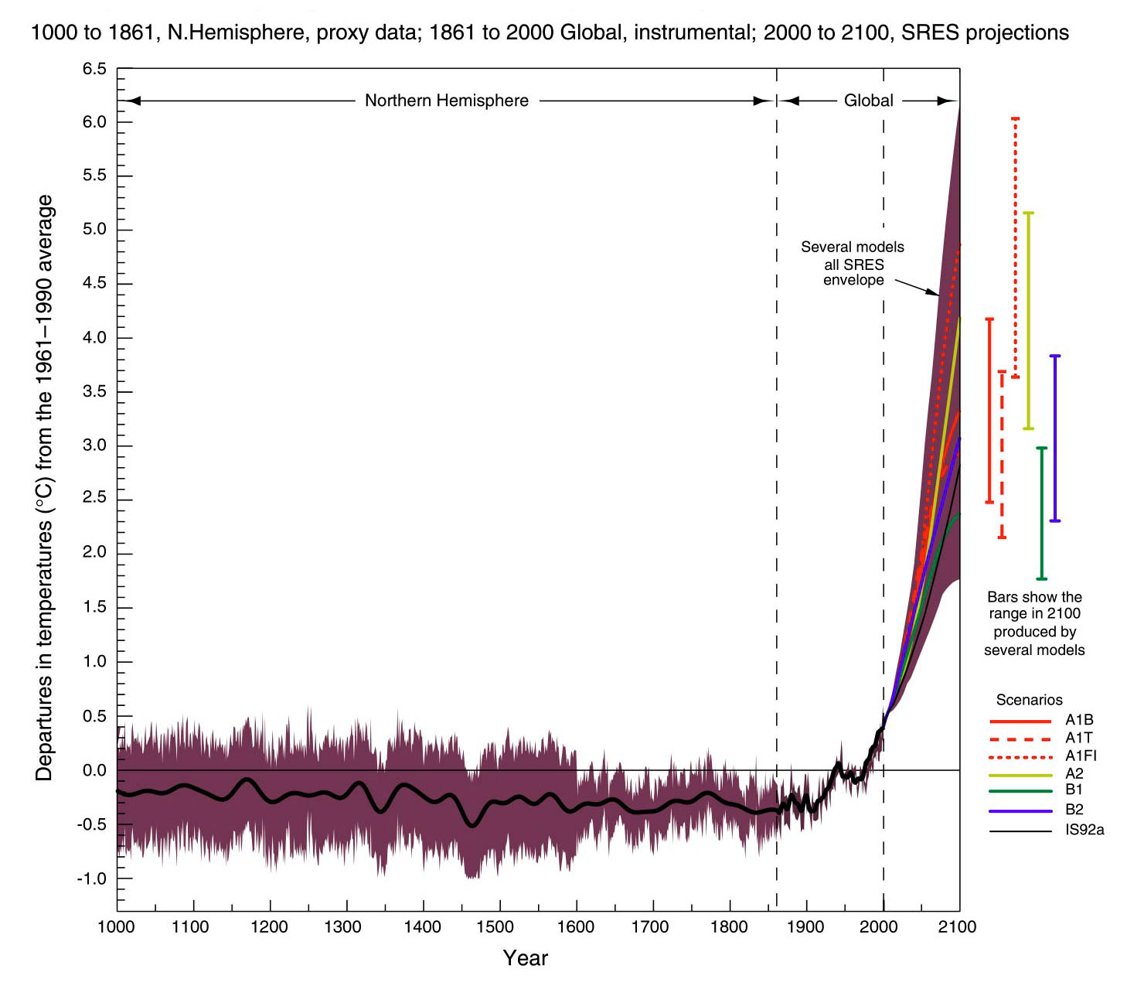
Reconstructed Surface Temperatures
And Possible Future Warming:
An Alarmist Scenario?

Slide 21
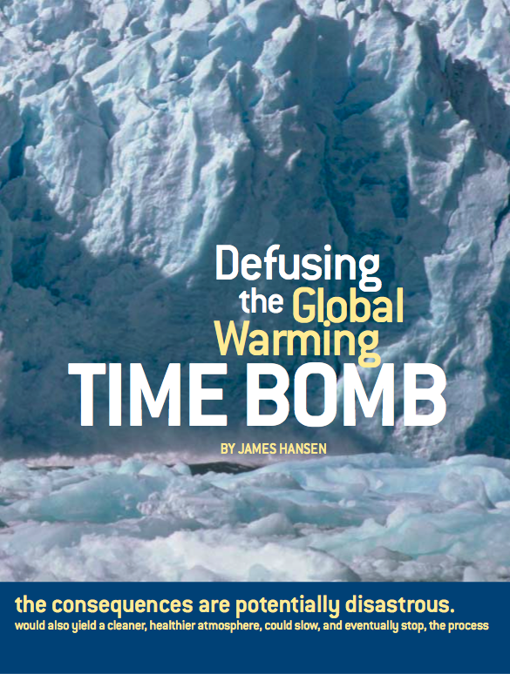
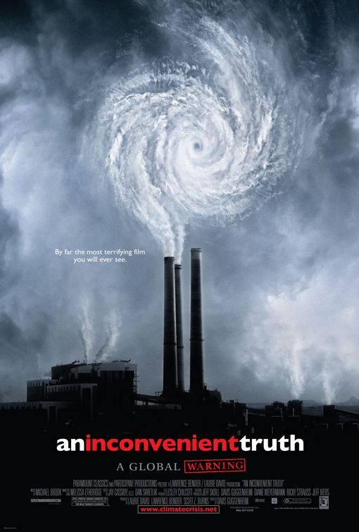
Not Alarmist For Some!

Slide 22


But For Others, The Answer Is Decidedly YES!
You may wonder why I included here “The Day After Tomorrow”, a decidedly anti-global warming movie. I view it as dreadful and doing more harm than good because for the most part it can’t be taken seriously.

Slide 23
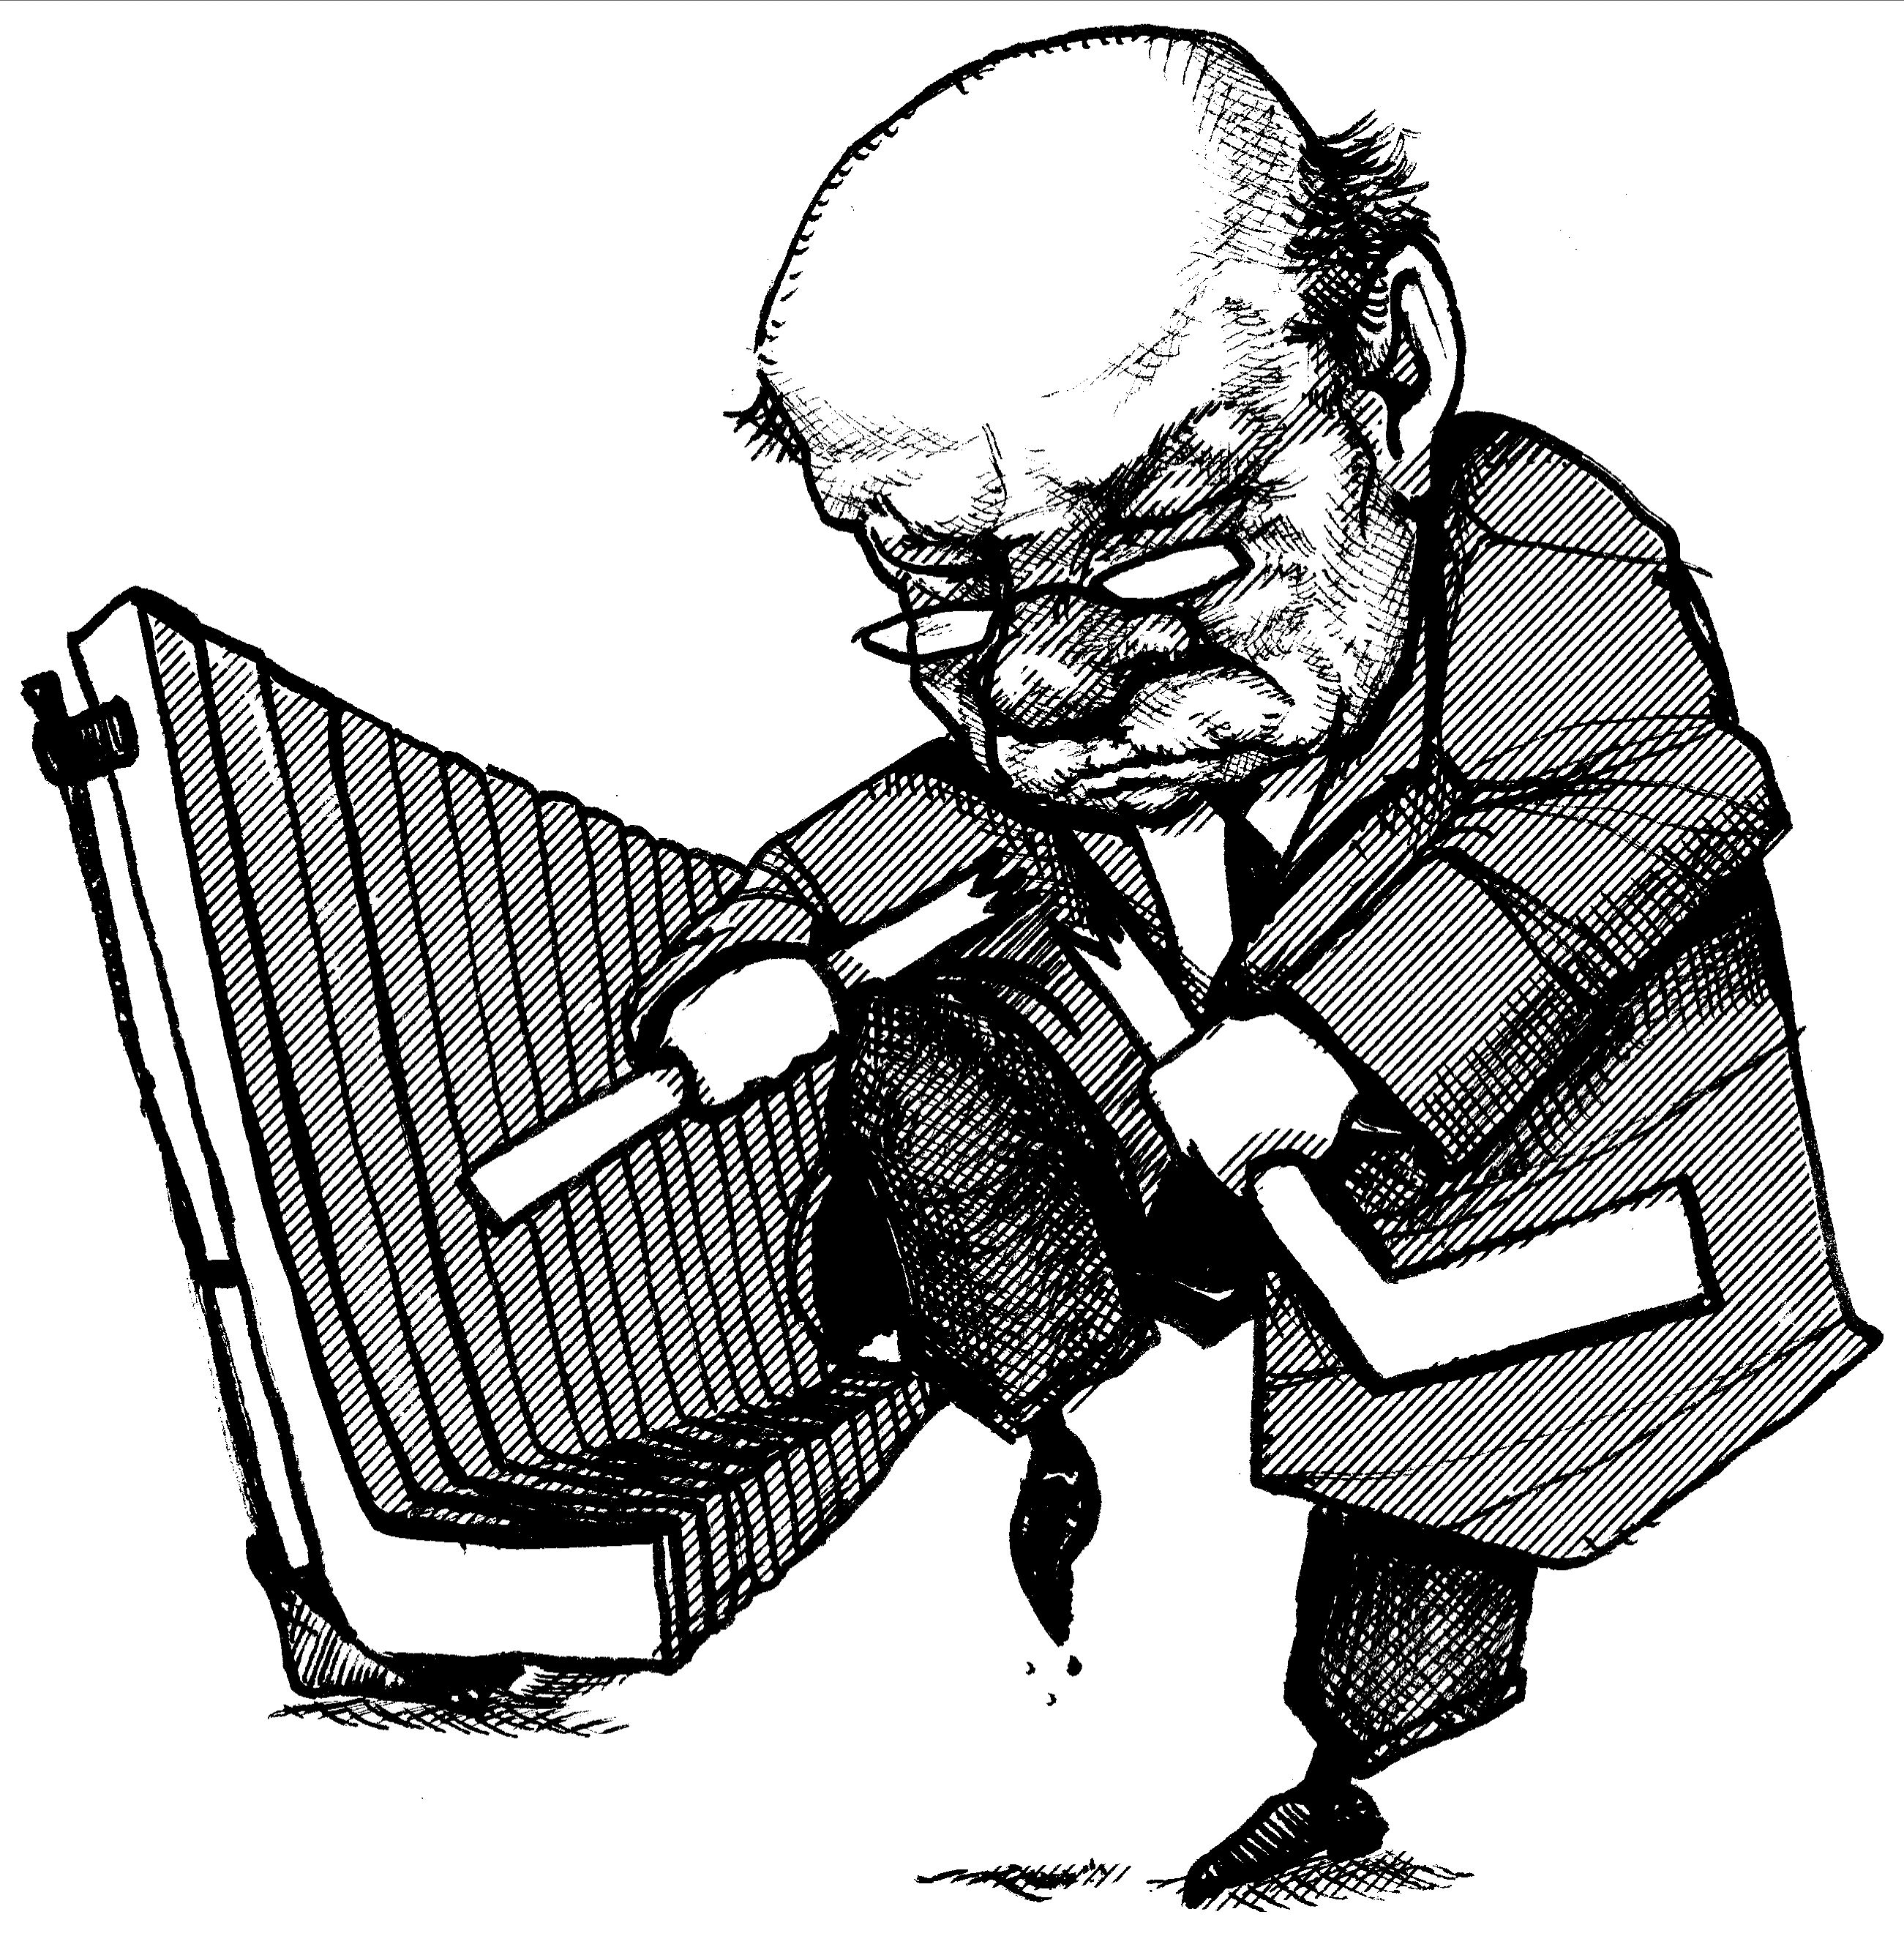
Thus, There Has Been Efforts To Break The Hockey Stick As The Poster Child Of Global Warming.
“Hockey Stick”

Slide 24
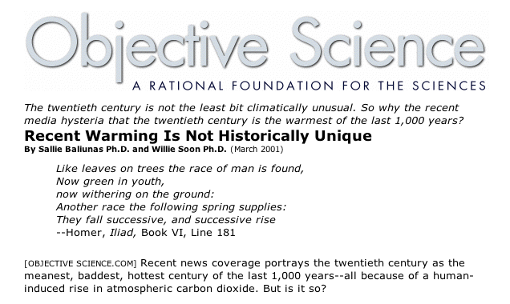
Breaking The Hockey Stick? Does The
Medieval Warm Period Do It? If It Was As Warm As Today In Medieval Times, Maybe Current Warming Is Natural.

Slide 25
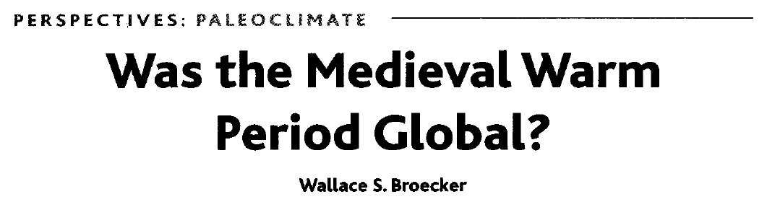
The Lack Of A Clearly Defined MWP Caused Wally Broecker To Question The
Validity Of The Hockey Stick.
MWP?

Slide 26
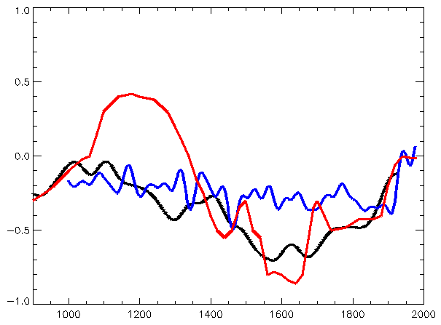
Crude Temperature Estimates Back To The
Medieval Warm Period From The First
IPCC Assessment In 1990 Also Suggest That The Hockey Stick Is Wrong.
MWP
Hockey Stick

Slide 27
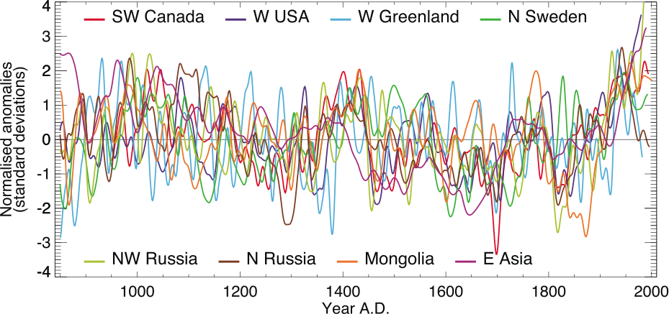
However, The Heterogeneous Nature Of Climate During The ‘Medieval Warm Period’ In The Northern Temperature Makes It Hard To Say That It Was Warmer Back 1,000 Years Ago.
Notes:
Box 6.4, Figure 1. The heterogeneous nature of climate during the ‘Medieval Warm Period’ is illustrated by the wide spread of values exhibited by the individual records that have been used to reconstruct NH mean temperature. These consist of individual, or small regional averages of, proxy records collated from those used by Mann and Jones (2003), Esper et al. (2002) and Luckman and Wilson (2005), but exclude shorter series or those with no evidence of sensitivity to local temperature. These records have not been calibrated here, but each has been smoothed with a 20-year filter and scaled to have zero mean and unit standard deviation over the period 1001 to 1980.

Slide 28
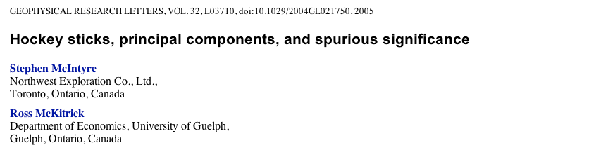
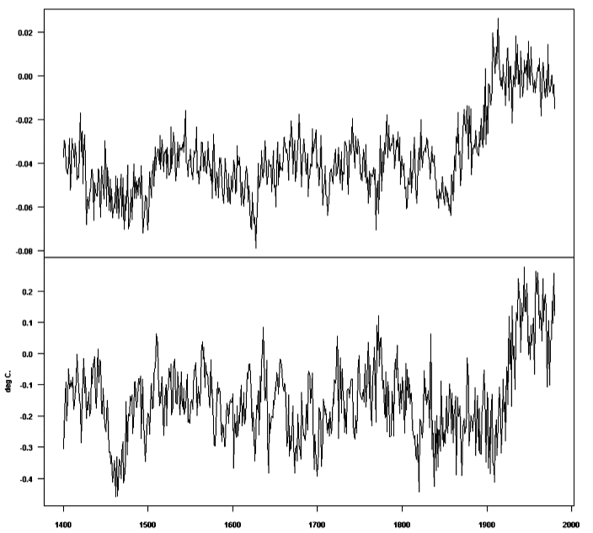
Breaking The Hockey Stick?
Synthetic “Hockey Stick”
(Calculated By The Same Method)
A Computational
Error In Calculating
The Hockey Stick
Has Also Lead To
Questions About
Its Validity
Actual Hockey Stick

Slide 29
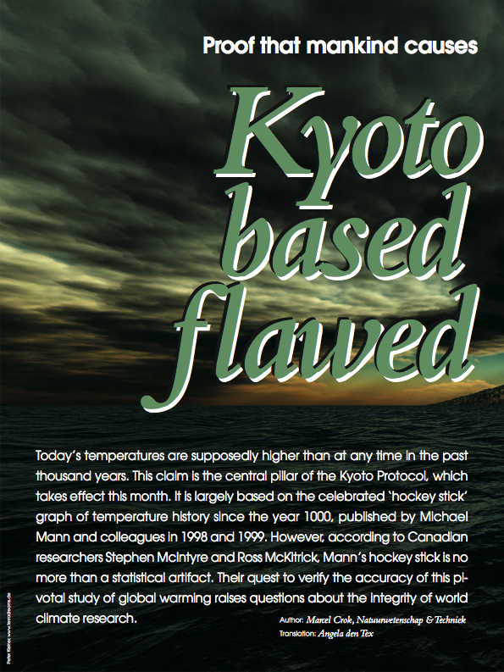

Breaking The Hockey Stick?

Slide 30
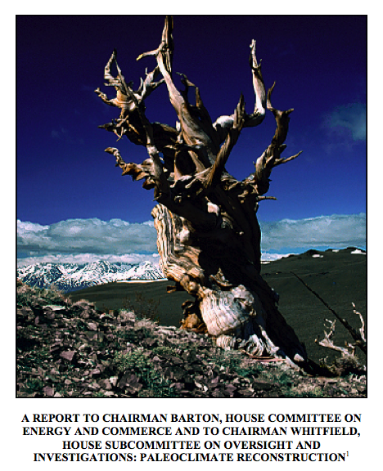
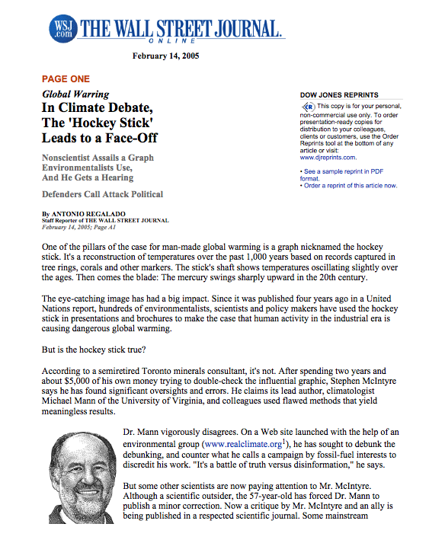
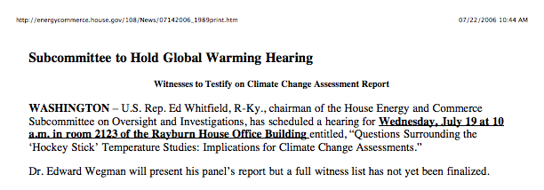
Breaking The Hockey Stick?
So is the Hockey Stick broken?

Slide 31
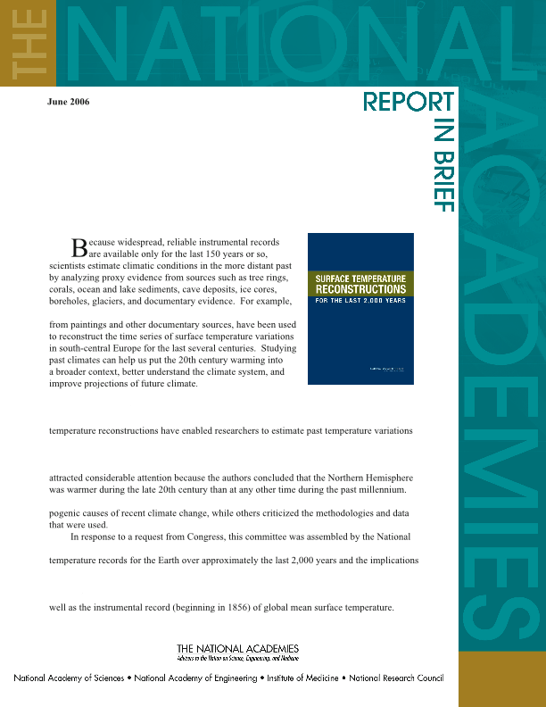
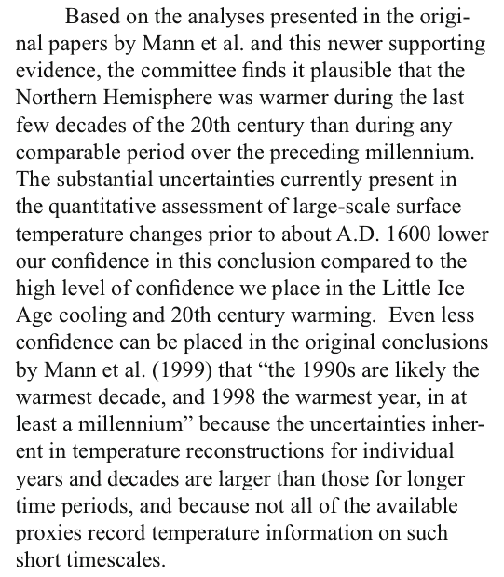
National Academies Of Science Report
Not really.
But can the Hockey Stick be improved?
The answer is undoubtedly “Yes”!

Slide 32
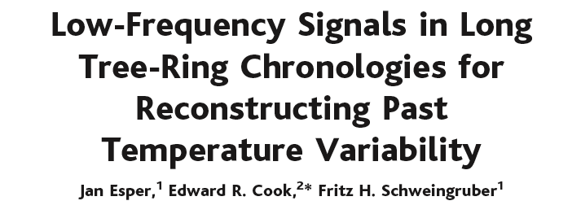

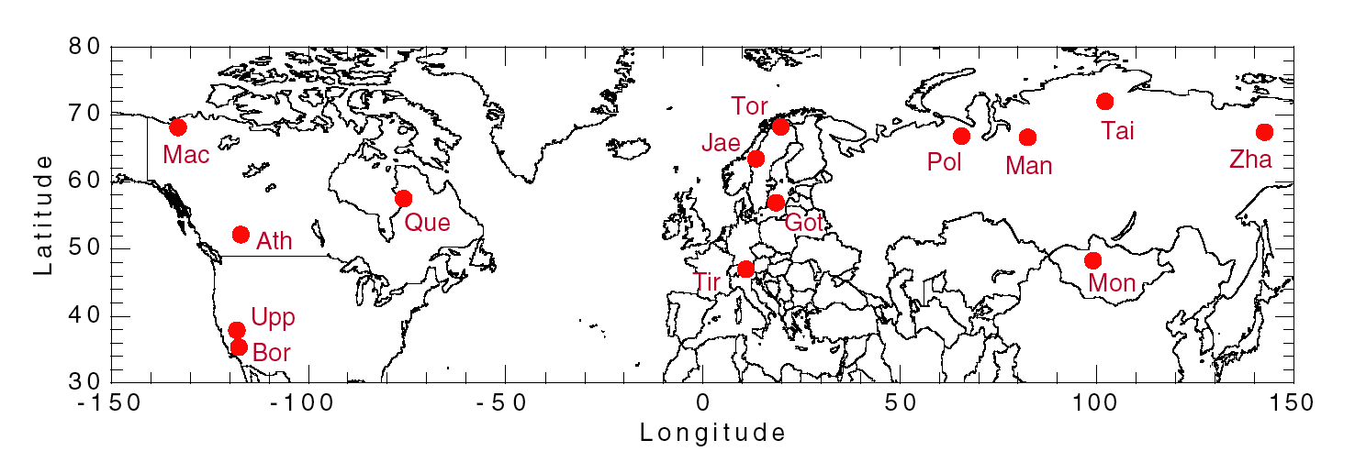

Slide 33
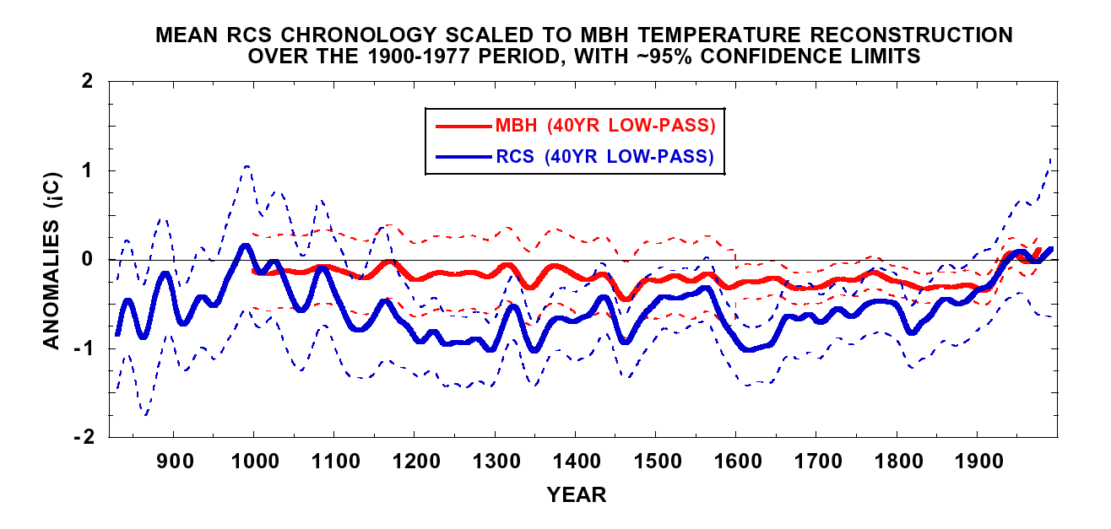
So maybe the Hockey Stick
can be improved, but who
would want to do that?

Slide 34
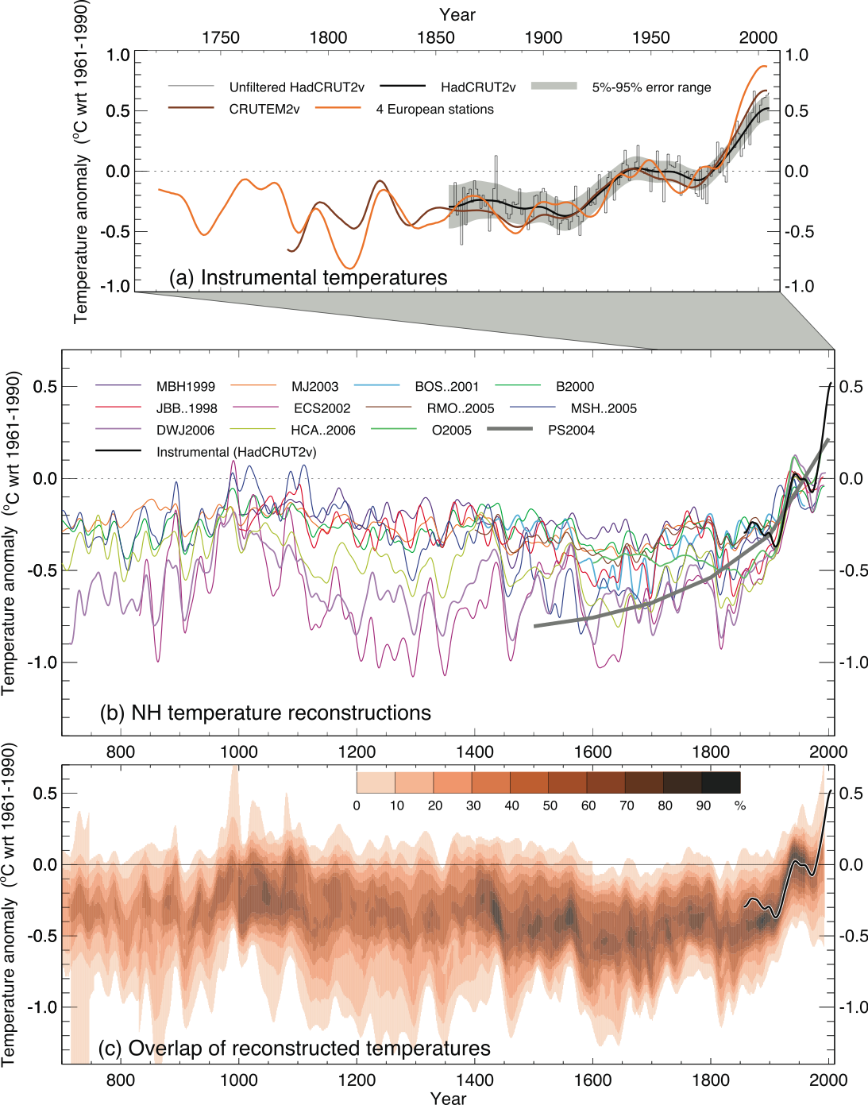
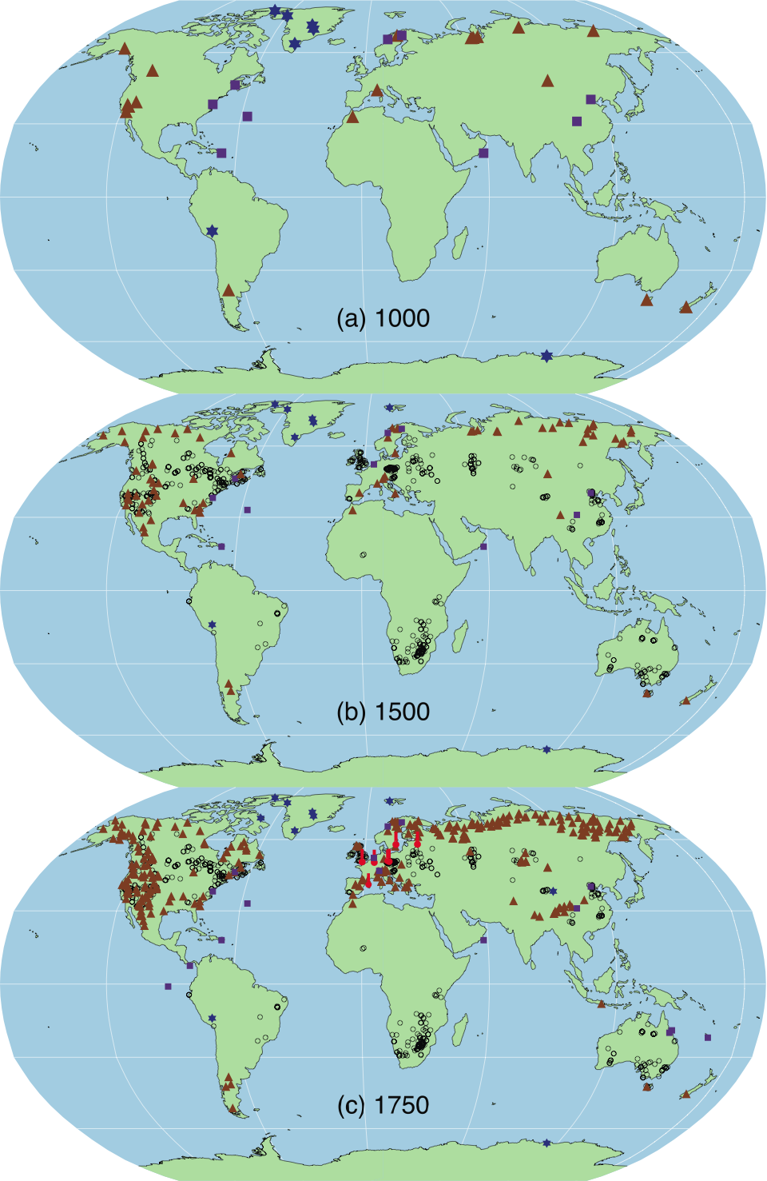
Many Revisions Of The Hockey Stick Have Already Been Made, As Global Change Science Continually Improves.

Slide 35
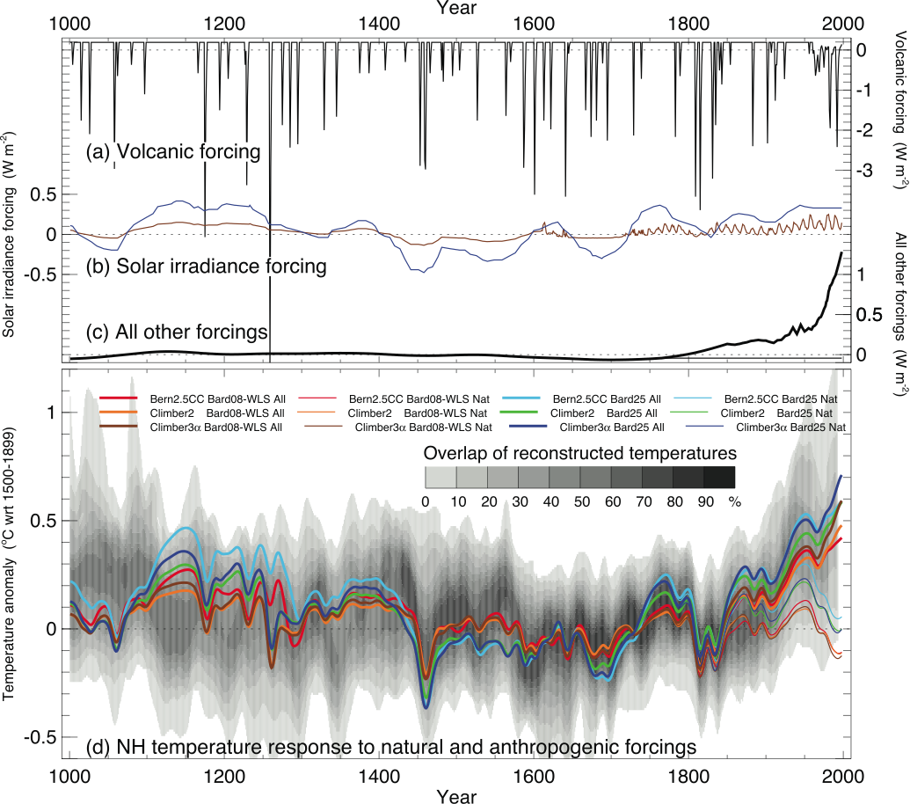
Modeling Experiments Also Support The Contributions
Of Greenhouse Gases To Global Warming
Notes:
Figure 6.14. Simulated temperatures during the last 1 kyr with and without anthropogenic forcing, and also with weak or strong solar irradiance variations. Global mean radiative forcing (W m^{–2}) used to drive climate model simulations due to (a) volcanic activity, (b) strong (blue) and weak (brown) solar irradiance variations, and (c) all other forcings, including greenhouse gases and tropospheric sulphate aerosols (the thin flat line after 1765 indicates the fixed anthropogenic forcing used in the ‘Nat’ simulations). (d) Annual mean NH temperature (°C) simulated by three climate models under the forcings shown in (a) to (c), compared with the concentration of overlapping NH temperature reconstructions (shown by grey shading, modified from Figure 6.10c to account for the 1500 to 1899 reference period used here). ‘All’ (thick lines) used anthropogenic and natural forcings; ‘Nat’ (thin lines) used only natural forcings. All forcings and temperatures are expressed as anomalies from their 1500 to 1899 means; the temperatures were then smoothed with a Gaussian-weighted filter to remove fluctuations on time scales less than 30 years. Note the different vertical scale used for the volcanic forcing compared with the other forcings. The individual series are identified in Table 6.3.

Slide 36
So What Is the ‘Take Home’ Message Here?
The world has warmed over much of the 20th century with the most rapid warming occurring since about 1970.
Compared to the past 1,000 years of record estimated mainly from tree rings, the recent warming is unusual and, perhaps, unprecedented.
The warming is probably caused by a combination of both natural causes and those due to greenhouse gases injected into the atmosphere by human activities, with the latter being increasingly important now.
The ‘Hockey Stick’ galvanized both support for and opposition to the concept that the world has warmed in a way that has been caused by human activities. It has been highly politicized in the process.
While the ‘Hockey Stick’ is not perfect, the basic conclusions made from it have not changed appreciably, even as improved reconstructions of past temperatures have been developed.
So what does this mean in terms of the need for reducing greenhouse gas emissions, mainly CO₂ due to fossil fuel combustion?

Slide 37
Even if fossil fuel use does not contribute to global warming as much as some think (I think it does), there are other reasons to reduce greenhouse gas emissions:
National Security: Reduce our dependence on foreign oil and its geopolitical consequences and entanglements;
Economic Security: Increase our energy use efficiency and make us more economically competitive around the world;
Public Health: Improve our air quality and the health of Americans by reducing pollutants related to fossil fuel use;
Environmental Quality: Reduce our the impact on the environment caused by the mining of fossil fuels such as coal and oil shale;
In the process, greenhouse gas emissions will be reduced even if that is not the main intension and any impact on global warming will likewise be reduced. It is a ‘Win-Win’ situation if done intelligently.
Thank you!

