Slide 1


The Role of Paleo-Drought Atlases in Climate Change Research: The NADA, MADA, OWDA, ANZDA, and soon the SADA!
Edward R. Cook
Tree-Ring Laboratory
Lamont-Doherty Earth Observatory
Columbia University, New York
Statistical Methods for Climate Reconstruction from Tree Rings
Programa de Cursos Avanzados
CONICET, Mendoza
April 4-7, 2018

Slide 2
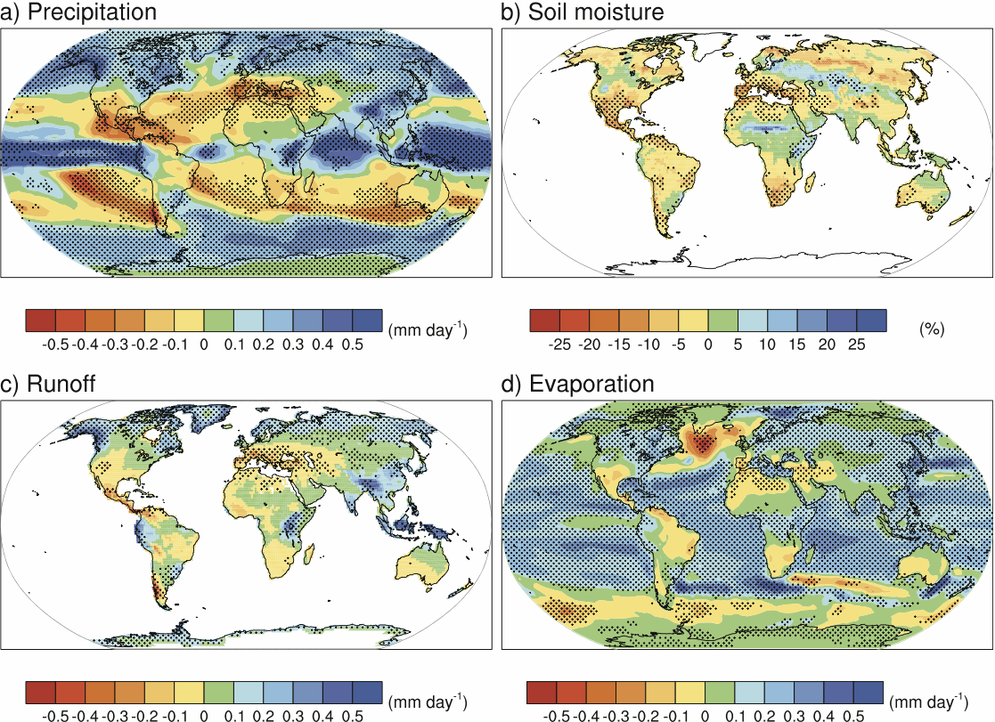
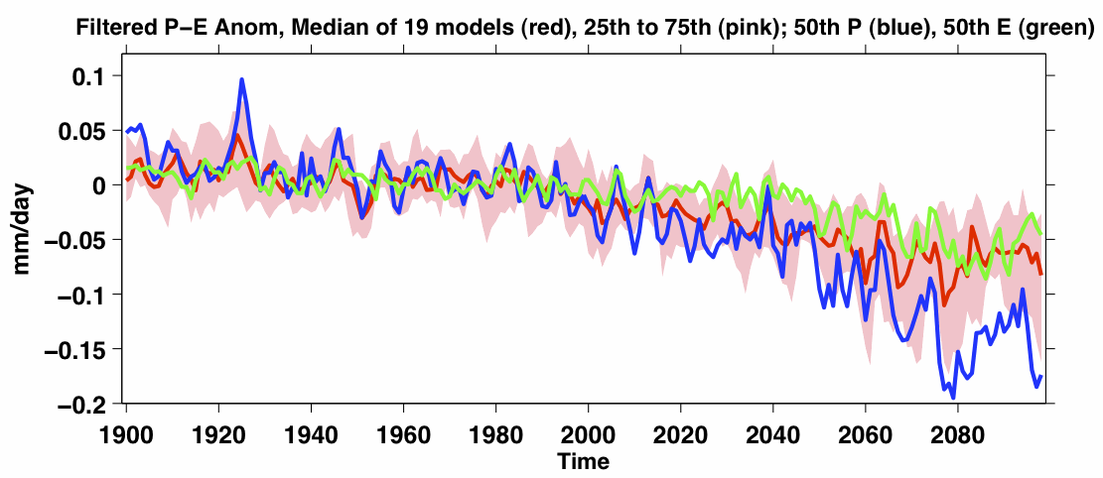
Why Tree-Ring Drought Atlases?
We must better understand the causes of hydroclimatic variability during the Common Era.
Climate models project that subtropical drying is likely to occur due to greenhouse warming and this may be happening already in the American Southwest.
Changes are annual means for the period
2080–2099 relative to 1980–1999
drying
Seager et al., 2007
Figure courtesy of IPCC

Slide 3
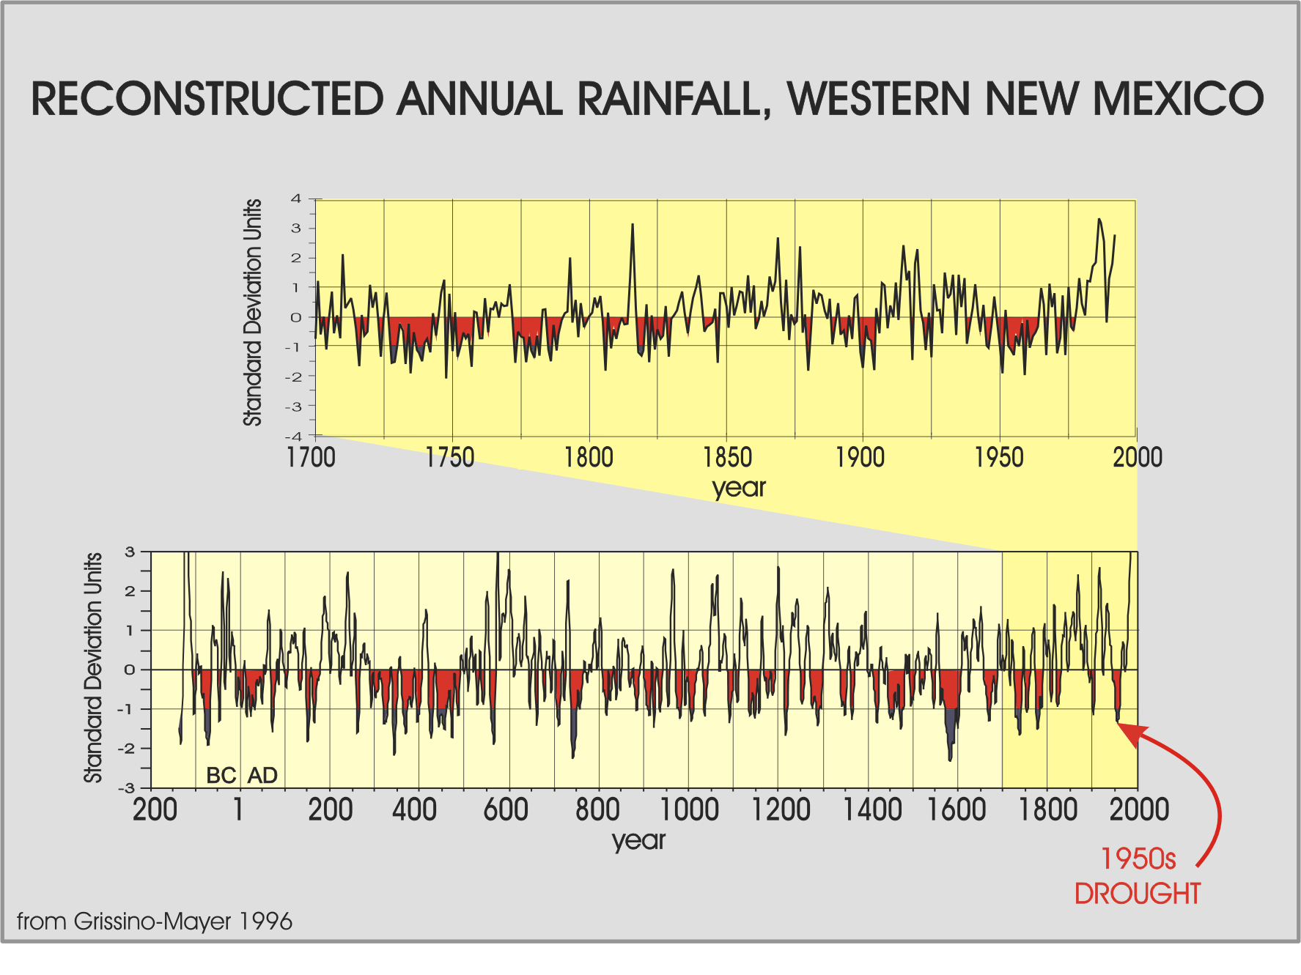
Why Tree-Ring Drought Atlases?
Yet, ominously we now know that droughts of unprecedented severity and duration occurred in the American West and elsewhere long before raising atmospheric CO₂. Thus, these past megadroughts must be viewed as “natural” phenomena.
Knowing how such “natural” megadroughts occurred in the pre-industrial low-CO₂ era is necessary for predicting how likely future megadroughts in the anthropocene will be.
Megadroughts

Slide 4
How are Tree-Ring Drought Atlases Produced?
From the generous contributions of tree-ring data by the global tree-ring research community and archival support of the
NOAA International Tree-Ring Data Bank (ITRDB)

Slide 5
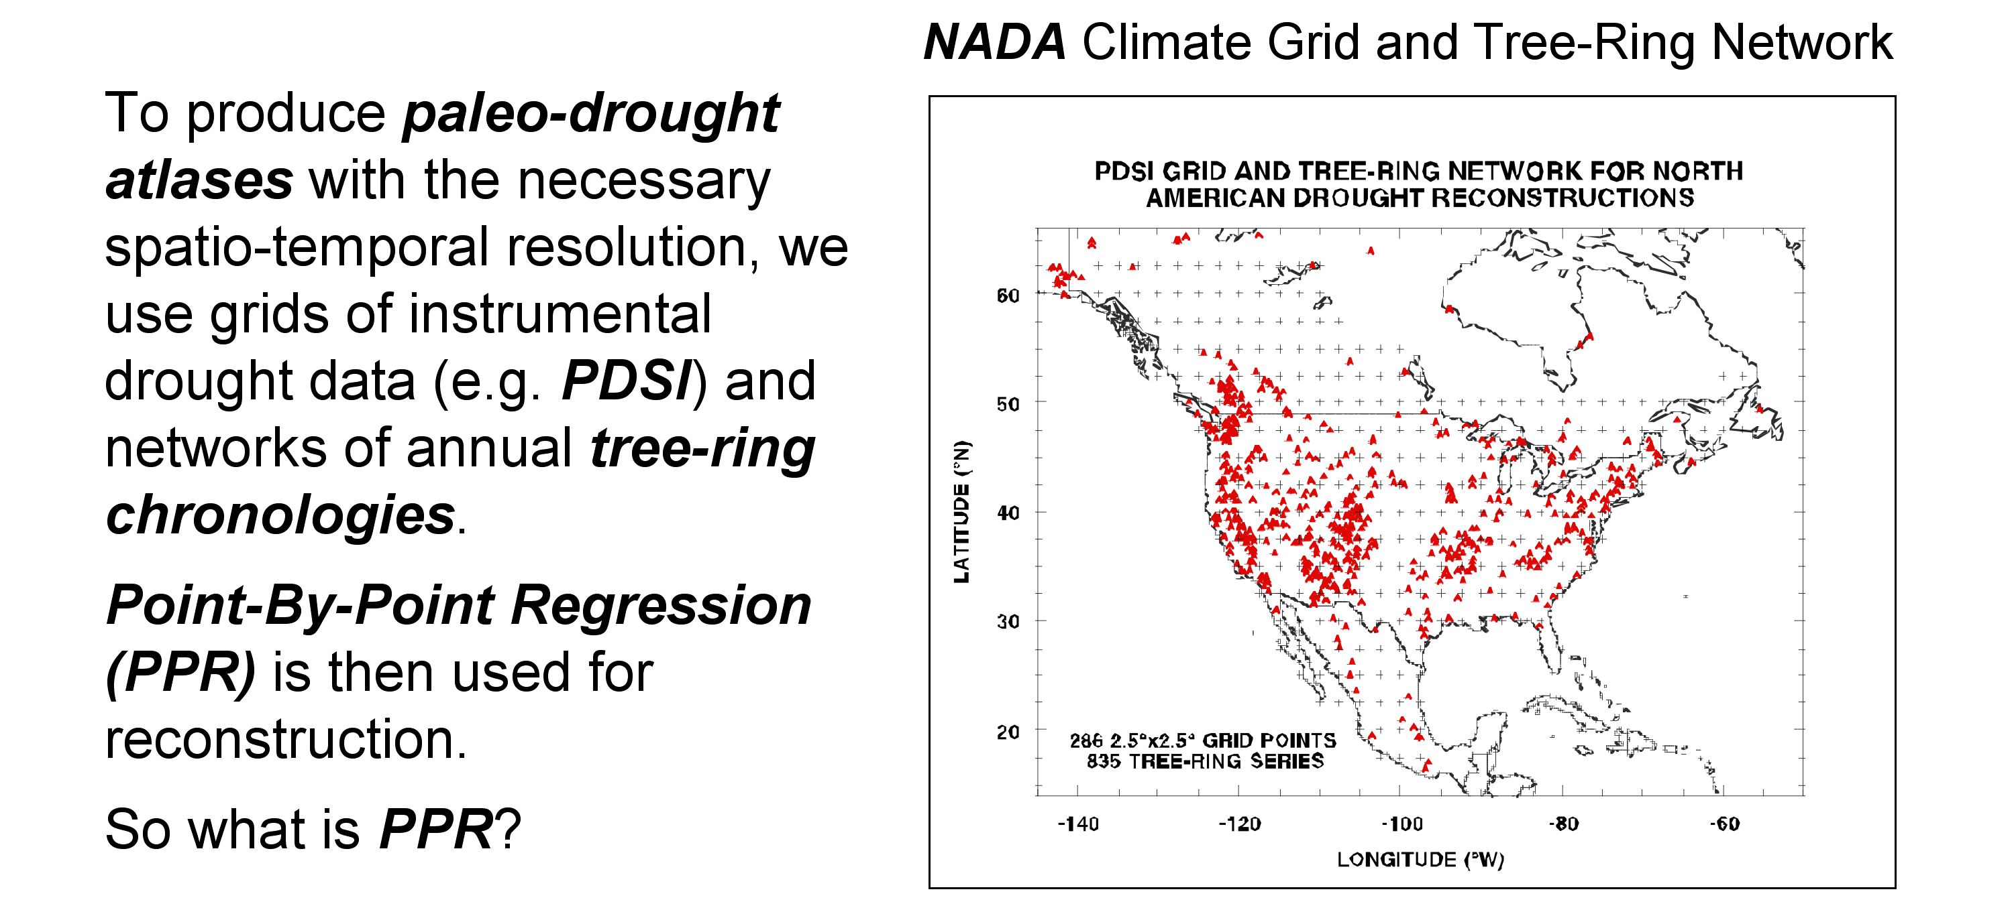
How are Tree-Ring Drought Atlases Produced?
(At least the way I do them!)
*
Point-By-Point Regression*
(PPR)
*See: Cook, E.R., Meko, D.M., Stahle, D.W., and Cleaveland, M.K. 1999. Drought reconstructions for the continental United States. Journal of Climate 12:1145-1162.

Slide 6
So what is Point-By-Point Regression (PPR)?
Sequential fitting of single grid point principal component regression models over a grid.
Each grid point model is individually determined by an overlapping set of tree-ring chronologies based on a search radius related to the correlation decay length (e-folding distance) of the climate field grid points.
Tree-ring chronologies can be autoregressively modeled and screened for significance as candidate predictors of PDSI. They can also be lagged.
Nested reconstructions can be easily created to extend the reconstructions back in time.
Spatial climate information is preserved through the inherent spatial covariance structure between the grid points in the climate field itself.

Slide 7
So why not use joint space-time multivariate reconstruction methods instead of PPR?
Joint space-time methods? Canonical regression? Orthogonal spatial regression? SVD? Regularized expectation maximization? Potential problems here!
No local control over the grid point models: what tree-ring chronologies are used at each grid point, how they are used, and how each grid point model is fit.
Curse of dimensionality (frequently more variables than observations, resulting in rank-deficient matrices).
Reduced space (EOF) approaches to get around this “curse” will leave an EOF “fingerprint”on the spatial structure of the resulting reconstructions based on the EOF cutoff chosen. The reconstructed field will also be rank-deficient at the level of the EOF cutoff.

Slide 8
PPR Originally Used Four levels of Variable Screening for Creating Each Grid Point Regression Model
Level-1: An initial search radius around each grid point is used to locate candidate tree-ring chronologies - can dynamically expand if needed.
Level-2: Only those tree-ring chronologies that correlate “significantly” with PDSI over the calibration period are retained as candidate predictors - a typical choice is the 90% 1-α level.
Level-3: After PCA of the retained Level-2 chronologies, retain only those PCs with eigenvalues>1.0 (Kaiser-Guttman Rule) as candidate predictors in PC regression - a priori and objective.
Level-4: Enter the Level-3 orthogonal tree-ring PCs in stepwise regression by order of explanatory variance and use the minimum-AIC criterion to determine the final order of the regression model - a priori and objective.

Slide 9
An Example of Using the Level-1 Search Radius in North America

Slide 10
Oops! No Tree-Ring Chronologies Found within 450 km

Slide 11
Make Search Radius Dynamic until Chronologies are Found
Grid Point #162

Slide 12
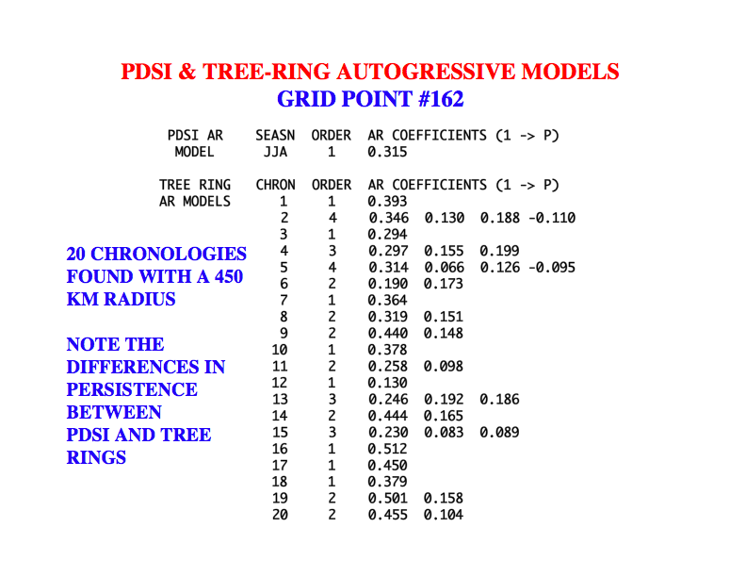

Slide 13
Level-2 Screening of the Level-1 Tree-Ring Chronologies
Grid Point #162
*p<0.10 2-tailed; 19 of 20 pass for year t
CORRELATION WITH PDSI
SEASN TREE-RING SITE YR T YR T+1
JJA CO HORSETOOTH RESERVOIR 1660 1987 0.286* -0.050
JJA CO JEFFERSON COUNTY 1548 1987 0.382* -0.043
JJA CO TURKEY CREEK BLUFF 1640 1987 0.357* -0.085
JJA CO KASSLER 1700 1987 0.284* -0.210
JJA CO VAN BIBBER CREEK 1682 1987 0.560* -0.089
JJA CO Valley View Ranch 1534 1998 0.487* 0.014
JJA CO KIM 1628 1998 0.479* -0.135
JJA CO Sheep Pen Canyon 1460 1998 0.602* -0.063
JJA CO BLACK FOREST EAST 1709 1997 0.500* -0.105
JJA CO ROUND PRARIE 1743 1997 0.530* -0.183
JJA KS TORONTO LAKE 1730 1982 0.512* -0.205
JJA KS FALL RIVER 1738 1982 0.541* -0.149
JJA NE PUMKIN CREEK 1640 1979 0.209 -0.153
JJA NE Niobrara Valley Preserve 1589 1997 0.570* -0.088
JJA NE Canyon Road 1489 1997 0.374* -0.109
JJA NE Ash Canyon 1567 1997 0.322* -0.103
JJA NE SNAKE RIVER 1728 1998 0.522* -0.106
JJA NE LONE PINE CREEK 1732 1997 0.431* -0.096
JJA SD CEDAR BUTTE PINE 1646 1991 0.417* -0.102
JJA SD CEDAR BUTTE JUNIPER 1691 1991 0.420* -0.123

Slide 14
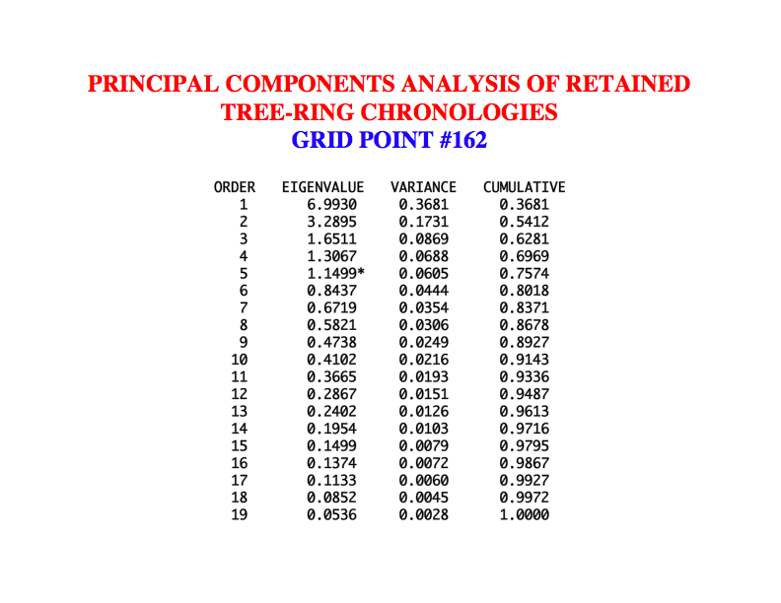

Slide 15
Relatively little distance decay

Slide 16
Level-3 Eigenvalue-1 Cutoff and Level-4 Regression Model
Grid Point #162
CALIBRATION PERIOD: 1928 1978
STEP VAR PCVAR CORR TSTAT RSQ CUM ARSQ ERE CVRE AIC
---- --- ----- ---- ----- --- --- ---- --- ---- ---
1 1 36.8 0.725 7.37 0.526 0.526* 0.516* 0.507* 0.521* -33.78*
2 3 8.7 0.222 1.59 0.049 0.575* 0.557* 0.540* 0.557* -37.11*
3 2 17.3 0.222 1.59 0.049 0.624* 0.600* 0.577* 0.596* -41.02*
4 5 6.1 -0.216 -1.55 0.047 0.671* 0.642* 0.615* 0.639* -45.32*
5 4 6.9 0.200 1.43 0.040 0.711* 0.679* 0.648* 0.670* -49.38*
6 6 4.4 -0.034 -0.24 0.001 0.712* 0.673 0.635 0.645 -46.89
MINIMUM AIC REGRESSION MODEL ORDER: 5 PERCENT VARIANCE EXPLAINED: 71.1 %
VERIFICATION PERIOD: 1900 1927
PEARSON ROBUST
STEP VAR RSQ RSQ RE CE
---- --- ----- ----- ----- -----
1 1 0.379* 0.370* 0.474* 0.358*
2 3 0.251* 0.207* 0.351* 0.207*
3 2 0.361* 0.302* 0.462* 0.343*
4 5 0.431* 0.367* 0.524* 0.419*
5 4 0.598* 0.695* 0.642* 0.562*

Slide 18
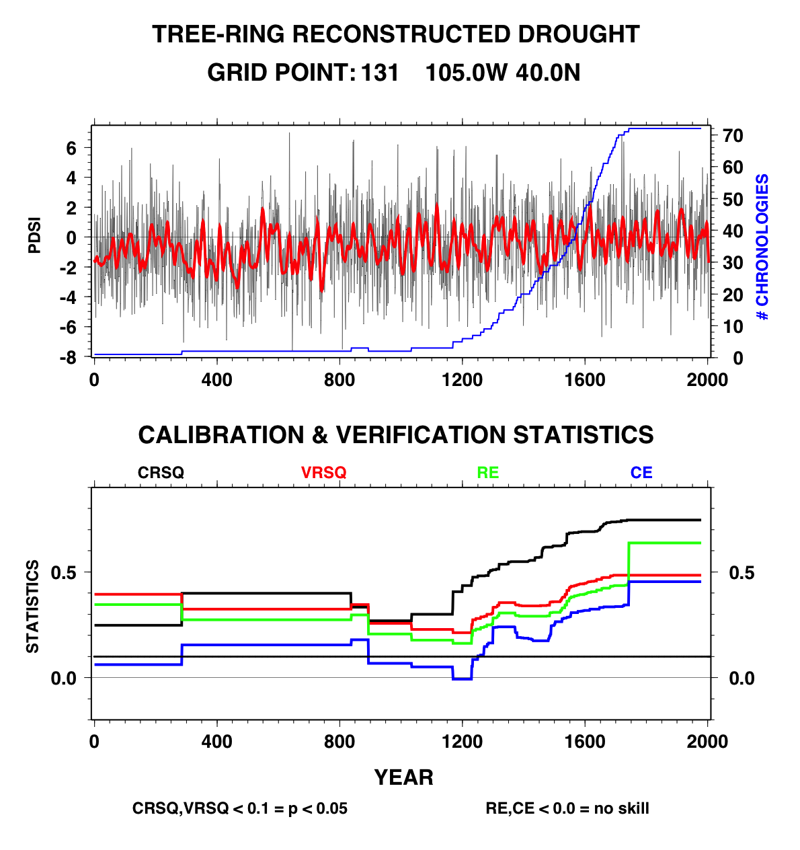

Slide 19
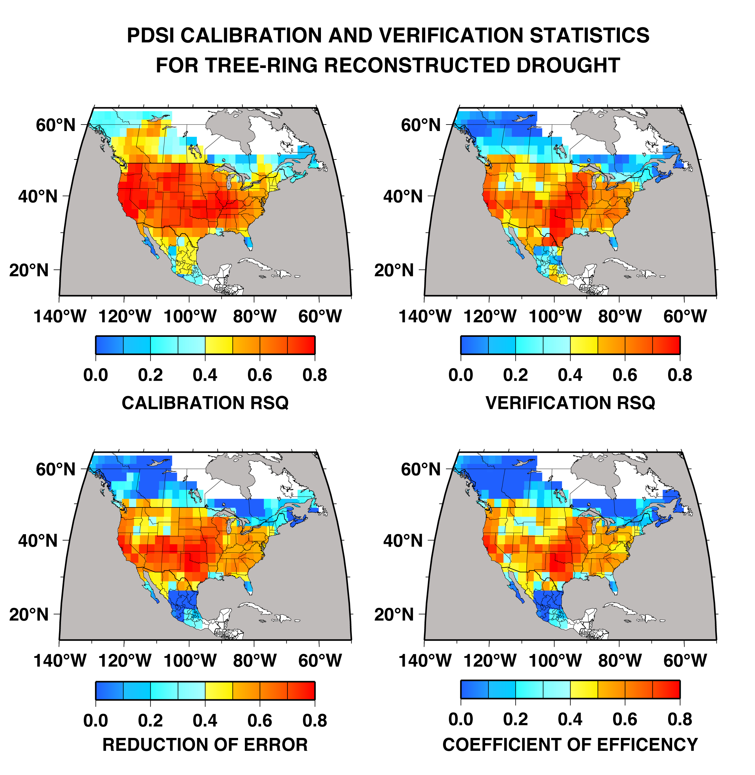

Slide 20
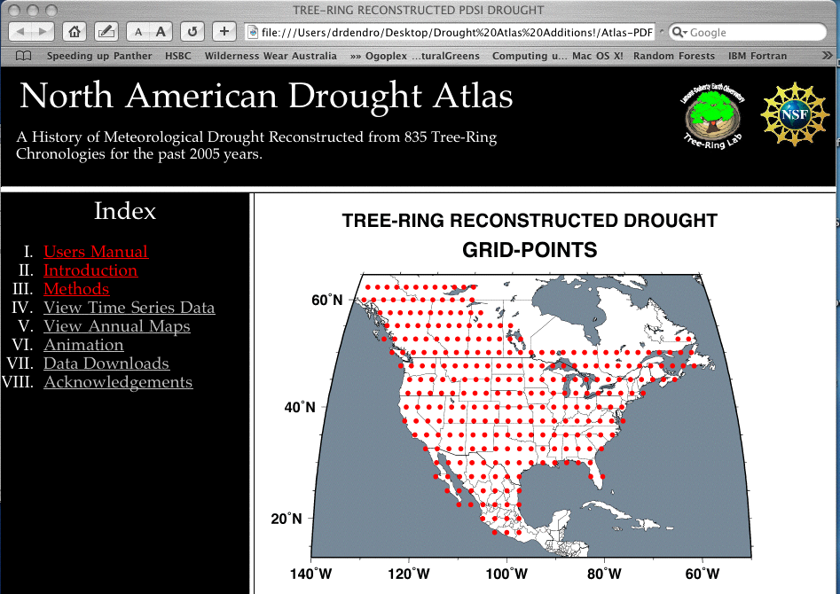
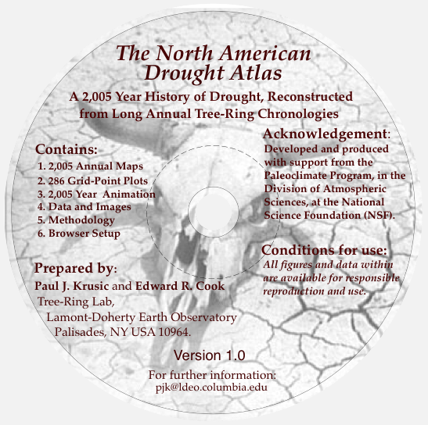
To this end, the North American Drought Atlas (NADA) was developed and released to the public in 2004
E. R. Cook, C. A. Woodhouse, C. M. Eakin, D. M. Meko, D. W. Stahle, 2004. Long-term aridity changes in the western United States.
Science 306, 1015–1018.

Slide 21
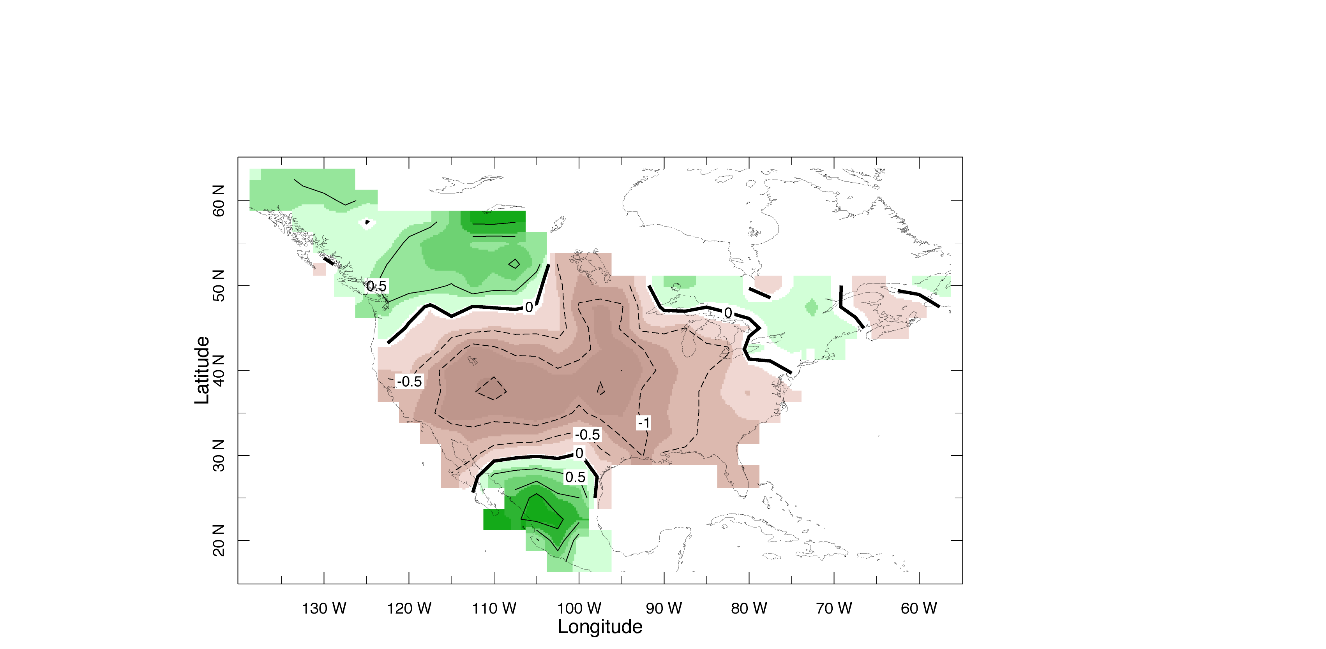
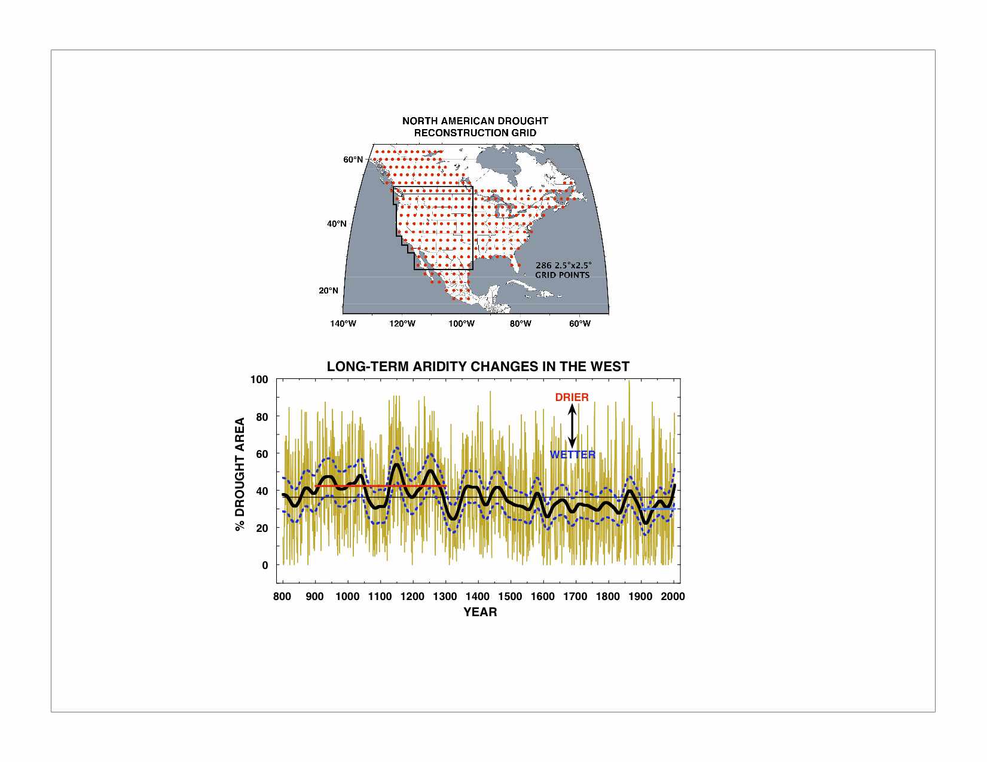
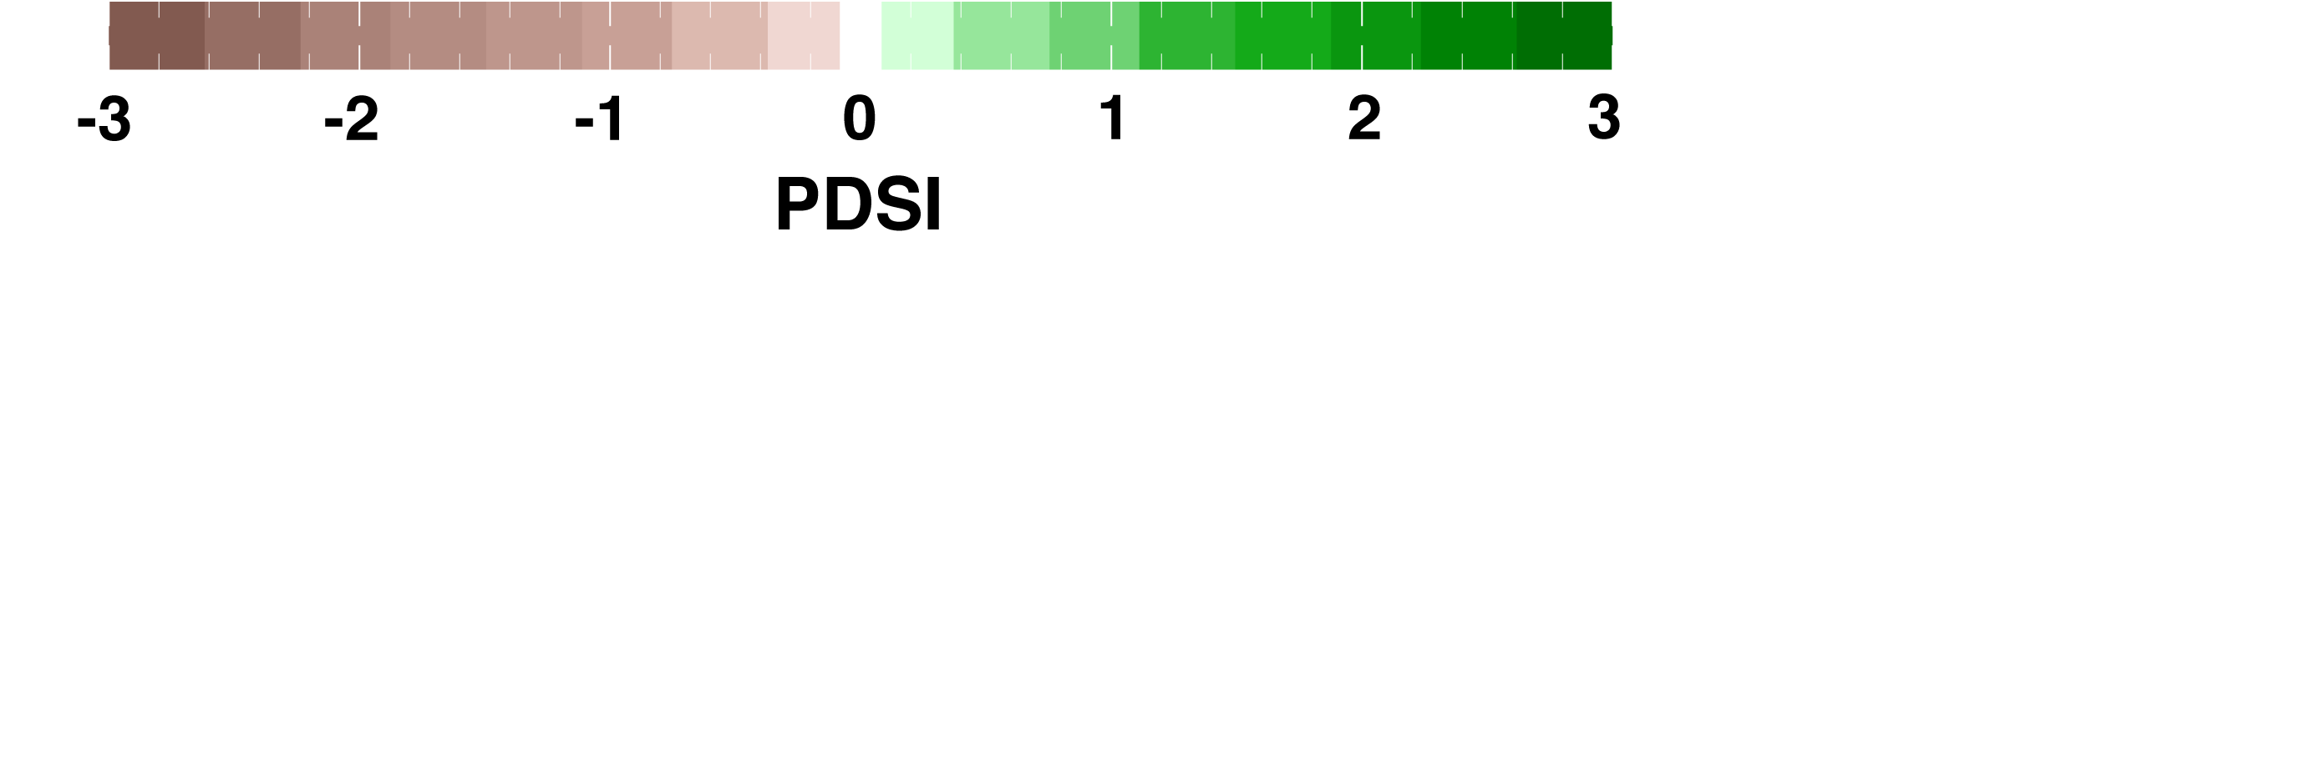
What has the NADA been used for?
Documenting and Mapping Large-Scale Megadroughts
Revealing Long-Term Aridity Changes
in the Western U.S. since AD 800
48 Years Duration
1434-1481
Adapted from Cook et al., 2004

Slide 22
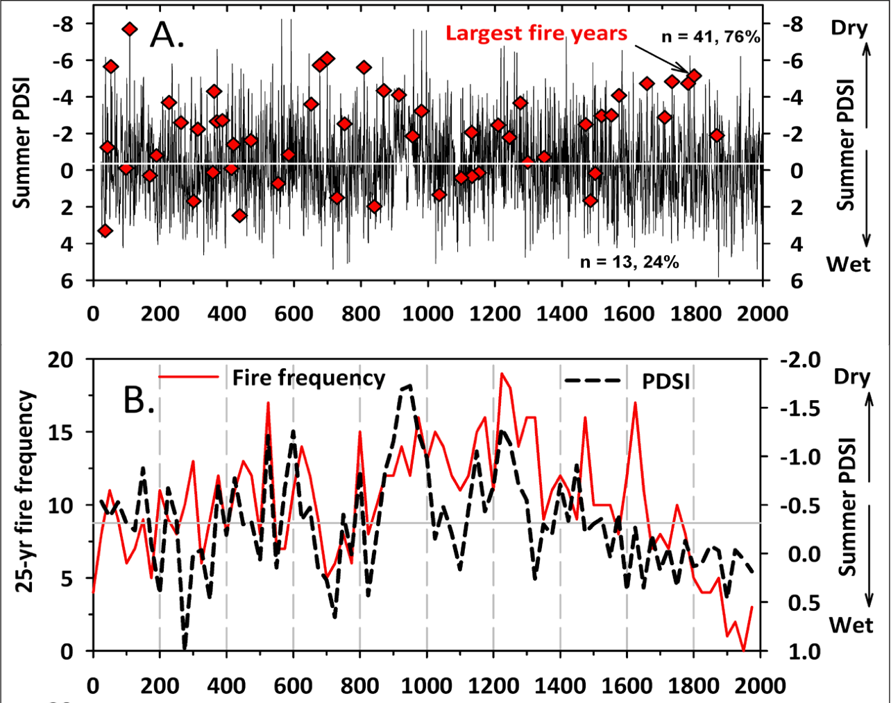
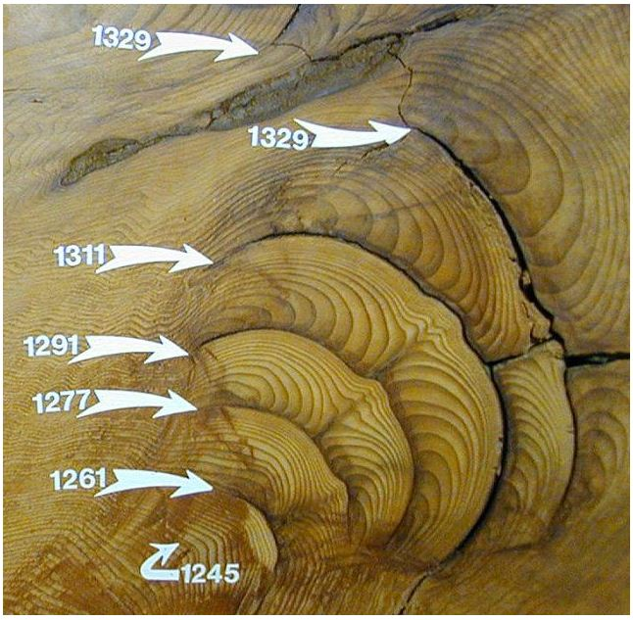
What else has the NADA been used for?
Data For Comparing Forest Fire Histories To Past Droughts
“Multi-Millennial Fire History Of Giant Forest, Sequoia National Park, California, USA” (Swetnam et al., 2009, Fire Ecology)
Giant Sequoia Fire Scars
Photo Courtesy of Tom Swetnam
From Swetnam et al., 2009

Slide 23
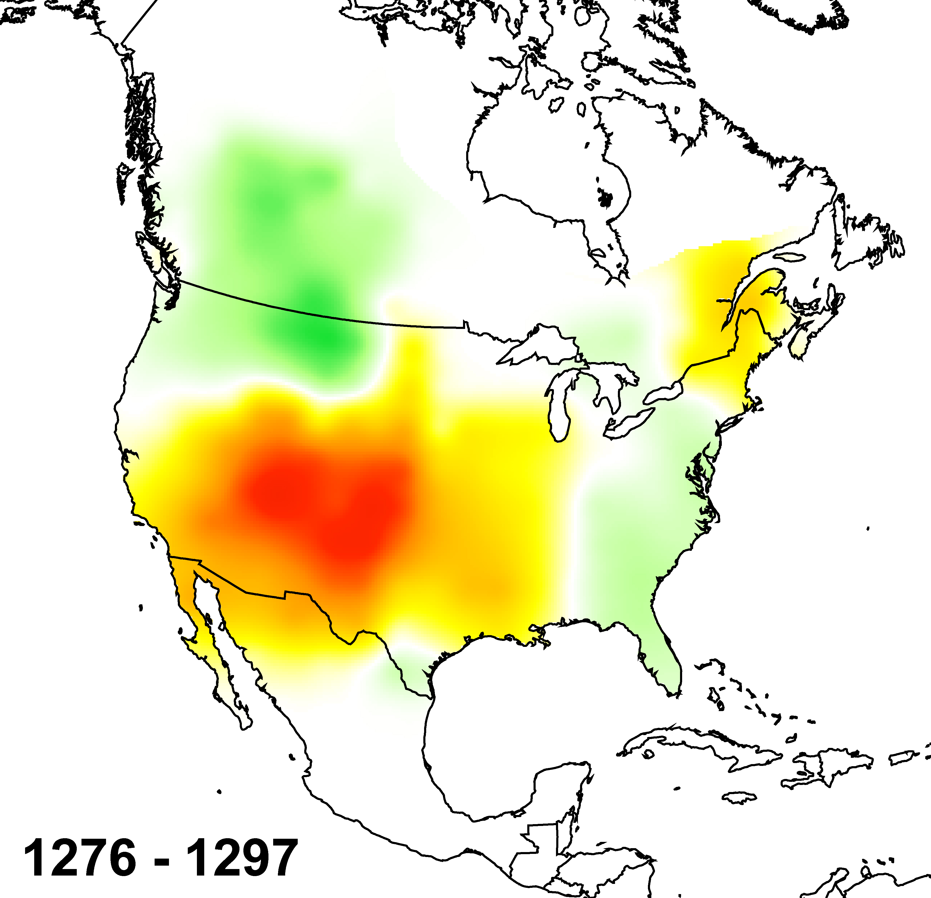
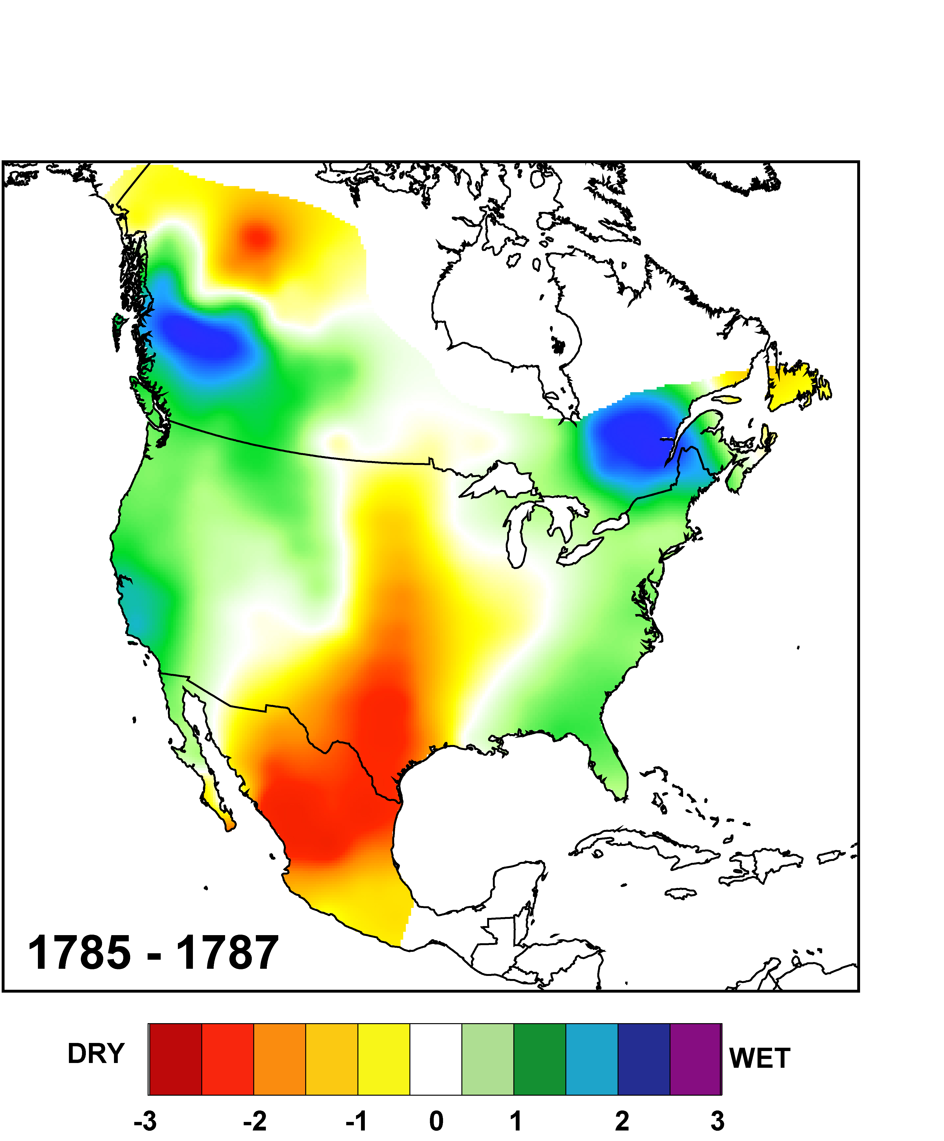
One Last NADA Example
(There are many more that could be shown)
Suggested Links Between Droughts And Cultural Disasters
“Great Pueblo Drought”
Overpopulation/Overexploitation
Of Natural Resources
Social System Collapse
(Douglass, 1929)
“El Año de Hambre”
Famine and Disease Kill 300,000
“Most disastrous single event in the
history of colonial maize agriculture” (Gibson, 1964)
Figures courtesy of David Stahle

Slide 24
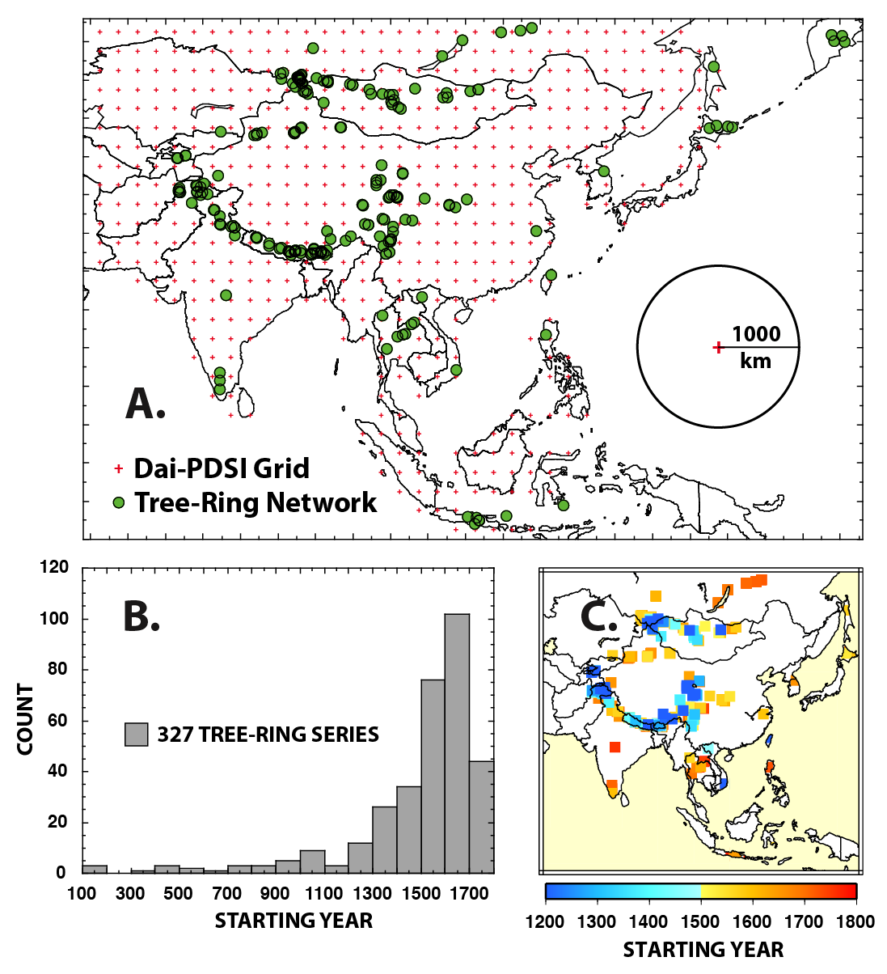
Another tree-ring drought atlas now: the Monsoon Asia Drought Atlas (MADA)
Cook, E.R., K.J. Anchukaitis, B.M. Buckley, R.D. D’Arrigo, G.C. Jacoby, and W.E. Wright. 2010. Asian monsoon failure and megadrought during the last millennium. Science 328(5977):486-489.
MADA Climate Grid and Tree-Ring Network
As with the NADA, a grid of instrumental drought indices and a network of annual tree-ring chronologies were used to produce the MADA.
An ensemble version of Point-By-Point Regression was used for reconstruction. See Cook et al. (2010) for details.
From Cook et al., 2010

Slide 25
Ensemble Point-by-Point Regression (EPPR)
Fixed screening probability in original PPR method eliminated;
Replaced by weighting each tree-ring chronology by some power of it correlation with each grid point PDSI
wTR = uTR * r^{p}
where wTR is the weighted tree-ring series, uTR is the original unweighted tree-ring series in standard normal deviate form, r is the correlation between the tree-ring series and Dai-PDSI over the 1951-1989 calibration period, and p is some power ≥0. Preserves rank order importance.
Doing so perturbs the covariance matrix of the predictors that are subjected to PCA prior to use of tree-ring PCs in regression;
This was done for, say, eight values of p: 0, 0.1, 0.25, 0.5, 0.67, 1.0, 1.5, and 2.0 to produce an initial ensemble of eight (8) members.

Slide 26
p=0 (no weighting)
90% hard rejection used by Cook et al. (1999) found to be a “near-global optimum” has been eliminated now.
Power-transformed correlations replace hard rejection with continuous weighting that ranges greatly over the span of powers (p>0) shown.

Slide 27
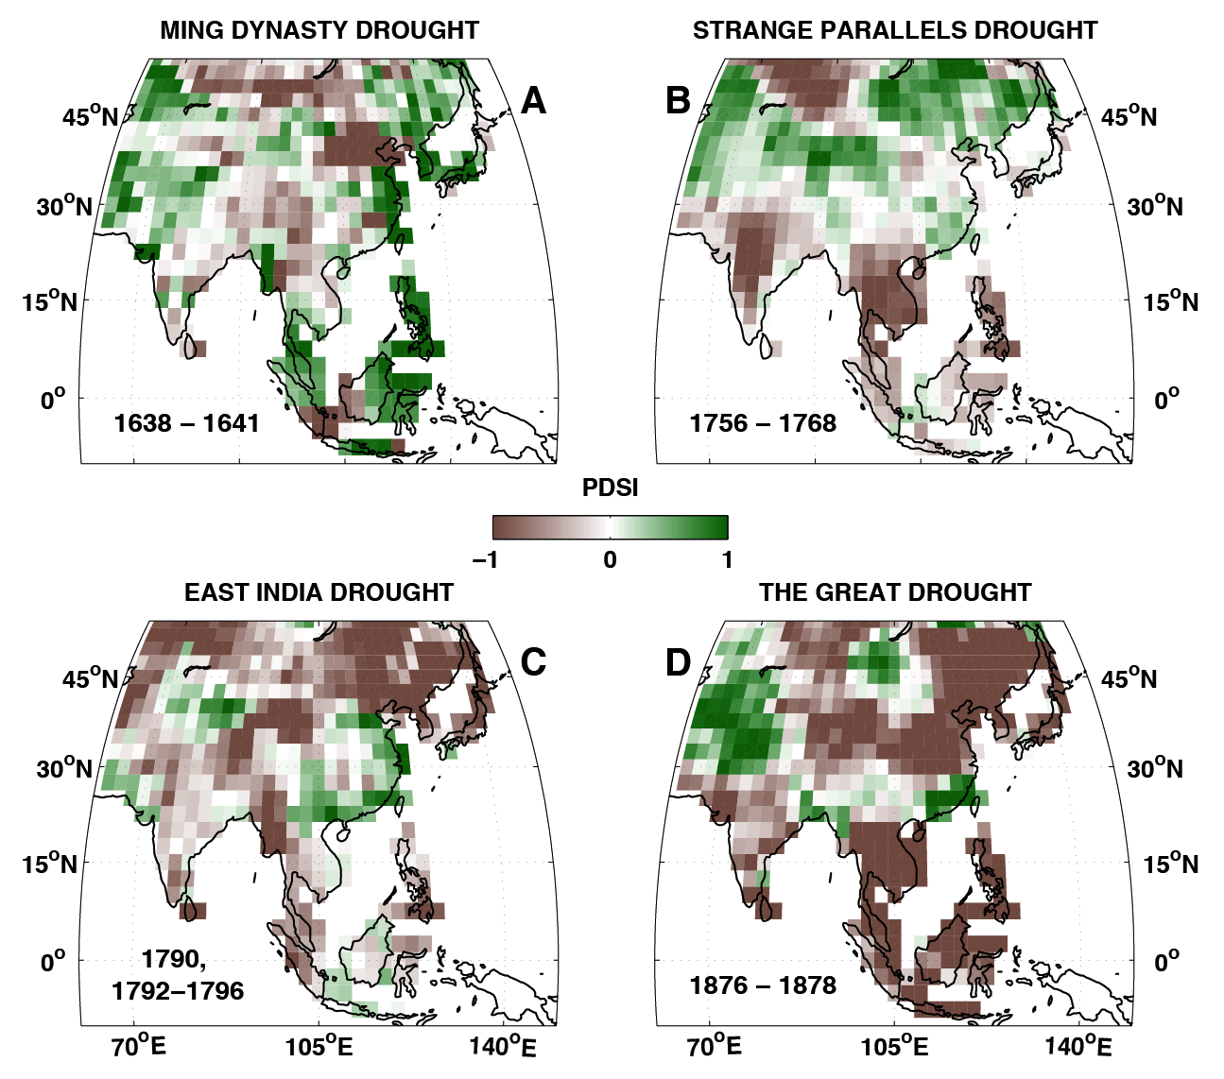
What has the MADA been used for?
Mapping ‘Historical’ Monsoon Failures in Full Spatial Detail
“Asian Monsoon Failure and Megadrought During the Last Millennium”
(Cook et al., 2010, Science)
From Cook et al., 2010

Slide 28
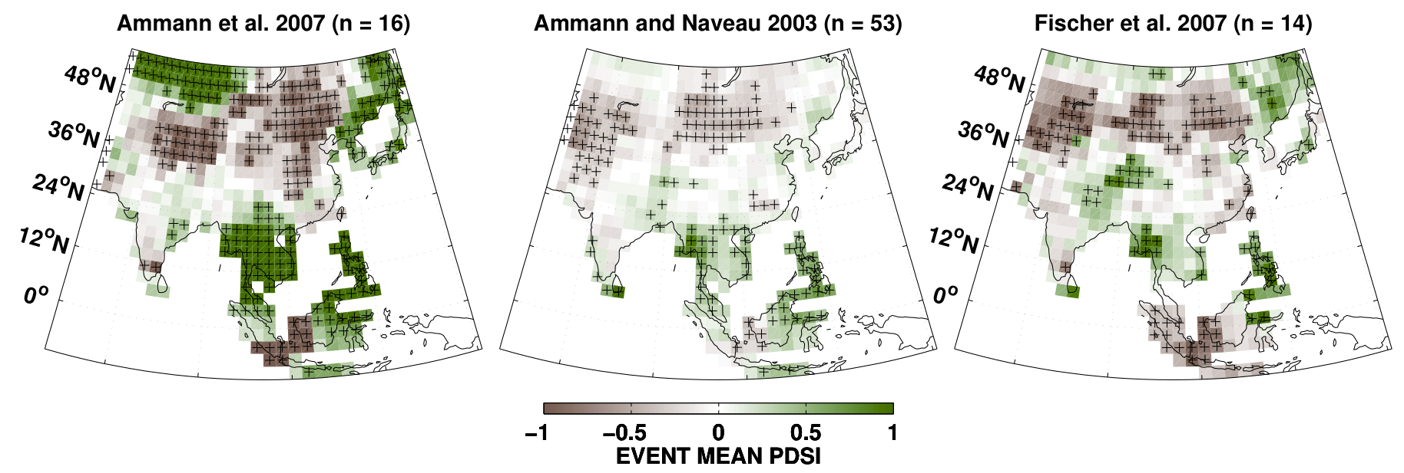
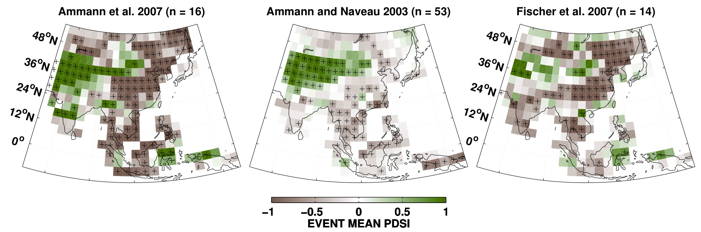
Using MADA for data/model comparisons
“The Influence of Volcanic Eruptions on the Climate of the Asian Monsoon Region” (Anchukaitis et al., 2010, Geophy. Res. Lett.)
Superposed
Epoch
Analysis:
MADA vs.
CSM 1.4
Three
published
key year
lists.
Wet
Wet
Wet
MADA
From
Anchukaitis
et al., 2010.
Dry
Dry
Dry
MODEL
Almost opposite results. Who’s right? I’ll bet on the trees because they were there!

Slide 29
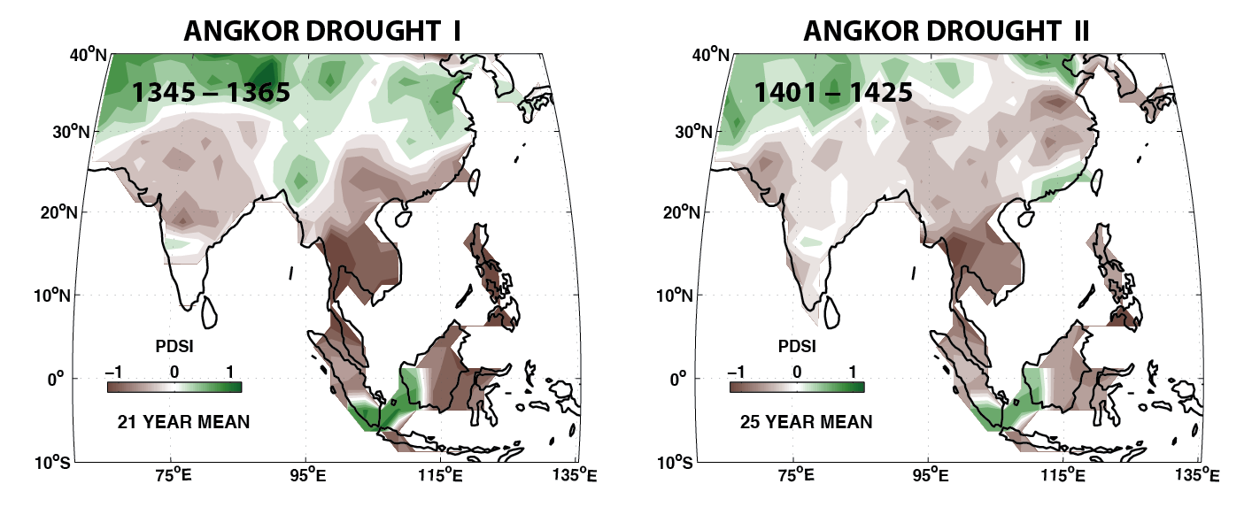
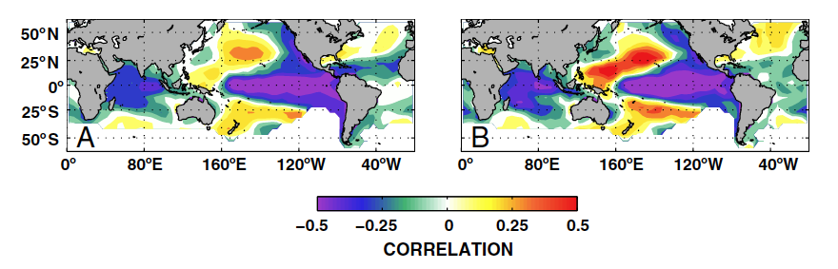
One Last MADA Example
Megadroughts and ENSO linked to cultural demise in Southeast Asia!
“Climate as a Contributing Factor in the Demise of Angkor, Cambodia” (Buckley et al., 2010, Proc. Nat. Acad. Sci.)
Correlations
between SE Asia
drought and SSTs
From Buckley
et al., 2010

Slide 30
The Scientific Impact of the NADA and MADA
-- Evidence from Citation Indices --
"Long-term aridity changes in the western United States", Science, 2004 - The NADA: Google Scholar: 1282, Web of Science: 793
"Asian monsoon failure and megadrought during the last millennium", Science, 2010 – The MADA: Google Scholar: 546, Web of Science: 372
These citation indices objectively reveal the considerable scientific impact the NADA and MADA have had in general and help justify the continuing development of tree-ring drought atlases elsewhere in the world.
With this segue, here is what has happened more recently.

Slide 31
A 3rd NH tree-ring drought atlas has been produced now: The “Old World Drought Atlas” (OWDA)
Cook, E. R., et al. 2015. Old World Megadroughts and Pluvials during the Common Era. Science Advances 1(10), e1500561,
doi:10.1126/sciadv.1500561.
*MXDA
*The “Mexican Drought Atlas” (MXDA) is in review at Quaternary Science Reviews.

Slide 32
The OWDA Target Field and Tree-Ring Network
OWDA Target: 5414 0.5° JJA scPDSI Grid Points
OWDA Tree-Ring Network: 106 Chronologies

Slide 33
Historical Climatology Studies in Europe Allow for
Comparisons with of the OWDA – Example 1
“The Great European Famine of 1315, 1316, and 1317”
Lucas, H.S. 1930. Speculum – A Journal of Medieval Studies.
The Great Famine – Northern Europe in the Early Fourteenth Century
Jordon, W.C. 1996. Princeton University Press.
Caused by too much spring-summer rain beginning in 1314.
PDSI
PDSI
PDSI

Slide 34
Historical Climatology Studies in Europe Allow for
Comparisons with of the OWDA – Example 2
“Droughts in the Czech Lands, 1090–2012 AD”
R. Brazdil et al. 2013. Climate of the Past 9:1985-2002.
Mean of Eight Noteworthy Czech Lands Droughts:
1442, 1471, 1473, 1540, 1590, 1616, 1718, 1719
>95% (2-tailed)
PDSI
PDSI
Mean >95% CL

Slide 35
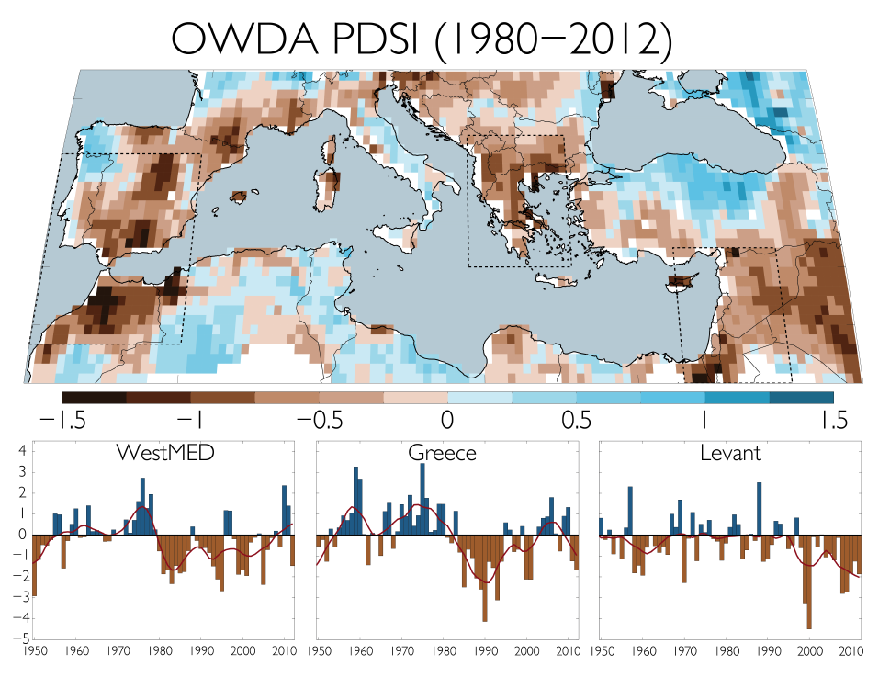
The OWDA also allows us to investigate the recent Mediterranean drying trend – the Levant is drying most. How unusual is it compared to the past 900 years?
Levant
From: Cook, B.I., et al. 2016. Spatiotemporal drought variability in the Mediterranean
over the last 900 years. J. Geophys. Res. Atmos., 121, doi:10.1002/2015JD023929.

Slide 36
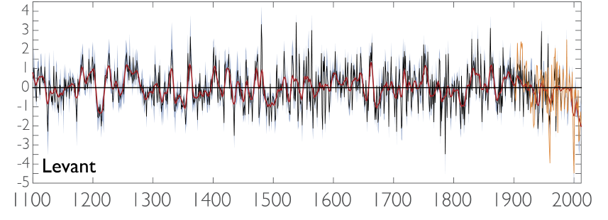
Here is the average reconstruction back to 900 CE over the Levant. So, how unusual is it compared to the past
900 years? Pretty unusual. Anthropogenically forced?
“Estimating uncertainties using a resampling approach, we conclude that there is an 89% likelihood that this drought is drier than any comparable period of the last 900 years and a 98% likelihood that it is drier than the last 500 years.” (Cook et al. 2016).

Slide 37
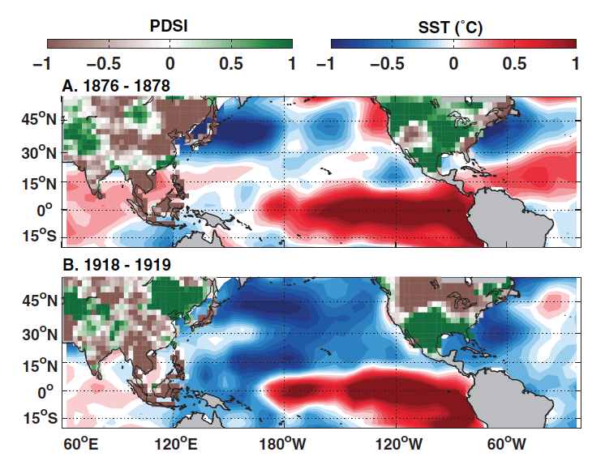
Individual drought atlases are good, but multiple drought atlases are better because they can be jointly used to
search for coupled modes of climate forcing:
This can be done because, as constructed, the drought atlases are based on completely independent data. Below is an example from the MADA (2010) publication: the MADA and NADA are “connected” by an tropical Pacific El Niño “bridge” in 1876-78 that produced dry conditions in Asia and wet conditions in North America as expected.

Slide 38
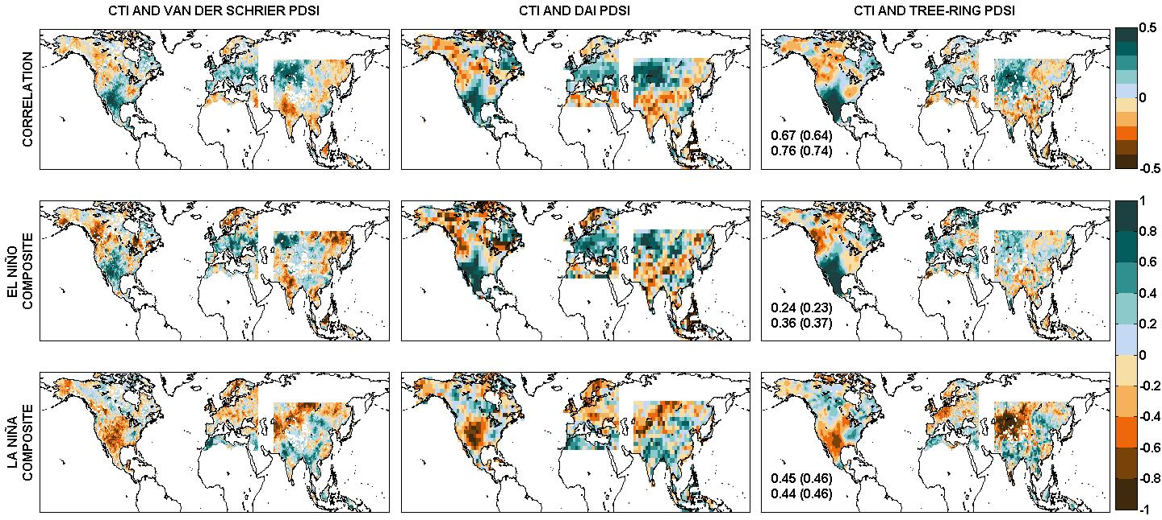
ENSO and PDSI (1901-1978) Drought Atlas Correlations
Another example of how multiple drought atlases can be used to identify coupled modes of climate forcing:
Instrumental
van der Schrier PDSI
Instrumental
Dai PDSI
Reconstructed
Tree-Ring PDSI
Correlation
Figure courtesy of Hun Baek and Jason Smerdon
The patterns of correlation between ENSO and the instrumental and tree-ring drought atlases are remarkably similar!
This suggests that a ENSO-forced coupled mode of hydroclimatic variability exists in the independent drought atlases, but the sign of forcing differs by region within and between atlases.

Slide 39
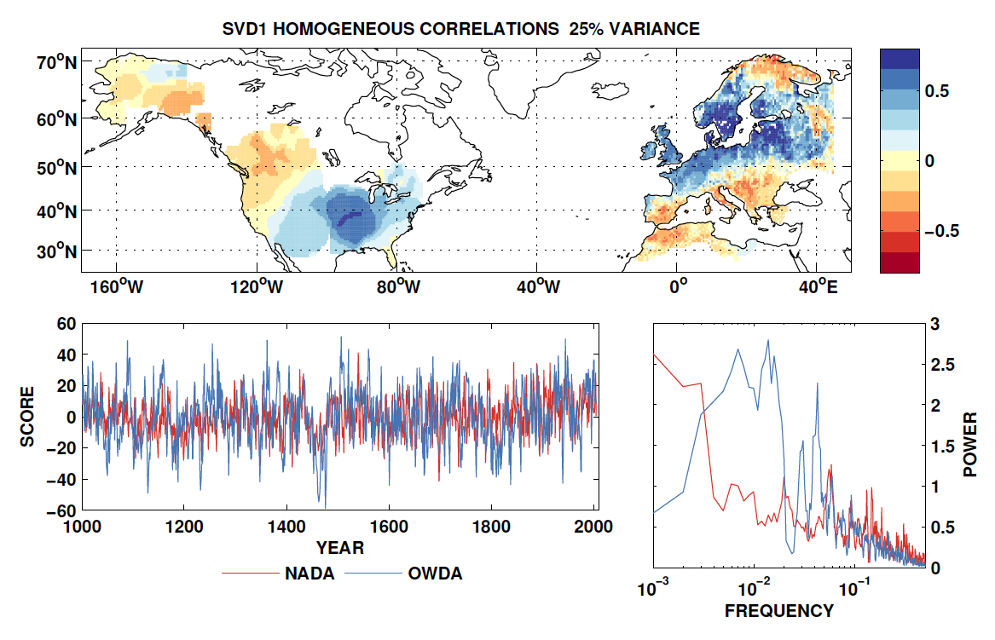
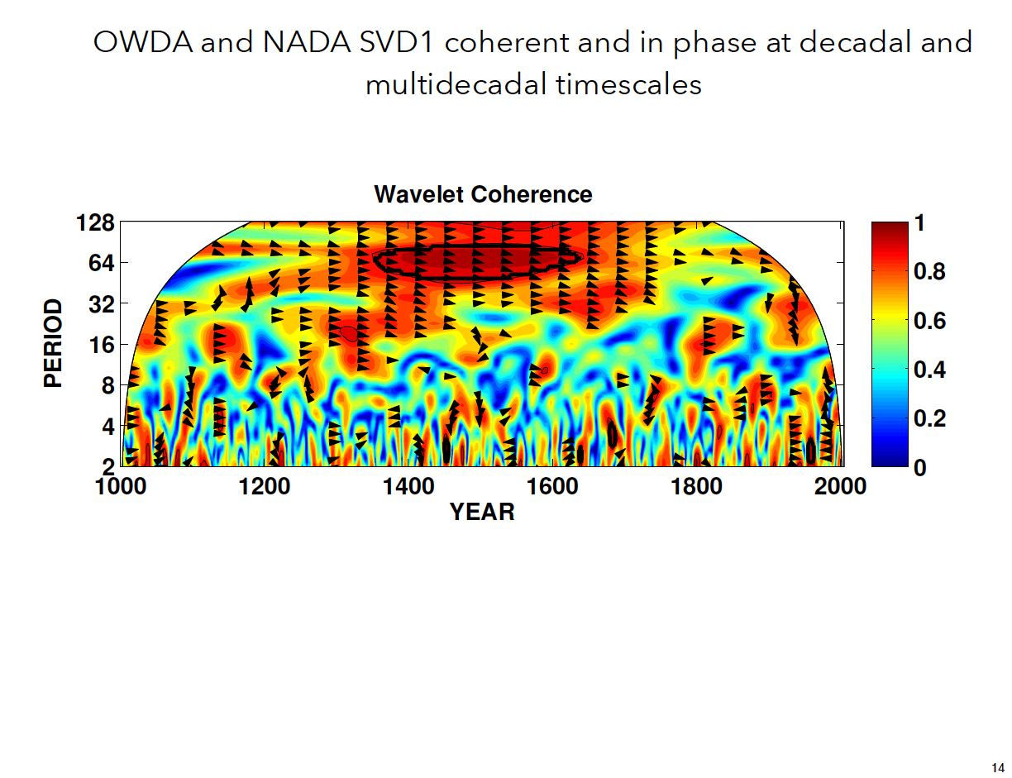
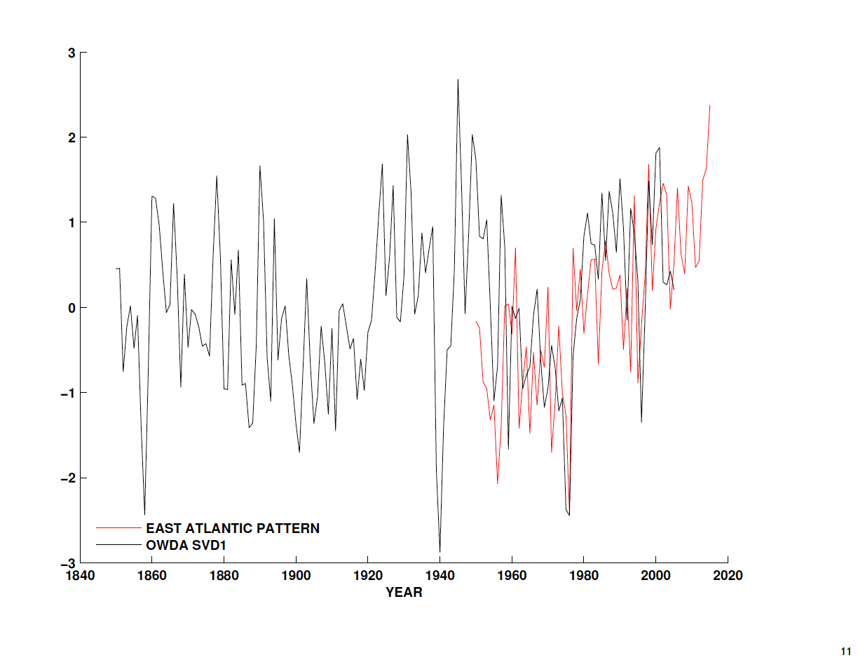
A more sophisticated “coupled mode” analysis can also be conducted: NADA vs. OWDA here
Using the Singular Value Decomposition (SVD) method of Bretherton, a search for coupled modes in the NADA and OWDA has revealed an amazing degree of coupling: the leading two modes SVD1 & SVD2 explained 25% & 19% of the joint variance, 44% in total (Anchukaitis and Cook, in prep.). SVD1 results are shown here:
OWDA and NADA Wavelet Coherence
SVD1 SCORES
EAST ATLANTIC PATTERN MATCH WITH OWDA SVD1
Figures courtesy of Kevin Anchukaitis

Slide 40
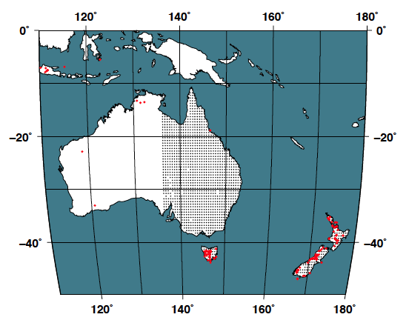
Now for a recently published SH tree-ring* drought atlas:
Australia-New Zealand Drought Atlas (ANZDA):
Palmer, J.G. et al. 2015. Drought variability in the eastern Australia and New Zealand summer drought atlas (ANZDA, CE 1500–2012) modulated by the Interdecadal Pacific Oscillation. Environmental Research Letters 10, doi:10.1088/1748-9326/10/12/124002.
1375 0.5° DJF scPDSI points reconstructed from 177 tree-ring and one coral-proxy records using PPR.
*One annual coral
record included.
From: Palmer et al. 2015.

Slide 41
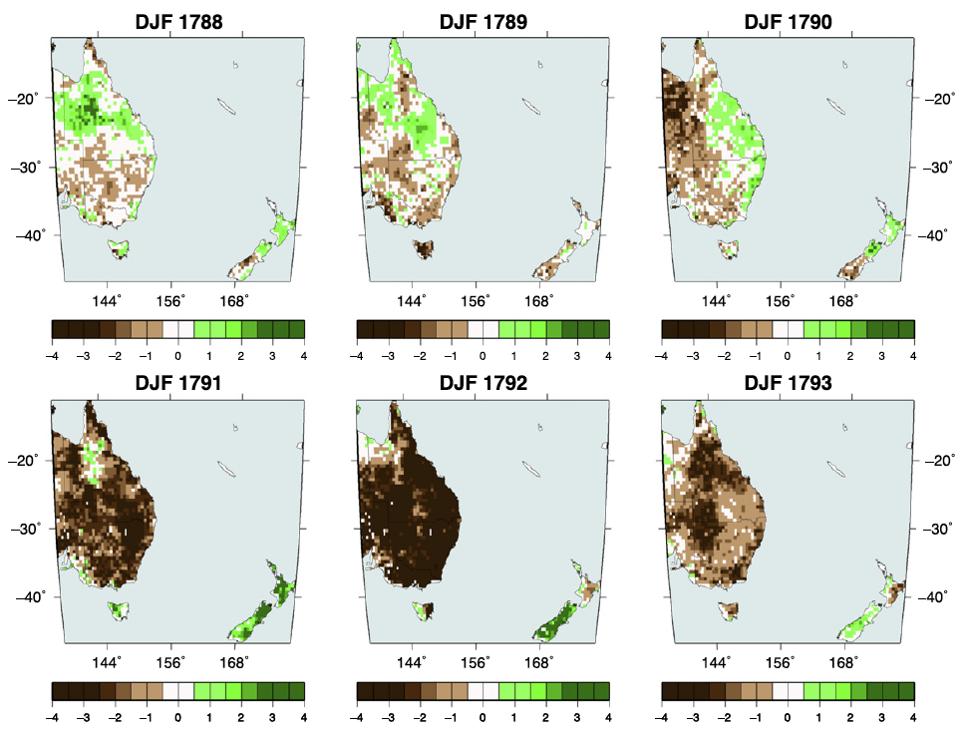
The ANZDA: European arrival in 1788 was greeted by overall fine conditions, followed by severe drought
a few years later (agrees with historical records).
Botany
Bay
From: Palmer et al. 2015.

Slide 42
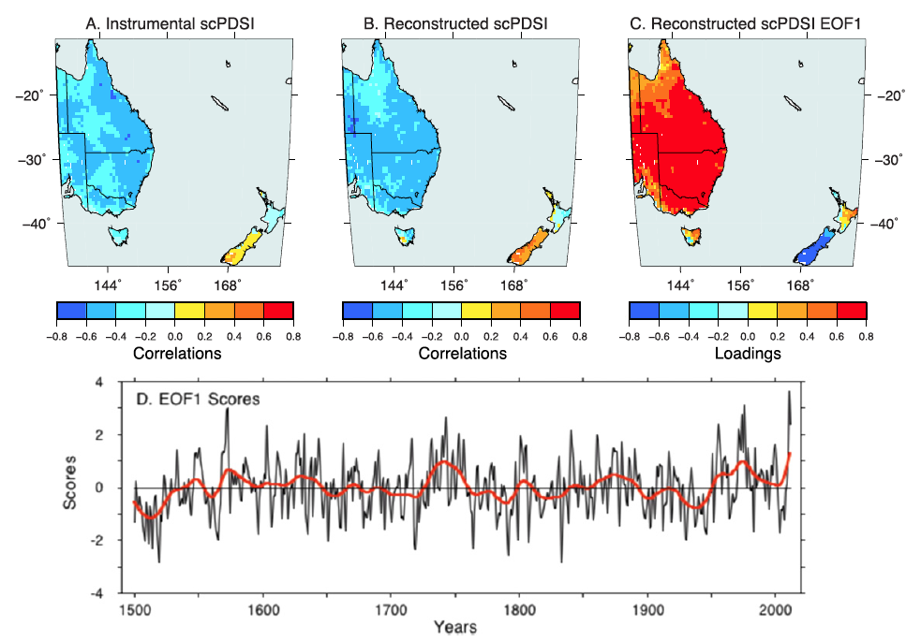
Variability in wet and dry over ANZDA is tightly coupled with the phase of the Interdecadal Pacific Oscillation (IPO) as measured by the Tripole Index (TPI) (Henley et al. 2015).
1902-1975
correlations
with DJF TPI
D. EOF1 Scores ~50% of the total variance
From the ANZDA, this is effectively a
reconstruction of the DJF Tripole Index
From: Palmer et al. 2015.

Slide 43
The ANZDA also allows us to investigate recent drying and wetting patterns over Australia. How unusual are they compared to the past 500 years?
B
C
Loading
A
A. Southeastern Australia B. Western Queensland C. Coastal Queensland
From: Cook, B.I., et al. 2016. The paleoclimate context and future trajectory
of extreme hydroclimate events in eastern Australia. J. Geophys. Res. Atmos.,
in revision.

Slide 44
The ANZDA: Consider the very wet 2011 year. How unusual?
Southeastern Australia
Western Queensland
2011 exceeds
all but one past
event in Coastal
Queenland at the 95% 1-tailed level compared to reconstruction prediction intervals.
Coastal Queensland
From: Cook et al., 2016.

Slide 45
So what is the next proposed tree-ring drought atlas?
The South American Drought Atlas (SADA)!

Slide 46
Now, I will stop and pass on the
discussion of the SADA and its creation to my friend and colleague Pini Morales.

