Slide 1
Point-by-Point Regression (PPR)
Sequential fitting of single grid point principal component regression models over a grid.
Grid point models are individually determined by overlapping sets of tree-ring chronologies located within a search radius related to the correlation decay length (e-folding distance) of the climate field grid points.
Tree-ring chronologies can be autoregressively modeled and screened for significance as predictors of the predictand field. They can also be lagged (e.g. t, t+1) w.r.t. climate.
Nested reconstructions can be easily created to extend the reconstructions back in time and can vary in length over the domain as dictated by the tree-ring chronologies.
Spatial climate variability over the climate field is preserved through the inherent spatial covariance structure between the grid points in the climate field itself.

Slide 2
So why not use joint space-time multivariate Climate Field Reconstruction (CFR) methods instead of PPR?
Joint space-time methods? Canonical regression? Orthogonal spatial regression? SVD? RegEM? Potential problems here!
No control over the grid point models: what tree-ring chronologies are used at each grid point, how they are used, and how each grid point model is fit.
No control over the inclusion of potentially unstable long-range teleconnections across the domain by chance alone.
Curse of dimensionality (frequently more variables than observations, potentially severe rank-deficiency).
Reduced space (EOF) methods used to get around this “curse” leave an EOF spatial “fingerprint” structure on the resulting reconstructions based in part on the EOF truncation chosen. The reconstructed field will even more rank-deficient.
The Russian Drought Atlas (RUDA) under development will now be used to describe some new stuff about PPR.

Slide 3
The Russian Drought Atlas (RUDA)
Based on a 4259-point, 0.5° grid of self-calibrating PDSI (scPDSI) for the June-July-August season and a newly developed network of 602 annual tree-ring chronologies. Autoregressive modeling is applied in PPR to both tree rings and scPDSI following the ‘random shock model’ method of Dave Meko, with t and t+1 candidate tree-ring predictors used in principal components regression to reconstruct scPDSI.
Correlation-weighted PPR is used with two search radii (500km and 1000km) for finding tree-ring series. The duel search radii are in the e-folding distance range of PDSI for the most part and emphasize both more local (500km) and more distant (1000km) signals in the irregular tree-ring network.
A relatively new option in PPR allows one to not use certain nested reconstructions that fall below a correlation threshold R between the first (shortest, but best replicated) reconstruction nest and any of the subsequent (longer, but less well replicated) reconstruction nests.

Slide 4
RUDA scPDSI Grid and Tree-Ring Network
4259 Point 0.5° Grid
602 Tree-Ring Series

Slide 5
Correlation-Weighted PPR
Hard-rejection screening in original PPR (e.g. at the 90% level) does not have to be used now, but hard-rejection screening can still be used if wanted.
It has been largely superceded by weighting each tree-ring chronology by some power of its correlation with each grid point of climate
wTR = uTR ∗ r^{p}
where wTR is the weighted tree-ring series, uTR is the original unweighted tree-ring series in standard normal deviate form, r is the correlation between the tree-ring series and the climate variable of interest, and p is some power ≥0. Preserves rank order importance.
Doing so perturbs the covariance matrix of the predictors that are subjected to PCA prior to use of tree-ring PCs as predictors in regression.
This is typically done for eight values of p: 0, 0.10, 0.25, 0.50, 0.67, 1.0, 1.5, and 2.0 to produce an eight (8) members ensemble.

Slide 7
RUDA Calibration/Validation results for a PPR 16-member ensemble average of correlation-weighted RUDAs
Calibration Period: 1931-1984; Validation Period: 1901-1930;
CRSQ: Calibration R²; CVRE: Cross-Validation RE; VRSQ: Validation Pearson r²
VRE: Validation Reduction of Error; VCE: Validation Coeffient of Efficiency;
RBAR: Average correlation between ensemble members

Slide 8
Now on to other aspects of PPR, with
some simpler applications and how
to set it up to run.

Slide 9
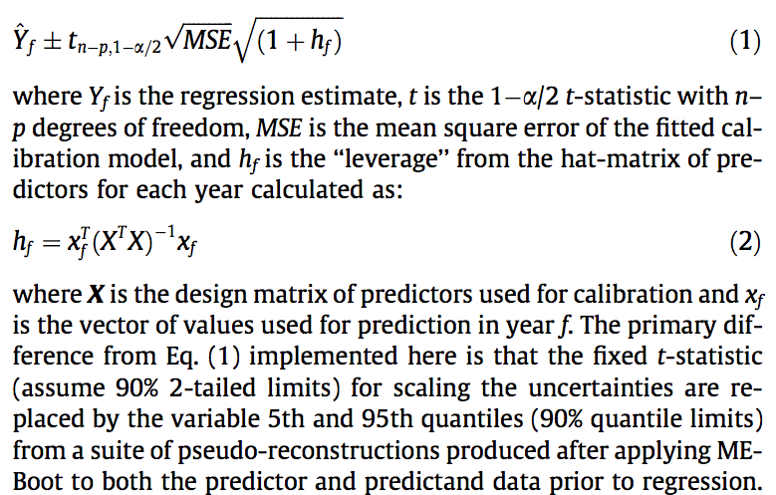
PPR can also easily estimate reconstruction uncertainties in two ways: classical parametric prediction intervals and semi-parametric intervals based on applying the maximum entropy bootstrap to the data. In either case, the form of the prediction intervals is the same (see Olive, 2007):

Slide 10
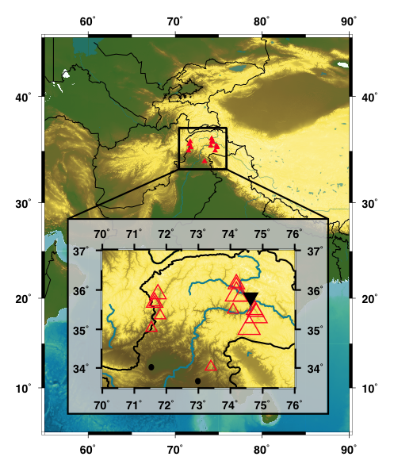
A recently published reconstruction of Upper Indus Basin discharge from tree rings by Ed Cook and colleagues* shows how this is done.
*Cook, E.R., Palmer, J.G., Ahmed, M., Woodhouse, C.A., Fenwick, P., Zafar, M.U., Wahab, M. Khan, N. 2013.
Five centuries of upper Indus River flow from tree rings. J. Hydrology 486:365–375.

Slide 11
Indus River Discharge Reconstruction with Semi-Parametric Uncertainties
From: Cook, E.R., Palmer, J.G., Ahmed, M., Woodhouse, C.A., Fenwick, P., Zafar, M.U., Wahab, M. Khan, N. 2013. Five centuries of upper Indus River flow from tree rings. J. Hydrology 486:365–375.

Slide 12
Uncertainties on Calibration/Validation Statistics are also possible
using the Maximum Entropy Bootstrap procedure
From: Cook, E.R., Palmer, J.G., Ahmed, M., Woodhouse, C.A., Fenwick, P., Zafar, M.U., Wahab, M. Khan, N. 2013. Five centuries of upper Indus River flow from tree rings. J. Hydrology 486:365–375.

Slide 13
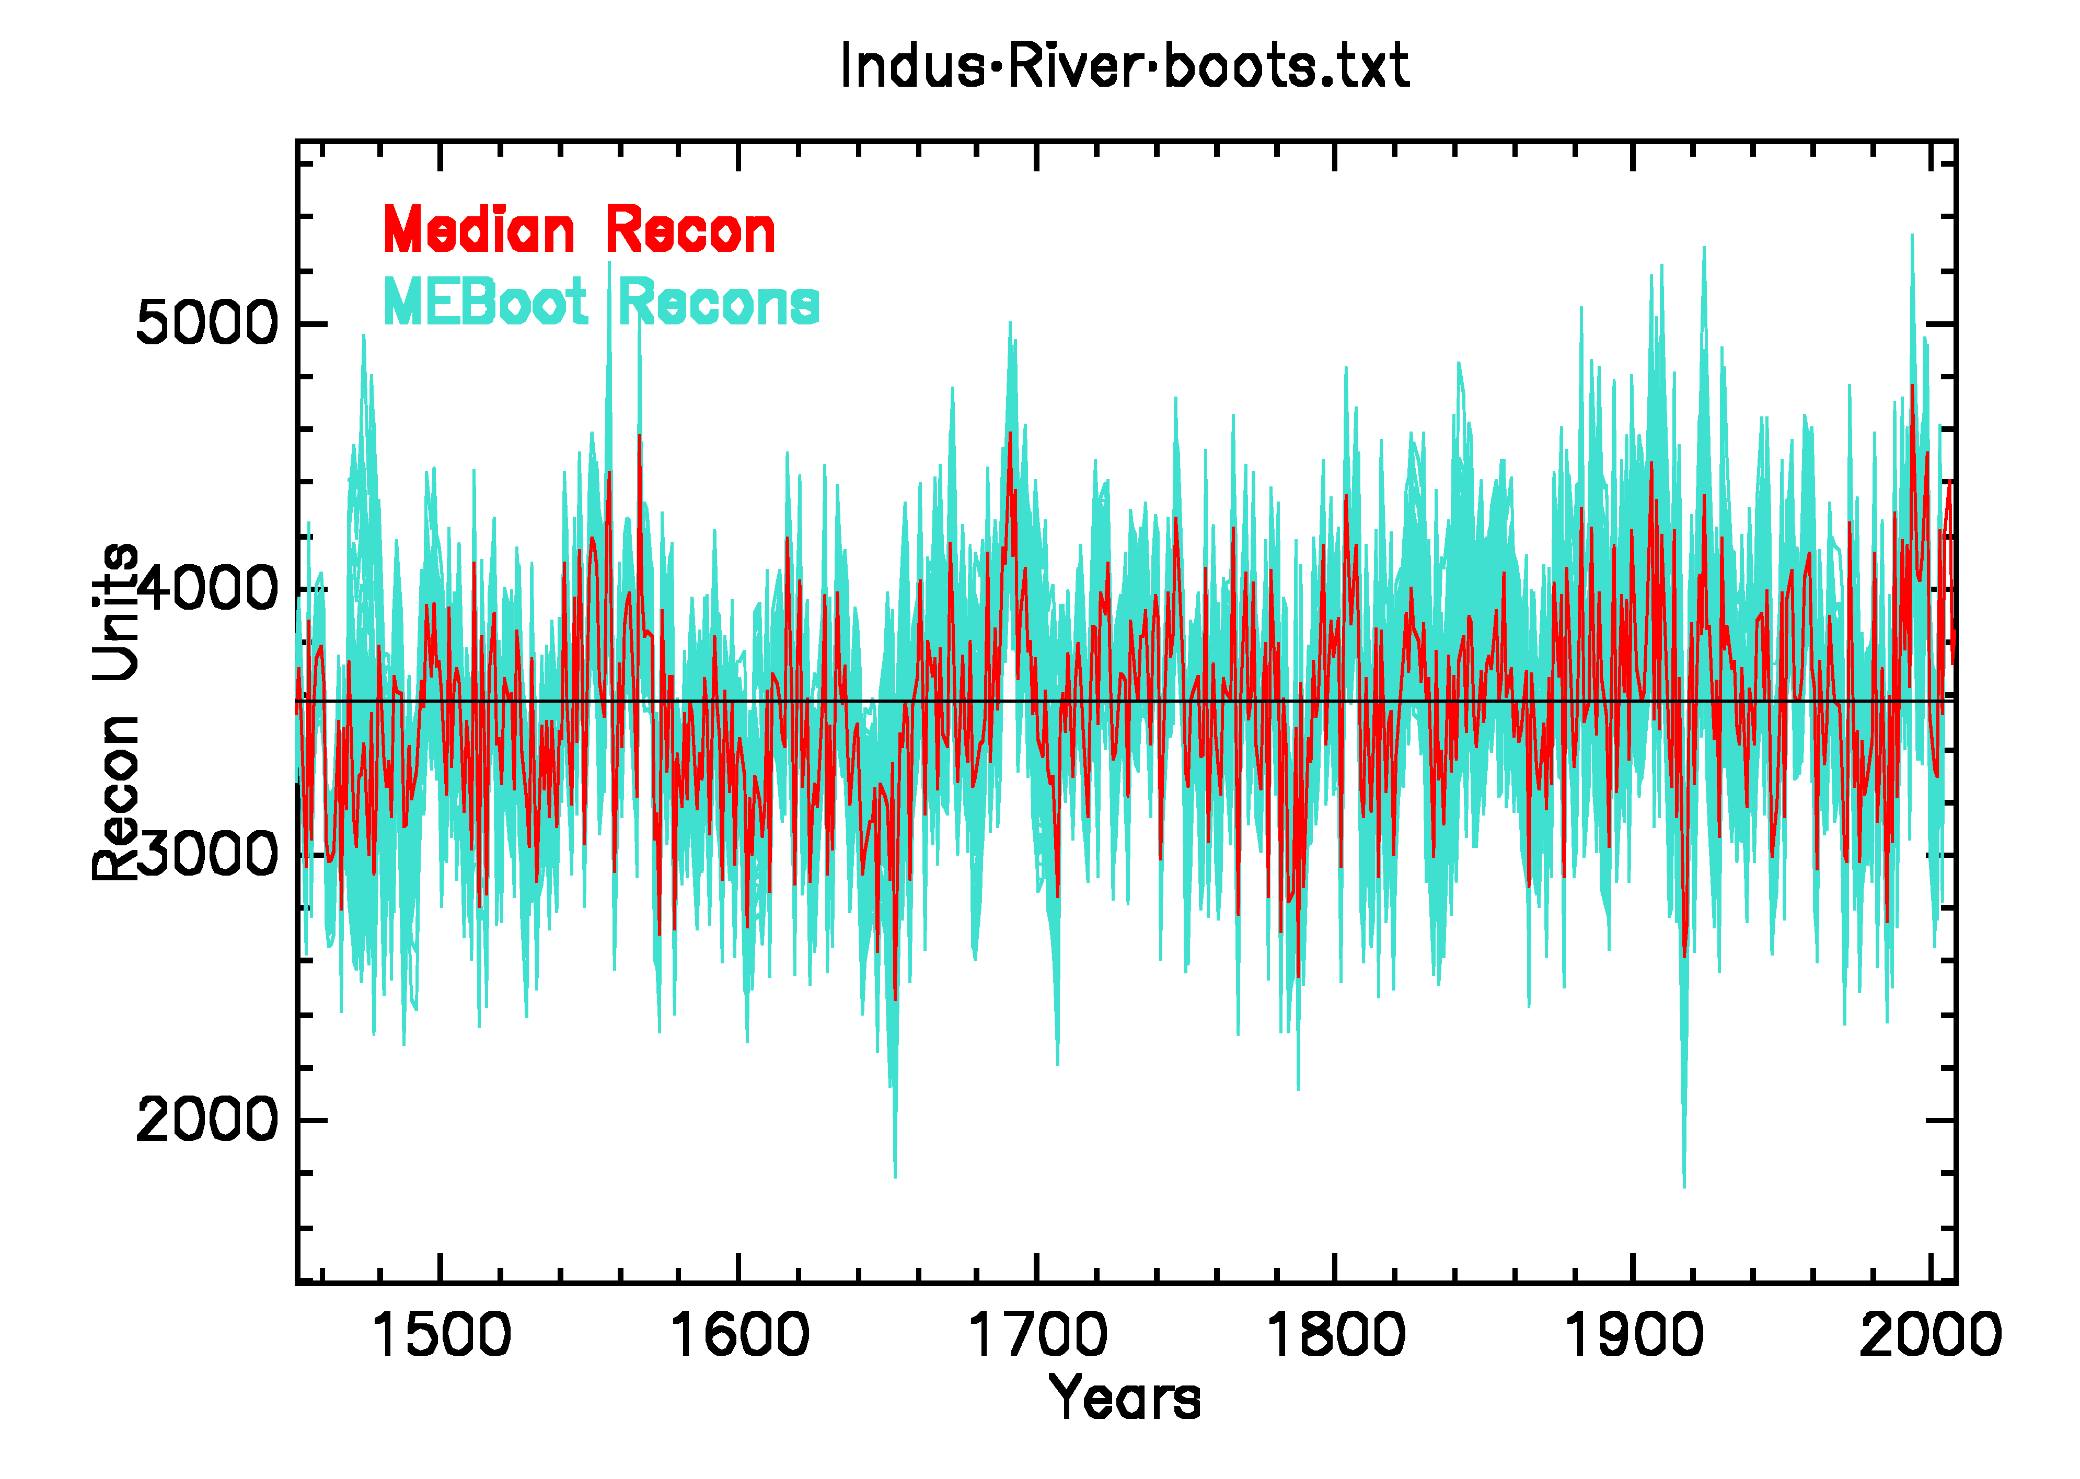
This comes from the generation of pseudo-reconstruction ensembles using the maximum entropy bootstrap, in this case 300.

Slide 14
PPR can also handle highly skewed, zero-bounded P and Q data. This is done through an adaptive power transformation applied to the actual data. Here is the Salinas River, CA water year data before and after adaptive power transformation. The only rub is that all values being transformed must be ≥ 0, so no anomalies are allowed.
SKEW BEFORE: 1.160 PROB: 0.0000 POWER: 1.000 *HINKLEY D: 0.1882
SKEW AFTER: -0.022 PROB: 0.9212 POWER: 0.250 HINKLEY D: -0.0022
The adaptive power transformation is designed to induce data symmetry, not data normality. In so doing, it appears to eliminate the reconstruction of negative values of P and Q after the power transformed reconstruction has been inverse power transformed back to original data units. This is a nice feature that will be illustrated next for the Salinas River water year Q reconstruction.
*Hinkley, D.A. 1977. On quick choice of power transformation. Applied Statistics 26:67-69.

Slide 15
Over the Instrumental Data Period: 1902-2011
No negative values using PT

Slide 16
Over the Full Reconstruction Period: 1379-2011
No negative values using PT

Slide 17
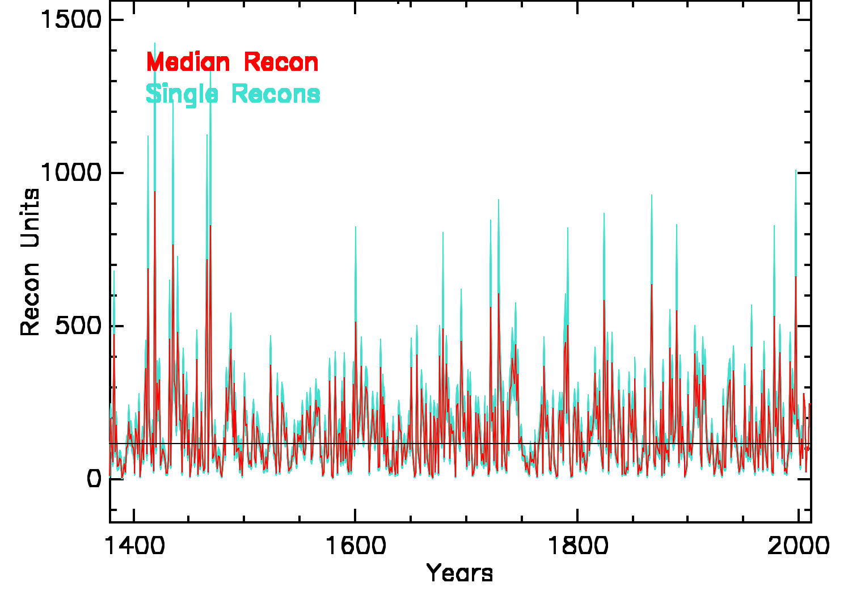
Salinas River MEBootrap Pseudo-Reconstructions
No negative values using PT
No negative values using PT

Slide 18
Salinas River PPR Parameter File – Lots of Options!
Salinas_Monthly_Flows.txt !climate field to reconstruct
(i4,12f12.4) !climate field read format
Salinas_flowXY.txt !climate field grid point LAT/LON file
(f10.3,f9.3) !lat/lon coordinates read format
latlon !lat/lon coordinates order read in
DG_crns_list.txt !tree-ring data header file name
1902 2003 !calibration period first and last years
1902 2003 !verification period first and last years
2 !climate AR model: calib (1) or entire (2)
JFMAMJJASONDJFMAMJJASOND !possible climate mask months
000000000111111111112 !selected climate mask months
NO !reconstruct climate data anomalies?
1 !model order choice: t=1:1, AIC:2, BIC:3
YES !backtrack to best verified model?
YES !Adaptive power transform choice
0 !high-pass filter tree rings: spline in yrs
0.50 !minimum correlation for consecutive nests
0 !spline stabilize reconstruction variance?
DVAR DIST MINS MINFY MINC ARMOD NLAG SCREEN NTAIL SCALE SAVE WGT HPLP NBOOT !runtime parameters list
FLOW 500 1 1800 1 0 1 90 2 2 2 0.000 0 300 !runtime parameters used
So you need four (4) input data files to run PPR:
The file of monthly climate, streamflow, whatever – Salinas_Monthly_Flows
The file of monthly data lat/lon coordinates – Salinas_flowXY
The file list of tree-ring chronology headers – DG_crns_list
The file of tree-ring chronologies found by the headers list – DG.CRNS
I am now going to show you these data files. You will probably find some rather obnoxious to set up, but the PPR program can help.

Slide 19
Salinas_Monthly_Flows.txt format: (i4,12f12.4)
36.281 -121.322 Monthly Salinas River Discharge, California
1901 -9.9999 -9.9999 -9.9999 -9.9999 -9.9999 -9.9999 -9.9999 -9.9999 -9.9999 1.1378 1.7030 2.0177
1902 1.8887 35.9550 45.4962 20.2746 7.4108 3.2005 1.0240 0.1813 0.0829 0.7289 3.9345 4.2781
1903 16.4599 21.8278 36.0298 34.4418 6.4702 2.8922 1.2364 0.3451 0.0663 0.2078 1.5489 0.9937
1904 1.6839 12.9358 30.3257 16.4869 6.1440 1.9673 0.4088 0.0340 1.0350 5.7268 2.7674 4.6118
. . . . . . . . . . . . .
2008 50.6238 31.6262 12.3260 4.3309 2.0784 0.8735 0.4877 0.3398 0.2643 0.4233 1.0203 3.2768
2009 2.7914 28.6722 39.1019 7.7369 4.5815 2.3783 0.8723 0.4316 0.2833 23.6052 3.2739 11.7343
2010 60.6742 48.3830 37.5241 30.6615 13.8051 6.4010 3.0113 1.6384 1.0937 1.1681 2.8848 20.9352
27.1779 38.6749 92.5398 30.7349 11.5144 10.4676 3.5271 1.6384 1.1965 -9.9999 -9.9999 -9.9999
Salinas_flowXY.txt format: (f10.3,f9.3)
36.281 -121.322 -- the lat/lon coordinates must match exactly between the data and xy files.
DG_crns_list.txt Tree-Ring Header file, here only one chronology
DG RSRB27 QUDG 1379 2003 36 29 -120 53 ROCK SPRINGS RANCH
DG.CRNS Tucson tree-ring index chronology file in standard Tucson format
DG RSRB27 QUDG 1379 2003 36 29 -120 53 ROCK SPRINGS RANCH ssfstb
RSRB2713799990 09990 09990 09990 09990 09990 09990 09990 09990 0 277 2 ssfstb
RSRB2713801226 2 964 2 743 21672 2 918 21176 2 628 2 669 2 811 2 763 4 ssfstb
RSRB271390 17 4 430 4 696 4 486 4 949 4 983 41205 41060 71093 7 968 7 ssfstb
RSRB271400 952 7 764 7 418 71144 71089 7 886 71283 7 224 7 747 71037 7 ssfstb
RSRB271410 783 71325 71519 7 873 71888 71201 71047 7 739 71102 7 530 7 ssfstb
. . . . . . . . . .
The tree-ring header must match exactly between the list and chronology files. The format of the Headers must be exact as shown. Lat/lon coordinates must be in degrees/minutes. Yes, I know. Groan!!! I am going to fix this, but for now you have to suck it up! All these files can have multiple data sets and entries in them. This is how the point-by-point execution of PPR occurs over a grid.

Slide 20
Let’s go back to the Salinas River PPR Parameter File
Salinas_Monthly_Flows.txt !climate field to reconstruct
(i4,12f12.4) !climate field read format
Salinas_flowXY.txt !climate field grid point LAT/LON file
(f10.3,f9.3) !lat/lon coordinates read format
latlon !lat/lon coordinates order read in
DG_crns_list.txt !tree-ring data header file name
1902 2003 !calibration period first and last years
1902 2003 !verification period first and last years
2 !climate AR model: calib (1) or entire (2)
JFMAMJJASONDJFMAMJJASOND !possible climate mask months
000000000111111111112 !selected climate mask months
NO !reconstruct climate data anomalies?
1 !model order choice: t=1:1, AIC:2, BIC:3
YES !backtrack to best verified model?
YES !Adaptive power transform choice
0 !high-pass filter tree rings: spline in yrs
0.50 !minimum correlation for consecutive nests
0 !spline stabilize reconstruction variance?
DVAR DIST MINS MINFY MINC ARMOD NLAG SCREEN NTAIL SCALE SAVE WGT HPLP NBOOT !runtime parameters list
FLOW 500 1 1800 1 0 1 90 2 2 2 0.000 0 300 !runtime parameters used
We can see that the calibration and verification periods can be specified, but only as contiguous blocks of years. No k-fold action is allowed. Here the same years are used for both, but they can be easily changed.
In the last two lines, the runtime parameters list is shown: what they are and how they can be changed or added. By adding a second line of parameters used, you can make a second PPR run with those changed parameters. This is how an ensemble of runs is created. See next.

Slide 21
See what I mean for the Russian Drought Atlas Parameter File
RUDA_scPDSI_1901_2016.txt !climate field to reconstruct
(1x,i4,12f6.2) !climate field read format
RUDA_scPDSI_1901_2016_XY.txt !climate field grid point LAT/LON file
(f10.3,f9.3,a) !lat/lon coordinates read format
lonlat !lat/lon coordinates order read in
RUDA_Crns_List.txt !tree-ring data header file name
1931 1984 !calibration period first and last years
1901 1930 !verification period first and last years
2 !climate AR model: calib (1) or entire (2)
JFMAMJJASONDJFMAMJJASOND !possible climate mask months
00000113 !selected climate mask months
YES !reconstruct climate data anomalies?
2 !model order choice: t=1:1, AIC:2, BIC:3
YES !backtrack to best verified model?
NO !adaptive power transformation used?
0 !high-pass filter tree rings: spline in yrs
0.50 !minimum correlation for consecutive nests
0 !spline stabilize reconstruction variance?
DVAR DIST MINS MINFY MINC ARMOD NLAG SCREEN NTAIL SCALE SAVE WGT HPLP NBOOT !runtime parameters list
RUDA 500 20 1850 3 1 2 0 2 2 1 0.000 0 0 !runtime parameters used
RUDA 500 20 1850 3 1 2 0 2 2 1 0.100 0 0 !runtime parameters used
RUDA 500 20 1850 3 1 2 0 2 2 1 0.250 0 0 !runtime parameters used
RUDA 500 20 1850 3 1 2 0 2 2 1 0.500 0 0 !runtime parameters used
RUDA 500 20 1850 3 1 2 0 2 2 1 0.670 0 0 !runtime parameters used
RUDA 500 20 1850 3 1 2 0 2 2 1 1.000 0 0 !runtime parameters used
RUDA 500 20 1850 3 1 2 0 2 2 1 1.500 0 0 !runtime parameters used
RUDA 500 20 1850 3 1 2 0 2 2 1 2.000 0 0 !runtime parameters used
RUDA 1000 20 1850 3 1 2 0 2 2 1 0.000 0 0 !runtime parameters used
RUDA 1000 20 1850 3 1 2 0 2 2 1 0.100 0 0 !runtime parameters used
RUDA 1000 20 1850 3 1 2 0 2 2 1 0.250 0 0 !runtime parameters used
RUDA 1000 20 1850 3 1 2 0 2 2 1 0.500 0 0 !runtime parameters used
RUDA 1000 20 1850 3 1 2 0 2 2 1 0.670 0 0 !runtime parameters used
RUDA 1000 20 1850 3 1 2 0 2 2 1 1.000 0 0 !runtime parameters used
RUDA 1000 20 1850 3 1 2 0 2 2 1 1.500 0 0 !runtime parameters used
RUDA 1000 20 1850 3 1 2 0 2 2 1 2.000 0 0 !runtime parameters used
This is a 16-member ensemble run using two search radii.

Slide 22

Let’s fire up and demo the PPR program now,
but a few comments first.
It is really impossible to teach you how to run PPR with all its options in such a short time, but it is still instructive to show you how it runs and what output files are produced.
PPR has in it some noteworthy TEST and HELP files that will be instructive to show off too.
Regarding availability of the compiled program, I do everything on Macs and that is the preferred platform. However, Paul can produce a Windows version of PPR. Please go through me for this request.
The PPR Fortran 77 source code is a monster that needs to be completely rewritten to optimize memory allocation and storage. I plan to do this over the next year. Park Williams is working on a Matlab version with me too.
There are actually two versions of PPR available now. The first can do 1,000s of grid points for spatial reconstruction, but cannot do MEBootstrap resampling. The second can do a few dozen grid points with full MEBootstrap resampling. Chose your poison!

Slide 23
Some New PPR Stuff
Recall that a relatively new option has been added to PPR that allows one to not use certain nested reconstructions that fall below a correlation threshold R between the first (shortest, but best replicated) reconstruction nest and any of the subsequent (longer, but less well replicated) reconstruction nests. As such, this can be viewed as a way to promote reconstruction stability.
An R from 0 (accept every nest) to some more stringent level like 0.50 or even higher can be selected, but there is a cost associated with using high levels of R. That cost is less spatial completeness and shorter reconstruction lengths overall. On the other hand, a higher R protects against producing a reconstruction field with potentially spurious patterns of variability back in time. The choice of R is clearly up to how one wishes to evaluate risk.
Examples of reconstructing the RUDA with four levels of R applied will be shown next. Each chosen level (0.2, 0.3, 0.4, 0.5) exceeds the 99% C.L. threshold, given the length (typically >150 years) of the first reconstruction nest even after correction for autocorrelation.

Slide 25
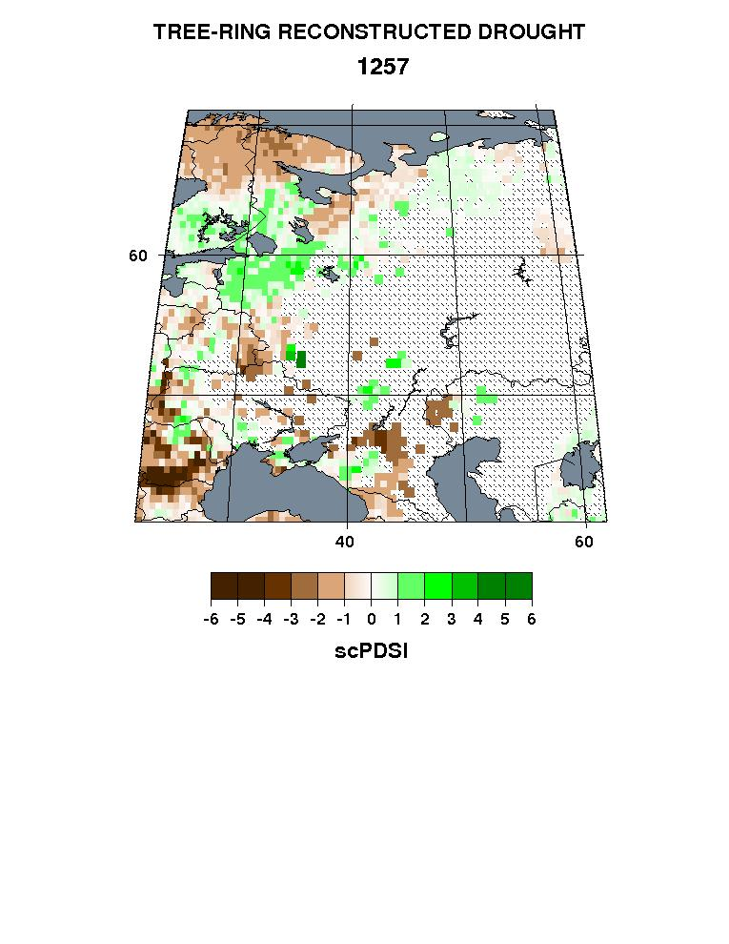
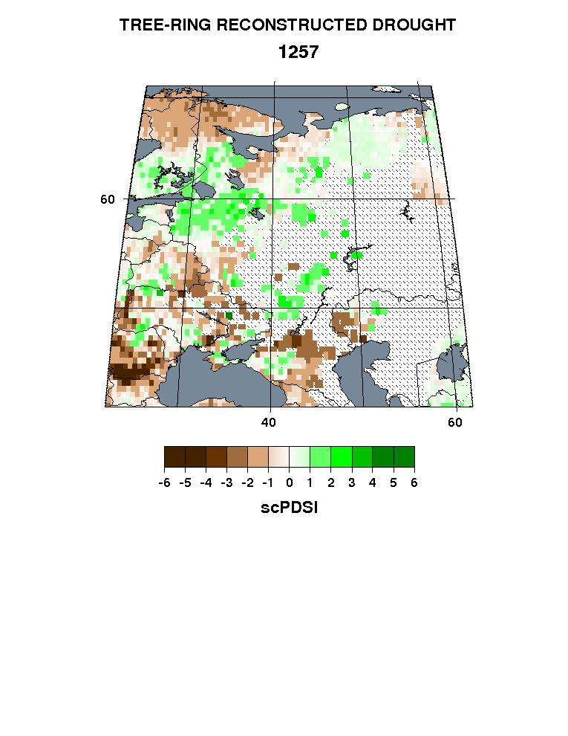
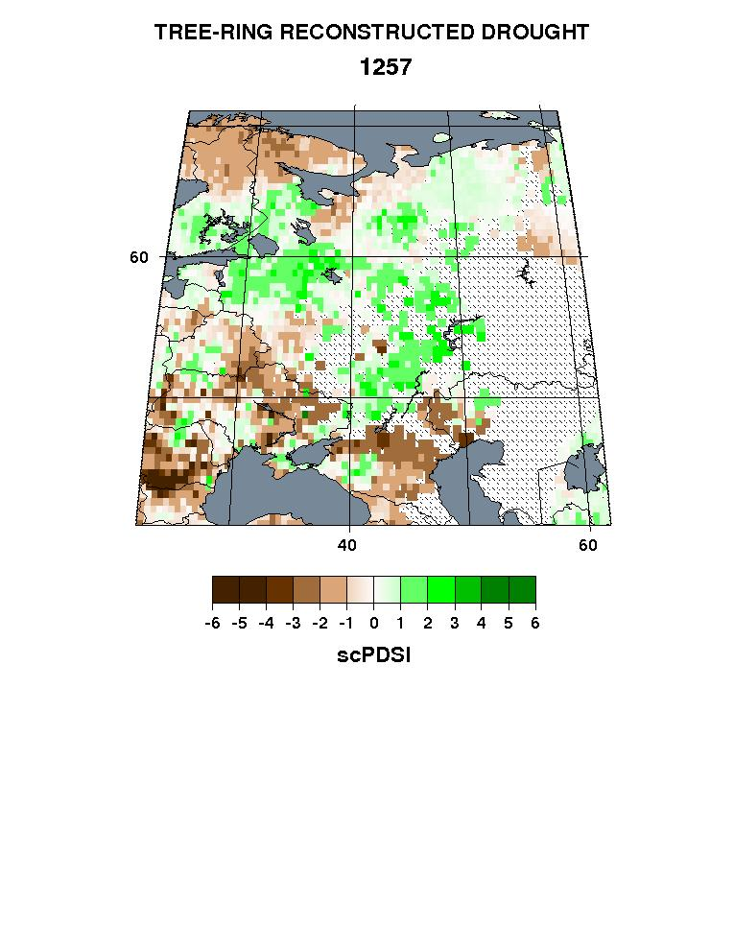
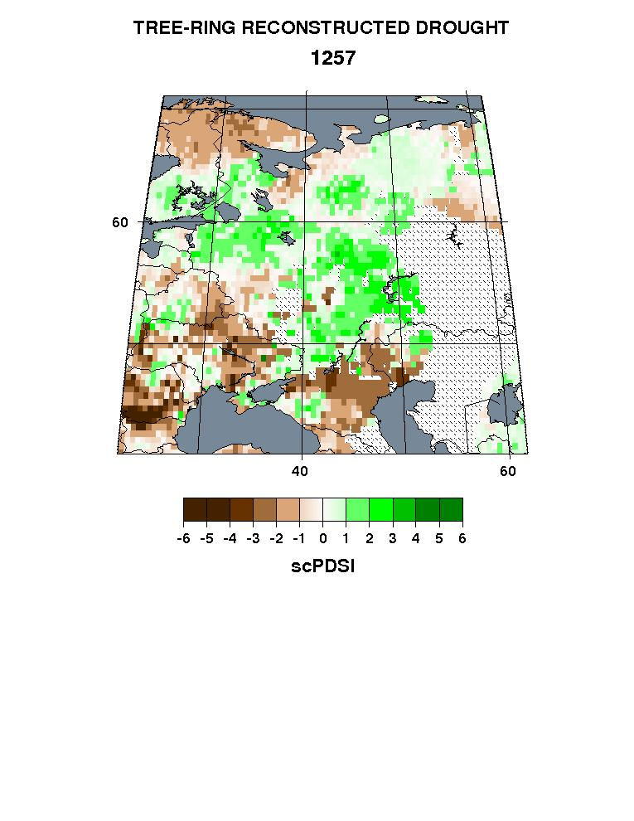
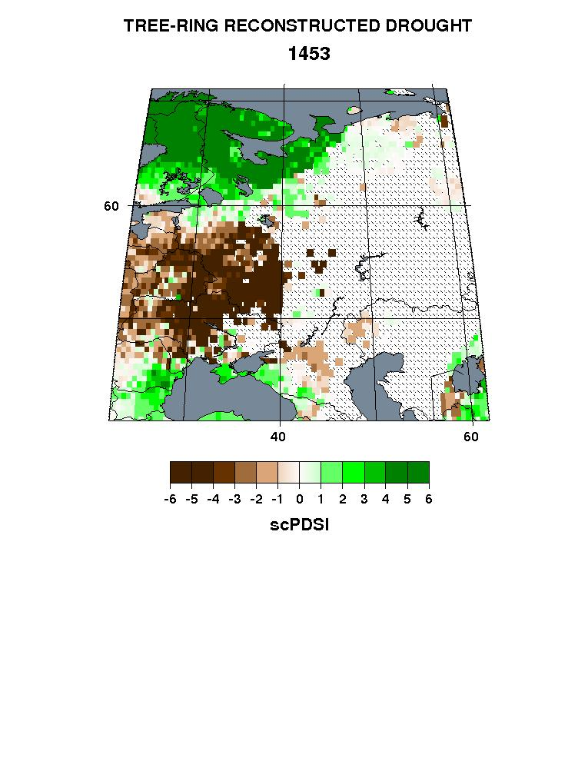
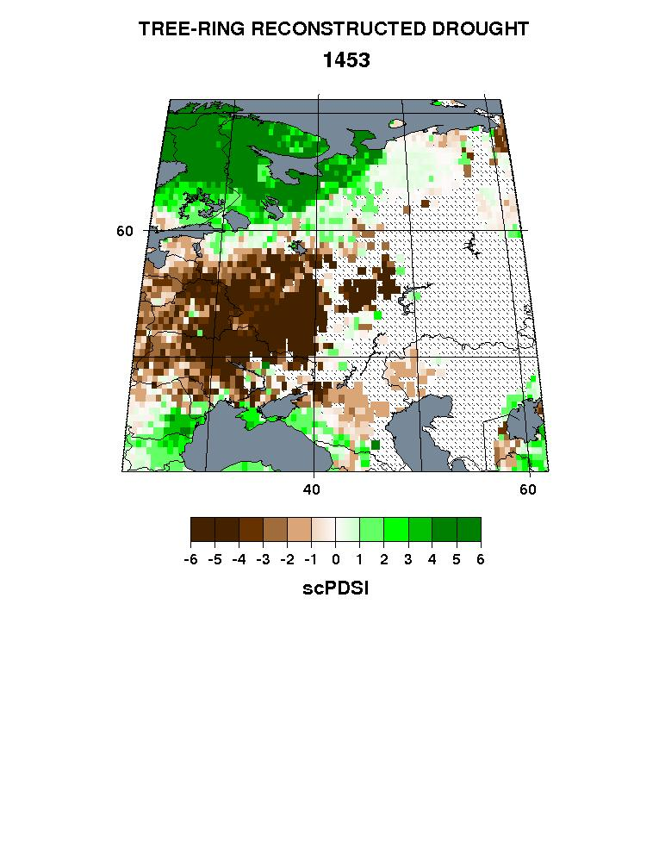
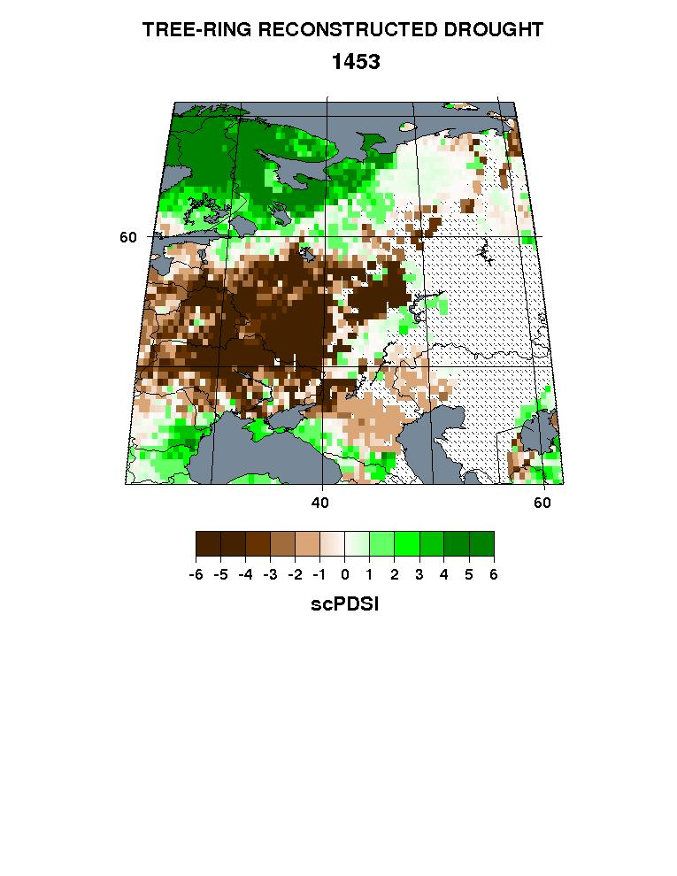

Effect of Nest Correlation Cutoff Choice On Spatial Completeness
For Two Volcanically-Themed Years In The RUDA
Year: 1257
R>0.50 Miss: 51.7%
R>0.40 Miss: 41.6%
R>0.30 Miss: 31.2%
R>0.20 Miss: 22.7%
Year: 1453
R>0.50 Miss: 44.8%
R>0.40 Miss: 35.0%
R>0.30 Miss:25.5%
R>0.20 Miss: 20.4%
Iter4
Iter6
Iter8
Iter10

Slide 26
Effect of Nest Correlation Cutoff Choice On Spatial Completeness
For Two Volcanically-Themed Years In The RUDA
Year: 1257
R>0.50 Miss: 51.7%
R>0.40 Miss: 41.6%
R>0.30 Miss: 31.2%
R>0.20 Miss: 22.7%
This region appears to be reconstructed quite naturally using less stringent cutoffs. R>0.20 looks quite reasonable, but some interior gaps remain (red). How might we fill them without reducing R further? How might we expand the spatial coverage of this year even more?
Year: 1453
R>0.50 Miss: 44.8%
R>0.40 Miss: 35.0%
R>0.30 Miss:25.5%
R>0.20 Miss: 20.4%
Iter4
Iter6
Iter8
Iter10

Slide 27
Queen’s Case Imputation and Smoothing (QCIS)
The problem: After running PPR you notice that there are spatial gaps in certain time periods (empty grid cells surrounded by reconstructed values) because some grid cell reconstructions are shorter than adjacent ones. You also notice that there are occasional “erratics” (e.g., reconstructed values inconsistent with surrounding values) in the reconstructed fields caused by random effects in the PPR procedure. This implies the need to both impute and smooth the field.
There are numerous ways to do this, but most (e.g., reduced-space methods, RegEM) do not provide easy local control over what information is used to fill in the missing values to extend the shorter reconstructions back in time. Nor is it obvious what kind of spatial smoothing is best for preserving local spatial details. It is for this reason that I developed a method that I call Queen’s Case Imputation and Smoothing (QCIS).

Slide 28
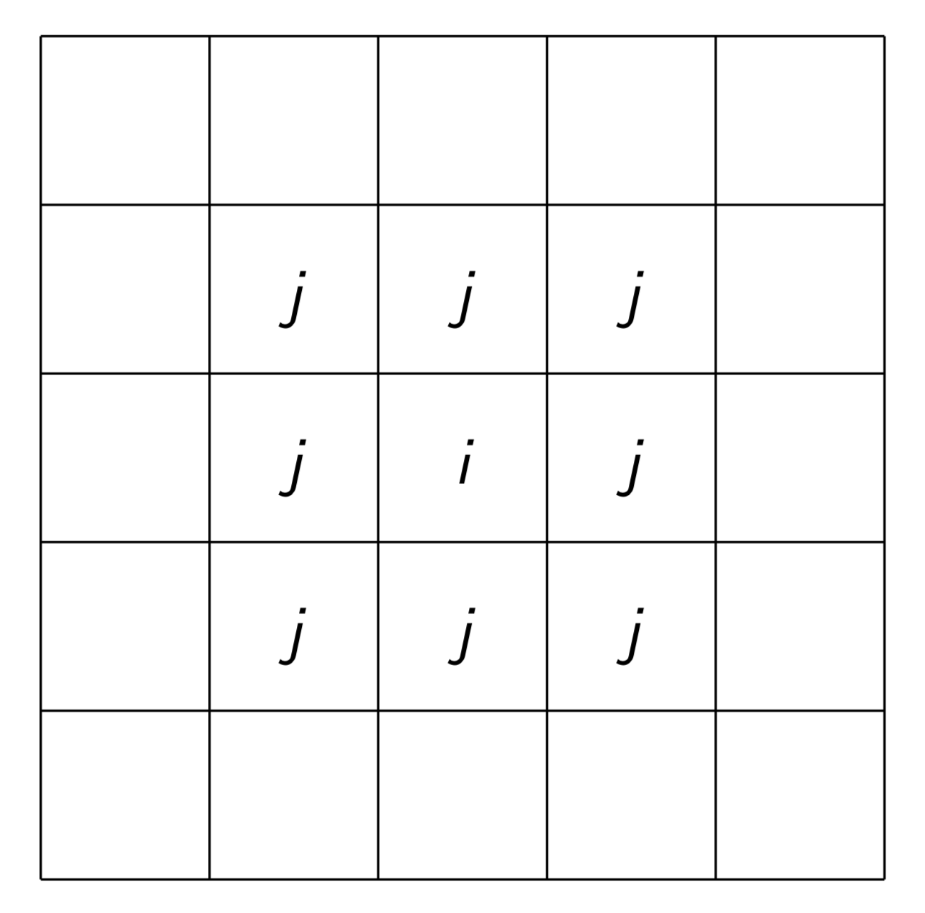
Queen’s Case Imputation and Smoothing (QCIS)
The problem: After running PPR you notice that there are spatial gaps in certain time periods (empty grid cells surrounded by reconstructed values) because some grid cell reconstructions are shorter than adjacent ones. You also notice that there are occasional “erratics” (e.g., reconstructed values inconsistent with surrounding values) in the reconstructed fields caused by random effects in the PPR procedure. This implies the need to both impute and smooth the field.
There are numerous ways to do this, but most (e.g., reduced-space methods, RegEM) do not provide easy local control over what information is used to fill in the missing values to extend the shorter reconstructions back in time. Nor is it obvious what kind of spatial smoothing is best for preserving local spatial details. It is for this reason that I developed a method that I call Queen’s Case Imputation and Smoothing (QCIS).
It is based on the Queen’s Case Adjacency model used in spatial statistics.

Slide 29
Queen’s Case Imputation and Smoothing (QCIS)
QCIS is based on the premise that infilled or imputed missing values should not rely on potentially unstable teleconnection signals for infilling, as reduced-space and RegEM methods can easily do. This has always been an underlying goal of PPR. It is also based on the desire to make the spatial smoothing as consistent as possible with the PPR method used to produce the original field reconstruction.
QCIS proceeds thusly: Begin with a fully reconstructed field produced by PPR, or an ensemble field average of multiple PPR runs. The reconstruction at center grid point i is re-estimated by the j (1-8) surrounding grid point reconstructions produced initially by PPR, with the initial reconstruction itself at grid point i added as an additional predictor to guarantee a new centrally weighted estimate at that grid point.
Asymmetry in the correlations of the j grid points around grid point i also allows for local anisotropy to be taken into account.

Slide 30
Queen’s Case Imputation and Smoothing (QCIS)
This is explicitly done by recalibrating the reconstruction at grid point i using the available reconstructions at i and j as predictors and the same instrumental climate data originally used by PPR as the predictand to produce each new QCIS grid point reconstruction. This procedure is applied point-by-point across the field just like PPR.
The calibration and verification periods used in producing the original PPR field reconstruction are also used in QCIS for direct calibration/verification comparisons to be made. And the same principal components regression method used in PPR is also used in QCIS for making consistent comparisons.
It is obvious that QCIS is designed to produce a new centrally weighted-average field reconstruction based on a Queen’s Case Adjacency model and principal components regression that is consistent with PPR.

Slide 31
Queen’s Case Imputation and Smoothing (QCIS)
In this sense, QCIS acts as a 9-point (j+i) regression kernel that re-estimates the reconstruction at grid point i, where the regression beta’s (β_{j}) determine the relative weighting of the predictors in a centrally weighted manner. Only at the boundaries of the domain will <9 predictors be available.
i
(j)
Y_{i,t} = Σ β_{j} X_{j,t} j=1,9

Slide 32
Queen’s Case Imputation and Smoothing (QCIS)
The QCIS regression kernel locally smooths the field of reconstructions as a regression-weighted average of up to 9 prior reconstructions, with central weighting applied.
If any of the j reconstructions are longer than original reconstruction i, the new reconstruction at i is extended back in time using the PPR nesting procedure. This is where the imputations come from.
As is readily apparent, QCIS can also be applied iteratively k times by applying the QCIS procedure sequentially to each k-1 imputed and smoothed field. This results in additional imputation where possible, with progressively more smoothing of the field occurring as well. How one decides on the number of iterations of QCIS to apply is not clear, but fewer is almost certainly better.
Examples of applying QCIS to the new Russian Drought Atlas (RUDA) are shown next. First the calibration/verification maps.

Slide 33
RUDA 500-1000km 16-Member Ensemble CalVer
QCIS k=0

Slide 34
RUDA 500-1000km 16-Member Ensemble CalVer
QCIS k=1

Slide 35
RUDA 500-1000km 16-Member Ensemble CalVer
QCIS k=2

Slide 36
RUDA 500-1000km 16-Member Ensemble CalVer
QCIS k=3

Slide 37
RUDA 500-1000km 16-Member Ensemble CalVer
QCIS k=4

Slide 38
RUDA 500-1000km 16-Member Ensemble CalVer
QCIS k=6

Slide 39
RUDA 500-1000km 16-Member Ensemble CalVer
QCIS k=8

Slide 40
RUDA 500-1000km 16-Member Ensemble CalVer
QCIS k=10

Slide 41
QCIS: What have we learned thus far?
QCIS improves the calibration/verification statistics somewhat over those from the original reconstruction field produced by PPR (k=0). Since no imputation is being done over the short calibration/verification period, this is due to smoothing. The rate of improvement diminishes after the first few iterations.
QCIS smooths the reconstruction fields and this acts to smooth the calibration/verification fields as well. In so doing, the smoothing tends to improve and expand the larger contiguous blocks of calibration/verification statistics, but weakens the small isolated blocks of initially “significant” verification.
QCIS improves the average correlation (RBAR) between ensemble members. Again, this is most noticeable in the first few iterations. After k=3, some odd behavior in RBAR is increasingly indicated with more iterations. Not sure why!
From this evaluation, QCIS might be limited to max(k=3). But imputation demands could require more. Let’s see ...

Slide 42
k=0: Directly out of PPR

Slide 43
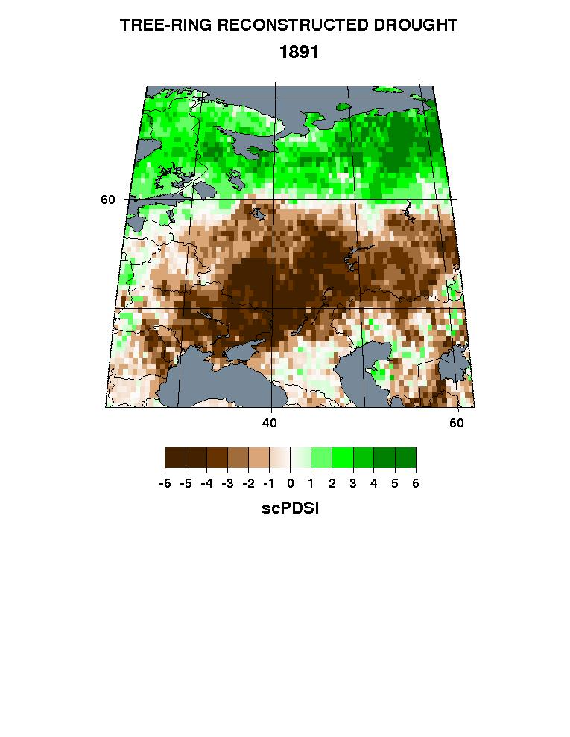
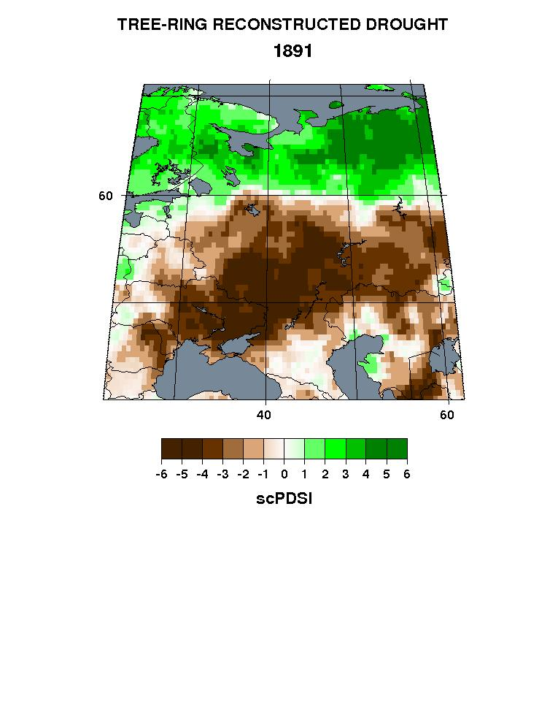
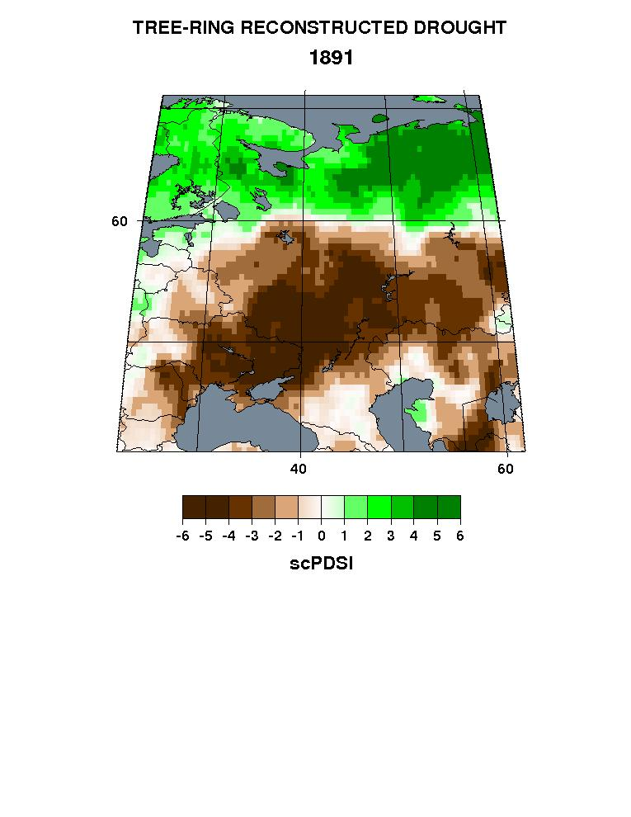

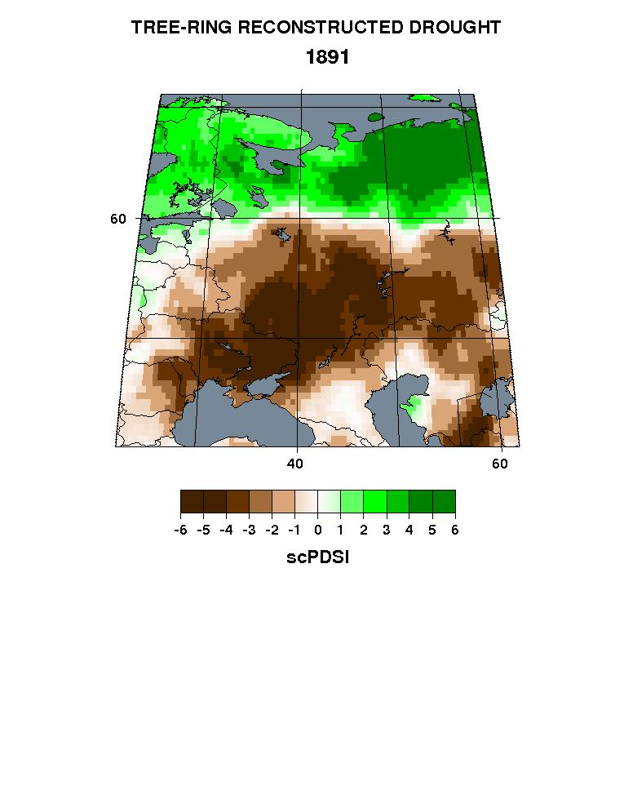



Iterated QCIS on a 16-member R>0.20 Ensemble Average
Year: 1891
PPR
k=0 Miss: 0%
k=1 Miss: 0%
k=2 Miss: 0%
k=3 Miss: 0%
k=4 Miss: 0%
k=6 Miss: 0%
k=8 Miss: 0%
k=10 Miss: 0%

Slide 44
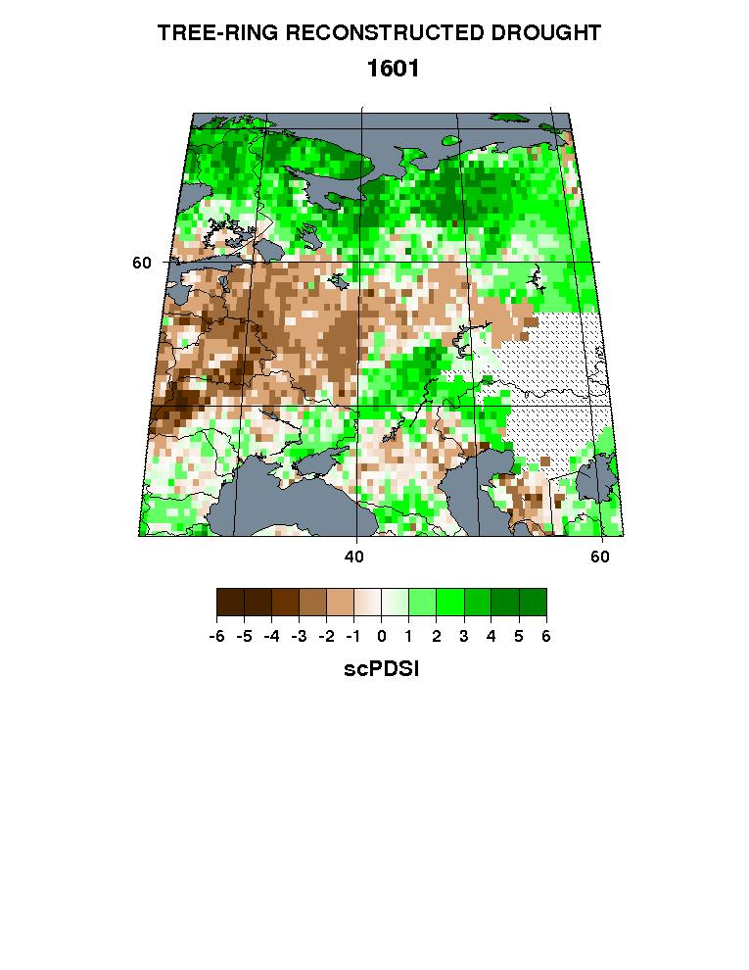
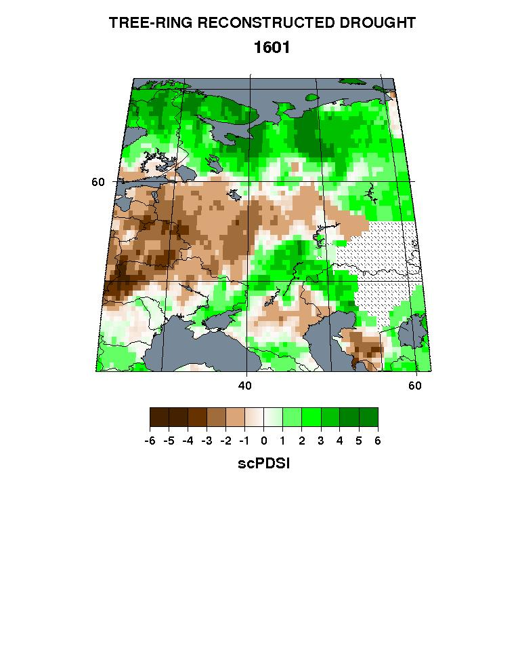
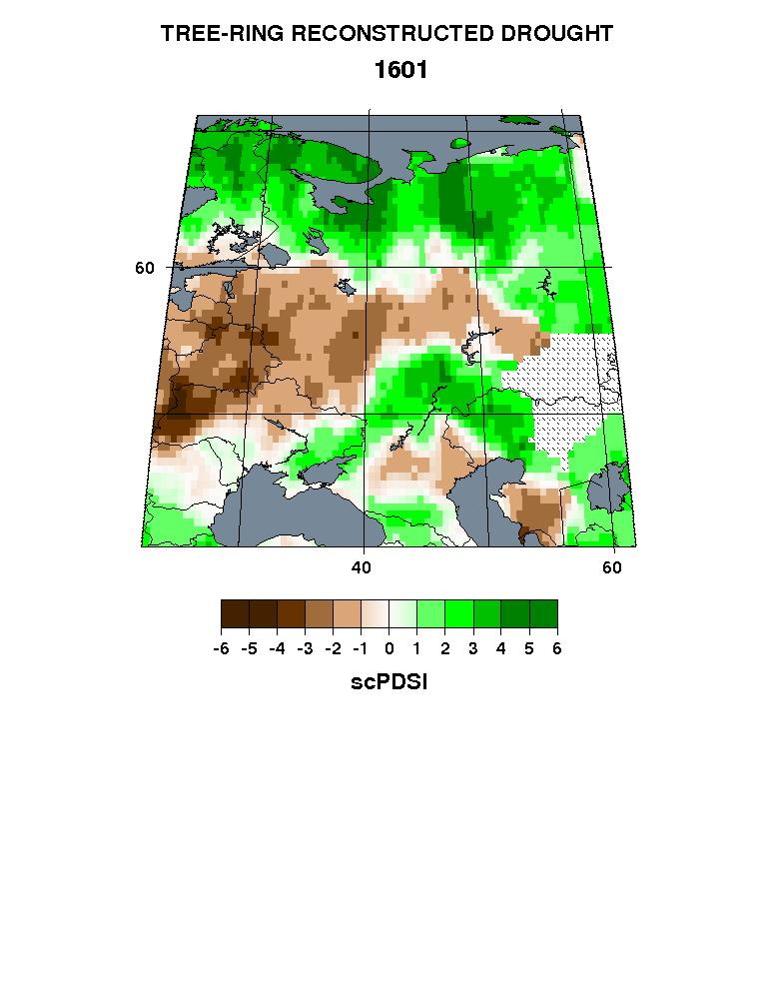
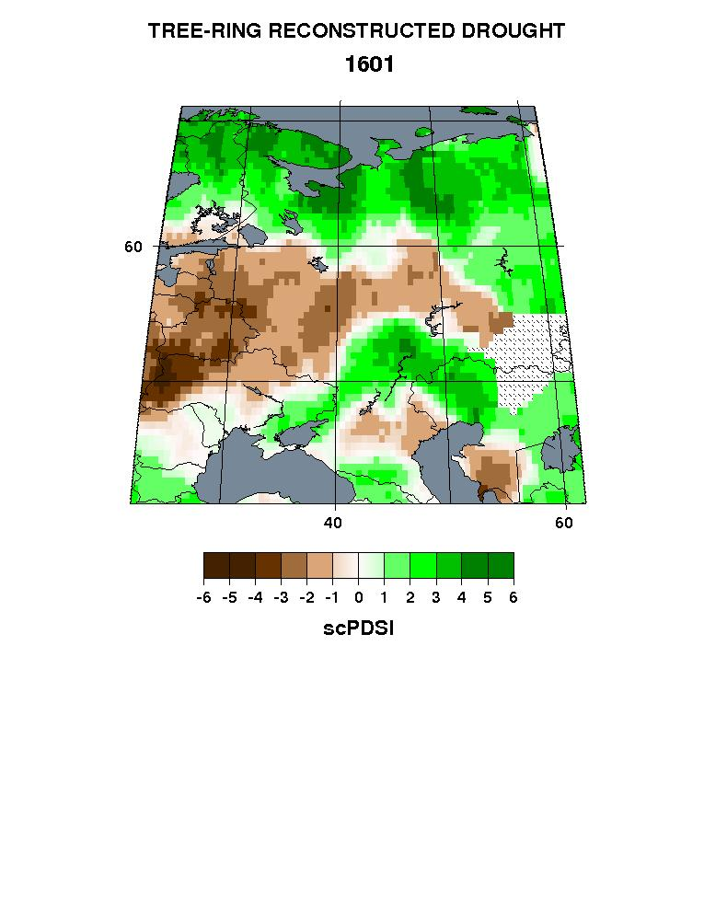
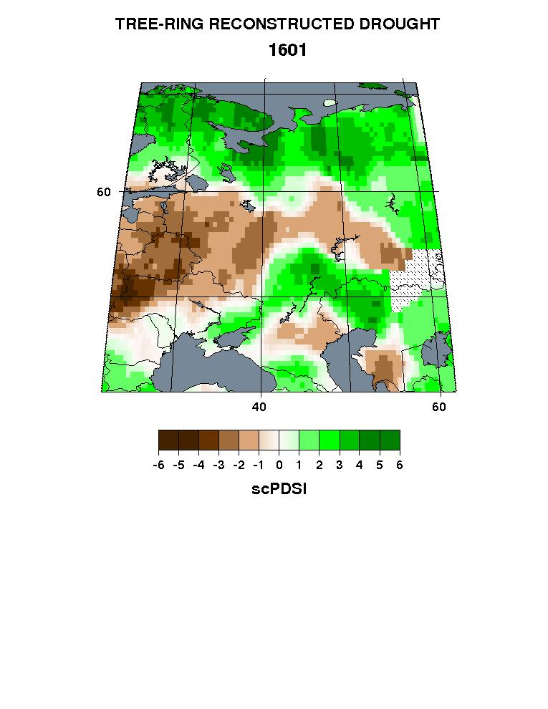

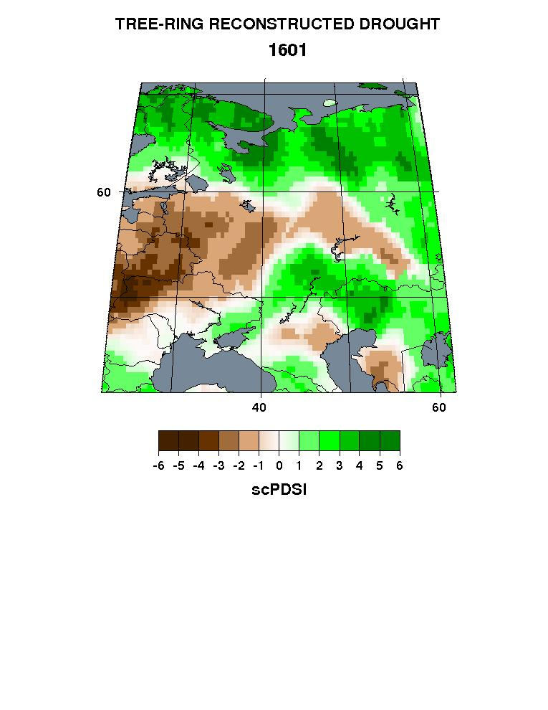

Iterated QCIS on a 16-member R>0.20 Ensemble Average
Year: 1601
PPR
k=0 Miss: 9.7%
k=1 Miss: 7.8%
k=2 Miss: 5.8%
k=3 Miss: 4.2%
k=4 Miss: 2.6%
k=6 Miss: 0.7%
k=8 Miss: 0.0%
k=10 Miss: 0.0%

Slide 45
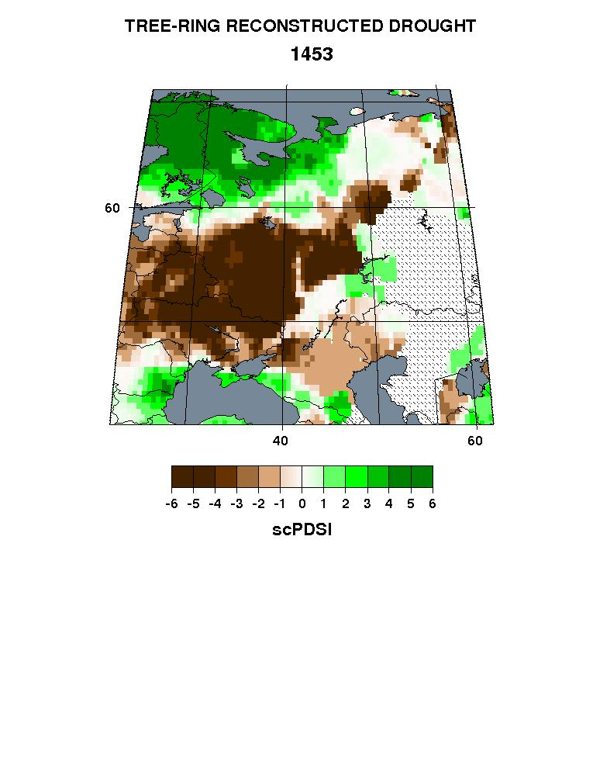
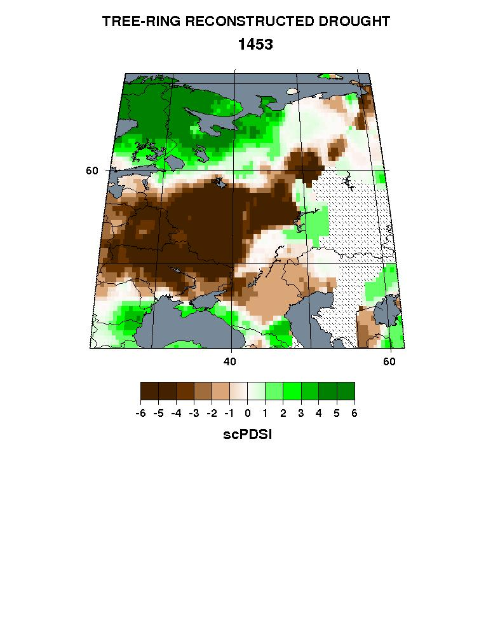

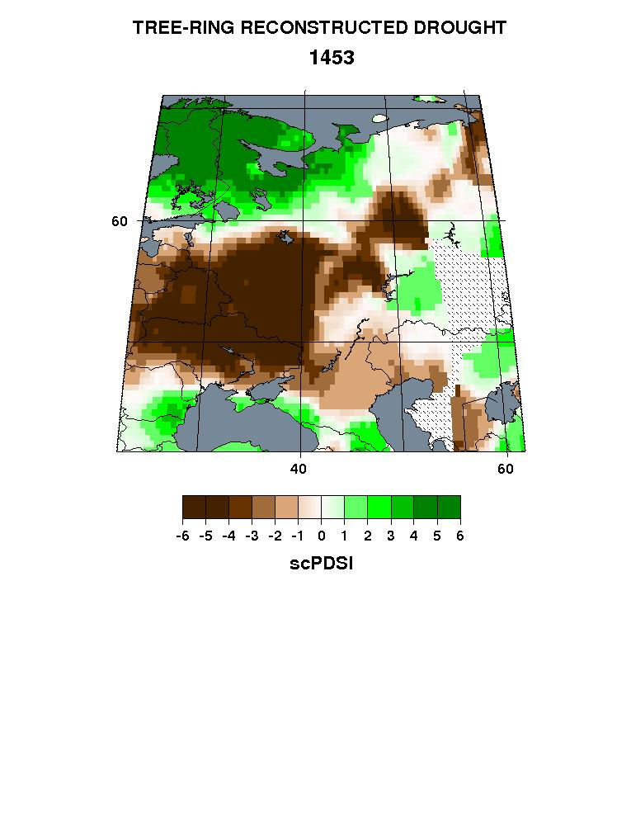
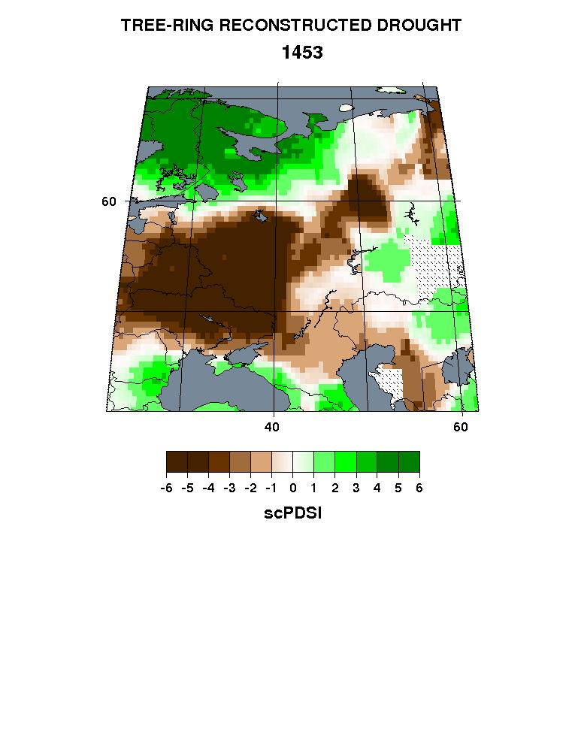
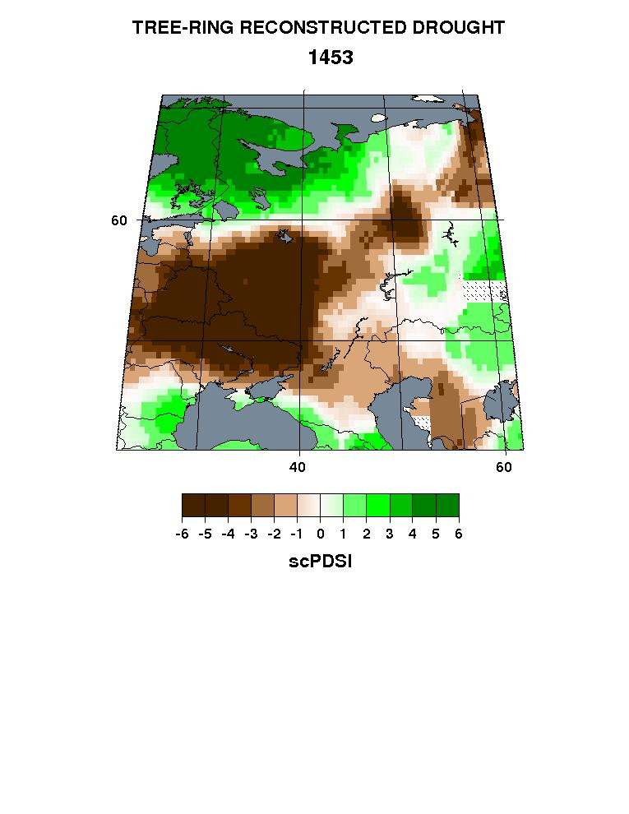
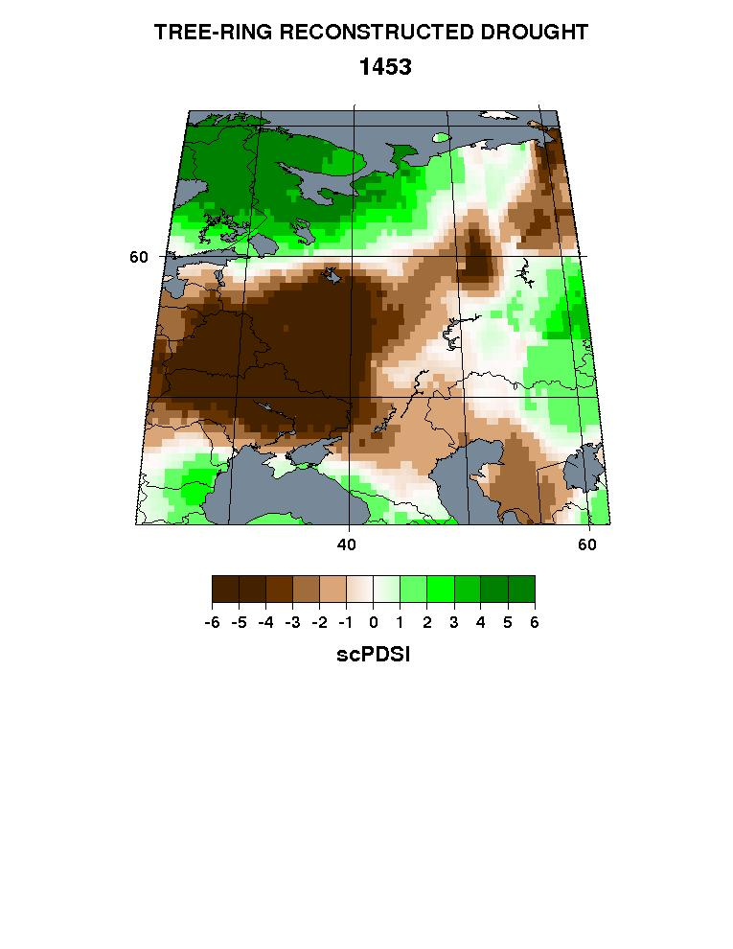
Iterated QCIS on a 16-member R>0.20 Ensemble Average
Year: 1453
PPR
k=0 Miss: 20.4%
k=1 Miss: 15.6%
k=2 Miss: 12.6%
k=3 Miss: 10.0%
k=4 Miss: 7.5%
k=6 Miss: 3.9%
k=8 Miss: 1.5%
k=10 Miss: 0.02%

Slide 46
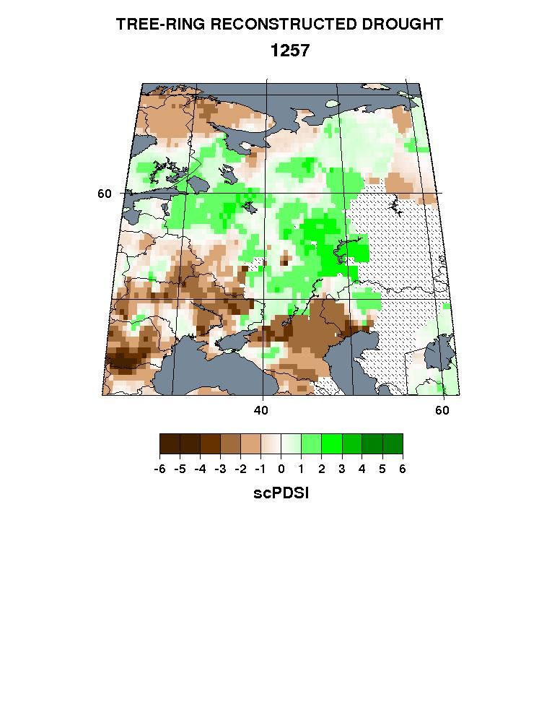
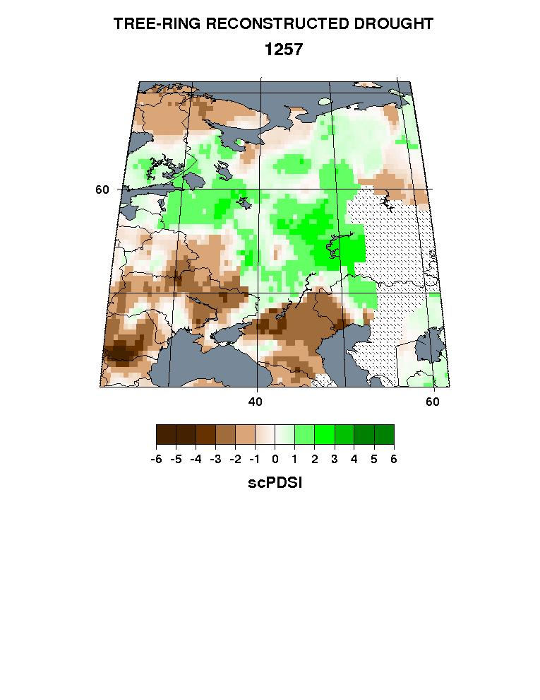

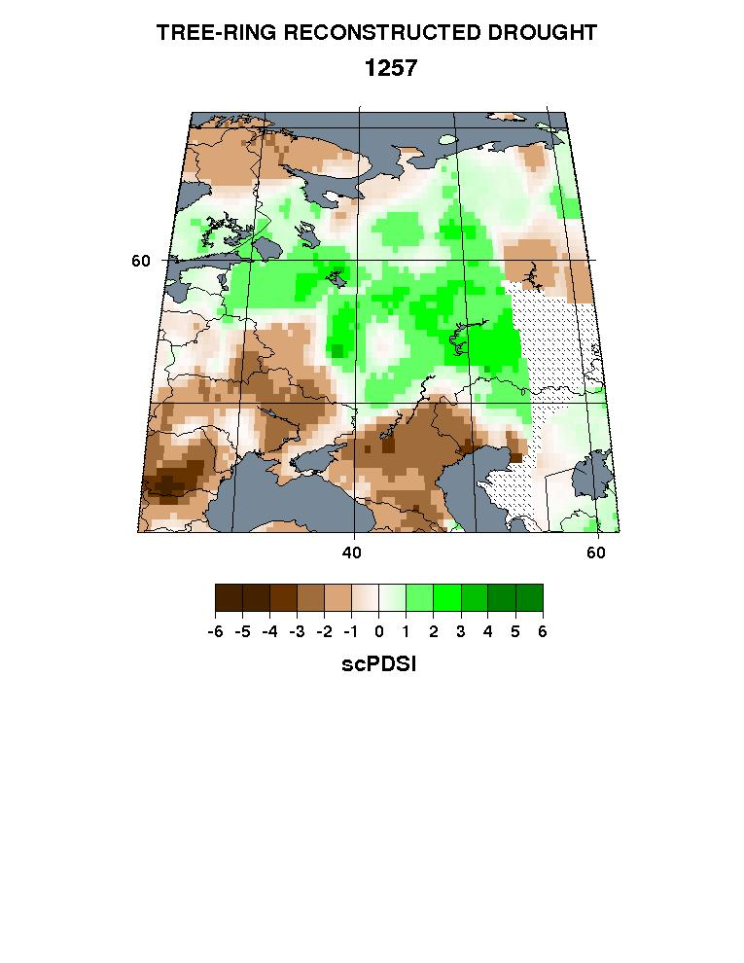
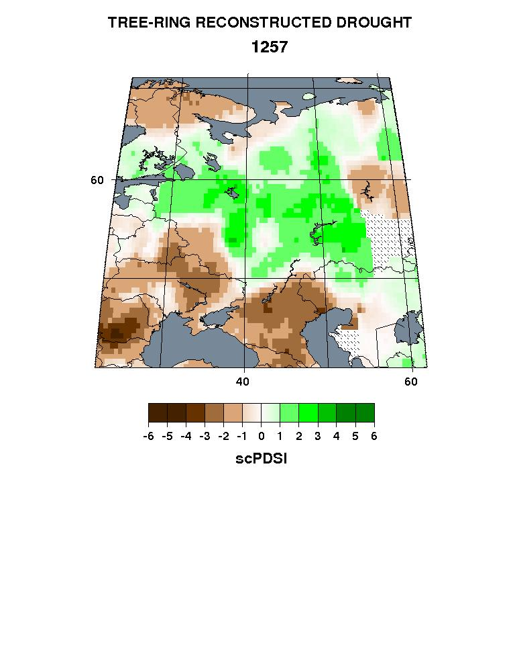
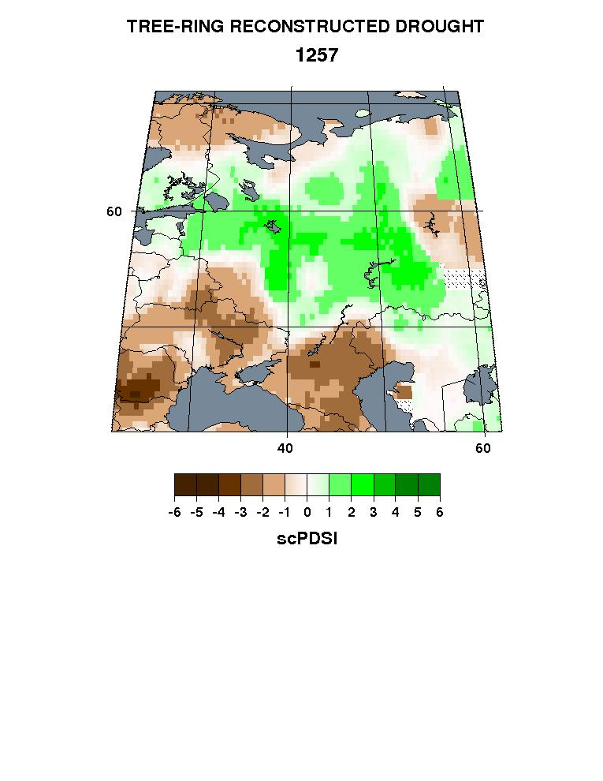
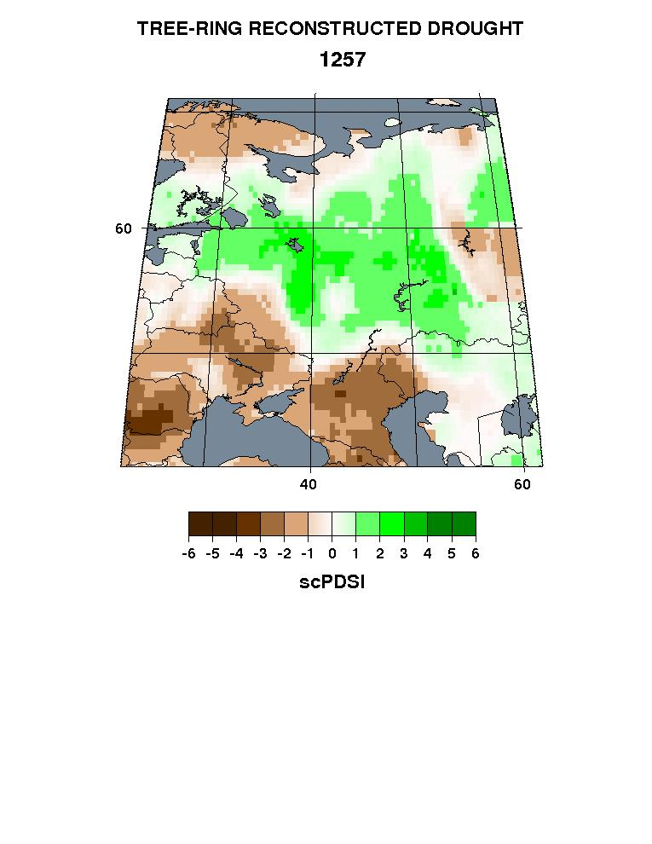
Iterated QCIS on a 16-member R>0.20 Ensemble Average
Year: 1257
PPR
k=0 Miss: 22.7%
k=1 Miss: 16.3%
k=2 Miss: 12.8%
k=3 Miss: 10.1%
gaps
no gaps
k=4 Miss: 7.6%
k=6 Miss: 3.9%
k=8 Miss: 1.5%
k=10 Miss: 0.02%

Slide 47
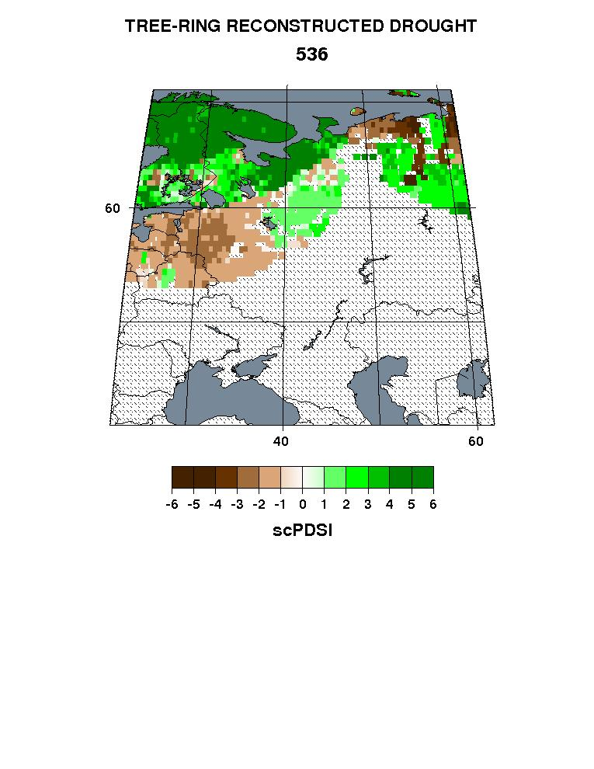
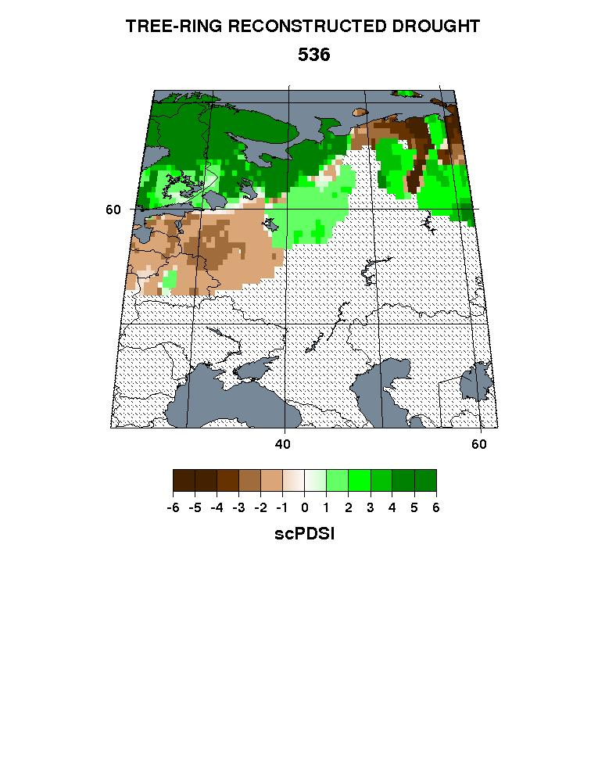
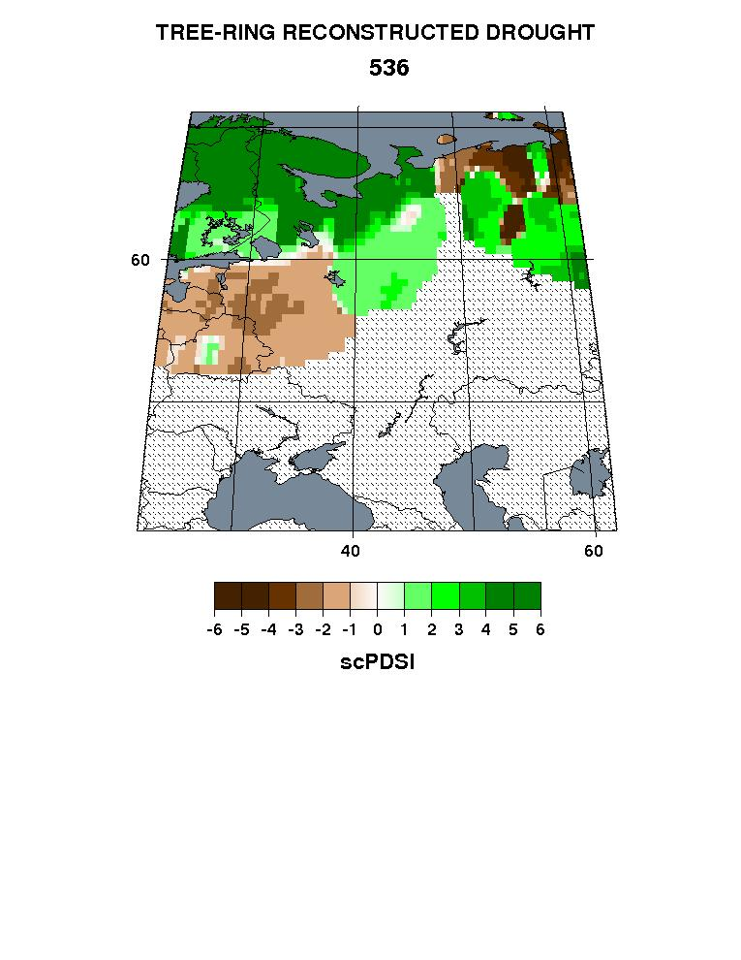
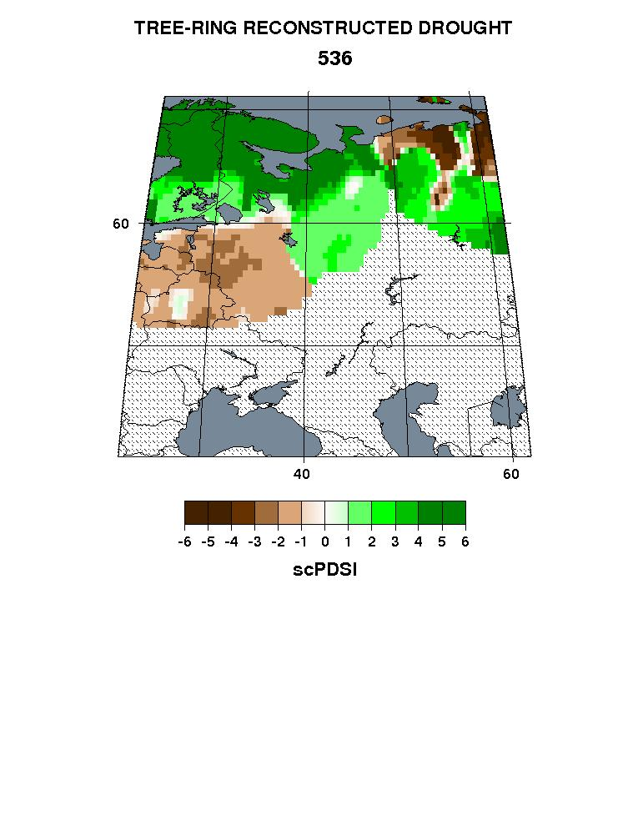
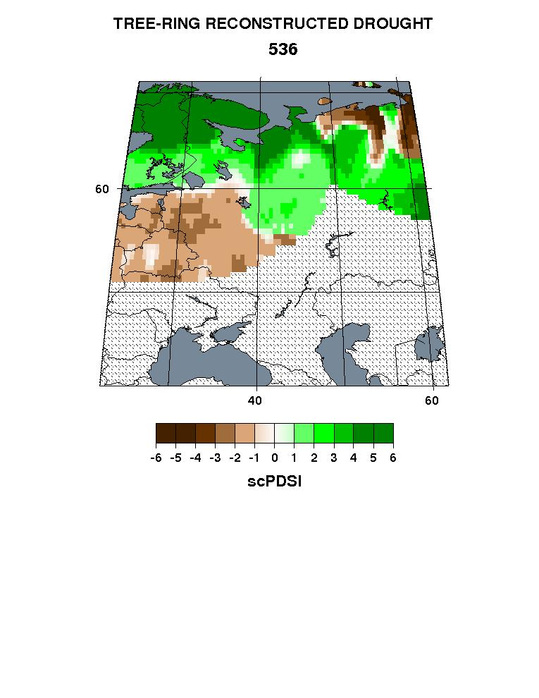
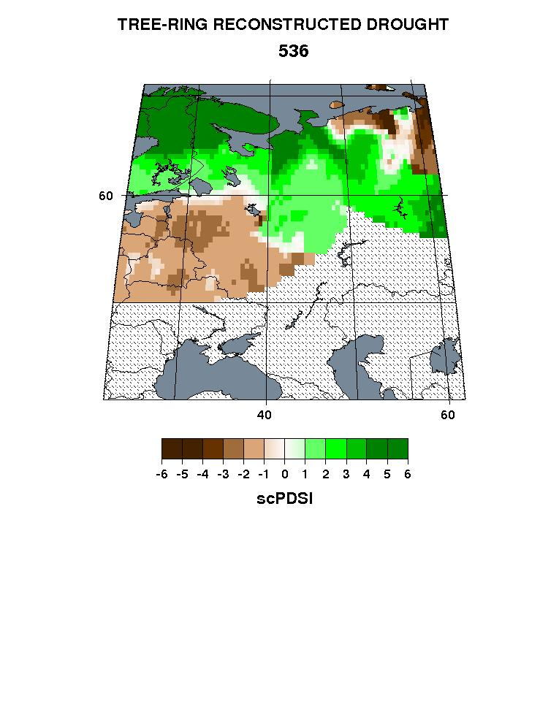
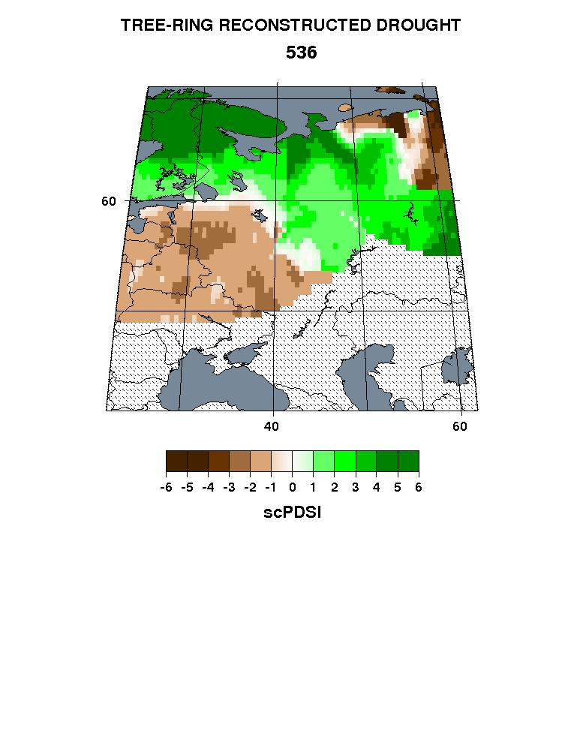
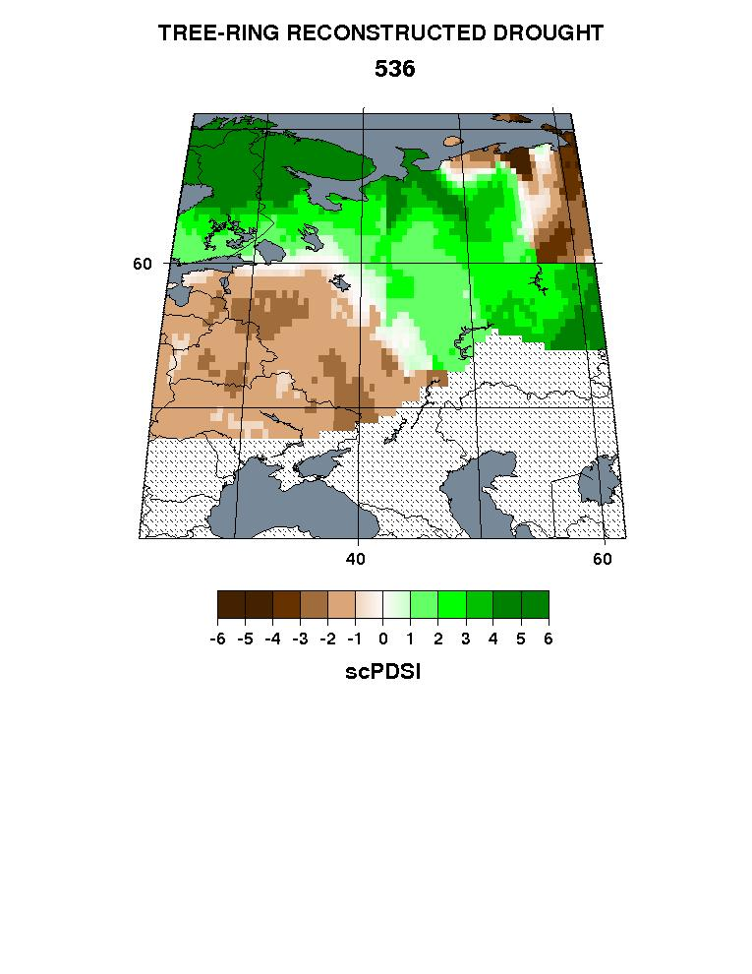
Iterated QCIS on a 16-member R>0.20 Ensemble Average
Year: 536
(a cautionary example)
PPR
k=0 Miss: 61.1%
k=1
k=2
k=3
k=4
k=6
k=8
k=10
Infilling the void is unlikely to provide believable estimates!

Slide 48
QCIS: What more have we learned?
QCIS iterations result in a decline in percent missing grid cells back in time and illustrate the progressive nature of this joint imputation and smoothing procedure.
QCIS does not noticeably distort the larger spatial patterns of wetness and dryness even for iterations as high as 10, as the 1891 map with no missing values shows. But there is noticeable spatial smoothing as the iterations increase and this leads to the gradual merging or disappearance of some smaller spatial details, especially for k>4. Exactly where to stop the iterations is still unclear, but again somewhere around 3-4 iterations seems to be a prudent maximum.
QCIS infills or imputes missing values back in time as shown for the maps of the volcanically-themed years 1601, 1453, and 1257, including interior gaps, e.g. in 1257, to produce more spatially complete fields farther back in time.
However, one caution in using QCIS is that you can’t get something from nothing, e.g. year 536.

