Slide 1


Signal Free Tree-Ring Standardization:
A Tutorial and Computer Programs
Edward R. Cook
Tree-Ring Laboratory
Lamont-Doherty Earth Observatory
Columbia University, New York
Statistical Methods for Climate Reconstruction from Tree Rings
Programa de Cursos Avanzados
CONICET, Mendoza
April 4-7, 2018

Slide 2
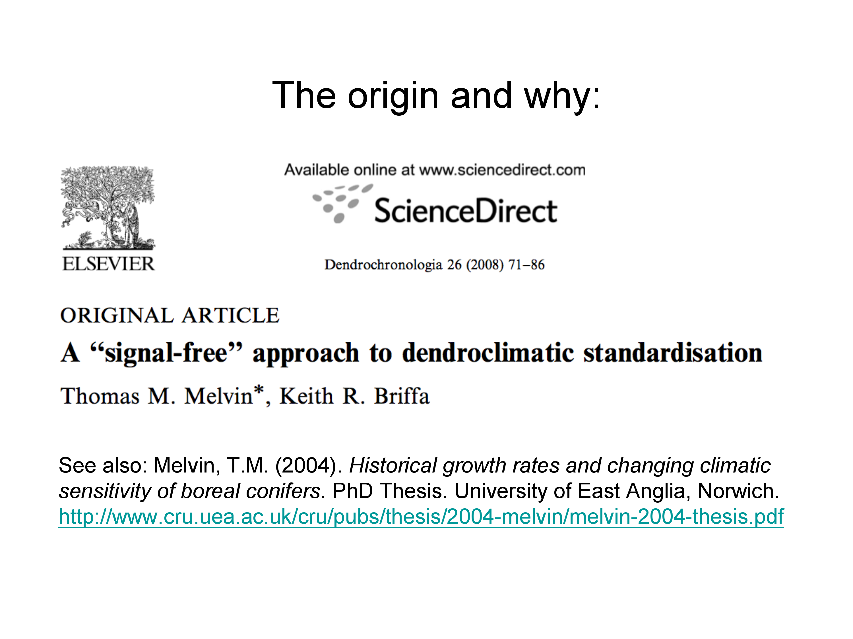

Slide 3
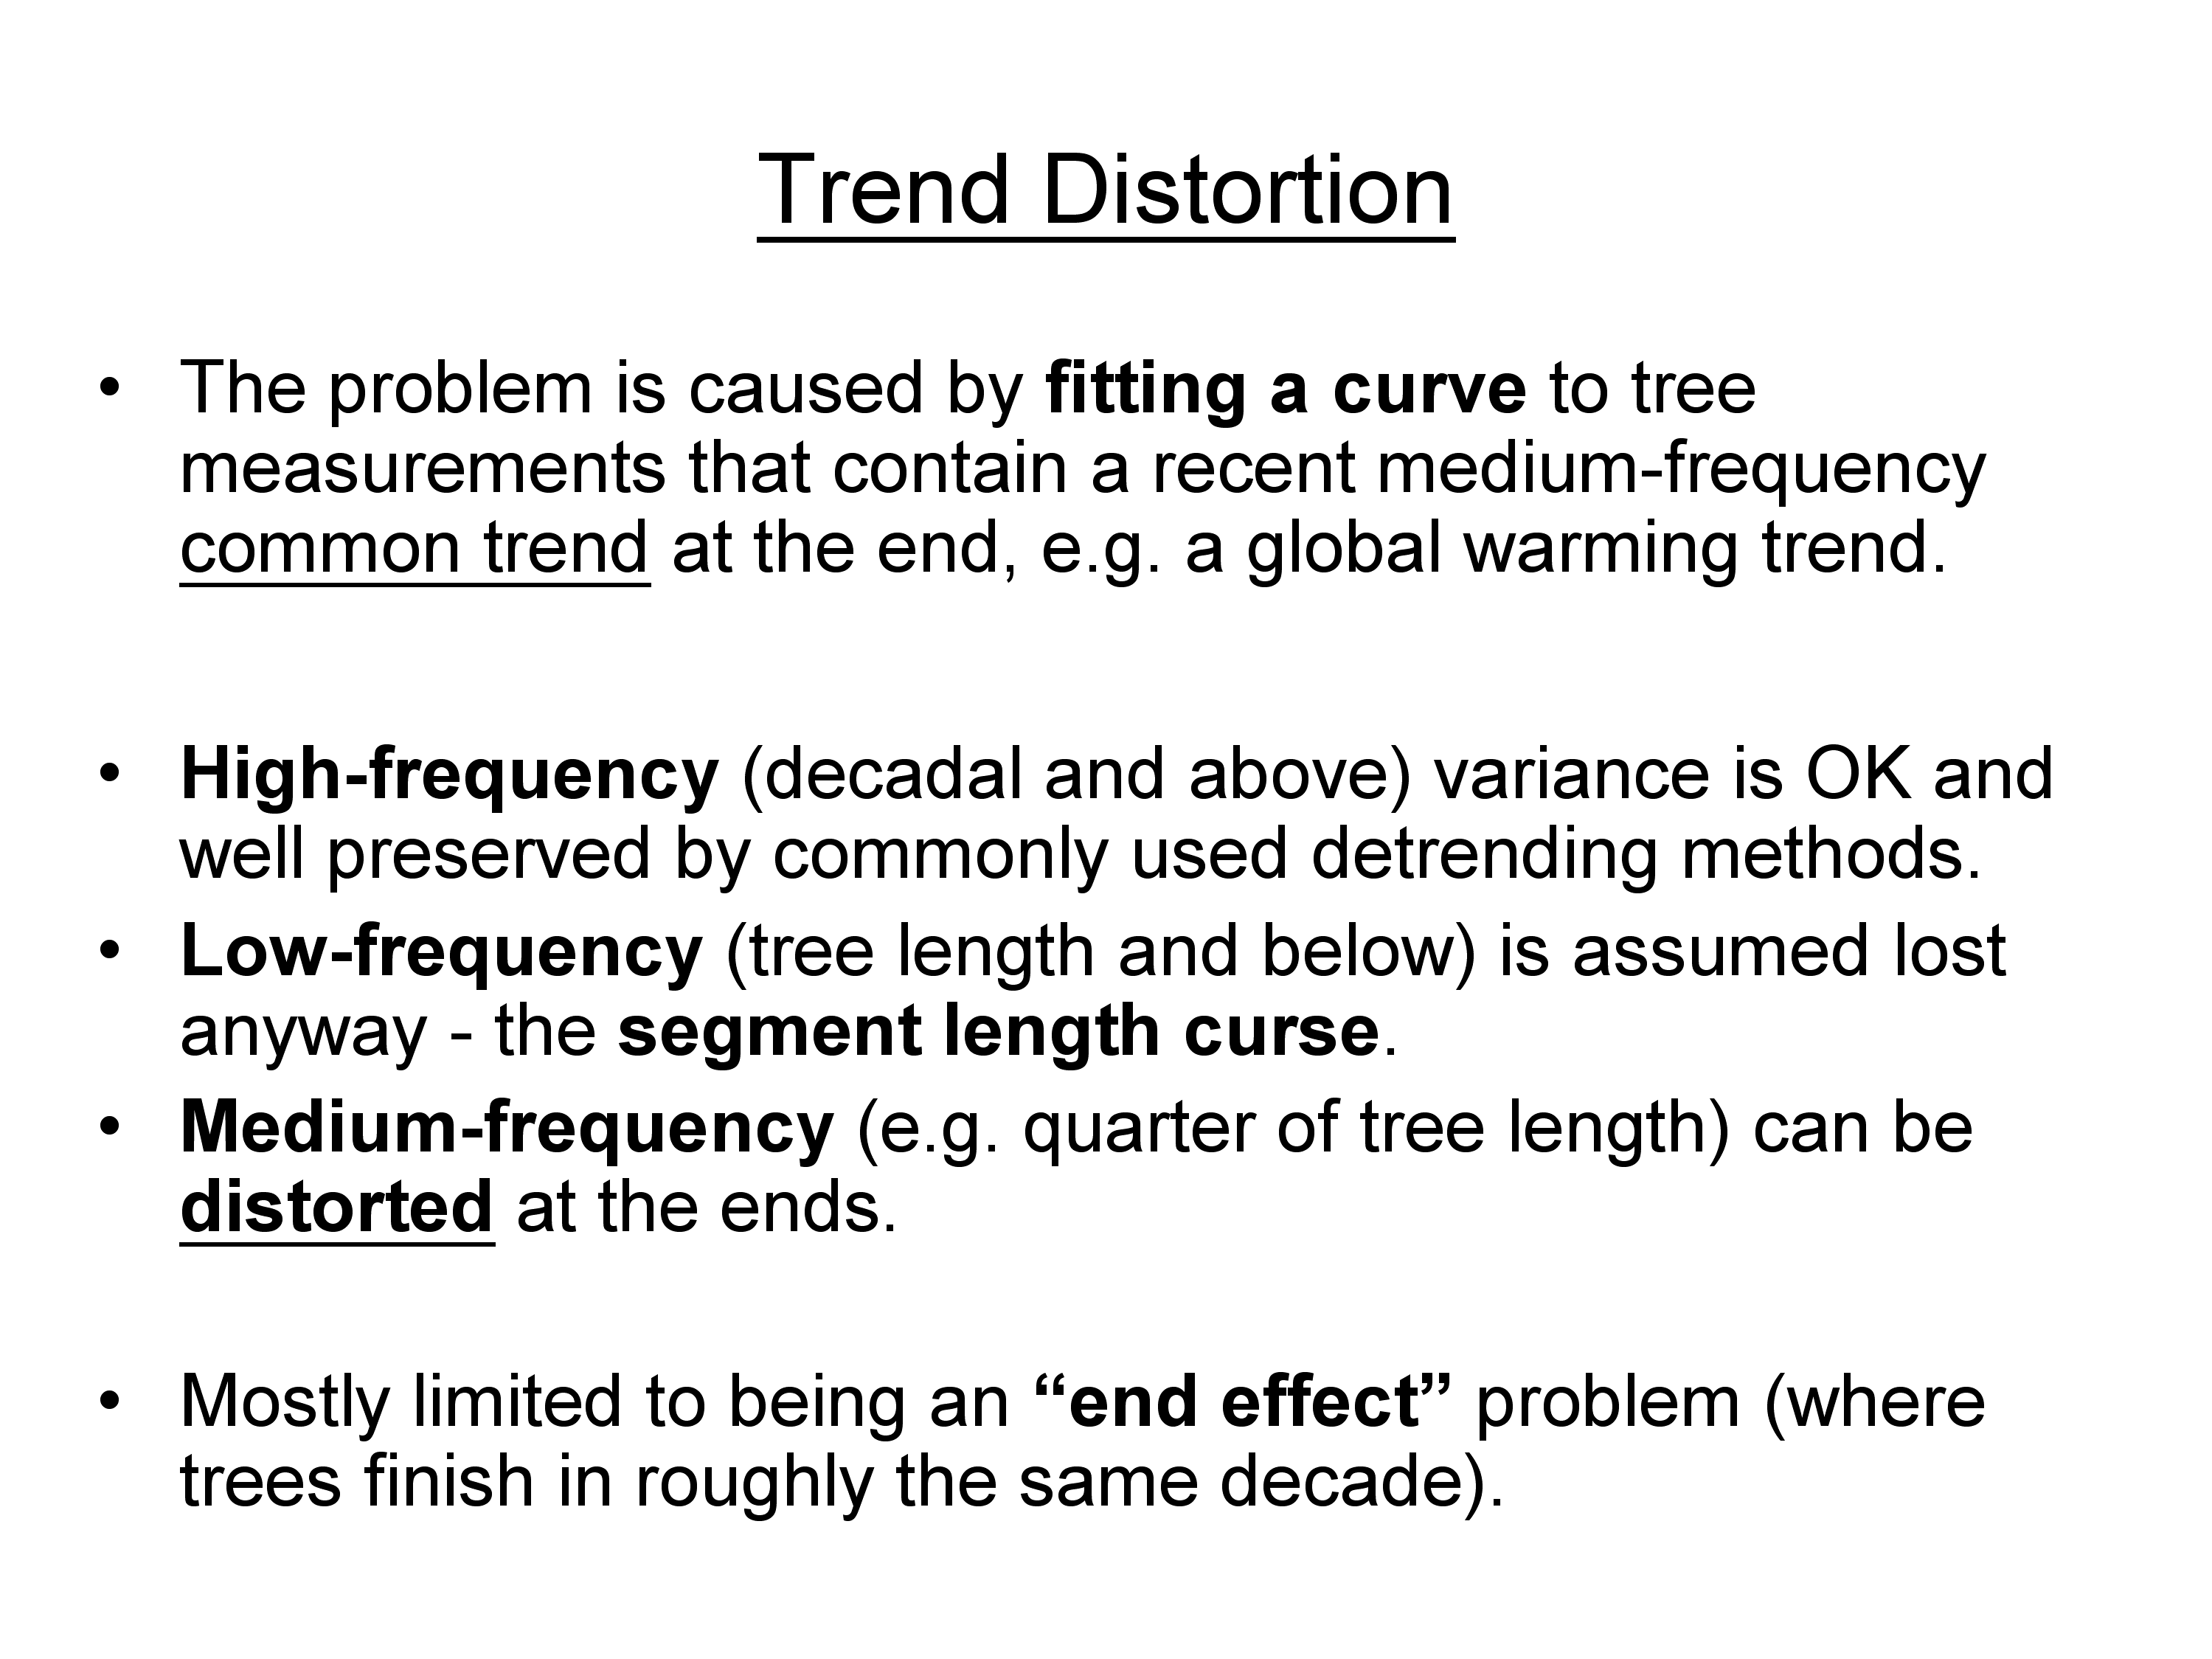

Slide 4
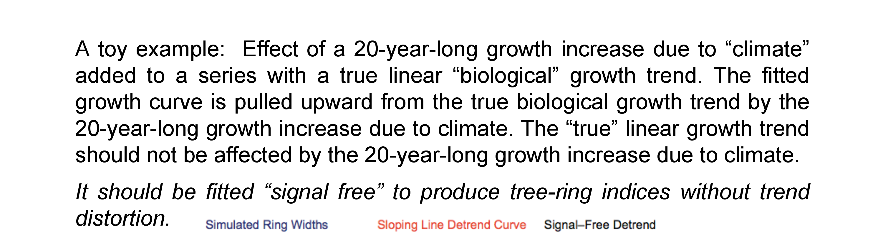
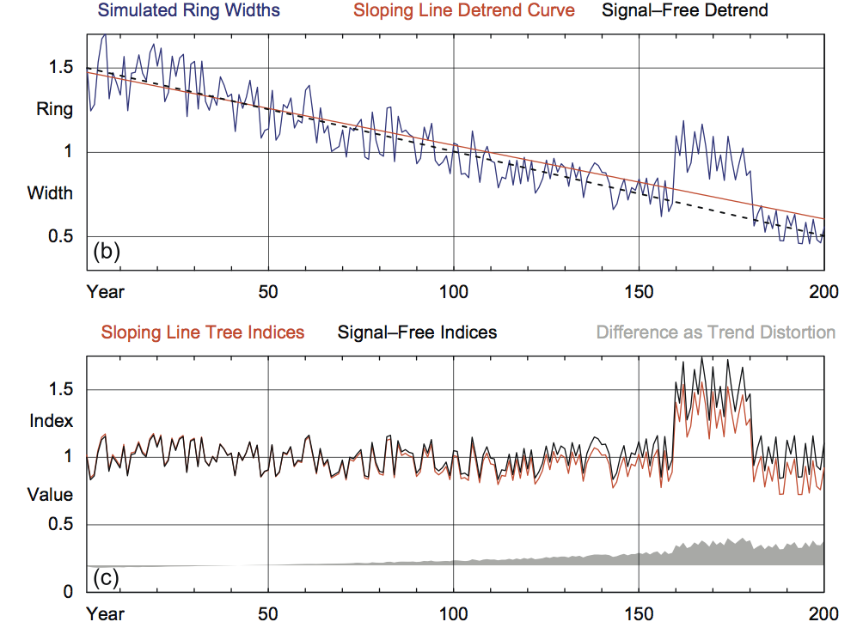

Slide 5
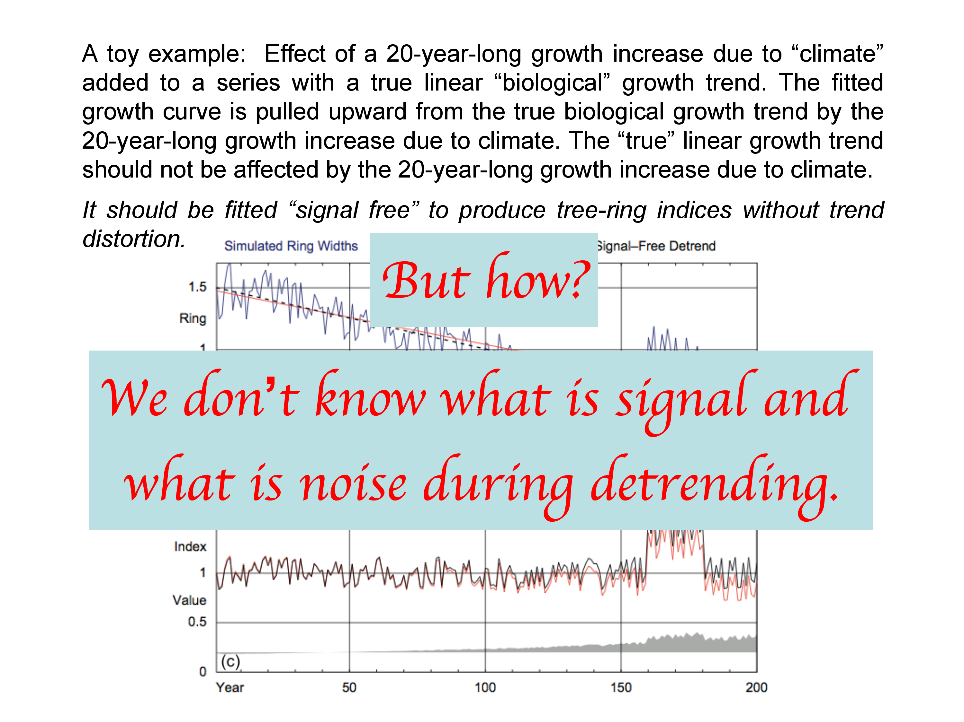

Slide 6
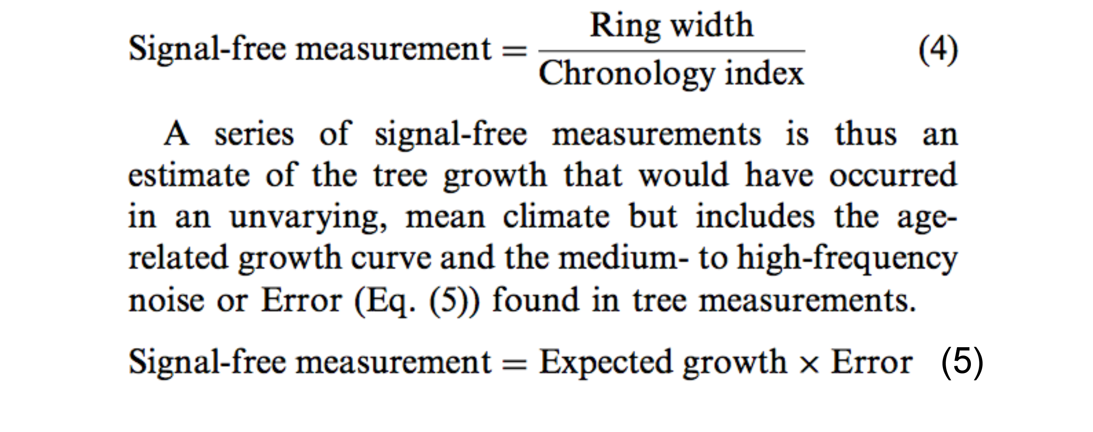
Tom Melvin’s solution:
Iteratively produce a final series of “signal free”
measurements that do not distort the fitting
of the expected “biological” growth curve.
From Melvin and Briffa (2008)

Slide 7
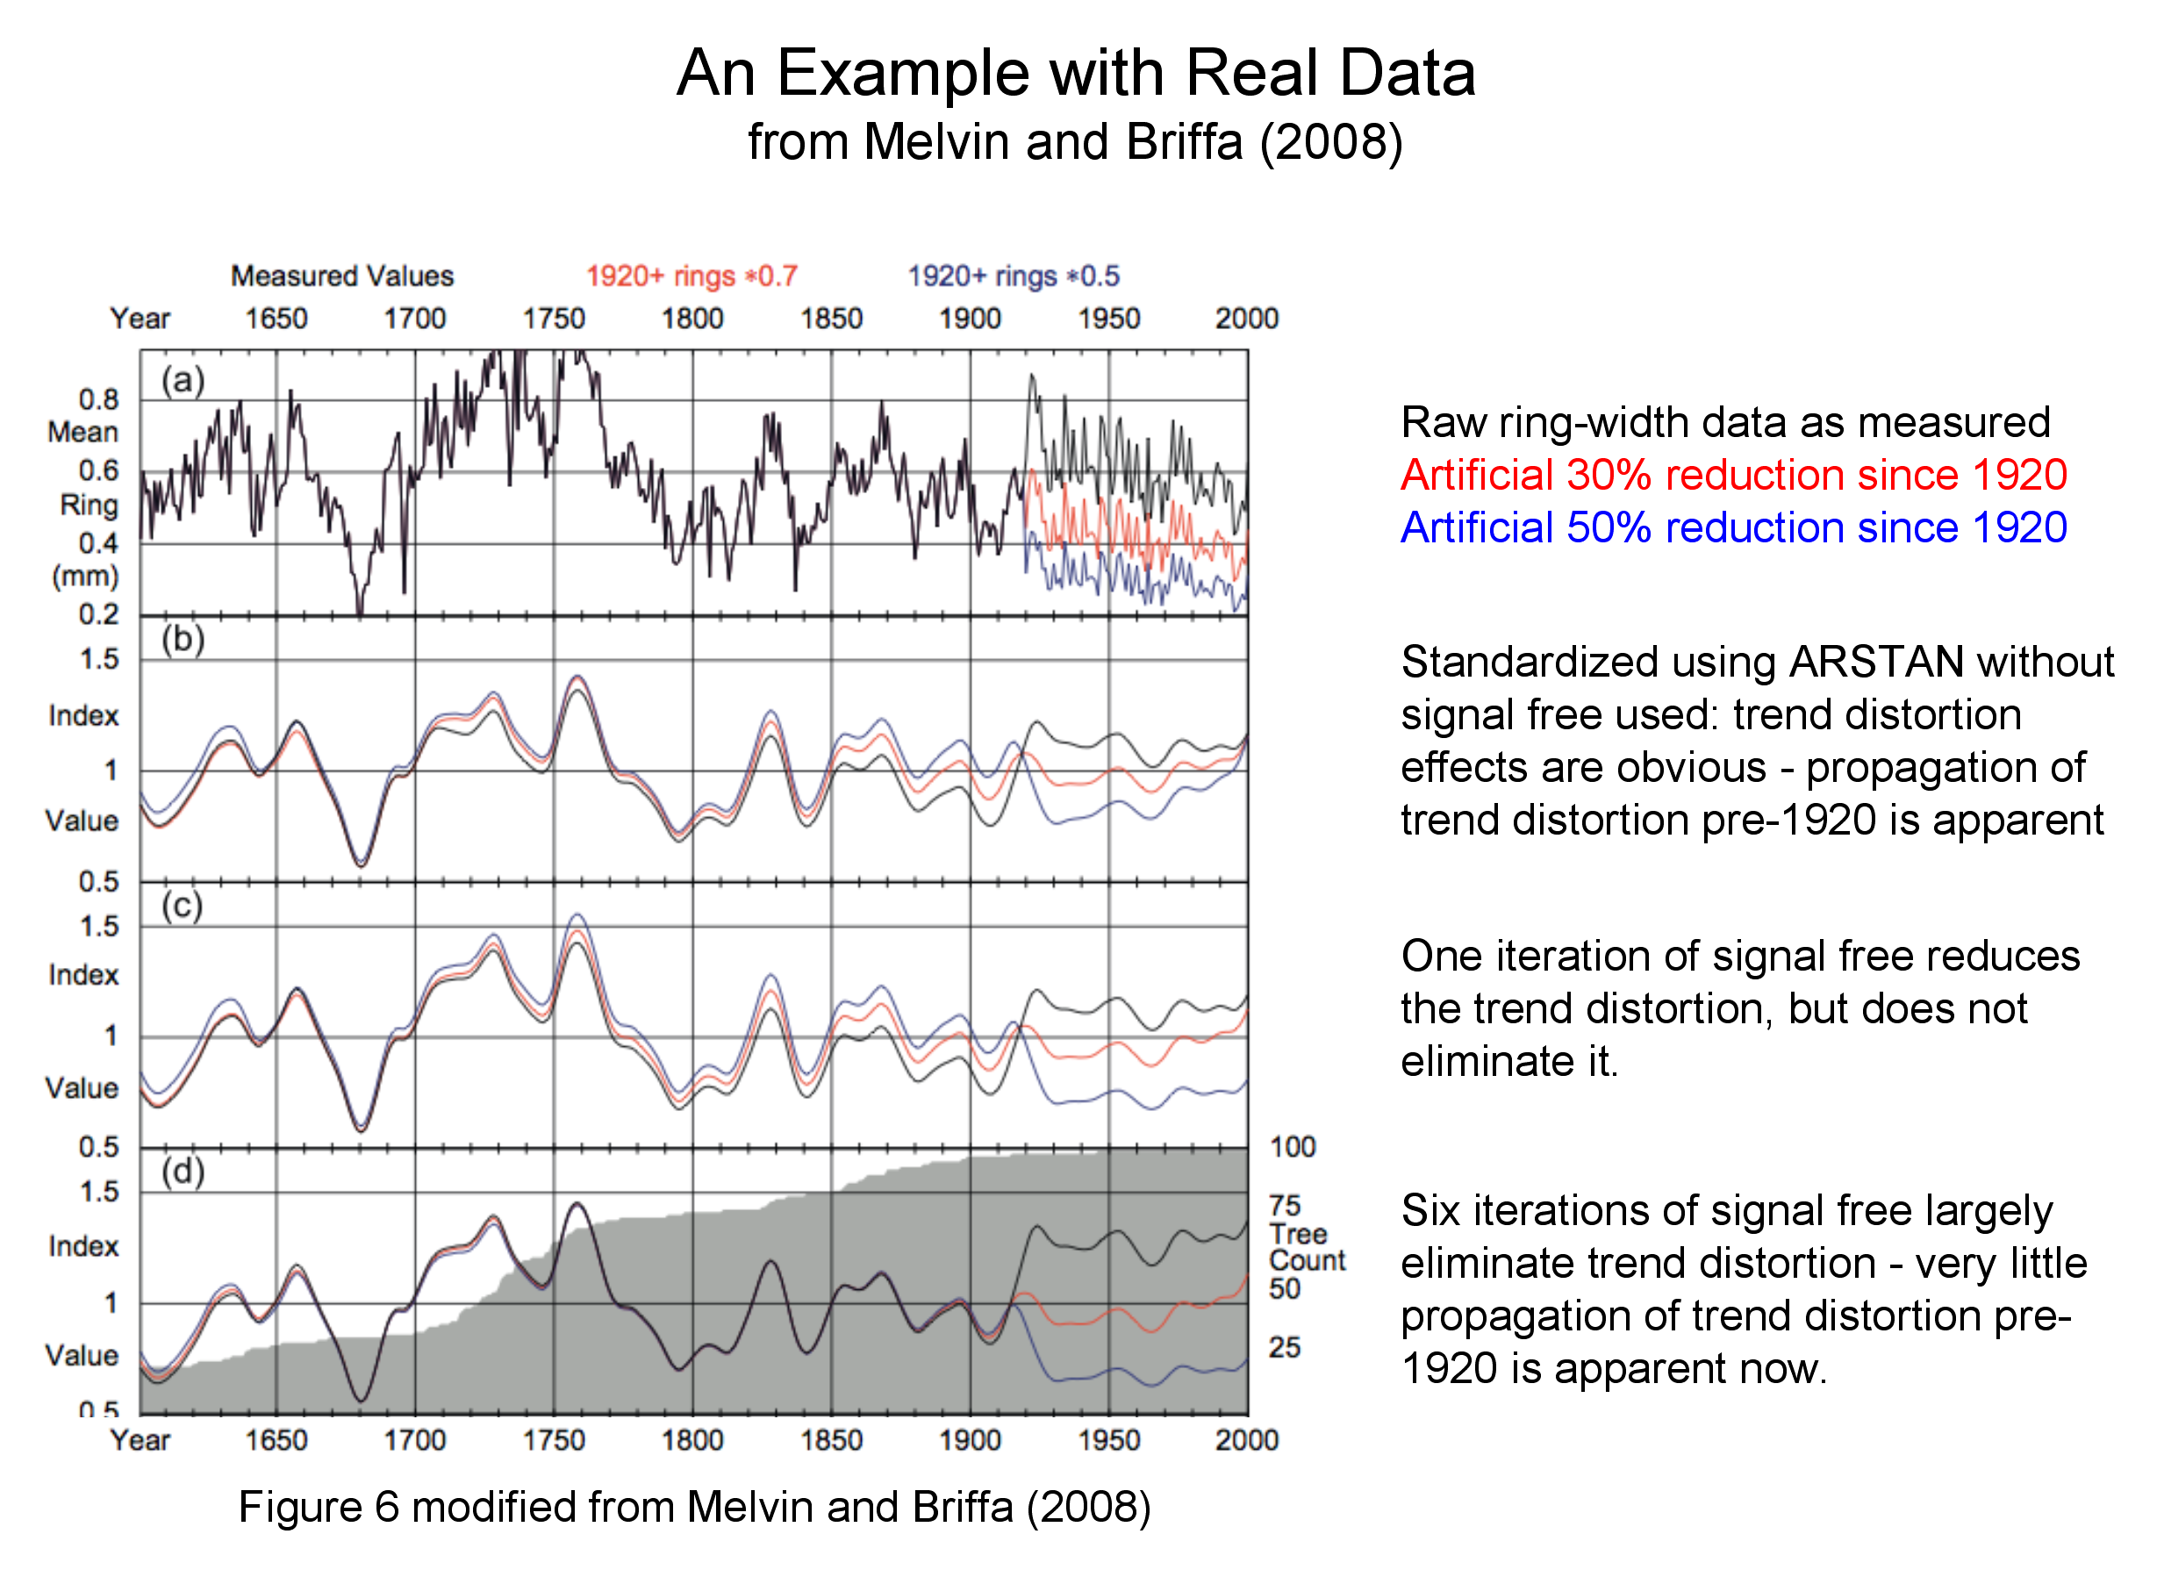

Slide 8
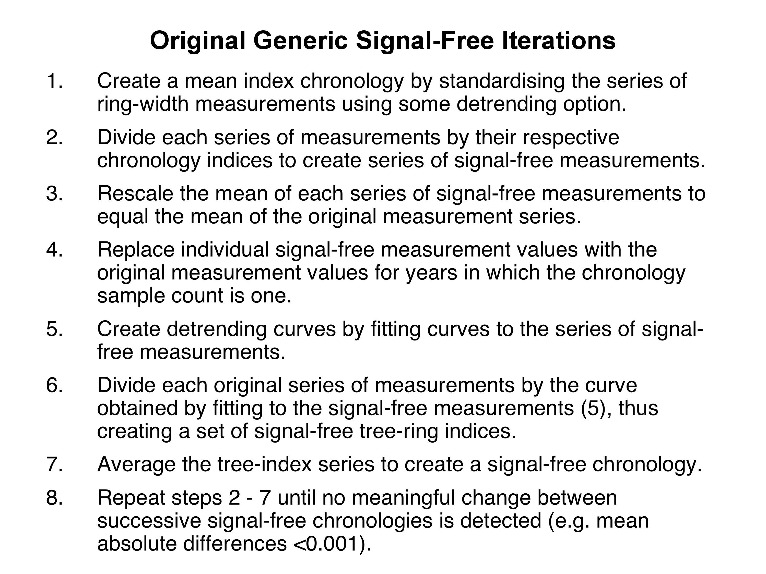

Slide 9
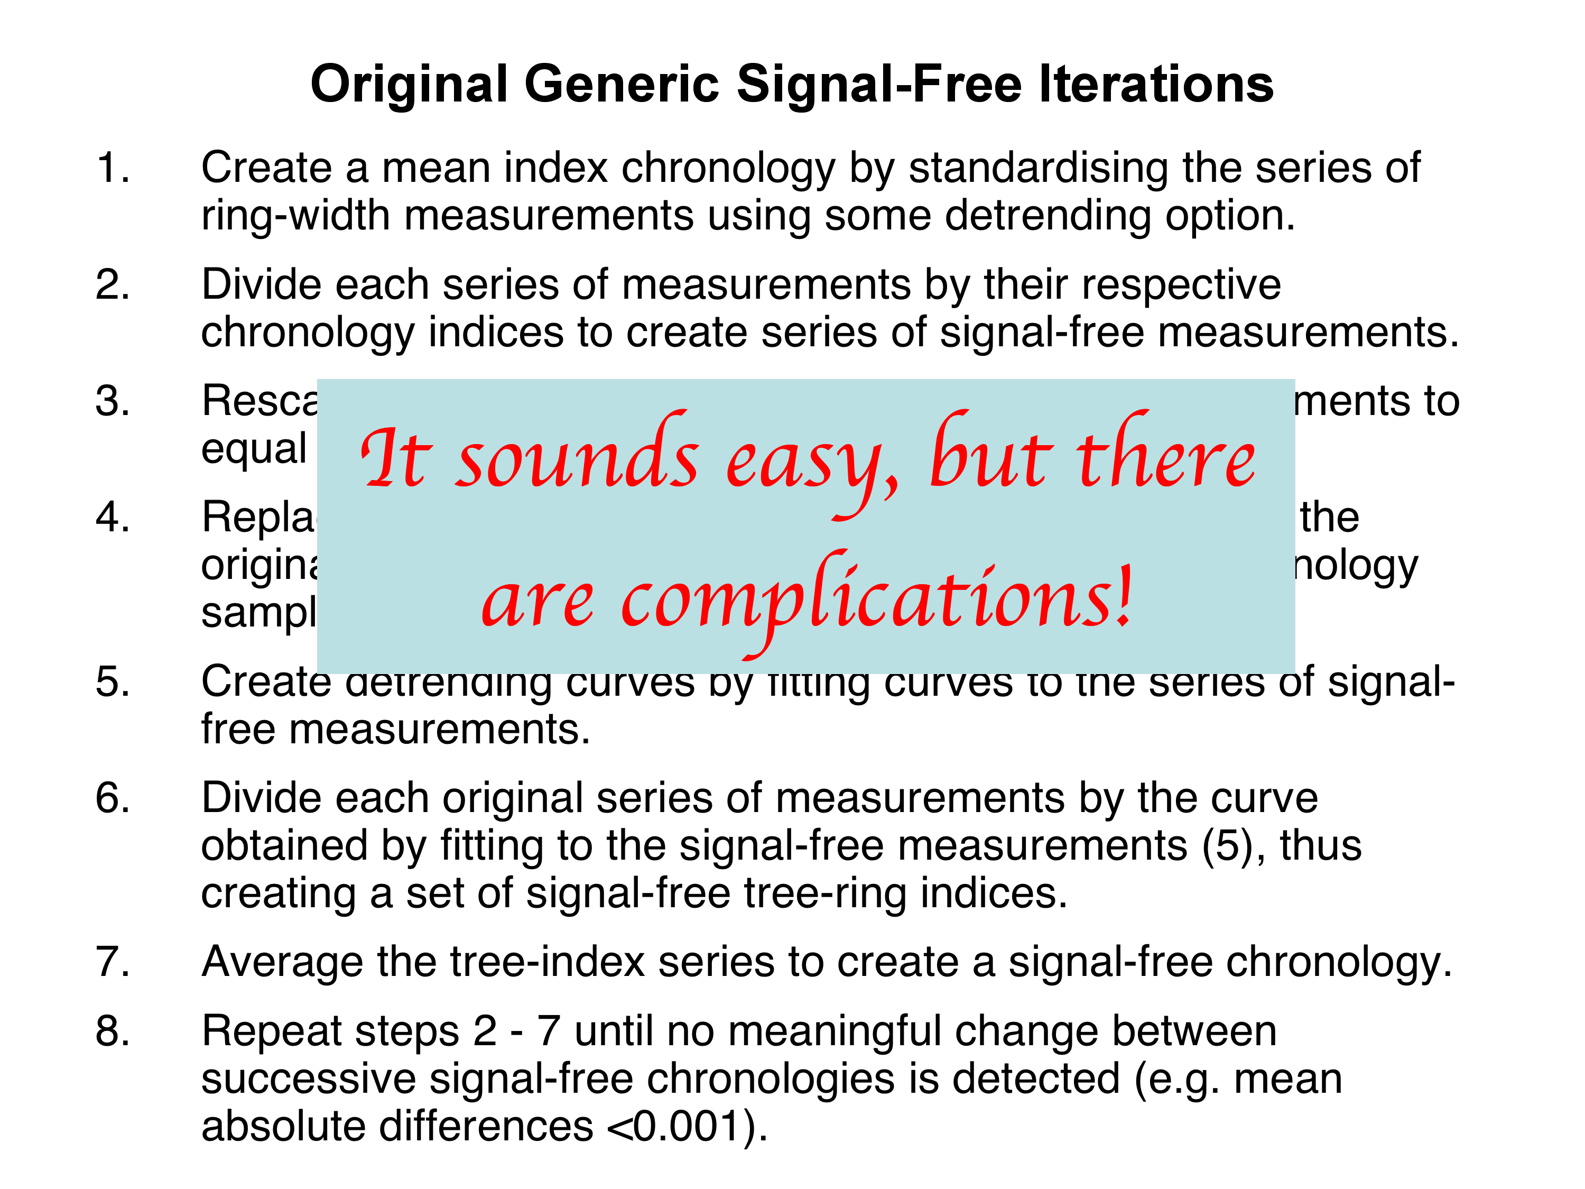

Slide 10
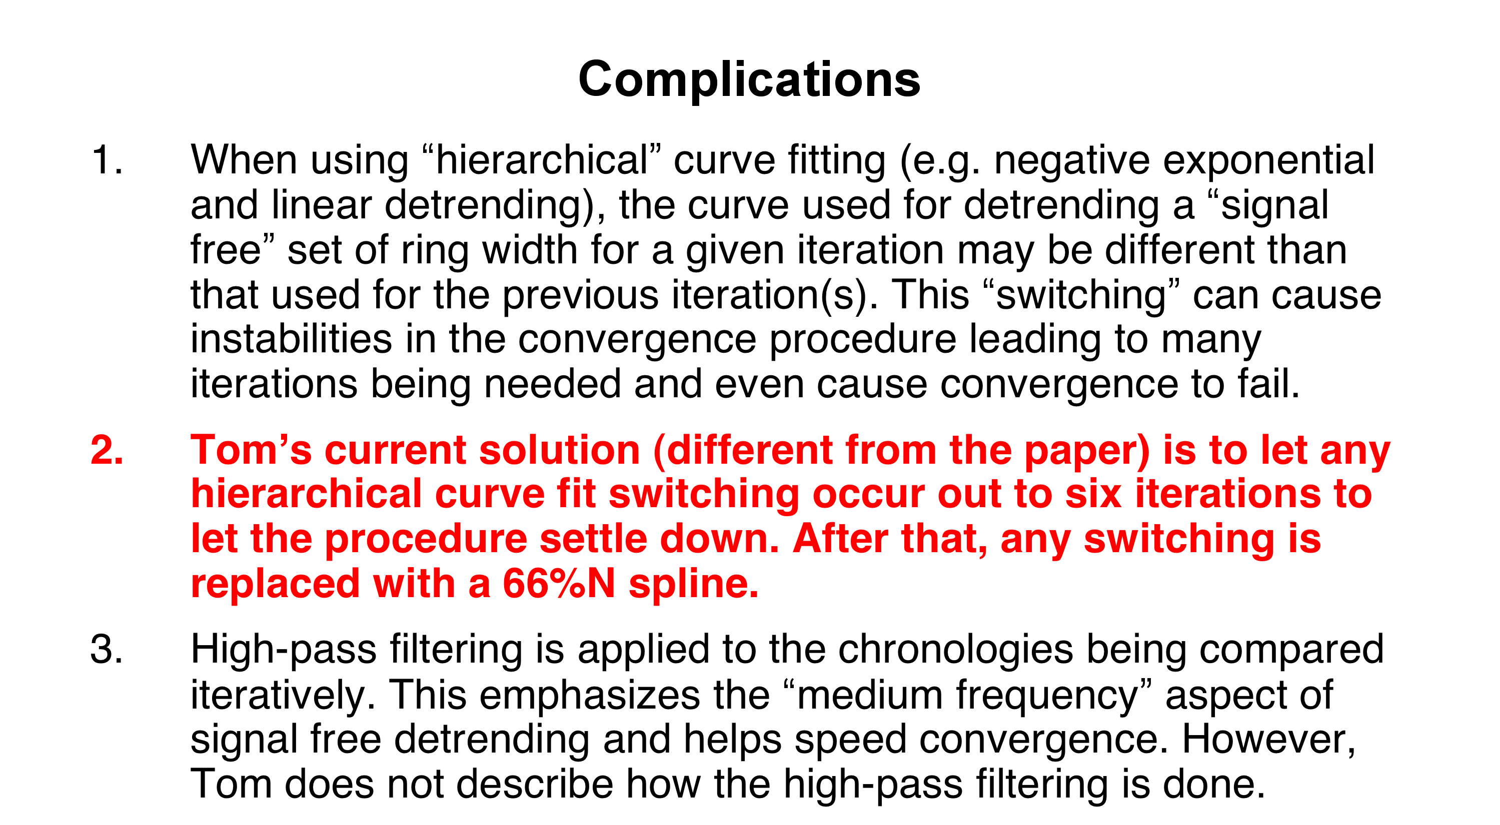

Slide 11
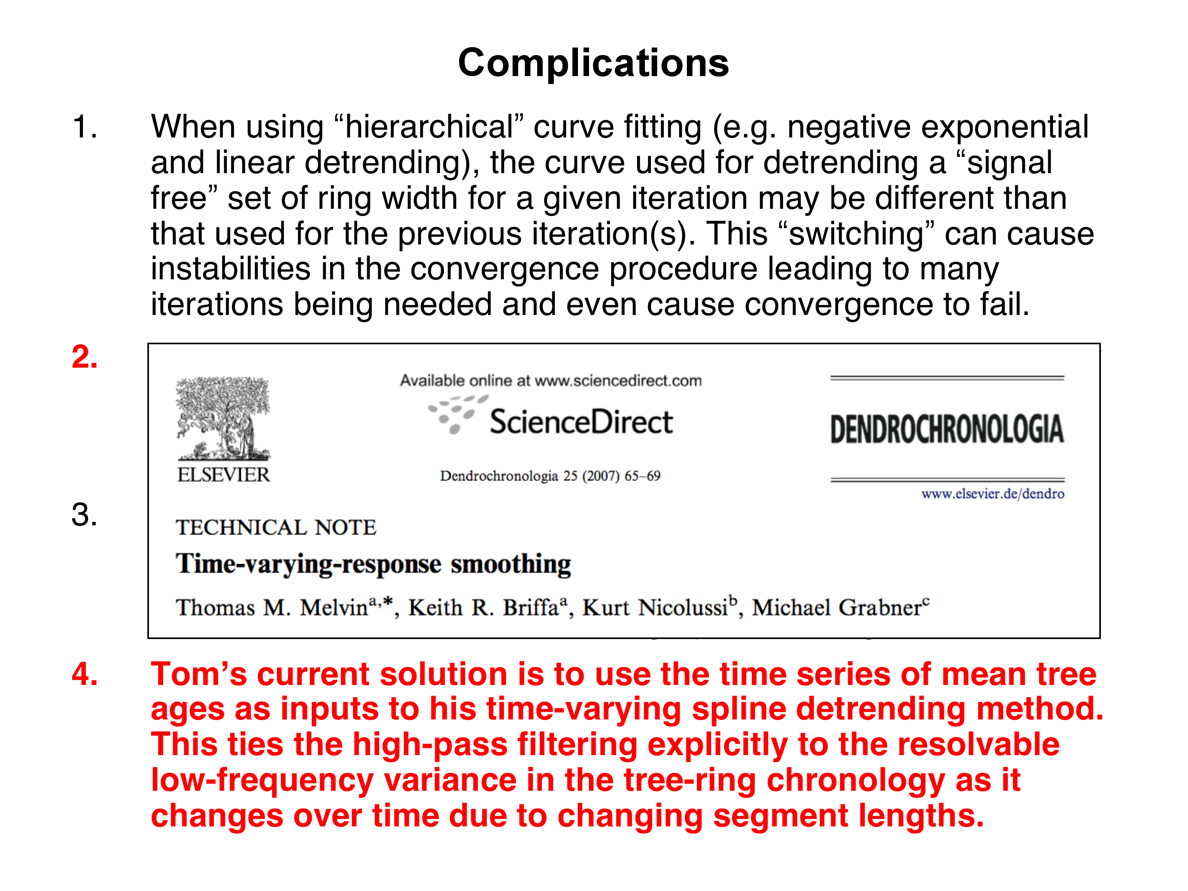

Slide 12
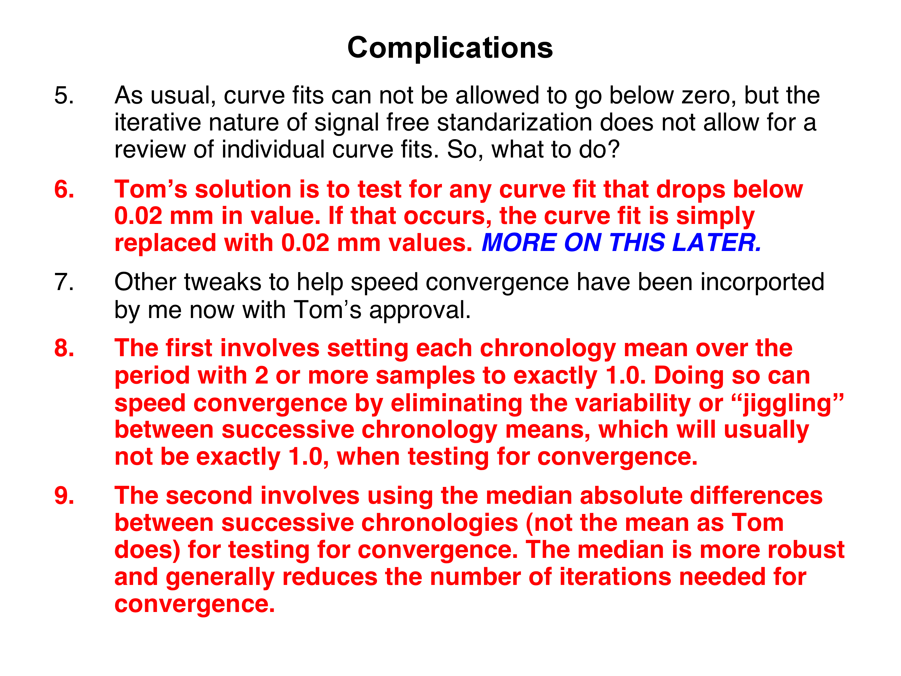

Slide 13
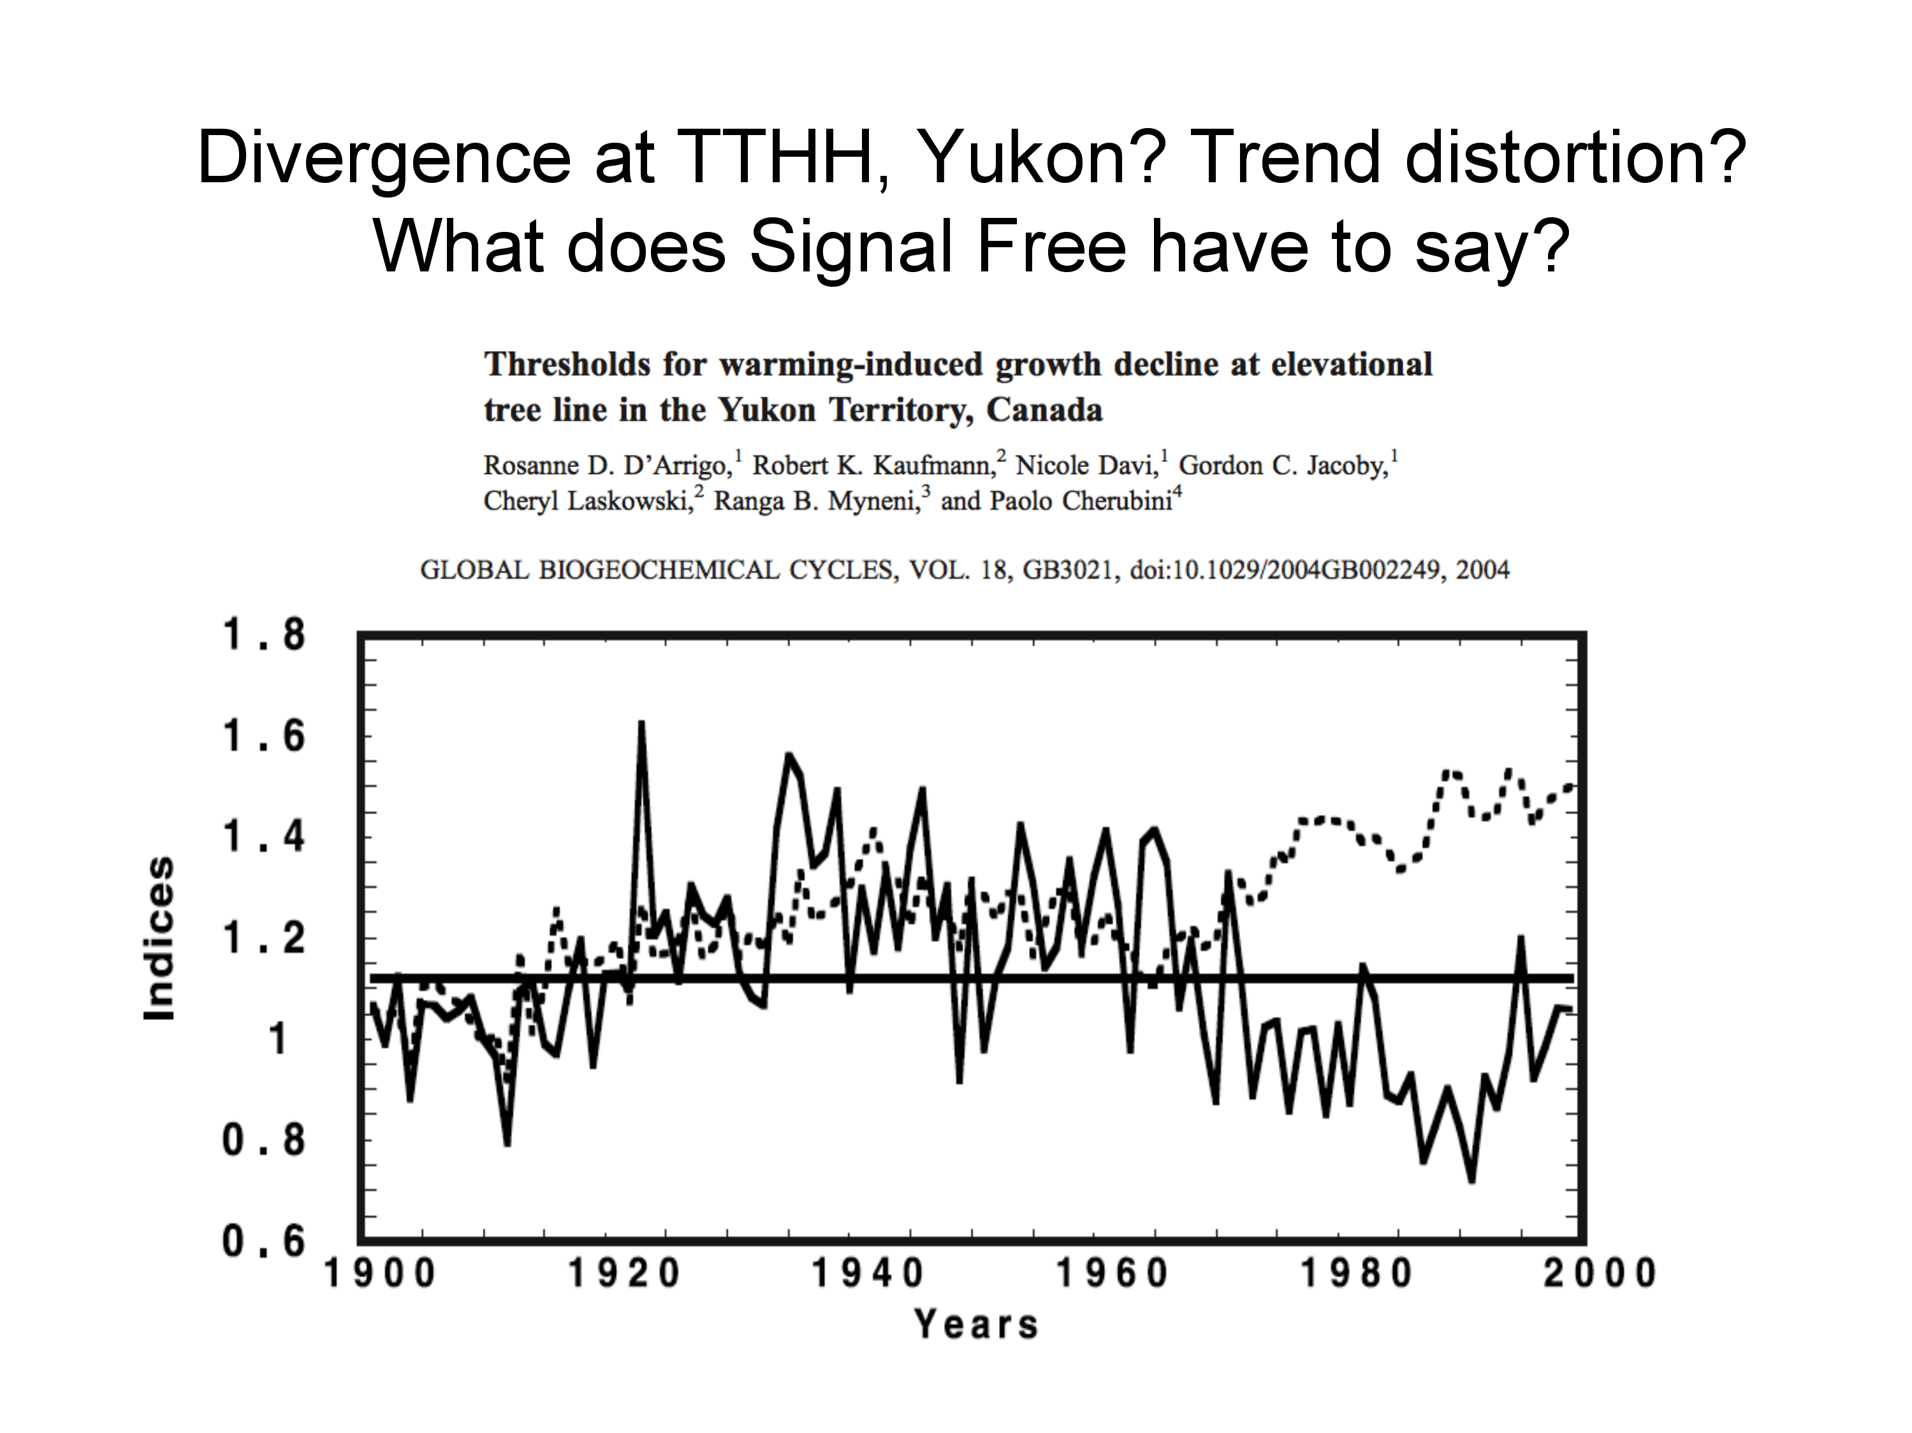

Slide 14
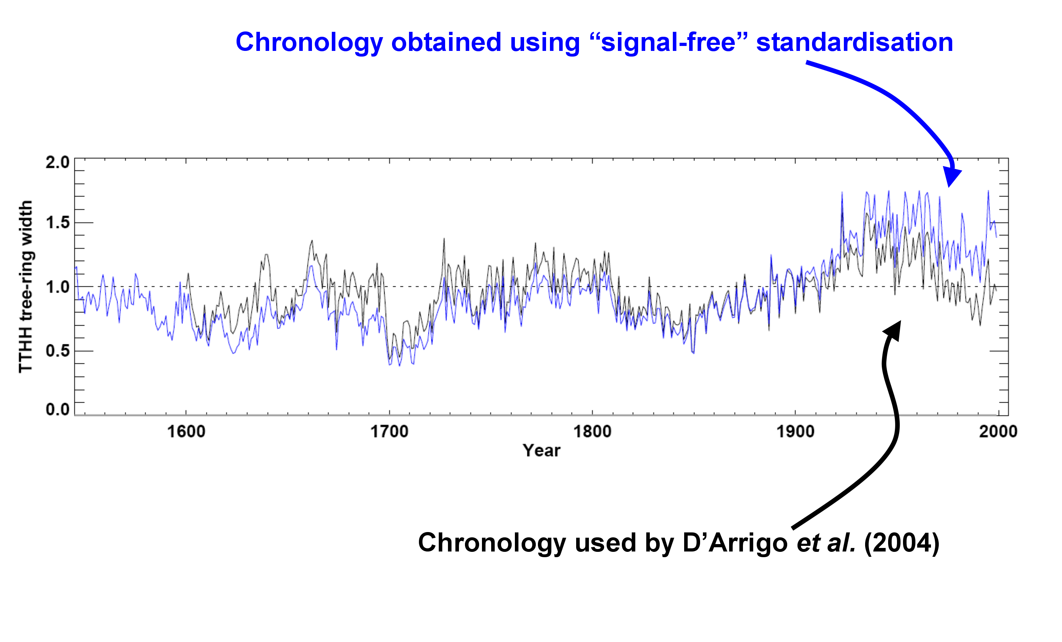
TTHH chronologies: the impact of Signal Free
standardization on the evaluation of “divergence”
All TTHH analyses done by Keith Briffa and Tom Melvin

Slide 15
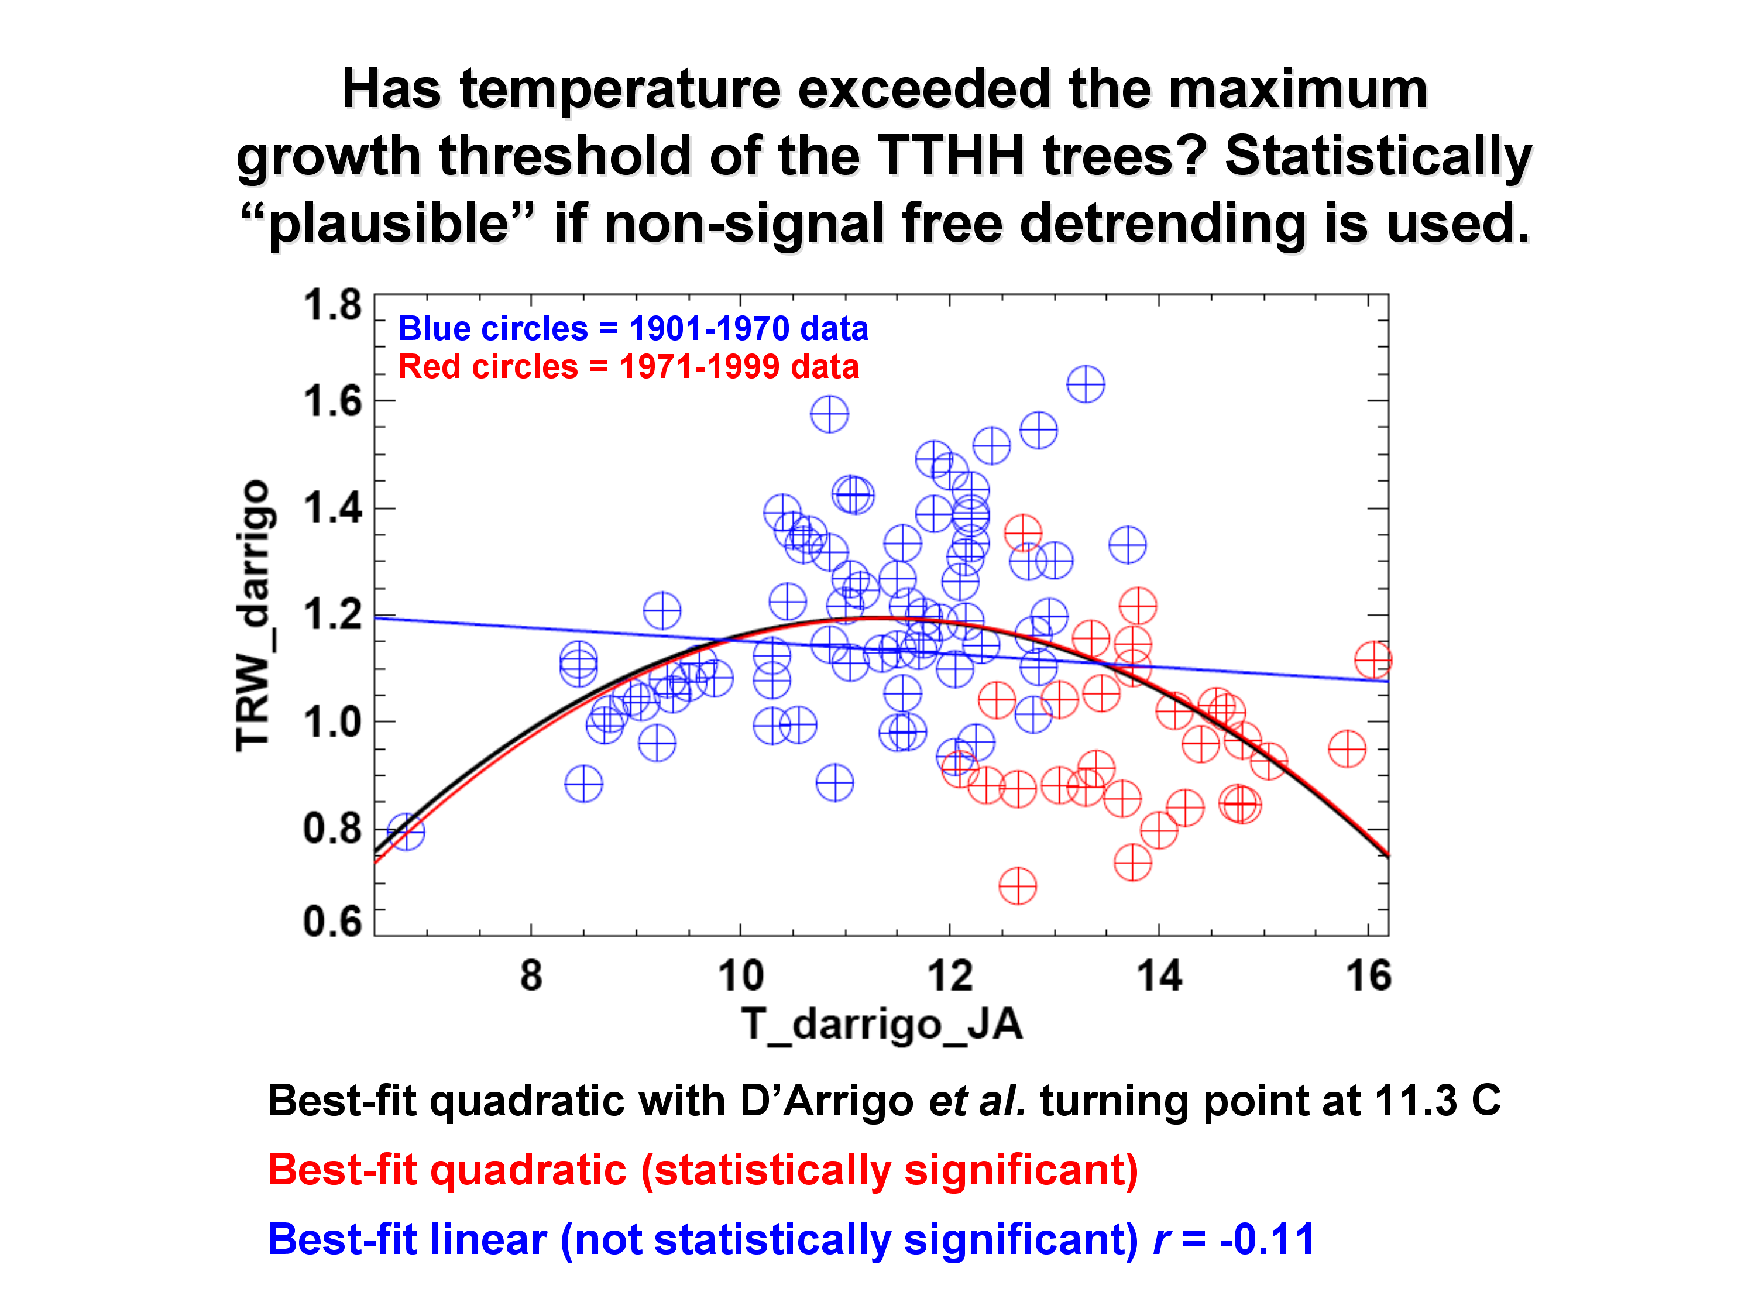

Slide 16
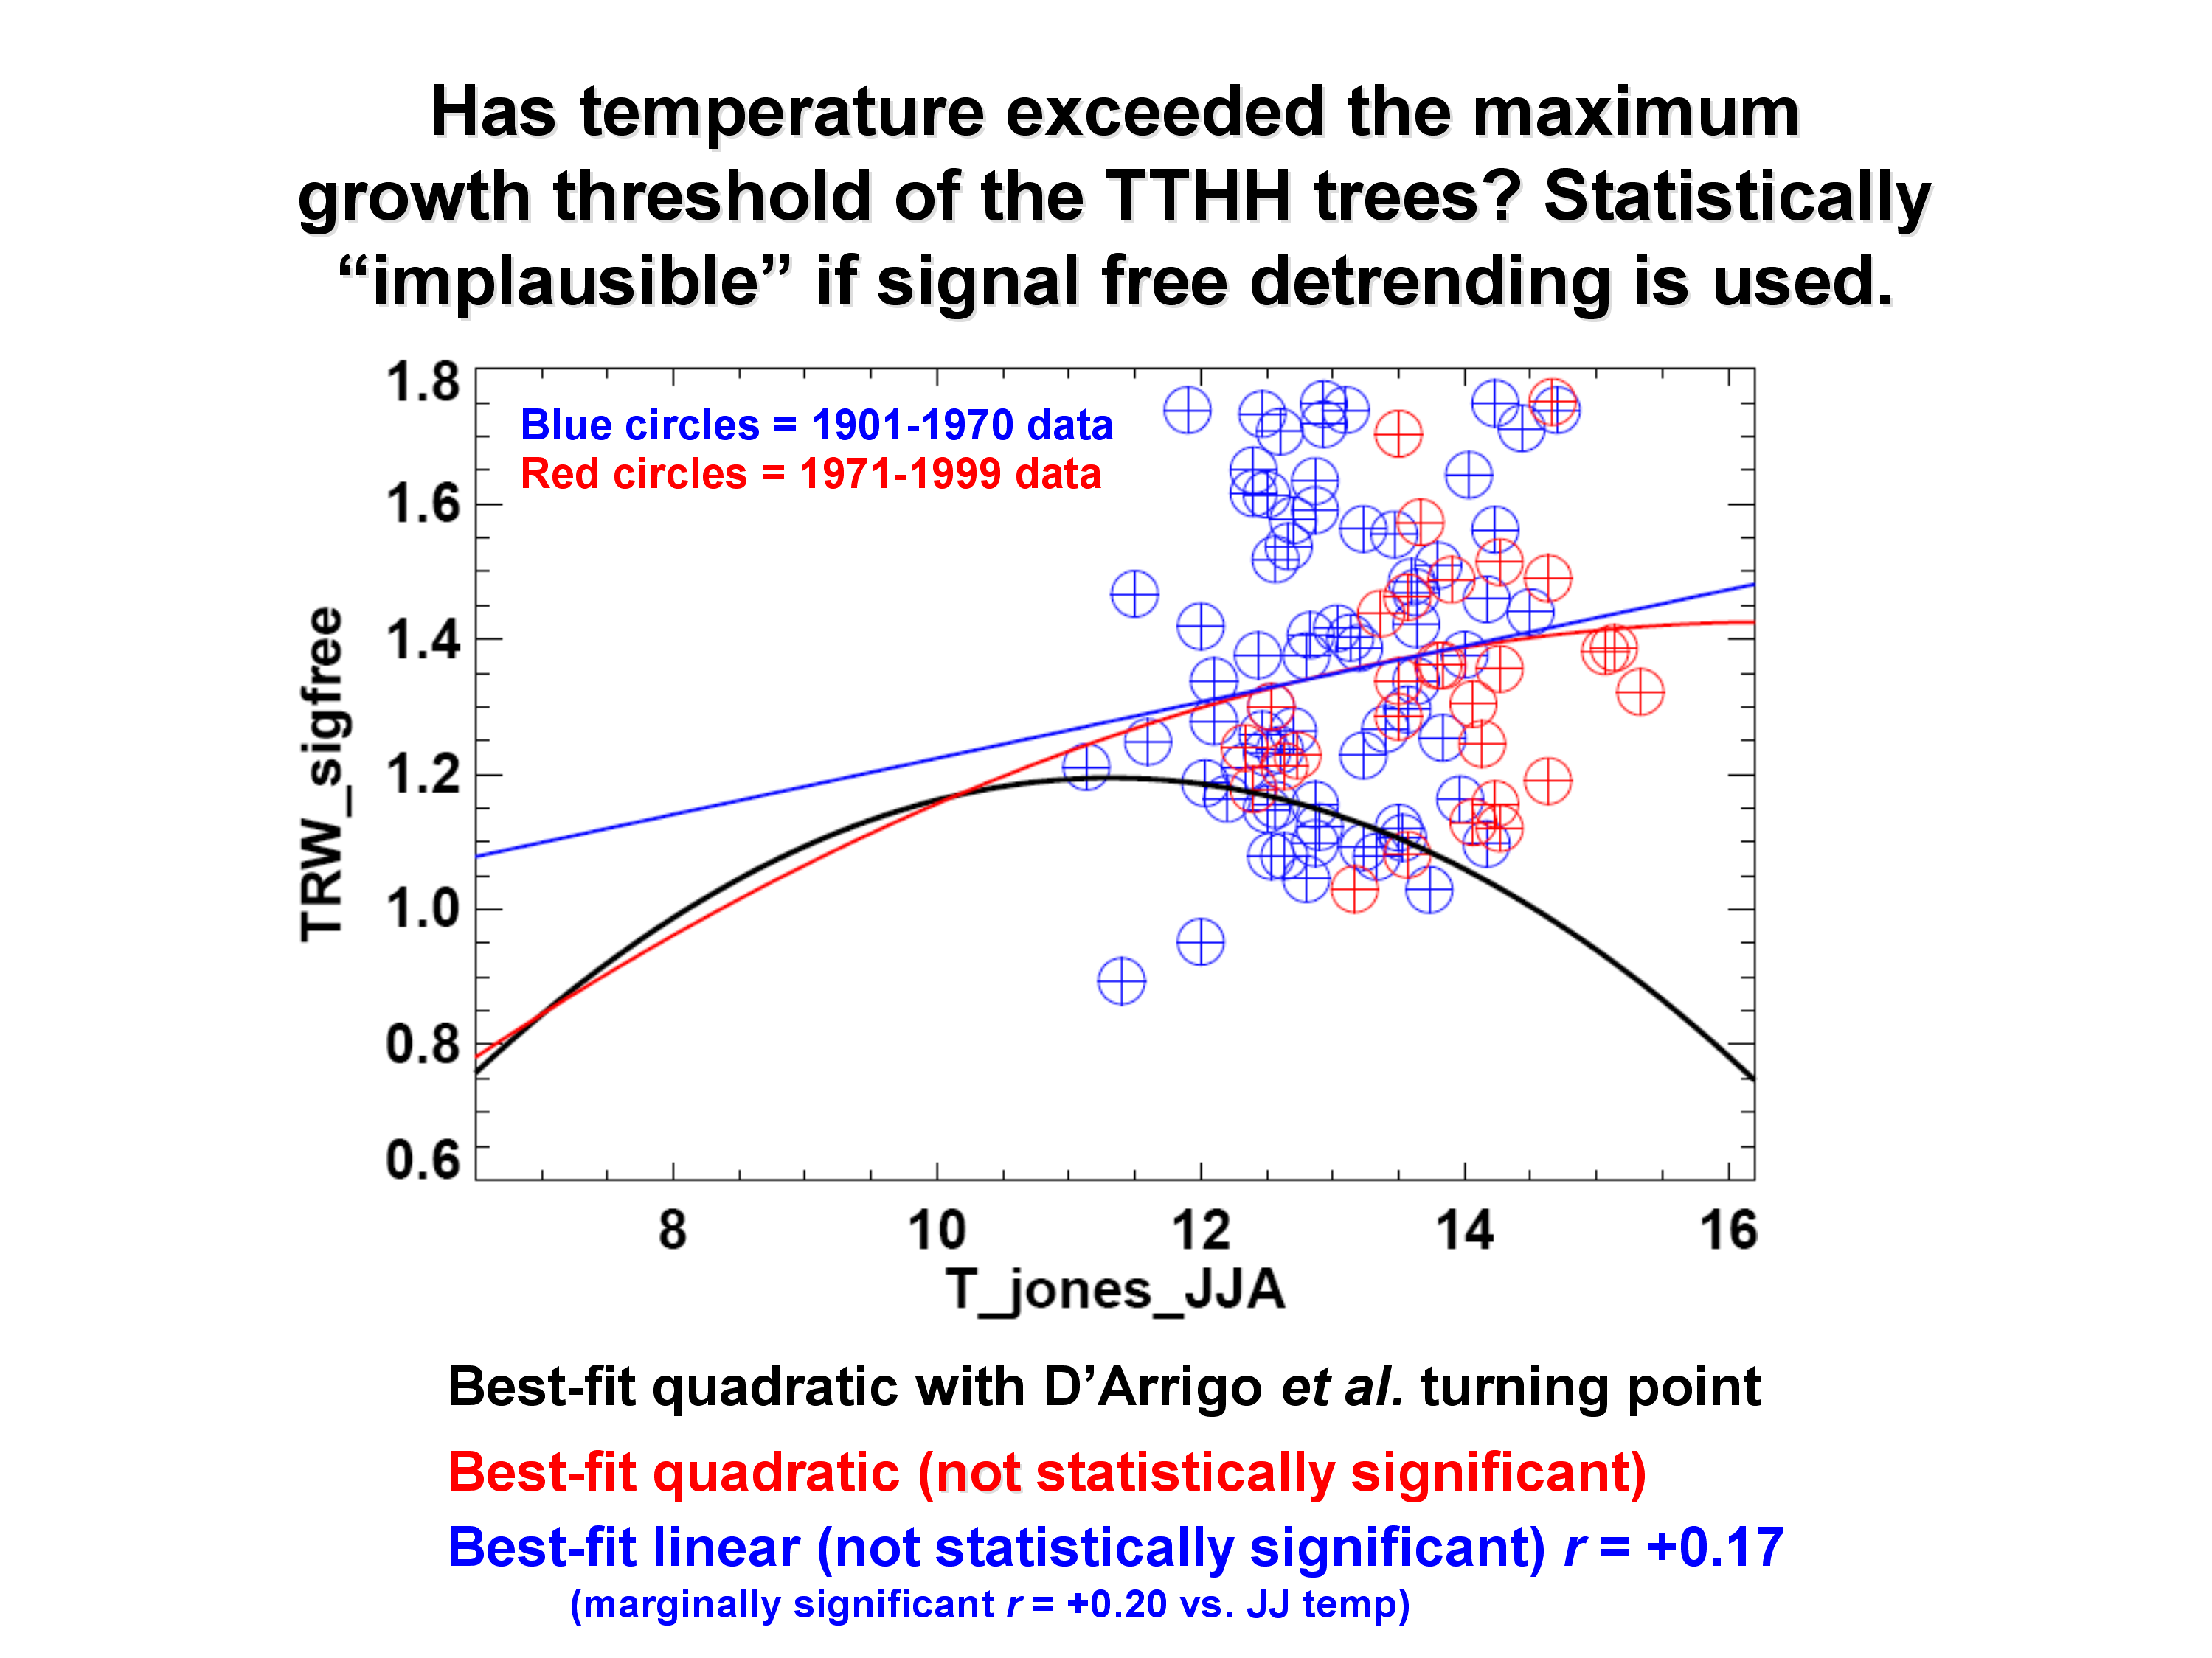

Slide 17
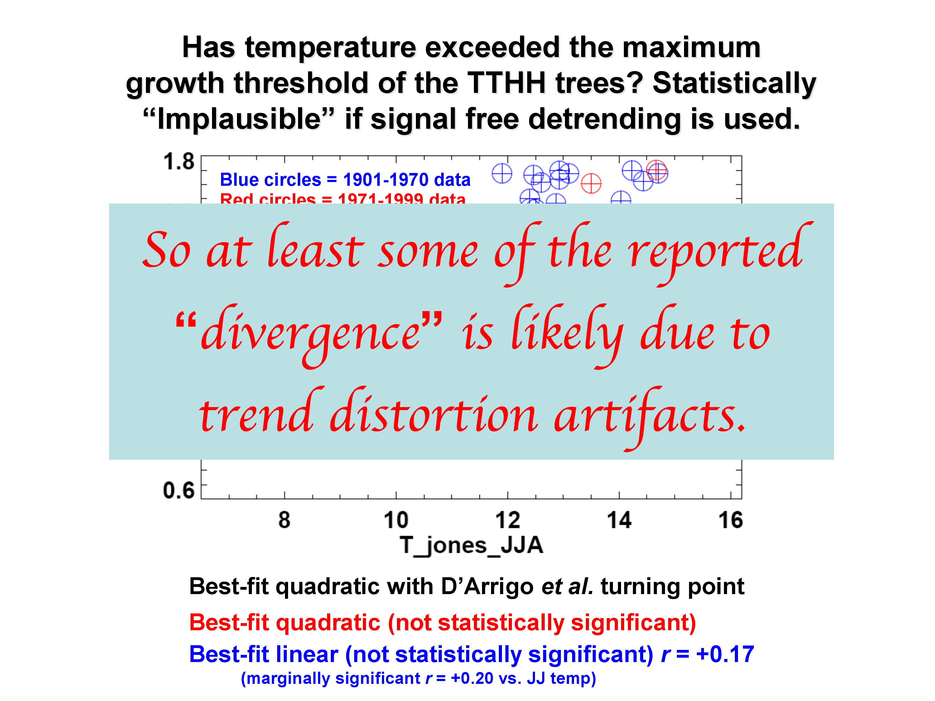

Slide 18
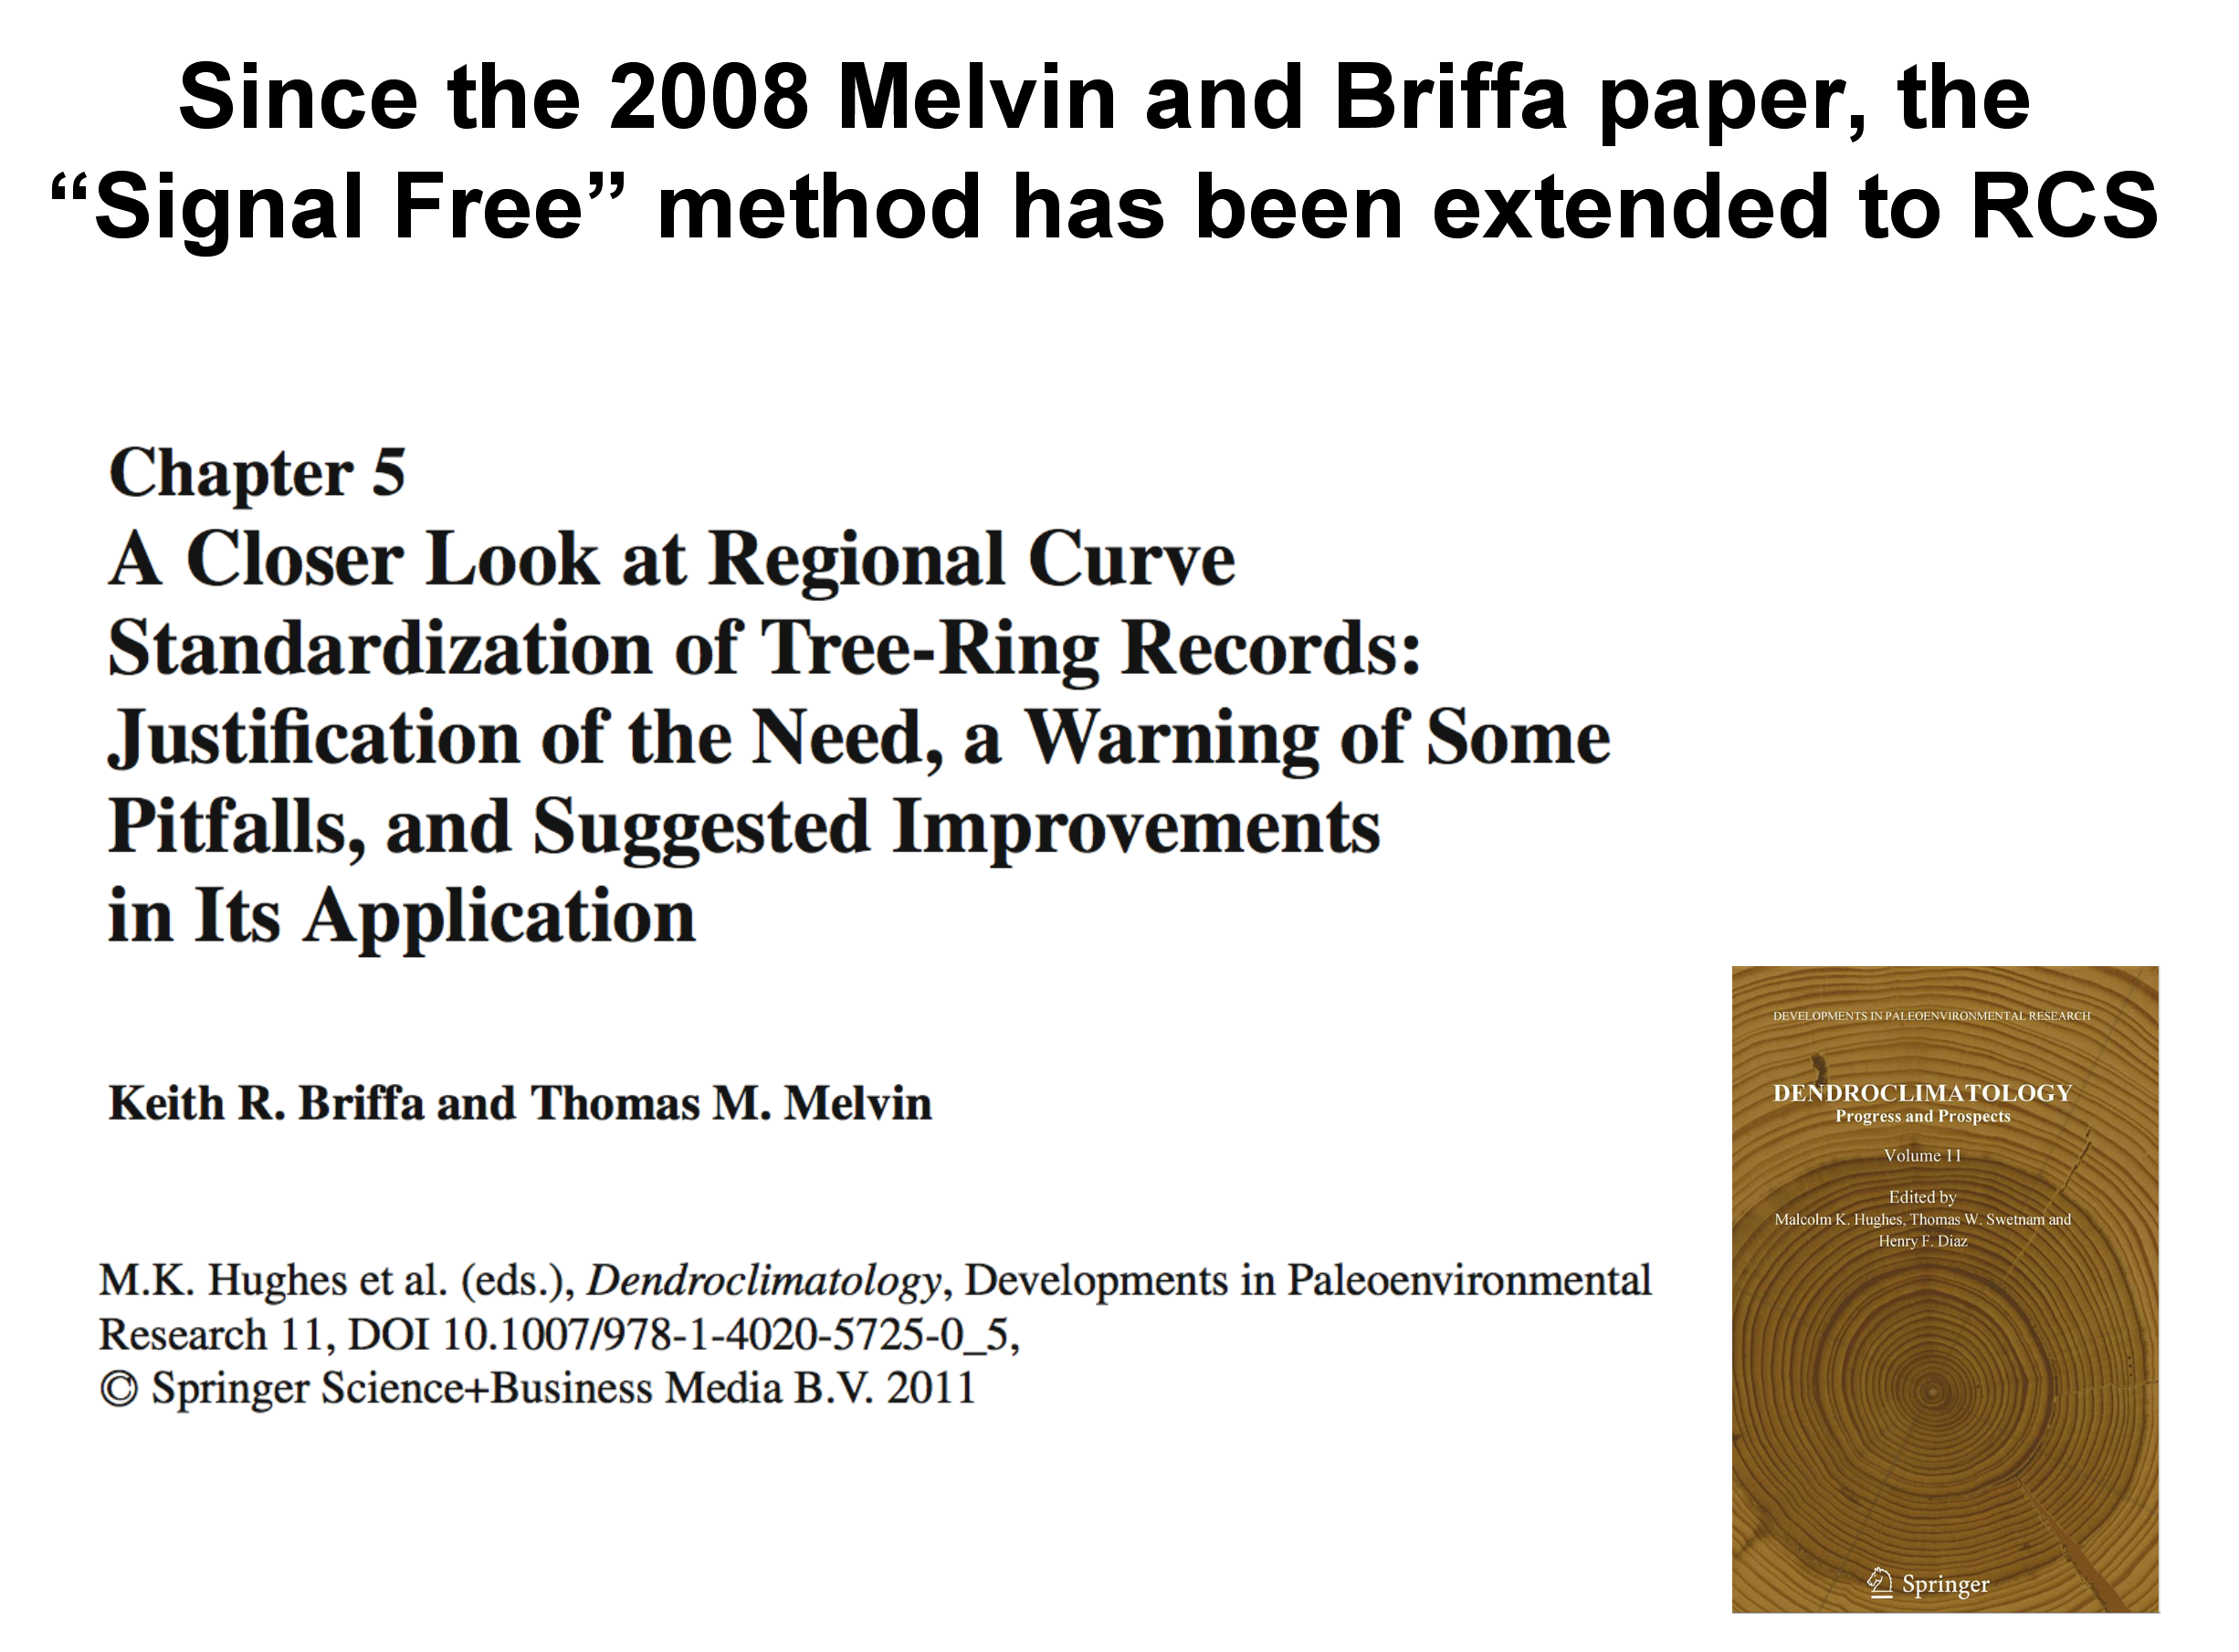

Slide 19
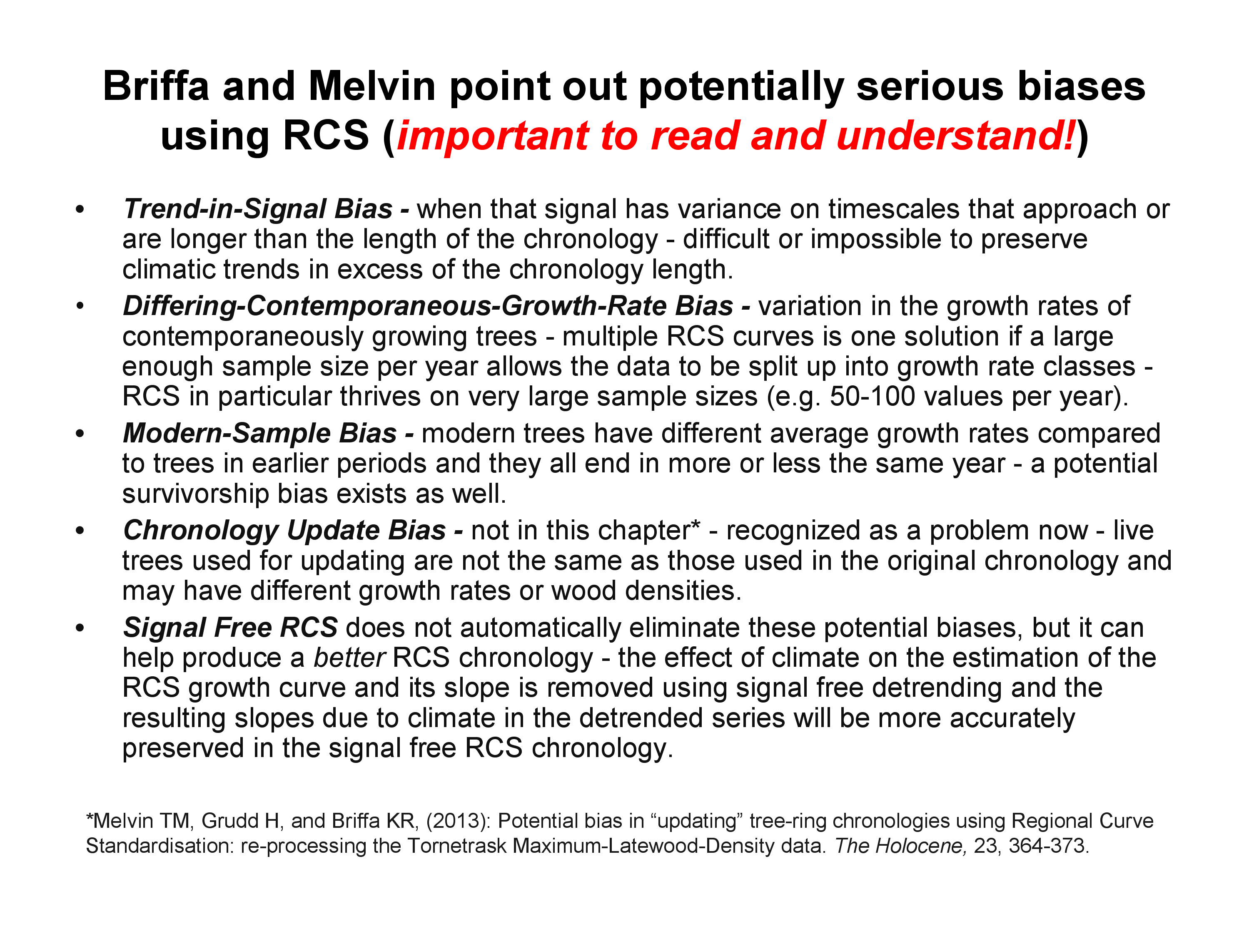

Slide 20
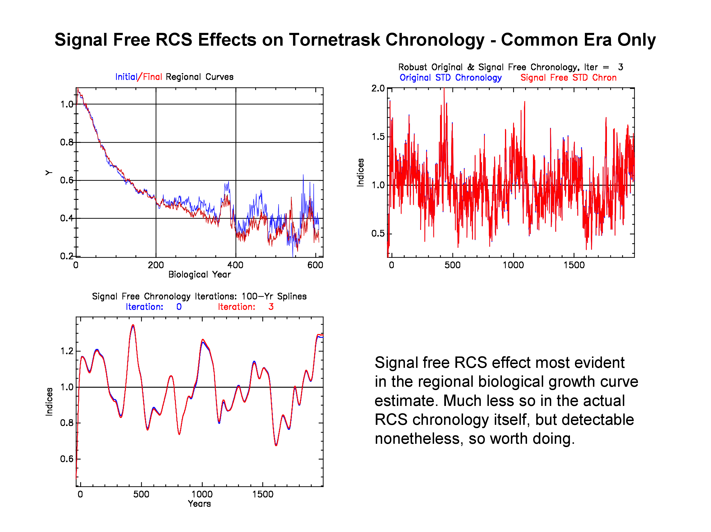

Slide 21
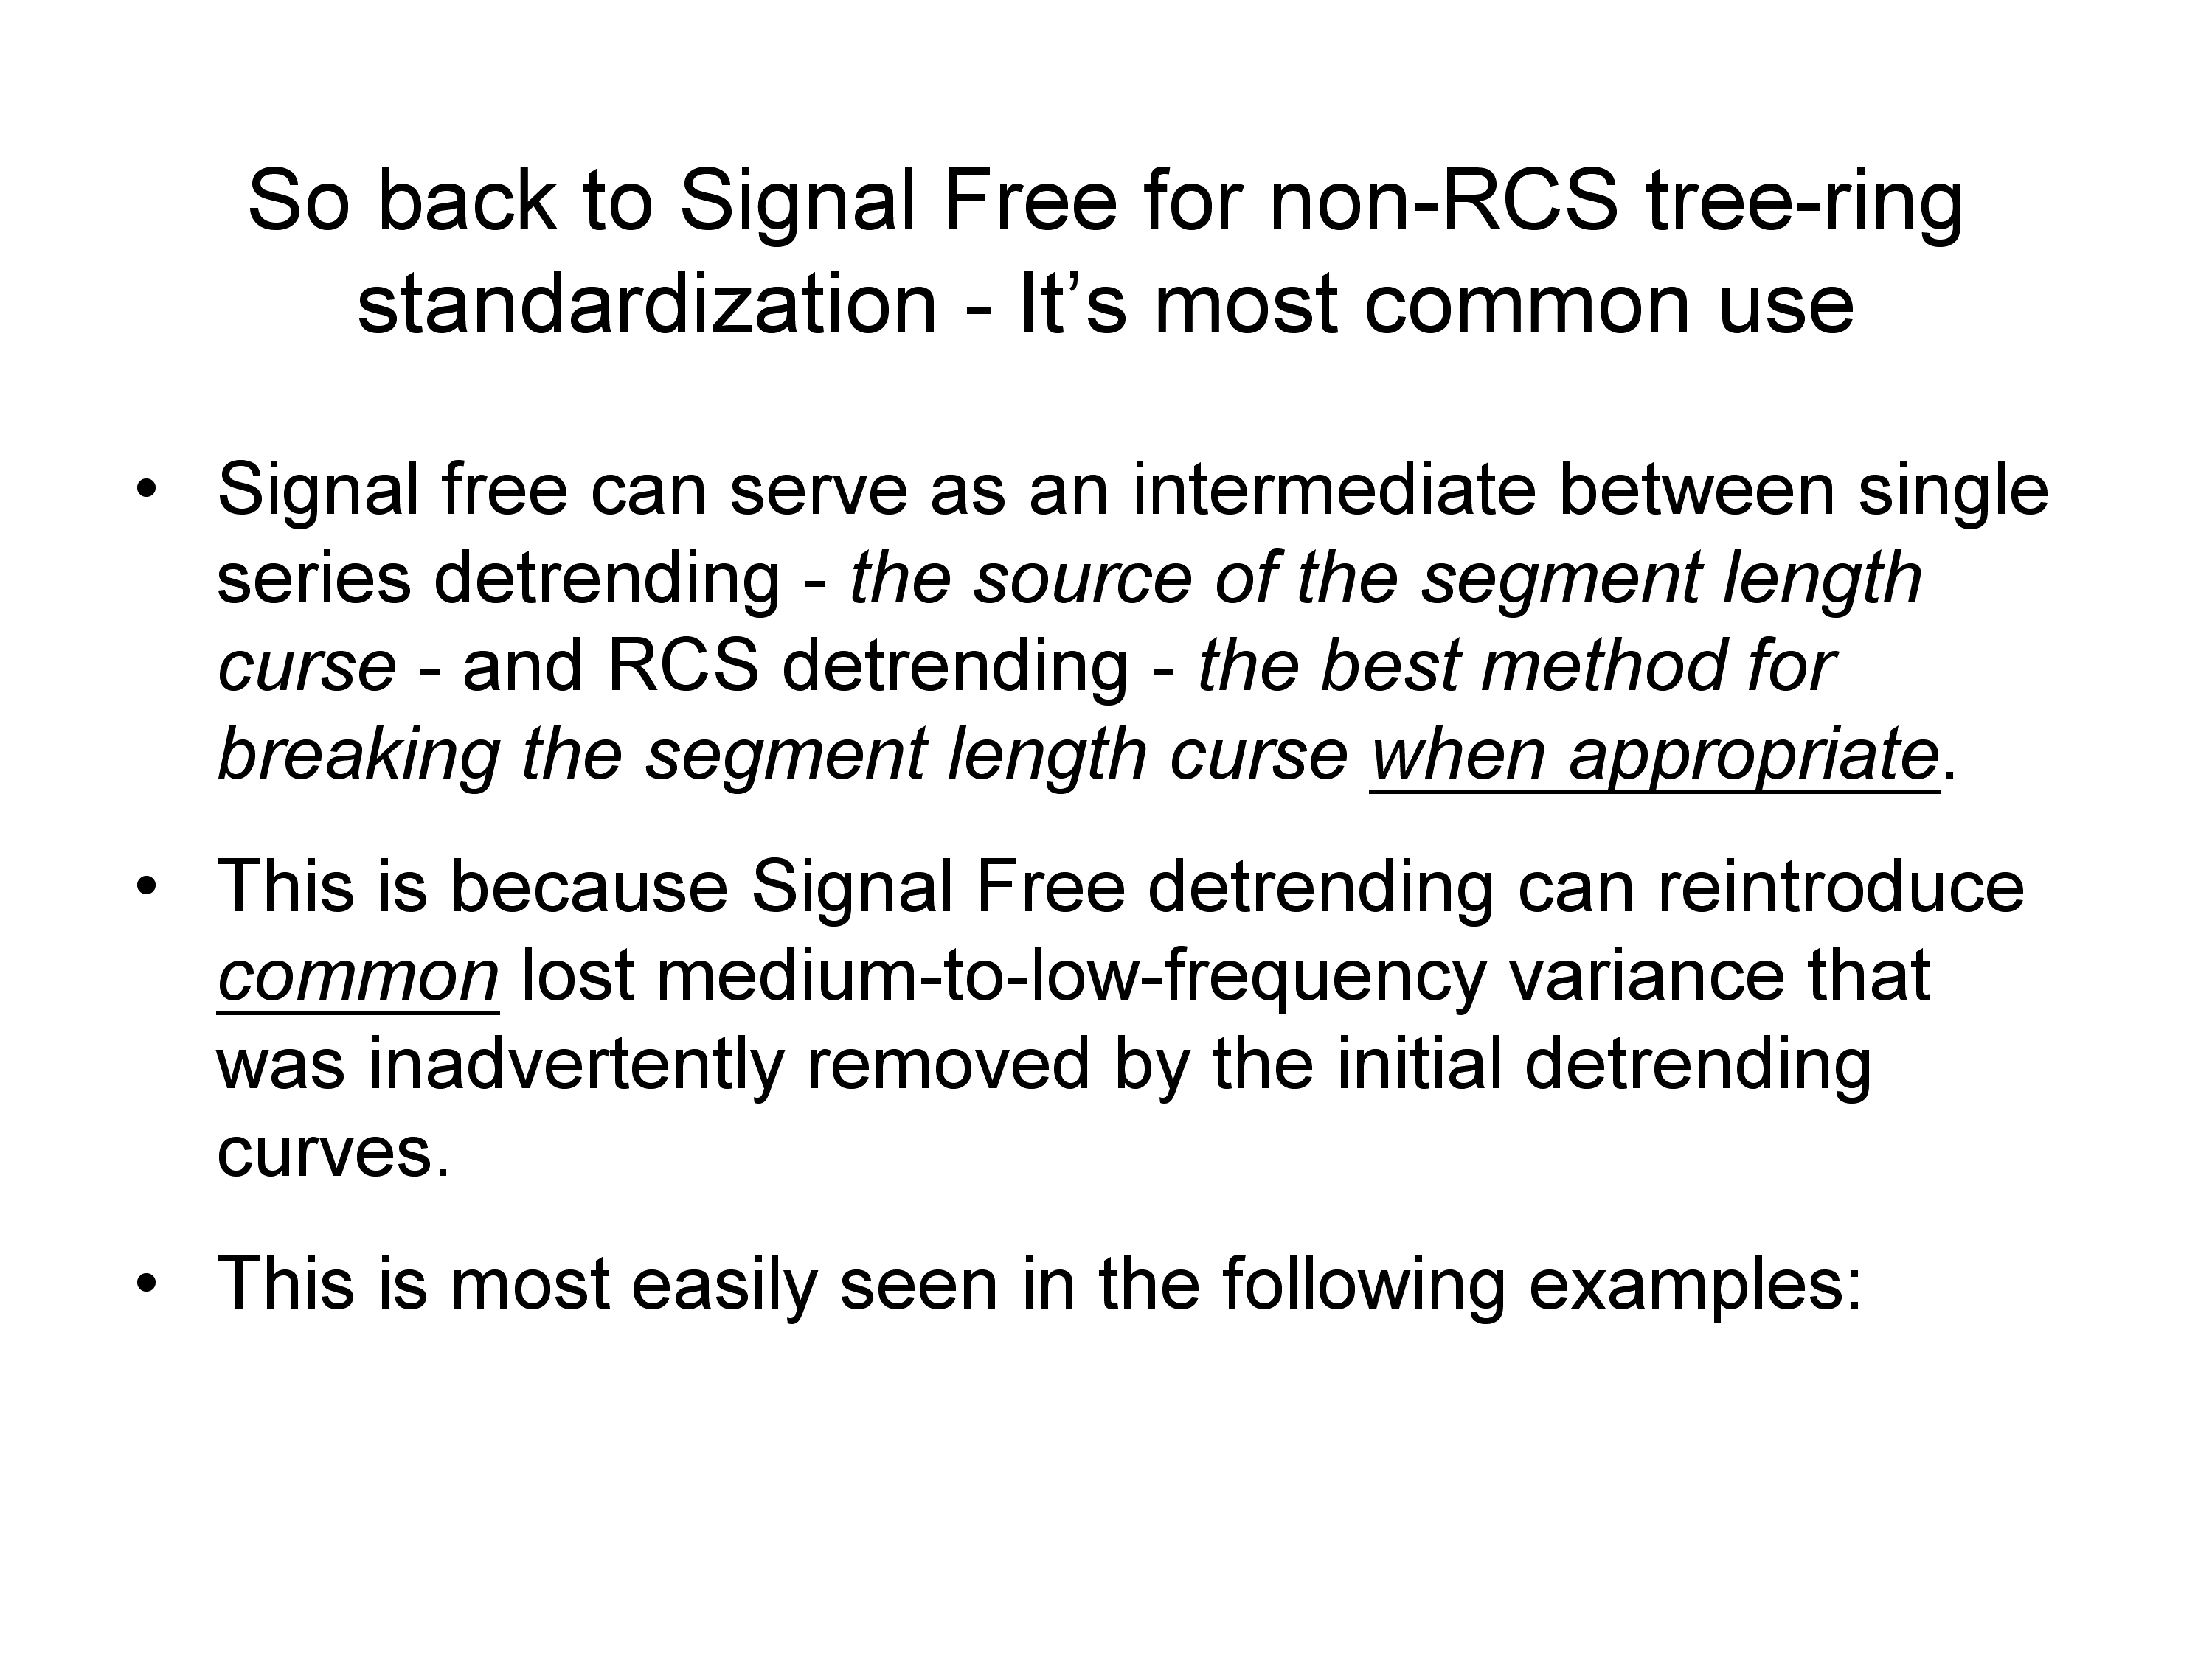

Slide 22
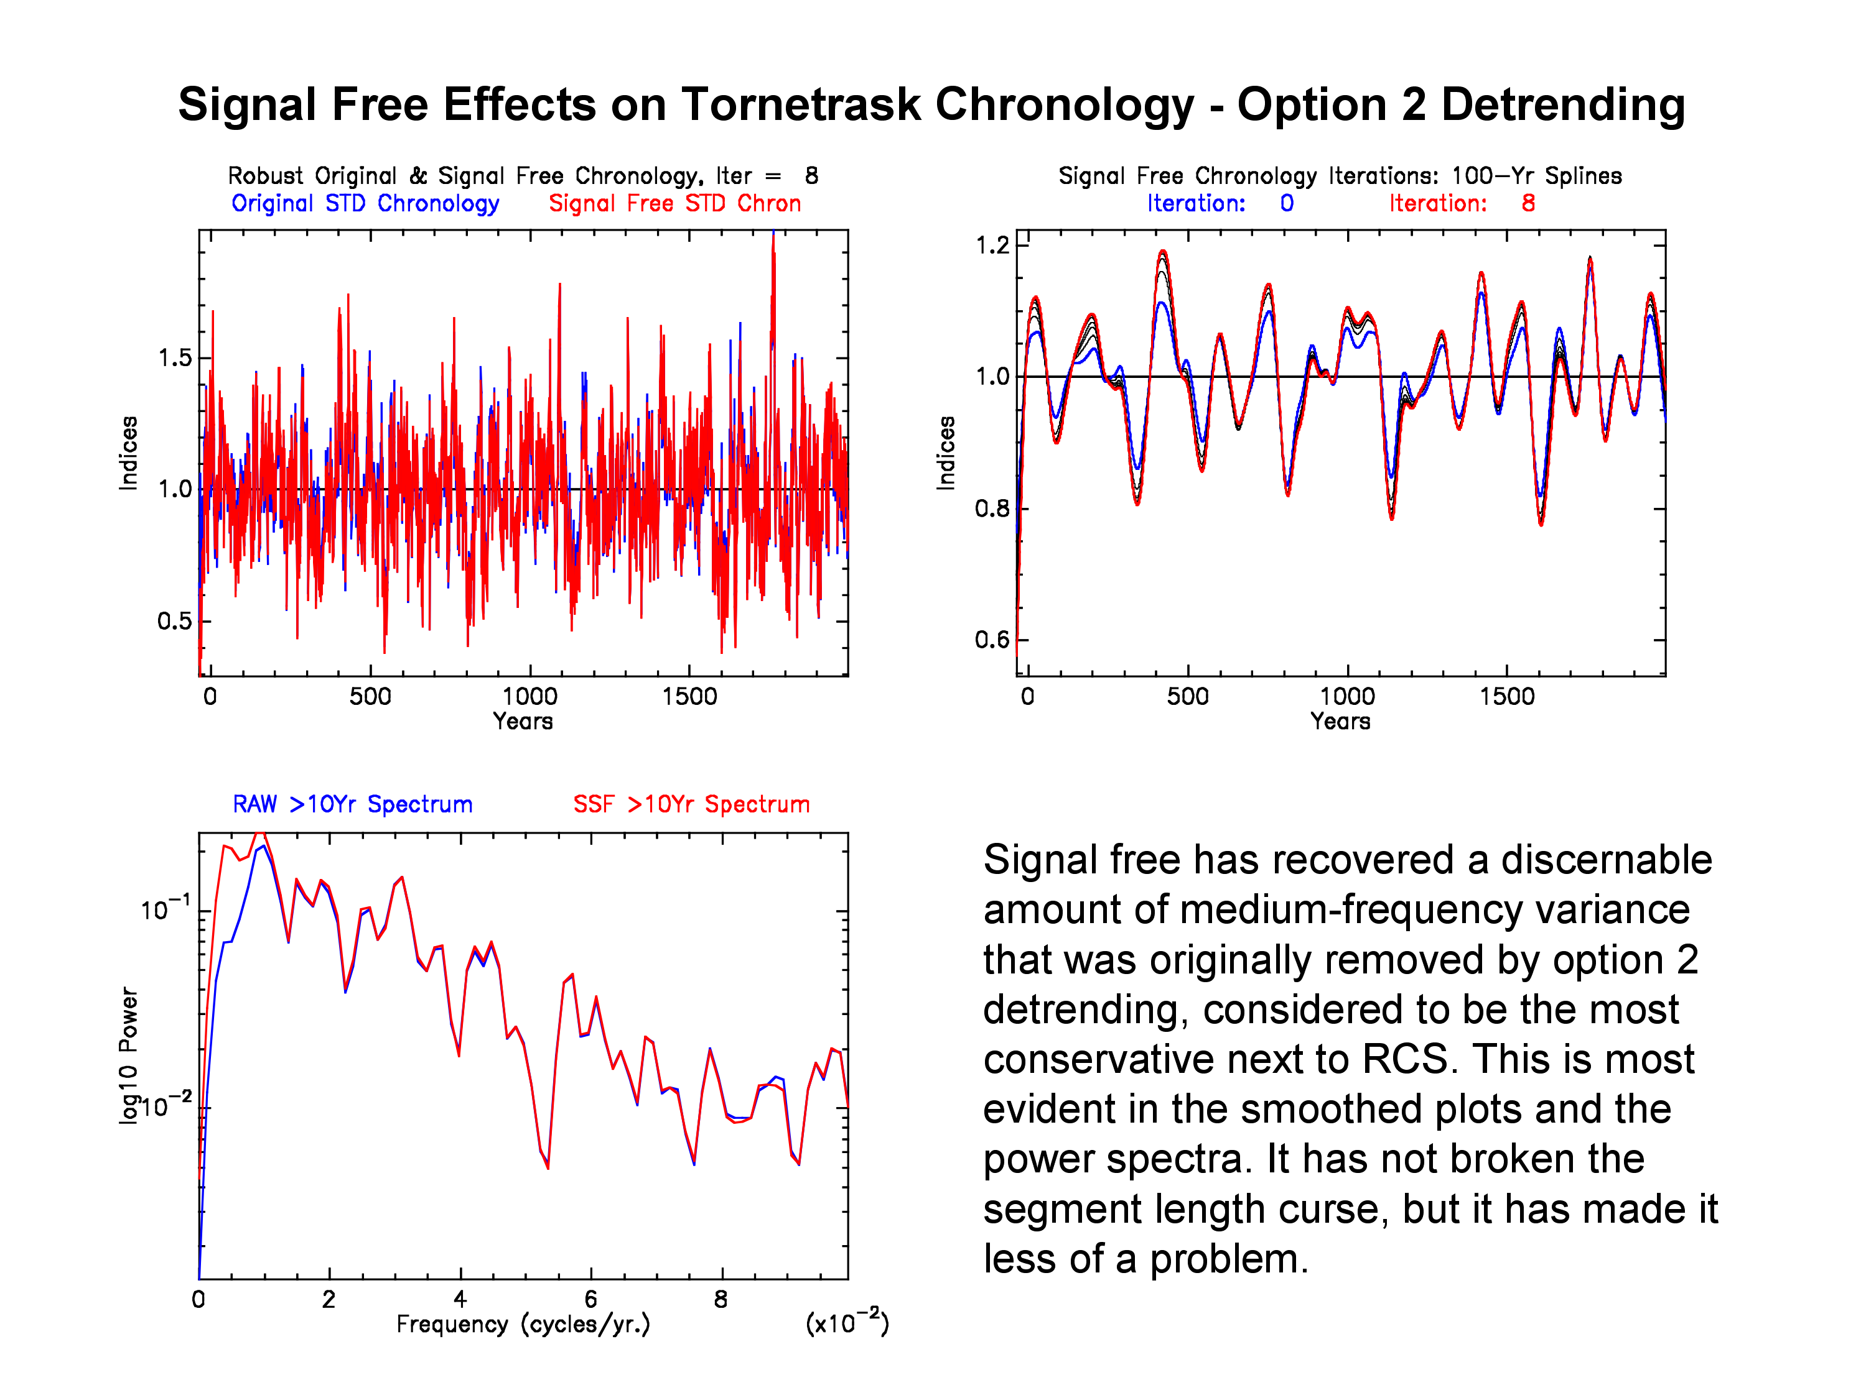

Slide 23
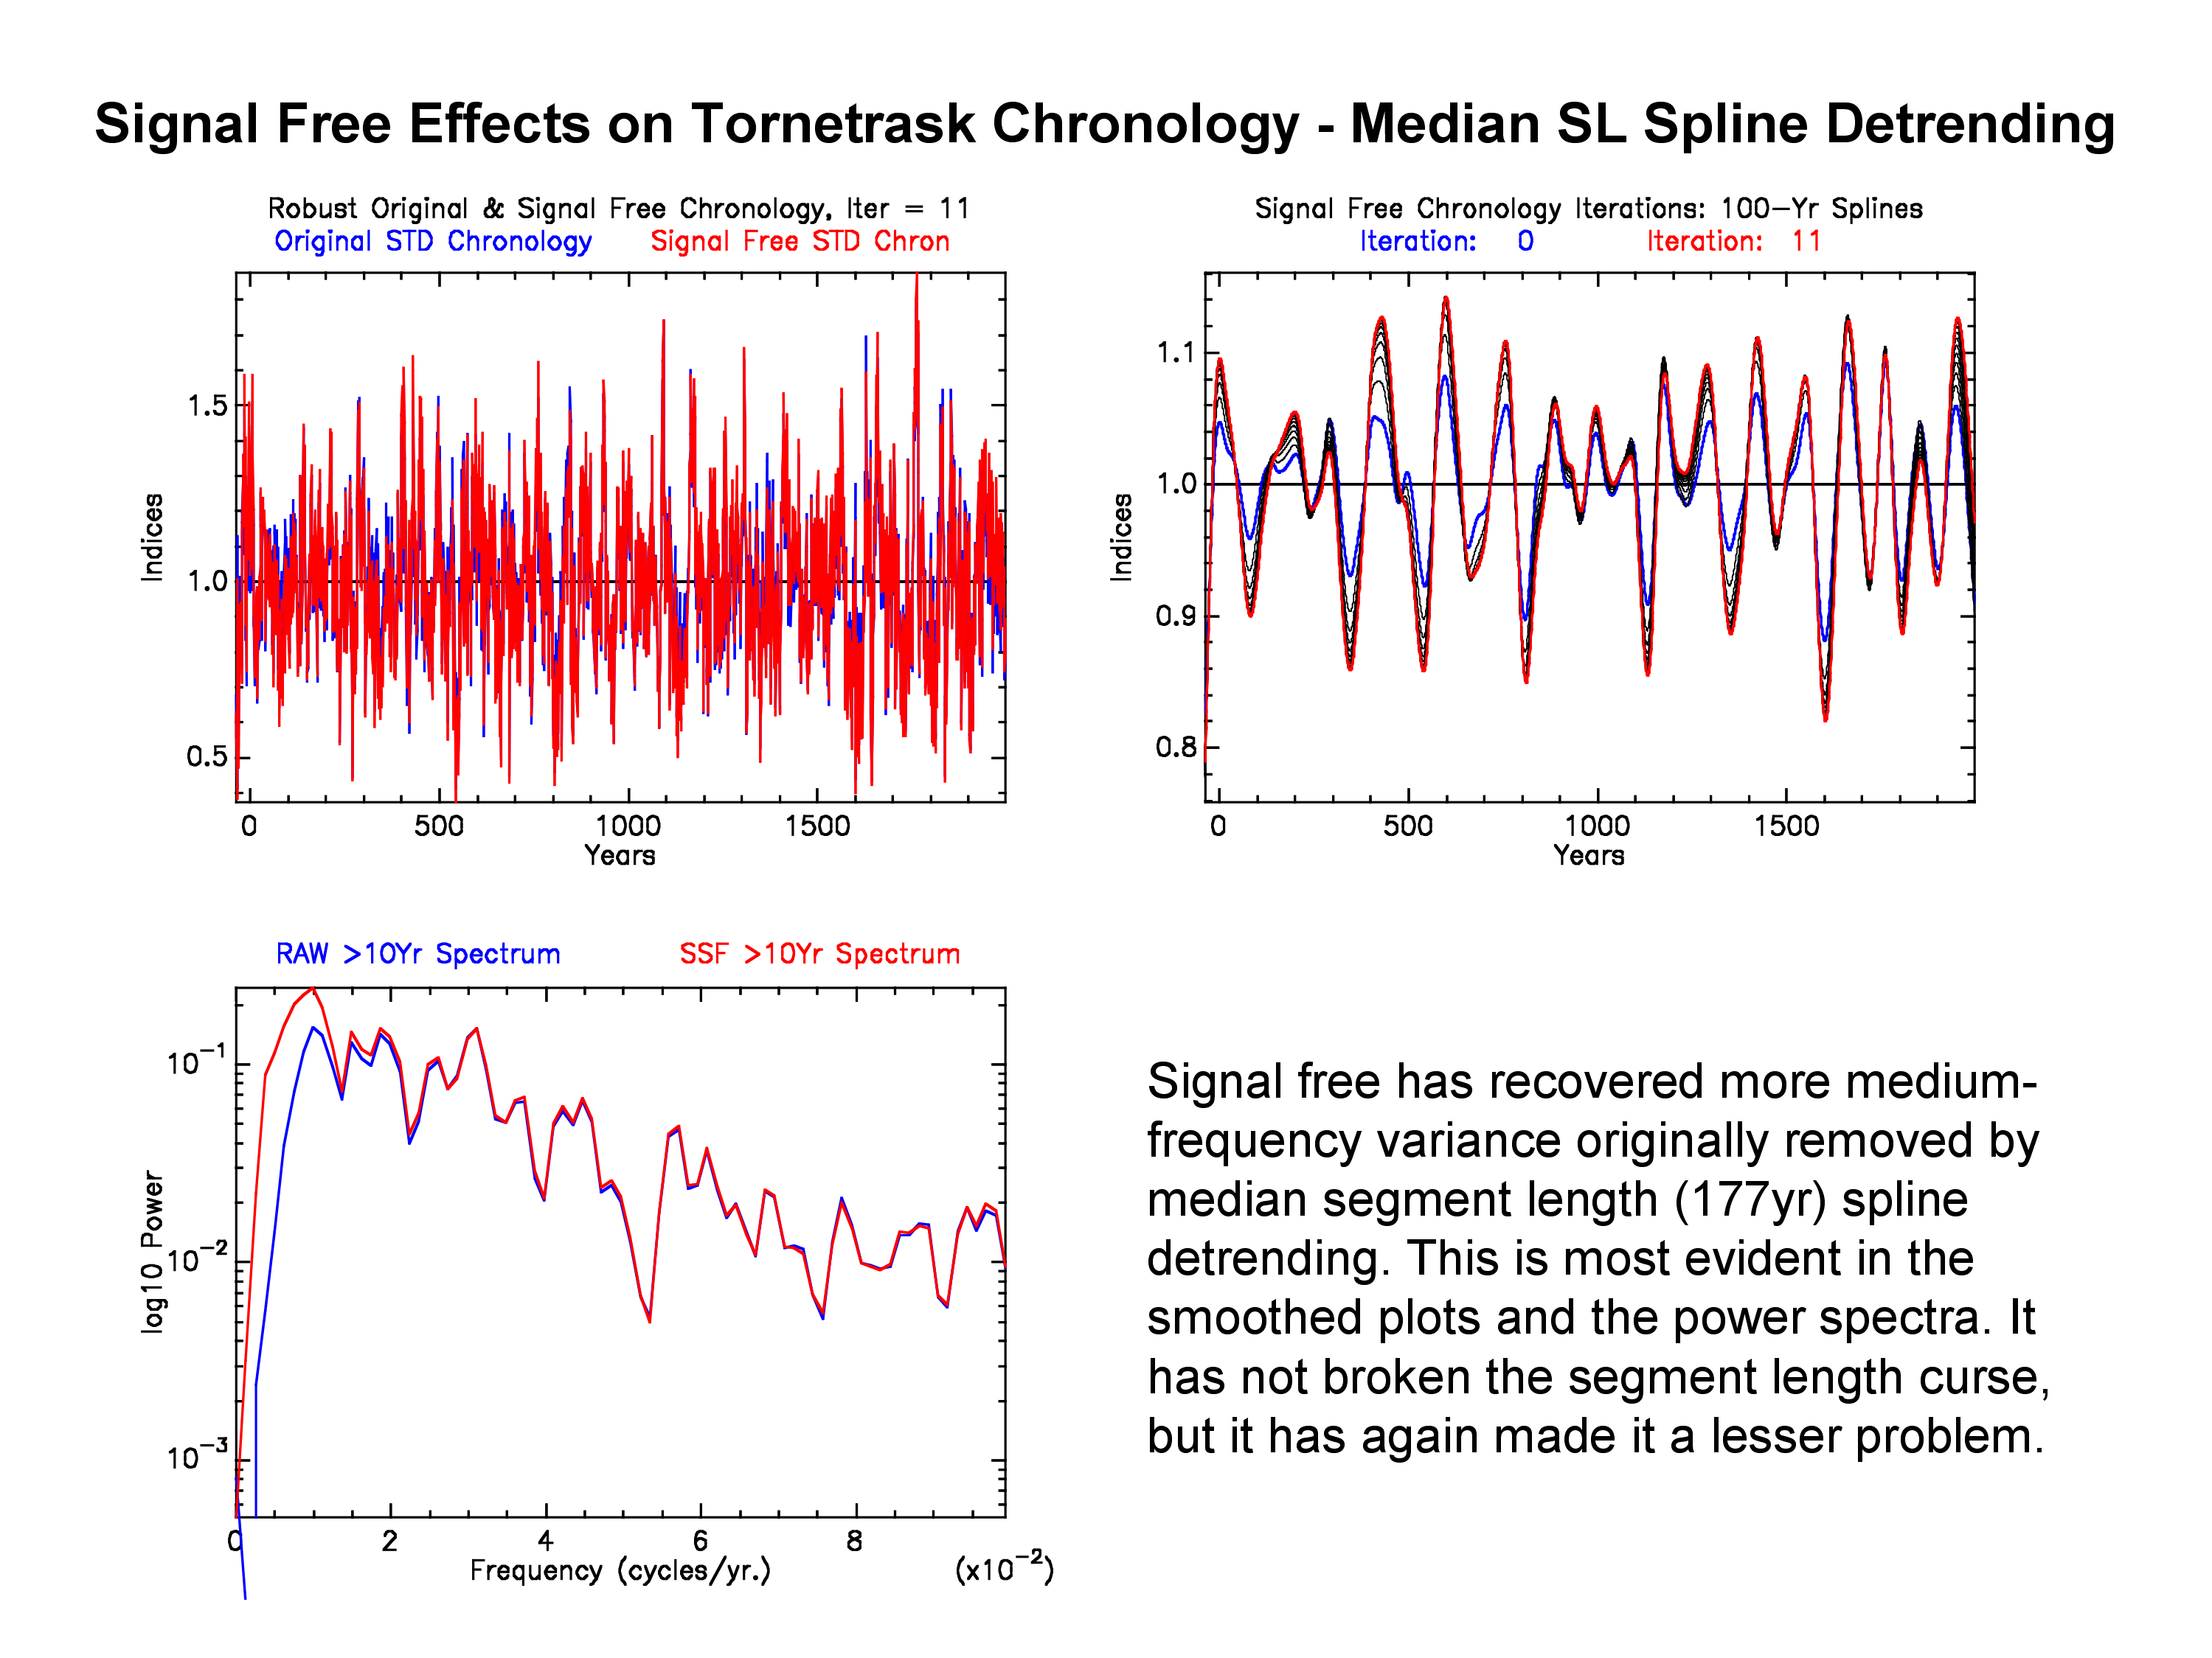

Slide 24
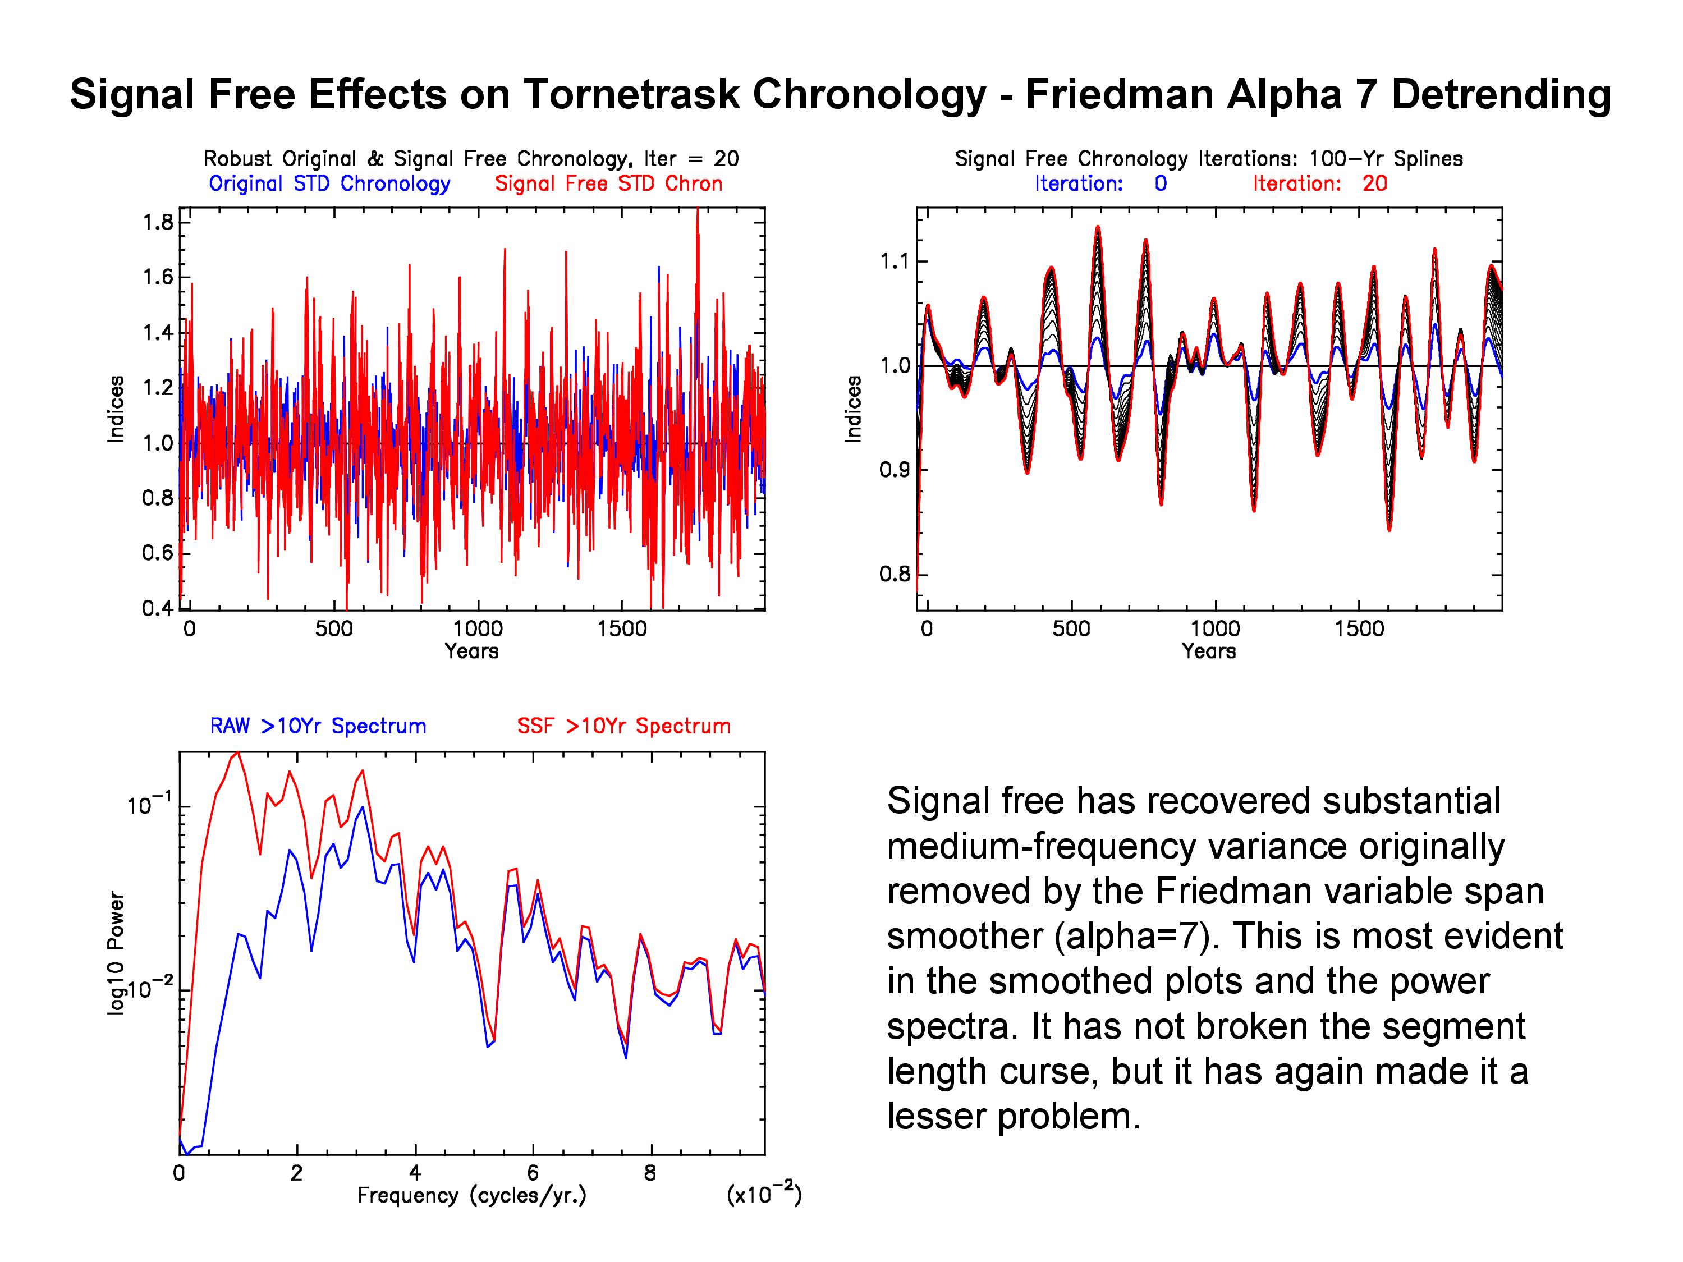

Slide 25
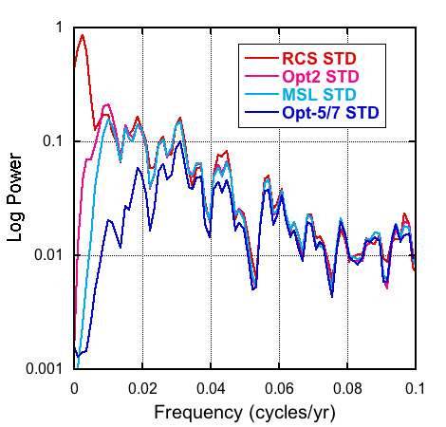
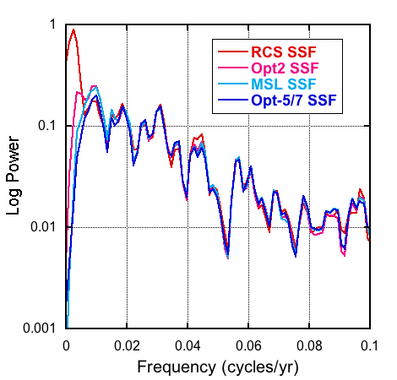
Overlay Plots of Tornetrask Power Spectra for Different
Detrending Options Before and After Signal Free
Tornetrask STD Power Spectra
Tornetrask SSF Power Spectra
Signal Free recovers lost common medium frequency variance
caused by overly flexible detrending curves. Good in principle!

Slide 26
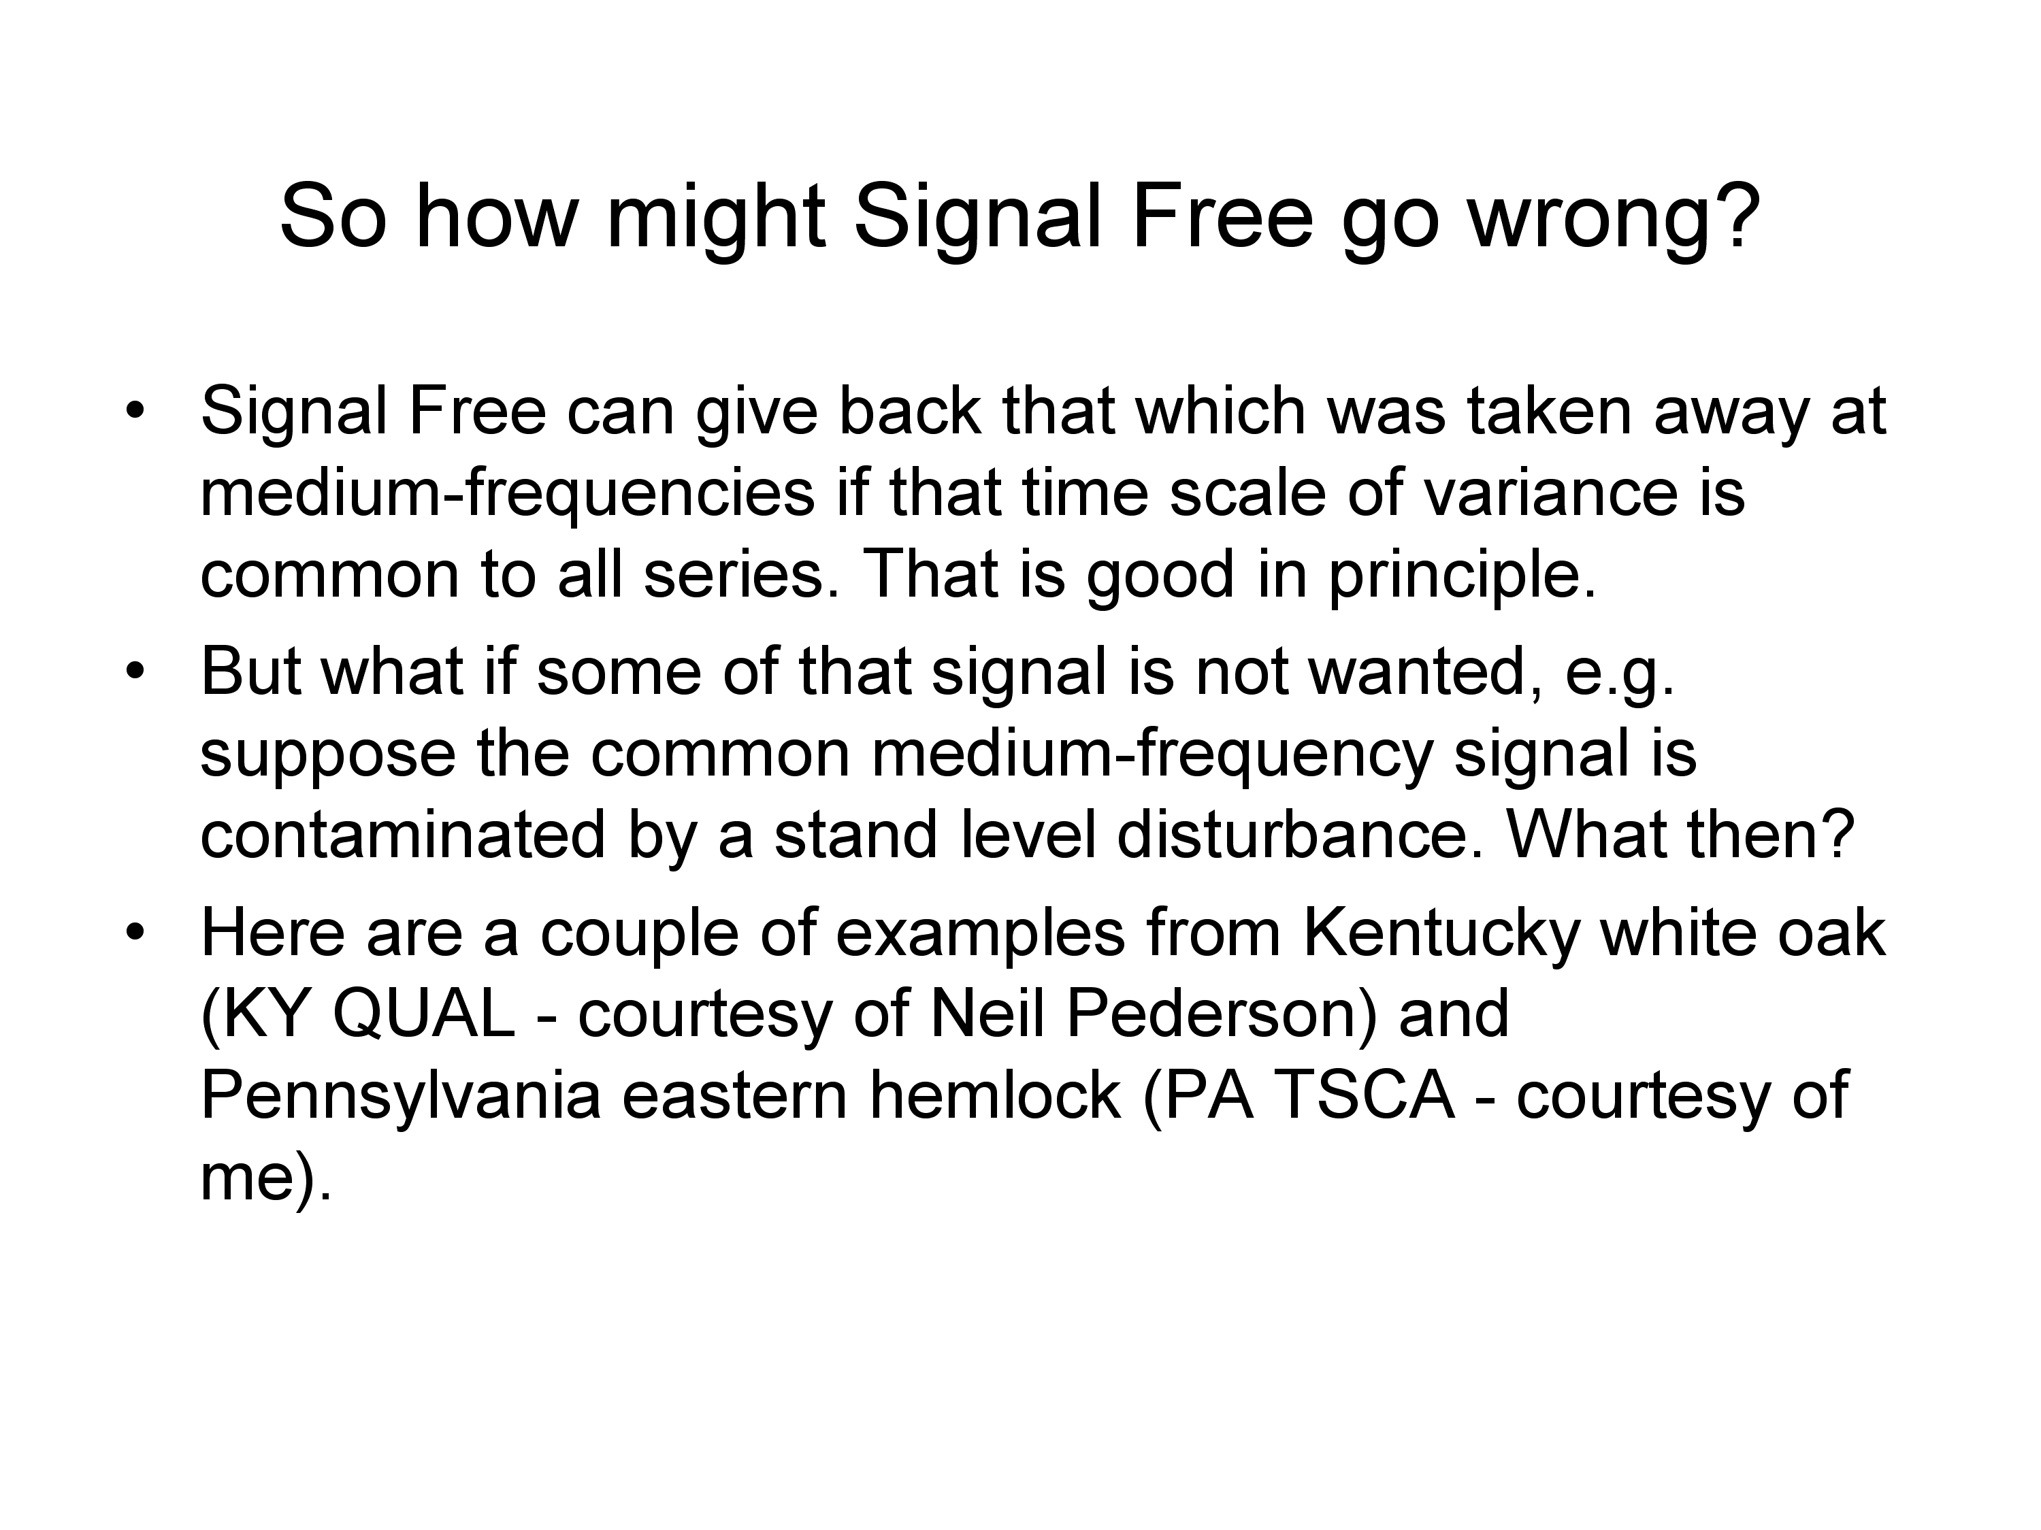

Slide 27
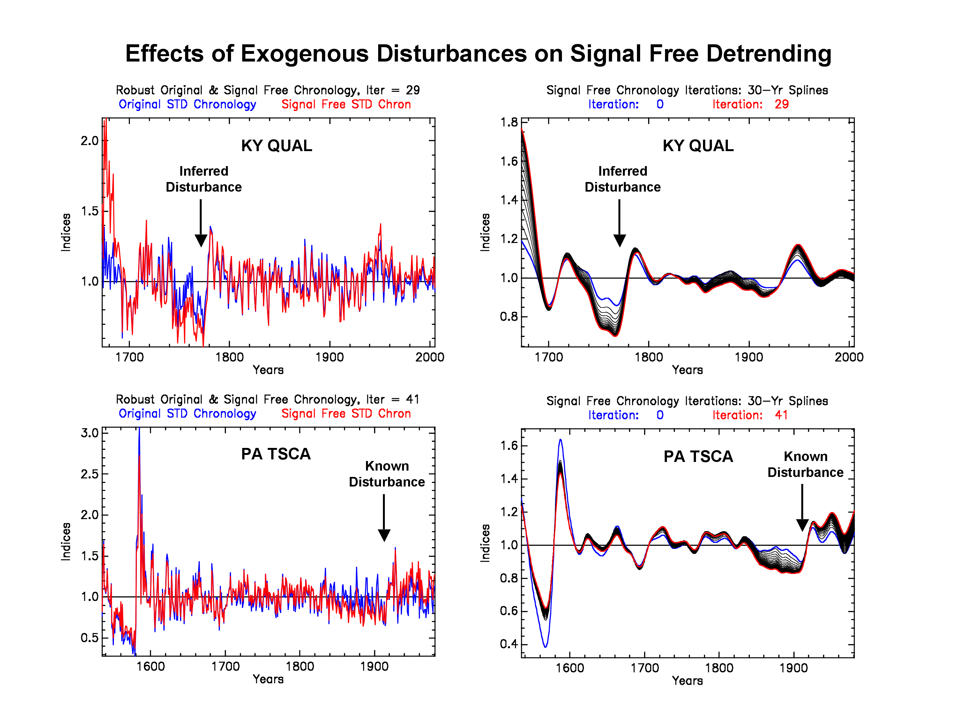

Slide 28
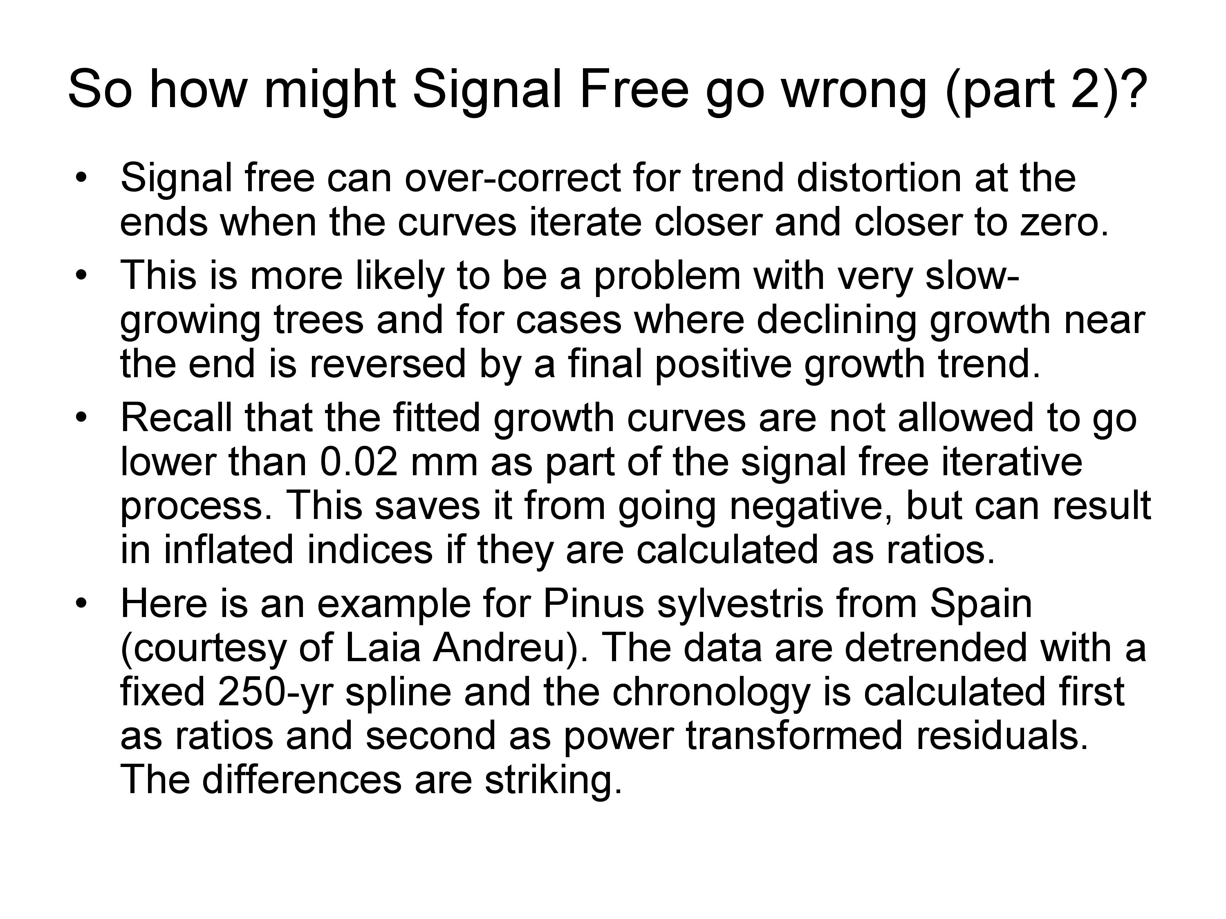
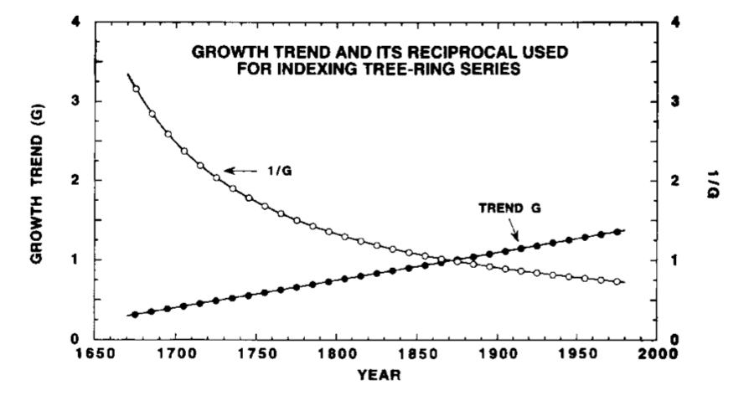
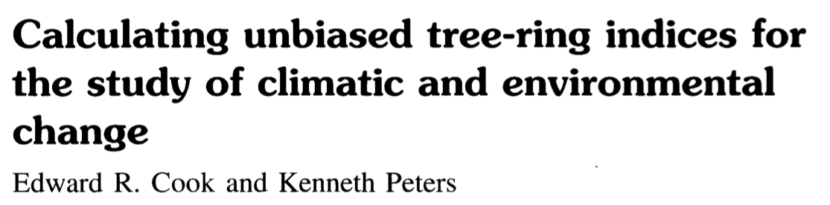
See:

Slide 29
See:

Slide 30
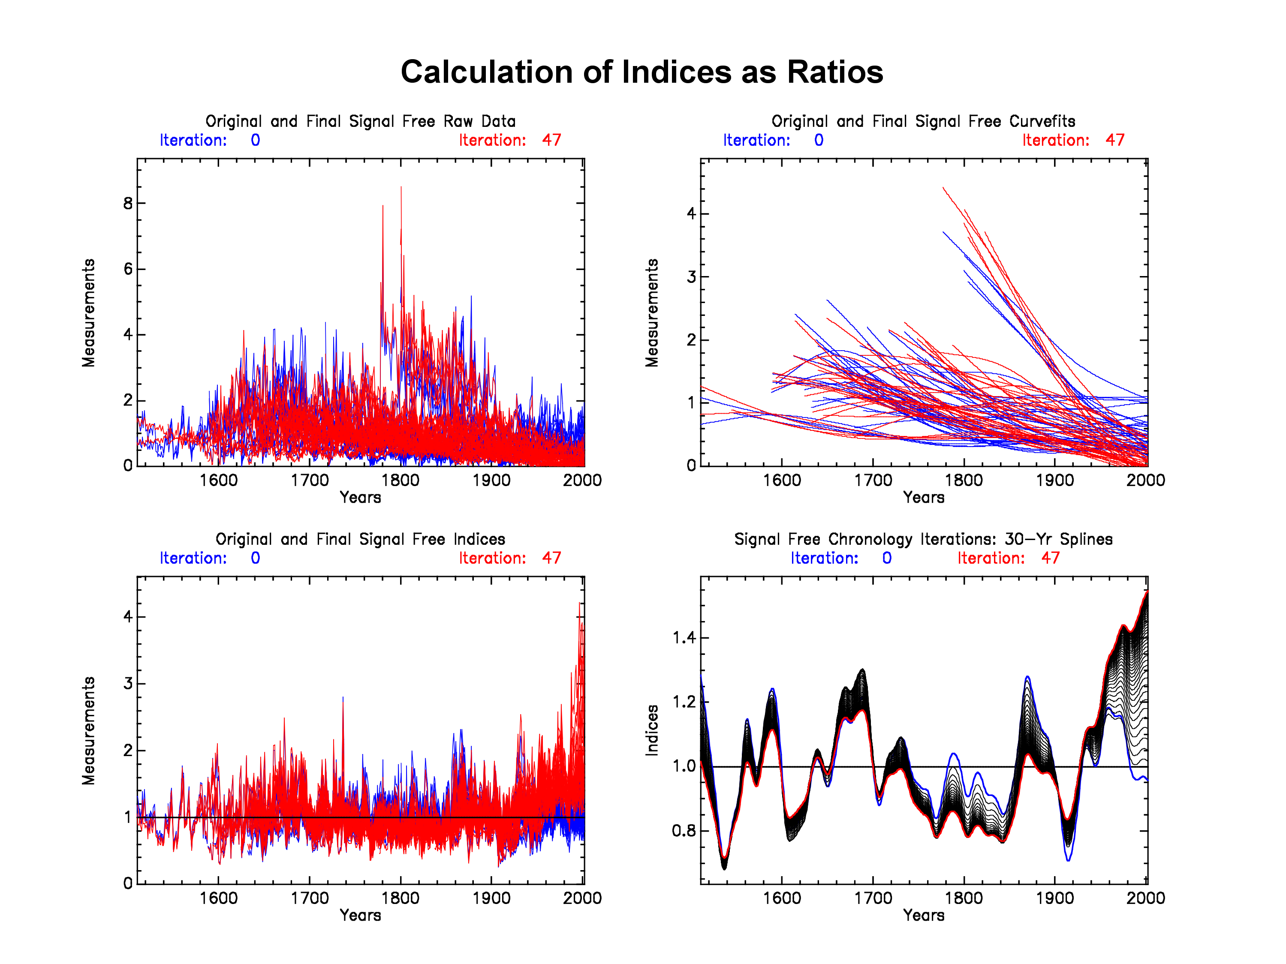

Slide 31
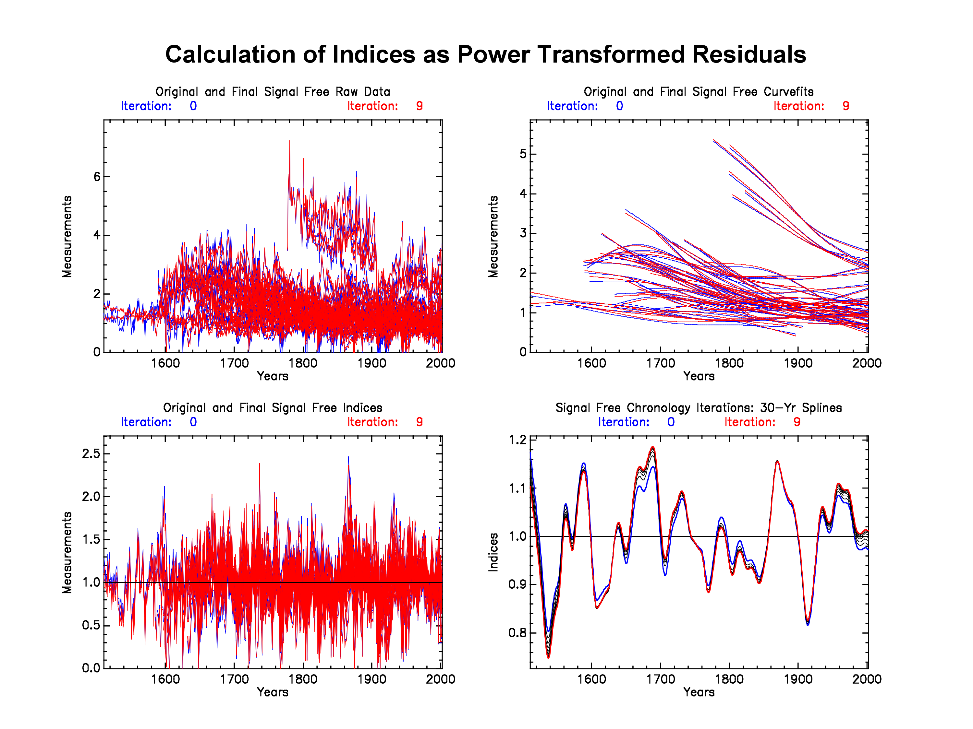

Slide 32
Some Comments Now
The somewhat catastrophic effect of using ratios in Signal Free here is a consequence of the flexible splines iterating closer to zero as the Signal Free data are adjusted.
This effect can be largely eliminated using power transformed residuals as the basis of tree-ring index calculation.
This does not mean that ratios are “bad”. I personally like them as the initial choice for standardizing tree-ring data.
However, if there is some suggestion of index inflation in the data due to the calculation of ratios, it is always good to try power transformed residuals for comparison.
One last point. The problem shown here is much less likely to happen if monotonic growth curves like negative exponentials and linear regressions are used. So changing the curve fit option can provide some relief as well if ratios are calculated.

Slide 33
So what about computer programs for calculating Signal Free tree-ring chronologies?
Presently there are two options that I am aware of: the CRUST (Climatic Research Unit Standardisation of Tree-ring data) program by Tom Melvin and the RCSsigFree program.
CRUST has been released now by Tom and is without doubt the most comprehensive program for conducting Signal Free tree-ring standardization. I recommend that you contact Tom at T.M.Melvin@uea.ac.uk concerning its availability.
The RCSsigFree program was written by Paul Krusic and me, with some early help from Tom. It is a far simpler and rather basic program compared to CRUST and is not a replacement for CRUST. It is also not a new version of ARSTAN and therefore has far fewer capabilities in it.

Slide 34
RCSsigFree_v45v2e
This is the program written by Paul and me. It doesn’t have a snappy name like CRUST, but it can do basic Signal Free standardization. The options include:
Signal Free standardization based on ratios or residuals with or without power transformation can be done.
Signal Free detrending of individual series and signal free RCS standardization are both implemented.
Many of the curve fit options found in ARSTAN are available, plus Tom’s time-varying spline routine used now as the default detrending option.
Running RBAR variance stabilization with optional secondary spline variance stabilization can be done.
High-resolution graphics like in ARSTAN are produced, with some designed for Signal Free diagnostic purposes.

Slide 35
RCSsigFree_v45v2e
Some additional comments
This program is available now as both Mac OS and Windows XP versions. For download, go to http://www.ldeo.columbia.edu/res/fac/trl/public/ftp/index.php?dir=Public%2FSoftware%2F and download the SignalFree program. Also the newest version of ARSTAN. If you already run ARSTAN with graphics, you can run this program without installing any fonts file needed by PLPLOT.
Like ARSTAN, there is no User’s Manual. This is really a “work in progress” (“labor of love”?) program that Paul and I have spent the several years jointly working on. We believe it is quite stable now, but any “crashes” should be reported promptly to Paul and me if you are SURE it is not your fault. Constructive comments and suggestions are of course welcome.

