Slide 1
My Career In Dendrochronology: How A Bit Of Serendipity and Epiphany Changed Everything For Me
Edward R. Cook
Tree-Ring Laboratory
Lamont-Doherty Earth Observatory
Presented at:
"Serendipity and Epiphany in Scientific Discovery"
September 9, 2022
Fayerweather Hall
Columbia University

Slide 2
To Begin
My talk is perhaps the hardest one I have ever given because "Serendipity and Epiphany in Scientific Discovery" is hard to explain. It is very personal and just sort of happens! In addition, there are many definitions of Serendipity and Epiphany. Here are ones that best suit my experiences:
Serendipity: "A combination of events which have come together by chance to make a surprisingly good or wonderful outcome." (https://en.wiktionary.org/wiki/serendipity)
Epiphany: "A moment when you suddenly feel that you understand, or suddenly become conscious of, something that is very important to you." (https://dictionary.cambridge.org/us/dictionary/english/epiphany)

Slide 3
But Serendipity and Epiphany are
often preceded by sage advice:
I learned from my Trenton Junior College biology professor Heber "Doc" Donohoe that it was good to become friends with the smartest 'kid' in the class you are taking. You will learn much more that way and always be challenged in the process. Excellent advice!
Then as I was getting ready to transfer to the University of Arizona in 1968 for a major in, of all things, Wildlife Biology, "Doc" recommended that I take "Introduction to Dendrochronology" because it was the only place in the country where I could learn it. More excellent advice!
Which I did in my senior year and it changed everything for me! Is advice the same as serendipity? I don't know.

Slide 4
Marvin A. Stokes (1927 - 2010), taught me dendrochronology as an undergraduate and was later my M.S. advisor and friend for many years. He was head of the Modern Studies section of the University of Arizona Laboratory of Tree-Ring Research (LTRR).
The day I stepped into Marv's West Stadium classroom in 1969, my career path changed forever. Serendipity? I think this qualifies.

Slide 5
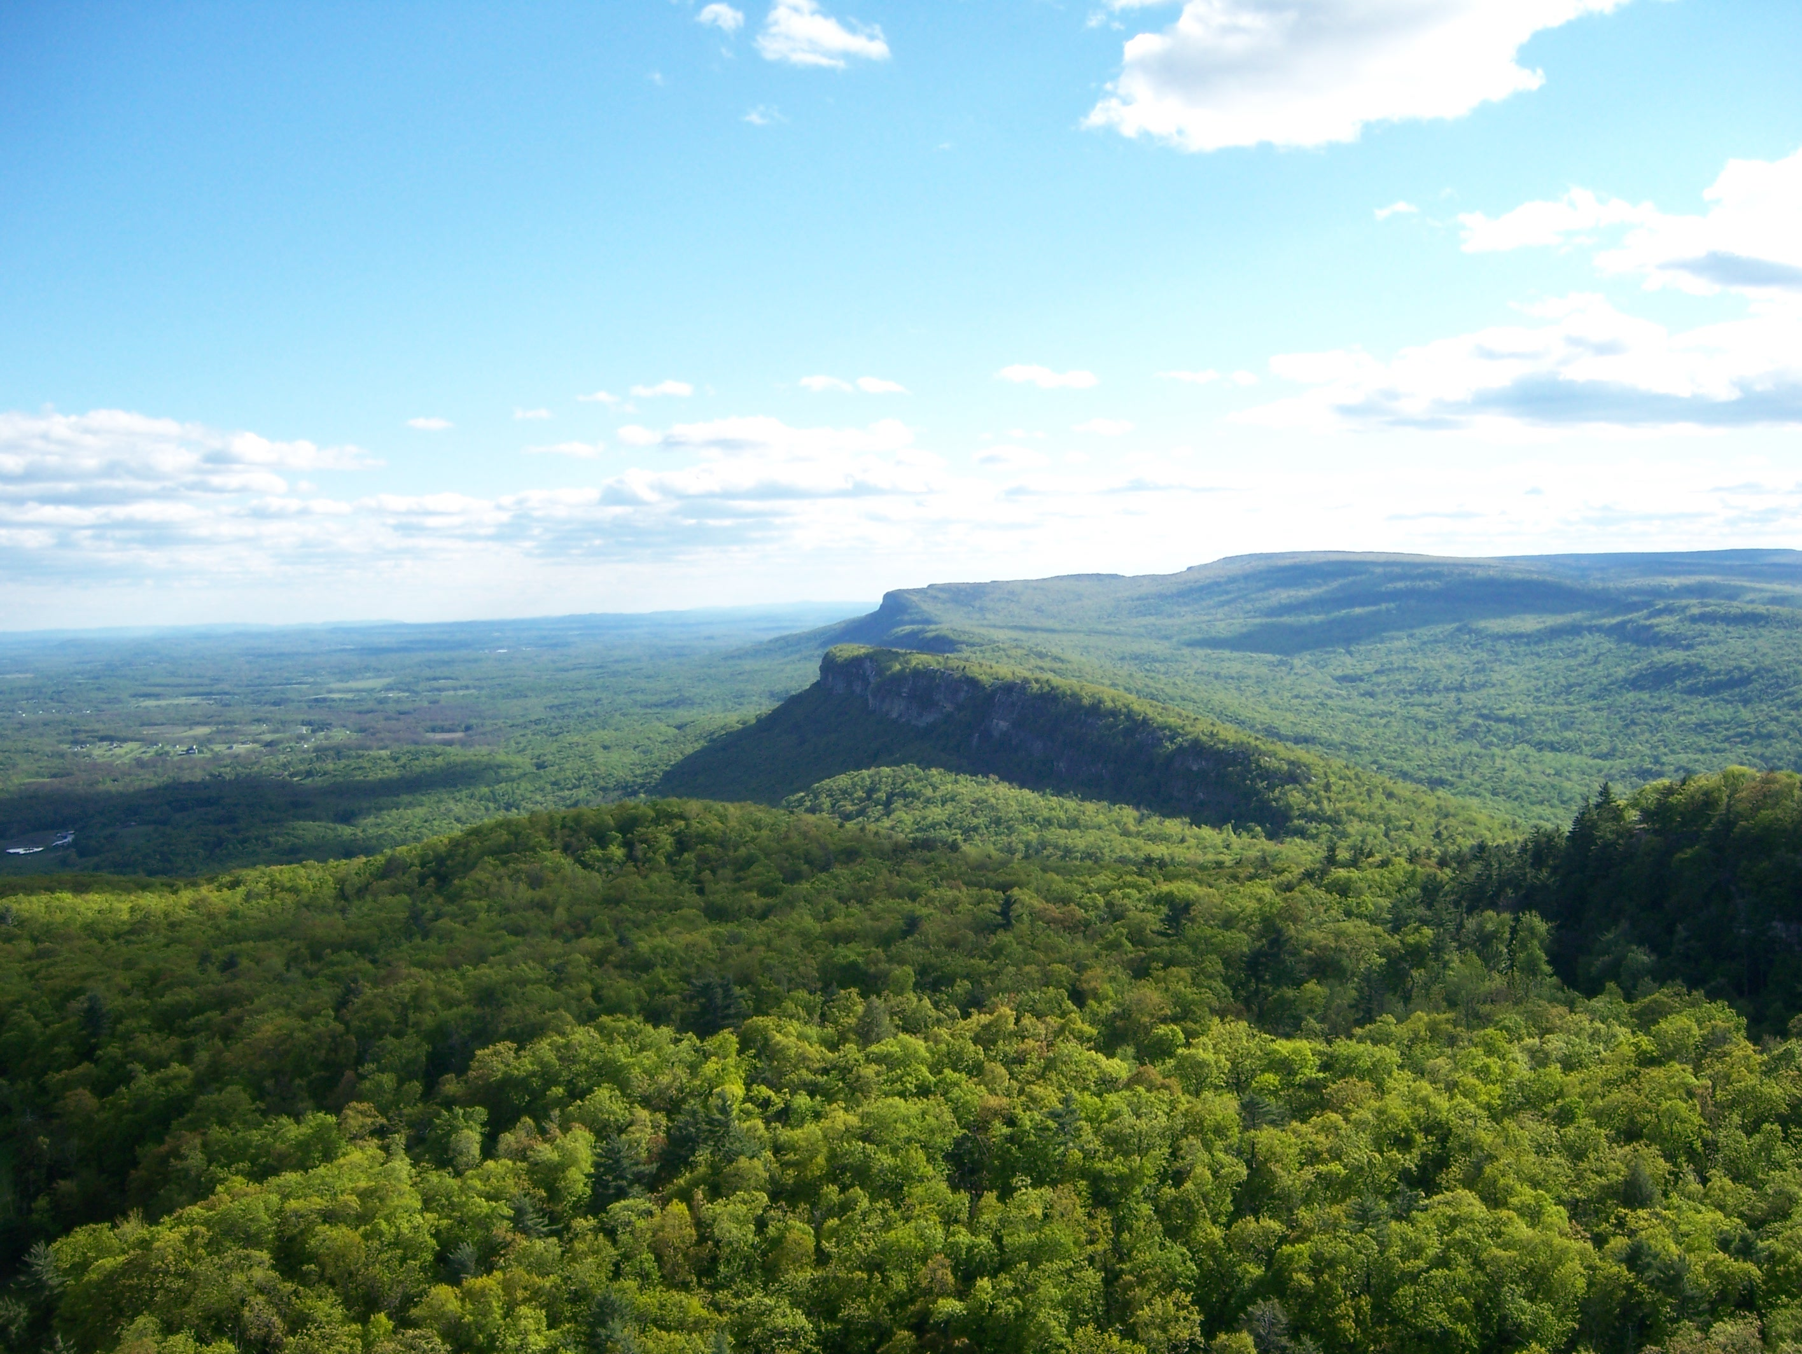
Now comes my era of scientific serendipity ("occurrence and development of events by chance in a happy or beneficial way"). After being inspired by Marv Stokes, I went into the U.S. Army in 1970, was stationed at the U.S. Military Academy at West Point, and ended up discovering ancient trees growing only 90 miles north of New York City in the Shawangunk Mountains ('The Gunks'). Go figure!

Slide 6
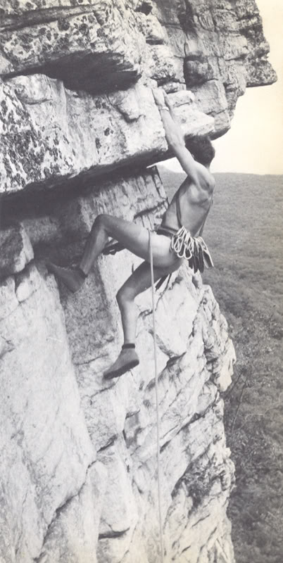
The Shawangunk Mountains (‘The Gunks’) also supported crazy rock climbers. That is not me by the way!
Oldest known Pitch Pine

Slide 7
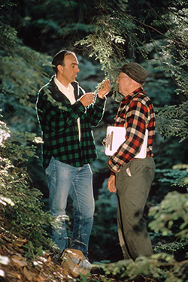
My tree-ring research was made possible by Daniel Smiley, family naturalist at Mohonk Lake and his long-time assistant Paul Huth.
Dan was a huge believer in serendipity and our totally accidental meeting is an example of that.

Slide 8
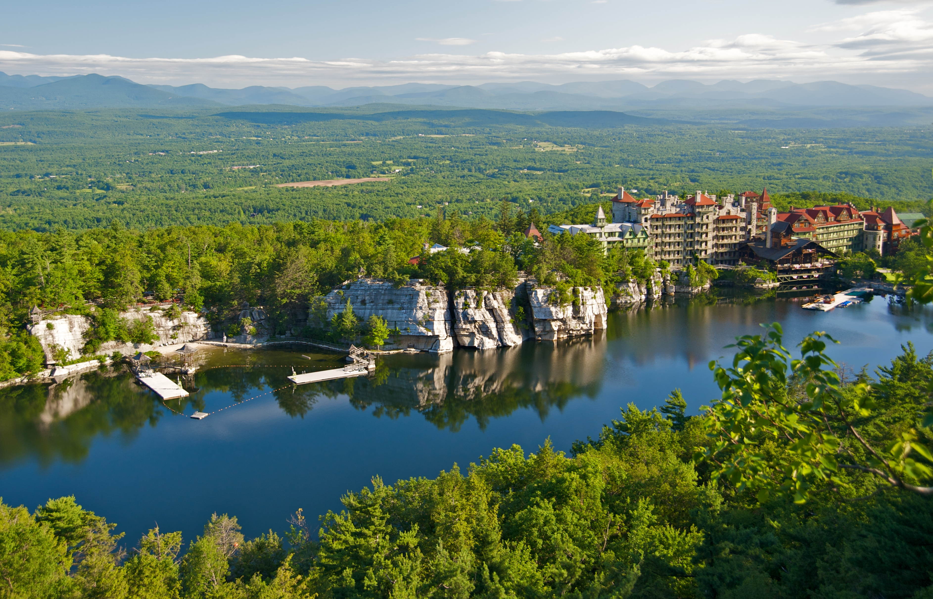
Mohonk Lake and the Mohonk Mountain House
Not a bad place to do fieldwork, huh?

Slide 9
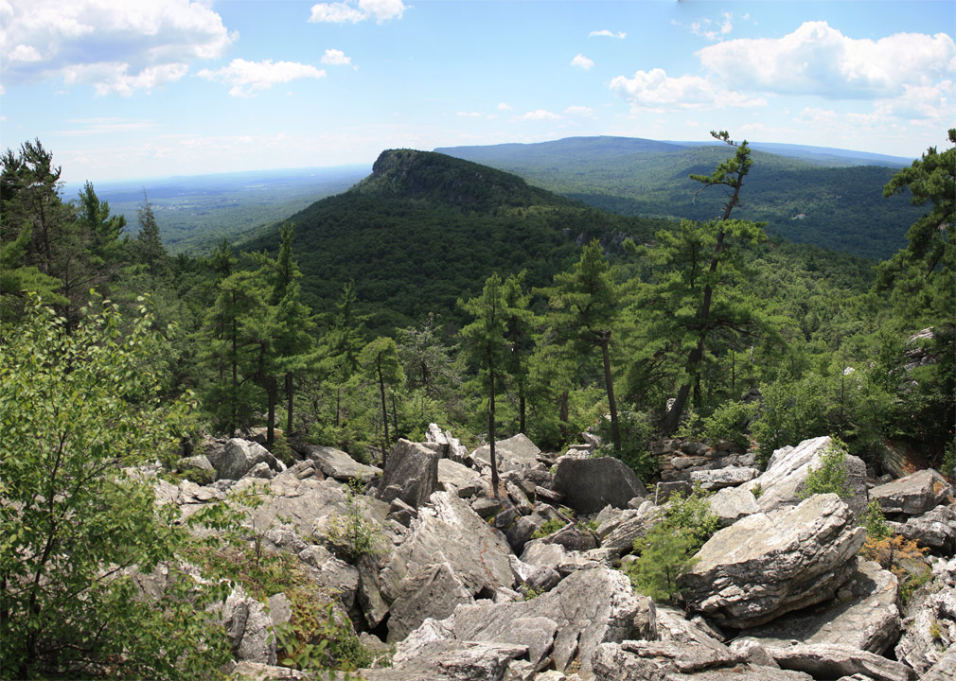
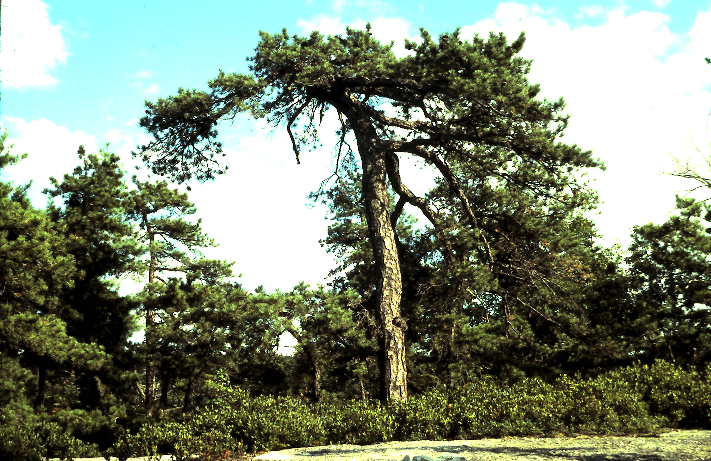
Here is what I discovered at Mohonk Lake and the 'Gunks', which led me to
pursue a Master’s Degree in dendrochronology under Marv Stokes after I mustered out of the U.S. Army in 1973.
Conglomerate Talus
White Pine & Eastern Hemlock
Conglomerate Slab
Pitch Pine
Both Species
300+ Years Old
Oldest Known
Pitch Pine
First Year: 1616
My summer fieldwork was conducted in 1974 in the Shawangunk Mountains and I was based out of Mohonk Lake through the support of Dan Smiley.

Slide 10
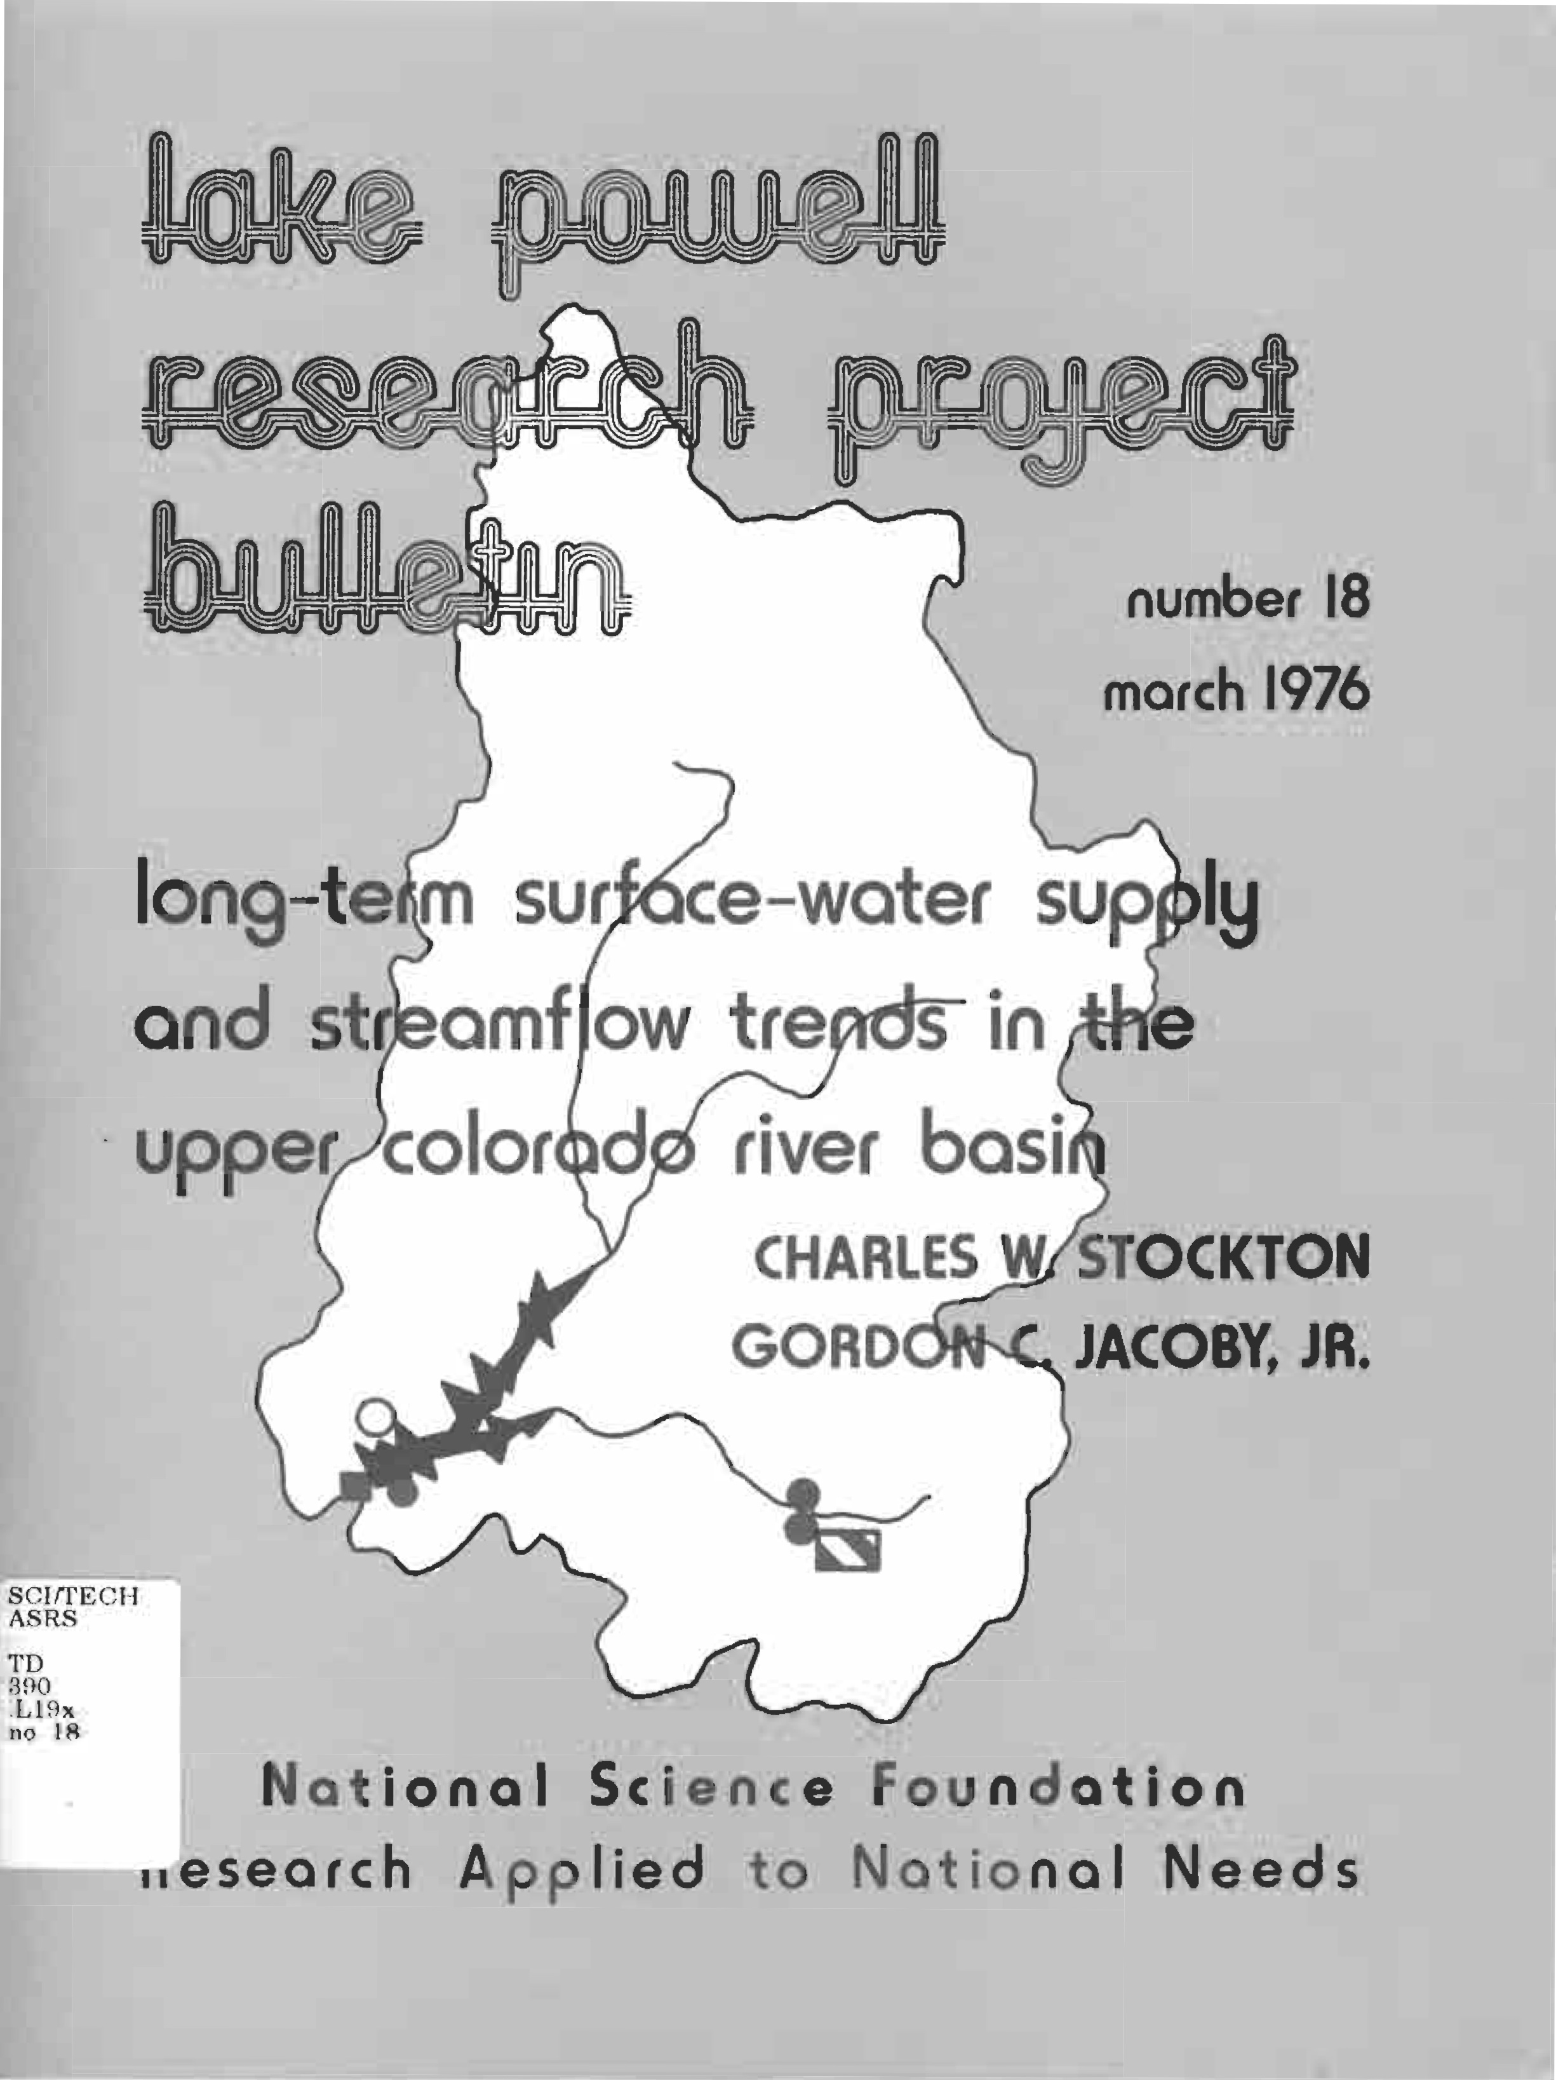
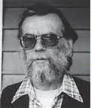
In 1975 I completed my Master’s thesis in dendrochronology and needed a job. Back then there was almost nothing available in dendrochronology except in Arizona. But I wanted to go elsewhere.
Then "out of the blue" (serendipity?), dendrohyrologist Chuck Stockton suggested that I talk to Gordon Jacoby about establishing a Tree-Ring Lab at a place called Lamont-Doherty Geological Observatory. [What? Never heard of it!] with the encouragement of Wally Broecker. [Who? Never heard of him!]
Ignorance is bliss? I might have been too frightened to take the job given Lamont's and Wally's well earned and at times difficult scientific reputations.
Gordon C. Jacoby

Slide 11
Even so, I took the job beginning in September 1975 and was quickly put in charge of processing tree-ring data. This initially meant compiling and running Fortran computer programs from the LTRR. To do this I had to learn how to program in Fortran. So I took a night course in Fortran at Rockland Community College to learn how.
As an aside, the digital computer available at the time at Lamont was an IBM 1130 with 16k central memory, a card reader, and a 10MB removable disk platter. By today's standards, it was amazing that any tree-ring analyses could be done on it. It required writing very tight Fortran code and each time reading in a program binary deck and lots of data cards that sometimes jammed the card reader. Ugh!
Anyone here want to go back to those times?

Slide 12
All of this was fine, but one day in 1976, as I looked dissatisfied at output from a LTRR computer program, I literally had my fundamental research epiphany ("a moment of sudden and great revelation or realization") in wondering:
"Is this all there is?"
This sudden awaking doesn't sound terribly profound, but it was for me. By this I mean did the Tucson LTRR have all the answers for analyzing tree-ring data? I realized this couldn't possibly be true because the mesic closed canopy forests of eastern North America were radically different from the open-canopy arid-site conifer forests that the LTRR methods were based on.

Slide 13
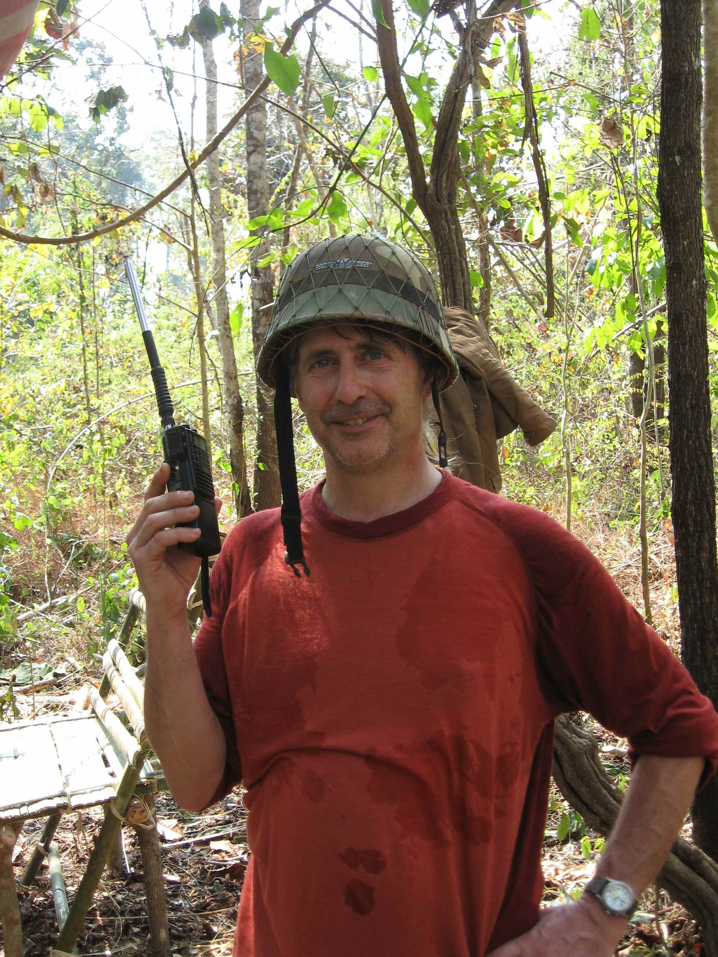
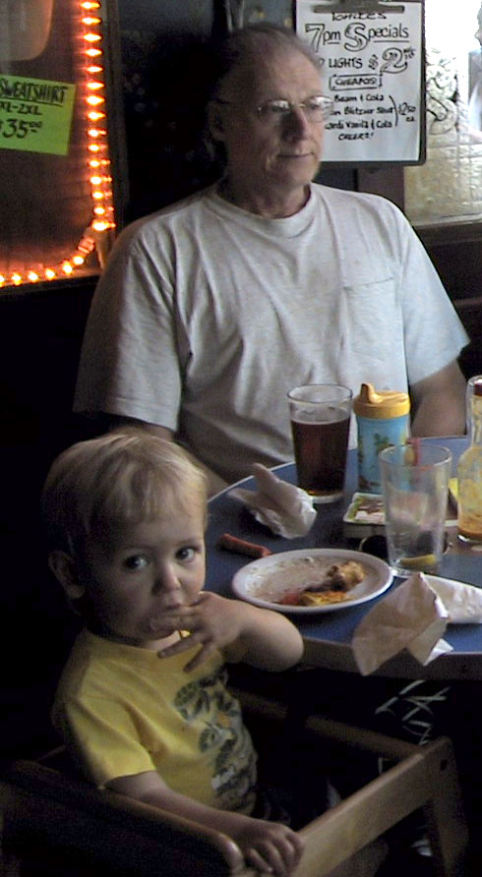
I wanted to do more, much more. This epiphany is when my research future truly began. I immersed myself in multivariate statistics, time series modeling, econometrics, and any other statistical methods that could be useful. I mostly learned them all on my own and how to implement them in Fortran. They became more intuitive to me that way.
But I also had help from two really smart research assistants:
Paul Krusic
Ken Peters
Without these guys
my research career
would not have been nearly as successful and enjoyable.
Not
Ken Peters

Slide 14
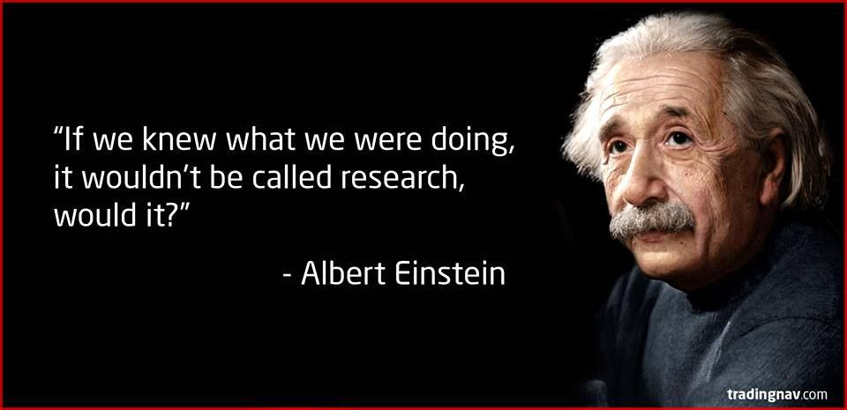
All along the way I learned to embrace uncertainty and actually enjoy it because of the thrill of discovery.

Slide 15
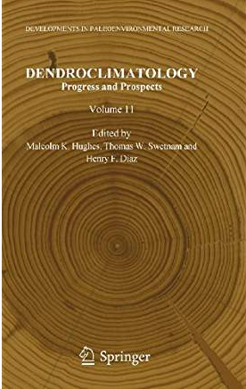
For those who are interested, this chapter describes some
of my thoughts on conducting scientific research.

Slide 16
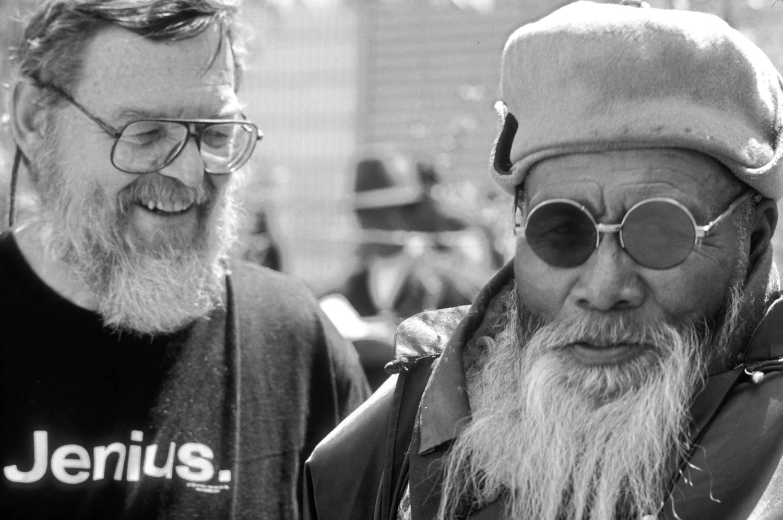
That's all I have to say about serendipity and epiphany, although
meeting this guy in China just by chance clearly qualities.

