Slide 1
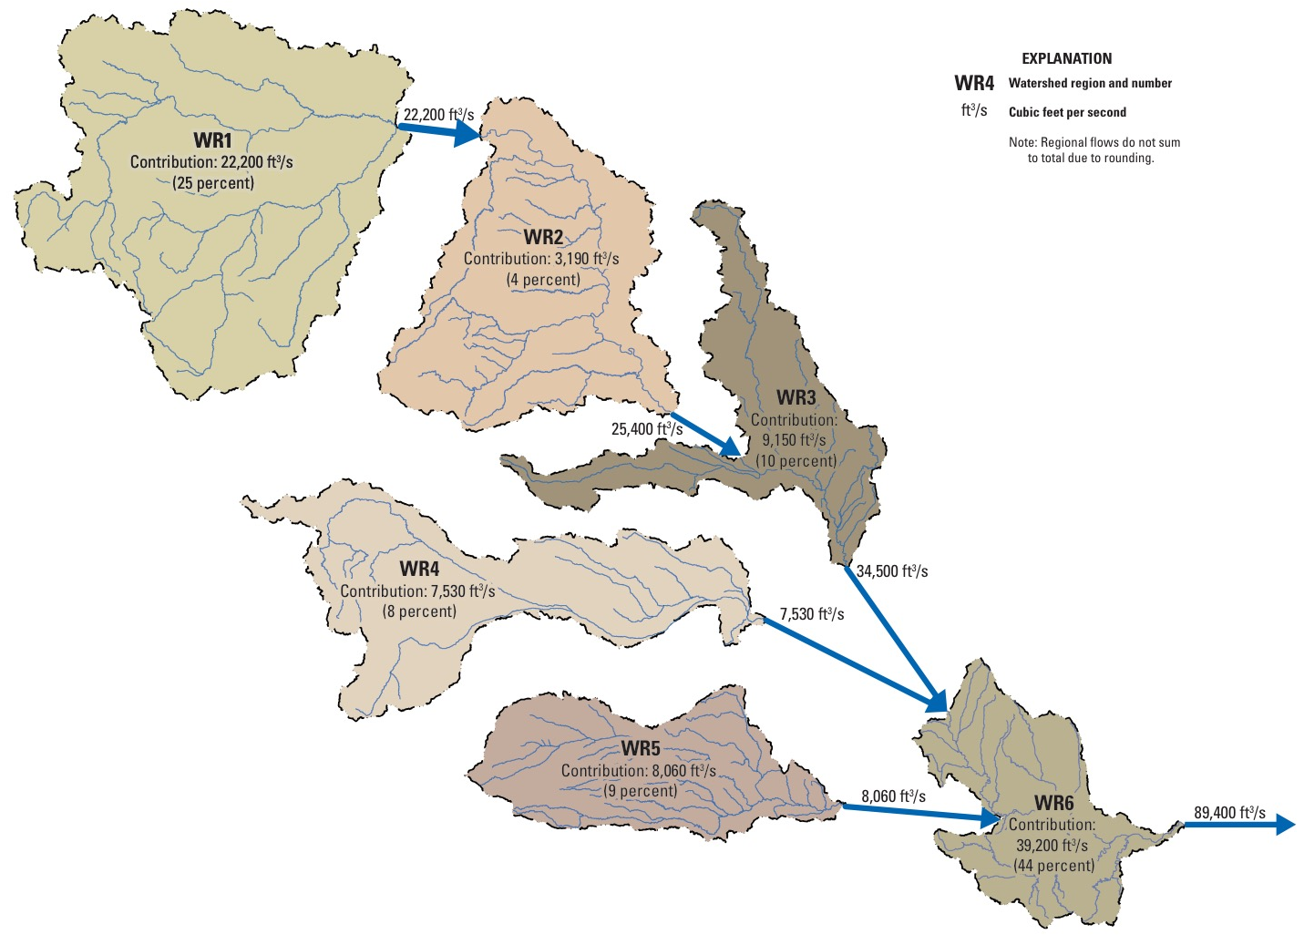
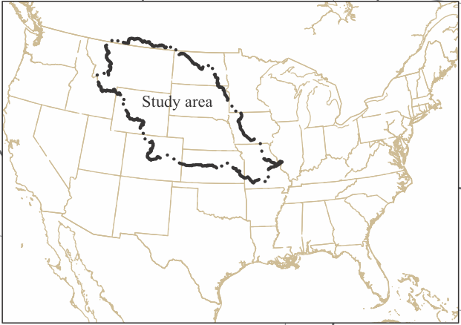
Why it is difficult to reconstruct water year discharge at HEMO:
Many small sub-basin contributions have to be considered
25%
4%
10%
8%
9%
44%
Figure S1. Missouri River watershed regions WR1-6 contributions to total water year discharge at Hermann, Missouri ( ), years 1960-2011. Map modified from Norton et al. (2014, their Figure 16).

Slide 2
Many tree-ring chronologies are available, but not all will be useful.
Screening is required: 95% 1-tailed positive correlation used.
Figure S2. The candidate tree-ring network (896 chronologies) used to reconstruct water year streamflow at HEMO. The network is divided into approximate upper (UMRB) and lower (LMRB) basin sub-networks for screening to a much smaller subset of 'common' tree-ring predictors.

Slide 3
What is the best target streamflow series to use for calibration/validation?
McCabe WBM estimates are longer and appear to do an excellent job.
ACE appears to have underestimation bias in it as well.
Figure S3. ACE water year discharge estimates at HEMO compared to estimates based on the McCabe water balance model (WBM). This comparison shows that the WBM estimates are sufficiently accurate compared to ACE to be used as the target time series and it also goes back farther to 1901.

Slide 4
Method of Reconstruction:
Principal Component Regression (PCREG)
PCREG is a dimension-reducing regression method based on applying principal component analysis (PCA) to the suite of M predictors over the N year calibration to produce a reduced set of orthogonal predictors that contain most of the useful information in the predictor data set. PCA is based on the correlation matrix here to give each predictor equal weight. See Cook et al. (1999, Appendix A) for details.
Besides dimension reducing, PCA deals efficiently with multi-collinearity among the predictors that is frequently encountered when selecting a subset of tree-ring predictors used to reconstruct the same variable.
PCA transforms the intercorrelated set of predictors into a new set of orthogonal predictors containing a decreasing level of common signal in their respective principal components (PCs) as measured by their eigenvalues. These common signals are loaded most highly the first M' leading PCs, where M'<M, but only a subset of m' predictors may be entered into the regression model. M' is chosen using the Kaiser-Guttman Eigenvalue-1 cutoff rule. This is the 'dimension-reducing' aspect of PCREG.
The orthogonality of the m' predictors entered into the model serves to stabilize the regression model by eliminating multi-collinearity. The entry of variables in the model is also simplified by ordering the variables for testing based on their simple correlations with the predictand variable. The stopping rule for entering variables might be based on the minimum AIC or t-test. Here a t=1.0 stopping test was used.

Slide 5
Table S1. Tests to determine the most robust set of tree-ring predictors for reconstructing HEMO streamflow. Out of an initial set of 885 candidate predictors (Fig. S2) screened for correlation with HEMO streamflow (95% 1-tailed positive), only 183 were found to have stable correlations with HEMO discharge over two independent calibration periods. Use of these 183 "common" predictors resulted in improved validation statistics in all cases.

Slide 6
Tree-Ring Network Used for reconstruction of HEMO Streamflow
Figure S4. The final tree-ring network (183 chronologies) used to reconstruct water year streamflow at HEMO. The selection was based on the results shown in Table S1 that retained chronologies based on successful calibration in two equal-length, non-overlapping time periods.

Slide 7
Figure S5. The declining number and distribution of tree-ring chronologies from 1800 CE back to 1000 CE. Before 1400 CE the number and distribution of chronologies for reconstruction at HEMO is increasingly inadequate.

Slide 8
Figure S6. Evaluating HEMO nested reconstruction uncertainty. How far back in time can the reconstruction be trusted? Probably as far back as 1360 CE based on what is shown in S6b (reasonably stable correlation >0.85 from 1590 to 1360 with the best replicated 1800-1980 reconstruction nest) and S6c (reasonably stable leave-one-out CVRE >0.65) even as the number of tree-ring chronologies declines from 69 to 39. Before 1360 both measures of reconstruction stability systematically decline.

Slide 9
Figure S7. Tree-ring networks used to sequentially extend the HEMO reconstruction forward by 10-year intervals from 1990 to 2020. The 2020 extension is clearly the weakest with respect to number available.

Slide 10
Extended Old HEMO Reconstruction Out To 2020

Slide 11
For HEMO based on PCREG I estimate uncertainties based on a combination of classical
regression Prediction Intervals coupled with the Maximum Entropy Bootstrap

Slide 12
Shown to be comparable to Bayesian
Regression credible intervals in:
MEBoot uncertainty estimation coupled with
regression prediction intervals was introduced in:

Slide 13
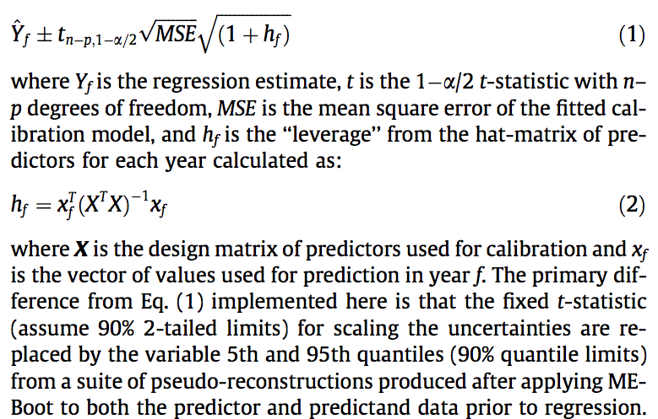
PPR can also easily estimate reconstruction uncertainties in two ways: classical parametric prediction intervals and semi-parametric intervals based on applying the maximum entropy bootstrap to the data. In either case, the form of the prediction intervals is the same (see Olive, 2007):

Slide 14
1000 HEMO Maximum Entropy Bootstrap Pseudo-Reconstructions

