Slide 1
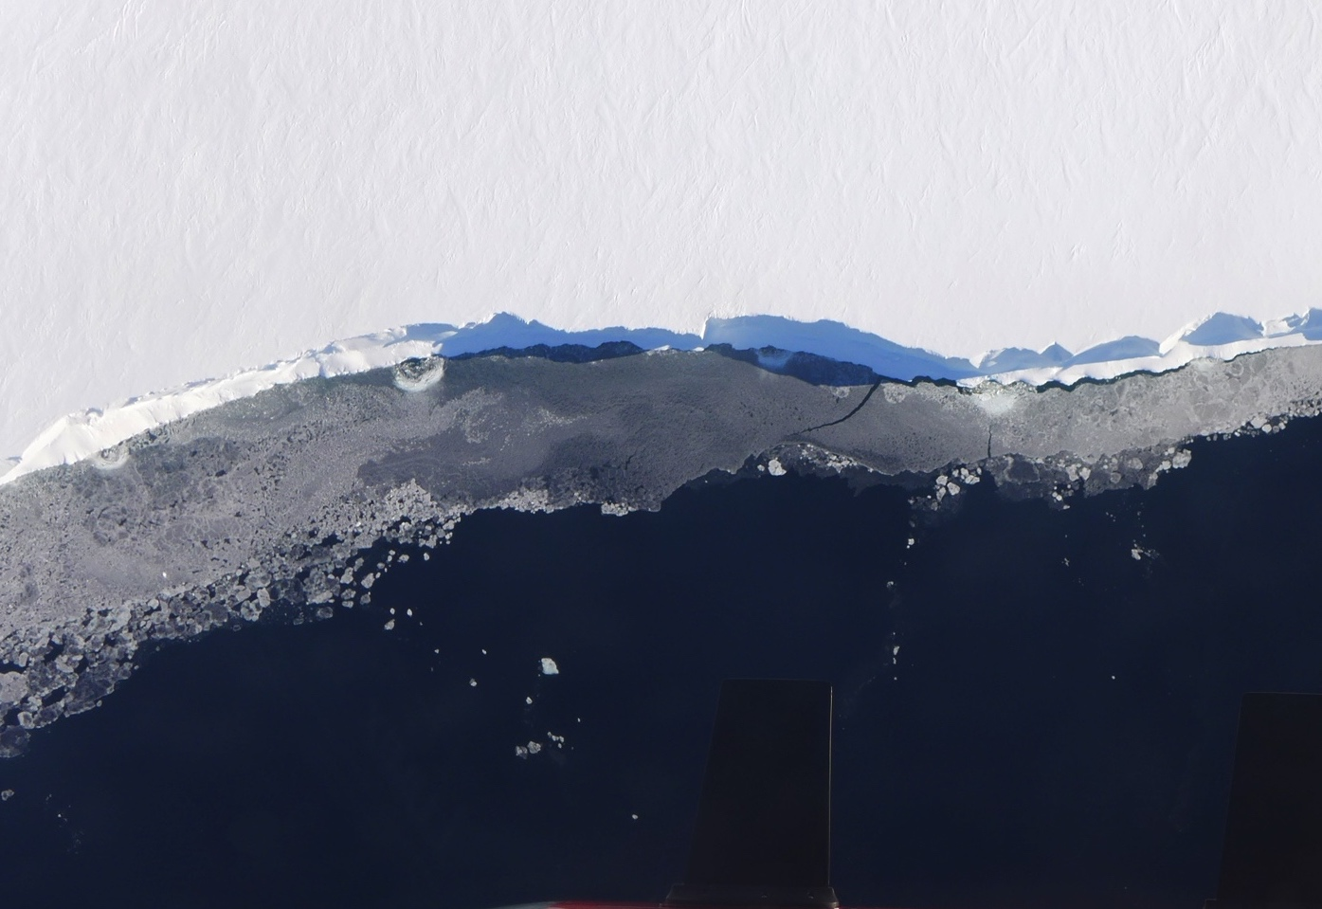
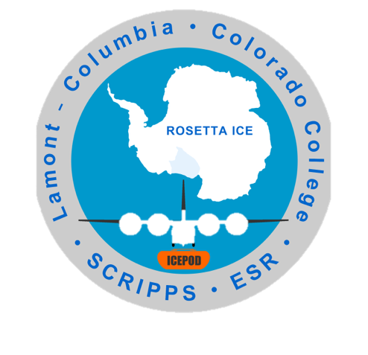



ROSETTA ICE PROJECT
Photo: Flying along the front of the Ross Ice Shelf in Antarctica

Slide 2
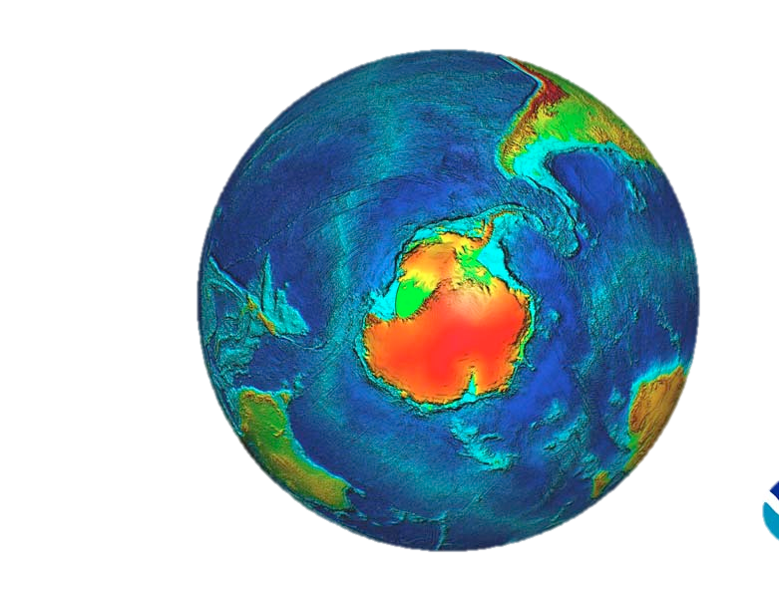

The Rosetta Project focuses on measuring the Ross Ice Shelf in Antarctica. What is an ice shelf?
Ross Ice Shelf
Ice elevation Map of Antarctica

Slide 3
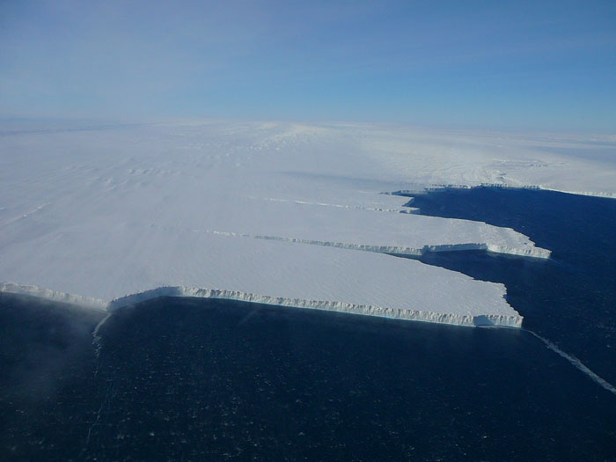

Antarctica is covered by ice that flows off the land into the ocean, and forms ice shelves where it enters the ocean. The shelves are very thick.
Pine Island ice shelf, West Antarctica photo M. Wolovick
These floating shelves are 50+ meters thick above the water and much thicker below water. They stay pinned to the land on several sides.
Notes:
Far from the edges of the ice sheets but…

Slide 4
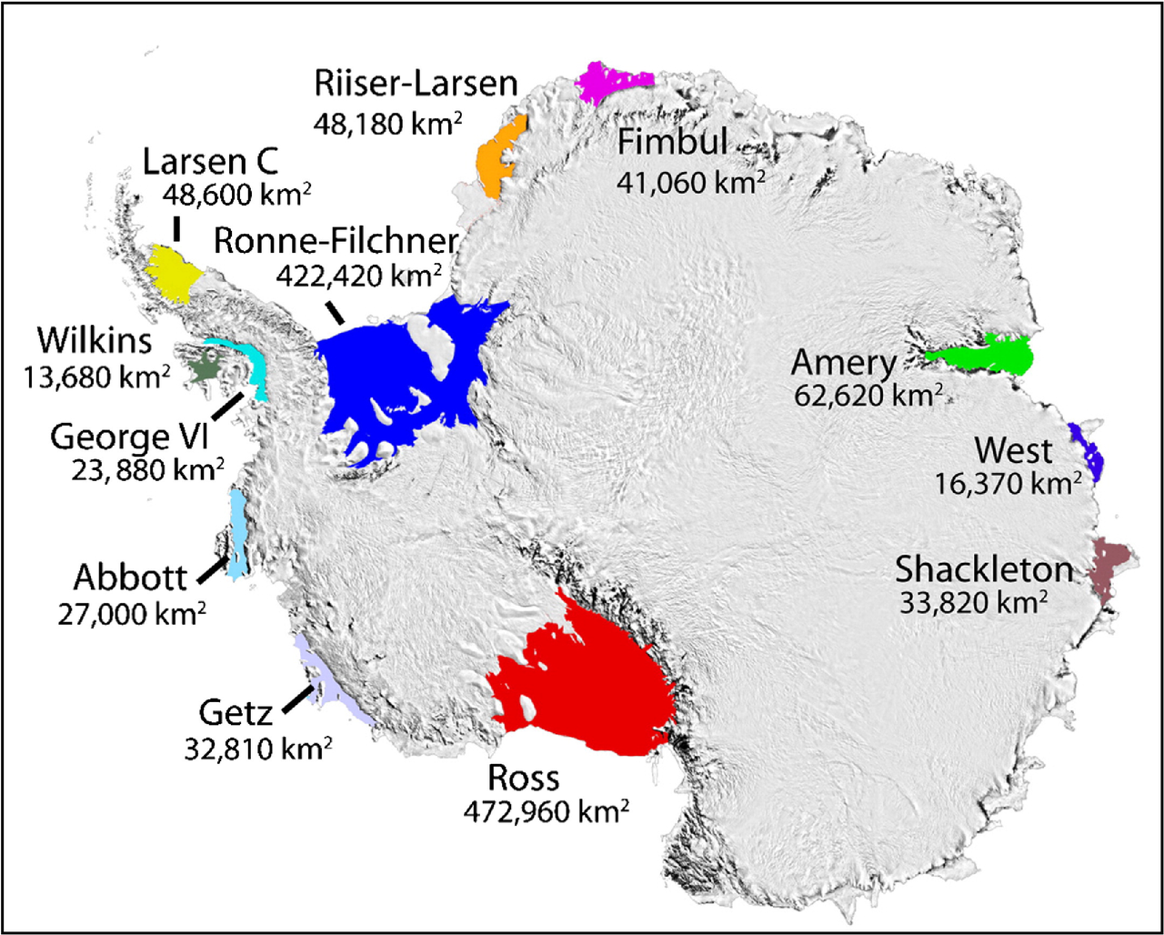
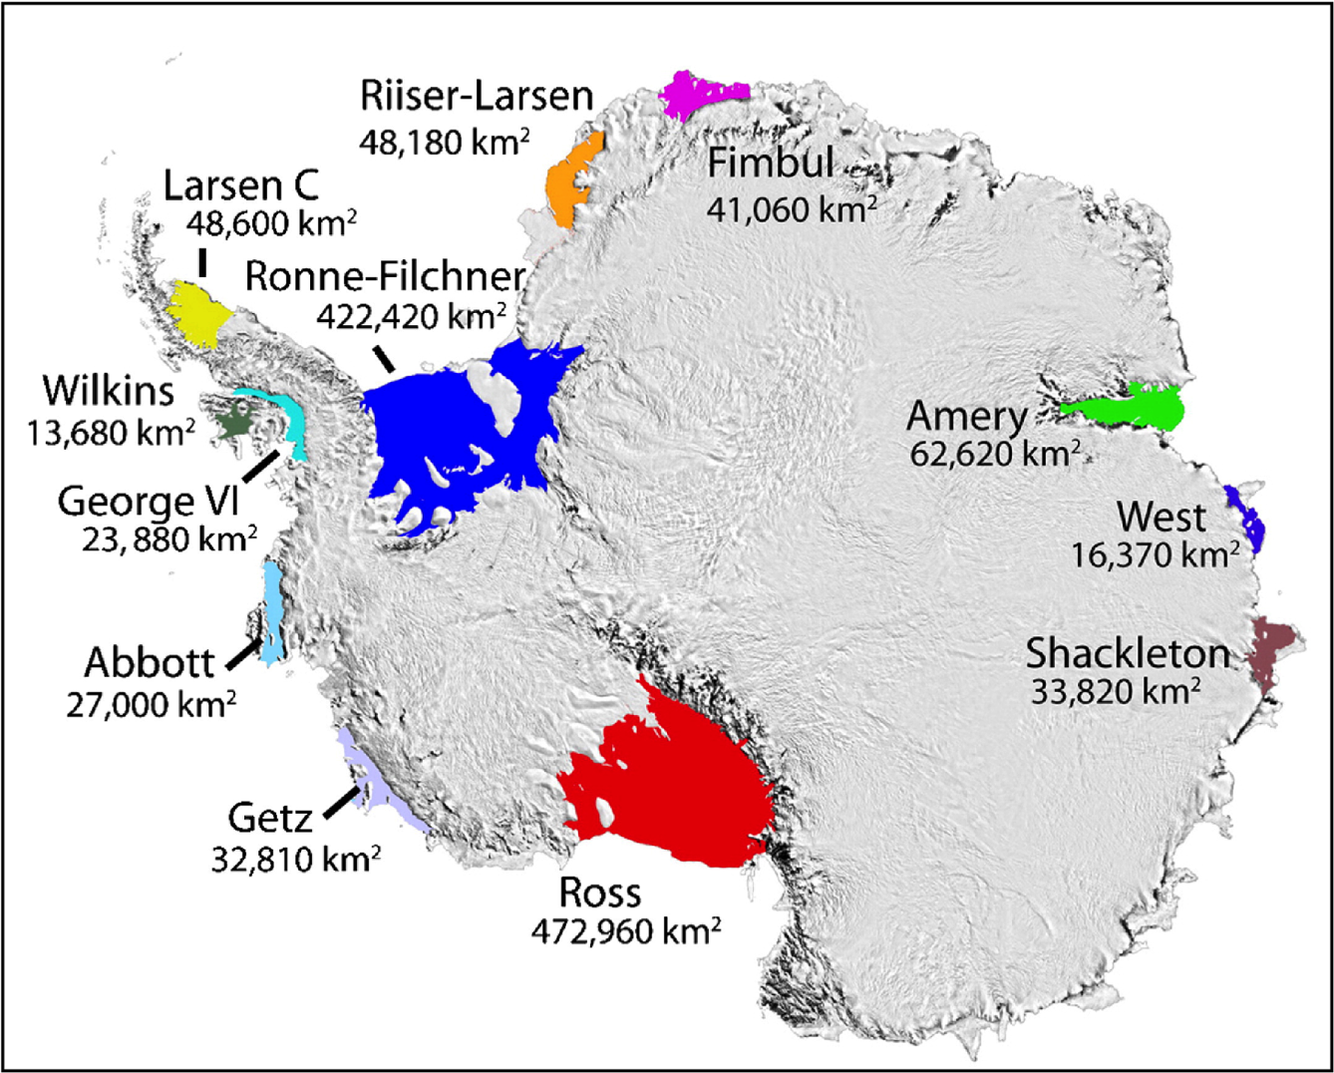
Antarctica is surrounded by ice shelves
The shelves, colored above, are important as they push back on the land ice, slowing its flow. Ross is the largest ice shelf.

Slide 5
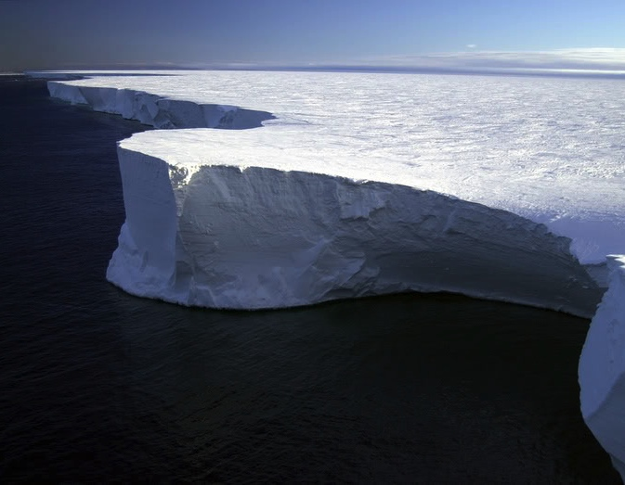
Ross Ice Shelf is a critical brace as it sits at the edge of the most vulnerable part of Antarctica –West Antarctica
Photo Josh Landis
The ice shelf is the size of France and sits 50 meters above water, and up to 1200 meters thick in some areas
Notes:
An enormous crack in the ice was first discovered on Pine Island Glacier as early as 2011. Now, the crack has breached and a body of ice measured at approximately 278 square miles has broken away.

Slide 6
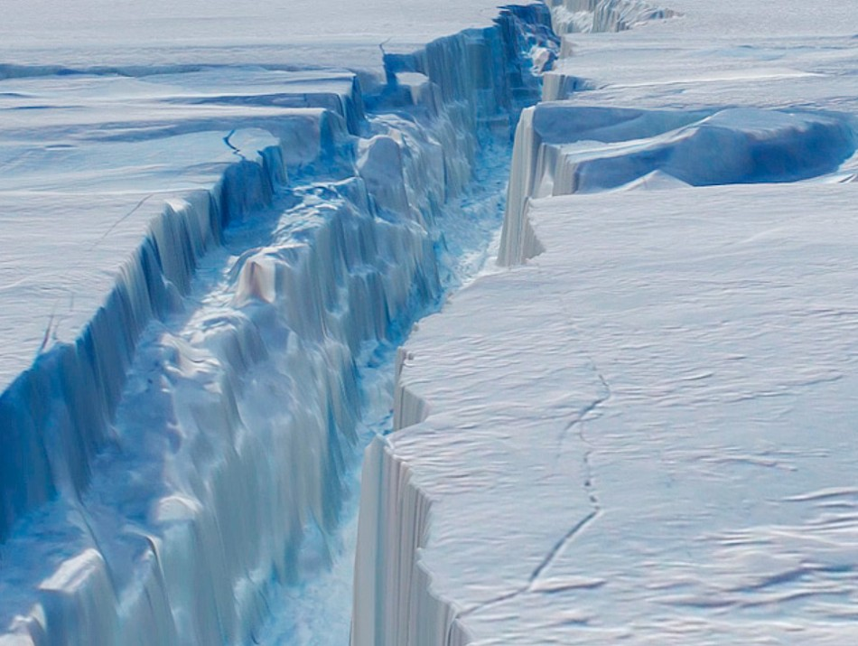
We have seen some ice shelves weaken and lose large sections of ice. We want to see how the Ross Ice Shelf is changing.
Above is a break in the Pine Island Ice Shelf that caused ice to calve creating a large Iceberg - 278 sq. miles of ice in July 2013.
Notes:
An enormous crack in the ice was first discovered on Pine Island Glacier as early as 2011. Now, the crack has breached and a body of ice measured at approximately 278 square miles has broken away.

Slide 7
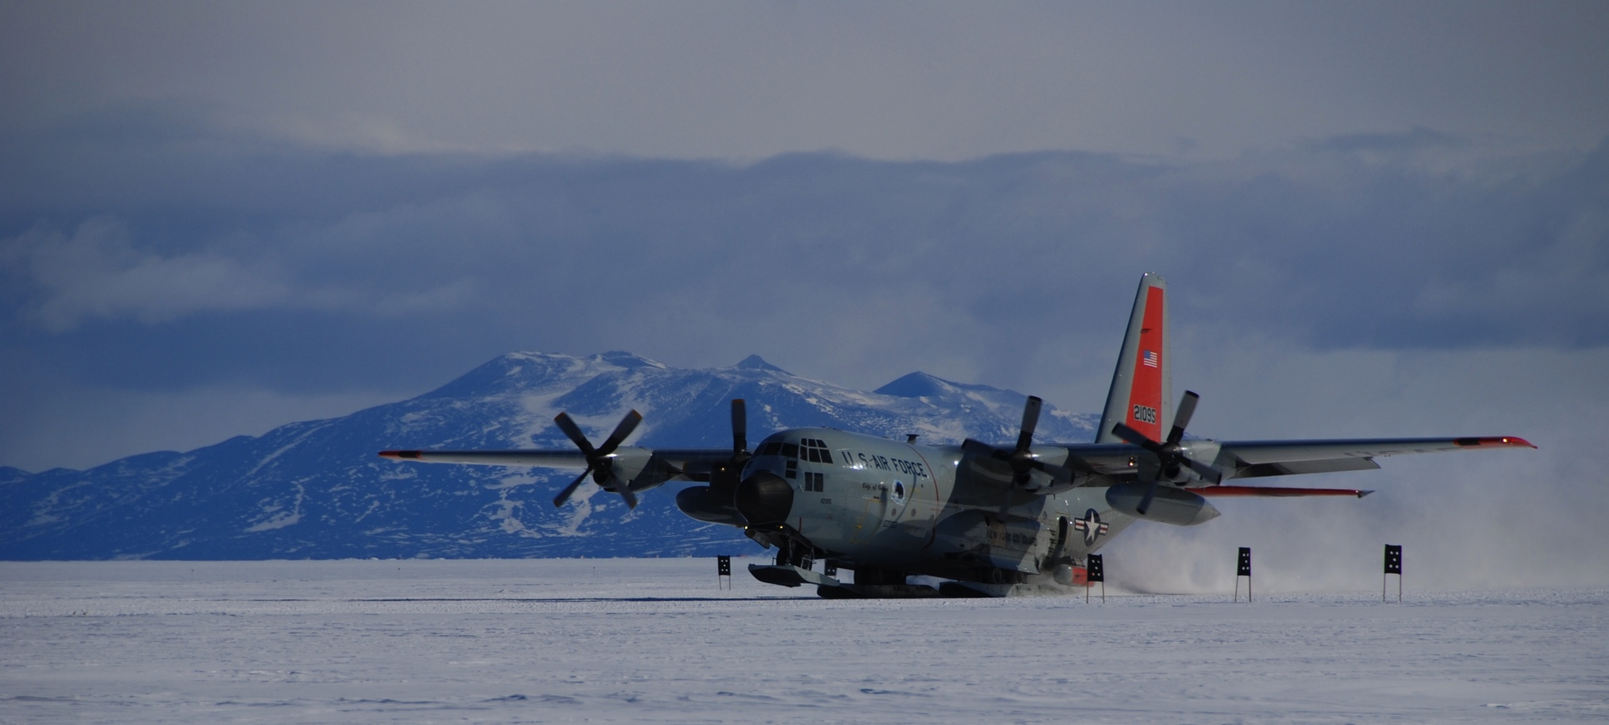
To understand how the Ross Ice Shelf is changing the Rosetta Project is measuring (1) shelf thickness, (2) the shape of the ocean floor below, and (3) ocean circulation in front of the shelf.
LC130 – large freight plane on skis
Photo Mark Kurz
We use this large plane in collecting most of the measurements.

Slide 8
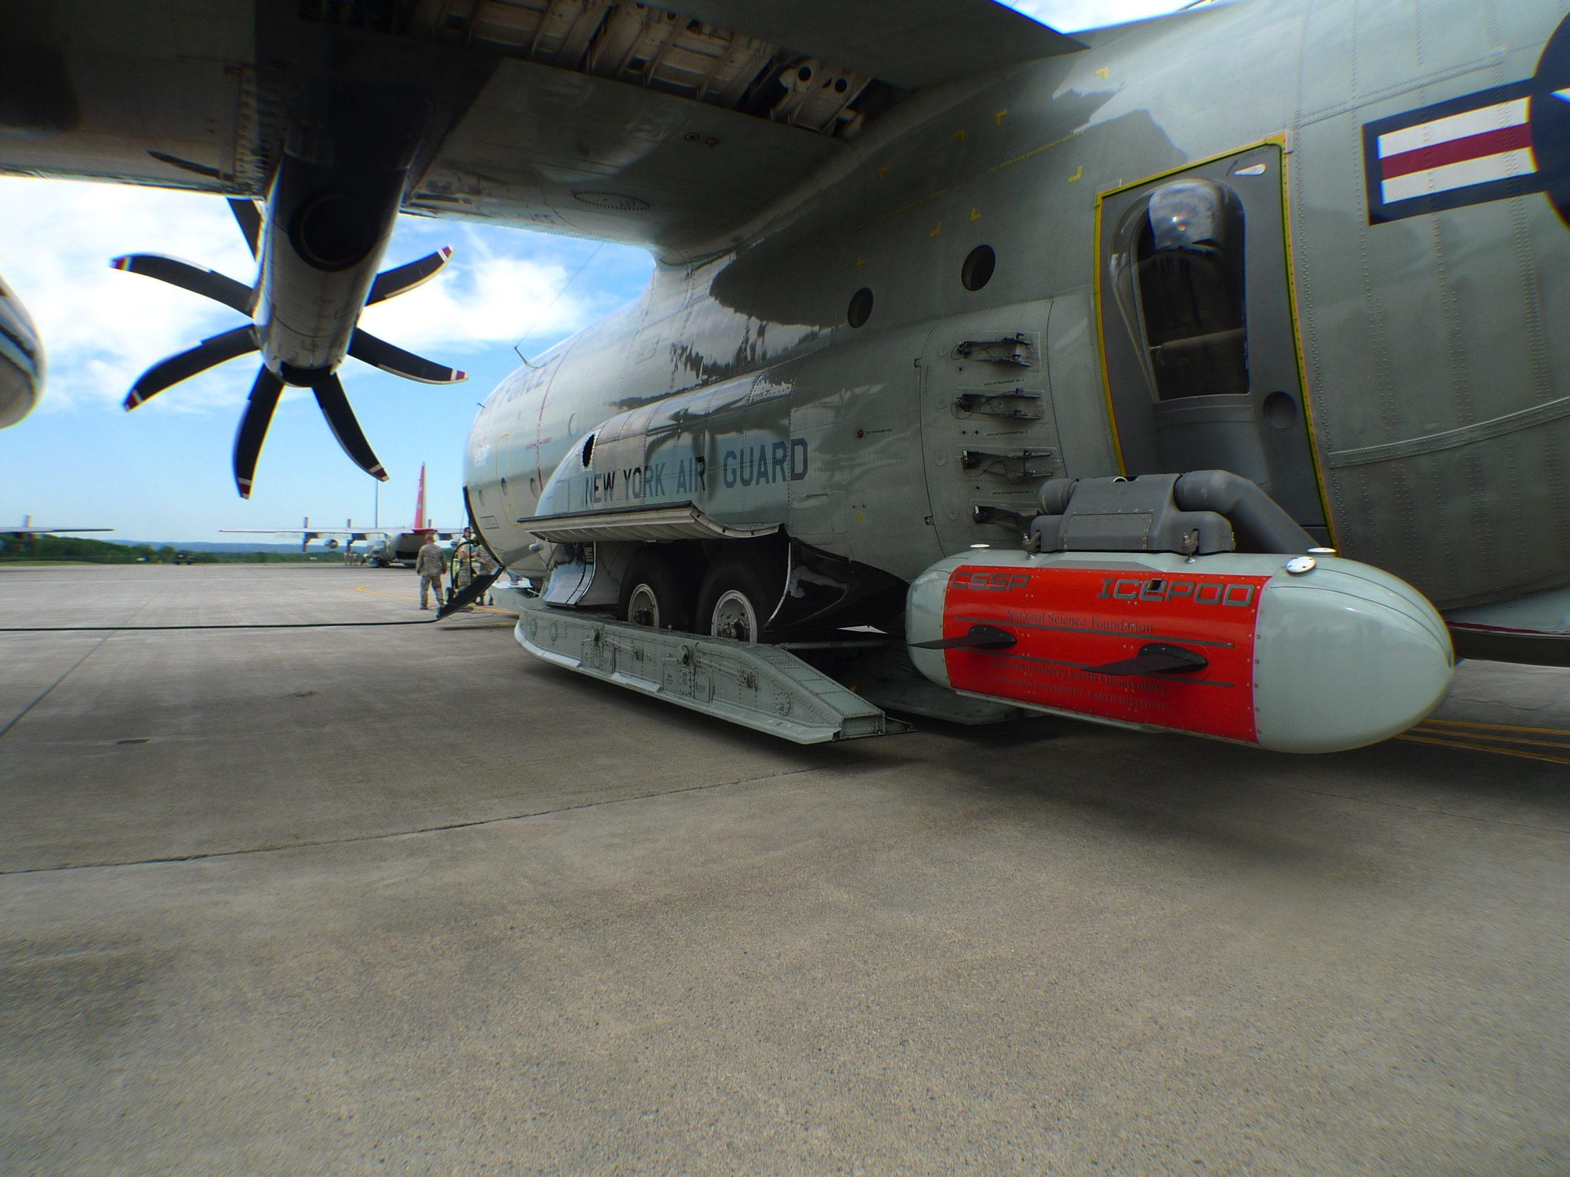
Off the side of the plane hangs a container called ‘IcePod’
Inside IcePod is a group of instruments that can measure the ice thickness (radar), ice surface (lidar), the type of rock below the ice (magnetometer) and a GPS.

Slide 9
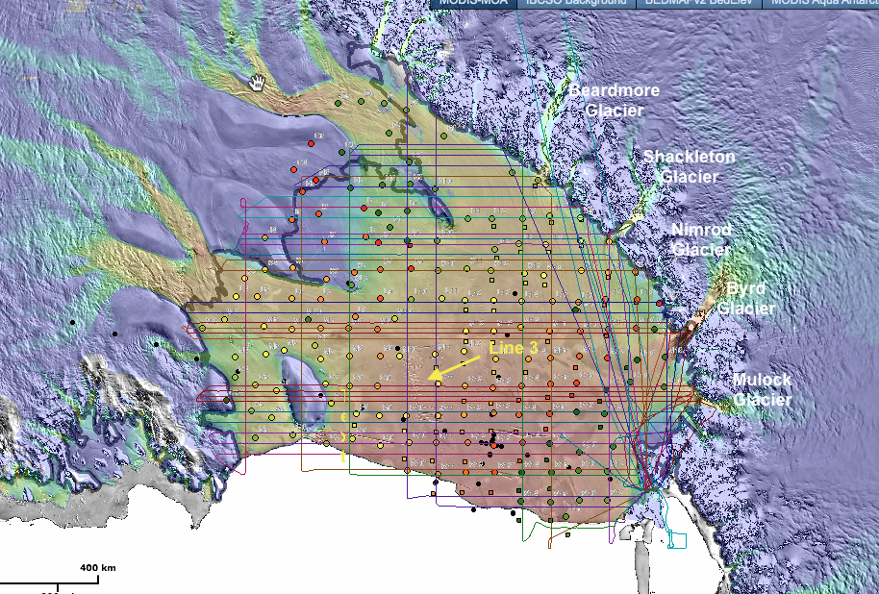
We have collected data across the shelf and will collect more this season
Flying back and forth across the ice to collect straight lines of data is called “mowing the lawn”

Slide 10
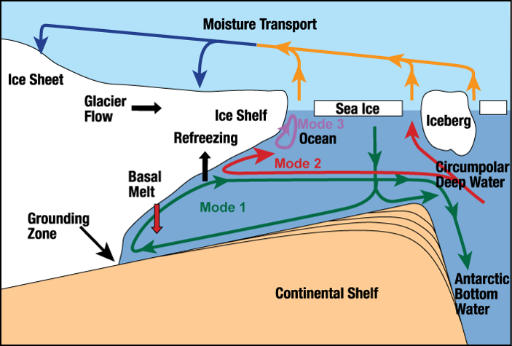
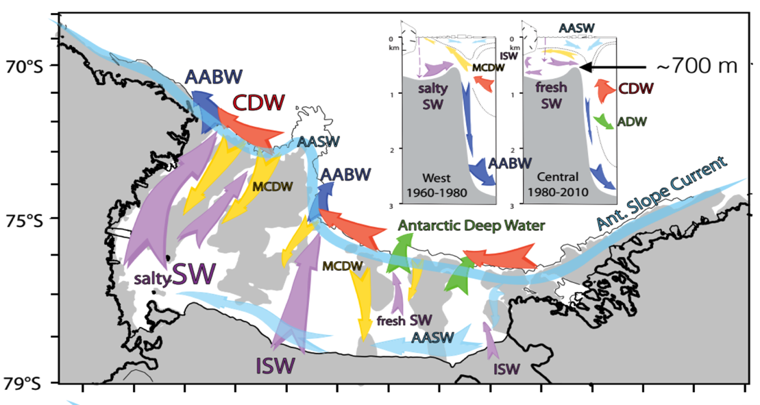
But we also need to know how the warm water is getting under the shelf as…
  This influences the ice sheet stability
  Circulation moves heat, salinity, and fresh water under the ice shelf and around continent
  Circulation is steered by the shape (bathymetry) of the sea floor as well as influenced by the geometry and roughness of ice shelf cavity
In this side view you can see ways that water moves onto, under and away from the ice shelf
Smith et al., 2012
Ocean circulation patterns are complicated and not well known under the ice shelf.

Slide 11
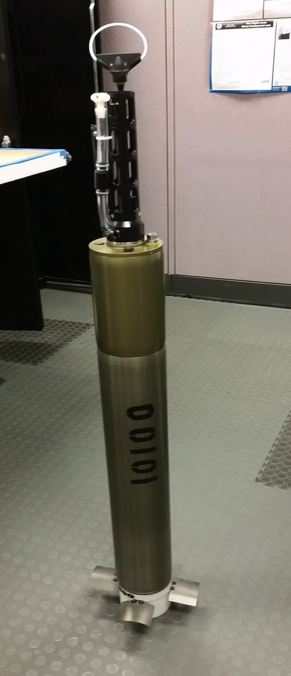
This season we also want to learn about the ocean at the front of the shelf. The LC130 can’t help us there.
For that we hope six of these Alamo floats can.

Slide 12
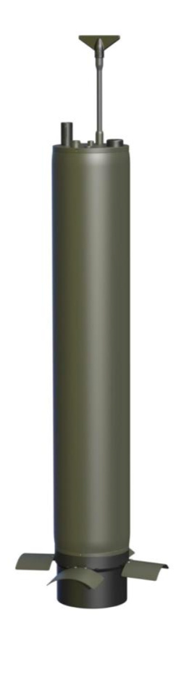
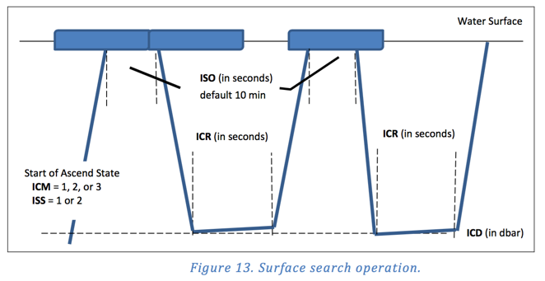

ALAMO floats are full of instruments to measure temperature, pressure (depth), salinity, circulation – and they phone it in to us!
1) SBE41 - A thermistor, a borosilicate conductivity cell, and a strain-gauge pressure sensor.
2) GPS
3) Iridium model and ice-hardened antenna
4) And oil pump and bladder
Credit: A. Massa/S. Jayne

Slide 13
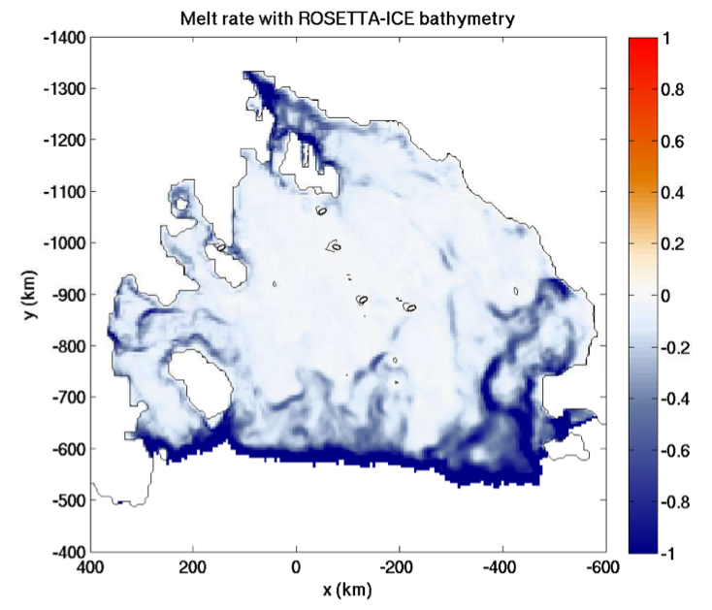
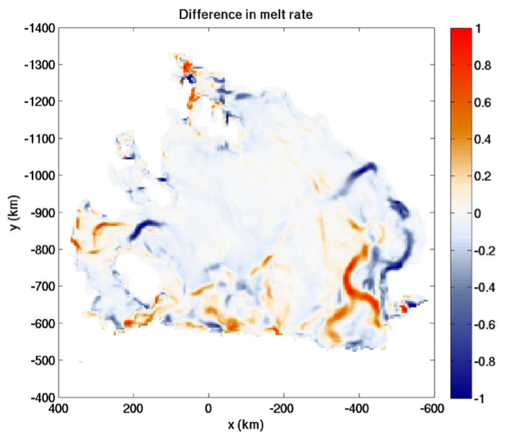
These instruments follow ocean circulation collecting measurements to show us how water moves along and under the shelf. This will improve our models of melt rate of the shelf.
m/yr
m/yr
Model of Ross Ice Shelf melt rate (blue is melt) using the new Rosetta data.
Shows the difference in melt rate using our new data and the old model.

Slide 14
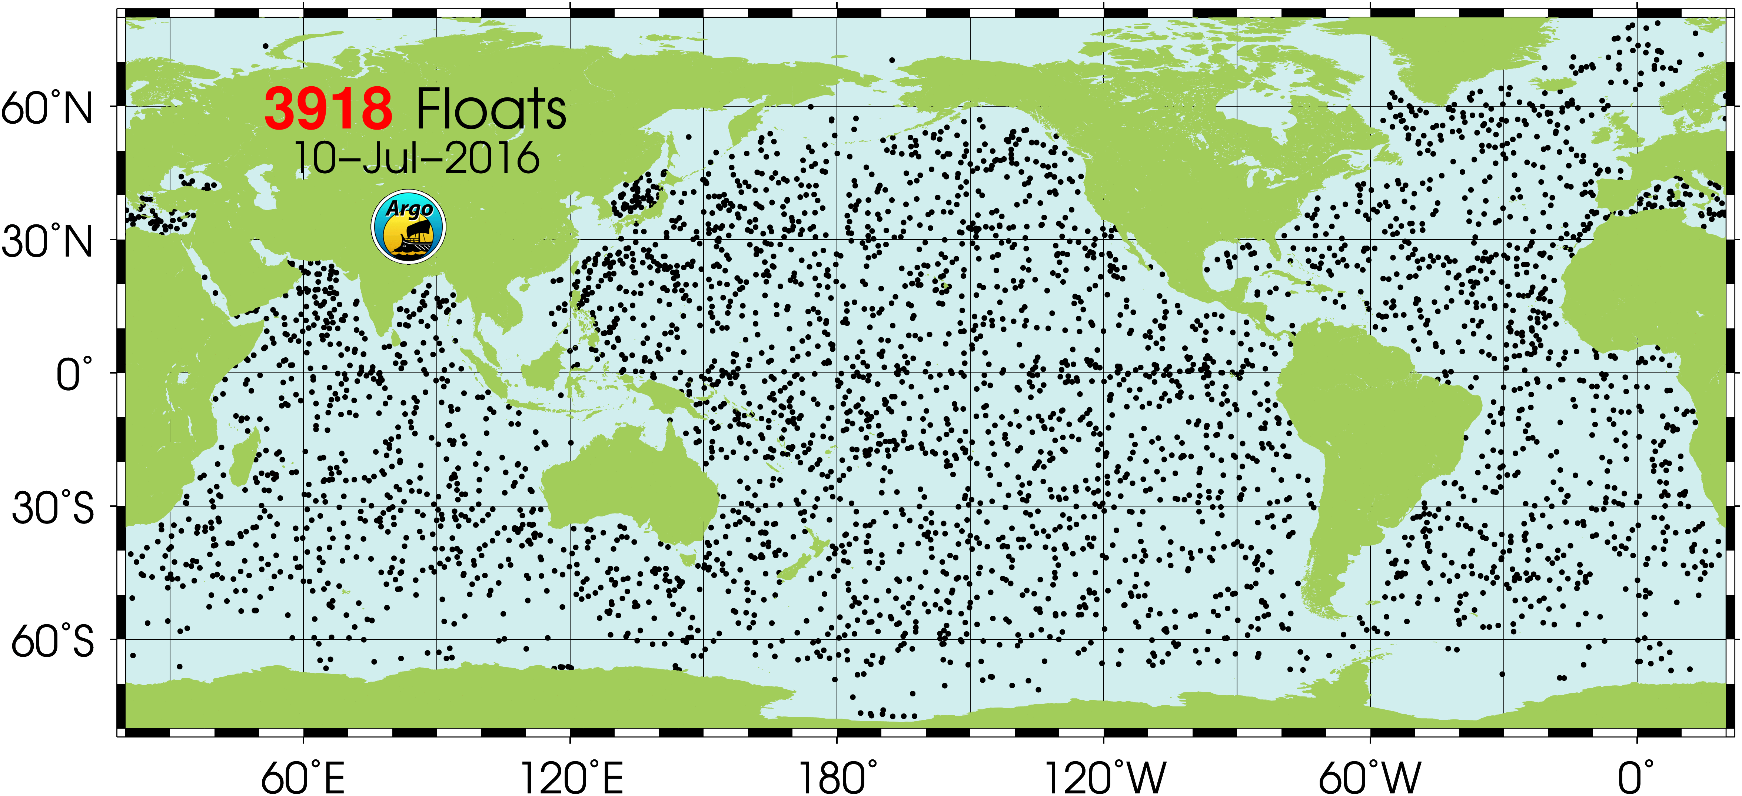
Around the world’s oceans there are floats telling us about the ocean. These help us develop accurate models of circulation.

Slide 15
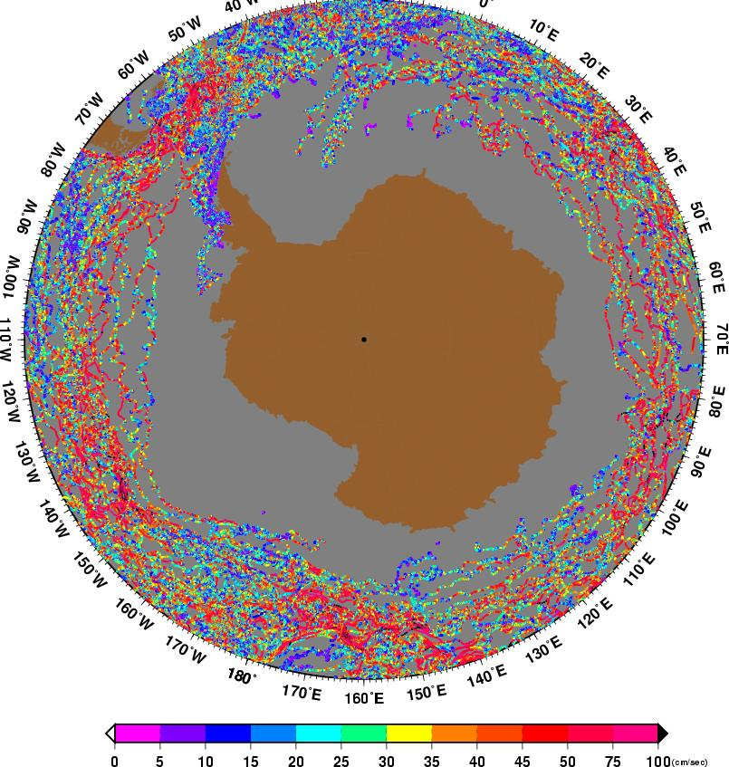
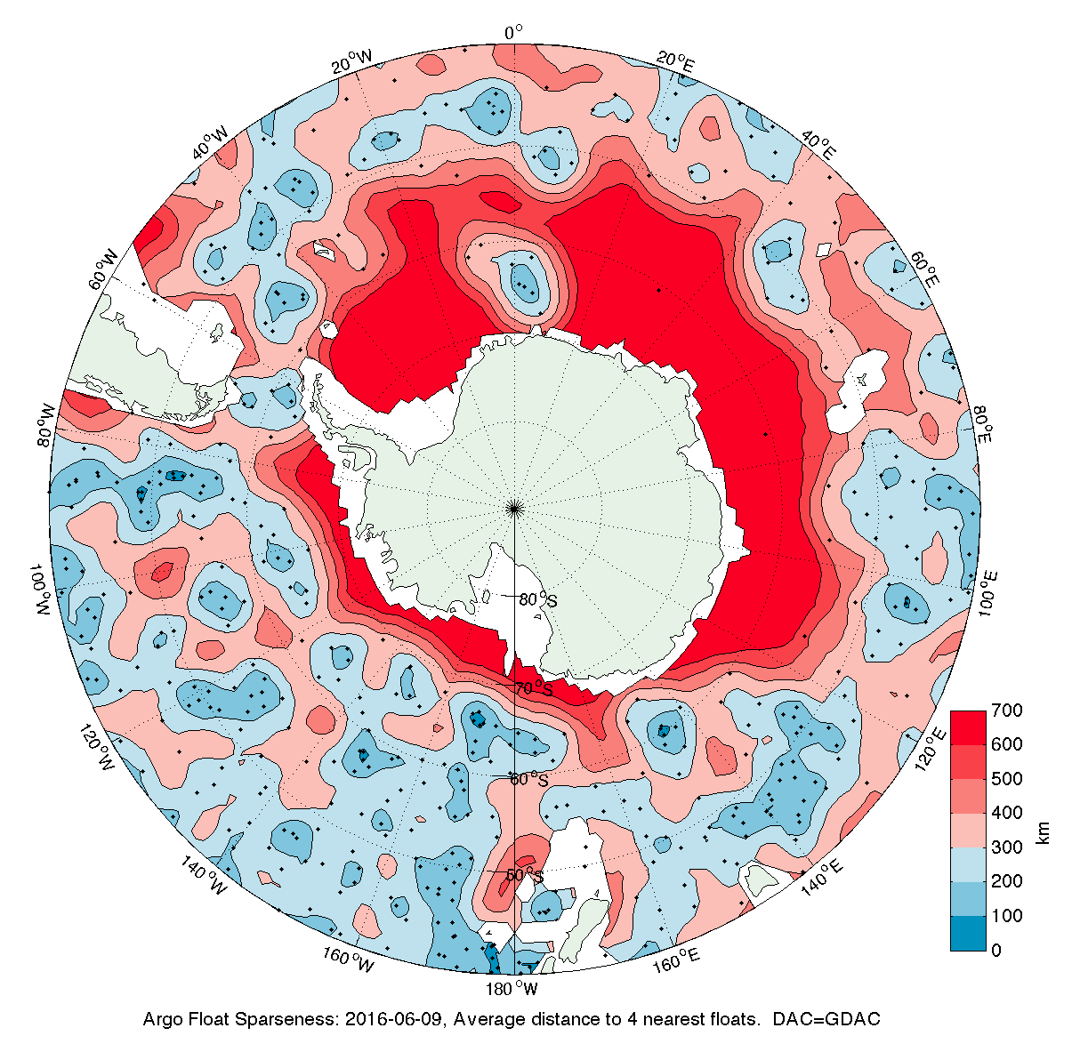
Why do we have to put in new floats in front of Ross Ice Shelf? As you can see there few floats near Antarctica, we need more information!
Image of current speed/drift rate - historical floats in southern ocean (not older than 2003)
Map of the distance to the 4 nearest floats around Antarctica – this is a float desert!

Slide 16
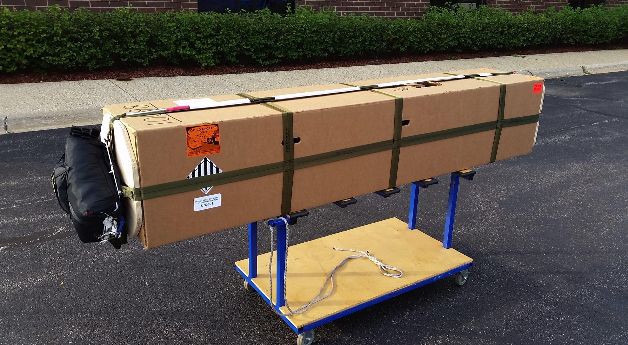
How do we get them in front of the Ross Ice Shelf? We throw them out of the plane into the ocean.
It has its own parachute

Slide 17
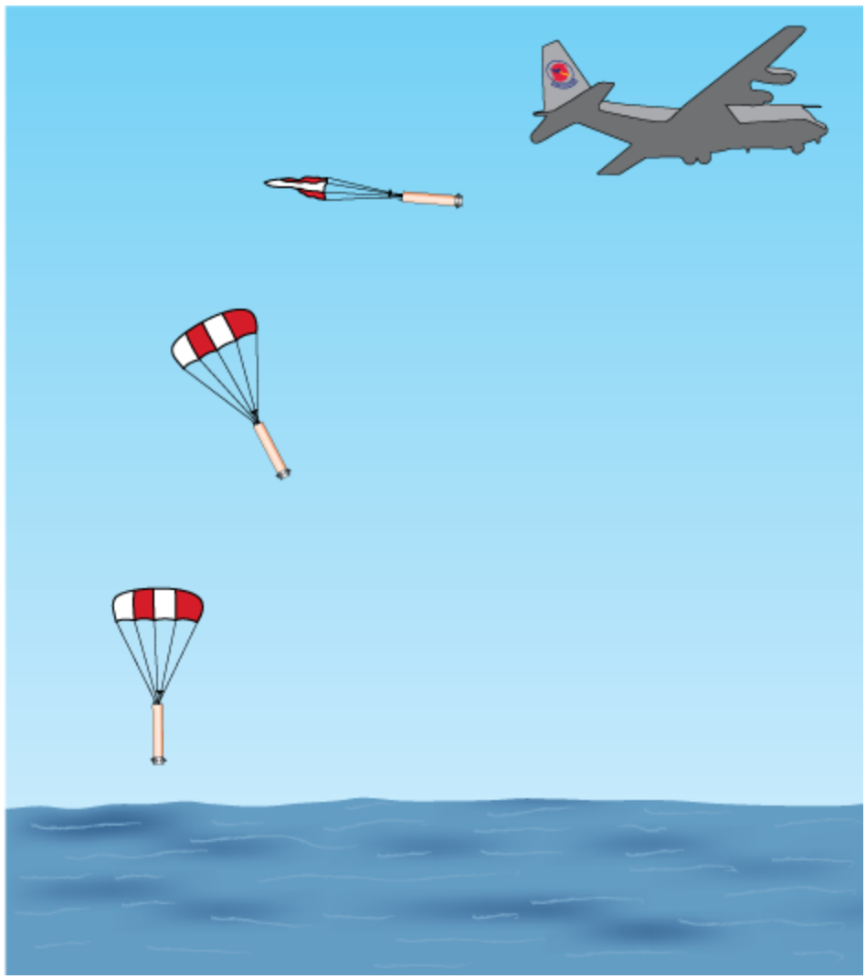
WHOI

Slide 18
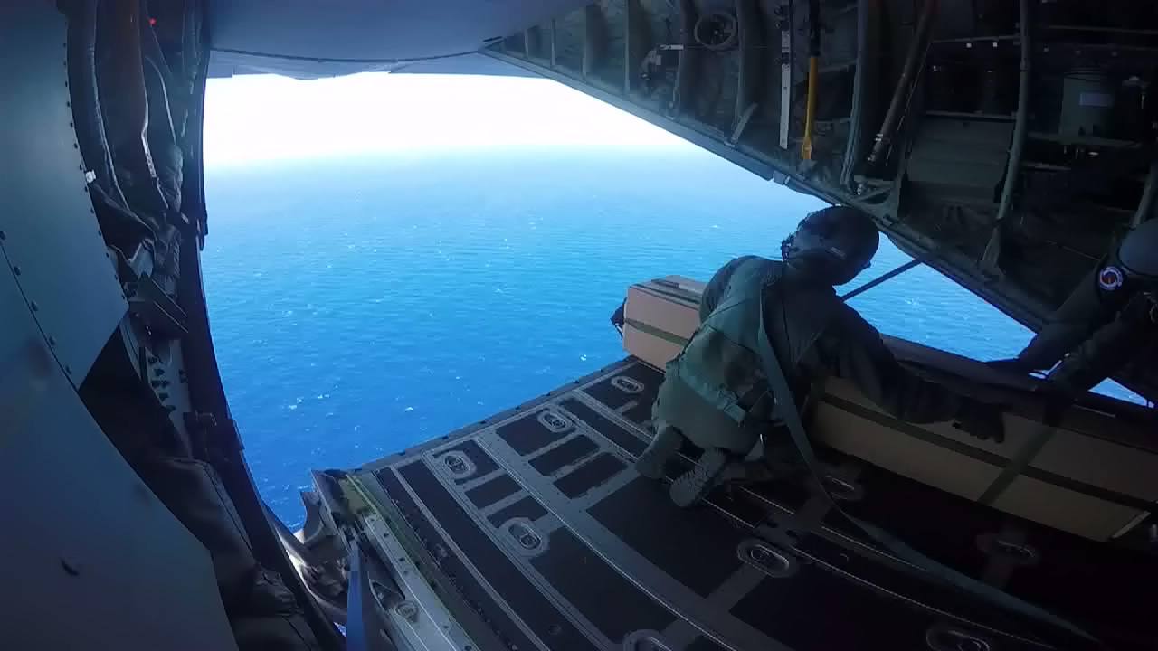
The guard dropping an Alamo out of the back of the LC130 plane

Slide 19
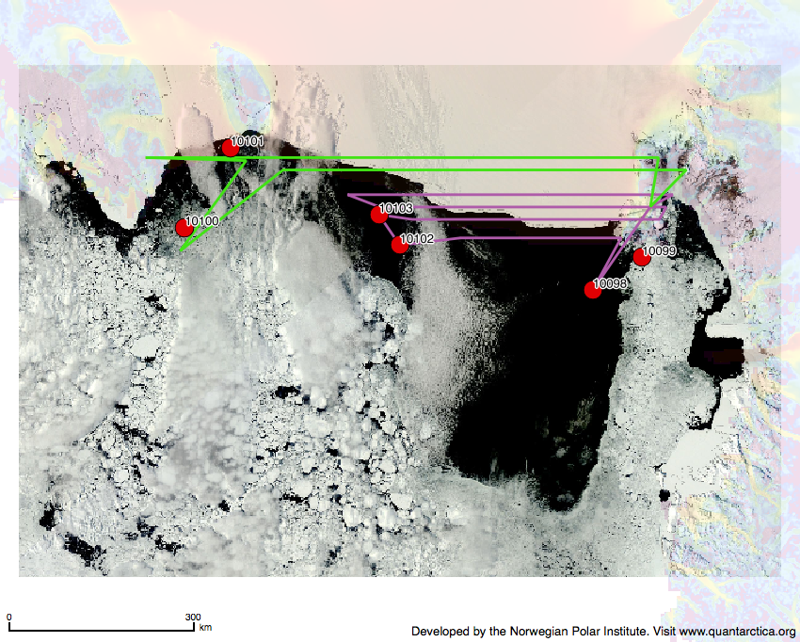
We dropped six buoys along the front of the Ross Ice Shelf.
(# 1) Just like meteorologists run a weather model to predict wind flow and movement, we used an ocean circulation model with a buoy depth of 300 meters to predict where the buoys might travel (# 2).
1) A map of sea ice along the Ross Ice shelf edge from Dec. 4, 2015 with the 6 Alamo drop locations in red. The colored lines are flight paths.
2) Image of Alamo drift patterns shown over existing bathymetry

Slide 20
Each Alamo buoy is named for an Antarctic seabird
You can follow their ‘flight pattern’ as they glide out of the aircraft and then bob up and down in the ocean sending data home to us
10100 – Snow Petrel
10099– Sooty Shearwater
10103– South Polar Skua
10098 – Adelie Penguin
10102 – Antarctic Tern
10101 – Wandering Albatross

Slide 21
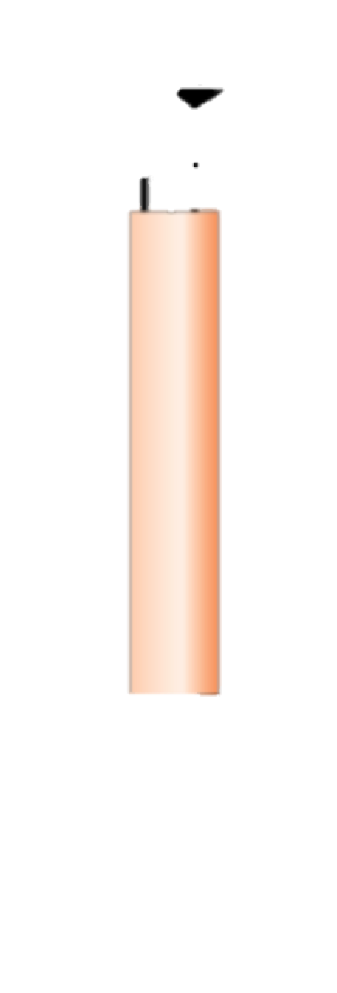
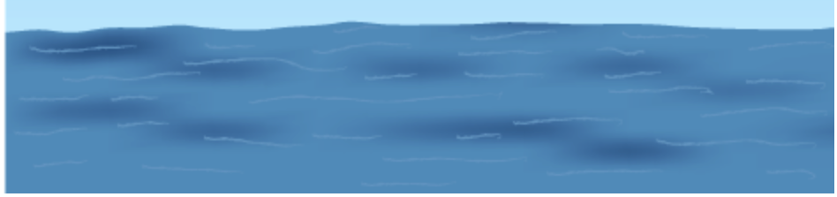
The buoys have two different behaviors and reporting rates…
Most will park on the seafloor and wait. Periodically they will be awakened.
Once awakened they will rise to the surface collecting data as they go up, and phone it in.
Then they will return to the bottom waiting until it is time to collect more data.

Slide 22
One will free drift/float around in the ocean (the one we call Albatross 10101)
Periodically they will be turned on. They will drop down to the ocean bottom and as they rise to the surface they will collect data.
They will then go back to drifting

Slide 23
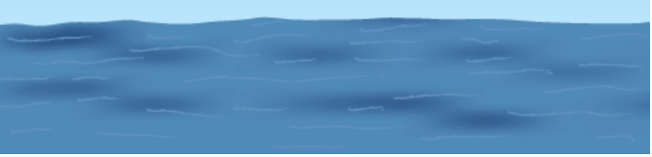
Most phone home daily while one (10099) phones in every 3 to 4 days
Coming up to report Daily
Coming up every 3 to 4 Days

Slide 24
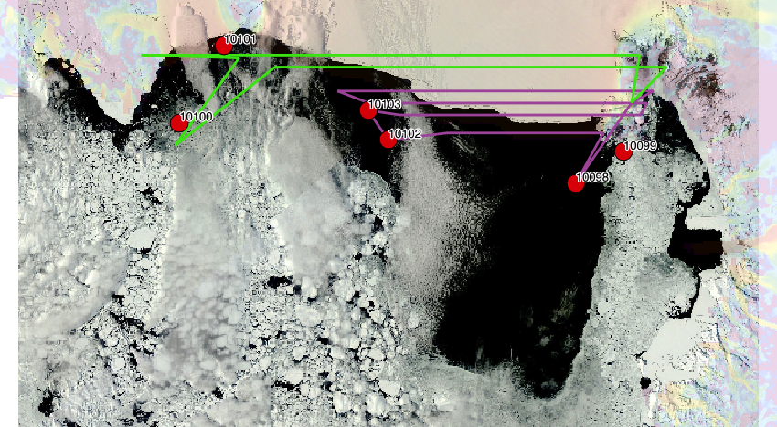
Select a float and once they drop you can follow them.
http://www.ldeo.columbia.edu/res/pi/rosetta/Alamo.html

