Slide 1
Earthquakes in Harriman Park
Bill Menke
Seismologist
Public Lecture
American Canoe Association
Hilltop Facility
4PM Saturday May 21 2011

Slide 2
Another Small Earthquake Rattles Central N.J. WCBS-TV | Feb 15, 2009
MORRISTOWN, N.J. (CBS) -- For the second time in two weeks, a small earthquake has rattled an area of central New Jersey.
The latest earthquake, with a magnitude of 2.2, was recorded shortly before 5:30 p.m.
…
"It sounded like an explosion and the house shook," resident Dan Servidio said.
The epicenter was five miles west-northwest of Morristown, along the Ramapo fault. It could be felt in Rockaway, Dover and Morris Plains as far as 30 miles away.
"We felt rumbling and thought something fell off a shelf," resident Lisa Cheek said.
"I was upstairs on my computer, and all of a sudden I hear a boom, boom, boom, then a bang, bang, bang. My monitor almost fell off of my computer desk," said resident Stephen Garcia. "So I immediately went downstairs to check on my grandma and ask her if she was alright or if she fell."

Slide 3
earthquake = shaking of the ground
due to slip on a fault
fault = crack in the ground
across which motion occurs

Slide 4
table
glass of water
pencils
floor

Slide 5
table
push the table
glass of water
pencils
floor

Slide 6
table
the legs slowly bend
glass of water
pencils
floor

Slide 7
table
the legs snap back straight
glass of water
pencils
floor
snap!
snap!

Slide 8
table
spilling of the water, a tsunami
shaking of the table, the earthquake
floor
snap!
snap!
leg sliding on the floor, the faulting

Slide 9
The World is Riddled With Faults
a fault never goes away unless the rock is heated almost to its melting point
the earth is very old and so has had lots of opportunity to accumulate faults

Slide 10
faults break up the rock
faulted rock is easily washed away
rivers often follow faults

Slide 11
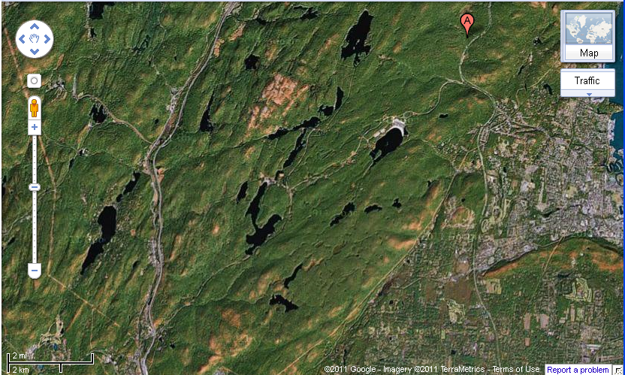

Slide 12
Lake Tiorati
Stony Point
Lake Welch
Tuxedo Park
Pomona
ACA
Sloatsburg

Slide 14
RAMAPO FAULT

Slide 15
DOWN
UP
DOWN BY 4 Miles
UP

Slide 16
what a fault looks like up close

Slide 17
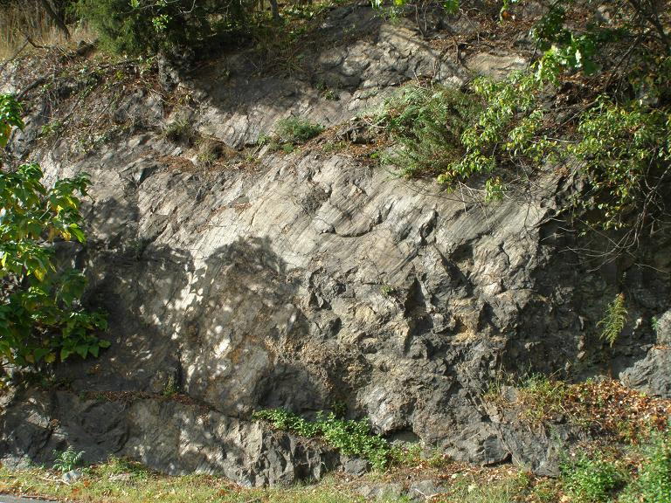
Pavilion Road, Suffern NY

Slide 18
slickenslides = fault scratches

Slide 19
Note that there are multiple layers of scratches, and that some extend into the rock – they are not just on the surface

Slide 20
Note that there are multiple layers of scratches, and that some extend into the rock – they are not just on the surface
one layer
another layer

Slide 21
sizes … length of a fault how much it slipped magnitude of the resulting earthquake

Slide 22
sizes … length of a fault how much it slipped magnitude of the resulting earthquake
faults come in all lengths

Slide 23
sizes … length of a fault how much it slipped magnitude of the resulting earthquake
usually only a portion of the fault slips
slip about 1/10000 of the portion‘s length

Slide 24
sizes … length of a fault how much it slipped magnitude of the resulting earthquake
magnitude depends on length and slip

Slide 25
tiny earthquake 1.3 mm of slip on a fault 100 meters long and 100 meters wide magnitude 2.2 moderate earthquake 1.3 meters of slip on a fault 10 km long and 10 km wide magnitude 6.3 huge earthquake 130 meters of slip on a fault 1000 km long and 200 km wide magnitude 9.8

Slide 26
tiny earthquake 1/20 inch of slip on a fault 300 feet long and 300 feet wide magnitude 2.2 moderate earthquake 4.3 feet of slip on a fault 6 mi long and 6 mi wide magnitude 6.3 huge earthquake 500 feet of slip on a fault 600 mi long and 120 mi wide magnitude 9.8

Slide 27
suppose the whole Ramapo Fault slipped
40 meters of slip on a fault 300 km long and 20 kilometers wide magnitude 8.4
128 feet of slip on a fault 185 miles long and 12 miles wide magnitude 8.4
very unlikely scenario now
undoubtedly happened very few centuries when that fault was active 220 million years ago
in the
Age of the Dinosaurs

Slide 28
still, you can see why the Ramapo Fault is a concern …

Slide 29
why do faults slip?
the surface of the earth is being squeezed and stretched by slow motions of the interior driven by the slow cooling of the earth

Slide 30
crust
220 million years ago
(age of the dinosaurs)
period of stretching that ultimately led to the formation of the Atlantic Ocean
stretching
stretching

Slide 31
Hudson Highlands
Ramapo fault
30 km or 20 miles
crust

Slide 32
180 million years ago
(still the age of the dinosaurs)
period of stretching ended
Newark Basin
sand and mud
crust

Slide 33
for the last 180 million years no major stretching or squeezing but still some minor deformation due to things happening far away and/or below us

Slide 34
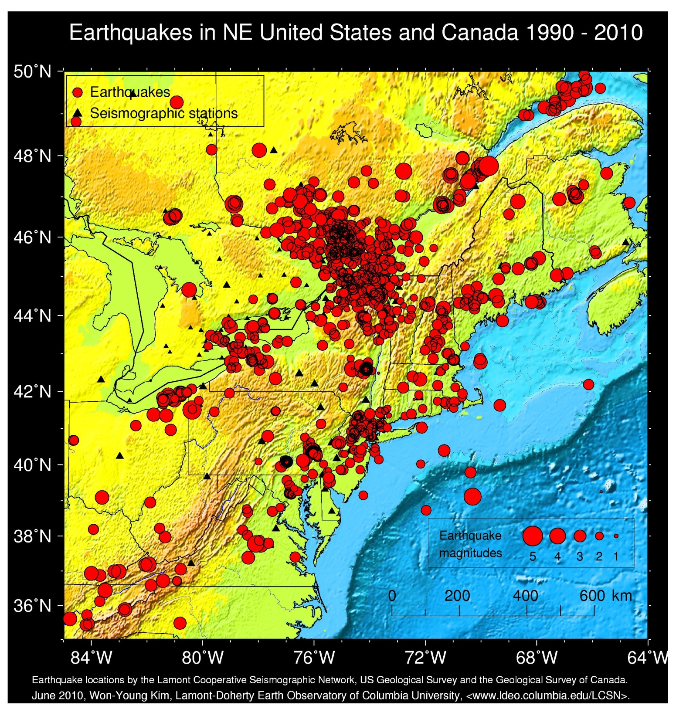

Slide 36
rate of earthquakes
magnitude | 40 years | 400 years | 4000 years
2.0-2.9 | 93 | 1,000 | 10,000
3.0-3.9 | 10 | 100 | 1,000
4.0-4.9 | 1 | 10 | 100
5.0 to 5.9 |  | 1 | 10
6.0 to 6.9 |  |  | 1
observed
predicted

Slide 37
rate of earthquakes
magnitude | 40 years | 400 years | 4000 years
2.0-2.9 | 93 | 1,000 | 10,000
3.0-3.9 | 10 | 100 | 1,000
4.0-4.9 | 1 | 10 | 100
5.0 to 5.9 |  | 1 | 10
6.0 to 6.9 |  |  | 1
this is the one that will cause real damage
observed
predicted

Slide 39
Indian Point

Slide 40
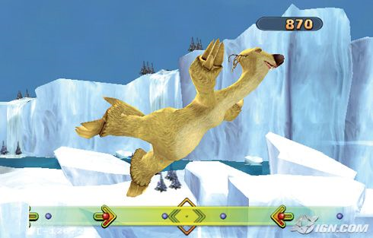
end of the ice age – 20,000 years ago

Slide 41
smooth surfaces should be easy to detect fault offset

Slide 42
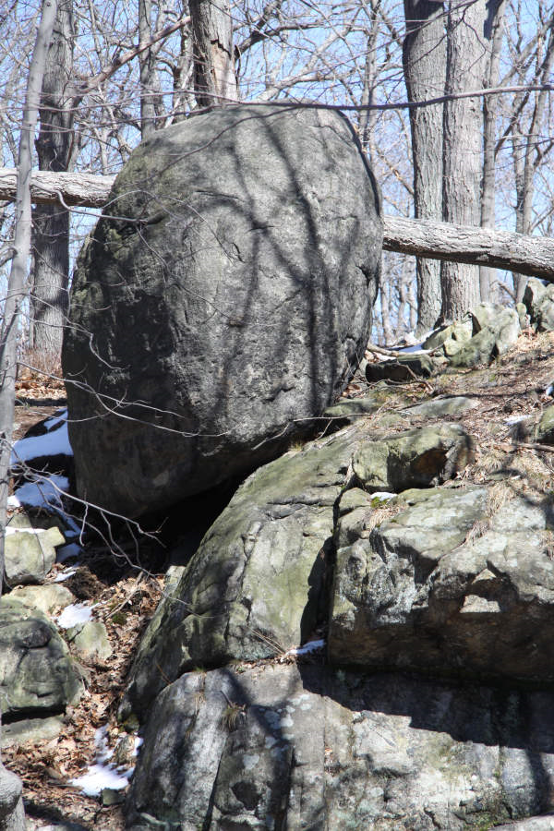
precariously perched glacial boulders --- could be used to place a limit on the amount of shaking

Slide 43
no evidence (yet) for really big earthquake in the last 20,000 years anywhere in the Harriman Park Area but we haven’t looked very hard so far

