Slide 1
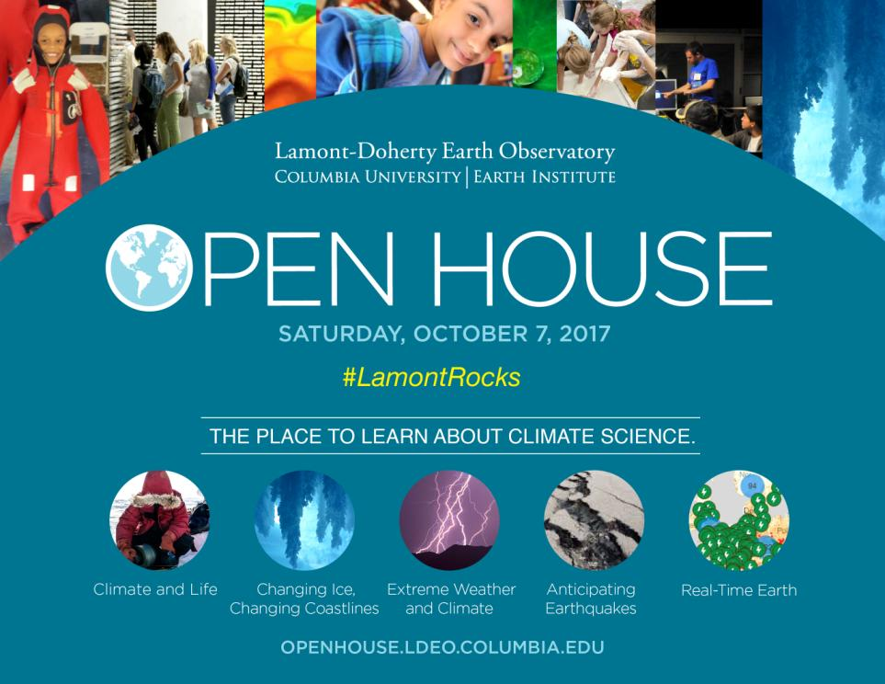

Slide 2





Barakat Abdul:
Leadership School
of East Harlem
Kyra Herzberger: Pascack Hills High School
Summer Internships for High School and College Students
using the example of a project on the Peekskill Meteorite
by Dr. Dallas Abbott, Intern Program PI, Columbia University
Dionne Hutson:
City College of New York
Alyssa Marrero:
Kingsborough Community College

Slide 3
Why a Summer Internship?
Internships are the first thing potential employers look at after you graduate.
It’s a way to build employable skills.
It’s more interesting than working at McDonalds.
Paid college internships can pay a stipend of 5K for 10 weeks with free housing and travel.
It’s a way to find the best career for you.

Slide 4
What organizations offer paid internships in
science and engineering?
LDEO- We have both high school and college programs
NASA
National Science Foundation
NOAA
DOE (Dept. of Energy)
NIH (National Institute of Health)
Your College or University (ask your professors about a summer job in research)

Slide 5
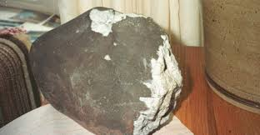
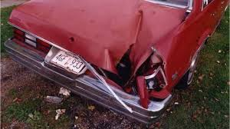
A Typical Summer Research Project at LDEO: Can We Find Fragments of the Peekskill Meteorite in the Hudson River?

Slide 6
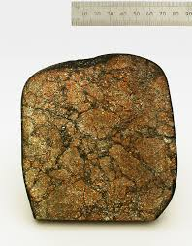
Why Did We Want to Research the Peekskill Meteorite 25 Years Later?
1) If we found pieces of the meteorite, we would know the age of the layer in the Hudson- Oct 9, 1992. Geologists need dates and Hudson sediments are difficult to date.
Peekskill meteorite with polished surface displayed at the Museum of Natural History in New York City

Slide 7
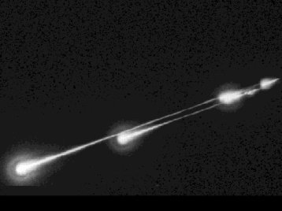
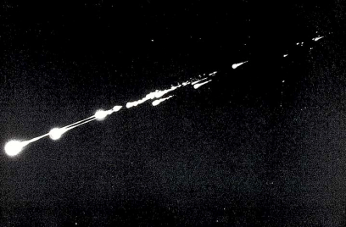
Why Did We Want to Research the Peekskill Meteorite 25 Years Later?
2) The Peekskill parent body broke into over 37 pieces some perhaps nearly as large as the meteorite OR the parent body produced 1000 1 gram size pieces.
javascript:;
javascript:;

Slide 8
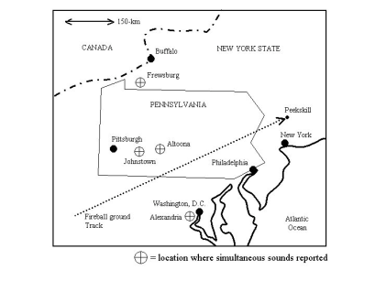
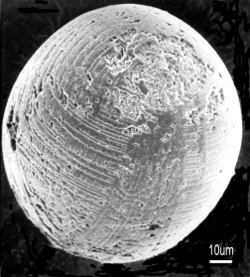
Why Did We Want to Research the Peekskill Meteorite 25 Years Later?
3) The Peekskill meteorite crossed over the Hudson River and we might be able to find its fine dust.
I type cosmic spherule-smaller
than dot here .

Slide 9
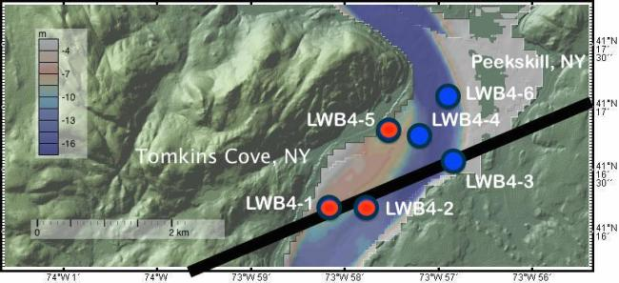
Why Did We Think We Might Find Something
25 Years Later?
1) Before the summer started, we found cores with unusual magnetic properties.
Red dots: Cores measured 2- 3 times because
highly magnetic

Slide 10
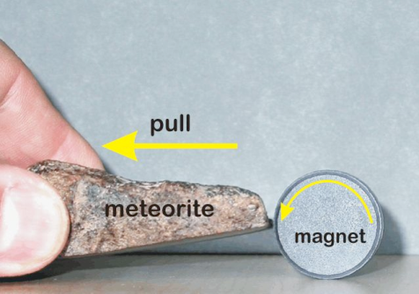
Why Did We Think We Might Find Something
25 Years Later?
Meteorites are VERY magnetic.
Even a cheap magnet will be strongly attracted to most meteorites

Slide 11
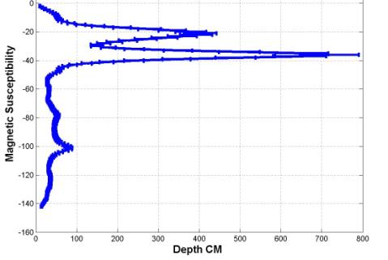
Why Did We Think We Might Find Something
25 Years Later?
2) An unusual magnetic layer started at about the right depth in core LWB4-5 to be from the year 1992.
Counted annual layers from cycles in Mn: Mn higher in spring,
lower in late summer

Slide 12
What Were the Surprises and Discoveries?
1) The unusual magnetic layer was about 30 cm thick and had two peaks, one at depth-unexpected
Why two peaks, perhaps some denser material sank?
Yes, Hudson river mud is low density compared to meteorites!

Slide 13
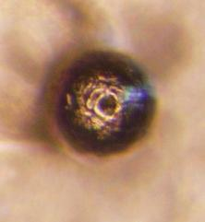
What Were the Surprises and Discoveries?
2) The unusual magnetic layer contained tiny magnetic spherules resembling cosmic spherules
Small magnetic spherules, as expected for meteorite dust

Slide 14
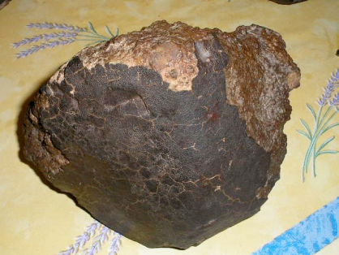
Explanation:
Tiny magnetic spherules come
from melting of the outer rind of a meteorite
Meteorite from Africa with dark fusion crust-composed of melted meteorite-usually made of iron oxide. Iron oxide is also magnetic.

Slide 15
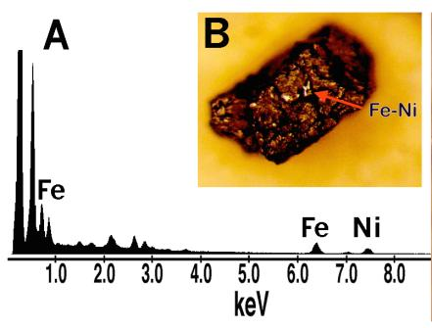
What Were the Surprises and Discoveries?
3) The unusual magnetic layer contained large magnetic particles-one with enough Ni to be meteoritic

Slide 16
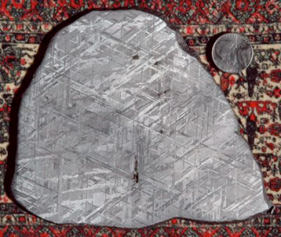
Explanation:
High Ni (without high Cr) is a marker for extraterrestrial material like meteorites
About 95% of all meteorites contain iron-nickel (FeNi)
metal. "Iron-nickel" means that the metal is mostly
iron but it contains 4-30% nickel as well as a few
tenths of a percent cobalt. Iron-nickel metal in
meteorites also has high concentrations (by terrestrial
standards) of rare metals like gold, platinum, and
iridium. It's usually easiest and cheapest to test for
nickel, however, because it's more abundant than
the rare metals.

Slide 17
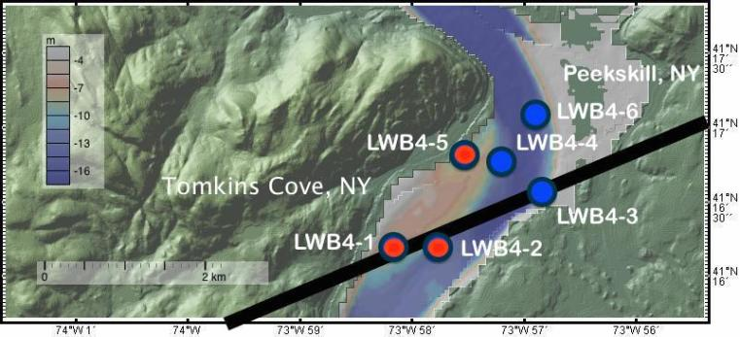
What Next?
Oral History and Interviews- Is anyone
here from Tomkins Cove, NY?

Slide 18
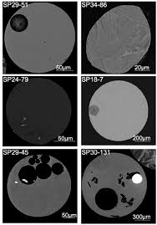
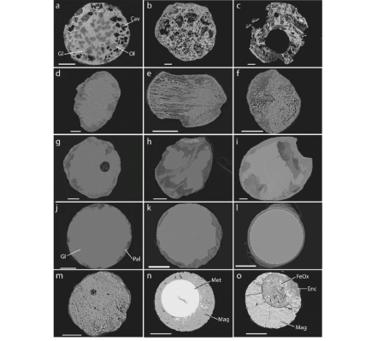
Why Didn’t We Find More Ni-rich grains?
melting of Ni bearing meteoritic material forms Fe oxide crust- Ni is inside spherules
Fe-Ni interior
Cosmic Spherule

Slide 19
What Next?
2) Examine more cores-all data from one
Core- LWB4-5. Two more are unusual.

Slide 20
What Next?
3) Measure Ir in sediments from magnetic
layer-Ir marker for meteorites

Slide 21
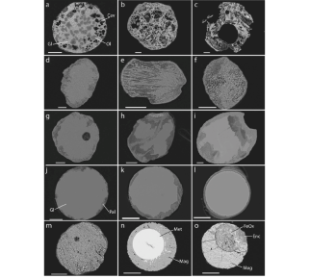
What Next?
4) Make thin sections of our samples and
analyze interiors with quantitative methods
Olivine
Fe-Ni grain

Slide 22
Peekskill Meteorite is just
One summer internship project.
Many other disciplines at LDEO have
Intern projects:
Paleoclimate, Earthquake Studies,
Volcano Studies, Oceanography, Marine Biology, Studies of Piermont Marsh (high school program)

Slide 23
How to Apply for Internships
You will need:
Two letters of recommendation from
faculty at your school.
Transcript of your grades.
Statement of interest.
Fill out the online application form.

Slide 24
Suggestions for Good Letters of Recommendation
Tell faculty what types of internships
you are applying for.
2) Remind faculty about your history: what classes
you took with them and when.
3) Let faculty know about your extracurricular
activities, including the number of hours you work
each week.
4) If necessary, explain why parts of your
transcript are less stellar (illness, family problems?)

Slide 25
Strategies for a Great Application
Contract references and transcript office
at least two weeks before the deadline.
2) If the application form doesn’t tell you
(ours does),check that all materials were received.
3) Take time with your statement of interest,
it should be at least 2 paragraphs long and it
should be well-written.
4) If you can, read and comment on papers
by scientists you wish to work with- this is rare.

Slide 26
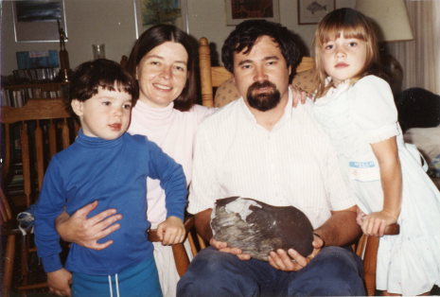
Do you have questions about internships or the Peekskill meteorite? If you are interested in Internships be sure to take the one page handout
with more information (see links on followng page)
Abbott-Menke family
Christmas picture 1992
with Peekskill meteorite

Slide 27
Links to more resources on internships
https://scied.ucar.edu/soars/reu/running-an-reu/what-is-an-reu
http://www.ldeo.columbia.edu/education/programs/summer-internship/lamont-summer-intern-program
http://www.ldeo.columbia.edu/SSFRP/
http://pathwaystoscience.org/pdf/Applying_LettersOfRecommendation.pdf

