Slide 1
Informative yet succinct title
Your name & affiliation
Your mentor’s name and affiliation (no advisor)
Large enough font with appropriate visual emphasis
High contrast between text and background
Little text (you have 30 seconds to tell the story)
Pretty pictures (a good lure!)

Slide 2
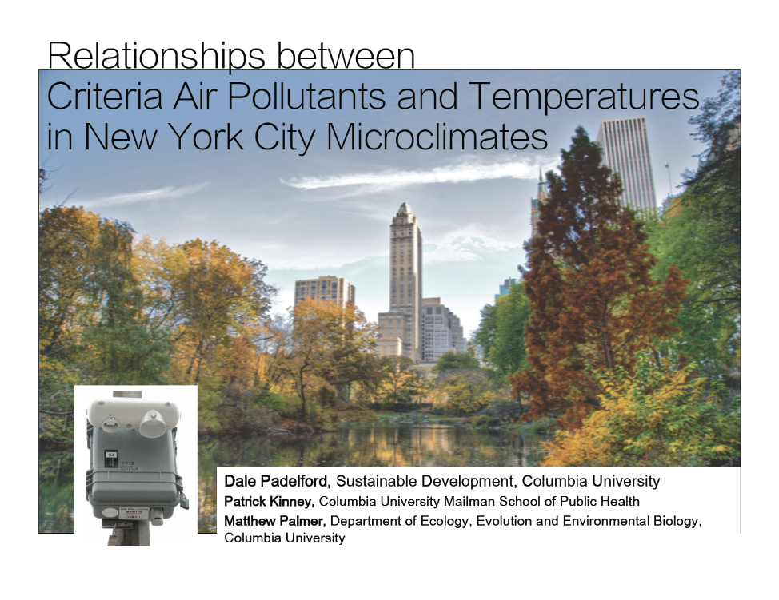

Slide 3
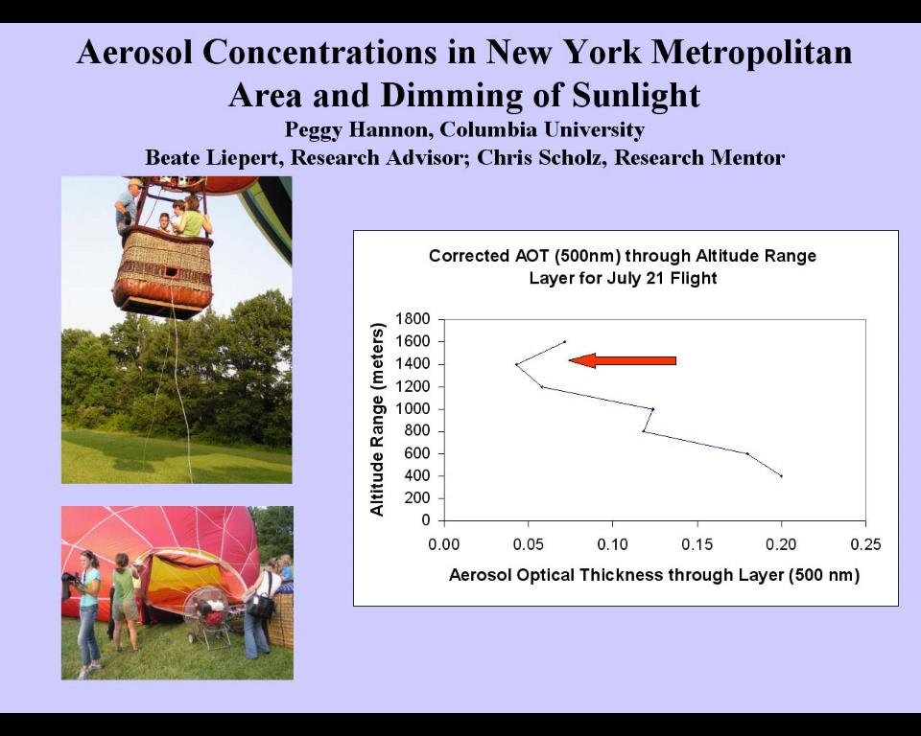
Hannon

Slide 4
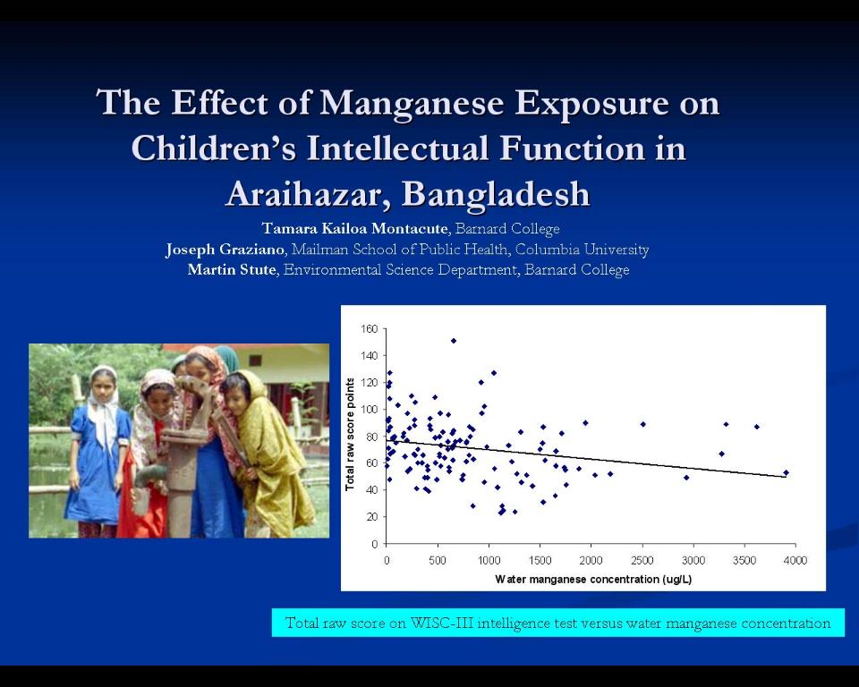
Montacute

Slide 6
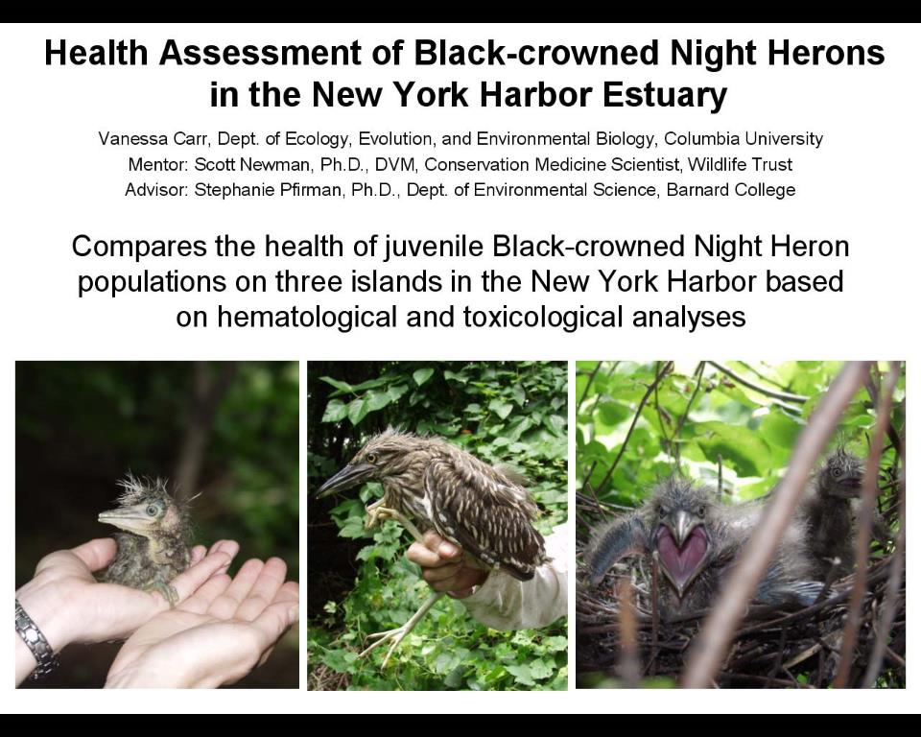
Carr

Slide 7
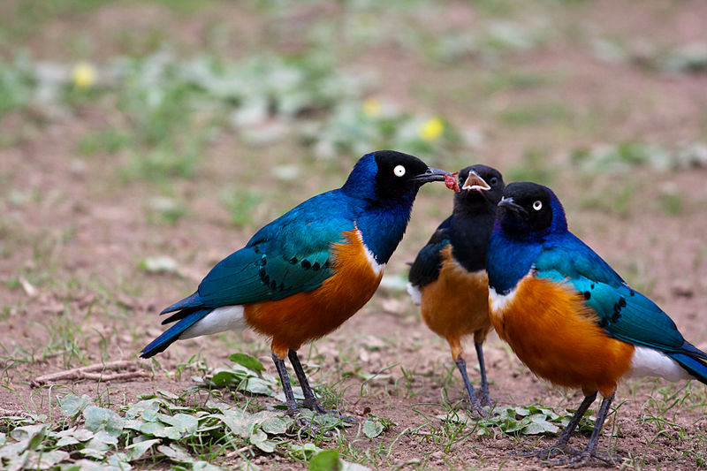
A comparison of SNP and microsatellite markers for parentage in a cooperatively breeding bird
Lucia Weinman, Department of Ecology, Evolution and Environmental Biology
Dustin Rubenstein, Department of Ecology, Evolution and Environmental Biology

Slide 9
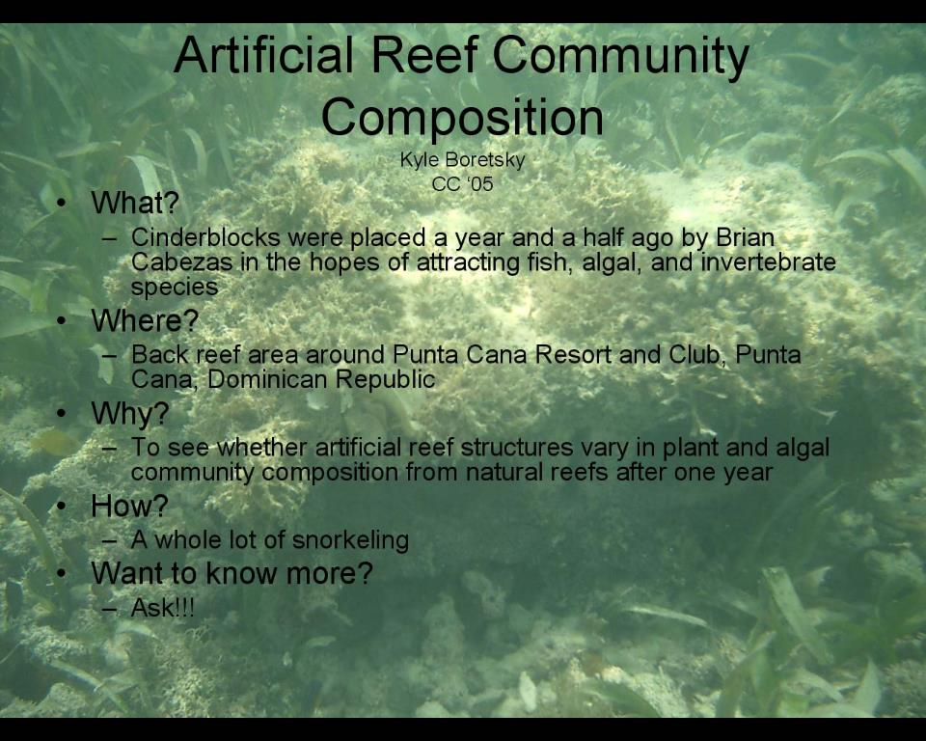
boretsky

Slide 10
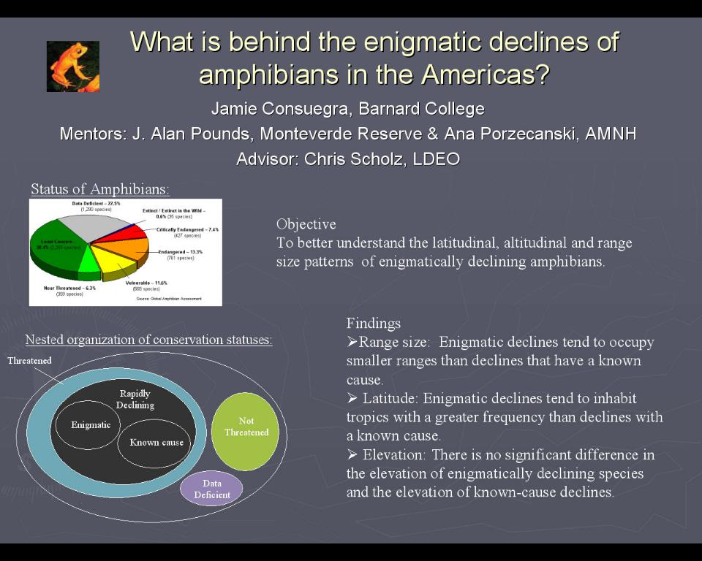
Conuegra

Slide 11
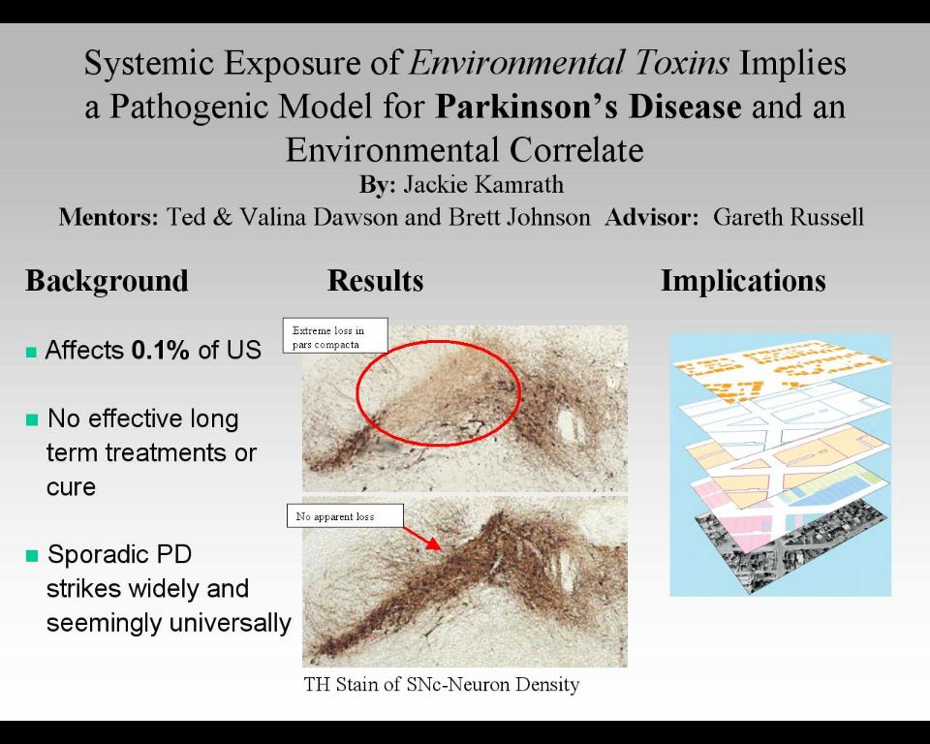
Kamrath

Slide 12
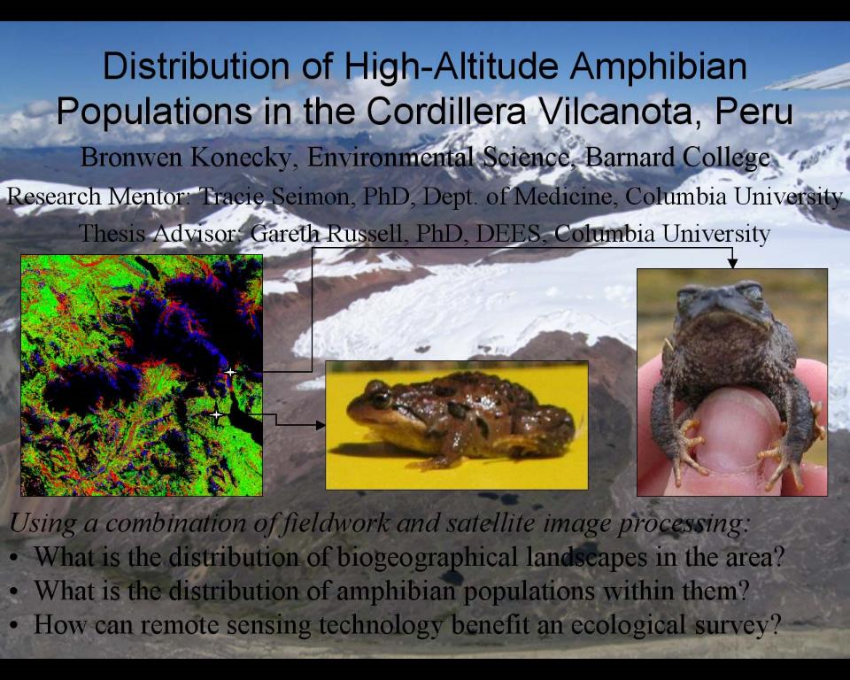
Konecky

Slide 13
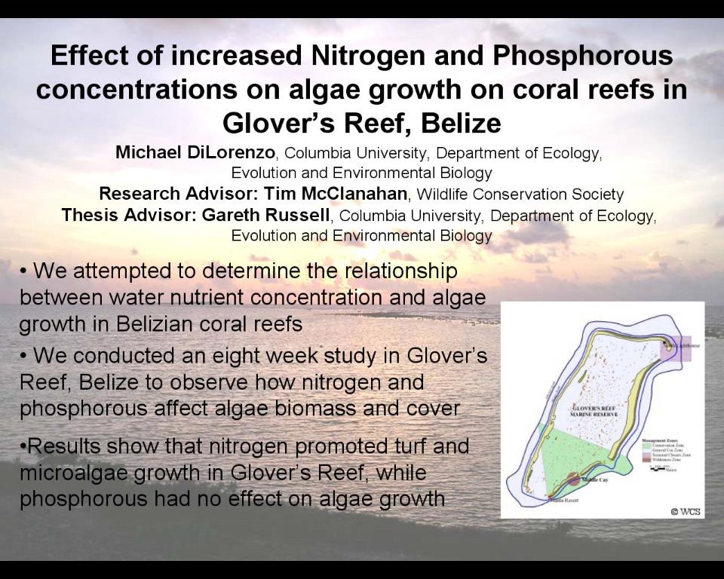
Di Lorenzo

Slide 14
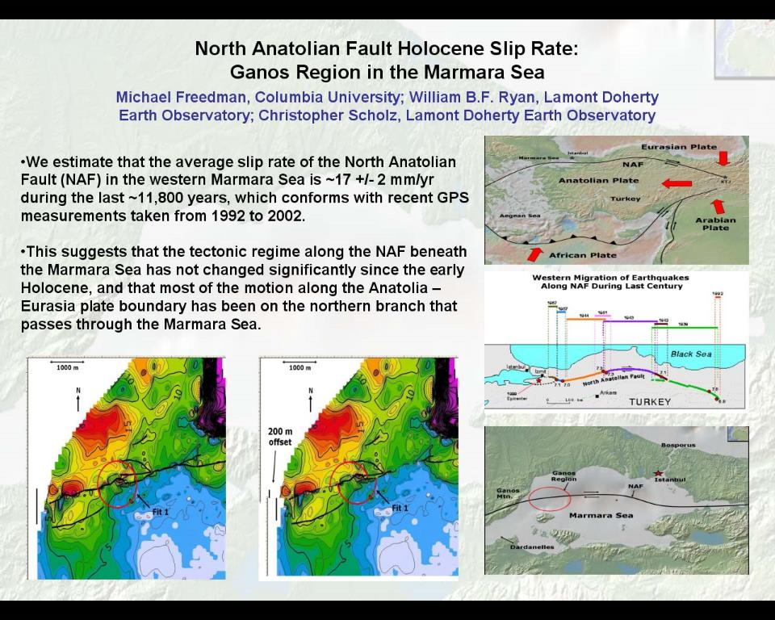
Freedman

Slide 15
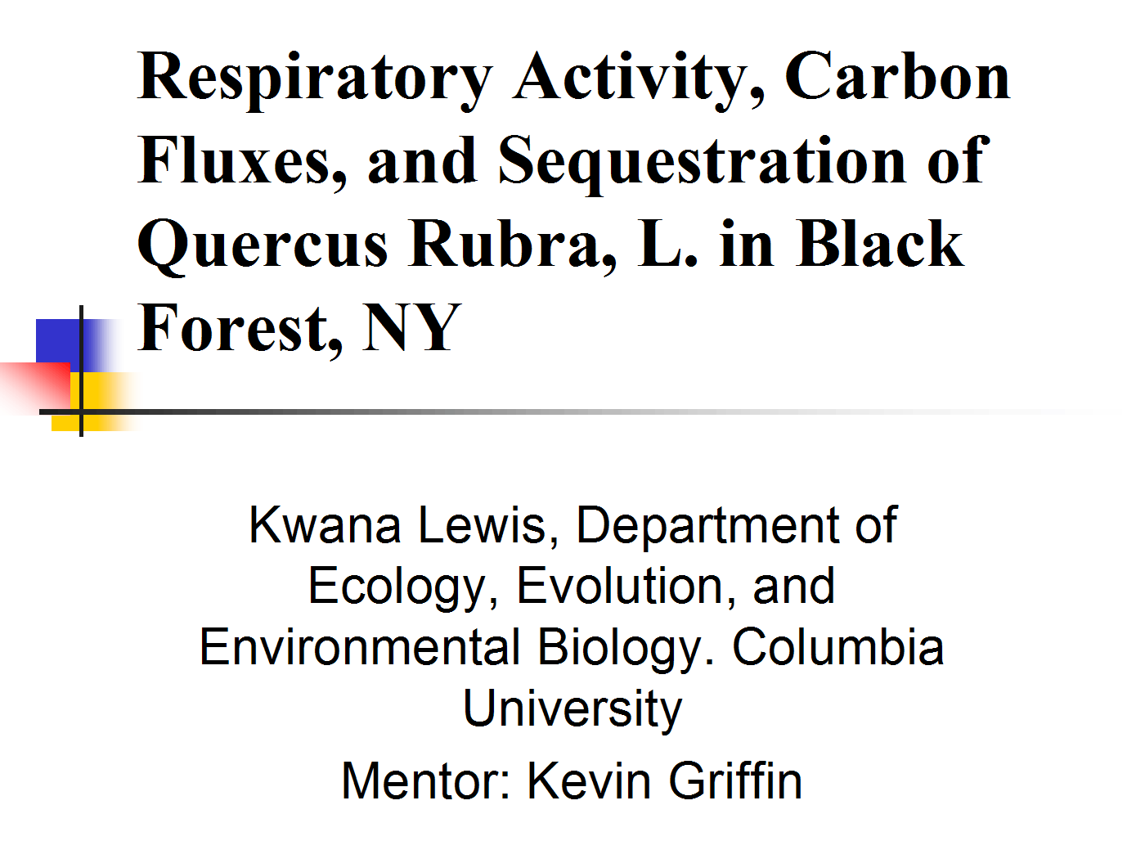
Lewis

Slide 16
Designing a Sustainable Water System for Manhattanville
Dawn Henning, EAEE Advisor: Prof. Upmanu Lall
Goal: To design a complete water system that uses only naturally occurring water at the site, and takes advantage of economies of scale offered by a site vs a single building
System
Collection
Storage
Treatment
Distribution
Rooftop
Stormwater
Filtration
Disinfection
Gravity
Pumps
Chlorine
UV

Slide 17
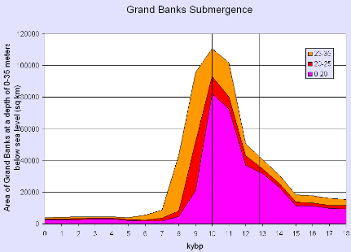
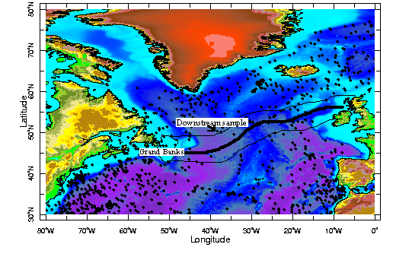

The role of the Grand Banks in the Younger Dryas:
Neodymium as a tracer for Sediment-Laden Sea-ice along the Arctic Front
Dan Knappmiller, DEES
Mentors: Stephanie Pfirman, BC
Sidney Hemming, SUNY Stony Brook
Advisor: Martin Stute, BC
Due to its location at the southwest corner of the Arctic Front during the Younger Dryas cooling event (12.7-10.0 kiloyears before present), the Grand Banks may have contributed to the southerly extension of North Atlantic sea-ice and the Arctic Front during the Younger Dryas.
Figure 10: Grand Banks submergence during Younger Dryas. Maximum sediment entrainment would have occurred during the YD due to large area with depth of 0-35 meters below sea level (marked by vertical lines on figure).
We were interested in tracing (with neodymium) Grand Banks sediment entrained in sea-ice during the Younger Dryas across the North Atlantic along the Arctic Front.
Could be used in future to define southern extent of Arctic Front during Younger Dryas and show influence of Grand Banks.
Figure 7: North Atlantic Ocean with approximated Arctic front and the location of our downstream core (LDEO Deep-Sea Sample Repository). The Arctic Front has been estimated based upon previous studies (e.g. Ruddiman and McIntyre, 1981; Rosell-Mele et al., 1998; Renssen and Vandenberghe 2003; de Vernal et al., 2000a; Broecker et al., 1988).

Slide 18
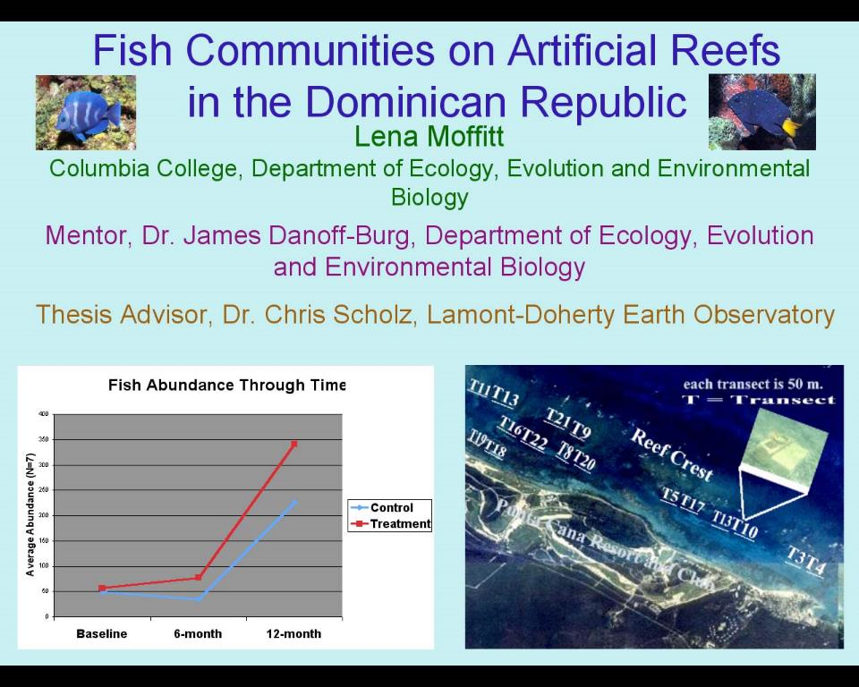
Moffitt

Slide 19
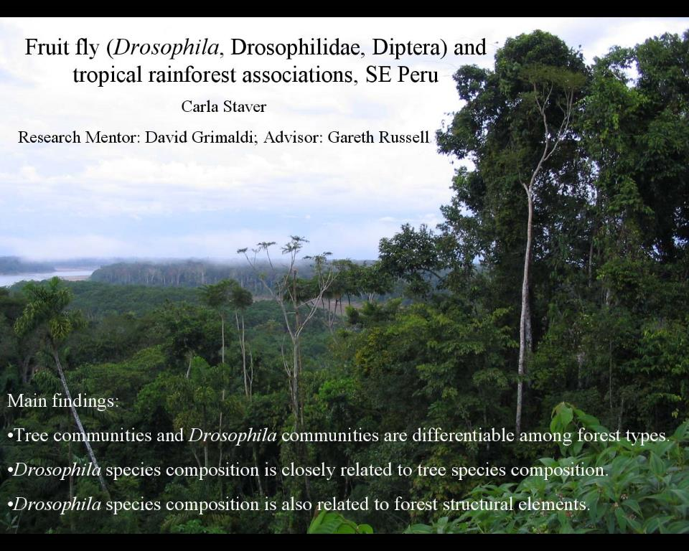
Staver

Slide 20
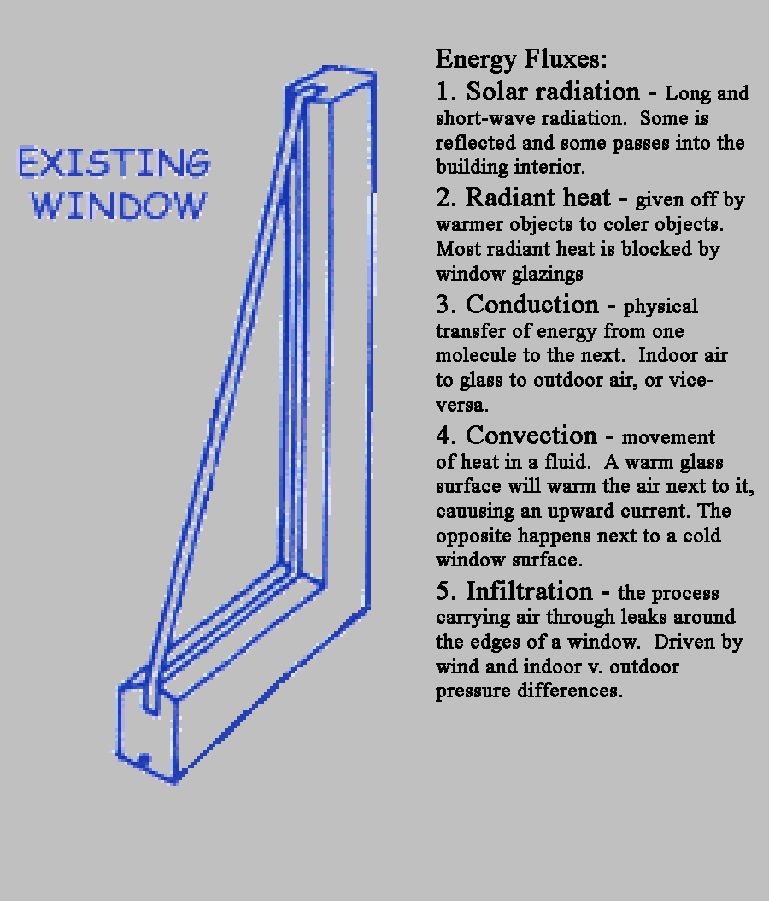
Building Renovations for Improved Energy Conservation
Greg O’Keeffe, Earth & Environmental Engineering
Most energy loss in buildings occurs through windows
A number of upgrade options exist
  Double glazing glass
  Thermal shutters
  Thermal shades
What combination of these alternatives is best?

Slide 21
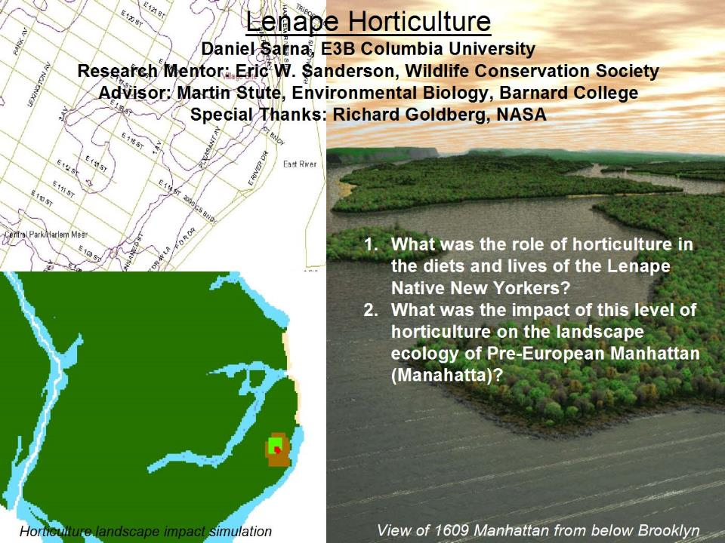
Sarna

Slide 22
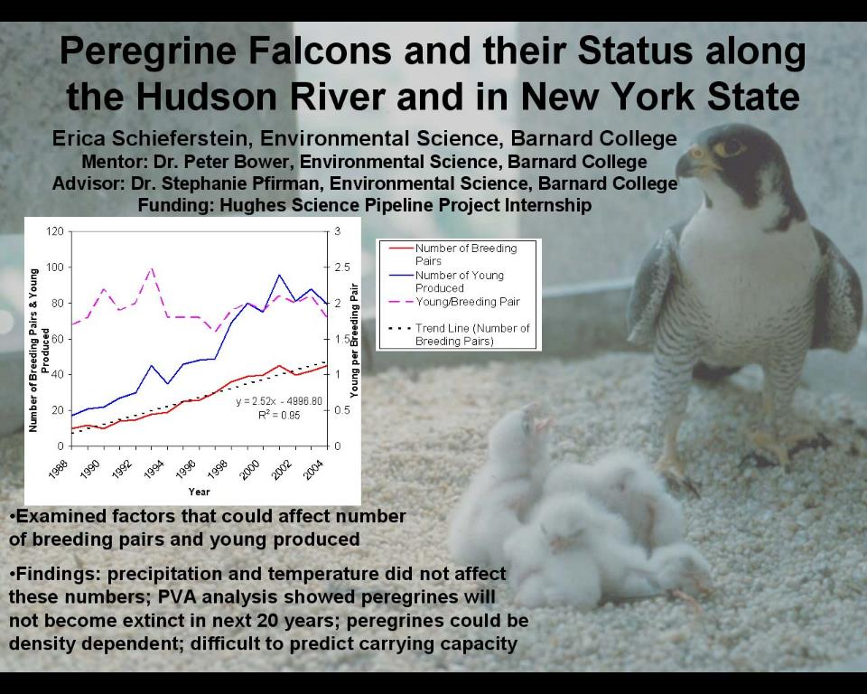
Schieferstein

Slide 23
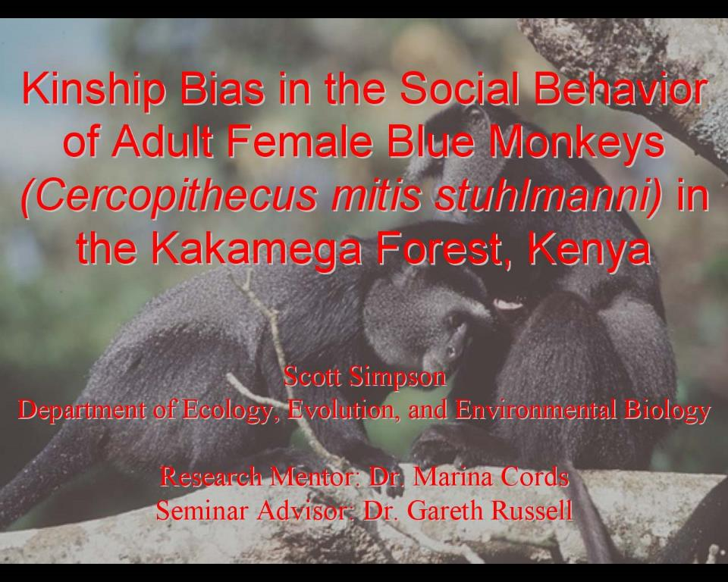
Simpson

Slide 24
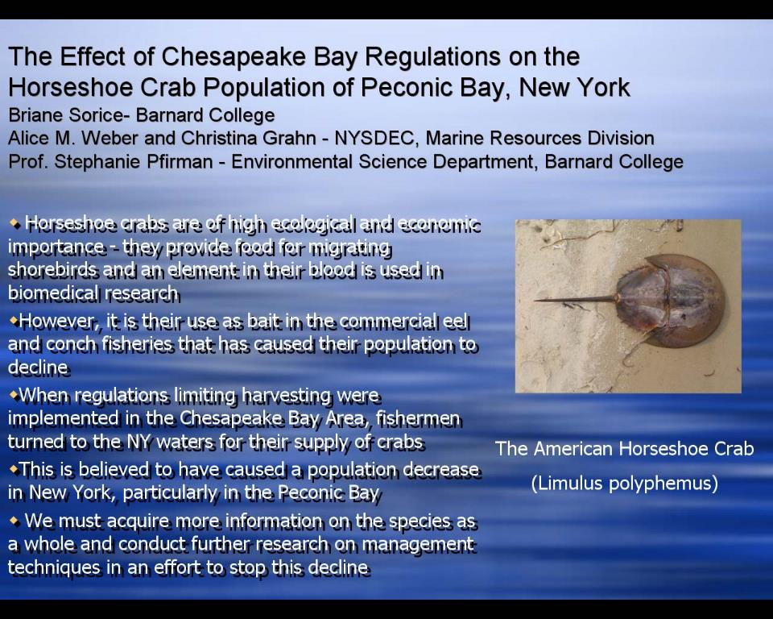
Sorice

Slide 25
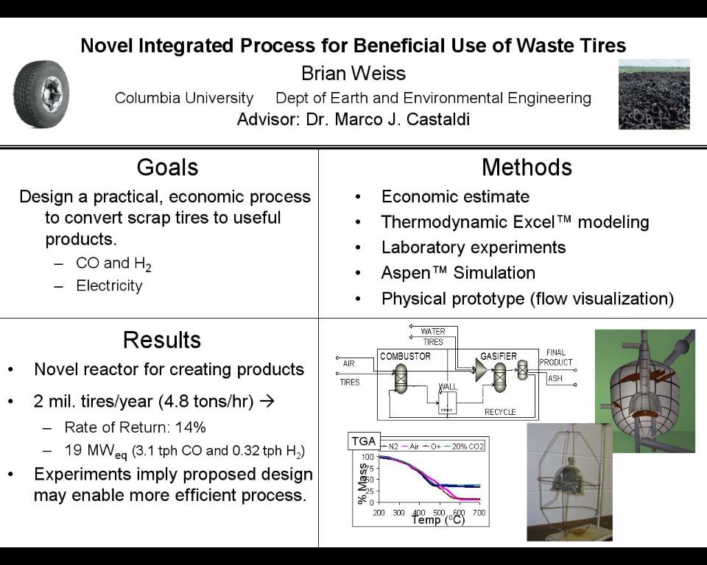
Weiss

Slide 26
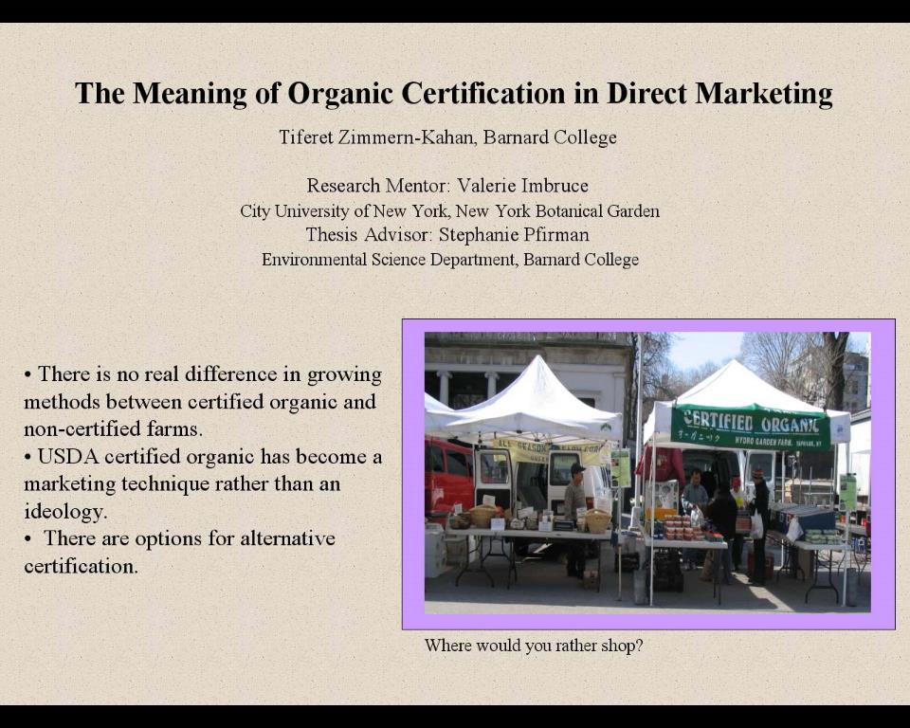
Zimmern-Kahan

Slide 27
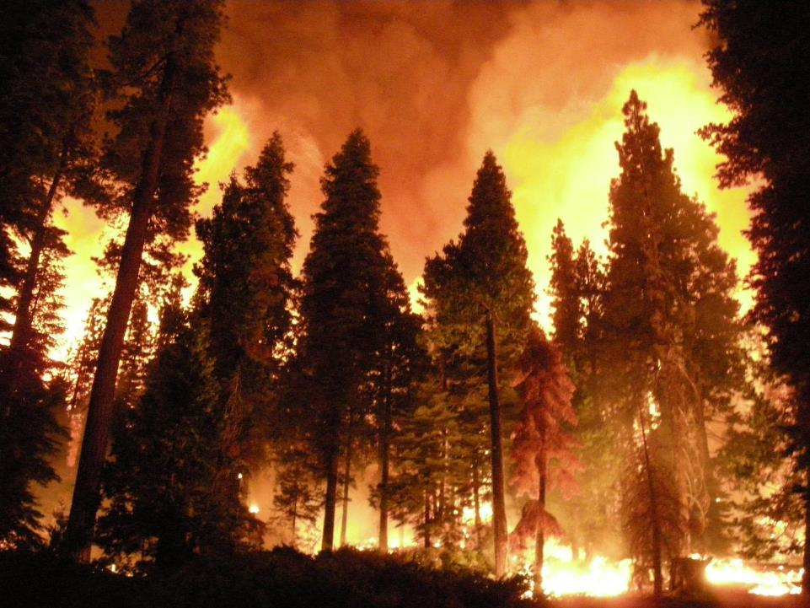
The Effect of Wildfires in Determining Species Persistence in Mixed-Conifer Forests of the Pacific Northwest
Maia Claman, Department of Ecology, Evolution, and Environmental Biology, Columbia University
Jeremy Fried, United States Forest Service Inventory and Analysis Department
Image URL: http://www.fs.usda.gov/wps/portal/
Notes:
I’m Maia Claman. As forest fires increase in extent and severity in response to global climate change, it is useful to numerically assess how this change affects species persistence in the timber-rich Pacific Northwest, since some trees are better adapted to surviving fires than others. Using a US Forest Service fire-effects survey, I built and analyzed a database of 6000 individuals of 7 common tree species. I found statistically significant trait-based species effects that were in turn dependent on tree size and fire severity, which indicates potential species composition shifts in response to a changing future climate.

Slide 28
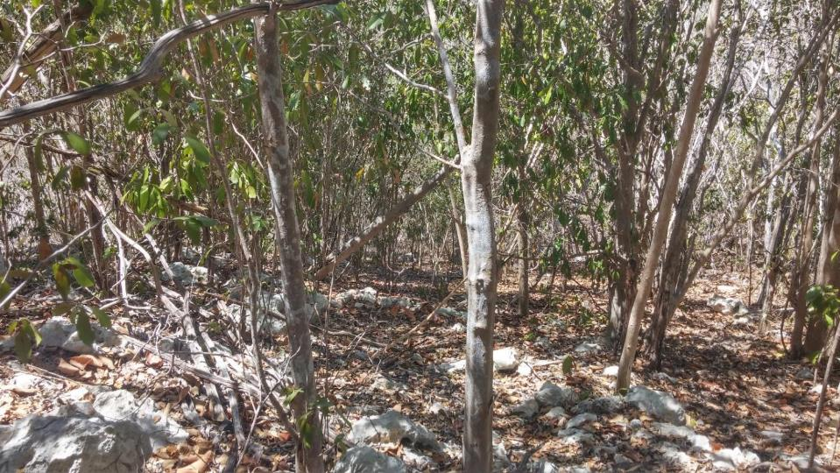
Leaf Litterfall Effects on Soil Nutrient
Heterogeneity in a Puerto Rican Dry Forest
Dev Harrington
Research mentor: María Uriarte
Department of Ecology, Evolution, and Environmental Biology, Columbia University

Slide 29
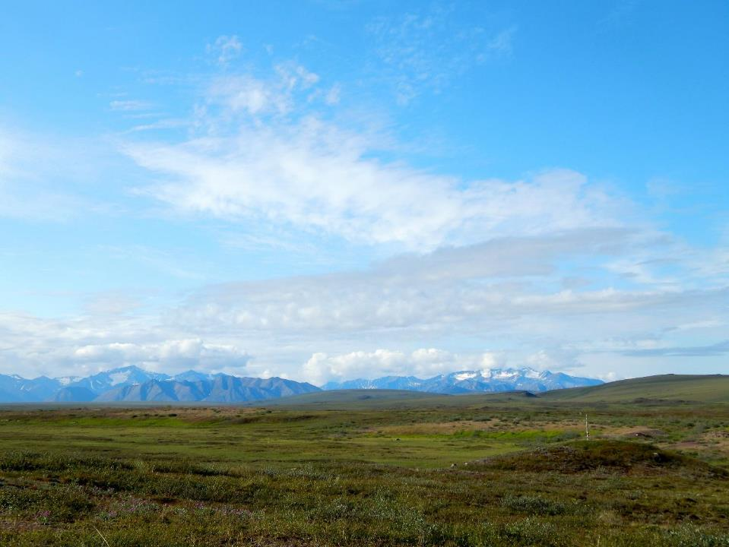
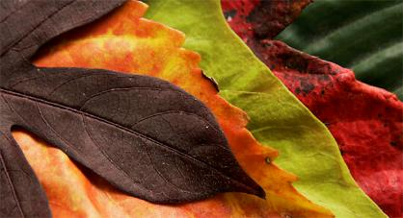
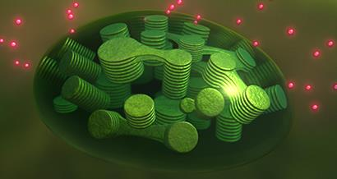
The potential for photosynthetic optimization in varying light environments in the Arctic tundra
Xanthophyll Pigments
Chlorophyll Fluorescence
http://www.dpchallenge.com/image.php?IMAGE_ID=468494
NASA Goddard's Conceptual Image Lab/T. Chase 2013
Christa Shen¹
Kevin Griffin¹
¹Department of Ecology, Evolution and Environmental Biology, Columbia University
Notes:
Hi everyone, my name is Christa Shen and my study looked at whether leaves throughout an Arctic shrub canopy experienced different physiological responses that would optimize photosynthesis given varying levels of light availability. We used two photo-protective metrics to gauge photosynthetic efficiency: xanthophyll pigment interconversion cycle and chlorophyll fluorescence. We found that there was not a significant amount of variation in these metircs within the shrub canopies, which suggests that current models which assume a homogenous light environment throughout the canopy are sufficient for predicting ecosystem fluxes.

Slide 30
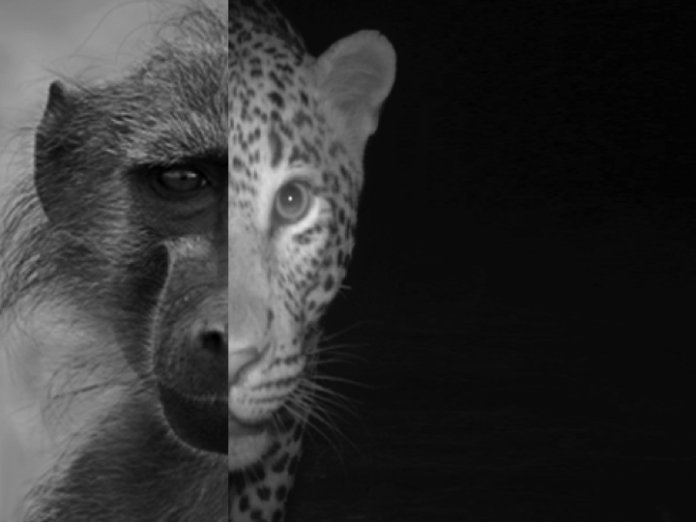
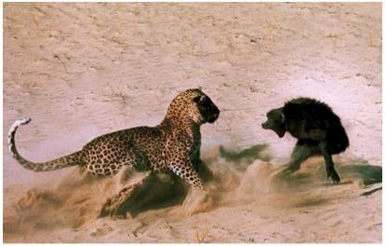
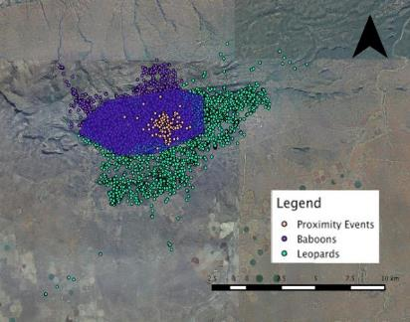
Chacma Baboon
Response to
Leopard Predation
Threat
Leigh West
Columbia University
Sam Williams
Durham University
Katy Williams, Primate and Predator Project
Notes:
Good afternoon, my name is Leigh West and for my thesis I investigated the extent to which leopard movement patterns influenced chacma baboon behavior within South Africa’s Soutpansberg Mountains. By examining interactions between these two species using GPS and behavioral data, I gained an understanding of a cryptic predator’s hunting strategies and its prey’s defenses. I found that leopard-baboon encounters preferentially occurred in rocky and bush habitats. Baboons exhibited higher levels of anti-predator strategies in rocky habitats as well as areas of high measured leopard activity, but not in bush habitats. Thus, considering baboon reactions to leopard presence, real or perceived, reveals that baboons’ perception of predation risk aligned moderately well with ‘actual’ threat posed by leopards at the study site.

Slide 31
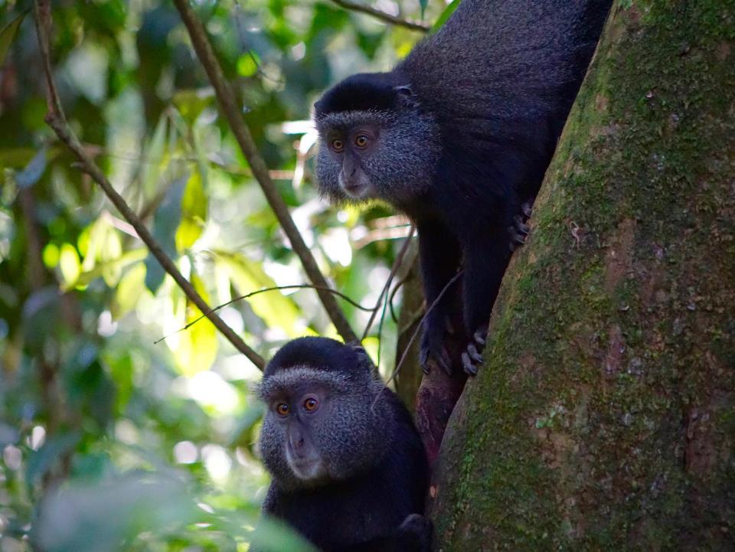
Recognition of Paternal Kin Selection in Blue Monkeys (Cercopithecus mitis)
Taylor Minich¹
Marina Cords¹
¹Department of Ecology, Evolution, and Environmental Biology, Columbia University
Cooperative behaviors:
Direct contact
Feeding in proximity
Resting in proximity
Notes:
Hi, I’m Taylor Minich and I studied paternal kin recognition in blue monkeys. Cooperation between kin is theoretically selected for if it indirectly benefits the fitness of the kin partners. Blue monkeys have been shown to bias their behavior towards maternal kin. I calculated the proportion of time an adult female subject spent with a partner, either paternally related or unrelated, to the total time the subject and partner were together for three cooperative behaviors, and found no significant difference between paternal kin and unrelated individuals. Blue monkeys do not bias their behavior towards paternal kin

Slide 32
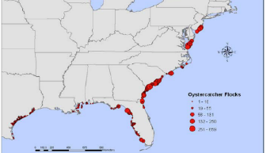
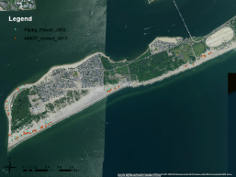
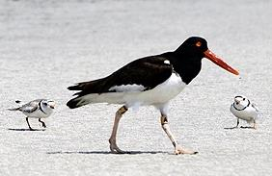
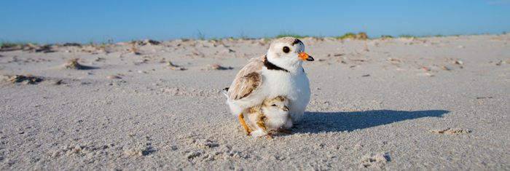
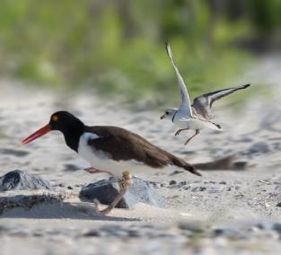
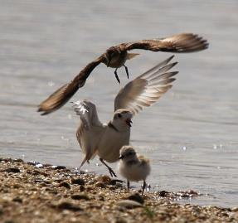
piping plover
http://www.dec.ny.gov/animals/7086.html
Breezy Point, Queens, NY
American oystercatcher
The Effects of Nest Density and Behavioral Interactions
on the Nesting Success of the
Piping Plovers and American Oystercatchers
Hein Sihn, Dept. of Ecology, Evolution, and Environmental Biology, Columbia University
Mentor: Susan B. Elbin, Ph.D., New York City Audubon Society
Photo by Michael Stubblefield.
http://scarboroughbeachesalert.com/tag/piping-plovers/

Slide 33
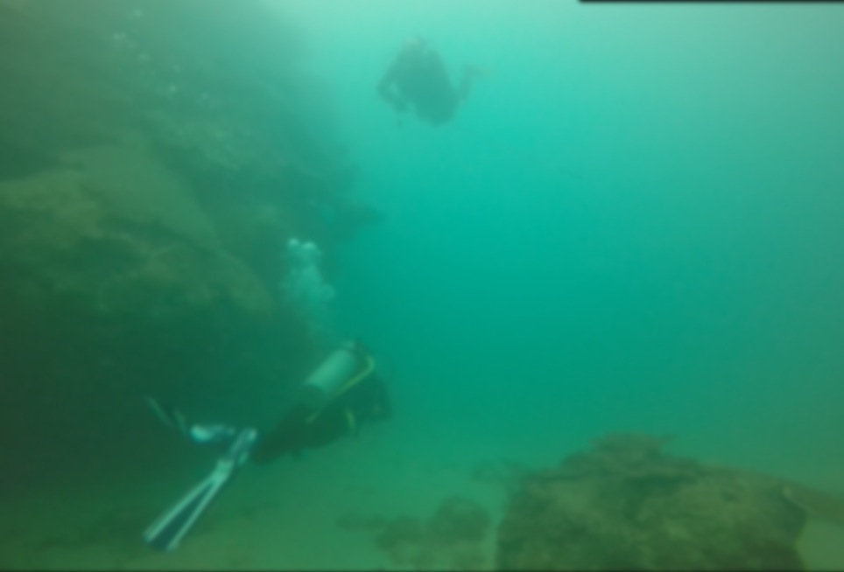
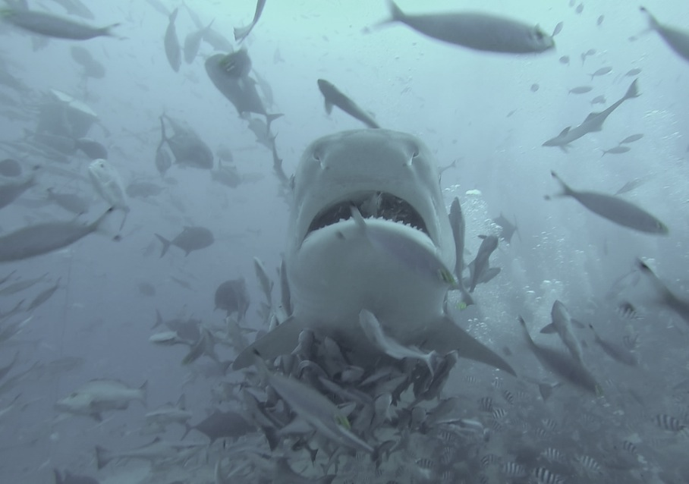
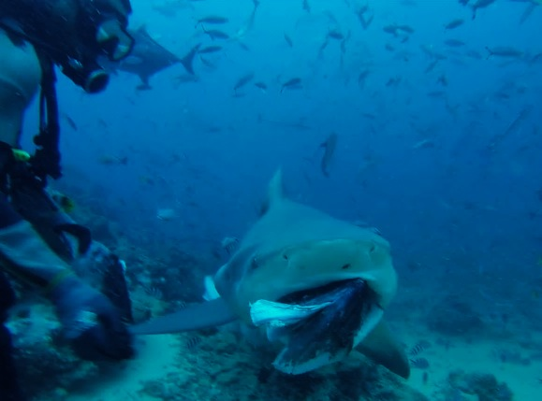
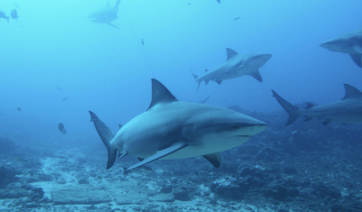
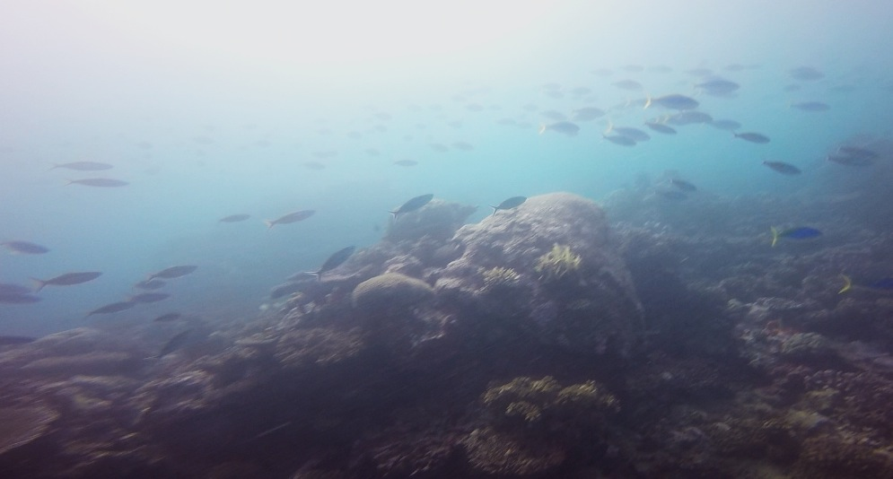
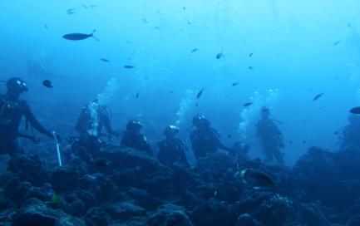
The Implications of Shark Ecotourism on Fish
Abundance and Diversity in Marine Protected Areas in Fiji
Mallory G McKeon¹, Joshua A Drew¹
1Department of Ecology, Evolution, and Environmental Biology, Columbia University

Slide 34
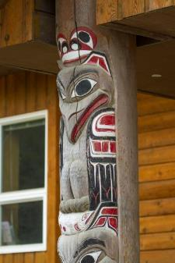
First Nation and Ecosystem-Based Foresters’ Relationships and Practices with Western Redcedar (Thuja plicata) in Coastal British Columbia
Marie Zahn, Department of Ecology, Evolution and Environmental Biology, Columbia University, NYC
Research mentor: Nancy J. Turner, School of Environmental Studies, University of Victoria, BC, Canada
http://www.dailydesigninspiration.com/photography/evan-leeson/western-red-cedar/
©Steven Akre/Outwest Photo

Slide 35














Estimating Tick Survivorship in Two Contrasting Environments
Daniella Kahn, Department of Ecology, Evolution and Environmental Biology
Connecticut
Block Island
Maria Diuk-Wasser
Columbia University, Dept. of Ecology, Evolution and Environmental Biology
Notes:
Hi! My name is Daniella Kahn and I measured the survivorship of fed tick larvae that successfully found hosts as nymphs the following summer. My research compares tick survival rates in two contrasting environments: the complex ecosystem of Connecticut, and the relatively simpler ecosystem of Block Island, Rhode Island. I found ticks to have survival rates of as much as three times greater and more on Block Island than Connecticut, correlating with greater humidity and mouse density on the island. Implications of this research can go into improving predictions of tick-host attachment rates and consequently transmission rates of tick-borne diseases.

Slide 36

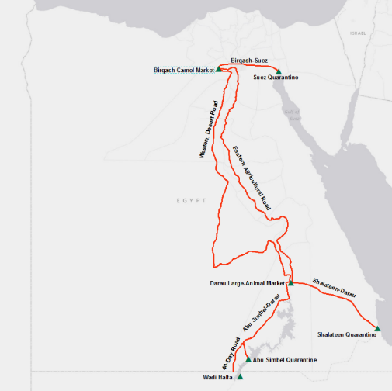
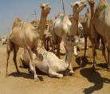
Assessing the role of camel trade in the ecological transmission
of the Middle East respiratory syndrome coronavirus (MERS-CoV)
Faisal Abdel-Qader, Department of Ecology, Evolution, and Environmental Biology
Research Mentor: Dr. Maureen Miller, EcoHealth Alliance

Slide 37
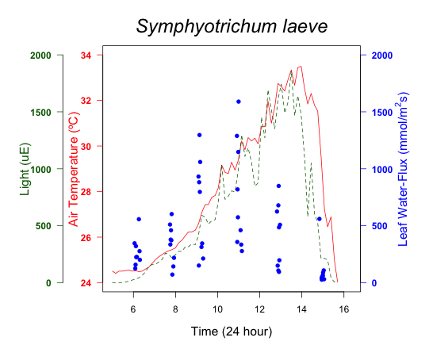
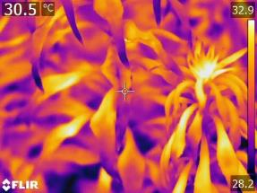
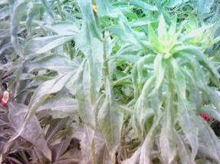
ECOSYSTEM SERVICES FROM NEW YORK GREEN ROOFS:
DIFFERENCES IN WATER-USE BETWEEN PLANT SPECIES
Rachel Tao
Research Mentor: Matthew Palmer
Ecology, Evolution, and Environmental Biology, Columbia University
Thermal Image: Oenothera biennis
RGB Image: Oenothera biennis

Slide 38



Areas and Seasons of High Lead Density and Toxicity in Neighborhoods Across New York City: the Feral Pigeon as a Bioindicator
Fayme Cai, Department of Ecology, Evolution, and Environmental Biology (EEEB), Columbia University
ejpphoto/Flickr
Notes:
Hi everyone, my name is Fayme Cai, and I worked with a wildlife rehab center, the Wild Bird Fund, to pinpoint where and when in New York City pigeons are suffering from lead poisoning. My results supported the use of the feral pigeon as a bioindicator, and I found that neighborhood and season interact together to produce an effect on lead level. I hope that my study can be used to advise policies to combat lead toxicity in wildlife and humans alike. Thank you!

Slide 39



Reconstruction of the North Atlantic end-member of the thermohaline circulation across the mid-Pleistocene Transition
Joohee Kim, Dept. of Earth and Environmental Sciences, Columbia University
Steven L. Goldstein, Dept. of Earth and Environmental Sciences, Lamont-Doherty Earth Observatory
Leopoldo D. Pena, Lamont-Doherty Earth Observatory, University of Barcelona

Slide 40


Faulting along the Blanco Fracture Zone: Evidence for Spatially Distributed Slow Slip?
Julia Snyder, Columbia University
Mentor: Göran Ekström, Lamont Doherty Earth Observatory
Notes:
I am Julia Snyder. Worldwide, earthquakes account for stress release along tectonic plate boundaries. However, not all plate motion driven stress is released in earthquakes. Slow slip, characterized by enrichment of surface wave, is one suggested mechanism. In a study of 422 earthquakes that occurred of 1980-2014, 258 were identified as slow slip events using a surface wave analysis known as Centroid Moment Tensor. When relocated using a surface wave correlation, the slow-slip earthquakes showed spatial distribution along the entire transform, and in both extensional and strike-slip earthquake faulting types.

