Slide 1
Methods of Library Research
September 20, 2012
Satyajit Bose

Slide 2
How to get Started?
If you have a mentor, ask for 2-3 recent papers that help to frame your topic.
  Keep notes on the references (especially the interpretation of the reference in the lit review where the reference was cited)
If you do not have a mentor, start your own library search and ask your advisor and everyone you meet on your quest for a mentor

Slide 3
What kinds of papers are ideal?
  1-2 papers which give you the broad context
  1-2 papers which are examples of detailed analysis closely related to your thesis question.
  Remember to read an example senior thesis with your advisor (a senior thesis ≠ a published paper)

Slide 4
Library Research
Columbia Libraries webpage
CLIO catalogue
Citation Indexes:
  ISI Web of Science/EconLit
  Google Scholar is convenient but NOT comprehensive
Statistics databases
Physical Visit to the Library:
  Talk to reference librarian in your subject
  Browse the bookshelves around a book you know to be useful

Slide 5
Organizing your References
Many options:
  EndNote
  RefWorks
  Zotero (Firefox plugin)
  BibTeX
  Index cards
Always carry a notebook to write down ideas as they occur

Slide 6
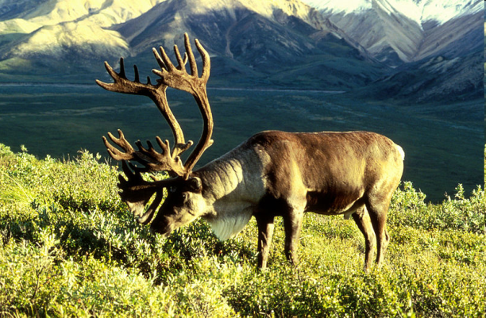
Naskapi Hunting Rule
A good rule to follow in the quest for knowledge (in the early stages)
  If you successfully hunted a caribou in one direction yesterday, then don’t go hunting for caribou in that direction today.

