Slide 1
2023 EESC W3400
Lec 07: Cooling of the solid Earth
Computational Earth Science
Bill Menke, Instructor
Emily Glazer, Teaching Assistant
TR 2:40 – 3:55

Slide 2
today:
Rays
an approximate but very effective method for
understanding wave motions
seismic waves in solid earth
acoustic waves in the atmosphere
gravity waves on the surface of the earth
electromagnetic waves in transparent media
distortion of the images of galaxies due the curvature of space

Slide 3
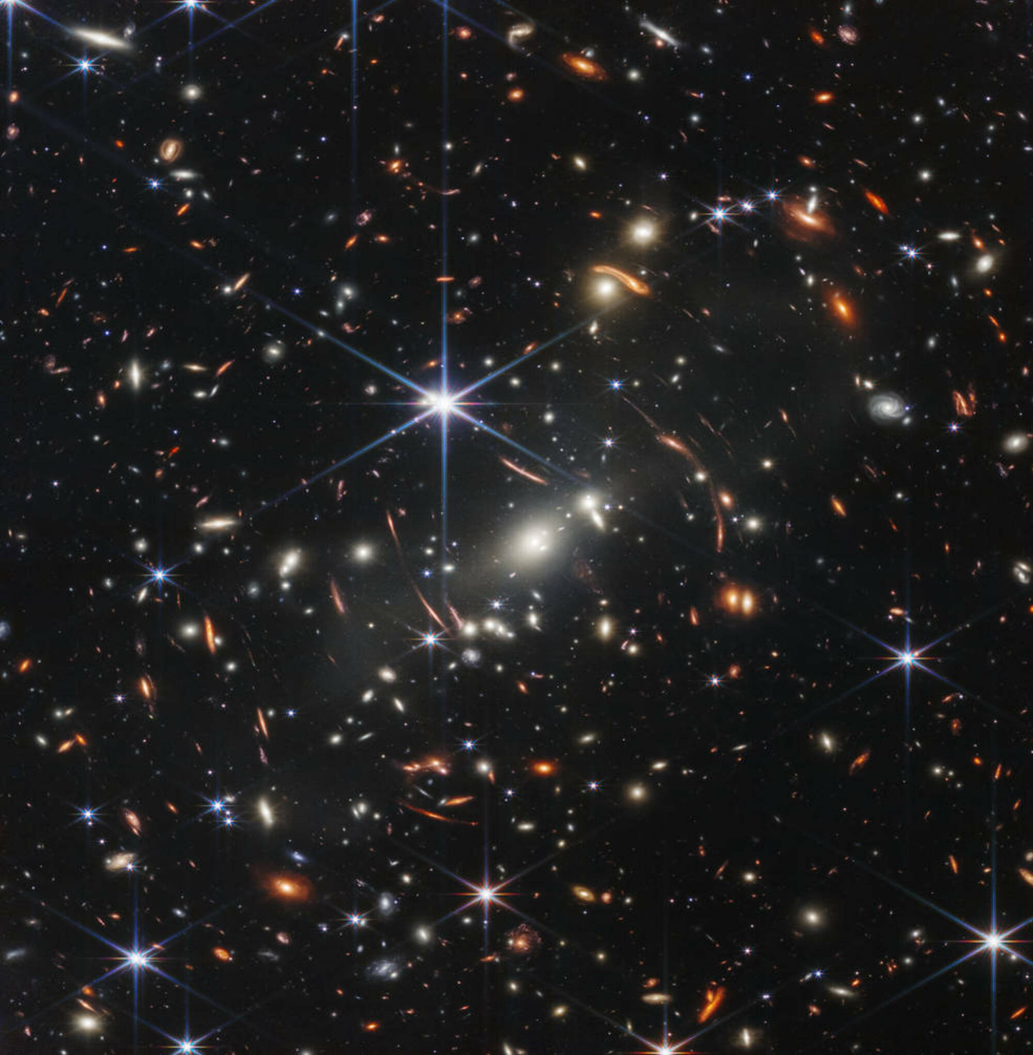
do some of the red galaxies look odd?

Slide 4
nearby
distant
galaxy
view from Earth

Slide 5
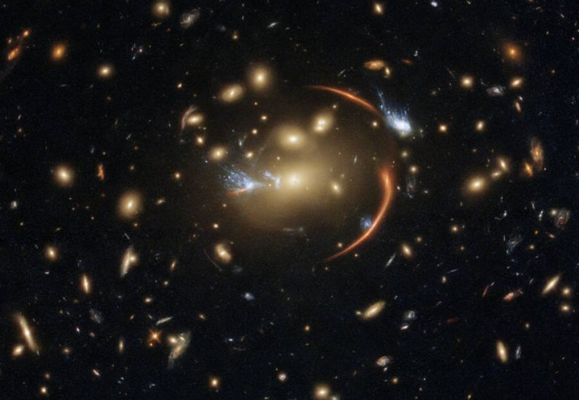

Slide 6
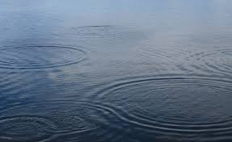
circular waves on a pond made by raindrops

Slide 7
local direction
of propagation
local direction
of propagation
wavefront
source
circular waves on a pond made by raindrops

Slide 8
wavefront – curve of equal travel time T
local direction
of propagation
local direction
of propagation
wavefront
T=3
T=2
source

Slide 9
wavefront – curve of equal travel time TC
local direction
of propagation
local direction
of propagation
wavefront
T=3
T=2
source

Slide 10
Simplified Physics of Wave Motion
The wavefront advances
parallel to itself
at a speed given by the local properties of the medium

Slide 11
SLOW
FAST
T=3
T=2

Slide 12
T=4
SLOW
FAST
T=3
T=2

Slide 13
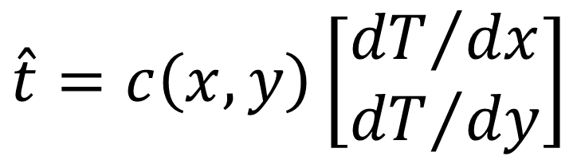

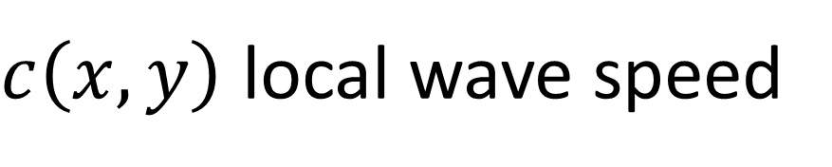

all of the physics boils down to
$$\hat{t}=c\left(x,y\right)\left[\begin{matrix}{dT}/{dx} \\ {dT}/{dy}\end{matrix}\right]$$
SLOW
T=3
$$\hat{t}$$
$$c\left(x,y\right)$$
$c\left(x,y\right)$ local wave speed

Slide 14
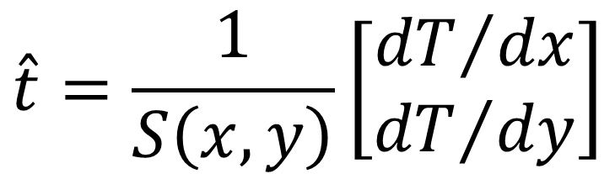
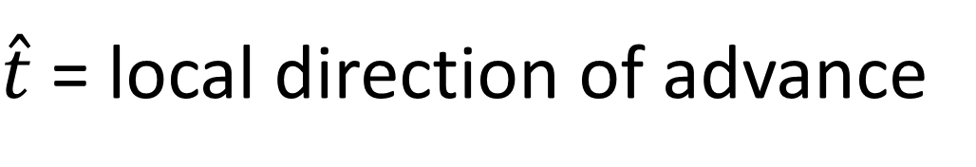
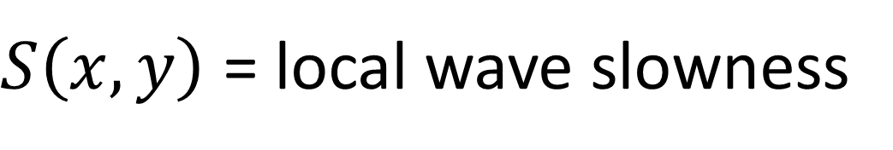
$\hat{t}$= local direction of advance
$$\hat{t}=\frac{1}{S\left(x,y\right)}\left[\begin{matrix}{dT}/{dx} \\ {dT}/{dy}\end{matrix}\right]$$
SLOW
T=3
$$\hat{t}$$
$$c\left(x,y\right)$$
$S\left(x,y\right)$ = local wave slowness

Slide 15
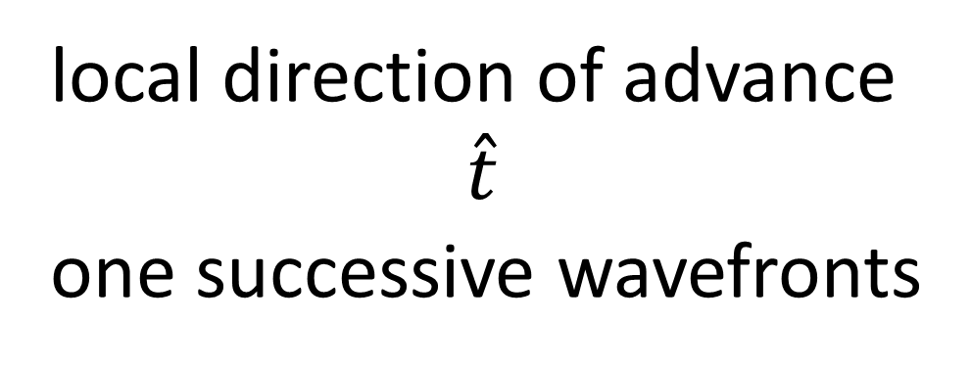
T=4
FAST
T=3
T=2
local direction of advance
$$\hat{t}$$
one successive wavefronts

Slide 16
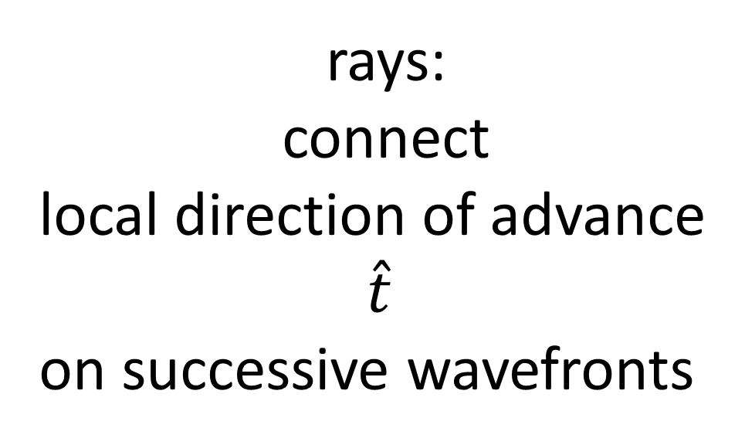
T=4
FAST
T=3
rays:
connect
local direction of advance
$$\hat{t}$$
on successive wavefronts
T=2

Slide 17
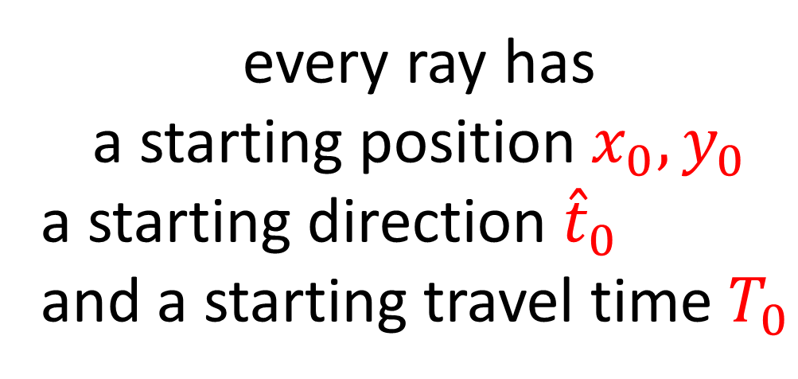
T=5
T=4
FAST
T=3
every ray has
a starting position $x_{0}, y_{0}$
a starting direction ${\hat{t}}_{0}$
and a starting travel time $T_{0}$
To=2

Slide 18
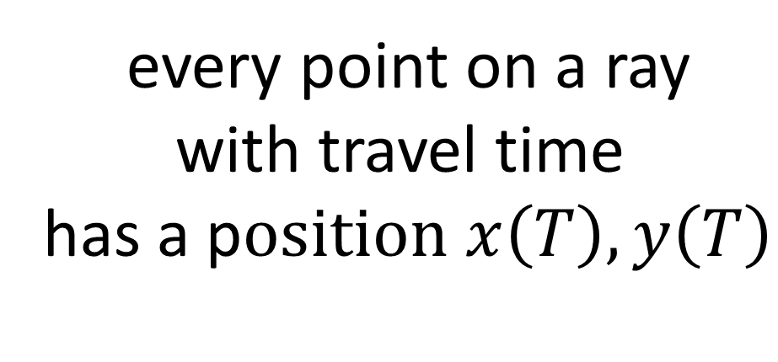

$$x\left(T\right),y\left(T\right)$$
T=5
T=4
FAST
T=3
every point on a ray
with travel time
has a p$osition x\left(T\right),y\left(T\right)$
T=2

Slide 19
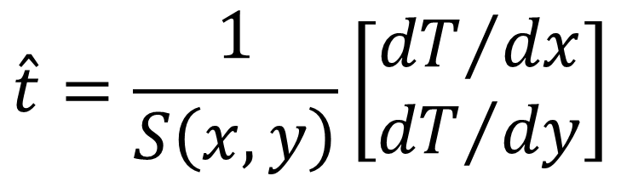
equation for ray tangent as a function of travel time and local slowness
$$\hat{t}=\frac{1}{S\left(x,y\right)}\left[\begin{matrix}{dT}/{dx} \\ {dT}/{dy}\end{matrix}\right]$$
want to convert
equation for ray position $\left[\begin{matrix}x\left(T\right) \\ y\left(T\right)\end{matrix}\right]$as a function of travel time and local slowness

Slide 20
equation for ray tangent as a function of travel time and local slowness
$$\hat{t}=\frac{1}{S\left(x,y\right)}\left[\begin{matrix}{dT}/{dx} \\ {dT}/{dy}\end{matrix}\right]$$
messy calculus
equation for ray position $\left[\begin{matrix}x\left(T\right) \\ y\left(T\right)\end{matrix}\right]$as a function of travel time and local slowness

Slide 21
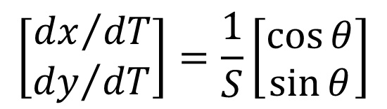
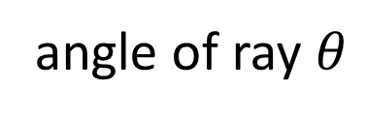
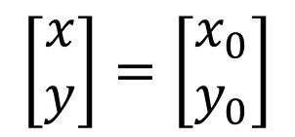
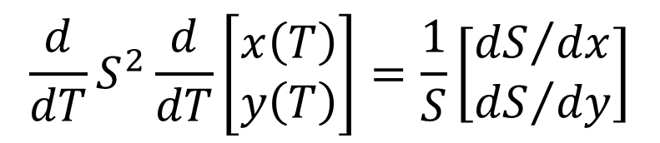
equation for ray tangent as a function of travel time and local slowness
$$\hat{t}=\frac{1}{S\left(x,y\right)}\left[\begin{matrix}{dT}/{dx} \\ {dT}/{dy}\end{matrix}\right]$$
initial conditions
$$\left[\begin{matrix}x \\ y\end{matrix}\right]=\left[\begin{matrix}x_{0} \\ y_{0}\end{matrix}\right]$$
ray equation
$$\frac{d}{dT}S^{2}\frac{d}{dT}\left[\begin{matrix}x\left(T\right) \\ y\left(T\right)\end{matrix}\right]=\frac{1}{S}\left[\begin{matrix}{dS}/{dx} \\ {dS}/{dy}\end{matrix}\right]$$
$$\left[\begin{matrix}{dx}/{dT} \\ {dy}/{dT}\end{matrix}\right]=\frac{1}{S}\left[\begin{matrix}\cos{θ} \\ \sin{θ}\end{matrix}\right]$$
angle of ray $θ$

Slide 22
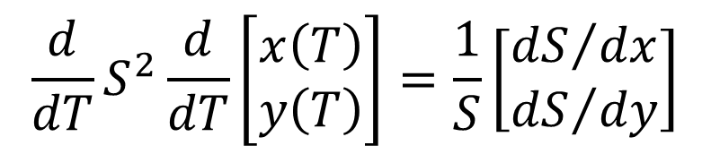
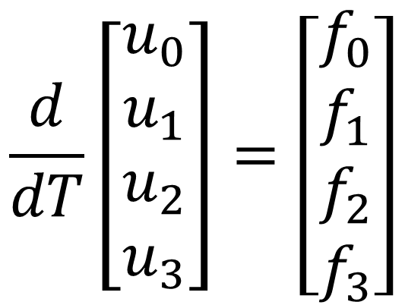
manipulate it into the form
ray equation
$$\frac{d}{dT}\left[\begin{matrix}u_{0} \\ u_{1} \\ u_{2} \\ u_{3}\end{matrix}\right]=\left[\begin{matrix}f_{0} \\ f_{1} \\ f_{2} \\ f_{3}\end{matrix}\right]$$
$$\frac{d}{dT}S^{2}\frac{d}{dT}\left[\begin{matrix}x\left(T\right) \\ y\left(T\right)\end{matrix}\right]=\frac{1}{S}\left[\begin{matrix}{dS}/{dx} \\ {dS}/{dy}\end{matrix}\right]$$

Slide 23
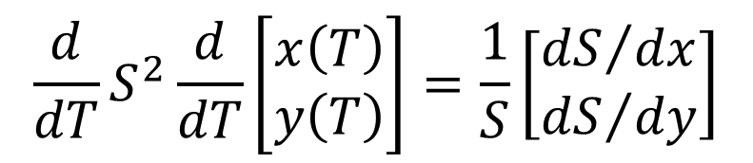
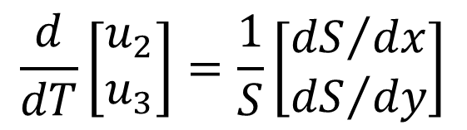
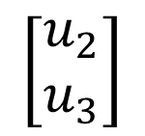
manipulate it into the form
ray equation
$$\frac{d}{dT}\left[\begin{matrix}u_{0} \\ u_{1} \\ u_{2} \\ u_{3}\end{matrix}\right]=\left[\begin{matrix}f_{0} \\ f_{1} \\ f_{2} \\ f_{3}\end{matrix}\right]$$
$$\frac{d}{dT}S^{2}\frac{d}{dT}\left[\begin{matrix}x\left(T\right) \\ y\left(T\right)\end{matrix}\right]=\frac{1}{S}\left[\begin{matrix}{dS}/{dx} \\ {dS}/{dy}\end{matrix}\right]$$
call it
$$\left[\begin{matrix}u_{2} \\ u_{3}\end{matrix}\right]$$
so
$$\frac{d}{dT}\left[\begin{matrix}u_{2} \\ u_{3}\end{matrix}\right]=\frac{1}{S}\left[\begin{matrix}{dS}/{dx} \\ {dS}/{dy}\end{matrix}\right]$$

Slide 24
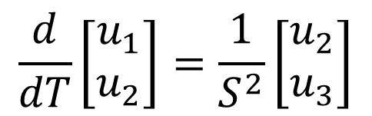
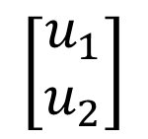
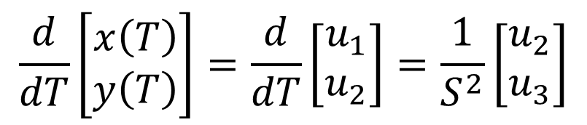
manipulate it into the form
ray equation
$$\frac{d}{dT}\left[\begin{matrix}u_{0} \\ u_{1} \\ u_{2} \\ u_{3}\end{matrix}\right]=\left[\begin{matrix}f_{0} \\ f_{1} \\ f_{2} \\ f_{3}\end{matrix}\right]$$
$$\frac{d}{dT}S^{2}\frac{d}{dT}\left[\begin{matrix}x\left(T\right) \\ y\left(T\right)\end{matrix}\right]=\frac{1}{S}\left[\begin{matrix}{dS}/{dx} \\ {dS}/{dy}\end{matrix}\right]$$
$$\left[\begin{matrix}u_{2} \\ u_{3}\end{matrix}\right]$$
call this
$$\left[\begin{matrix}u_{1} \\ u_{2}\end{matrix}\right]$$
call this
so
so
$$\frac{d}{dT}\left[\begin{matrix}x\left(T\right) \\ y\left(T\right)\end{matrix}\right]=\frac{d}{dT}\left[\begin{matrix}u_{1} \\ u_{2}\end{matrix}\right]=\frac{1}{S^{2}}\left[\begin{matrix}u_{2} \\ u_{3}\end{matrix}\right]$$
$$\frac{d}{dT}\left[\begin{matrix}u_{2} \\ u_{3}\end{matrix}\right]=\frac{1}{S}\left[\begin{matrix}{dS}/{dx} \\ {dS}/{dy}\end{matrix}\right]$$
$$\frac{d}{dT}\left[\begin{matrix}u_{1} \\ u_{2}\end{matrix}\right]=\frac{1}{S^{2}}\left[\begin{matrix}u_{2} \\ u_{3}\end{matrix}\right]$$

Slide 25
manipulate it into the form
ray equation
$$\frac{d}{dT}\left[\begin{matrix}u_{0} \\ u_{1} \\ u_{2} \\ u_{3}\end{matrix}\right]=\left[\begin{matrix}f_{0} \\ f_{1} \\ f_{2} \\ f_{3}\end{matrix}\right]$$
$$\frac{d}{dT}S^{2}\frac{d}{dT}\left[\begin{matrix}x\left(T\right) \\ y\left(T\right)\end{matrix}\right]=\frac{1}{S}\left[\begin{matrix}{dS}/{dx} \\ {dS}/{dy}\end{matrix}\right]$$
$$\frac{d}{dT}\left[\begin{matrix}u_{2} \\ u_{3}\end{matrix}\right]=\frac{1}{S}\left[\begin{matrix}{dS}/{dx} \\ {dS}/{dy}\end{matrix}\right]$$
$$\frac{d}{dT}\left[\begin{matrix}u_{1} \\ u_{2}\end{matrix}\right]=\frac{1}{S^{2}}\left[\begin{matrix}u_{2} \\ u_{3}\end{matrix}\right]$$
bottom half
top half

Slide 26
def myfun( t, u ):
f = np.zeros((M,));
myS, mySx, mySy = Sfun( u[0], u[1] );
mySr = 1.0/myS;
myS2r = mySr**2;
f[0] = u[2] * myS2r;
f[1] = u[3] * myS2r;
f[2] = mySr * mySx;
f[3] = mySr * mySy;
return f;

Slide 27
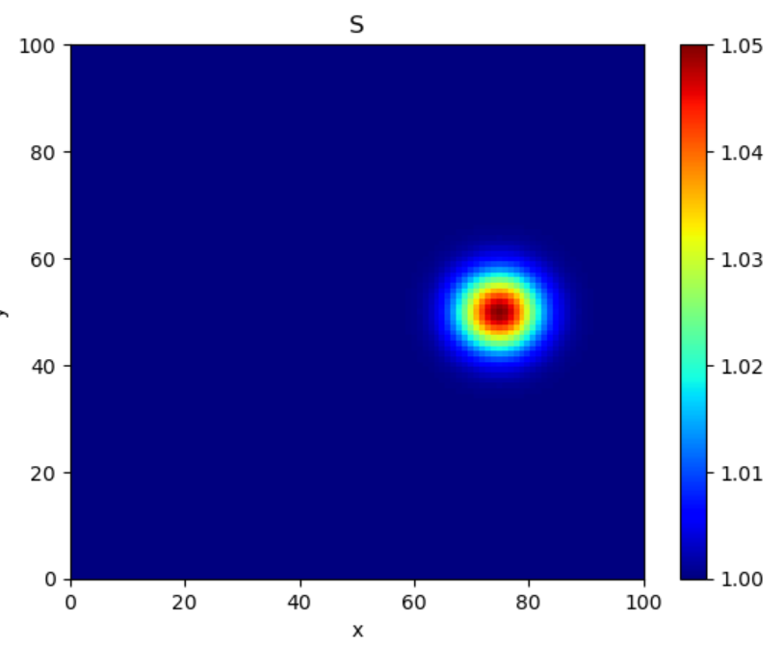
high slowness = “slow”

Slide 28
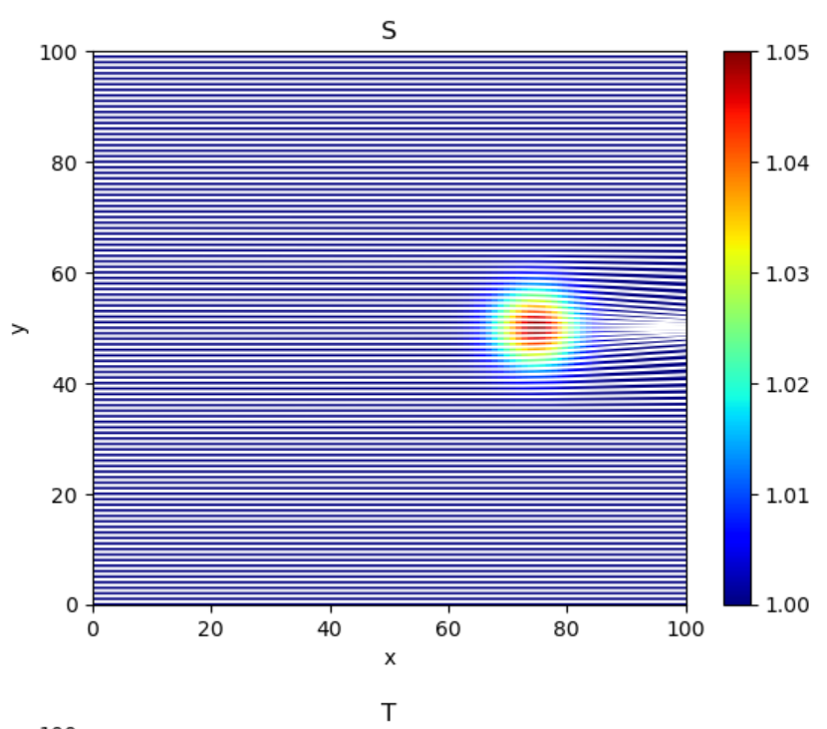
rays bent towards
one another
“focused”

Slide 29
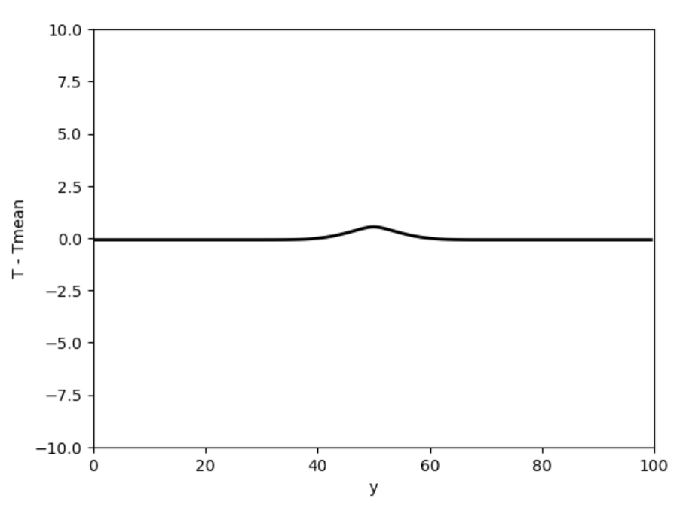
Travel time anomaly = travel time – travel time in uniform media
Late arrivals

Slide 30
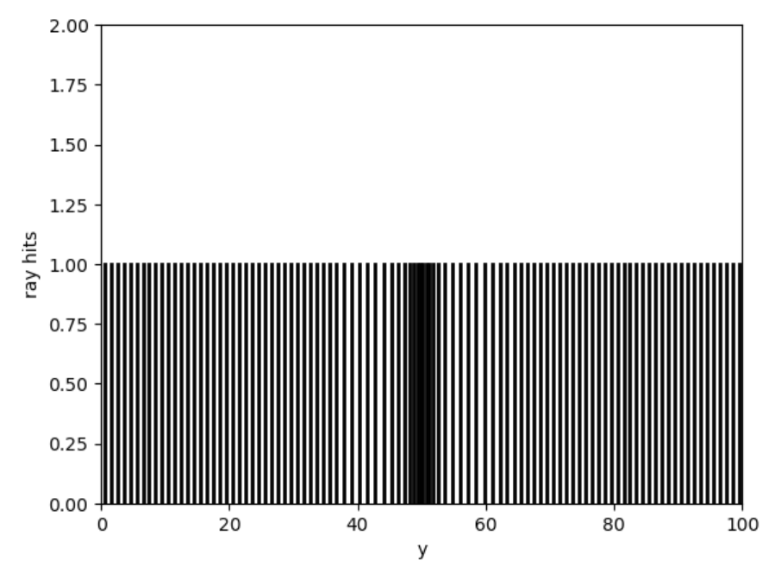
Ray density = proxy for brightness of wave
bright
normal
dim
dim
normal

Slide 31
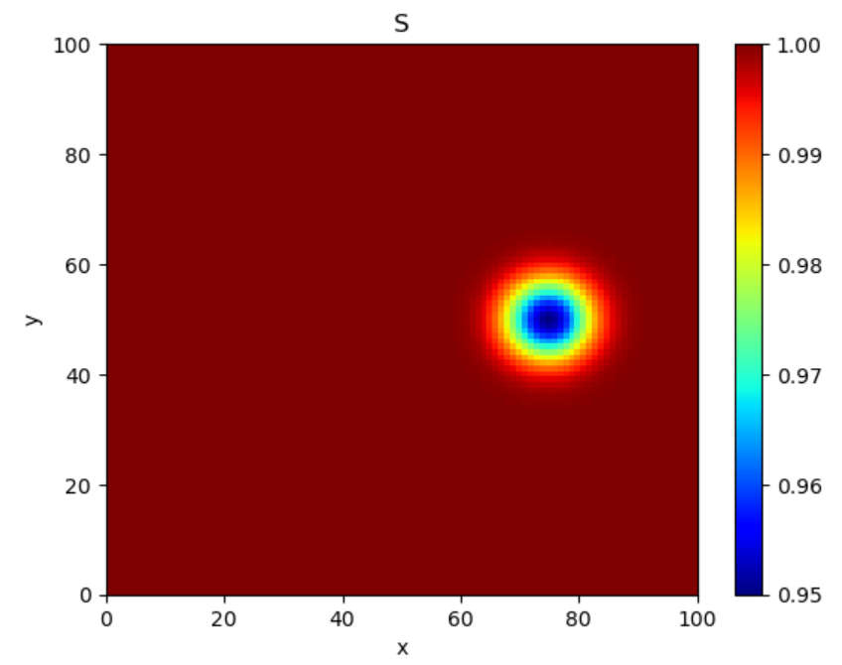
low slowness = “fast”

Slide 32
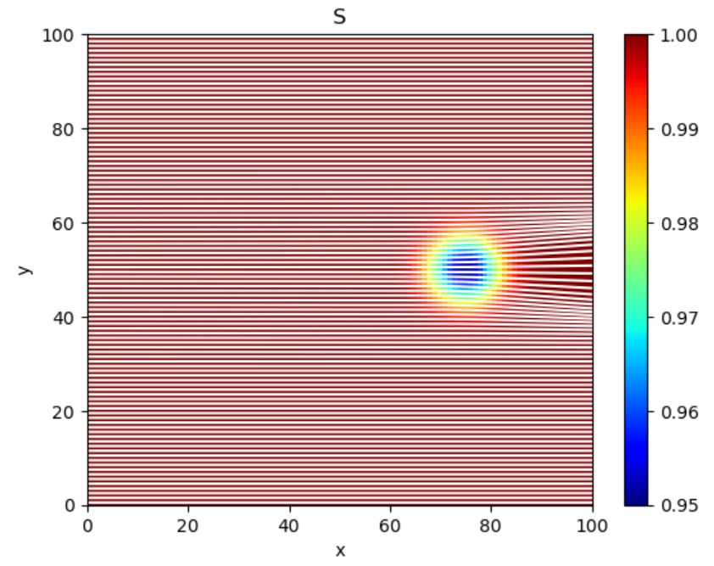
rays bent away from
one another
“de-focused”

Slide 33
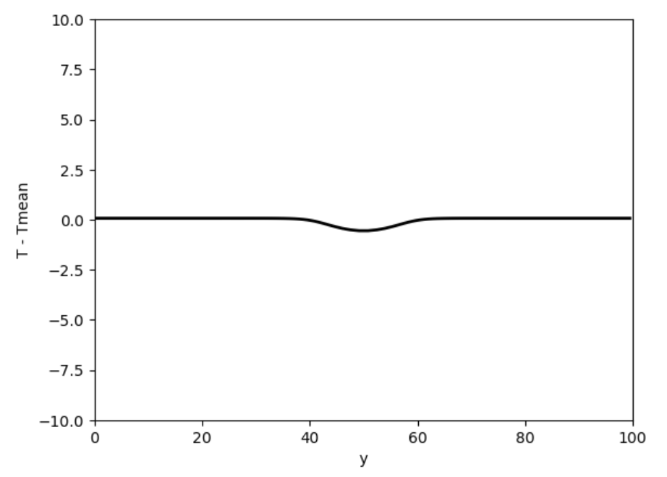
Travel time anomaly = travel time – travel time in uniform media
Early arrivals

Slide 34
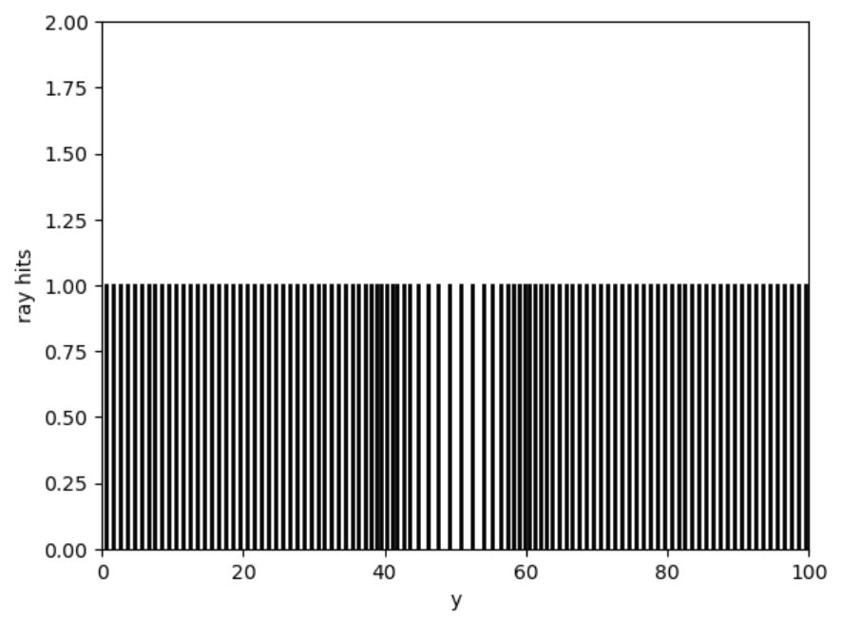
Ray density = proxy for brightness of wave
dim
normal
bright
bright
normal

Slide 35
# tunable parameters
S1 = -0.05; # the maximum slowness perturbation of the anomaly
xc = 75; # x-position of the center of the anomaly
yc = 50; # y-position of the center of the anomaly
sxx=5.0; # length scale of anomaly in x-direction
syy=5.0; # length scale of anomaly in y-direction
tilt = 0.0; # tilt of anomaly in degrees (0=no tilt)
th=0.0; # the angle of the rays (0=no tilt)

Slide 36
Group A
make a fairly large round, fast anomaly at about x=70
Investigate how the results change as you make the anomaly faster and faster
Are there y’s at which several rays arrive at different times?
Email to me single-slide pptx

Slide 37
Group B
make a fairly large round, fast anomaly at about x=70
Investigate how the results change as you make the anomaly slower and slower
Are there y’s at which several rays arrive at different times?
Email to me single-slide pptx

Slide 38
Group C
make a fairly round small slow anomaly at x=85. (This is a crude model of a mantle hotspot).
consider two case, waves with an angle of +10 degrees and -10 degrees
Investigate how the results change as you make the anomaly deeper and deeper
Can you infer the depth of the anomaly? There is an effect here called “parallax”. Explain ...
Email to me single-slide pptx

Slide 39
Group D
make an smallish elongated (twice as long in x than in y, and tilted at 10 degrees) slow anomaly at about x=75. (This is a crude model of a subduction zone).
Consider three case, waves with an angles of +10 degrees, zero and -10 degrees
Investigate how the results change between these three wave directions.
Can you infer the sense of the tilt of the anomaly?
Email to me single-slide pptx

