Slide 1
2023 EESC W3400
Lec 11: Periodicities and Fourier series
Computational Earth Science
Bill Menke, Instructor
Emily Glazer, Teaching Assistant
TR 2:40 – 3:55

Slide 2
today:
Climate Data Discussion
smoothing with least squares
sine & cosine components with least squares

Slide 3
Climate Data Discussion

Slide 4
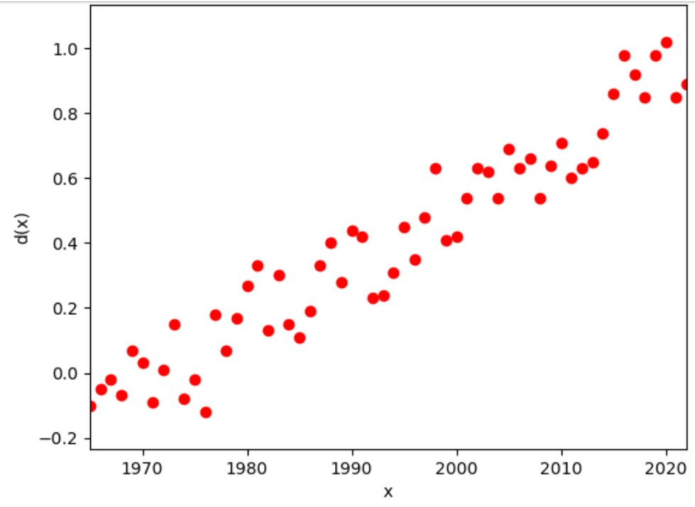

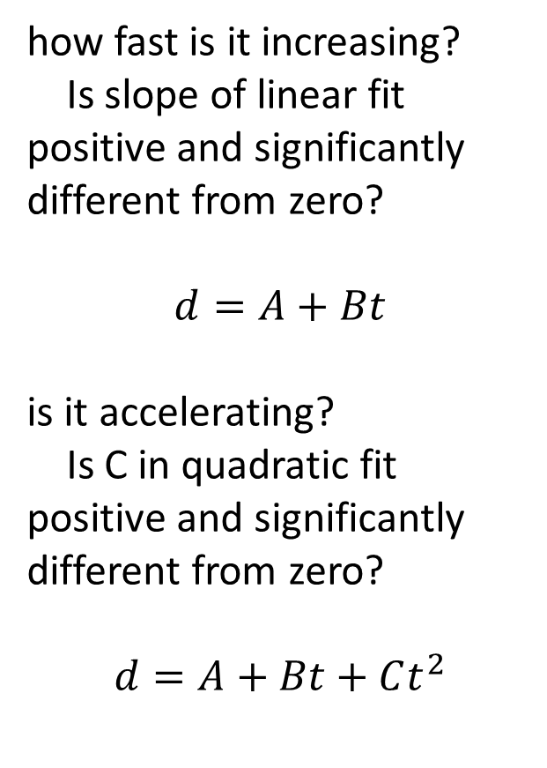
Group 1: global_temp.txt (years, $∆$deg C)
how fast is it increasing?
Is slope of linear fit positive and significantly different from zero?
$$d=A+Bt$$
is it accelerating?
Is C in quadratic fit positive and significantly different from zero?
$$d=A+Bt+Ct^{2}$$

Slide 5
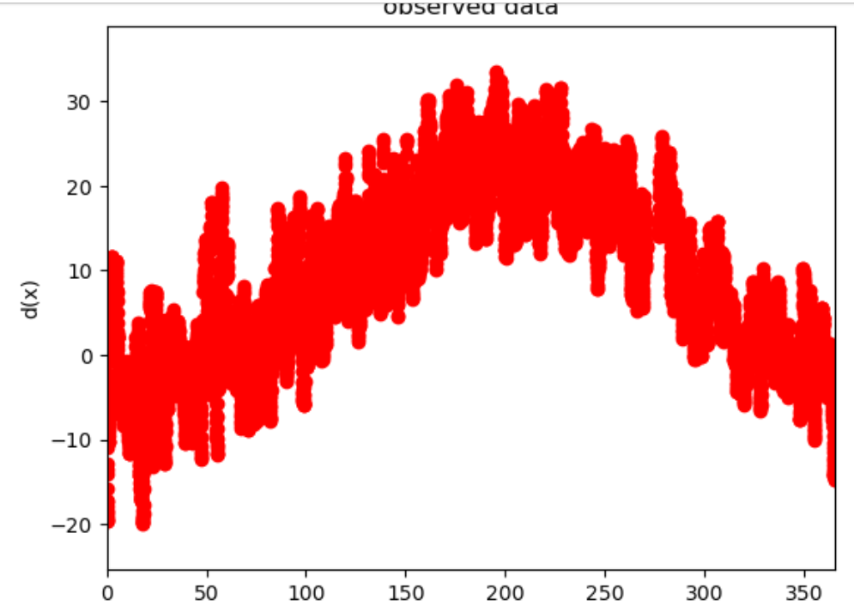
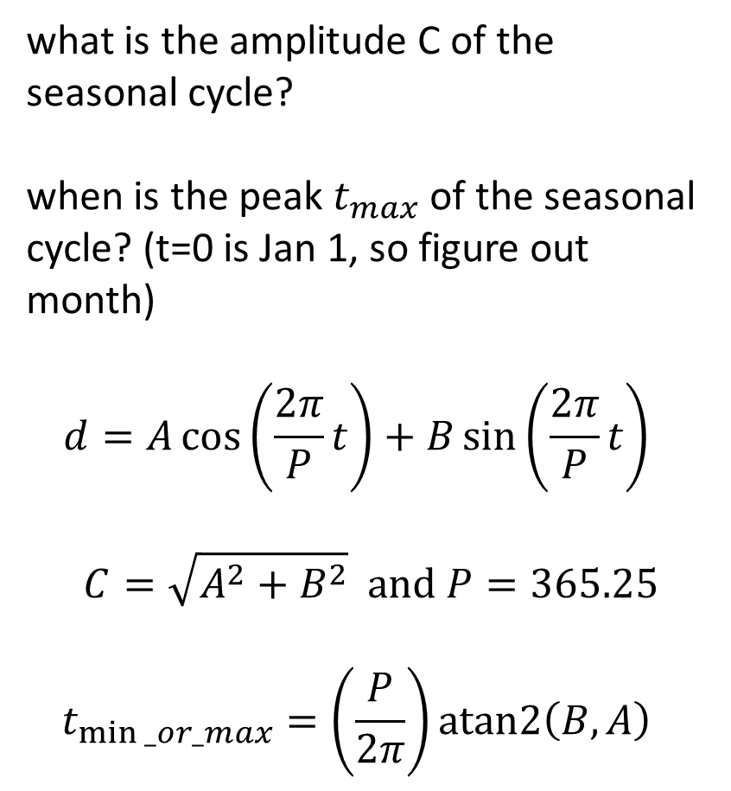
Group 2: brf_temp.txt (days, deg C)
what is the amplitude C of the seasonal cycle?
when is the peak $t_{max}$ of the seasonal cycle? (t=0 is Jan 1, so figure out month)
$$d=A\cos\left(\frac{2π}{P}t\right)+B\sin\left(\frac{2π}{P}t\right)$$
$$C=\sqrt{A^{2}+B^{2}} and P=365.25$$
$$t_{min⁡_or_max}=\left(\frac{P}{2π}\right)atan2\left(B,A\right)$$

Slide 6
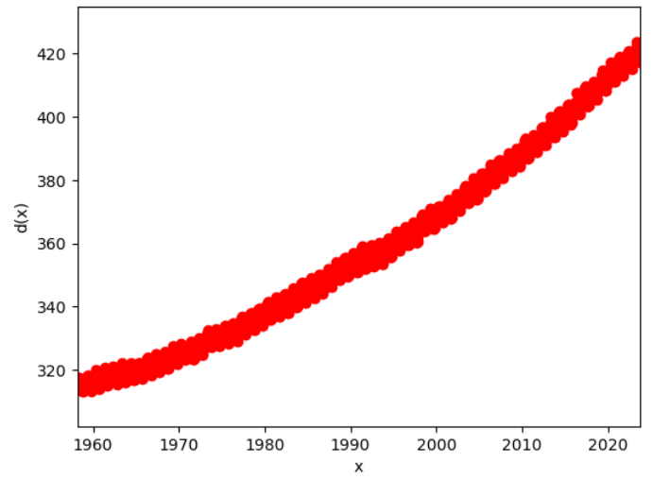
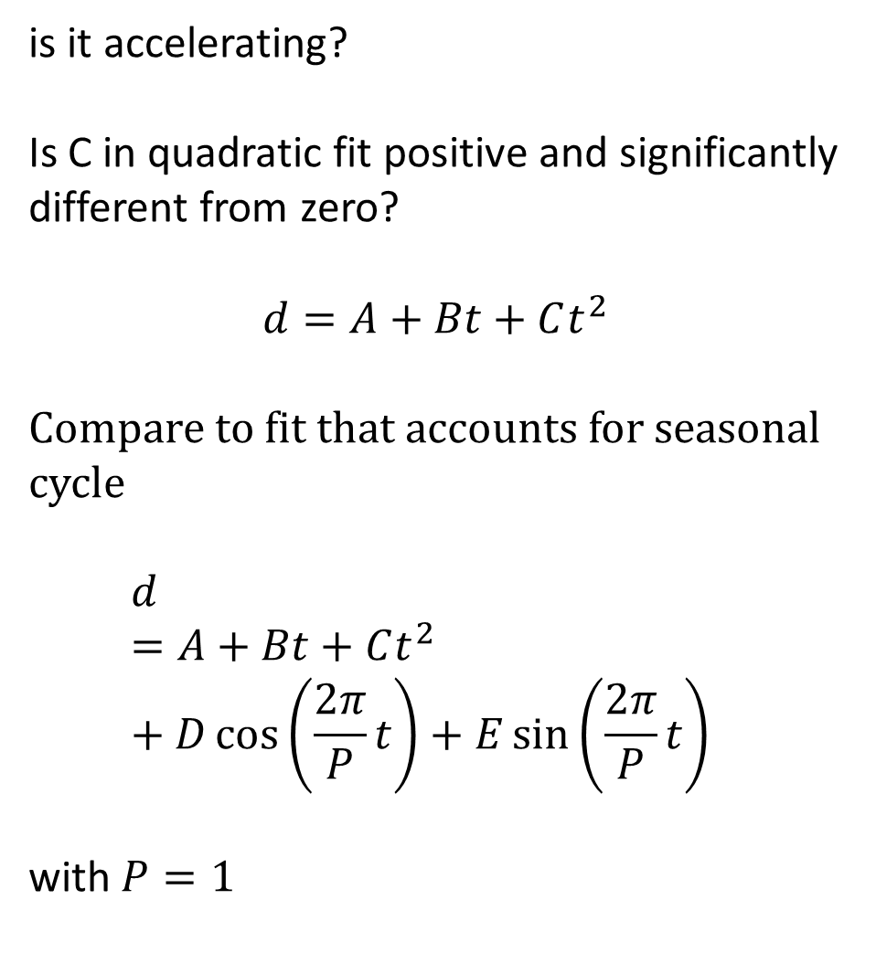
Group 3: keeling.txt (years, ppm CO2)
is it accelerating?
Is C in quadratic fit positive and significantly different from zero?
$$d=A+Bt+Ct^{2}$$
Compare to fit that accounts for seasonal cycle
$$d=A+Bt+Ct^{2}+D\cos\left(\frac{2π}{P}t\right)+E\sin\left(\frac{2π}{P}t\right)$$
with $P=1$

Slide 7
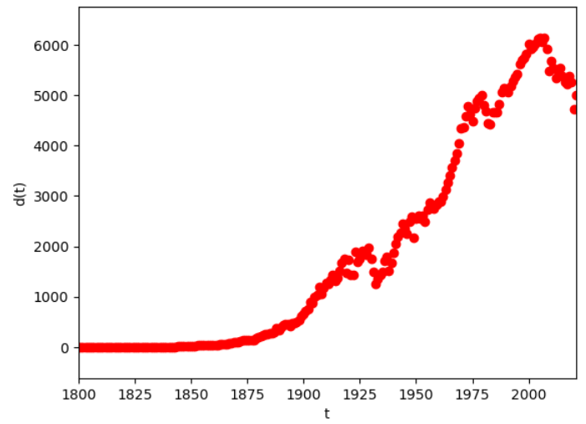
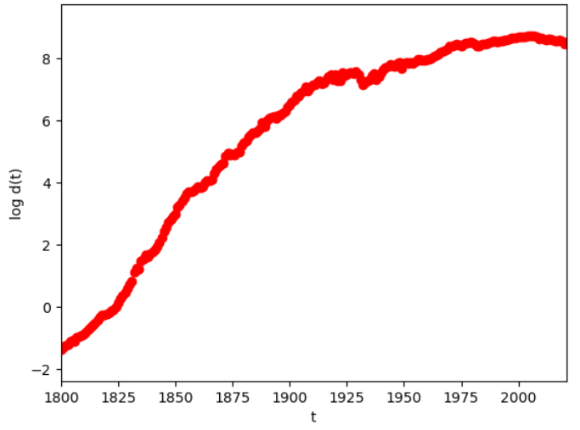
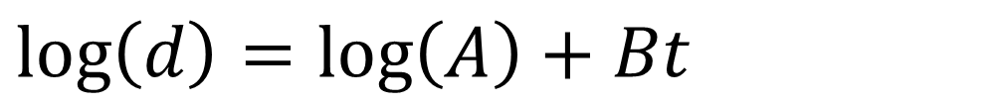
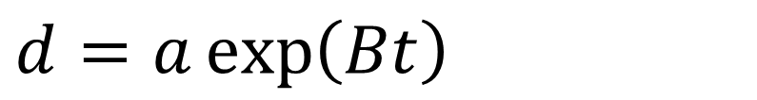
Group 3: emissionsUSA.txt (years, Mt Carbon)
exponential growth is linear when you take the log of the data
In about what year Y does US emissions depart from an exponential growth curve?
Do a linear fit of log(d) for 1800 through year Y, for a variety of Ys, and see when the posterior standard error of the data starts to get big.
$$d=a\exp\left(Bt\right)$$
$$\log\left(d\right)=\log\left(A\right)+Bt$$

Slide 8
smoothing with least squares

Slide 9
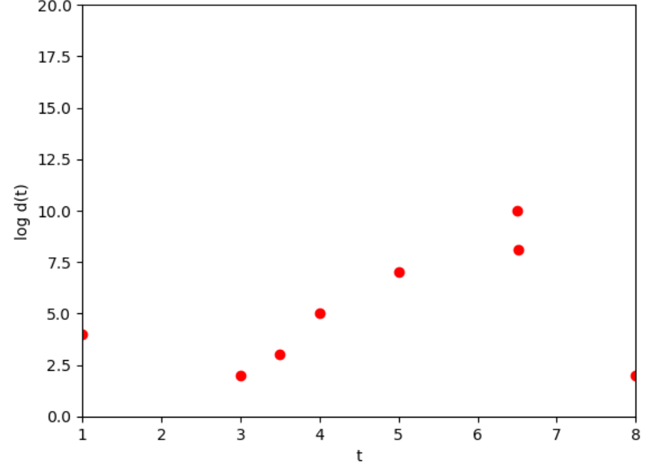
observed data (red)

Slide 10
goal is to find a smooth curve that approximately fits data
?

Slide 11


$$w$$
$$t_{0}$$

Slide 12

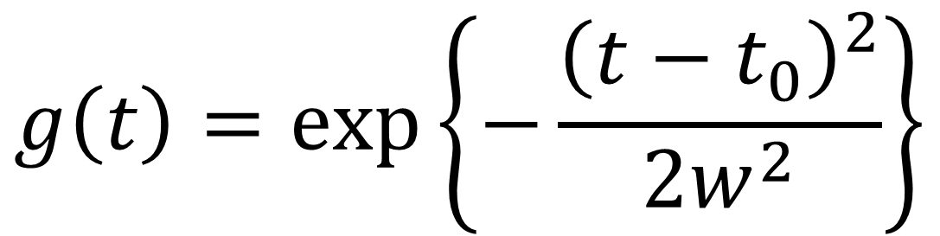
Gaussian centered at $t_{0}$ with half-with $w$
$$g\left(t\right)=\exp\left\{−\frac{{\left(t−t_{0}\right)}^{2}}{2w^{2}}\right\}$$

Slide 13
sets a scale length of
variation
$$w$$
center position
$$t_{0}$$

Slide 14
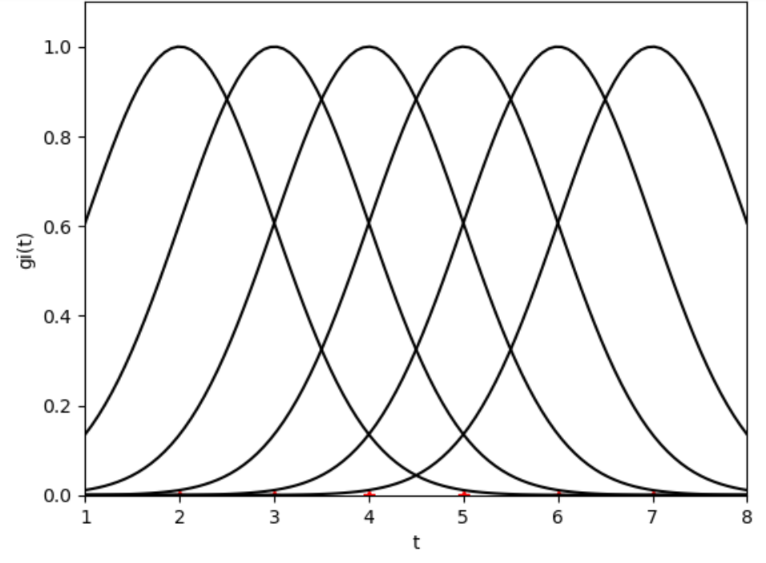
$$w$$
$$t_{0}$$

Slide 16
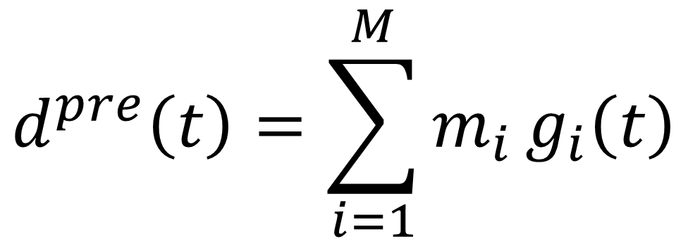
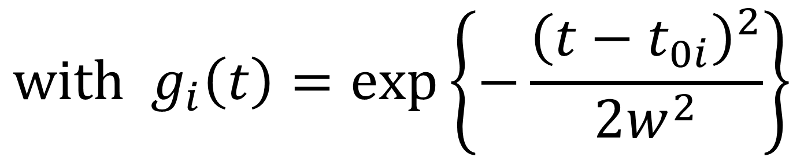
Model
$$d^{pre}\left(t\right)=\sum_{i=1}^{M}{m_{i}}g_{i}\left(t\right)$$
$$with g_{i}\left(t\right)=\exp\left\{−\frac{{\left(t−t_{0i}\right)}^{2}}{2w^{2}}\right\}$$

Slide 17

least-squares solution
$m^{est}={\left[G^{T}G\right]}^{−1}$ $G^{T}$ $d^{obs}$
$d^{pre}=G$ $m^{est}$
$$e=d^{obs}−d^{pre}$$
$E=e^{T}$ $e$
$$σ_{d}^{2}=E/\left(N−M\right)$$
$$C=σ_{d}^{2}{\left[G^{T}G\right]}^{−1}$$
$$σ_{m_{i}}=2 \sqrt{C_{ii}} (95\% confidence)$$
really only need these two lines

Slide 18
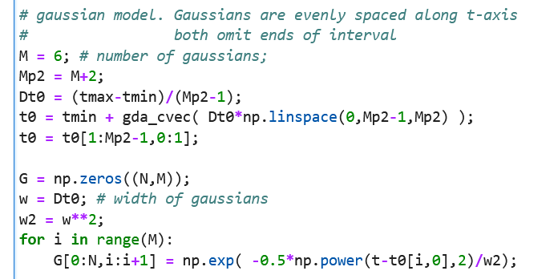

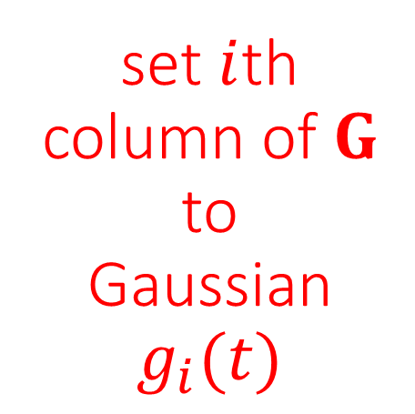
Hard part is to build G
given $M$ make list of evenly spaced
$t_{0i}$s
set $i$th column of $G$ to
Gaussian
$g_{i}(t)$

Slide 19
least-squares solution
$m^{est}={\left[G^{T}G\right]}^{−1}$ $G^{T}$ $d^{obs}$
$d^{pre}=G$ $m^{est}$
$$e=d^{obs}−d^{pre}$$
$E=e^{T}$ $e$
$$σ_{d}^{2}=E/\left(N−M\right)$$
$$C=σ_{d}^{2}{\left[G^{T}G\right]}^{−1}$$
$$σ_{m_{i}}=2 \sqrt{C_{ii}} (95\% confidence)$$
really only need these two lines

Slide 20
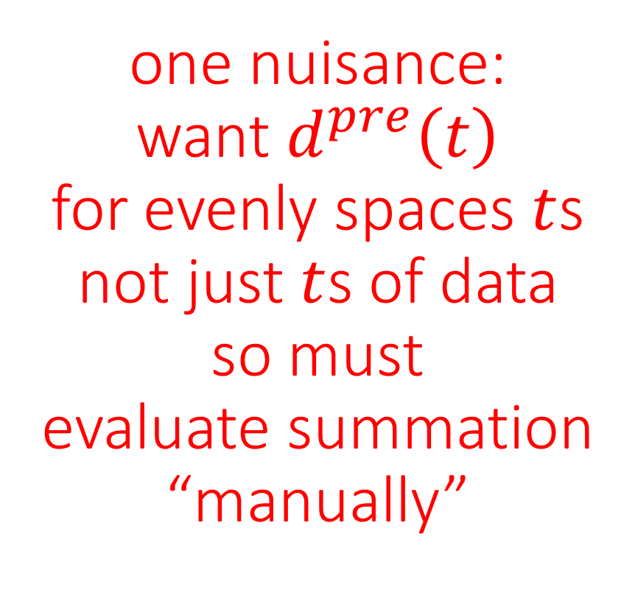
least-squares solution
$m^{est}={\left[G^{T}G\right]}^{−1}$ $G^{T}$ $d^{obs}$
$d^{pre}=G$ $m^{est}$
$$e=d^{obs}−d^{pre}$$
$E=e^{T}$ $e$
$$σ_{d}^{2}=E/\left(N−M\right)$$
$$C=σ_{d}^{2}{\left[G^{T}G\right]}^{−1}$$
$$σ_{m_{i}}=2 \sqrt{C_{ii}} (95\% confidence)$$
one nuisance:
want $d^{pre}\left(t\right)$
for evenly spaces $t$s
not just $t$s of data
so must
evaluate summation
“manually”

Slide 21
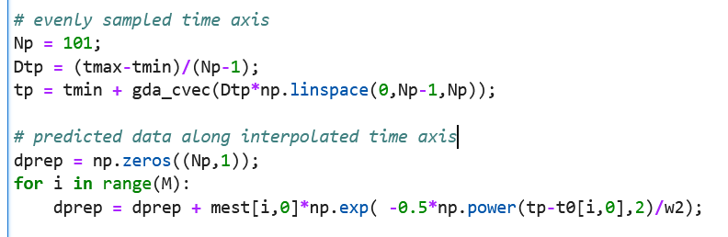

Slide 22
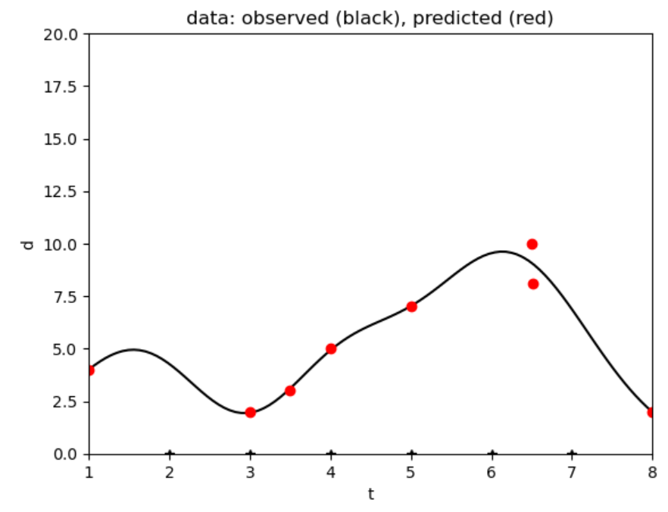
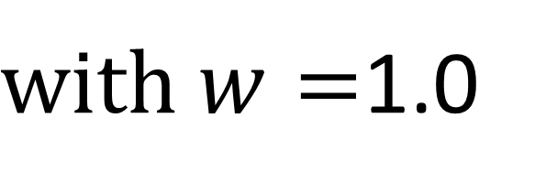
$with w=$1.0

Slide 23
sine & cosine components with least squares

Slide 24
importance of periodicities
Notes:
Need to be able to recognize when a periodicity is present, determine is period and its strength.

Slide 25
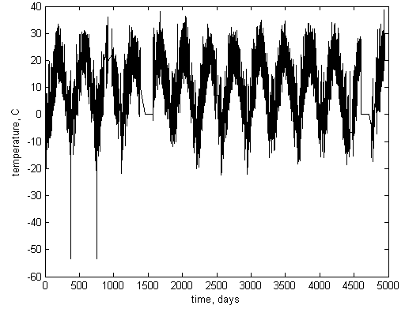
Air temperature
Black Rock Forest
365 days
1 year
Notes:
Black Rock Forest air temperature has a yearly periodicity with strength of ±20 degrees C …

Slide 26
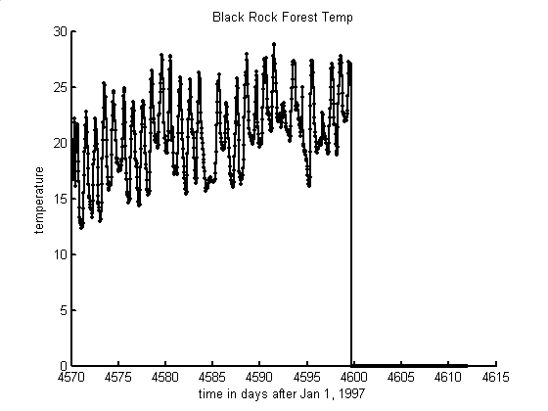
Air temperature
Black Rock Forest
1 day
time, days
Notes:
… and a daily periodicity with strength of ±5 degrees C …

Slide 27
temporal periodicities and their periods
astronomical
rotation
daily
revolution
yearly
other natural
ocean waves
a few seconds
anthropogenic
electric power
60 Hz
work week
7 days
Notes:
Ask the class to contribute others, such as (astronomical) ocean tides (12 hours, daily, monthly), precession of the equinox (26,000 years), sunspots (11 years) (other natural) heart beats (a few Hz), predator-prey oscillations (varies), (anthropogenic) work patterns (weekly), machinery (varies)

Slide 28
sinusoidal oscillation
f(t) = C cos{ 2π (t-t₀) / T }
amplitude, C
d(t)
period, T
time, t
delay, t₀
Notes:
Review the basic nomenclature

Slide 29
lingo
temporal
f(t) = C cos{ 2π t / T }
spatial
f(x) = C cos{ 2π x / λ }
amplitude, C
amplitude, C
period, T
wavelength, λ
frequency, f=1/T
-
angular frequency, ω=2 π /T
wavenumber, k=2 π / λ
f(t) = C cos(ωt)
f(x) = C cos(kx)
Notes:
temporal periodicities are described differently than spatial periodicities.

Slide 30
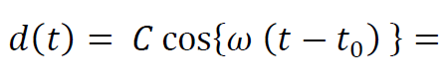
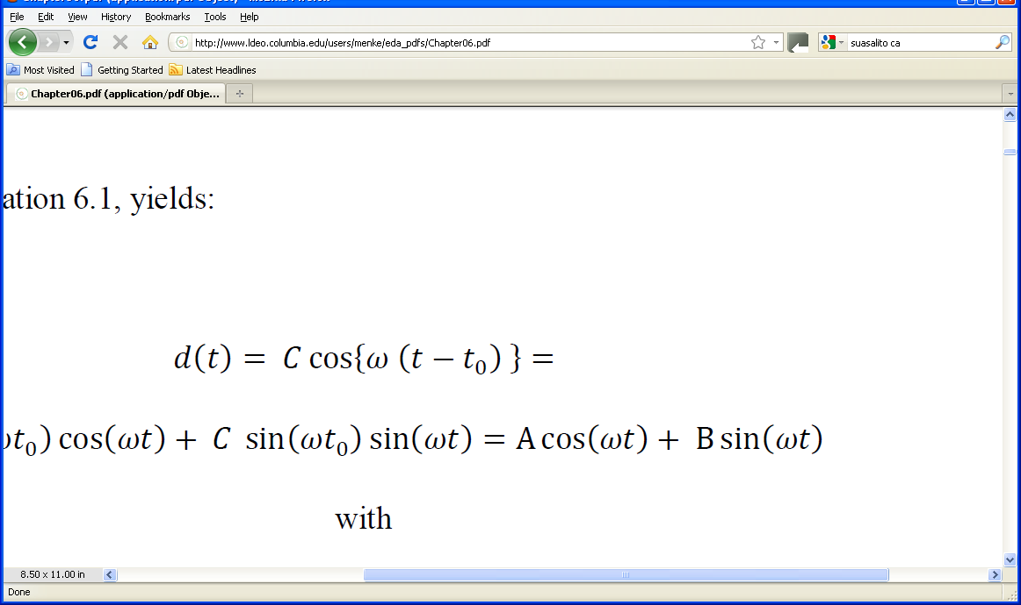
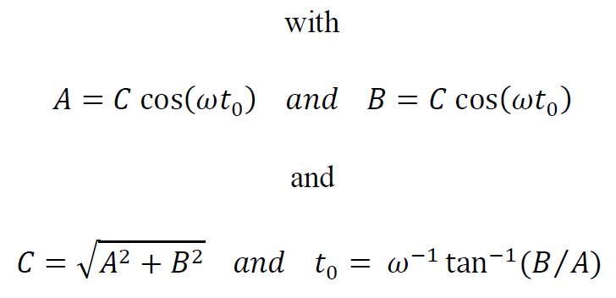
pairing sines and cosines to avoid using time delays
Notes:
Sines and cosines of the same frequency are always paired to avoid having to use explicit time shifts.

Slide 31
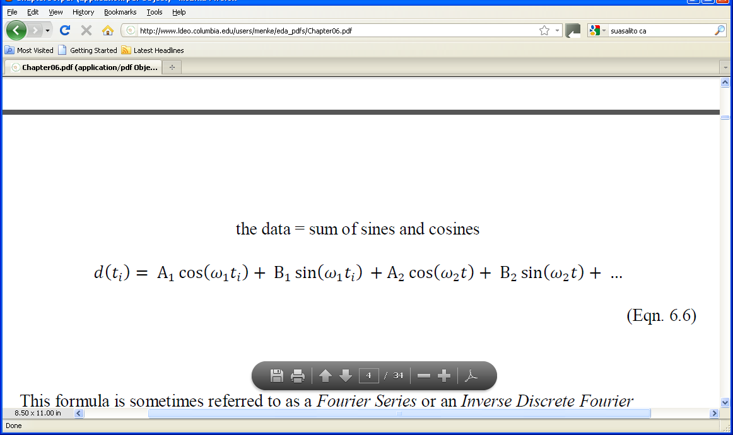
linear model containing nothing but sines and cosines
Notes:
Mention that this brings the discussion back techniques that they already understand, that is,
linear models and their solution by least squares.

Slide 32
A’s and B’s are model parameters
ω’s are known
Notes:
The A’s and B’s quantify the strength of a periodicity at a given frequency. They are the model parameters.
The ω‘s give the frequencies at which periodicities can occur.

Slide 33
two choices
values of frequencies?
total number of frequencies?

Slide 34
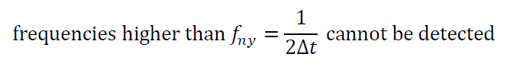
surprising fact about data evenly sampled in time (or space)
Nyquist frequency
Notes:
This is very important.

Slide 35
d₁ (t) = cos(ω₁t), with ω₁=2Δω
d₁(t)
time, t
d₂(t) = cos{ω₂t}, with ω₂=(2+N)Δω,
d₂(t)
time, t
Notes:
example of aliasing, two sinusoids, when sampled at the same, evenly spaced times (circles), produce identical patterns.

Slide 36
values of frequencies?
evenly spaced, f_{n} = (n-1)Δ f
minimum frequency of zero
maximum frequency of f _{ny}
total number of frequencies? N/2+1
number of model parameters, M
= number of data, N
Notes:
Mention that zero frequency just gets you a constant, because cos(0)=1 and sin(0)=0.

Slide 37
values of frequencies?
evenly spaced, f_{n} = (n-1)Δ f
minimum frequency of zero
maximum frequency of f _{ny}
total number of frequencies? N/2+1
number of model parameters, M
= number of data, N
As long as N is even
Notes:
Mention that zero frequency just gets you a constant, because cos(0)=1 and sin(0)=0.

Slide 38
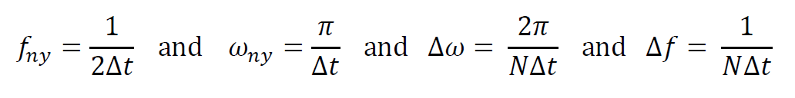
implies
Notes:
Second two formula are derived from first two by dividing by N/2.

Slide 39
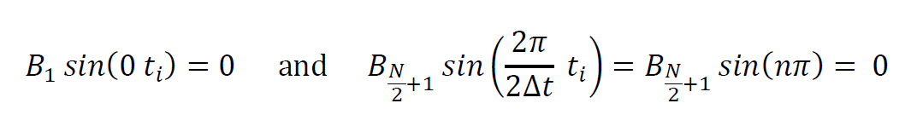
Number of Frequencies
why N/2+1 and not N/2 ?
first and last sine are omitted from the Fourier Series since they are identically zero:
Notes:
Emphasize that choice M=N (number of model parameters equal number of data) is motivated by desire to
use as many sines and cosines as possible without needing to add prior information.

Slide 40
cos(½NΔω t)
cos(0t)
cos(Δω t)
sin(Δωt)
cos(2Δω t)
sin(2Δω t)
Notes:
Idea behind a Fourier Series is that the data are a sum of these sinusoidal patterns.
Zero frequency is a constant. First non-zero frequency corresponds to one full
period over the length of the time series. Nyquist frequency is just a “cosine” that
oscillates from +1 to -1 every sample.

Slide 41
cos(½NΔω t)
cos(0t)
cos(Δω t)
sin(Δωt)
cos(2Δω t)
sin(2Δω t)
doesn’r really look much like a cosine
Notes:
Idea behind a Fourier Series is that the data are a sum of these sinusoidal patterns.
Zero frequency is a constant. First non-zero frequency corresponds to one full
period over the length of the time series. Nyquist frequency is just a “cosine” that
oscillates from +1 to -1 every sample.

Slide 42
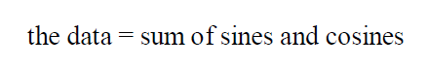
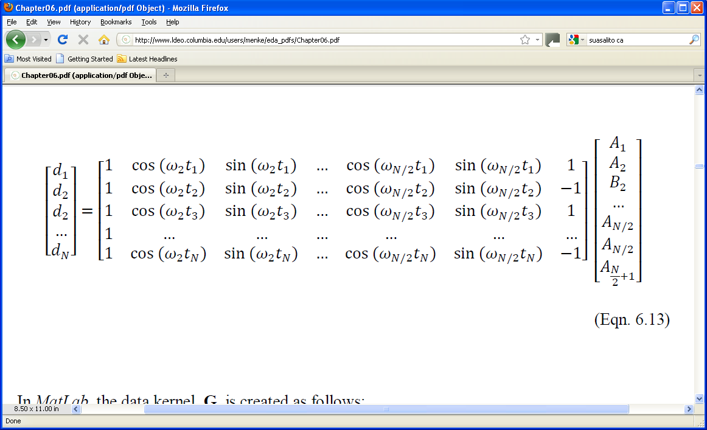
model containing only sines and cosines
“Discrete Fourier Series”
d = Gm
Notes:
Here we get back to the linear problem.

Slide 43
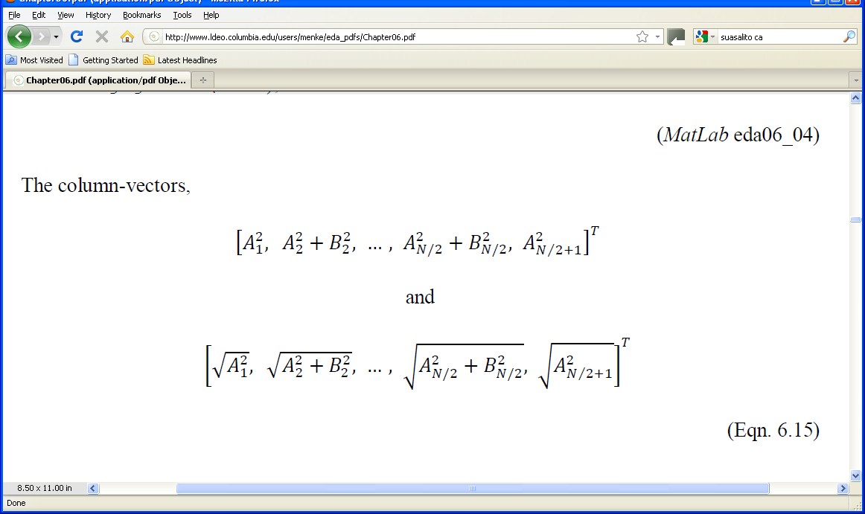
how to plot the model parameters?
A’s and B ’s
plot
against frequency
Notes:
Remind the class that A²+B²=C², the square of the amplitude of a time-shifted cosine.
This form emphasizes the overall amplitude of the oscillatory pattern, irrespective of its time-shift.

Slide 44
power spectral density
big at frequency ω when
when sine or cosine at the frequency
has a large coefficient

Slide 45
alternatively, plot
amplitude spectral density
Notes:
Plots of amplitude spectral density are useful if there are several peaks of different size, since the big
peak does not stand so high compared to power spectral density.

Slide 46
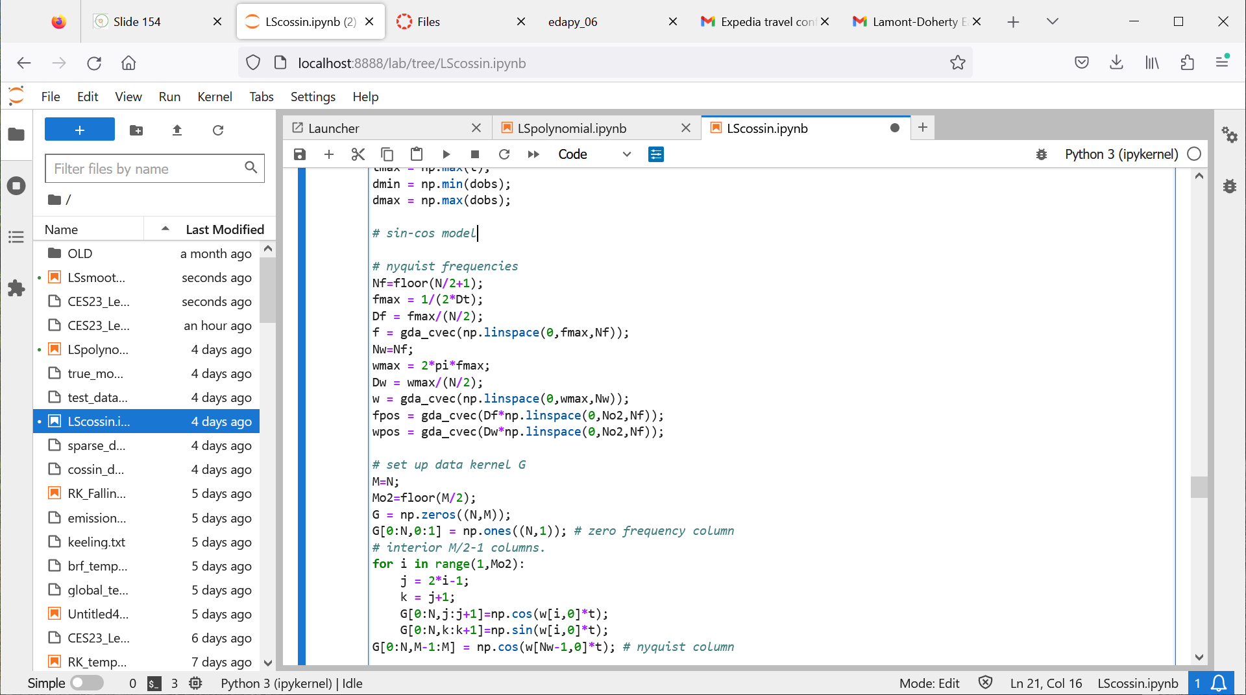

Slide 47

$$G$$

Slide 48
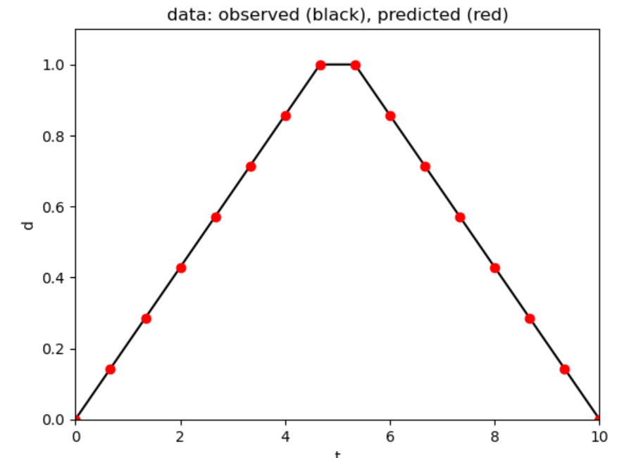

Slide 49
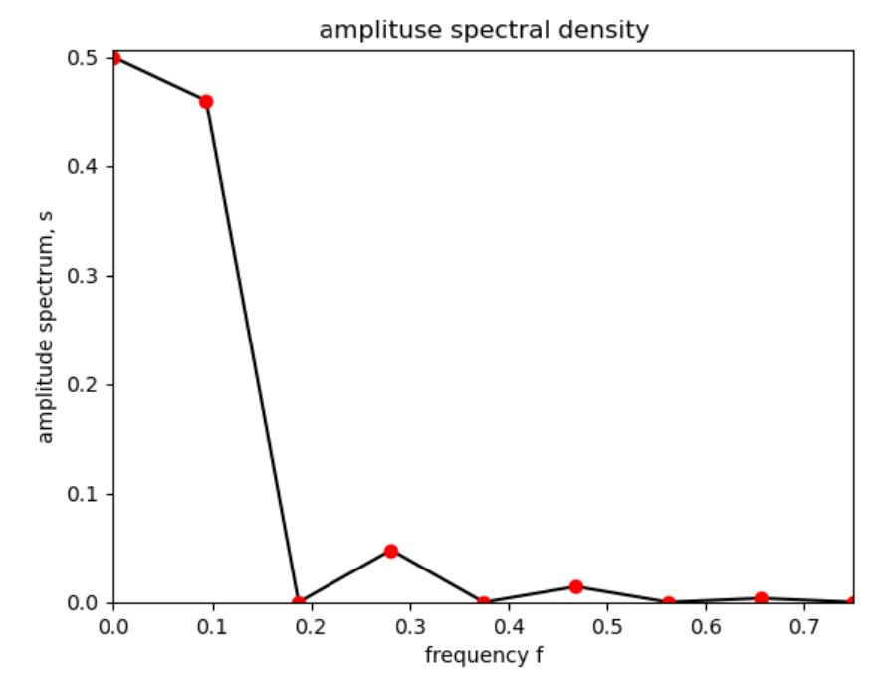

Slide 50
lots of power at low frequencies
every other frequency zero
due to symmetry of data about center of time interval

