Slide 1
2023 EESC W3400
Lec 12: Fast Fourier Transform illustrated
using environmental time series
Computational Earth Science
Bill Menke, Instructor
Emily Glazer, Teaching Assistant
TR 2:40 – 3:55

Slide 2
Today
Spectral Analysis and the Fast Fourier Transform

Slide 3
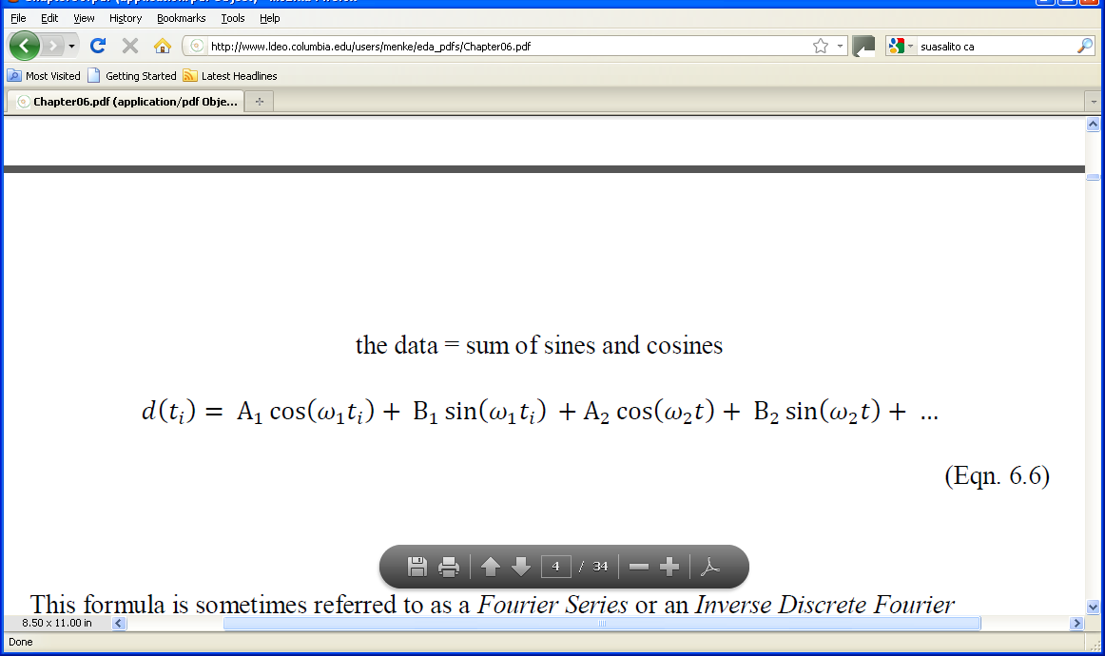
Notes:
Mention that this brings the discussion back techniques that they already understand, that is,
linear models and their solution by least squares.

Slide 4
A’s and B’s are model parameters
ω’s are known
Notes:
The A’s and B’s quantify the strength of a periodicity at a given frequency. They are the model parameters.
The ω‘s give the frequencies at which periodicities can occur.

Slide 5
two choices
total number of frequencies?
values of frequencies?

Slide 6

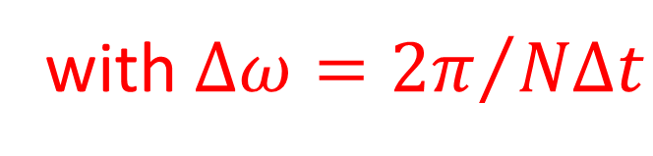
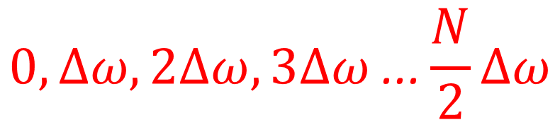
two choices
total number of frequencies?
values of frequencies?
$$M=\frac{N}{2}+1$$
$$0, ∆ω,2∆ω,3∆ω\text{ ...}\frac{N}{2}∆ω$$
with $∆ω={2π}/{N∆t}$

Slide 7
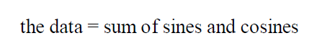
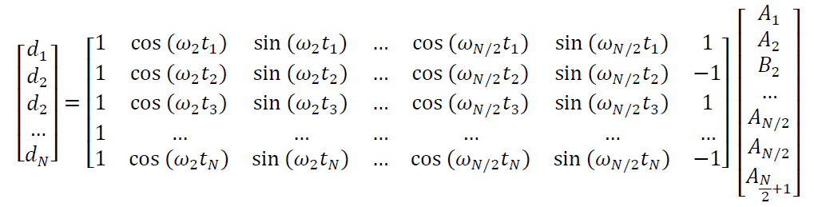

$$B_{N/2}$$
d = Gm
Notes:
Here we get back to the linear problem.

Slide 8
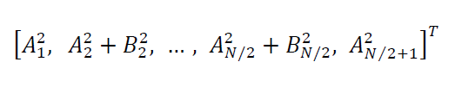
power spectral density
plot
against frequency
Notes:
Remind the class that A²+B²=C², the square of the amplitude of a time-shifted cosine.
This form emphasizes the overall amplitude of the oscillatory pattern, irrespective of its time-shift.

Slide 9
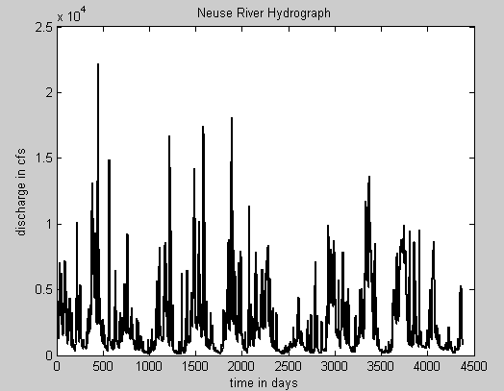

Slide 10
Annual Cycle

Slide 11
Stream Flow
Neuse River
amplitude
spectral density
frequency, cycles per day
Notes:
Note that the shorter periods are all integral fractions of one year. Thus, they are synchronized by the annual
cycle and are being driven by it.

Slide 12
Stream Flow
Neuse River
amplitude
spectral density
all interesting frequencies near origin,
so plot period, T=1/f instead
frequency, cycles per day
Notes:
Note that the shorter periods are all integral fractions of one year. Thus, they are synchronized by the annual
cycle and are being driven by it.

Slide 13
Stream Flow
Neuse River
amplitude
spectral density
frequency, cycles per day
amplitude
spectral density
period, days
Notes:
Note that the shorter periods are all integral fractions of one year. Thus, they are synchronized by the annual
cycle and are being driven by it.

Slide 14
Stream Flow
Neuse River
60.0 days
365.2 days
amplitude
spectral density
182.6 days
period, days
Notes:
Note that the shorter periods are all integral fractions of one year. Thus, they are synchronized by the annual
cycle and are being driven by it.

Slide 15
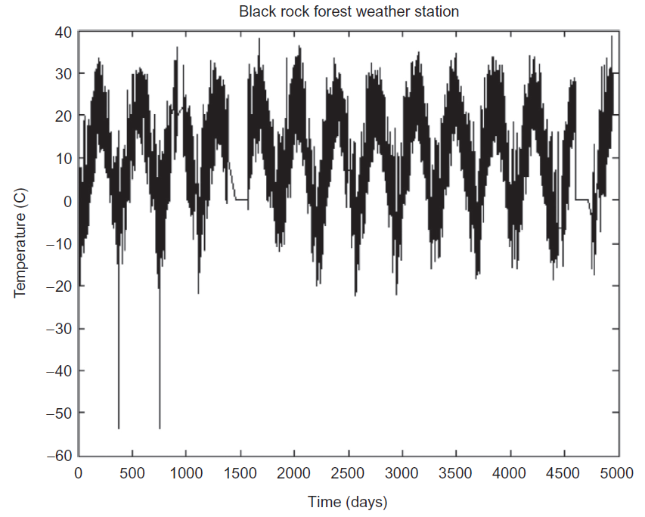
Annual Cycle

Slide 16
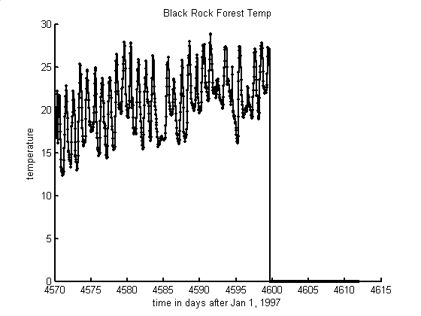
daily cycle
Annual Cycle
time, days

Slide 17
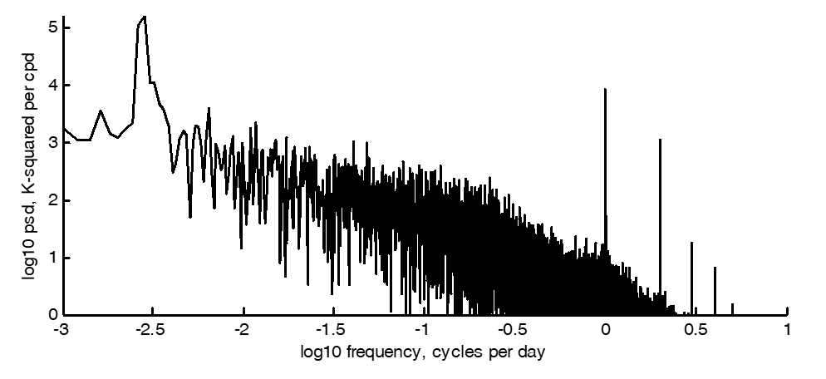

Slide 18
Daily Cycle
Annual Cycle

Slide 19
Ocean Tide (Battery, New York City)
$$5$$
sea height, $d\left(t\right)$ (ft)
$$0$$
$$−5$$
$$150$$
$$160$$
$$170$$
$$180$$
$$190$$
$$200$$
$$210$$
time, $t$ (days)

Slide 20
25 hours
12.5 hours
$$5$$
sea height, $d\left(t\right)$ (ft)
$$0$$
$$−5$$
$$150$$
$$160$$
$$170$$
$$180$$
$$190$$
$$200$$
$$210$$
time, $t$ (days)

Slide 21
$$1.25$$
asd, $s\left(p\right)$
$$0.00$$
$$0.0$$
$$0.5$$
$$1.0$$
$$1.5$$
$$2.0$$
period,$p$ (days)

Slide 22
semi-diurnal tide
$$1.25$$
diurnal tide
asd, $s\left(p\right)$
$$0.00$$
$$0.0$$
$$0.5$$
$$1.0$$
$$1.5$$
$$2.0$$
period,$p$ (days)

Slide 23
$$1.25$$
asd, $s\left(p\right)$
sun
moon
$$0.00$$
$$0.0$$
$$0.5$$
$$1.0$$
$$1.5$$
$$2.0$$
period,$p$ (days)

Slide 24

d = Gm
$$B_{N/2}$$
One problem with least squares solution ...
$m^{est}={\left[G^{T}G\right]}^{−1}$ $G^{T}$ $d^{obs}$
Notes:
Here we get back to the linear problem.

Slide 25
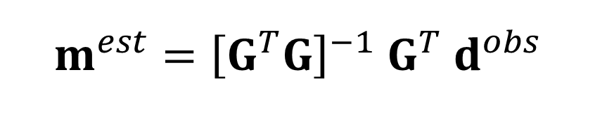

d = Gm
$$B_{N/2}$$
Almost nobody does it this way ...
$m^{est}={\left[G^{T}G\right]}^{−1}$ $G^{T}$ $d^{obs}$
Notes:
Here we get back to the linear problem.

Slide 26
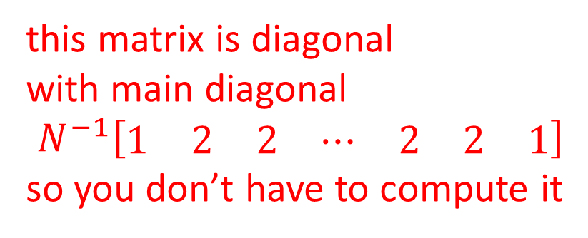
d = Gm
$$B_{N/2}$$
this matrix is diagonal
with main diagonal
$$N^{−1}\left[\begin{matrix}1 & 2 & 2 & ⋯ & 2 & 2 & 1\end{matrix}\right]$$
so you don’t have to compute it
$m^{est}={\left[G^{T}G\right]}^{−1}$ $G^{T}$ $d^{obs}$
Notes:
Here we get back to the linear problem.

Slide 27
d = Gm
$$B_{N/2}$$
furthermore,
an extremely efficient way to
compute this product is known ...
$m^{est}={\left[G^{T}G\right]}^{−1}$ $G^{T}$ $d^{obs}$
... and called the Fast Fourier Transform
Notes:
Here we get back to the linear problem.

Slide 28
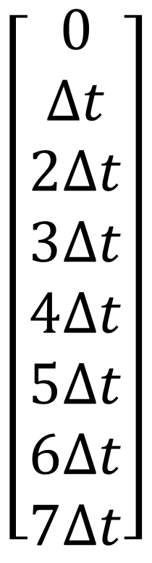
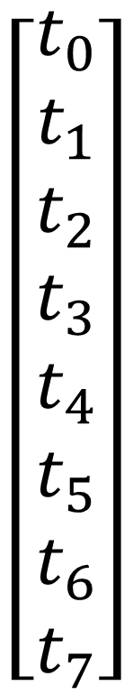
$$\left[\begin{matrix}t_{0} \\ t_{1} \\ t_{2} \\ t_{3} \\ t_{4} \\ t_{5} \\ t_{6} \\ t_{7}\end{matrix}\right]$$
$$\left[\begin{matrix}0 \\ ∆t \\ 2∆t \\ 3∆t \\ 4∆t \\ 5∆t \\ 6∆t \\ 7∆t\end{matrix}\right]$$
uniformly sampled times

Slide 29
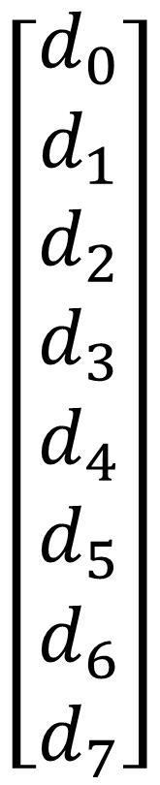
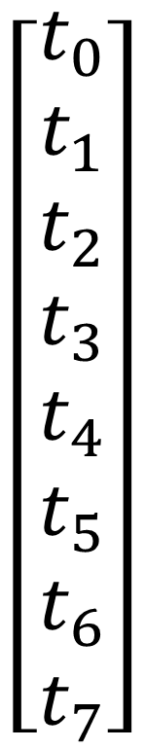
$$\left[\begin{matrix}t_{0} \\ t_{1} \\ t_{2} \\ t_{3} \\ t_{4} \\ t_{5} \\ t_{6} \\ t_{7}\end{matrix}\right]$$
$$\left[\begin{matrix}d_{0} \\ d_{1} \\ d_{2} \\ d_{3} \\ d_{4} \\ d_{5} \\ d_{6} \\ d_{7}\end{matrix}\right]$$
corresponding
data

Slide 30
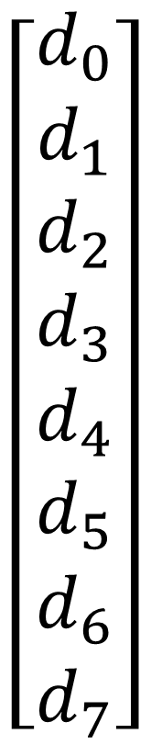
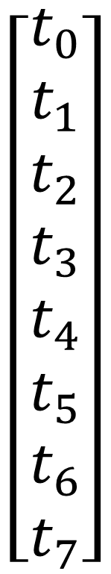
$$\left[\begin{matrix}t_{0} \\ t_{1} \\ t_{2} \\ t_{3} \\ t_{4} \\ t_{5} \\ t_{6} \\ t_{7}\end{matrix}\right]$$
$$\left[\begin{matrix}d_{0} \\ d_{1} \\ d_{2} \\ d_{3} \\ d_{4} \\ d_{5} \\ d_{6} \\ d_{7}\end{matrix}\right]$$
FFT
FFT = Fast Fourier Transform

Slide 31
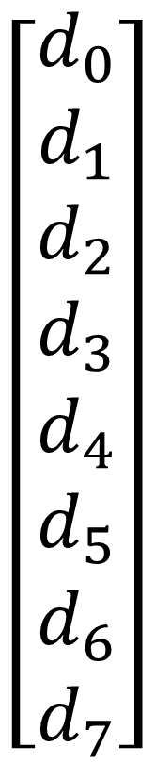
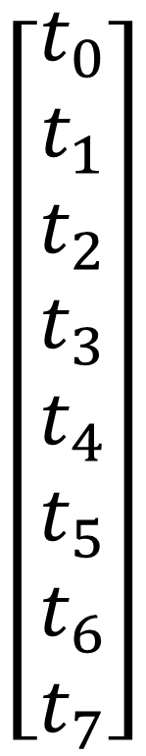
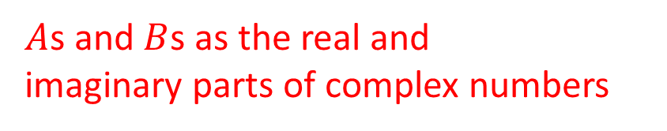
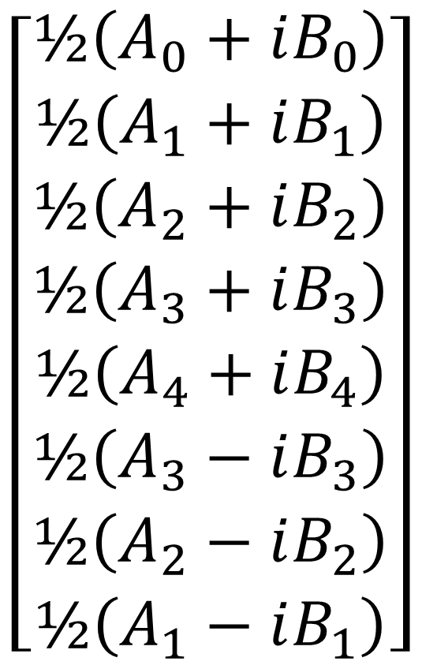
$$\left[\begin{matrix}d_{0} \\ d_{1} \\ d_{2} \\ d_{3} \\ d_{4} \\ d_{5} \\ d_{6} \\ d_{7}\end{matrix}\right]$$
$$\left[\begin{matrix}½\left(A_{0}+iB_{0}\right) \\ ½\left(A_{1}+iB_{1}\right) \\ ½\left(A_{2}+iB_{2}\right) \\ ½\left(A_{3}+iB_{3}\right) \\ ½\left(A_{4}+iB_{4}\right) \\ ½\left(A_{3}−iB_{3}\right) \\ ½\left(A_{2}−iB_{2}\right) \\ ½\left(A_{1}−iB_{1}\right)\end{matrix}\right]$$
$$\left[\begin{matrix}t_{0} \\ t_{1} \\ t_{2} \\ t_{3} \\ t_{4} \\ t_{5} \\ t_{6} \\ t_{7}\end{matrix}\right]$$
FFT
$A$s and $B$s as the real and
imaginary parts of complex numbers

Slide 32
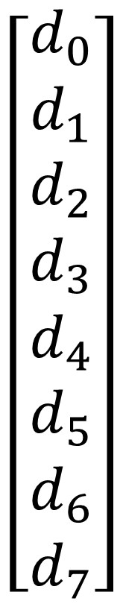
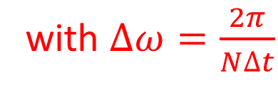
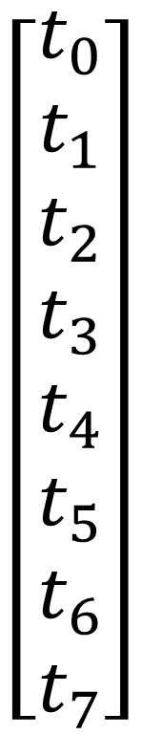
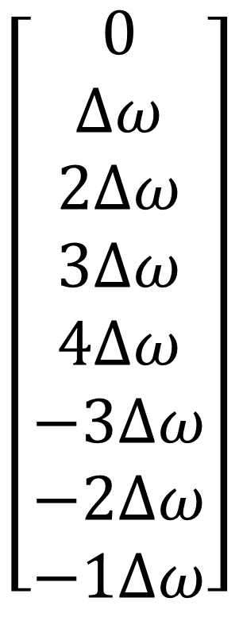
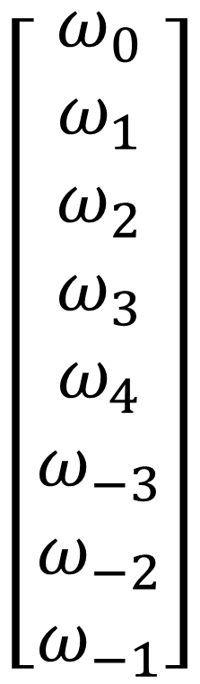
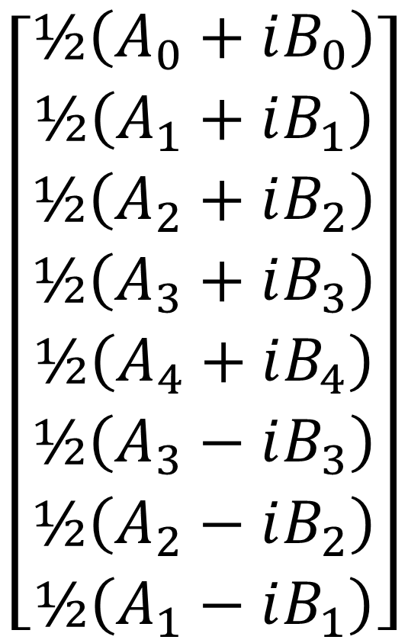
$$\left[\begin{matrix}d_{0} \\ d_{1} \\ d_{2} \\ d_{3} \\ d_{4} \\ d_{5} \\ d_{6} \\ d_{7}\end{matrix}\right]$$
$$\left[\begin{matrix}½\left(A_{0}+iB_{0}\right) \\ ½\left(A_{1}+iB_{1}\right) \\ ½\left(A_{2}+iB_{2}\right) \\ ½\left(A_{3}+iB_{3}\right) \\ ½\left(A_{4}+iB_{4}\right) \\ ½\left(A_{3}−iB_{3}\right) \\ ½\left(A_{2}−iB_{2}\right) \\ ½\left(A_{1}−iB_{1}\right)\end{matrix}\right]$$
$$\left[\begin{matrix}t_{0} \\ t_{1} \\ t_{2} \\ t_{3} \\ t_{4} \\ t_{5} \\ t_{6} \\ t_{7}\end{matrix}\right]$$
$$\left[\begin{matrix}ω_{0} \\ ω_{1} \\ ω_{2} \\ ω_{3} \\ ω_{4} \\ ω_{−3} \\ ω_{−2} \\ ω_{−1}\end{matrix}\right]$$
$$\left[\begin{matrix}0 \\ ∆ω \\ 2∆ω \\ 3∆ω \\ 4∆ω \\ −3∆ω \\ −2∆ω \\ −1∆ω\end{matrix}\right]$$
FFT
frequencies the ones we want
with $∆ω=\frac{2π}{N∆t}$

Slide 33
top part all we need
$$\left[\begin{matrix}d_{0} \\ d_{1} \\ d_{2} \\ d_{3} \\ d_{4} \\ d_{5} \\ d_{6} \\ d_{7}\end{matrix}\right]$$
$$\left[\begin{matrix}½\left(A_{0}+iB_{0}\right) \\ ½\left(A_{1}+iB_{1}\right) \\ ½\left(A_{2}+iB_{2}\right) \\ ½\left(A_{3}+iB_{3}\right) \\ ½\left(A_{4}+iB_{4}\right) \\ ½\left(A_{3}−iB_{3}\right) \\ ½\left(A_{2}−iB_{2}\right) \\ ½\left(A_{1}−iB_{1}\right)\end{matrix}\right]$$
$$\left[\begin{matrix}t_{0} \\ t_{1} \\ t_{2} \\ t_{3} \\ t_{4} \\ t_{5} \\ t_{6} \\ t_{7}\end{matrix}\right]$$
$$\left[\begin{matrix}ω_{0} \\ ω_{1} \\ ω_{2} \\ ω_{3} \\ ω_{4} \\ ω_{−3} \\ ω_{−2} \\ ω_{−1}\end{matrix}\right]$$
$$\left[\begin{matrix}0 \\ ∆ω \\ 2∆ω \\ 3∆ω \\ 4∆ω \\ −3∆ω \\ −2∆ω \\ −1∆ω\end{matrix}\right]$$
FFT
note
$${\left(A_{i}+iB_{i}\right)}^{∗}\left(A_{i}+iB_{i}\right)=A_{i}^{2}+B_{i}^{2}=p.s.d.$$
* = complex conjucation

Slide 34
# generic frequency set-up
No2 = floor(N/2); # integer version of N/2
fmax=1/(2.0*Dt); # nyquist frequency
Df=fmax/No2; # frequency smaping
Nf=No2+1; # number of non-negative frequencies
f=gda_cvec(Df*np.concatenate(
( np.linspace(0,No2,Nf),np.linspace(-No2+1,-1,No2-1)),axis=0));
Dw=2*pi*Df; # angular frequeny increment
w=2*pi*f; # full (pos and neg) angular frequency vector
Nw=Nf; # number of non-negative angular frequencies
fpos=gda_cvec(Df * np.linspace(0,No2,Nf)); # non-negative freq’s
wpos=2*pi*fpos; # non-negative angular frequencies

Slide 35
Most people apply these two pre-processing steps to the data:
Remove the mean of the data
Taper the ends of the data vector

Slide 36
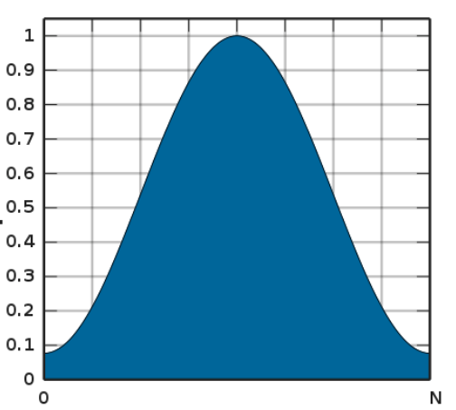
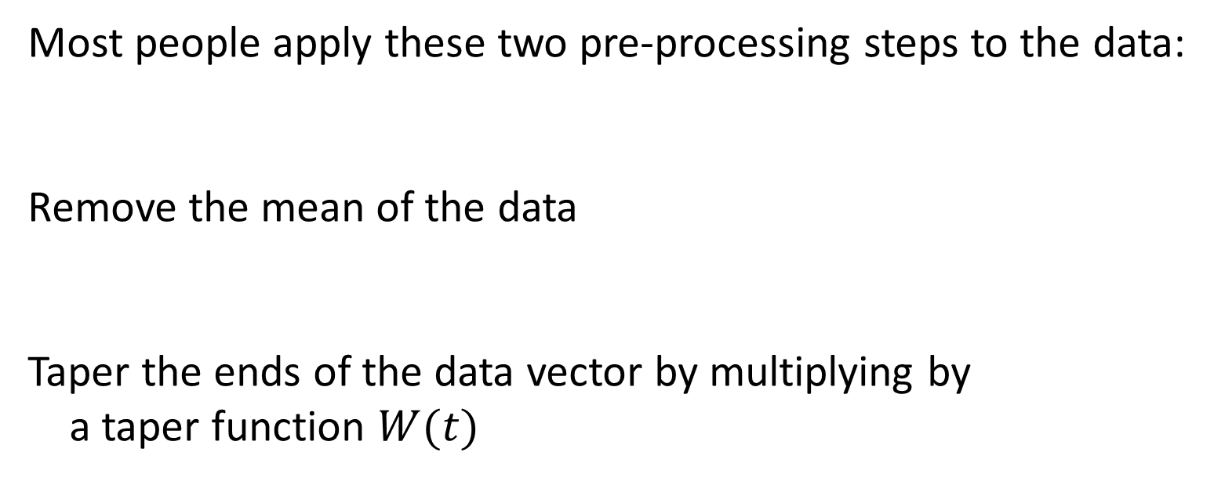

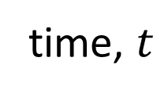
Most people apply these two pre-processing steps to the data:
Remove the mean of the data
Taper the ends of the data vector by multiplying by
a taper function $W(t)$
# remove mean
dobs = dobs - np.mean(dobs);
$$W(t)$$
time, $t$
# Hamming window function
W = gda_cvec(0.54-0.46*np.cos(2*pi*np.linspace(0,N-1,N)/(N-1)));
dtapered = np.multiply( W, dobs );

Slide 37
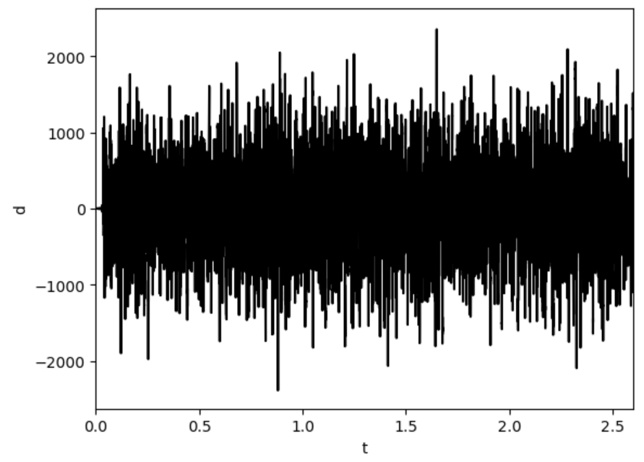
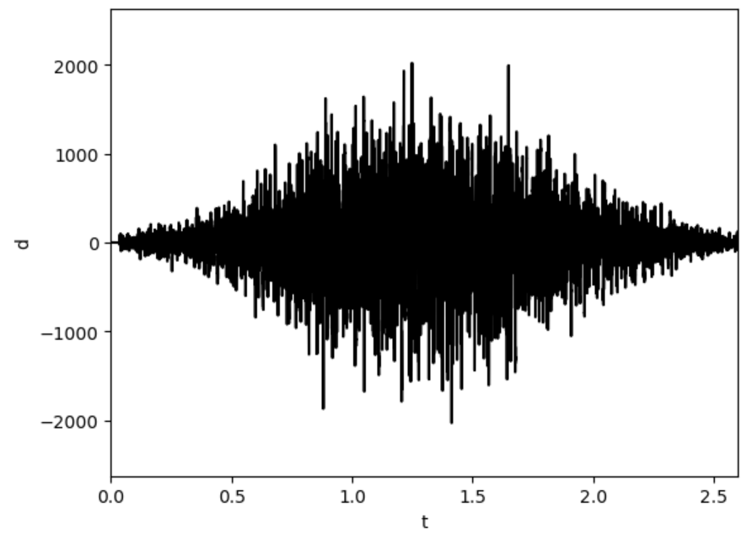
sound in my office
(mostly the air conditioner)
Before Pre-Processing
After Pre-Processing

Slide 38
# compute fourier coefficients. Note normalization of Dt
dbar = Dt*np.fft.fft(dtapered, axis=0); # fourier transform
dbarpos = dbar[0:Nf,0:1]; # non-negative frequencies
T = N*Dt; # time series length
s2 = (2/T) * np.real(np.multiply(dbarpos.conj(), dbarpos));

Slide 39
Fast Fourier Transform
# compute fourier coefficients. Note normalization of Dt
dbar = Dt*np.fft.fft(dtapered, axis=0); # fourier transform
dbarpos = dbar[0:Nf,0:1]; # non-negative frequencies
T = N*Dt; # time series length
s2 = (2/T) * np.real(np.multiply(dbarpos.conj(), dbarpos));

Slide 40
# compute fourier coefficients. Note normalization of Dt
dbar = Dt*np.fft.fft(dtapered, axis=0); # fourier transform
dbarpos = dbar[0:Nf,0:1]; # non-negative frequencies
T = N*Dt; # time series length
s2 = (2/T) * np.real(np.multiply(dbarpos.conj(), dbarpos));
Power Spectral Density
(normalized in the standard way used in the literature)

Slide 41
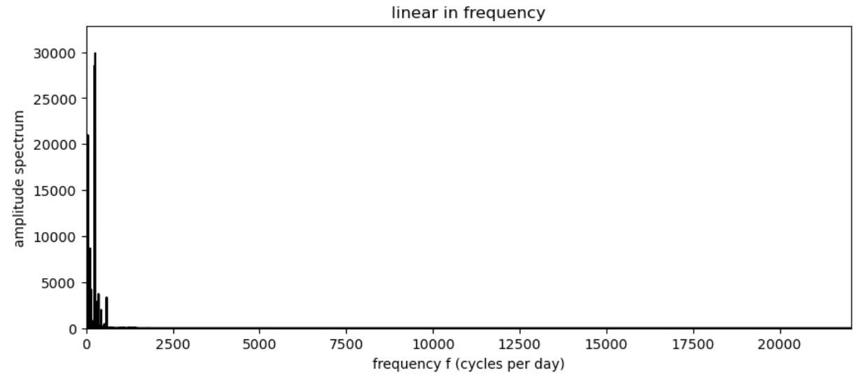
sound in my office
(mostly the air conditioner)
Nyquist
frequency
all interesting frequencies near origin,

Slide 42
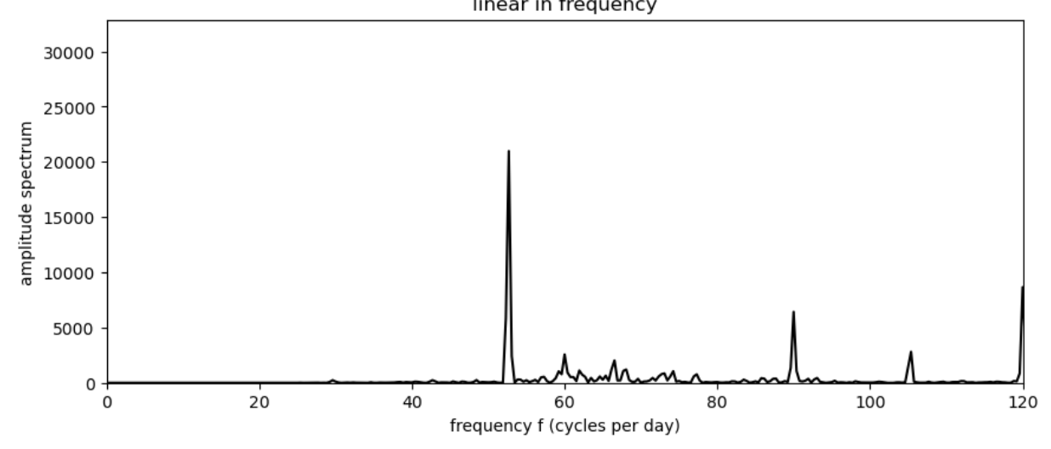
sound in my office
(mostly the air conditioner)
biggest pear about 53 Hz
some 60 Hz noise

Slide 43
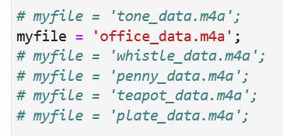
Groups 1-4 Assignments
computer the psd of 2-4 seconds of audio noise
either make your own, or use the assignment at left.
Examine the psd
what frequency range has the most energy?
are there distinct spectral peaks?
Do more than one if you have the time
1
2
3
4

