Slide 1
2023 EESC W3400
Lec 13: Useful things that can be done using the Fast Fourier Transform
Computational Earth Science
Bill Menke, Instructor
Emily Glazer, Teaching Assistant
TR 2:40 – 3:55

Slide 2
Today
Additional Uses of the Fast Fourier Transform

Slide 3
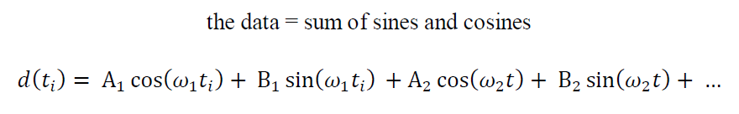
Notes:
Mention that this brings the discussion back techniques that they already understand, that is,
linear models and their solution by least squares.

Slide 4
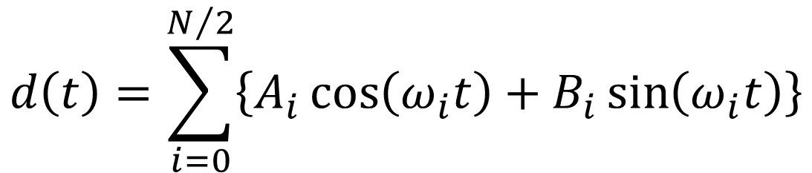
$$d\left(t\right)=\sum_{i=0}^{N/2}{\left\{A_{i}\cos\left(ω_{i}t\right)+B_{i}\sin\left(ω_{i}t\right)\right\}}$$
Notes:
Mention that this brings the discussion back techniques that they already understand, that is,
linear models and their solution by least squares.

Slide 5
FFT
dbar = np.fft.fft(d, axis=0);
IFFT
d = np.fft.ifft(dbar, axis=0);
Notes:
Mention that this brings the discussion back techniques that they already understand, that is,
linear models and their solution by least squares.

Slide 6
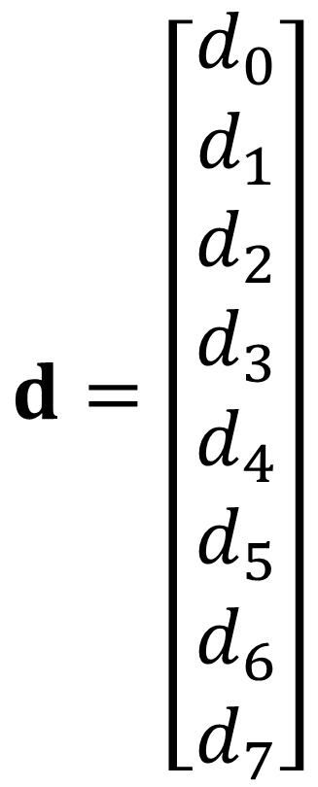
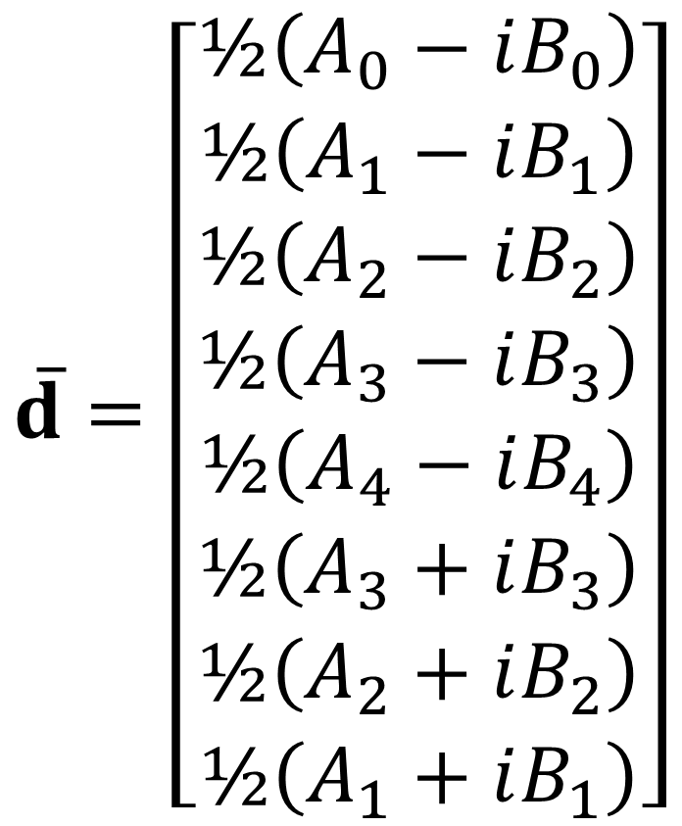
$$\overline{d}=\left[\begin{matrix}½\left(A_{0}−iB_{0}\right) \\ ½\left(A_{1}−iB_{1}\right) \\ ½\left(A_{2}−iB_{2}\right) \\ ½\left(A_{3}−iB_{3}\right) \\ ½\left(A_{4}−iB_{4}\right) \\ ½\left(A_{3}+iB_{3}\right) \\ ½\left(A_{2}+iB_{2}\right) \\ ½\left(A_{1}+iB_{1}\right)\end{matrix}\right]$$
$$d=\left[\begin{matrix}d_{0} \\ d_{1} \\ d_{2} \\ d_{3} \\ d_{4} \\ d_{5} \\ d_{6} \\ d_{7}\end{matrix}\right]$$

Slide 7
using FFT to take a derivative

Slide 8
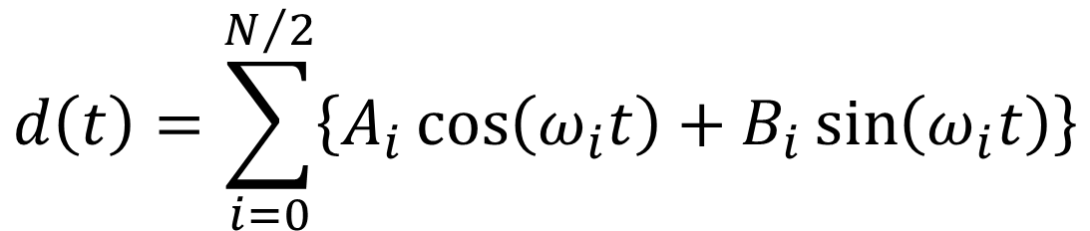
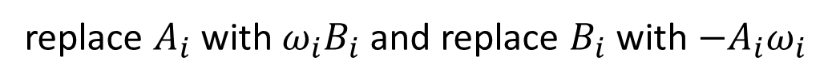
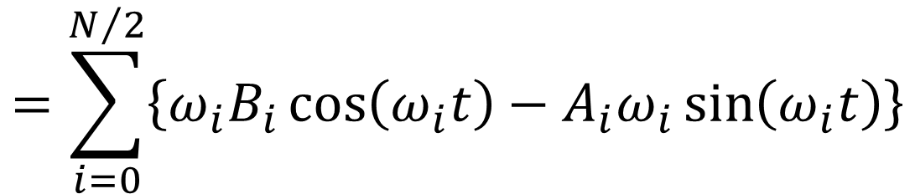
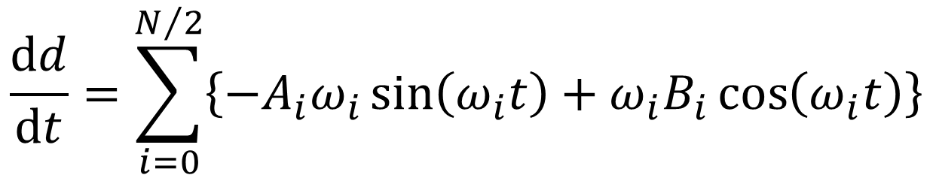
$$d\left(t\right)=\sum_{i=0}^{N/2}{\left\{A_{i}\cos\left(ω_{i}t\right)+B_{i}\sin\left(ω_{i}t\right)\right\}}$$
$$\frac{dd}{dt}=\sum_{i=0}^{N/2}{\left\{{−A}_{i}ω_{i}\sin\left(ω_{i}t\right)+ω_{i}B_{i}\cos\left(ω_{i}t\right)\right\}}$$
$$=\sum_{i=0}^{N/2}{\left\{{ω_{i}B_{i}\cos\left(ω_{i}t\right)−A}_{i}ω_{i}\sin\left(ω_{i}t\right)\right\}}$$
like the original sum, but ...
replace $A_{i}$ with $ω_{i}B_{i}$ and replace $B_{i}$ with ${−A}_{i}ω_{i}$
Notes:
Mention that this brings the discussion back techniques that they already understand, that is,
linear models and their solution by least squares.

Slide 9
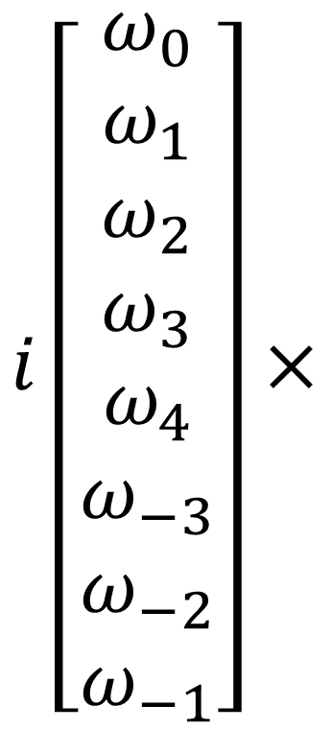
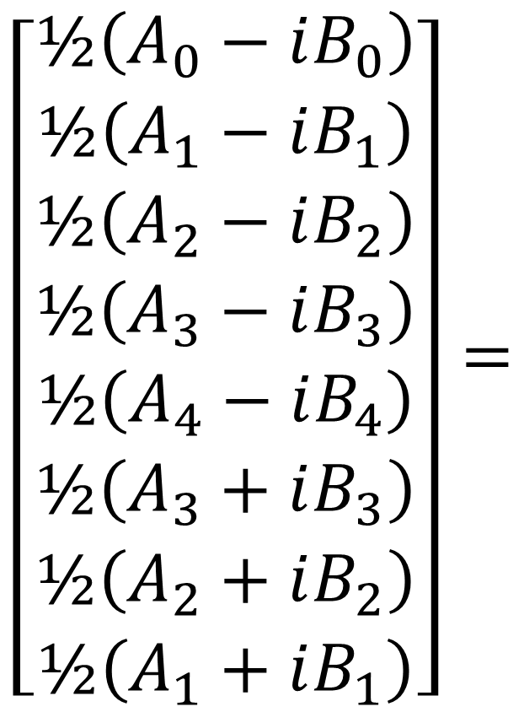
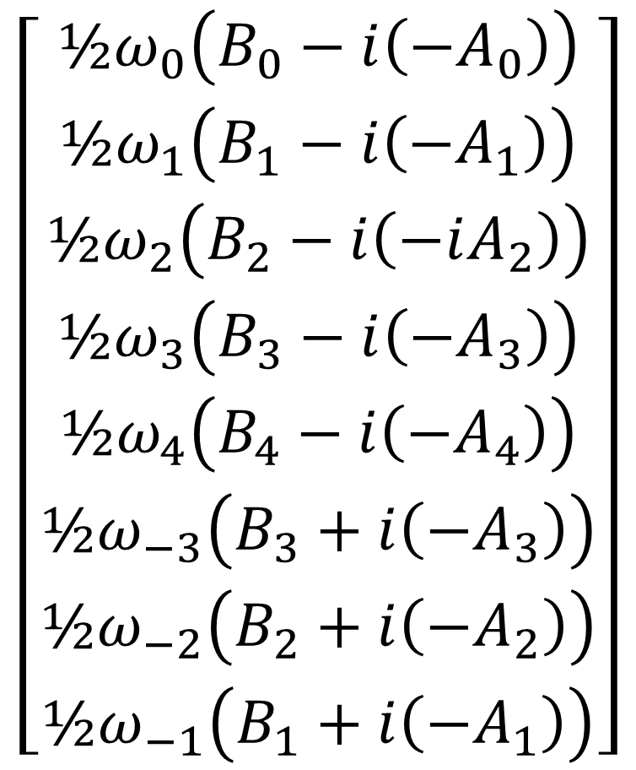
$\overline{d}$
$$\left[\begin{matrix}½ω_{0}\left(B_{0}−i\left(−A_{0}\right)\right) \\ ½ω_{1}\left(B_{1}−i\left(−A_{1}\right)\right) \\ ½ω_{2}\left(B_{2}−i\left(−iA_{2}\right)\right) \\ ½ω_{3}\left(B_{3}−i\left(−A_{3}\right)\right) \\ ½ω_{4}\left(B_{4}−i\left(−A_{4}\right)\right) \\ ½ω_{−3}\left(B_{3}+i\left(−A_{3}\right)\right) \\ ½ω_{−2}\left(B_{2}+i\left(−A_{2}\right)\right) \\ ½ω_{−1}\left(B_{1}+i\left(−A_{1}\right)\right)\end{matrix}\right]$$
$$\left[\begin{matrix}½\left(A_{0}−iB_{0}\right) \\ ½\left(A_{1}−iB_{1}\right) \\ ½\left(A_{2}−iB_{2}\right) \\ ½\left(A_{3}−iB_{3}\right) \\ ½\left(A_{4}−iB_{4}\right) \\ ½\left(A_{3}+iB_{3}\right) \\ ½\left(A_{2}+iB_{2}\right) \\ ½\left(A_{1}+iB_{1}\right)\end{matrix}\right]=$$
$$i\left[\begin{matrix}ω_{0} \\ ω_{1} \\ ω_{2} \\ ω_{3} \\ ω_{4} \\ ω_{−3} \\ ω_{−2} \\ ω_{−1}\end{matrix}\right]×$$
to manipulate the complex vector $\overline{d}$ , just multiply by $−iω$

Slide 10
dbar = np.fft.fft(d, axis=0);
prod = np.multiply( complex(0.0,1.0)*w, dbar);
dddt = np.fft.ifft(prod, axis=0);

Slide 11
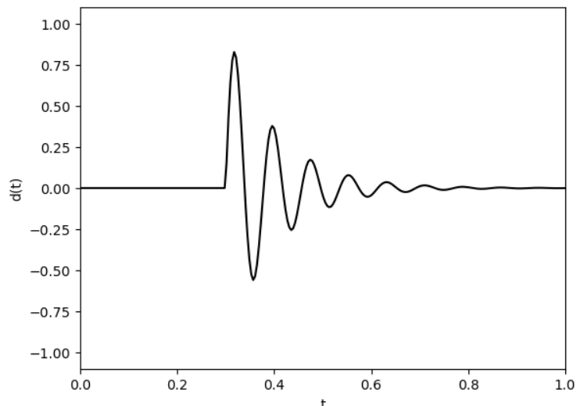

Slide 12
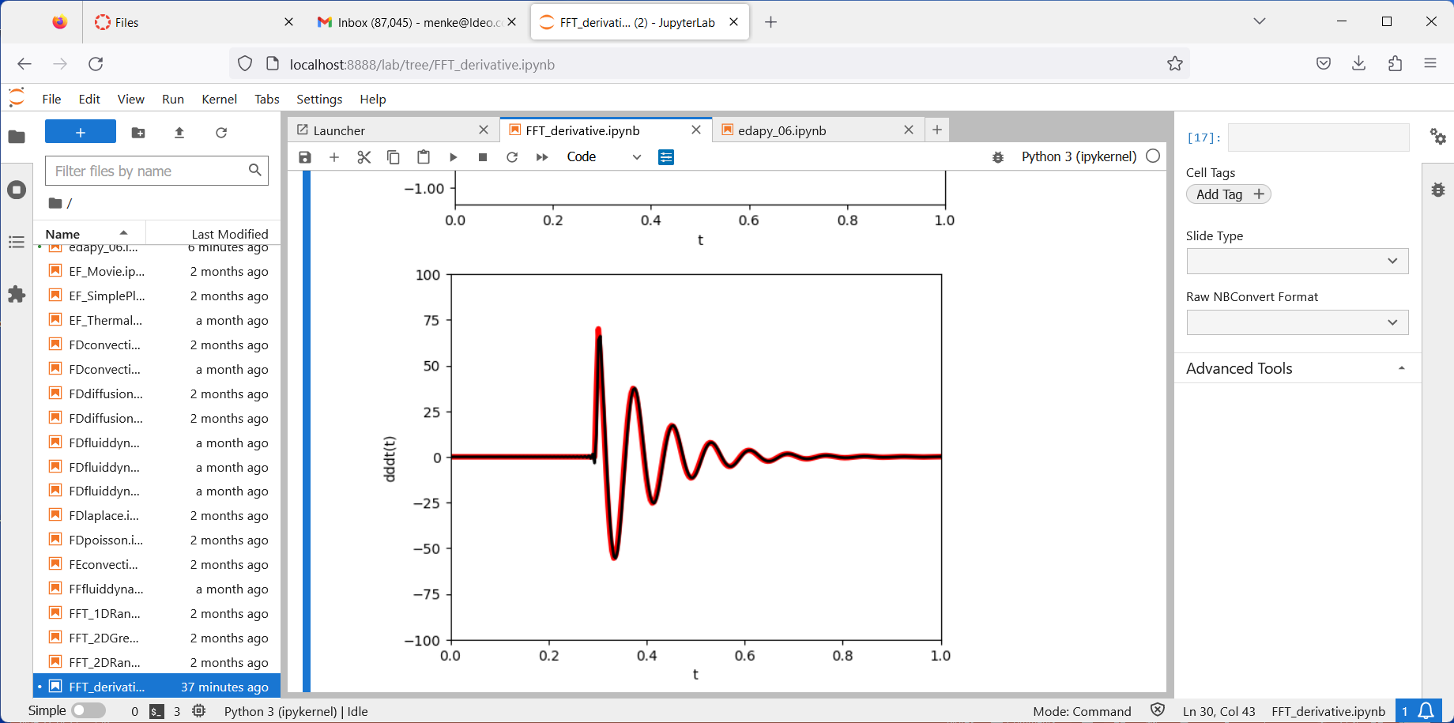
Finite difference
FFT

Slide 13
Finite difference
FFT
Gibb’s
Effect

Slide 14
using FFT to implement a time shift

Slide 15





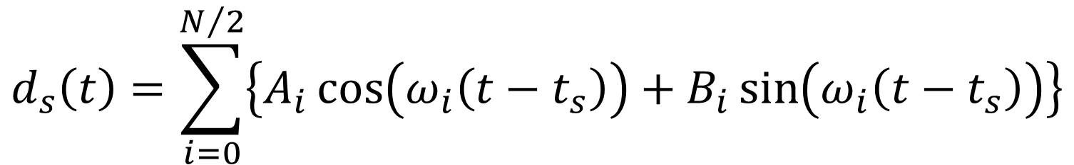

$$d\left(t\right)=\sum_{i=0}^{N/2}{\left\{A_{i}\cos\left(ω_{i}t\right)+B_{i}\sin\left(ω_{i}t\right)\right\}}$$
$$d_{s}\left(t\right)=\sum_{i=0}^{N/2}{\left\{A_{i}\cos\left(ω_{i}\left(t−t_{s}\right)\right)+B_{i}\sin\left(ω_{i}\left(t−t_{s}\right)\right)\right\}}$$
$$d\left(t\right)$$
$$d\left(t\right)$$
$$t$$
$$t_{s}$$
$$t$$
$$0$$
right shift (delay) ... peak at zero becomes a peak at $t_{s}$
Notes:
Mention that this brings the discussion back techniques that they already understand, that is,
linear models and their solution by least squares.

Slide 16
remember your trig formulas?
$\cos\left(\left(a−b\right)\right)=\cos{a}$ $\cos{b}+$ $\sin{a}$ $\sin{b}$
$$\sin\left(\left(a−b\right)\right)=\sin{a}\cos{a}+\cos{a}\sin{a}$$
messy! a lot of algebra involved

Slide 17
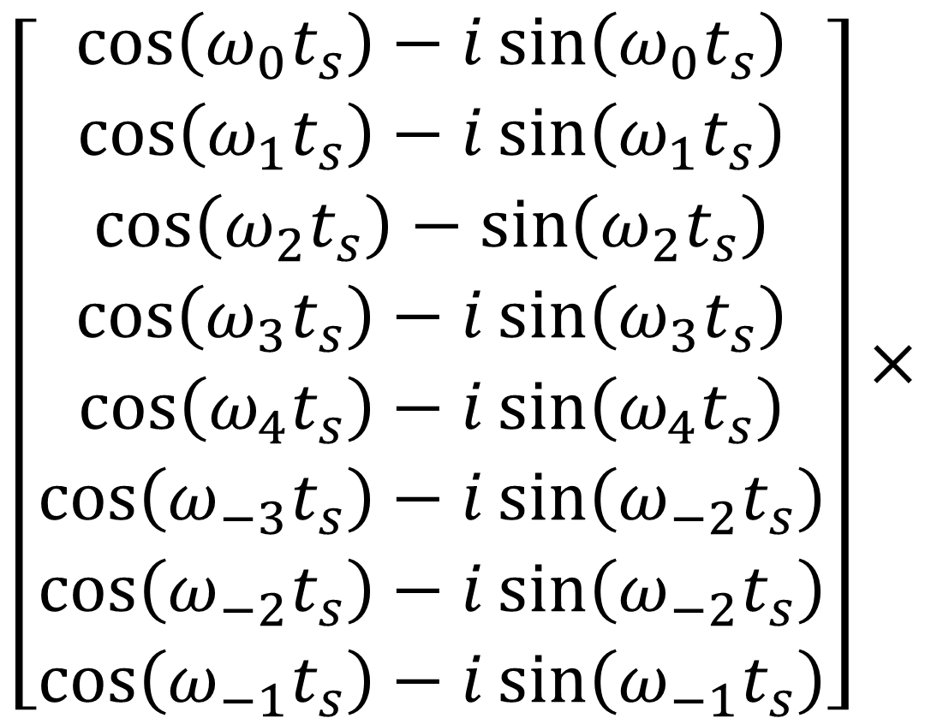
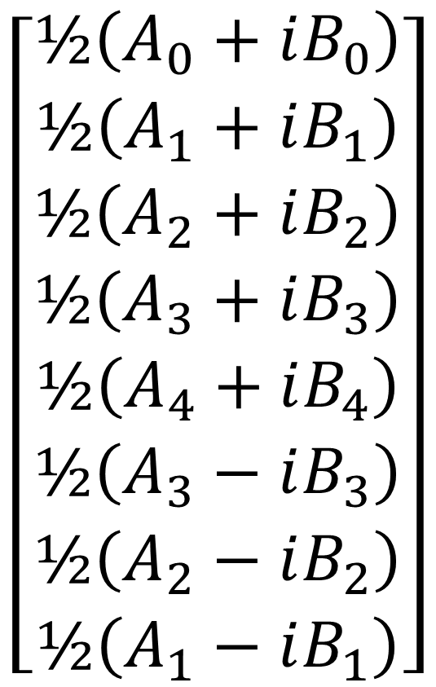
$\overline{d}$
$$\left[\begin{matrix}½\left(A_{0}+iB_{0}\right) \\ ½\left(A_{1}+iB_{1}\right) \\ ½\left(A_{2}+iB_{2}\right) \\ ½\left(A_{3}+iB_{3}\right) \\ ½\left(A_{4}+iB_{4}\right) \\ ½\left(A_{3}−iB_{3}\right) \\ ½\left(A_{2}−iB_{2}\right) \\ ½\left(A_{1}−iB_{1}\right)\end{matrix}\right]$$
$$\left[\begin{matrix}\cos\left(ω_{0}t_{s}\right)−i\sin\left(ω_{0}t_{s}\right) \\ \cos\left(ω_{1}t_{s}\right)−i\sin\left(ω_{1}t_{s}\right) \\ \cos\left(ω_{2}t_{s}\right)−\sin\left(ω_{2}t_{s}\right) \\ \cos\left(ω_{3}t_{s}\right)−i\sin\left(ω_{3}t_{s}\right) \\ \cos\left(ω_{4}t_{s}\right)−i\sin\left(ω_{4}t_{s}\right) \\ \cos\left(ω_{−3}t_{s}\right)−i\sin\left(ω_{−2}t_{s}\right) \\ \cos\left(ω_{−2}t_{s}\right)−i\sin\left(ω_{−2}t_{s}\right) \\ \cos\left(ω_{−1}t_{s}\right)−i\sin\left(ω_{−1}t_{s}\right)\end{matrix}\right]×$$

Slide 18
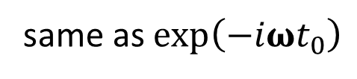
same as $\exp\left(−iωt_{0}\right)$
$\overline{d}$
$$\left[\begin{matrix}½\left(A_{0}+iB_{0}\right) \\ ½\left(A_{1}+iB_{1}\right) \\ ½\left(A_{2}+iB_{2}\right) \\ ½\left(A_{3}+iB_{3}\right) \\ ½\left(A_{4}+iB_{4}\right) \\ ½\left(A_{3}−iB_{3}\right) \\ ½\left(A_{2}−iB_{2}\right) \\ ½\left(A_{1}−iB_{1}\right)\end{matrix}\right]$$
$$\left[\begin{matrix}\cos\left(ω_{0}t_{s}\right)−i\sin\left(ω_{0}t_{s}\right) \\ \cos\left(ω_{1}t_{s}\right)−i\sin\left(ω_{1}t_{s}\right) \\ \cos\left(ω_{2}t_{s}\right)−\sin\left(ω_{2}t_{s}\right) \\ \cos\left(ω_{3}t_{s}\right)−i\sin\left(ω_{3}t_{s}\right) \\ \cos\left(ω_{4}t_{s}\right)−i\sin\left(ω_{4}t_{s}\right) \\ \cos\left(ω_{−3}t_{s}\right)−i\sin\left(ω_{−2}t_{s}\right) \\ \cos\left(ω_{−2}t_{s}\right)−i\sin\left(ω_{−2}t_{s}\right) \\ \cos\left(ω_{−1}t_{s}\right)−i\sin\left(ω_{−1}t_{s}\right)\end{matrix}\right]×$$

Slide 19
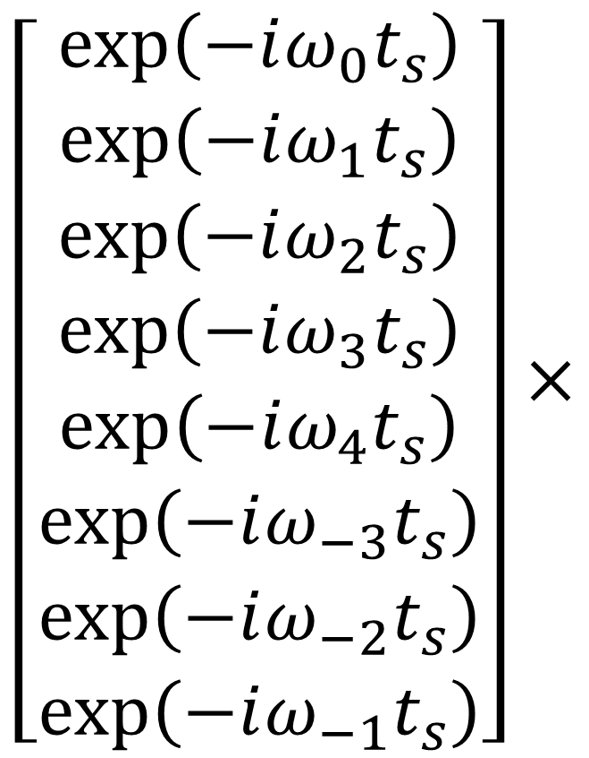
$\overline{d}$
$$\left[\begin{matrix}\exp\left(−iω_{0}t_{s}\right) \\ \exp\left(−iω_{1}t_{s}\right) \\ \exp\left(−iω_{2}t_{s}\right) \\ \exp\left(−iω_{3}t_{s}\right) \\ \exp\left(−iω_{4}t_{s}\right) \\ \exp\left(−iω_{−3}t_{s}\right) \\ \exp\left(−iω_{−2}t_{s}\right) \\ \exp\left(−iω_{−1}t_{s}\right)\end{matrix}\right]×$$
$$\left[\begin{matrix}½\left(A_{0}+iB_{0}\right) \\ ½\left(A_{1}+iB_{1}\right) \\ ½\left(A_{2}+iB_{2}\right) \\ ½\left(A_{3}+iB_{3}\right) \\ ½\left(A_{4}+iB_{4}\right) \\ ½\left(A_{3}−iB_{3}\right) \\ ½\left(A_{2}−iB_{2}\right) \\ ½\left(A_{1}−iB_{1}\right)\end{matrix}\right]$$
to delay the complex vector $\overline{d}$ , just multiply by $\exp\left(−iωt_{0}\right)$

Slide 20
dbar = np.fft.fft(d, axis=0);
myexp = np.exp( -complex(0.0,1.0)*w*ts );
prod = np.power( myexp, dbar);
dshift = np.fft.ifft(prod, axis=0);

Slide 21
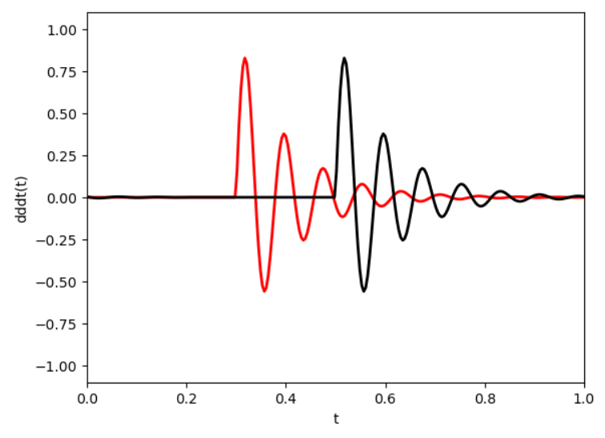
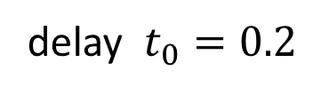
delay $t_{0}=0.2$

Slide 22
delay $t_{0}=0.2$
Wrap around

Slide 23
Dispersion a wave phenomenon in which different frequencies propagate at different velocities

Slide 24
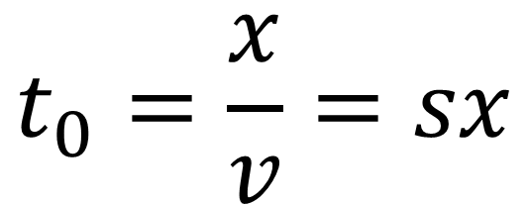
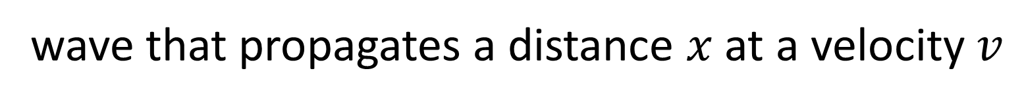
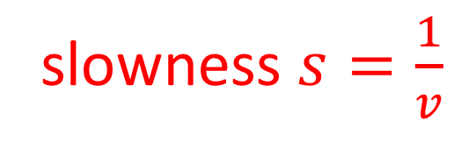
wave that propagates a distance $x$ at a velocity $v$
$$t_{0}=\frac{x}{v}=sx$$
slowness $s=\frac{1}{v}$

Slide 25
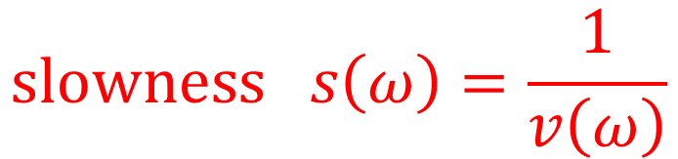
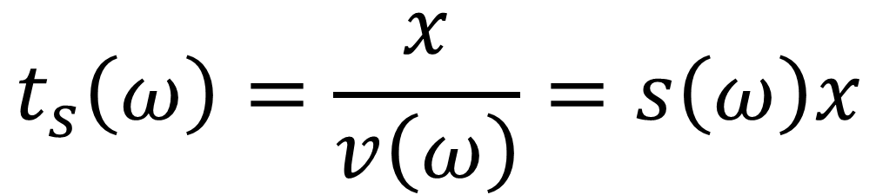
dispersion: different frequencies travel at different speeds
$$t_{s}\left(ω\right)=\frac{x}{v\left(ω\right)}=s\left(ω\right)x$$
$$slowness s\left(ω\right)=\frac{1}{v\left(ω\right)}$$

Slide 26
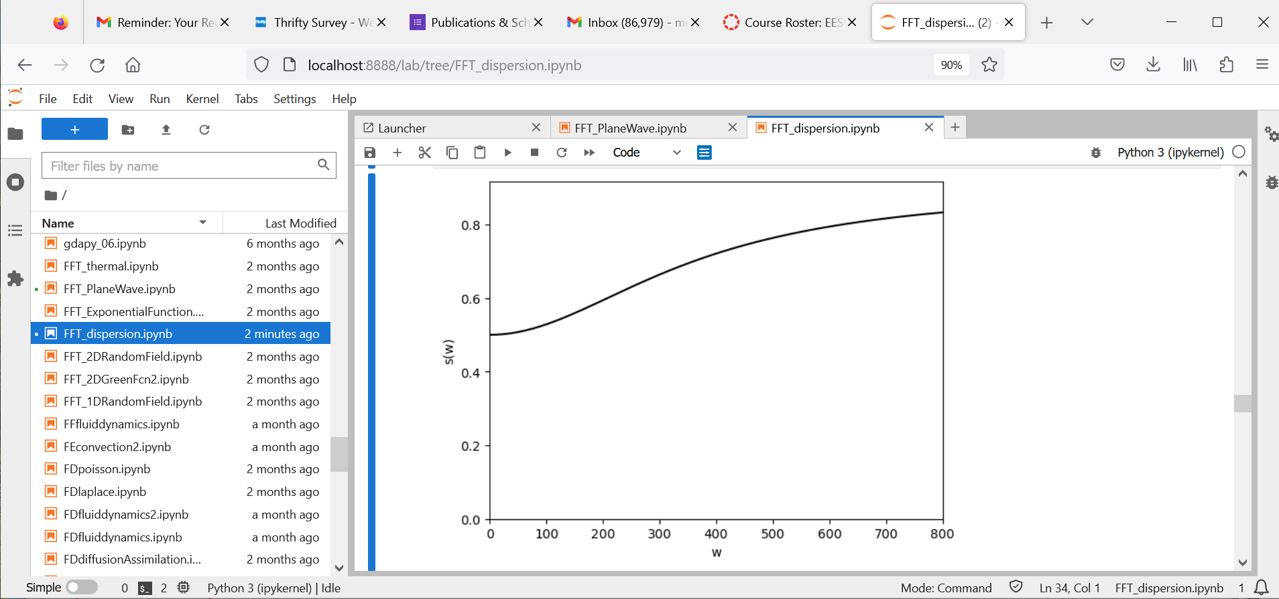
“normal” dispersion
low frequencies fast
high frequencies slow

Slide 27
“reverse” dispersion
low frequencies slow
high frequencies fast

Slide 28
dbar = np.fft.fft(d, axis=0);
wts = x*np.divide( w, np.reciprocal(v) );
myexp = np.exp( -complex(0.0,1.0)*wts );
prod = np.power(myexp, dbar);
ddispersed = np.fft.ifft(prod, axis=0);

Slide 29
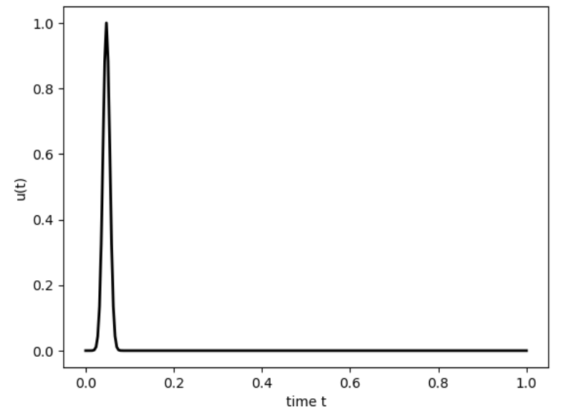
x=0
“normal” dispersion

Slide 30
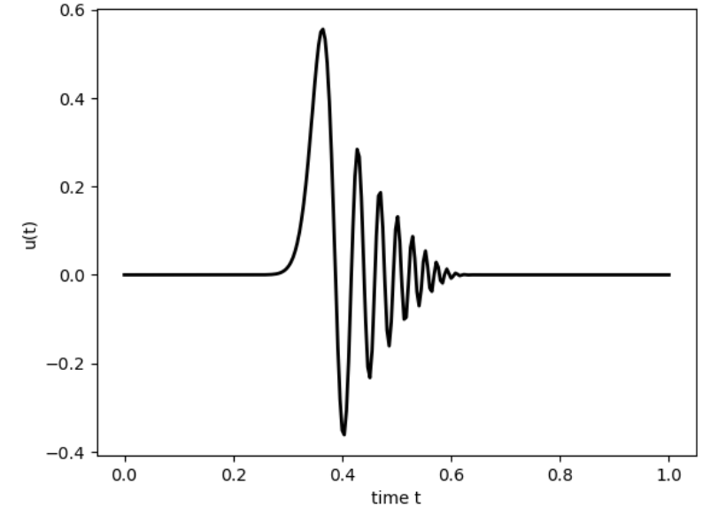
x=0.6

Slide 31
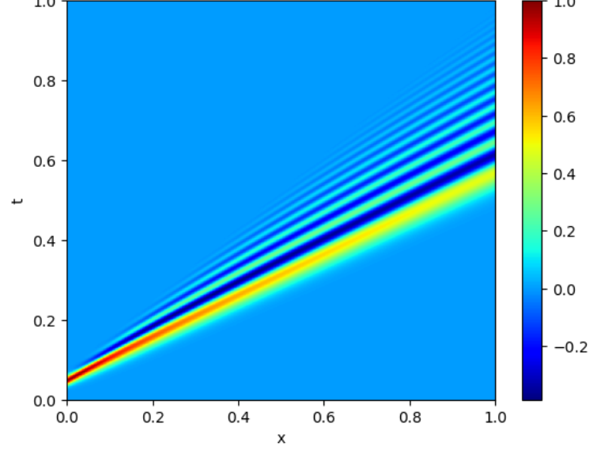

Slide 32
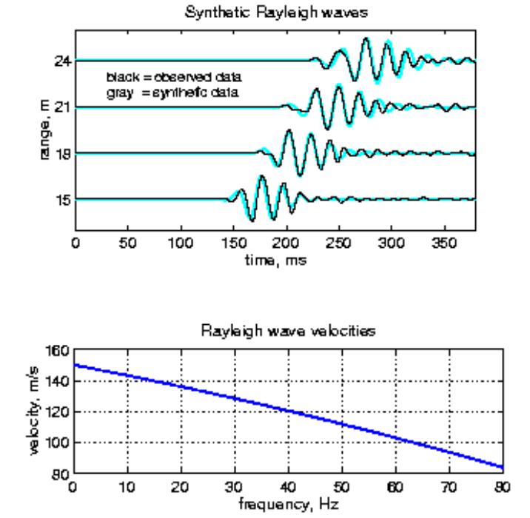

Slide 33
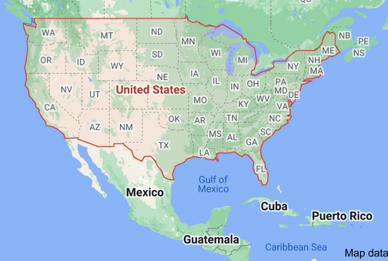
earthquake
Seismic Station

Slide 34
Learn about dispersion in this region by comparing seismograms

Slide 35
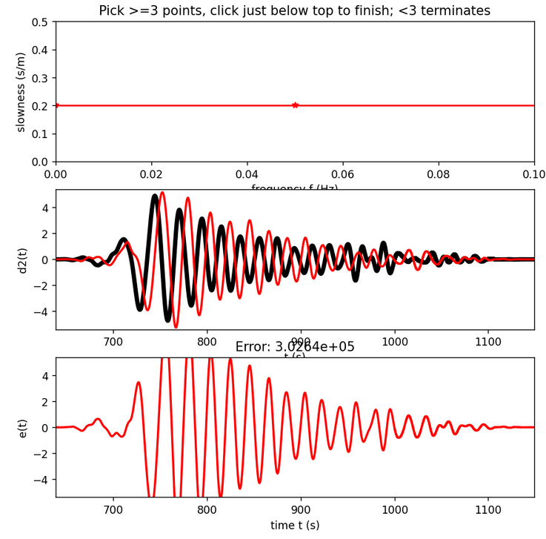
Dispersion Curve
Rayleigh waves observed on two stations, aligned via dispersion curve
Error

Slide 36
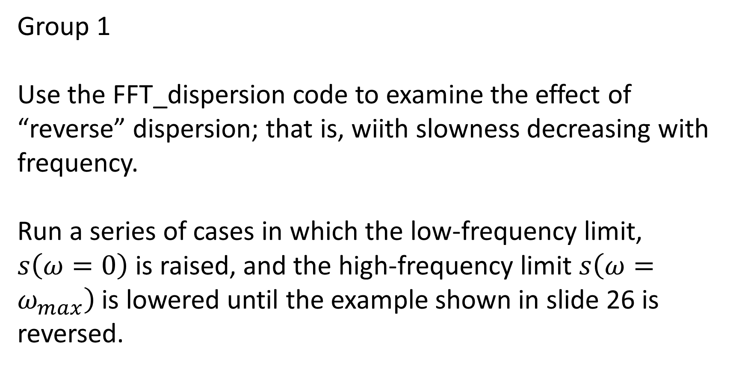
Group 1
Use the FFT_dispersion code to examine the effect of “reverse” dispersion; that is, wiith slowness decreasing with frequency.
Run a series of cases in which the low-frequency limit, $s\left(ω=0\right)$ is raised, and the high-frequency limit $s\left(ω=ω_{max}\right)$ is lowered until the example shown in slide 26 is reversed.

Slide 37
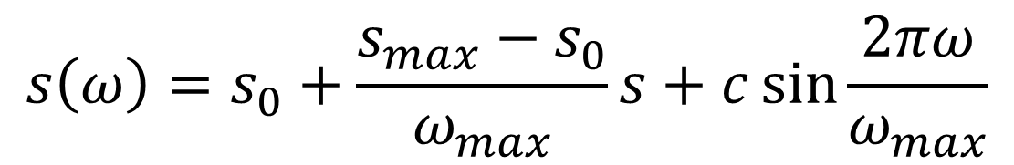

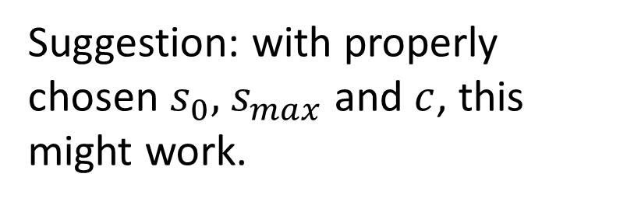
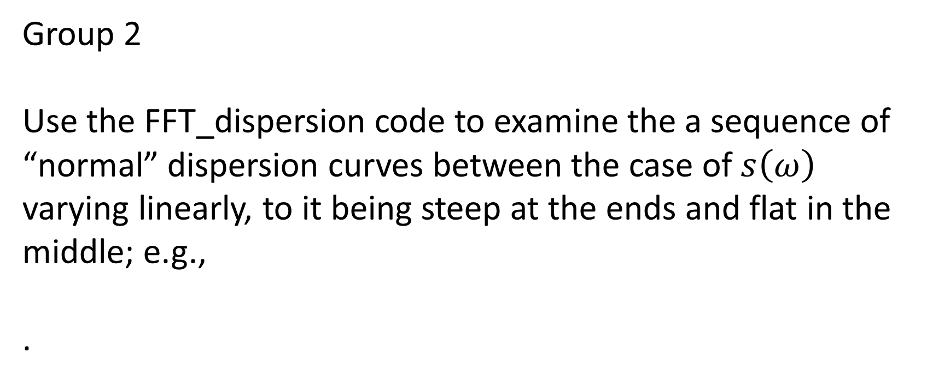



Group 2
Use the FFT_dispersion code to examine the a sequence of “normal” dispersion curves between the case of $s\left(ω\right)$ varying linearly, to it being steep at the ends and flat in the middle; e.g.,
.
$$s\left(ω\right)$$
to
.
$$s\left(ω\right)$$
$$ω$$
$$ω$$
Suggestion: with properly chosen $s_{0},$ $s_{max}$ and $c$, this might work.
$$s\left(ω\right)=s_{0}+\frac{s_{max}−s_{0}}{ω_{max}}s+c\sin{\frac{2πω}{ω_{max}}}$$

Slide 38
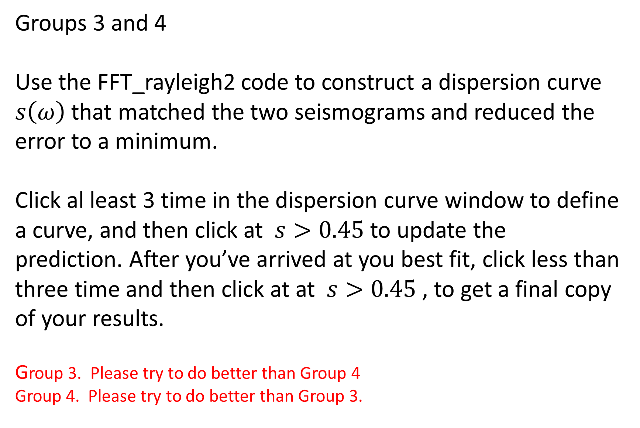
Groups 3 and 4
Use the FFT_rayleigh2 code to construct a dispersion curve $s\left(ω\right)$ that matched the two seismograms and reduced the error to a minimum.
Click al least 3 time in the dispersion curve window to define a curve, and then click at $s>0.45$ to update the prediction. After you’ve arrived at you best fit, click less than three time and then click at at $s>0.45$ , to get a final copy of your results.
Group 3. Please try to do better than Group 4
Group 4. Please try to do better than Group 3.

